Slide 1




Quasilinear relaxation of energetic particles interacting with Alfvénic modes
Vinícius Duarte^{1,2}, Nikolai Gorelenkov¹ and Herb Berk³
With invaluable contributions from
Mario Podestà¹, Eric Fredrickson¹, Gerrit Kramer¹, Raffi Nazikian¹, Stan Kaye¹, David Pace⁴,
Mike Van Zeeland⁴, Bill Heidbrink⁵ and Guo Meng⁶
¹Princeton Plasma Physics Laboratory, USA
²University of São Paulo, Brazil
³University of Texas, Austin, USA
⁴General Atomics, USA
⁵University of California, Irvine, USA
⁶Peking University, China
Transport Task Force, Williamsburg, VA, April 27th 2017
Notes:
To dos:
Understand differences with kick model
What RBQ brings that was not present before

Slide 2
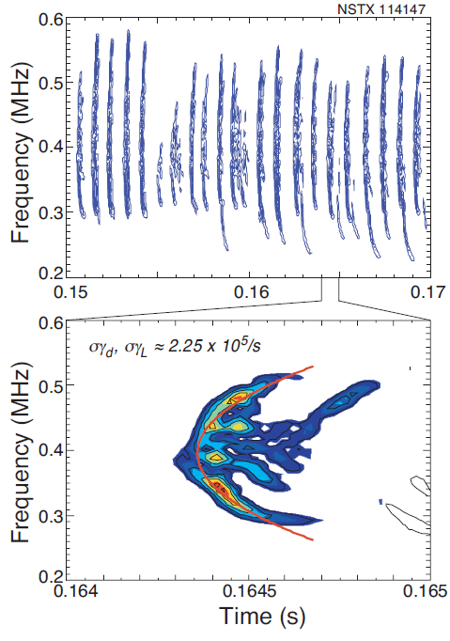
Alfvén waves can exhibit a range of bifurcations upon their interaction with fast ions
Typical scenarios:
fixed frequency and frequency splitting-> frequency is determined by the equilibrium
chirping and avalanches -> frequency is highly affected by the fast ions response
NSTX
JET
NSTX
Fasoli, PRL 1998
Podestà, NF 2011
Fredrickson, PoP 2006

Slide 3
Prediction of character of energetic-particle-driven transport in tokamaks
What tools can be used to model each type of transport?
Diffusive transport (typical for fixed-frequency modes)
can be modelled using reduced theories, such as quasilinear
typical in conventional tokamaks
Convective transport (typical for chirping frequency modes)
needs to retain full nonlinear features of the wave, is sustained by nonlinear phase-space structures
typical in spherical tokamaks

Slide 4
Prediction of character of energetic-particle-driven transport in tokamaks
What tools can be used to model each type of transport?
Diffusive transport (typical for fixed-frequency modes)
can be modelled using reduced theories, such as quasilinear
typical in conventional tokamaks
Convective transport (typical for chirping frequency modes)
needs to retain full nonlinear features of the wave, is sustained by nonlinear phase-space structures
typical in spherical tokamaks
Both can lead to similar fast ion loss levels, up to 40%

Slide 5
Prediction of character of energetic-particle-driven transport in tokamaks
What tools can be used to model each type of transport?
Diffusive transport (typical for fixed-frequency modes)
can be modelled using reduced theories, such as quasilinear
typical in conventional tokamaks
Convective transport (typical for chirping frequency modes)
needs to retain full nonlinear features of the wave, is sustained by nonlinear phase-space structures
typical in spherical tokamaks
Both can lead to similar fast ion loss levels, up to 40%
In this talk:

Slide 6
Prediction of character of energetic-particle-driven transport in tokamaks
What tools can be used to model each type of transport?
Diffusive transport (typical for fixed-frequency modes)
can be modelled using reduced theories, such as quasilinear
typical in conventional tokamaks
Convective transport (typical for chirping frequency modes)
needs to retain full nonlinear features of the wave, is sustained by nonlinear phase-space structures
typical in spherical tokamaks
Both can lead to similar fast ion loss levels, up to 40%
In this talk:
development of a criterion for the likelihood of each nonlinear scenario and its comparison with experiments

Slide 7
Prediction of character of energetic-particle-driven transport in tokamaks
What tools can be used to model each type of transport?
Diffusive transport (typical for fixed-frequency modes)
can be modelled using reduced theories, such as quasilinear
typical in conventional tokamaks
Convective transport (typical for chirping frequency modes)
needs to retain full nonlinear features of the wave, is sustained by nonlinear phase-space structures
typical in spherical tokamaks
Both can lead to similar fast ion loss levels, up to 40%
In this talk:
development of a criterion for the likelihood of each nonlinear scenario and its comparison with experiments
quasilinear diffusion approach and perspectives for whole device modeling

Slide 8

Weak nonlinear dynamics of driven kinetic systems can be used to distinguish between fixed-frequency and chirping responses
Starting point: kinetic equation plus wave power balance
Assumptions:
Perturbative procedure for
Truncation at third order due to closeness to marginal stability
Bump-on-tail modal problem, uniform mode structure
Cubic equation: lowest-order nonlinear correction to the evolution of mode amplitude A:
Berk, Breizman and Pekker, PRL 1996 Lilley, Breizman and Sharapov, PRL 2009
Notes:
Marginal stability allows collisions to compete with mode growth
Initial frequency shift and hole & clump dettachment appears during the explosive phase.
delta omega~gammaL

Slide 9
Weak nonlinear dynamics of driven kinetic systems can be used to distinguish between fixed-frequency and chirping responses
Starting point: kinetic equation plus wave power balance
Assumptions:
Perturbative procedure for
Truncation at third order due to closeness to marginal stability
Bump-on-tail modal problem, uniform mode structure
Cubic equation: lowest-order nonlinear correction to the evolution of mode amplitude A:
Berk, Breizman and Pekker, PRL 1996 Lilley, Breizman and Sharapov, PRL 2009
-_
-_
stabilizing
destabilizing (makes integral sign flip)
3
Notes:
Marginal stability allows collisions to compete with mode growth
Initial frequency shift and hole & clump dettachment appears during the explosive phase.
delta omega~gammaL

Slide 10
Weak nonlinear dynamics of driven kinetic systems can be used to distinguish between fixed-frequency and chirping responses
Starting point: kinetic equation plus wave power balance
Assumptions:
Perturbative procedure for
Truncation at third order due to closeness to marginal stability
Bump-on-tail modal problem, uniform mode structure
Cubic equation: lowest-order nonlinear correction to the evolution of mode amplitude A:
If nonlinearity is weak: linear stability, solution saturates at a low level and f merely flattens (system not allowed to further evolve nonlinearly).
If solution of cubic equation explodes: system enters a strong nonlinear phase with large mode amplitude and can be driven unstable (precursor of chirping modes).
Berk, Breizman and Pekker, PRL 1996 Lilley, Breizman and Sharapov, PRL 2009
-_
-_
stabilizing
destabilizing (makes integral sign flip)
Notes:
Marginal stability allows collisions to compete with mode growth
Initial frequency shift and hole & clump dettachment appears during the explosive phase.
delta omega~gammaL

Slide 11


A criterion for chirping onset in tokamaks
Using an action and angle formulation, the previous weak nonlinear theory leads to
>0: fixed-frequency solution likely
<0: chirping likely to occur
Phase space integration
Resonance surfaces:
Eigenstructure information:
Criterion was incorporated into NOVA-K code:
nonlinear prediction from linear physics elements
The criterion predicts that micro-turbulence should be key in determining the likely nonlinear character of a mode, e.g., fixed-frequency or chirping

Slide 12
Correlation between chirping onset and a marked reduction of the turbulent activity in DIII-D
The thermal ion heat conductivity is used as a proxy for the fast ion anomalous transport
experiments in DIII-D are scheduled to further test the proposed criterion
Duarte et al, NF 2017.

Slide 13
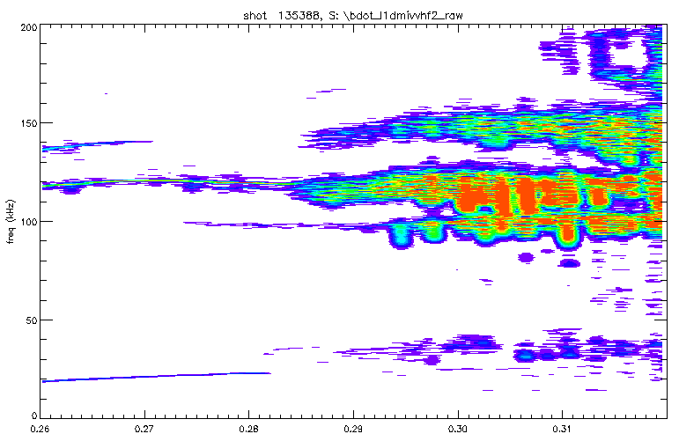
Correlation between chirping onset and a marked reduction of the turbulent activity in NSTX
The thermal ion heat conductivity is used as a proxy for the fast ion anomalous transport
GTS code is being used as na independent calculatation of fast ion diffusivity
Chirping is ubiquitous in NSTX but rare in DIII-D is consistent with the inferred fast ion micro-turbulent levels

Slide 14
Nonlinear chirping vs Quasilinear approach
Requires particles to remember their phases from one trapping bounce to another;
Full kinetic approach necessary;
Entropy is conserved in the absence of collisions.
Requires particles to forget their phase (via collisions, turbulence or mode overlap);
Assumes that the modes remain linear (therefore NOVA is suited) while the distribution function is allowed to slowly evolve nonlinearly in time;
Entropy increases due to particle memory loss.
The chirping criterion is a useful tool to make sure the quasilinear approach is applicable for a given mode

Slide 15
Resonance-broadened quasilinear (RBQ) diffusion model¹
Broadened delta
function
Formulation in action and angle variables^{2,3}
Broadening is the platform that allows for momentum and energy exchange between particles and waves:
¹Berk, Breizman, Fitzpatrick, NF 1995.
²Kaufman PoF 1972.
³Duarte, Gorelenkov and Berk, 2017 (unpublished).
-_

Slide 16
Parametric dependencies of a broadened resonance
old idea (Dupree PoF 1966): the turbulent spectrum contributes to diffuse particles away from their original unperturbed trajectories
broadening specification:
analytical predictions for the simplified driven, bump-on-tail system close to and far from marginal stability lead to particular choices of coefficients a, b and c.
guiding-center code ORBIT is being used to verify the resonance width scaling for realistic mode structure and resonances calculated by NOVA.

Slide 17
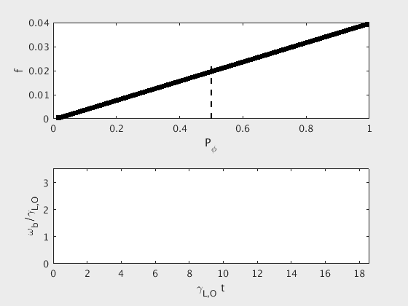
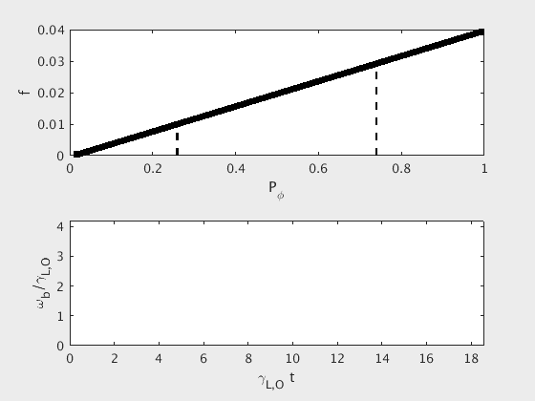
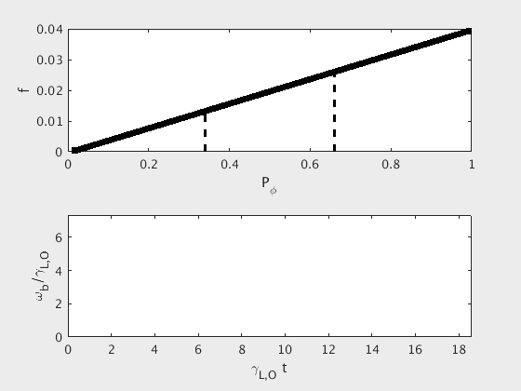
Resonance Broadened Quasilinear (RBQ) code computation of fast ion relaxation
Upper plot: distribution function as a function of the canonical toroidal momentum
Lower plot: evolution of the nonlinear bounce frequency (~square root of mode amplitude)
Single mode saturation
Two isolated modes
Two overlapping modes
When modes overlap, there is a sudden release of stored fast ion energy, which lead to substantial mode growth

Slide 18
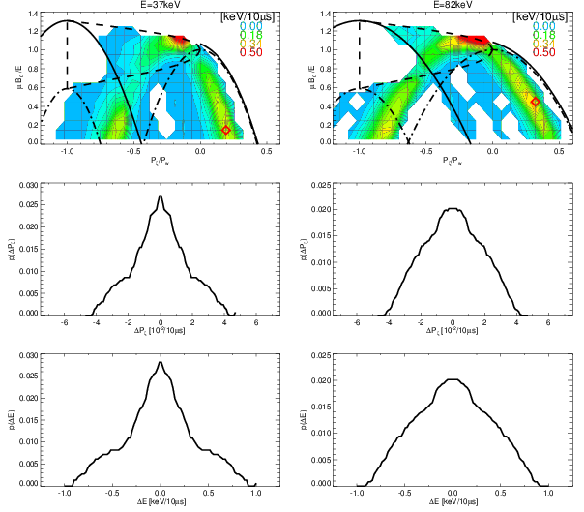
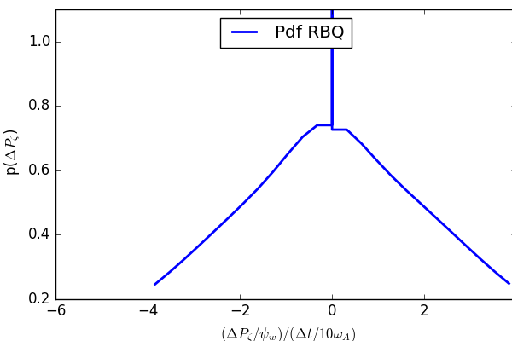
Resonance Broadened Quasilinear (RBQ) code is being interfaced with TRANSP
Whole device modeling using TRANSP is interfaced with RBQ via a Probability Distribution Function (PDF)
PDFs are used actively in Kick modeling¹
RBQ can self-consistently provide:
mode amplitude evolution
diffusion coefficient at any given phase space location
Intermittency and domino behaviors
¹ Podestà, PPCF 2014

Slide 19
Outcome
Criterion gives confidence in the application of quasilinear modeling;
Refinement of the fast ion diffusivity that enters the chirping criterion is being done with the gyrokinetic code GTS;
Experiments on DIII-D to further test the proposed chirping criterion predictions;
Although a reduced model, RBQ provides a platform for rich dynamics seen in experiments: it resolves velocity space and account for losses and intermittency;
Whole device modeling, RBQ interfacing with TRANSP.

Slide 20
Thank you

Slide 21
Additional material

Slide 22
Conclusions and outcome
Proper quantitative analysis require realistic mode structures and multiple resonance surfaces;
Analyses and observation show that micro-turbulence is a key mediator behind transitions between fixed frequency and chirping phases on DIII-D;
Micro-turbulence explains why chirping is ubiquitous in conventional tokamaks and rare in spherical tokamaks;
The model agrees with the observation of abrupt large events (ALEs) on JT-60U when supra-Alfvénic beams are on;
DIII-D experiments are scheduled to further test the theory predictions;
RBQ code is being interfaced with TRANSP. EPs losses in whole device modeling are targeted [Duarte et al (in preparation) and TTF 2017].
10

Slide 23
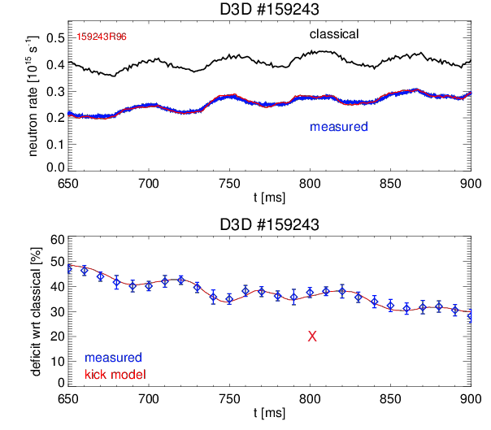
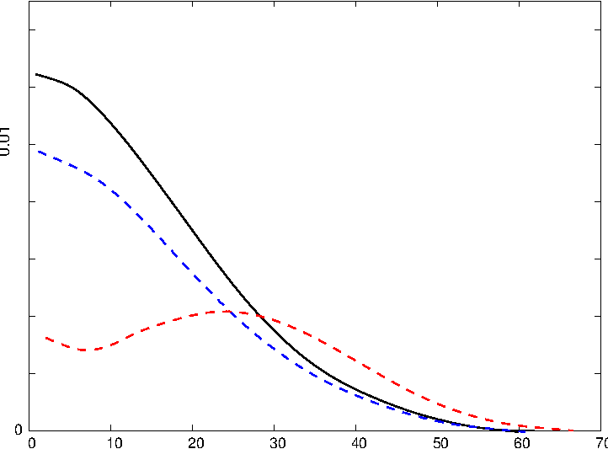
Q2 progress: Perturbative critical gradient (CG) model has been applied to DIII-D #159243 for neutron deficit comparisons
CG XP by Collins [PRL’16] are used within this milestone
5 RSAE, TAEs were used
Maxwellian DF of beam ions was used
No AE amplitudes are used by CGM
Perturbative CGM (under)-predicts
neutron deficit in DIII-D AE only XPs
Podestà’s kick model describes well neutron deficit

Slide 24
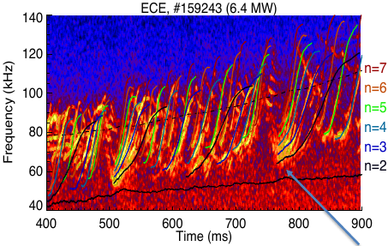
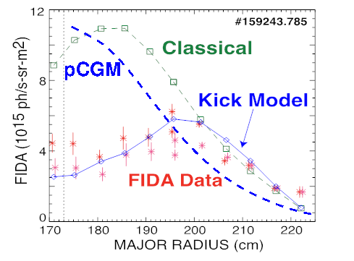
FY17 Notable: Validation of reduced fast-ion transport models in high q_{min} steady state plasmas
Q2 progress update
DIII-D critical gradient (CG) experiment is being modeled for reduced models V&V
TRANSP run has been performed with classical EP confinement model, Heidbrink’16 PoP
Kick model captures hollow EP profile.
  two constraints: amplitudes from measurements & neutron deficit
  hollow EP profiles provided challenges for modeling & understanding
  significantly different from classical (TRANSP) predictions
Perturbative, first fully predictive CGM underestimate EP redistribution & neutron deficit
  neutron deficit is about factor of 2 lower than measured => motivates self consistent QL model
Notes:
the first fully predictive model underestimates transport; kick model is a point of reference; next steps are to improve predictive capability.

Slide 25
Ongoing work
Chirping:
Study of the reasons for transition to chirping in NSTX;
Study of chirping prediction/likelihood for typical ITER scenarios;
Experiments on DIII-D to further test the proposed chirping criterion predictions;
Possibility of capturing full chirping cycles with ORBIT;
Chirping criterion check with M3D-K (Shen, Fu)
Quasilinear:
Numerical determination of the resonance broadening parametric dependencies;
RBQ code validation and interfacing with NOVA/NOVA-K;
Make use of Podestà’s kick model routines to use RBQ to provide probability distribution functions to global transport codes, such as TRANSP.

Slide 26
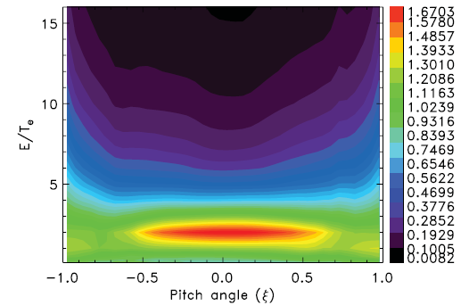

Correction to the diffusion coefficient: the inclusion of electrostatic microturbulence
Microturbulence on fast ions: complex interplay between gyroaveraging, field anisotropy and poloidal drift effects leads to non-zero EP diffusivity¹
Microturbulence can well exceed pitch-angle scattering at the resonance² (enhancement of phase-space holes and clumps destruction)
From GTC gyrokinetic simulations for passing particles:³
Unlike in DIII-D and TFTR, ion transport in NSTX in mostly neoclassical
¹Estrada-Mila et al, PoP 2005
²Lang and Fu, PoP 2011
³Zhang, Lin and Chen, PRL 2008
Ratio of fast ion diffusivity to thermal ion diffusivity³
5

Slide 27
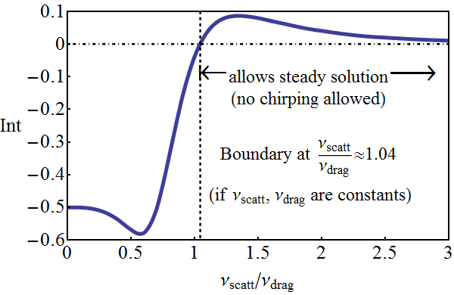
Velocity dependence of the relevant ratio for the chirping criterion is consistent with observations of abrupt large events (ALEs) in JT-60U
In JT-60U, chirping is more frequent when high energy negative-ion-based NBI is used
Collisional operator for fast ions:
Chirping likelihood is much greater for supra-Alfvénic injection (when the main resonance is at rather than
at
9

Slide 28
Collisional operator for fast ions
Fast ions resonating with Alfvénic modes have 1D dynamics:

Slide 29
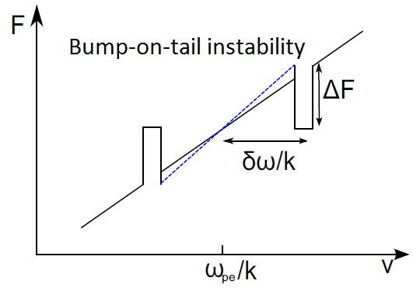
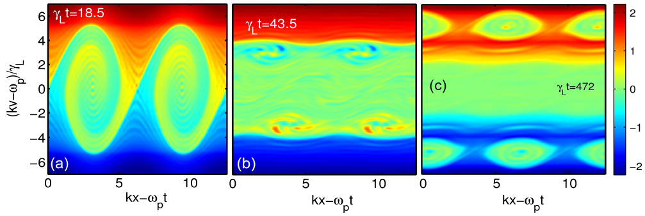
Phase space holes and clumps in kinetically driven, dissipative systems – reduced bump-on-tail model
Nonlinear Landau damping perspective: incomplete phase mixing leads to small sideband oscillations that may tap free energy at the edges of the resonance plateau
Self-organization process: chirping allows for a balance between the free energy from the distribution function and the wave dissipation
Holes and clumps carry the resonance with them→convective instability
self-trapped structures
hole
Vlasov simulations by Lilley and Nyqvist, PRL 2014
clump
Notes:
Nonperturbative modes: their very existence is associated with energetic particle response

Slide 30
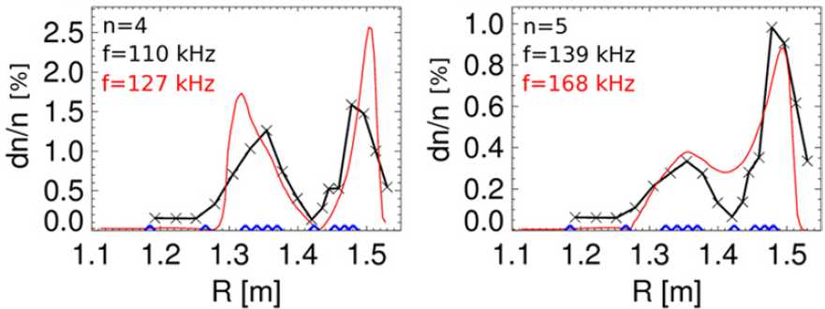
Mode structure identification
NOVA code: finds linear, ideal mode structures
Its kinetic postprocessor NOVA-K computes resonance surfaces and provides damping and linear growth rates. Phase space and bounce averages are necessary to calculate effective collisional coefficients
NOVA’s mode structures are compared with NSTX reflectometer measurements (fluid displacement times the local density gradient is equivalent to the density fluctuation). In DIII-D ECE is used
Podestà et al, NF 2012
7
Notes:
Comparison with exp data justifies application of chip crit. (put in the end)

Slide 31
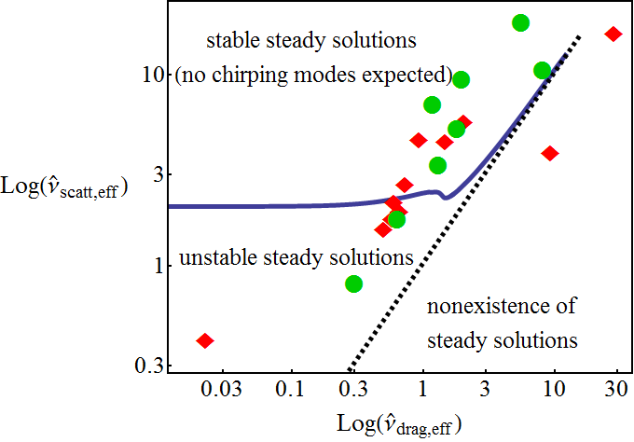
Chirping in terms of effective collisional coefficients for realistic resonances and mode structures
Experimental observations:
Red diamonds: chirping was observed
Green dots: no chirping observed
Pitch-angle scattering: leads to loss of correlation (loss of phase information from one bounce to another)
Drag (slowing down): coherently moves structures down in velocity
Bump-on-tail modeling is not enough to resolve the regions in collisional space that allows for chirping modes
Missing physics in the simplified theoretical prediction: mode structure, (multiple) resonance surfaces and phase-space and bounce averages
Follow from cubic
equation
9
Notes:
Distr. Function of NBI-produced ions establishes itself as drag=slowing down=dynamical friction.
Distr. Function of ICRH-accelerated ions forms via Pitch-angle scattering=velocity-space diffusion
Turbulence contributes to washing out
(chirping needs particles to remember their phases from one bounce to another)

Slide 33
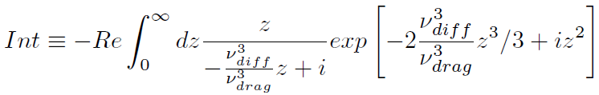
Generalized criterion dependence on the ratio scattering/drag
>0: steady state solution
<0: chirping may happen
-_
-_
Scattering: leads to loss of correlation (loss of phase information from one bounce to another)
Drag (slowing down): coherently moves structures down in velocity
Diffusive effects suppress chirping structures while slowing down enhances them

Slide 34
Theory predictions on experimental conditions that could be changed to suppress chirping in NSTX-U
Increase Te (drag decreases)
Avoid H mode
Increase overall stochasticity (3D fields¹, Alfvénic overlap, ripples, NTMs, …)
Make NSTX-U plasma more turbulent:
Decrease the rotation shear
Decrease beta
Increase grad T
Decrease grad n
This changes
3D fields applied at 0.5s
¹Bortolon, PRL 2013
Diffusive effects suppress chirping structures while slowing down enhances them

Slide 35
Recently identified transitions from fixed-frequency to chirping in NSTX
(credits to Eric Fredrickson)
Transitions in NSTX are currently not understood. Possible explanations: (i) change in the beam beta, (ii) rotation and (iii) resonance speed.

Slide 36

Outline
Introduction to frequency chirping
Berk-Breizman model: cubic equation for mode amplitude evolution at early times
Generalization to multi-dimensional resonances in space and realistic mode structure
Inclusion of microturbulence in the model
Analysis of modes in TFTR, DIII-D and NSTX
Quasilinear modeling
Conclusions and outcome

Slide 37
Thank you

Slide 38
Additional material

Slide 39
Conclusions and outcome
Proper quantitative analysis require realistic mode structures and multiple resonance surfaces;
Analyses and observation show that micro-turbulence is a key mediator behind transitions between fixed frequency and chirping phases on DIII-D;
Micro-turbulence explains why chirping is ubiquitous in conventional tokamaks and rare in spherical tokamaks;
The model agrees with the observation of abrupt large events (ALEs) on JT-60U when supra-Alfvénic beams are on;
DIII-D experiments are scheduled to further test the theory predictions;
RBQ code is being interfaced with TRANSP. EPs losses in whole device modeling are targeted [Duarte et al (in preparation) and TTF 2017].
10

Slide 40
Ongoing work
Chirping:
Study of the reasons for transition to chirping in NSTX;
Study of chirping prediction/likelihood for typical ITER scenarios;
Experiments on DIII-D to further test the proposed chirping criterion predictions;
Possibility of capturing full chirping cycles with ORBIT;
Chirping criterion check with M3D-K (Shen, Fu)
Quasilinear:
Numerical determination of the resonance broadening parametric dependencies;
RBQ code validation and interfacing with NOVA/NOVA-K;
Make use of Podestà’s kick model routines to use RBQ to provide probability distribution functions to global transport codes, such as TRANSP.

Slide 41
Correction to the diffusion coefficient: the inclusion of electrostatic microturbulence
Microturbulence on fast ions: complex interplay between gyroaveraging, field anisotropy and poloidal drift effects leads to non-zero EP diffusivity¹
Microturbulence can well exceed pitch-angle scattering at the resonance² (enhancement of phase-space holes and clumps destruction)
From GTC gyrokinetic simulations for passing particles:³
Unlike in DIII-D and TFTR, ion transport in NSTX in mostly neoclassical
¹Estrada-Mila et al, PoP 2005
²Lang and Fu, PoP 2011
³Zhang, Lin and Chen, PRL 2008
Ratio of fast ion diffusivity to thermal ion diffusivity³
5

Slide 42
Velocity dependence of the relevant ratio for the chirping criterion is consistent with observations of abrupt large events (ALEs) in JT-60U
In JT-60U, chirping is more frequent when high energy negative-ion-based NBI is used
Collisional operator for fast ions:
Chirping likelihood is much greater for supra-Alfvénic injection (when the main resonance is at rather than
at
9

Slide 43
Collisional operator for fast ions
Fast ions resonating with Alfvénic modes have 1D dynamics:

Slide 44
Phase space holes and clumps in kinetically driven, dissipative systems – reduced bump-on-tail model
Nonlinear Landau damping perspective: incomplete phase mixing leads to small sideband oscillations that may tap free energy at the edges of the resonance plateau
Self-organization process: chirping allows for a balance between the free energy from the distribution function and the wave dissipation
Holes and clumps carry the resonance with them→convective instability
self-trapped structures
hole
Vlasov simulations by Lilley and Nyqvist, PRL 2014
clump
Notes:
Nonperturbative modes: their very existence is associated with energetic particle response

Slide 45
Chirping in terms of effective collisional coefficients for realistic resonances and mode structures
Experimental observations:
Red diamonds: chirping was observed
Green dots: no chirping observed
Pitch-angle scattering: leads to loss of correlation (loss of phase information from one bounce to another)
Drag (slowing down): coherently moves structures down in velocity
Bump-on-tail modeling is not enough to resolve the regions in collisional space that allows for chirping modes
Missing physics in the simplified theoretical prediction: mode structure, (multiple) resonance surfaces and phase-space and bounce averages
Follow from cubic
equation
9
Notes:
Distr. Function of NBI-produced ions establishes itself as drag=slowing down=dynamical friction.
Distr. Function of ICRH-accelerated ions forms via Pitch-angle scattering=velocity-space diffusion
Turbulence contributes to washing out
(chirping needs particles to remember their phases from one bounce to another)

Slide 47
Generalized criterion dependence on the ratio scattering/drag
>0: steady state solution
<0: chirping may happen
-_
-_
Scattering: leads to loss of correlation (loss of phase information from one bounce to another)
Drag (slowing down): coherently moves structures down in velocity
Diffusive effects suppress chirping structures while slowing down enhances them

Slide 48
Theory predictions on experimental conditions that could be changed to suppress chirping in NSTX-U
Increase Te (drag decreases)
Avoid H mode
Increase overall stochasticity (3D fields¹, Alfvénic overlap, ripples, NTMs, …)
Make NSTX-U plasma more turbulent:
Decrease the rotation shear
Decrease beta
Increase grad T
Decrease grad n
This changes
3D fields applied at 0.5s
¹Bortolon, PRL 2013
Diffusive effects suppress chirping structures while slowing down enhances them

Slide 49
Recently identified transitions from fixed-frequency to chirping in NSTX
(credits to Eric Fredrickson)
Transitions in NSTX are currently not understood. Possible explanations: (i) change in the beam beta, (ii) rotation and (iii) resonance speed.

Slide 50
Outline
Introduction to frequency chirping
Berk-Breizman model: cubic equation for mode amplitude evolution at early times
Generalization to multi-dimensional resonances in space and realistic mode structure
Inclusion of microturbulence in the model
Analysis of modes in TFTR, DIII-D and NSTX
Quasilinear modeling
Conclusions and outcome

