Slide 1




NSTX-U
Supported by
Theory needs for NSTX-U and ITER
Coll of Wm & Mary
Columbia U
CompX
General Atomics
FIU
INL
Johns Hopkins U
LANL
LLNL
Lodestar
MIT
Lehigh U
Nova Photonics
Old Dominion
ORNL
PPPL
Princeton U
Purdue U
SNL
Think Tank, Inc.
UC Davis
UC Irvine
UCLA
UCSD
U Colorado
U Illinois
U Maryland
U Rochester
U Tennessee
U Tulsa
U Washington
U Wisconsin
X Science LLC
J. Menard, S. Kaye, and the
NSTX-U Topical Science Group Leaders
Culham Sci Ctr
York U
Chubu U
Fukui U
Hiroshima U
Hyogo U
Kyoto U
Kyushu U
Kyushu Tokai U
NIFS
Niigata U
U Tokyo
JAEA
Inst for Nucl Res, Kiev
Ioffe Inst
TRINITI
Chonbuk Natl U
NFRI
KAIST
POSTECH
Seoul Natl U
ASIPP
CIEMAT
FOM Inst DIFFER
ENEA, Frascati
CEA, Cadarache
IPP, Jülich
IPP, Garching
ASCR, Czech Rep
PPPL Theory Department Retreat
Princeton University and PPPL
September 24-25 and 27, 2012

Slide 2
Outline
NSTX Upgrade – mission and Upgrade project elements
Theory and modeling needs organized by topical area
Some opinions on prioritization
Note: Much of this content was developed by the NSTX-U topical science group (TSG) leaders for the NSTX-theory brainstorming meeting and for the NSTX-U PAC-31 and five year plan
  http://nstx-u.pppl.gov/five-year-plan/five-year-plan-2014-18/theory-needs-and-requirements
  http://nstx-u.pppl.gov/program/program-advisory-committee/pac-31

Slide 3
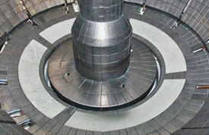
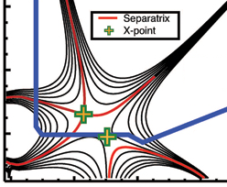

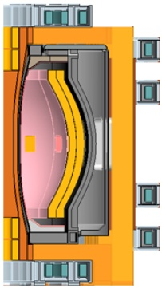
NSTX Upgrade Mission Elements
Advance ST as candidate for Fusion Nuclear Science Facility (FNSF)
Develop solutions for plasma-material interface
Advance toroidal confinement physics predictive capability for ITER and beyond
Develop ST as fusion energy system
ST-FNSF
Lithium
“Snowflake”
ITER
ST Pilot Plant

Slide 4

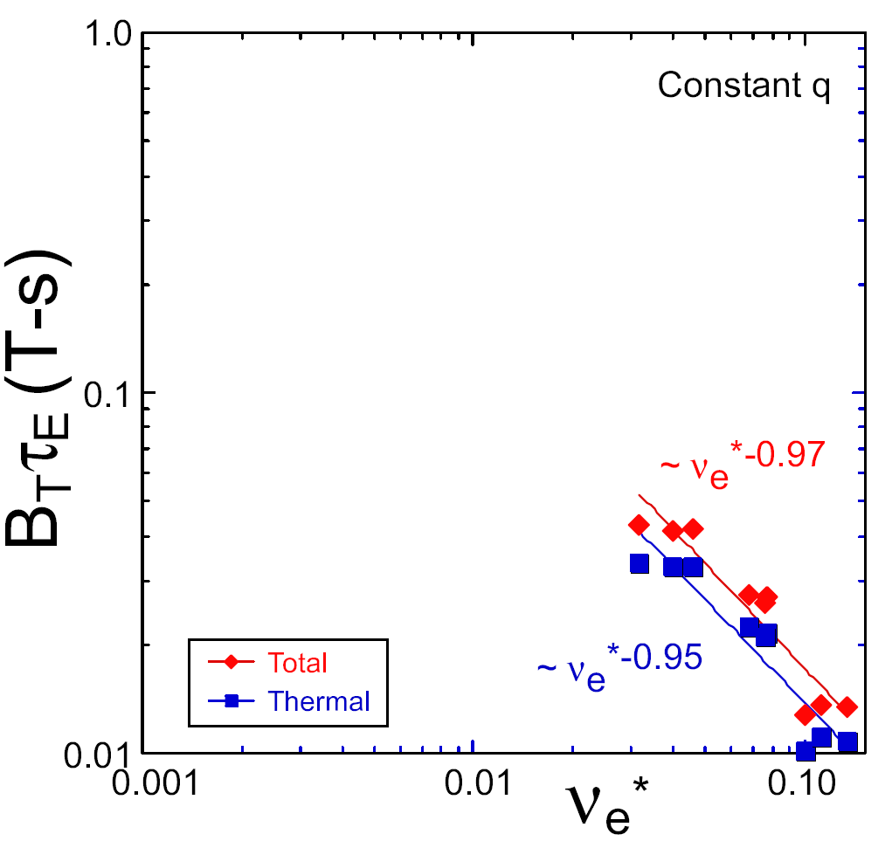
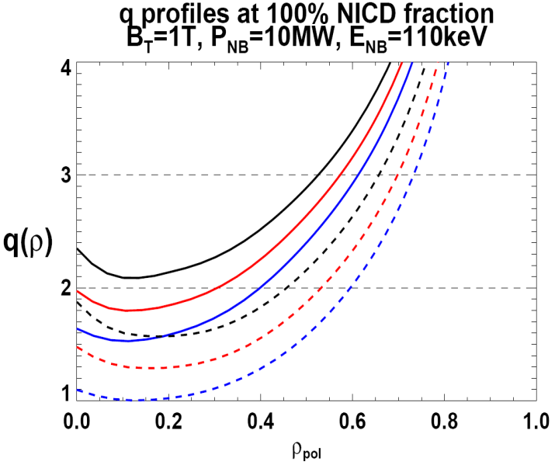

NSTX Upgrade will address critical plasma confinement and sustainment questions by exploiting 2 new capabilities
Previous
center-stack
New
center-stack
ST-FNSF
constant q, β, ρ∗
2 × higher B_{T} and I_{P} increases T, reduces ν* toward ST-FNSF to better understand confinement
  Provides 5x longer pulses for profile equilibration, NBI ramp-up
NSTX Upgrade
?
ITER-like scaling
TF OD = 20cm
TF OD = 40cm
Normalized e-collisionality ν_{e}* ∝ n_{e} / T_{e}²
I_{P}=0.95MA, H_{98y2}=1.2, β_{N}=5, β_{T} = 10%
B_{T} = 1T, P_{NBI} = 10MW, P_{RF} = 4MW
  2x higher CD efficiency from larger tangency radius R_{TAN}
100% non-inductive CD with q(r) profile controllable by:
  tangency radius, density, position
n
e
/
n
Greenwald
0.95
0.72
R_{TAN} [cm]
__________________
50, 60, 70, 130
60, 70,120,130
70,110,120,130
Present NBI
New 2nd NBI

Slide 5
Topical Areas
Transport and Turbulence
Boundary Physics
Macroscopic Equilibrium and Stability
Solenoid-free Start-up and Ramp-up
Waves and Energetic Particles
Advanced Scenarios and Control
Disruptions

Slide 6
Topical Areas
Transport and Turbulence
Boundary Physics
Macroscopic Equilibrium and Stability
Solenoid-free Start-up and Ramp-up
Waves and Energetic Particles
Advanced Scenarios and Control
Disruptions

Slide 7
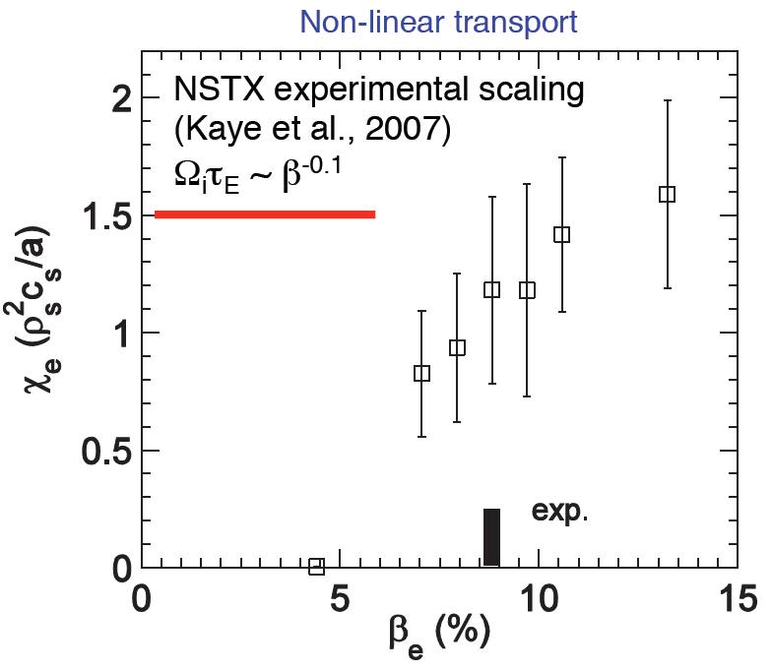
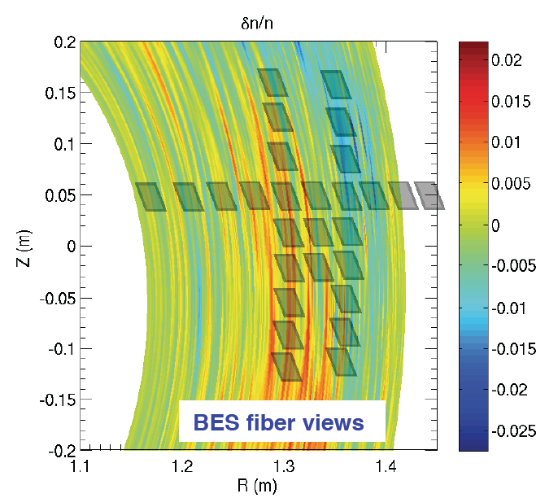
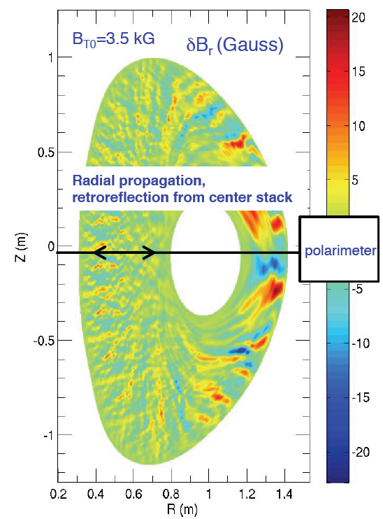
NSTX-Upgrade will extend diagnosis and understanding of micro-instabilities potentially responsible for anomalous transport in STs
GYRO simulations
of micro-tearing
(W. Guttenfelder)
Electrons dominant loss channel for ST thermal confinement
  Micro-tearing strong candidate for anomalous thermal e-transport at higher β
  ETG can also contribute to e-transport at lower β
  Alfvénic instabilities (GAE/CAE) can also cause core electron transport
NSTX-U goal is to study full turbulence wave-number spectrum:
  low-k – ITG/TEM/AE/μ-tearing (BES, polarimetry) + high-k – ETG (μ-wave scattering)
NSTX-U enables access to unique turbulence regime with high β + lower ν*

Slide 8
NSTX-U theory and modeling needs for Transport and Turbulence
NBI-heated H-mode core-flat region (r/a <~ 0.4)
  Empirical/semi-empirical scaling of core T_{e} profile flattening with fast ion population, gradient, β_{fast}, etc…
  Simulations of fast particle driven instabilities and associated transport
  Development of reduced models (theory, semi-empirical, etc…) of χ_{e}, χ_{φ} and D_{j||} for use in predictive simulations
  The effect of turbulence spreading from H-Mode core gradient region (r/a~0.4-0.9)
H-Mode core gradient region (r/a ~ 0.4-0.9)
  Identify1D profile database for model validation from relevant discharges
  Test TGLF (or develop other reduced models) against linear and nonlinear gyrokinetics for NSTX-relevant parameters, especially for ETG, micro-tearing
  Develop reduced models with global effects
  May need global, multi-scale simulations due to large profile variations
  Reconcile anomalous electron and momentum transport with neoclassical χ_{i}

Slide 9
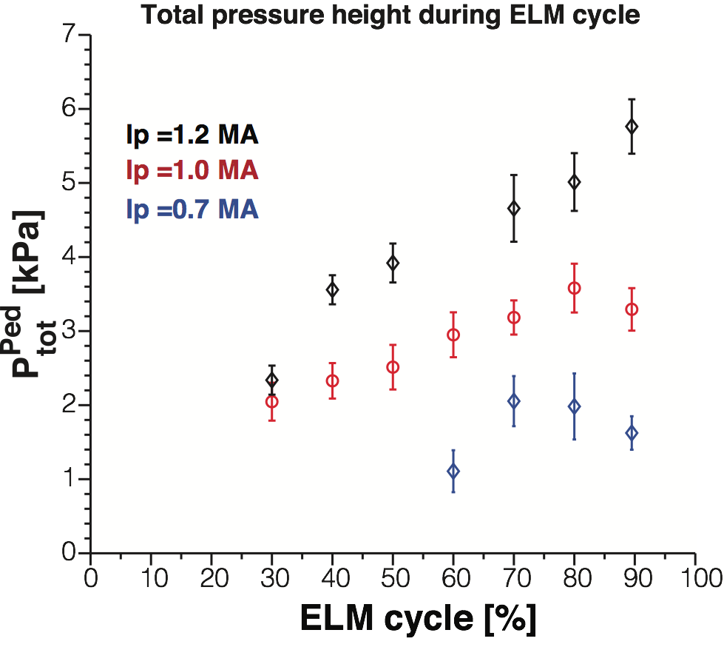
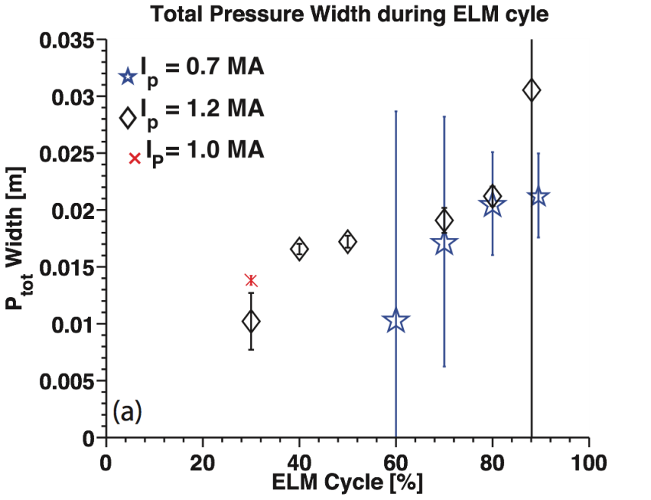
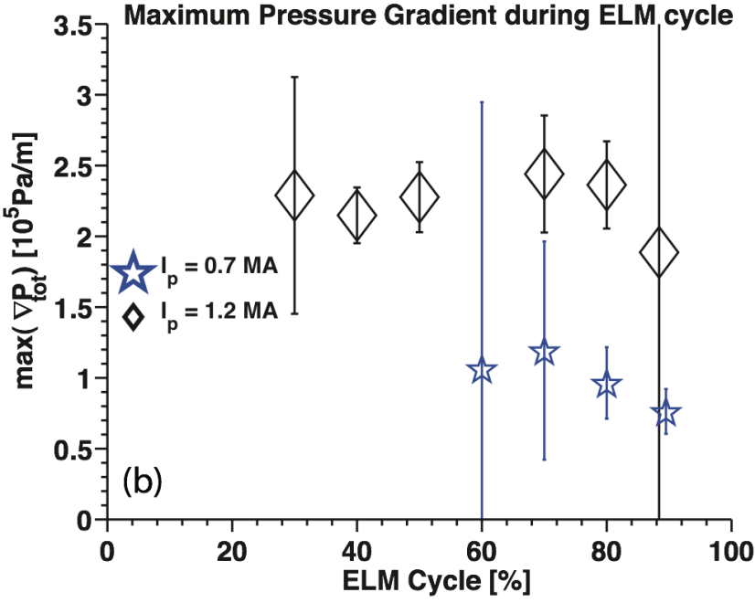
Pedestal width and height progressively increase during ELM cycle but the peak pressure gradient remains clamped
Pedestal Height
Pedestal width
Pedestal height
saturation/may be rollover
Diallo Nucl. Fusion (2011)
Pedestal height increases by a factor ≤ 3
  Height scales with Ip
Pedestal width increases independently of Ip
Gradient is clamped early in ELM cycle
Maximum pressure
gradient

Slide 10
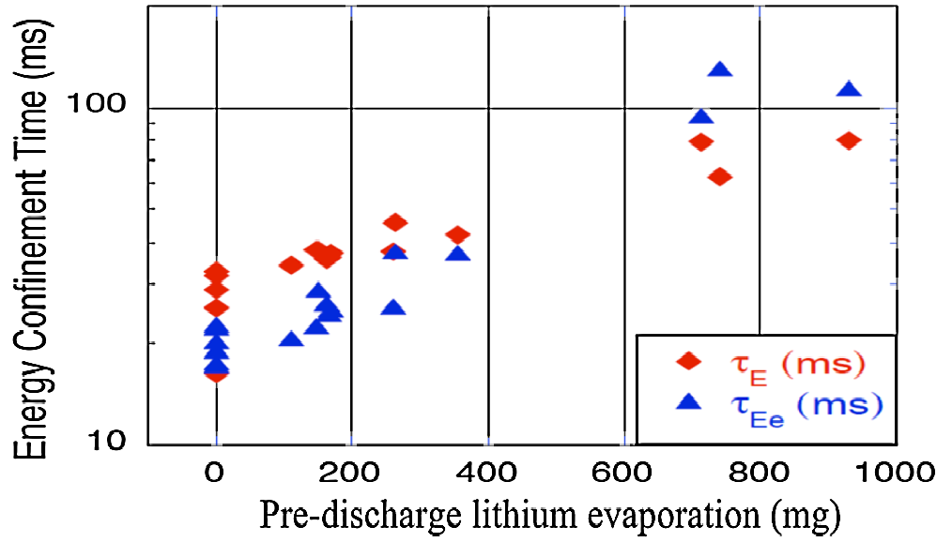
NSTX-U theory and modeling needs for pedestal turbulence, transport, stability
H-mode pedestal (r/a>0.9)
  Empirical/semi-empirical scaling of pedestal height & width with “engineering” parameters (I_{p}, B_{T}, n_{e}, Z_{eff}) and/or theory parameters (ν*, β, ρ*)
  Development and validation of pedestal height models with data (EPED1, others)
  Pedestal turbulence (Local and global gyrokinetic, fluid codes, e.g. GYRO, XGC, BOUT++, GTS, GEM)
  Predict microstability (KBM,…) thresholds in pedestal (linear gyrokinetics, others)
Role of Li in confinement improvement, ELM suppression
Energy confinement increases continuously with increased Li evaporation in NSTX
High confinement very important for FNSF and other next-steps
what is τ_{E} upper bound?
R. Maingi, et al., PRL 107, 145004 (2011)

Slide 11
Topical Areas
Transport and Turbulence
Boundary Physics
Macroscopic Equilibrium and Stability
Solenoid-free Start-up and Ramp-up
Waves and Energetic Particles
Advanced Scenarios and Control
Disruptions

Slide 12
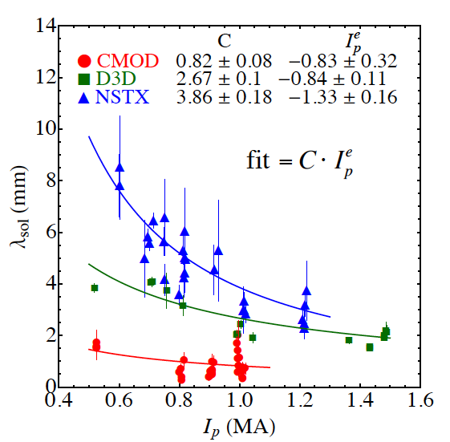
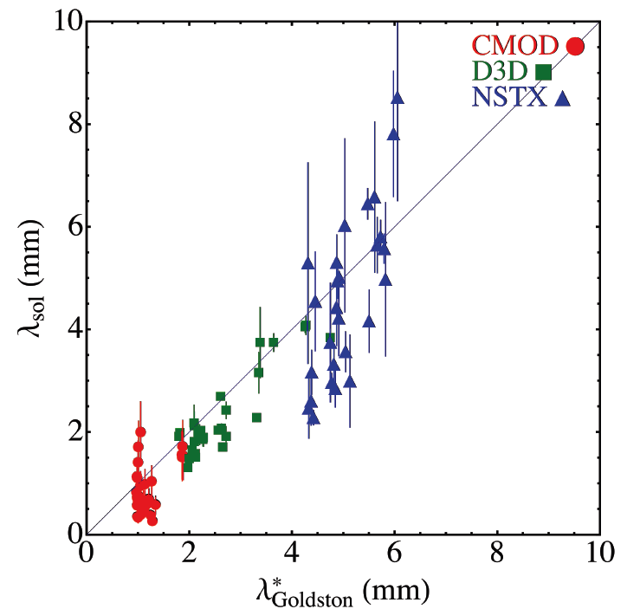
SOL width and divertor heat flux studies in NSTX elucidate on divertor projections for NSTX-U, ST-FNSF and ITER
λ_{q}^{mid} contracts with increasing I_{p}: λ_{q}^{mid} ~ I_{p}^{-1.3}
Comparison with SOL models
  Parallel transport: conductive/convective, cross-field : collisional / turbulent / drift
  XGC0 reproduced I_{p} dependence λ_{q}^{mid} ~ I_{p}^{-1.0}
  SOLT: I_{p} scaling is weaker than observed
    P_{SOL}, collisionality, L_{II} /R set cross-field transport and turbulence structure that affect λ_{q}
  Goldston drift-based model of SOL flows
    Attached H-mode regimes, λ_{q} ~ (2a/R) ρ_{i}
    ∇B and curvature drift motion sets SOL width, Spitzer thermal conduction sets T_{sep}
  Exploring mechanisms setting steep pressure gradient region and connection to SOL width
Projections to NSTX-U
  λ_{q}^{mid} = 3±0.5 mm
  As q_{peak} ~ I_{p} and q_{peak}~P_{SOL}, q_{peak} ~ 20-30 MW/m²
M. Makowski, APS 2011

Slide 13
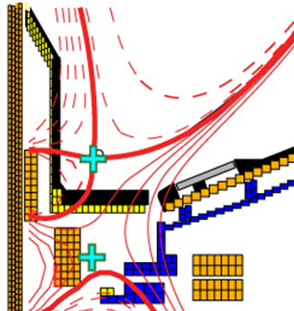
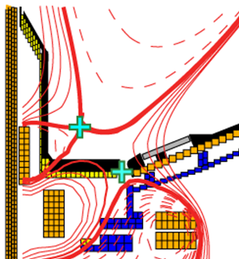
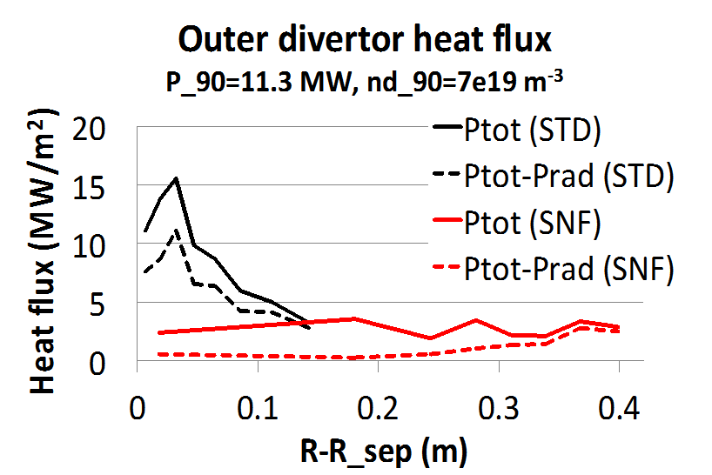
NSTX-U theory and modeling needs for Boundary Physics
Scrape-off layer width, transport, and turbulence
  Role of turbulence and convective cells in setting SOL width
  Impact of Li on the SOL width, physics of collisionless SOL
  Characterization of the edge flows, interplay between blobs and flows
Divertor transport, radiation and plasma-surface interactions
  Steady state and transient transport in standard, snowflake divertors
  Validate fluid, kinetic and gyro-kinetic edge transport models
    Also validated radiation models including high Z atoms, PMI models
    q_{peak} reduced from ~15 MW/m² (STD) to 0.5-3 MW/m² (SNF)
Standard (STD)
Snowflake (SNF)

Slide 14
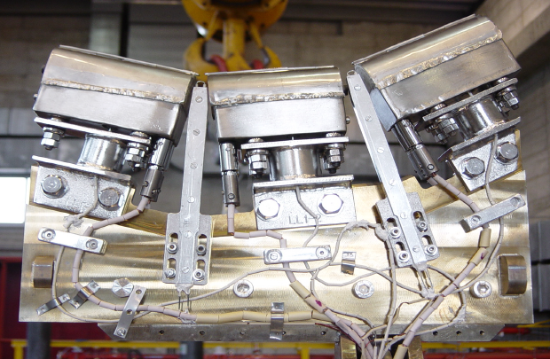
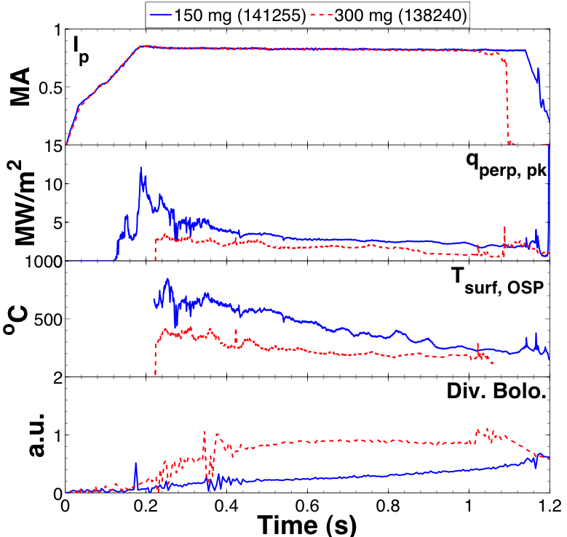
Liquid metals have the potential to mitigate steady-state and transient heat-loads, and protect underlying PFCs
150 mg
300 mg
2 otherwise identical shots (no ELMs)
I_{p} = 0 .8 MA, P_{nbi} ~ 4 MW
high δ, f_{exp} ~20
FTU capillary porous system (CPS)
CPS in T-11 handles > 10MW/m²
  Self-shielding radiative layers observed
CPS e-beam tested to:
  25 MW/m² for 5 - 10 minutes
  50 MW/m² for 15s
Plasma focus tested to 60 MJ/m²
off-normal load
NSTX: Increased Li evaporation correlated with lower q_{pk}
  T_{surf} at OSP = 800˚C → 400˚C with heavy Li
  q_{pk} stays < 3 MW/m² with heavy Li, divertor P_{rad} increases
  This occurs despite narrowing of heat-flux width at divertor
  Need theory and modeling to understand roles of C, Li radiation, detachment physics, etc.

Slide 15
Topical Areas
Transport and Turbulence
Boundary Physics
Macroscopic Equilibrium and Stability
Solenoid-free Start-up and Ramp-up
Waves and Energetic Particles
Advanced Scenarios and Control
Disruptions

Slide 16
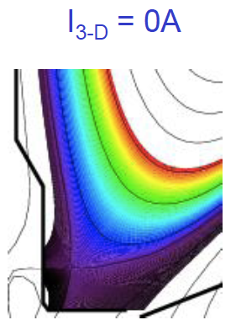
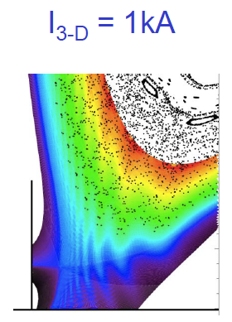
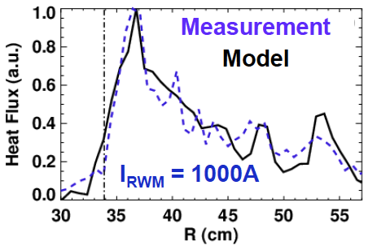
NSTX studies of ELM regimes and ELM control contribute to mitigation strategies for ITER and future STs
ELM triggering with n=3 RMP
  Weak RMP impact on pedestal transport
  Strong impact on stability
    T_{e}, pressure gradient increase
    PEST shows edge unstable with n=3
  Triggered ELMs are phase locked to the imposed 3D fields for n=1 and n=3
Small transport ELM-like events from 3D field application below ELM triggering threshold (w.r.t. duration or amplitude)
Divertor heat and particle structures during ELMs, intrinsic and 3D fields
  Applied 3D fields reattach detached divertor plasma
  Developing model of toroidally non-uniform heat and particle flux structures using EMC3-EIRENE
Collaboration with MAST in perturbed equilibria modeling
Discussing collaboration with ASDEX in small ELM analysis, effects of 3D fields on detachment

Slide 17
NSTX-U theory and modeling needs for Macroscopic Equilibrium and Stability
Category | Existing efforts | Associated physics issues
More robust equilibrium reconstruction and modeling including toroidal rotation and SOL, and stability analysis | EFITs including rotation LRDFITs including rotation (E,LRD)FITs + FLOW (E,LRD)FITs + FLOW + M3D-C1 | Stability boundary with toroidal rotation? Stability boundary including separatrix? Can be routinely available as GEQDSK in NSTX-U?
Quasi-linear 3D equilibrium modeling including islands, neoclassical, and kinetic MHD effects | IPEC with tensor pressures and islands + POCA + Inner-layer FLOW, MARS-F, MARS-K M3D-C1 | 3D equilibrium with opened islands? 3D equilibrium with rotation? 3D equilibrium with anisotropic pressure? Self-consistent modeling for NTV in NSTX-U?
Quasi-linear stability modeling including neoclassical and kinetic MHD effects | MISK with anisotropic pressures and fast ions MARS-K, NOVA-K M3D-C1 | RWM passive stability with 2nd NBIs in NSTX-U? Effects by Self-consistent eigenfunction? Second RWM code with full kinetic treatment?

Slide 18
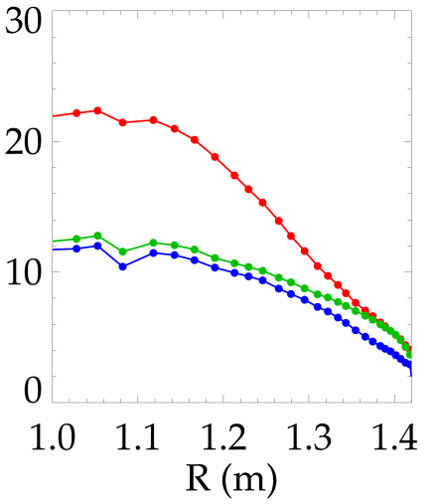
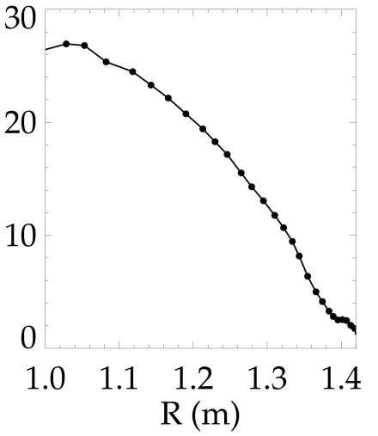
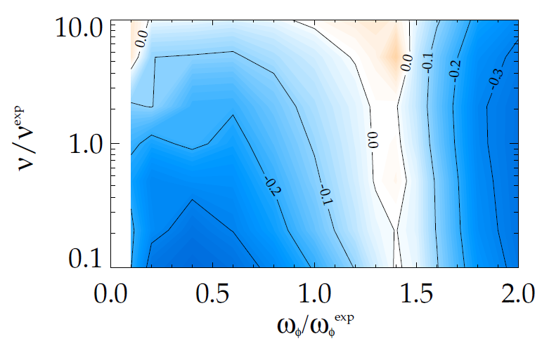
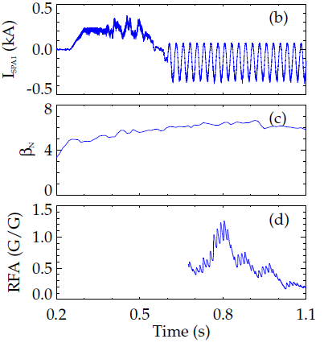
Study of RWM kinetic stabilization is unveiling complex rotation and collisionality dependence
RWM can be stabilized by kinetic effects through rotational resonance
  Implying importance of rotation control, NTV, NCC coils
NSTX-tested kinetic RWM stability theory showed that reduced ν* can be stabilizing through kinetic resonances
J. W. Berkery et al, PRL 104 035003 (2010)
J. W. Berkery et al., POP 17 082504 (2010)
S. A. Sabbagh et al., NF 50 025020 (2010)
RWM, RFA vs. rotation
J. W. Berkery et al., PRL 106 075004 (2011)
NSTX RWM stability (γ_{W}) vs. (ν, ω_{ϕ}) by MISK
(140102)
(137722)
ω_{φ} [kHz]
marginal ω_{φ} profile: ω_{φ} ^{exp}
Marginal
Stability
unstable
stable
unstable
Collisionality
140102
J. W. Berkery (Columbia. U)
S. A. Sabbagh (Columbia. U)
Plasma Rotation
Time (s)

Slide 19
NSTX-U theory and modeling needs for Macroscopic Equilibrium and Stability
Category | Existing efforts | Associated physics issues
Non-linear (as well as linear) 3D modeling for time-evolving dynamics of islands, neoclassical, full kinetic MHD effects | M3D-C1 with distribution function solver (Ramos theory or NTV theory) XGC0 | Non-linear effects in 3D equilibrium and stability, including SW (q=1) and NTM? Two fluid effects in 3D equilibrium and stability? Full kinetic effects in 3D equilibrium and stability?
Full 3D modeling for external structure for RWM dynamics | Multi-mode VALEN3D Plasma permeability with neoclassical, kinetic effects VALEN3D + Plasma permeability | Full 3D current effects on RWM? Effects of full 3D + kinetic plasma permeability on RMW stability and control?
Gas penetration physics modeling including MGI and runaway electrons and disruption simulation | DEGAS2 for gas penetration TSC for runaway electrons M3D for disruption simulation Use of 3D equilibrium sequence | Gas penetration with atomic physics? Runaway electrons in NSTX-U? Coupling gas and plasma modeling? Why mode locking cause a disruption? What is the origin of a density limit disruption?

Slide 20
Topical Areas
Transport and Turbulence
Boundary Physics
Macroscopic Equilibrium and Stability
Solenoid-free Start-up and Ramp-up
Waves and Energetic Particles
Advanced Scenarios and Control
Disruptions

Slide 21
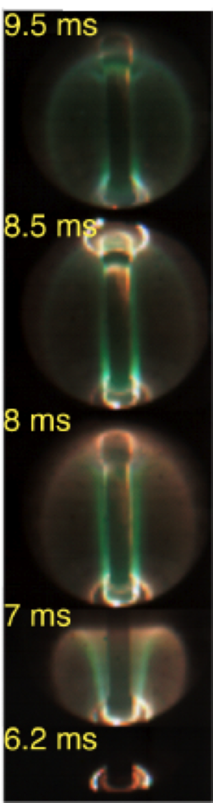
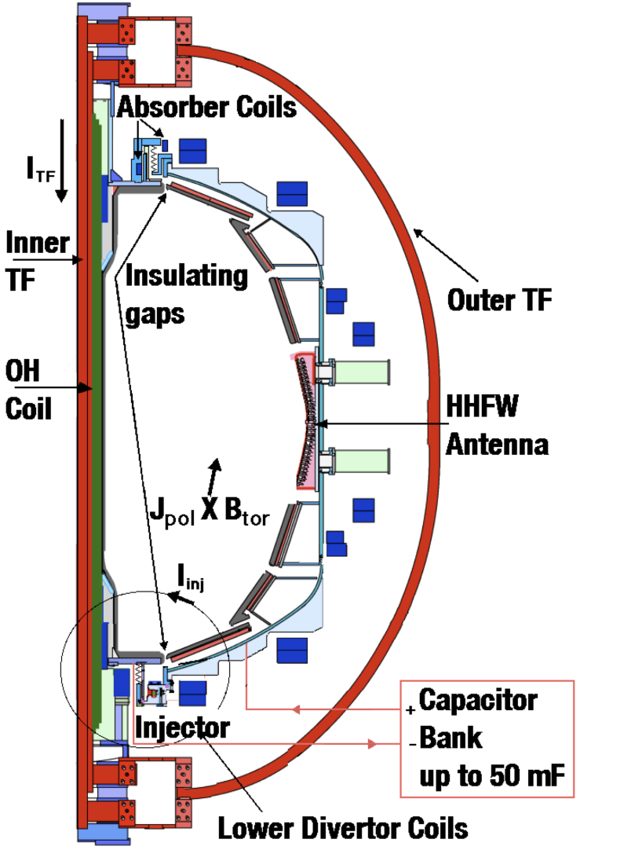
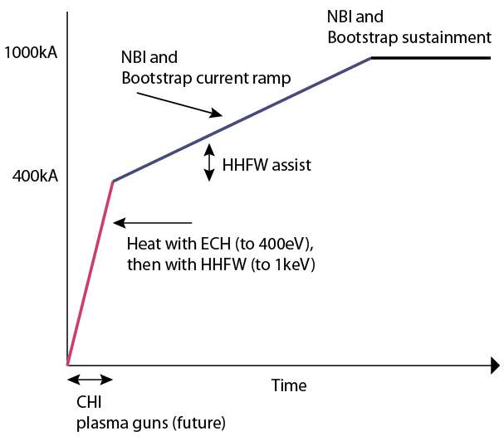
CHI planned to be used as initial current seed for subsequent non-inductive current ramp-up in NSTX-U, ST-FNSF
CHI in NSTX/NSTX-U
NSTX-U Start-up and Ramp-up strategy
NSTX-U goal is to demonstrate and understand solenoid-free current start-up and ramp-up

Slide 22
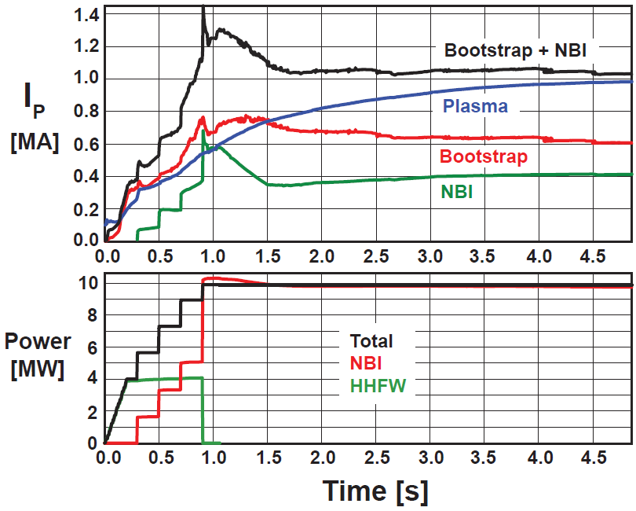
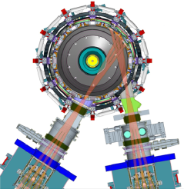
Non-inductive ramp-up from ~0.4MA to ~1MA projected to be possible with new centerstack (CS) + more tangential 2nd NBI
New CS provides higher TF (improves stability), 3-5s needed for J(r) equilibration
More tangential injection provides 3-4x higher CD at low I_{P}:
  2x higher absorption (40→80%) at low I_{P} = 0.4MA
  1.5-2x higher current drive efficiency
TSC simulation of non-inductive ramp-up from I_{P} = 0.1MA, T_{e}=0.5keV target at B_{T}=1T
Present NBI
More tangential 2nd NBI

Slide 23
NSTX-U theory and modeling needs for Solenoid-Free Plasma Start-up and Ramp-up
3-D resistive MHD model to determine conditions for generating flux-surface closure at the end of the injection time, as in the experiment.
  e.g. resistive effects, localized magnetic fluctuations
  Obtain quantitative comparison with experiment and quantify the influence of the time-changing flux on the dynamics of the CHI plasma
2-D and 3-D MHD and transport models to determine scaling of electron heating and temperature, etc., with injection parameters and χ_{e} and the resulting effect on I_{P}, size, flux-surface closure, etc.
  Understand the relationship between electrode driven current and impurity generation and their impact on the performance of the resulting discharge
  Develop a 3-D MHD model of point source helicity injection (plasma guns)
Understand the scaling of CHI current generation with respect to the injected poloidal flux and injector current for extrapolation to next-steps
Understand requirements for current drive by NBI in a helicity injection generated target; determine conditions to successfully ramp-up current

Slide 24
Topical Areas
Transport and Turbulence
Boundary Physics
Macroscopic Equilibrium and Stability
Solenoid-free Start-up and Ramp-up
Waves and Energetic Particles
Advanced Scenarios and Control
Disruptions

Slide 25
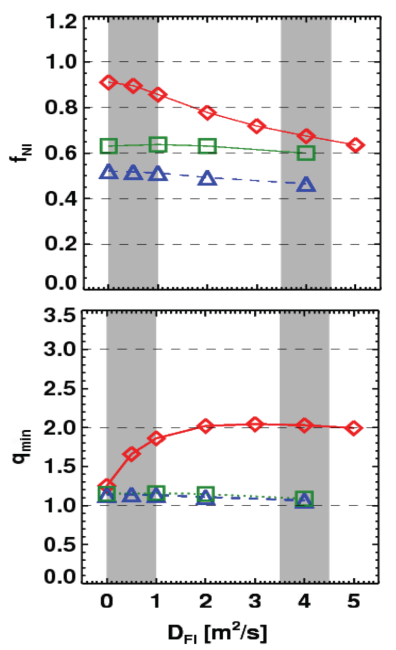
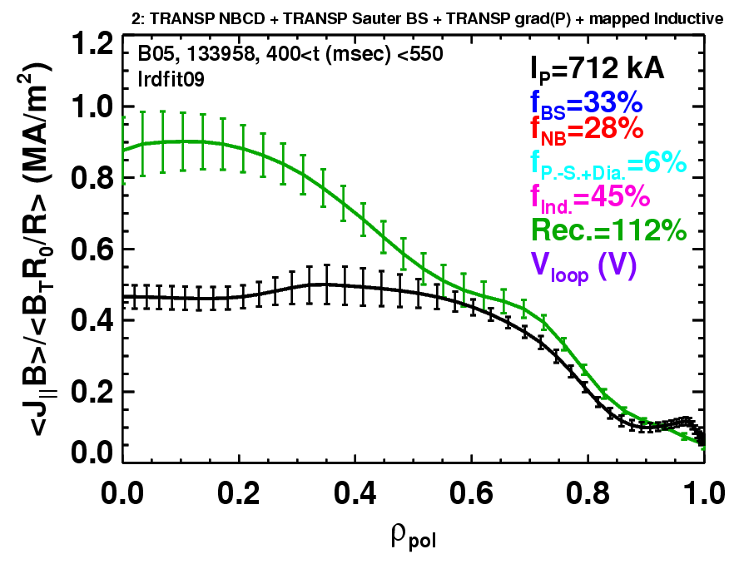
Rapid TAE avalanches could impact NBI current-drive in advanced scenarios for NSTX-U, FNSF, ITER AT
NSTX-U TRANSP simulations
NSTX: rapid avalanches can lead to
redistribution/loss of NBI current drive
Discrepancy between reconstruction and total assuming
classical J_{NBCD}
1 MA, 1T, H₉₈=1, near non-inductive
1.6 MA, 1T, partial inductive
1.2 MA, 0.55T, high β_{T}
All: f_{GW}=0.7, H₉₈=1
Minor radius
700kA high-β_{P} plasma with rapid
TAE avalanches has time-average D_{FI} = 2-4m²/s

Slide 26
NSTX-U theory and modeling needs for Energetic Particles
Improve and validate existing tools for *AE stability calculations, with emphasis on ST geometry (low aspect ratio)
  Validate non-linear fast-ion instabilities and transport against NSTX data and extend to NSTX-U scenarios using M3D-K
  Improve treatment of fast ion distribution (Fnb from NUBEAM?) in NOVA-K
  Include rotation effects, assess effects of redistribution of fast-ions on rotation
  Develop self-consistent models of thermal e-transport induced by *AE modes
Include externally-driven perturbations into existing AE codes
  Implement in NOVA, M3D-K, HYM, and/or SPIRAL to guide the design of antennae for use in experiments to characterize AE stability properties, and/or drive *AE modes for ‘phase-space engineering’
    Implement perturbations ranging from sub-kHz (from external coils) up to CAE/GAE frequency range, including TAE band
    Couple IPEC to SPIRAL and/or M3D-K, or include *AE antenna models in RF codes
Improve TRANSP to model/predict the evolution of fast ion population
  Incorporate *AE-induced fast ion transport models
  Use fast ion diagnostics to constrain TRANSP/NUBEAM f(r,v) evolution

Slide 27
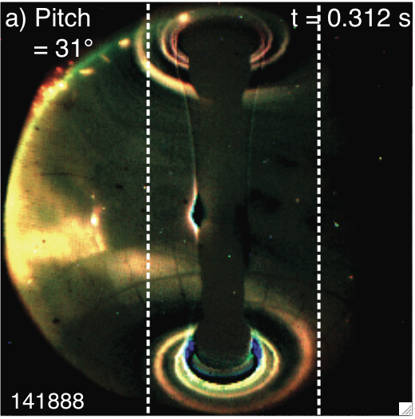
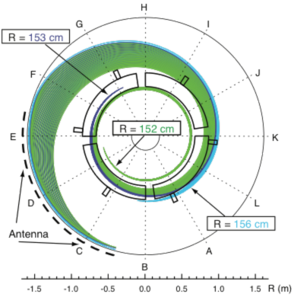
Significant fraction of the HHFW power may be lost in the SOL in front of antenna and flow to the divertor region
View from Top
Divertor
HHFW
Antenna
Divertor
HHFW
Antenna
Visible camera image shows edge RF power flow follows magnetic field from antenna to divertor
SPIRAL results show field lines (green) spiraling from SOL in front of HHFW antenna to divertor
Field line mapping predicts RF power deposited in SOL, not at antenna face
  3D AORSA will assess surface wave excitation in NSTX-U
Proposed DIII-D experiment to look for RF edge losses during 2012 run
NSTX-U experiments and modeling to emphasize HHFW heating of high NBI power, long-pulse H-modes → assess effect of varying outer gap
R. J. Perkins, et al., PRL (2012)

Slide 28
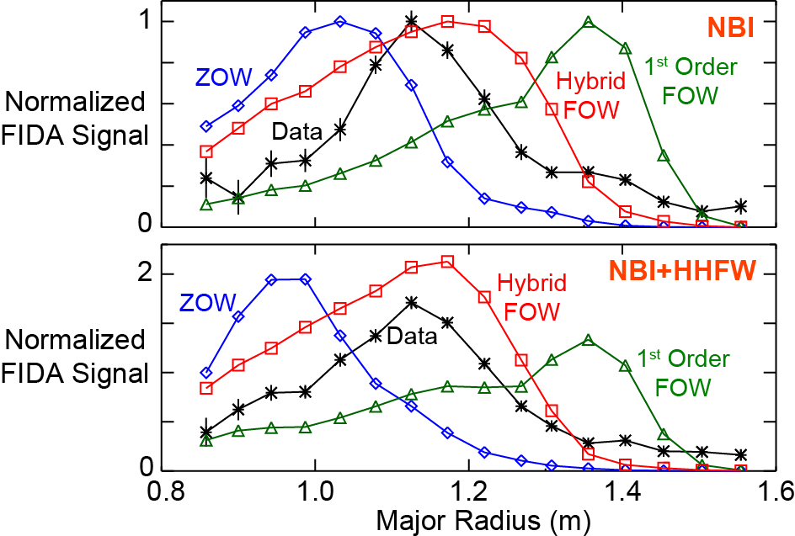
NSTX-U theory and modeling needs for Wave Heating and Current Drive
Extend RF models to include realistic model of scrape off layer
  Predict dependence of surface wave power flows to the divertor region, RF sheaths, and parameteric decay instability (PDI).
    The spectral solver AORSA has already been extended to the wall in NSTX.
    An alternate approach is to couple core spectral solvers (TORIC and AORSA) to either finite element method (FEM) or particle-in-cell (PIC) codes.
Improve models of fast-ion interactions w/ ICRF, HHFW
  Use ORBIT-RF/AORSA, sMC/AORSA and the new CQL3D finite-orbit-width (FOW) code to model fast-wave acceleration of fast-ions and losses, compare to FIDA and NPA/ssNPA data.
  Compare calculated spectra of energetic particles going to wall to fast-ion loss detectors.
  Carry out couplings between AORSA and FOW code ORBIT RF, and FOW CQL3D with the HHFW version of TORIC.

Slide 29
Topical Areas
Transport and Turbulence
Boundary Physics
Macroscopic Equilibrium and Stability
Solenoid-free Start-up and Ramp-up
Waves and Energetic Particles
Advanced Scenarios and Control
Disruptions

Slide 30
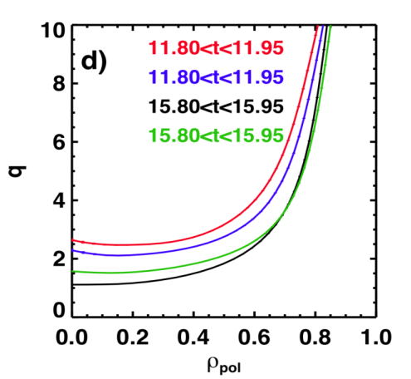
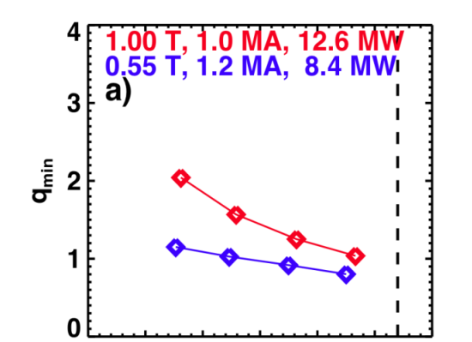
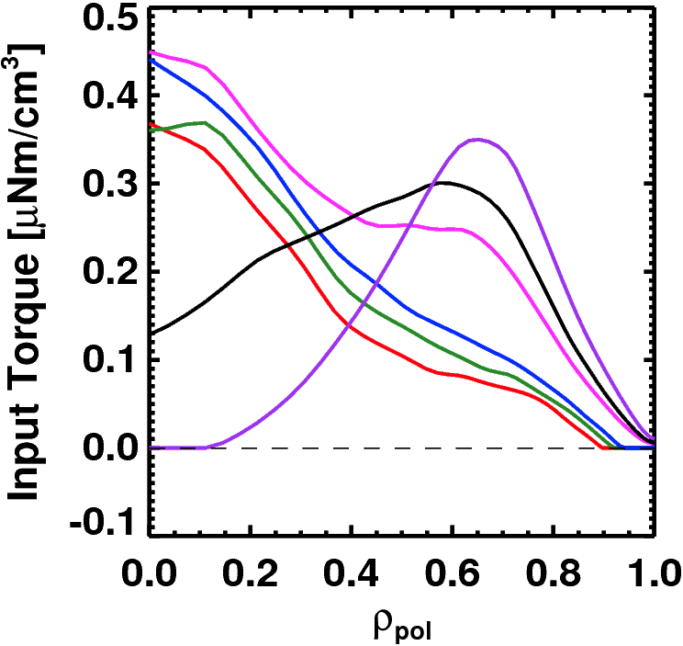
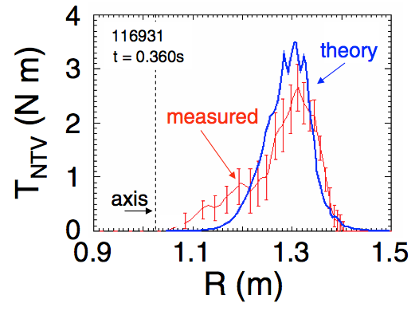
Goals of NSTX Advanced Scenario and Control (ASC) TSG
Study, implement, optimize axisymmetric control techniques.
  Kinetic and magnetic profiles
  Boundary and divertor magnetic geometry control, vertical position control
Combine various tools developed in other TSGs into integrated scenarios.
  Examples: ELM pacing for impurity density control
High non-inductive fraction utilizing bootstrap + NBI current drive
  Typically coupled with optimization to low l_{i}, high elongation
Progressing towards profile control:
Rotation profile actuators
q profile actuators
Torque profiles from 6 NBI srcs
Measured and Calculated NTV Torque Profiles
Variations in Beam Sources
Largest R_{tan}
800 kA and 1 T
[50,60,70,130] cm
[50,60,120,130] cm
[60,70,110,120] cm
[70,110,120,130] cm
Neutral
Beams
(TRANSP)
Smallest R_{tan}
27 22 17 12 7 2
Outer Gap
Milestone R14-3

Slide 31
Two Overarching ASC Theory/Modeling Needs
1: Need advanced control algorithms for boundary shape, divertor geometry, kinetic and magnetic profiles, and divertor heat fluxes.
  Should include actuator dynamics & saturation.
2: In order to tune those control algorithms, need integrated codes with fast, benchmarked models for how sources of particles, momentum, heat and current modify the kinetic and magnetic profiles and free-boundary equilibrium.

Slide 32
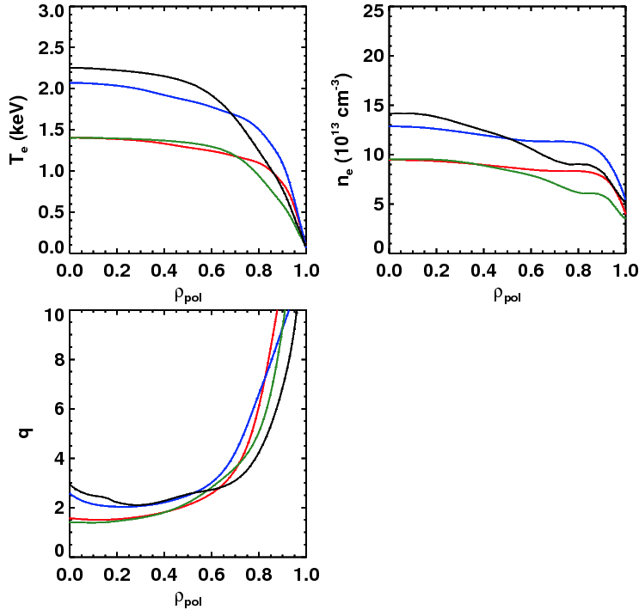
Project NSTX-U Non-Inductive Current Level at B_{T}=1.0 T and P_{inj}=12.6 MW To Be Between ~900 & ~1300 kA
Dashed: ITER-98 confinement scaling
Solid: ST confinement scaling
Narrow, H_{ST}=1
Broad, H_{ST}=1
Narrow, H_{ST}=1
Broad, H_{ST}=1
Broad, H₉₈=1
Broad, H₉₈=1
Narrow, H₉₈=1
Narrow, H₉₈=1
(S. Kaye, NF 2005)
Fix: 1.0T, P_{inj}=12.6 MW, f_{GW}=0.72
Fix: A=1.75, κ=2.8
Find the non-inductive current level for 2 confinement and 2 profile assumptions…yields 4 different projections.
Broad, H_{ST}=1
Confinement | Profiles | I_{P} [kA] | β_{N} | q_{min}
H₉₈=1 | Broad | 975 | 4.34 | 1.5
H_{ST}=1 | Broad | 1325 | 5.32 | 2.0
H₉₈=1 | Narrow | 875 | 4.87 | 1.4
H_{ST}=1 | Narrow | 1300 | 5.97 | 2.1
Narrow, H_{ST}=1
Broad, H₉₈=1
Narrow, H₉₈=1

Slide 33
Need #1: Models for Scenario Development
NBCD with *AE modes
  In the absence of low-f MHD, the neutral beam drive current is apparently classical.
  At higher values of β_{fast}, *AE modes can lead to redistribution/modification of the fast ion distribution.
  Theory is needed for when these modes will turn on, and what their effect on the pressure & current profile will be.
  Need measurements of fast ion distribution (FIDA, neutrons, ssNPA, fusion product detector) and NBCD profile for comparison.
Prediction of the thermal & momentum transport
  The bootstrap current depends sensitively on the gradients in the thermal profiles. NBCD depends on T_{e}/n_{e}. Global stability depends on rotation.
  Conversely, the transport, and hence thermal profiles, can be a strong function of the current and rotation profiles
  Need a model for the thermal and momentum transport and its response to actuators.
  Include both core & pedestal (and the joining region), including fast-ion MHD leading to transport.
Need accurate, benchmarked models for HHFW and EBW H&CD within integrated codes such as TRANSP.

Slide 34
Need #2: Realtime Control
Need a reliable algorithm for the individual and combined control of the current and rotation profiles, along with β_{N}.
  The theory of that algorithm should help us to understand to what extent these quantities can be independently controlled given the coupled actuators V_{loop}, P_{inj}, J_{NBCD}, T_{NB} and T_{NTV}.
Need the ability to test the actual control algorithms in simulations with high degrees of physics fidelity, i.e. flight simulator mode.
  Could in principle be accomplished by connecting PCS to PTRANSP, CORSICA, or TSC.
Need the ability to predict the future equilibrium and stability properties of the plasma.
  Faster than realtime look-ahead of the evolution of the equilibrium
    (Very) reduced transport models.
  Stability assessments of those future states (n=0, n=1, ELM?). Future coil currents and boundary shape.
  Control intervention based on the predictions.

Slide 35
Topical Areas
Transport and Turbulence
Boundary Physics
Macroscopic Equilibrium and Stability
Solenoid-free Start-up and Ramp-up
Waves and Energetic Particles
Advanced Scenarios and Control
Disruptions

Slide 36
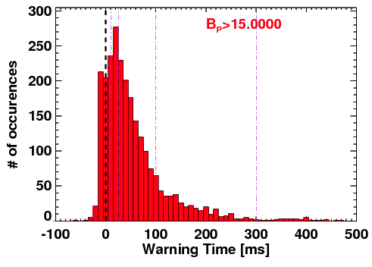
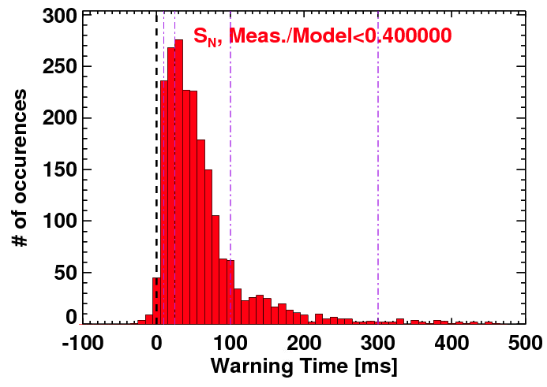
NSTX Disruption Detection Studies Show That No
Single Diagnostic Can Predict All Disruptions
Examined >20 different signals that might be used for disruption prediction.
  Rotation, confinement, rotating MHD, RWMs and locked-modes, q*, β_{N}, f_{GW}, P_{rad}/P_{tot},…
For each signal, define limits beyond which disruptions become likely.
  Use physics based predictions of signals if possible.
Example #2: Neutron Emission
Predict the neutron rate using a 0D slowing-down model
Measured/Model ratios <~0.4 indicative of imminent disruptions
Example #1: In-Vessel n=1 RWM sensors
Instantaneous values >~15 G indicative of imminent disruption.

Slide 37
(A short list of) theory and modeling needs for disruptions
Continued validation of linear instability models:
  VDE, external kink, internal kink/sawtooth, locked mode, NTM, RWM
Non-linear MHD models to understand instability evolution
  Does mode saturate or lead to disruption?
  Requires at least a reduced model of transport – possibly WDM
Improved models of thermal quench dynamics (fast reconnection) which can occur on sub-ms time-scales.
Improved boundary conditions in MHD codes, i.e. for the interactions of the main plasma with the wall during thermal and current quench
  Important for calculating resulting halo current resistance and width, and forces on the resistive wall/blanket components during current quench phase
Improved models of runaway electron transport in 3D fields from plasma-driven instabilities and external 3D fields
  Use of RMP to increase runaway electron losses observed on several devices
  Also important for understanding impurity transport during massive gas injection
Identify and understand new runaway electron loss mechanisms – e.g. whistler-wave instabilities for B < ~2T – potential advantage for ST?

Slide 38
Summary – with an opinion on priorities
Transport and Turbulence
  E-M e-transport mechanisms for ST & ITER (micro-tearing, GAE/CAE)
Boundary Physics
  Pedestal transport and structure, SOL heat flux width, effects of lithium
Macroscopic Equilibrium and Stability
  Plasma response to 3D fields – including drift-kinetic/two-fluid effects
Solenoid-free Start-up and Ramp-up
  Role of 2D vs. 3D reconnection in transient CHI, scaling to next-steps
Waves and Energetic Particles
  Models of non-linear evolution of AE modes, resultant fast-ion transport
Advanced Scenarios and Control
  Development of (any kind of useful) reduced (electron) transport model
Disruptions
  Thermal quench dynamics, BCs/halo currents, RE transport by 3D fields

Slide 39
Backup Slides

Slide 40
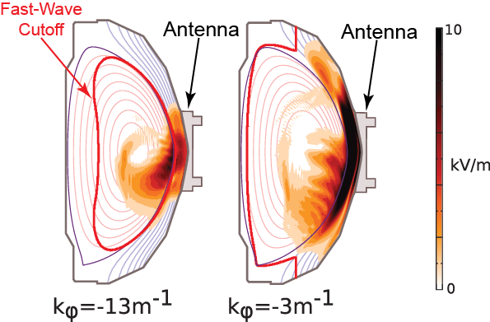
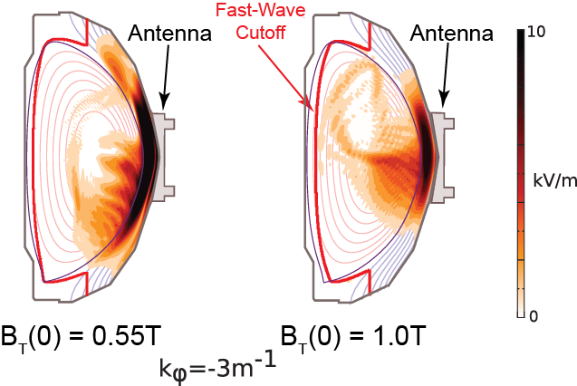

AORSA predicts large amplitude coaxial standing modes between plasma and wall in NSTX H-mode
Edge coaxial mode seen in NSTX
B_{T}(0) = 0.55 T simulations
Edge mode significantly reduced when B_{T}(0) is increased from 0.55 T to 1 T
2-D AORSA simulation for HHFW in NSTX
B_{T}(0) = 0.55T NBI H-mode shot 130608*
Future plans call for a quantitative comparison of predicted SOL electric fields with measurements:
  Requires better resolution in SOL and detailed antenna geometry
*D. L. Green, et al., Phys. Rev. Lett. 107, 145001 (2011)

Slide 41
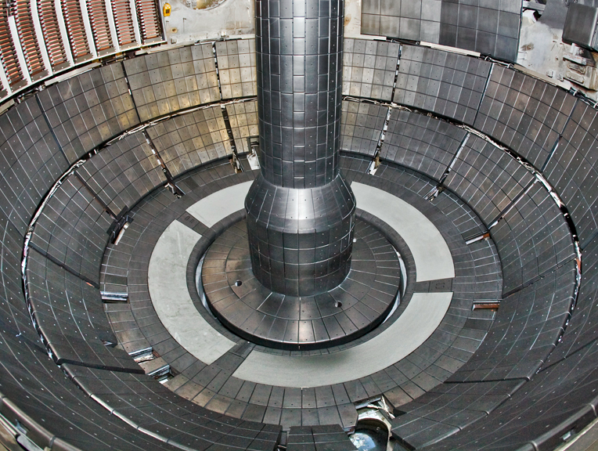
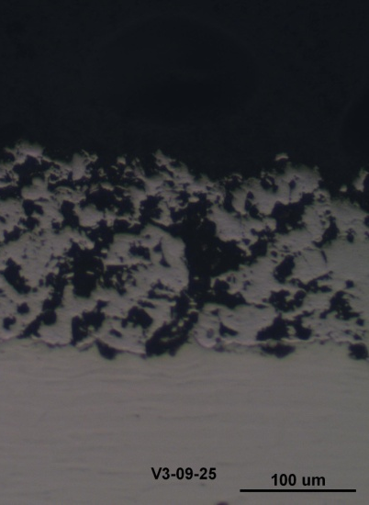
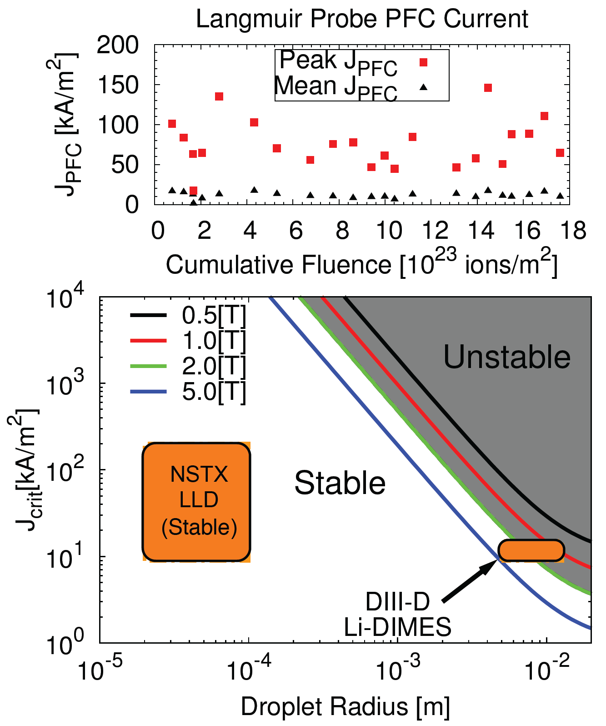
LLD with optimized pore size and layer thickness can provide stable lithium surface
PAC29-5c
LLD
LLD surface cross section: plasma sprayed porous Mo
LLD filled with 67 g-Li by evaporation,
(twice that needed to fill the porosity).
No major Mo or macroscopic Li influx observed even with strike point on LLD.
No lithium ejection events from LLD observed during NSTX transients > 100 kA/m²
  Thin layers and small pore diameters increase critical current (J_{crit}) for ejection.
  Modelling consistent with DIII-D Li-DIMES ejection at 10kA/m² and NSTX experience.
M.A. Jaworski, et al., J. Nucl. Mater. 415 (2011) S985.
D. Whyte, et al., Fusion Eng. Des. 72 (2004) 133.

Slide 42
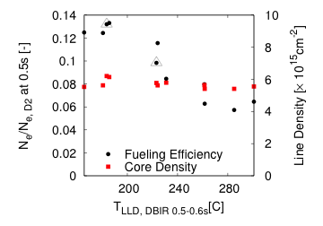
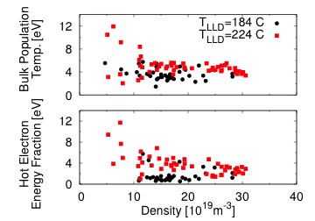

Molten lithium by plasma bombardment coincided with reduced fueling efficiency and higher target T_{e}
Mid-run experiments indicated fueling efficiency drop when T_{LLD} > T_{Li,melt}
    Increases in both bulk T_{e} as well as tail fraction consistent w/ absorbing surface
    Fueling efficiency decreased about 50%, but multi-variable experiment (increased gas with increased surface temperature)
Impact energies lower than earlier estimates
  TRIM runs indicate little penetration
  Motivates flowing system to mitigate continual gettering during vacuum exposure
Mid-Run
H.W. Kugel, et al., Fusion Eng. Des. 2011 in press.
M.A. Jaworski, et al., Fusion Eng. Des. 2012, in press.

Slide 43

Average T_{surf} on LLD and graphite tile at equal radii suggests that T_{surf} is reduced due to improved heat removal through the LLD Cu
Series of 10 repeat discharges with outer strike point on the LLD
  Graphite and LLD in this case begin with T_{surf}~70°C
T_{avg} on graphite gap tile increases through all shots in √t fashion
  Average T_{surf} of ~250°C
T_{avg} plotted at same radius, but on LLD
  T_{surf} increases more slowly
  Efficient heat removal through LLD depth/Cu
However during transients such as ELMs, T_{LLD} > T_{ATJ} during the transient
  Measured T_{surf} response is dominated by thin film on the upper surface during transients [K Gan, APS 2011]

Slide 44


Peak Divertor Heat Flux and inter-ELM λ_{q} are reduced when 300 mg of Li Evaporation is Used
Both deposited and parallel divertor heat flux is reduced when 300 mg of Li is evaporated
λ_{q, int} contracts with increased Li deposition
  Trend is not predicted by current SOL width models
  Suggests the importance of including divertor recycling in estimations of λ_{q}
SOLPS modeling is in progress to better understand divertor physics

Slide 45

Non-Inductive Operating Points Projected Over a Range of Toroidal Fields, Densities, and Confinement Levels
Projected Non-Inductive Current Levels for κ~2.85, A~1.75, f_{GW}=0.7
B_{T}=1.0 T, I_{P}=1 MA, P_{inj}=12.6 MW
Contours of Non-Inductive Fraction
B_{T} [T] | P_{inj} [MW] | I_{P} [MA]
0.75 | 6.8 | 0.6-0.8
0.75 | 8.4 | 0.7-0.85
1.0 | 10.2 | 0.8-1.2
1.0 | 12.6 | 0.9-1.3
1.0 | 15.6 | 1.0-1.5
Contours of q_{min}
From GTS (ITG) & GTC-Neo (neoclassical):
  χ_{i,ITG}/χ_{i,Neo}~10⁻²
  Assumption of neoclassical ion thermal transport should be valid.

Slide 46

Full-orbit, finite-orbit-width (FOW) CQL3D will accurately model neoclassical transport, ion loss & heat flowing to SOL
Recent FIDA simulations using "hybrid" full-orbit FOW CQL3D show much better agreement shift with FIDA data:
  "Hybrid" FOW CQL3D has full orbits but does not treat orbit topologies correctly at trapped-passing boundaries
  Expect proper treatment of orbit topologies will bring the simulations into even better agreement with FIDA data
A full-orbit neoclassical transport model, and losses to SOL and wall still need to be implemented
Initial tests of full-orbit FOW CQL3D show accurate modeling of fast-ion losses, power absorption and RF-driven current profiles

Slide 47


Simple Predictor Can Predict Disruptions With High Probability of Success
Predictor based on combinations of threshold based tests.
  Multiple thresholds for each test.
  No machine learning
Produces a very low missed disruption rate.
Most false positives are due to “near disruptive” events.
If tuned for a missed disruption fraction of 2%, then false positive rate is only 6%.
Physics Origins of “False Positives”
Milestone R13-4

