Slide 1



NSTX-U Disruption PAM Working Group Meeting
S.A. Sabbagh and R. Raman
Department of Applied Physics and Applied Mathematics, Columbia University, New York, NY
University of Washington, Seattle, WA
For the NSTX-U DPAM Working Group
NSTX-U DPAM Working Group Meeting
PPPL
10/29/15
Slides: http://nstx.pppl.gov/DragNDrop/Working_Groups/DPAM/2015/DPAM_mtg_10-29-15/
V1.3

Slide 2
Outline / Agenda
Interface to the FES Workshop on Transient Events
Connection to JRT-16 Joint Research Target Milestones
Disruption characterization and forecasting approach and present analysis implementation
Group discussion on disruption identification and “homework”

Slide 3
Significant progress since last meeting addressing charges to Working Group
Strong interface to the FES Workshop on Transient Events
  S.A. Sabbagh was leader of Disruption Prediction sub-panel
  Disruption Prediction panel work completed in July, final report due Nov
Significant DPAM milestones for JRT-16
  For disruption prediction, avoidance, and mitigation
Code written for automated analysis of Disruption Event Characterization And Forecasting (DECAF code)
Communication of initial DECAF results to organizations
  To DOE, ITPA (MDC-21 (Global mode stabilization) and MDC-22 (Disruption Prediction), PPPL TSD (disruption) mtg, smaller meetings
  Strong interest expressed to test DECAF on DIII-D when code is ready

Slide 4
1. Interface to the FES Workshop on Transients and Product of the Disruption Prediction sub-panel
Web page
  https://www.burningplasma.org/activities/?article=Transients
Disruption Prediction panel report brief outline (59 pages)
  Overview and summarized recommendations
  Disruption detection: measured & modeled triggers (how to cue action)
    Plasma response and instabilities
    Confinement transitions
    Power balance and plasma heating
    Density limits
    Tokamak dynamics
    Technical problems and human error
  Triggering thresholds (when to cue action)
  Modeling and measurement – further considerations
  Accomplishments since ReNeW 2009
  Research evolution for future devices (ITER, FNSF, DEMO)
  Ten-year research plan RECOMMENDATIONS (5 “Pursuits” defined)
  Resources needed
  Expected impact of research

Slide 5
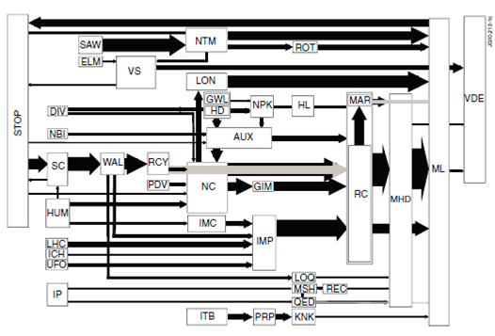
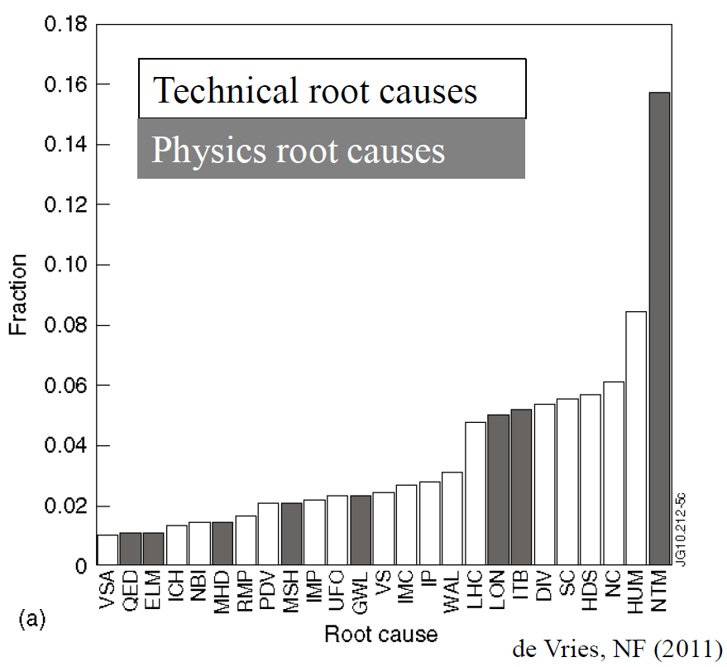
JET disruption event characterization provides framework to follow for understanding / quantifying DPAM progress
JET disruption event chains
Related disruption event statistics
P.C. de Vries et al., Nucl. Fusion 51 (2011) 053018
JET disruption event chain analysis performed by hand, desire to automate
NSTX-U DPAM Working Group formed
  List of disruption chain events defined, interested individuals identified

Slide 6
Disruption event chain characterization capability started for NSTX-U as next step in disruption avoidance plan
Disruption prediction framework from upcoming DOE “Transient Events” report
Approach to disruption prevention
  Identify disruption event chains and elements
  Predict events in disruption chains
    Attack events at several places
    Give priority to early events
  Provide cues to avoidance system to break the chain
  Provide cue to mitigation system if avoidance deemed untenable
t
S.A. Sabbagh (for Disruption Prediction panel)

Slide 7
Significant physics research is needed to predict opportunities for avoidance in disruption event chain
Example: A typical NTM disruption event chain (see Prediction Section 3.1.1.1)
trigger
sawooth, edge localized mode, or other MHD mode triggers NTM onset
saturated instability
n > 0 mode onset, growth on relatively slow resistive timescale (non-linearly saturates if rotating faster than resonant braking bifurcation velocity)
mode
lock
mode rotation drops to critical rotation bifurcation value
further growth of 3D mode field leads to disruption
Examples of gaps in physics understanding
  Prediction of stability in low rotation plasmas
  Accurate non-ideal MHD stability maps
  Physical understanding of how mode locking produces disruption
  More comprehensive, validated physical understanding of role of rotation and profile in MHD stability

Slide 8
Disruption Prediction is a Multi-disciplined Task
Theoretical investigation
  Understanding of underlying physics of triggers and events required to create and extrapolate prediction algorithms to unexplored frontiers of next-step tokamak operation
Tokamak experiments
  Validate theory and determine reproducibility of the events
Modeling at several levels (e.g. quasi-empirical, linear, non-linear)
  Connect theory and experiment – the basic component of creating prediction algorithms; from r/t modeling coupled to sensors, etc. - to full non-linear MHD
Diagnostics
  Develop sensors required for advanced prediction algorithms in present tokamaks; to survive harsher conditions in next-step, fusion-producing devices
Control theory and application
  Design/test the compatibility and success of the coupled prediction and avoidance elements in the real-time disruption avoidance systems
Predictive analytics
  Use data, statistical algorithms and machine-learning techniques to identify the likelihood of future outcomes based on historical trends (AND physical models)

Slide 9
2. Joint Research Target JRT-16 – focuses on elements of disruption mitigation, prediction, and avoidance
FY16 DOE Joint Research Target summary (1 page)
  File: http://nstx.pppl.gov/DragNDrop/Working_Groups/DPAM/Repository/JRT16QuarterlyMilestones-V9.pdf
Mitigation
  Test newly-designed ITER-type massive gas injection valve to study benefits of private flux region massive gas injection vs. mid-plane inj.
Prediction / Avoidance
  Use disruption prediction algorithm to characterize the reliability of predicting a few types of common disruptions from at least two devices
  Report on capability to reduce disruption rate through active improvement of plasma stability
  Test on at least one facility to detect in real time an impending disruption and take corrective measures to safely terminate the plasma discharge
Culminating Milestones

Slide 10
3. Disruption Event Characterization And Forecasting (DECAF) code has been written – development continues…
DECAF code development guidance
  Code is portable (and needs to stay that way)
  Code must be able to accept and process data from several tokamaks
DECAF code characteristics – high-level overview
  Written in Python for portability
    Runs on Linux and Windows distributions of Anaconda (Python 2.7)
      At the moment, the plan is to not use IDL or proprietary libraries
    Code written to easily allow reading data from various machines without changes to source code
    Code related to disruption events and physics models are separated into modules for ease of parallel development of code
  Under Git version control
    In a controlled repository on PPPL cluster – not GitHub
  Analysis started / development continues
    First using NSTX data; directly applicable to NSTX-U and other devices

Slide 11
DECAF is structured to ease parallel development of disruption characterization, physics criteria, and forecasting
Physical event modules separated
  Present grouping follows work of deVries – BUT, is easily appended or altered
Warning algorithm
  Present approach follows work of Gerhardt, et al. – BUT is easily appended or altered
General idea:
  Build from successful foundations – BUT keep approach flexible
Physical event modules
Code control workbooks
Density Limits
Confinement
Main data structure
Mode stability
Tokamak dynamics
Output processing
Power/current handling
Technical issues

Slide 12
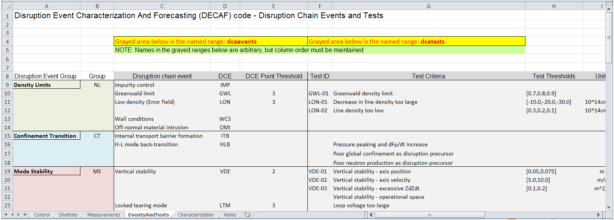
Control workbook concept eases use and development - and keeps source code from devolving into a hardwired mess!
Essential for portability
  Future code development can’t afford to “cut corners” by sacrificing code generality and flexibility

Slide 13
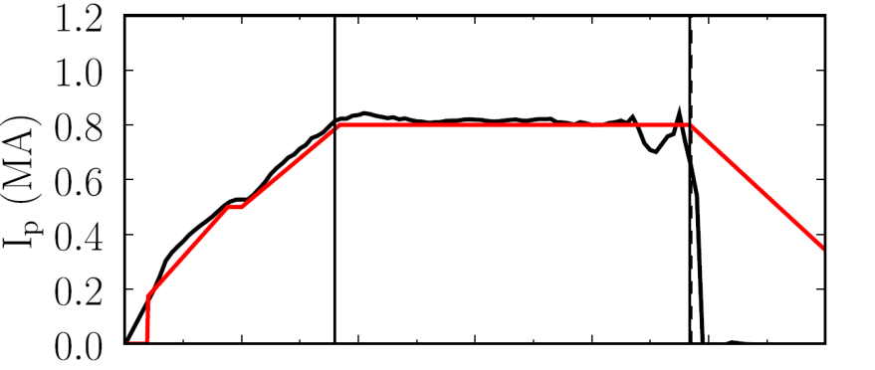
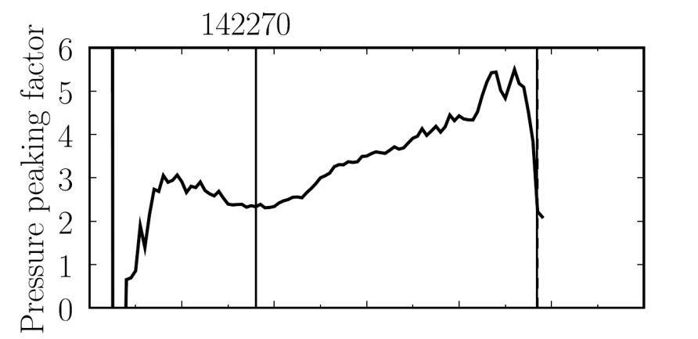

Disruption Event Characterization And Forecasting Code (DECAF) yielding initial results (pressure peaking example)
35 physical disruption chain events identified; 12 technical/human error events
10 physical events are presently defined in code with quantitative warning points
  Code written to be easily expandable and portable to other tokamaks
This example: Pressure peaking (PRP) disruption event chain identified by code before disruption
  (PRP) Pressure peaking warnings identified first
  (VDE) VDE condition subsequently found 19 ms after last PRP warning
  (IPR) Plasma current request not met
  (SCL) Shape control warning issued
NSTX
142270
Disruption
PRP warnings
Event chain
PRP
VDE
IPR
SCL
Detected at: 0.4194s
0.4380s
0.4522s
0.4732s
J.W. Berkery, S.A. Sabbagh, Y.S. Park (Columbia U.)

Slide 14
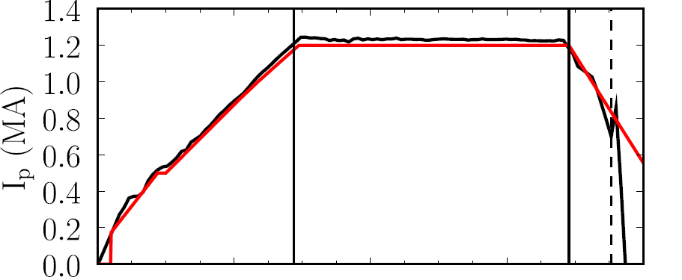
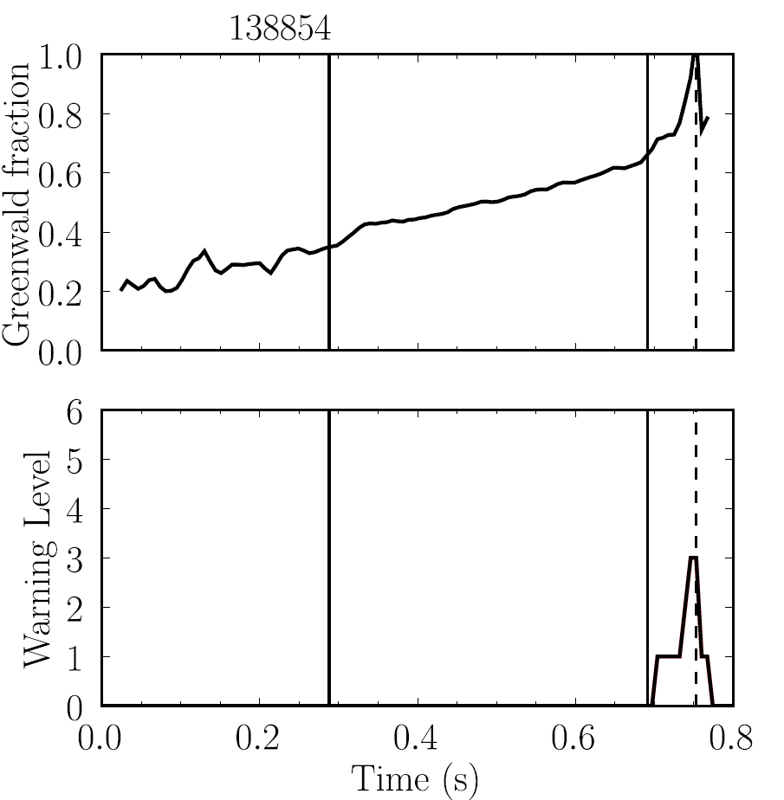
Disruption Event Characterization And Forecasting Code (DECAF) yielding initial results (density limit example)
NSTX
138854
This example: Greenwald limit disruption event chain identified by code during I_{p} rampdown before disruption
  (GWL) Greenwald limit warning issued
  (VDE) VDE condition then found 0.6 ms after GWL warning
  (IPR) Plasma current request not met
Disruption during
I_{p} ramp-down
GWL warnings
Event chain
GWL
VDE
IPR
Detected at: 0.7442s
0.7448s
0.7502s
J.W. Berkery, S.A. Sabbagh, Y.S. Park (Columbia U.)

Slide 15
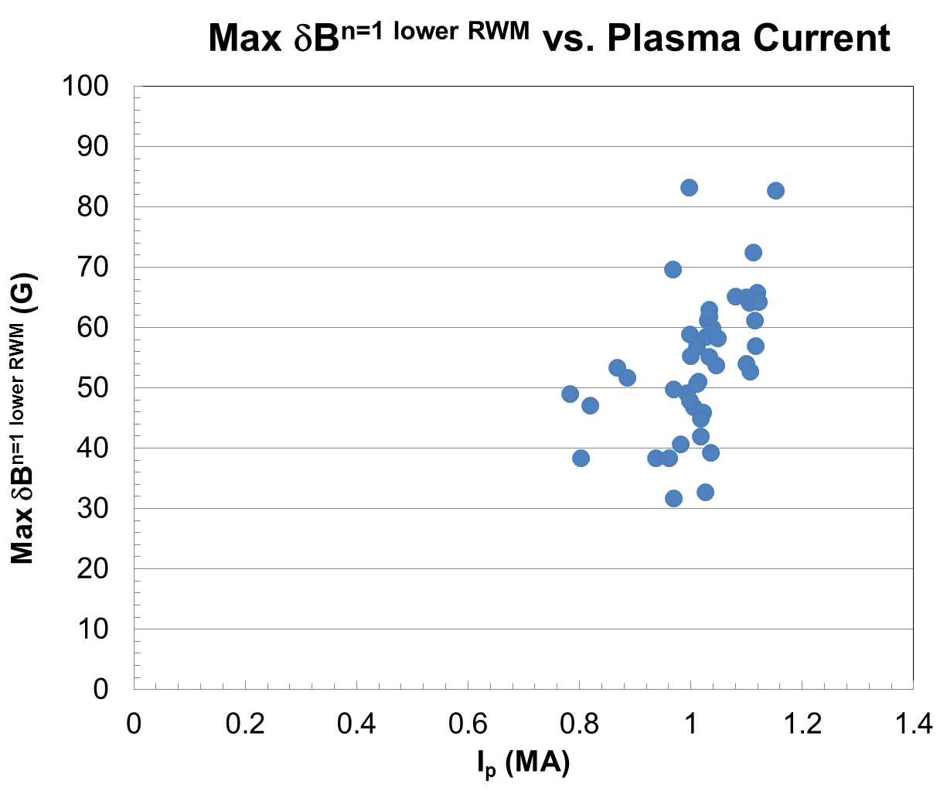
      ITER High Priority need: What levels of plasma disturbances (δB_{p}; δB_{p}/B_{p}(a)) are permissible to avoid disruption?
NSTX RWM-induced disruptions analyzed
Analyze events leading to disruption using new analysis code “DECAF” (Disruption Event Characterization And Forecasting)
  See MDC-22 talk by G. Pautasso for more initial DECAF results
Compare maximum δB_{p} (n = 1 amplitude) causing disruption vs I_{p}
NSTX
RWM-induced
Disruptions
(n = 1 global
MHD mode)
Maximum δB_{p} increases with I_{p}
Next step: add results from other devices

Slide 16
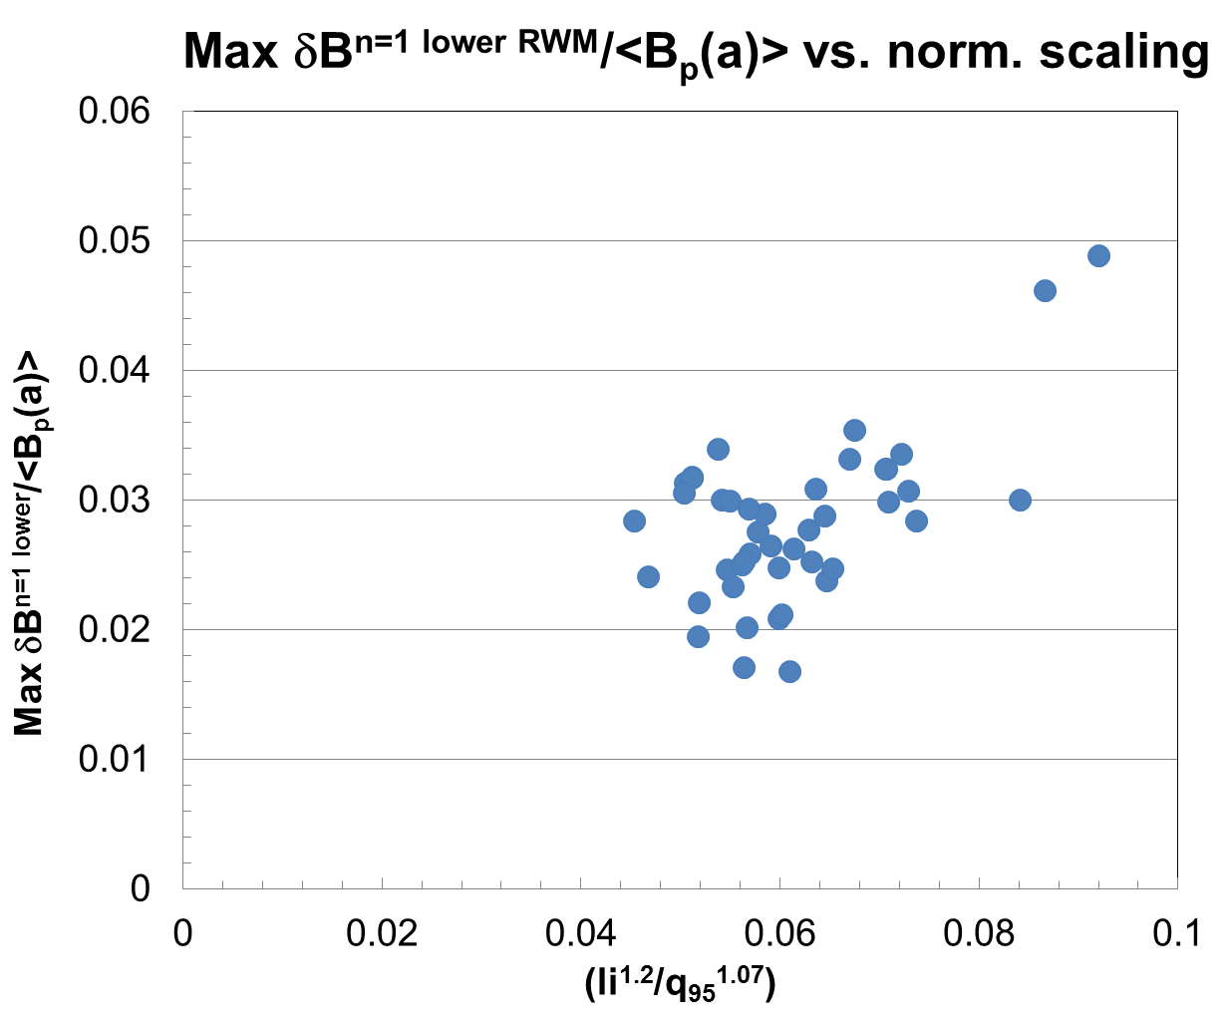
      Maximum δB_{p}/<B_{p}(a)> might follow a de Vries-style scaling l_{i}^{p1}/q₉₅^{p2}
NSTX RWM-induced disruptions analyzed
Compare maximum δB_{p} causing disruption vs. de Vries locked NTM scaling
  Normalized parameters
NSTX analysis uses kinetic EFIT reconstructions
  l_{i} instead of l_{i}(3)
  <B_{p}(a)>_{fsa} used
NSTX
RWM-induced
Disruptions
(n = 1 global
MHD mode)

Slide 17
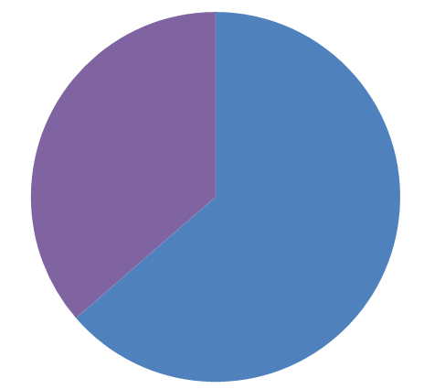
(Although thresholds are not at all optimized yet) what did DECAF show when applied to this 44 shot NSTX database?
These events found for all shots
  DIS: Disruption occurred
  RWM: RWM event warning
    Note: this module is not smart enough yet to distinguish RWM from locked TM
  VDE: VDE warning (42 shots)
  IPR: Plasma current request not met
  LOQ: Low edge q warning
Very simple RWM event criteria
  RWM B_{P}^{n=1} lower sensor amplitude used
  Simple criterion + no threshold optimization at all ➔ “false positive” rate is high; adjust criteria to reduce it
Code already sees common disruption event chains
  (event)➔VDE➔SCL➔IPR occurs in 52% of the shots
  “false positives” on VDE affecting this %
“RWM event” warning timing
(simple criterion, no optimization)
Before 100 ms of DIS
(36%)
Within 100 ms of DIS
(64%)
Common event chain
(event)
VDE
SCL
IPR
J.W. Berkery, S.A. Sabbagh (Columbia U.)

Slide 18
How to participate in the DECAF effort
Contribute to defining criteria in physics modules
  Specific discussions on defining measured & modeled triggers for disruption forecasting / detection will be a main focus of future NSTX-U DPAM Working Group meetings
    Includes all “levels” of modeling and diagnostic input
    Focused on producing quantitative formulations of disruption prediction
(in the near future) Help develop code
  Contributing to the physics modules
    Main communication through NSTX-U DPAM WG
  (If desired, contribute to code functionality as well)
    Main communication through smaller “code” meetings

Slide 19
Future DECAF development aims to follow an Integration Manager Workflow using Git
Integration managers organize tasks to minimize effort duplication and code conflicts
  Communication to group via DPAM meetings, web site, etc.
Developers can pull code from main repository
Integration managers gather code to inspect that
  Coding guidance is followed
  Conflicts are avoided
Integration managers push code to main repository
  After cross-checks are made among integration managers
Main repository
Integration manager
Developer
Developer
Integration manager
Developer
Developer
What we do now
What is planned

Slide 20
4. Next steps in DECAF code development – improve accuracy of physics-based event determination/forecasting
(Starting the process of DECAF improvement: For group discussion / participation)
How should the time of disruption (thermal & current quench) be defined; what are the best measurements to define it?
What do you see are the zeroth-order physics-based criteria that should be evaluated in the DECAF Python modules?
(Send email on these topics if you have more ideas after the meeting)

Slide 21
“Homework Assignment” for those willing to help the disruption prediction effort (and able to read NSTX data)
In your opinion, what caused the disruptions that occurred in the following NSTX shots? (No cheating by checking the logbook!)
  133753
  133778
  137442
  138786
  138793
  138854 (note: comment on the minor disruption and full current quench)
  139341
  140580
  141202 (note: comment on the minor disruption and full current quench)
  142270
Please send your conclusions (include as much detail as desired from your analysis!) by 11/11/15 to sabbagh@pppl.gov

Slide 22
Supporting Slides Follow

Slide 23
NSTX-U DPAM Working Group meeting: List of disruption chain events defined, interested individuals identified
Impurity control (NC)
  bolometry-triggered shutdown (SPG); "tailoring” radiation-induced TM onset (LD, DG)
  change plasma operational state / excite ELMs, etc. (TBD – perhaps JC)
Greenwald limit (GWL)
  density/power feedback, etc. (DB)
Locked TM (LTM)
  TM onset and stabilization conditions, locking thresholds (JKP,RLH,ZW)
  TM entrainment (YSP)
Error Field Correction (EFC)
  NSTX-U EF assessment and correction optimization (CM,SPG)
  NSTX-U EF multi-mode correction (SAS, YSP, EK)
Current ramp-up (IPR)
  Active aux. power / CD alteration to change q (MDB, SPG)
Shape control issues (SC)
  Active alteration of squareness, triangularity, elongation – RFA sensor (SPG,MDB)
Transport barrier formation (ITB)
  Active global parameter, V_{φ}, etc. alteration techniques (SAS,JWB,EK)
H-L mode back-transition (HLB)
  Active global parameter, V_{φ}, etc. alteration techniques (SAS,JWB,EK)
Approaching vertical instability (VSC)
  Plasma shape change, etc. (SPG, MDB)
Resistive wall mode (RWM)
  Active global parameter, V_{φ}, etc. alteration techniques (SAS,JWB)
  Active multi-mode control (SAS,YSP,KT)
Ideal wall mode (IWM)
  Active global parameter, V_{φ}, etc. alteration techniques (JEM)
Internal kink/Ballooning mode (IKB)
  Active global parameter, V_{φ}, etc. alteration techniques (SAS,JWB)
  Active multi-mode control (SAS, YSP, KT)
Abbreviations:
JWB: Jack Berkery
AB: Amitava Bhattacharjee
DB: Devon Battaglia
MDB: Dan Boyer
JC: John Canik
LD: Luis Delgado-Aparicio
DG: Dave Gates
SPG: Stefan Gerhardt
MJ: Mike Jaworski
EK: Egemen Kolemen
RLH: Rob La Haye
JEM: Jon Menard
CM: Clayton Myers
JKP: Jong-Kyu Park
YSP: Young-Seok Park
RR: Roger Raman
SAS: Steve Sabbagh
KT: Kevin Tritz
ZW: Zhirui Wang
TBD: (To be decided)
Interest from Theory
  Amitava Bhattacharjee, Allen Boozer, Dylan Brennan, Bill Tang have requested involvement
Interested? contact:
sabbagh@pppl.gov
raman@pppl.gov

