Slide 1




NSTX
Supported by
Improved Armor for CHI Gap
Goal of Meeting and Presentation:
Present Design Requirements and Potential Solutions for Hand-Off to Engineering
Stefan Gerhardt
Columbia U
CompX
General Atomics
FIU
INL
Johns Hopkins U
LANL
LLNL
Lodestar
MIT
Nova Photonics
New York U
ORNL
PPPL
Princeton U
Purdue U
SNL
Think Tank, Inc.
UC Davis
UC Irvine
UCLA
UCSD
U Colorado
U Illinois
U Maryland
U Rochester
U Washington
U Wisconsin
Culham Sci Ctr
U St. Andrews
York U
Chubu U
Fukui U
Hiroshima U
Hyogo U
Kyoto U
Kyushu U
Kyushu Tokai U
NIFS
Niigata U
U Tokyo
JAEA
Hebrew U
Ioffe Inst
RRC Kurchatov Inst
TRINITI
NFRI
KAIST
POSTECH
ASIPP
ENEA, Frascati
CEA, Cadarache
IPP, Jülich
IPP, Garching
ASCR, Czech Rep

Slide 2
Goals
Problem: Plasma & heat entering the CHI gap has been known to
  degrade discharge performance due to imperfect PFCs, and
  damage diagnostics in the CHI gap,
Problem may be more severe in NSTX-Upgrade, where the horizontal inner target is more narrow.
Goal: Install armor on outboard side of CHI gap.
  Graphite is not considered a plausible candidate due to high temperature bake-out requirement.
Provides 2 benefits
  For cases with OSP on OBD bull-nose tiles, armor increases tolerance to transient inboard motion of the SP.
  For cases with OSP in the inner horizontal target, armor improves power handling of the far(ther) SOL heat flux.
Not planning for this armor to be a primary, “steady-state” power handling component.

Slide 3
Requirements
Solution should cover all plasma facing horizontal stainless steel surfaces on the outer vessel, inboard of the first BBQ rail.
  Small stainless fasteners still allowed.
Solution must tolerate loads from 2 MA, 1T disruptions as per NSTX-U GRD.
Solution must tolerate NSTX bakeout.
Solution must not compromise CHI operation.
Solution should not mandate changes to OBD graphite tiles.
Solution should preserve the magnetic flux loops just outboard of the vessel flange.
There should be thermocouples imbedded in some number of the shields.
  # of TCs TBD.
Heat fluxes:
  Solution should tolerate time average heat load of 3 MW/m² for 5 seconds.
  Should tolerate 0.1 second duration transient loads of 15 MW/m², every 1 second, with a steady background of 1.5 MW/m², for a total of 5 seconds.
  These requirements can be iterated with physics as necessary.
Should be consistent with cold lithium deposition.
If single point grounded, should be able to take at least 20 kA for total ring (CHI, Halo currents).
Solution should minimize changes to axisymmetric passive currents.

Slide 4
Outline
Pictures of the Gap.
NSTX-U Equilibria.
Heat flux requirement.
Proposed solutions (schematic).
Primitive electromagnetic analysis.
Comment on fasteners and design concepts.
Proposed next steps.

Slide 5
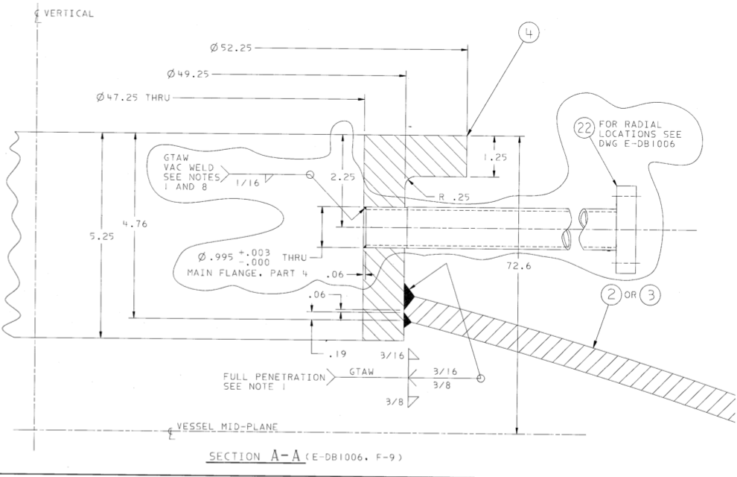
Schematic of the NSTX Upper/Lower Outer Vessel

Slide 6
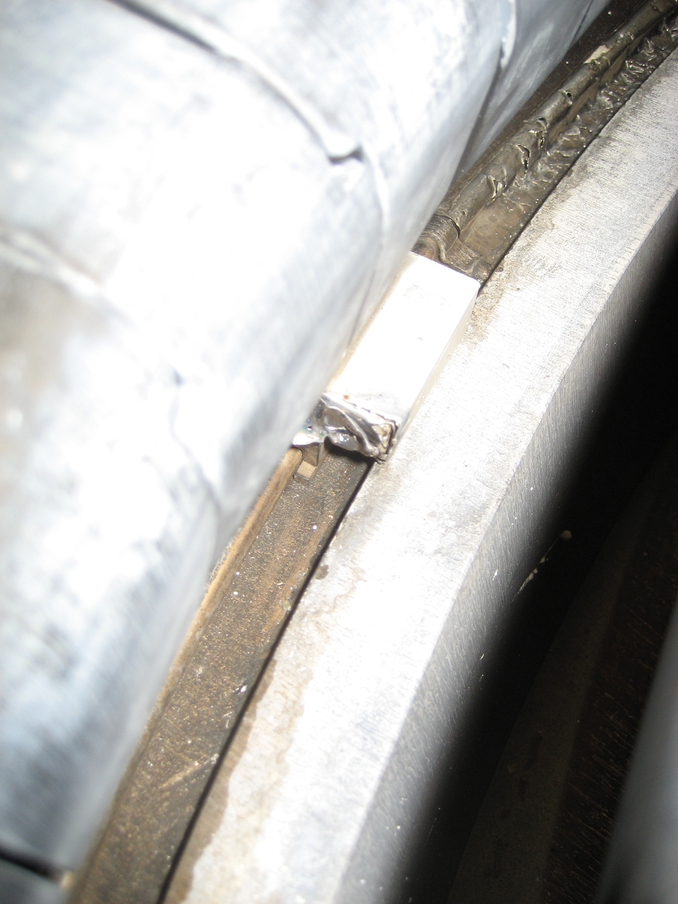
Picture of CHI Gap
Bull-node tiles
Flux Loop
Damaged Sensor (removed during outage due to excessive damage)
Vessel Flange
Gap was wider than the flange in NSTX.
Want this view to show only shields!
No stainless flange.
No flux loop.
No vessel.

Slide 7
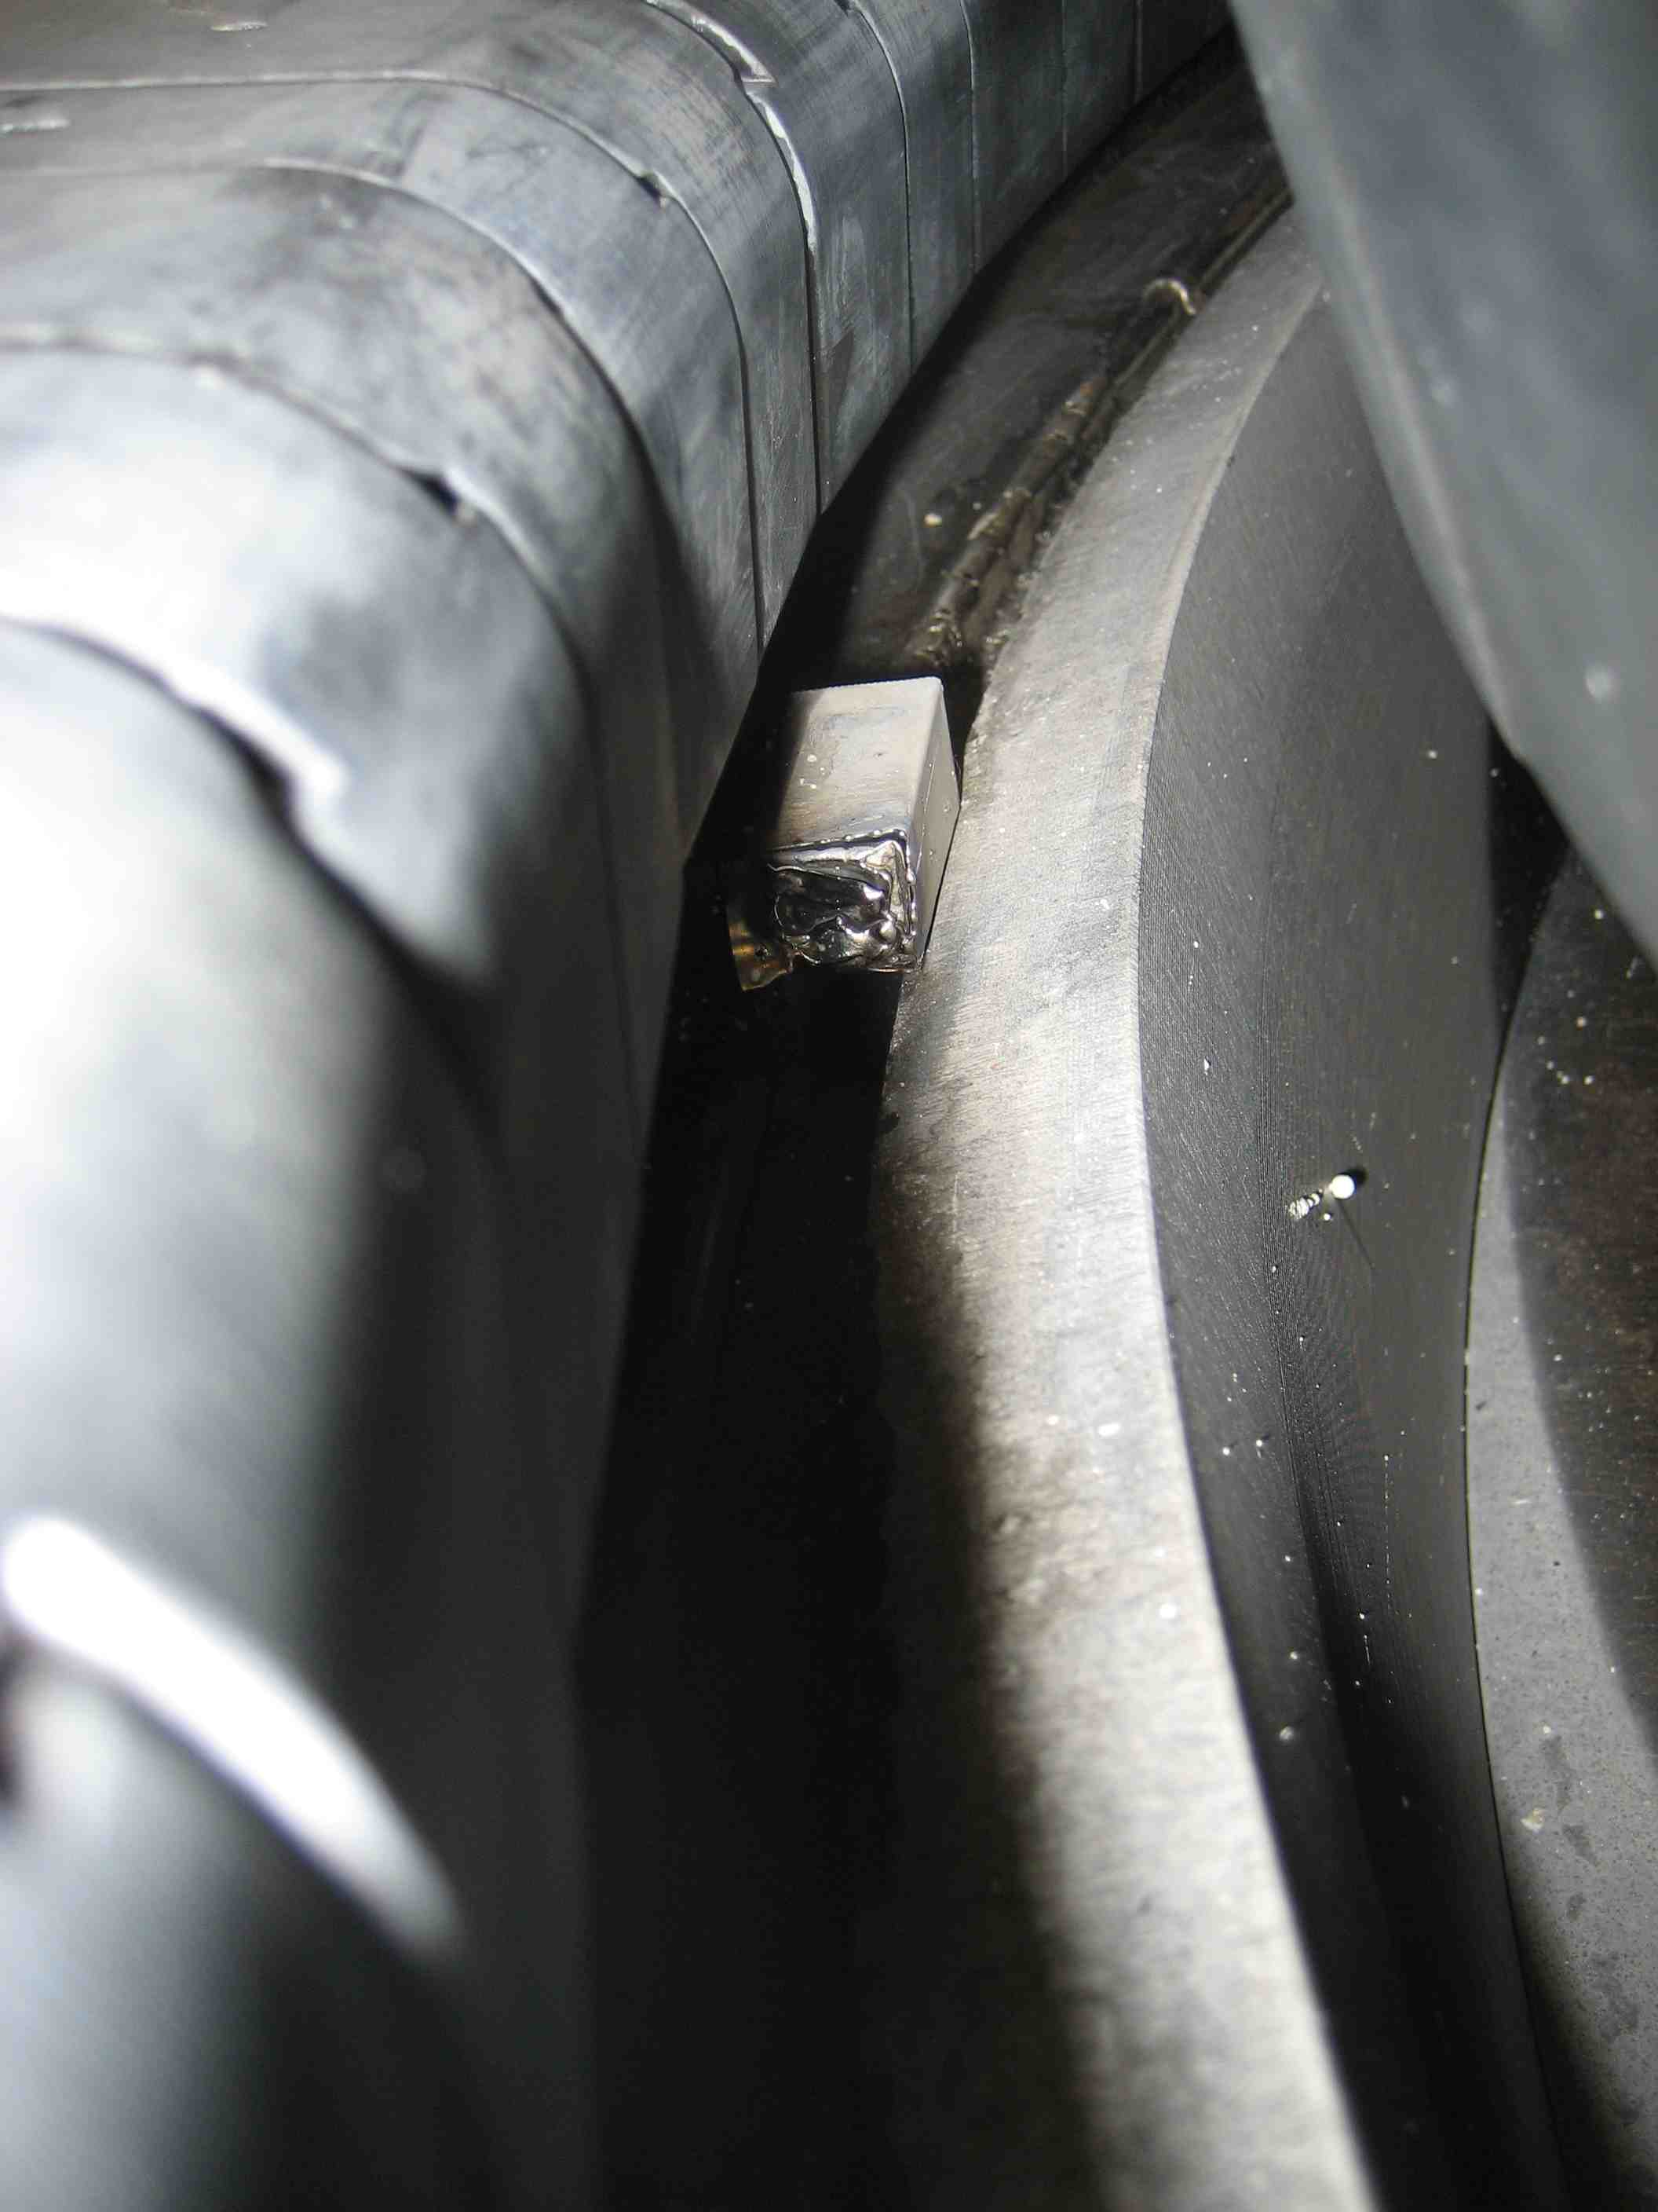
Another Picture

Slide 8
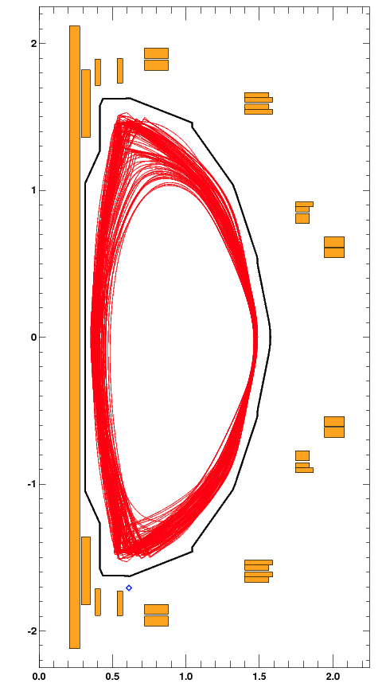
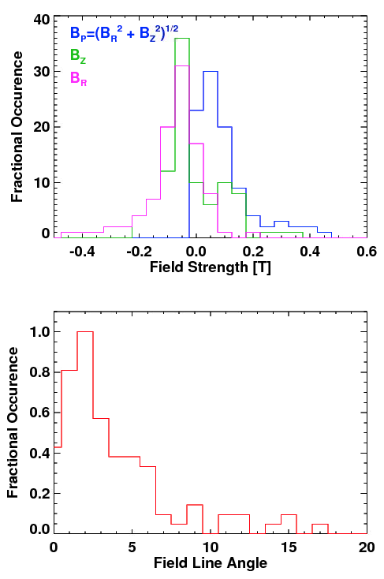
Database of Equilibria used to Determine Most Likely Field and Field Line Angles at Shield Location
Equilibria from J. Menard
All have B_{T}=1.0 T, I_{P}=2.0 MA
LSN, DN, SFD, high-delta, low-delta,…
Field line angle is with regard to the horizontal surface on the top of the flange.
Most have small field line angles.
A few outliers…

Slide 9
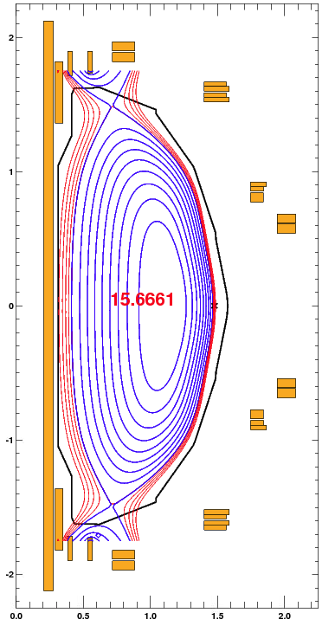
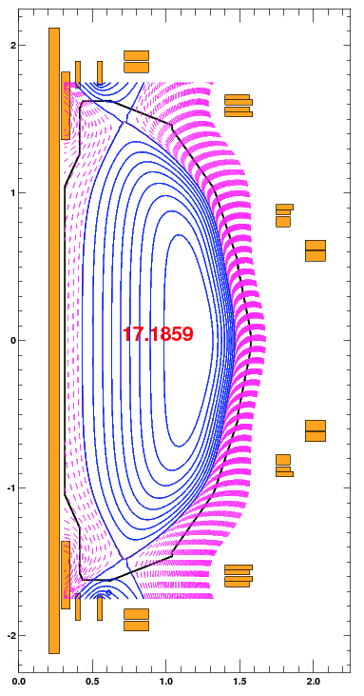
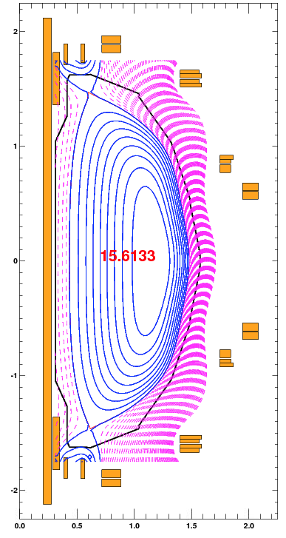
Cases with Larger Field Line Angle are Typically Well Into the Private Flux Region
Field line angle at sensor in red in center of equilibrium

Slide 10
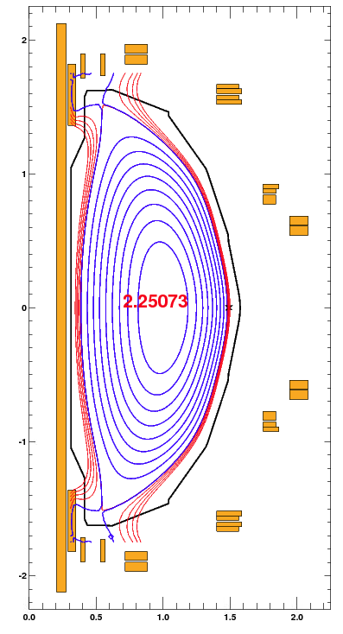
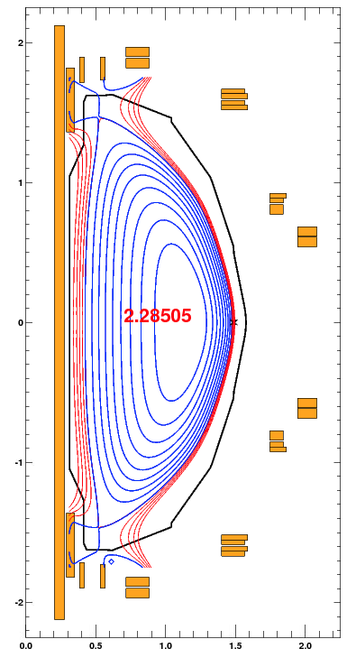
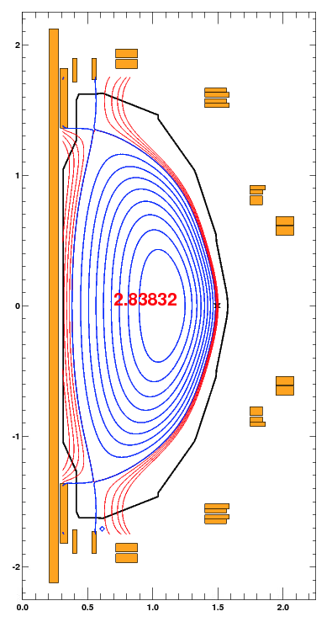
Cases of Concern Typically Have Small Field Line Angles Less Than 7 Degrees (I)
0.5 cm flux lines in red

Slide 11
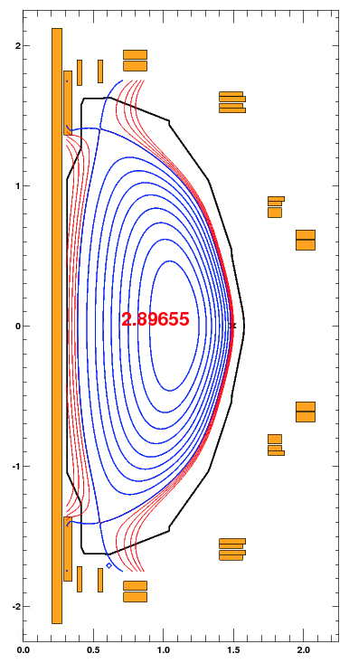
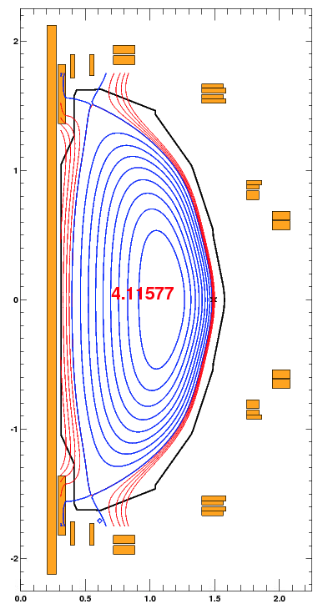
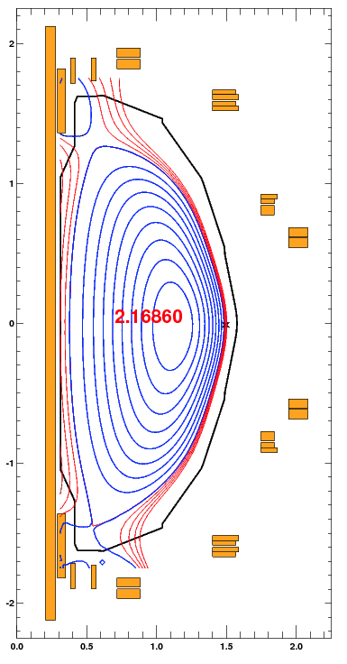
Cases of Concern Typically Have Small Field Line Angles Less Than 7 Degrees (II)
0.5 cm flux lines in red

Slide 12
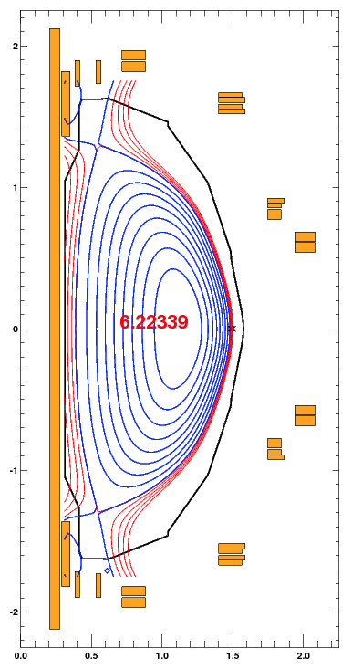
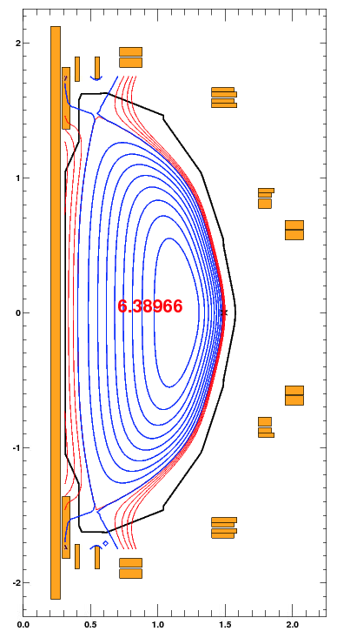
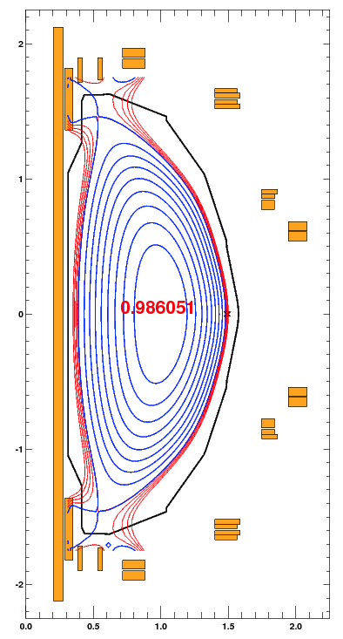
Cases of Concern Typically Have Small Field Line Angles Less Than 7 Degrees (III)
0.5 cm flux lines in red

Slide 13
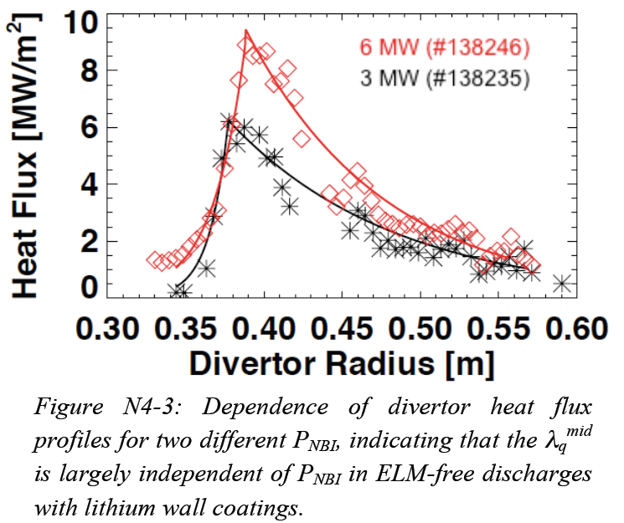
Heat Loading Requirement From NSTX Data and I_{P} Scaling, Assuming Similar Flux Expansion
Steady-state heat flux requirements:
  Assume that the radial distribution of heat is similar in form to NSTX cases.
  Drops by a factor of 2 in 5cm at 800 kA-> λ₀=0.05/log(2)=0.072
  Take a configuration with the OSP 8 cm inboard of the CHI gap.
  Heat Flux @ 1.2 MA, 12 MW, Q_{pk}=20 MW/m²: ~3 MW/m² steady state is required
Transient heat flux requirements
  Come from instances where the OSP is on the bullnose tiles, transiently drifts in.
  Assume a steady heat flux of 1.5 MW/m².
  Add a 0.1 seconds transient at 15 MW/m², every second.
  Time average power is 1.5+0.1*15=3 MW/m²
4th Quarter JRT Report

Slide 14
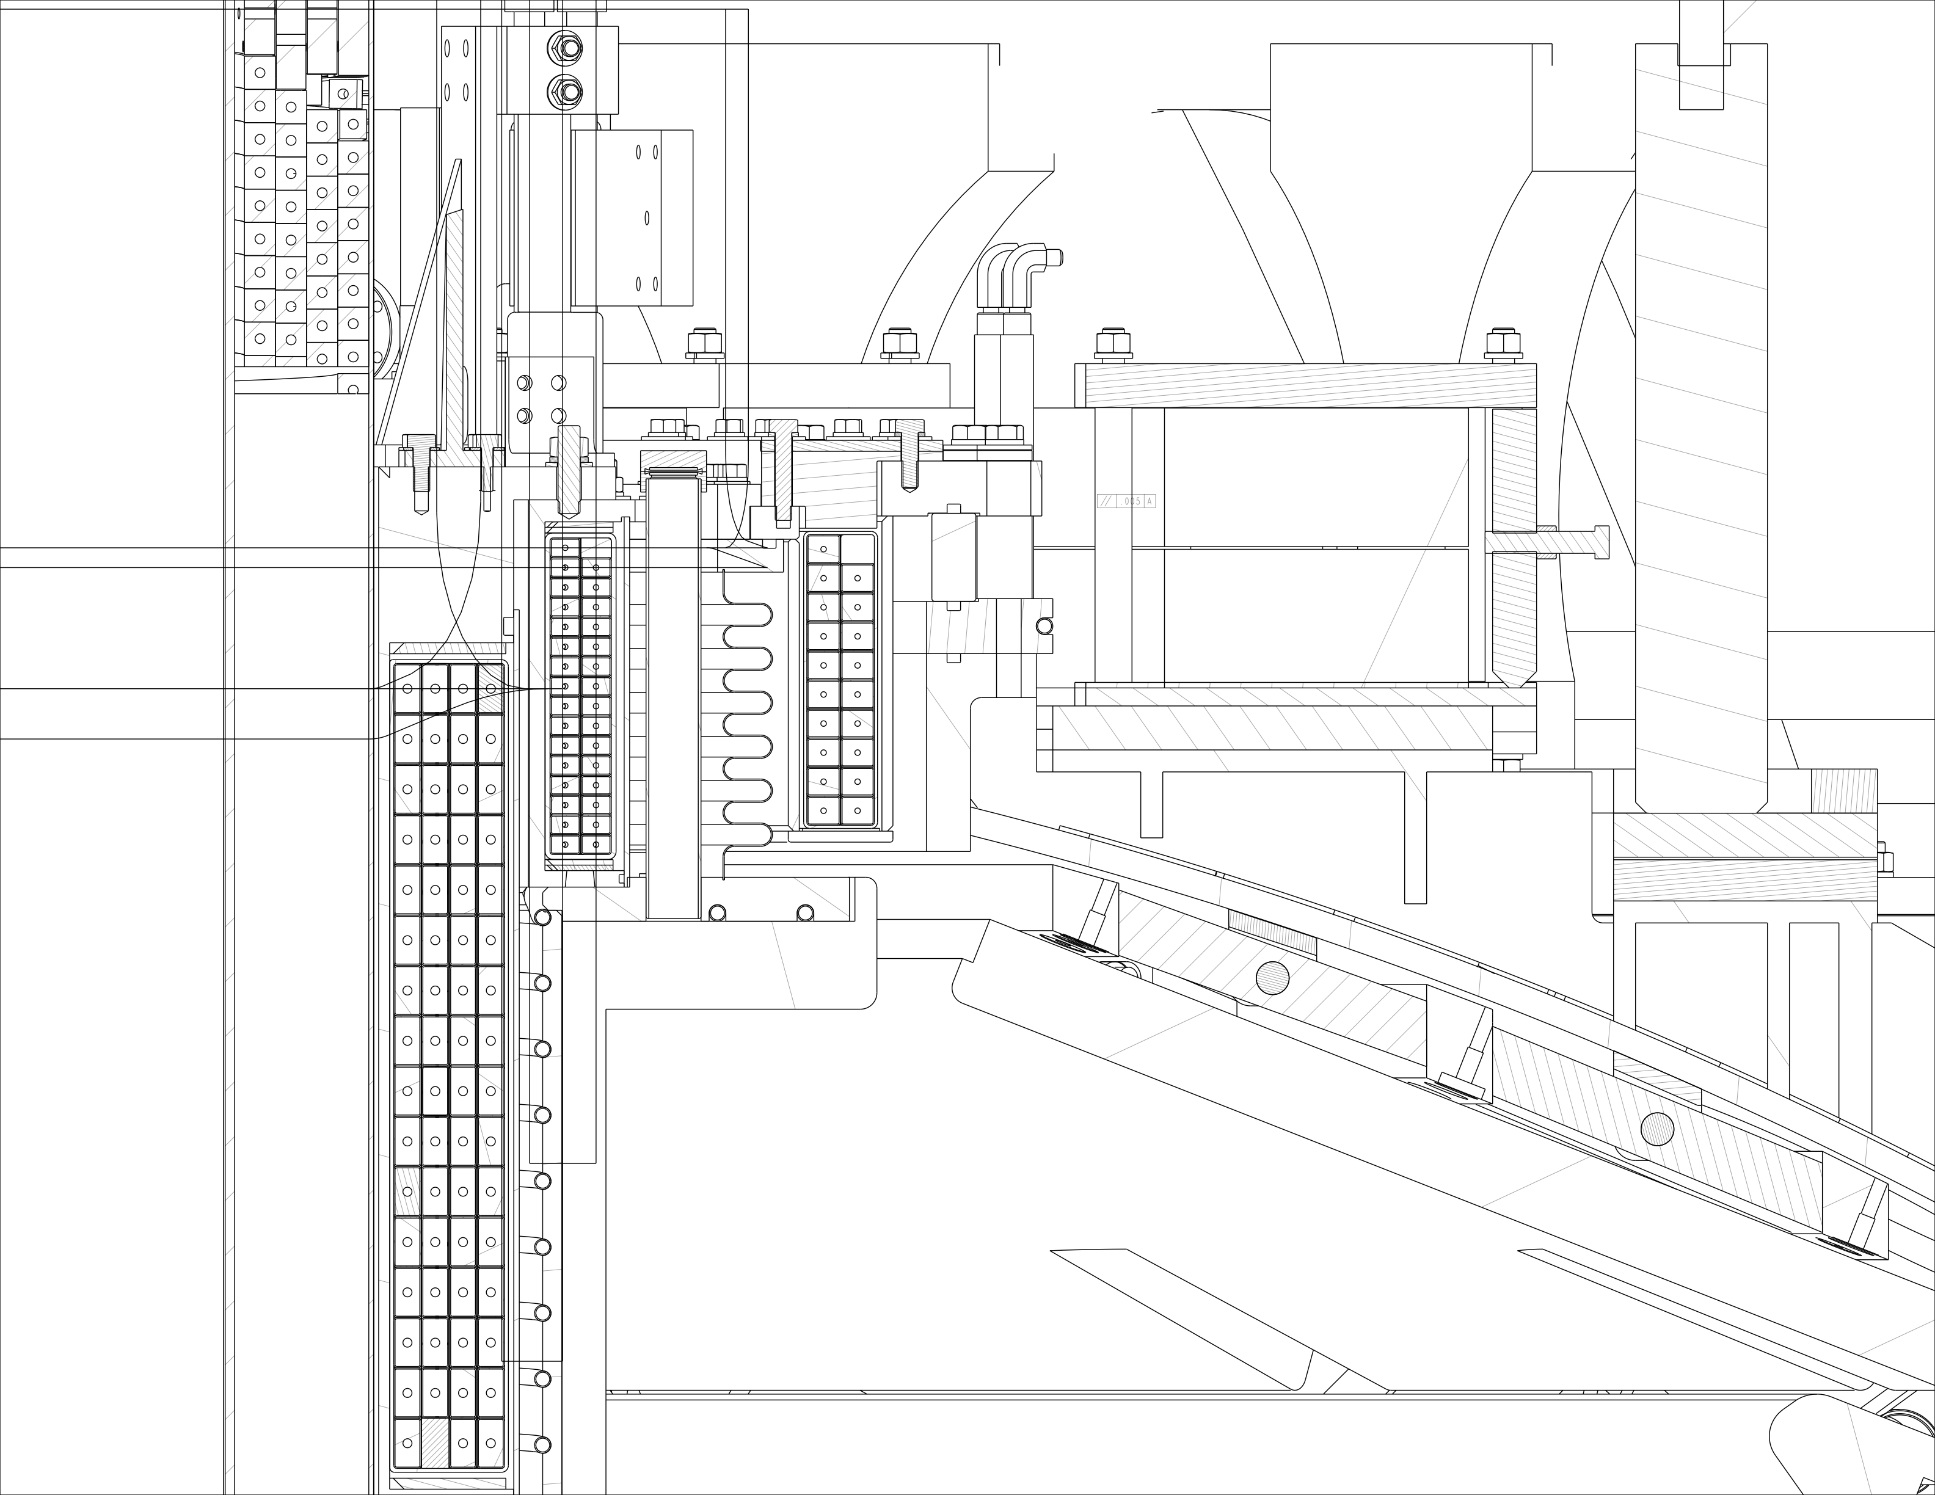
CHI Gap is More Narrow in the Upgrade
Gap
Flange

Slide 15
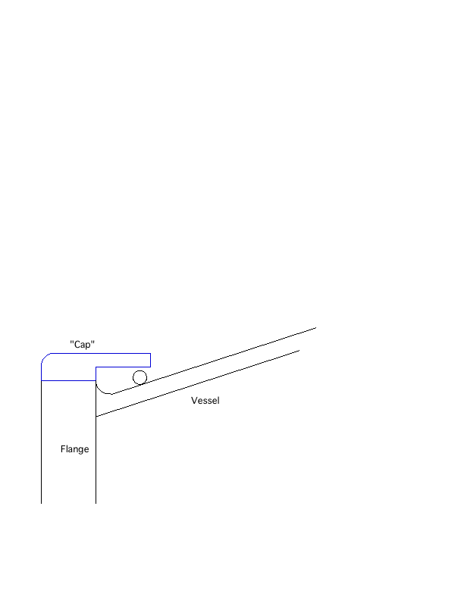
Propose to Put a “Cap” on the Main Vessel Flange
Vessel Top
Vessel Bottom

Slide 16
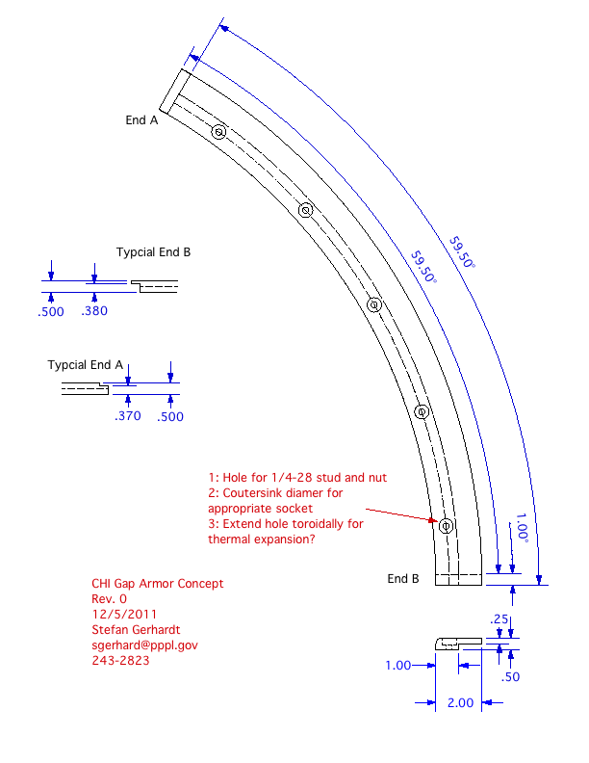
Concept #1 Was For a Small # Solid Moly Arcs
Arc to be bolted directly to flange.
Needed to look at changes to the aggregate vessel resistivity

Slide 17
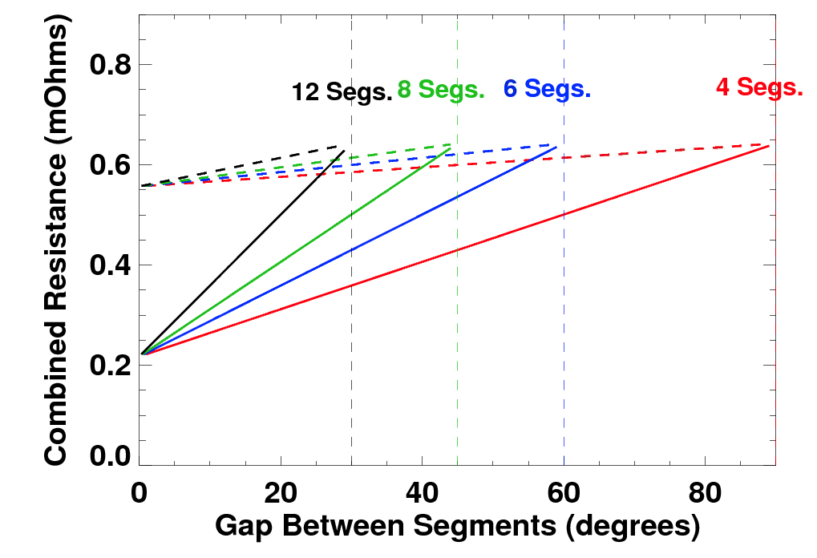
Substantial Modification to Local Vessel Resistivity
With Bulk Molybdenum
Shields
Gap
Gap
Shields
Full flange
Section of Vessel 2” Wide
Vessel Flange
Vessel Wall
Toroidal Angle
Compute the toroidal resistance of local conductors vs. gap between shields and # of shields.
Molybdenum has low resistivity.
  η_{SS}= 7x10⁻⁷ Ωm
  η_{Mo}= 5.5x10⁻⁸ Ωm
  η_{Cu}= 1.7x10⁻⁸ Ωm
Molybdenum shields reduce local resistivity by a factor of ~3 if not isolated from vessel.
  Like a 2” by .2” copper ring inside the vessel.
Solid: Moly. Shields
Dashed: Bulk Stainless Shields

Slide 18
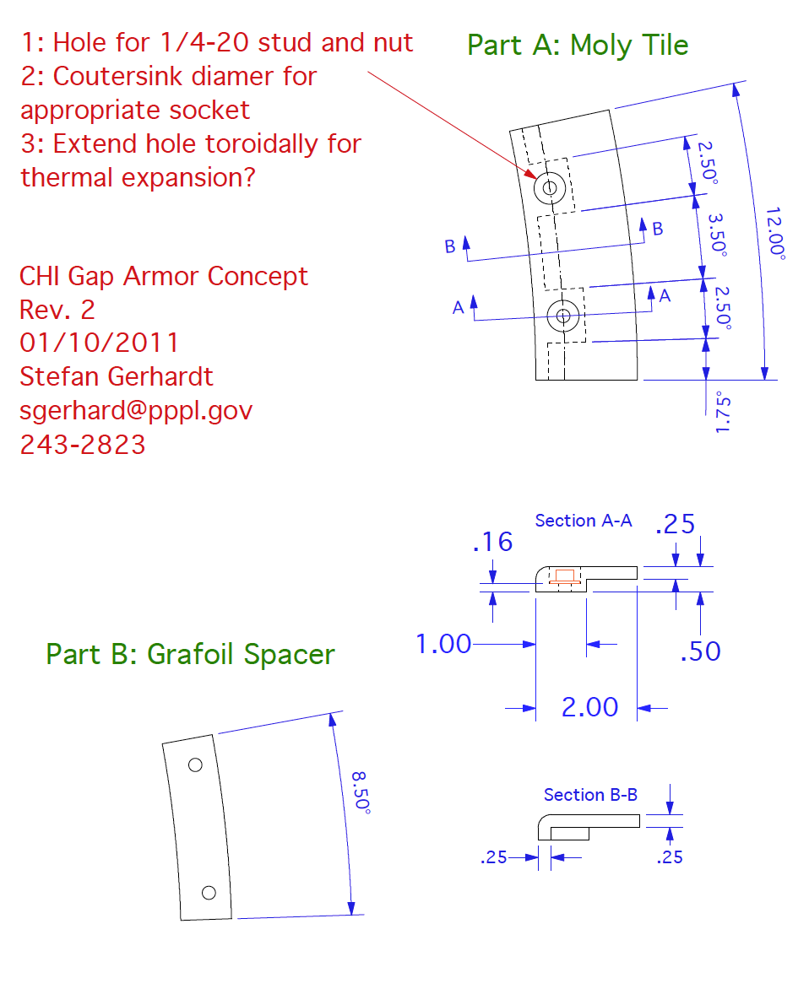
Concept #2 Thins the Moly & Uses Grafoil Pads
Grafoil has higher resistivity.
  η_{SS}= 7x10⁻⁷ Ωm
  η_{Mo}= 5.5x10⁻⁸ Ωm
  η_{Cu}= 1.7x10⁻⁸ Ωm
  η_{grafoil}~ 4x10⁻⁶ Ωm
Use 1 mm thick grafoil sheet.
1”x1” pad has resistance of 6.4x10⁻⁶ Ω.
  60 of them have resistance of 0.35 mΩ
Can be trivially cut using a simple template and scissors or razor.

Slide 19
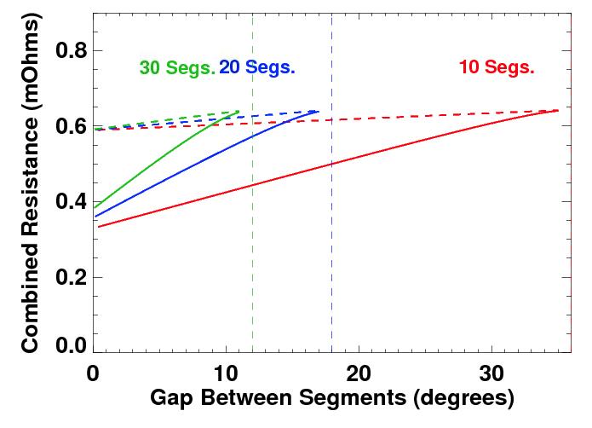
Thinned Tiles and Grafoil Shims Largely Eliminate the Low Resistance Problem
Shields
Shields
Full flange
Section of Vessel 2” Wide
Vessel Flange
Vessel Wall
Toroidal Angle
Compute the toroidal resistance of local conductors vs. gap between shields and # of shields.
Take an average height of 0.6*0.5”=0.33” and insert pads at each end.
3.5 degree electrical gap between shields.
Local toroidal resistance drops from 0.62Ω to 0.5Ω.
May not need to isolate the bolts.
  R_{bolt}=72μΩcm*0.4cm/(π*0.3cm*0.3cm)=100 μΩ
  This in parallel with the 6.4 μΩ grafoil pad.
  But it might be good to put an insulating sleeve in to maintain the full 0.4 cm.
Solid: Moly. Shields
Dashed: Bulk Stainless Shields

Slide 20
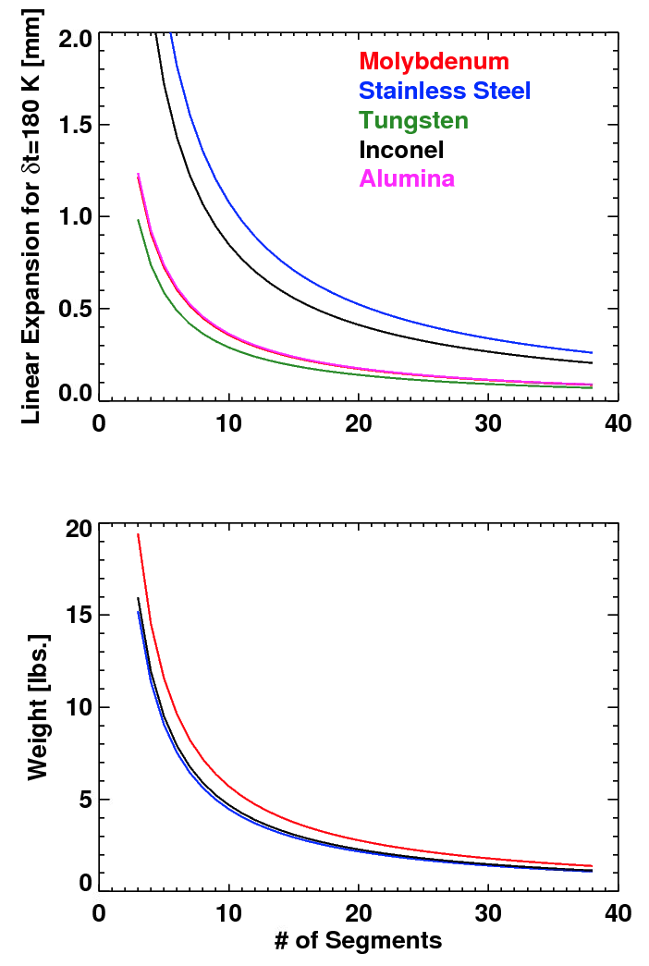
Consider Using Coatings to Solve Electrical Problems
Coating on top or bottom:
  Molybdenum or tungsten sprayed on top of solid shields.
    Bulk shields could be from inconel or stainless.
  Electrically insulating coating on bottom of tile.
    Alumina coating on bottom of tile.
Substantial difference in thermal expansion coefficients between resistive base metals and refractory coating metals.
  α_{Mo}=5.3x10⁻⁶ m/mK
  α_{W}=4.3x10⁻⁶ m/mK
  α_{SS}=16.0x10⁻⁶ m/mK
  α_{Inconel}=12.6x10⁻⁶ m/mK
  α_{alumina}=5.4x10⁻⁶ m/mK
Alumina and molybdenum have very similar expansion coefficents.
Molybdenum and stainless weigh a similar amount.
  This for 0.5x2” cross section.

Slide 21
Concept #3 Uses Solid Molybdenum Shields With Alumina Under-Coatings.
Use solid molybdenum
Use cross-section like concept #1
  30 pieces/tiles.
  12 degrees per tile
Coat the bottoms with alumina.
  R. Ellis has lots of experience with alumina coating on SS, didn’t think that coating Moly would be an issue.
  A&A Ceramics, White Engineering.
Stainless fasteners could be used to limit the current.
  R_{bolt}=72μΩcm*0.4cm/(π*0.3cm*0.3cm)=100 μΩ
  R_{tot}= 60*0.0001mΩ = 6mΩ
    Possibly sleeve them to ensure the full 0.4 cm length.
  Will still leave ~5/(0.006+0.002)~600A flowing through bolts during disruption.
    May want to isolate 1 side to eliminate the current entirely.
Use a sheet of grafoil mainly for mechanical reasons.
  Provide compliance, protect the coating.
  Also provides some extra resistance if the coating is compromised.

Slide 22
Circulating Currents Yield a B_{T}xm_{z} Torque About a Radial Axis (I)
Estimate the inductance and resistance based on the boundary of the tile.
  Assume that the most important current flows in a single large circulation.
  L/R time of ~0.5-1 msec for molybdenum, and ~0.1 msec for bulk stainless
Solve for time evolution of currents for a specified dB/dt
Inductive Limit
Resistive Limit
Intermediate
Solve ODE and find maximum current
Does not take into account coupling to other components.

Slide 23
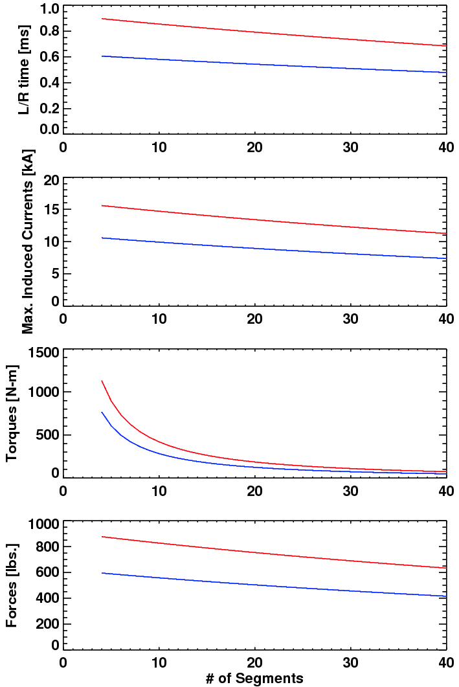
Circulating Currents Yield a B_{T}xm_{z} Torque About a Radial Axis (II)
Calculate torques and forces as a function of the # of Moly segments.
  Height of 0.5” (concept 1 & 3)
  Height of 0.33” (concept 2)
L/R times are neither purely inductive nor resistive.
Torques decrease as the # of segments is increased.
Forces on the end are more constant.
  From Force=Torque/Length
Concept #2 has ~500 lbs.
Concept #3 has 700-800 lbs.

Slide 24
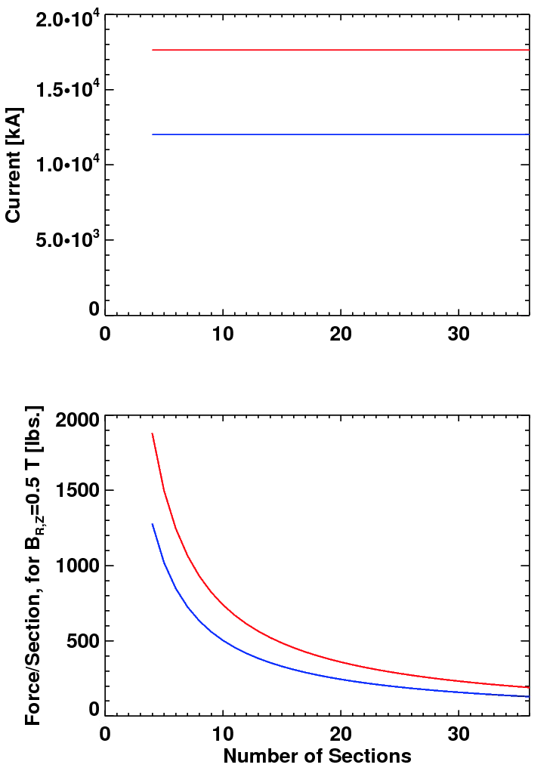
Current Quench Leads to Axisymmetric Force
Fast 700 kA disruption leads to ~1.0 V from loops near CHI gap.
  Add a factor of 2 safety margin, and then scale by 2.0/0.7~3 for NSTX-U
  Result is 6 V
Assume a conservative radial/vertical field of 0.5 T.
Color code:
  Red: Solid moly bolted to the vessel flange
  Blue: Thinned molybdenum with grafoil spacers, called concept #2.
Concept #3 has a negligible force from axisymmetric effects if the isolation is maintained and bolts are isolated.

Slide 25
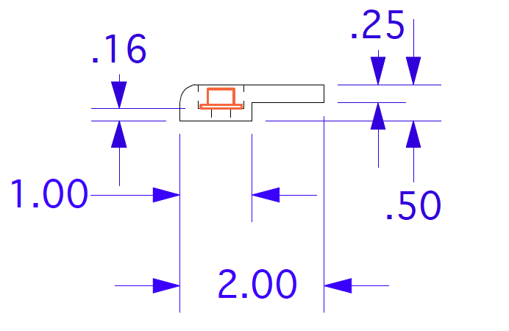
Finalizing Fastener Design Part of Engineering Scope
Welded ¼-20 studs appear to have enough strength:
  316 Stainless Steel, ¼-20 threaded rod from McMaster
    min. tensile strength of 70,000 psi.
  Diameter of 0.2” yields strength of 2200 lbs.
  Factor of 2 safety margin yields 1000 lbs.
  Properly done stud welding has the bolt fail before the weld.
Do not want to have field lines striking stainless fasteners.
  Assume an 8 degree field line.
Welded stud and counter-sunk nut may be workable.
Engineering should assess whether:
  there are T-bar/Dovetail like solutions for fasteners.
  the fasteners can/should electrically isolate the shields.
    Insulators must be compatible with Li deposition
8.1 degrees

Slide 26
Candidate Solutions
Concept #1: Small # of molybdenum shields bolted to flange.
  Good: Simplest mechanical solution of all. Possibly best power handling.
  Bad: Significant modifications to the conducting structure. Large disruption loads.
Concept #2: Thinned molybdenum shields with grafoil spacers.
  Good: Mechanically simple, reduced disruption load and small changes to net conductivity.
  Bad: More machining on the molybdenum shields themselves
Concept #3: Solid molybdenum shields with alumina coating and grafoil sheets on back side for electrical isolation.
  Good: Mechanically simple, reduced disruption load and small changes to net conductivity.
  Bad: May need to isolate fasteners. Less experience with these coatings.
Concept #4: Solid stainless steel or inconel shields w/ molybdenum or tungsten coatings on plasma facing side.
  Good: Simple installation, low disruption loading, minimal changes to electrical configuration.
  Bad: Potential issues with cyclic thermal stress and flaking, especially with plasma heat to the front face.

Slide 27
Candidate Solutions
Concept #1: Small # of molybdenum shields bolted to flange.
  Good: Simplest mechanical solution of all. Possibly best power handling.
  Bad: Significant modifications to the conducting structure. Large disruption loads.
Concept #2: Thinned molybdenum shields with grafoil spacers.
  Good: Mechanically simple, reduced disruption load and small changes to net conductivity.
  Bad: More machining on the molybdenum shields themselves
Concept #3: Solid molybdenum shields with alumina coating and grafoil sheets on back side for electrical isolation.
  Good: Mechanically simple, reduced disruption load and small changes to net conductivity.
  Bad: May need to isolate fasteners. Less experience with these coatings.
Concept #4: Solid stainless steel or inconel shields w/ molybdenum or tungsten coatings on plasma facing side.
  Good: Simple installation, low disruption loading, minimal changes to electrical configuration.
  Bad: Potential issues with cyclic thermal stress and flaking, especially with plasma heat to the front face.
Concepts #1 and #4 are much less desirable.
Heat flux and thermal analysis can probably help determine which of #2 or #3 is better.

Slide 28
Recommendations For Near Term (assuming the project wants to do this).
Need an engineer to be assigned.
We should test the mechanical stability of alumina coatings on molybdenum.
Disruption analysis should be checked by engineering.
Thermal analysis needs to be done.
  Will the more complicated mechanical structure of the thinned tile create local thermal stresses.
  Will the alumina coating provide an unacceptable barrier to the heat leaving the tile.
    Probably not…k=30 W/mK for Al₂O₃, compared to 138 for molybdenum and 16 for stainless steel.
Finish determination of fasteners.
  For reducing the modifications to the conducting structures, neither concept really required the fasteners be isolated as long as current is forced through ~0.5 cm of the ¼-20 bolt/stud.
    But concept #3 may want them isolated to avoid damaging currents in the bolts/studs themselves.
  Need to assess if a T-bar or dove-tail solution exists.
  Allows studs/nuts to be welded in vessel at convenient time.

