Slide 1




NSTX
Supported by
CHI Gap Shields
SPG, HK, RR
Columbia U
CompX
General Atomics
FIU
INL
Johns Hopkins U
LANL
LLNL
Lodestar
MIT
Nova Photonics
New York U
ORNL
PPPL
Princeton U
Purdue U
SNL
Think Tank, Inc.
UC Davis
UC Irvine
UCLA
UCSD
U Colorado
U Illinois
U Maryland
U Rochester
U Washington
U Wisconsin
Culham Sci Ctr
U St. Andrews
York U
Chubu U
Fukui U
Hiroshima U
Hyogo U
Kyoto U
Kyushu U
Kyushu Tokai U
NIFS
Niigata U
U Tokyo
JAEA
Hebrew U
Ioffe Inst
RRC Kurchatov Inst
TRINITI
NFRI
KAIST
POSTECH
ASIPP
ENEA, Frascati
CEA, Cadarache
IPP, Jülich
IPP, Garching
ASCR, Czech Rep

Slide 2
Desire to Improve the Power Handling Capability of the CHI Gap
Issue: Plasma & heat entering the CHI gap has been known to
  degrade discharge performance due to heat flux on SS, and
  damage diagnostics in the CHI gap,
Problem may be more severe in NSTX-Upgrade, where the horizontal inner target is more narrow.
Goal: Install armor on outboard side of CHI gap.
  Graphite is not considered a plausible candidate due to high temperature bake-out requirement.
Provides 2 benefits
  For cases with OSP on OBD bull-nose tiles, armor increases tolerance to transient inboard motion of the SP.
  For cases with OSP in the inner horizontal target, armor improves power handling of the far(ther) SOL heat flux.
Not planning for this armor to be a primary, “steady-state” power handling component.
Have already identified candidate concepts, and are working with engineering to implement.

Slide 3
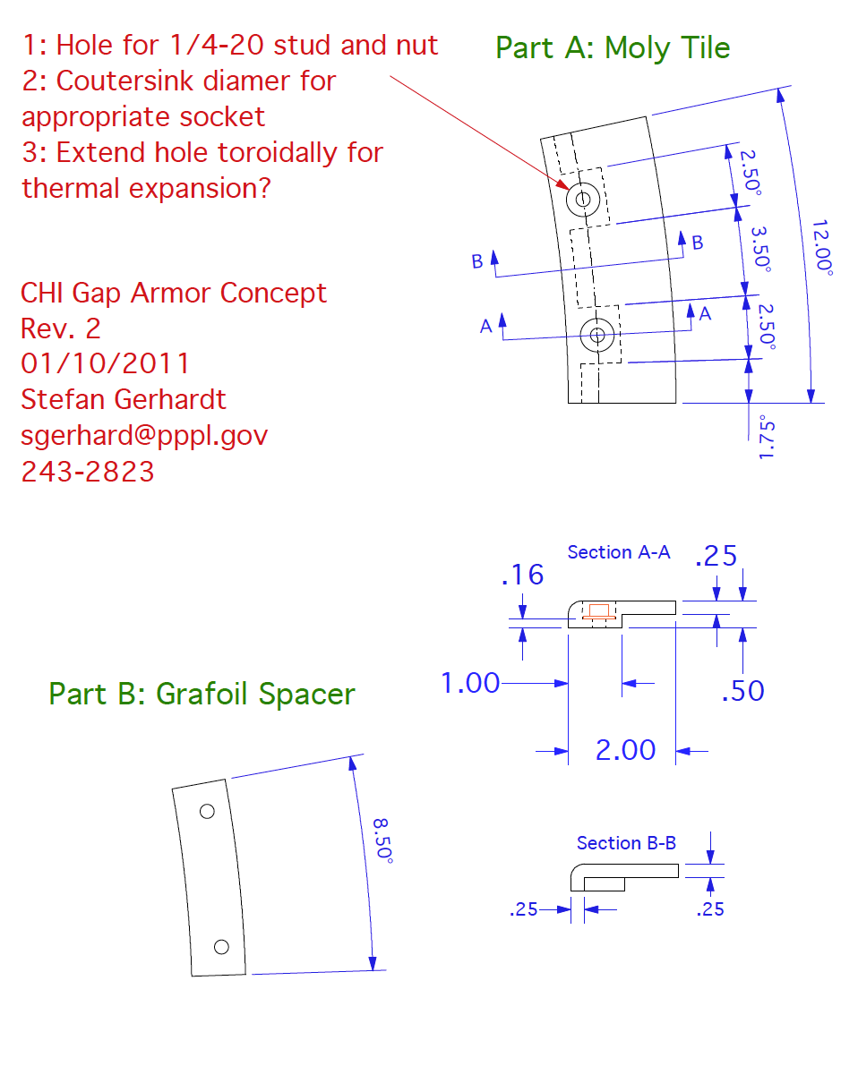
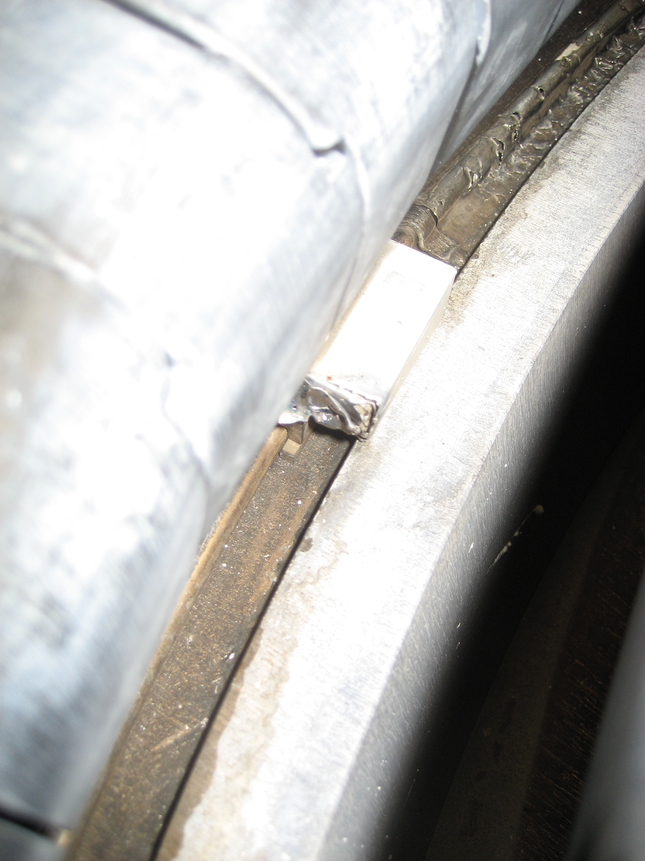
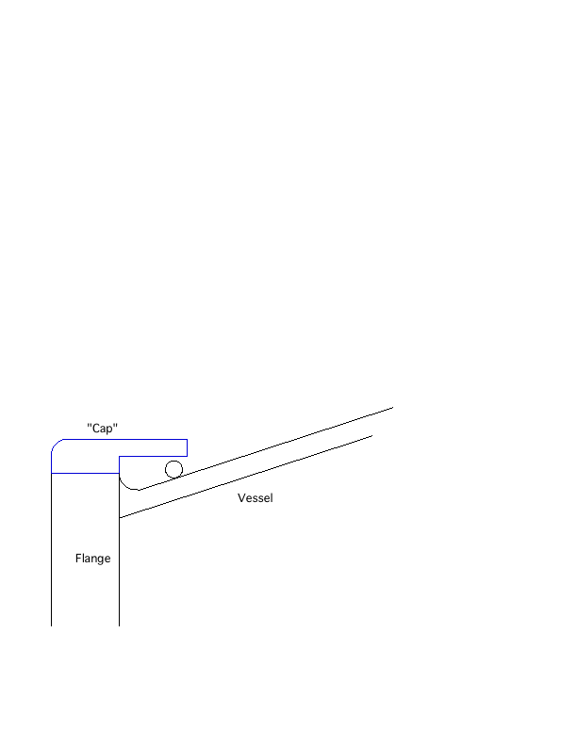
Concept for Moly. Tile
asdfd

