Slide 1




NSTX
Supported by
NSTX-Upgrade Magnetics And Related Diagnostics
SPG
Columbia U
CompX
General Atomics
FIU
INL
Johns Hopkins U
LANL
LLNL
Lodestar
MIT
Nova Photonics
New York U
ORNL
PPPL
Princeton U
Purdue U
SNL
Think Tank, Inc.
UC Davis
UC Irvine
UCLA
UCSD
U Colorado
U Illinois
U Maryland
U Rochester
U Washington
U Wisconsin
Culham Sci Ctr
U St. Andrews
York U
Chubu U
Fukui U
Hiroshima U
Hyogo U
Kyoto U
Kyushu U
Kyushu Tokai U
NIFS
Niigata U
U Tokyo
JAEA
Hebrew U
Ioffe Inst
RRC Kurchatov Inst
TRINITI
NFRI
KAIST
POSTECH
ASIPP
ENEA, Frascati
CEA, Cadarache
IPP, Jülich
IPP, Garching
ASCR, Czech Rep
Basic goal is to restore previous functionality and support machine operations and protection.

Slide 2
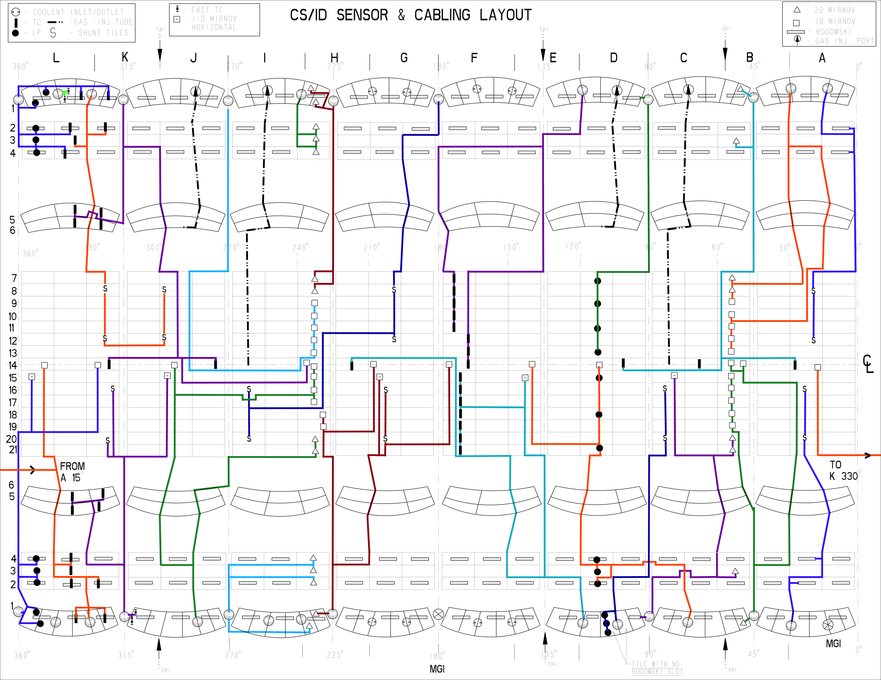
R. Kaita and K. Tressmer Have Lead Effort to Develop CS Magnetics Even Better than for NSTX
5 New B_{T} Sensors for CS midplane HCs.
18 CS shunt tiles for CS HCs.
Additional poloidal array with 27 B_{R} and B_{P} sensors.

Slide 3
DCPS and Vessel Changes May Mandate Upgrades to the System
DCPS = “Digital Coil Protection System”…realtime code calculating mechanical and thermal stresses/forces on coils and their mounting systems.
  Rectifiers can make currents that can break the machine.
High degree of redundancy is required in terms of both sensors and calculations.
  Every current (coils & plasma), is measured two different ways
  The measurements are compared, and if they differ, the shot is interdicted.
As presently envisioned, loss of either of the two rogowskis would preclude further operation.
  Rogowskis can fail in ways that mandate substantial machine disassembly for repair.
Can make a strong case that installing a 3rd Rogowski is appropriate.
Both rogowskis are processed through a single analog computer called the “I_{P} Calculator”.
  Common loops voltages, power supplies, data transmission,…for both rogowskis.
  May need to add redundancy in these systems.
    For instance, when flux loops are reinstalled, install 2 (pairs) instead of a single at each location.
Must also add channels to I_{p} calculator system for additional linked divertor coils, and make modifications for changes to inner-vessel resistances.
May need to add more flux loops, I_{P} calculator channels, for additional conducting structures in the new CS.
Some of this is NSTX-U scope, some maybe not…I don’t know.
NSTX-U magnetics must be considered in the context of the DCPS.

Slide 4
Grounding and Other Issues
Desire to improve noise immunity for CHI, other operations. Two contributing factors are:
  Long, fairly high-inductance ground connections for magnetics racks.
  Multitude of diagnostics and other facility electronics mixed in with the magnetics.
Would like to improve rack grounding.
  Present ground both racks with #2 cables.
  Would like to replace with bus bar.
Cat. 3 racks moving to 119’ platform, while Cat. 4 racks staying at 100’ level.
  Would like to connect Cat. 3 racks to inner vessel at the top of the machine.
Want to eliminate intermixing of bolometers, stepper motor controllers, other electronics, with magnetics.
Additional electronics needed:
  Inner vessel: ~31 channels of new integrators, and a single SAD for bringing data to realtime system.
  Outer vessel: None new, but some gains modified.

Slide 5
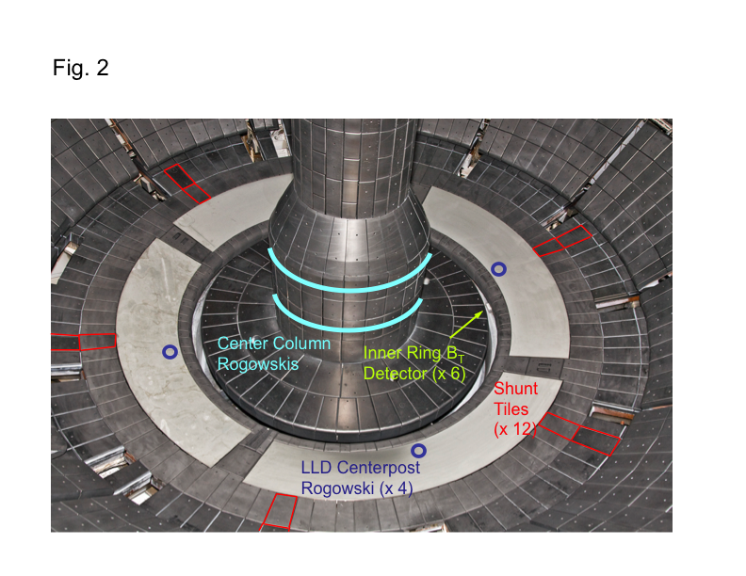
Diagnostics for Divertor/Halo/Hiro Currents on Outer Vessel Not Yet Specified
FY-10/11 run had 12 shunt tiles and 4 LLD rogowskis.
  Used for disruption, ELM, SOLC, HHFW studies.
LLD removal eliminates the rogowskis and 6 of the shunt tiles.
Basic installation/restoration would be to restore 6-8 tiles per row, in each of rows 2,3, & 4.
  Should be worked out with interested parties.
See first content slide for inner vessel halo current measurements.

