Slide 1
REQD FUTURE POWER SYSTEM CHANGES
Following additional work is required to be performed to restore full capability of the machine:
1. Provide power feed to a) PF1bU, b) PF1cU, c) PF1cL coils.
This involves designing the power loop and providing Power Supplies, CLRs, Disconnect & Ground Switches, DCCTs, Protective relaying etc.
2. Upgrade PF5 feed such that PF5 coil can be injected up to 34kA
This would require an additional branch to the existing power supply. Note that PF5 is powered up to 24kA in the current set up.
3. Upgrade TF feed such that TF can be pulsed every 20 minutes.
(Note that we can with appropriate controls, pulse with a period < 40 / 20 minutes based on the I^2*t imposed on the coil system.)
In the current scope the TF can be pulsed only once in 40 minutes. This requires additional power cabling from the Transition area to the NSTX Test Cell, additional changes in the PCTS, enhancing the feed from PCTS to coil terminals.
We can also consider providing a water cooled bus in the NSTX Test Cell Basement from the place the power cables are terminated.

Slide 2
POWER SYSTEM CHANGES CONTD.
4. Make changes as needed to operate CHI from 2kV to 4kV.
In order to address this requirement we must plan right now to choose the appropriate insulation for the CHI leads and the Inner vessel. Note that the Inner Vessel to Outer Vessel will require to be hipotted at 9kV instead of 5kV as at present.
5. Convert PF1a circuit from a 3- Wire scheme to a 2 - Wire scheme.
This is required to upgrade CHI from 2kV to 4kV. The work involves additional cabling.
6. Change DCCT positions such that these measure the coil currents directly.
At the present time the DCCTs are above the SDS in some circuits
*7. Repair MG2 weld to restore normal rating
At present MG2 can be used only at about 15% of the full energy rating
*8. Repair MG1 Welds so that it can be an effective standby.
This also increases the life of the MGs by alternating usage of the sets
Following tasks are being performed at present. Part of this task was originally included in the NSTX upgrade scope but were transferred to Operations cost.
Change FD/FG for all the suppliies needed to power NSTX. Eliminate the PC link.
Note that we are currently performing this task. In this modification we are changing the FD/FG for active rectifiers which will be used for NSTX. Also a slow PLC I/O will be provided in these rectifiers to interface with the main PLC that will be provided in the Cntrol Boards.)
(* MG information from Mounir Awad)

Slide 3
PWR SUPPLY TABLE (Extracted information from CN design point spreadsheets)

Slide 4
MG REQUIREMENTS
(Extracted from CN design point spreadsheets)

Slide 5
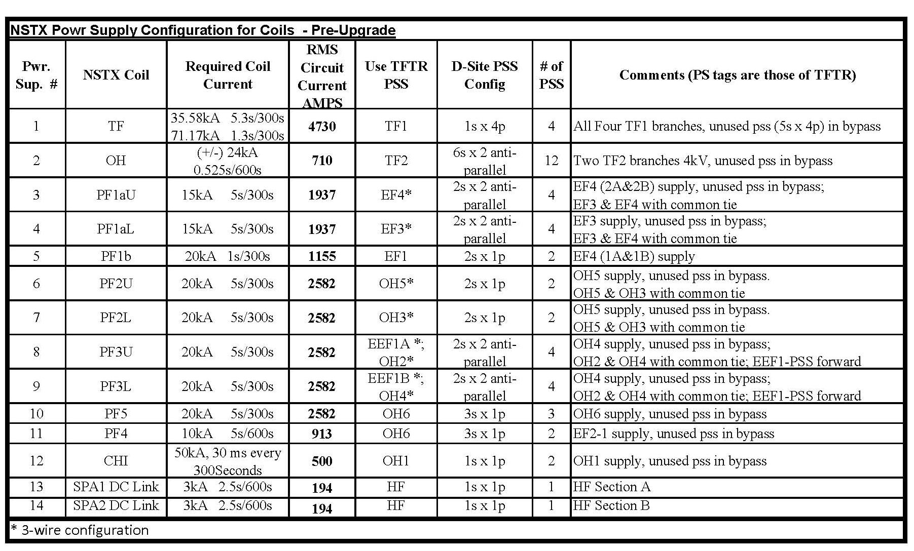
NSTX PRE-UPGRADE CIRCUITS

