Slide 1





NSTX
Supported by
Proposed Facility Enhancements for NSTX Upgrade
Columbia U
CompX
General Atomics
FIU
INL
Johns Hopkins U
LANL
LLNL
Lodestar
MIT
Nova Photonics
New York U
ORNL
PPPL
Princeton U
Purdue U
SNL
Think Tank, Inc.
UC Davis
UC Irvine
UCLA
UCSD
U Colorado
U Illinois
U Maryland
U Rochester
U Washington
U Wisconsin
Culham Sci Ctr
U St. Andrews
York U
Chubu U
Fukui U
Hiroshima U
Hyogo U
Kyoto U
Kyushu U
Kyushu Tokai U
NIFS
Niigata U
U Tokyo
JAEA
Hebrew U
Ioffe Inst
RRC Kurchatov Inst
TRINITI
NFRI
KAIST
POSTECH
ASIPP
ENEA, Frascati
CEA, Cadarache
IPP, Jülich
IPP, Garching
ASCR, Czech Rep
V. A. Soukhanovskii for the LLNL Collaboration Team
NSTX-U Facility Enhancement Brainstorming Meeting
Princeton, NJ
7 February 2012

Slide 2
LLNL proposals for NSTX-U facility enhancements
Divertor Gas Injector Upgrades for radiative divertor feedback control (gas actuators)
Supersonic Gas Injector Upgrades
Glow Discharge Cleaning System Upgrades
Vacuum vessel and Infrastructure upgrades for divertor Thomson Scattering diagnostic

Slide 3
LLNL proposed development of real-time feedback control of radiative divertor for NSTX-U
Proposed and partially funded as part of DoE ECRP Award in 2010
Goal: steady-state feedback control of divertor heat flux and detachment compatible with pedestal stability and H-mode core confinement metrics – critical for NSTX-U 12 MW 2 MA 5 s discharges
Use diagnostic signal indicative of divertor detachment / reduced heat flux as control parameter and pass it on to PCS for fast gas valve control for divertor impurity seeding control (actuator)
Control parameters (diagnostics side):
  PFC temperature / heat flux monitoring (e.g., fast IR diodes)
  P_{rad} (e.g., fast bolometers, AXUV diodes, VUV spectroscopy)
  Recombination rate (D Balmer, Paschen lines), Divertor ion current (e.g., Langmuir probes), D or Impurity pressure (e.g., Optical Penning gauge)
  Pedestal pressure, core impurity density, MARFE monitoring, etc
Actuators:
  Gas valves (midplane and divertor)

Slide 4
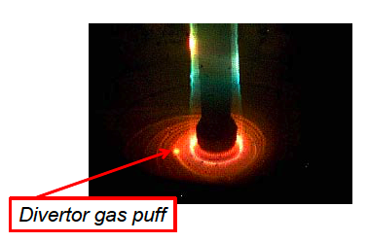
Upgrades to divertor gas injection system
(D-GIS) motivated by NSTX-U divertor experiments
NSTX (present) D-GIS design motivated by divertor detachment experiments performed in 2005-2008:
  Gas delivery system is shared between D-GIS and SGI (connected to one remote gas bottle)
  All components rated to 100 PSI
  One divertor gas port in CHI gap
  Pre-programmed PZV control from vacuum operator PC
Plasma TV photo
courtesy of F. Scotti
Proposed D-GIS enhancements:
  Make four toroidally symmetric gas ports (add in-vessel gas lines)
  Make remotely controlled independent gas delivery system to handle several gases (D₂, He, Ne, Ar, CD₄, …)
  Add pre-programmed control to PCS
  Develop and implement feedback control algorithm

Slide 5
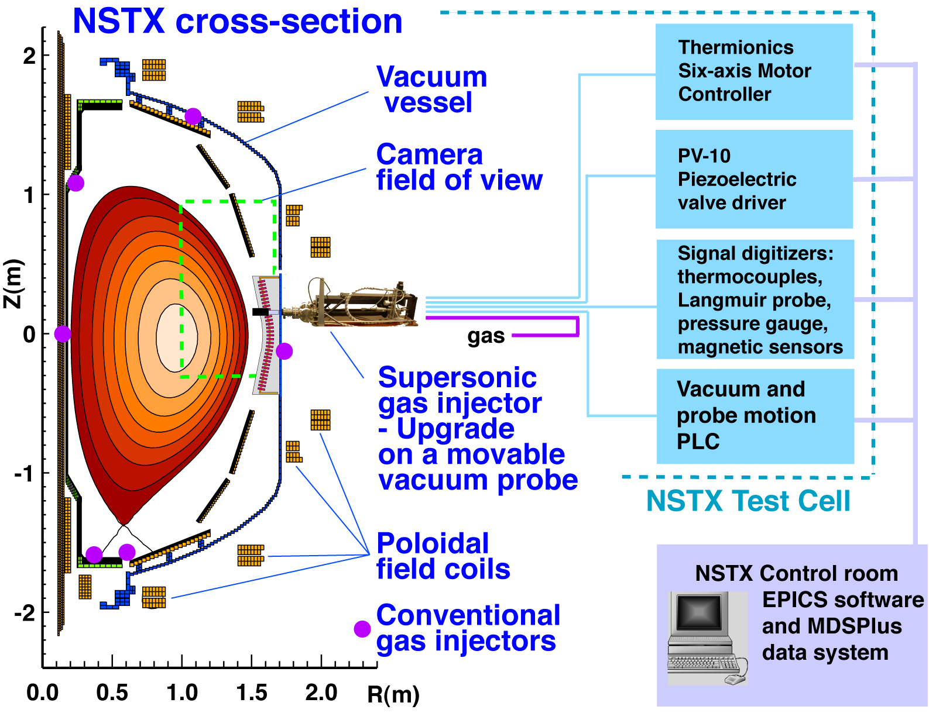
Supersonic gas injector is a complex computer-controlled high gas pressure apparatus

Slide 6
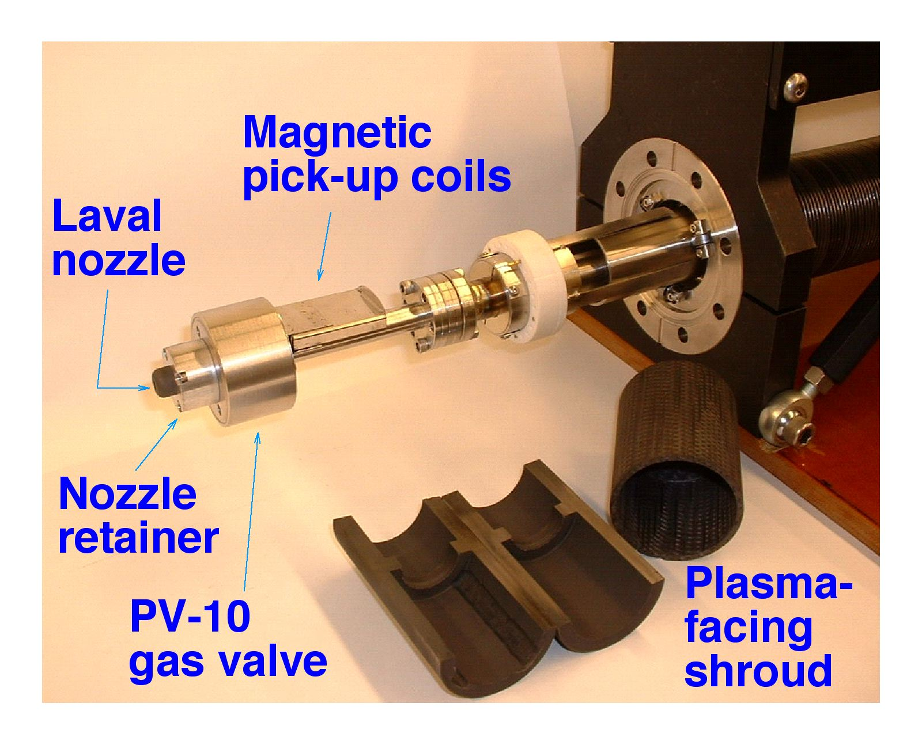
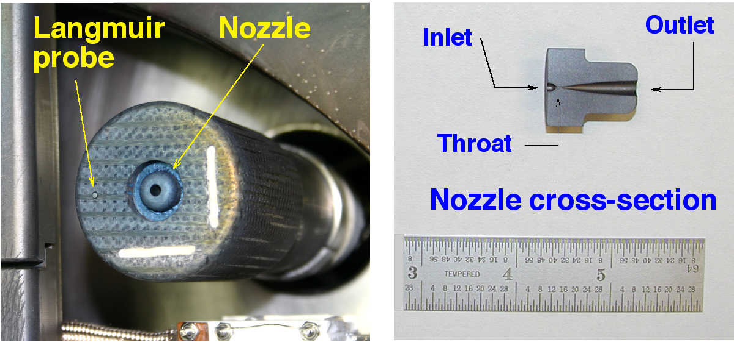
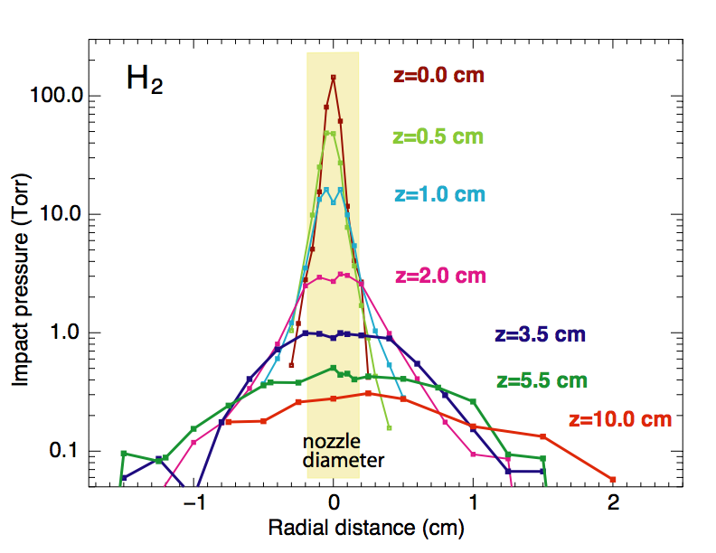
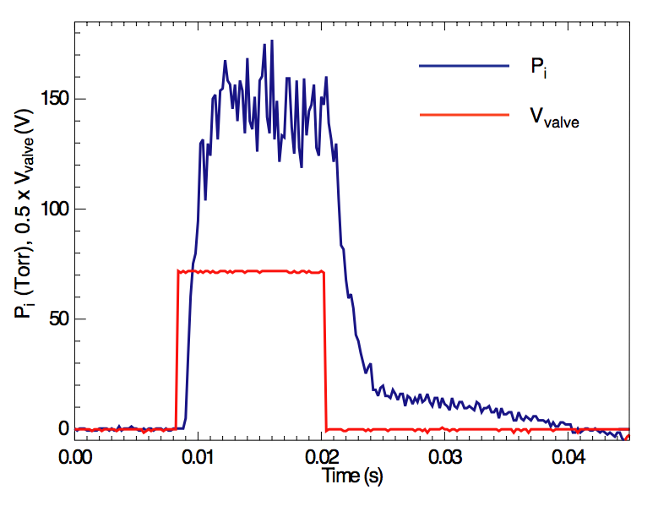
Supersonic gas injector consists of Laval nozzle and piezoelectric valve
SGI is operated at flow rates 20-250 Torr l /s
Supersonic deuterium jet properties:
  Jet divergence half-angle:
  6º - 25º (measured)
  Mach number M = 4 (measured)
  Estimated: T ~ 60 - 160 K,
  n < 5 x 10²³ m⁻³,
  v_{flow} = 2.4 km/s, v_{therm} ~ 1.1 km/s
  Nozzle Re = 6000

Slide 7
SGI upgrades proposed in 2008 but never implemented…
Use present valve / nozzle for stationary SGI mounted on the wall in the shadow of limiter
Use movable probe from present SGI to prototype cryogenic SGI
  Design and make new metal nozzle
  Use non-piezo valve (EM, pneumatic, others)
  Design cryogenic cooling system (liquid N₂)
Present limit on reservoir pressure (5000 Torr = 96 PSI) seems sufficient for fueling with present nozzle 250 Torr l / s
Develop PCS control

Slide 8
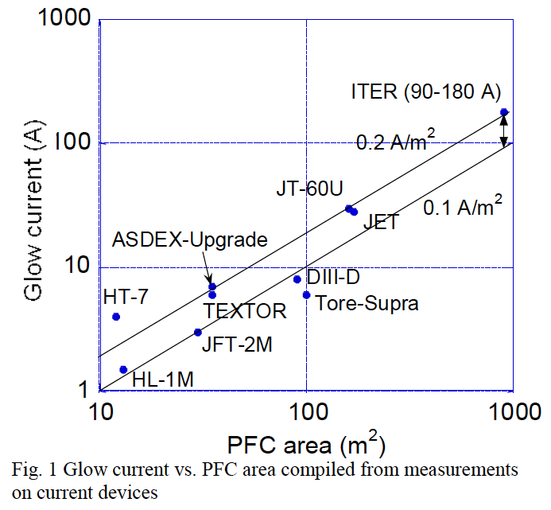
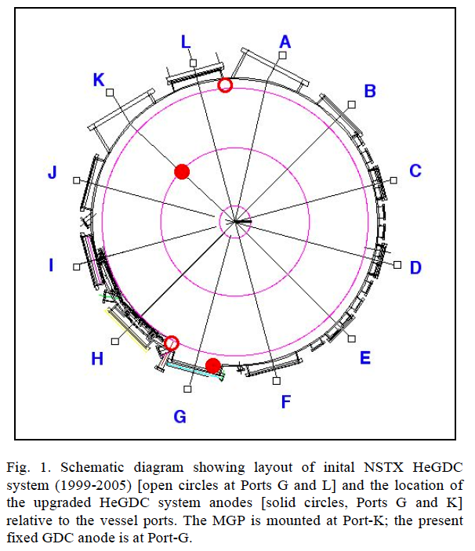
Propose to re-examine present glow discharge system for optimization toward NSTX-U
Shimada, EPS 2011
Tokamak GDC figure of merit: 0.1-0.2 A/m²
NSTX PFC area 41 m², current ~3.5 A, two anodes
NSTX-U: greater PFC area -> need higher current (?), more uniform coverage (?)

Slide 9
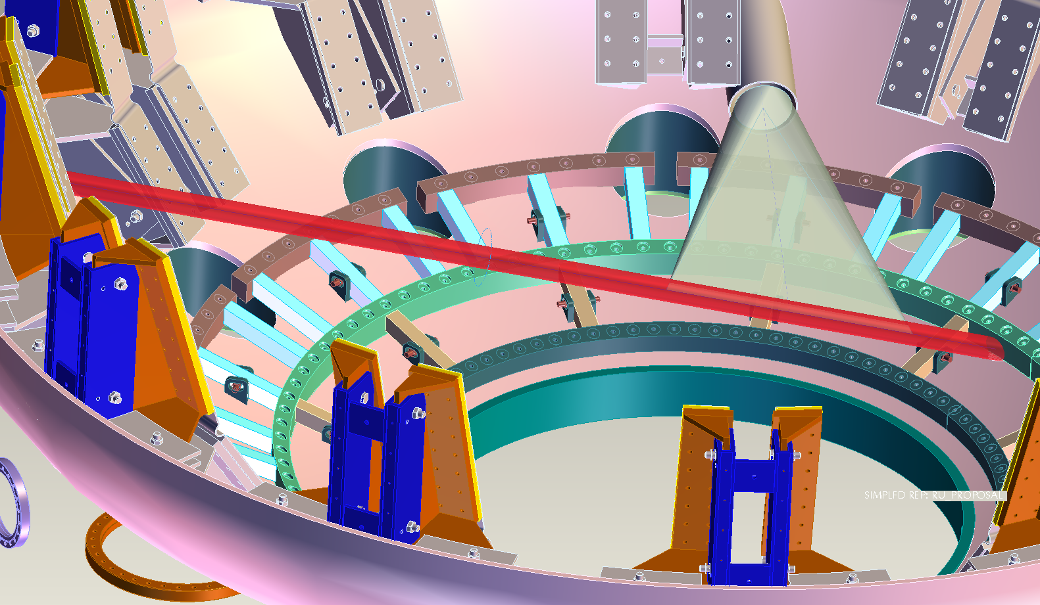
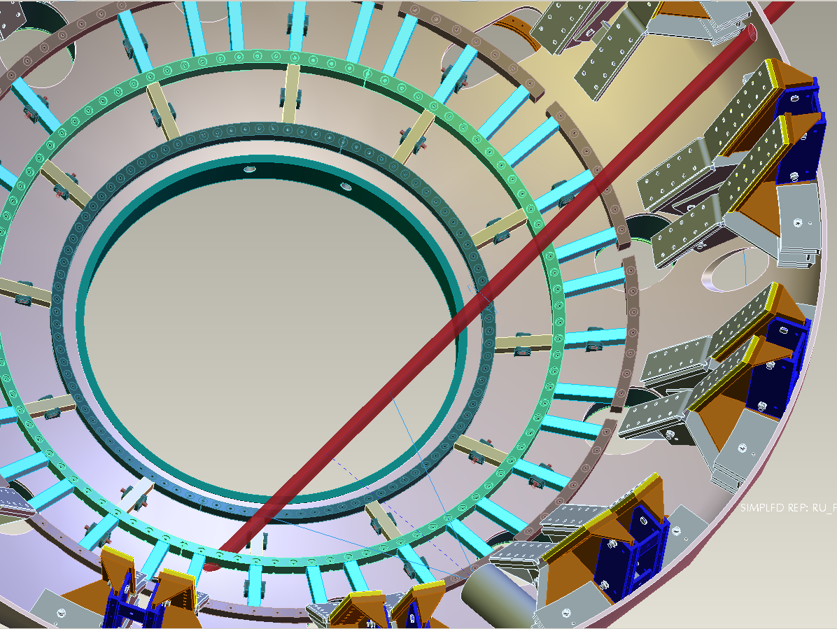
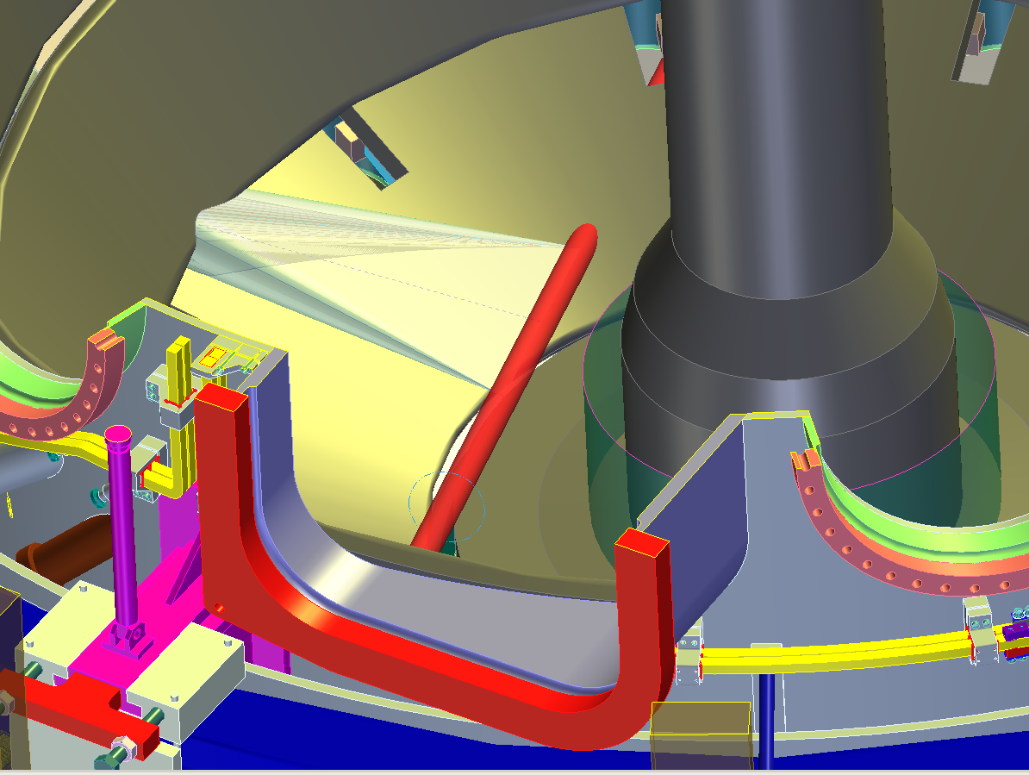
LLNL is proposing Divertor Thomson Scattering system for divertor and lithium studies in NSTX-U
Unique (“true”) divertor T_{e} and n_{e} measurements
  DTS systems available only on DIII-D and TCV
LLNL progress toward NSTX-U DTS
  Initial identification of implementation issues on NSTX (done in 2008)
  Maintenance and operation of DIII-D DTS (planned and performed now)
  Conceptual design of DTS diagnostic (planned for 2013-2014)
    Determine laser beam and collection optics geometries
    Specify system elements and project performance
Need to keep DTS in mind when facility enhancements are planned

