Slide 1




NSTX
Supported by
Non-axisymmetric Control Coil Upgrade and related ideas
S.A. Sabbagh¹, J.W. Berkery¹ J.M. Bialek¹, T.E. Evans², S.P. Gerhardt³, Y.S. Park¹, K. Tritz⁴
¹Department of Applied Physics, Columbia University, NY, NY
²General Atomics, San Diego, CA
³Plasma Physics Laboratory, Princeton University, Princeton, NJ
NSTX-U Facility Enhancement Brainstorming Meeting
February 8th, 2012
PPPL
Columbia U
CompX
General Atomics
FIU
INL
Johns Hopkins U
LANL
LLNL
Lodestar
MIT
Nova Photonics
New York U
ORNL
PPPL
Princeton U
Purdue U
SNL
Think Tank, Inc.
UC Davis
UC Irvine
UCLA
UCSD
U Colorado
U Illinois
U Maryland
U Rochester
U Washington
U Wisconsin
Culham Sci Ctr
U St. Andrews
York U
Chubu U
Fukui U
Hiroshima U
Hyogo U
Kyoto U
Kyushu U
Kyushu Tokai U
NIFS
Niigata U
U Tokyo
JAEA
Hebrew U
Ioffe Inst
RRC Kurchatov Inst
TRINITI
NFRI
KAIST
POSTECH
ASIPP
ENEA, Frascati
CEA, Cadarache
IPP, Jülich
IPP, Garching
ASCR, Czech Rep
V1.0

Slide 2
Proposal and Motivation for Non-axisymmetric Control Coil (NCC) goes back many years – research still needed
Capabilities
  2nd NBI
    q profile variation
    momentum source variation
  Non-axisymmetric control coil (NCC) – at least four applications
    RWM stabilization (n > 1, higher β_{N})
    DEFC with greater field correction capability
    ELM mitigation (n = 6)
    V_{φ} control increase; n > 1 propagation)
  Non-magnetic RWM sensors; advanced RWM active feedback control algorithms (ITER, etc.)
  Possible alteration of stabilizing plate materials / electrical connections
Proposed Internal Non-axisymmetric Control Coil (NCC)
(12 coils toroidally)
RWM with n > 1 RWM
observed
Secondary PP option
Existing
coils
Primary
PP option
(Sabbagh, et al., Nucl. Fusion 46, 635 (2006). )

Slide 3
NCC upgrade can investigate several key physics issues, some new ideas based on new capabilities/understanding
NCC physics
  Performance analysis performed for both RWM stability (Columbia) and ELM mitigation (GA - Evans) – now need to redo for NSTX-U (including recent physics understanding)
  Several configurations considered:
    Coils internal to vessel, coils external to vessel (i.e. “distant” coils)
    Coils in front of primary/secondary passive plates, or among plates with altered plate material for some of the plates (e.g. SS)
  Possible inclusion of diagonal elements for “stellarator” field
NCC in light of present day ideas / capabilities
  Internal “hairpin” coils (similar to KSTAR IVCC design) may ease implementation, give greater flexibility for physics studies
  New RWM state-space controller allows far greater flexibility of global mode stabilization physics studies with these coils, with a relatively simple control software upgrade
  New option of coils closer to divertor for control of “divertor” mode (multi-mode physics)
  New consideration: field spectrum to produce favorable V_{φ} profile by NTV and NBI for kinetic global mode stability (MISK physics)
  Examine best NCC field spectrum to potentially change edge fast ion profile for RWM and edge mode stability alteration (MISK physics)
  Addition of “delta coils”: strategically located dipole fields to enhance field spectrum for ELM mitigation, and possibly for time-dependent pulsed fields for ELM studies (T. Evans)

Slide 4
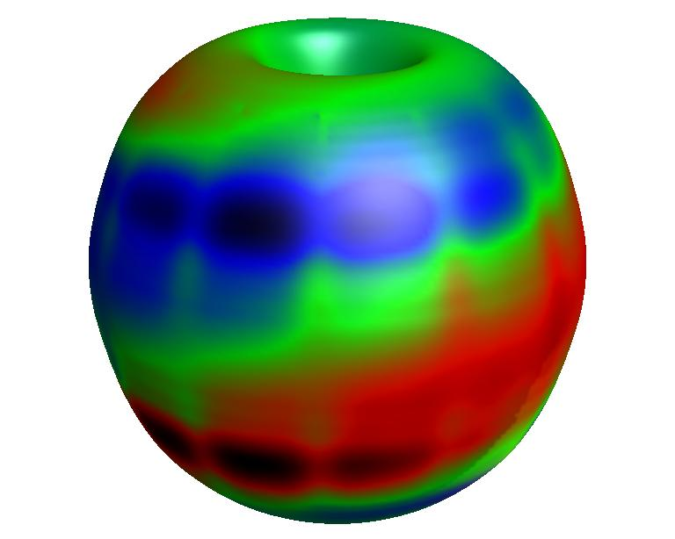
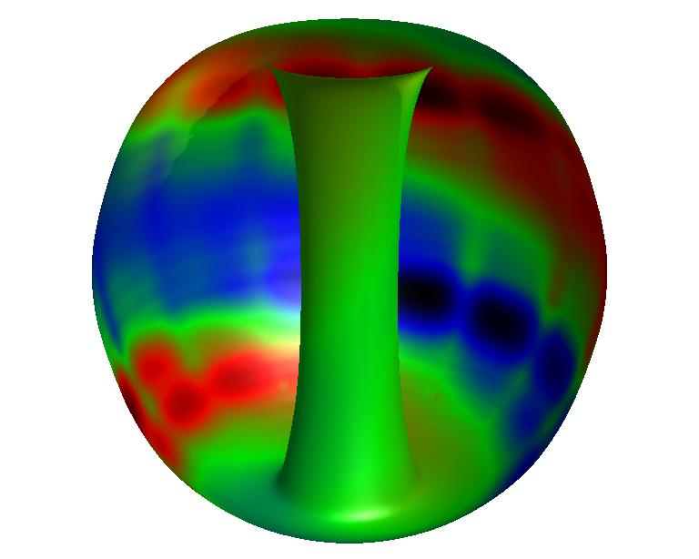
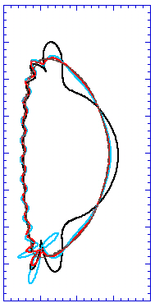
Multi-mode RWM computation shows 2nd eigenmode component has dominant amplitude at high β_{N} in NSTX stabilizing structure
δB^{n} RWM multi-mode composition
δB^{n} from wall, multi-mode response
β_{N} = 6.1
2.0
133775
mode
2
t = 0.655s
1.0
mode 1
Z(m)
θ
0.0
mode
3
NSTX RWM not stabilized by ω_{φ}
  Computed growth time consistent with experiment
  2nd eigenmode (“divertor”) has larger amplitude than ballooning eigenmode
NSTX RWM stabilized by ω_{φ}
  Ballooning eigenmode amplitude decreases relative to “divertor” mode
  Computed RWM rotation ~ 41 Hz, close to experimental value ~ 30 Hz
ITER scenario IV multi-mode spectrum
  Significant spectrum for n = 1 and 2
δB^{n} amplitude (arb)
-1.0
mode 3
-2.0
mode 2
0.0
1.0
2.0
R(m)
mode
1
Unstable
Stabilized by rotation
ideal eigenmode number
mmVALEN code
BP9.00059 J. Bialek, et al.; see poster for detail

