Slide 1




NSTX
Supported by
Potential Upgrades to the NBI System for NSTX-Upgrade
SPG, TS
Columbia U
CompX
General Atomics
FIU
INL
Johns Hopkins U
LANL
LLNL
Lodestar
MIT
Nova Photonics
New York U
ORNL
PPPL
Princeton U
Purdue U
SNL
Think Tank, Inc.
UC Davis
UC Irvine
UCLA
UCSD
U Colorado
U Illinois
U Maryland
U Rochester
U Washington
U Wisconsin
Culham Sci Ctr
U St. Andrews
York U
Chubu U
Fukui U
Hiroshima U
Hyogo U
Kyoto U
Kyushu U
Kyushu Tokai U
NIFS
Niigata U
U Tokyo
JAEA
Hebrew U
Ioffe Inst
RRC Kurchatov Inst
TRINITI
NFRI
KAIST
POSTECH
ASIPP
ENEA, Frascati
CEA, Cadarache
IPP, Jülich
IPP, Garching
ASCR, Czech Rep
Beam dumps
Power supplies
Injection Angle

Slide 2
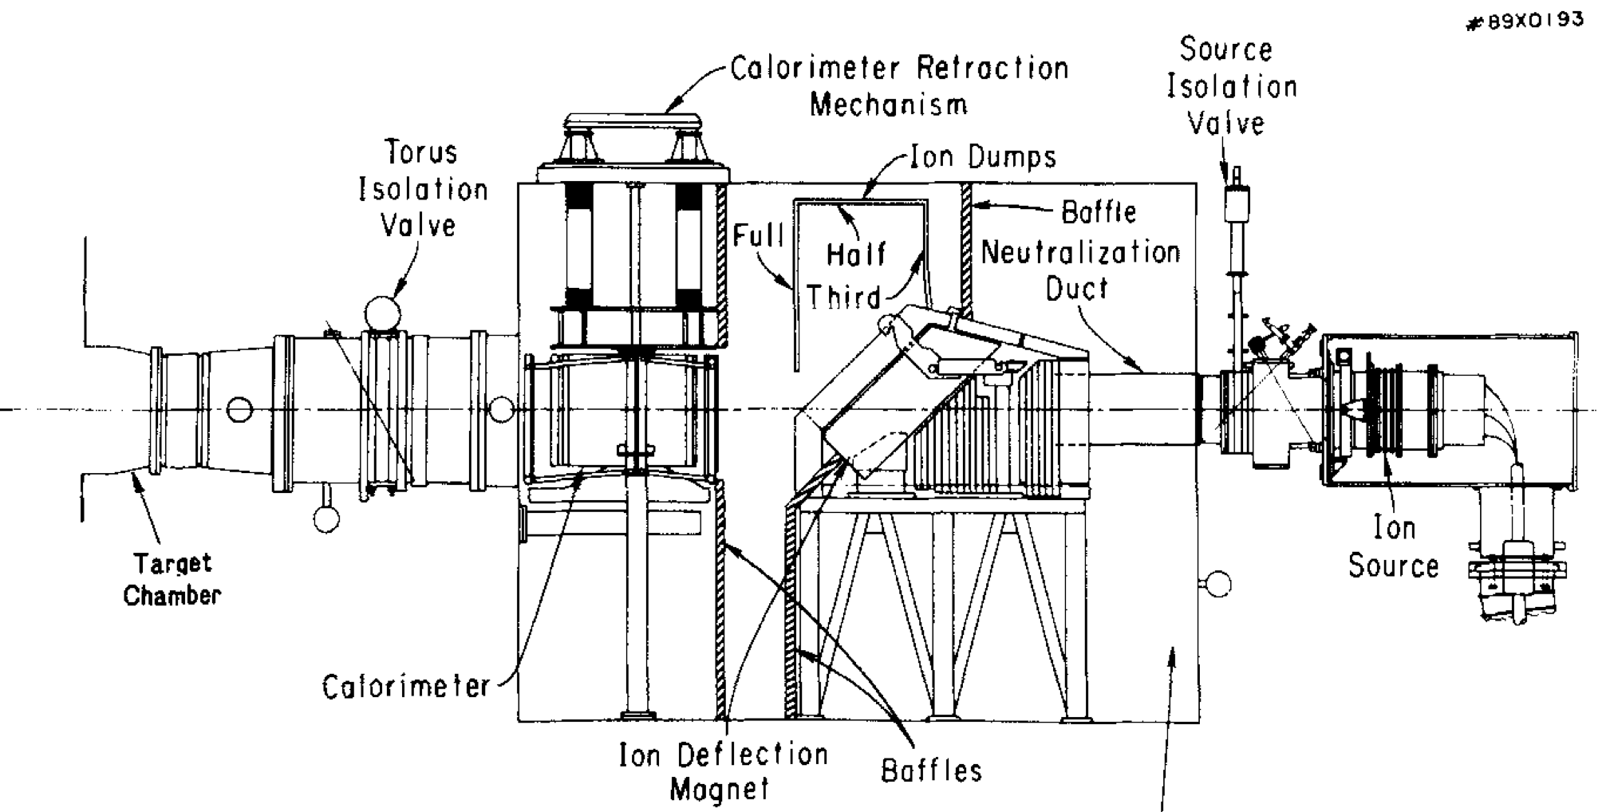
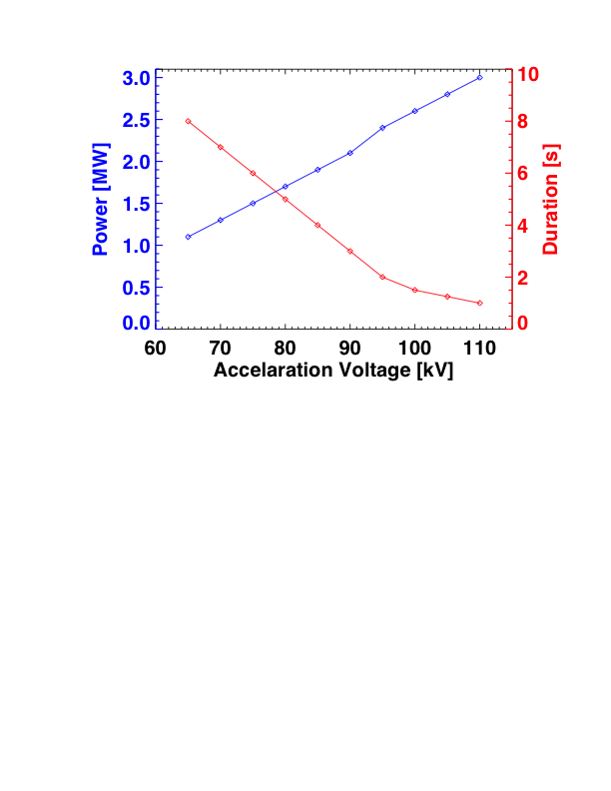
Ion Dumps Limit Pulse Length for a Given Voltage
Example Performance Impact
100% non-inductive scenario at B_{T}=1 T, 6 sources, H_{98y,2}=1
Also:
Beam diagnostics will have significant issues at 80 kV due to small beam penetration.
Will be an issue even if the higher power is not desired.
V [kV] | I_{P} [MA] | W_{tot} [kJ] | Duration [s]
80 | 800 | 425 | 5
100 | 1050 | 650 | 1.5
Pulse duration limit is due to low-cycle fatigue & surface cracking on the primary energy ion dump.
Done on an “every 2.5 minutes, full pulse duration, 10 hour day, 3 months a year” basis.
  May be very conservative
TFTR ran 95 kV for 4 seconds for a few shots, with no observed damage.
Can maybe extend limits after engineering revisits assumptions, but if not…

Slide 3
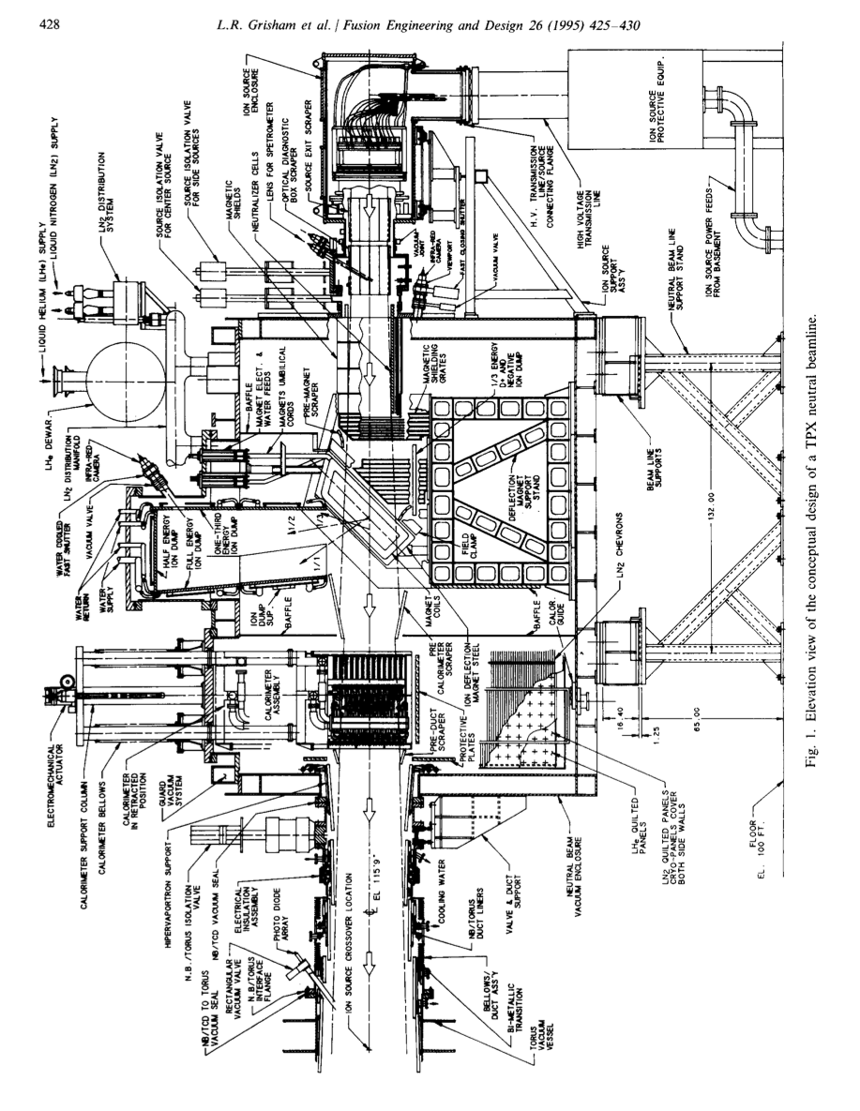
Designs from Late TFTR Period Could Increase the Dump Power Handling
TPX design for 1000 s pulses used many hypervaportrons…mandate extensive upgrade to the water system.
Simpler upgrade for 5 sec, 100 kV operation extends the beam dump vertically
  Adds a second, water cooled plate in a “clapboard” configuration.
Need analysis of 2nd and 3rd energy dumps, other components.
Note: Longer-pulse operation at high power would increase wear on the sources

Slide 4
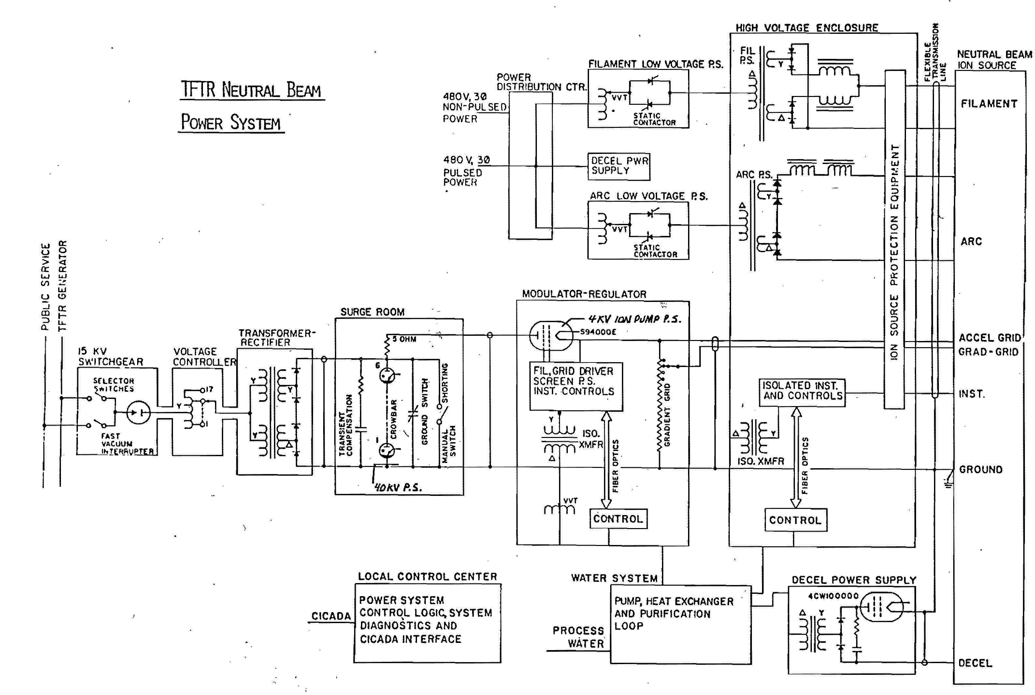
Power Supply Side Considerations
Much of the NSTX-Upgrade physics program assumes that beams can be arbitrarily modulated.
  Concerns about the grid power handling were somewhat alleviated by successful 15 ms on/off modulation in 2011
Arc and filament supplies are unregulated.
  Can make beam modulations more difficult
Could upgrade them to IGBT supplies.
  Propose to see how things work, then consider upgrades here as necessary.
Limited supply of high-voltage modulator tubes.
  Increased pulse length at high power will tax the tubes more heavily.

Slide 5
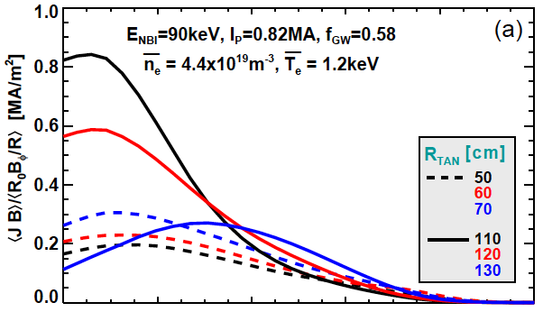
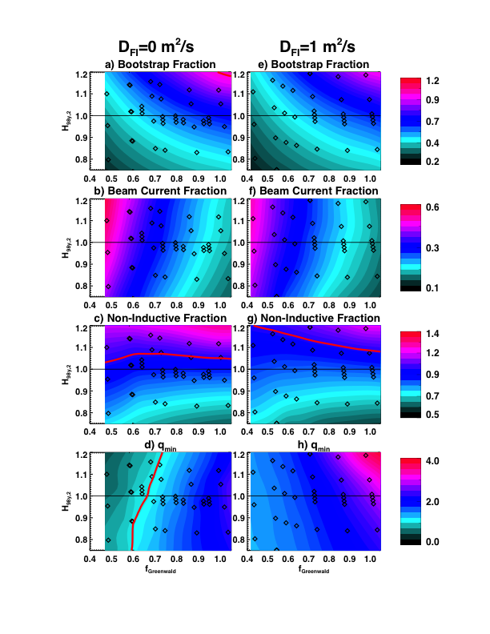
Elevated q_{min} Operating Space Might Be Extended By Tilting 2nd Beamline
1 T, 1 MA, 6 source, 90 kV scenarios
Sources 2B & 2C (R_{tan}=110 & 120) tend to have strong central current drive.
  Outer gaps of 15 or more cm help alleviate the problem for the 2C source.
Results in q_{min} being driven under 1.0 for many lower-density scenarios.
  2C source at R_{tan}=110 cm may not be that useful for long-pulse.
Tilting the beamline would move this peak off-axis, potentially widening stable the operating space.
  Need to do TRANSP simulations as part of the 5-year plan lead-in.

