Slide 1
Point-Source Helicity Injection Startup
Capabilities are being explored for NSTX-U…
~1 MA startup plasma, appropriate for OH, NBI, and/or RF sustainment
Well-defined startup procedures and plasma development scenarios
Unobtrusive and retractable injection hardware
Pegasus results are evolving the conceptual design:
Arc gun needed to generate the “seed” plasma
Formation of the poloidal field null is sensitive the geometry
Outer-PF induction provides finite Volt-seconds
Passive electrodes may be the optimum tool for providing maximum effective Volt-seconds with high Taylor limit for I_{p}
Electrodes and guns require different fuelling → active gas control
Local limiters mitigate impurities (Pegasus Z_{eff} ≤ 2 during HI; ~1 in OH)

Slide 2
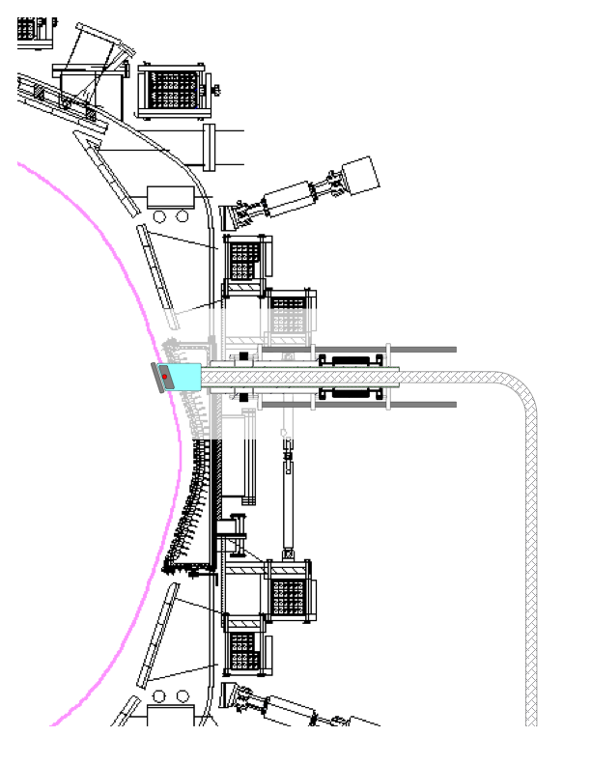
Conceptual design for the NSTX-U startup system
Gun/electrode injector:
Single 8+ inch port off midplane
Retractable behind gate valve
Combines gun with large electrode
Piezoelectric gas control
Local limiter structure
Power supplies:
Bias comparable to Pegasus (1-2 kV; 15 kA; Δt ~ 1 ms)
Arc plasma uses simple PFN supply
Robust operating scenarios
Especially null formation and I_{p} buildup
Pegasus experiments informing and validating scenario development

