Slide 1




NSTX-U
Supported by
NSTX-U Five Year Plan
Research Program Overview
Coll of Wm & Mary
Columbia U
CompX
General Atomics
FIU
INL
Johns Hopkins U
LANL
LLNL
Lodestar
MIT
Lehigh U
Nova Photonics
ORNL
PPPL
Princeton U
Purdue U
SNL
Think Tank, Inc.
UC Davis
UC Irvine
UCLA
UCSD
U Colorado
U Illinois
U Maryland
U Rochester
U Tennessee
U Tulsa
U Washington
U Wisconsin
X Science LLC
Jon Menard (PPPL)
NSTX-U Program Director
Culham Sci Ctr
York U
Chubu U
Fukui U
Hiroshima U
Hyogo U
Kyoto U
Kyushu U
Kyushu Tokai U
NIFS
Niigata U
U Tokyo
JAEA
Inst for Nucl Res, Kiev
Ioffe Inst
TRINITI
Chonbuk Natl U
NFRI
KAIST
POSTECH
Seoul Natl U
ASIPP
CIEMAT
FOM Inst DIFFER
ENEA, Frascati
CEA, Cadarache
IPP, Jülich
IPP, Garching
ASCR, Czech Rep
NSTX-U 5 Year Plan Review
LSB B318, PPPL
May 21-23, 2013

Slide 2
Outline
NSTX-U mission and capabilities
Five year plan goals
Proposed facility enhancements
Role of collaborations
Plan organization
Overview of research plans by science area
Plan summary
Mapping of presentations to charge questions

Slide 3
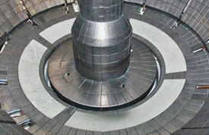
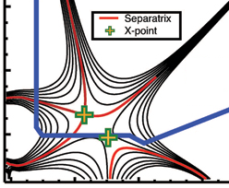

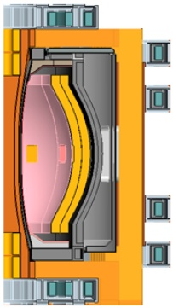
NSTX Upgrade mission elements
Advance ST as candidate for Fusion Nuclear Science Facility (FNSF)
  Motivation for ST as FNSF: high neutron wall loading, potentially smaller size, cost, and tritium consumption, accessible / maintainable
Develop solutions for the plasma-material interface challenge
  Exploit strong heating + smaller R → high P/R and P/S approaching FNSF/Demo levels
Explore unique ST parameter regimes to advance predictive capability - for ITER and beyond
  Non-linear Alfvénic modes, fast-ion dynamics
  Study electron gyro-scale turbulence at low ν*
  High β, rotation, shaping, for transport, MHD
Develop ST as fusion energy system
ST-FNSF
Lithium
“Snowflake”
ITER
ST Pilot Plant

Slide 4

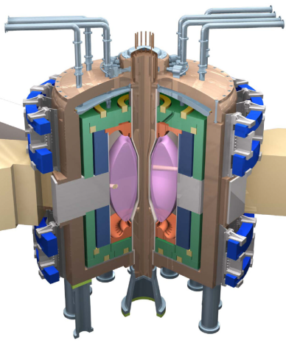
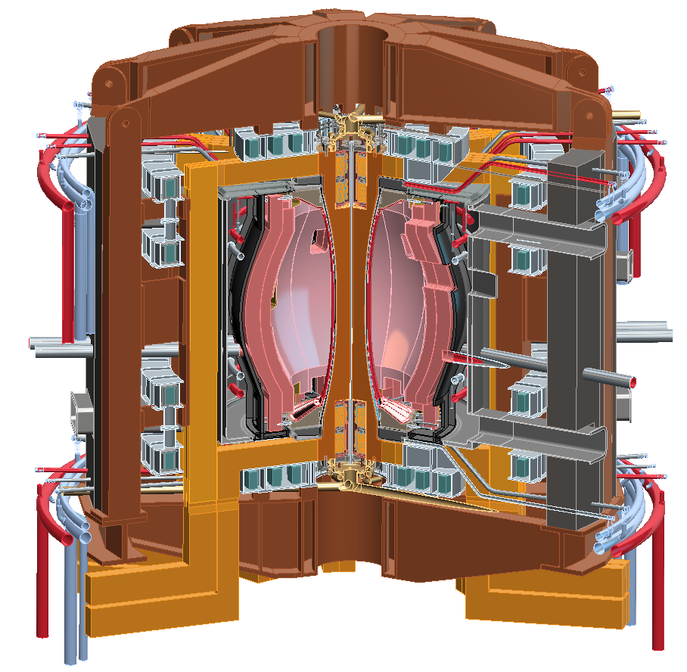
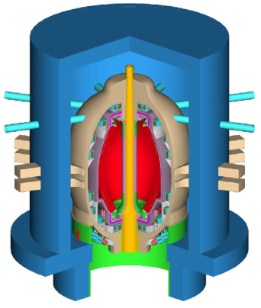
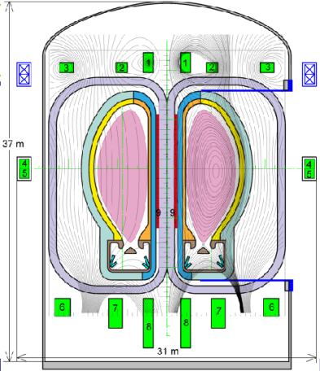
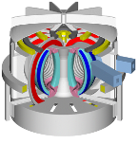
NSTX Upgrade will access next factor of two increase in performance to bridge gaps to next-step STs
Low-A
Power Plants
Parameter | NSTX | NSTX Upgrade | Fusion Nuclear Science Facility | Pilot Plant
Major Radius R₀ [m] | 0.86 | 0.94 | 1.3 | 1.6 – 2.2
Aspect Ratio R₀ / a | ≥ 1.3 | ≥ 1.5 | ≥ 1.5 | ≥ 1.7
Plasma Current [MA] | 1 | 2 | 4 – 10 | 11 – 18
Toroidal Field [T] | 0.5 | 1 | 2 – 3 | 2.4 – 3
Auxiliary Power [MW] | ≤ 8 | ≤ 19* | 22 – 45 | 50 – 85
P/R [MW/m] | 10 | 20 | 30 – 60 | 70 – 90
P/S [MW/m²] | 0.2 | 0.4-0.6 | 0.6 – 1.2 | 0.7 – 0.9
Fusion Gain Q |  |  | 1 – 2 | 2 – 10
ARIES-ST (A=1.6)
JUST (A=1.8)
* Includes 4MW of high-harmonic fast-wave (HHFW) heating power
VECTOR (A=2.3)
Non-inductive start-up, ramp-up, sustainment
Confinement scaling (esp. electron transport)
Stability and steady-state control
Divertor solutions for mitigating high heat flux
Key issues to resolve for next-step STs

Slide 5
NSTX-U aims to access performance levels of next-steps, approach Pilot-Plant regimes
Requirements for ST / tokamak next-steps:
1.0
Bootstrap fraction
0.9
ST-Pilot
Full non-inductive (NI) current drive for steady-state operation
  ST requires NI start-up/ramp-up
High confinement to minimize auxiliary heating, device size
Sustained high β to minimize magnet size, forces, power
Divertor/first-wall survival with intense power/particle fluxes
f_{BS}
0.8
ST-FNSF
0.7
NSTX-U
0.6
NSTX
0.5
2.0
Normalized Confinement
1.8
ST-Pilot
H_{98y2}
1.6
1.4
ST-FNSF
1.2
NSTX
NSTX-U
1.0
8.0
Normalized Beta
β_{N}
7.0
ST-Pilot
6.0
NSTX
5.0
NSTX-U
ST-FNSF
4.0
3.0
1.0
ST-FNSF
ST-Pilot
P/S
0.8
0.6
NSTX-U
[MW/m²]
0.4
0.2
NSTX
0.0
Power exhaust challenge

Slide 6

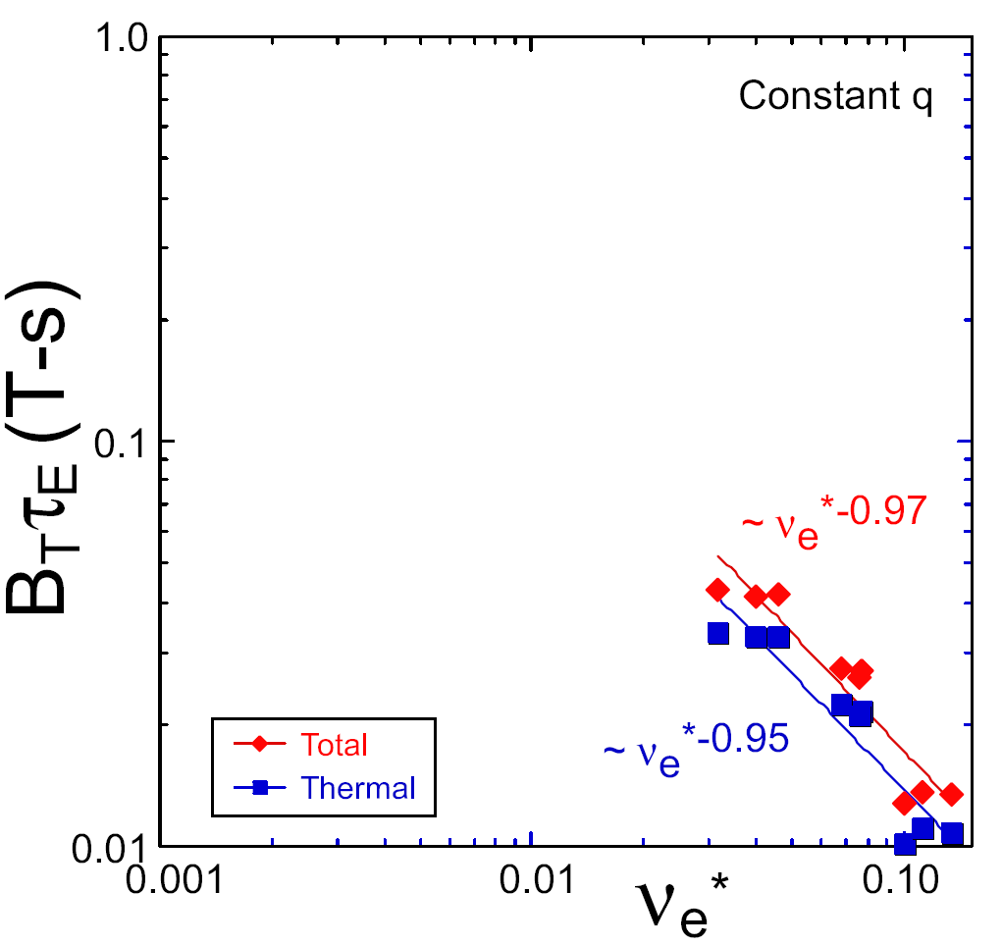
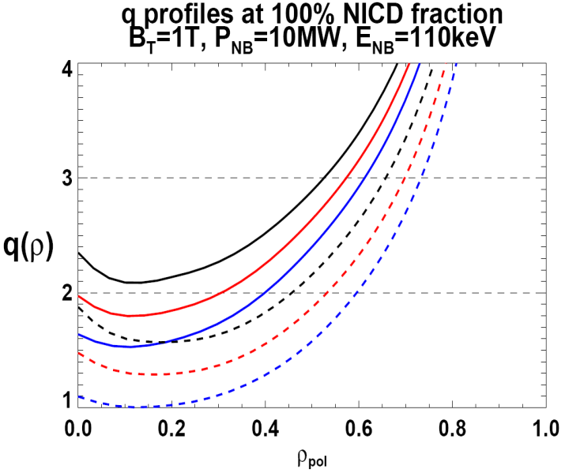

NSTX Upgrade incorporates 2 new capabilities:
Previous
center-stack
New
center-stack
ST-FNSF
Reduces ν* → ST-FNSF values to understand ST confinement
  Expect 2x higher T by doubling B_{T}, I_{P}, and NBI heating power
  5x longer pulse-length
  q(r,t) profile equilibration
  Test non-inductive ramp-up
constant q, β, ρ∗
NSTX Upgrade
?
NSTX
ITER-like scaling
TF OD = 20cm
TF OD = 40cm
Normalized e-collisionality ν_{e}* ∝ n_{e} / T_{e}²
I_{P}=0.95MA, H_{98y2}=1.2, β_{N}=5, β_{T} = 10%, B_{T} = 1T, P_{NBI} = 10MW, P_{RF} = 4MW
  2x higher CD efficiency from larger tangency radius R_{TAN}
100% non-inductive CD with core q(r) profile controllable by:
  NBI tangency radius
  Plasma density, position (not shown)
n
e
/
n
Greenwald
0.95
0.72
R_{TAN} [cm]
__________________
50, 60, 70, 130
60, 70,120,130
70,110,120,130
Present NBI
New 2nd NBI

Slide 7
Highest priority research goals for 5 year plan:
Demonstrate 100% non-inductive sustainment at performance that extrapolates to ≥ 1MW/m² neutron wall loading in FNSF
Access reduced ν* and high-β combined with ability to vary q and rotation to dramatically extend ST physics understanding
Develop and understand non-inductive start-up and ramp-up
(overdrive) to project to ST-FNSF with small/no solenoid
4. Develop and utilize high-flux-expansion “snowflake” divertor
and radiative detachment for mitigating very high heat fluxes
5. Begin to assess high-Z PFCs + liquid lithium to develop high-duty-factor integrated PMI solutions for next-steps
Longer-term (5-10 year) goal:
Integrate 100% non-inductive + high β and τ_{E} + divertor solution + metal walls

Slide 8
Additional facility enhancements will greatly aid achievement of high-priority goals
Extensive diagnostic/facility idea input gathered 2011-2012
Options ranked according to program impact, cross-links, cost
Programmatic impact includes:
  Importance to next-step ST viability
  Physics or operational contributions to ITER
  Uniqueness for ST or in world program
Highest priority facility enhancements (5YP base funding):
  1. Cryo-pump: n_{e} , collisionality control important to all science areas and scenarios, also enables comparison between cryo and Li-coatings
  2. ECH/EBW (1MW, 28GHz): ECH critical for heating helicity-injection start-up plasma for HHFW/NBI ramp-up, longer-term: off-axis EBW H&CD
  3. Off-midplane non-axisymmetric control coils (NCC): far greater variation of poloidal & toroidal spectrum for EF, RWM, rotation, ELM physics & control
Boundary/PMI research highest priority for incremental funding:
  High-Z walls, flowing liquid Li divertor, Divertor Thomson Scattering

Slide 9
5 year plan goals embody world-leading research
Demonstrate 100% non-inductive sustainment at performance that extrapolates to ≥ 1MW/m² neutron wall loading in FNSF
Access reduced ν* and high-β combined with ability to vary q and rotation to dramatically extend ST physics understanding
Develop and understand non-inductive start-up and ramp-up
(overdrive) to project to ST-FNSF with small/no solenoid
4. Develop and utilize high-flux-expansion “snowflake” divertor
and radiative detachment for mitigating very high heat fluxes
5. Begin to assess high-Z PFCs + liquid lithium to develop high-duty-factor integrated PMI solutions for next-steps
NSTX-U will be ST leader, complement AT approach (DIII-D)
Low ν* + high β + turbulence diagnostics unique in world
Unique helicity injection + RF + NBI start-up/ramp-up techniques
With MAST Super-X, STs leading development of novel divertors
Aiming to lead development of replenishable / liquid metal PFCs

Slide 10
Achievement of NSTX-U goals will continue to rely on extensive collaborator involvement
Collaborations involve broad group of domestic and international users
  Collaborators were involved in originally proposing, designing NSTX
  Many diagnostic systems are built and operated by collaborators
 | PPPL/PU | National Team (non-PPPL/PU) | International | Total |  | Number of institutions
Total Researchers | 79 | 166 | 61 | 306 |  | Total | 61
Post-Docs | 5 | 9 | 0 | 14 |  | Domestic | 32
Students | 3 | 26 | 4 | 33 |  | International | 29
DOE annually solicits proposals for collaboration by U.S. researchers
  Collaborations are competitively peer-reviewed on a 3-4 year cycle
Collaborators participate fully in the research program
  Leadership positions in research team to plan upgrades and research
    Authorship of 3 of 8 topical science chapters were led by collaborators
  Propose, develop, and execute experiments
  Data analysis, review, publications, presentations
See Chapter 11 for FES-funded NSTX-U collaborator plans

Slide 11
Plan organization and research thrusts
NSTX-U topical science groups (TSGs) are responsible for program plan definition and 5 year plan presentations + chapters
  TSG structure: experimental leader/deputy + theory co-leader for strong theory-experiment linkages
Each chapter contains 2-4 research “thrusts” defining actions to achieve the 5 high-level goals (see previous page) for the 5 year plan
The remainder of this presentation will review research highlights, provide an overview of the TSG research thrusts
  TSG presentations also note respective FY2013-15 research milestones for FES field work proposal (FWP)

Slide 12
Highest priority research goals for 5 year plan:
Demonstrate 100% non-inductive sustainment at performance that extrapolates to ≥ 1MW/m² neutron wall loading in FNSF
Access reduced ν* and high-β combined with ability to vary q and rotation to dramatically extend ST physics understanding
Develop and understand non-inductive start-up and ramp-up
(overdrive) to project to ST-FNSF with small/no solenoid
4. Develop and utilize high-flux-expansion “snowflake” divertor
and radiative detachment for mitigating very high heat fluxes
5. Begin to assess high-Z PFCs + liquid lithium to develop high-duty-factor integrated PMI solutions for next-steps

Slide 13
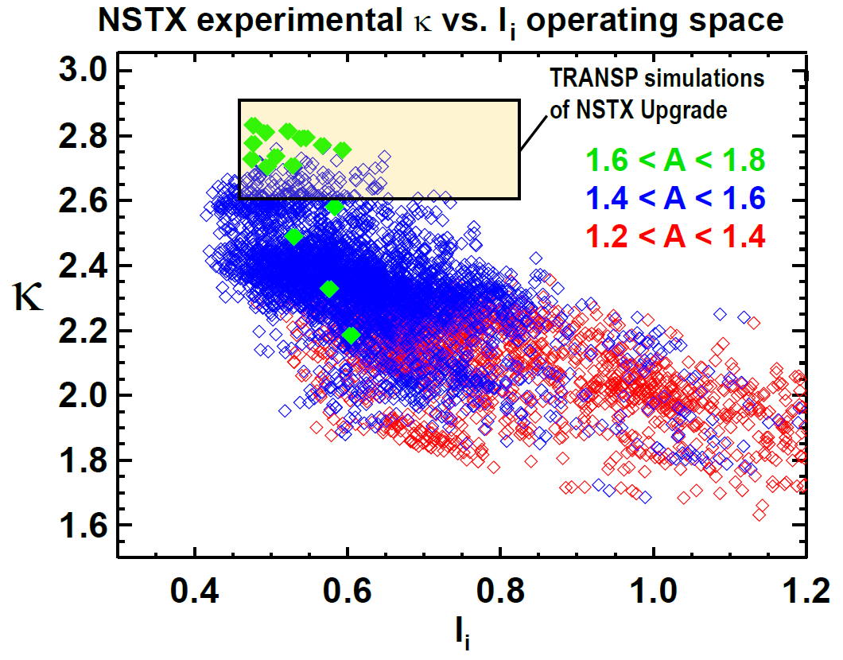
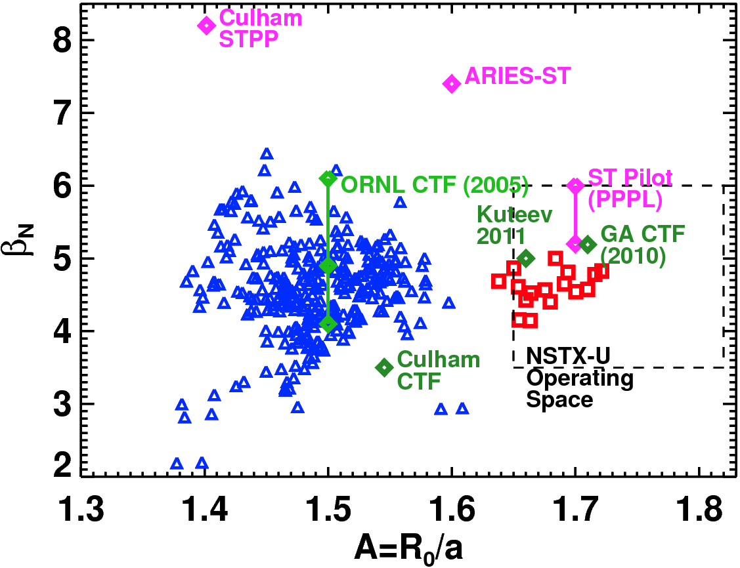
NSTX has already accessed shaping and stability performance needed for an ST-FNSF
NSTX data points

Slide 14
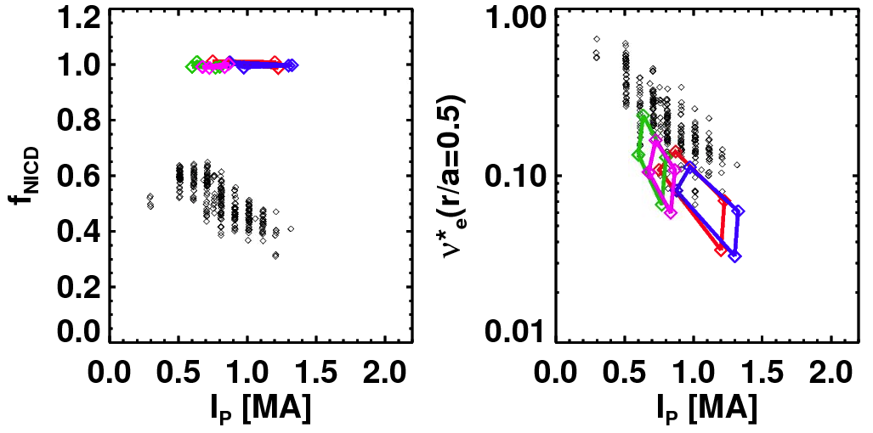
Next step is to access & control 100% non-inductive plasmas
NSTX achieved:
NSTX-U projections (TRANSP):
Maximum sustained non-inductive fractions of 65% w/NBI at I_{P} = 0.7 MA
70-100% non-inductive transiently with HHFW current-drive + bootstrap
100% non-inductive at I_{P} = 0.6-1.3MA for range of power, density, confinement
I_{P}=1 MA, B_{T}=1.0 T, P_{NBI}=12.6 MW
Contours of Non-Inductive Fraction
NSTX-U projections
Total non-inductive current fraction
NSTX Results
H_{98y2}
via high harmonic FW
I_{p} (MA)

Slide 15
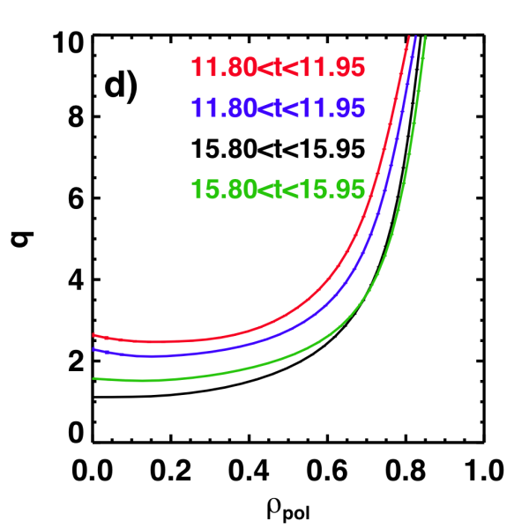
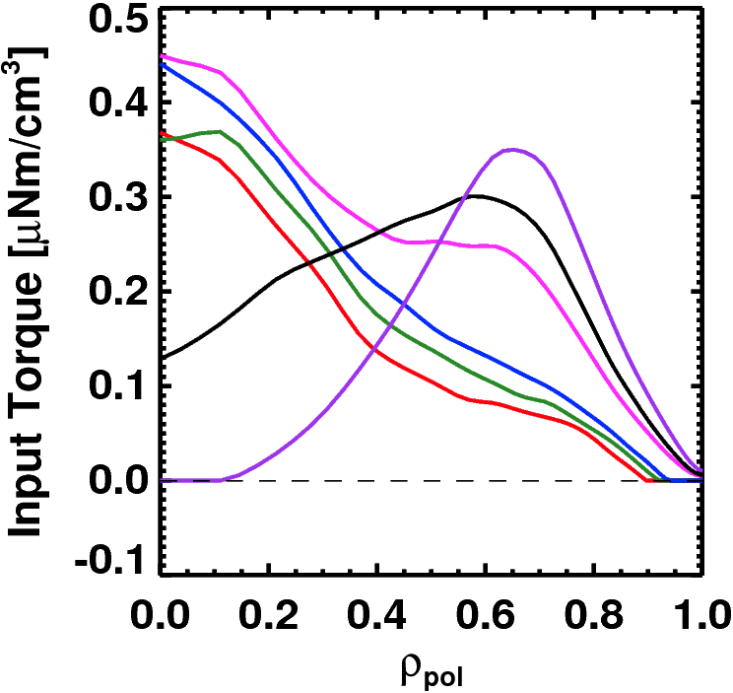
NSTX-U is developing a range of profile control actuators for detailed physics studies, scenario optimization for FNSF
Rotation Profile Actuators
q-Profile Actuators
Torque Profiles From
6 Different NB Sources
Variations in Beam Sources
Largest R_{tan}
800 kA and 1 T
[50,60,70,130] cm
[50,60,120,130] cm
[60,70,110,120] cm
[70,110,120,130] cm
Neutral
Beams
(TRANSP)
Smallest R_{tan}
800 kA Partial Inductive, 87% < f_{NI} < 100%
Also torques from 3D fields
Also density and outboard gap

Slide 16
Advanced Scenarios and Control (ASC) 5 Year Goal:
Develop basis for steady-state operation/control for next-step STs, help resolve key scenario and control issues for ITER
ASC Thrusts:
Develop and assess new physics scenarios
  100% non-inductive operation
  Lower ν*: high-current, partial-inductive scenarios, extend to long-pulse
Implement axisymmetric control algorithms and tools
  Rotation and current profile control
  Improved shape and vertical position control
  Heat flux control for high-power scenarios
Develop disruption avoidance by controlled plasma shutdown
Assess scenario physics for next-step devices
See presentation by Stefan Gerhardt

Slide 17
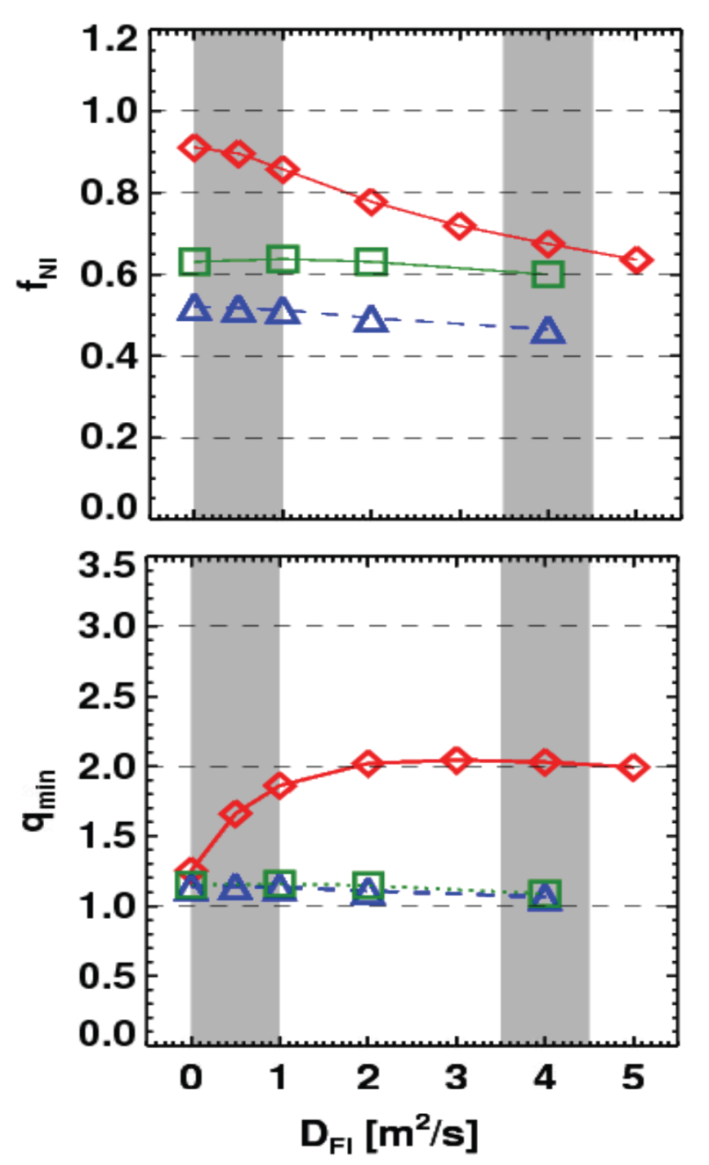
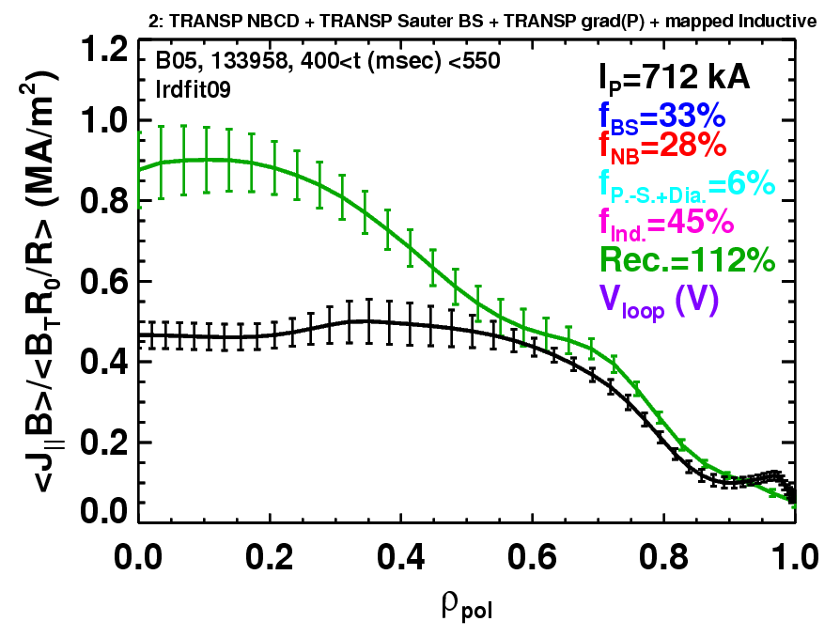
Rapid TAE avalanches could impact NBI current-drive in advanced scenarios for NSTX-U, FNSF, ITER AT
NSTX-U TRANSP simulations
NSTX: rapid avalanches can lead to
redistribution/loss of NBI current drive
Discrepancy between reconstruction and total assuming
classical J_{NBCD}
1 MA, 1T, H₉₈=1, near non-inductive
1.6 MA, 1T, partial inductive
1.2 MA, 0.55T, high β_{T}
All: f_{GW}=0.7, H₉₈=1
Minor radius
700kA high-β_{P} plasma with rapid
TAE avalanches has time-average D_{FI} = 2-4m²/s

Slide 18
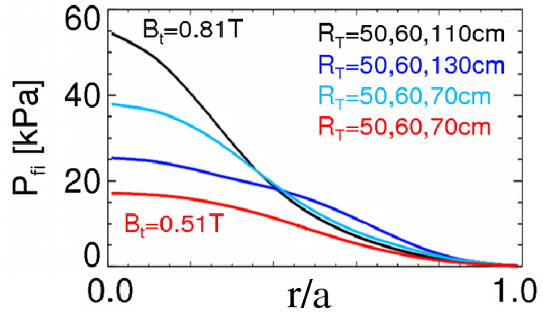
Energetic Particle (EP) 5 Year Goal:
Develop predictive capability for fast-ion transport caused by Alfven Eigenmodes (AEs), explore control of AE modes
EP Thrusts:
Develop predictive tools for projections of *AE-induced fast ion transport in FNSF and ITER
  Compare data to simulation, develop reduced models
    ORBIT, NOVA-K, M3D-K, HYM to understand mode-induced transport
Vary fast-ion instability drive using NBI, q, rotation, 3D fields
Measure *AE mode structure
  Magnetics, BES, reflectometry
Characterize fast ion transport vs. *AE type
Assess requirements for fast-ion phase-space engineering
  AE spectroscopy, also stability control using NBI, q, rotation, 3D fields
See presentation by Mario Podestá

Slide 19
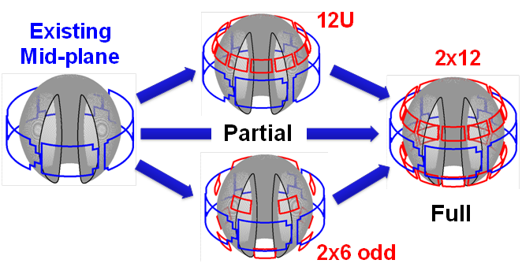
NSTX/NSTX-U is making leading contributions to high-β_{N} stability physics, and assessing possible 3D coil upgrades
n=1 MHD spectroscopy: high β_{N} can be more stable
  Combination of rotation and current profile effects at high beta
  Important for advanced scenarios
Resonant Field
Amplification (G/G)
NCC options:
Identified several off-midplane 3D coil sets favorable for profile, mode control

Slide 20
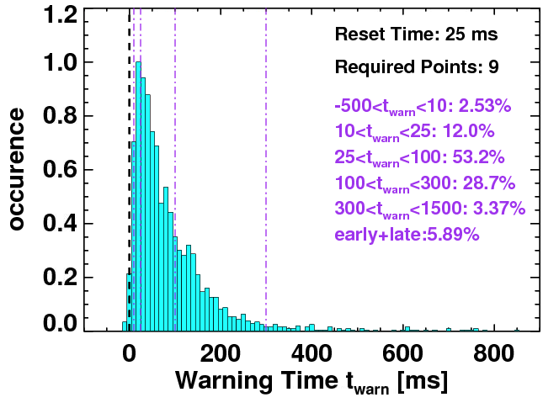
NSTX has also made leading contributions to disruption warning research
Disruption warning algorithms:
  Based on sensors + physics-based variables (not neural net)
  < 4% missed, 3% false positives
  ITER requires 95-98% prediction success for VDE, thermal quench
  Will assess applicability to ITER through ITPA Joint Activity
  Will also assess for ST-FNSF
Will use to trigger ramp-down and/or mitigation in NSTX-U
Neutron emission
RWM growth
Model locking
V_{loop}, v_{φ}, τ_{E}
dZ/dt
f_{p}, l_{i}
False positives

Slide 21
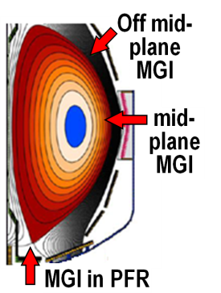
Macroscopic Stability (MS) 5 Year Goal:
Establish the physics and control capabilities needed for sustained stability of high performance ST plasmas
MS Thrusts:
Understand and advance passive and active feedback control to sustain macroscopic stability
  Study effects of reduced ν*, also q and rotation on LM, RWM, NTM
  Advance RWM state-space control for EF, RWM for ITER, next-steps
Assess 3D field effects to provide basis for optimizing stability through rotation profile control by 3D fields
  EF penetration, rotation damping, ELM triggering and suppression
Understand disruption dynamics, develop prediction and detection, avoidance, mitigation
  Enhance measurements of disruption heat loads, halos
  Develop novel particle delivery techniques for mitigation:
    MGI in private-flux-region (PFR), electromagnetic particle injector
See presentations by Jack Berkery, Jong-Kyu Park

Slide 22
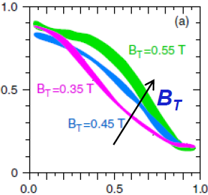
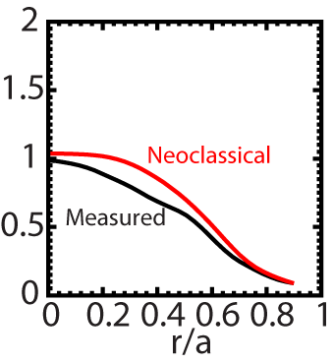
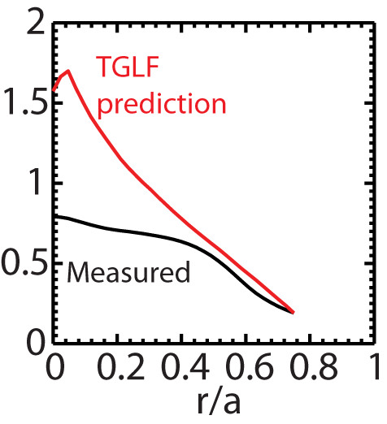
Beginning to test/utilize transport models to predict NSTX temperature profiles, identify possible missing physics
NSTX H-modes showed broadening of T_{e} profile as B_{T} was increased
  Similar broadening trend observed with increased lithium deposition
  B_{T}τ_{E} scales as ~1/ν* in both datasets
T_{e} (keV)
r/a
Utilizing neoclassical + drift wave models to simulate NSTX T_{i} and T_{e} profiles (collaboration with GA)
  Need model for χ in edge region
  Discrepancy in core T_{e} prediction for beam-heated H-modes
T_{i} (keV)
T_{e} (keV)
Over-prediction of core T_{e} in NSTX may be due to transport from GAE/CAE modes not included in gyro-Landau-fluid model

Slide 23
Transport and Turbulence (TT) 5 Year Goal:
Establish predictive capability for transport in next-step devices focusing on the ST high-β + low-collisionality regime
TT Thrusts:
Characterize H-mode global energy confinement scaling in the lower collisionality regime of NSTX-U
Identify modes causing anomalous electron thermal, momentum, particle/impurity transport
  Exploit scaling dependencies of modes
    Example: μ-tearing χ_{e} ~ ν¹, ETG χ_{e} ~ ν⁰
  Relate predicted turbulence to data:
    Low-k (BES), δB (polarimetry), high k_{r} & k_{θ} (μ-wave)
  Builds on identification of ETG w/ novel high-k_{r} scattering in NSTX
Establish and validate reduced transport models
See presentation by Yang Ren

Slide 24
Highest priority research goals for 5 year plan:
Demonstrate 100% non-inductive sustainment at performance that extrapolates to ≥ 1MW/m² neutron wall loading in FNSF
Access reduced ν* and high-β combined with ability to vary q and rotation to dramatically extend ST physics understanding
Develop and understand non-inductive start-up and ramp-up
(overdrive) to project to ST-FNSF with small/no solenoid
4. Develop and utilize high-flux-expansion “snowflake” divertor
and radiative detachment for mitigating very high heat fluxes
5. Begin to assess high-Z PFCs + liquid lithium to develop high-duty-factor integrated PMI solutions for next-steps

Slide 25
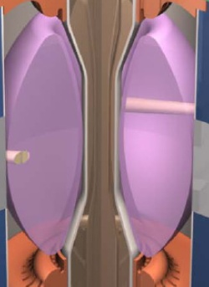
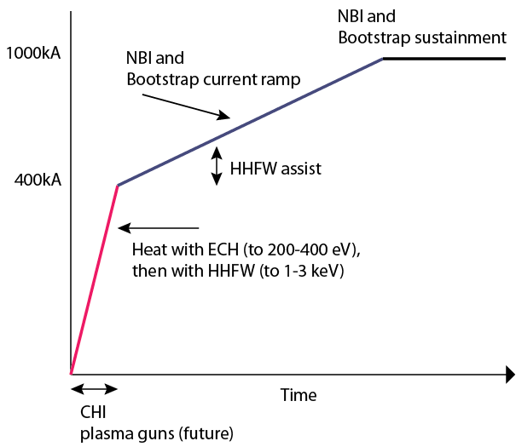
Plasma initiation with small or no transformer is unique challenge for ST-based Fusion Nuclear Science Facility
ST-FNSF has no/small central solenoid
NSTX-U Non-Inductive Strategy:

Slide 26

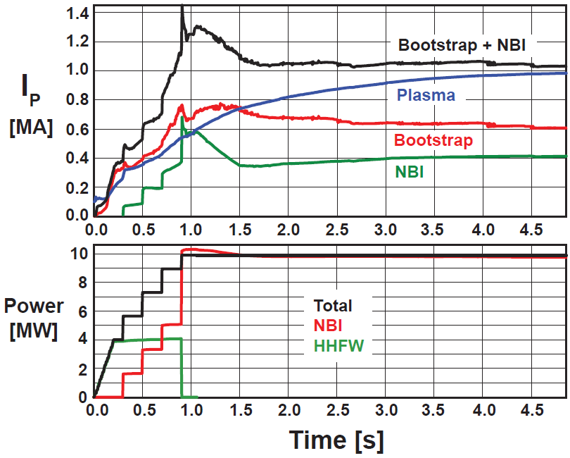
Simulations support non-inductive start-up/ramp-up strategy
TSC code (2D) successfully simulates CHI I_{P} ~200kA achieved in NSTX
TRANSP: NSTX-U more tangential NBI → 3-4x higher CD at low I_{P} (0.4MA)
TSC: non-inductive ramp-up from 0.4MA to 1MA possible w/ BS + NBI
1.0 ms
1.6 ms
2.7 ms
2
1
Z (m)
0
-1
-2
0
1
2
0
1
2
0
1
2
R (m)
R (m)
R (m)
TSC + tools included in 5 year plan support CHI I_{P} → 400kA in NSTX-U
  Higher injector flux, toroidal field, CHI voltage
  1MW 28GHz ECH (increases T_{e})
But, RF heating (ECH and/or HHFW) of CHI likely required to couple to NBI

Slide 27
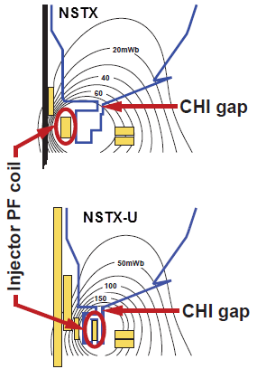
Plasma Start-up and Ramp-up (PSR) 5 Year Goal:
Develop and understand non-inductive start-up/ramp-up to project to ST-FNSF operation with small or no solenoid
PSR Thrusts:
Initial years: Establish, extend solenoid-free plasma start-up, test NBI+BS over-drive ramp-up
  Assess impact of new gap geometry, PF coil positions
  Increase CHI closed-flux I_{P} from 200kA → 300-400kA
  Assess NBI H&CD in 300-400kA ohmic target
  Attempt NBI + bootstrap ramp-up: ΔI_{P} ~ 100-400kA
Later years: Ramp-up CHI plasma using ECH + HHFW + NBI, test “plasma gun” (point-helicity source) start-up
  Maximize levels of CHI-produced I_{P}, extend with ECH and HHFW
  Test NBI coupling to heated CHI, attempt full non-solenoidal start-up
  Commission, test plasma guns (being developing on Pegasus) on NSTX-U
See presentation by Roger Raman

Slide 28
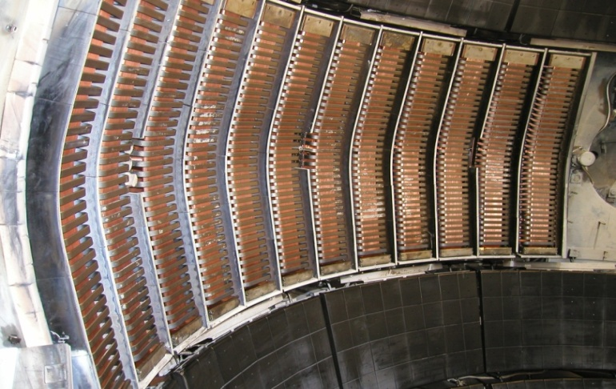
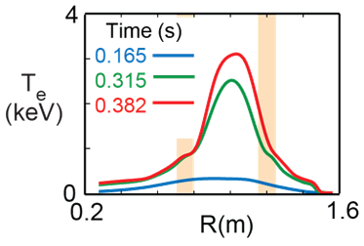
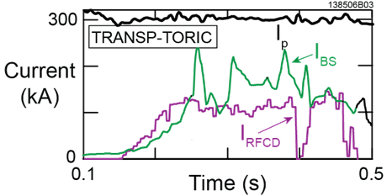
HHFW can efficiently heat low I_{P} targets for plasma start-up
NSTX high-harmonic fast-wave (HHFW) antenna will also be utilized on NSTX-U
  12 strap, 30MHz, P_{RF} ≤ 6MW
  HHFW: highest ST T_{e}(0) ~ 6keV
T_{e}(0)=3keV RF-heated H-mode at I_{P} = 300kA with only P_{RF} = 1.4MW
Non-inductive fraction ≥ 70%
  f_{BS} ~50%, f_{RFCD} ~ 20-35%

Slide 29
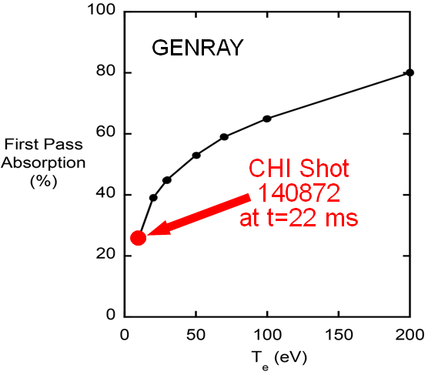
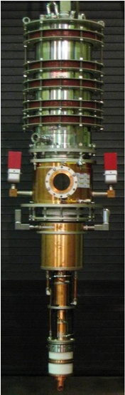
Radio-frequency Heating and Current Drive (RF) 5 Year Goal:
Provide and understand heating and current-drive for full non-inductive (NI) start-up and ramp-up in support of FNSF
RF Thrusts:
Develop HHFW and EC heating for fully non-inductive plasma current start-up and ramp-up
  Extend HHFW to higher power (3-4MW), demonstrate HHFW-driven 100% non-inductive at 300-400kA
    Goal: maintain I_{P} to confine 2nd NBI fast-ions
Validate advanced RF codes for NSTX-U, predict RF performance in ITER and FNSF
  Use ECH (~1MW, 28GHz), then HHFW to increase T_{e} of CHI plasmas for NBI
  Test high-power EBW to generate start-up current - builds on MAST results
See presentation by Gary Taylor

Slide 30
Highest priority research goals for 5 year plan:
Demonstrate 100% non-inductive sustainment at performance that extrapolates to ≥ 1MW/m² neutron wall loading in FNSF
Access reduced ν* and high-β combined with ability to vary q and rotation to dramatically extend ST physics understanding
Develop and understand non-inductive start-up and ramp-up
(overdrive) to project to ST-FNSF with small/no solenoid
4. Develop and utilize high-flux-expansion “snowflake” divertor
and radiative detachment for mitigating very high heat fluxes
5. Begin to assess high-Z PFCs + liquid lithium to develop high-duty-factor integrated PMI solutions for next-steps

Slide 31

Pedestal width scaling differs from conventional aspect ratio
Pedestal width scaling
0.16
Pedestal width scaling β_{θ}^{α} applies to multiple machines
NSTX pedestal width is larger
  Data → stronger scaling: ~β_{θ} vs. β_{θ}^{0.5}
  Preliminary EPED calculations: ~β_{θ}^{0.8}
  Measured low-k turbulence correlation lengths consistent with XGC1 predictions
0.4 (β_{θ}^{ped})
^{1.05}
NSTX
0.12
Pedestal width (ψ_{N})
C-Mod
0.08
DIII-D
0.04
^{0.5}
~ 0.08 (β_{θ}^{ped})
0.00
0.1
0.3
0.5
0.7
0.9

Slide 32
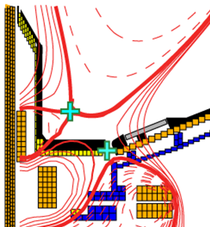
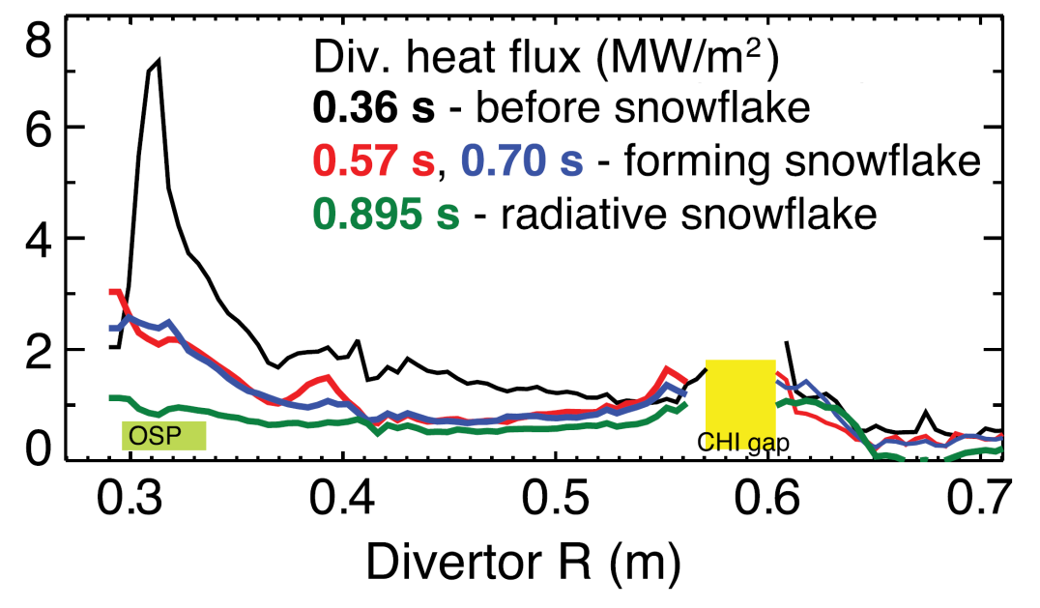
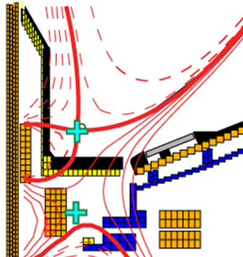
Snowflake divertor effective for heat flux mitigation
NSTX: can reduce heat flux by 2-4× via partial detachment
Snowflake → additional x-point near primary x-point
  NSTX: High flux expansion = 40-60 lowers incident q⊥
  Longer field-line-length promotes temperature drop, detachment
Standard Divertor
Snowflake Divertor
  Note: X-divertor (UT-Austin) also places secondary x-point near limiter, but flares flux much farther from primary x-point and requires larger number of coils

Slide 33
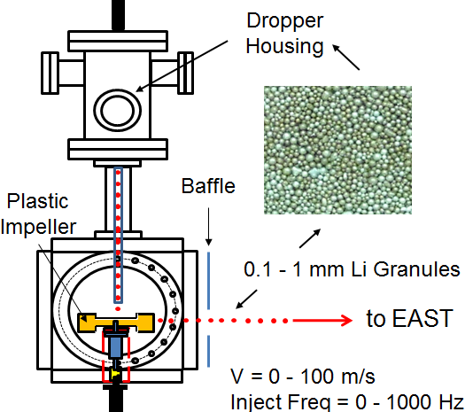
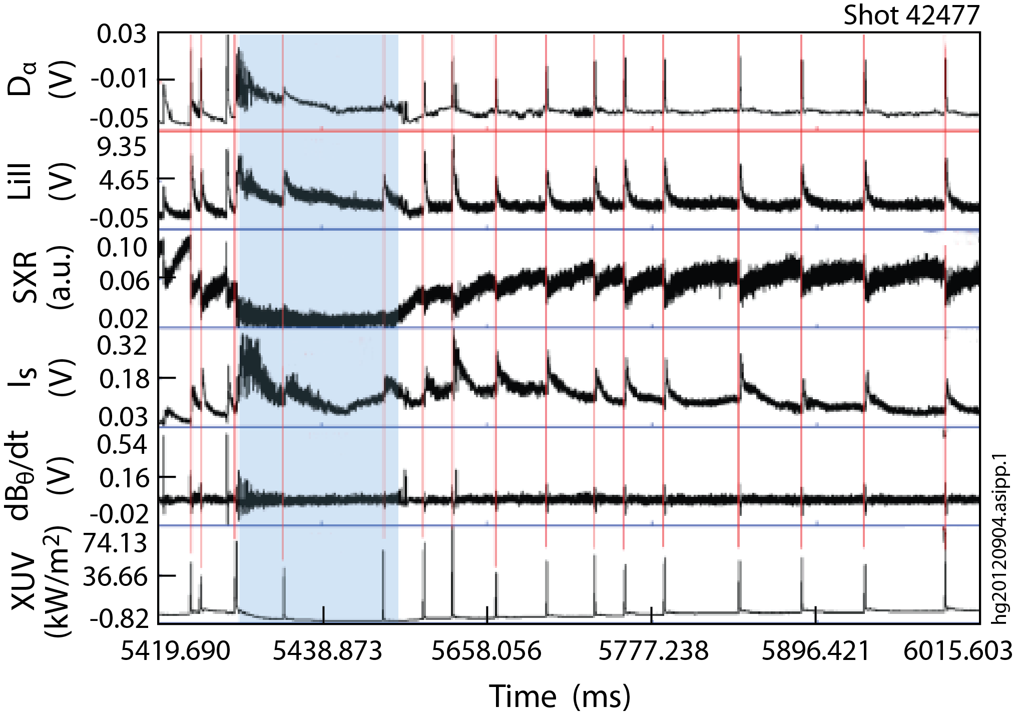
Lithium Granule Injector (LGI) developed for NSTX is promising tool for pedestal control and scenario optimization
Successful EAST collaboration
  Demonstrated LGI ELM-pacing at 25 Hz with nearly 100% triggering reliability
  Capable of up to 1 kHz injection
LGI will be tested on NSTX-U for high-frequency ELM pacing
  Possible density control technique:
    Combine Li coatings for D pumping with LGI for ELM-expulsion of carbon
  Goal: reduce Z_{eff} to ~2-2.5
  Injection of Li granules could also potentially replenish PFC Li coatings
JET/ITER: potentially interested in testing Be granules for ELM pacing
EAST data

Slide 34
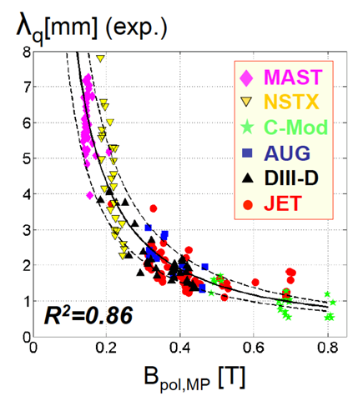
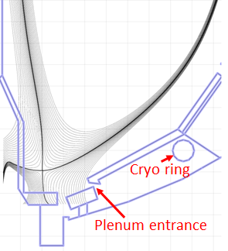
Boundary Physics (BP) 5 Year Goal:
Develop and understand integrated plasma exhaust solutions compatible with high core performance for FNSF and ITER
BP Thrusts:
Assess, optimize, control pedestal structure, transport, stability
Assess and control divertor heat fluxes
  Measure SOL widths at lower ν, higher B_{T}, I_{P}, P_{SOL}
    Compare data to fluid and gyro-kinetic models
  Assess, control, optimize snowflake divertor
  Develop highly-radiating divertor w/ feedback control
  Assess impact of high-Z tile row(s) on core impurities
Establish and compare long-pulse particle control methods
  Validate cryo-pump physics design, assess density control
  Compare cryo to lithium coatings for n_{e}, impurity, ν* control
See presentations by Rajesh Maingi, Vlad Soukhanovskii

Slide 35
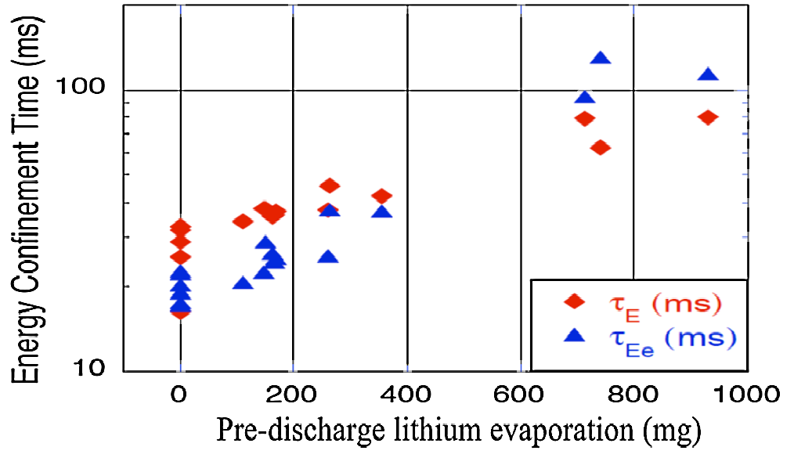
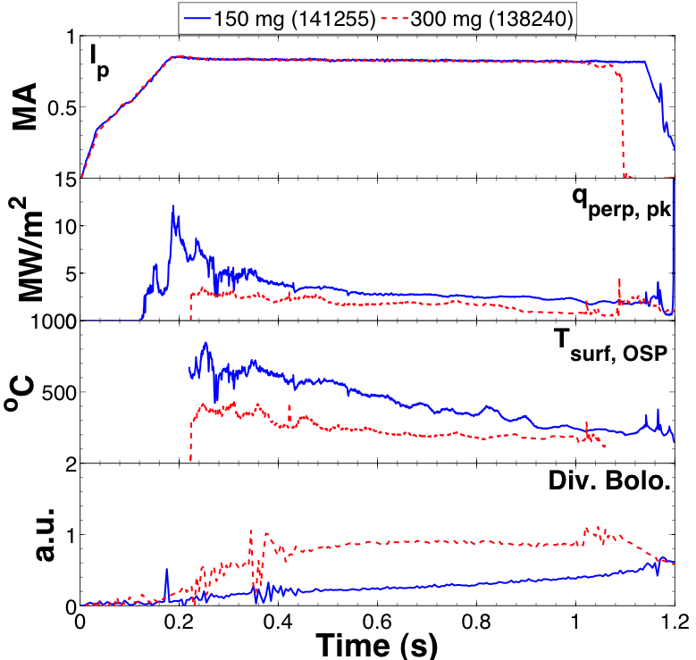
Plasma confinement increases continuously with increasing lithium coatings; Li may also be means of heat flux mitigation
150 mg
300 mg
ELM-free discharges
I_{P} = 0 .8 MA, P_{NBI} ~ 4 MW
High δ, f_{exp} ~20
Energy Confinement Time (ms)
Pre-discharge lithium evaporation (mg)
R. Maingi, et al., PRL 107 (2011) 145004
Global parameters improve
  H98(y,2) increases from ~0.9 → 1.3-1.4
  No core Li accumulation
ELM frequency declines to zero
Edge transport declines
High τ_{E} critical for FNSF, next-steps
Increased Li deposition may be advantageous for power handling
  Lower peak divertor heat flux and T_{surface}
  Increased divertor radiation
May require threshold Li level
Motivates “vapor-shielding” research
What is τ_{E} upper bound?

Slide 36
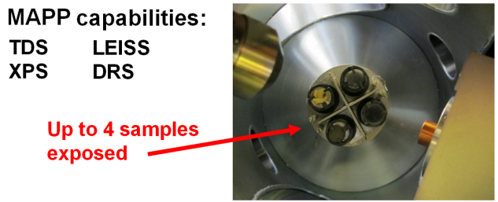
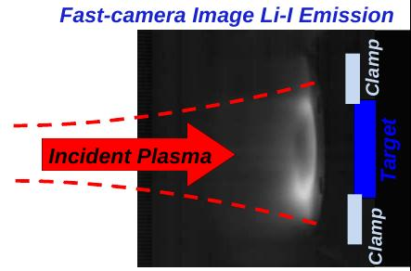
Materials and PFCs (MP) 5 Year Goal:
Initiate comparative assessment of high-Z and liquid metal PFCs for long-pulse high-power-density next-step devices
MP Thrusts:
Understand Li surface-science at extended PFC operation
  “Atoms to tokamaks” collaboration with PU
  Utilize Materials Analysis Particle Probe (MAPP)
  to ID in-situ between-shot coating composition
Assess tokamak-induced material migration and evolution
  QCMs, marker-tiles, MAPP + QCM for shot-to-shot analysis of migration
Lab-based R&D: flowing Li loops, capillary-restrained Li surfaces
Establish the science of continuous vapor-shielding
  Study Li vapor-shielding in linear plasma device Magnum-PSI
  Extend Magnum results to NSTX-U
See presentation by Mike Jaworski

Slide 37
Thrusts strongly support all 5 high-level goals, but MS, TT, BP, ASC thrusts contribute most broadly
Demonstrate 100% non-inductive sustainment at performance that extrapolates to ≥ 1MW/m² neutron wall loading in FNSF
Access reduced ν* and high-β combined with ability to vary q and rotation to dramatically extend ST physics understanding
Develop and understand non-inductive start-up and ramp-up
(overdrive) to project to ST-FNSF with small/no solenoid
4. Develop and utilize high-flux-expansion “snowflake” divertor
and radiative detachment for mitigating very high heat fluxes
5. Begin to assess high-Z PFCs + liquid lithium to develop high-duty-factor integrated PMI solutions for next-steps
MS1 | MS2 | MS3 | TT1 | TT2 | TT3 | BP1 | BP2 | BP3 | MP1 | MP2 | MP3 | EP1 | EP2 | RF1 | RF2 | PSR1 | PSR2 | ASC1 | ASC2 | ASC3 | ASC4
MS1 | MS2 | MS3 | TT1 | TT2 | TT3 | BP1 | BP2 | BP3 | MP1 | MP2 | MP3 | EP1 | EP2 | RF1 | RF2 | PSR1 | PSR2 | ASC1 | ASC2 | ASC3 | ASC4
MS1 | MS2 | MS3 | TT1 | TT2 | TT3 | BP1 | BP2 | BP3 | MP1 | MP2 | MP3 | EP1 | EP2 | RF1 | RF2 | PSR1 | PSR2 | ASC1 | ASC2 | ASC3 | ASC4
MS1 | MS2 | MS3 | TT1 | TT2 | TT3 | BP1 | BP2 | BP3 | MP1 | MP2 | MP3 | EP1 | EP2 | RF1 | RF2 | PSR1 | PSR2 | ASC1 | ASC2 | ASC3 | ASC4
MS1 | MS2 | MS3 | TT1 | TT2 | TT3 | BP1 | BP2 | BP3 | MP1 | MP2 | MP3 | EP1 | EP2 | RF1 | RF2 | PSR1 | PSR2 | ASC1 | ASC2 | ASC3 | ASC4

Slide 38
Summary: NSTX-U 5 year plan will make leading contributions to fusion science, next-step applications
Provides ST basis (and assists AT) for FNSF and for ITER
  Actuators + controls for 100% non-inductive at high confinement, β
  Non-inductive formation and ramp-up - needed for ST, benefits AT
  Disruption warning/detection, novel disruption mitigation
Novel plasma-material-interface solutions for next-steps
  Lead “snowflake” development, combine with radiation/detachment
  Lead in liquid metals for recycling/erosion control, vapor-shielding
Unique contributions to toroidal predictive capability
  Non-linear AE instabilities relevant to ITER burning plasmas/DEMO
  High β + low ν EM-effects on transport
    Example: micro-tearing relevant to ST, potentially relevant to ITER pedestal

Slide 39
Mapping of presentations to charge questions

Slide 40
Summary of presentation content to aid addressing review charge question 1
Assess the scientific and technical merit of the ongoing and planned research
  Does the proposed research effectively address important issues in plasma and fusion energy science and technology at the forefront of the field e.g., those issues described in the FESAC reports:
    Research Needs for Magnetic Fusion Energy (2010)
    Priorities of the Magnetic Fusion Energy Science Program (2013)?
  How well does the proposed research compare with that carried out at other U.S. and foreign tokamak facilities, both in terms of merit and originality?
  How well does it maintain a U. S. leadership position in key areas of fusion research?
  What is the likelihood that the research will lead to new or fundamental advances in fusion science and technology?
Menard backup
Kaye, Maingi, Soukhanovskii
Menard, All

Slide 41
Summary of presentation content to aid addressing review charge question 2
Comment on the appropriateness of the proposed research plan.
  Is the proposed plan adequately developed and likely to lead to scientifically valid conclusions?
  Does the proposed research employ innovative concepts or methods, and are potential problems identified along with appropriate mitigation strategies?
  Assess the strengths of the program w.r.t. manpower development through graduate student training.
All
Ono

Slide 42
Summary of presentation content to aid addressing review charge question 3
Evaluate the competency of the proposed senior research personnel, adequacy of the proposed research environment & resources.
  How well qualified are the applicant's personnel to carry out the proposed research?
  Does the proposed work provide for an:
    adequate set of diagnostics, necessary facility upgrades
    interactions with theory and modeling
    collaborations involving a broad group of domestic and international users?
  Assess the program's governance practices and the performance of the program management team, as well as the support to collaborators provided by PPPL.
  How well do the collaborative arrangements achieve the goal of an integrated research team?
Ono
Ono
All, Bhattacharjee
Menard & backup,
Plan Chapter 11
Menard backup – governance section
All, Menard backup, Plan Chapter 11

Slide 43
Summary of presentation content to aid addressing review charge question 4
Assess the reasonableness of the proposed costs for fusion research and facility operations.
  The cost review should be done at a summary type level, examining major items and using projections from ongoing operational experience.
  Does the technical proposal call for the equipment and components, labor skill mix, and hours set forth in the summary cost information, and are these reasonable to carry out the proposed research?
  Are the overall proposed costs reasonable? (Please note that the cost details of the proposal will also be reviewed separately by DOE. However, we are interested in hearing your views on this topic.)
Ono, Ono backup

Slide 44
Summary of presentations and documents to aid addressing review charge question 5
Assess the performance of the NSTX research team during the previous five-year period.
  Were research and diagnostic milestones met?
  Were NSTX research results appropriately disseminated, and are they having an impact on the international fusion effort?
  How well did the NSTX team compare theory and experiment to further the FES goal of improving predictive modeling?
Also, assess the plans for NSTX Upgrade facility operations (at a top level)
  Are planned operating, maintenance, repair and upgrade schedules appropriate to support the planned research program?
  Are environment, safety, health and quality assurance matters being given appropriate priority?
Ono backup
Ono, Publication Listings
All, Bhattacharjee
Ono, Ono backup

Slide 45
Supplementary Material
Governance

Slide 46
NSTX-U
Supported by
NSTX-U Program Governance, Collaborator
Support, Research Planning Process
Coll of Wm & Mary
Columbia U
CompX
General Atomics
FIU
INL
Johns Hopkins U
LANL
LLNL
Lodestar
MIT
Lehigh U
Nova Photonics
ORNL
PPPL
Princeton U
Purdue U
SNL
Think Tank, Inc.
UC Davis
UC Irvine
UCLA
UCSD
U Colorado
U Illinois
U Maryland
U Rochester
U Tennessee
U Tulsa
U Washington
U Wisconsin
X Science LLC
Jon Menard and Masa Ono (PPPL)
NSTX-U Program and Project Directors
Culham Sci Ctr
York U
Chubu U
Fukui U
Hiroshima U
Hyogo U
Kyoto U
Kyushu U
Kyushu Tokai U
NIFS
Niigata U
U Tokyo
JAEA
Inst for Nucl Res, Kiev
Ioffe Inst
TRINITI
Chonbuk Natl U
NFRI
KAIST
POSTECH
Seoul Natl U
ASIPP
CIEMAT
FOM Inst DIFFER
ENEA, Frascati
CEA, Cadarache
IPP, Jülich
IPP, Garching
ASCR, Czech Rep
NSTX-U 5 Year Plan Review
LSB B318, PPPL
May 21-23, 2013

Slide 47
Outline and relationship to review charge
NSTX-U Organization
Support from PPPL
Role of collaborators
Developing the research program
  Research priorities and major directions
  Formulating annual research plan
  Developing and executing experiments
Milestone performance history
Scheduling operation, maintenance & upgrades
Managing environment, safety & health concerns
Evaluate the competency of the proposed senior research personnel and the adequacy of the proposed research environment and resources
How well do the collaborative arrangements achieve the goal of an integrated research team?
Assess the program's governance practices and performance of program management team, and support to collaborators provided by PPPL
Assess the current performance of facility operations at a top level

Slide 48
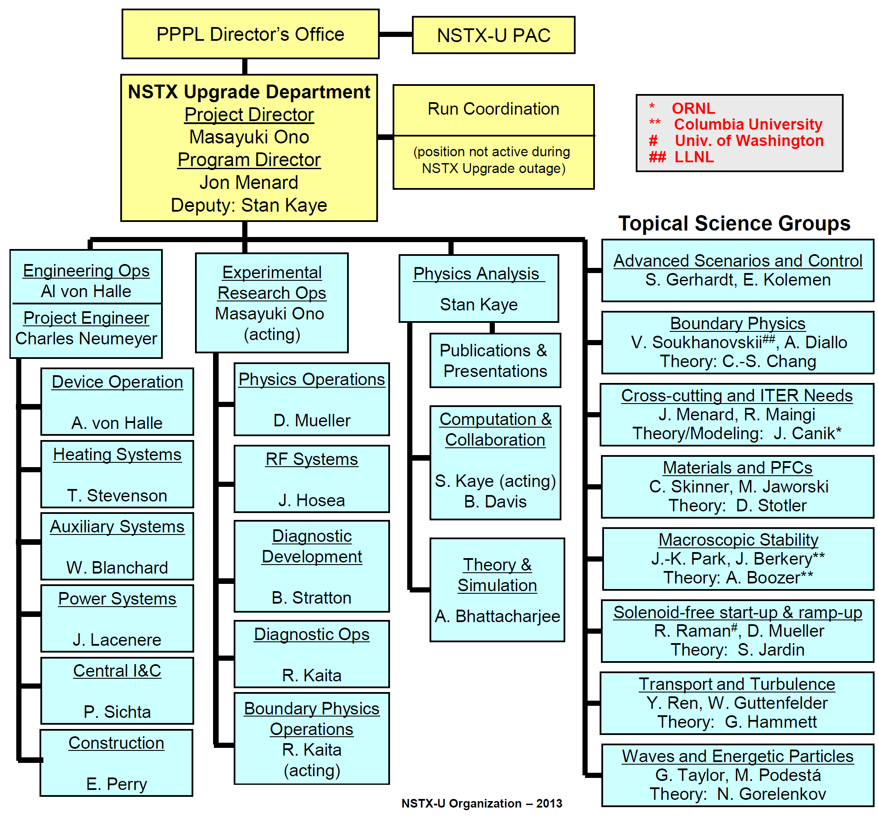
NSTX-U Organization within PPPL

Slide 49
NSTX-U continues extensive collaborator involvement
Collaborations involve a broad group of domestic and international users
  Collaborators were involved in originally proposing, designing NSTX
  Many diagnostic systems are built and operated by collaborators
DOE annually solicits proposals for collaboration with NSTX
  Both new proposals and renewal of existing collaborations
  Collaborations are competitively peer-reviewed on a 3-4 year cycle
Collaborators participate fully in the research program
  Meetings of research team to plan upgrades and research
  Proposing, developing and executing experiments
  Reviewing, analyzing and discussing results
  Publishing and presenting the results of their work

Slide 50
All NSTX-U collaborations are governed by documented agreements reviewed by Program and Project directors
Record of Discussion
  Results of discussions between prospective collaborators and an
  NSTX-U Research Contact in support of proposals submitted to DOE
  Includes goals of research, describes on- and off- site components
  of work involved and estimates of support required from NSTX
Record of Agreement
  Describes agreed commitments of resources, equipment and facilities by a collaborating institution and NSTX-U
Data Usage Agreement
  Governs access to and publication of data
  Provides for project and peer review of external publications
  Policies for access to, use, and publication of NSTX-U data are the same for PPPL staff and collaborators

Slide 51
Development of the NSTX-U Research Program
Guided by NSTX-U mission elements
  Advance ST as candidate for Fusion Nuclear Science Facility (FNSF)
  Develop solutions for the plasma-material interface challenge
  Explore unique ST parameter regimes to advance predictive capability for ITER and beyond
  Develop ST as fusion energy system
and evolving device and diagnostic capabilities
Research Milestones and plans for facility enhancements are:
  Developed by NSTX-U program and project leadership in discussion with Topical Science Group leaders
  Reviewed by the NSTX-U Program Advisory Committee (PAC)
  Agreed with DOE as part of the Field Work Proposal (FWP) process
  Complemented by Facility and Diagnostic Milestones

Slide 52
Topical Science Groups (TSGs) play major role in governing the research program
Lead brainstorming, organization, writing of 5 year plan
Determine and address highest priority scientific issues through discussion and consensus at open meetings
Organize the NSTX-U Research Forum sessions for the TSG
Draft scientific milestones utilizing expertise of the TSG
Propose and execute experiments to achieve milestones and address priorities
Define facility and theory resources to achieve research goals
Aid dissemination of results with Physics Analysis Division
  Journal publications, invited talks, seminars, colloquia, conferences, ITPA, BPO
Provide summaries of scientific progress at NSTX-U team meetings and other venues to promote discussion
Assist and report to the NSTX-U Program and Project directors

Slide 53
Annual NSTX-U Research Forum provides all team members opportunity to propose experiments
Held at PPPL over 2 ½ days ~3-6 months before start of experiments
  Involves wide participation, both on-site and by web + teleconference
Follows an open invitation to submit ideas for experiments
  Provided guidance from TSG Leaders on 1-2 highest priority themes for each topical area
In opening plenary session, NSTX-U Program Director provides initial guidance on runtime allocation
  Based on: milestones, facility development, ITER needs, contingency
Includes presentations from other facilities (e.g. DIII-D, MAST, EAST)
Proposals for experiments discussed and prioritized by TSGs:
  Opening and summary plenary sessions, 3-4 parallel break-out sessions
  TSGs asked to identify gaps, overlaps and combine if appropriate
Final plenary session reviews recommended prioritized experiments from TSGs and plans for developing Experimental Proposals (XPs)

Slide 54
NSTX-U experimental proposals guide usage of facility during experimental operation
Experimental Proposals (XPs) are documents describing:
  Justification for the experiment and that it is well suited to NSTX
  The plan for executing the required shots and scans efficiently
  The required machine and diagnostic capabilities
  Plans for analysis, reporting, and publication of the results
XPs are discussed in TSG meetings and recommended for review by the research team led by the Run Coordinator
  All meetings are open and accessible by web + telecon from off-site
  Review “chits” may be submitted, pointing out deficiencies and/or recommending changes to improve the experiment
Final version is approved, posted on the Web and a formal “run copy” is prepared when the experiment is scheduled
NSTX-U also provides Experimental Machine Proposals (XMPs) which are used to commission new systems or capabilities
  Reviewed and approved by Experimental Research Operations

Slide 55
Results and analysis of experiments are presented to and discussed by the whole team
5:00pm “end of run-day” meeting
  Progress on performing the plan, very preliminary highlights of data
Weekly Physics Meeting (Monday afternoons at 1:30PM)
  Preliminary analysis
Mid-run Assessment
  Progress towards meeting milestones
  Needs for additional runtime to complete experiments
  Need for experiments not foreseen at Research Forum
Annual Results Review
  Progress towards comprehensive analysis and conclusions
  Plans for publication
Annual Run Assessment
  Discussion of successes and difficulties encountered
  Generate, log, and track suggestions to improve planning and execution of experiments, communication
All meetings are accessible by web + teleconference

Slide 56
In 2008, the NSTX team performed
43 experimental proposals
12 Experimental Machine Proposals were also performed
Run lasted from Feb 18 through July 14 (21 calendar weeks)
Included 4 scheduled maintenance weeks, 4 days unscheduled maintenance time and 2 holidays
  Scheduled maintenance to avoid running during major meetings
Achieved 16.6 run weeks, exceeding milestone target of 15
Schedule for experiments in the next 1 - 2 weeks is developed at a weekly Program/Operations meeting chaired by Run Coordinator
  Adapt schedule to evolving status and availability of facility, heating systems, diagnostics, collaborator travel etc.
  Meeting is accessible by web + teleconference, schedule is posted on web and updated as conditions change
  Schedule up to 4 experiments (XPs and/or XMPs) on each run day
Daily plan discussed at “8:30am Meeting” and summarized in an email distributed widely

Slide 57
Maintenance, repair and upgrade activities are carefully planned and managed
PPPL Work Planning system used to approve and track progress on major activities and upgrades
Work Permits used to maintain configuration control and proper work practices in NSTX Test Cell
  Requirements for procedures and permits (e.g. RWP)
  Provides record for checks of area before resuming operation
Specific training required for both PPPL and collaborator staff to work in the NSTX Test Cell
  General Employee Training
  Radiation Safety Training
  Lockout/Tagout (Control of Energy Sources)
  Basic Electric Safety
  Knowledge of applicable Administrative Procedures
Periodic Preventive Maintenance is performed on critical systems
  On-Line Management System is being implemented

Slide 58
Attention to Environment, Safety and Health central to NSTX planning, maintenance, and operation
DOE Integrated Safety Management is used throughout PPPL to integrate safety into all work planning and execution
ES&H is a line management responsibility
  e.g. performing regular safety walkthroughs & work observations
A Safety Assessment Document is maintained for NSTX
  Identifies hazards of systems and components
  Addresses design features & administrative controls to mitigate hazards
  Provides detailed FMEA of NSTX systems
Work on NSTX performed using Job Hazard Analyses (JHAs).
Targeted safety inspections conducted by NSTX Activity Certification Committee for new/modified installations with safety implications
Safety issues are presented and discussed all Team Meetings
NSTX received a special NJ State award in March 2008 for working 7 consecutive years (1/1/01-12/31/07) without an away-from-work case

Slide 59
Summary: NSTX-U provides an open, productive, and safe research environment for all team members
Drawing on highly qualified staff from PPPL and a broad group of domestic and international collaborators, NSTX/NSTX-U has created a well integrated research team to exploit its unique facilities
Governance practices are designed to promote collaborative research
  Open access to meetings, data, presentations and documents
  Allocation of experimental runtime is through an open process
Topical Science Groups provide scientific leadership for NSTX research
  Approximately 1/3-1/2 of the TSG leaders are collaborators
  Approximately half of invited talks and publications led by collaborators
PPPL provides resources and support to promote NSTX-U research
Detailed planning and control are applied to ensure that operation is efficient and that commitments are met
NSTX/NSTX-U has consistently achieved its operational goals and its milestones for science, facility upgrades, and diagnostic development
Processes have been established to promote continuous improvement
There is a strong focus on safety, well supported by PPPL management

Slide 60
Supplementary Material
Support of ReNeW Thrusts

Slide 61
NSTX-U research strongly supports ReNeW Thrusts
ITER burning plasma (1-4), creating & predicting high-performance/steady-state (5-8)
Develop measurement techniques to understand and control burning plasmas
  Developing MSE-LIF diagnostic to measure |B| to constrain q(r) + total pressure profile w/o heating NBI
Control transient events in burning plasmas
  Extend development of advanced high-β MHD mode-ID and state-space feedback control techniques
  Achieve ELM suppression and/or triggering with lithium coatings and granules, 3D fields
Understand the role of alpha particles in burning plasmas
  Vary f_{NB}(v), multi-mode *AE fast-ion transport + full profile/fast-ion diagnostic set + theory/modeling
Qualify operational scenarios and the supporting physics basis for ITER
  Assess transport processes during current ramp-up – both inductive and non-inductive
  Extend extensive studies of H-mode threshold scalings and physics to higher B_{T}, I_{P}, P_{aux}, lower ν*
  Use high-power HHFW to study H-mode confinement with dominant e-heating, low torque input
  Improve understanding of unique low-A, high-β H-mode pedestal structure, turbulence, transport
Expand the limits for controlling and sustaining fusion plasmas
  NSTX-U targeting fully-non-inductive high-β_{T} (10-20%) plasmas with q and rotation profile control
Develop predictive models for fusion plasmas, supported by theory and challenged with experimental measurement
  Provide unique low-A, low ν*, high-β, high v_{fast} / v_{Alfvén} data to challenge wide range of theory, simulations
Exploit high-temperature superconductors, magnet innovations to advance fusion research
Understand highly integrated dynamics of dominantly self-heated/sustained burning plasmas

Slide 62
NSTX-U research strongly supports ReNeW Thrusts
Taming the PMI (9-12), harnessing fusion power (13-15), configuration optimization (16-18)
Unfold the physics of boundary layer plasmas
  Provide unique low-A, high-β data on SOL/divertor widths/transport and turbulence (GPI, BES)
  Exploring/understanding fast-wave antenna coupling to edge, power loss to divertor
Decode and advance the science and technology of plasma-surface interactions
  Leaders in exploration of lithium PFCs, will extend to high-power, long-pulse, vapor-shielded regimes
Improve power handling through engineering innovation
  Advanced radiative + high-flux-expansion divertors + static/flowing liquid Li at high power density
Demonstrate an integrated solution for plasma-material interfaces compatible with an optimized core plasma
  Will test integration of liquid metal and high-Z PFCs, radiation, snowflake with high performance core
Establish the science and technology for fusion power extraction and tritium sustainability
Develop the material science and technology needed to harness fusion power
Create integrated designs and models for attractive fusion power systems
  A world-leader in informing physics basis and design of low-A fusion power systems
Develop the spherical torus to advance fusion nuclear science
  NSTX-U is lead U.S. ST program and facility covering extensive range of ST research topics
Optimize steady-state, disruption-free confinement w/ 3D shaping, emphasizing QS
  Providing unique ST data and understanding of how 3D fields influence core/edge transport/stability
Achieve high-performance toroidal confinement w/ minimal externally applied magnetic field

Slide 63
Supplementary Material
5-10 year plan goals and tools

Slide 64


NSTX-U goal staging: first establish ST physics + scenarios, transition to long-pulse + PMI integration (5YP incremental)
2014 | 2015 | 2016 | 2017 | 2018 | 2019 | 2020 | 2021 | 2022 | 2023
Upgrade Outage
Establish ST physics, scenarios
Integrate long-pulse + PMI solutions
Increase CHI closed-flux current
Achieve NI start-up/ramp-up
New
center-stack
Start-up and Ramp-up
Assess plasma gun start-up at increased device size
Increase/extend ramp-up heating and off-axis current-drive for advanced scenarios
Develop/understand ECH/EBW H&CD for ST
Boundary Physics
Establish main-ion density and ν* control
Understand snowflake divertor performance
Understand high-Z first-wall erosion, migration, particle sources & sinks
Materials and PFCs
Assess baseline graphite PFC performance
Assess high-Z tile/divertor impact and performance
Assess high-Z divertor and/or first-wall
Assess impact of high-temperature first-wall
Inform choice
of FNSF:
aspect ratio, divertor, and PFCs
Liquid
metals / lithium
Establish low impurities / Z_{eff} , assess increased Li coverage, replenishment
Test flowing liquid metal for heat-flux mitigation, surface replenishment
Assess flowing LM PFC with full toroidal coverage
MHD
Understand kinetic MHD, extend mode and disruption detection, develop mitigation
Enhance non-axisymmetric field spectrum and capabilities with off-midplane coils for control of: RWM, EF, RMP, rotation, NTM, EP
Transport & Turbulence
Understand ES and EM turbulence at high β, low ν*, emphasizing e-transport
Extend wave-number coverage of turbulence measurements
Waves and Energetic Particles
Characterize AE stability, fast-ion transport, NBI-CD, support plasma start-up, assess effectiveness of fast-wave in NBI H-modes
Prototype driving edge-harmonic oscillations (EHOs) and/or *AE
2nd NBI
Scenarios and Control
Demonstrate full non-inductive, high I_{P} & P_{AUX} operation Control: boundary, β, divertor heat flux, Ω & q profiles
Assess integrated control of long-pulse / high-performance

Slide 65
10 year plan tools with 5YP incremental funding
1.1 × (FY2012 + 2.5% inflation)
2014 | 2015 | 2016 | 2017 | 2018 | 2019 | 2020 | 2021 | 2022 | 2023
Upgrade Outage
1.5 → 2 MA, 1s → 5s
Metallic PFCs, 5s → 10-20s
Run Weeks:
20
16
16
20
22
6
18
22
22
New
center-stack
Start-up and Ramp-up
Upgraded CHI for ~0.5MA
0.5-1 MA CHI
up to 1 MA plasma gun
Extend NBI duration to 10-20s and/or implement 2-4 MW off-axis EBW H&CD
1 MW ECH/EBW
2 MW
Boundary Physics
Lower divertor cryo-pump
Divertor Thomson
Upper divertor cryo-pump
Materials and PFCs
High-Z tile row on lower OBD
High-Z first-wall + lower OBD tiles
High-Z PFC diagnostics
All high-Z PFCs
Hot high-Z FW PFCs using bake-out system
Inform choice
of FNSF:
aspect ratio, divertor, and PFCs
Liquid
metals / lithium
Upward
LiTER
LLD using bakeable cryo-baffle
Flowing Li divertor
or limiter module
Full toroidal flowing Li lower OBD
Li granule injector
MGI disruption mitigation
Partial NCC
NCC SPA upgrade
Full NCC
MHD
Enhanced MHD sensors
Transport & Turbulence
δB polarimetry
DBS, PCI, or other intermediate-k
High k_{θ}
Waves and Energetic Particles
HHFW limiter upgrade
HHFW straps to excite EHO
High-power AE antenna
2nd NBI
1 coil AE antenna
4 coil AE antenna
Charged fusion product, neutron-collimator
Scenarios and Control
Establish control of:
Control integration, optimization
Control integration, optimization with long-pulse and full metal wall
n_{e}
q_{min}
Divertor P_{rad}
Snowflake
Rotation

Slide 66
5 year plan tools with 5YP base funding
(FY2012 + 2.5% inflation)
2014 | 2015 | 2016 | 2017 | 2018
Upgrade Outage
1.5 → 2 MA, 1s → 5s
Run Weeks:
16
14
14
16
Cryo-pump, high-Z tile row on cryo-baffle, and partial NCC would be installed in-vessel during ~1 year outage between FY2016 and FY2017
  NSTX-U would operate 1st half of FY2016 and 2nd half of FY2017
New
center-stack
Start-up and Ramp-up
Upgraded CHI for ~0.5MA
up to 0.5 MA plasma gun
1 MW ECH/EBW
Boundary Physics
Lower divertor cryo-pump
High-Z PFC diagnostics
Materials and PFCs
High-Z tile row on lower OBD
High-Z tile row on cryo-baffle
Full high-Z lower OBD
Liquid
metals / lithium
Upward
LiTER
LLD using bakeable cryo-baffle
Li granule injector
MHD
MGI disruption mitigation
Partial NCC
Enhanced MHD sensors
Transport & Turbulence
δB polarimetry
High k_{θ}
Waves and Energetic Particles
Charged fusion product
2nd NBI
1 coil AE antenna
4 coil AE antenna
Scenarios and Control
Establish control of:
n_{e}
q_{min}
Snowflake
Rotation
Divertor P_{rad}

Slide 67
NSTX-U 5 year plan aims to develop ST physics and scenario understanding necessary for assessing ST viability as FNSF
2015 | 2016 | 2017 | 2018 | 2019 | 2020 | 2021 | 2022 | 2023
Establish ST physics, scenarios
Integrate long-pulse + PMI
Maximum
B_{T} [T] and I_{P} [MA]
0.8, 1.6
1, 2
Structural force
and coil heating
limit fractions
0.5, 0.5
1.0, 0.75
1.0, 1.0
Extend NBI, plasma duration from 5s to 10-20s
Nominal τ_{pulse} [s]
1 – 2
2 – 4
4 – 5
Sustained β_{N}
3 – 5
4 – 6
NCC
5 – 6
ν* / ν* (NSTX)
0.6
0.4
Cryo
0.3 – 0.2
0.2 – 0.1
Inform choice
of FNSF
aspect ratio
and divertor
Inform choice
of FNSF plasma facing components
Non-inductive
fraction (Δt ≥ τ_{CR})
70 – 90%
80 – 110%
90 – 120%
100 – 140%
NBI+BS I_{P} ramp-up: initial → final [MA]
0.6 → 0.8
0.5 → 0.9
0.4 → 1.0
CHI closed-flux
current [MA]
0.15 – 0.2
0.2 – 0.3
ECH
0.3 – 0.5
0.4 – 0.6
P_{heat} [MW] with
q_{peak} < 10MW/m²
8
10
15
20
Snowflake and radiative divertor exhaust location
Divertor heat-flux control
Lower
Lower or Upper
Lower + Upper
High-Z tile row
High-Z tile rows
High-Z outboard divertor
High-Z first-wall
All high-Z
High-Z and
lithium PFCs
Increased Li coating coverage
Liquid Li on high-Z divertor tiles
Flowing Li module
Flowing Li divertor

Slide 68
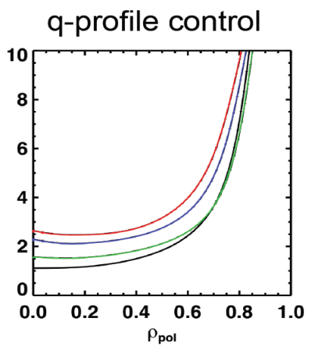
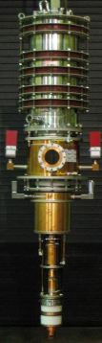
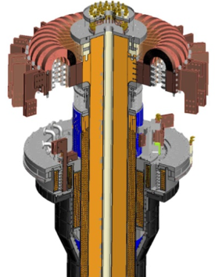
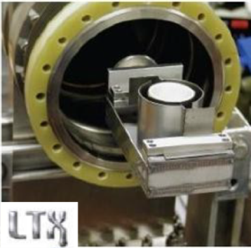
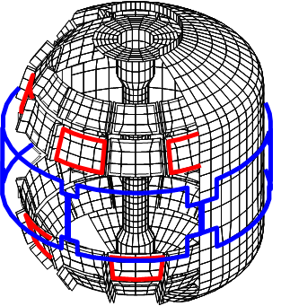




NSTX-U five year plan utilizes cross-cutting set of existing/early tools + additional facility enhancements
Requirements for next-step STs:
Present NBI
q profile control
28 GHz, 1-2MW
Gyrotron
Full non-inductive (NI) current drive for steady-state operation
  Including NI start-up/ramp-up
ECH / EBW for start-up
(Longer-term: EBW H&CD)
New 2nd NBI → 2×P_{NBI}
Vary PFC Li coverage to vary recycling, p(ρ), τ_{E}
Cryo-pump for D, n_{e}, ν* control w/o Li coatings
High confinement to minimize auxiliary heating, device size
New CS: 2×B_{T}, I_{P} 5×longer pulse
Midplane + off-midplane non-axis. control coils (NCC) for EFC, RWM, ELM-RMP, NTV
Sustained high β to minimize magnet size, forces, power
Extended low-f MHD sensor set
Snowflake divertors + partial detachment
Erosion & shielding of high-Z tiles + Li
Divertor/first-wall survival with intense power/particle fluxes
Li granule injector (LGI) for ELM pacing

Slide 69
NSTX-U internal component staging supports goal to assess compatibility of high τ_{E} and β + 100% NICD with metallic PFCs
Base budget case
Nominal 2014-18 5 year plan steps for implementation of cryo-pump + high-Z PFCs + LLD
2015
2016
2017
2018-19
2021
2022-23
All
high-Z FW + divertors
+ flowing LLD module
C
BN
Li
High-Z
Cryo +
full lower
outboard high-Z divertor
Cryo + high-Z FW and OBD
+ liquid Li divertor (LLD)
Lower
OBD
high-Z row of tiles
Cryo + U+L OBD
high-Z rows of tiles
High-Z tile row
Cryo-pump
Bakeable cryo-baffle for liquid Li
Flowing Li module

Slide 70
NSTX-U internal component staging supports goal to assess compatibility of high τ_{E} and β + 100% NICD with metallic PFCs
Incremental budget case
Nominal 2014-18 5 year plan steps for implementation of cryo-pump + high-Z PFCs + LLD
2015
2016
2017
2018
2019-20
Cryo-pump
2021
Upper cryo + all
high-Z & higher-T PFCs
+ full toroidal LLD
Cryo + high-Z FW and OBD
+ liquid Li divertor (LLD)
All
high-Z FW + divertors
+ flowing LLD module
C
BN
Li
High-Z
Lower
OBD
high-Z row of tiles
Cryo + high-Z FW and OBD
PFCs
High-Z tile row
Cryo-pump
Bakeable cryo-baffle for liquid Li
Flowing liquid Li divertor (LLD) module
Full toroidal flowing Li

Slide 71
Base 5 year plan funding provides run-time and field + current to exploit new Upgrade capabilities
FY2013
FY2014
FY2015
Expt. Run Weeks:
0
0
16
Macroscopic Stability
R14-1
Assess access to reduced density
and ν* in high-performance scenarios (with ASC, BP TSGs)
Transport and Turbulence
R13-1
Perform integrated physics+optical design of new high-k_{θ} FIR system
R15-1
Assess H-mode τ_{E}, pedestal, SOL characteristics at higher B_{T}, I_{P}, P_{NBI} (with BP, M&P, ASC, WEP TSGs)
Boundary
Physics
R13-2
Materials & PFCs
Assess relationship between lithium-conditioned surface composition and plasma behavior
R14-2
R15-2
Waves+Energetic Particles
Perform physics design of ECH & EBW system for plasma start-up & current drive in advanced scenarios
Assess reduced models for *AE mode-induced fast-ion transport
Assess effects of NBI injection on fast-ion f(v) and NBI-CD profile (with SFSU, MS, ASC TSGs)
Solenoid-free Start-up/ramp-up
R13-3
R14-3
Adv. Scenarios and Control
Assess advanced control techniques for sustained high performance (with MS, BP TSGs)
R15-3
Develop physics+operational tools for high-performance discharges (with CC, ASC, MS, BP, M&P TSGs)
R13-4
ITER Needs + Cross-cutting
Identify disruption precursors and disruption mitigation & avoidance techniques for NSTX-U and ITER
Joint Research Target
Stationary regimes w/o large ELMs, improve understanding of increased edge particle transport
Quantify plasma response to non-axisymmetric (3D) magnetic fields in tokamaks
TBD

Slide 72
accelerates snowflake + start-up/ramp-up research for FNSF, fully utilizes facility during 1st year of ops
Incremental funding
FY2013
FY2014
FY2015
Expt. Run Weeks:
0
0
14
20
Macroscopic Stability
R14-1
Assess access to reduced density
and ν* in high-performance scenarios (with ASC, BP TSGs)
Transport and Turbulence
R13-1
Perform integrated physics+optical design of new high-k_{θ} FIR system
R15-1
Assess H-mode τ_{E}, pedestal, SOL characteristics at higher B_{T}, I_{P}, P_{NBI} (with BP, M&P, ASC, WEP TSGs)
Boundary
Physics
Develop snowflake configuration, study edge and divertor properties
(with ASC, TT, MP)
R13-2
Materials & PFCs
Assess relationship between lithium-conditioned surface composition and plasma behavior
IR15-1
R14-2
R15-2
Waves+Energetic Particles
Perform physics design of ECH & EBW system for plasma start-up & current drive in advanced scenarios
Assess reduced models for *AE mode-induced fast-ion transport
Assess effects of NBI injection on fast-ion f(v) and NBI-CD profile (with SFSU, MS, ASC TSGs)
Solenoid-free Start-up/ramp-up
R13-3
Assess CHI & low-I_{P} FW heating at higher B_{T}, test NBI+BS I_{P} ramp-up (with WEP, ASC TSGs)
R14-3
IR15-2
Adv. Scenarios and Control
Assess advanced control techniques for sustained high performance (with MS, BP TSGs)
R15-3
Develop physics+operational tools for high-performance discharges (with CC, ASC, MS, BP, M&P TSGs)
R13-4
ITER Needs + Cross-cutting
Identify disruption precursors and disruption mitigation & avoidance techniques for NSTX-U and ITER
Joint Research Target
Stationary regimes w/o large ELMs, improve understanding of increased edge particle transport
Quantify plasma response to non-axisymmetric (3D) magnetic fields in tokamaks
TBD

Slide 73
Supplementary Material
Support of ITER, predictive capability, and FNSF

Slide 74
NSTX has made, and NSTX-U will continue to make substantial contributions to ITER
MS: Plasma response effects in error field correction, kinetic effects on RWM, mode control and NTV, physics-based disruption warning system, novel disruption mitigation tests
TT/BP: ELM pacing with 3D fields (future: possible suppression or triggering w/ 3D fields or granules), impurity transport, SOL heat-flux-width scaling, divertor detachment physics
EP: Non-linear *AE avalanche dynamics and fast-ion transport + transport by 3D fields – highly relevant to burning plasmas
RF: Power coupling, edge power loss, interactions w/ fast-ions
ASC: Advanced integrated plasma control, contributions to disruption prediction-avoidance-mitigation framework

Slide 75
Unique physics regimes + advanced diagnostics strongly support predictive capability development
MS: Kinetic MHD for RWM stability, plasma response and momentum transport from 3D fields (MISK, IPEC, POCA, VALEN, …)
TT: High-β/electromagnetic effects on electron transport from micro-tearing and Alfvenic instabilities (GYRO, GTS, …, HYM, ORBIT)
BP/MP: Edge kinetic neoclassical & turbulent transport (GENE, GS2, XGC0-1), SOL turbulence (SOLT), snowflake/detachment: neutrals, impurities (UEDGE, SOLPS, BOUT++, EIRENE, DEGAS2, DIVIMP)
EP: Gyro-center and full orbit following (ORBIT, SPIRAL), linear and non-linear Alfven instability,fast-ion transport (NOVA-K, M3D-K, HYM)
RF: heating, edge power loss (AORSA, TORIC, SPIRAL), RF/fast-ion interactions (hybrid FOW CQL3D), ECH/EBW heating & CD (GENRAY)
PSR/ASC: 2D/3D helicity injection physics (TSC, NIMROD), time-dependent ramp-up/sustainment modeling (TSC/TRANSP/NUBEAM)

Slide 76




NSTX/ST researchers contributing to LDRD-funded study of Mission and Configuration of an ST-FNSF
Overarching goal of study:
  Determine optimal mission, performance, size
Goals of study:
  Review existing designs, ID advantageous features, improve configuration
  Key considerations for configuration:
    T self-sufficiency
    Maintainability, upgradeability, overall flexibility
    Key components: coils, divertors, shields, blankets, ports
  Develop self-consistent assessment + configuration for use by community
FY2013 progress:
  Developing/comparing configurations with range of sizes: R=2.2, 1.6, 1.0m
  Assessing impact of different divertors: conventional, snowflake, super-X
  May be minimum device size (R~1.5-1.6m) for TBR > 1 with DCLL
    Preliminary: breeding in divertor and/or centerstack first-wall/shield may be required
Russia
Culham
UT Austin
ORNL
PPPL

