Slide 1




NSTX-U
Supported by
NSTX-U Project Status and
5 Year Plan Facility Overview
Culham Sci Ctr
U St. Andrews
York U
Chubu U
Fukui U
Hiroshima U
Hyogo U
Kyoto U
Kyushu U
Kyushu Tokai U
NIFS
Niigata U
U Tokyo
JAEA
Tsukuba U
Hebrew U
Ioffe Inst
RRC Kurchatov Inst
TRINITI
NFRI
KAIST
POSTECH
SNU
ASIPP
ENEA, Frascati
CEA, Cadarache
IPP, Jülich
IPP, Garching
ASCR, Czech Rep
Columbia U
CompX
General Atomics
FIU
INL
Johns Hopkins U
LANL
LLNL
Lodestar
MIT
Nova Photonics
New York U
ORNL
PPPL
Princeton U
Purdue U
SNL
Think Tank, Inc.
UC Davis
UC Irvine
UCLA
UCSD
U Colorado
U Illinois
U Maryland
U Rochester
U Washington
U Wisconsin
Masa Ono
for the NSTX-U Team
NSTX-U Five Year Plan Review Meeting
May 21 - 23, 2013

Slide 2
Talk Outline
Previous five year (FY2009-13) Project Summary and Status
NSTX Upgrade Project Overview
NSTX-U Operational Preparation Status
NSTX-U Facility / Diagnostic Five Year Plans
Budget
Summary

Slide 3
NSTX Facility Achieved Nearly All Operational Targets
Facility Operated Safely for Over 2 Million Staff Work Hours
• All facility and diagnostic milestones achieved on schedule in FY2009 – 2012 except in FY 2011, the operational week goal was not met due to a TF coil failure (see back-up slides 38 - 43.)
• Achieved record number of total plasma shots and plasma shots per week for each of FY2009 and FY2010. Introduction of lithium improved shots/week by ~ 50 % since the pre-lithium operations.
NSTX Plasma Operation Statistics
Fiscal Year | Run Week Milestone | Achieved Run Weeks | Achieved Shots | Achieved Shots/Week | Lithium Operations (%)
2011 | 14 | 4.2 | 839 | 199 | ~ 100
2010 | 15 | 15.4 | 2941 | 191 | ~ 100
2009 | 16 | 16.8 | 2750 | 163 | 92
2008 | 15 | 16.5 | 2570 | 156 | 46
2007 | 12 | 12.6 | 1890 | 150 | 69
2006 | 11 | 12.7 | 1615 | 127 | 0
2005 | 17 | 18.0 | 2221 | 124 | 0
NSTX received the State of New Jersey Commissioner of Labor and Workforce Development’s 2010 Continued Excellence Award for working 10 consecutive years (2,011,666 hours) without an away from work lost time injury/illness case.

Slide 4
Strong Publications and Conference Participations
Growing Number of Highly Capable Young Researchers
Calendar Year | Refereed Publication | PRLs | APS Invited | IAEA Papers
2008 | 40 | 2 | 6 | 20
2009 | 45 | 6 | 5
2010 | 63 | 5 | 10 | 25
2011 | 58 | 5 | 8
2012 | 56 | 1 | 4 | 30
• Half of the publications and invited talks were led by collaborators
• 9 of 17 PRLs published in 2009-2012 were led by students and junior researchers
NSTX Research Team Membership:
  • Experienced research team consists of 70 PPPL researchers and 236 non-PPPL researchers with 59 APS Fellows, 3 Presidential Early Career Award winners, 4 DOE Early Career Award winners.
  • Significant number of young researchers : 17 recent research staff, 14 post-docs, and 33 students.

Slide 5
NSTX Researchers Received Community Recognition
Strong collaborator contributions
• Stefan Gerhardt (PPPL) and Joshua Breslau (PPPL) received in 2009 and US DOE Presidential Early Career Awards.
• V. Soukhanovskii (LLNL), J.P. Allain (Purdue U), J-K Park (PPPL) and A. Diallo (PPPL) received 2010 and 2013 DOE OS Early Career Awards.
• S. Sabbagh (Columbia University) was honored at IAEA (Daejeon, Korea) for his 2009 Nuclear Fusion Paper Award.
• E. Fredrickson (2008-PPPL), R. Maingi (2009-ORNL), J. Menard (2010-PPPL) and S. Sabbagh (2010-Columbia University) were elected APS-DPP Fellows.
• J-K Park (PPPL) received the 2010 Marshall N. Rosenbluth Outstanding Doctoral Thesis Award.
• J-K Park received the 2011 Outstanding Young Researcher Award (OYRA) from Association of Korean Physicists in America (AKPA).
• NSTX “Snow-flake Divertor” team won the R&D 100 Award for 2012. Also featured in Oct. 2012 FES Science Highlights.

Slide 6
Facility Upgrade Activity Comparison with 5 Year Plan
Facility Plan Evolved Due to Technical and Programmatic Changes
Planned Run Weeks
15
15
15
15
Actual Run Weeks
1６.5
1６.8
１５.4
4.2
Upgrade Outage
Center Stack
Design/Procurement
See the Upgrade Project Progress and Schedule slides for more detail
Fabrication
New Center-Stack
Assembly/Installation
Heating & CD
Design/Procurement/Fabrication/Installation
HHFW Antenna Upgrade
2nd NBI
HHFW ELM resilience
350 kW ECH-PI
MHD
Dual massive gas injector
EF/RWM/RMP
(SPA upgrade)
Improved
LITER
Two additional LITERS
Boundary
LLD-I
Long-pulse divertor
Moly inboard tiles
Dual Lithium Dropper
SGI Upgrade
Core Fueling
CHI
Staged bank firing
CHI Cap Bank Upgrade
Absorber control coils
Initial PEGASUS/MST-like plasma guns
Additional Upgrades
Postponed Upgrades

Slide 7
Diagnostic Upgrade Activity Comparison with 5 Year Plan
Diagnostic Plan Evolved Due to Technical and Programmatic Changes
Planned Run Weeks
15
15
15
15
Actual Run Weeks
1６.5
1６.8
１５.4
4.2
Upgrade Outage
Improved EFC, RWM control
MSE
rt-EFIT
Control
HHFW
loading control
Real-time V_{φ}
Real-time
MSE
NBI control
V_{φ} control
P-CHERS(70 ch)
β control
(NBI)
δ control
Profile
MSE/CIF (19 ch)
Multi Energy-Pedestal-SXR Array
MSE/CIF (16 ch)
MPTS Higher Spatial Resolution
MPTS Third Laser
MSE/LIF
MHD
Multi-Color-T_{e}(r)
Divertor Halo Current
RWM State-Space Controller
Non-magnetic RWM-ID
Diagnostic
relocation
for 2nd NBI
Turbulence
Corr. Reflect.
Magnetic turbulence diagnostic
BES
Energetic
Particles
High-k Scattering
Remote-control
FIReTIP (2 MHz)
High-k Scattering k-θ
Fast-ion D-alpha camera
Tangential FIDA
Reflectometer
16 ch
Neutron Collimator
Waves
Improved EBW Radiometer
High-k HHFW (30 MHz)
TAE Antenna
Edge USXR
High Frequency Mirnov Array
Ion Flow Meas
Divertor Bolo.
Additional Upgrades
Dust Detector
Wide-angle divertor camera
MAPP Probe
Boundary
Divertor imaging spectrometer
Postponed Upgrades
Lithium CHERS
Divertor Ly-alpha array
Surface analysis probe
Optical Penning Gauge
99-element divertor probe
NIR Spectroscopy
Fast IR Camera
Fast Eroding Probe
Dual-Band IR Camera
Wide-angle Dual-Band IR Camera

Slide 8
Talk Outline
Previous five year (FY 2009-13) Project Summary and Status
NSTX Upgrade Project Overview
NSTX-U Operational Preparation Status
NSTX-U Facility / Diagnostic Five Year Plans
Budget
Summary

Slide 9
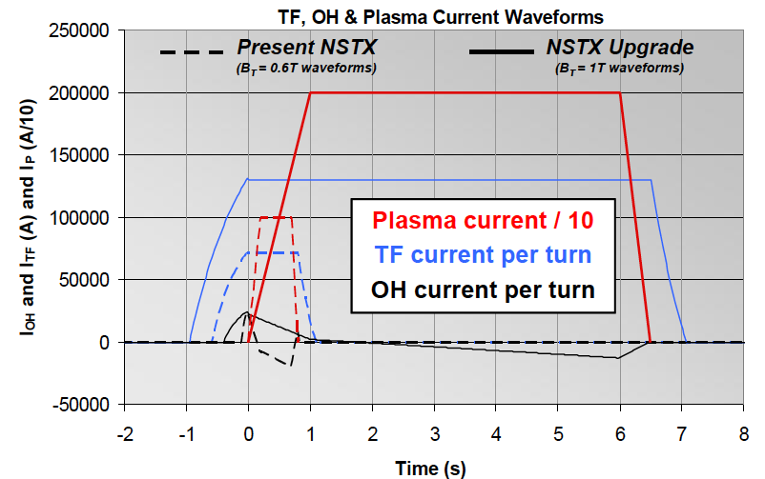


Substantial Increase in NSTX-U Device / Plasma Performance
Higher performance requires facility / infrastructure enhancements
Previous
center-stack
New
center-stack
TF OD = 20cm
TF OD = 40cm
NSTX
 | R₀ (m) | A_{min} | I_{p} (MA) | B_{T} (T) | T_{TF} (s) | R_{CS} (m) | R_{OB} (m) | OH flux (Wb)
NSTX | 0.854 | 1.28 | 1 | 0.55 | 1 | 0.185 | 1.574 | 0.75
NSTX-U | 0.934 | 1.5 | 2 | 1 | 6.5 | 0.315 | 1.574 | 2.1
Present NBI
New 2nd NBI

Slide 10
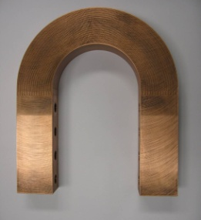
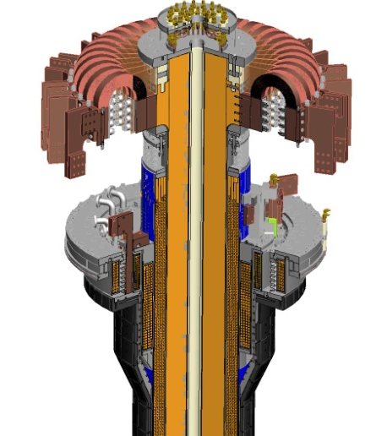
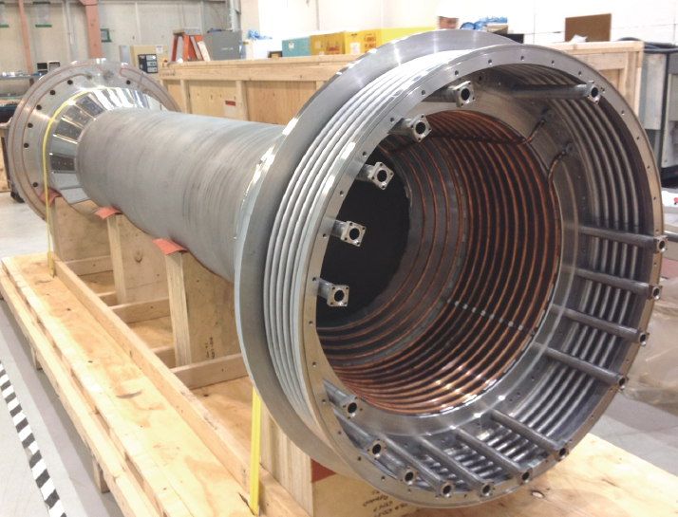
Improved Center-Stack Design to Handle Increased Forces
Identical 36 TF Bars and Innovative Flex-Bus Design
TF cooling lines
Electric Discharge Machining Cuts
TF flex-bus
Tested for
300 k cycles
TF Coil
CHI bus
PF Coil 1c
PF Coil 1b
PF Coil 1a
CS Casing
OH Coil

Slide 11
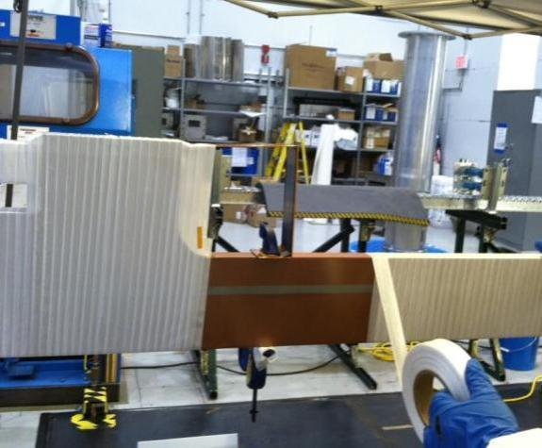
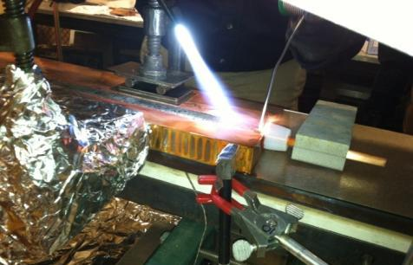
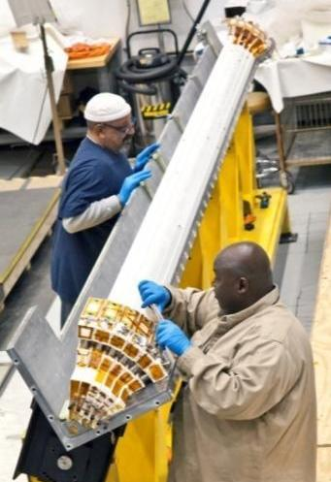
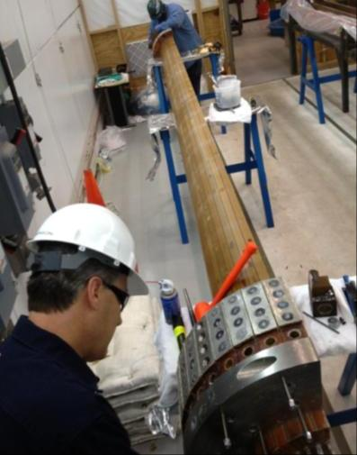
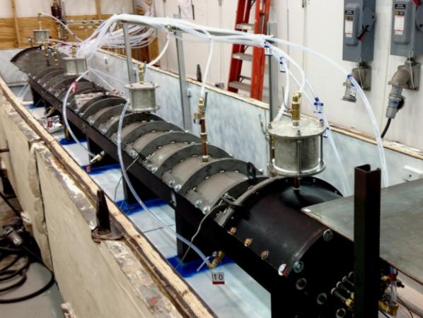
Center Stack Fabrication & Assembly Proceeding Well
Innovative manufacturing techniques developed
Cooling tube soldered with resin-based flux into inner TF conductor
Conductor being wrapped with fiberglass insulation
Insulated conductor being placed into mold
Assembled TF mold ready for Vacuum Pressure Impregnation with CTD-425
Three Quadrants successfully VPI’d !

Slide 12
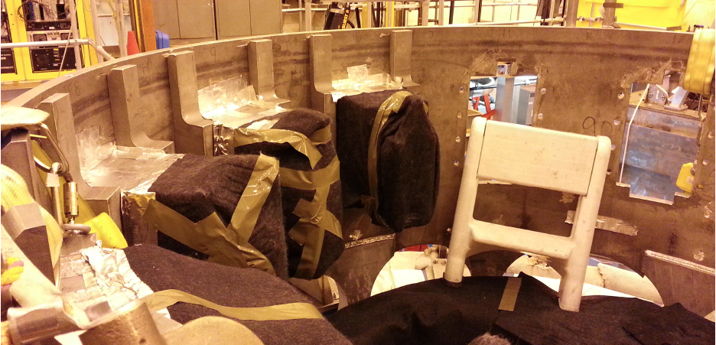
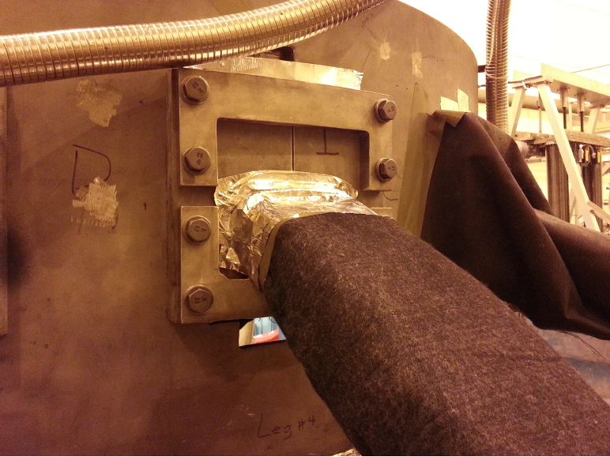
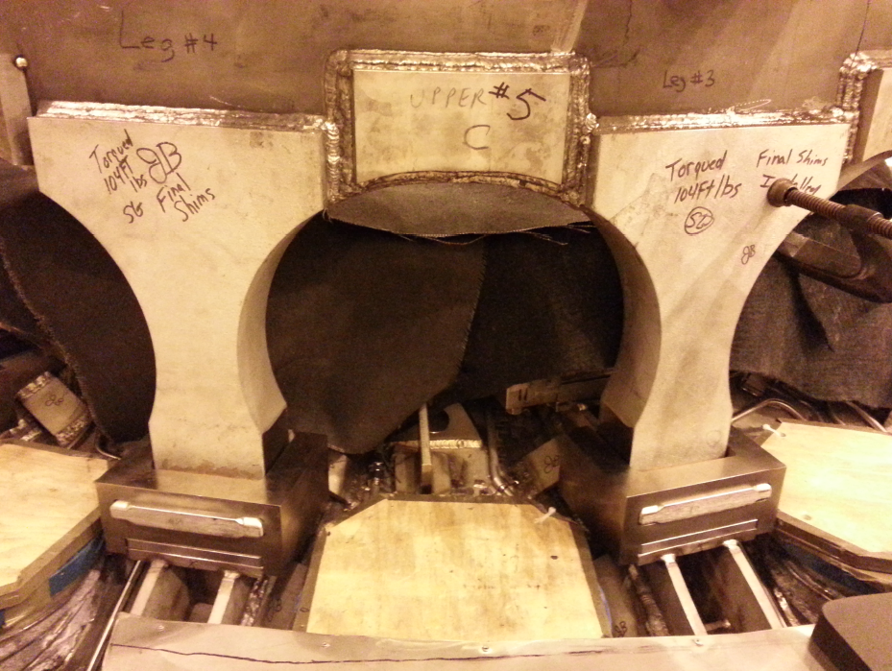
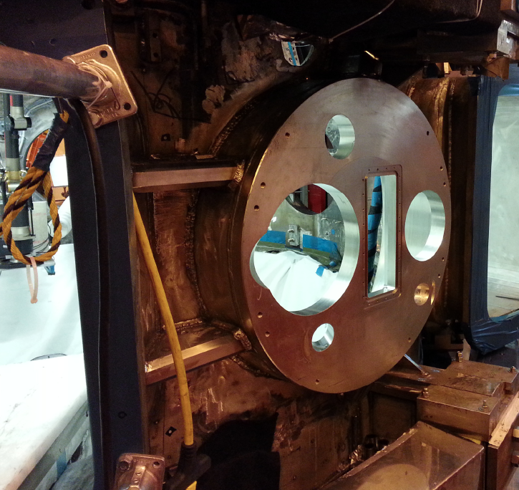
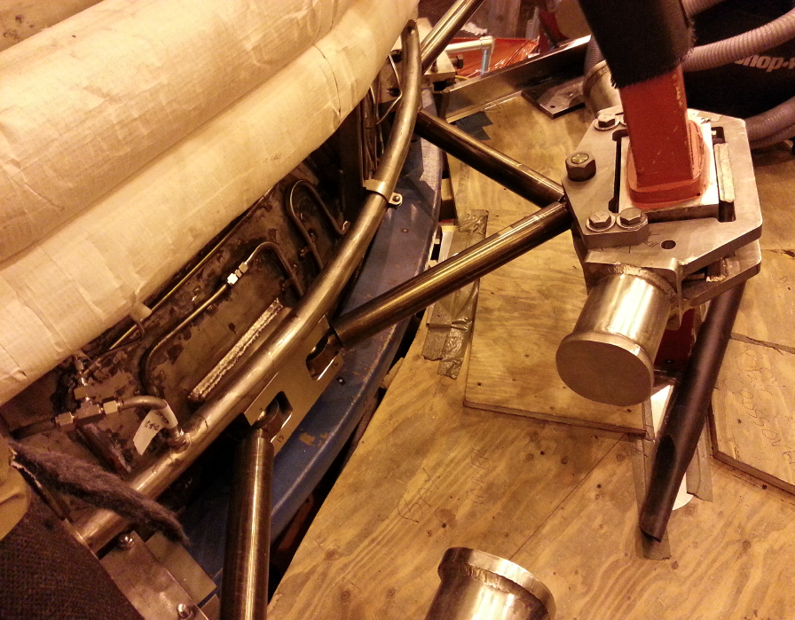
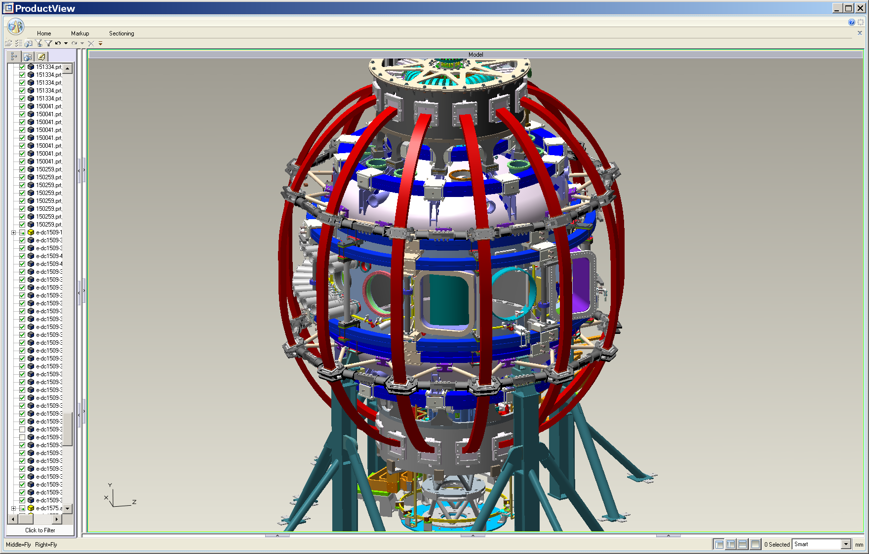
Support Structural and Vacuum Vessel Upgrades
Must handle 4 x higher electromagnetic loads
Upper Al Block Internal Reinforcements
Upper Al Block External Reinforcements
Upper Umbrella Arch Reinforcements
Bay-L Cap
TF-VV Clevis &TF Outer Leg Support
See back-up slides 44 for more detail

Slide 13
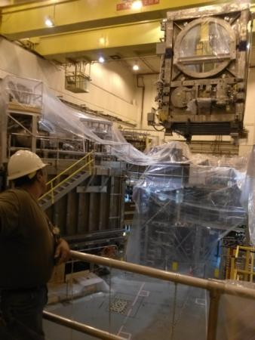
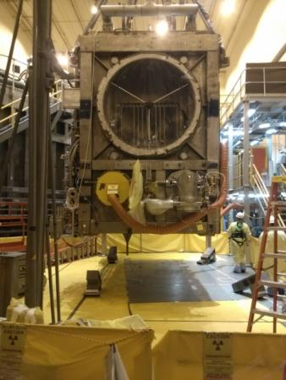
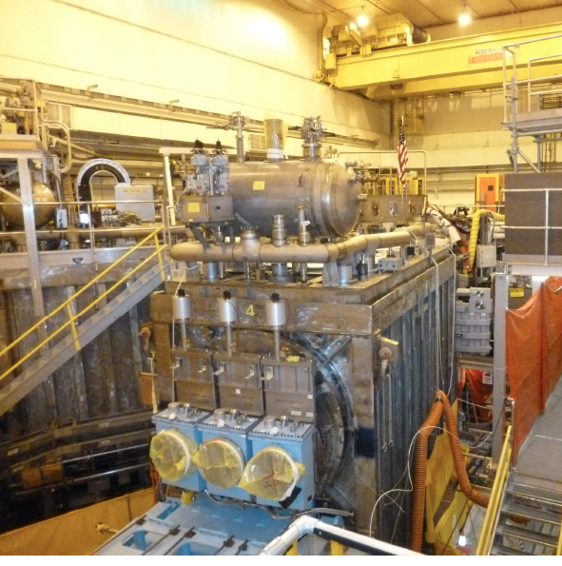
Relocation of the 2nd NBI beam line box from the TFTR test cell into the NSTX-U Test Cell Complete.
TFTR NBI beam box and components successfully tritium decontaminated.
Beam Box being lifted over NSTX
Beam Box placed in its final location and aligned
Beam Box being populated with components

Slide 14
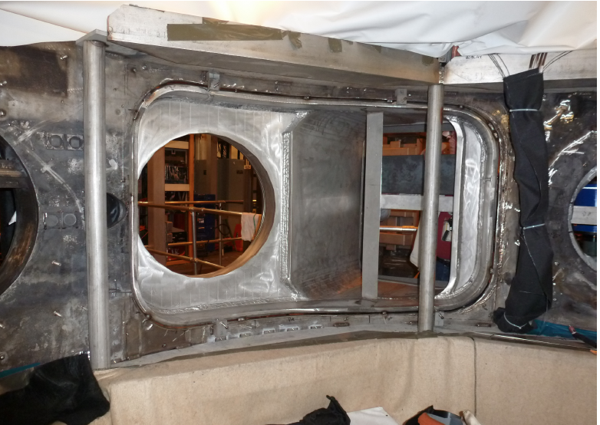
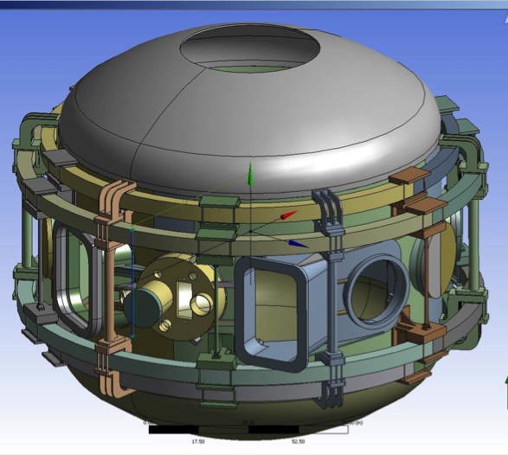
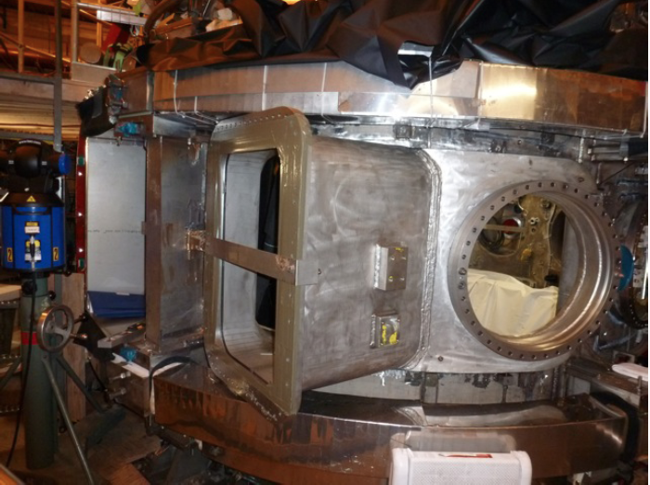
Highly Tangential 2nd NBI Enabled by JK-Cap
Outer Wall Radius Moved Outward to Avoid Beam Clipping
Interior View of Bay J-K
Exterior View of Bay J-K
JK cap

Slide 15
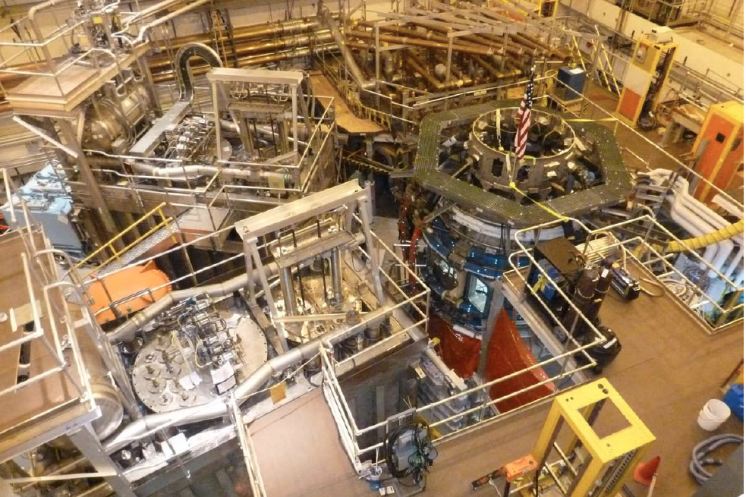
Aerial View of the NSTX-U Test Cell (April 2013)
HHFW
System
1st NBI
NSTX-U
2nd NBI
See back-up slides 45-46 for earlier test cell pictures

Slide 16
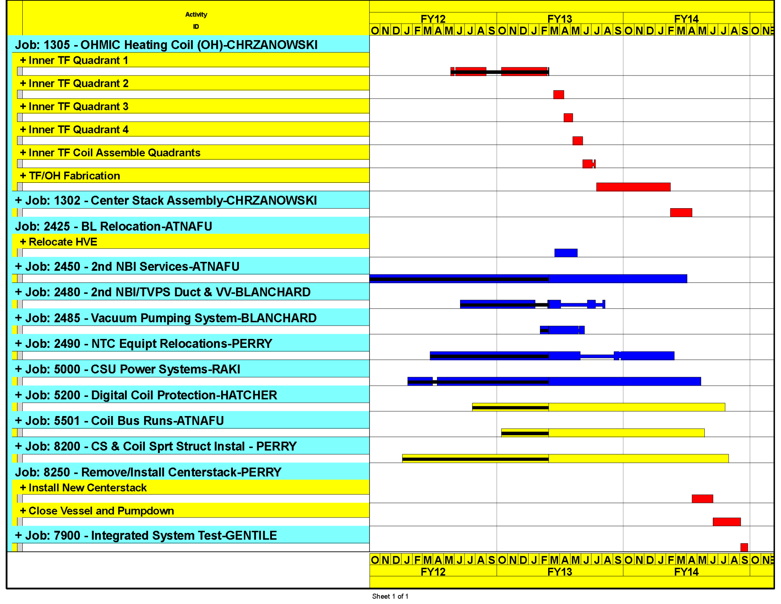
Upgrade schedule on track for early finish
Aiming to start research operation in FY 2015
Critical path through the centerstack fabrication and installation
Forecast Early October, 2014

Slide 17
Talk Outline
Previous five year (FY 2009-13) Project Summary and Status
NSTX Upgrade Project Overview
NSTX-U Operational Preparation Status
NSTX-U Facility / Diagnostic Five Year Plans
Budget
Summary

Slide 18
Engineering and Research Operations Activities
In Preparation for the NSTX-U Operations
The NSTX-U diagnostic and facility enhancement brainstorming meetings were held in July 2011 and Feb. 2012, respectively. Fifty eight diagnostics ideas and fifty one facility enhancement ideas were presented. The presentation material is available on the web URL:http://nstx.pppl.gov/DragNDrop/Five_Year_Plans/2014_2018/.
Significant collaboration research contributions are being made in diverse science areas by the NSTX-U research team. A summary is available on the web: http://nstx.pppl.gov/DragNDrop/Collaboration/.
Physics & Engineering Operations (see back-up slides # 47 – 50)
  Improving the PFC geometry in the vicinity of the CHI gap to protect the vessel and coils due to ~ 10x higher divertor heat loads
  Replacing electronics that control & protect rectifiers.
  Upgrading the poloidal field coil supplies to support up-down symmetric snowflake divertors.
  Upgrading the Plasma Control System (PCS) for NSTX-U.
Fabricating new port covers to support high-priority diagnostics. (see back-up slide # 51)

Slide 19
NSTX-U diagnostics to be installed during first 2 years
Half of NSTX-U Diagnostics Are Led by Collaborators
MHD/Magnetics/Reconstruction
  Magnetics for equilibrium reconstruction
  Halo current detectors
  High-n and high-frequency Mirnov arrays
  Locked-mode detectors
  RWM sensors
Profile Diagnostics
  MPTS (42 ch, 60 Hz)
  T-CHERS: T_{i}(R), V_{φ}(r), n_{C}(R), n_{Li}(R), (51 ch)
  P-CHERS: V_{θ}(r) (71 ch)
  MSE-CIF (18 ch)
  MSE-LIF (20 ch)
  ME-SXR (40 ch)
  Midplane tangential bolometer array (16 ch)
Turbulence/Modes Diagnostics
  Poloidal Microwave high-k scattering
  Beam Emission Spectroscopy (48 ch)
  Microwave Reflectometer,
  Microwave Polarimeter
  Ultra-soft x-ray arrays – multi-color
Energetic Particle Diagnostics
  Fast Ion D_{α} profile measurement (perp + tang)
  Solid-State neutral particle analyzer
  Fast lost-ion probe (energy/pitch angle resolving)
  Neutron measurements
  Neutral particle analyzer (single channel)
Edge Divertor Physics
  Gas-puff Imaging (500kHz)
  Langmuir probe array
  Edge Rotation Diagnostics (T_{i}, V_{φ}, V_{pol})
  1-D CCD H_{α} cameras (divertor, midplane)
  2-D divertor fast visible camera
  Metal foil divertor bolometer
  AXUV-based Divertor Bolometer
  IR cameras (30Hz) (3)
  Fast IR camera (two color)
  Tile temperature thermocouple array
  Divertor fast eroding thermocouple
  Dust detector
  Edge Deposition Monitors
  Scrape-off layer reflectometer
  Edge neutral pressure gauges
  Material Analysis and Particle Probe
  Divertor VUV Spectrometer
Plasma Monitoring
  FIReTIP interferometer
  Fast visible cameras
  Visible bremsstrahlung radiometer
  Visible and UV survey spectrometers
  VUV transmission grating spectrometer
  Visible filterscopes (hydrogen & impurity lines)
  Wall coupon analysis
New capability

Slide 20
Transition to operations - planning underway
NSTX-U Start-up Process Similar to NSTX
NSTX-U ISTP, Commissioning, and Startup will follow the same process as NSTX initial commissioning and startup from February 1999.
Pre-operational test of subsystems (PTP’S)
Activity Certification Committee (ACC) review
DOE Readiness assessment (RA)
Integrated system test procedure (ISTP) (per OP-NSTX-02 rev 14)
CD-4 Demonstrated
Performance
Key Operations Milestones
Begin Diagnostic Installation – August 1st, 2013
Complete in-vessel construction work October 1st 2013.
Complete Diagnostic installation & calibration – December 1st, 2013
Rough Pump down – January 1st, 2014
Commence operations, run XP’s
NSTX-U Team Development of XPs for FY 2015 run
Shake-down
(see back-up slides # 52)
NSTX-U Operations Team Similar to NSTX
Notes:
ACC > ORA >
PTP’s >>>ISTP OP-NSTX-02

Slide 21
Formulating Strategy Toward Full NSTX-U Parameters
After CD-4, the plasma operation could enter quickly into new regimes
 | NSTX (Max.) | Year 1 NSTX-U Operations (2015) | Year 2 NSTX-U Operations (2016) | Year 3 NSTX-U Operations (2017) | Ultimate Goal
I_{P} [MA] | 1.2 | ~1.6 | 2.0 | 2.0 | 2.0
B_{T} [T] | 0.55 | ~0.8 | 1.0 | 1.0 | 1.0
Allowed TF I²t [MA²s] | 7.3 | 80 | 120 | 160 | 160
I_{P} Flat-Top at max. allowed I²t, I_{P}, and B_{T} [s] | ~0.4 | ~3.5 | ~3 | 5 | 5
1st year goal: operating points with forces up to ½ the way between NSTX and NSTX-U, ½ the design-point heating of any coil
  Will permit up to ~5 second operation at B_{T}~0.65
2nd year goal: Full field and current, but still limiting the coil heating
  Will revisit year 2 parameters once year 1 data has been accumulated
3rd year goal: Full capability

Slide 22
Talk Outline
Previous five year (FY 2009-13) Project Summary and Status
NSTX Upgrade Project Overview
NSTX-U Operational Preparation Status
NSTX-U Facility / Diagnostic Five Year Plans
Budget
Summary

Slide 23


10 year plan tools with 5YP incremental funding
1.1 × (FY2012 + 2.5% inflation)
2014 | 2015 | 2016 | 2017 | 2018 | 2019 | 2020 | 2021 | 2022 | 2023
Upgrade Outage
1.5 → 2 MA, 1s → 5s
Metallic PFCs, 5s → 10-20s
Run Weeks:
20
16
16
20
22
6
18
22
22
New
center-stack
Start-up and Ramp-up
Upgraded CHI for ~0.5MA
0.5-1 MA CHI
up to 1 MA plasma gun
Extend NBI duration to 10-20s and/or implement 2-4 MW off-axis EBW H&CD
1 MW ECH/EBW
2 MW
Boundary Physics
Lower divertor cryo-pump
Divertor Thomson
Upper divertor cryo-pump
Inform U.S. next-step conceptual
design to optimize: aspect ratio, divertor, and PFCs
Materials and PFCs
High-Z tile row on lower OBD
High-Z first-wall + lower OBD tiles
High-Z PFC diagnostics
All high-Z PFCs
Hot high-Z FW PFCs using bake-out system
Liquid
metals / lithium
Upward
LiTER
LLD using bakeable cryo-baffle
Flowing Li divertor
or limiter module
Full toroidal flowing Li lower OBD
Li granule injector
MGI disruption mitigation
Partial NCC
NCC SPA upgrade
Full NCC
MHD
Enhanced MHD sensors
Transport & Turbulence
δB polarimetry
DBS, PCI, or other intermediate-k
High k_{θ}
Waves and Energetic Particles
HHFW limiter upgrade
HHFW straps to excite EHO
High-power AE antenna
2nd NBI
1 coil AE antenna
4 coil AE antenna
Charged fusion product, neutron-collimator
Scenarios and Control
Establish control of:
Control integration, optimization
Control integration, optimization with long-pulse and full metal wall
n_{e}
q_{min}
Divertor P_{rad}
Snowflake
Rotation

Slide 24
5 year plan tools with 5YP base funding
(FY2012 + 2.5% inflation)
2014 | 2015 | 2016 | 2017 | 2018
Upgrade Outage
1.5 → 2 MA, 1s → 5s
Run Weeks:
16
14
14
16
Cryo-pump, high-Z tile row on cryo-baffle, and partial NCC would be installed in-vessel during ~1 year outage between FY2016 and FY2017
  NSTX-U would operate 1st half of FY2016 and 2nd half of FY2017
New
center-stack
Start-up and Ramp-up
Upgraded CHI for ~0.5MA
up to 0.5 MA plasma gun
0.5-1 MA CHI
1 MW ECH/EBW
Boundary Physics
Lower divertor cryo-pump
Divertor Thomson
Materials and PFCs
High-Z tile row on lower OBD
High-Z tile row on cryo-baffle
High-Z PFC diagnostics
All high-Z PFCs
Delayed scope
Liquid
metals / lithium
Upward
LiTER
LLD using bakeable cryo-baffle
Flowing Li divertor
or limiter module
Reduced scope
Li granule injector
Deferred scope
MGI disruption mitigation
Partial NCC
NCC SPA upgrade
MHD
Enhanced MHD sensors
Transport & Turbulence
δB polarimetry
DBS, PCI, or other intermediate-k
High k_{θ}
Waves and Energetic Particles
HHFW limiter upgrade
HHFW straps to excite EHO
2nd NBI
1 coil AE antenna
4 coil AE antenna
Charged fusion product, neutron-collimator
Scenarios and Control
Establish control of:
Control integration, optimization
n_{e}
q_{min}
Divertor P_{rad}
Snowflake
Rotation

Slide 25
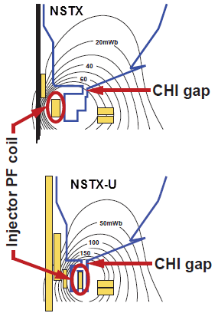
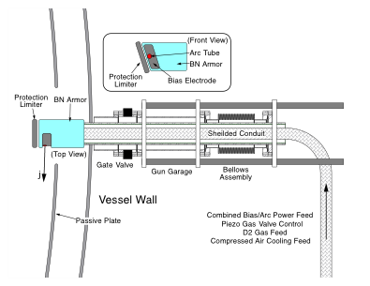
Solenoid-free Start-up
High priority goal for NSTX-U in support of FNSF
CHI Start-Up
PEGASUS Point Source
• Inj. Flux in NSTX-U is about 2.5 times higher than in NSTX
• NSTX-U coil insulation greatly enhanced for higher voltage ~ 3 kV operation
PEGASUS Plasma Gun
U. Washington
U. Wisconsin
FY 2013-14 Non-Inductive Start-up Systems Design for Post-Upgrade Operations
• CHI will start with the present 2 kV capability then enhanced to ~ 3 kV higher voltage as needed.
• PEGASUS gun start-up producing exciting results Ip ~ 160 kA. The PEGASUS gun concept is technically flexible to implement on NSTX once fully developed. High current gun for the NSTX-U will be developed utilizing the PEGASUS facility in collaboration with University of Wisconsin.

Slide 26
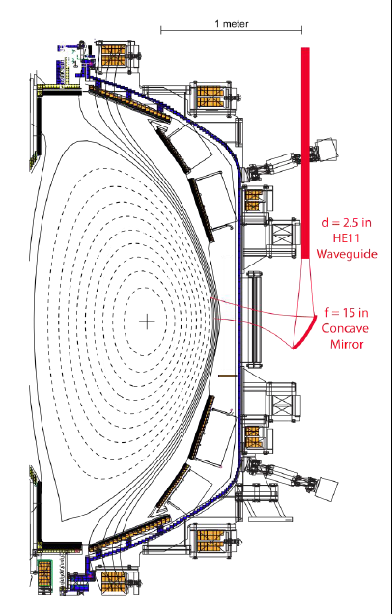
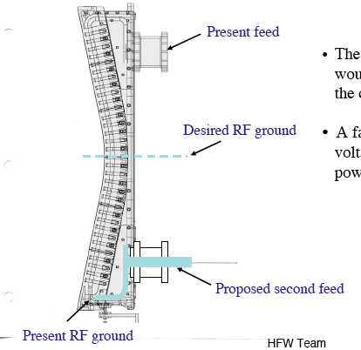
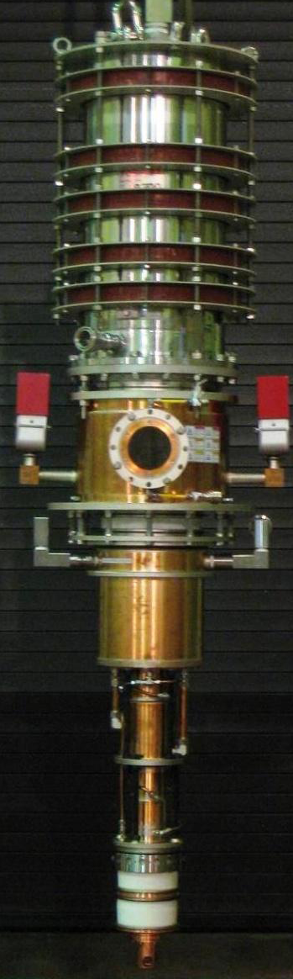
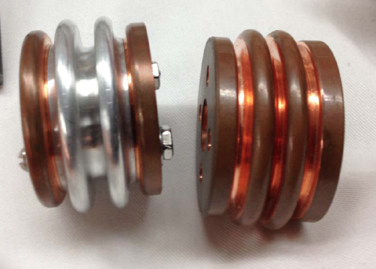
Strengthen HHFW Antenna Feeds for Disruption Load
A MW-Class 28 GHz ECH System for Non-Inductive Operation
HHFW antenna feedthru modification for disruption loads
28 GHz, 1.5 MW Tsukuba Gyrotron
A compliant section
Photo courtesy of C-Mod Group
28 GHz ECH/EBWH waveguide and mirror concept
• FY 2013/14 - HHFW Antenna feed enhancements against disruptive loads
• FY 2013/15 – Start MW-class ECH/EBW system conceptual design for non-inductive operations (MOU with Tsukuba University)

Slide 27
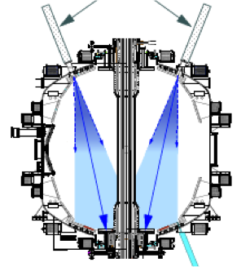
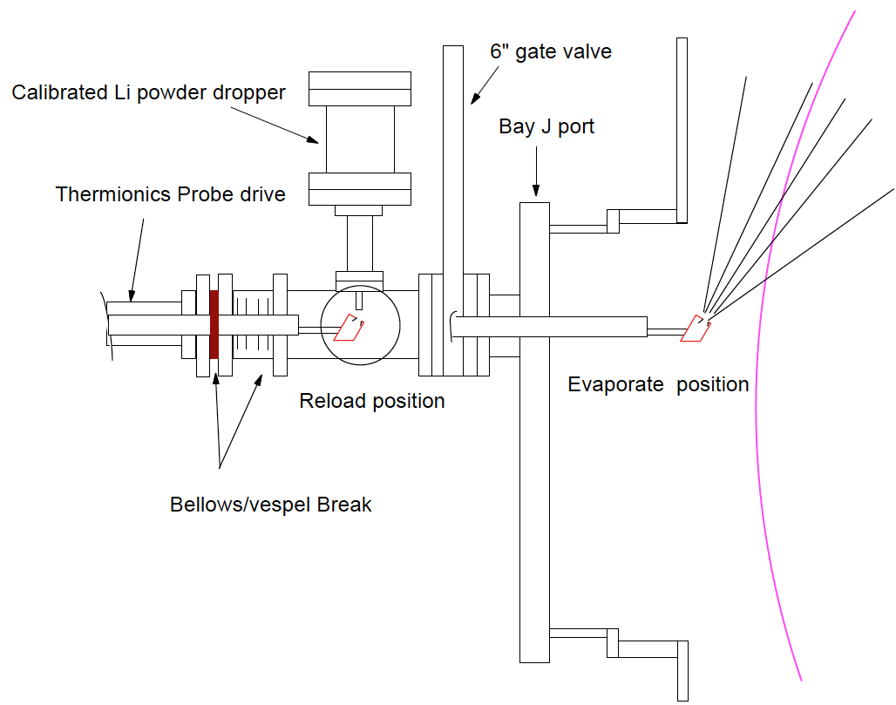
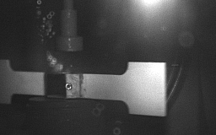
NSTX-U Lithium Capability During Initial Two Years
Lithium Evaporators and Granular Injector
Existing LITERS
New Upward Evaporating LITER
• Upward Evaporating LITER to increase Li coverage for increased plasma performance
NSTX-U lithium granular injector
for ELM pacing
• High frequency ELM pacing with a relatively simple tool.
• ELM pacing successfully demonstrated on EAST (D. Mansfield, IAEA 2012)
Granule Reservoir
Struck Granule Horizontally
Redirected at 70 m/s
t = 800 μs

Slide 28
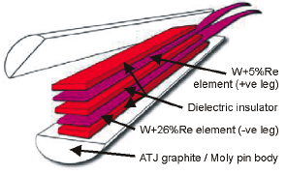
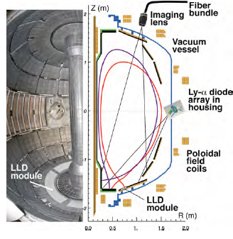
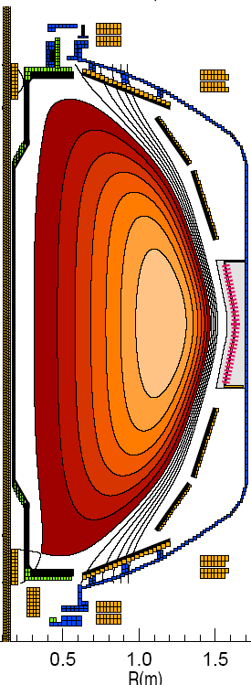
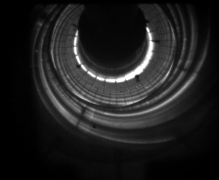
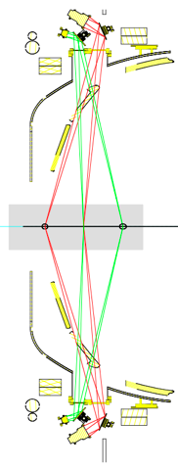
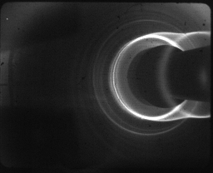
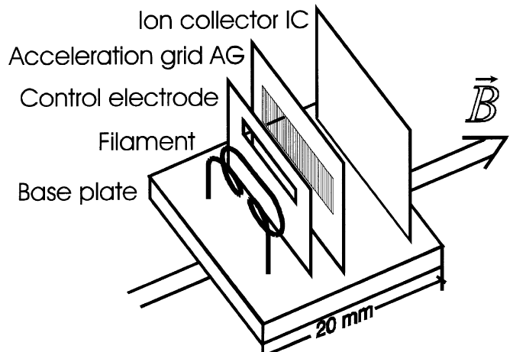
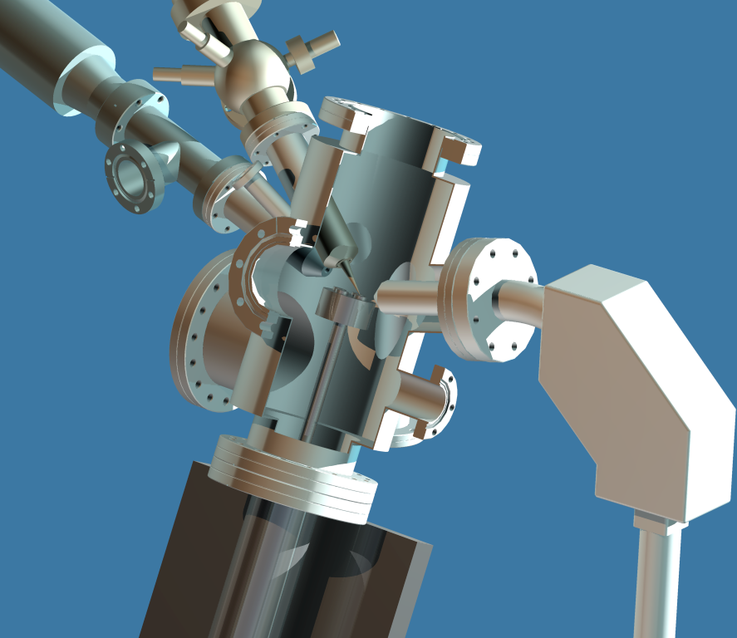
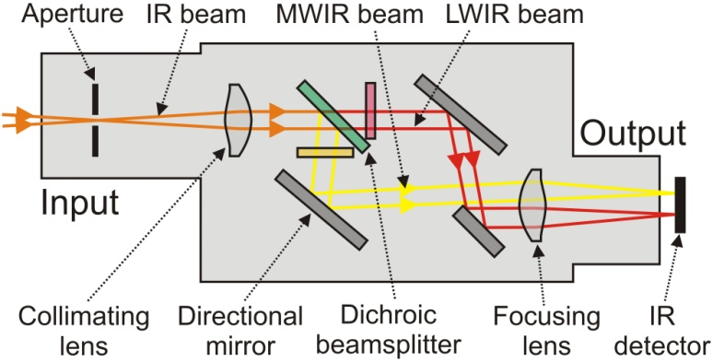
Baseline Capability for PMI Research
Supporting divertor and lithium research
Divertor fast eroding thermocouples
Two fast 2D visible and IR cameras with full divertor coverage
Divertor Imaging
Spectrometer
ORNL
LLNL, ORNL, UT-K
LLNL
Li I
  Lithium CHERS
ORNL
C II
Divertor fast pressure gauges
MAPP probe for between-shots surface analysis
Dual-band fast IR Camera
(see back-up slides # 53 and 54)
Purdue U.
Notes:
With the NSTX PAC recommendation, we have been increasing the LLD diagnsotic capabilities including lithium CHEERS, PMI probe, Lyman Alpha LLD recycling diode array, three view divertor bolometer, and two color fast IR divertor camera.

Slide 29
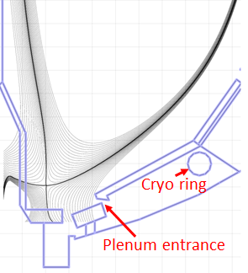
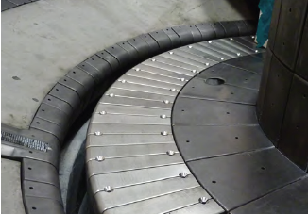
Boundary Facility Capability Evolution
NSTX-U will have very high divertor heat flux capability of ~ 40 MW/m²
2015
2016
2017
2018
C
BN
Li
High-Z
Lower
OBD
high-Z row of tiles
Cryo + high-Z FW and OBD
+ liquid Li divertor (LLD)
Cryo + high-Z FW and OBD
PFCs
High-Z tile row
Cryo-pump
Bakeable cryo-baffle for liquid Li
NSTX Moly Tiles
ORNL

Slide 30
New MHD and Plasma Control Tools for NSTX-U
Sustain β_{N} and Understand MHD Behavior Near Ideal Limit
Partial NCC option (2 x 6 odd parity)
Full NCC
Existing
RWM
coils
Non-axisymmetric Control Coils (NCC)
Columbia U., GA
• NCC can provide expanded RWM, NTV, RMP, and EF physics studies with more flexible field spectrum (n ≤ 6, or n ≤ 3 depending on set).
• 2nd 3-channel Switching Power Amplifier (SPA) commissioned in July 2011 to power 6 independent currents in existing midplane RWM and NCC coils.
• An extended MHD sensor set to measure theoretically predicted poloidal mode structure and to improve mode control.
• A Real-Time Velocity (RTV) diagnostic in a new plasma rotation control system for active instability avoidance by controlling rotation profile.
• Multi-poloidal location massive gas injector system will be implemented.

Slide 31
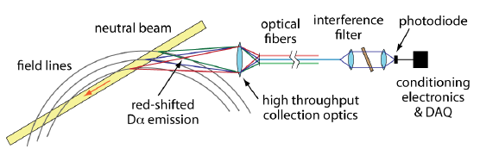
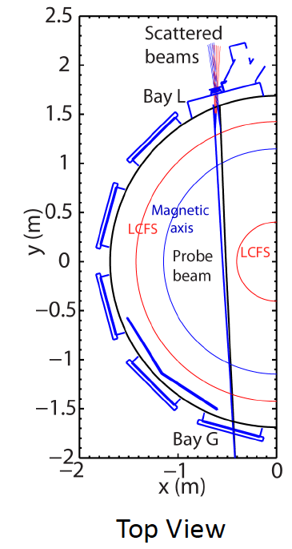
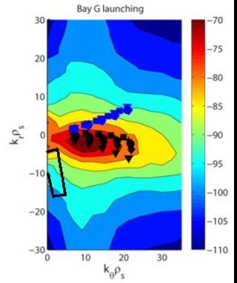
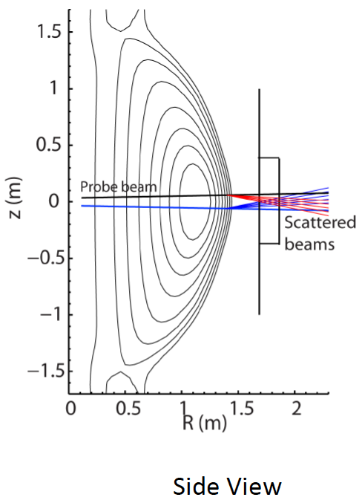
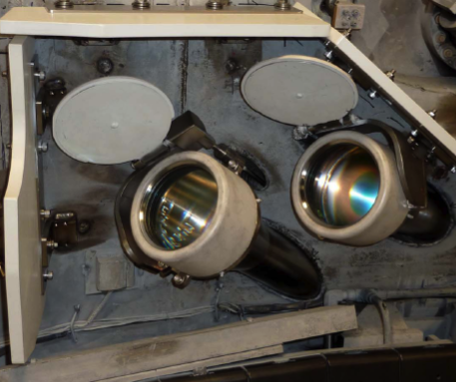
Transport and Turbulence
BES together with high-k to provide comprehensive turbulence diagnostic
Modes
0.1
1
k⊥(cm⁻¹)
10
100
μTEARING
ITG/TEM
ETG
BES, pol
BES
BES, Polarimeter
μwave Scattering
48 ch BES available for NSTX-U
(24 ch BES available in 2011)
New high-k scattering system for allowing
2-D k spectrum
Optical fibers
UCD
Neutral Beam
field lines
red-shited
Dα emission
High throughput collection optics
U. Wisconsin
A 288 GHz polarimetry system for magnetic fluctuation measurements is being tested on DIII-D.
UCLA
Notes:
Here is an overview of the NSTX facility operation and upgrade plan for FY 10-12. We plan to run 14 run weeks in each of fiscal year. We will conduct one extra ARRA week this year using the carry over from last fiscal year. For incremental, we propose to run up to 6 run weeks each in FY 11 and 12. We have a very strong set of upgrade becoming available this year . In FY 11, our base upgrade activities are either supported by ARRA funding or by the collaborators. Our base upgrade resources will be mostly devoted to the preparation for the major upgrade outage planned in FY 13-14 to install a new center-stack and the 2nd NBI which will be described by Ron Strykowsky our upgrade project manager.

Slide 32
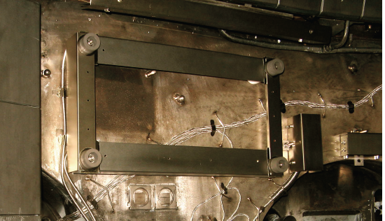
Energetic Particle Research Capabilities
For NBI fast ion transport and current drive physics
FIDA Views
Fast Ion D-Alpha Diagnostics
UCI
• Vertical FIDA system measures trapped or barely passing (co-going) particles.
• New tangential FIDA system measures co-passing fast ions
• Both FIDA systems have time resolution of 10 ms, spatial resolution ≈ 5 cm and energy resolution ≈ 10 keV.
Vertical
Tangential
FY 2013 - 14 Energetic Particle Conceptual Design and Diagnostic Upgrade
  Solid State-NPA enhancement
  Charged Fusion Product Array
  Proto-type active TAE antenna
UCI
FIU
5-turn radial active TAE antenna installed in 2011

Slide 33
Talk Outline
Previous five year (FY 2009-13) Project Summary and Status
NSTX Upgrade Project Overview
NSTX-U Operational Preparation Status
NSTX-U Facility / Diagnostic Five Year Plans
Budget
Summary

Slide 34
NSTX Five Year Plan Budget Summary ($M)
Special financial challenges to transition from construction to operation
 | FY14 |  | FY15 |  | FY16 |  | FY17 |  | FY18
Budget Cases | Base | 10% Incr | Base | 10% Incr | Base | 10% Incr | Base | 10% Incr | Base | 10% Incr
Run Weeks | 0 | 0 | 16 | 4 | 14 | 2 | 14 | 2 | 16 | 4
Facility Ops | $12.7 |  | $26.6 | $1.0 | $29.0 | $0.5 | $29.7 | $0.5 | $30.9 | $1.0
Facility Enhancements | $0.7 | $4.2 | $2.8 | $2.3 | $5.0 | $2.8 | $5.1 | $3.0 | $4.9 | $2.5
NSTX-U | $23.2 |  | $3.8
Facility Total | $36.6 | $4.2 | $33.1 | $3.3 | $34.0 | $3.3 | $34.9 | $3.5 | $35.7 | $3.5
PPPL Research | $10.5 |  | $12.9 | $0.9 | $13.2 | $0.9 | $13.5 | $0.9 | $13.9 | $0.9
Collab Interface | $0.5 | $0.5 | $0.7 | $0.5 | $0.7 | $0.5 | $0.8 | $0.5 | $0.8 | $0.5
Collaborators | $6.2 | $0.6 | $6.4 | $0.6 | $6.6 | $0.7 | $6.7 | $0.7 | $6.9 | $0.7
Science Total | $17.2 | $1.1 | $20.0 | $2.0 | $20.5 | $2.1 | $21.0 | $2.1 | $21.6 | $2.2
NSTX-U Total | $53.8 | $5.3 | $53.2 | $5.3 | $54.5 | $5.4 | $55.9 | $5.6 | $57.3 | $5.7
• FY 2014 and 2015 would be a transition period from construction to operation.
• Research and Operations team budget for NSTX-U is similar to that of NSTX.
• Base funding enables preparation and operation of NSTX-U while completing the Upgrade Project on schedule.
• Significant post upgrade facility/diagnostic enhancements will starts in FY 2016.
• Incremental scenario will enable full NSTX-U operation and timely implementation of the five year plan major facility and diagnostic enhancements.

Slide 35
Base NSTX-U Five Year Plan Budget Summary
Base DOE Guidance Budget – Inflation adjusted flat FY 2012 budget
• FY12 budget + 2.5% inflation
Collaborations
Collaboration Diagnostic Interface
PPPL Research
Upgrade Project
Facility Enhancement
Facility Ops
0
16
14
14
16
Run Weeks
FY 14
FY 15
FY 16
FY 17
FY 18
In FY 14-15, the Upgrade Project needs to be completed.
In FY 14-15, modest budget is available for 5 year plan long lead facility enhancements (e.g., ECH, Cryo-pump, and NCC), only enabling design and R&D activities.
For FY 15 and beyond, the budget facility operations and PPPL/Collaboration research are based on similar operations and research staff coverage to NSTX.

Slide 36
Optimized NSTX-U Five Year Plan Has been Developed
Exciting Opportunities and Challenges Ahead
• Present NSTX Five Year Plan has been progressing well.
  Most of the research, facility, and diagnostic milestones have been achieved on schedule.
  Research team has been active in conferences and publication areas.
  Facility/diagnostic enhancements implemented during the period contributed to the research productivities.
• NSTX upgrade outage activities are progressing well
  Diagnostics were stored and secured for the upgrade activities.
  Researchers are working productively on data analysis, collaboration, next five year plan and preparation for the NSTX-U operation.
  NSTX operations technical staff were shifted to the Upgrade Project tasks in FY 2012 – 13.
  NSTX Upgrade Project is thus far progressing on budget and on schedule.
• Exciting 5 Year Plan (FY 2014 – 18) has been developed
  Aiming to provide necessary data base for FNSF design and construction.
  Strong contribution to toroidal physics, ITER, and fusion energy development.
  10% incremental budget would enable timely implementation of facility capabilities to support the exciting NSTX-U Five Year Plan.

Slide 37
Back-up Slides

Slide 38
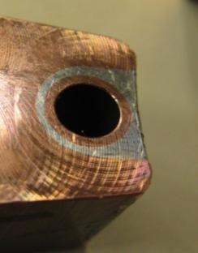


NSTX TF Fault Traced to Zinc Chloride Base Flux
Lessons Learned Applied to New TF Bundle Fabrication
  • Zinc chloride based flux used for cooling water tube soldering was the cause of insulation failure.
  • An independent review endorsed the findings.
  • Developed new soldering technique with resin-based flux for the new center-stack
Close up views of new solder cross section
New TF conductor on soldering station

Slide 39
NSTX FY 09 Milestones
Milestone | Description | Baseline | Completed
JRM(09) | Particle control and hydrogenic fuel retention in tokamaks , NSTX to explore lithium surface | 09/30/09 | 09/30/09
R(09-1) | Understand the physics of RWM stabilization and control as a function of rotation. | 09/30/09 | 09/30/09
R(09-2) | Study how j(r) is modified by super- Alfvénic ion driven modes. | 09/30/09 | 09/30/09
R(09-3) | Perform high-elongation wall-stabilized plasma operation. | 09/30/09 | 09/30/09
F(09-1) | Operate NSTX Facility for 11 Experimental Run Weeks. | 09/30/09 | 09/30/09
F(09-2) | Complete fabrication of the liquid lithium divertor target for particle pumping. | 09/30/09 | 09/30/09
AF(09-1)* | Operate NSTX Facility for 5 additional Experimental Run Weeks | 05/30/10 | 05/30/10
D(09-1) | Upgrade the divertor bolometer to three views with 20 channels. | 09/30/09 | 09/30/09
D(09-2) | Complete fabrication of the Beam Emission Spectroscopy system for transport studies. | 09/30/09 | 09/30/09
AD(09-1)* | Complete engineering design of MPTS Extra Channels. | 11/30/09 | 11/30/09
 | * ARRA related milestones

Slide 40
NSTX FY 10 Milestones
Notes:
40

Slide 41
NSTX FY 11 Milestones
Notes:
41

Slide 42
NSTX FY 12 Milestones
Notes:
42

Slide 43
NSTX FY 13 Milestones
Notes:
43

Slide 44
NSTX-U Support Structures Enhanced
To Handle 4x Electromagnetic Forces
Install Upper & Lower Al Block External-Internal Reinforcements
Install New Upper Lid
Replace Upper & Lower PF2/3 clamp hardware
Install Upper & Lower Umbrella Arch Reinforcements
Install additional (upper & lower) PF2 Clamp
Install New TF Outer Leg (TFOL) Support
Install new TF-VV Clevis
Replace existing Upper & Lower Pf4/5 clamp hardware
Install New Pf4/5 Support
Replace existing Pf4/5 Support Column
Install new TFOL Connecting Rods & Rod Ends
Modify support to provide clearance for connecting rod
Install New Upper & Lower Umbrella Leg/Foot/Slide
Install New Lower Lid
Add Extensions & Anchors to Supports
Install New Pedestal

Slide 45

Aerial View of the NSTX Test Cell (Oct. 2011)
HHFW
System
1st NBI
NSTX
Pumping Duct

Slide 46

Aerial View of the NSTX Test Cell (Feb. 2012)
HHFW
System
NSTX
1st NBI

Slide 47



All Graphite PFC Day-1 NSTX-U Configuration
Improved gap tiles to protect PF1C and Exposed SS surfaces
Existing Tile Design
CHI Gap
• NSTX-U plasma operation may increase the gap area thermal loading by ~ x 10
Center Stack
Secondary Passive Plates
PF 1C
HHFW
Antenna
NBI Armor
Improved Tile Design
Primary Passive Plates
CHI Gap
New Gap Overhung Tiles to provides necessary protection
CHI Gap
In-board
Divertor
PF 1C
Out-board
Divertor

Slide 48

Transrex AC/DC Convertors of the NSTX FCPC
Upgrading of Firing Generators and Fault Detectors
Transrex AC/DC Convertors of the NSTX Field Coil Power conversion System (FCPC) provide a pulsed power capability of 1800 MVA for 6 seconds. The modular converter concept of 74 identical (with a paired sections A & B), electrically isolated 6-pulse “power supply sections” was originally used on TFTR, and then adapted to NSTX.
  Many parts from 1984 are nearing end-of-life due to age and wear, replacement parts are rare or unavailable, and that performance can be improved using more modern equipment.
  Precise control of thyrister firing angles by the FCPC firing generators becomes more critical for the new 8-parallel, 130kA TF system configuration.
  Ability to separately control the “A” and “B” sections of each power supply unit allows for more efficient utilization of the 74 available sections.
  The new Firing Generator (FG) will deliver firing pulses with greater resolution, precision, and repeatability, and can receive and process separate commands to the A and B sections
Status:
The prototype FG has been fully tested in a Transrex rectifier, and production units are being fabricated.
The new Fault Detector (FD) provides improved external interface compatible with the NSTX-U data acquisition system.
The FD prototype has been completed in conjunction with the new FG in a Transrex rectifier.

Slide 49
NSTX-U Plasma Control System Upgrade
Migration to more modern computer for real-time applications
Sample rate: 5 → 20 KHz
Added 32 channels
PC Links replaced with much faster “Firing Generator” Serial Links
Analog Inputs
Coil Currents
Power Supplies
Magnetics
(including upgrades)
Neutral Beams
(1st and 2nd BLs)
Gas Injection
Vacuum
Rotation data
Pitch angle data
FPDP: 1 → 4 links
Analog Inputs
416 channels
PC Links
Power Supplies
(inc. 3 new coils)
Neutral Beams
(including new BL)
Gas Injection
Real-Time
Computer
Digital Inputs
12 words
FPDP
FPDP
Digital Outputs
Time Stamp
micro seconds
Analog Outputs
Hardware Upgrades
New computer: cores: 8 → 32
Commercial Linux Real-Time operating system & advanced real-time debug tools.
New quad-port fiber optic FPDP I/O boards.
Software Upgrades
Ported PPPL code and GA PCS to 64-bit.
Generate commands for new firing generators .
Coil Protection (DCPS) functions incorporated in PSRTC.
Numerous new control algorithms.
PCS algorithms re-written using GA format.
PSRTC to be re-written.
Physics Algorithms For Development Once Hardware/Software Infrastructure is Complete
Modified shape control
Snowflake Control
Dud Detection & Soft Landings
Rotation, Current, β_{N}
SGI and density control
new diagnostic algorithms
A second instance of this real-time computer will be acquired before operation providing a backup for NSTX-U operations and allowing parallel testing of control code during NSTX-U operations.

Slide 50

NSTX-U PF Coil Power System Upgrade
Enables up-down symmetric divertor operations
The first-year power supply capabilities of NSTX-Upgrade will yield considerable experimental flexibility, namely, up-down symmetric PF-1C coils compared to only at the bottom.
By powering the PF-1A & PF-1C coils, it will be possible to generate up-down symmetric snowflake divertors
  Capability did not exist in NSTX.
  Bipolar PF-1C allows easy comparison between snowflake and standard divertors.
The new configuration should provide better control for the CHI absorber region.
Longer-term, upgrades to the power supply systems may add considerable new capability:
  - The PF-2 coils may be upgraded to bipolar operations. This will allow those coils to either create the snowflake divertor or to control the lower plasma-wall gap in the high-triangularity shapes, without changes to the power supply links.
  - The PF-1B coil, which will not be powered during initial upgrade operations, may be important for maintaining a steady snowflake divertor through the full OH swing.

Slide 51

NSTX-U facility/diagnostics port assignment
Port flanges designed and ordered

Slide 52
Plans to Rapidly Recover Physics Operations Capabilities
Plasma Operations with:
I_{p}≤1.0 MA, B_{T}≤0.5
Develop:
Breakdown and current ramp scenarios
Shape & position control
Reliable H-mode
Diagnostic operations
Continue to add diagnostic & control capabilities while initiating physics experiments.
ISTP:
(Integrated Systems Test Procedure)
Establishes facility in state of readiness for operations.
I_{p}≤1.5-1.6 MA
B_{T}≤0.75-0.8
July-Sept. 2014
ISTP-1 & CD-4 Prep
MPTS Calibrations, Bake Out, CD-4
Operations
Commissioning
Phys. Ops
ISTP-2
Phys.
Ops
~ 2-3 Months
ISTP-2
Required to increase the field and current for later research phase
Attempt 50 kA CD-4 plasma before bake-out. If water in PFCs prevents success, then repeat after bake-out.

Slide 53


Surface Analysis Facilities to Elucidate Plasma-Surface Interactions
PPPL Collaboration with B. Koel et al., Princeton University
The Surface Science and Technology Laboratory (SSTL) with three surface analysis systems and an ultrahigh vacuum deposition chamber.
The Surface Imaging and Microanalysis Laboratory (SIML) with a Thermo VG Scientific Microlab 310-F High Performance Field Emission Auger and Multi-technique Surface Microanalysis Instrument.
Recently solid lithium and Li coated TZM were examined using X-ray photoelectron spectroscopy (XPS), temperature programmed desorption (TPD), and Auger electron spectroscopy (AES) in ultrahigh vacuum conditions and after exposure to trace gases.
Experiment on SSTL determined that lithiated PFC surfaces in tokamaks will be oxidized in about 100 s in the expected NSTX-U vacuum conditions. (C. H. Skinner et al., PSI_20 accepted to J. Nucl. Mater. )
X-ray photo-electron spectroscopy
Lithium coated TZM being examined by TPD and AES.

Slide 54


Materials Analysis and Particle Probe – MAPP –
to relate PFC surface conditions and plasma behavior in “real time”
PFC analysis after run is difficult to relate to plasma behavior
  Reflects cumulative effect of multiple evaporations and surface compound formation
  Hard to determine determine surface conditions during any specific discharge
MAPP provides in-situ and between-shots solution
  PFC sample can be exposed during shot and withdrawn for between-shots analysis
MAPP chamber showing diagnostics for sample analysis
MAPP will be tested on LTX during outage
J.P. Allain (Purdue), R. Kaita, et al.,

