Slide 1




NSTX-U
Supported by
NSTX-U Five Year Plan Contributions
to ITER
Coll of Wm & Mary
Columbia U
CompX
General Atomics
FIU
INL
Johns Hopkins U
LANL
LLNL
Lodestar
MIT
Lehigh U
Nova Photonics
Old Dominion
ORNL
PPPL
Princeton U
Purdue U
SNL
Think Tank, Inc.
UC Davis
UC Irvine
UCLA
UCSD
U Colorado
U Illinois
U Maryland
U Rochester
U Tennessee
U Tulsa
U Washington
U Wisconsin
X Science LLC
S.M. Kaye
Deputy Program Director, NSTX-U
Culham Sci Ctr
York U
Chubu U
Fukui U
Hiroshima U
Hyogo U
Kyoto U
Kyushu U
Kyushu Tokai U
NIFS
Niigata U
U Tokyo
JAEA
Inst for Nucl Res, Kiev
Ioffe Inst
TRINITI
Chonbuk Natl U
NFRI
KAIST
POSTECH
Seoul Natl U
ASIPP
CIEMAT
FOM Inst DIFFER
ENEA, Frascati
CEA, Cadarache
IPP, Jülich
IPP, Garching
ASCR, Czech Rep
NSTX-U Five Year Plan Review
PPPL – B318
May 21-23, 2013

Slide 2
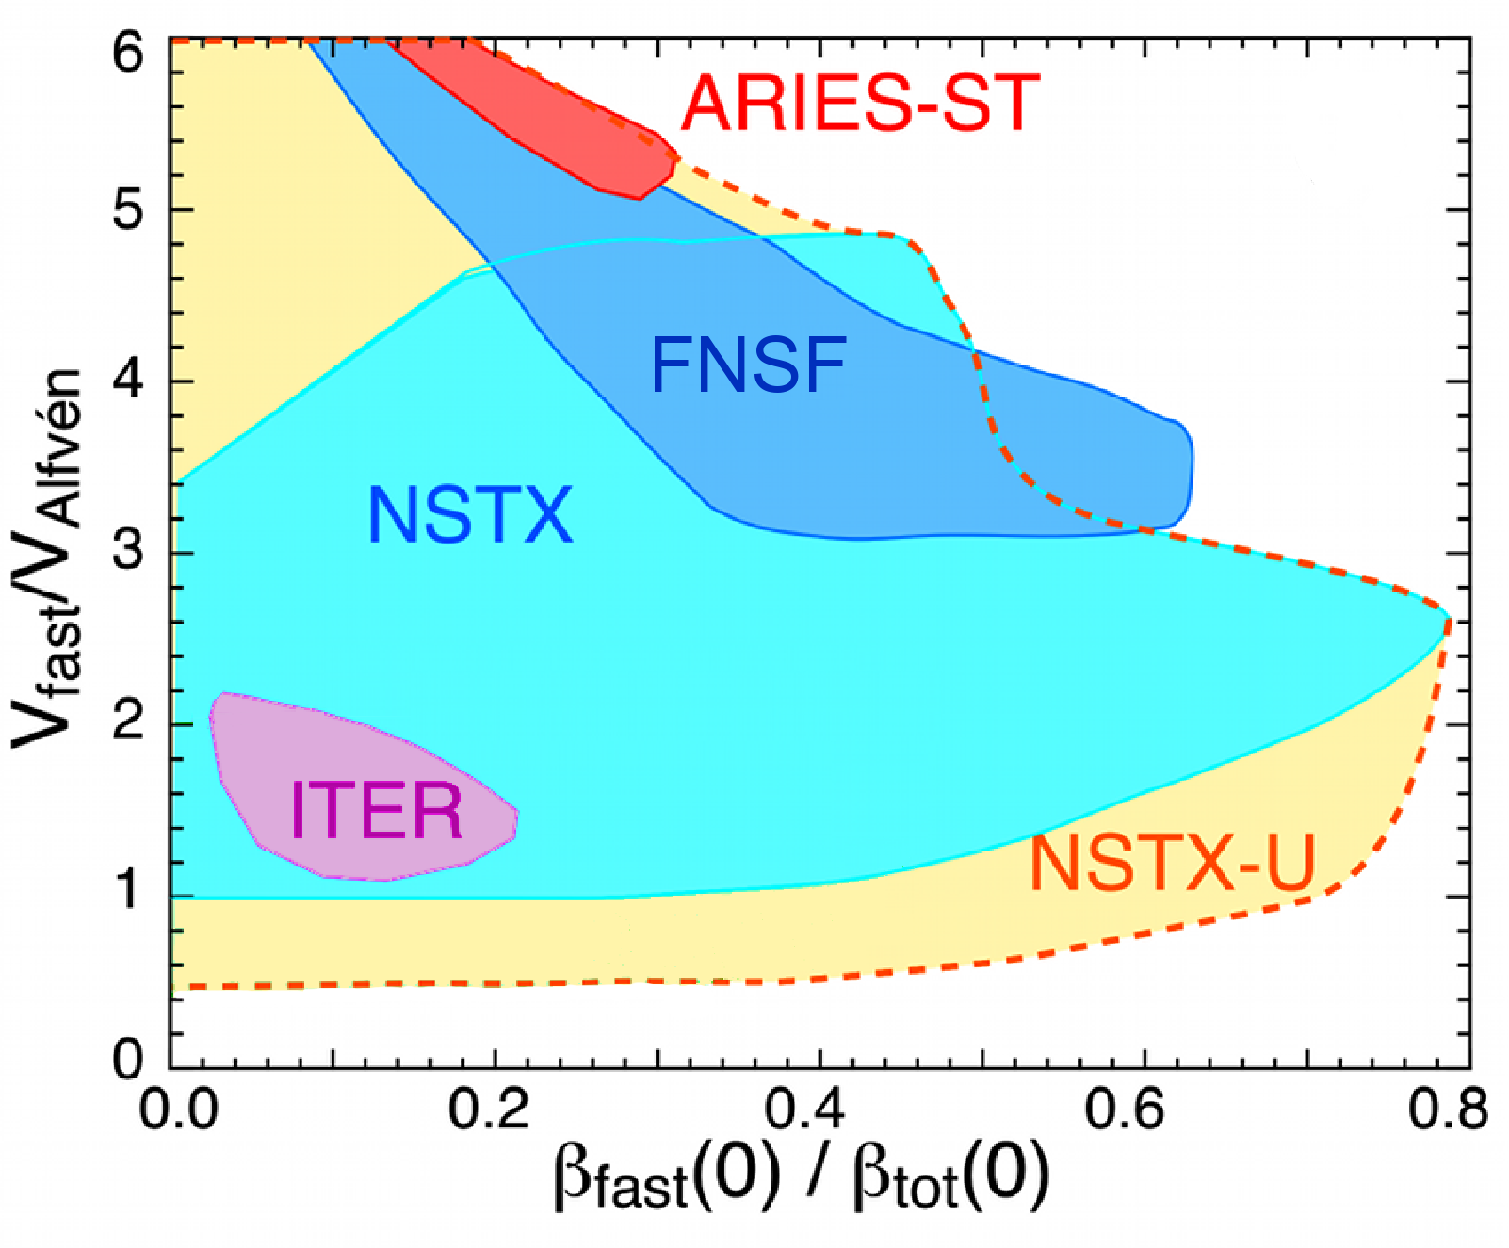
NSTX-U Will Make Contributions to ITER in All Topical Science Areas
Explore fundamental toroidal physics issues
Use high toroidicity, shaping, expanded operating range as leverage for theory validation
Develop operational/control/hardware approaches & capabilities
  In Energetic Particle area, direct overlap with some ITER parameters under normal, high-performance operating conditions
Approach of this Overview is to summarize the 5 year physics research on NSTX-U that most strongly addresses the ITER R&D needs
  Emphasis is on Urgent and High Priority needs for ITER
  In most cases, NSTX-U will contribute to the longer term physics and operational scenario development, as opposed to near-term design issues

Slide 3
ITER High Priority R&D Items Outlined by D. Campbell in
Dec. 2012 ITPA CC Meeting Presentation
MHD
  Design of disruption mitigation system
  High success detection to trigger rapid shutdown, MGI
  Error fields, Locked mode, RWM control
Divertor and Plasma-Wall Interactions
  Heat fluxes to PFCs; SOL widths and dependences
  Tungsten: effect of transient and s-s heat loads, melting
  Migration, fuel inventory, dust
Pedestal and Edge Physics
  ELM control (3D fields and other)
  L-H threshold and ensuing pedestal evolution
Transport and Confinement
  H-mode ingress/egress, role of metallic PFCs
  Particle transport and fueling: impurity transport
Energetic Particles
  Predict AE stability, behavior, effect on fast ions: code V&V
  Fast ion losses due to application of 3D fields
Integrated Operating Scenarios
  Develop integrated control scenarios
  Investigate hybrid and steady-state scenarios
  Validate heating and current drive scenarios
Physics areas in which NSTX-U can contribute
In remainder of talk, will focus on areas where NSTX-U can make the greatest impact (underlined)
Through talk, will map NSTX-U research to specific TSG Research Thrusts (e.g., ASC-2)

Slide 4
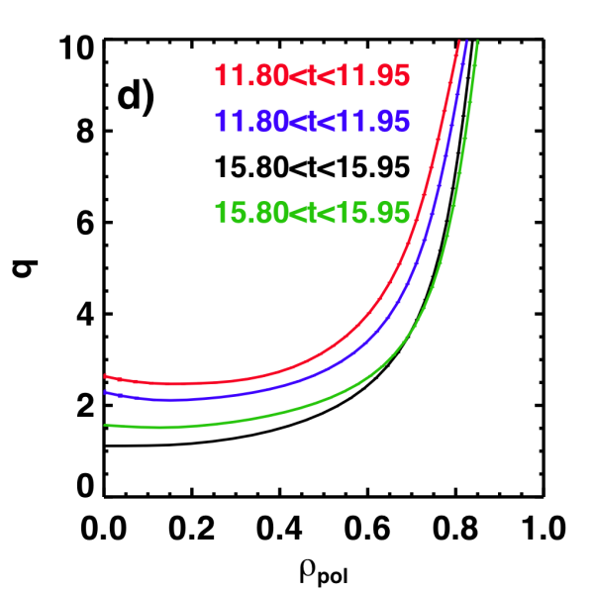
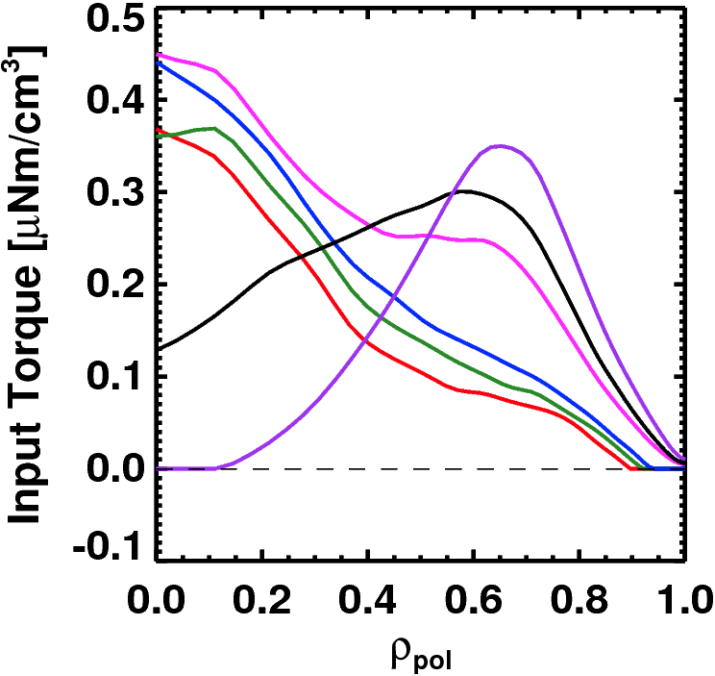
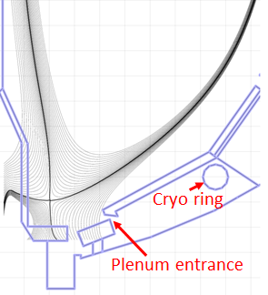
NSTX-U Will Have Flexible Profile Control Capabilities That Will Benefit All Research Areas
Rotation Profile Actuators
q-Profile Actuators
Torque Profiles From 6 Different
NB Sources
Normalized Integrated Torque From 3D Coils
Variations in Beam Sources
Largest R_{tan}
800 kA and 1 T
[50,60,70,130] cm
[50,60,120,130] cm
[60,70,110,120] cm
[70,110,120,130] cm
Smallest R_{tan}
Midplane n=3
Cryopump, Li conditioning, higher I_{p}, B_{T} for lower ν*

Slide 5
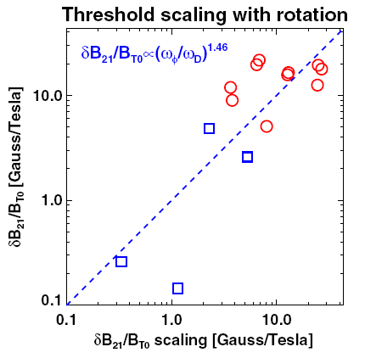
Multiple Physics Effects Govern Plasma Stability
Locked mode thresholds depend
on EF and v_{φ} (MS-2, ASC-2)
RWM stability depends on ν∗, v_{φ},
kinetic effects (MS-1, ASC-2)
High rotation

Slide 6
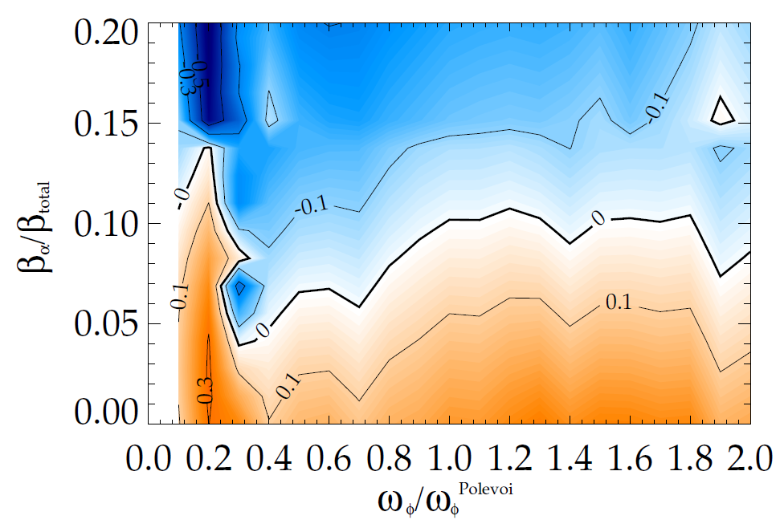
Multiple Physics Effects Govern Plasma Stability
Locked mode thresholds depend
on EF and v_{φ} (MS-2, ASC-2)
RWM stability depends on ν∗, v_{φ},
kinetic effects (MS-1, ASC-2)
High rotation
ITER
ITER EF study
Contributions to ITER scenario stability have already been made by NSTX-U
researchers
stable
expected
β_{α}
Required EF currents
to avoid locking
expected ω_{φ}
unstable

Slide 7
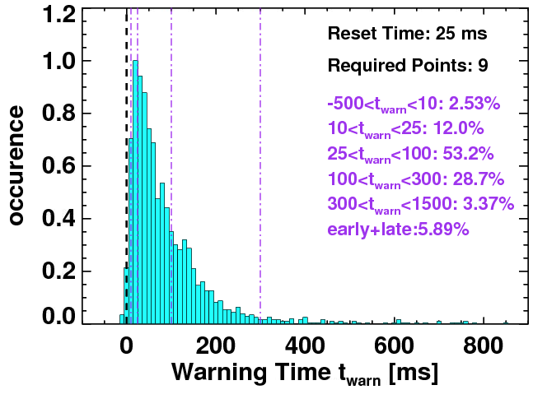
Successful Disruption Mitigation Requires Accurate Prediction and Ability to Limit TQ/CQ Effects
Disruption Warning System (ASC-3)
  Disruption warning algorithm based on combination of sensor- and physics-based variables
  < 4% missed, 3% false positives (> 300 ms prior)
Approach to be assessed on larger R/a devices through ITPA Joint Activity
Neutron emission
RWM growth
Mode locking
V_{loop}, v_{φ}, τ_{E}
dZ/dt
f_{p}, l_{i}
False positives

Slide 8
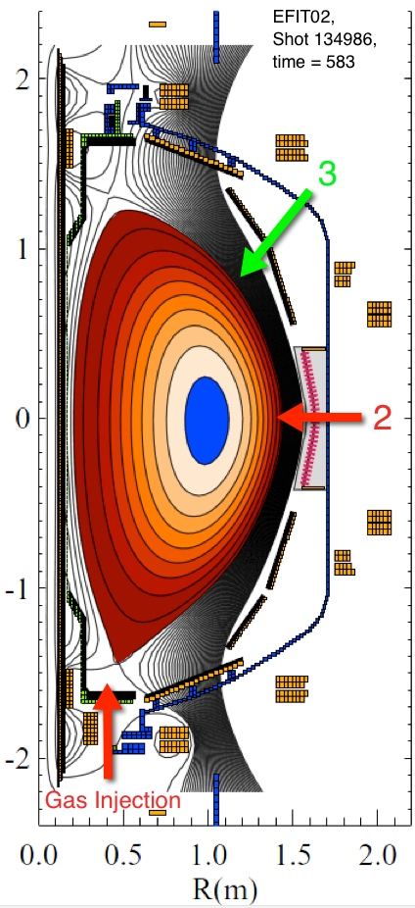
Successful Disruption Mitigation Requires Accurate Prediction and Ability to Limit TQ/CQ Effects
Disruption Warning System (ASC-3)
  Disruption warning algorithm based on combination of sensor- and physics-based variables
  < 4% missed, 3% false positives (> 300 ms prior)
Approach to be assessed on larger R/a devices through ITPA Joint Activity
MGI system will be implemented in YR1 of operation (MS-3)
  Assess SOL gas penetration for different injection locations (esp. private flux region)
  May be able to influence design for ITER
Electromagnetic Particle Injector (EPI)
  Rail gun technique for rapid and large amount of particle injection
  To be proposed by NSTX-U collaborator

Slide 9
Longer-term Objective is to Develop an Integrated, Physics-Based Disruption Prediction-Avoidance-Mitigation Framework
Predictors (Measurements)
Shape/position
Eq. properties (β, l_{i}, V_{loop},…)
Profiles (p(r), j(r), v_{φ}(r),…..)
Plasma response (n=0-3, RFA, …)
Divertor heat flux
Plasma Operations
Control Algorithms: Steer
Towards Stable Operation
Isoflux and vertical position ctl
LM, NTM avoidance
RWM and dynamic EF control
RWMSC (plasma response)
Divertor radiation control
Avoidance Actuators
PF coils
2nd NBI: q, v_{φ}, p control
3D fields (upgraded + NCC):
EF, v_{φ} control
n=1-3 feedback
Divertor gas injection

Slide 10
Longer-term Objective is to Develop an Integrated, Physics-Based Disruption Prediction-Avoidance-Mitigation Framework
Predictors (Measurements)
Shape/position
Eq. properties (β, l_{i}, V_{loop},…)
Profiles (p(r), j(r), v_{φ}(r),…..)
Plasma response (n=0-3, RFA, …)
Divertor heat flux
General framework &
algorithms applicable
to ITER
Plasma Operations
Control Algorithms: Steer
Towards Stable Operation
Isoflux and vertical position ctl
LM, NTM avoidance
RWM and dynamic EF control
RWMSC (plasma response)
Divertor radiation control
Avoidance Actuators
PF coils
2nd NBI: q, v_{φ}, p control
3D fields (upgraded + NCC):
EF, v_{φ} control
n=1-3 feedback
Divertor gas injection
Loss of Control
Disruption Warning
System
Mitigation
Early shutdown
Massive Gas Injection
EPI (tbp)
Framework to be assessed in ITPA JEX/JAC

Slide 11
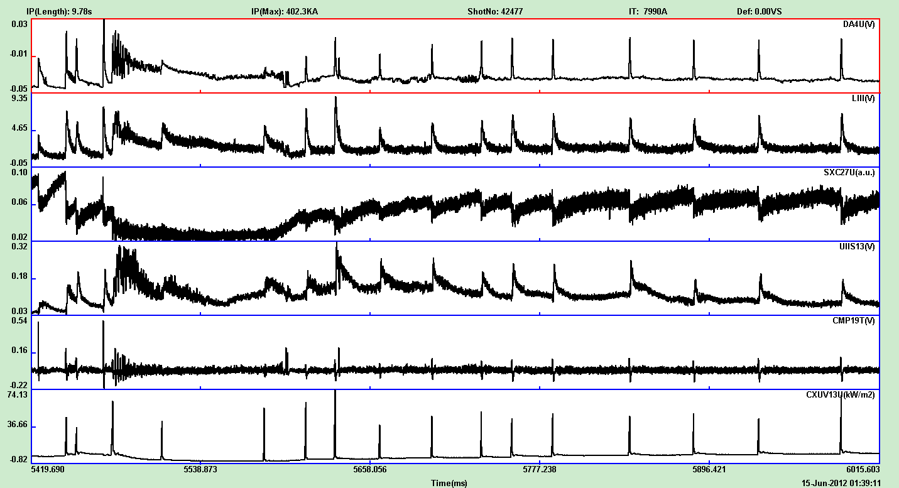
ELM Control is a High Priority R&D Issue for ITER,
But Is Not Limited to ITER (BP-1)
NSTX
ELM control by applied 3D fields
  NSTX results show pacing, not suppression
  Expanded capability with upgraded 3D system + NCC
    Greater range of poloidal mode spectra (suppression?)
    Higher frequency ELM triggering
    More edge-localized, less core rotation damping (NTV)
  Assess effect in lower ν∗ pedestal
    ELM control by other means
  Li granule injection: successful on EAST,
    Be granule injection of possible interest for JET, ITER
  Vertical kicks in expanded operating space
  Small-ELM & ELM-free regimes (EPH-mode?)
EAST
Dα
LiII
SXR
Div Probe
MHD
XUV
Time (ms)

Slide 12
Understanding Pedestal Transport & Stability Will Provide Key to Optimizing ELM Control (BP-1)
Use Li suppression of ELMs as a basis for studying the pedestal/ELM stability
Identify dominant microinstabilities that govern pedestal structure
Density profile change with Li conditioning changes μinstability properties, and determines stability to ELMs
μtearing, hybrid TEM/KBM, ETG modes important in different regions of pedestal
Separatrix
No lithium
Li conditioned

Slide 13
Understanding Pedestal Transport & Stability Will Provide Key to Optimizing ELM Control (BP-1)
Use Li suppression of ELMs as a basis for studying the pedestal/ELM stability
Identify dominant microinstabilities that govern pedestal structure
Density profile change with Li conditioning changes μinstability properties, and determines stability to ELMs
μtearing, hybrid TEM/KBM, ETG modes important in different regions of pedestal
Separatrix
No lithium
Li conditioned
Use variety of tools on NSTX-U to study profile and μinstability changes
  Conditioning, cryopump, expanded operating space for lower ν∗
Polarimeter (δB) on NSTX-U to assess μtearing
  Role of μtearing on ITER?
Full k-range for δn (BES, μwave scattering)
Knowing the n_{e} profile needed for optimized ELM control can guide the development of ITER fueling techniques

Slide 14
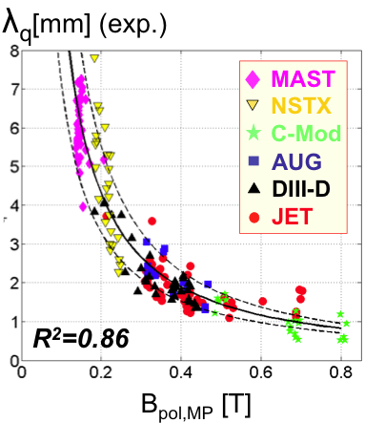
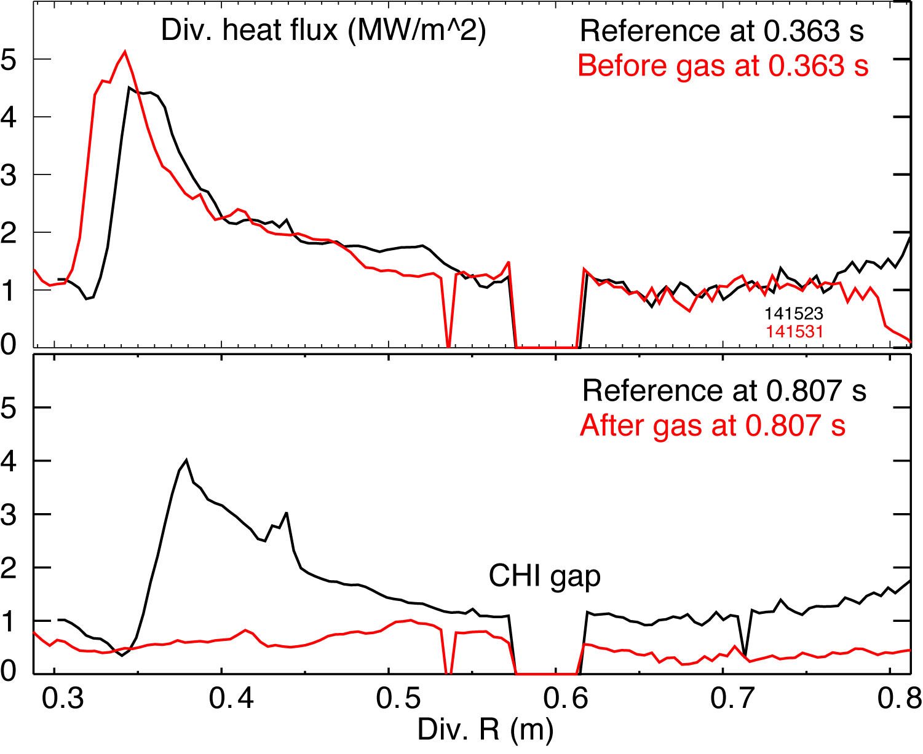
NSTX-U Will Study and Mitigate High Divertor Heat Fluxes in Long-Pulse Discharges
P/R~20 MW/m, P/S~0.4 MW/m²
  ITER P/R~25 MW/m, P/S~0.2 MW/m²
Study SOL widths, dependences (BP-2)
  Ability to double B_{T}, I_{p}, B_{p} and operate at lower ν∗ to test SOL width scalings
  NSTX heat flux reduced by divertor gas puffing (BP-2, ASC-2)
  Develop real-time divertor radiation control in NSTX-U
  Extend SOL scalings to partially detached regime
  Study effects of 3D on divertor heat flux
High-Z PFCs can address ITER issues of metal PFC heat load handling, migration, dust (MP-2)
  Row(s) of high-Z tiles can contribute to studying mixed material issues
  Study effect of vapor shielding of PFCs for power reduction at divertor/first wall (MP-3)
    High temperature Li surface, non-coronal Li radiation
    Li/Mo or W in NSTX-U possible proxy for Be/W in ITER divertor/first wall
Attached
Detached (radiative)

Slide 15
ITER Has Heightened Interest in Studying Impurity Transport in the Edge and Core Regions
Impurity seeding with JET, AUG metal walls required for good confinement
  Is impurity transport near edge neoclassical? Will impurities accumulate in core?
Develop requirements for ELM-pacing to control impurity content
C impurity studies using MIST, STRAHL indicate departures from neoclassical in the Li-conditioned plasma edge
NSTX-U will explore impurity transport at lower ν∗ (TT-2)
  Assess neo vs turbulent transport
    BES ➔ High-k
    Rotation shear control with 2nd NBI, 3D
  Mixed impurity effects
  High-Z transport: row(s) of high-Z PFC
Carbon profile peaking

Slide 16
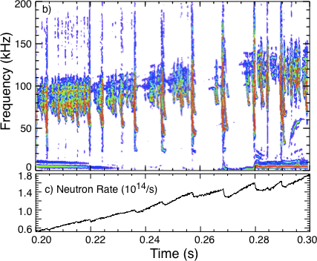
Energetic Particle Modes are Strongly Non-Linear in NSTX-U (& Possibly in ITER Hybrids and RS)
Non-linear behavior of AE modes regularly seen in NSTX
  Avalanches (mode overlap) & effect on fast ions; coupling to low-f MHD (kinks, RWM)
NSTX-U research on avalanches and non-linear physics is essential for the code validation needed for projecting to ITER (EP-1)
  Ability to vary q, with 2nd NB – strong effect on non-linear behavior
  Higher TF, NB flexibility to vary v_{fast}, β_{fast}
  AE antenna to study mode stability, excitation
  Suite of fast ion diagnostics
  Strong code development and validation effort (linear and non-linear)

Slide 17
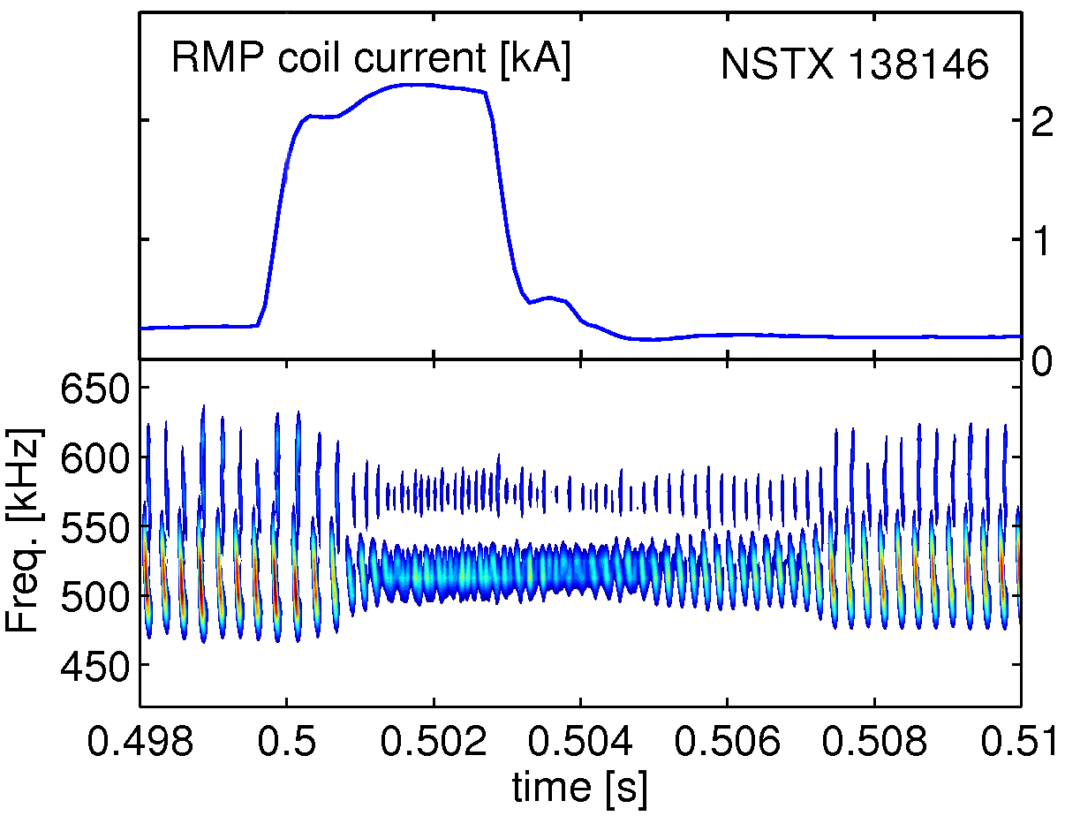
Energetic Particle Modes are Strongly Non-Linear in NSTX-U (& Possibly in ITER Hybrids and RS)
Non-linear behavior of AE modes regularly seen in NSTX
  Avalanches (mode overlap) & effect on fast ions; coupling to low-f MHD (kinks, RWM)
NSTX-U research on avalanches and non-linear physics is essential for the code validation needed for projecting to ITER (EP-1)
  Ability to vary q, with 2nd NB – strong effect on non-linear behavior
  Higher TF, NB flexibility to vary v_{fast}, β_{fast}
  AE antenna to study mode stability, excitation
  Suite of fast ion diagnostics
  Strong code development and validation effort (linear and non-linear)
GAE activity
Applied 3D fields affects AE stability and fast ion distribution, transport (EP-2)
  Studies initiated on NSTX; high priority for ITER
  Flexible NB, 3D (NCC) systems to be used

Slide 18
NSTX-U Will Develop and Validate Steady-State, Non-Inductive Operational Scenarios: Issues Relevant to ITER
HHFW coupling studies (RF-1)
  Dependence of coupling on geometry, edge profiles (conditioning, cryopump)
  Interaction with fast ions (flexible NB)
  HHFW power losses in SOL: validate RF codes (TORIC, AORSA-3D, CQL3D), probe arrays, IR cameras
NB/bootstrap current drive to produce fully/partially non-inductive plasmas (ASC-2)
Control & disruption avoidance (integrated control algorithms+actuators)
  Effect of rotating halo currents and resonant e-m loads on structure
    How will this scale to ITER?
AORSA-3D
Visible Light
NSTX Halo Currents

Slide 19
Strong Participation in ITPA Joint Expts and Activities
Representatives in every ITPA TG
Leadership in many
  S. Kaye: immediate past-Chair of Transport and Confinement
  R. Maingi: Deputy Chair of Boundary Physics
  S. Sabbagh: Leads WG on RWM Feedback control in MHD
  C. Skinner: Leader of Special Working Group on First Wall Diagnostics
NSTX-U physicists spokespersons for many JEX/JACs

Slide 20
ITPA JEX/JAC Involving NSTX-U Researchers as of Jan. 2013
 | Pedestal/Edge Physics and DIVSOL
DSOL-24 | Disruption heat loads | PEP-27 | Pedestal profile evolution following L-H/H-L transition
PEP-6 | Pedestal structure and ELM stability in DN | PEP-29 | Vertical jolts/kicks for ELM triggering and control
PEP-19 | Basic mechanisms of edge transport with RMP | PEP-34 | ELM energy losses and their dimensionless scaling
 | Energetic Particles
EP-2 | Fast ion losses and redistribution from localized Aes | EP-6 | Fast ion losses and associated heat loads from edge perturbations
 | Integrated Operating Scenarios
IOS-3.2 | Define access conditions to get to SS sceanrio | IOS-4.3 | Collisionality scaling of confinement in advanced inductive regime
IOS-4.1 | Access conditions for advanced inductive scenario | IOS-5.2 | Maintaining ICRH coupling in expected ITER regime
 | MHD
MDC-2 | Joint experiments on resistive wall mode physics | MDC-17 | Active disruption avoidance
MDC-8 | Current drive prevention/stabilization of NTMs | MDC-18 | Evaluation of axisymmetric control aspects
MDC-15 | Disruption database development
 | Transport and Confinement
TC-9 | Scaling of intrinsic rotation with no external momentum input | TC-15 | Dependence of momentum and particle pinch on collisionality
TC-10 | Exptl id of ITG, TEM and ETG turbulence and comparison with codes | TC-17 | ρ∗ scaling of the edge intrinsic torque
TC-11 | He and impurity profiles and transport coefficients | TC-24 | Impact of RMP on transport and confinement
TC-12 | H-mode transport and confinement at low aspect ratio

Slide 21
NSTX-U Research Contributes to ITER
High-Priority ITER R&D Needs
Strong contributions will be made in a large number of areas
Contributions to ITER R&D facilitated by device upgrades
  Higher B_{T}: lower ν*, RF coupling, *AE stability
  Higher I_{p}: lower ν*, higher B_{pol} (SOL scalings)
  Cryopump: lower ν* (core and ped), steady-state ops
  2nd NB (off-axis); rotation control, q control
  Enhanced 3D coils/NCC: rotation and ELM control, stability, steady-state
  Li granule injector ELM control
  Integrated control algorithms, MGI, EPI: steady-state, disruption mitigation
Will mostly contribute to longer-term physics basis and operational scenario development
  NSTX-U MGI research may impact near-term design for ITER
Use unique NSTX-U configuration and capabilities as leverage for validating physics models that are used for predictions at higher R/a (including for ITER)
Strong participation in ITPA, leadership in a number of areas

