Slide 1




NSTX-U
Supported by
NSTX-U Initial Operations Plan
5 Year Plan for Scenarios and Control
S.P. Gerhardt, PPPL
E. Kolemen, PPPL
for the NSTX-U Research Team
Coll of Wm & Mary
Columbia U
CompX
General Atomics
FIU
INL
Johns Hopkins U
LANL
LLNL
Lodestar
MIT
Lehigh U
Nova Photonics
ORNL
PPPL
Princeton U
Purdue U
SNL
Think Tank, Inc.
UC Davis
UC Irvine
UCLA
UCSD
U Colorado
U Illinois
U Maryland
U Rochester
U Tennessee
U Tulsa
U Washington
U Wisconsin
X Science LLC
Culham Sci Ctr
York U
Chubu U
Fukui U
Hiroshima U
Hyogo U
Kyoto U
Kyushu U
Kyushu Tokai U
NIFS
Niigata U
U Tokyo
JAEA
Inst for Nucl Res, Kiev
Ioffe Inst
TRINITI
Chonbuk Natl U
NFRI
KAIST
POSTECH
Seoul Natl U
ASIPP
CIEMAT
FOM Inst DIFFER
ENEA, Frascati
CEA, Cadarache
IPP, Jülich
IPP, Garching
ASCR, Czech Rep
NSTX-U 5 Year Plan Review
LSB B318, PPPL
May 21-23, 2013

Slide 2
Outline
Plans for Entering the First NSTX-U Operations Period
ASC Research Plans for 5-year Period
  Thrust 1: Scenario Physics
    Development of 100% non-inductive operation.
    Extension of the high-current, partial-inductive space to long-pulse.
  Thrust 2: Axisymmetric Control Development
    Develop methods to control the heat flux for high-power scenarios.
    Develop rotation and current profile control
  Thrust 3: Automated Rampdowns
    Develop detection of impending disruptions.
    Develop techniques for the automated termination of discharges.
  Thrust 4: Scenario Physics for Next Step Devices
    Determine the optimal, simultaneous q- and rotation profiles.
    Study the conditions for classical beam current drive.
    Explore & validate integrated models for projections to FNSF.

Slide 3
Operations Activities Designed to Fit in the Existing NSTX-U Project Schedule
Projected Near Term Schedule:
Time | Activity
July-Nov., 2013 | Diagnostic Reinstallations/Calibrations In Parallel with Construction Activities
Dec. 2013 – March, 2014 | Close Machine (w/o CS), Leak Checking, Prep. for CS installation.
April-May, 2014 | CS Installation
June, 2014 | Final Calibrations, Particularly Those Diagnostics Requiring CS for Calibration
July-Sept., 2014 | Run Prep, Internal and DOE Readiness Reviews, Integrated Systems Testing, First plasma (CD-4)

Slide 4
Initial Operations Plans Designed to Rapidly Recover Physics Operations Capabilities
Plasma Operations with:
I_{p}≤1.0 MA, B_{T}≤0.5
Develop:
Breakdown and current ramp scenarios
Shape & position control
Reliable H-mode
Diagnostic operations
Continue to add diagnostic & control capabilities while initiating physics experiments.
ISTP:
(Integrated Systems Test Procedure)
Establishes facility in state of readiness for operations.
I_{p}≤1.5-1.6 MA
B_{T}≤0.75-0.8
July-Sept. 2014
ISTP-1 & CD-4 Prep
MPTS Calibrations, Bake Out, CD-4
Operations
Commissioning
Phys. Ops
ISTP-2
Phys.
Ops
~ 2-3 Months
ISTP-2
Required to increase the field and current for later research phase
Attempt 50 kA CD-4 plasma before bake-out. If water in PFCs prevents success, then repeat after bake-out.

Slide 5
NSTX-U Field and Current Capabilities Will Be Increased Over a ~3 Year Period
 | NSTX (Max.) | Year 1 NSTX-U Operations (2015) | Year 2 NSTX-U Operations (2016) | Year 3 NSTX-U Operations (2017) | Ultimate Goal
I_{P} [MA] | 1.2 | ~1.6 | 2.0 | 2.0 | 2.0
B_{T} [T] | 0.55 | ~0.8 | 1.0 | 1.0 | 1.0
Allowed TF I²t [MA²s] | 7.3 | 80 | 120 | 160 | 160
I_{P} Flat-Top at max. allowed I²t, I_{P}, and B_{T} [s] | ~0.4 | ~3.5 | ~3 | 5 | 5
1st year goal: operating points with forces up to ½ the way between NSTX and NSTX-U, ½ the design-point heating of any coil
  Will permit up to ~5 second operation at B_{T}~0.65
2nd year goal: Full field and current, but still limiting the coil heating
  Will revisit year 2 parameters once year 1 data has been accumulated
3rd year goal: Full capability
NSTX-Upgrade engineers developing a plan for mechanical diagnostics to assess the accuracy of the mechanical models underlying protection levels

Slide 6
Outline
Plans for Entering the First NSTX-U Operations Period
ASC Research Plans for 5-year Period
  Thrust 1: Scenario Physics
    Development of 100% non-inductive operation.
    Extension of the high-current, partial-inductive space to long-pulse.
  Thrust 2: Axisymmetric Control Development
    Develop methods to control the heat flux for high-power scenarios.
    Develop rotation and current profile control
  Thrust 3: Automated Rampdowns
    Develop detection of impending disruptions.
    Develop techniques for the automated termination of discharges.
  Thrust 4: Scenario Physics for Next Step Devices
    Determine the optimal, simultaneous q- and rotation profiles.
    Study the conditions for classical beam current drive.
    Explore & validate integrated models for projections to FNSF.

Slide 7
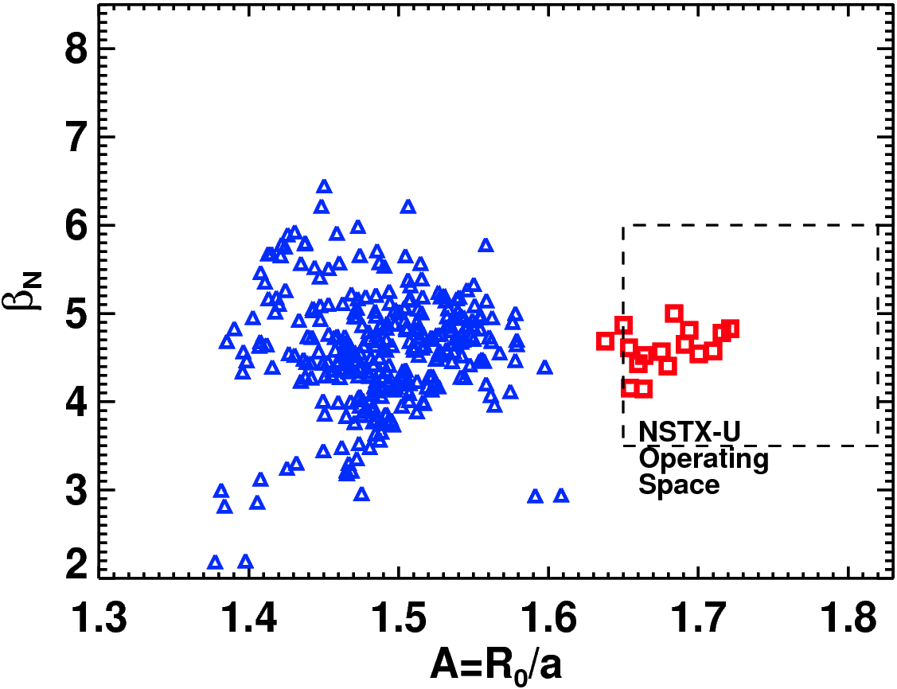
ASC Research Targets Integrated, Steady-State Scenario Needs for FNSF/CTF and ITER
Steady-state scenarios for ITER or a CTF/FNST must:
Have 100% non-inductive current drive.
  NSTX-U ASC: Explore a range of β_{N} with 100% non-inductive CD.
Control the divertor heat flux to be within acceptable material limits.
  NSTX-U ASC: divertor geometry and radiation control.
Simultaneously optimize confinement and passive global stability.
  NSTX-U ASC: optimization and control of the boundary, rotation and current profiles.
Detect and respond to disruptions and off-normal events.
  NSTX-U ASC: disruption detection and soft-shutdowns.
NSTX Operational Space: β_{N} vs A
>1τ_{E} average for each point
Conventional NSTX Operating Space
High-A Experiment During FY-11 Run

Slide 8
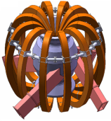
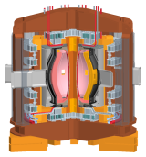
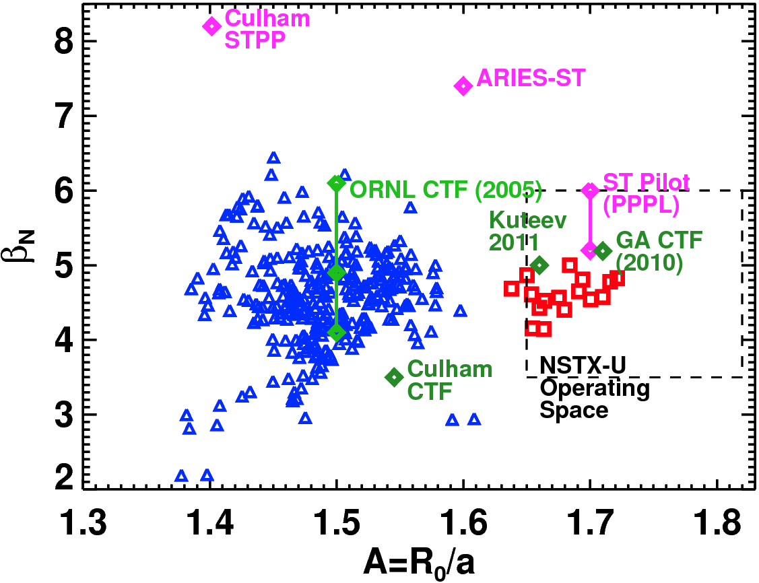
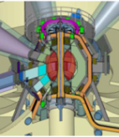
ASC Research Targets Integrated, Steady-State Scenario Needs for FNSF/CTF and ITER
Steady-state scenarios for ITER or a CTF/FNST must:
Russia PPPL
Have 100% non-inductive current drive.
  NSTX-U ASC: Explore a range of β_{N} with 100% non-inductive CD.
Control the divertor heat flux to be within acceptable material limits.
  NSTX-U ASC: divertor geometry and radiation control.
Simultaneously optimize confinement and passive global stability.
  NSTX-U ASC: optimization and control of the boundary, rotation and current profiles.
Detect and respond to disruptions and off-normal events.
  NSTX-U ASC: disruption detection and soft-shutdowns.
ORNL UK

Slide 9
Outline
Plans for Entering the First NSTX-U Operations Period
ASC Research Plans for 5-year Period
ASC Programmatic Goal For 5 Year Plan:
Develop the basis for integrated, steady-state operation and axisymmetric control for next-step STs, while helping resolve key scenario and control issues for ITER.
ASC Operational Goal For 5 Year Plan:
Establish stationary, 100% non-inductive operation, and partial inductive operation up to I_{P}=2 MA, for 5 seconds over a wide range of Greenwald fractions.
Research required to meet these goals divided into four thrusts.

Slide 10
Outline
Plans for Entering the First NSTX-U Operations Period
ASC Research Plans for 5-year Period
  Thrust 1: Scenario Physics
    Development of 100% non-inductive operation.
    Extend the high-current, partial-inductive scenarios to long-pulse.
  Thrust 2: Axisymmetric Control Development
    Develop methods to control the heat flux for high-power scenarios.
    Develop rotation and current profile control.
  Thrust 3: Disruption Avoidance By Controlled Discharge Shutdown
    Develop detection of impending disruptions.
    Develop techniques for the automated termination of discharges.
  Thrust 4: Scenario Physics for Next Step Devices
    Determine the optimal, simultaneous q- and rotation profiles.
    Study the conditions for classical beam current drive.
    Explore & validate integrated models for projections to FNSF.
Four thrusts support all 5 high-level programmatic goals for NSTX-U (see J. Menard talk)

Slide 11
Outline
Plans for Entering the First NSTX-U Operations Period
ASC Research Plans for 5-year Period
  Thrust 1: Scenario Physics
    Development of 100% non-inductive operation.
    Extend the high-current, partial-inductive scenarios to long-pulse.
  Thrust 2: Axisymmetric Control Development
    Develop methods to control the heat flux for high-power scenarios.
    Develop rotation and current profile control.
  Thrust 3: Disruption Avoidance By Controlled Discharge Shutdown
    Develop detection of impending disruptions.
    Develop techniques for the automated termination of discharges.
  Thrust 4: Scenario Physics for Next Step Devices
    Determine the optimal, simultaneous q- and rotation profiles.
    Study the conditions for classical beam current drive.
    Explore & validate integrated models for projections to FNSF.

Slide 12
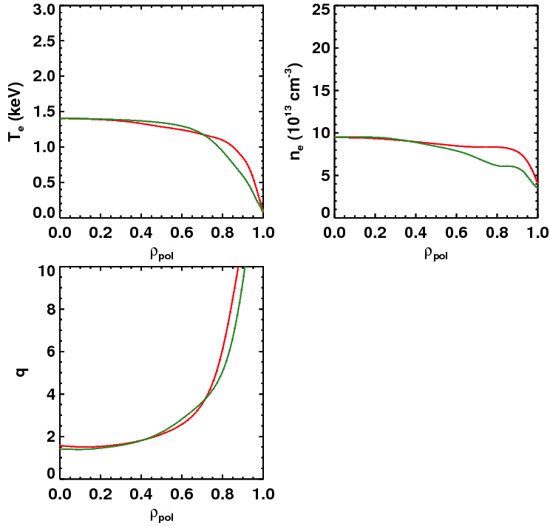
Anticipate The Non-Inductive Current Level at B_{T}=1.0 T and P_{inj}=12.6 MW To Be Between ~900 & ~1300 kA
Thrust #1
Dashed: ITER-98 confinement scaling
Broad, H₉₈=1
Broad, H₉₈=1
Narrow, H₉₈=1
Narrow, H₉₈=1
Free-Boundary TRANSP Calculations
S.P. Gerhardt, et al,
Nuclear Fusion 52 083020 (2012)
Fix: 1.0T, P_{inj}=12.6 MW, f_{GW}=0.72
Fix: A=1.75, κ=2.8
Determine the non-inductive current level for 2 confinement and 2 profile assumptions…yields 4 different projections.
Confinement | Profiles | I_{P} [kA] | β_{N} | q_{min}
H₉₈=1 | Broad | 975 | 4.34 | 1.5
H₉₈=1 | Narrow | 875 | 4.87 | 1.4
Broad, H₉₈=1
Narrow, H₉₈=1

Slide 13
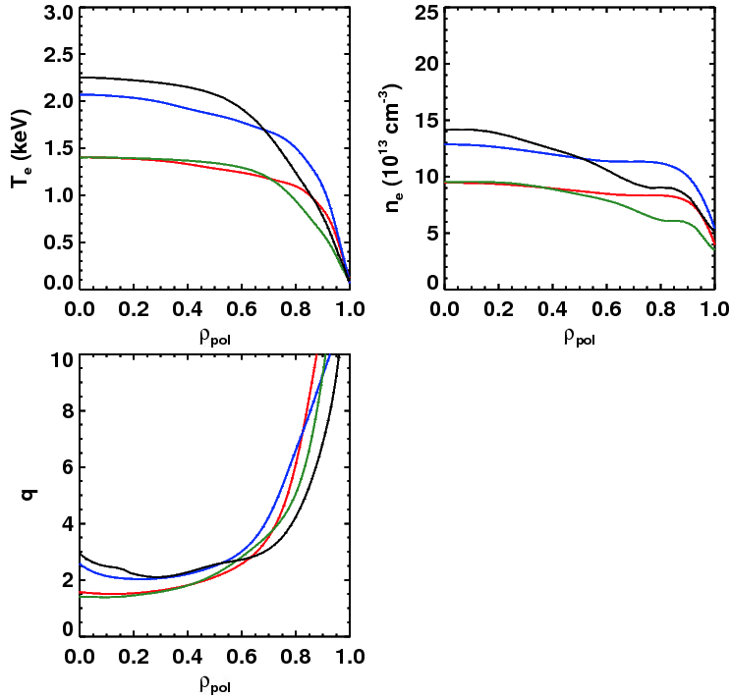
Anticipate The Non-Inductive Current Level at B_{T}=1.0 T and P_{inj}=12.6 MW To Be Between ~900 & ~1300 kA
Thrust #1
Dashed: ITER-98 confinement scaling
Solid: ST confinement scaling
Narrow, H_{ST}=1
Broad, H_{ST}=1
Narrow, H_{ST}=1
Broad, H_{ST}=1
Broad, H₉₈=1
Broad, H₉₈=1
Narrow, H₉₈=1
Narrow, H₉₈=1
(S. Kaye, NF 2006)
Free-Boundary TRANSP Calculations
S.P. Gerhardt, et al,
Nuclear Fusion 52 083020 (2012)
Fix: 1.0T, P_{inj}=12.6 MW, f_{GW}=0.72
Fix: A=1.75, κ=2.8
Determine the non-inductive current level for 2 confinement and 2 profile assumptions…yields 4 different projections.
Broad, H_{ST}=1
Confinement | Profiles | I_{P} [kA] | β_{N} | q_{min}
H₉₈=1 | Broad | 975 | 4.34 | 1.5
H_{ST}=1 | Broad | 1325 | 5.32 | 2.0
H₉₈=1 | Narrow | 875 | 4.87 | 1.4
H_{ST}=1 | Narrow | 1300 | 5.97 | 2.1
Narrow, H_{ST}=1
Broad, H₉₈=1
Narrow, H₉₈=1

Slide 14
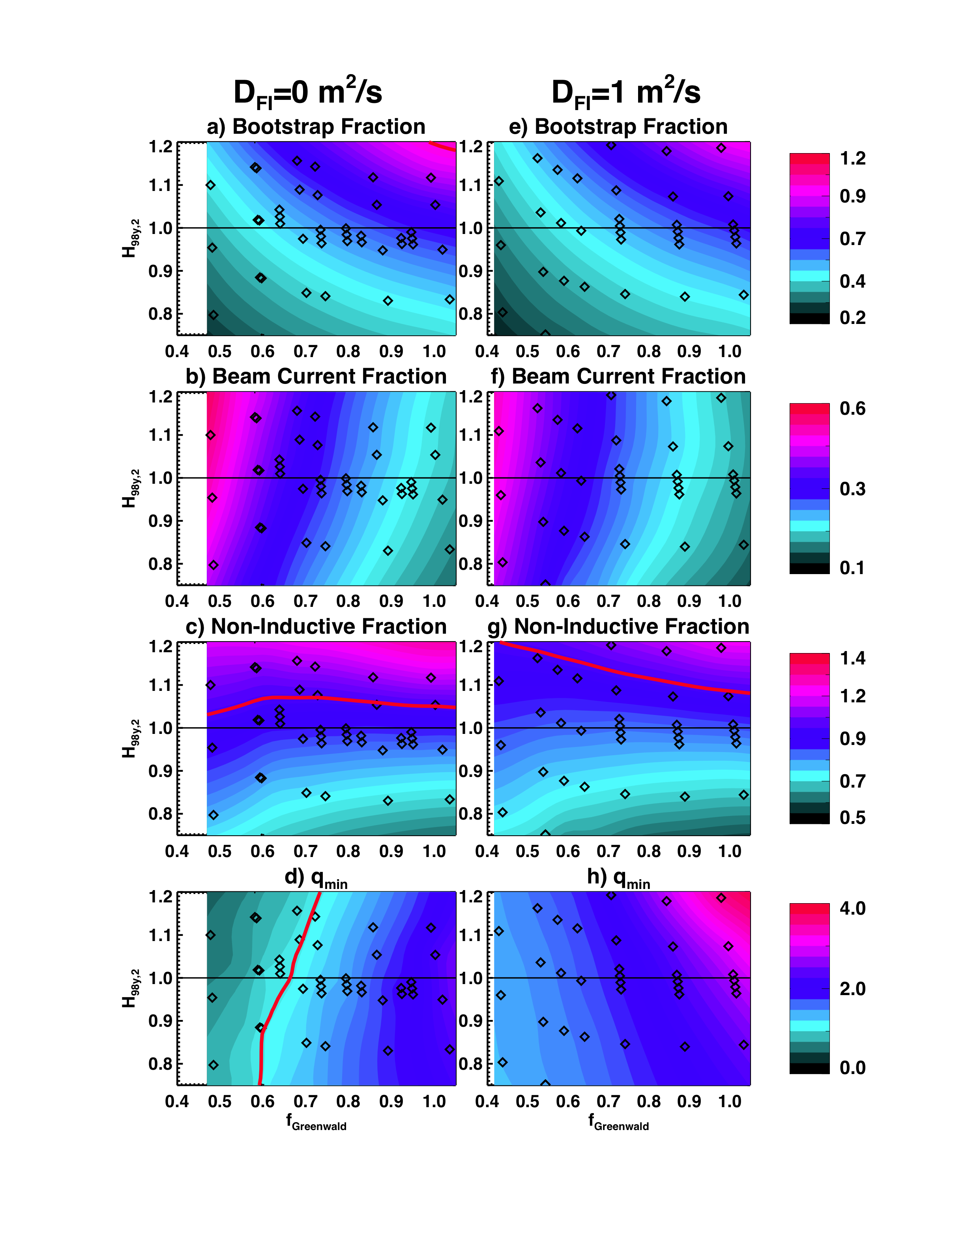
Non-Inductive Operating Points Projected Over a Range of Toroidal Fields, Densities, and Confinement Levels
Thrust #1
TRANSP calculations yield research goals for 100% non-inductive sustainment.
Related research: non-inductive ramp-up:
  Reduce I_{P} beneath the 100% non-inductive operating point, assess non-inductive overdrive.
  See SFSU talk by R. Raman for details.
Goal for end of 5YP: demonstrate non-inductive formation, ramp-up, and sustainment in a single discharge.
B_{T}=1.0 T, I_{P}=1 MA, P_{inj}=12.6 MW
Operation Year | B_{T} [T] | Current Goal [kA] | Duration Goal
1 (2014) | 0.75 | ~600-800 | A few τ_{E}
2 (2015) | 0.75-1.0 | ~600-1000 | 1-2 τ_{R}
3-4 (2016-17) | 1 | 800-1300 | Up to 4.5 s at lower I_{P}
Contours of Non-Inductive Fraction
f_{NI}=1
Contours of q_{min}
q_{min}=1
Particle & heat flux control, NBCD tools required to realize these scenarios discussed in upcoming slides.

Slide 15
Outline
Plans for Entering the First NSTX-U Operations Period
ASC Research Plans for 5-year Period
  Thrust 1: Scenario Physics
    Development of 100% non-inductive operation.
    Extend the high-current, partial-inductive scenarios to long-pulse.
  Thrust 2: Axisymmetric Control Development
    Develop methods to control the heat flux for high-power scenarios.
    Develop rotation and current profile control.
  Thrust 3: Disruption Avoidance By Controlled Discharge Shutdown
    Develop detection of impending disruptions.
    Develop techniques for the automated termination of discharges.
  Thrust 4: Scenario Physics for Next Step Devices
    Determine the optimal, simultaneous q- and rotation profiles.
    Study the conditions for classical beam current drive.
    Explore & validate integrated models for projections to FNSF.

Slide 16
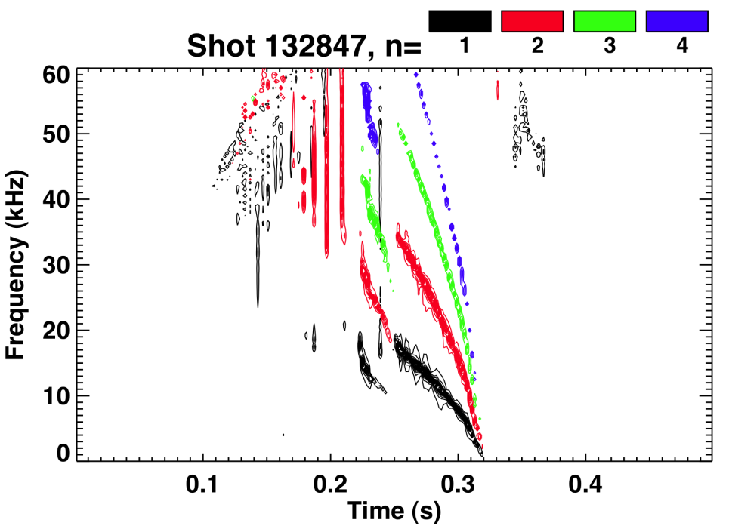
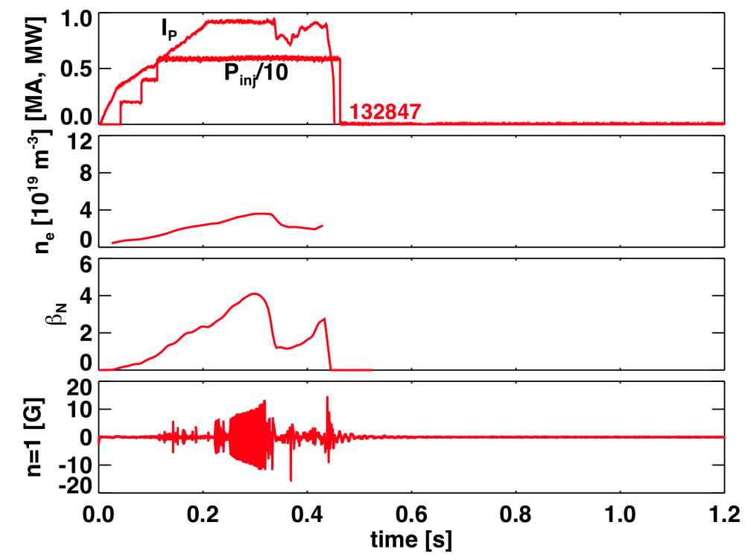
Optimizing the Early Discharge Evolution Will Play an Important Role in Achieving Low Collisionality at High-Current
Frequency Drops to Zero
132847: Fueled from low-field side
BP, MS TSGs

Slide 17
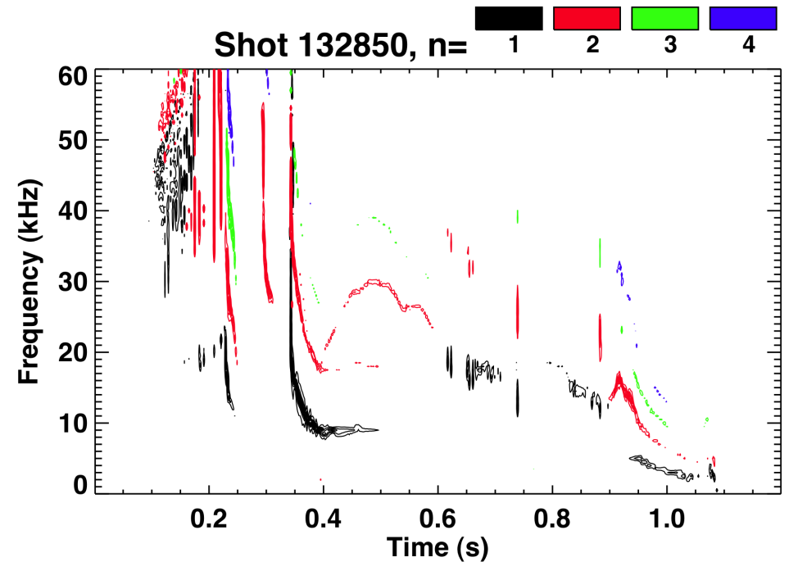
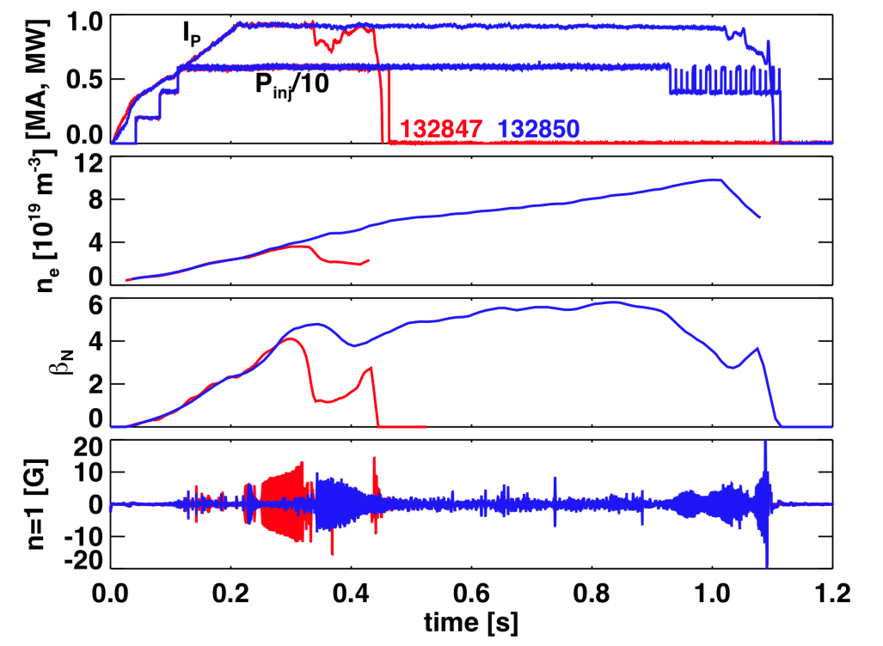
Optimizing the Early Discharge Evolution Will Play an Important Role in Achieving Low Collisionality at High-Current
Frequency Saturates
132847: Fueled from low-field side
132850: Fueled from both low- and high- field sides
Timing and magnitude of fueling has profound impact on discharge evolution, will be optimized in NSTX-U.
  Will slower I_{P} ramps w/ larger solenoid facilitate reduced fueling?
  Will improved solenoid design and reduced error fields improve lower-density startup?
  Will the extra torque from the new beams reduce prevalence of locking?
Milestone R14-1
BP, MS TSGs

Slide 18
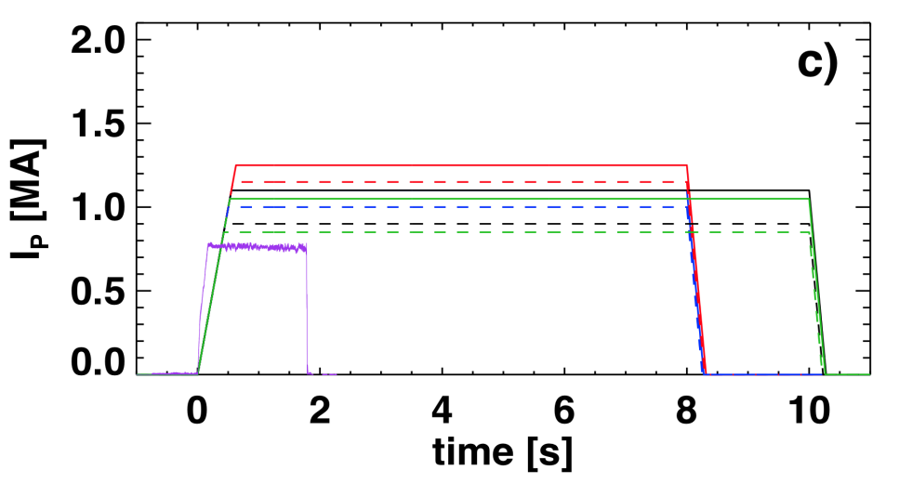
Will Develop Long-Pulse Partial Inductive Operation Up to 2 MA with High Power
Thrust #1
Two motivations for partial inductive operation:
  High-I_{P} operation supports collisionality scaling and divertor heat flux studies
  Long pulse operation for particle retention and disruptivity reduction studies
Years 1 & 2 of ops. (2015 & 2016): Re-optimize startup for reduced fueling and low collisionality.
  Optimize fueling, ramp-rate, error field correction, torque input to facilitate reduced density
Years 3 & 4 of ops. (2017-2018): Performance Extension
  Discharges up to 2 MA for 5 seconds.
  Long pulse at ~1 MA for up to 10 seconds
  Assess HHFW for increased power and profile variations.
High-I_{P} & long pulse development will be connected to progress in:
  Particle Control
  Heat flux mitigation
B_{T}=0.75 T, 8-10 Second Discharge Scenarios Limited by q_{min}>1.1 or OH Coil I²t
2 Confinement and 2 Profile Assumptions
6x65 kV Beams
Longest Ever NSTX Discharge
Addresses milestone R15-3, Supports milestone R15-1
3 x Modulated 80 kV Beams
BP, MS TSGs

Slide 19
Operation Tools for Density & Impurity Control
Thrust #1
Years 1 & 2 of ops. (2015-2016): Examine Wall Conditioning, Fueling, and ELM Pacing
Boronized PFC Studies
  Utilize regimes with natural ELMs to control impurity accumulation
  Between-shot He glow for wall conditioning
  Deuterium inventory may rise throughout the discharge
Lithiated PFC Studies
  High-τ_{E}, ELM-free regimes w/ Li conditioning
  Pulsed 3D fields or lithium granules for ELM pacing to provide impurity control
  Deuterium inventory likely well controlled, but unclear if target Z_{eff}~2 can be achieved
Techniques to Be Covered in Greater Detail in Talks By Maingi, Soukhanovskii, Jaworski
BP, M&P TSGs

Slide 20
Operation Tools for Density & Impurity Control
Thrust #1
Years 1 & 2 of ops. (2015-2016): Examine Wall Conditioning, Fueling, and ELM Pacing
Boronized PFC Studies
  Utilize regimes with natural ELMs to control impurity accumulation
  Between-shot He glow for wall conditioning
  Deuterium inventory may rise throughout the discharge
Lithiated PFC Studies
  High-τ_{E}, ELM-free regimes w/ Li conditioning
  Pulsed 3D fields or lithium granules for ELM pacing to provide impurity control
  Deuterium inventory likely well controlled, but unclear if target Z_{eff}~2 can be achieved
Realtime Density Measurements via FIReTIP
PCS control of Supersonic Gas Inj. for Density Control
Both Scenarios:
Techniques to Be Covered in Greater Detail in Talks By Maingi, Soukhanovskii, Jaworski
BP, M&P TSGs

Slide 21
Operation Tools for Density & Impurity Control
Thrust #1
Years 1 & 2 of ops. (2015-2016): Examine Wall Conditioning, Fueling, and ELM Pacing
Boronized PFC Studies
  Utilize regimes with natural ELMs to control impurity accumulation
  Between-shot He glow for wall conditioning
  Deuterium inventory may rise throughout the discharge
Lithiated PFC Studies
  High-τ_{E}, ELM-free regimes w/ Li conditioning
  Pulsed 3D fields or lithium granules for ELM pacing to provide impurity control
  Deuterium inventory likely well controlled, but unclear if target Z_{eff}~2 can be achieved
Realtime Density Measurements via FIReTIP
PCS control of Supersonic Gas Inj. for Density Control
Both Scenarios:
Years 3 & 4 of ops. (2017-2018): Utilize Cryo-pumping and Partial NCC
Cryo-pump in lower-divertor to provide deuterium inventory control
  Natural or paced ELMs to control core impurity accumulation
  Make comparisons to regimes with paced ELMs and lithium pumping
Partial NCC to aid in ELM pacing and RMP studies
  Attempt direct modification of pedestal particle transport via RMP
  Determine optimal spectrum for magnetic ELM pacing, with minimal rotation damping
Techniques to Be Covered in Greater Detail in Talks By Maingi, Soukhanovskii, Jaworski
BP, M&P TSGs

Slide 22
Full Utilization of the NSTX-U Will Require Heat Flux Mitigation Solutions
Limit #1: Thermal stresses in target tiles can exceed ATJ graphite limits.
  Inner horizontal target tiles qualified for 5 sec operation at Q_{ave}=5 MW/m², Q_{Pk}=8.0 MW/m²
Limit #2: Desire to avoid tile surface temperatures exceeding T_{max}~1200 C.
  Due to enhanced sublimation.
Conservative assumption:
Primary solutions:
Discharge Parameters |  |  | Worst-Case Standard DN Divertor f_{exp}=15 & f_{div}=0.4 |  | f_{exp}=60 & f_{div}=0.4 or f_{exp}=15 & f_{div}=0.1
I_{P} [MA] | P_{inj} [MW] | Heating Duration [s] | Q_{Pk} [MW/m²] | Time to T_{max} [s] | Q_{Pk} [MW/m²] | Time to T_{max} [s]
0.75 | 10.2 | 5.0 | 6 | 12.6
1.5 | 10.2 | 5.0 | 18 | 1.4
2.0 | 10.2 | 5.0 | 28 | 0.5
1.5 | 15.6 | 1.5 | 27 | 0.6
2.0 | 15.6 | 1.5 | 43 | 0.25
100% NI
Long Pulse
Highest Power
BP TSG

Slide 23
Full Utilization of the NSTX-U Will Require Heat Flux Mitigation Solutions
Limit #1: Thermal stresses in target tiles can exceed ATJ graphite limits.
  Inner horizontal target tiles qualified for 5 sec operation at Q_{ave}=5 MW/m², Q_{Pk}=8.0 MW/m²
Limit #2: Desire to avoid tile surface temperatures exceeding T_{max}~1200 C.
  Due to enhanced sublimation.
Conservative assumption:
Primary solutions:
Broadening the heat channel (f_{exp}) via the snowflake divertor
Increasing the fraction of radiated power (decreasing f_{div})
Discharge Parameters |  |  | Worst-Case Standard DN Divertor f_{exp}=15 & f_{div}=0.4 |  | f_{exp}=60 & f_{div}=0.4 or f_{exp}=15 & f_{div}=0.1
I_{P} [MA] | P_{inj} [MW] | Heating Duration [s] | Q_{Pk} [MW/m²] | Time to T_{max} [s] | Q_{Pk} [MW/m²] | Time to T_{max} [s]
0.75 | 10.2 | 5.0 | 6 | 12.6 | 1.5 | 200
1.5 | 10.2 | 5.0 | 18 | 1.4 | 4.5 | 22
2.0 | 10.2 | 5.0 | 28 | 0.5 | 7 | 8.7
1.5 | 15.6 | 1.5 | 27 | 0.6 | 7 | 9.3
2.0 | 15.6 | 1.5 | 43 | 0.25 | 11 | 4.0
100% NI
Long Pulse
Highest Power
BP TSG

Slide 24
Outline
Plans for Entering the First NSTX-U Operations Period
ASC Research Plans for 5-year Period
  Thrust 1: Scenario Physics
    Development of 100% non-inductive operation.
    Extend the high-current, partial-inductive scenarios to long-pulse.
  Thrust 2: Axisymmetric Control Development
    Develop methods to control the heat flux for high-power scenarios.
    Develop rotation and current profile control.
  Thrust 3: Disruption Avoidance By Controlled Discharge Shutdown
    Develop detection of impending disruptions.
    Develop techniques for the automated termination of discharges.
  Thrust 4: Scenario Physics for Next Step Devices
    Determine the optimal, simultaneous q- and rotation profiles.
    Study the conditions for classical beam current drive.
    Explore & validate integrated models for projections to FNSF.

Slide 25
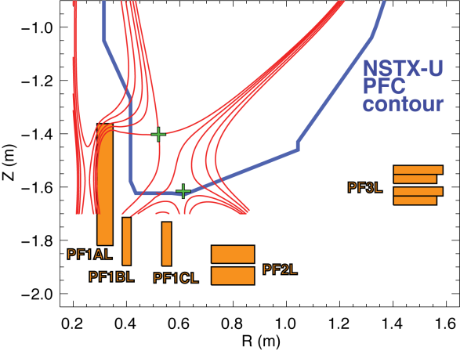
Snowflake Geometry and/or Divertor Radiation Control Required for High-Current Operation
Physics of these techniques to be covered in Boundary Physics talk
Control development plans
  Pre-operational year (2014):
    Collaborate on snowflake divertor physics and control experiments at DIII-D
  Years 1 & 2 of ops (2015-2016):
    Develop schemes for snowflake divertor control (dual X-point control) using new divertor coils
Thrust #2
Snowflake Divertor in NSTX-U
Increases divertor volume and flux expansion.
    Assess magnetic balance control in the presence of 4 X-points
    Develop the realtime measurements for divertor radiation control
    Assess impact on core physics performance
  Between years 2 & 3 of ops: Install cryo-pump
  Years 3 & 4 of ops (2017-2018):
    Utilize cryo-pump + snowflake divertor for increasing the pulse length at higher current
    Begin implementation of closed loop radiative divertor control
    Assess impact of divertor/edge impurities on the core scenario
Milestone R14-3
BP TSG

Slide 26
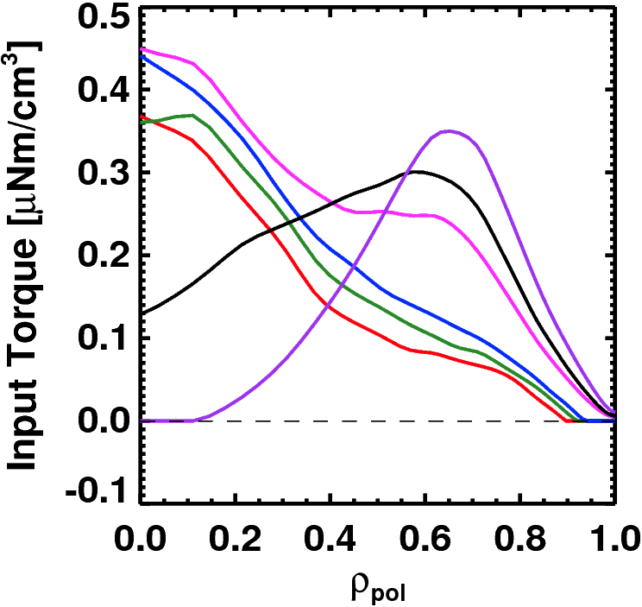
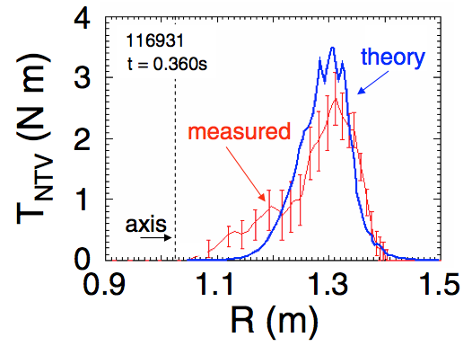
NSTX-U Will Have Significant Actuators For Profile
Control Studies
Thrust #2
Rotation Profile Actuators
Torque Profiles From 6 Different NB Sources
Largest R_{tan}
Neutral
Beams
(TRANSP)
Smallest R_{tan}
Measured and Calculated Torque Profiles from 3D Fields
(n=3)
Zhu, et al., PRL
MS, EP TSGs

Slide 27
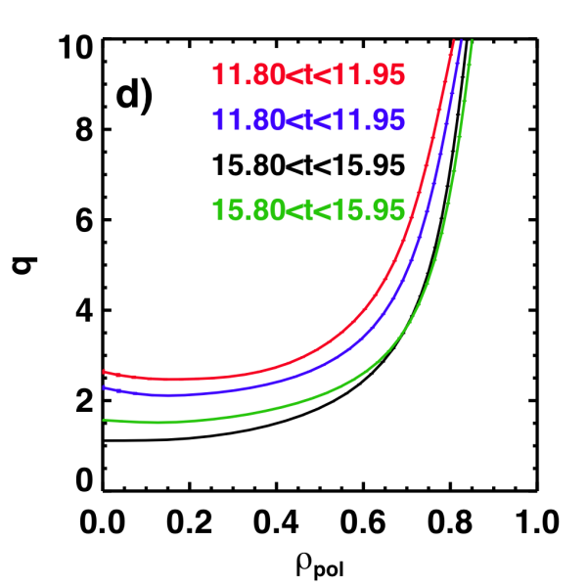
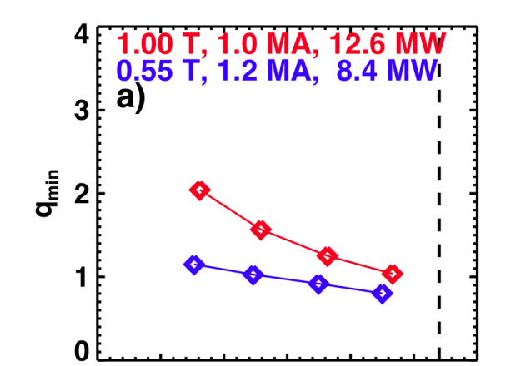
NSTX-U Will Have Significant Actuators For Profile
Control Studies
Thrust #2
Rotation Profile Actuators
q-Profile Actuators
Torque Profiles From 6 Different NB Sources
Variations in Beam Sources
800 kA Partial Inductive, 87% < f_{NI} < 100%
Largest R_{tan}
800 kA and 1 T
[50,60,70,130] cm
[50,60,120,130] cm
[60,70,110,120] cm
[70,110,120,130] cm
Neutral
Beams
(TRANSP)
Smallest R_{tan}
Measured and Calculated Torque Profiles from 3D Fields
Variations in Outer Gap (1.69<A<1.81)
(n=3)
Zhu, et al., PRL
Milestone R14-3
27 22 17 12 7 2
Outer Gap
MS, EP TSGs

Slide 28
Profile Control Techniques Will be Developed To Support NSTX-U Physics Studies and Next-Step ST Designs
Thrust #2
Pre-ops. Year: Continue developing control schemes for NSTX-U actuators.
  Lehigh: Collaboration on q-profile control algorithms, building on their experience at DIII-D.
  Princeton University: Collaboration on rotation profile control algorithms.
  Continue operations collaborations on KSTAR and EAST.
Years 1 & 2 of ops. (2014-2015):
  Test ability of different NB source selection to change the q-profile.
    Study as a function of density, fast-ion β, source voltage.
    Assess the NBCD calculations underpinning NSTX-U and most next-step ST studies.
  Commission real-time MSE (Nova Photonics) and rotation (PPPL) diagnostics.
  Make first tests of β_{N} + central rotation (F_{T,0}) and, if feasible, β_{N}+q_{min} control.
Years 3 & 4 of ops. (2016-2017):
  Expand rotation control to the full profile.
  Complete β_{N}+q_{min} control and assess combined control, e.g., β_{N}+F_{T,0}+q_{min}.
  Assess NTV capabilities from NCC for enhanced rotation profile control.
  Work with MS group to develop physics-based requests for disruption avoidance goals.
Milestone R14-3
MS, EP TSGs

Slide 29
Outline
Plans for Entering the First NSTX-U Operations Period
ASC Research Plans for 5-year Period
  Thrust 1: Scenario Physics
    Development of 100% non-inductive operation.
    Extend the high-current, partial-inductive scenarios to long-pulse.
  Thrust 2: Axisymmetric Control Development
    Develop methods to control the heat flux for high-power scenarios.
    Develop rotation and current profile control.
  Thrust 3: Disruption Avoidance By Controlled Discharge Shutdown
    Develop detection of impending disruptions.
    Develop techniques for the automated termination of discharges.
  Thrust 4: Scenario Physics for Next Step Devices
    Determine the optimal, simultaneous q- and rotation profiles.
    Study the conditions for classical beam current drive.
    Explore & validate integrated models for projections to FNSF.

Slide 30
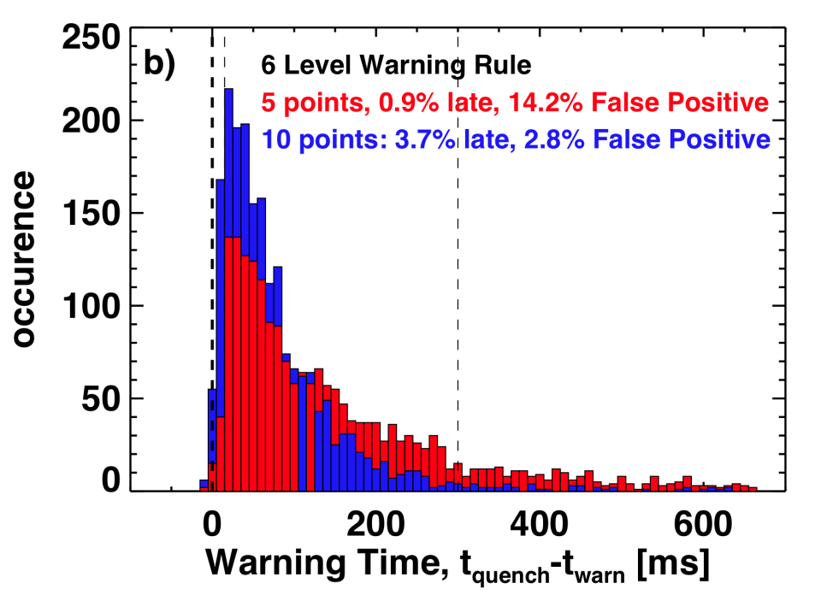
Disruption Avoidance Via Discharge Shut-Down Will be Developed
Thrust #3
Disruption detection algorithms have been developed using NSTX data
  Compare diagnostic data to thresholds & assign “penalty points” when thresholds are exceeded.
  Sum the “penalty point”, and declare a warning when the point total exceeds a given threshold.
Provides the foundation of disruption detection in NSTX-U.
Years 1 & 2 of ops.:
  Implement basic detector in PCS, and design architecture of control response.
  Assess accuracy of predictor for NSTX-U disruptions, and refine as necessary.
  Do initial tests of automated rampdowns.
Years 3 & 4 of ops.:
  Add additional realtime diagnostics for improved detection fidelity.
  Optimize rampdowns for different types of alarms.
  Incorporate on-line MGI if it appears promising.
Under consideration for an ITPA joint experiment.
(S.P. Gerhardt, et al., accepted for publication in Nuclear Fusion)
Connections of MS TSG:
n>=1 control, including disruption avoidance scenarios, covered by MS TSG.
MGI physics covered by MS TSG
Milestone R13-4
MS TSG

Slide 31
Outline
Plans for Entering the First NSTX-U Operations Period
ASC Research Plans for 5-year Period
  Thrust 1: Scenario Physics
    Development of 100% non-inductive operation.
    Extend the high-current, partial-inductive scenarios to long-pulse.
  Thrust 2: Axisymmetric Control Development
    Develop methods to control the heat flux for high-power scenarios.
    Develop rotation and current profile control.
  Thrust 3: Disruption Avoidance By Controlled Discharge Shutdown
    Develop detection of impending disruptions.
    Develop techniques for the automated termination of discharges.
  Thrust 4: Scenario Physics for Next Step Devices
    Determine the optimal, simultaneous q- and rotation profiles.
    Study the conditions for classical beam current drive.
    Explore & validate integrated models for projections to FNSF.

Slide 32

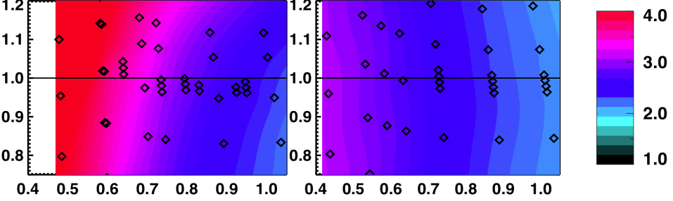

Explore Optimal Scenarios for Next Step STs
All Topics in Collaboration with Other TSGs
Thrust #4
Study optimal current and rotation profiles for confinement and stability.
  e.g., what value of q_{min} provides the best core confinement and stability?
  Explore alternative optimal scenarios, such as EPH or w/ ITBs.
Study the conditions for classical beam current drive
  Study what parameters determine when *AE modes lead to anomalies in the fast ion diffusion and NBCD.
  Can anomalous diffusion be used for scenario optimization?
Assess integrated models for projections to FNSF.
  Compare NBCD & q-profile predictions from integrated codes to NSTX-U.
  Project scenarios to ST FNSF devices.
Fast Ion Diffusivity
0 m²/s 1 m²/s
1 T,
1 MA
12.6 MW
q_{min}
q_{min}
Pressure Peaking
Pressure Peaking
H_{98(y,2)} H_{98(y,2)} H_{98(y,2)}
atan(δW_{with-wall}/5)
atan(δW_{with-wall}/5)
f_{Greenwald} f_{Greenwald}
Red: Internal Modes Unstable
Green: stable
Blue/Black: External modes unstable
Milestone R15-2
MS, EP, T&T TSGs

Slide 33
ASC Research Supports Development of High-Performance Integrated Scenarios for NSTX-U, FNSF & ITER
Plans for initial NSTX-U operations have been formed, in support of physics program objectives
ASC 5-year plan designed to provide solutions for
  the operations needs for the NSTX-U research program, and
  scenarios for next-step ST scenarios
    while providing important scenario and control support for ITER.
Research will address outstanding needs by
  developing stationary scenarios over a range of non-inductive fractions, plasma currents, and collisionalities
  developing measurements, algorithms, and actuators for control of
    the current & rotation profiles,
    the core density,
    the divertor geometry and radiation,
  validating models for NBCD & thermal transport to enable projections for next-step STs

Slide 34
Backup

Slide 35
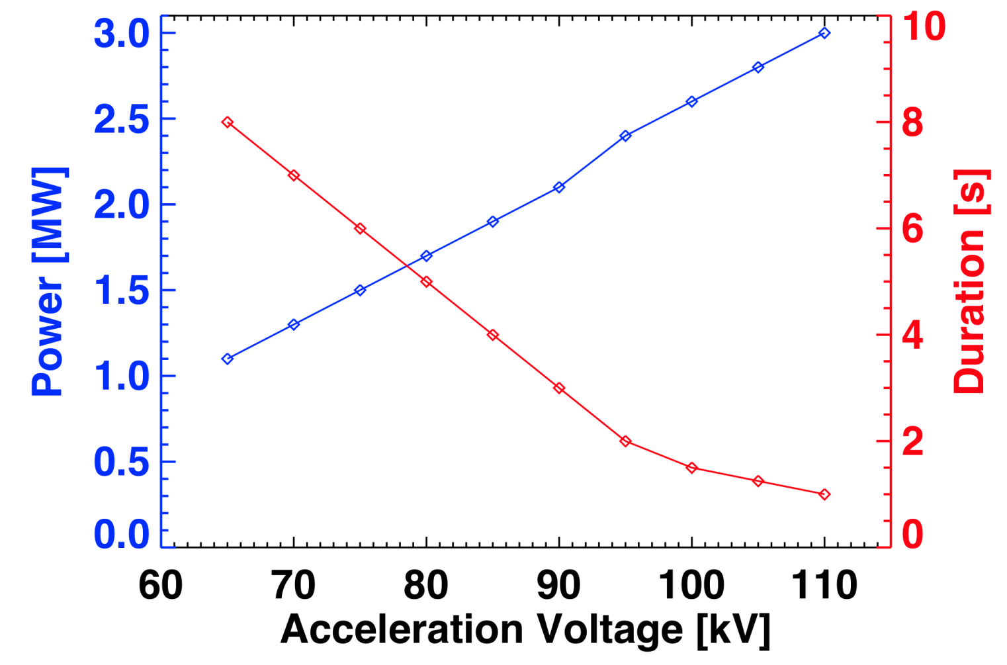
Trade-Off Between Power and Pulse Length For the NSTX (TFTR) Neutral Beams
Pulse duration at a given power limited by heating on the primary energy ion dump.
  Designs exist to increase the size of the ion dumps, increase the allowed pulse duration.

Slide 36
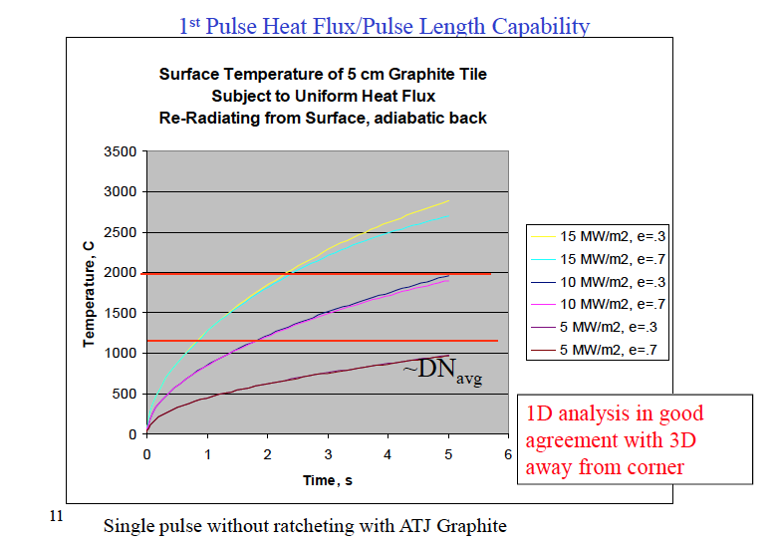
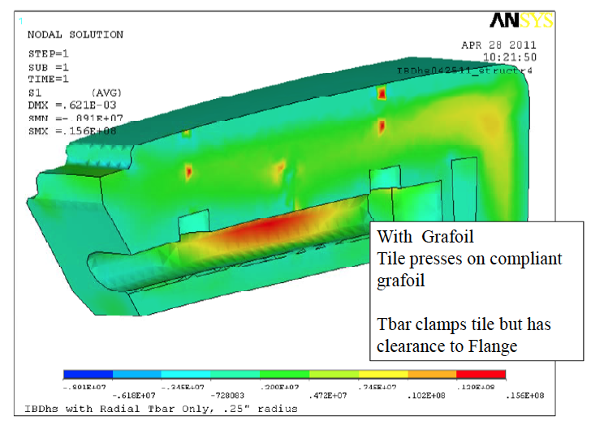
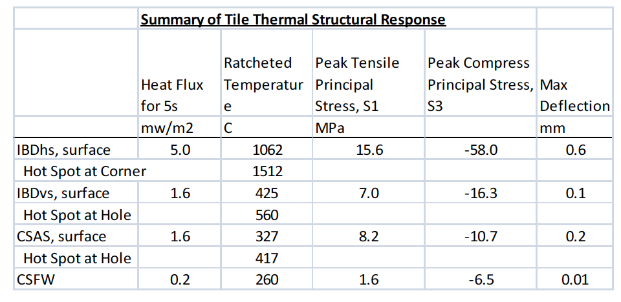
Criterion For Heat Flux Limits
Calibrate expression for tile surface temperature against engineering models:
  T_{surf}=CQ_{ave}t1^{/2}
  Use T_{surf}=1000 C, t=5 s, Q_{avg}=5 MW/m².
    Derive C~90 Cm²/MWs^{1/2}
Derive heat flux Q from simple scalings:

Slide 37
Physics and Engineering Operations Activities Over the Next ~Year Will Provide the Baseline For NSTX-U Operations
Upgrading the Plasma Control System (PCS) for NSTX-U.
  Upgrading to new 32-core computer.
  Switching to 64 bit real-time Linux with advanced debugging tools.
  Upgrading shape-control codes for new divertor coils, gas injector controls for new/additional injectors, additional physics algorithms
  Improving the real-time data-stream.
  Assisting with development of a new Digital Coil Protection System (DCPS).
Upgrading HHFW antenna feedthroughs for higher disruption forces.
Boundary Physics Operations
  Improving the PFC geometry in the vicinity of the CHI gap to protect the vessel and coils.
  Developing an upgraded Boronization system.
  Developing lithium technologies (granule injector, upward LITER).
Diagnostic Upgrades
  Fabricating new port covers to support high-priority diagnostics.
  Installing additional, redundant magnetic sensors.
  Upgrading diagnostics: Bolometry (PPPL), ssNPAs, spectroscopy (collaborators)
Physics & Engineering Operations
  Replacing electronics that control & protect rectifiers.
  Upgrading the poloidal field coil supplies to support up-down symmetric snowflake divertors.
  Developing PF null/breakdown scenario w/ new CS.

Slide 38
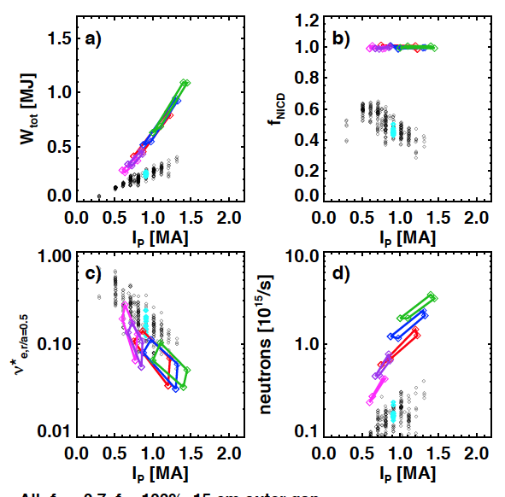
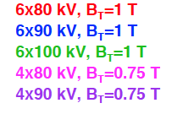
Pursue 100% Non-Inductive Current at Progressively
Higher I_{P} and B_{T}
Thrust #1
Free-Boundary TRANSP calculations of NSTX-U operations points.
  See: S.P. Gerhardt, et al, Nuclear Fusion 52 083020 (2013)
TRANSP Projections for 100% Non-Inductive Scenarios
Each polygon for a given engineering configuration, multiple profile and confinement assumptions
Projected Non-Inductive Current Levels for κ~2.85, A~1.75, f_{GW}=0.7
NSTX Data
B_{T} [T] | P_{inj} [MW] | I_{P} [MA] | Heating Duration [s]
0.75 | 6.8 | 0.6-0.8 | 5
0.75 | 8.4 | 0.7-0.85 | 3
1.0 | 10.2 | 0.8-1.2 | 5
1.0 | 12.6 | 0.9-1.3 | 3
1.0 | 15.6 | 1.0-1.5 | 1.5
NSTX Data
NSTX Data
NSTX Data
End of year 1 target
BP, MS TSGs

Slide 39
Shape/Position & Fueling Control Will Be Developed to Support NSTX-U Operations
Thrust #2
Shape/Position Control Considerations
  Vertical control of high-A NSTX plasmas found to be problematic when l_{i} exceeded ~0.6.
  Boundary and PMI research programs will require accurate control of the strikepoints.
Years 1 & 2 of ops.
  Assess vertical stability of NSTX-U plasmas.
  Improve control as necessary via better algorithms or measurements.
  Re-tune strike-point controllers for new divertor coils.
Years 3 & 4 of ops.
  Implement realtime n=0 stability and loss of control assessments.
    Connection to Thrust #3.
Fueling Control Considerations
  Realization of lowest-collisionality will require high-efficiency fueling.
  Full utilization of the cryo-pump will require better control of fueling
Years 1 & 2 of ops.
  Utilize super-sonic gas injection for improved fueling during the current ramp.
  Develop realtime density measurements.
  Assess closed-loop density control during the current ramp.
Years 3 & 4 of ops.
  Utilize cryo-pumping + advanced fueling to achieve closed-loop density control during the discharge flat-top.
BP TSG

