Slide 1




NSTX-U
Supported by
NSTX-U 5 Year Plan for Macroscopic Stability
Coll of Wm & Mary
Columbia U
CompX
General Atomics
FIU
INL
Johns Hopkins U
LANL
LLNL
Lodestar
MIT
Lehigh U
Nova Photonics
Old Dominion
ORNL
PPPL
Princeton U
Purdue U
SNL
Think Tank, Inc.
UC Davis
UC Irvine
UCLA
UCSD
U Colorado
U Illinois
U Maryland
U Rochester
U Tennessee
U Tulsa
U Washington
U Wisconsin
X Science LLC
J. Berkery (Columbia University)
J.-K. Park, A. Boozer,
S.A. Sabbagh, S. Gerhardt, R. Raman,
J.M. Bialek, K. Kim, J. Menard
for the NSTX Research Team
Culham Sci Ctr
York U
Chubu U
Fukui U
Hiroshima U
Hyogo U
Kyoto U
Kyushu U
Kyushu Tokai U
NIFS
Niigata U
U Tokyo
JAEA
Inst for Nucl Res, Kiev
Ioffe Inst
TRINITI
Chonbuk Natl U
NFRI
KAIST
POSTECH
Seoul Natl U
ASIPP
CIEMAT
FOM Inst DIFFER
ENEA, Frascati
CEA, Cadarache
IPP, Jülich
IPP, Garching
ASCR, Czech Rep
NSTX-U 5 Year Plan Review
LSB B318, PPPL
May 21-23, 2013

Slide 2
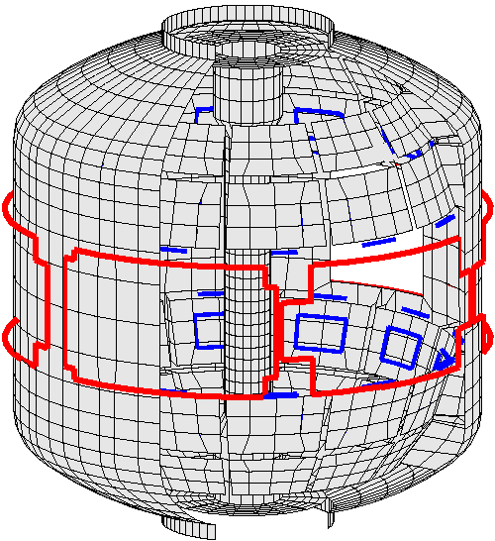
Macroscopic stability group will provide the physics basis for long-pulse sustainment
Uniqueness of NSTX/NSTX-U:
  high β above no-wall limit, high rotation with strong NTV braking
Accomplishments in NSTX:
  EF correction; RWM active control
  Comparison of kinetic RWM stabilization theory to experiments
  NTV physics for magnetic braking
  Disruption prediction algorithm and halo current measurements
Midplane control coils
  n = 1 – 3 error field correction
  Magnetic braking of ω_{φ} by NTV
Poloidal sensors (B_{p})
Stabilizer
plates
Radial sensors (B_{r})
  n = 1 active RWM control with: combined B_{r} and B_{p} PID control or model-based RWM state-space (RWMSC) active control

Slide 3
Overall objective: establish the physics and control capabilities needed for sustained stability of high performance ST plasmas
Demonstrate 100% non-inductive sustainment at performance that extrapolates to ≥ 1MW/m² neutron wall loading in FNSF
Access reduced ν* and high-β combined with ability to vary q and rotation to dramatically extend ST physics understanding
Thrust 1, Stability:
  Understand and advance passive and active feedback control to sustain macroscopic stability at low collisionality
Thrust 2, 3D Fields:
  Understand 3D field effects and provide physics basis for optimizing stability through equilibrium profile control by 3D fields
Thrust 3, Disruptions:
  Understand disruption dynamics and develop techniques for disruption prediction, avoidance, and mitigation in high-performance ST plasmas

Slide 4
Overall objective: establish the physics and control capabilities needed for sustained stability of high performance ST plasmas
Thrust 1, Stability:
  Understand and advance passive and active feedback control to sustain macroscopic stability at low collisionality
    Resistive wall mode (RWM) active control
    New non-axisymmetric control coils (NCC) and enhanced magnetic sensors
    MHD mode stability physics
Thrust 2, 3D Fields:
  Understand 3D field effects and provide physics basis for optimizing stability through equilibrium profile control by 3D fields
Thrust 3, Disruptions:
  Understand disruption dynamics and develop techniques for disruption prediction, avoidance, and mitigation in high-performance ST plasmas

Slide 5
Dual-component PID (B_{r} + B_{p}) and model-based RWM state-space (RWMSC) active control will enable long pulse, high β operation
Year 1 of 5 year plan (2014):
  Expand/analyze RWMSC for 6 coil control and n>1 physics
Active n = 1 B_{p} + B_{R} feedback control
6
β_{N}
Feedback on
140124
140125
140126
140127
4
2
B_{r} phase = 225º
0
6
B_{r}^{n = 1} (G)
Years 2 & 3:
  Establish B_{r} + B_{p} active control capability in new machine, use with snowflake divertor
4
2
B_{r} phase = 180º
0
0.0
0.2
0.4
0.6
0.8
1.0
1.2
t (s)
B_{r} phase = 0º
B_{r} phase = 90º
  Examine RWMSC with:
    independent actuation of six coils
    multi-mode control with n up to 3
    rotational stabilization in the model
RWMSC
  Advantages:
  potential for use of external coils with less power
Years 4 & 5:
  Utilize model-based active control with the new NCC to demonstrate improved global MHD mode stability and very low plasma disruptivity, producing highest-performance, longest-pulse plasmas

Slide 6
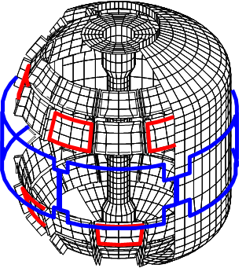
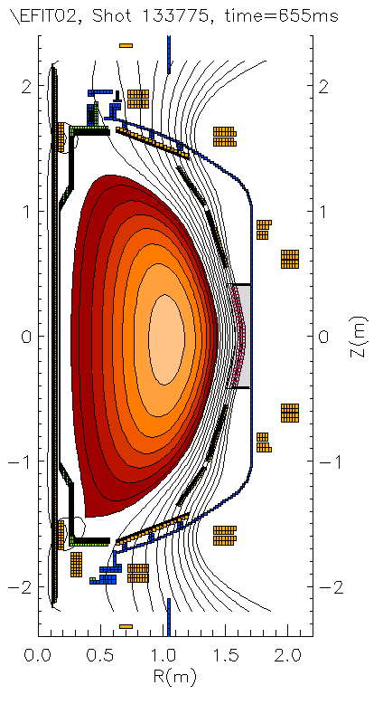
NCC will greatly enhance physics studies and control;
Enhanced magnetics near divertor will measure multi-modes
Years 4 & 5:
  Implement improvements to active feedback of n =1-3 modes via RWMSC control allowed by the partial NCC
  Utilize rotation profile control capabilities allowed by the partial NCC to demonstrate reduced disruptivity by actively avoiding global instability boundaries
Partial NCC
(Next talk by Park will concentrate on NCC)
Existing coils
Multi-mode n = 1 ideal eigenfunction for fiducial plasma
Present sensor locations
Proposed new sensor locations
Mode diagnosis:
  If two modes are near marginal, need to be able to distinguish
  Measure increased amplitude near divertor (3D analysis shows >2x increase over present sensors)
  Similar results in ITER simulations
Significant toroidal phase change would be measured
  Can help constrain the RWMSC
mmVALEN

Slide 7
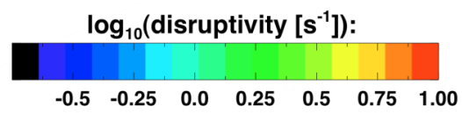
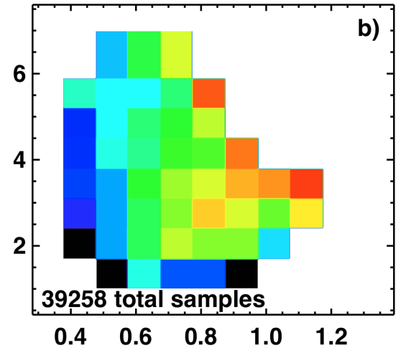
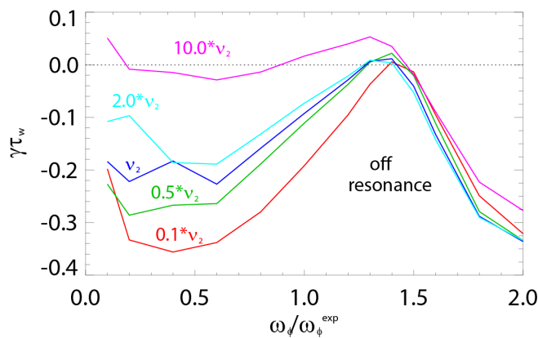
MHD spectroscopy shows improved stability at high β_{N}/l_{i}; kinetic RWM stability may be enhanced at low ν
Resonant Field Amplification (RFA) vs. β_{N}/l_{i}
Theory: RWM γ vs. ν and ω_{φ}
unstable
mode
All NSTX discharges since 2006
0.1
0.0
-0.1
-0.2
-0.3
-0.4
Decreasing
Collisionality
β_{N}
Growth rate γτ_{w}
off
resonance
on resonance
0.0 0.5 1.0 1.5 2.0
Rotation ω/ω_{exp}
l_{i}
Years 1 - 3:
  Investigate the dependence of stability on reduced ν through MHD spectroscopy; compare to kinetic stabilization theory
Years 4 & 5:
  Utilize rotation control, NCC, and cryo-pump (for reduced ν) to change proximity to kinetic resonances for RWM control
Mode stability directly measured in experiment using MHD spectroscopy
  Decreases up to β_{N}/l_{i} = 10 then increases at higher β_{N}/l_{i}
  Agrees with larger NSTX disruption database

Slide 8
Realizing NSTX-U long-pulse scenarios will require stability of internal MHD modes
NSTX-U: Combinations of NB sources
Low frequency mode activity measured with multi-energy soft X-ray
Coupled saturated 1/1 kink and 2/1 tearing modes grow when q_{min} -> 1
(steady-state)
Years 2 & 3:
  Use new neutral beam and q_{min} control to determine increment of q_{min} above rational values to avoid internal modes
  Detect internal modes with RWMSC and non-magnetically with ME-SXR
Years 4 & 5:
  Examine time-evolution of global mode internalization using newly-installed, additional toroidally-displaced ME-SXR diagnostic
  Combine rotation, q, and β_{N} control to demonstrate improved RWM/internal MHD mode stability

Slide 9
Overall objective: establish the physics and control capabilities needed for sustained stability of high performance ST plasmas
Thrust 1, Stability:
  Understand and advance passive and active feedback control to sustain macroscopic stability at low collisionality
Thrust 2, 3D Fields:
  Understand 3D field effects and provide physics basis for optimizing stability through equilibrium profile control by 3D fields
    Error field (EF) correction
    Locking and tearing modes with resonant and non-resonant Efs
    Tearing mode physics vs. rotation and rotation shear
    Neoclassical toroidal viscosity
Thrust 3, Disruptions:
  Understand disruption dynamics and develop techniques for disruption prediction, avoidance, and mitigation in high-performance ST plasmas

Slide 10
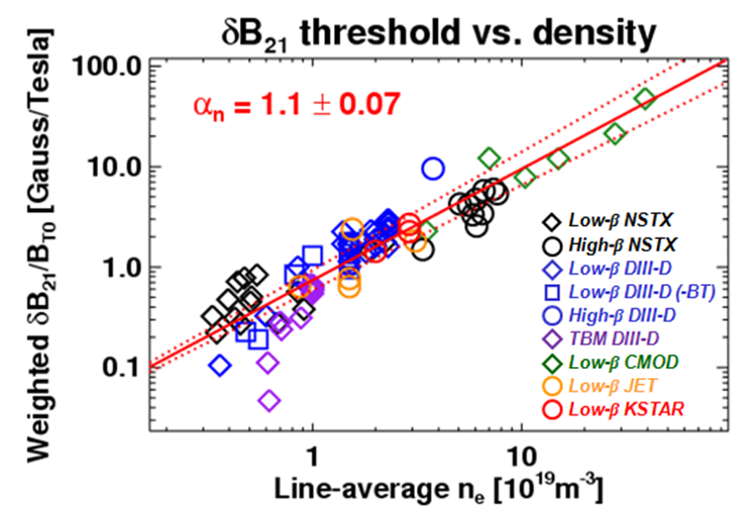
Correction of intrinsic error fields (EFs) is critical for performance; Resonant and non-resonant EFs affect locking and tearing stability
Year 1:
  Use IPEC to model EFs
Years 2 & 3:
  Assess intrinsic EFs in new machine
  Optimize dynamic EF correction, including n>1 and using 6 SPAs and RWMSC
  Investigate resonant EF effects on tearing mode onset
Years 4 & 5:
  Utilize NCC to understand locking and tearing modes in the presence of resonant and non-resonant EFs
    develop predictability for ITER
Dynamic error field correction in NSTX
Gain
Resonant error field threshold vs. locking density (IPEC) for five devices

Slide 11
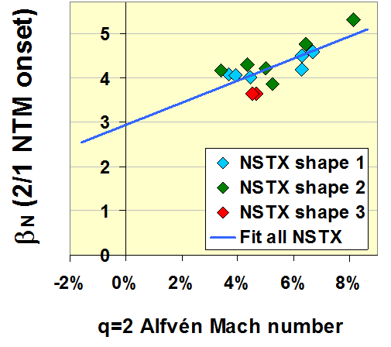
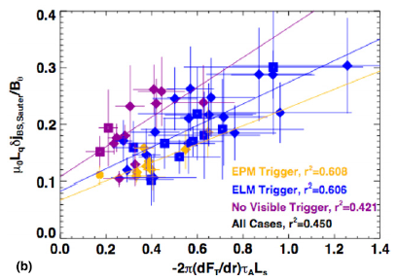
NSTX-U will investigate tearing mode physics vs. rotation and rotation shear
Year 1:
  Analyze NSTX TM/NTMs, project to NSTX-U with resistive DCON, MARS-K, M3D-C1
Years 2 & 3:
  Investigate the rotation and rotational shear vs. TM/NTM in NSTX-U, compared with NSTX
  Investigate the β limit for TM/NTM onsets with varied rotation and rotation-shear
Years 4 & 5:
  Use the partial NCC and the 2nd NBI beam to study TM/NTM dynamics as a function of (β_{N},v_{ϕ})
    develop predictability for ITER
Low rotation is bad for the NTM threshold
Rotation shear may be an even more important parameter
Onset bootstrap drive
Rotation shear

Slide 12
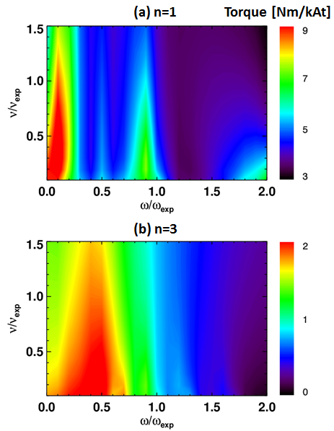
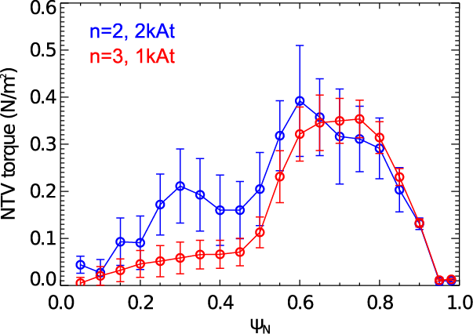
NSTX-U will investigate neoclassical toroidal viscosity (NTV) at reduced ν, which is important for rotation control and ITER
Year 1:
  Analyze existing NSTX NTV data on ν dependence and offset rotation
  Develop/benchmark leading theory/codes
    NTVTOK, IPEC, POCA, FORTEC-3D
Theoretically, torque can be a strong function of rotation and ν
1.5
1.0
0.5
9
0
Analytic
n=1 braking
NSTX
ν/ν_{exp}
Years 2 & 3:
  Assess NTV profile and strength at reduced collisionality, and examine the NTV offset rotation at long pulse
  Prepare an initial real-time model of NTV profile for use in initial tests of the plasma rotation control system
Years 4 & 5:
  Utilize NCC, demonstrate low rotation profile operation (ITER-like) in steady-state with closed-loop rotation control
0.0 0.5 1.0 1.5 2.0
ω/ω_{exp}
POCA NTV calculations for n=2 and n=3 magnetic braking

Slide 13
Overall objective: establish the physics and control capabilities needed for sustained stability of high performance ST plasmas
Thrust 1, Stability:
  Understand and advance passive and active feedback control to sustain macroscopic stability at low collisionality
Thrust 2, 3D Fields:
  Understand 3D field effects and provide physics basis for optimizing stability through equilibrium profile control by 3D fields
Thrust 3, Disruptions:
  Understand disruption dynamics and develop techniques for disruption prediction, avoidance, and mitigation in high-performance ST plasmas
    Prediction and avoidance
    Mitigation with MGI
    Transient heat loads and halo currents

Slide 14
Disruption prediction by multiple means will enable avoidance via profile or mode control or mitigation by MGI (1)
Predictors (Measurements)
Shape/position
Eq. properties (β, l_{i}, V_{loop},…)
Profiles (p(r), j(r), v_{φ}(r),…..)
Plasma response (n=0-3, RFA, …)
Divertor heat flux
General framework & algorithms applicable to ITER
Plasma Operations
Control Algorithms: Steer
Towards Stable Operation
Isoflux and vertical position ctl
LM, NTM avoidance
RWM and dynamic EF control
RWMSC (plasma response)
Divertor radiation control
Avoidance Actuators
PF coils
2nd NBI: q, v_{φ}, p control
3D fields (upgraded + NCC):
EF, v_{φ} control
n=1-3 feedback
Divertor gas injection
Loss of Control
Disruption Warning
System
Mitigation
Early shutdown
Massive Gas Injection
EPI (tbp)

Slide 15
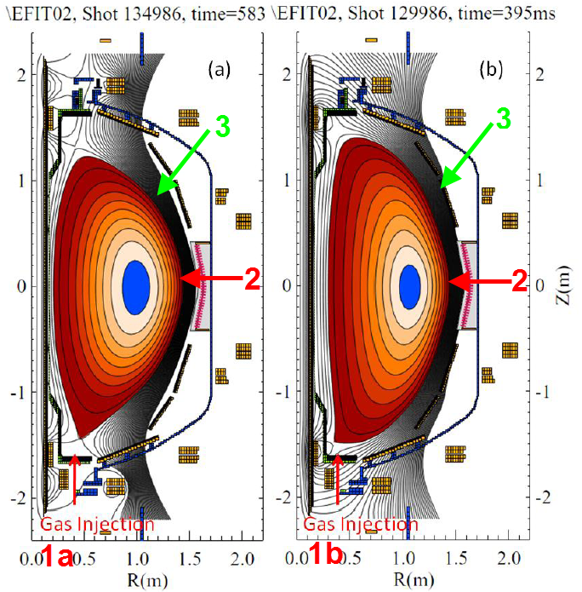
Disruption prediction by multiple means will enable avoidance via profile or mode control or mitigation by MGI (2)
Predictors
Disruption Warning System
Mitigation
γ contours
Control Algorithms
Kinetic Physics
Evaluate simple physics criteria for global mode marginal stability in real-time
Avoidance Actuators
MHD Spectroscopy
Use real-time MHD spectroscopy while varying rotation, q_{min}, and β_{N} to predict disruptions
q, v_{φ} , β_{N} control
Resonant Field
Amplification (G/G)
1
RWMSC observer
Compare mismatch between the RWMSC observer and sensor measurements, and disruption occurence
  ITER gas-loading :
  Injection into private flux region with higher assimilation efficiency?
3D fields, feedback

Slide 16
Disruption prediction by multiple means will enable avoidance via profile or mode control or mitigation by MGI (3)
Year 1:
  Evaluate initial simple physics model for marginal stability based on kinetic stability physics
Years 2 & 3:
  Measure plasma stability using MHD spectroscopy vs. key variables and compare to theory
  Compare the mismatch between the RWMSC observer model and sensor measurements, and disruption occurrence
Years 4 & 5:
  Implement real-time evaluations of: kinetic stability model, MHD spectroscopy, and RWMSC observer disruption prediction for input to profile control algorithms
Year 1:
  Model neutral gas penetration of SOL
Years 2 & 3:
  Commission MGI system
  Characterize density assimilation vs. poloidal location
Years 4 & 5:
  Utilize EPI system
  Trigger the MGI system based on warning of an impending disruption
Predictors
Mitigation

Slide 17
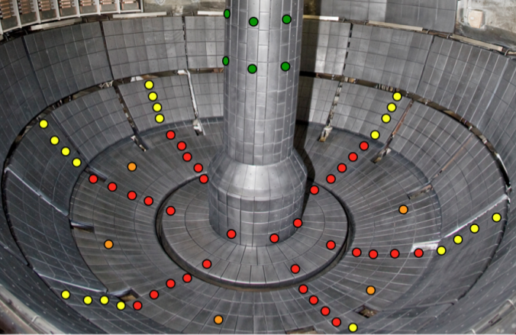
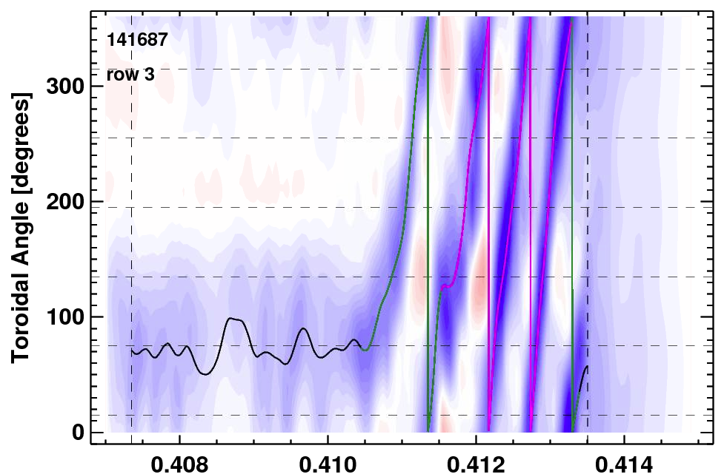
NSTX-U will provide projections of transient heat loads and halo currents for ITER and FNSF
Year 1:
  Examine thermal loading projections for ITER, including assumptions of axisymmetry
Years 2 & 3:
  Investigate halo current toroidal asymmetry and loading on the center column, using newly installed center column shunt tiles
  Upgrade shunt tile diagnostics for complete coverage of divertor
  Study spatial extent and timing of the heat deposition during VDEs
Years 4 & 5:
  Assess halo current scalings using the full field and current capabilities
  Study 3D and non-axisymmetric effects on the divertor heat loading
New diagnostic: high-speed IR thermography (ORNL)
Halo current diagnostics
= Existing
= Baseline plan
(others incremental)
Halo current rotation
300
200
100
0
φ
0.410 0.412 0.414
Time [s]
ITER high priority item: ITER has vessel resonances at frequencies of rotating halo currents

Slide 18
Summary of NSTX-U 5 year plan for
Macroscopic Stability
MS research is establishing the physics understanding and control capabilities needed for sustained stability of high performance ST plasmas
  In unexplored ST operational regime: low ν, high β, low l_{i}, long pulse
NSTX-U will make critical contributions in the areas of:
  Advancement of stability physics and control to sustain macroscopic stability at low collisionality
  Understanding 3D field effects and providing the physics basis for profile control by 3D fields
  Understanding disruption dynamics and developing techniques for disruption prediction, avoidance, and mitigation
MS research in NSTX-U will be greatly enriched, and have significantly greater impact on ITER, by having the NCC coils

Slide 19
Backup

Slide 20
NSTX-U macroscopic stability research is directly coupled to ITER through the ITPA
Through the experimental outage, our group:
  Maintains contributions to five joint experiments and two working groups
    leads the MDC-2 joint experiment / analysis on RWM physics
    co-leads the Working Group 7 effort on aspects of active mode control
  Communicated NSTX research bi-annually at each ITPA MHD Stability group meeting for many years
  Led two elements of the recent ITPA Integrated Plasma Control Working Group study, led by Dr. Joseph Snipes of ITER
    also contributed with direct calculations for ITER on RWM and error field control associated with this effort.
 | MHD
MDC-2 | Joint experiments on resistive wall mode physics | MDC-17 | Active disruption avoidance
MDC-8 | Current drive prevention/stabilization of NTMs | MDC-18 | Evaluation of axisymmetric control aspects
MDC-15 | Disruption database development | MDC-21 | Global mode stabilization for disruption prediction and avoidance (proposed)
NSTX-U stability research plans expand this effort in the coming five year period.

Slide 21
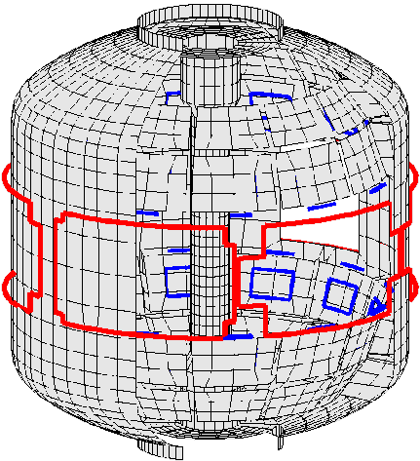
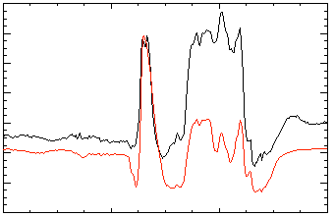
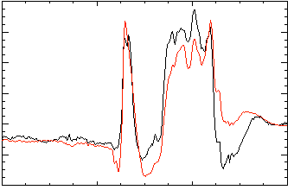
Dual component (B_{R}, B_{p}) PID and state space control
Active n = 1 B_{p} + B_{R} feedback control
Calculation of B_{r} + B_{p} control (VALEN)
6
β_{N}
Feedback on
140124
140125
140126
140127
2.8
4
phase = 0º
2.6
2
B_{r} phase = 225º
B_{r}^{n = 1} (G)
phase = 90º
0
6
B_{r}^{n = 1} (G)
2.4
phase = 180º
4
0.0
0.04
0.08
0.12
2
B_{r} phase = 180º
Δt (s) (model)
0
Model validation and predictive capability:
VALEN code feedback predictions
0.0
0.2
0.4
0.6
0.8
1.0
1.2
t (s)
B_{r} phase = 0º
B_{r} phase = 90º
RWM State Space Controller
3D wall,
ports,
mode currents
No NBI port
With 3D NBI port
80
δ
B
B
90
δ
p
90
p
40
Measurement
Sensor Differences (G)
Measurement
0
Controller
Controller
Inclusion of 3D mode and wall detail improves control
0.56
0.58
0.60
t (s)
0.56
0.58
0.60
t (s)

Slide 22
RWM active control capability increases as partial NCC coils are added
Using present midplane RWM coils
Partial NCC 1x12 (upper), favorable sensors
NCC upper
1x12 coils
Partial 1x12 NCC coil set significantly enhances control
  Present RWM coils: active control to β_{N}/β_{N}^{no-wall} = 1.25
  NCC 1x12 coils: active control to β_{N}/β_{N}^{no-wall} = 1.54
Existing
RWM
coils

Slide 23
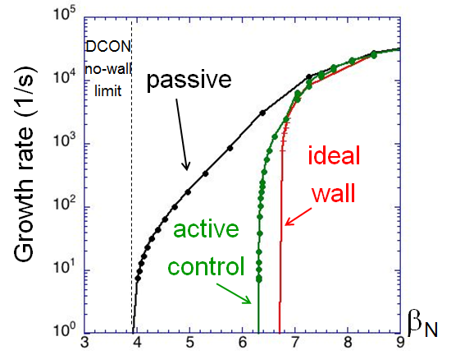
RWM active control capability increases further with full NCC
NCC 2x6 odd parity, with favorable sensors
NCC 2x12 with favorable sensors, optimal gain
NCC full
2x12 coils
Full NCC coil set allows control close to ideal wall limit
  NCC 2x6 odd parity coils: active control to β_{N}/β_{N}^{no-wall} = 1.61
  NCC 2x12 coils, optimal sensors: active control to β_{N}/β_{N}^{no-wall} = 1.70
Existing
RWM
coils
NCC partial
2x6 coils

Slide 24
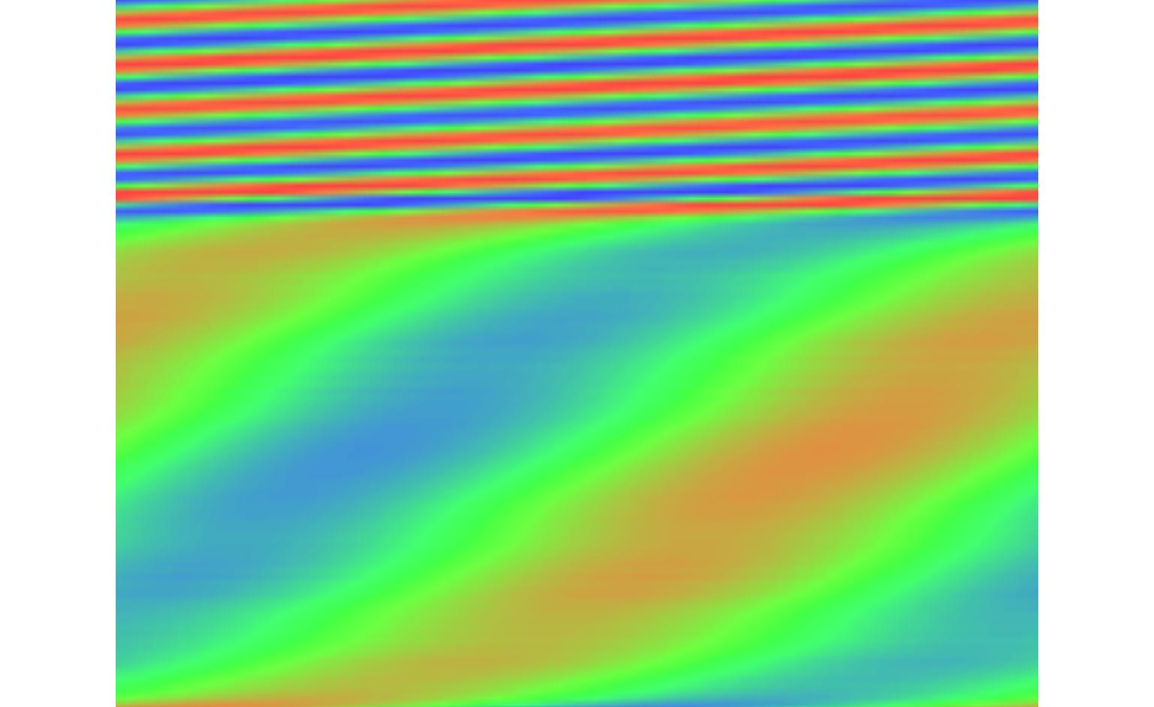
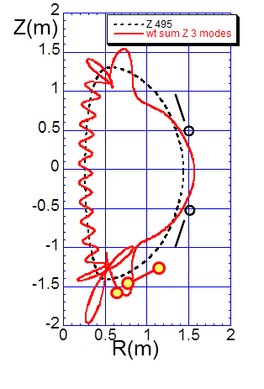
Multi-mode theory shows high amplitude near divertor, enhanced magnetics proposed
Multi-mode n = 1 ideal eigenfunction for fiducial plasma
poloidal angle
n = 1 mode
Present sensor positions
center
column
Multi-mode physics
  Implement in RWMSC
  Validate theory predictions with measurements
  Found similar results in ITER simulations
new sensors
toroidal angle
outboard midplane
new sensors
Present sensor locations
Proposed new sensor locations
Global mode diagnosis: measure theoretically increased amplitude in the divertor at high β_{N}
3D analysis of candidate sensor positions show >2x increase in signal over present sensors
Significant toroidal phase change would be measured
  Constrain RWM state space controller
mmVALEN
code

Slide 25
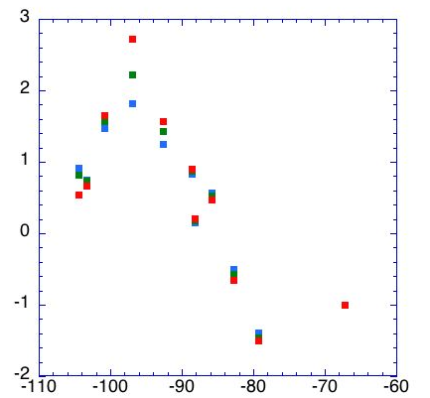
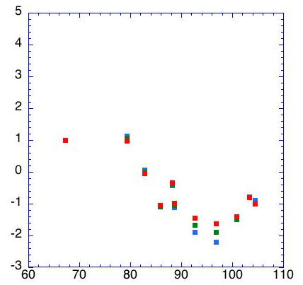
3D analysis of extended MHD sensors show significant mode amplitude off-midplane, approaching divertor region
n = 1 ideal eigenfunction for high beta plasma
Z(m)
Present sensor locations
B_{R} sensors (nominally normal, B_{norm})
B_{p} sensors (nominally tangential, B_{tan})
θ
New sensor locations (includes
one new location above midplane)
R(m)
B_{norm} vs. theta (normalized to present Br sensors)
Z_{plasma} = -10 cm
Model characteristics
  New 3D model of divertor plate
  3D sensors with finite toroidal extent; n*A of existing sensors
Results summary
  Field amplitude increases >2x with new sensors
  Perturbed field reversals observed with new sensors
  Signals sufficient with plasma shifted off-midplane
= -5 cm
= 0 cm
Present sensors
B_{norm}(normalized)
Φ = 0 deg
Φ = 0 deg
θ (deg)
θ (deg)

Slide 26
Stability control improvements significantly reduce unstable RWMs at low l_{i} and high β_{N}; improved stability at high β_{N}/l_{i}
Resonant Field Amplification (RFA) vs. β_{N}/l_{i}
unstable
mode
Unstable RWM
Stable / controlled RWM
Mode stability directly measured in experiments using MHD spectroscopy
  Stability decreases up to β_{N}/l_{i} = 10
  Stability increases at higher β_{N}/l_{i}
  Presently analysis indicates consistency with kinetic resonance stabilization
Disruption probability reduced by a factor of 3 on controlled experiments
  Reached 2 times computed n = 1 no-wall limit of β_{N}/l_{i} = 6.7
Lower probability of unstable RWMs at high β_{N}/l_{i}

Slide 27
Internal modes may limit long-pulse scenarios; kinetic RWM stability may be enhanced at low ν
Experiments measuring global stability vs. ν support kinetic RWM stability theory
Theory: RWM γ vs. ν and ω_{φ}
Coupled m/n = 1/1+2/1 modes grow when q_{min} approaches 1
0.1
0.0
-0.1
-0.2
-0.3
-0.4
γτ_{w}
Collisionality
  EPM or ELM triggers cause modes to onset at larger q_{min}.
  “triggerless” internal kinks as q_{min} -> 1
off
resonance
on resonance
0.0 0.5 1.0 1.5 2.0
Model validation and predictive capability:
MISK code RWM stability calculations
ω/ω_{exp}
Expectations at lower ν:
Experiment: RFA vs ν
1.5
off resonance
Unstable
  More stability on resonance almost no effect off-resonance
RWMs
Various combinations of neutral beam sources
1.0
n = 1 RFA (G/G)
0
.5
on resonance
0.0
0
1
2
3
ν
ii
[kHz]
Mode stability directly measured in experiment using MHD spectroscopy
  Decreases with ν “on resonance”
  Independent of ν “off resonance”
NBCD can determine the required increment of q_{min} above rational values to avoid internal modes

Slide 28
Internal kink/ballooning modes must be measured via non-magnetic means
Non-magnetic measurement is also important for mode control systems to be used in future devices with high neutron fluence
The RWMSC can determine how incorrect the observer is in reproducing the measured magnetic flux
  Can be used as a criterion as input to a disruption warning system.
Multi-energy soft X-ray can measure low frequency mode activity
  used to determine mode amplitude and in conjunction with the external magnetic sensors to determine the degree to which the mode is internal

Slide 29
Understanding neoclassical toroidal viscosity (NTV) is crucial for rotation control
R(12-1)
“Investigate magnetic braking physics to develop toroidal rotation control at low ν”
Model validation and predictive capability: NTV calculations with multiple codes, comparison to experiments
NTVTOK code:
  Shaing theory NTV computation including ion and electron effects
  Comparison to experiment of NTV in all collisionality regimes
A new δf guiding-center particle code, POCA, was developed to investigate neoclassical transport in perturbed tokamaks.
  solves the Fokker-Planck equation with non-axisymmetric magnetic field perturbations
POCA NTV calculations for n=2 and n=3 magnetic braking in NSTX
Analytic NTV calculations for (a) n=1 and (b) n=3 magnetic braking in NSTX, as a function of collisionality and rotation
(a) n=1
(b) n=3
1.5
1.0
0.5
9
0
1.5
1.0
0.5
2
0
ν/ν_{exp}
ν/ν_{exp}
0.0 0.5 1.0 1.5 2.0
0.0 0.5 1.0 1.5 2.0
ω/ω_{exp}
ω/ω_{exp}

Slide 30
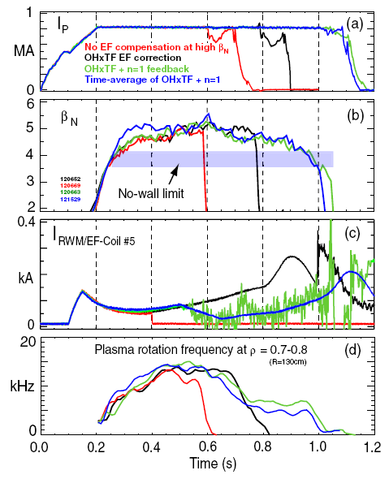
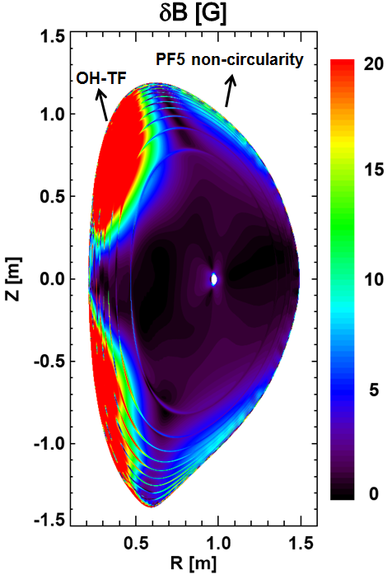
Correction of intrinsic error fields is critical for studies of 3D field physics and for performance
The perturbed n=1 field (IPEC) from intrinsic error fields in NSTX
Various successful error field correction schemes in NSTX
Dynamic error field correction (green)
  sustains β_{N} above the no-wall limit
  sustains substantial toroidal rotation
NSTX-U will have a different error field
  Identification of error field in first year of operation
  measure vacuum fields; revise models
  Perform n=1,2 compass scans with 6 independent SPAs.
  RWMSC for dynamic error field correction
Predictive capability:
IPEC model of error fields

Slide 31
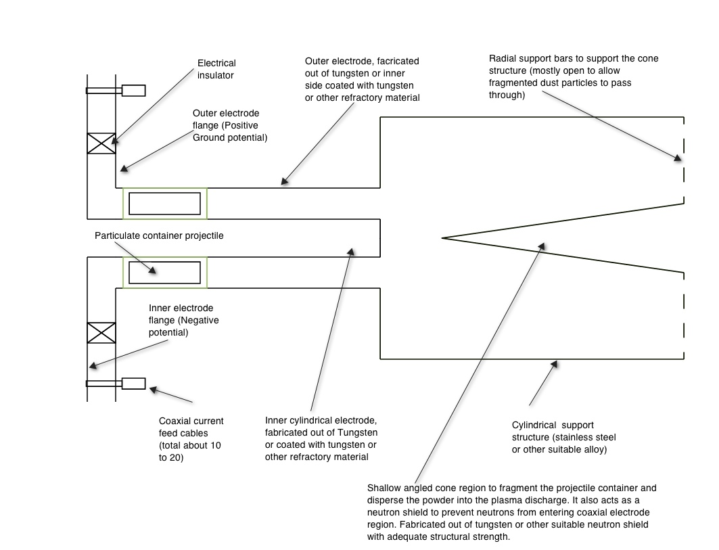
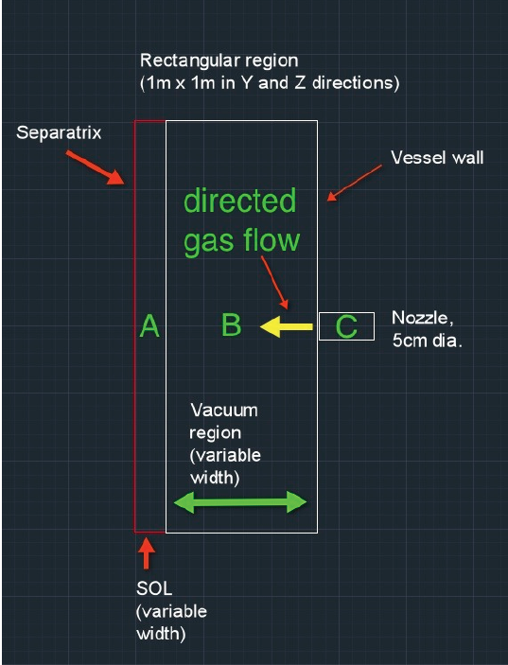
Disruption mitigation technologies that will benefit the ITER design are being prepared
MGI research will assess gas penetration efficiency by injection at different poloidal locations
A novel mitigation technology, an electromagnetic particle injector (EPI), will be used to terminate plasmas
Cone for shattering
Particulate container projectile
Rail gun electrodes
The EPI is capable of delivering:
  A large particle inventory
  All particles at nearly the same time
  Particles tailored to contain multiple elements in different fractions and sizes
  Tailored particles fully ionized only in higher current discharges (to control current quench rates)
Well suited for long stand-by mode operation
Predictive capability: Modeling using DEGAS-2 is quantifying the gas penetration past the SOL for NSTX-U
NSTX-U can offer new insight by
  Reducing the amount of gas
  Injecting gas into the private flux and lower x-point regions of divertor to determine if these are more desirable locations for MGI.

Slide 32
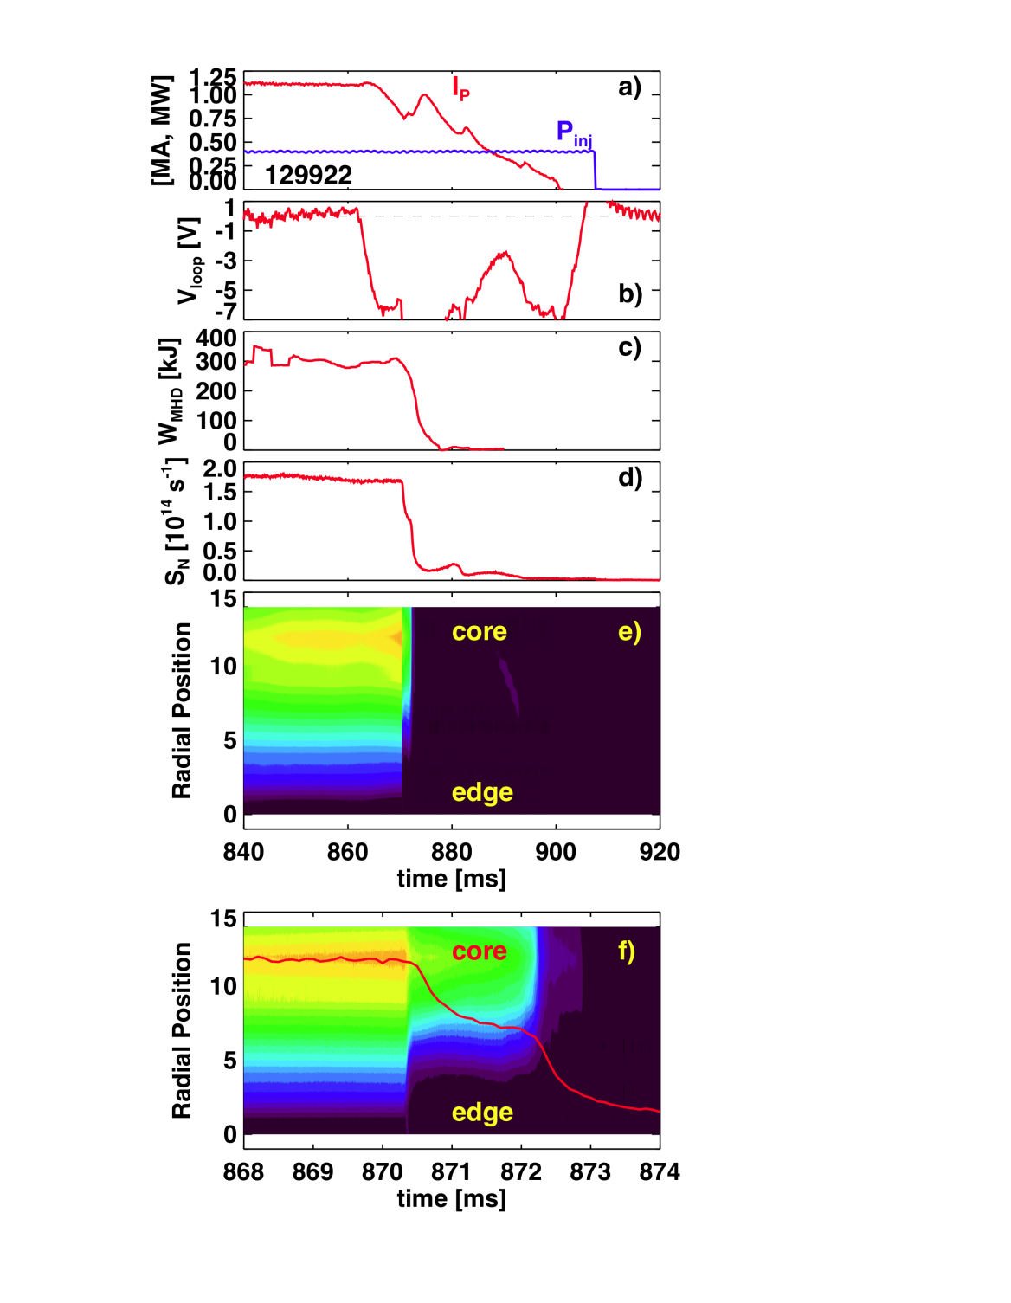
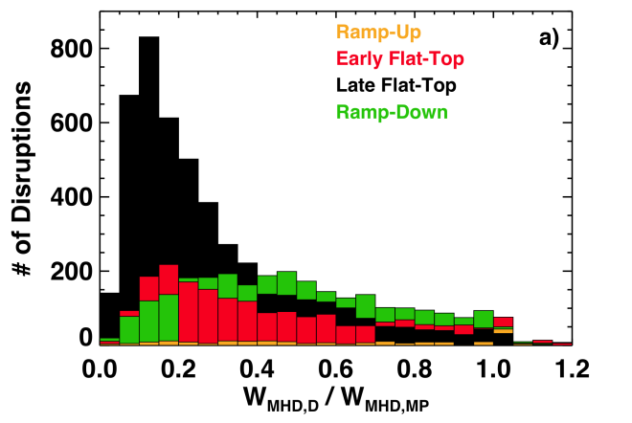


        Understanding of thermal quench physics and transient heat loads is critical for projections
 | NSTX-U | ITER | ST-Pilot | Power Reactor
Thermal Loading [MJ m² s^{-1/2}] | 15 | 540 | 768 | 2061
Example of rapid disruption with high stored energy
Examining assumptions:
  How much stored energy?
rapid thermal quench
Soft X-ray
Typically only 15-20% of the stored energy remains in a late flat top disruption in NSTX
neutron emission [arb.]
  Halo currents are non-axisymmetric, but are heat fluxes?
Proposed expansion of the NSTX-U shunt tile diagnostic set
300
200
100
0
φ
Time [s]
0.408 0.410 0.412 0.414

Slide 33

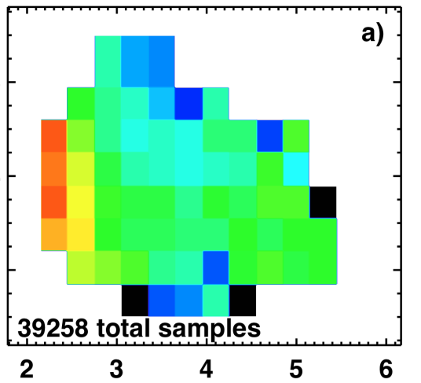
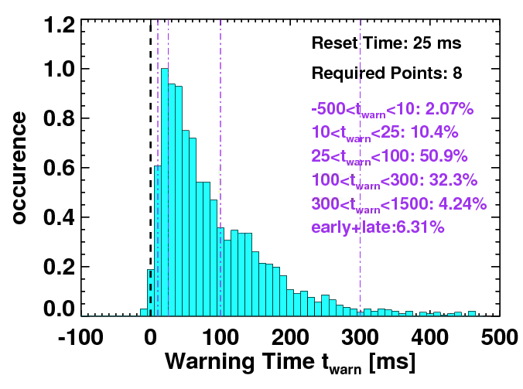
Disruptivity studies and warning analysis of NSTX database are being conducted for disruption avoidance in NSTX-U
Disruptivity
Warning Algorithms
Disruption warning algorithm shows high probability of success
  Based on combinations of single threshold based tests
β_{N}
l_{i}
q*
All discharges since 2006
Physics results
  Low disruptivity at relatively high β_{N} ~ 6; β_{N} / β_{N}^{no-wall(n=1)} ~ 1.3-1.5
    Consistent with specific disruption control experiments, RFA analysis
  Strong disruptivity increase for q* < 2.5
  Strong disruptivity increase for very low rotation
Results
  ~ 98% disruptions flagged with at least 10ms warning, ~ 6% false positives
  False positive count dominated by near-disruptive events

Slide 34
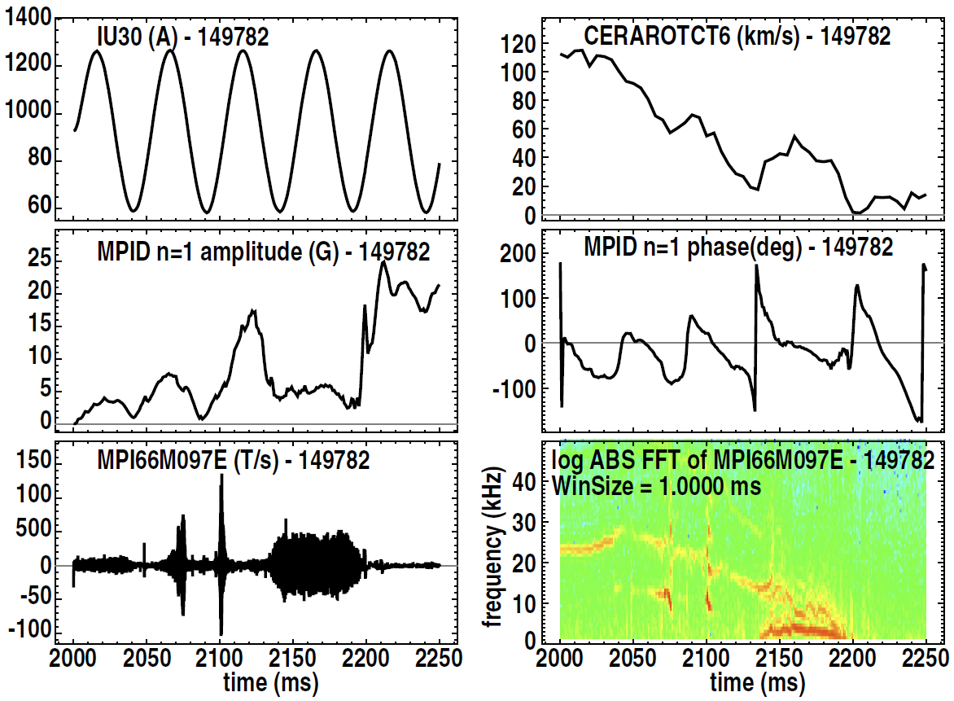
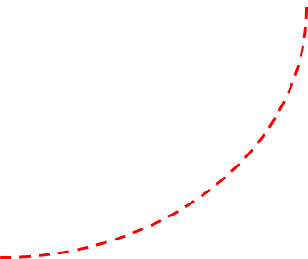
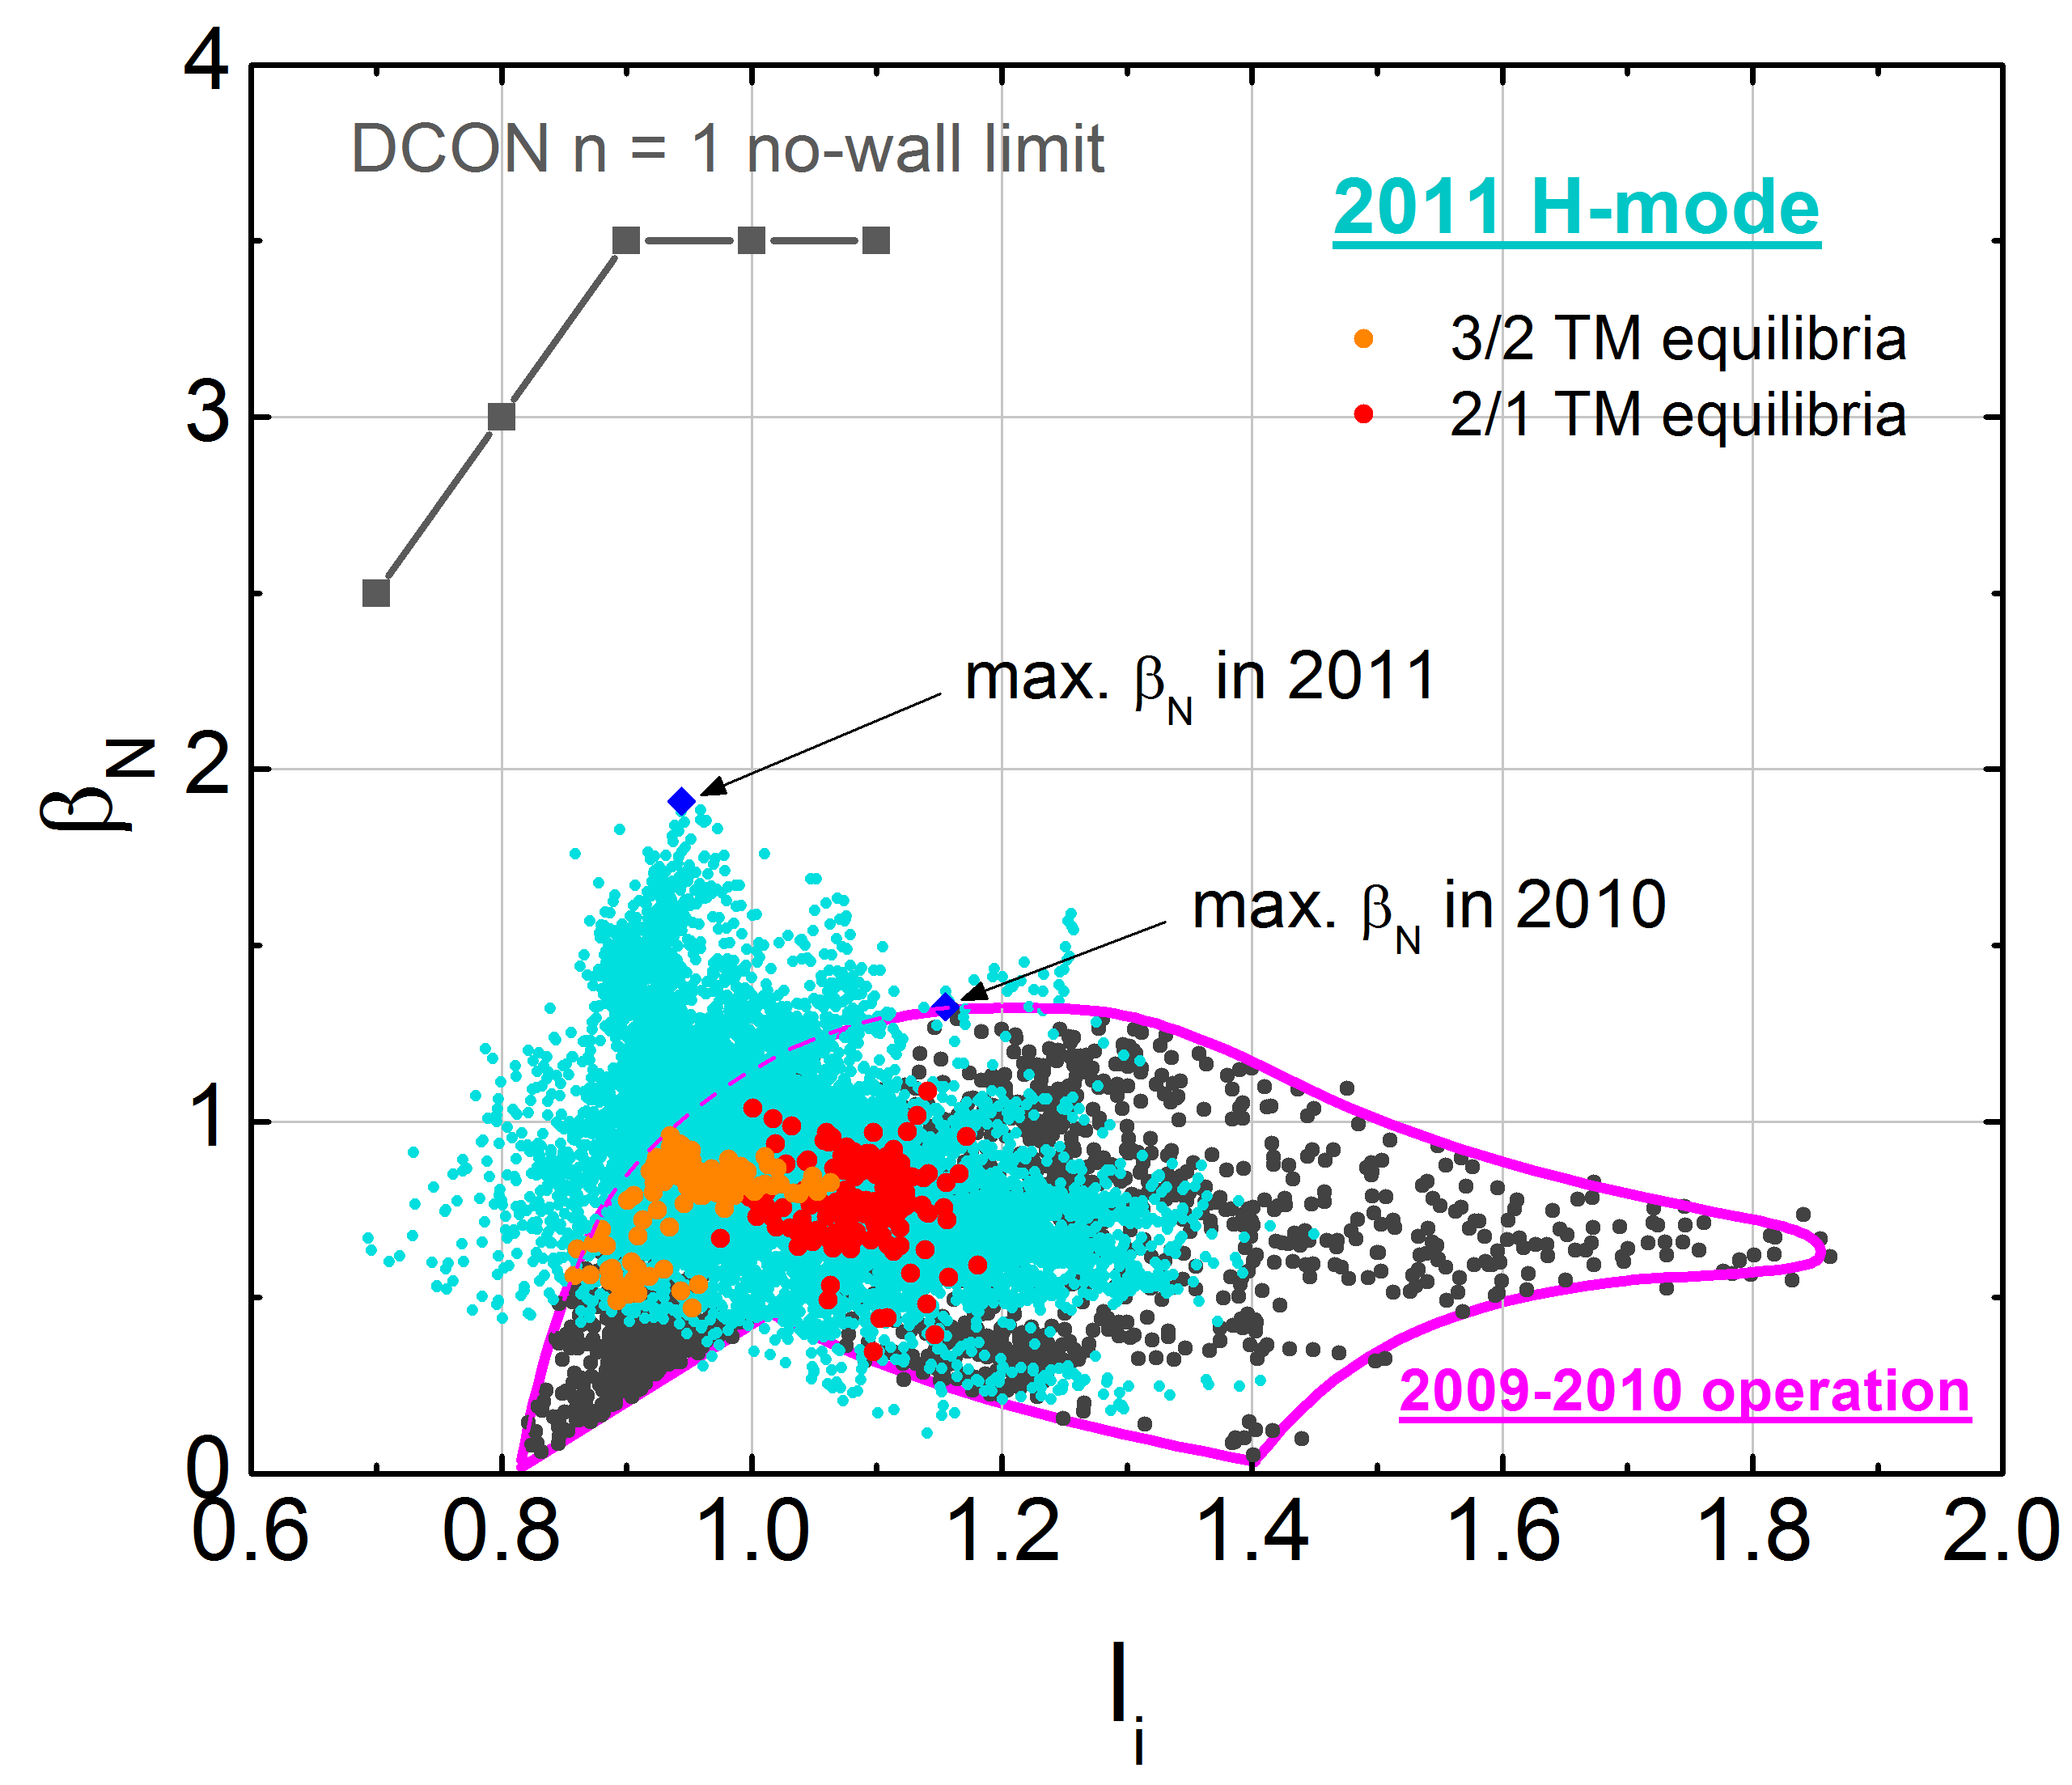
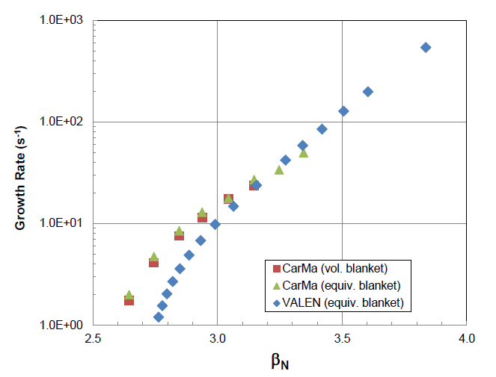
MS group continues strong collaborations with other devices such as KSTAR, DIII-D, and ITER team
KSTAR: equilibrium operating space 2009 –11
(evolution of > 130 discharges) + new results
DIII-D: RFA of ~ 20Hz n = 1 increase to very high levels while β_{N} increases and rotation decreases
Rapidly rotating n = 1 appears (TM?), clamps RFA amplitude
New MP2012-04-23-021
session 1 session 2+
ITER: RWM passive growth rates by CarMa and VALEN
Plasmas have passed the predicted “closest approach” to the n = 1 ideal no-wall stability limit: l_{i} = 0.7, β_{N} = 2.5

Slide 35
Many important computational codes are used for theory-experiment comparison on NSTX-U
Code | Description | Scope | Improvements
VALEN | Models currents in structures with thin shell finite elements | RWM active feedback simulation, growth rate prediction with 3D walls | Multi-mode effects, study extra time delay in plasma model
RWMSC | Resistive wall mode state-space controller computations | Generate control matrices for real-time controller, and offline physics studies | Generalization for partial actuator availability, n > 1 and multi-mode spectrum
NTVTOK | Shaing theory NTV computation including ion and electron effects | Calculation for comparison to experiment of NTV in all collisionality regimes | Continued implementation of NTV models, guided by experiment
DCON | Ideal MHD stability code | Ideal Kink stability analysis with and without the wall up to n=6 | Resistive layer physics across rational surfaces (Resistive DCON)
MISK | Modifications to ideal stability by kinetic effects | Calculation of resistive wall mode stability | Improved model of energetic particle, anisotropy effects
DEGAS-2 | Monte Carlo code to compute transport of neutral atoms | Calculation of neutral gas penetration through SOL | Include multiple gas species Use exact NSTX-U SOL conditions from UEDGE
EFIT | Equilibrium reconstruction code | Between-shots equilibrium reconstruction | Higher resolution, auto best level, new diagnostics
IPEC/GPEC | Ideal and general perturbed equilibrium with 3D fields | Plasma response, locking, and NTV studies with 3D fields | General force balance equation including general jump conditions
MARS-K | Self-consistent kinetic stability calculation | Calculation of RWM stability and plasma response to perturbation | Inclusion of energy dependent collisionality for NTV calculation
M3D-C¹ | Implicit resistive and 2-fluid MHD code | Linear and nonlinear MHD stability | Neoclassical terms, resistive wall being added
FORTEC-3D | Monte-Carlo drift-kinetic physics simulation code | Non-ambipolar transport and NTV physics in general geometry | Continued integration with IPEC and application to NSTX-U
POCA | δf guiding-center orbit code | Calculation of neoclassical transport, perturbed pressures and NTV | Improved numerical scheme to enhance computation speed

Slide 36
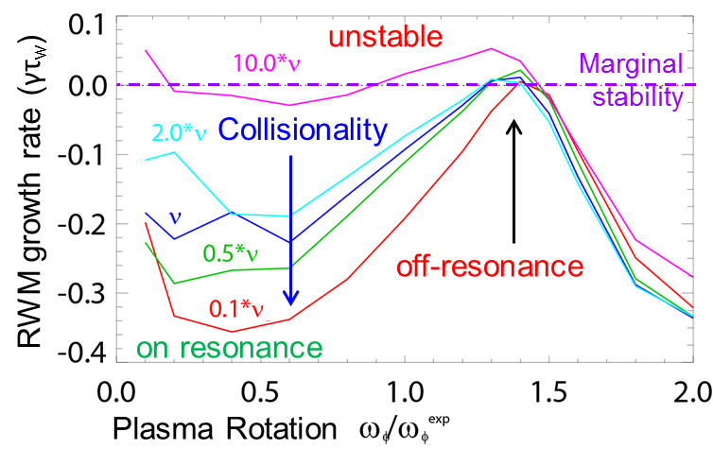
Many important computational codes are used for theory-experiment comparison on NSTX-U
Code
VALEN
RWMSC
NTVTOK
DCON
MISK
DEGAS-2
EFIT
IPEC/GPEC
MARS-K
M3D-C¹
FORTEC-3D
POCA

Slide 37
2014-18 Macroscopic Stability Research Timeline
FY13
14
15
16
17
18
5 year plan period
5 year plan period
5 year goal
Physics
Thrust #1
Optimize shaping, RWM/TM control (n≥1 using the second SPA), validate internal mode physics and RMW kinetic physics
Optimize and combine rotation profile and β-feedback control using NCC, to improve stability and for fully non-inductive operation
      Provide FSNF/Pilot projection,
      Integrate MS control to improve RWM/TM/ELM/ internal mode stability, disruption avoidance, with disruption mitigation protection
Thrust #2
Optimize error field correction (n≥1), dynamic correction, and understand NTV physics in reduced v* and controlled rotation
Understand non-resonant error field effects using NCC, NTV effects vs. rotation profile on transport, utilize 3D field to improve stability
Thrust #3
Study halo currents, disruption loads, and precursors, and test MGI or other mitigation techniques
Investigate avoidance scenarios and couple to mitigation techniques
Tools
Diagnostics
Real-time velocity measurement and MSE, toroidally displaced ME-SXR
Real-time MPTS, X-ray imaging spectrometer,
Internal dB measurement from MSE,
enhanced magnetic sensors
Expanded shunt tile measurements, disruption load diagnostics
Theory
Utilize equilibrium reconstruction, and transport and stability codes
Integrate and validate 3D equilibrium, stability, and transport codes
Gas penetration dynamics
Disruption simulation
Facility
Second switching power amplifier (SPA),
MGI disruption mitigation system
Non-axisymmetric Control Coil (NCC), enhanced magnetics, cryopump for low v*
Plasma Control
RWM state-space control (n≥1), error field control, snowflake divertor control
Utilize 3D field for rotation (profile) and β-feedback control, to improve RWM/TM/internal mode stability
Integrate MS control with disruption avoidance and mitigation

