Slide 1




NSTX-U
Supported by
NSTX-U 5 Year Plan for Non-axisymmetric Control Coil (NCC) Applications
J.-K. Park,
J. W. Berkery, A. H. Boozer,
J. M. Bialek, S. A. Sabbagh, J. M. Canik, K. Kim,
R. Maingi, T. E. Evans, S. P. Gerhardt, J. E. Menard
for the NSTX Research Team
Coll of Wm & Mary
Columbia U
CompX
General Atomics
FIU
INL
Johns Hopkins U
LANL
LLNL
Lodestar
MIT
Lehigh U
Nova Photonics
ORNL
PPPL
Princeton U
Purdue U
SNL
Think Tank, Inc.
UC Davis
UC Irvine
UCLA
UCSD
U Colorado
U Illinois
U Maryland
U Rochester
U Tennessee
U Tulsa
U Washington
U Wisconsin
X Science LLC
Culham Sci Ctr
York U
Chubu U
Fukui U
Hiroshima U
Hyogo U
Kyoto U
Kyushu U
Kyushu Tokai U
NIFS
Niigata U
U Tokyo
JAEA
Inst for Nucl Res, Kiev
Ioffe Inst
TRINITI
Chonbuk Natl U
NFRI
KAIST
POSTECH
Seoul Natl U
ASIPP
CIEMAT
FOM Inst DIFFER
ENEA, Frascati
CEA, Cadarache
IPP, Jülich
IPP, Garching
ASCR, Czech Rep
NSTX-U 5 Year Plan Review
LSB B318, PPPL
May 21-23, 2013

Slide 2
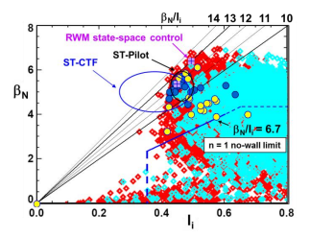
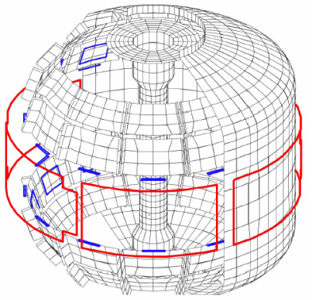
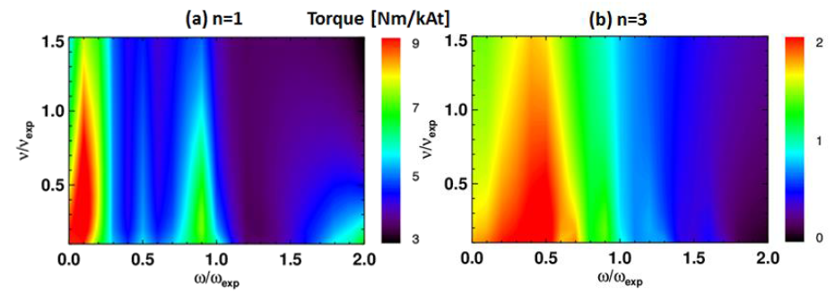
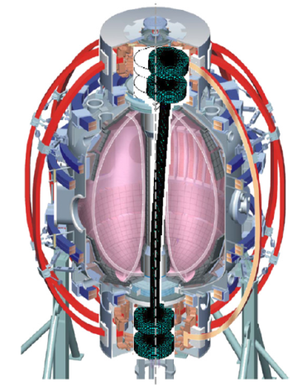


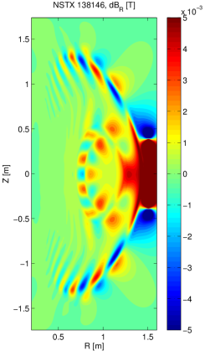
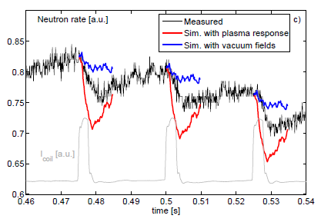
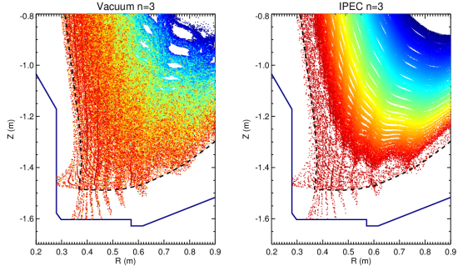
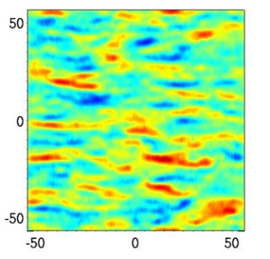

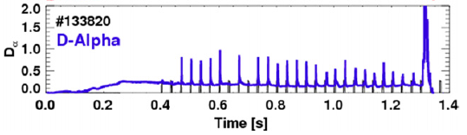
Motivation: Expanded 3D field capability on NSTX-U is essential to meet NSTX-U programmatic/TSG goals, and support ITER
Expanded 3D field capability needed to control error fields, RWMs, momentum (rotation), particle/heat transport, ELM control, etc.
3D transport and NTV physics
RWM active control
Fast ion instability (GAE,TAE) control
Response modeling
Resonant (OH-TF) and non-resonant (PF5) error field control
3D field applications
Particle/heat load splitting
Turbulence suppression
ELM pacing
Flow shear

Slide 3
Outline
Proposed NCC geometry for NSTX-U
  Partial and full choices for NCC
Physics analysis and NCC applications
  Resonant and non-resonant error field control
  RWM active control
  Rotation control via NTV
  RMP characteristics for stochastic and neoclassical transport
  RMP characteristics for 3D stability
Summary
  Coil performance comparison table
Future plan for analysis

Slide 4
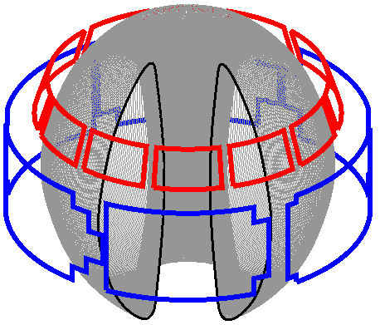
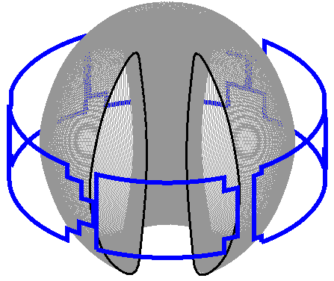
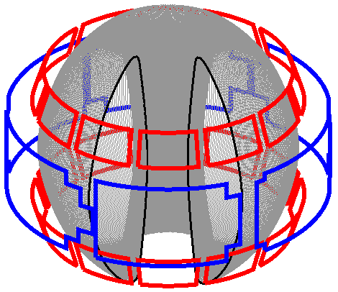
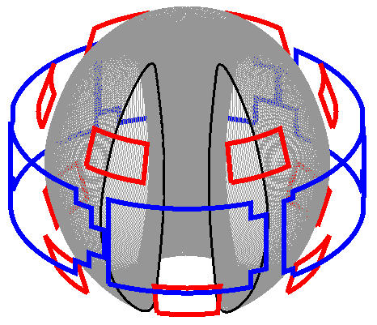
A range of off-midplane NCC coil configurations is being assessed for potential physics capabilities
NCC proposal: Use two off-midplane rows of 12 coils toroidally
  To produce wide poloidal spectrum to vary resonant vs. non-resonant coupling
  To rotate n=1 – 4 fields to diagnose plasma response such as heat flux spreading in divertor
  Poloidal positions of 2x12 coils have been selected based on initial studies
Partial NCCs are also under active investigation
  Anticipate possible staged installation to the full 2x12
  3 best options will be discussed and compared with existing midplane coils
Existing
Midplane coils
12U
NCC Options
2x12
2x6-Odd

Slide 5
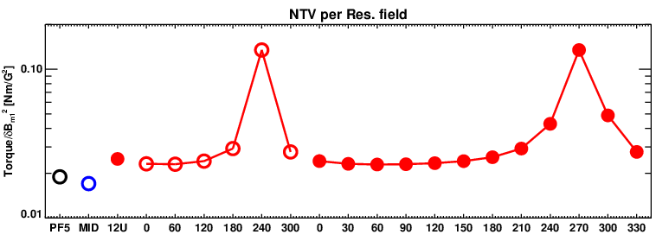
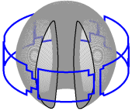
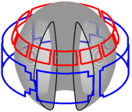
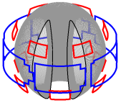
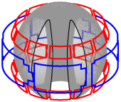
Wide variation of n=1 non-resonant vs. resonant field made possible by NCC
IPEC and combined NTV analysis show that 2x6-Odd partial NCC and 2x12 full NCC can provide range of non-resonant error field control while minimizing n=1 resonant error field, which is a critical issue for tokamaks
Non-resonant field physics can be quantified by NTV, via
  High F_{N-R} as well as its variability are important
MID
12U
2x6-Odd
2x12
F_{N-R} [Nm/G²]
Phase difference for 2x6-Odd
Phase difference for 2x12
* Combinations of midplane coils with NCC are partially tested and shown in backup slides

Slide 6
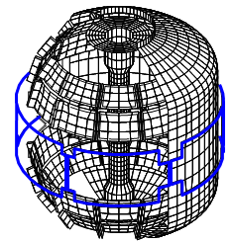
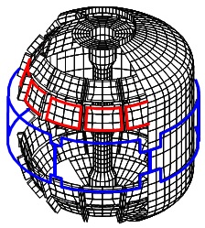
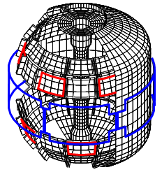
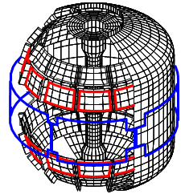
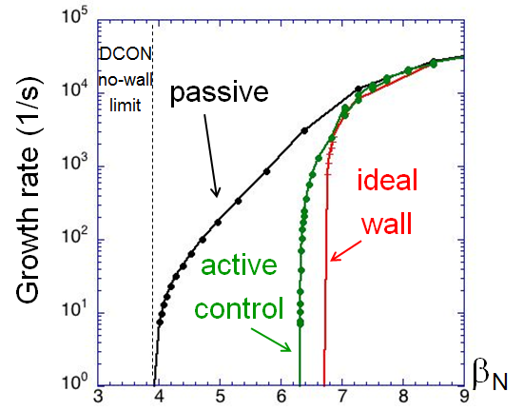
RWM control capability increases and physics studies are expanded with NCC
VALEN3D analysis shows RWM control performance increases as NCC coils are added
  Can operate very close to the ideal-wall limit with full 2x12 NCC
  Can be quantified by β-gain
Midplane
12U
2x6-Odd
2x12
β_{N} = 4.9 ; F_{β} = 1.25
β_{N} = 6.1 ; F_{β} = 1.54
β_{N} = 6.3 ; F_{β} = 1.61
β_{N} = 6.6 ; F_{β} = 1.70

Slide 7
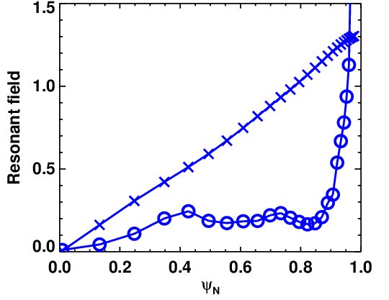
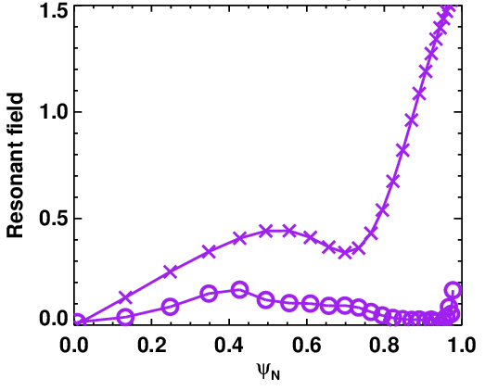
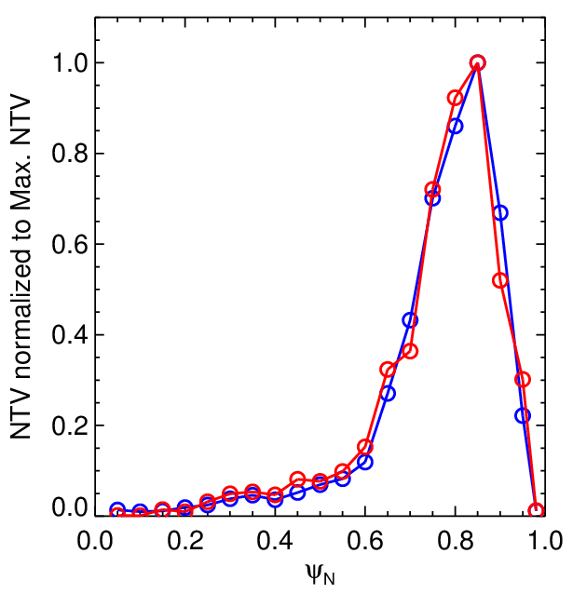
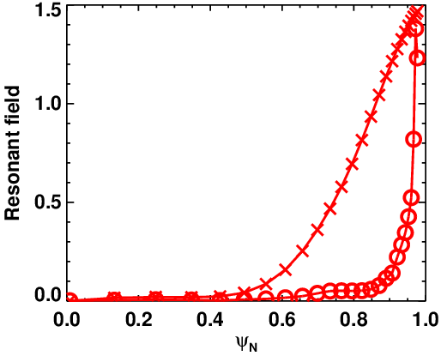
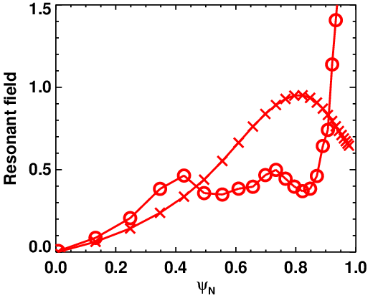
NCCs greatly expand possible resonant field profiles for similar n=3 NTV braking – will aid understanding of RMP
Midplane
Midplane + NCC
Vacuum –x–
IPEC –O–
Vacuum –x–
IPEC –O–
NTV torque profiles by POCA
2x6-Odd NCC n=3
Midplane n=3
Addition of NCC can minimize edge resonant field
2x6-Odd (Phase 1)
2x6-Odd (Phase 2)
Vacuum –x–
IPEC –O–
Vacuum –x–
IPEC –O–
Phase of NCC can control resonant profile width
Full NCC can further enhance variability of NTV across radius to control rotation and shear, and thus microscopic-to-macroscopic instabilities (backup slides)

Slide 8
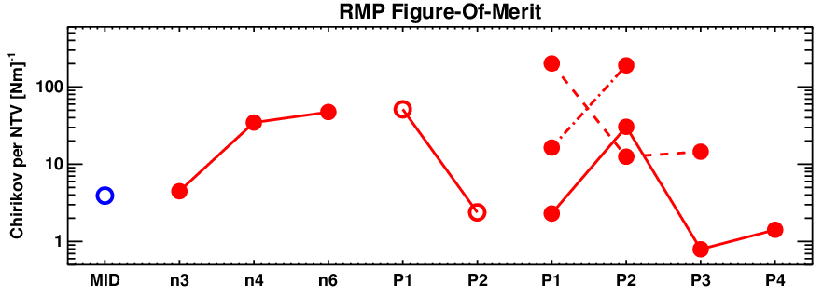
NTV at fixed Chirikov can be varied by 1 order of magnitude with partial NCC, 2 orders of magnitude with full NCC
Empirical RMP characteristics: Chirikov overlap and pitch-alignment
  Chirikov overlap implies dominant stochastic transport in the edge
  Good pitch-alignment implies small non-resonant fields, which are related to small neoclassical 3D transport (NTV) in the core
  These mixed hypothesis can be quantified by
MID
12U
2x6-Odd
n=4
2x12
n=3
F_{N-C} [Nm]⁻¹
n=3
n=6
n=3
n=3
12U
Phase difference 2x6-Odd
Phase difference 2x12

Slide 9
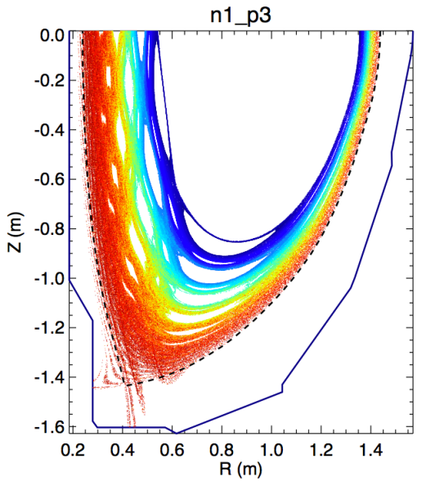
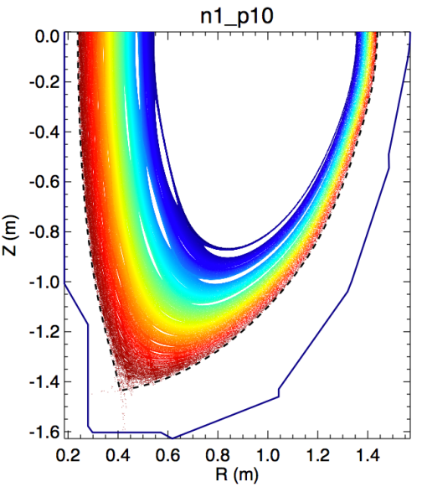
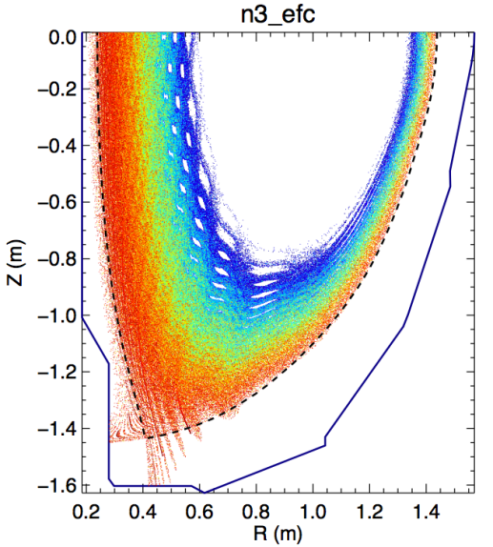
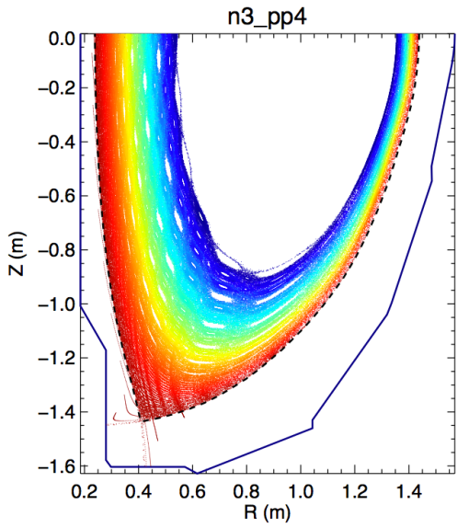
Field line tracing calculations show vacuum stochastic layers can be substantially modified by NCC
POCA-FLT simulations for NCCs show important modifications of vacuum stochastic layers for both n=1 and n=3
Although the vacuum hypothesis may not be precise even in the edge, these predictions can be tested in NSTX-U for ELM control and compared with divertor diagnostics for particle and heat splitting
Resonant n=1
Less resonant n=1
Midplane n=3
Less resonant
n=3 using NCC

Slide 10
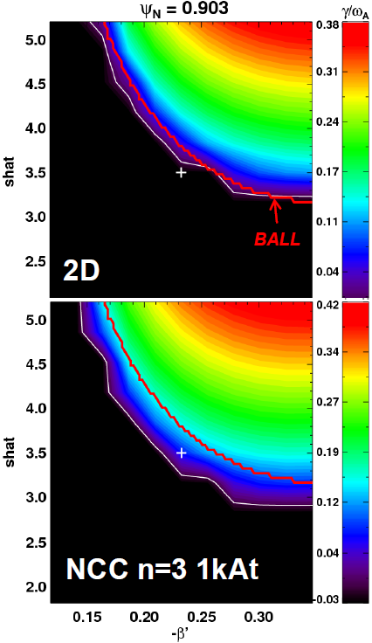
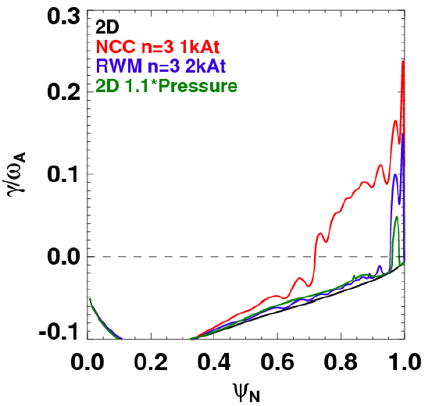
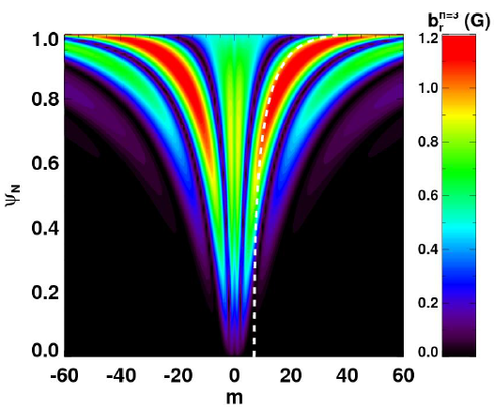
Stability analysis using stellarator tools indicates 3D equilibrium effects are important for pedestal ballooning instability
Midplane coil applications in NSTX showed strong ELM triggering and pacing
VMEC+COBRA analysis for NSTX-U shows NCCs may significantly increase this capability
  NCCs can broaden ballooning unstable region by ~30% compared to midplane coils or 2D (benchmarked with BALL)
ISOLVER+VMEC+COBRA
Magnetic shear
Full NCC n=3 (Up-down symmetric)
2D
NCC n=3 1kAt
Midplane n=3 2kAt
2D 1.1*Pressure
Increased ELM instability by NCC
Magnetic shear

Slide 11
Summary of initial analysis
For partial NCCs, 2x6-Odd is more favorable than 12U for error field, RWM control, rotation control, and RMP characteristics
  12U can provide high-n rotating capability, but poloidal spectrum is limited
Full NCC greatly expands capability for NTV and RMP physics and control
Quantified FOM table:
Figures of Merit | Favorable values | MID | 12U | 2x6-Odd | 2x12
EF (n=1) | High F_{N-R} | 0.017 | 0.025 | 0.13 | 0.13
RWM (n=1) | High F_{β} | 1.25 | 1.54 | 1.61 | 1.70
NTV (n≥3) | Wide ΔF_{N-N} | 1.00 | 2.00 | 3.97 | 19.6
RMP (n≥3) | High F_{N-C} | 3.92 | 41.3 | 51.3 | 201
 | Wide ΔF_{N-C} | 1.00 | 10.5 | 22.1 | 252
* Figures of merit for NTV is defined and illustrated in backup slides

Slide 12
Analysis plans for upcoming year
Additional configurations will be investigated
  Combine NCC and midplane, including different Ampere-turn ratios, and with constraint of only 6 independent power supplies
  Various target plasmas with different q_{min} and q-shear
Important coil configurations will be identified using FOMs, with varied collisionality and rotation
  IPEC-NTV, MISK, MARSK, MARSQ, NTVTOK, VALEN3D, TRIP3D will be used to quantify error field, NTV, RWM, RMP characteristics
  SVD methods with FOM matrices, with and without coil constraints, will also be performed to assess fundamental advantages of NCCs in NSTX-U
Advanced computations will be performed for selected coil configurations, target plasmas, kinetic profiles
  POCA, FORTEC3D, and XGC0 will be used for selected cases

Slide 13
Backup

Slide 14
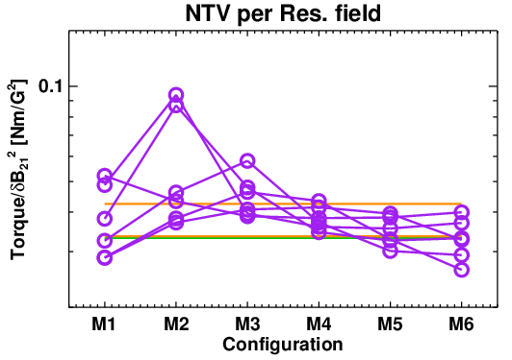
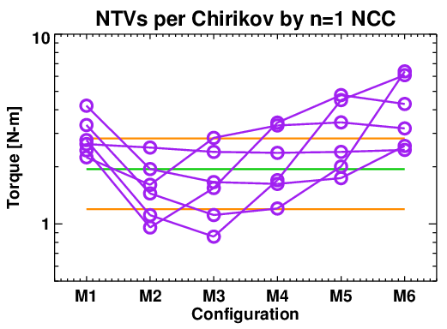
Partial NCCs combined with midplane coils can greatly extend selectivity of n=1 resonant vs. non-resonant field
Partial NCCs, if combined with midplane coils, can greatly extend “non-resonant” and “resonant field selectivity” by changing alignment between fields to resonant helical pitch
RMP FOM can be also further increased or decreased
  Particularly 2x6 is essential to decrease torque/dB₂₁², and thus increase “resonant field selectivity”, and also to decrease torque per Chirikov
Optimized currents are expected to further improve n=1 capability
NCC+EFC
Different phase between upper and lower
NCC+EFC
Upper+EFC
EFC
Upper+EFC
Highly resonant for core
Highly resonant for edge
Phase difference between NCC and EFC n=1
Phase difference between NCC and EFC n=1
*All coils are in the same currents (1kAt is the base) and ratio is not optimized

Slide 15
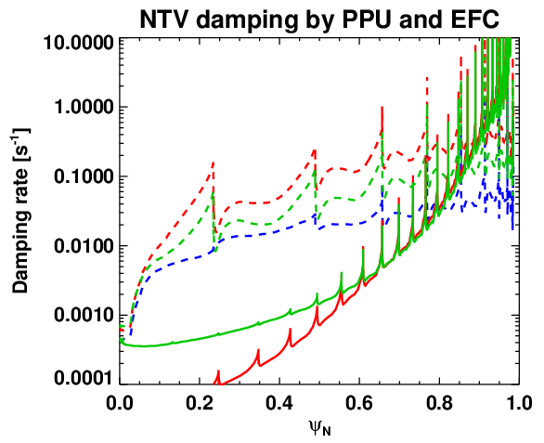
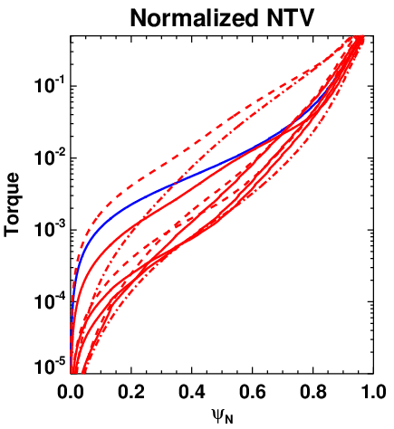
Controllability of rotation by NTV braking can be enhanced by 2x12, and also by mixed n’s
Semi-analytic calculations show that full NCC can greatly enhance variability of NTV across radius, which is essential to control rotation profiles and shear, and therefore microscopic-to-macroscopic instabilities
  NTV variability for core to edge can be defined as
n=1 non-resonant error fields, if successfully utilized, can further increase NTV profile control
MID
2x12
Mixed n and current ratios between NCCs
2xPPU+EFC (P5) n=1
EFC n=1
2xPPU+EFC (P2) n=1
EFC n=3
PPU n=3
Enhanced variability
n=3 EFC
n=3 2x12
n=4 2x12
n=6 2x12

