Slide 1




NSTX-U
Supported by
NSTX-U 5 Year Plan for Pedestal, Scrape-off Layer and Divertor Physics
Coll of Wm & Mary
Columbia U
CompX
General Atomics
FIU
INL
Johns Hopkins U
LANL
LLNL
Lodestar
MIT
Lehigh U
Nova Photonics
Old Dominion
ORNL
PPPL
Princeton U
Purdue U
SNL
Think Tank, Inc.
UC Davis
UC Irvine
UCLA
UCSD
U Colorado
U Illinois
U Maryland
U Rochester
U Tennessee
U Tulsa
U Washington
U Wisconsin
X Science LLC
V. A. Soukhanovskii (LLNL),
A. Diallo, R. Maingi, C. S. Chang (PPPL),
and J. Canik (ORNL),
for the NSTX-U Research Team
Culham Sci Ctr
York U
Chubu U
Fukui U
Hiroshima U
Hyogo U
Kyoto U
Kyushu U
Kyushu Tokai U
NIFS
Niigata U
U Tokyo
JAEA
Inst for Nucl Res, Kiev
Ioffe Inst
TRINITI
Chonbuk Natl U
NFRI
KAIST
POSTECH
Seoul Natl U
ASIPP
CIEMAT
FOM Inst DIFFER
ENEA, Frascati
CEA, Cadarache
IPP, Jülich
IPP, Garching
ASCR, Czech Rep
NSTX-U 5 Year Plan Review
LSB B318, PPPL
May 21-23, 2013

Slide 2
Boundary Physics Program provides broad support for the NSTX-U 5 year plan goals
Demonstrate 100% non-inductive sustainment at performance that extrapolates to ≥ 1MW/m² neutron wall loading in FNSF
Access reduced ν* and high-β combined with ability to vary q and rotation to dramatically extend ST physics understanding
Develop and understand non-inductive start-up and ramp-up
(overdrive) to project to ST-FNSF with small/no solenoid
Develop and utilize high-flux-expansion snowflake divertor
and radiative detachment for mitigating high heat fluxes
Begin to assess high-Z PFCs + liquid lithium to develop high-duty-factor integrated PMI solutions for next-steps
Longer-term (5-10 year) goal:
Integrate 100% non-inductive + high β and τ_{E} + divertor solution + metal walls

Slide 3
Boundary Physics program in NSTX-U contributes to critical research areas for FNSF and ITER
Boundary Physics Thrusts (and outline of the talk)
  BP-1: Assess and control pedestal structure, edge transport and stability
    Pedestal structure, transport and turbulence studies
    ELM characterization and control
  BP-2: Assess and control divertor heat and particle fluxes
    SOL transport and turbulence, impurity transport
    Divertor heat flux mitigation with impurity seeding and divertor geometry
  BP-3: Establish and compare long-pulse particle control methods
    Validate cryo-pump physics design, assess density control and recycling
    Compare cryo to lithium coatings for particle (collisionality) control

Slide 4
Boundary Physics program in NSTX-U contributes to critical research areas for FNSF and ITER
Boundary Physics Thrusts (and outline of the talk)
  BP-1: Assess and control pedestal structure, edge transport and stability
    Pedestal structure, transport and turbulence studies
    ELM characterization and control
  BP-2: Assess and control divertor heat and particle fluxes
    SOL transport and turbulence, impurity transport
    Divertor heat flux mitigation with impurity seeding and divertor geometry
  BP-3: Establish and compare long-pulse particle control methods
    Validate cryo-pump physics design, assess density control and recycling
    Compare cryo to lithium coatings for particle (collisionality) control

Slide 5
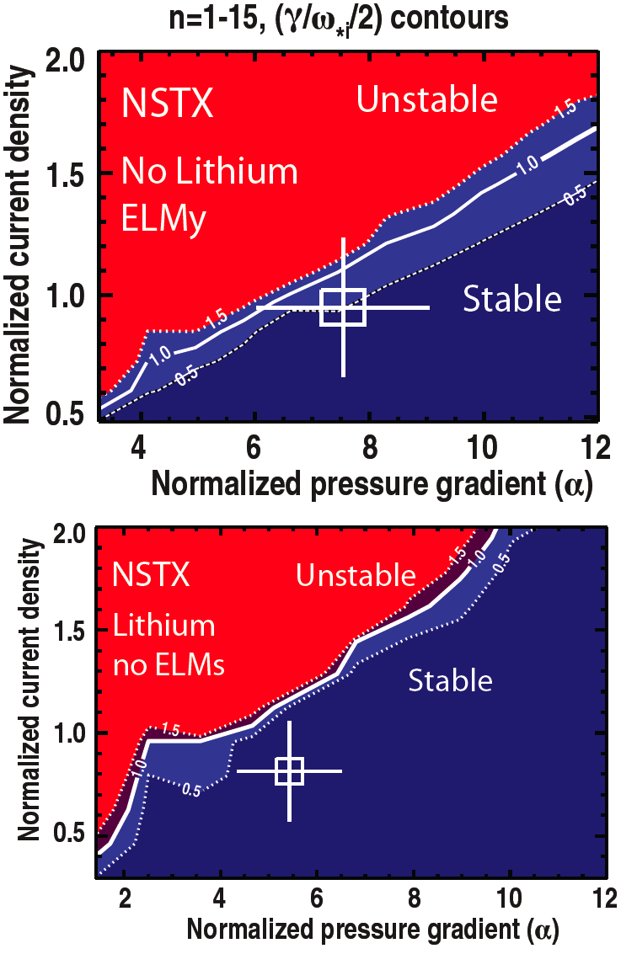

Pedestal studies focus on instabilities and turbulence that limit pedestal heights, widths, and gradients
BP-1
  Peeling ballooning limits on pedestal height and width consistent with ELMy/ELM-free operation
  Lithium and 3-D fields used to manipulate profiles
Kinetic ballooning mode (KBM) being tested as a mechanism to limit pressure gradient (width and height)
  Scaling with β_{pol}^{ped} stronger in STs than higher R/a
  No evidence yet of KBM fluctuation
0.16
0.4 (β_{θ}^{ped})
^{1.05}
NSTX
0.12
Pedestal width (ψ_{N})
0.08
C-Mod
DIII-D
0.04
~ 0.08 (β_{θ}^{ped})
^{0.5}
  Diagnostics:
  30 point core Thomson (NSTX) → 42 point (NSTX-U)
0.00
0.1
0.3
0.5
0.7

Slide 6
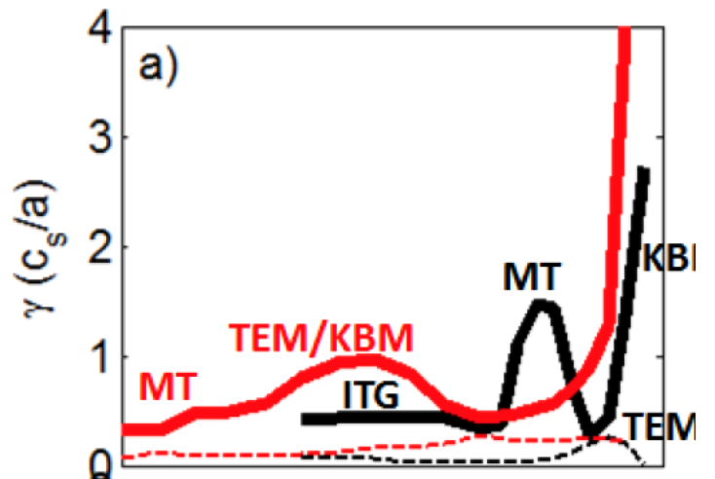
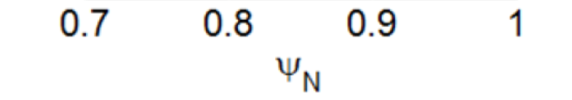
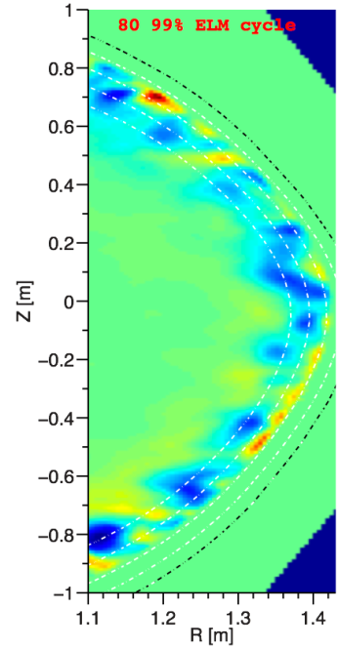
NSTX-U will extend understanding of different microinstabilities and their role for pedestal control
BP-1
Flux-tube simulations provide indication of dominant edge instabilities
  TEM / KBM modes dominant where pressure gradient is largest (GS2/GENE)
  Microtearing unstable at pedestal top, stabilized with Li (GS2)
  These studies will be extended to lower ν∗ in NSTX-U
Lithium
No lithium
KBM
TEM
Developing fuller-physics simulations needed for edge
  XGC1 (full-f, global w/ separatrix, neutrals)
    ITG simulations show correlation lengths consistent with measurements
  Global, EM δf (GENE/GYRO)
Theory
(non-linear
XGC1 code)
3 cm | 2 – 4 cm (reflecto-metry)
11 cm | 10 – 14 cm (BES)
Experiment
radial
poloidal
  Diagnostics (NSTX-U):
  42 point MPTS, reflectometry, 48 point BES
80% - 99% ELM cycle
139047
R = 1.38m

Slide 7
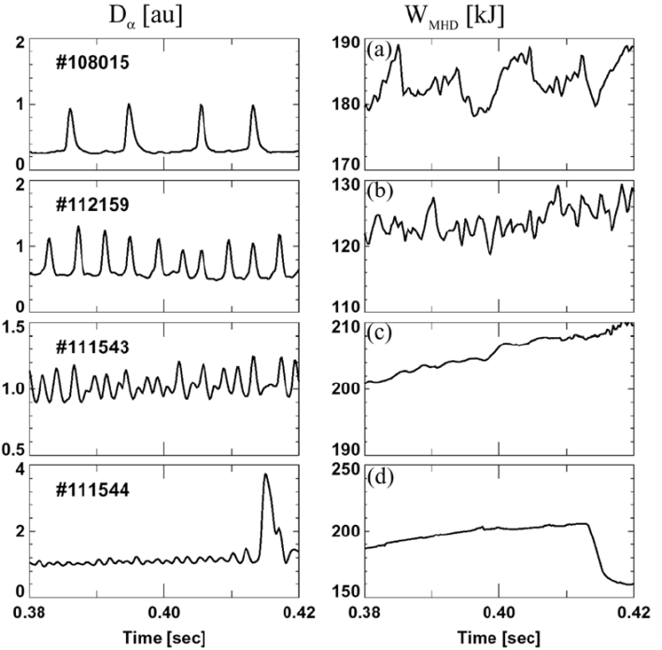
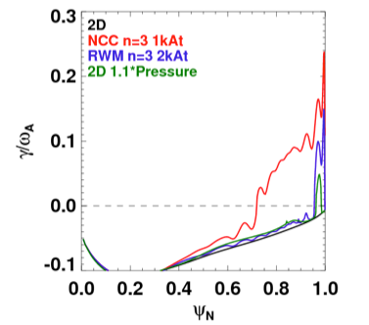
NSTX-U will focus on developing small / acceptable ELM regimes, and active ELM and pedestal control
Many ELM type regimes observed in NSTX: Type I, II, III, V, mixed
  Phenomenology dependent on ν*_{ped}, P_{SOL}, I_{p,} shaping
Pedestal and ELM control techniques
  Lithium evaporation
    In NSTX, reduced p’ and edge bootstrap current
  Lithium granule injector (tested at EAST)
  Enhanced Pedestal (ELM-free) H-mode
  3-D fields
    In NSTX, n=3 RMP destabilized ELMs (but weak impact on transport)
    In NSTX-U, NCC coils
      Wider spectrum, wider ballooning unstable edge region
Type I
Type III
Type V
Mixed

Slide 8
Plans for pedestal transport, turbulence, and ELM control research
Year 1 of 5 Year Plan
  Continue cross-machine comparison of pedestal structure with DIII-D and Alcator C-Mod
  Continue gyro-kinetic modeling of electromagnetic turbulence
Years 2-3 of 5 Year Plan
  Assess the L-H power threshold at higher I_{p}
  Pedestal structure and turbulence vs engineering and physics parameters
  ELM control with lithium coatings, lithium granule injector, and 3D fields
  Access to new operational regimes (enhanced pedestal H-mode, I-mode)
  Initiate assessment of SOL current generation and impact on ELM models and control
  Incremental: begin to design and construct power supplies to drive EHOs
Years 4-5 of 5 Year Plan
  Compare effect of cryopumping and high-Z PFCs on pedestal structure and turbulence
  Edge transport and ELM stability with NCC coils, comp. with gyro-kinetic calculations
  Combine the new particle control tools (cryopump and LGI) to trigger ELMs
  Diagnostics: MPTS, CHERS, BES, reflectometry, GPI

Slide 9
Boundary Physics program in NSTX-U contributes to critical research areas for FNSF and ITER
Boundary Physics Thrusts (and outline of the talk)
  BP-1: Assess and control pedestal structure, edge transport and stability
    Pedestal structure, transport and turbulence studies
    ELM characterization and control
  BP-2: Assess and control divertor heat and particle fluxes
    SOL transport and turbulence, impurity transport
    Divertor heat flux mitigation with impurity seeding and divertor geometry
  BP-3: Establish and compare long-pulse particle control methods
    Validate cryo-pump physics design, assess density control and recycling
    Compare cryo to lithium coatings for particle (collisionality) control

Slide 10
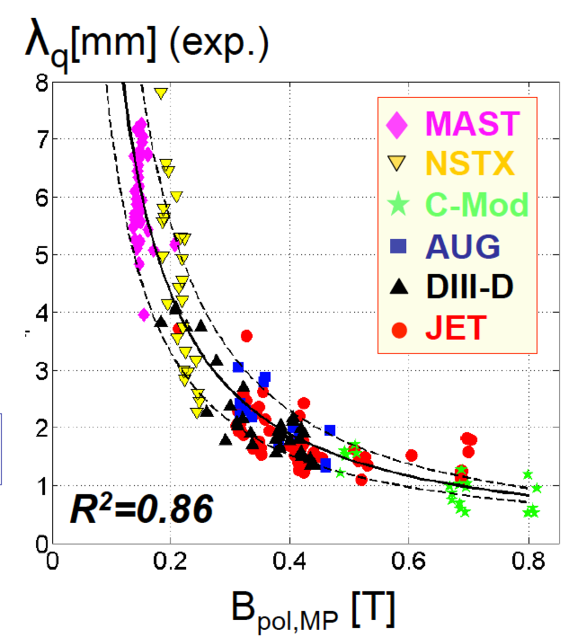
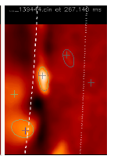
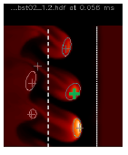
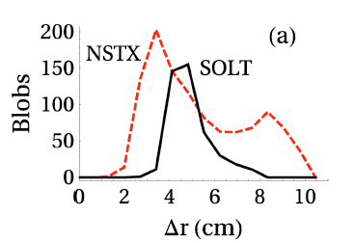
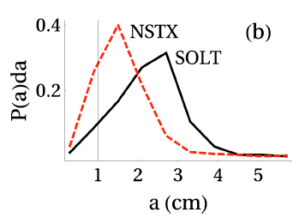
NSTX-U will help reduce SOL width scaling uncertainties for next-steps and assess relative importance of turbulent and drift-based transport
BP-2
SOL width scaling critical for divertor projections
  In NSTX: λ_{q}^{mid} ~ I_{p}^{-1.6}, independent of P_{SOL} and B_{t}
    For NSTX-U (2 MA): λ_{q}^{mid} = 3±0.5 mm
  Multi-machine database (Eich IAEA FEC 2012):
  λ_{q}^{mid} (mm) = (0.63+/-0.08) x B_{pol,MP}^{-1.19}
    For NSTX-U (B_{p}~0.55 T): λ_{q}^{mid} ~ 1.3 mm
Comparison of λ_{SOL} with SOL models
  Parallel transport: conductive/convective, cross-field : collisional / turbulent / drift
  Goldston heuristic drift-based model
    λ_{SOL} ~ (2a/R) ρ_{θ,} for NSTX-U: λ_{q}^{mid} ~ 6 mm
  XGC0 (drift-kinetic): λ_{q}^{mid} ~ I_{p}^{-1.0} at lower I_{p}
  SOLT (fluid turbulence): I_{p} scaling is weaker than observed
Comparison of GPI, BES data and SOL transport and turbulence simulations
  Blob formation, motion, interaction with sheared flows
  Role of magnetic X-point geometry and finite ion gyro width
  Effects of 3-D fields on turbulence
GPI SOLT

Slide 11
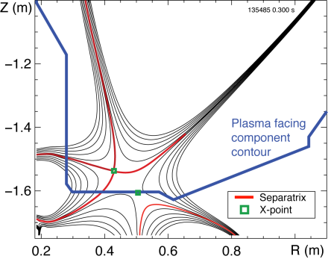
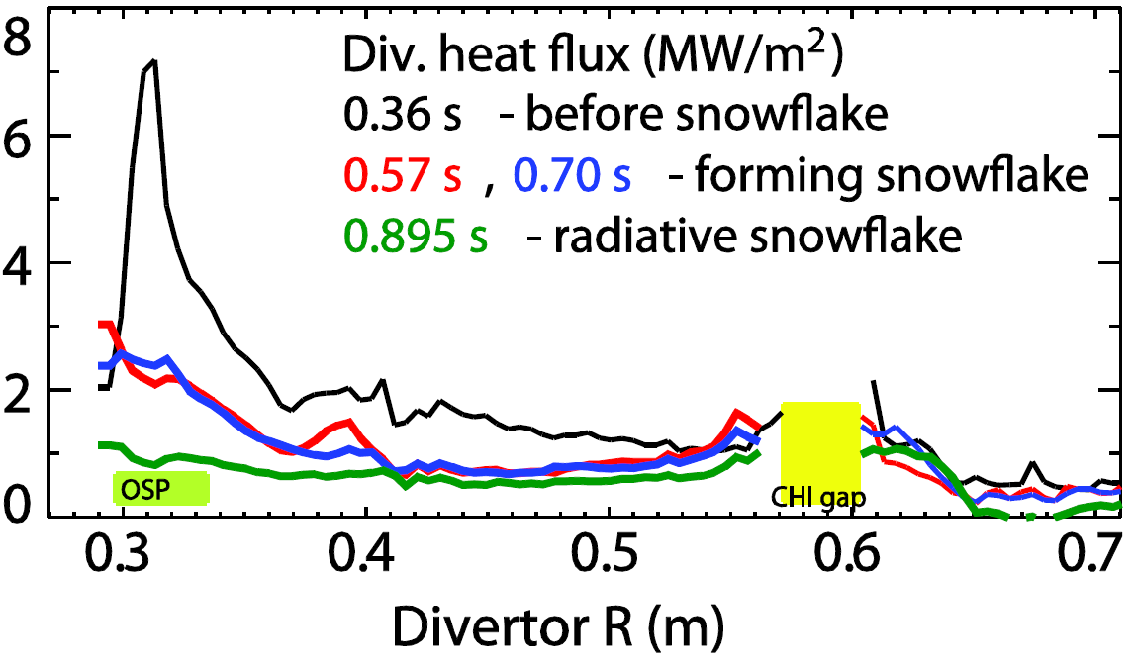
Standard and snowflake divertor geometries will be combined with radiation for heat flux mitigation and detachment studies
BP-2
Radiative divertor and snowflake geometry successfully applied in NSTX for heat flux mitigation in high-performance H-modes
  Peak divertor heat flux reduced from 6-12 MW/m² to 1-2 MW/m² while maintaining H98(y,2)~1
  In snowflake geometry, heat flux reduced during Type I ELMs
Snowflake divertor configuration
  Second-order null (B_{p} ~ 0 and grad B_{p} ~ 0)
  Predicted divertor and pedestal properties confirmed in TCV, NSTX, and DIII-D
Outstanding questions
  Real-time magnetic control
    Snowflake variants, up-down symmetric snowflake
  Pedestal and ELM stability
  SOL transport and turbulence
    Flux tube squeezing effects, X-point transport and drifts
    β-dependent heat transport
    Compatibility with particle control and high-Z PFCs
    Fluid turbulence and gyro-kinetic code validation

Slide 12
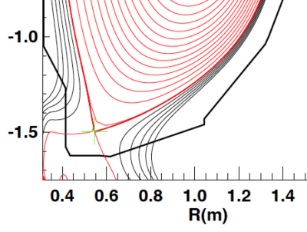
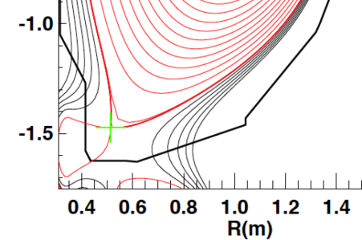
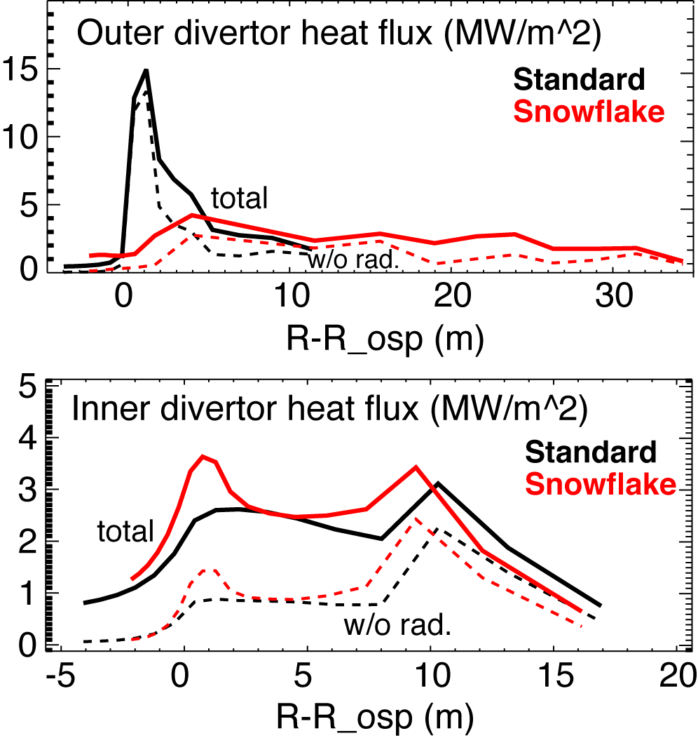
Simulations of snowflake divertor configuration for NSTX-U yield favorable projections
BP-2
Significant geometry effects affecting plasma-wetted area, heat transport and radiation
Significant heat flux reduction compatible with cryopump operation
  Multi-fluid edge transport model UEDGE with 4 % carbon
  for P_{NBI}=12 MW case, peak outer divertor heat flux reduction from 15 MW/m² to 4 MW/m²
    Due to increased plasma-wetted area, heat flux diffusion across longer flux tube length, and radiation
  Inner divertor detached
  Particle removal by cryopump results in reduced radiation
    But still significant heat flux reduction due to geometry
 | Standard | Snowflake
L_{X} (m) | 5 | 17
f_{exp} | 20 | 60-100
V_{div} (m³) | 0.070 | 0.128

Slide 13
Impurity-seeded radiative divertor with feedback control is planned for NSTX-U
BP-2
Detachment studies and validation of multi-fluid and gyro-kinetic models
  Single, double null and snowflake divertors will be combined with gas seeding
Seeding gas choice dictated by Z_{imp} and PFC
  Li/C PFCs compatible with D₂, CD₄, Ne, Ar seeding
  UEDGE simulations show Ar most effective
    Too much argon causes radiation collapse of pedestal
Feedback control of divertor detachment via impurity particle balance control
  Cryopump for particle removal
  Divertor gas injectors as actuators
  Real-time control sensors being identified
    PFC temperature via IR thermography or thermocouple
    Thermoelectric current between inner and outer divertor
    Impurity VUV spectroscopy or bolometry
    Neutral gas pressure
    Balmer / Paschen series spectroscopy

Slide 14
Plan for SOL and divertor research
BP-2
Year 1 of 5 Year Plan
  Continue analysis of SOL width database and comparison with models
  Collaboration with DIII-D on snowflake and radiative divertor experiments
Years 2-3 of 5 Year Plan
  Establish SOL width and divertor database vs. engineering and physics parameters
  Re-establish edge turbulence measurements (GPI, BES, cameras, probes)
  Initial radiative divertor experiments with D₂, CD₄ and Ar seeding and lithium
  Develop snowflake divertor magnetic control and assess pedestal stability, divertor power balance, turbulence, 3D fields as functions of engineering parameters
  Comparison with multi-fluid and gyro-kinetic models
Years 4-5 of 5 Year Plan
  Compare SOL width data with theoretical models and in the presence of 3D perturbations of various types, e.g. RMP coils, HHFW heating, NBI injection
  Combine snowflake configurations with pedestal control scenarios and tools, cryo
  Implement radiative divertor control, demonstrate long-pulse H-mode scenario
  Develop experiment-based model projections for ST-FNSF
Diagnostics: MPTS, CHERS, BES, GPI, IR cameras, Langmuir probes, spectroscopy
  Incremental: divertor Thomson Scattering to provide critical data for model validation for snowflake and radiative detachment studies

Slide 15
Boundary Physics program in NSTX-U contributes to critical research areas for FNSF and ITER
Boundary Physics Thrusts (and outline of the talk)
  BP-1: Assess and control pedestal structure, edge transport and stability
    Pedestal structure, transport and turbulence studies
    ELM characterization and control
  BP-2: Assess and control divertor heat and particle fluxes
    SOL transport and turbulence, impurity transport
    Divertor heat flux mitigation with impurity seeding and divertor geometry
  BP-3: Establish and compare long-pulse particle control methods
    Validate cryo-pump physics design, assess density control and recycling
    Compare cryo to lithium coatings for particle (collisionality) control

Slide 16
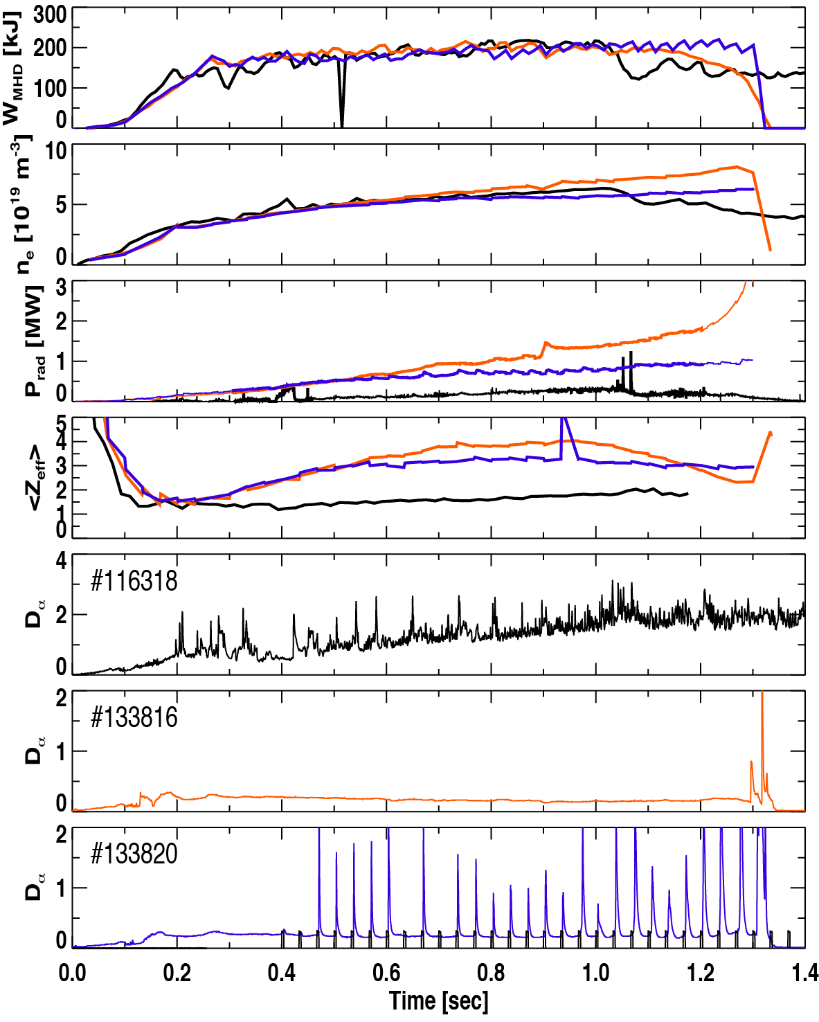
Particle control in NSTX-U will be accomplished with variety of fueling and exhaust techniques
BP-3
Density control goals for NSTX-U:
  Lower density to access reduced collisionality
    As low as f_{G}~0.3-0.5 desired
  Need to avoid density limit in long-pulse shots
    Greenwald fraction f_{G}~0.7-1.0 sufficient for non-inductive studies
  Develop FNSF-relevant pumping scenarios
Novel and conventional pumping and fueling techniques for density control
  Lithium coatings for deuterium pumping
  Cryopumping
  Conventional and supersonic gas injectors
Impurity control goal Z_{eff} ~ 2-2.5
  ELMy H-modes with boronized carbon PFCs
  ELM-triggering with 3D fields and lithium granules to expel impurities in H-modes with lithium

Slide 17
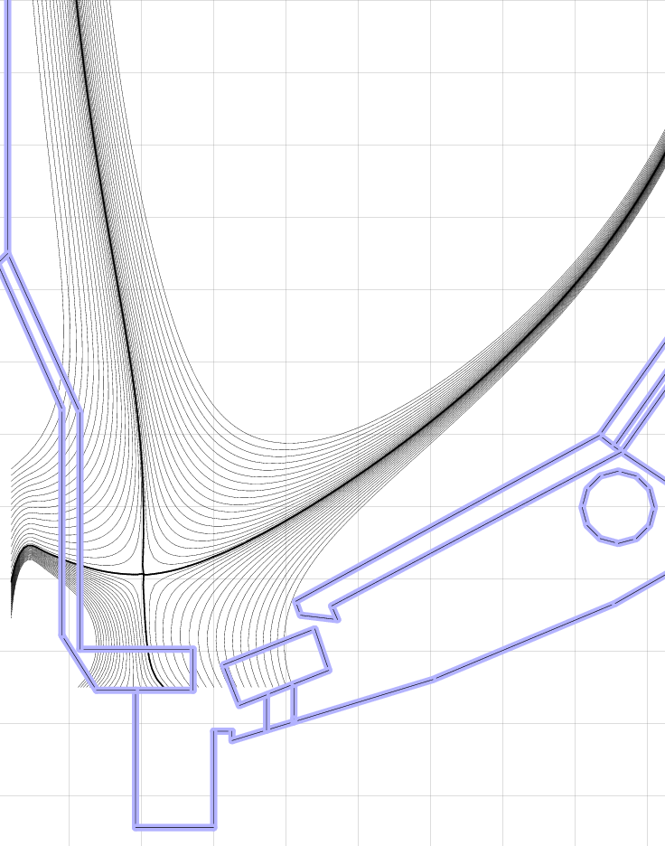
Cryo-pump will be key for density and collisionality control in Years 4-5
BP-3
Cryo-pump is proven technology for plasma density control
  NSTX-U design is similar to DIII-D
  Need plenum pressure of 0.6 mTorr to pump NBI input
Greenwald
fraction
Standard:
Cryo-pump
Pressures >1 mTorr can be reached over wide range of plasma shapes and SOL widths
  Semi-analytic pumping model used to optimize plenum geometry
Optimized plenum geometry can pump conventional and snowflake divertors over a range of R_{OSP}, I_{p}
  Cannot sustain f_{G} < 1 at 2 MA with standard divertor
  High snowflake flux expansion results in better pumping
Snowflake:

Slide 18
Plan for particle control research
BP-3
Years 1-3 of 5 Year Plan
  (Year 1) Complete cryopump physics design
  Perform engineering design and installation
  Validate cryopump physics design by comparing with initial experiments
  Assess lithium conditioning for density and impurity control
  Assess lithium coating lifetimes and interaction with ion fluxes
  Compare boronized and lithium-coated graphite plasma-facing componenets
    Perform local hydrogenic recycling and particle balance measurements in the upper and lower divertor areas, and main wall
Years 4-5 of 5 Year Plan
  Characterize performance of cryopump, compare with design calculations, and with lithium conditioning
  Assess pump performance with metallic PFCs
  Develop scenarios use the cryo-pump for deuterium control while maintaining ELMs for impurity flushing

Slide 19
Boundary program will advance pedestal physics and power and particle handling in NSTX-U for ST-FNSF, ITER
  Pedestal physics: test consistency with peeling ballooning, and test applicability of kinetic ballooning
  Use lithium conditioning, granules, and 3D fields as a way to manipulate the density and pressure profile
Power and particle handling: further develop snowflake and radiative divertors
  Test key predictions of snowflake configuration, and evaluate synergy with radiative divertors, graphite and high-Z plasma facing components, and cryopumping
Li and cryopump to achieve stationary density and low Z_{eff}
  Up to an order of magnitude reduction in ν* compared to NSTX

Slide 20
Backup

Slide 21
Planned NSTX-U facility upgrades enable access to new parameter space and unique capabilities
Planned upgrades (NSTX → NSTX-U ) | Operations year available | Boundary Physics area
P_{NBI} = 5 → 12 MW (5 s) 7.5 →15 MW (1.5 s) | 1-2 | Pedestal structure and ELM stability, L-H, divertor heat flux (12 → 15-20 MW/m²) P/R ~ 10 → 20 P/S ~ 0.2 → 0.4
I_{p} = 1.3 → 2 MA B_{t} = 0.5 → 1 T | 1-2 | L-H transition, pedestal structure and stability, SOL width, divertor heat flux
Pulse length 1.5 → 5-10 s | 1-2 | Steady-state divertor heat flux mitigation, density and impurity control
Axisymmetric PF (divertor) coils PF1A, 1B, 1C, 2L | 1-3 | Plasma shaping, L-H, divertor configuration control
High-Z plasma-facing components | 2 | Core and pedestal impurity transport, divertor transport
Non-axisymmetric control (NCC) coils | 3 | ELM control and pedestal transport
Divertor cryopump | 3 | Pedestal stability, density control, divertor transport and radiation control

Slide 22
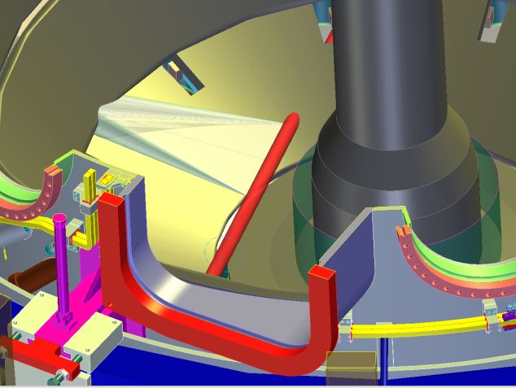
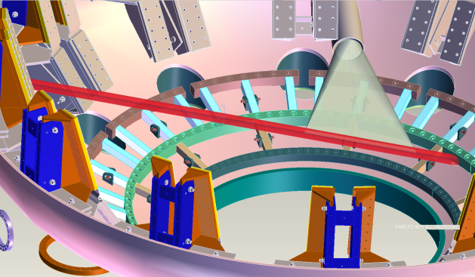
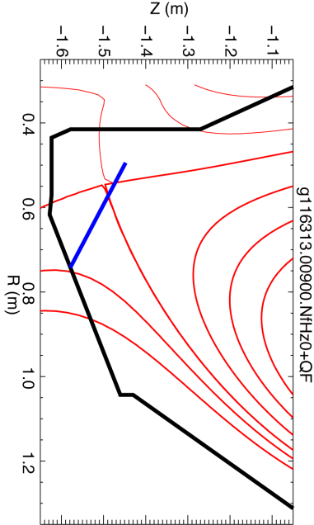
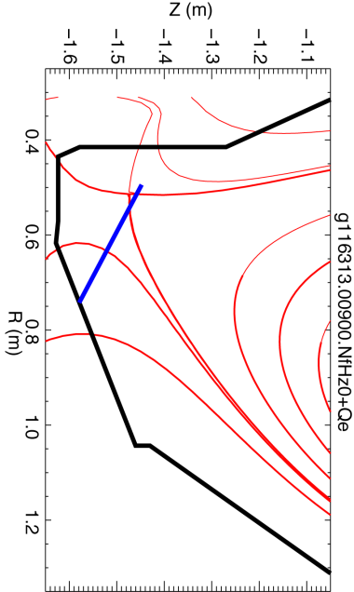
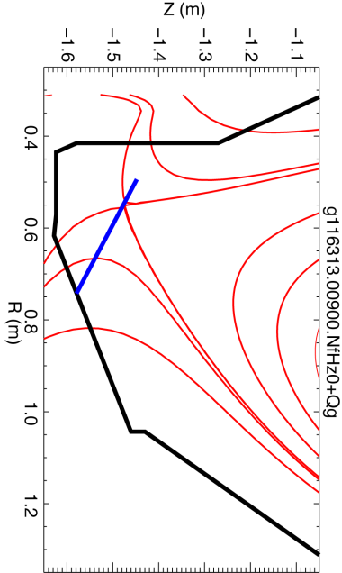
Divertor Thomson Scattering system would significantly enhance NSTX-U Boundary research capabilities
Physics contributions
  ELM and inter-ELM divertor transport
  SOL width scaling, role of X-point heat transport
  Radiative detachment model validation
  Snowflake divertor properties, incl. X-pt β_{p} measurements
  Divertor plasma-surface interaction and impurity transport studies, erosion rates via spectroscopy
A conceptual geometry identified for NSTX-U
Conceptual system design underway

Slide 23
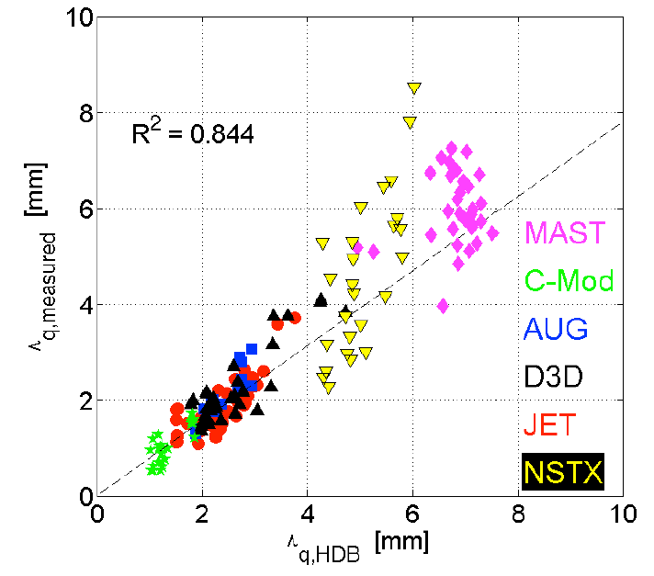
SOL width studies elucidate on heat flux scaling projections for NSTX-U, ST-FNSF and ITER
BP-2
Goal: compare SOL width scalings with models
SOL width scaling
  In NSTX: λ_{q}^{mid} ~ I_{p}^{-1.6}
    For NSTX-U (2 MA): λ_{q}^{mid} = 3±0.5 mm
  Multi-machine database (Eich IAEA FEC 2012):
  λ_{q}^{mid} (mm) (0.63+/-0.08)x B_{pol,MP}^{-1.19}
    For NSTX-U (B_{p}~0.55 T): λ_{q}^{mid} ~ 1.3 mm
  Comparison with SOL models
    Parallel transport: conductive/convective, cross-field : collisional / turbulent / drift
    Goldston heuristic model: ∇B and curvature drift motion sets SOL width λ_{SOL} ~ (2a/R) ρ_{i}, Spitzer thermal conduction sets T_{sep}
      For NSTX-U: λ_{q}^{mid} ~ 6 mm
Diagnostics: IR cameras, MPTS, Langmuir probes
  Divertor Thomson scattering (incremental) desirable

Slide 24
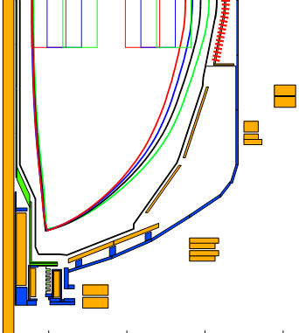
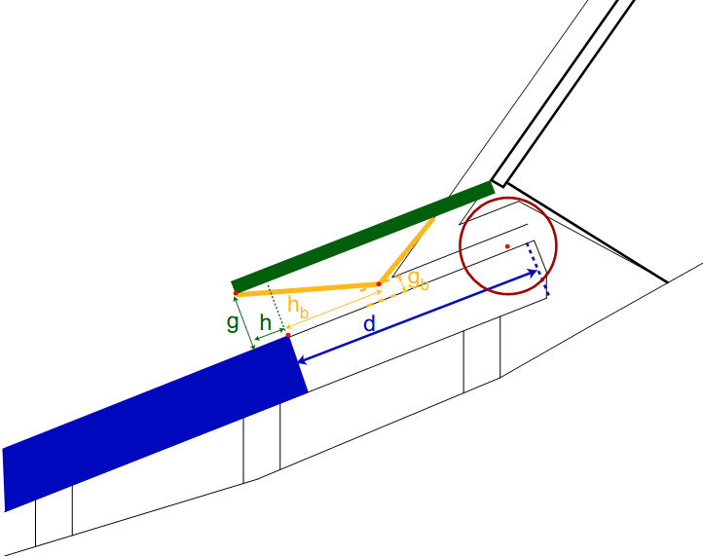
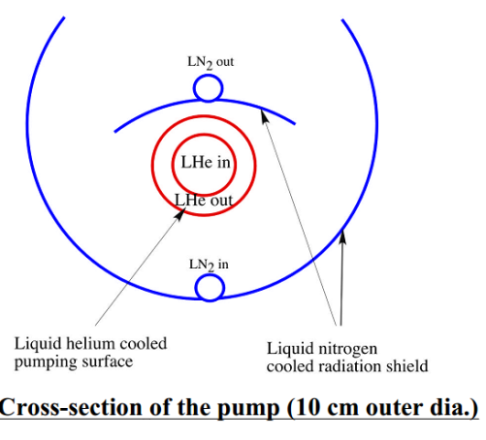
NSTX-U Years 3-4 will utilize cryo-pumping for particle control
Cryo-pump is proven technology for plasma density control
  More conventional pumped ELMy H-mode scenario
NSTX-U design is similar to DIII-D outer lower pump
  Plenum located under new baffling structure near secondary passive plates
  Pumping capacity of a toroidal liquid He cooled loop
    S=24,000 l/s @ R=1.2m (Menon, NSTX Ideas Forum 2002)
  Need plenum pressure of 0.6 mTorr to pump beam input (TRANSP)
g = throat height
h = throat length
Baffle
h
Cryo
g

Slide 25
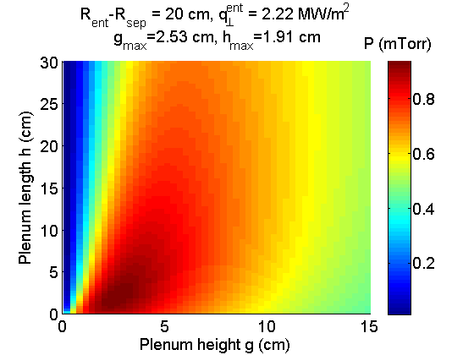
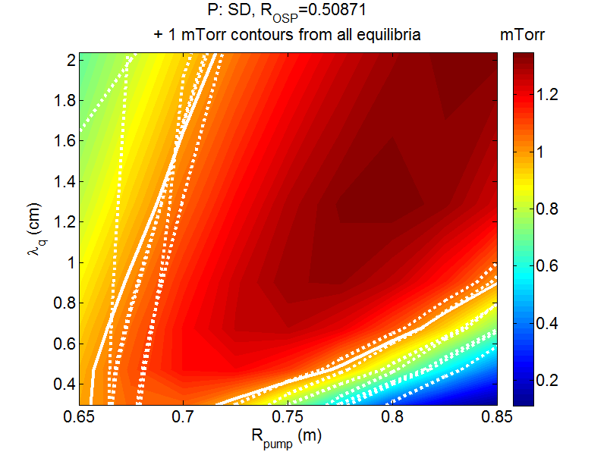
Semi-analytic pumping model used to optimize plenum geometry
Model developed for DIII-D pumping studies (Maingi, NF ‘99)
  Predicts plenum pressure, validated with DIII-D data
  Projected NSTX-U heat flux (I_{p} scaling) and divertor T_{e} (~15 eV) used as input
  Uses first-flight neutral model (insufficient for detached divertor)
Pressure is maximum for duct height g~2.5 cm, length h~2 cm
  But is only weakly reduced if these are increased together
With pump entrance at R=0.72m, pressures >1 mTorr can be reached over wide range of plasma shapes and SOL widths
  Comparable to pressures in DIII-D plenum
  Well above that needed to pump NBI particle input
+

Slide 26
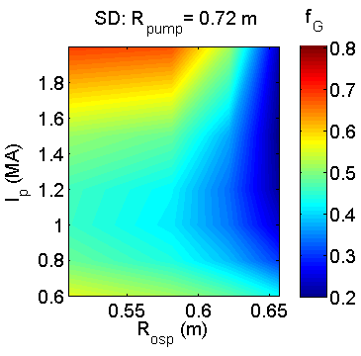
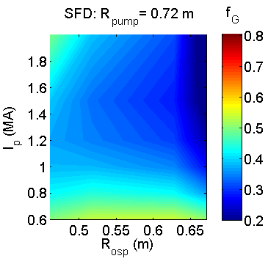
Optimized plenum geometry can pump to low density for conventional and snowflake divertors over a range of R_{OSP}, I_{p}
R_{OSP}: outer strike point radius
R_{pump}: plenum entrance radius
SD: standard divertor
SFD: snowflake divertor
f_{G}: n_{e}/n_{G}
Core density estimated assuming pumped flux=NBI input
  2-pt model used to estimate upstream density
  Assume n_{e}/n_{e}^{sep}~3
Can pump to f_{G}<0.5
  f_{G}~0.7 desirable for all scenarios, lower provides more flexibility
  Moving R_{OSP} closer to pump allows lower n_{e}, but limited by power handling
High flux expansion in SFD gives better pumping with SOL-side configuration
  More plasma in far SOL near pump
  More room to increase R_{OSP} at high I_{p}
q_{pk} > 10 MW/m²
-1.8 -1.6 -1.4 -1.2 -1.0 -0.8
Z (m)
0.4 0.6 0.8 1.0 1.2
R (m)

Slide 27
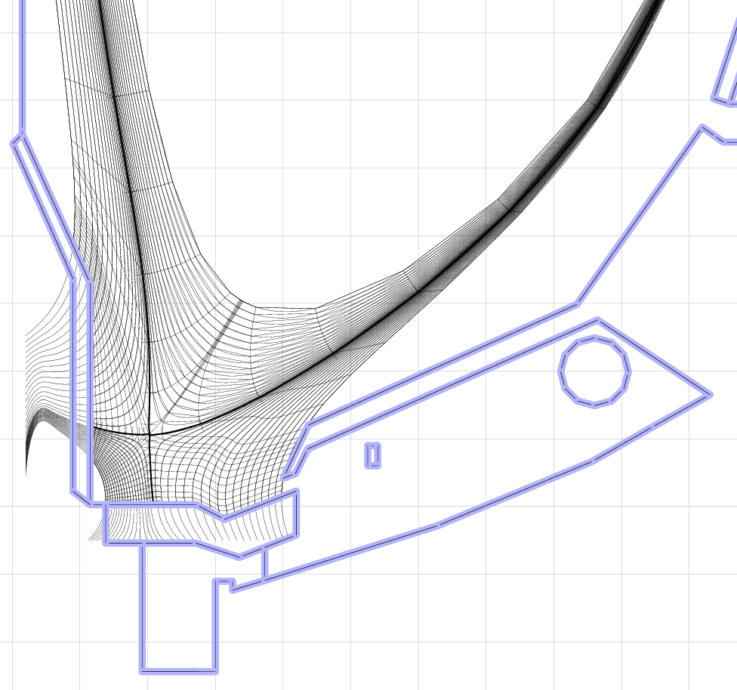
SOLPS calculations confirm optimization approach based on analytic model
SOLPS: 2D fluid plasma/neutral transport
  Plasma transport classical parallel to B (+kinetic corrections), ad-hoc cross-field transport coefficients
  Kinetic neutral transport using MC code EIRENE
    More comprehensive treatment of neutral transport (beyond first-flight)
    Can treat radiative/detached divertor
Range of divertor conditions have been produced using standard and snowflake equilibria
SOLPS-calculated plenum pressure agrees with analytic model for T_{e}^{div}>2 eV, factor of ~3 higher in detached regimes
-1.8 -1.6 -1.4 -1.2 -1.0
Z (m)
0.4 0.6 0.8 1.0 1.2
R (m)
Optimization of design presented here is conservative
  Pumping likely to be stronger for realistic conditions

