Slide 1




NSTX-U
Supported by
NSTX-U 5 Year Plan for Plasma Start-up and Current Ramp-up
R. Raman
D. Mueller, S.C. Jardin
F. Ebrahimi, S. Gerhardt, E.B. Hooper,
T.R. Jarboe, C.E. Kessel, B.A. Nelson,
F. Poli, A.J. Redd, C. Sovinec, G. Taylor
for the NSTX Research Team
Coll of Wm & Mary
Columbia U
CompX
General Atomics
FIU
INL
Johns Hopkins U
LANL
LLNL
Lodestar
MIT
Lehigh U
Nova Photonics
Old Dominion
ORNL
PPPL
Princeton U
Purdue U
SNL
Think Tank, Inc.
UC Davis
UC Irvine
UCLA
UCSD
U Colorado
U Illinois
U Maryland
U Rochester
U Tennessee
U Tulsa
U Washington
U Wisconsin
X Science LLC
Culham Sci Ctr
York U
Chubu U
Fukui U
Hiroshima U
Hyogo U
Kyoto U
Kyushu U
Kyushu Tokai U
NIFS
Niigata U
U Tokyo
JAEA
Inst for Nucl Res, Kiev
Ioffe Inst
TRINITI
Chonbuk Natl U
NFRI
KAIST
POSTECH
Seoul Natl U
ASIPP
CIEMAT
FOM Inst DIFFER
ENEA, Frascati
CEA, Cadarache
IPP, Jülich
IPP, Garching
ASCR, Czech Rep
NSTX-U 5 Year Plan Review
LSB B318. PPPL
May 21-23, 2013

Slide 2
Outline
Motivation & Goals
Transient CHI Plasma Start-up
Point Source Helicity Injection Plasma Start-up
Supporting modeling work
Research Thrusts
Plans for Current Ramp-up studies
Summary

Slide 3
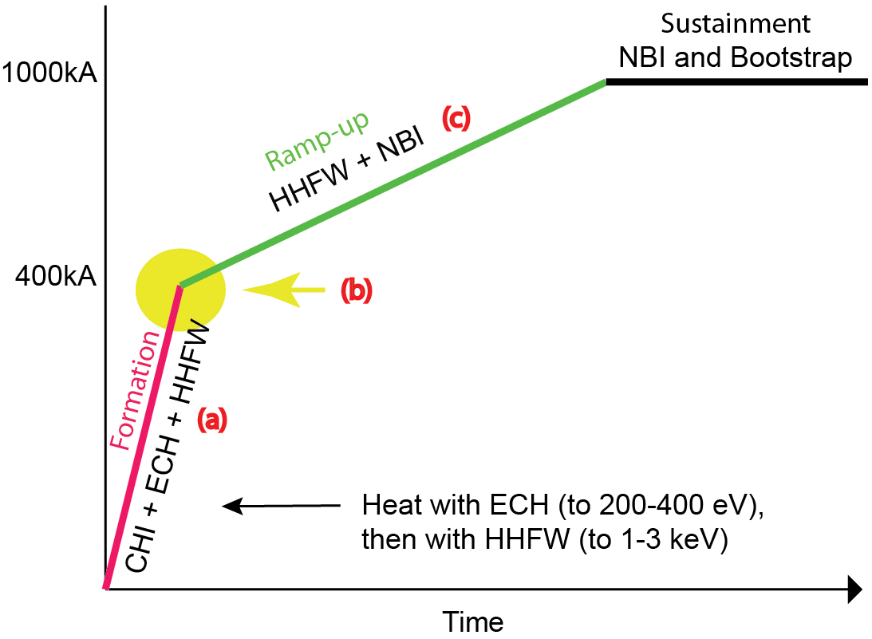
Goal: Develop & Understand Non-inductive Start-up/Ramp-up to Project to ST-FNSF Operation with Small or No Solenoid
NSTX-U Start-up and Ramp-up strategy
Aligned with OFES program vision for FNSF requirements
  Establish physics basis for ST-FNSF, and non-inductive start-up is essential in ST
  Simplify the tokamak concept to reduce cost
High level NSTX-U Thrusts:
  Establish and extend solenoid-free plasma start-up and test NBI ramp-up
  Ramp-up CHI plasma discharges using NBI and HHFW and test plasma gun start-up
NSTX-U is striving for fully non-inductive operations
CHI start-up & ramp-up is front end of that objective
Ramp-up scenario development will initially rely on inductively generated plasmas with varying plasma parameters

Slide 4
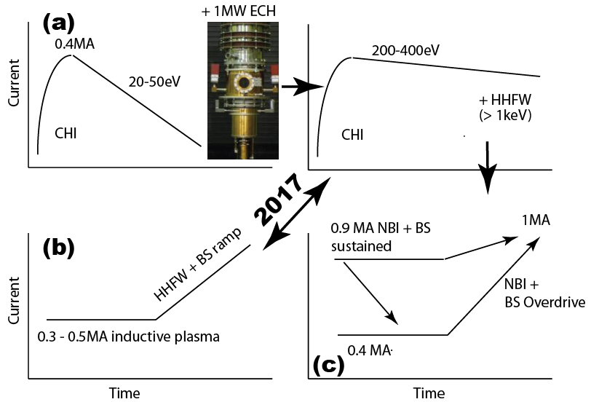
Start-up and Ramp-up Research Involves Three Parallel Paths that Will be Linked as Technical Capabilities Permit
(a) Generate and increase current produced by CHI
  Heat with ECH (to 200-400eV)
  Then heat with HHFW (to > 1keV)
  Then ramp-up current using NBI and BS current overdrive
(b) Current ramp-up of intermediate I_{p} plasmas (Wave particle TSG)
  Progressively increase initial current (from 0.3 to 0.5MA) and ramp-up using HHFW and BS current overdrive
  Assist extension of NBI CD to lower I_{p}
(c) Current ramp-up at near full I_{p} with NBI and bootstrap current overdrive
  Progressively reduce initial current from 0.9 to 0.4MA and non-inductively ramp-up current to 1MA using NBI and BS current overdrive

Slide 5
CHI and Plasma Gun Start-up

Slide 6

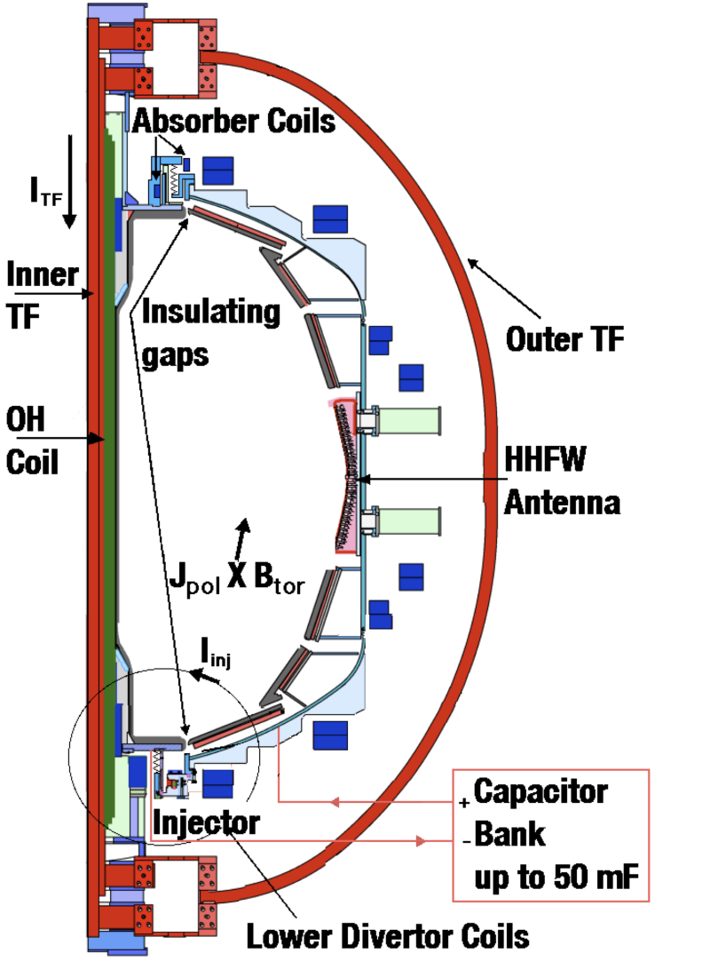
CHI is Planned to be Used as Initial Current Seed for Subsequent Non-inductive Current Ramp-up in NSTX-U
TSC (axisymmetric 2D ) simulation of CHI startup
CHI in NSTX/NSTX-U
1.0 ms
1.6 ms
2.7 ms
2
1 MW ECH
1
Z (m)
0
-1
-2
0
1
2
0
1
2
0
1
2
R (m)
R (m)
R (m)
Plasma Guns
New Tools for CHI on NSTX-U
  > 2.5 x Injector Flux (proportional to I_{p} )
  TF = 1 T (increases current multiplication)
  ECH (increases T_{e})
  > 2kV CHI voltage (increases flux injection)
  Full Li coverage (reduces low-Z imp.)
  Metal divertor, Cryo pump (increases T_{e})
Cryo pump

Slide 7
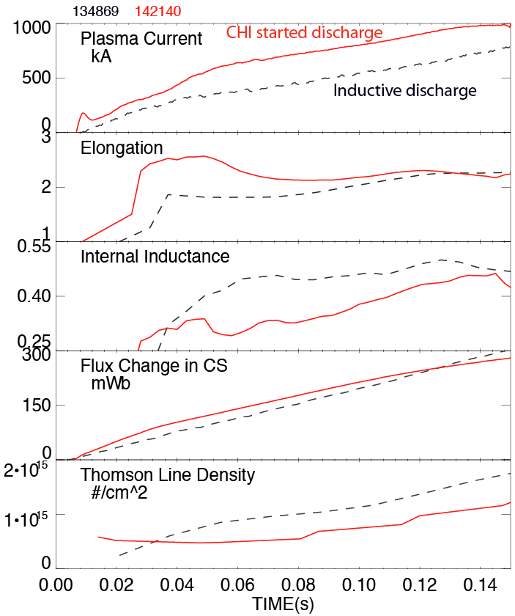
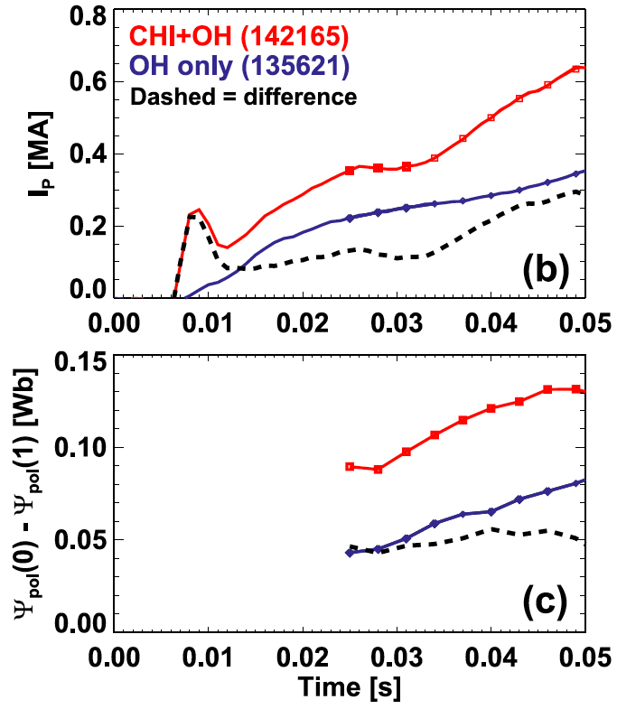
Plasma Discharge Ramping to 1MA Required 35% Less Inductive Flux when Coaxial Helicity Injection (CHI) is Used
CHI assisted startup in NSTX
CHI produces closed flux
change of ~ 50 mWb
High elongation
Low inductance
Low density
CHI produced plasma is clean
(Transitions to H-mode after coupling to induction)
CHI generates plasmas with low n_{e} below ECH cut-off

Slide 8
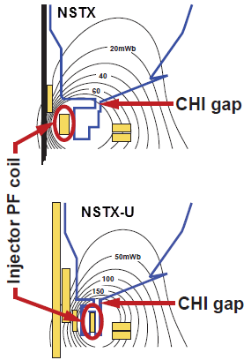
CHI Start-up to ~0.4MA is Projected for NSTX-U, and Projects to ~20% Start-up Current in Next-step STs
Parameters | NSTX | NSTX-U | ST-FNSF
Major Radius [m] | 0.86 | 0.93 | 1.2
Minor Radius [m] | 0.66 | 0.62 | 0.80
B_{T} [T] | 0.55 | 1.0 | 2.2
Toroidal Flux [Wb] | 2.5 | 3.9 | 15.8
Plasma current [MA] | 1 | 2 | 10
Projected Start-up Current (MA) | 0.2 | 0.4 | 2.0
Poloidal Flux (Wb) | 0.04 | 0.08 | 0.53
Injector Flux [Wb] | 0.047 | 0.1 | 0.66
FY15 Research Milestone (Incremental):
1) Establish CHI start-up and 2) Ramp-up a 300-600kA inductively generated plasma using RF and NBI (with Wave Particle TSG)
Injector flux in NSTX-U is ~ 2.5 times higher than in NSTX → supports increased CHI current

Slide 9
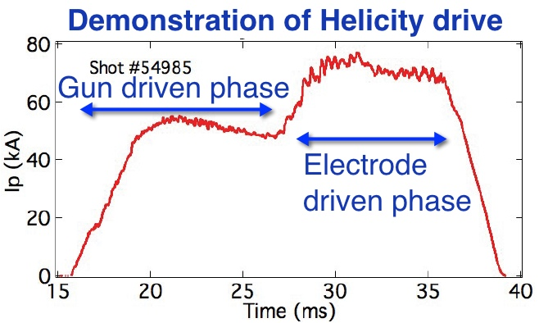

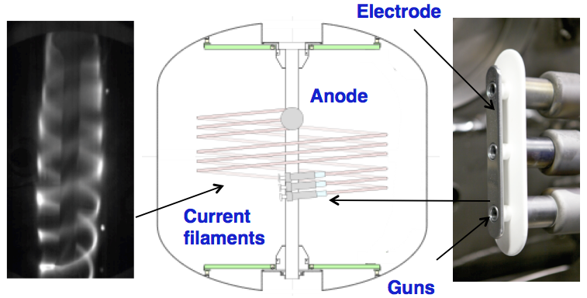
Local Helicity Injection Being Developed by PEGASUS is an Alternate Method for Plasma Start-up in NSTX-U
Retractability of guns potentially advantageous in FNSF/Demo nuclear environment
Plasma guns(s) & electrodes biased relative to anode or vessel
  Helicity injection rate
  I_{p} ~ (I_{inj} I_{TF} / electrode width)^{0.5}
Issues being addressed by Pegasus to achieve high I_{p}
  Large-area electrode with uniform current density
  Characterization of plasma confinement/dissipation and injector impedance
  Pegasus wants to deliver MA-class (I_{p} > 0.5 MA) to NSTX-U by end of 5YR plan

Slide 10
Non-inductive Current Ramp-up

Slide 11
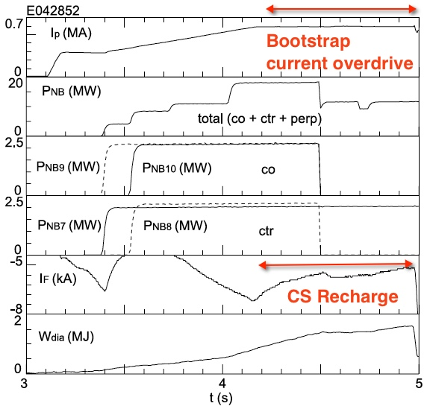
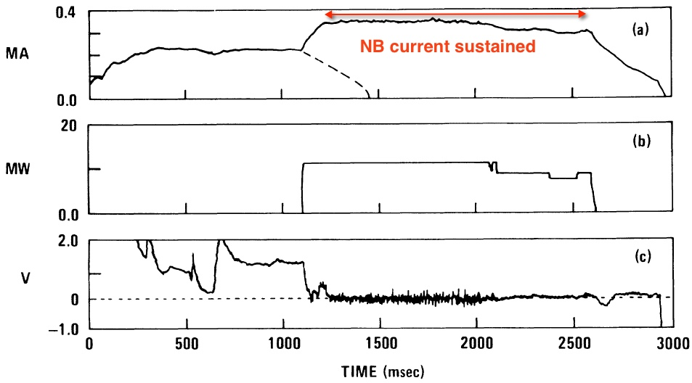
Results on JT-60U and DIII-D Suggest I_{p} Ramp-up is Possible with Combination of Bootstrap Current Overdrive and NBI CD
JT-60U [NF 46 (2006)]
Ref: Ushigome, Takase et al.,
DIII-D [PRL 61(1998)]
Ref: Simonen, et al.,
350 kA plasma sustained mostly by neutral beams and without MHD
NSTX-U research will extend previous experimental work to demonstrate full non-inductive start-up, ramp-up, and sustainment
Plasma current should have ramped-up if solenoid current had been held constant

Slide 12
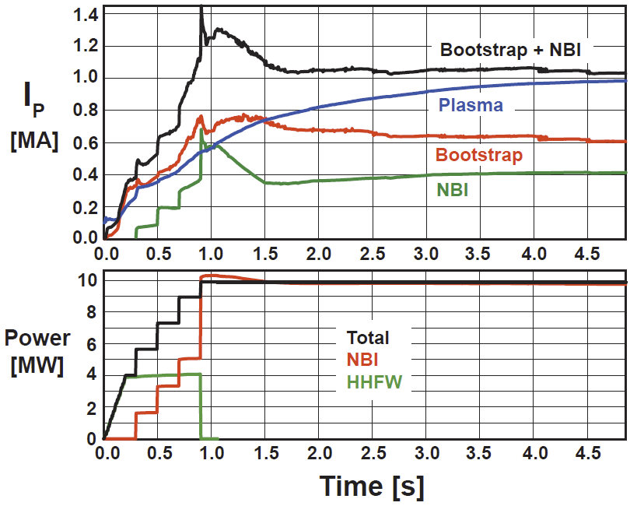
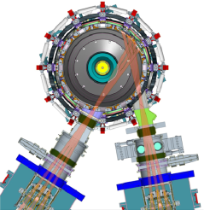
Non-inductive Ramp-up from ~0.4MA to ~1MA Projected to be Possible with More Tangential 2nd NBI
TSC simulation of non-inductive ramp-up from initial 400kA target
  Simulations now being improved to use TRANSP/NUBEAM loop within TSC
  Experimental challenges:
    - Maximum NBI power in low inductance CHI plasma
More tangential NBI provides 3-4x higher CD at low I_{P}:
  1.5-2x higher current drive efficiency, plus
  2x higher absorption (40→80%) at low I_{P} = 0.4MA
Present NBI
More tangential 2nd NBI

Slide 13
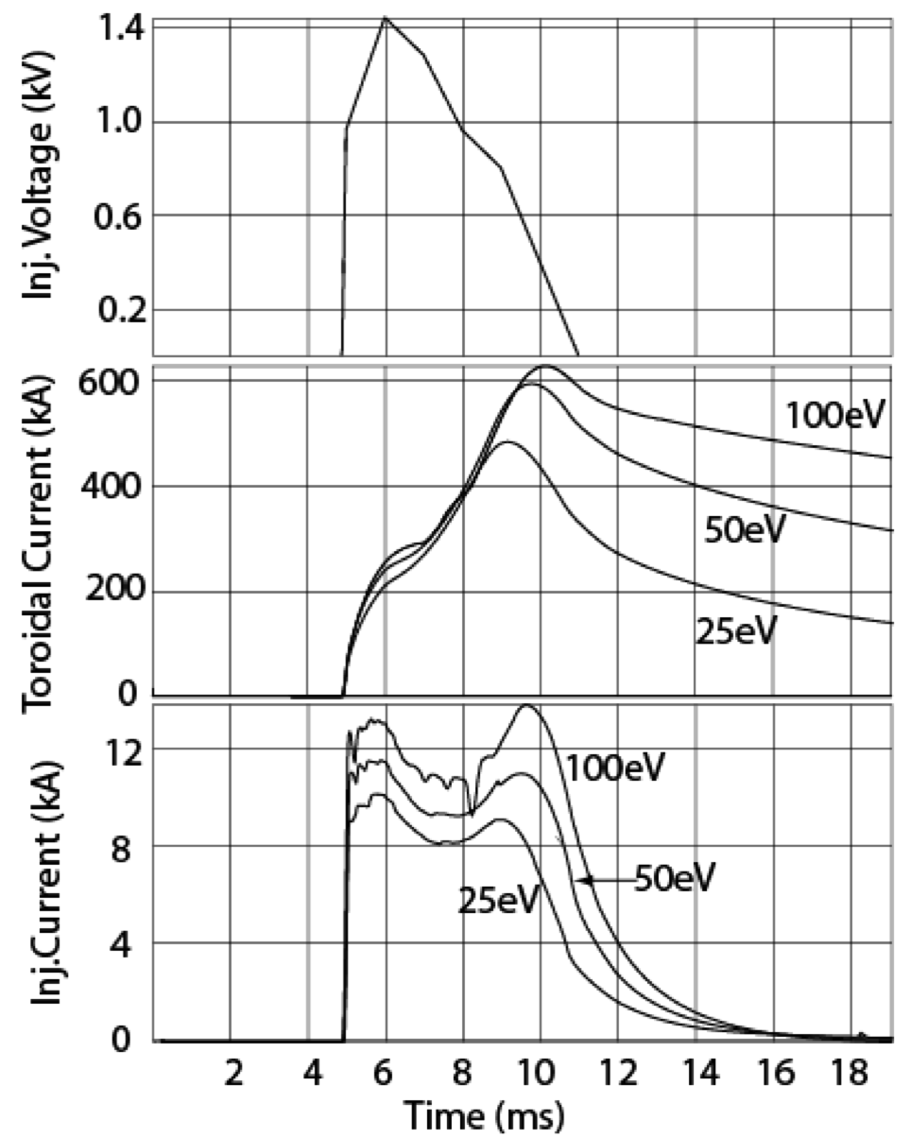
Ramp-up Strategy Significantly Benefits from
1-2 MW ECH to Heat CHI Plasma
TSC simulations indicate 0.6MW of absorbed ECH power could increase T_{e} to ~400eV in 20ms (with 50% ITER L-mode scaling)
  CHI discharge densities at T_{e} = 70 eV would allow 60% first-pass absorption by 28 GHz ECH in NSTX-U
  GENRAY
Increased T_{e} predicted to significantly reduce current decay rate due to resistive dissipation
  ECH heated plasma can be further heated with HHFW
  Maximum HHFW power < 4MW, higher B_{T} in NSTX-U would improve coupling
  HHFW has demonstrated heating a 300 kA / 300 eV plasma to > 1 keV in 20ms

Slide 14
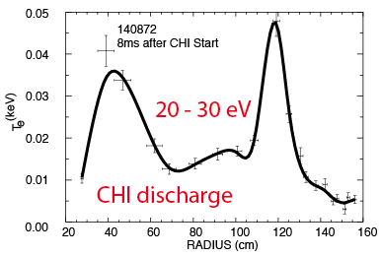
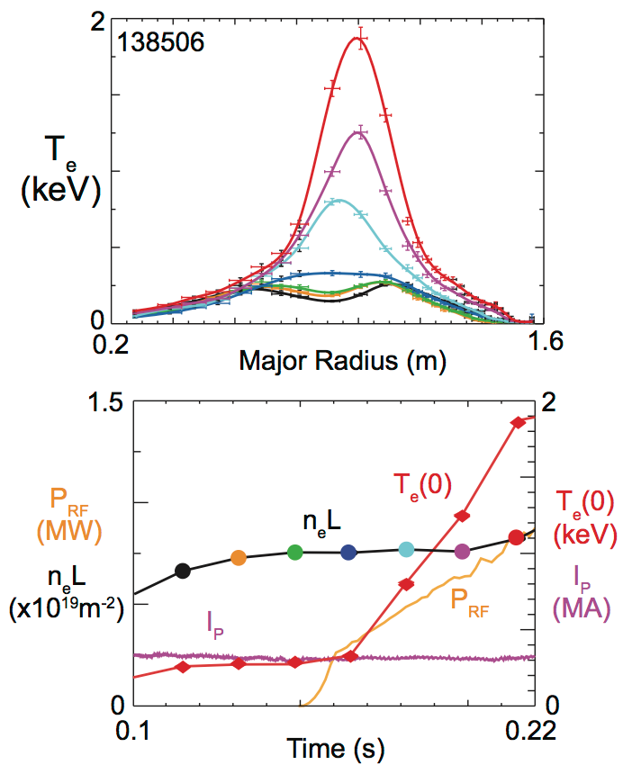
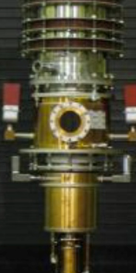
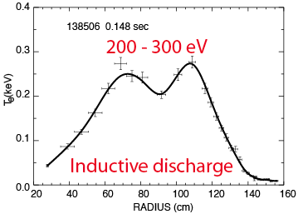
Bridge Electron Temperature Gap Between CHI Start-up and Current Ramp-up Requirements with ECH Heating
1MW
ECH
1-2 MW
HHFW
T_{e} = 1 keV
300eV
20ms

Slide 15
Research Plan

Slide 16
Thrust PSR-1a: Establish and Extend
Solenoid-free Plasma Start-up
FY15: Re-establish transient CHI discharges utilizing
  Graphite lower divertor tiles, increased toroidal field capability
  Full Li coating of lower divertor tiles + Li conditioning of upper divertor
  Develop CHI targets using TSC and model ECH absorption in TSC generated equilibria (FY13-14)
  Improve NIMROD simulations to obtain good agreement with NSTX transient CHI discharges (FY13-14) [See backup slide 27 for more detail]
FY15-16: Determine maximum toroidal currents generated by CHI
  Vary and increase the amount of injector flux, the size of the capacitor bank, and the CHI voltage (up to 2 kV).
  Study coupling of the CHI generated plasma to inductive drive
  Use experimental results to Improve TSC models for CHI start-up

Slide 17
Thrust PSR-1b: Test NBI Current Ramp-up
FY15-16: Assess NBI coupling + current drive efficiency in 300-800kA flat-top current inductive plasmas, compare to TSC/TRANSP
  Vary the plasma density and T_{e}
  Inject new more tangential beams into CHI + induction targets and assess current-drive and compare to TSC/TRANSP simulation
FY16-17: Use combinations of NBI and HHFW to attempt non-inductive ramp-up of I_{P} = 0.5-0.6MA (inductive target) to 0.8-9MA
  Use TSC/TRANSP in predictive mode to support experiments

Slide 18
Thrust PSR-2: Ramp-up CHI Plasma Discharges
Using ECH, HHFW and NBI and Test Plasma Gun Start-up
Maximize the levels of CHI-produced plasma currents using:
  1 MW 28GHz ECH (FY17) [CHI goal 0.3-0.5MA]
  Metallic divertor plates (as available) to reduce low-Z impurity radiation
  2.5-3 kV CHI capability (FY18) [CHI goal 0.4-0.6MA]
  Validate CHI started discharge modeled using NIMROD
FY17: Extend duration of high-current CHI target using ECH/HHFW and test effectiveness of NBI coupling to CHI-target
  Validate ECH heated CHI discharge models using GENRAY
FY17-18: Ramp-up of CHI target + ECH/HHFW → HHFW+NBI
  Validate simulations of current ramp up using TSC/TRANSP
  Develop TSC/TRANSP/GENRAY & NIMROD models for establishing start-up/ramp-up requirements in ST FNSF
FY17-18: If guns ready, commission and test on NSTX-U

Slide 19
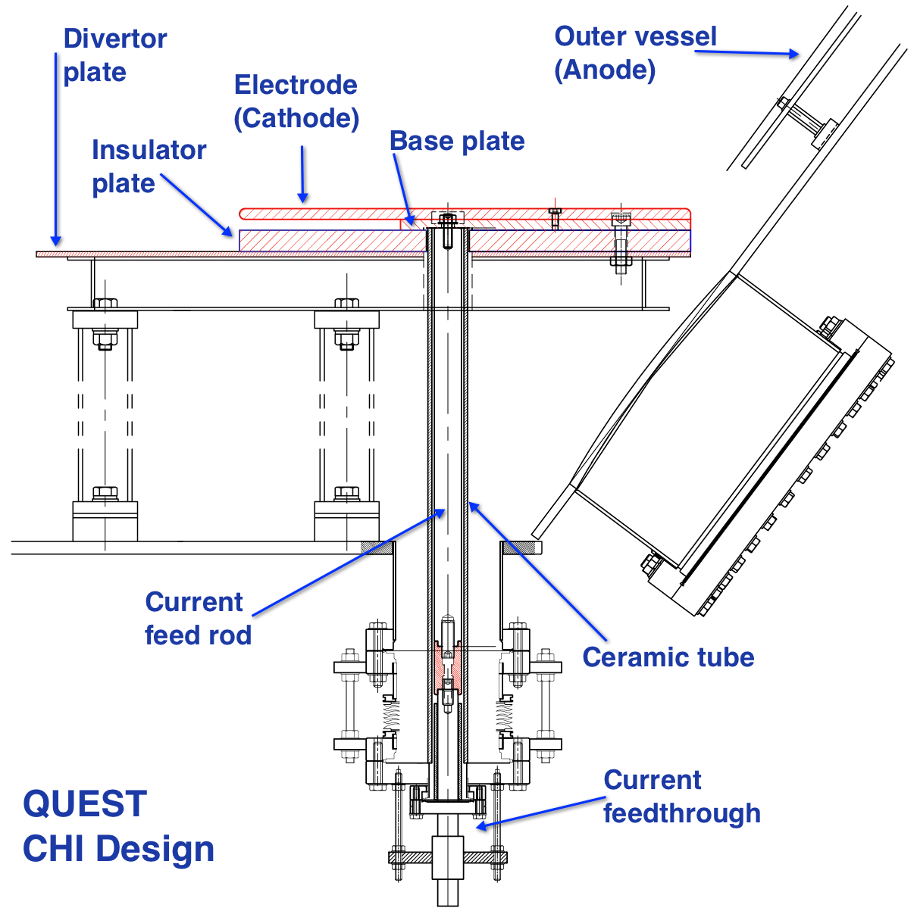
CHI Design for QUEST Supports NSTX-U and FNSF Research (Collaboration with Japan)
QUEST ST aims to develop technologies for SS operation
  Use CHI in biasing mode to vary edge density gradient for EBW experiments
  High CHI current provides new target for SS CD studies on QUEST
  Interested in potential of steady-state CHI for edge current drive (aided by all metal nature of QUEST + ECH)
Benefits to NSTX-U
  Test metal electrodes to reduce low-Z impurities
  Test ECH heating of CHI target at 0.5MW level
  Test new electrode configuration to enhance compatibility with FNSF
Electrodes mounted on top of existing divertor plate

Slide 20
NSTX-U is Well Poised to Demonstrate Full Non-inductive
Start-up and Ramp-up in Support of Next Step Devices
CHI start-up aided achievement of record-low flux consumption on NSTX to ramp to 1MA
  Compatibility with H-mode operation demonstrated
  Generates discharges with low internal inductance and density needed for ECH heating and non-inductive ramp-up with NBI on NSTX-U
  Favorable scaling with machine size (HIT-II, NSTX)
~1MW 28 GHz ECH would greatly enhance start-up/ramp-up capabilities
  Helicity injected plasmas require early heating to avoid rapid current decay
MHD codes now starting to reproduce NSTX CHI discharges
  TSC being used to develop initial start-up scenarios for NSTX-U
  NIMROD (and possibly M3D-C1) to improve understanding of flux closure mechanisms and the early dynamic phase of CHI
External collaboration aids NSTX-U, FNSF & ST Demo
  Plan to test metal electrodes and new electrode design on QUEST
  PEGASUS developing plasma gun start-up for implementation on NSTX-U

Slide 21
Back-up slides

Slide 22
Plans for Start-up/Ramp-up Simulations
(TSC-TRANSP/NUBEAM/GENRAY, NIMROD)
FY13 Start-up and Ramp-up of CHI-started discharge
  Use TRANSP analysis of NSTX CHI discharges with inductive ramp to obtain electron transport model
  Use TSC generated CHI equilibrium to obtain ECH absorption and heat deposition profiles and extend to 1T (GENRAY)
  Use TSC generated inductive equilibria (with varying parameters) to calculate NBI absorption efficiency and current drive
  Assess requirements for electron heating by HHFW (with ECH heating)
  Requirements for NBI ramp-up to1MA of CHI target with ECH + HHFW
  Improve NIMROD simulations to obtain good agreement with an NSTX transient CHI discharge
    Requirements for voltage/injector current programming and injector flux footprint shaping

Slide 23
Plans for Start-up/Ramp-up Simulations
FY13-14 Extend to NSTX-U geometry
  Develop start-up scenarios for FY15-16 Ops.
  Couple TSC directly to TRANSP/NUBEAM/GENRAY codes to self-consistently calculate NBI and RF power deposition profiles
  Assess impact of including additional parameters (n_{e} and Z_{eff}) and impact of injector gap width in NIMROD simulations
FY15-18 Support NSTX-U Ops. & Extend to FNSF/ST Demo
  Use experimental results to improve TSC/NIMROD models & extend to FNSF
  Use in predictive mode to support experiments
  Incorporate CHI model in free-boundary predictive TRANSP
  Understand plasma current growth rate implications for electron heating
  Understand 3D effects on fast flux closure as I_{p} is increased to MA levels
  Requirements for establishing a start-up discharge in next step devices

Slide 24
Hardware Preparations for NSTX-U Start-up
Diagnostics [FY13 - 14]
  New additional fast voltage monitors for upper divertor
  Additional dedicated current monitors near injector
  Special set of EMI shielded inner vessel magnetics
  Additional flux loops and Mirnov coils on lower and upper divertor
    Langmuir probe array on lower divertor
  Multipoint Thomson scattering, Filter scopes, multi chord bolometers and SXR arrays
Capacitor bank power supply [FY13 - 14] – Baseline capability
  Voltage increased to ~2 kV & improve voltage snubbing systems
  NSTX-U coil insulation is designed to support 4kV operations
  Capacitor bank power supply [YR16-18] – Upgraded capability
  Voltage increased to ~2.5-3 kV
  Additional modules for improved voltage control

Slide 25
Plans for External Collaboration & Design Studies
FY13-15
  Finalize CHI design for QUEST
  CHI system design for FNSF
  Participation with HIST device for CHI studies (device size scaling)
  Participation with PEGASUS on plasma gun start-up
    Assessment of hardware requirements for NSTX-U
  Possible installation of CHI capability on QUEST
    Establish Transient CHI discharges on QUEST
FY16-18
  Assessment of benefits of metal electrodes on QUEST
  Test of edge current drive & steady-state CHI on QUEST

Slide 26
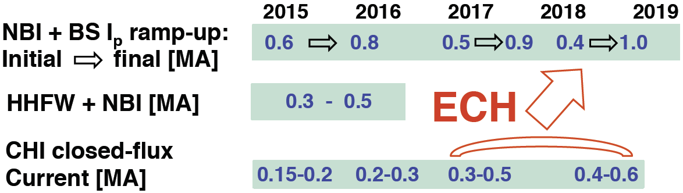
NSTX-U Current Start-up and Ramp-up Plan
Involves Three Parallel Paths
CHI initiated current progressively increased in current magnitude to exceed minimum I_{p} parameters established by inductive plasmas (ECH needed to increase T_{e})
HHFW + Bootstrap current overdrive developed on 0.3-0.5 MA plasmas to understand HHFW coupling to ECH heated CHI plasmas and to provide more flexibility in lower current levels at which to start NBI current ramp
The magnitude of the initial inductive I_{p} target will be progressively decreased below the 100% NBI + BS sustained value (~1 MA) to find the minimum I_{p} parameters for overdrive

Slide 27
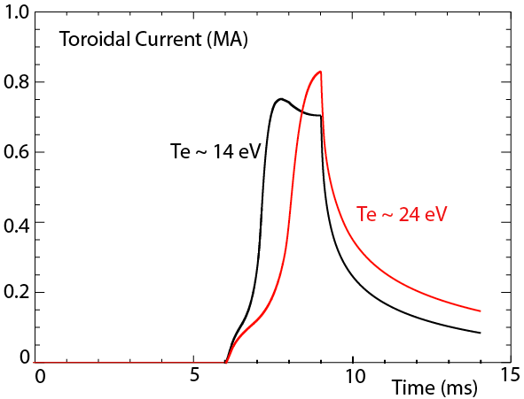
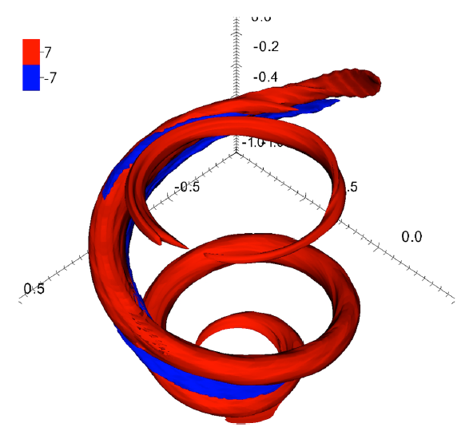
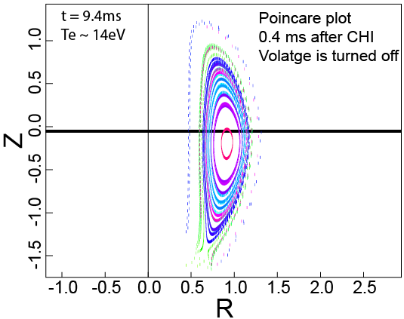
Nimrod will Study T_{e} Evolution, Transport and Ohmic Heating During CHI Evolution Phase
Will 3D physics in NIMROD alter our present expectations for scaling to next-step devices?
  MHD stability limits on CHI current density and/or current profile minimum
Ongoing simulations show promising results
  Now starting to show flux closure on experimental time scales
Point source (local) helicity injection simulations show release of a current ring following reconnection
E.B. Hooper (LLNL)
F. Ebrahimi (Princeton University)
J. B. O’Bryan (Univ. of Wisconsin)
C. Sovinec (Univ. of Wisconsin)

Slide 28
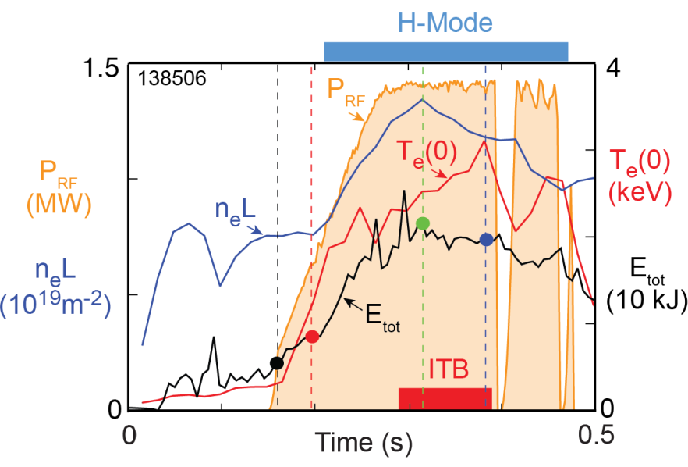
~500 kW of HHFW Increases T_{e}(0) to Over 1 keV in ~30 ms
300 kA Inductive Plasma
TRANSP analysis indicates significant levels of non-inductive
current drive fraction (discussed in Talk by Taylor)

Slide 29
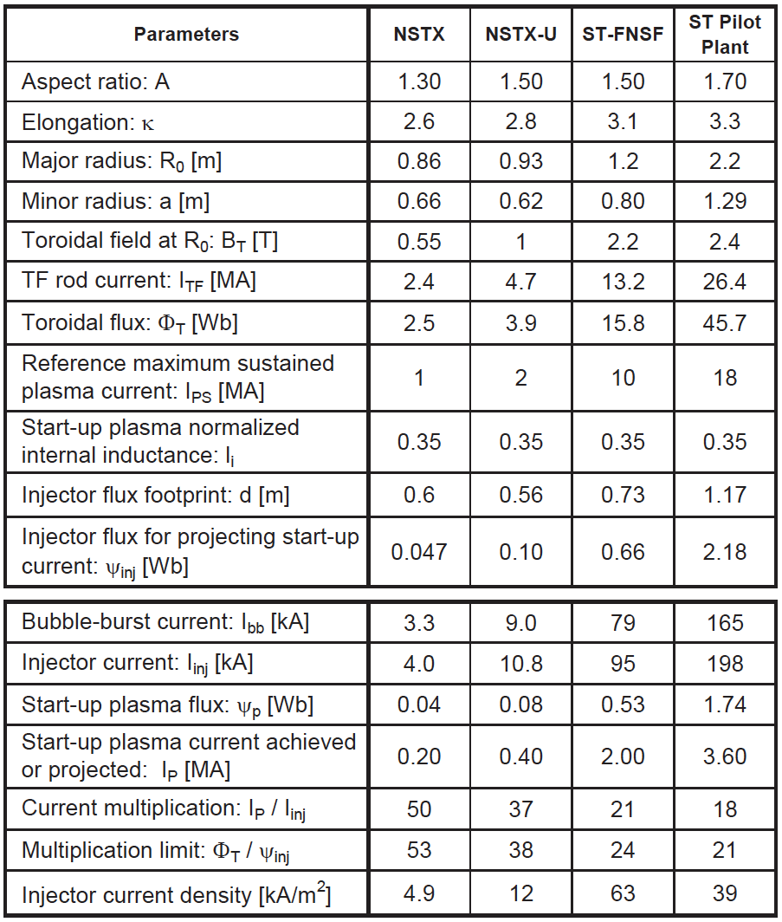
CHI Start-up to ~0.4MA is Projected for NSTX-U, and is Projected to Scale Favorably to Next-step STs
Injector flux in NSTX-U is ~ 2.5 times higher than in NSTX → supports increased CHI current
J. E. Menard et al., NF 52 (2012) 083015

Slide 30
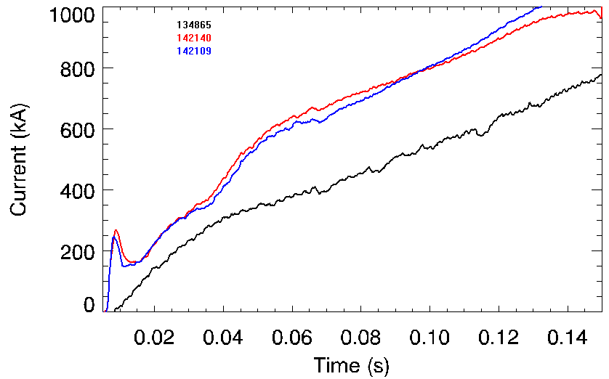
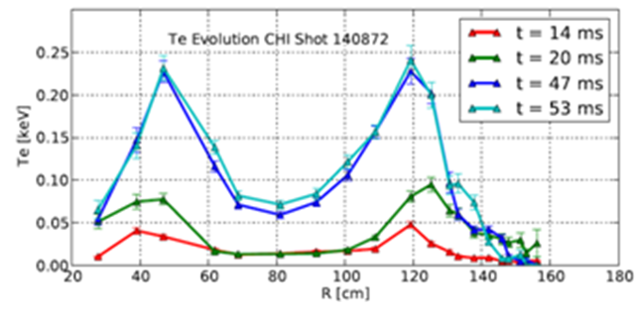
Standard L-mode NSTX Discharge Ramps to 1MA Requiring 50% More Inductive Flux than a CHI Started Discharge
Plasma current
2010
post IAEA
CHI started
Reference NSTX Inductive start-up
Hollow electron temperature profile maintained during current ramp
  - Important beneficial aspect of using CHI startup
Reference Inductive discharge
  - Uses 396mWb to get to 1MA
CHI started discharge
  Uses 258 mWb to get to 1MA (138 mWb less flux to get to 1MA)

