Slide 1




NSTX-U
Supported by
NSTX-U Program for Advancing Theory, Model Validation, and Predictive Capability
Coll of Wm & Mary
Columbia U
CompX
General Atomics
FIU
INL
Johns Hopkins U
LANL
LLNL
Lodestar
MIT
Lehigh U
Nova Photonics
Old Dominion
ORNL
PPPL
Princeton U
Purdue U
SNL
Think Tank, Inc.
UC Davis
UC Irvine
UCLA
UCSD
U Colorado
U Illinois
U Maryland
U Rochester
U Tennessee
U Tulsa
U Washington
U Wisconsin
X Science LLC
Amitava Bhattacharjee
Theory Department
Culham Sci Ctr
York U
Chubu U
Fukui U
Hiroshima U
Hyogo U
Kyoto U
Kyushu U
Kyushu Tokai U
NIFS
Niigata U
U Tokyo
JAEA
Inst for Nucl Res, Kiev
Ioffe Inst
TRINITI
Chonbuk Natl U
NFRI
KAIST
POSTECH
Seoul Natl U
ASIPP
CIEMAT
FOM Inst DIFFER
ENEA, Frascati
CEA, Cadarache
IPP, Jülich
IPP, Garching
ASCR, Czech Rep
NSTX-U 5 Year Plan Review
LSB B318, PPPL
May 21-23, 2013

Slide 2
Introductory Remarks
NSTX-U research program will advance theory, model validation and predictive capability by connecting experimentalists, theorists, and modelers, both here at PPPL and the community at large. This will provide confidence for modeling of ITER and next-step devices.
NSTX-U research teams consist of both experimentalists and theorists, with each Topical Science Group (TSG), co-led by two experimentalists and one theorist to facilitate synergism.
This talk will focus on how theory has and will address the five programmatic goals of the NSTX-U Five Year Plan.
  With apologies to the many contributors to the NSTX-U program, we will discuss only a few examples.
  The goal of theory and computation is to identify and explore important processes and/or mechanisms that account for experiments and suggest new ones, predict their outcomes, and investigate new methods of plasma control.
2

Slide 3
NSTX-U Five Year Plan Programmatic Goals
Demonstrate 100% non-inductive sustainment at performance that extrapolates to ≥ 1MW/m² neutron wall loading in FNSF.
Access reduced ν* and high-β, combined with ability to vary q and rotation to dramatically extend ST physics understanding.
Develop and understand non-inductive start-up and ramp-up
(overdrive) to project to ST-FNSF with small/no solenoid.
4. Develop and utilize high-flux-expansion “snowflake” divertor
and radiative detachment for mitigating very high heat fluxes.
5. Begin to assess high-Z PFCs + liquid lithium to develop high-duty-factor integrated PMI solutions for next-steps.
3

Slide 4
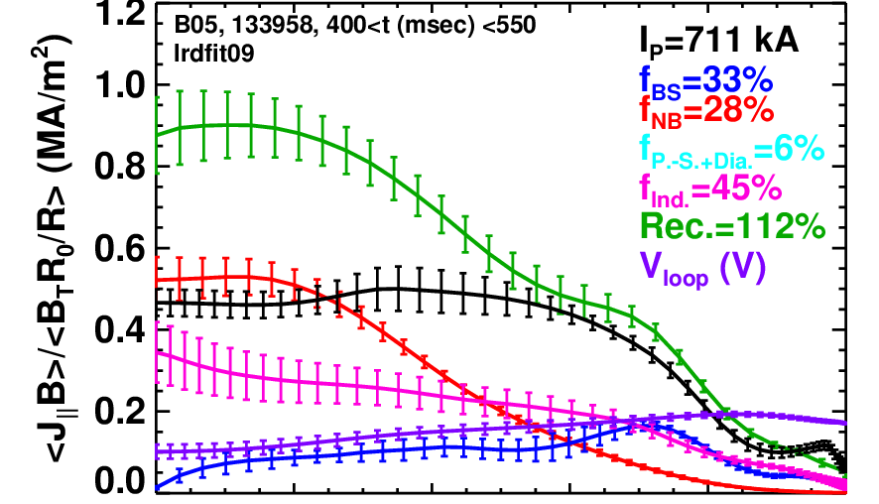
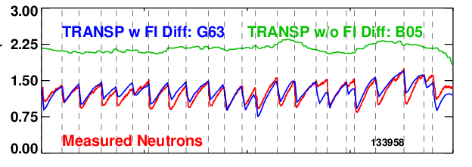
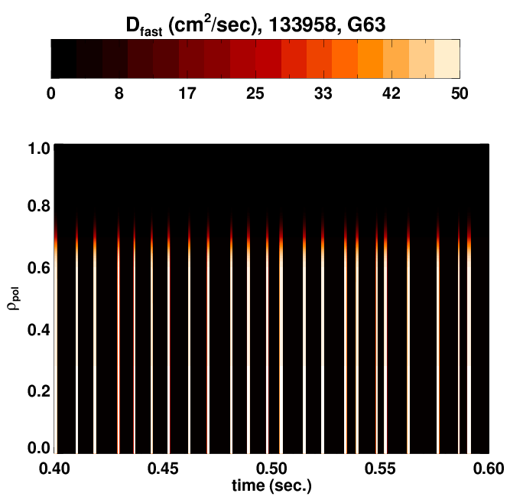
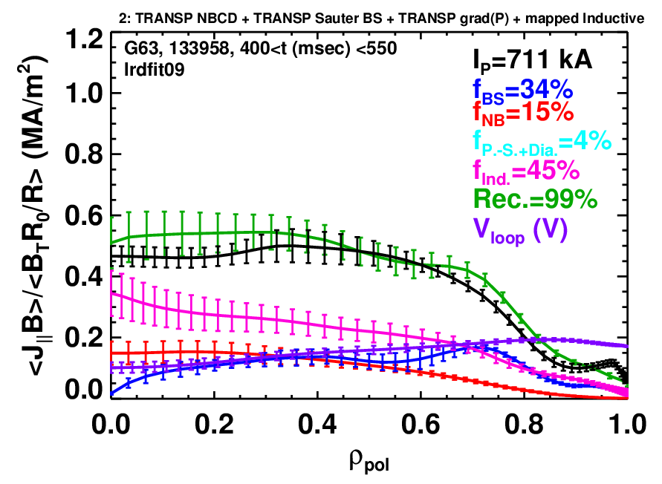
1. Demonstrate 100% non-inductive sustainment at performance that extrapolates to ≥ 1MW/m² neutron wall loading in FNSF
Experiments have shown that TAE modes can have a dramatic effect on the neutral beam current drive, an important element of attaining 100% non-inductive sustainment
700 kA High-β_{P} with Rapid TAE Avalanches
Discrepancy between reconstruction and total due to large classical J_{NBCD}.
Neutrons
Modeled TAE avalanches using ad-hoc spatially localized and time-dependent fast-ion diffusivity D_{FI}(ψ,t) (Gerhardt)
  Use S_{n} drops to determine D_{FI}(ψ,t) details
  Reinforces need for predictive modeling of avalanche transport using physics-based models
With Impulsive D_{FI}
Reduced J_{NBCD} eliminates discrepancy between reconstruction and total.
4

Slide 5
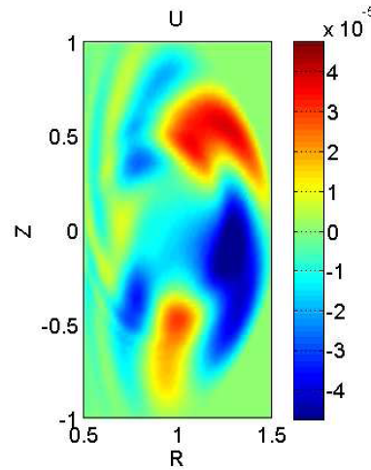
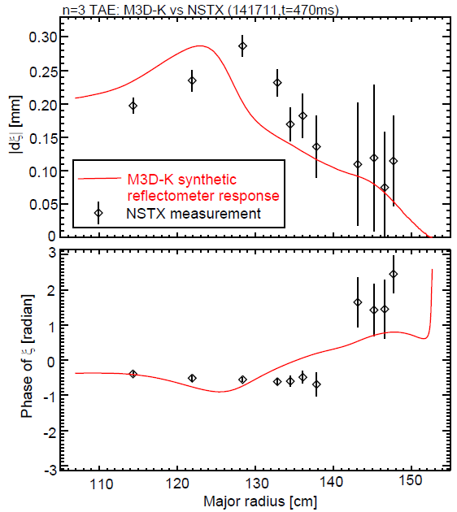
M3D-K simulations of TAE show strong similarity to NSTX experiments
Liu 2013 (PPPL, SWIP-China, UCLA, UCI)
Reasonable agreement between reflectometer measurement and M3D-K simulation of n=3 TAE in NSTX #141711. (f_{exp}=97kHz, f_{M3D-K}=106kHz )
EP effects and plasma toroidal rotation are included non-perturbatively.
Next step: nonlinear simulations of mode saturation and beam ion transport.
5

Slide 6
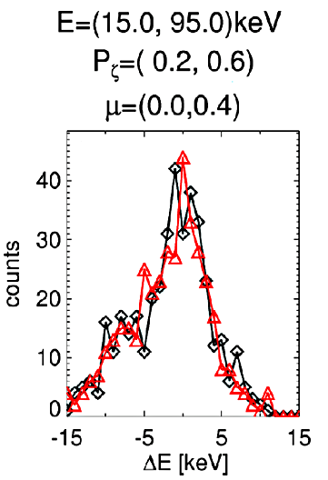
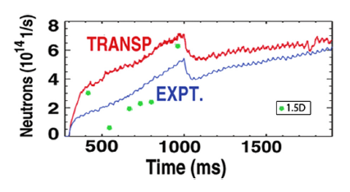
Predictive Models of AE-Induced Fast Ion Transport
Are Under Development
Resonant fast ion transport model is being implemented in NUBEAM to mimic F_{nb} modifications by resonant AEs
Quasi-linear relaxation model
Fast ion transport in both models rely on TAE mode spectrum and amplitudes calculated by linear/non-linear MHD codes (NOVA, NOVA-K, M3D-K) as well as unperturbed F_{NB} (NUBEAM/TRANSP)
Reduced model being tested against full ORBIT simulations with good agreement
QL model already developed for DIII-D with order-of-magnitude agreement
Both models will be implemented in TRANSP, with a view to making them available for other experiments, including ITER.
co-passing
ORBIT
Model
NSTX
DIII-D
Ghantous 2012
(PPPL, GA, IFS-UT, UCI)
6

Slide 7
Theory Plans for Goal 1
Further development of QL theory for EP interactions with AE modes
  The application of QL theory becomes possible due to the excitation of a large number of small-amplitude of AE modes which tend to flatten the fast-ion profile. The 1.5D model, so called because it depends it includes radial dependence of density and velocity of fast ions in resonance, should be broadened to include (1) a more complete QL theory in phase space, (2) extension of the theory for ITER applications, which requires extension to include two species, and more general distribution functions.
Phase space engineering
  Excite global CAE compressional mode---precise phasing is required to initiate and control diffusion.
Nonlinear mode-coupling (including CAE, GAE, and KAW) studies and their effects on ion distribution functions (using M3D-K, HYM, and NIMROD codes).
Effects of 3D external perturbations and microturbulence on fast ion confinement (using GTS and XGC-1)
7

Slide 8
2. Access reduced ν* and high-β combined with ability to vary q and rotation to dramatically extend ST physics understanding
Simulation of electromagnetic microtearing turbulence predicts significant transport at large beta and collisionality
Extrapolation to low collisionality suggests microtearing might be weaker for NSTX-U
Need for (1) quantitative improvement with flow shear and (2) scaling predictions of transport and thresholds
Local nonlinear GYRO
NSTX-U NSTX
Guttenfelder 2012
8

Slide 9
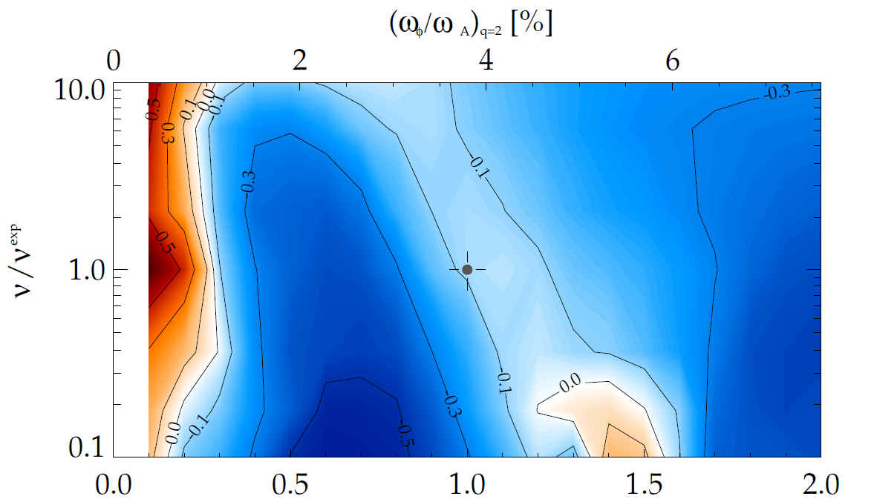
Kinetic RWM theory consistent with RWM destabilization at intermediate plasma rotation; stability altered by collisionality
γτ_{w} contours vs. ν and ω_{φ}
MISK code
(marginal stability)
Plasma evolution
Precession drift resonance stabilization
Marginal stability
Bounce/transit resonance stabilization
ν_{eff}/ν^{exp (marginal stability)}
instability
(experiment)
unstable
NSTX 121083
unstable
ω_{φ}/ω_{φ}^{exp (marginal stability)}
Destabilization appears between precession drift resonance at low ω_{φ}, bounce/transit resonance at high ω_{φ}
Destabilization moves to increased ω_{φ} as ν decreases
J.W. Berkery, et al., PRL 104 (2010) 035003
S.A. Sabbagh, et al., NF 50 (2010) 025020
9

Slide 10
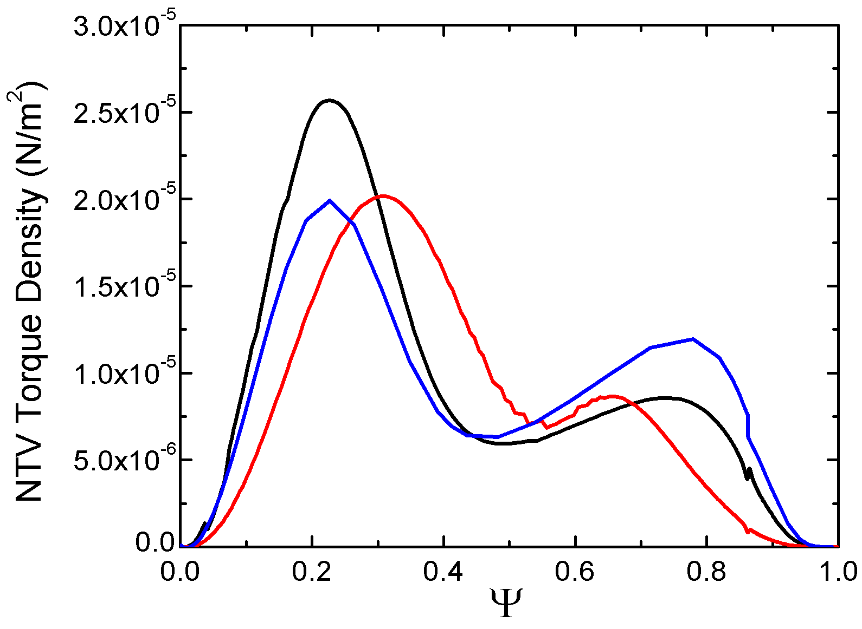
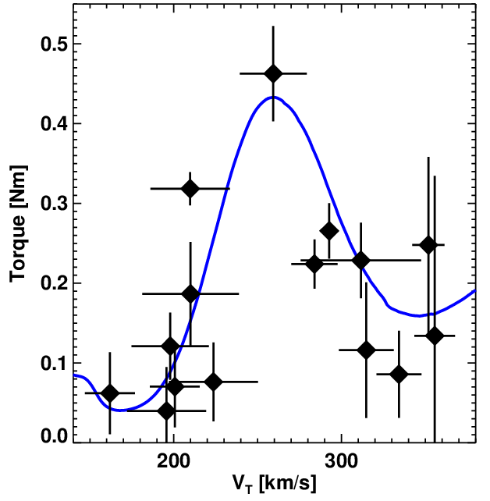
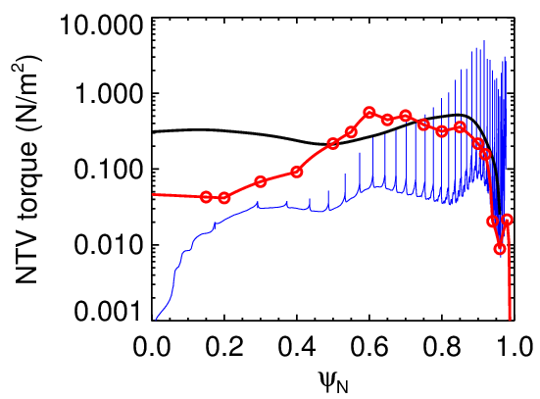
NSTX-U is an especially strong and unique laboratory for the study of neoclassical toroidal viscosity (NTV) theory
Theory unification: Kinetic MHD theory is equivalent to NTV theory
Verifications among 6 different codes
  IPEC-NTV [Park,Logan], MISK [Berkery,Hu], MARS-K [Liu,Wang]
  : Bounce-averaged, Krook, Regime-combined [Park,Porcelli,Betti]
  MARS-Q [Liu]: Bounce-averaged, ε-expansion, Pitch-angle, Pade approximation [Shaing,Cole]
  POCA [Kim]: Exact drift orbit, Pitch-angle [Boozer]
  FORTEC-3D [Satake] : Exact drift orbit, Fokker-Planck [Boozer]
Total torque/torque density in KSTAR & NSTX: tests of validation (recall Zhu 2006)
[Boozer,Mynick,Shaing,Cole,Park]
[Rostoker,Rosenbluth,Porcelli,Hu,Betti]
Benchmark among semi-analytic codes
Torque vs. rotation in KSTAR
Torque density profile in NSTX
A=10, m=3, n=1, low ν* and ω_{E}
n=1 mid + off-midplane coils
n=3 by midplane coils
Experiment
Experiment ~ 3.5Nm
n=3 Mid
IPEC-NTV
POCA: 2.7m
MARS-K
MARS-Q
IPEC-NTV
IPEC-NTV ~ 0.6Nm
10

Slide 11
Theory Plans for Goal 2
Global electromagnetic simulations for quantifying non-local effects and scaling of micro-tearing to low collisionality regime.
  PPPL global PIC codes are expected to have full electromagnetic capability by 2014, including strong shaping (GTC-NEO, GTS) as well as X-point divertor geometry (XGC-1). NSTX-U provides an ideal test-bed for these codes as well as benchmarking with other continuum codes (GYRO).
  Comparison of predictions of GTS, GYRO and XGC-1 with measurements of k-spectra and small-scale, high-frequency ZF (which represent an experimental challenge).
Important issues/concepts for reliable NTV validation and predictability, and NSTX-U will provide a near-ideal environment to test theory.
  NTV prediction for high-β, low-collisionality regime, and low-aspect ratio tokamak: discrepancies between codes and experiments tend to increase in these regimes. These are the targets of MARS-K and GPEC codes.
  To what extent can the torques due to NTV be localized, and what are the important relevant magnetic field distributions? What are the options for coil-placement locations? Can stellarator optimization methods be useful?
11

Slide 12
3. Develop and understand non-inductive start-up and ramp-up
(overdrive) to project to ST-FNSF with small/no solenoid
TSC/TRANSP used to validate 2D CHI current generation model and predict non-inductive ramp-up for NSTX-U
TSC/TRANSP simulation of non-inductive
ramp-up from initial CHI target
12

Slide 13
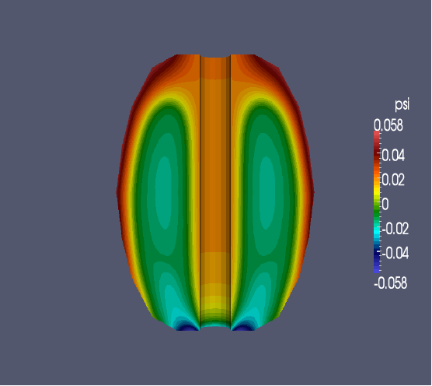
Theory Plans for Goal 3
Develop model for plasma transport during ramp-up phase
  Use electromagnetic GTS (when ready) to determine transport
  Model validation using NSTX results
NIMROD investigation of CHI current generation and flux closure
  - Effects of high-Lundquist-number, and a generalized Ohm’s law (Hall Current and electron pressure) on X-point formation and flux closure
  3D effects: field line stochasticization
  Helicity injection using plasma guns
Develop TSC/TRANSP capability to model non-inductive initiation, ramp-up and sustainment. (This is connected to Goal 1, specifically, to a predictive model for current profile evolution.)
  Couple TSC directly to NUBEAM to self-consistently calculate profiles
  Incorporate CHI model in free-boundary predictive TRANSP
Ebrahimi, Hooper, Sovinec, Raman 2013 (PPPL, LLNL, UW-Madison)
Axisymmetric NIMROD study
13

Slide 14
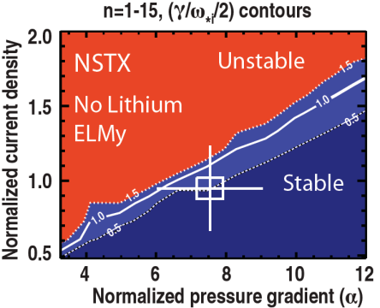

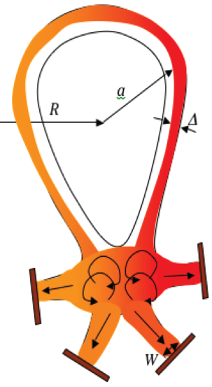
4. Develop and utilize high-flux-expansion “snowflake” divertor and radiative detachment for mitigating very high heat fluxes
“Snowflake” (SF) divertor is an example of innovative theory, which has had an important effect on setting new directions for experiments (NSTX, TCV).
Validate peeling-ballooning ELM stability model for SF configuration
  Magnetic shear inside separatrix may affect pedestal stability
  ELMs are stabilized by ELM. Are they destabilized by SF?
Validate SF null-point convective heat transport theory and null-point instability predictions
  Heat convection in null-point region with β_{pol}>>1 results in ELM heat flux reduction by up to factor of 10
    Heat partitioning among additional strike points
Ryutov 2007, 2012
14

Slide 15
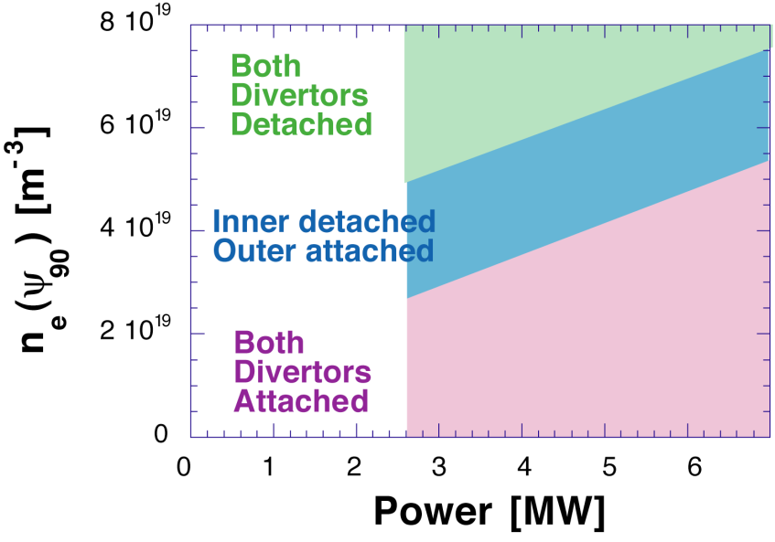
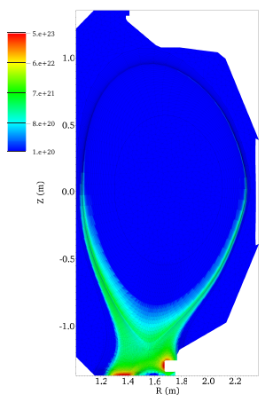
Theory Plans for Goal 4
Model UEDGE calculations predicted limited “window” of outer divertor detachment
  Not inconsistent with NSTX results, but
  fluid models (e.g., UEDGE, SOLPS) are only as good as the input transport assumptions
Coupling of XGC0/1 and DEGAS2 will provide self-consistent description of edge plasma and recycling
  Background plasma descriptions critical to further modeling efforts describing transport
Role of X-point ballooning (ideal and resistive), flute instabilities, and related transport using BOUT++ and XGC-1.
Effect of 3D fields and stochasticity
Neutral density
15

Slide 16
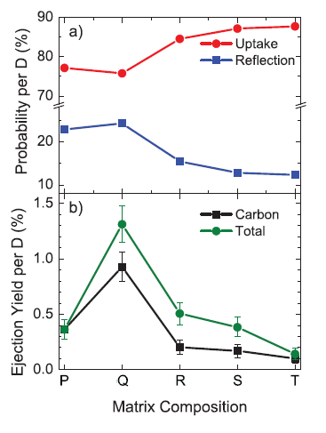
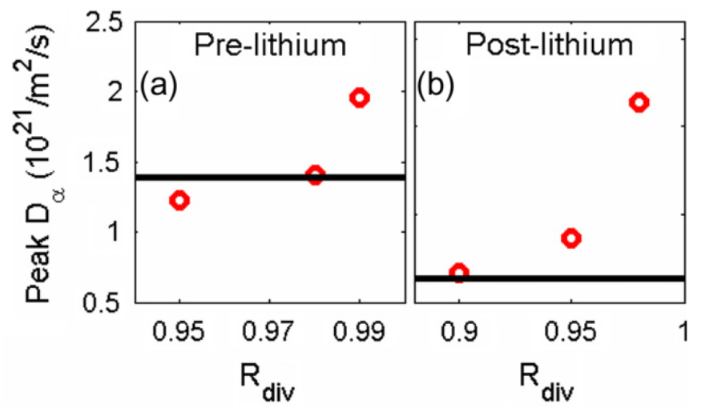
5. Begin to assess high-Z PFCs + liquid lithium to develop high-duty-factor integrated PMI solutions for next-steps
Material modeling provides model of erosion reduction retention with lithiated graphite
Sample P is pure carbon,
R is carbon+lithium+oxygen composite
(similar to NSTX PFCs)
Quantum-Classical Molecular Dynamics (QCMD) simulation calculates inter-atomic potentials and then simulates bombarding ions
Predicts increased retention and reduced impurity yield with composite PFC
  Qualitatively consistent with NSTX observations indicating reduced recycling with lithiated, graphite PFCs
Krstic PRL
2013 (ORNL)
Exp. Value
SOLPS
Divertor Recycling
Canik JNM 2011
16

Slide 17
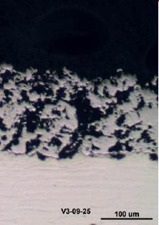
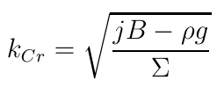
5. Begin to assess high-Z PFCs + liquid lithium to develop high-duty-factor integrated PMI solutions for next-steps (cont’d)
Analytical modeling predicts free-surface liquid metal stability against ejection
Linear stability of Raleigh-Taylor droplet formation from JxB ejection forces analyzed
Predicts stable operation with the use of porous materials and thin-layers of liquid metal
Consistent with NSTX LLD experiments indicating no ejection events during 2010 run campaign
  Ejection events observed on DIII-D, however
100 μm
For the fastest growing modes
Jaworski JNM 2011, Jaworski IAEA FEC 2012, Whyte FED 2004
17

Slide 18
Theory Plans for Goal 5
There is a relatively new, interdisciplinary effort at PPPL, involving a developing collaboration with colleagues in academic Departments (including science, engineering and applied math) at Princeton University as well as other institutions. The goals of this program are:
  – To investigate the mechanisms of D retention in lithiated PFCs, which is fundamental to the plasma performance improvements seen in many tokamaks around the world including NSTX.
  – To investigate the nature of lithium wetting of metals and stainless steel, which is is fundamental to developing lithium coated PFCs for use in long pulse fusion devices including NSTX-U.
  – The long-term ambition is to develop liquid PFCs as a revolutionary alternative to solid PFCs such as tungsten.
DEGAS2/XGC0/1 validation as input to fluid codes UEDGE, SOLPS
18

Slide 19
Summary
This talk has attempted an overview of the NSTX-U Program of theory, model validation, and predictive capability. This overview has not attempted to be comprehensive, and has focused on a few important examples (with apologies for the sins of omission and commission).
PPPL Theory and NSTX-U Theory collaborations will strongly support the high-priority research goals of the NSTX-U 5-year plan.
The NSTX-U program has made, and will continue to make, major contributions to model validation in support of FNSF and ITER.
19

Slide 20
Backup
20

Slide 21
Validation of DEGAS 2 Simulation Code Against GPI Data
Increase confidence in model for propagation of atoms & molecules in plasma edge.
3-D steady state simulations with synthetic diagnostic for GPI camera.
  DEGAS 2 background plasma from Thomson n_{e}, T_{e} & EFIT equilibrium.
Absolute calibration of camera & gas puff ⇒ compare photons / injected D atom:
  GPI: 1/89 ± 34%, DEGAS 2: 1/75 ± 18%.
vertical average
[B. Cao et al., Fus.
Sci. Tech. (2013)]
21
Notes:
DEGAS 2 simulations of GPI experiments aid in interpretation of the data:
First, by validating the commonly assumed model that the light emission is equal to the local atom density times a known function of the electron density and temperature. The simulations assess the importance of complicating factors, like molecules.
Second, the simulations quantify details of the experimental arrangement, e.g., the reduction in the spatial resolution of the diagnostic due to the toroidal extent of the neutral gas cloud.
Third, the comparisons validate the DEGAS 2 model itself, in particular, the atomic physics used to propagate atoms & molecules in the plasma edge.
A possible spin-off of this work is that one could use DEGAS 2 to infer the neutral atom density from passive emission recorded by an absolutely calibrated edge camera.
In these DEGAS 2 simulations, the background plasma is set up using an EFIT-based geometry and profiles from Thomson scattering. The geometry of the experiments is replicated in 3-D and a synthetic diagnostic of the GPI camera yields the simulated light emission.
Plot shows comparison of 2-D profiles: color image is DEGAS 2 result, white contours are GPI data (evenly spaced). Black line is separatrix, red line is limiter shadow, blue line is gas manifold location.
Radial profile obtained by integrating over vertical coordinate. These agree to within the estimated uncertainties.
Absolute calibrations of the camera and the total number of atoms puffed allow the photons / injected D atom to be compared. Again, these values agree to within the estimated uncertainties.

