Slide 1




NSTX-U
Supported by
5 Year Review Panel Questions – Day 1
Coll of Wm & Mary
Columbia U
CompX
General Atomics
FIU
INL
Johns Hopkins U
LANL
LLNL
Lodestar
MIT
Lehigh U
Nova Photonics
ORNL
PPPL
Princeton U
Purdue U
SNL
Think Tank, Inc.
UC Davis
UC Irvine
UCLA
UCSD
U Colorado
U Illinois
U Maryland
U Rochester
U Tennessee
U Tulsa
U Washington
U Wisconsin
X Science LLC
NSTX-U Team
Culham Sci Ctr
York U
Chubu U
Fukui U
Hiroshima U
Hyogo U
Kyoto U
Kyushu U
Kyushu Tokai U
NIFS
Niigata U
U Tokyo
JAEA
Inst for Nucl Res, Kiev
Ioffe Inst
TRINITI
Chonbuk Natl U
NFRI
KAIST
POSTECH
Seoul Natl U
ASIPP
CIEMAT
FOM Inst DIFFER
ENEA, Frascati
CEA, Cadarache
IPP, Jülich
IPP, Garching
ASCR, Czech Rep
NSTX-U 5 Year Plan Review
LSB B318, PPPL
May 21-23, 2013

Slide 2
Questions from Panel – 1-4 of 7
Compare and contrast the MAST and NSTX-U capabilities and plans
  What are the complementary research objectives?
  What sorts of plans for joint experiments exist?
  What are possibilities for confirmatory experiments?
  Addressed by J. Menard
More detail is desired on the attempt to get to steady state without a CS.
  How to you envision developing the transition from CHI to HHFW to NBCD?
  How do things fit together to inform FNSF after the end of 5-year plan?
  R. Raman covered first question in his presentation
  Informing FNSF: Addressed by J. Menard
What are your priorities that are for the upgrades included in the base program? Addressed by J. Menard
Please provide the FTEs for scientific staff, including collaborators
  Addressed by M. Ono

Slide 3
Questions from Panel – 5-7 of 7
What are the rep-rate limitations for high field operation?
  What arises first, second, third?
  How do you plan deal with them?
  Addressed by S. Gerhardt
What is the physics basis for the cryopump and the expected particle exhaust rates as compared to lithium coatings?
  Addressed by J. Canik
Is the cryopump compatible with MGI or NB operation? (… but we will answer a slightly different question):
Is MGI compatible with divertor cryopump and NB operation?
  Divertor cryo – Addressed by J. Canik / R. Maingi
  NBI cryo – Addressed by: R. Raman / S. Gerhardt

Slide 4
Questions from Panel – 1-4 of 7
Compare and contrast the MAST and NSTX-U capabilities and plans
  What are the complementary research objectives?
  What sorts of plans for joint experiments exist?
  What are possibilities for confirmatory experiments?
  Addressed by J. Menard
More detail is desired on the attempt to get to steady state without a CS.
  How to you envision developing the transition from CHI to HHFW to NBCD?
  How do things fit together to inform FNSF after the end of 5-year plan?
  R. Raman covered first question in his presentation
  Informing FNSF: Addressed by J. Menard
What are your priorities that are for the upgrades included in the base program? Addressed by J. Menard
Please provide the FTEs for scientific staff, including collaborators
  Addressed by M. Ono

Slide 5
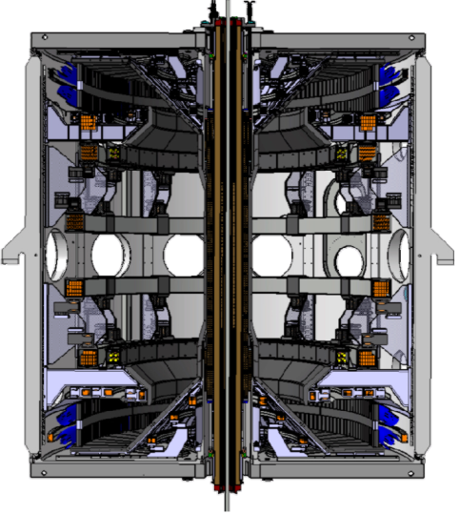
NSTX-U and MAST-U share common mission elements with complementary physics capabilities
Mission elements:
Establish knowledge-base for an ST-based FNSF
Extend physics understanding of tokamak, ITER
Develop innovative PMI solutions for next-steps
NSTX-U
MAST-U
• High β up to ideal-wall limit at low ν*
• BES, high-k, polarimetry for e & i-transport
• HHFW electron heating and CD
• High f_{BS} + co-NBI for high f_{NI}
• CHI/plasma gun, ECH, HHFW, NBI ramp-up
LiTER+paced ELMs for ion control (until cryo)
Snowflake, detachment, Li vapor shielding
J(r) control via large R_{tan} co-NBI
Long-term: transition to high-Z + flowing LM
• MHD studies near no-wall limit at low ν*
• BES, high-res Thomson for NTM, boundary
• EBW electron heating and CD
• High co-NBI CD fraction + BS for high f_{NI}
• Merging-compression, EBW for ramp-up
Divertor cryo-panels for D pumping
Long line-length Super-X divertor, detachment
Vertically-shifted off-axis co-NBI
Graphite PFCs

Slide 6
NSTX-U and MAST-U devices have similar current and field capability goals, but target complementary scenarios
NSTX → NSTX-U
MAST → MAST-U
I_{P} = 1MA (1.4MA max) → 2MA
B_{T} = 0.55 → 1T
τ_{pulse} = 1s → 5s
P_{NBI} = 5, 7.5MW → 10,15MW (5s,1.5s)
I_{P} = 1MA (1.2MA max) → 2MA
B_{T} = 0.55 → 0.84T
τ_{pulse} = 1s → 4s
P_{NBI} = 5MW → 7.5MW (4s) (Phase 1)
NSTX-U will have leading PMI capability: ITER-level P/R, P/S up to 24MW/m, 0.5MW/m²
from 15+6=21MW NBI+FW vs. MAST-U 7.5MW
Passive structure + MHD control differences motivate complementary scenarios:
Conformal close-fitting Cu plates
Mid-plane coils for RMP and active RWM/EF control (unless/until NCC)
Far conducting wall
Mid + off-mid-plane EF/RMP coils (MAST-U may not have off-midplane coils – TBD)
  Impact on elongation and beta
    NSTX-U: w/ wall-stabilization → κ = 2.5-3, β_{N} = 4.5-6 → f_{BS} = 60-80% → access lower l_{i} → higher κ
    MAST-U: w/o wall stabilization → κ = 2-2.5, β_{N} = 3-4.5 → f_{BS} = 30-50%
  100% non-inductive sustainment
    NSTX-U: Moderate-to-high f_{GW} = 0.4-1.0 → 20-40% NBI-CD → J(r) controllability challenging?
    MAST-U: Low to moderate f_{GW} = 0.25-0.5 → 50-75% NBI-CD → AE, low-n kink stability problematic?

Slide 7
NSTX-U researchers will be playing active role in MAST 2013 run campaign
Number | Title | Person in charge
FPP-001 | Time-resolved measurements of DD fusion products using proton detector & neutron camera/fission chamber during short timescale MHD activity & NBI blips | D. Darrow M. Cecconello
FPP-006 | Identification & study of TAE avalanches | E. Fredrickson
MHD-011 | Effect of I_{P} and β_{P} on pedestal | A. Diallo
TC-014 | Measure perturbative particle transport in MAST | Y. Ren
TC-011 | Momentum transport | W. Guttenfelder
Thanks to MAST team for strong outreach/accomodation to NSTX team
Gary Taylor assisting coordination of NSTX collaboration on MAST
Experiments to start very soon - will benefit MAST/MAST-U and NSTX-U
NSTX-U will accommodate MAST researchers during MAST-U outage
7

Slide 8
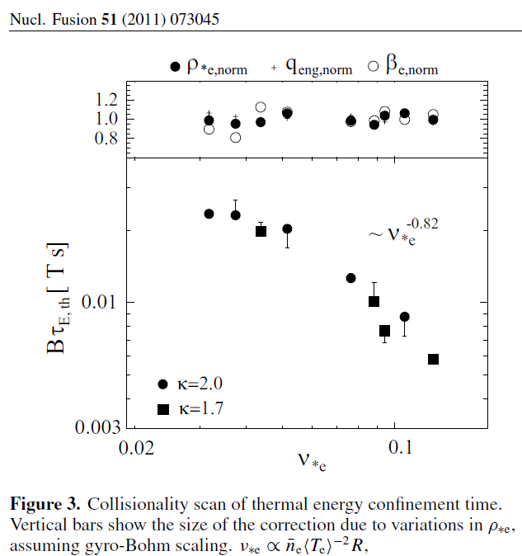
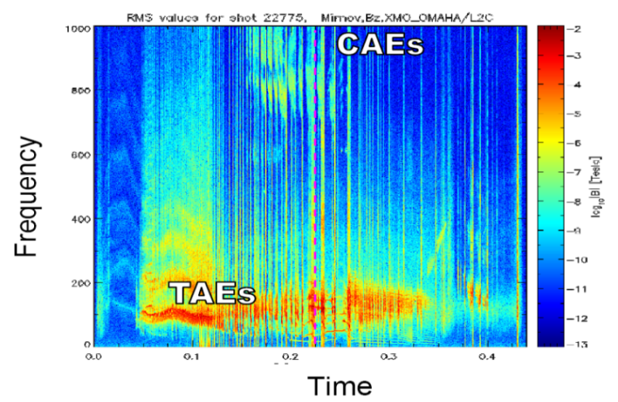
Expected joint research, confirmatory experiments
Underlying physics of collisionality scaling of thermal confinement
  NSTX + MAST observation of 1/ν scaling of confinement confirmed scaling as ST trend rather than device-specific trend
  Confinement scaling critical issue for projecting to next-step STs – data from both devices will be essential
MAST
Physics & impact of fast-ion instabilities
  Chirping/bursting TAE/EPM modes
  EP-induced modes
  Exploitation of active MHD spectroscopy (AE antenna) in ST geometry
  Fast-ion transport from *AE critical issue for NBI-CD in NSTX-U, MAST-U, FNSF
MAST

Slide 9
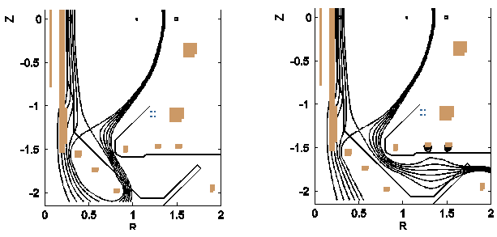
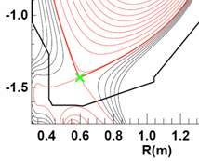
Expect substantial joint research on advanced divertors
MAST Upgrade
NSTX Upgrade
Conventional
Super-X
Conventional
Snowflake
MAST-U: Super-X + cryos NSTX-U: snowflake + lithium
  Both will access high flux expansion, variation of line-length, pumping
  Complementary: open vs. closed divertor, different pumping techniques
  Both will require advanced boundary control
    Example: control of multiple X-points/flux expansion
  Divertor requirements and optimization are critical issues for FNSF
Joint super-X and snowflake research on MAST-U, NSTX-U, DIII-D, TCV recently proposed by H. Wilson (University of York + many others) – unfortunately this proposal was not funded by UK EPSRC

Slide 10
Questions from Panel – 1-4 of 7
Compare and contrast the MAST and NSTX-U capabilities and plans
  What are the complementary research objectives?
  What sorts of plans for joint experiments exist?
  What are possibilities for confirmatory experiments?
  Addressed by J. Menard
More detail is desired on the attempt to get to steady state without a CS.
  How to you envision developing the transition from CHI to HHFW to NBCD?
  How do things fit together to inform FNSF after the end of 5-year plan?
  R. Raman covered first question in his presentation
  Informing FNSF: Addressed by J. Menard
What are your priorities that are for the upgrades included in the base program? Addressed by J. Menard
Please provide the FTEs for scientific staff, including collaborators
  Addressed by M. Ono

Slide 11
Aim to demonstrate and understand integrated non-inductive start-up and ramp-up for ST-FNSF near end of 5 year plan
2015 | 2016 | 2017 | 2018 | 2019
Maximum
B_{T} [T] and I_{P} [MA]
0.8, 1.6
1, 2
Ability to integrate will be highly dependent on physics, resources, run-time
Structural force
and coil heating
limit fractions
0.5, 0.5
1.0, 0.75
1.0, 1.0
Nominal τ_{pulse} [s]
1 – 2
2 – 4
4 – 5
Sustained β_{N}
3 – 5
4 – 6
NCC
5 – 6
ν* / ν* (NSTX)
0.6
0.4
Cryo
0.3 – 0.2
0.2 – 0.1
Integrated non-inductive start-up, ramp-up, and sustainment
Non-inductive
fraction (Δt ≥ τ_{CR})
70 – 90%
80 – 110%
90 – 120%
100 – 140%
CHI closed-flux
current [MA]
0.15 – 0.2
0.2 – 0.3
0.3 – 0.5
0.4 – 0.6
ECH
HHFW +BS non-inductive I_{P} [MA]
0.15– 0.25
0.2 – 0.3
0.3 – 0.4
0.3 – 0.5
NBI+BS I_{P} ramp-up: initial → final [MA]
0.6 → 0.8
0.5 → 0.9
0.4 → 1.0
Model, interpret, understand in NSTX-U with TSC, TRANSP, NIMROD, NOVA-K, AORSA, GENRAY, …
Extend models to FNSF → assess implications for FNSF design: coils, NBI, ECH/EBW, FW, …

Slide 12
Questions from Panel – 1-4 of 7
Compare and contrast the MAST and NSTX-U capabilities and plans
  What are the complementary research objectives?
  What sorts of plans for joint experiments exist?
  What are possibilities for confirmatory experiments?
  Addressed by J. Menard
More detail is desired on the attempt to get to steady state without a CS.
  How to you envision developing the transition from CHI to HHFW to NBCD?
  How do things fit together to inform FNSF after the end of 5-year plan?
  R. Raman covered first question in his presentation
  Informing FNSF: Addressed by J. Menard
What are your priorities that are for the upgrades included in the base program? Addressed by J. Menard
Please provide the FTEs for scientific staff, including collaborators
  Addressed by M. Ono

Slide 13
Prioritization of 5 year plan tools with 5YP base funding
Ranked according to programmatic impact, cross-TSG linkages, cost
2014 | 2015 | 2016 | 2017 | 2018
Plasma control development
  Highly cross-cutting, modest cost
Density control, access to low ν* and Z_{eff} cross-cutting for all 5YP goals
  Modest cost: upward LiTER, LGI
  Higher cost: divertor cryo-pump
Turbulence diagnostics (high-k, δB) critical for understanding transport at low ν, high b
  Modest cost, collaborator supported
Start-up/ramp-up critical ST issue
  Upgraded CHI: high impact, modest cost
1.5 → 2 MA, 1s → 5s
Run Weeks:
16
14
14
16
Start-up and Ramp-up
Upgraded CHI for ~0.5MA
up to 0.5 MA plasma gun
1 MW ECH/EBW
Boundary Physics
Lower divertor cryo-pump
Materials and PFCs
High-Z tile row on lower OBD
High-Z tile row on cryo-baffle
Liquid
metals / lithium
Upward
LiTER
LLD using bakeable cryo-baffle
Li granule injector
  *AE important for sustainment, ramp-up
    – AE antenna, charged FPD: low/modest cost
MHD tools vital for high β, FNSF control
  MHD sensors, MGI/EPI - modest cost
  NCC: cross-cutting, but higher cost
FNSF start-up: bridging T_{e} gap important
  ECH: higher cost, a bit less cross-cutting
  Plasma guns: moderate cost, technically ready?
  Begin high-Z studies, cryo-baffle LLD
  – Longer-term goal, modest/moderate cost
MHD
MGI disruption mitigation
Partial NCC
Enhanced MHD sensors
Transport & Turbulence
δB polarimetry
High k_{θ}
Waves and Energetic Particles
Charged fusion product
1 coil AE antenna
4 coil AE antenna
Scenarios and Control
Establish control of:
n_{e}
q_{min}
Snowflake
Rotation
Divertor P_{rad}

Slide 14
Questions from Panel – 1-4 of 7
Compare and contrast the MAST and NSTX-U capabilities and plans
  What are the complementary research objectives?
  What sorts of plans for joint experiments exist?
  What are possibilities for confirmatory experiments?
  Addressed by J. Menard
More detail is desired on the attempt to get to steady state without a CS.
  How to you envision developing the transition from CHI to HHFW to NBCD?
  How do things fit together to inform FNSF after the end of 5-year plan?
  R. Raman covered first question in his presentation
  Informing FNSF: Addressed by J. Menard
What are your priorities that are for the upgrades included in the base program? Addressed by J. Menard
Please provide the FTEs for scientific staff, including collaborators
  Addressed by M. Ono

Slide 15
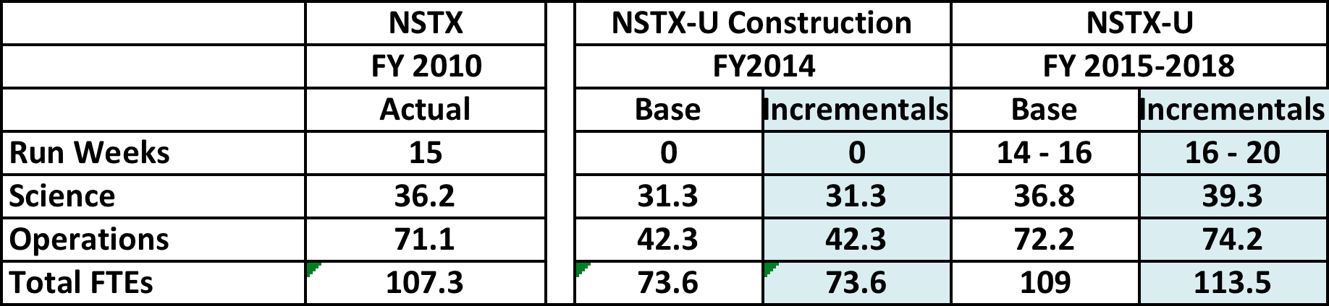
NSTX-U Research Manpower Summary
(#s are based on the recent count)
PPPL Science / Operations FTEs
• NSTX-U research and operations staffing level is similar to that of NSTX. Incremental funding will enable research staff enhancement to support increased research output.
• Collaborating FTE#s are not accurately known since the grant is managed directly by OFES. We estimate that 16.6 FTE non-lab collaborators and 5.4 lab collaborators are directly supported by the NSTX-U collaboration grant.
• There are other sources of funding for our collaborating researchers including advanced diagnostic initiative and theory related funding.
• International collaborators are generally funded by home institutions.
• 17 NSTX-U collaborating researchers are presently residing at PPPL.
• In addition, there are 33 students presently associated with NSTX-U research program.

Slide 16
Questions from Panel – 5-7 of 7
What are the rep-rate limitations for high field operation?
  What arises first, second, third?
  How do you plan deal with them?
  Addressed by S. Gerhardt
What is the physics basis for the cryopump and the expected particle exhaust rates as compared to lithium coatings?
  Addressed by J. Canik
Is the cryopump compatible with MGI or NB operation? (… but we will answer a slightly different question):
Is MGI compatible with divertor cryopump and NB operation?
  Divertor cryo – Addressed by J. Canik / R. Maingi
  NBI cryo – Addressed by: R. Raman / S. Gerhardt

Slide 17
NSTX Rep. Rates and NSTX-U TF Limitations
NSTX Rep. Rates:
  W/ boronization and He glow, 15-20 minutes was standard for high performance plasmas.
  W/ Lithium conditioning, 10 minutes was possible (though borderline too fast: ~4 minutes for data to arrive + 2 minutes to set up shot left only 4 minutes for thinking.)
NSTX-U: TF I²t increased a factor of 20, OH increased a factor of 3.5.
Basic spec. for NSTX-U is a τ_{P}=2400 s rep rate at full field and current, upgradable to τ_{P}=1200 s.
  Key point: CS systems themselves are qualified at τ_{P}=1200 s @ full performance
Key Constraint: TF bus work is presently sized for τ_{P}=2400 s, with an equivalent square wave of τ_{ESW}=7 seconds @ I_{TF}=130 kA, (I_{RMS}=7 kA).
  Year 1 max: τ_{ESW}=4.5 s @ I_{TF}=100 kA, then rep. rate is 15 minutes.
  Year 2 max: τ_{ESW}=5.5 s @ I_{TF}=125 kA, then rep. rate is 30 minutes.
  Year 3 max: τ_{ESW}=7.0 s @ I_{TF}=125 kA, then rep. rate is ~ 38 minutes.
1200 s upgrade for the TF involves increasing the cable runs between the rectifiers and the TF coils, increasing the RMS current to 10 kA:
  Year 3 max: τ_{ESW}=7.0 s @ I_{TF}=125 kA, then rep. rate is 16 minutes.

Slide 18
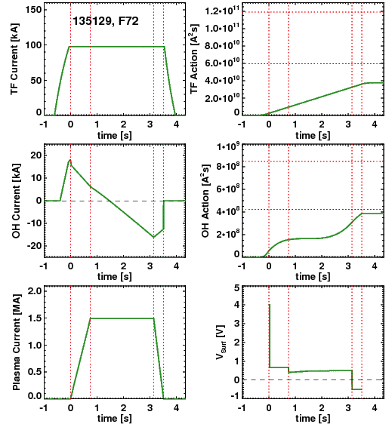
Other Coils Will Not Be Near As Limiting
Solenoid and Vertical Field Coil Already Designed for 1200 s at full capability (24 kA on VF coil).
Use OH pre-charge that causes the OH coils to maximize the time near zero.
  Proper pre-charge will be a function of the target plasma current and non-inductive level.
  In general, OH heating likely to provide pulse duration constraint in year 1 of NSTX-U (limiting heating to ½ the design point).
For year 1 example with 19 kA pre-charge with I_{RMS}=0.9 kA (1200 sec configuration), OH rep rate is 9 minutes.
  TF cools in 15 minutes for this case.
  Even most aggressive year 1 scenarios will not have cycle times longer than NSTX standards.
Example Year 1 Scenario at 1.5 MA and 0.75 T

Slide 19
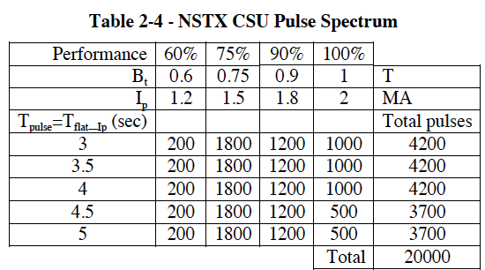
Anticipated Pulse Spectrum of NSTX-U Limits the Number of Full Field Long Pulse
For engineering design purposes, a distribution of pulses was assumed in the General Requirements Document.
  Based on the distribution of NSTX discharges
  20000 pulses = 10 years x 16 weeks x 5 days x 25 shots
    This implies a 20 minute rep rate for an 8.5 hour day.
Limited number of 1 T, 5 second discharges anticipated.
  Majority of research program anticipated to be ~0.75 T -> 23 minute rep rate for 7.0 second TF flat-tops.
  Limitation to 500-1000 shots very conservative with regard important fatigue limits.
Other mitigating effects:
  New PCS code that automates the TF rampdown after a disruption eliminates wasted TF heating/lifetime.
  Will monitor the TF RMS current to stay near, but beneath, the limits.
~18 min w/o upgrade
~26 min. w/o upgrade

Slide 20
Questions from Panel – 5-7 of 7
What are the rep-rate limitations for high field operation?
  What arises first, second, third?
  How do you plan deal with them?
  Addressed by S. Gerhardt
What is the physics basis for the cryopump and the expected particle exhaust rates as compared to lithium coatings?
  Addressed by J. Canik
Is the cryopump compatible with MGI or NB operation? (… but we will answer a slightly different question):
Is MGI compatible with divertor cryopump and NB operation?
  Divertor cryo – Addressed by J. Canik / R. Maingi
  NBI cryo – Addressed by: R. Raman / S. Gerhardt

Slide 21
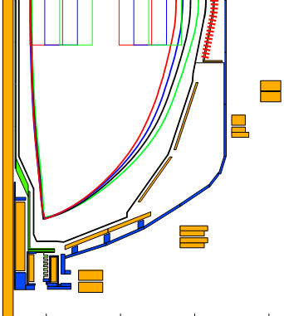
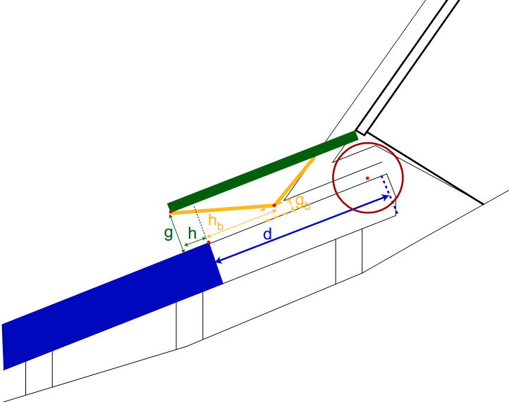
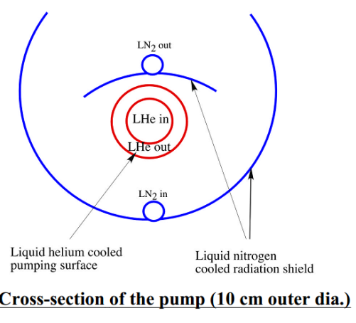
NSTX-U cryo-pumping design based on DIII-D system
Cryo-pump is proven technology for plasma density control
  More conventional pumped ELMy H-mode scenario
NSTX-U design is similar to DIII-D outer lower pump
  Plenum located under new baffling structure near secondary passive plates
  Pumping capacity of a toroidal liquid He cooled loop
    S=24,000 l/s @ R=1.2m (Menon, NSTX Ideas Forum 2002)
  Need plenum pressure of 0.6 mTorr to pump beam input (TRANSP)
g = throat height
h = throat length
Baffle
h
Cryo
g

Slide 22
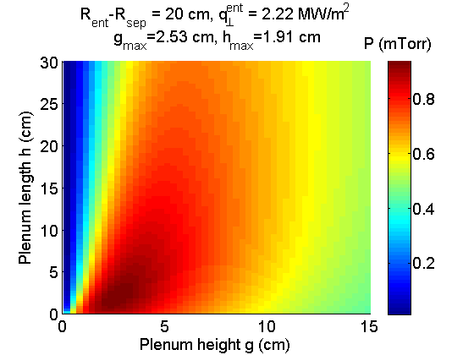
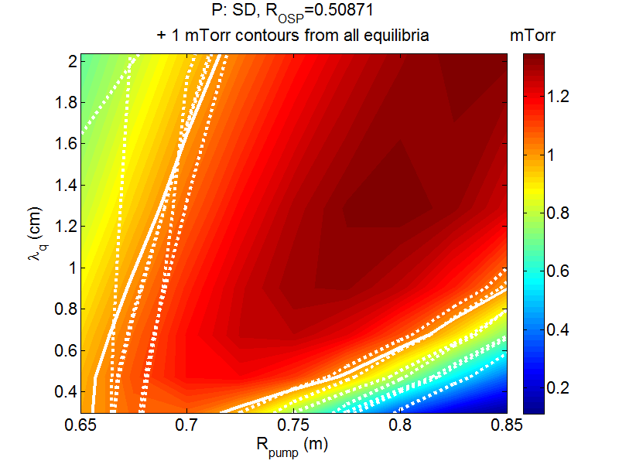
Semi-analytic pumping model used to optimize plenum geometry
Model developed for DIII-D pumping studies (Maingi, NF ‘99)
  Predicts plenum pressure, validated with DIII-D data
  Projected NSTX-U heat flux (I_{p} scaling) and divertor T_{e} (~15 eV) used as input
  Uses first-flight neutral model (insufficient for detached divertor)
Pressure is maximum for duct height g~2.5 cm, length h~2 cm
  But is only weakly reduced if these are increased together
With pump entrance at R=0.72m, pressures >1 mTorr can be reached over wide range of plasma shapes and SOL widths
  Comparable to pressures in DIII-D plenum
  Well above that needed to pump NBI particle input
+

Slide 23
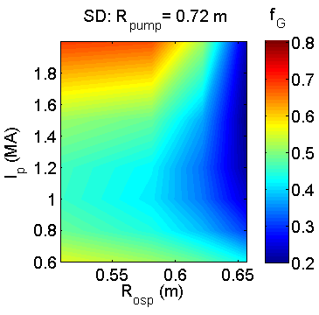
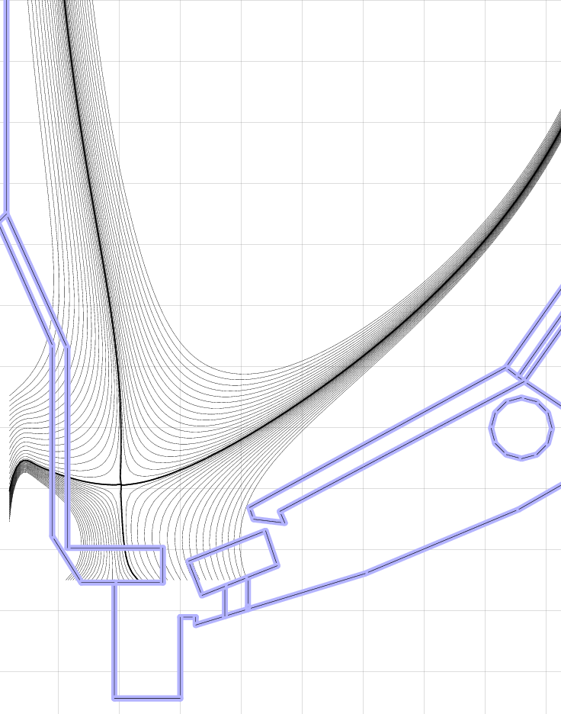
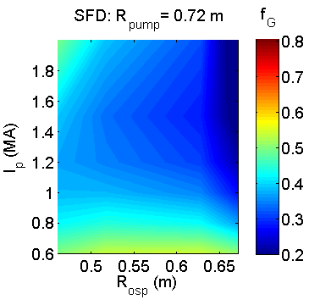
Optimized plenum geometry can pump to low density for conventional and snowflake divertors over a range of R_{OSP}, I_{p}
R_{OSP}: outer strike point radius
R_{pump}: plenum entrance radius
SD: standard divertor
SFD: snowflake divertor
f_{G}: n_{e}/n_{G}
Core density estimated assuming pumped flux=NBI input
  2-pt model used to estimate upstream density
  Assume n_{e}/n_{e}^{sep}~3
Can pump to f_{G}<0.5
  f_{G}~0.7 desirable for all scenarios, lower provides more flexibility
  Moving R_{OSP} closer to pump allows lower n_{e}, but limited by power handling
High flux expansion in SFD gives better pumping with SOL-side configuration
  More plasma in far SOL near pump
  More room to increase R_{OSP} at high I_{p}
q_{pk} > 10 MW/m²
-1.8 -1.6 -1.4 -1.2 -1.0 -0.8
Z (m)
0.4 0.6 0.8 1.0 1.2
R (m)

Slide 24
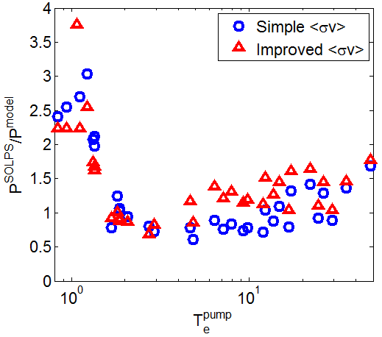
SOLPS calculations confirm optimization approach based on analytic model
SOLPS: 2D fluid plasma/neutral transport
  Plasma transport classical parallel to B (+kinetic corrections), ad-hoc cross-field transport coefficients
  Kinetic neutral transport using MC code EIRENE
    More comprehensive treatment of neutral transport (beyond first-flight)
    Can treat radiative/detached divertor
Range of divertor conditions have been produced using standard and snowflake equilibria
SOLPS-calculated plenum pressure agrees with analytic model for T_{e}^{div}>2 eV, factor of ~3 higher in detached regimes
Optimization of design presented here is conservative
  Pumping likely to be stronger for realistic conditions

Slide 25
Questions from Panel – 5-7 of 7
What are the rep-rate limitations for high field operation?
  What arises first, second, third?
  How do you plan deal with them?
  Addressed by S. Gerhardt
What is the physics basis for the cryopump and the expected particle exhaust rates as compared to lithium coatings?
  Addressed by J. Canik
Is the cryopump compatible with MGI or NB operation? (… but we will answer a slightly different question):
Is MGI compatible with divertor cryopump and NB operation?
  NBI cryo – Addressed by: S. Gerhardt / R. Raman
  Divertor cryo – Addressed by J. Canik / R. Maingi

Slide 26
MGI Experiments on NSTX-Upgrade are Primarily For Scientific Purposes
NSTX-U is designed to tolerate 2 MA disruptions.
  MGI is not anticipated to be a machine protection system
Experiments on other devices show that the leading edge of the gas front is most critical for mitigation
  NSTX-U experiments will aim at understanding the minimum required gas loading by varying the poloidal injection location
  Will use fast-opening electromagnetic valves of a design similar to JET and ITER, located close to the vessel, to minimize the gas input.
Anticipated MGI levels are up to 500-700 torrL at most
  D₂ or He, with smaller fractions of Ne or Ar.
  Values are ~5000 torr @ ~100 cc-> 500 torrL.
  Leads to ~6 mtorr vessel w/ one beam box, 4 mtorr w/ two beams boxes.
  NSTX-U TMP systems significantly upgraded, will help with He pumping.
Beams: Very desirable to use NBI + MGI to test penetration into H-mode pedestal.
Cryopump: May very well be possible to run MGI experiments with divertor cryopump not at liquid He temp, as it is not needed for experiments
26

Slide 27
Two Significant Issues Have Been Identified for NBI+MGI
Beam Reionization: Beam is “reionized” in the duct by the higher pressure, bent to the duct wall as it enters the TF.
  Can avalanche: sputtered/ejected material from beam strike can increase the duct pressure.
  Solution: Interlocks and procedures will be implemented to turn beams off before MGI. Experiment would be conducted within the beam slowing time.
    Updated Gas Injection PCS Spec. for NSTX-U has an explicit test of the beam power before firing MGI valves.
Beamline Cryopump Regen
  Helium provides a conduction path from panels to the hotter components.
  NB Group does regenerations by applying 5 mtorr of He to a closed box.
Experiments with NB valves open will need to maintain the pressure in the box beneath this level with some safety margin. 90 Torr.L He is acceptable (previously tested on NSTX)
  2015: 100 Torr.L D2, and gradually increase to 500-700 Torr.L D2 (understand assimilation efficiencies)
  2015: 500-700 Torr.L D2 + Neon
  2015: 500-700 Torr.L He + Neon (should be sufficient for full mitigation studies)
  2016: Determine minimum levels of He + Neon to achieve full mitigation
  2017: Determine minimum levels of He + Argon to achieve full mitigation
27

Slide 28
Heat load on the divertor cryo-pump during MGI needs assessment
As previously noted, beam cryo-pump already provides a significant constraint on the maximum He pressure for cases with beams:
  Divertor cryopump will only be needed for long-pulse examples, all of which will require beams.
Acceptable heat load on NSTX-U divertor cryo-pump has not yet been assessed
  DIII-D design maximum cryo heat load was ~ 10 W
  DIII-D tests were conducted with heat loads up to 25 W, with no spontaneous re-gen
  DIII-D cryo can pump large amounts of deuterium gas > 2500 torr-l, without re-gen
Reiterate: For scientific exploration of MGI physics, likely not necessary to utilize divertor cryo-pumps at all.
28

Slide 29
Backup

Slide 30
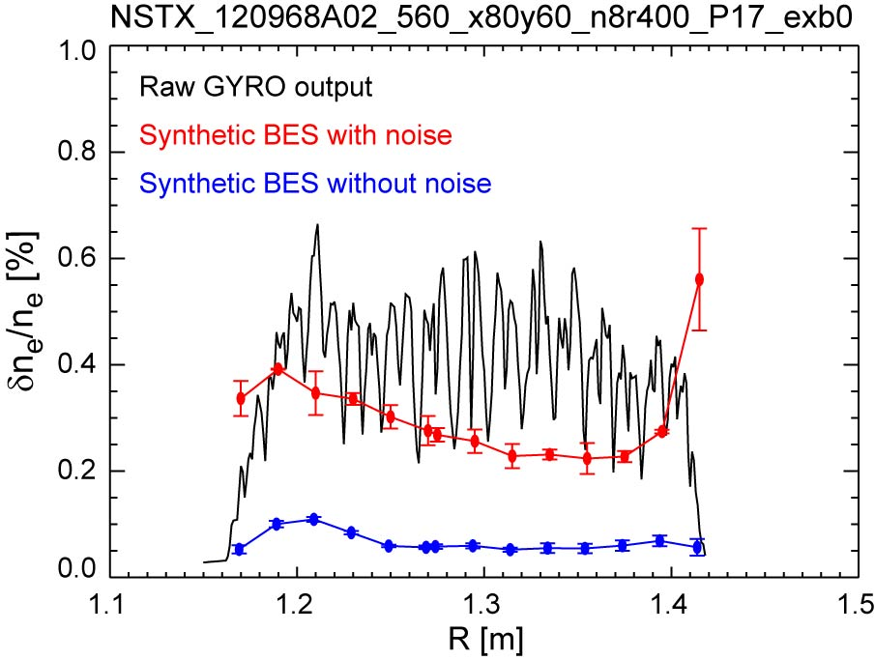
MAST-NSTX collaboration testing sensitivity of BES to microtearing turbulence through synthetic diagnostics
Using nonlinear NSTX microtearing simulations from GYRO with synthetic diagnostic for MAST BES
  Difficult to detect MT with expected signal-to-noise ratio (uncorrelated noise dominates)
  If S/N can be increased (e.g. significant time averaging) MT features may be measurable, such as:
  detectable correlated fluctuation levels (δn/n~0.1%)
  large poloidal correlation lengths (L_{p}~15-20 cm)
Future plans:
Pursue non-linear simulations for MAST discharges with available BES data
Propose experiments for FY13 at next MAST research forum (Dec 2012) to focus on relationship between collisionality scaling and microtearing turbulence
Density fluctuation (rms)
Poloidal correlation from synthetic diagnostic
W. Guttenfelder, et al. PPPL

Slide 31
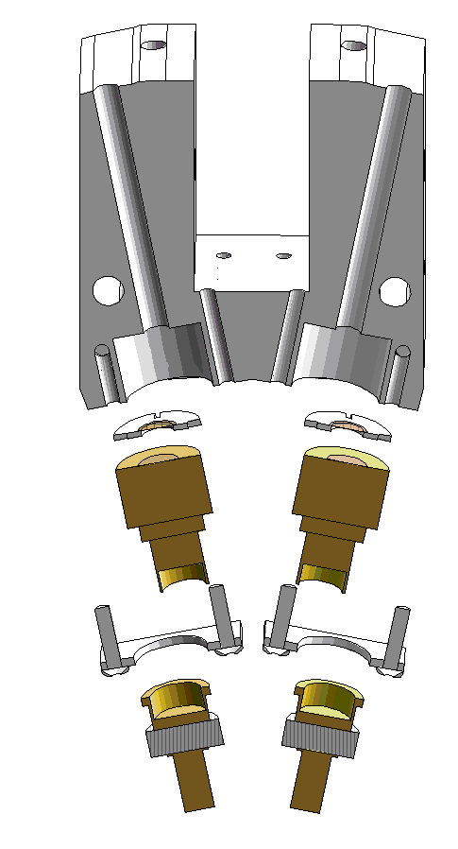
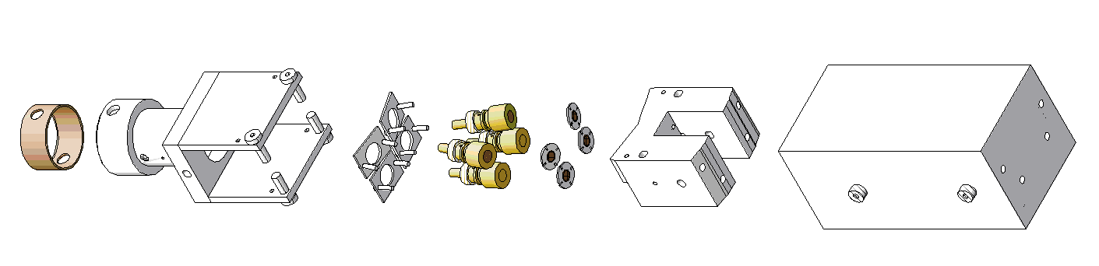
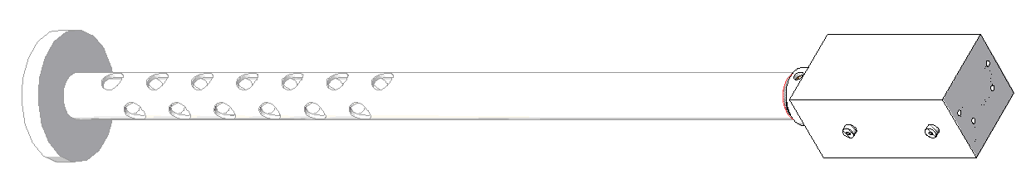
NSTX-U Charged Fusion Products Diagnostic on MAST
Provides fusion reactivity profile due to MHD and other phernomena
Collaborators: FIU, MAST, PPPL
MAST Installation: November 2012
Objective: obtain time-dependent, precise information on the d(d,p)t fusion rate profile with the goal of determining the neutral beam ion density profile as a function of R, z, and t
Shield
Module
Foils
Detectors
Bases
Connector
R. Perez et al., Florida International University

Slide 32
Data Acquisition Will Be Upgraded to Support Increased Data Load
Extension of pulse length to 5 seconds increases the data load considerably, and steps have been taken to bring down the data transfer time.
  Network upgrades
  Elimination of CAMAC
Expected times:
  3.5 minutes for MDS+ physics data.
  5 minutes for EPICS engineering data (mostly NB, MG, and rectifier signals)

