Slide 1
Measurement of Li thickness on Mo tiles by Rutherford Back Scattering of alpha particles
College W&M
Colorado Sch Mines
Columbia U
Comp-X
General Atomics
INL
Johns Hopkins U
LANL
LLNL
Lodestar
MIT
Nova Photonics
New York U
Old Dominion U
ORNL
PPPL
PSI
Princeton U
Purdue U
SNL
Think Tank, Inc.
UC Davis
UC Irvine
UCLA
UCSD
U Colorado
U Maryland
U Rochester
U Washington
U Wisconsin
Culham Sci Ctr
U St. Andrews
York U
Chubu U
Fukui U
Hiroshima U
Hyogo U
Kyoto U
Kyushu U
Kyushu Tokai U
NIFS
Niigata U
U Tokyo
JAEA
Hebrew U
Ioffe Inst
RRC Kurchatov Inst
TRINITI
KBSI
KAIST
POSTECH
ASIPP
ENEA, Frascati
CEA, Cadarache
IPP, Jülich
IPP, Garching
ASCR, Czech Rep
U Quebec
Dennis Mueller, Lane Roquemore
(PPPL)
Priya Raman (U of Illinois)
NSTX Physics Meeting
April 18, 2011
PPPL, Princeton, NJ

Slide 2
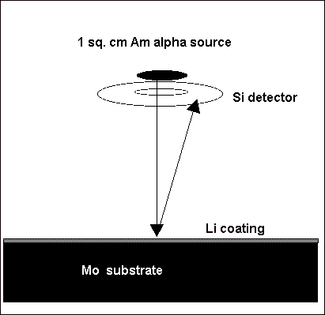
Routine in situ measurement of the thickness of coatings Mo tiles
Use Rutherford Back Scattering of alpha particles
Am²⁴¹ source
Solid state detector
Probe inserted to 10 cm above Mo divertor tiles
Desire measurement to be possible at least on a daily basis (few hour counting duration)

Slide 3
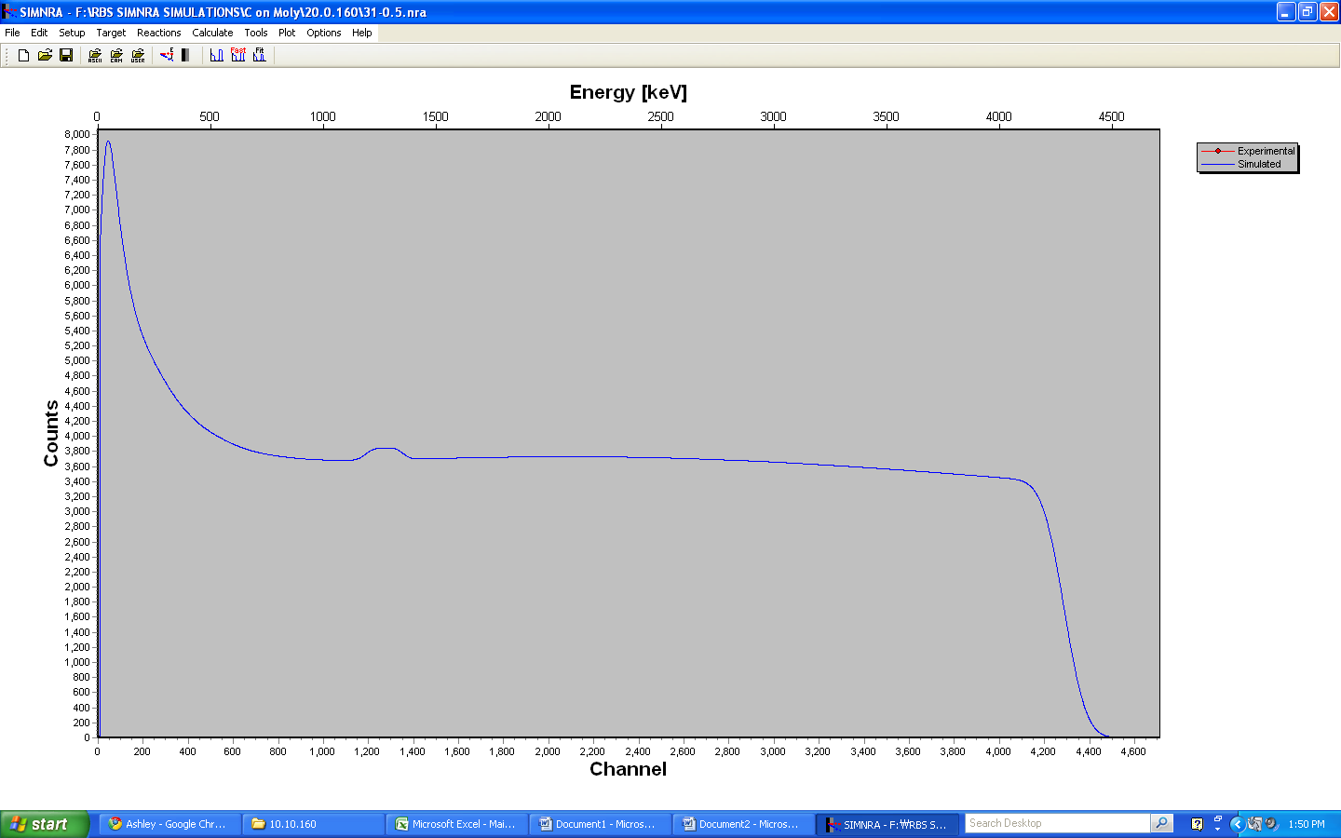
Simulated alpha particle spectrum
High energy edge
Alphas scattered from Mo
Alphas scattered from C
Energy spectrum of alpha particles from Am²⁴¹ source scattered from 0.5 μ thick C over Mo tile
SIMNRA simulation Matej Mayer, Max-Planck-Institut fu ̈r Plasmaphysik, Garching, Germany

Slide 4
Estimate of count rates
Commercially Am²⁴¹ sources are available in the mCi range.
  For ΔE ~ .3 MeV.
  stopping power for 5 MeV alphas in Am is about 300 keV/mg/cm²
  1 cm² source with thickness of 1 mg /cm² is about 3 mCi
  10⁸ α/s ~ 10⁶ α/s onto 1 cm² at distance of 10 cm
dσ/dΩ = 1.296 (mb/sr)(Z₁Z₂/E_{α})² [sin⁻⁴(θ/2)-2(M/A)²] for
  E_{α} = 5 MeV, M = 4, A = 96, Z₁ = 2, Z₂ = 42, θ = 160°
  dσ/dΩ = 387 mb/sr
Stopping power for 5 MeV α in Mo is 368 keV/mg/cm²
  100 keV in 0.27 mg/cm² 6.022e23 atoms/96g => 100 keV in 1.69e20atoms/cm²
  387 (mb/sr)10⁻²⁷(cm²/mb) 0.1sr 1.69e20 (/cm²)
  6.54e-5 fraction scattered into 0.1sr/100 keV
Scattered α from Mo would be ~5/s in a 100 keV wide bin for a 1 cm² detector at 10 cm in flattop.
  Modest optimization of geometry could increase rate 2-5 times without significantly affecting energy resolution (for example an annular detector)
  Counting for a hour would be enough to measure Li coating thickness of 1 to 15 μ on Mo

Slide 5
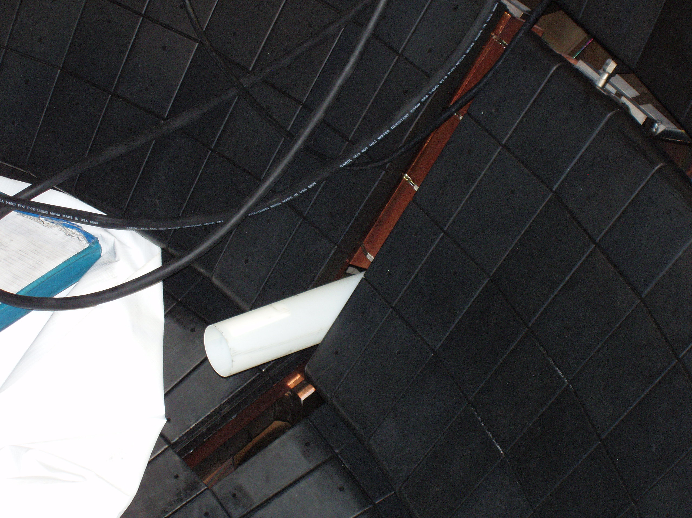
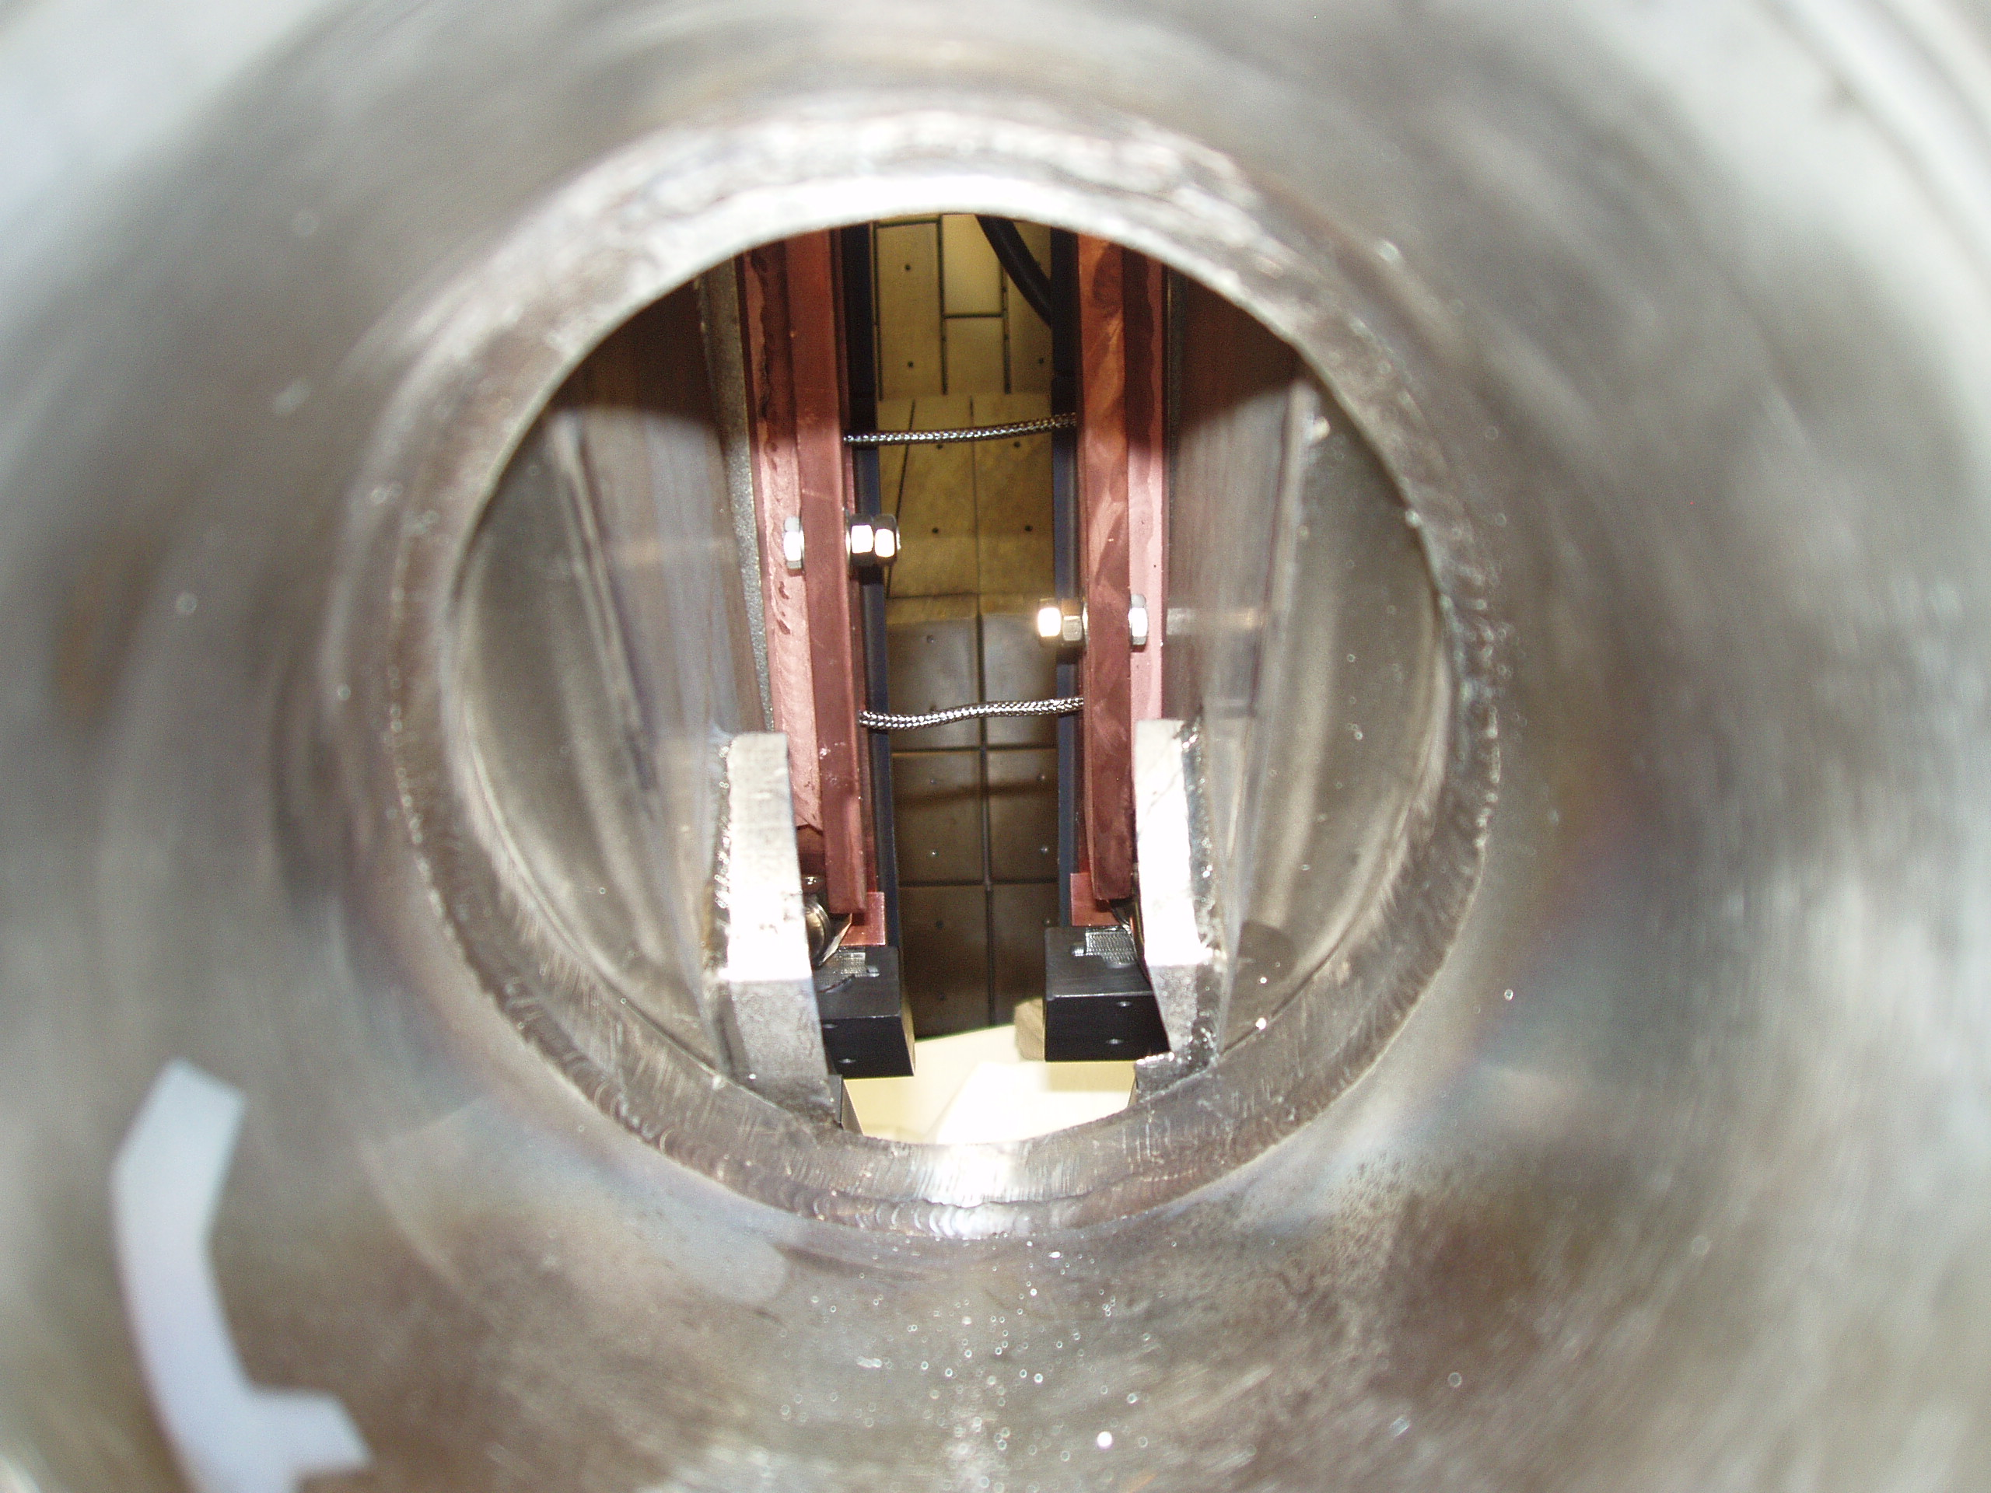
Requirements
Short term: test viability
  Suitable Am source
  Solid state detector and multichannel analyzer (or other data acq. System)
  Vacuum chamber
  Mounting hardware
  Mo sample and Mo sample with thin coatings (C for simplicity)
Implementation
  Valve on NSTX with manual probe assembly (port with access to lower divertor at proper height exists)
  Mounting hardware for source, detector and electronics
Source is nothing special, radiation safety requirements are nothing unusual

Slide 6
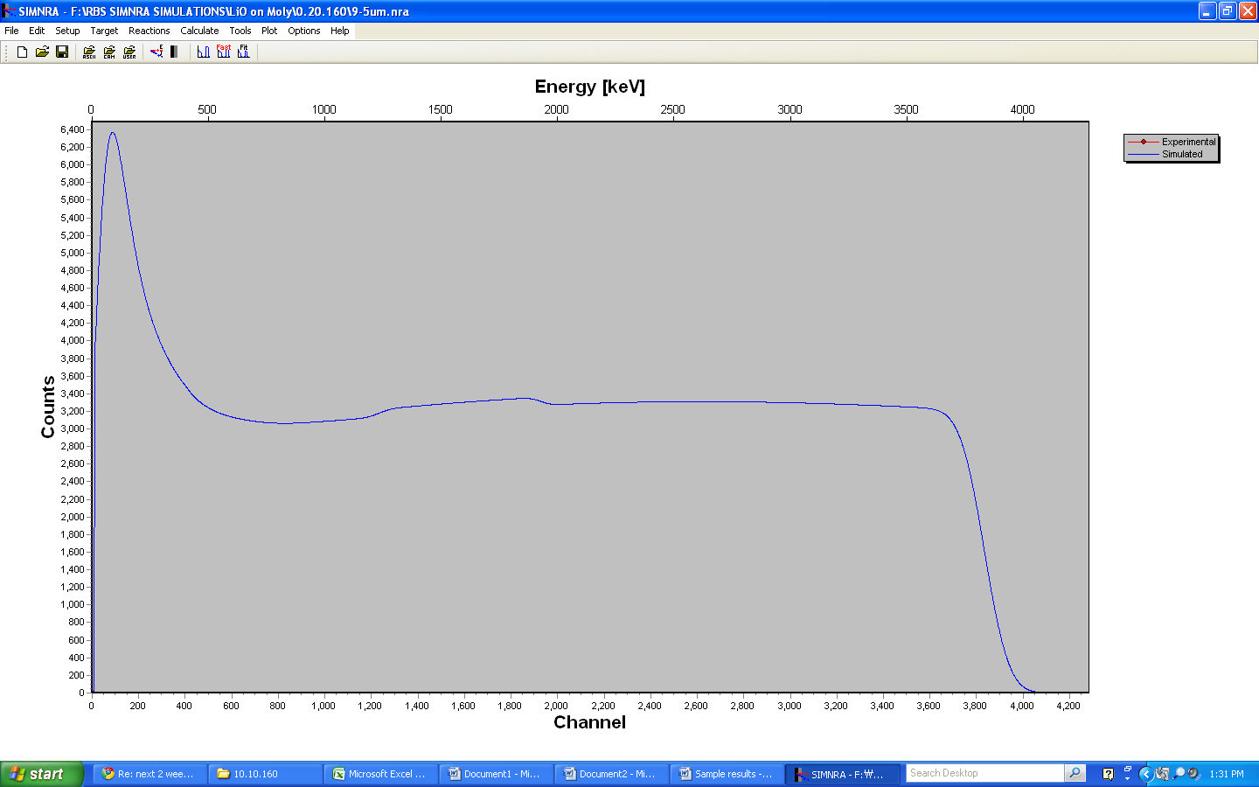
9. Thickness of LiO=5um
Note: peak due to scattering from O is broadened by energy loss in layer
Scattering from Mo
Scattering from O
Energy loss in LiO

Slide 7
LiO on moly
Max energy vs thickness plot for different angles
Atomic ratio LI:O = 80:20

Slide 8
LiO on Mo
Peak count vs thickness plot for different angles
Atomic ratio LI:O = 80:20

Slide 9
C on Mo
Max moly energy vs thickness plot for different angles

Slide 10
C on Mo
Peak count vs thickness plot for different angles

Slide 11
LiOC on Mo
Max moly energy vs thickness plot for different angles
Atomic ratio LI:O:C = 90:5:5

Slide 12
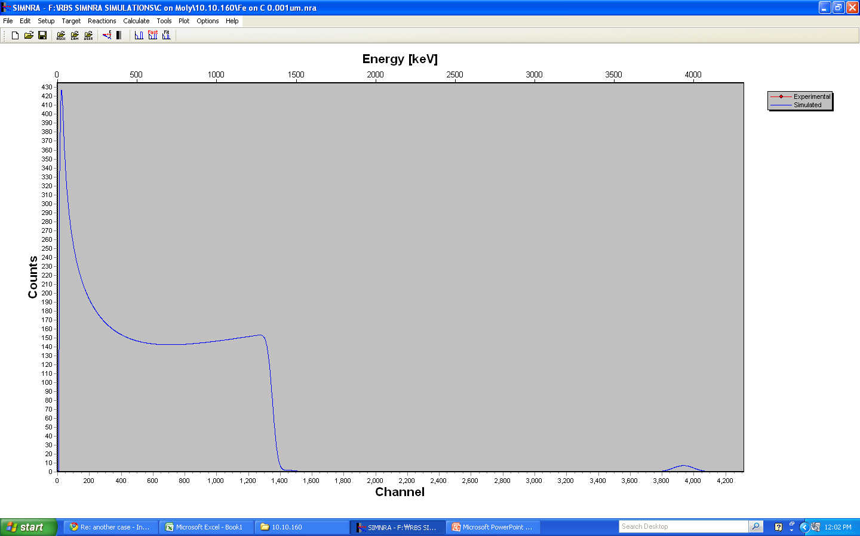
Could be used to measure Fe on graphite lower limit of thickness is about 1 nm
Fe (0.001um)on Carbon
Rate in Fe peak is ~0.5 counts/hr
~5e-4 concentration of Fe in 5 μ C
Orient source and detector to point towards graphite
Midplane probe would need long stroke
A few times during the run
Manual probe to minimize cost and risk

Slide 13
Summary
It appears feasible to measure the thickness of Li on a Mo substrate from 1 to 20 μ thick (C coating up to about 10 μ)
  Technically since alpha particles slow down primarily on electrons, it is the areal density of electrons that is measured
If the fraction of C or O exceeds about 10% of Li, the relative amount of can be inferred, subject to uncertainties due do resonant nuclear reactions.
Remains to be done:
  Investigate effects of geometry
  Finalize source strength and detector size/shape
  Design collimator
Port for inserting a probe holding the scattering assembly about 10 cm above the Mo tiles exists and will have a valve.

Slide 14
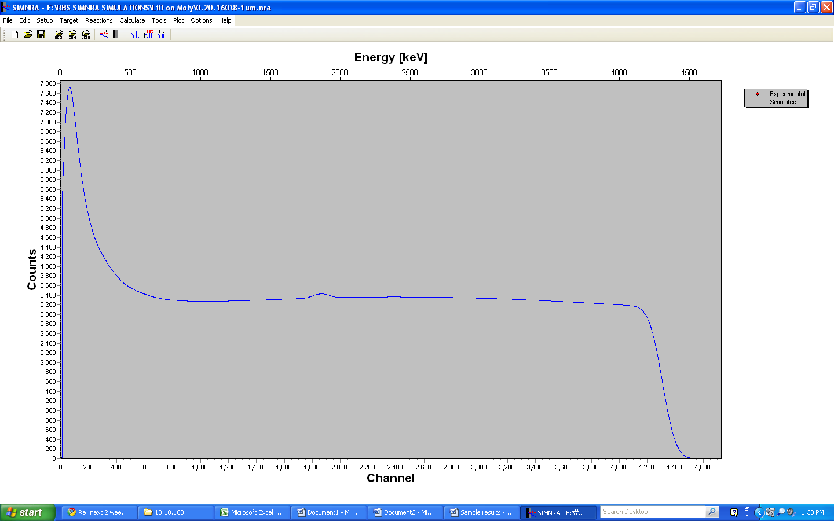
8. Thickness of LiO = 1um
Note: peak at about 1800 keV is due to scattering from O

Slide 15
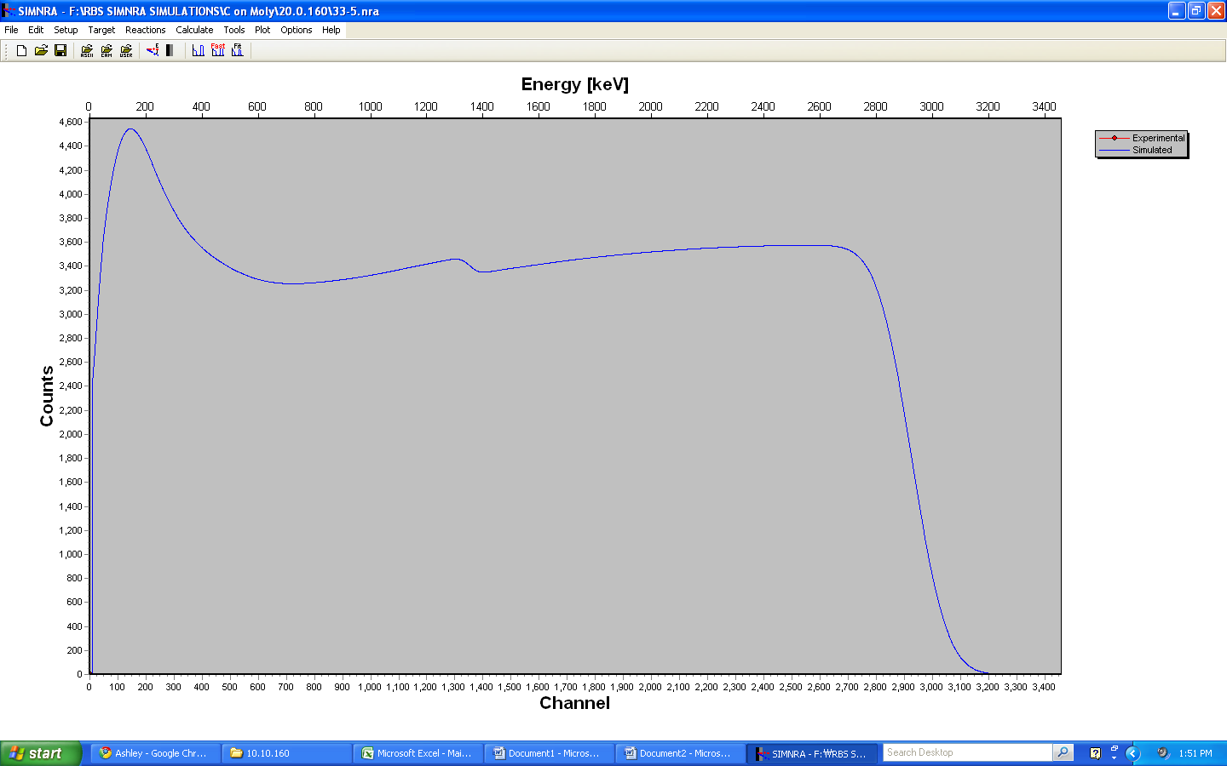
33. Thickness of C=5um

Slide 16
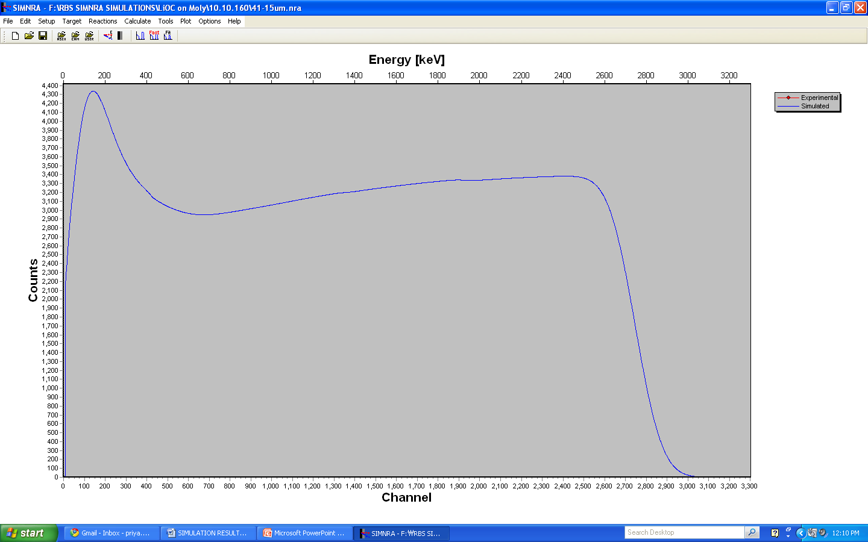
41.Thickness of LiOC = 15um
Note: Low concentration of O (5%) is barely visible at 1900 keV

