Slide 1
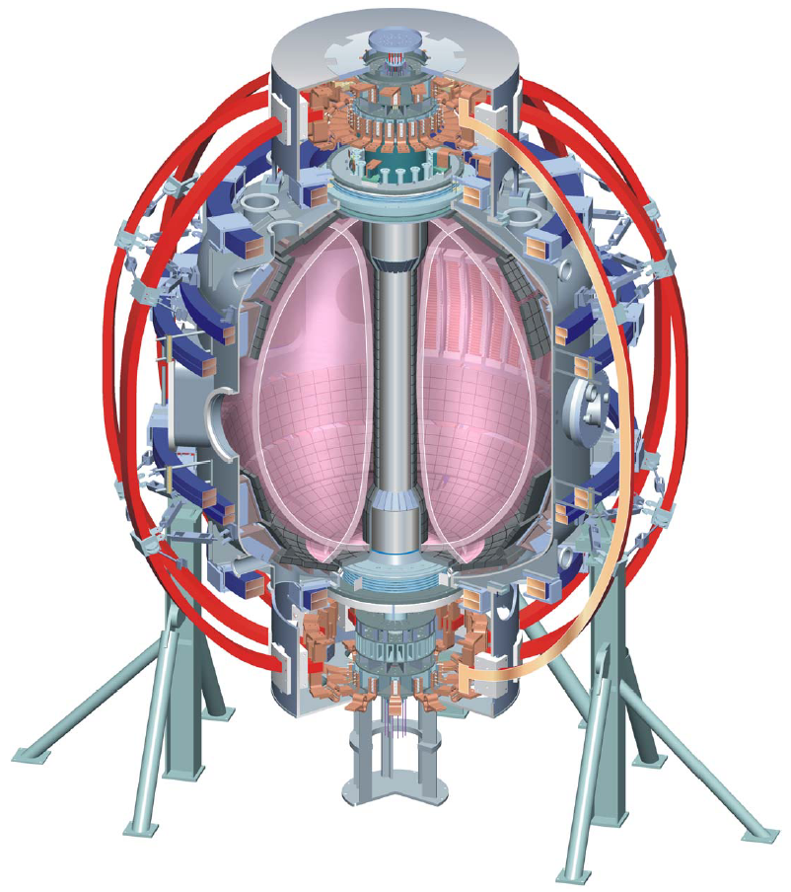


NSTX
Supported by
38th EPS Meeting (2011) – Some Comments on Stability and other Presentations
Columbia U
CompX
General Atomics
FIU
INL
Johns Hopkins U
LANL
LLNL
Lodestar
MIT
Nova Photonics
New York U
ORNL
PPPL
Princeton U
Purdue U
SNL
Think Tank, Inc.
UC Davis
UC Irvine
UCLA
UCSD
U Colorado
U Illinois
U Maryland
U Rochester
U Washington
U Wisconsin
S.A. Sabbagh
Department of Applied Physics and Applied Mathematics
Columbia University, NY
NSTX Physics Meeting
18th July, 2011
PPPL
Culham Sci Ctr
U St. Andrews
York U
Chubu U
Fukui U
Hiroshima U
Hyogo U
Kyoto U
Kyushu U
Kyushu Tokai U
NIFS
Niigata U
U Tokyo
JAEA
Hebrew U
Ioffe Inst
RRC Kurchatov Inst
TRINITI
NFRI
KAIST
POSTECH
ASIPP
ENEA, Frascati
CEA, Cadarache
IPP, Jülich
IPP, Garching
ASCR, Czech Rep
V1.0

Slide 2
Balance of Monday AM plenary talks covered first wall/ materials, and space plasmas
R. Neu: Preparing scientific basis for all metal wall in ITER
  rationale for choice of plasma PFCs
    low power loss by dilution, long lifetime PFCs, low dust production, low T co-deposition, low Atomic number for low radiative losses
  ITER PFCs
    Be in main chamber, Tungsten main material in divertor, and C in divertor in transition region
  Be influxes: large variation in experiments (by a factor of 10)
  H retention reduced in all-Tungsten AUG
  References:
    Suttrop: AUG ELM mitigation (I2.109) – a highlight talk
    Sips: JET DT (O5.127) – see comments by J. Hosea
  Significant attention to first wall/materials in presentations at the meeting
T. Pulkkinen: Plasmas in the Earth-Sun environment
    Included magnetic reconnection and particle acceleration, solar cycle, solar wind composition, plasmas of inner magnetosphere, lack of thermal equilibrium (1 MFP = Sun-Earth distance)

Slide 3
Comments on Some Stability Presentations (I)
Stability Plenary Presentation was a Meeting Highlight
  P. Martin: Near and beyond the limits: MHD stability and its active control
    Basic concepts: stellarator/tokamak/RFP, ITER, equilibrium and magnetic perturbations in these machines, fast particle modes, β, fusion power gain
    Disruptions: 4MN forces in JET, 40 MN forces in ITER - a significant concern
    Resonant field amplification: example from JET
    Instability avoidance / active control:
      Conducting wall can stabilize kink/ballooning
      Passive RWM stabilization: MISK results by Jack Berkery shown; DIII-D examples shown
      Active RWM stabilization in
        RFPs: RFX / EXTRAP-T2R: Modes not strongly coupled – large number (~ 150) control coils
        Tokamaks: NSTX RWM state space controller highlighted
      NTM control: sawtooth pacing to predict NTM onset, island phasing to match ECCD phase
      ELM stability: non-linear stability work (JOREK)

Slide 4
Piero Martin’s talk showed NSTX RWM state space controller results as a highlight
n = 1 DC applied field
  Simple method to generate resonant field amplication
  Can lead to mode onset, disruption
RWM state space controller sustains discharge
  With control, plasma survives n = 1 pulse
  n = 1 DC field reduced
  Transients controlled and do not lead to disruption
  NOTE: initial run – gains NOT optimized
Control applied
I_{p} (kA)
Control not applied
β_{N}
B_{p}^{n=1} (G)
I_{RWM-4} (kA)
ω_{φ}/2π_{~q=2}
(kHz)
140025
140026
t(s)

Slide 5
Comments on Some Stability Presentations (II)
I. Classen: Investigation of fast particle driven instabilities by 2D ECEI on AUG and DIII-D
  Tutorial on *AE modes, ECE radiometer - principles of imaging, AUG ECE imaging diagnostic / similar diagnostic on DIII-D
  Code results from: NOVA, TAEFL codes discussed (latter is a hybrid gyrofluid code), linear gyrokinetic LIGKA code
  Change of frequencies measured between modes can be used to determine the q profile
  Bursting modes - identified as BAEs and not off-axis fishbones
  BAEs cause fast ion losses in AUG (energy and pitch angle resolved)
Esposito: Disruption avoidance by means of ECE waves
  localized ECRH/ECCD on rational surface, triggered by a disruption precursor - were able to hold of disruptions
  AUG case ECCD triggered by Vloop, response time about 7ms
  NTM mode locking is held off with ECRH
    ECRH did not eliminate the NTM - just kept it from locking
    change in density can spoof this - need to actively move ECE mirror if density changes, as reonance moves
  AUG and FTU activities summarized
    (AUG: r/t TORBEAM, r/t equil. recon., r/t mirror control, reliable operation above Greewald limit)

Slide 6
Comments on Some Stability Presentations (III)
R. Cavazzana: Physics challenges and answers in RFP MA operation
  RFX MA operation - 48x4 independent active coils; transition to RFP helical equilibrium
  MHD dynamo engine: tearing modes, multiple vs. single helicity states
  key parameter for the helical state - dominant mode 1/7 vs. Secondary
  results from RELAX (1/4 dominant) vs. MST (1/5 dominant mode)
  control of m = 0 modes, lifetime of helical states
I. Chapman: Sawtooth control in tokamaks
  overview of sawtooth instability - good if short period, but may be long in ITER
    may need to pace sawteeth for ash removal in ITER
  long sawtooth period also leads to undesirable NTM triggering
  trapped particles are stabilizing for kink (?)
  co- and counter-passing ions can be stabilizing or destabilizing, depending on where fast particles are deposited
    objective here is to destabilize the kink to drive sawteeth at higher frequency
  code set being used for these studies MISHKA-HAGIS
  will ECCD control work in ITER?
    shear reduction as ECCD sweeps across q =1 surface, sawtooth period was changed in JET
  will ICRH control work in ITER?
    JET experiment was successful in not triggering NTM

Slide 7
Presentation on ELM mitigation on AUG was a highlight
W. Suttrop: First observations of ELM mitigation with new active control coils in AUG
  4 upper, 4 lower coils used in experiment (n = 2 configuration)
  shows 0.1% field perturbation (see also Fuchs P1.090)
  ELM mitigation shown with n = 2 fields
    2 periods of n = 2 pulses used - ELMs come back between pulses
    in ELM mitigated periods, very much smaller ELMs are seen - very small density fluctuations (Te fluctuations are larger)
    stepping up density with n = 2 coils on leads to ELM suppression
  mitigation means Type-1 ELMs replaced by frequent small ELMs
  pedestal density increase, T pedestal reduced by 10%, confinement/stored energy essentially unchanged
  D pellet injection does not trigger ELMs in this state
  there is a density threshold for ELM mitigation, independent of plasma rotation.
  Key aspects are very different from DIII-D results:
    there's a strong dependence on density
    NO dependence on field (up/down) parity
    NO dependence on q resonances
    NO dependence on Chirikov parameter - NEITHER necessary NOR sufficient

Slide 8
Comments on Some Stability Presentations (IV)
A. Huber: Radiation heat loads on plasma-facing components of JET during the massive gas injection experiment
  MGI valve mounted on the top of the machine on JET
  strong poloidally asymmetric radiation peaking factors in JET
  10% Ar, 90% D2 injected - nearly poloidally symmetric radiation pattern
  suggests that ITER will need 4 ports for MGI
R. Scannel: Evolution of edge pressure gradient during ELM cycle - MAST
  Notable - See comments by J. Hosea
  EPED model (Snyder) applied to MAST, high-n stability, GS2 code to KBM stability analysis, also passed on to ELITE
  single ELM cycles, examine/average many cycles - 50 profiles in 3 shots
  points taken through the ELM cycle; ETB moves slightly inward as ELM cycle advances
  edge high-n unstable region increases in size, from the edge inward - 99% flux to 97% flux, or so
  GS2 run to give stability to KBMs - KBM had stabilizing FLR effects
    stability limit falls during the ELM cycle, rather than the pressure gradient strongly increasing
    claims that infinite-n is a GOOD proxy for the KBM stability in MAST (?)

Slide 9
Comments on Some Stability Presentations (V)
Tuesday posters – some highlights
  Poster on 3D simulation of plasma interactions with edge structures in ITER
    Electric fields cause relocation of hot spots on tiles
    (comment) May need to alter edge field to prevent this – another potential use for internal non-axisymmetric coils in ITER
  Liu MARS-Q code: momentum balance has been added, with a JxB and NTV torque model included
Buratti: Kink and tearning modes in JET
  kink transforms to island topology over long timescales
    n =1 kinks onset from betaN about 1.2 - 4
    high betaN, high pressure peaking, high qmin are less stable to kink
  plasma crosses n = 1 no-wall limit when kink goes unstable
    but what about at the lowest betas? A: the lowest beta cases don't cross the no-wall limit - they are tearing from the start - there is no kink phase.
  shows ECE discrimination of kink vs, island, 150ms after kink, the island appears
    Sweet-Parker time for forced reconnection is only 8ms
    kink growth time is long - 70ms, so this is not thought to be a forced reconnection, but no theory was given to explain it

Slide 10
Evening sessions had mixed reviews
Welcome address (Monday): Madame Catherine Cesarsky (High Commissioner to Atomic Energy)
  Relatively simple presentation for this venue
  At least 3 European participants expressed embarrassment
ITER session (Tuesday) (Motojima, et al.)
  ITER first plasma delayed at least 1 year due to Japan earthquake/tsunami (coil construction delay)
    “insiders” quoted at least 2 year delay
  Non-axisymmetric coils still in design
    Continued worry about cost overruns, and what might be cut
  Compared to past talks, this one lacked energy a bit, and perhaps didn’t inspire future researchers
    Three young researchers questioned what they should be doing to stay in fusion research up to ITER first plasma

Slide 11
General Comments on the Meeting
Many of the contributed talks and posters did not draw clear conclusions
  Many presentations could be called “work in progress”
Excellent venue for poster sessions
  Wide boards, landscape format, plenty of room (uncharacteristic for EPS), but…
Poster sessions too short duration
  2 hours (!), and ~ 150 posters in a session
  Scheduled “free time” after the 2 hour session was used to see more posters
    or to present the two posters I was showing – each ran about 3.5 hours

