Slide 1




NSTX-U
Supported by
Discussion of
PFC/particle/lithium plans for NSTX-U
J. Menard
for the NSTX Research Team
Columbia U
CompX
General Atomics
FIU
INL
Johns Hopkins U
LANL
LLNL
Lodestar
MIT
Nova Photonics
New York U
ORNL
PPPL
Princeton U
Purdue U
SNL
Think Tank, Inc.
UC Davis
UC Irvine
UCLA
UCSD
U Colorado
U Illinois
U Maryland
U Rochester
U Washington
U Wisconsin
Culham Sci Ctr
U St. Andrews
York U
Chubu U
Fukui U
Hiroshima U
Hyogo U
Kyoto U
Kyushu U
Kyushu Tokai U
NIFS
Niigata U
U Tokyo
JAEA
Hebrew U
Ioffe Inst
RRC Kurchatov Inst
TRINITI
NFRI
KAIST
POSTECH
ASIPP
ENEA, Frascati
CEA, Cadarache
IPP, Jülich
IPP, Garching
ASCR, Czech Rep
NSTX Physics Meeting
PPPL – B318
Monday, January 30, 2012

Slide 2
Overview
This presentation is meant to provide strawman plans and ideas, and motivate discussion
It is up to TSG groups and the NSTX-U team to modify, improve, formulate the PMI plan
Common questions:
How will NSTX-U control particle inventory (main ion, impurities) for long pulse lengths?
How will NSTX-U handle very high heat fluxes at high current and heating power?
How will NSTX-U research contribute to the development of PMI solutions for FNSF/Demo?

Slide 3
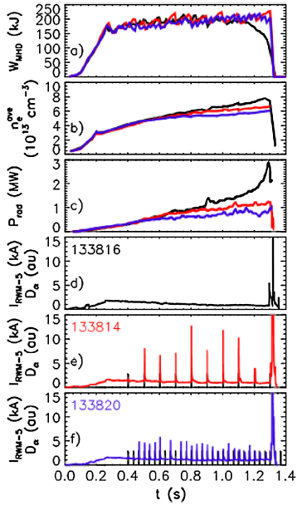
Scenarios exist which trend toward stationary
D and C inventory – but how do they extrapolate?
Li coatings + triggered ELMs come closest to achieving stationary D inventory and Z_{eff}
How do these results project to NSTX-U parameters?
  Up to 5x longer pulse
  Up to 2x higher NBI fueling
How persistent is D pumping by Li?
  Can we use run days where large lithium evaporation was only performed in morning, or at beginning of week, to inform the pumping persistence question?
This issue will begin to be addressed in FY2012 BP+LR research milestone
J. Canik - PRL 104, 045001 (2010)

Slide 4
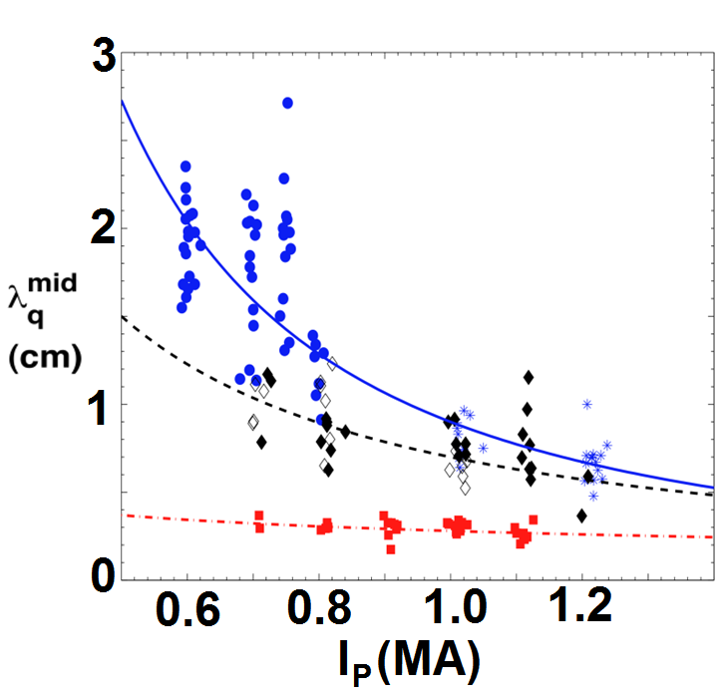
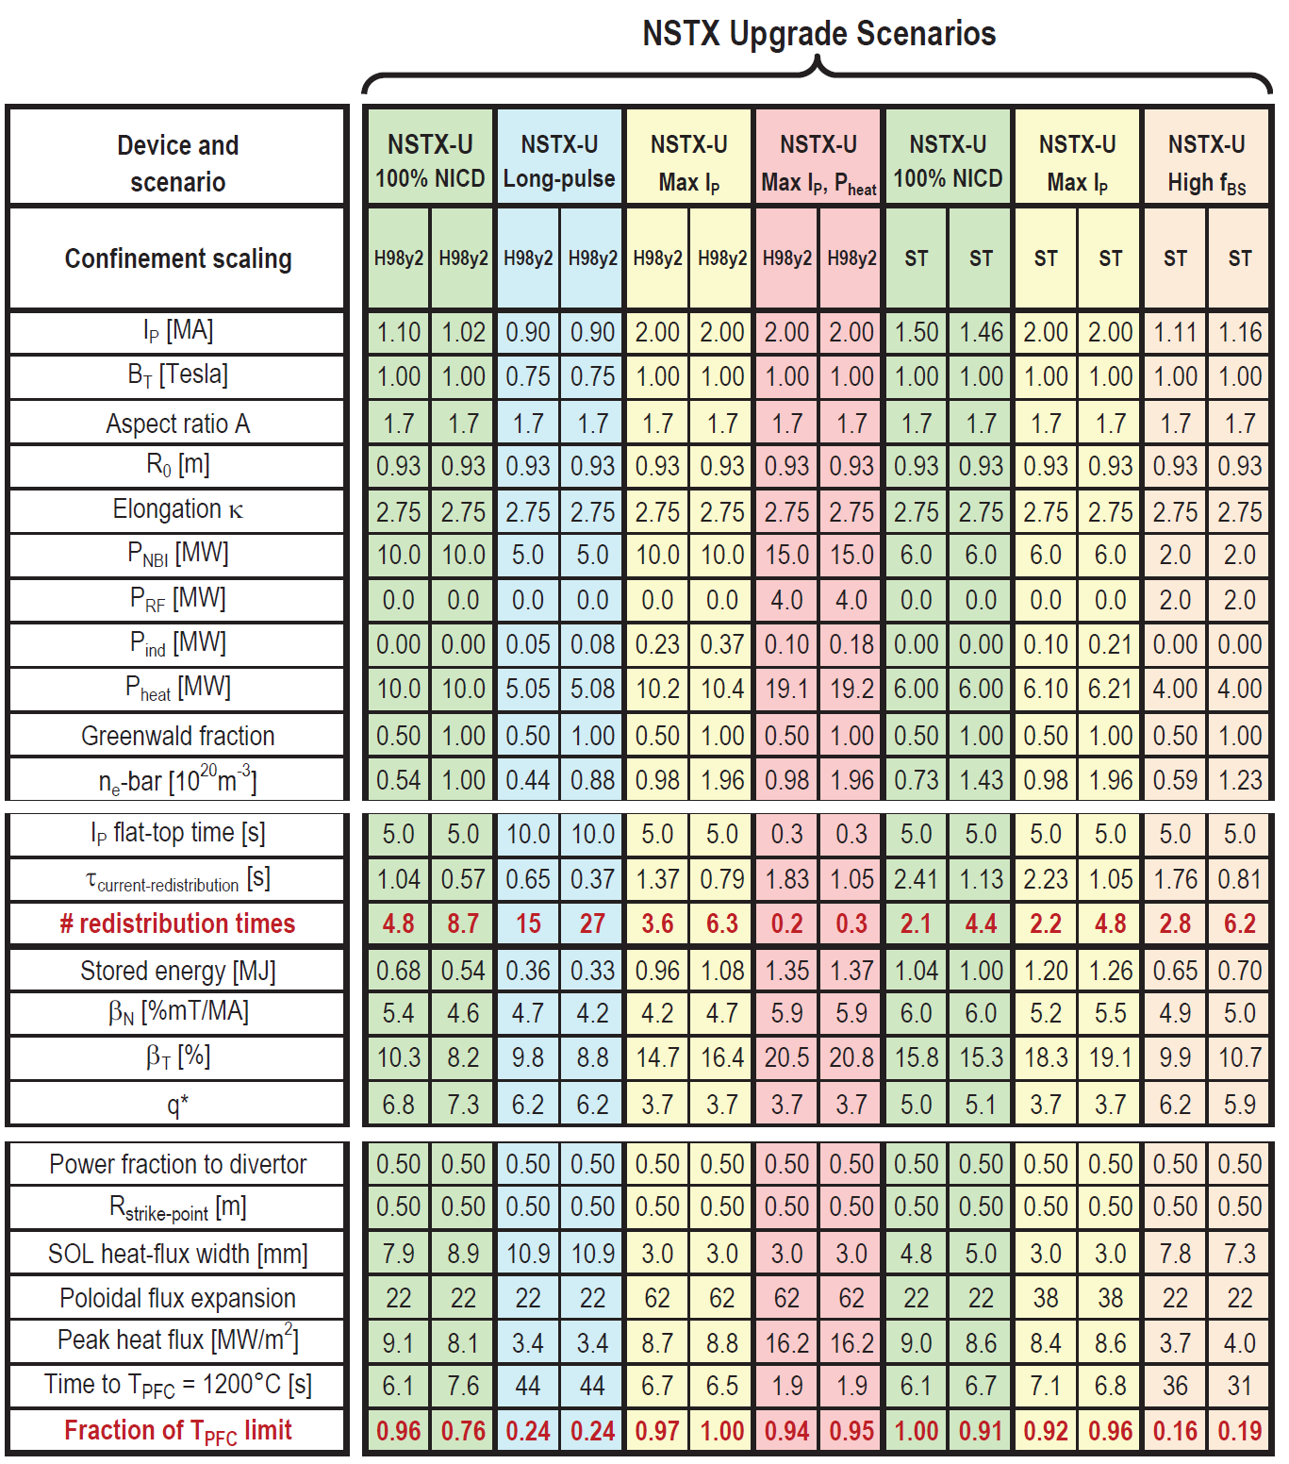
NSTX-U scenarios with high current and power are projected to challenge passive cooling limits of graphite divertor PFCs
0 mg Li: α=1.6
150 mg Li: α=1.1
300 mg Li: α=0.4
λ_{q}^{mid} ~ I_{p}^{-α}
High I_{P} scenarios projected to have narrow λ_{q}^{mid} → ~3mm
  At high power, peak heat flux ≥ 9MW/m² even with high flux expansion ~60 with U/L snowflake
  Numbers shown ignore radiation, plate tilt, strike-point sweeping
Passive cooling ok for low-I_{P} scenarios
Long-pulse + high I_{P} and power may ultimately require active divertor cooling

Slide 5
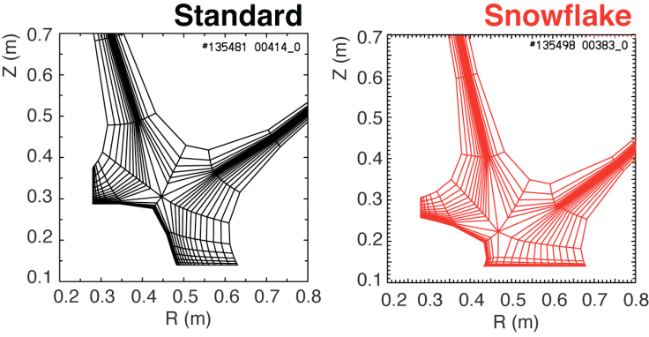
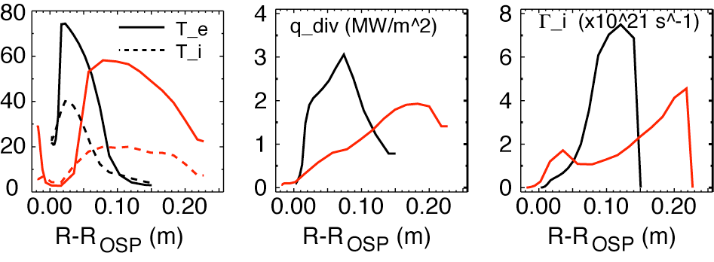
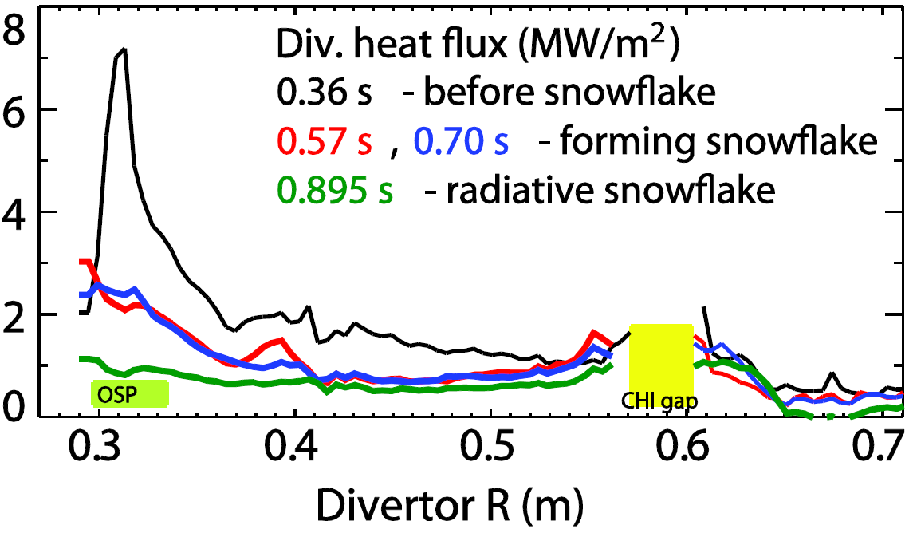
Major goal of NSTX-U PMI research will be investigating high flux expansion snowflake + detachment for large heat-flux reduction
UEDGE modeling performed comparing conventional divertor to snowflake
V. Soukhanovskii (LLNL) – EPS 2011
Snowflake synergistic with detachment/radiative divertor
    5-10x peak heat flux reduction
What are predictions for NSTX-U regimes? And for FNSF/Demo?
Is this configuration compatible with cryo-pumping and/or lithium pumping?

Slide 6
NSTX-U aims to address a wide range of PFC/PMI issues
(baseline/initial NSTX-U, long-range goal )
D pumping method
  Li coatings
  Cryo-pumping, flowing liquid lithium
Recycling, fueling techniques
  High recycling (R_{P}~0.98), edge fueling
  Intermediate/low recycling (R_{P}~0.90-0.98/0.5-0.9), core fueling
Heat flux mitigation methods
  High flux expansion, partial detachment/radiative divertor
  Flowing liquid metal, CPS/evaporative cooling, lithium radiation
Plasma facing component material
  Graphite
  Molybdenum, tungsten
PFC cooling and heating
  Passive cooling of divertor PFCs, room-temperature first-wall
  Active cooling/heating of divertor/first-wall (long-pulse ops/retention & diffusion)

Slide 7
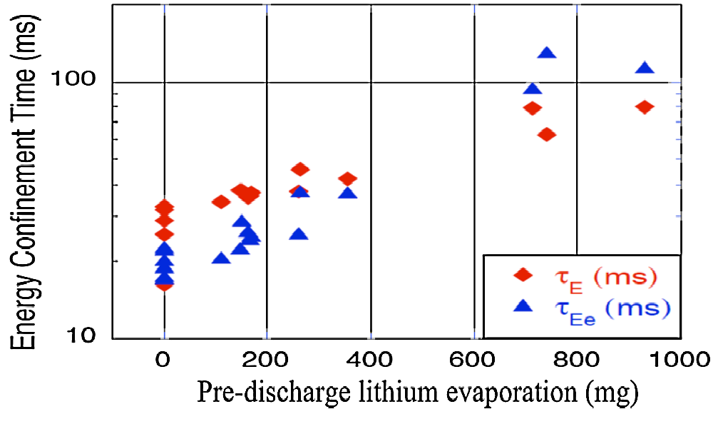
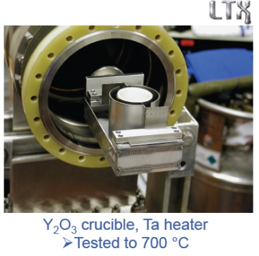
Lithium coatings will continue to be an important research tool for NSTX-U
R. Maingi, et al., PRL 107, 145004 (2011)
Work with LTX to understand Li chemistry, impact of wall temperature, Li coating thickness
Assess D pumping vs. surface conditions (MAPP), lab-based surface studies, PFC spectroscopy
Design/develop methods to increase Li coating coverage:
  upward evaporation
  evap into neutral gas
  Li paint sprayer
Assess impact of full wall coverage on pumping, confinement
Test Li coatings for pumping longer τ_{pulse} NSTX-U plasmas
Energy confinement increases continuously with increased Li evaporation in NSTX
High confinement very important for FNSF and other next-steps
what is τ_{E} upper bound?

Slide 8
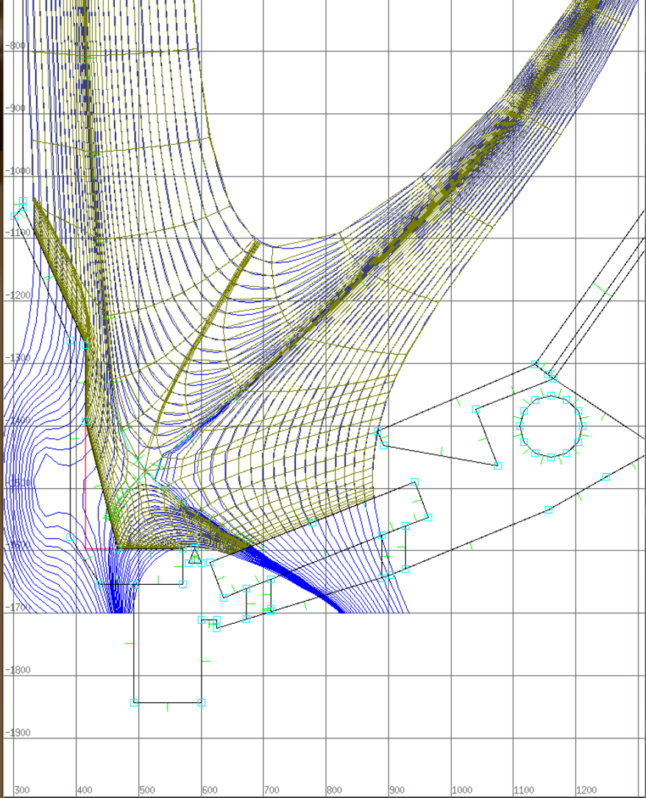
Divertor cryo-pumping being analyzed for D particle control
The persistence of Li coatings for D pumping presently not well characterized
  Unknown if Li coating will pump 5s NSTX-U
  May be possible to extrapolate to NSTX-U using time-depdendent SOLPS analysis of NSTX discharges with Li coatings
  Cryo-pumping and Li-coating R_{P} evolution to be addressed in FY12 BP milestone
Cryo-pumping is being assessed for compatibility with NSTX-U geometry, in-vessel components, and boundary shapes desired for NSTX Upgrade operations
  Attempting to identify designs that do not modify passive plates or supports
  Assume divertor region will be modified
  Length of baffle, details of pump entrance will be critical parameters to optimize
Baffle radial width
J. Canik (ORNL), D. Stotler

Slide 9
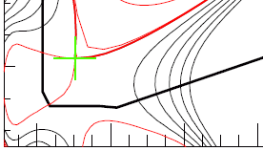
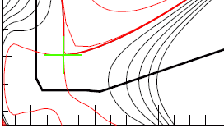
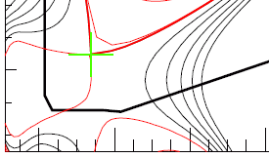
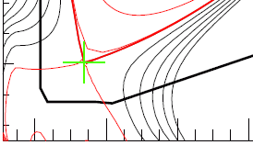
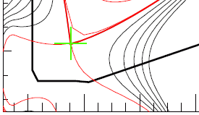
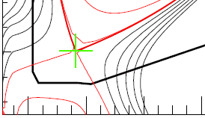
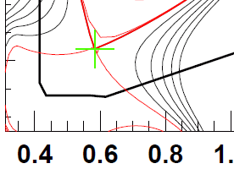
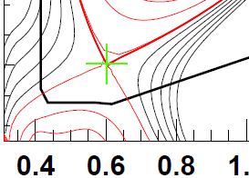
Divertor designs should aim to be compatible with boundary shapes most likely to be utilized in NSTX-U
  Snowflake divertors
  Standard divertors
What is optimal radius for entrance to cryo-pump?
  Estimate: R_{ent} = 0.7 to 0.85m
  Being assessed with SOLPS
LLD on OBD could have large surface area for particle & power exhaust
  Potentially less sensitive to strike-point radius

Slide 10
Flowing LLD development should be studied as alternative means of particle and power exhaust, access to low recycling
LLD, LTX → liquid Li required to achieve pumping persistence
  Flowing Li required to remove by-products of reactions with background gases
Substantial R&D needed for flowing Li
Need to identify optimal choice of concept for pumping, power handling:
  Slow-flowing thin film (FLiLi)
  Capillary porous system (CPS)
  Lithium infused trenches (LiMIT)
  All systems above require active cooling to mitigate highest heat fluxes of NSTX-U
Elimination of C from divertor needed for “clean” test of LLD D pumping
  May need to remove all C PFCs?
Possible approach:
Dedicate 1-2 toroidal sectors (30-60˚ each) to LLD testing
(and/or integrate with RDM?)
Test several concepts simultaneously
Full toroidal coverage after best concept is identified
C
Mo
Flowing LLD

Slide 11
Direct comparison of particle control from cryo-pumping and flowing LLD would greatly aid development of FNSF divertor
Cryo-pump
Could dedicate upper divertor to cryo-pumping and lower divertor to flowing Li
IF this is the preferred long-term approach, it argues for converting lower divertor to Mo tiles first to avoid re-doing upper divertor PFCs for cryo.
If flowing LLD region is sufficiently narrow radially, it could (maybe) be combined with cryo-pumping in the same divertor:
  Utilize cryo for D pumping?
  Utilize flowing Li + evaporative and/or radiative cooling for power exhaust?
  Can Li pump D while taking power exhaust?
C
BN
Mo
Flowing LLD
Cryo-pump
Flowing LLD

Slide 12
Fueling
Existing/baseline systems
  LFS gas puffing, high-field-side (will have faster turn-off in Upgrade)
  Supersonic Gas Injection (SGI) – 2-3x higher efficiency than LFS fueling
    Not yet integrated into PCS control
  NBI for core fueling
    Cannot decouple from heating
    Fueling will double at high power
5 year plan goals
  Need to demonstrate particle pumping (any flavor), density stationarity
  Need real-time density signal, algorithm, and actuator(s)
Longer term possibilities, especially for low recycling regimes
  Molecular cluster
  Pellet fueling
  CT injection
  Plasma jets
  Should these be part of upcoming 5 year plan?

Slide 13
Possible progression of PFC materials in NSTX-U
Baseline NSTX-U PFCs are all C (and BN) to minimize risk and cost
C is widely accepted to be unviable for FNSF/Demo applications due to erosion and re-deposition, retention, and neutron damage issues
W is viewed as most viable fusion material
Mo (TZM) has similar thermal/PMI properties to W, but is easier to fabricate and machine
One scientific limitation of the above baseline approach is that tests of high-Z PFCs – by themselves, and with lithium – are deferred/delayed
C
BN

Slide 14
Possible progression of PFC materials in NSTX-U
Upper Mo divertor to test Mo as PFC, Li on all Mo - requires upward Li evaporator and upper divertor diagnostics
Baseline
Having at least one divertor be all Mo (with Li coating capability) would:
  Enable comparisons of Mo vs. C
  Continue research planned for 2011-12, i.e. test effects of Li on Mo PFCs w.r.t. impurity production, possible temperature clamping
  Inform/accelerate decisions for metal PFCs
C
BN
Upper
Mo divertor
Mo
Lower C divertor enables comparison to NSTX results, reduces risk of high-Z PFCs for initial physics/long-pulse ops goals

Slide 15
Possible progression of PFC materials in NSTX-U
Baseline
Upper Mo
Upper Mo
Upper and lower Mo divertor enables double-null ops on similar high-Z PFCs for comparison to all C and/or upper-only Mo divertor
C
BN
Upper
Mo divertor
All
Mo divertor
Mo
If upper Mo divertor performed well, could then implement lower divertor Mo tiles

Slide 16
Possible progression of PFC materials in NSTX-U
Baseline
Upper Mo
Upper Mo
If C plasma impurities are present at unacceptable levels, all metal tiles and/or tile coatings may be needed for the CS and/or passive plates
C
BN
Upper
Mo divertor
All
Mo divertor
All Mo tiles
Mo
Lower Mo

Slide 17
Possible progression of PFC materials in NSTX-U
NSTX-U should ultimately progress to (nearly) complete wall coverage with metallic PFCs
Many possible progressions exist!
Baseline
C
BN
Mo PFCs
plus W divertor
Upper
Mo divertor
All
Mo divertor
All Mo tiles
All Mo PFCs
Mo
W
All metal PFCs (especially W in divertor) are most representative of what will be used in FNSF/Demo
Beginning of 5 yr plan
End of 5 yr plan

Slide 18
Active PFC cooling and heating
Active divertor cooling – if needed – would likely be implemented near end of 5 year plan period
  Very little discussion of this so far…
PFC (first-wall) heating could be useful for:
  Study retention/diffusion of hydrogenic species (needs high T_{wall})
  Liquid Li films over large surface areas (after changing to Mo/W PFCs)
  Consider using bake-out systems for accessing 200-350˚C
  Possible to go to higher temperature for FNSF/Demo relevance?
  Unclear if this can be implemented during upcoming 5 year plan – maybe implement in subsequent 5 year plan

Slide 19
Summary
Urge TSG/team discussion of these issues, as they will impact NSTX-U operation, operating space, other upgrade ideas
  What is missing or should be modified/deleted?
Have not yet addressed other lab-based R&D studies and proposals (such as FES materials solicitation) that could influence the NSTX-U plans and decisions
  Such studies/proposals should be incorporated into the overall plans and work-scope for 5 year planning purposes.
    Surface studies– collaboration with FOM/DIFFER
    B. Koel laboratory work on Li chemistry
    NSTX-U researcher collaborations on other fusion facilities…
    Other?
Once the proposed PMI plan is decided, can assess cost and schedule estimates, assign dates to the various elements

