Slide 1
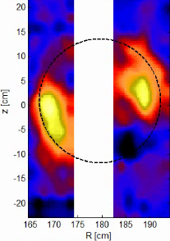
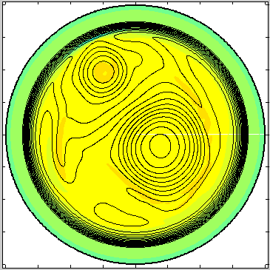
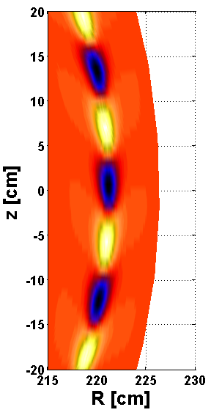
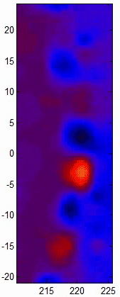
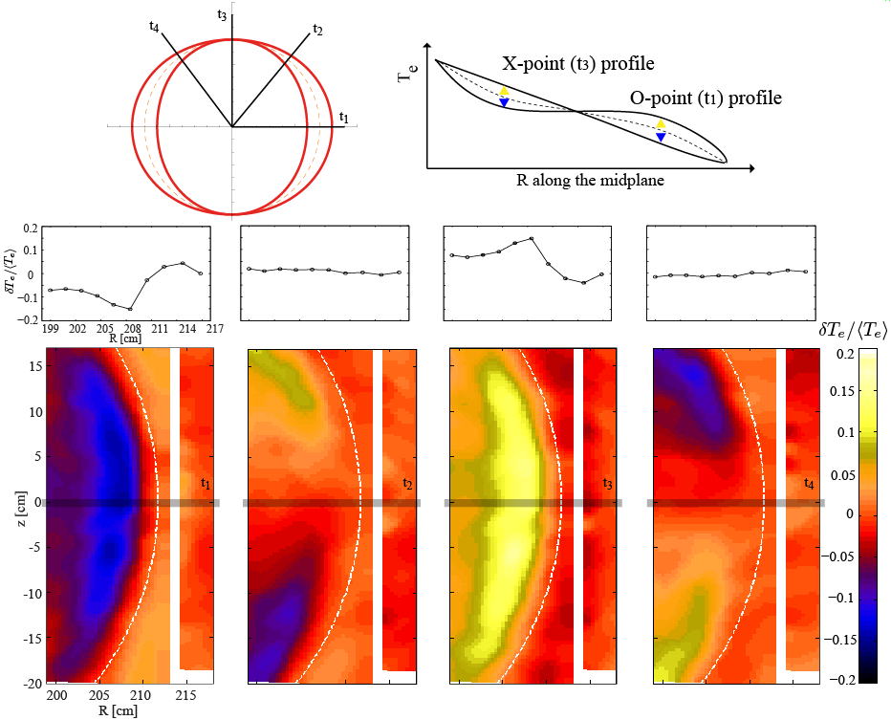





Validation/Verification of MHD physics via 2D/3D ECEI in KSTAR (ELM dynamics)
Dual flux tubes (dual m/n=1/1)
Edge Localized Modes
Simulated
image
Measured
image
Hyeon K. Park
POSTECH,
Pohang, Korea
m/n=2/1 Tearing Modes
A3 Seminar
Jan. 22-25 , 2013
Hokkaido, Japan
In collaboration with
M.J. Choi, M. Kim, J. Lee, W. Lee, G.S. Yun (POSTECH), C.W. Domier, N.C. Luhmann, Jr.
(UC Davis), Y.M. Jeon, S.G. Lee (NFRI), I. Joseph, W. Meyer, X.Q. Xu (LLNL),
Notes:
Satoru on MHD stability and Houyang’s talks on current drive, ELM control (instability in general) is essential for SS operation in Tokamaks and Stellarators. Do we have models to challenge the future (SS on high beta and long pulse?? Answer is “No” Then are we continue on “empirical physics?? Answer is “No”

Slide 2
Outline
2D/3D ECEI system for visualization
  Improvement of the predictive capability of complex dynamics of MHDs, Waves and Turbulence
  Verification/validation of the ELMs in KSTAR
    Validation: synthetic image of the ELMs via BOUT++ simulation
    Verification: ELM dynamics/responses to the external perturbations (e.g. MP and SMBI)
    Fundamental of the role of magnetic perturbation ?
The beginning of 3D imaging in KSTAR
  Sawtooth, Tearing mode, and ELMs, etc.

Slide 3
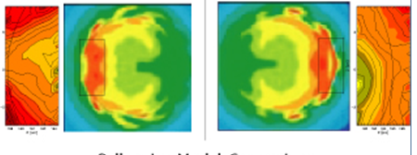
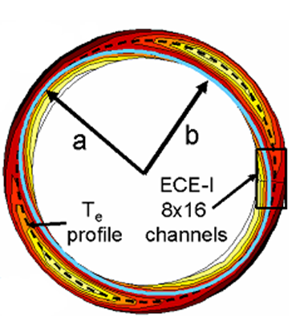
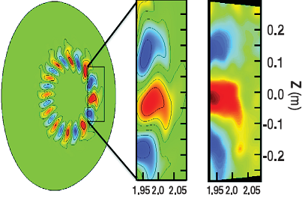
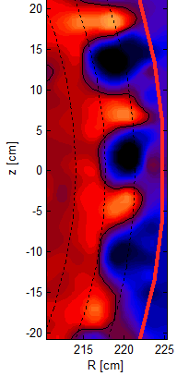
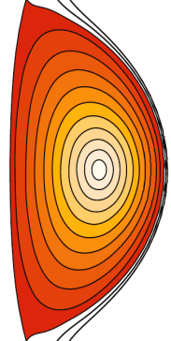

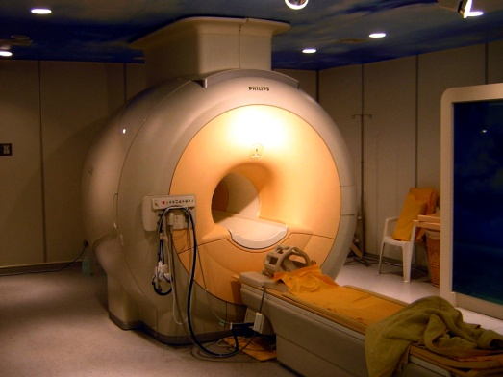
Why 2D/3D visualization (ECEI)?
Improve predictive capability of MHD and wave physics
(e.g. Sawtooth, NTM, Alfvén waves, and ELMs)
Sawtooth crashes (TEXTOR)
H.K. Park et al., PRL (2006)
Tearing modes (TEXTOR)
I. Classen et al., PRL (2007)
Alfvén waves (DIII-D)
B. Tobias et al., PRL (2010)
ELMs (KSTAR)
G.S. Yun et al., PRL (2011)
Dual m/n=1/1
Mode
G.S. Yun et al.,
PRL (2012)
Analogous to evolution of
diagnostic capabilities from
Stethoscope to MRI/CT
“SEEING IS BELIEVING”
for complex system

Slide 4
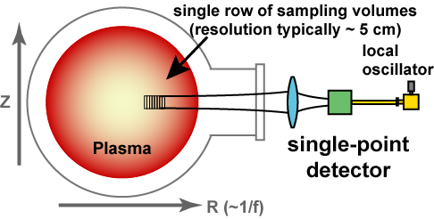
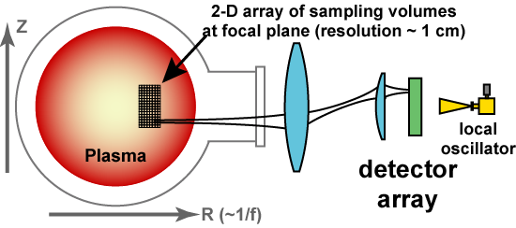
ECE imaging for T_{e} fluctuation measurement
Conventional 1-D ECE system
2-D ECE imaging system
ECE measurement is an established tool for electron temperature measurement in high temperature plasmas
Sensitive 1-D array detector, imaging optics, and wide-band mm wave antenna, and IF electronics are required for 2-D imaging system
T_{e} fluctuation measurement
  Real time fluctuations can be studied down to ~2% level (lower w/ SVD, etc……)
  Fluctuation studies down to 0.1 % level have been performed using long time integration

Slide 5
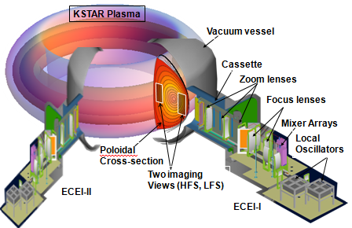
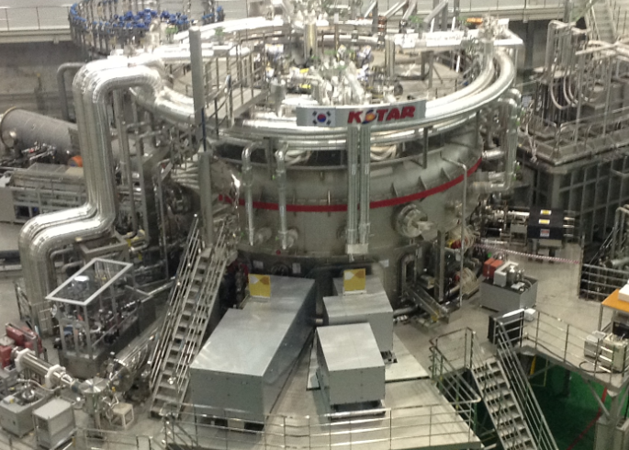
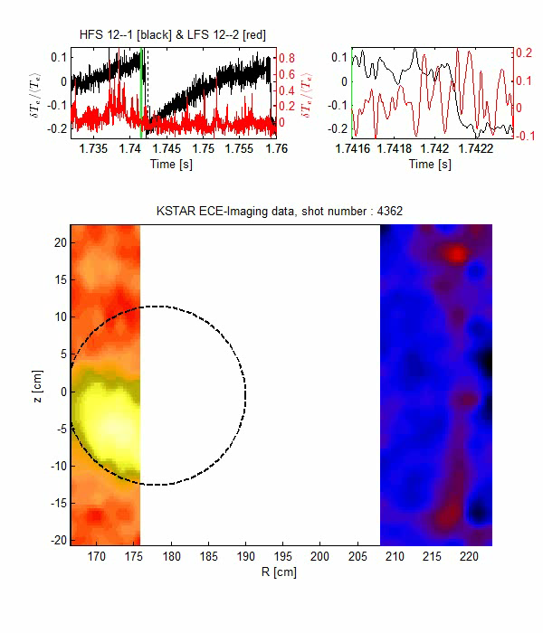
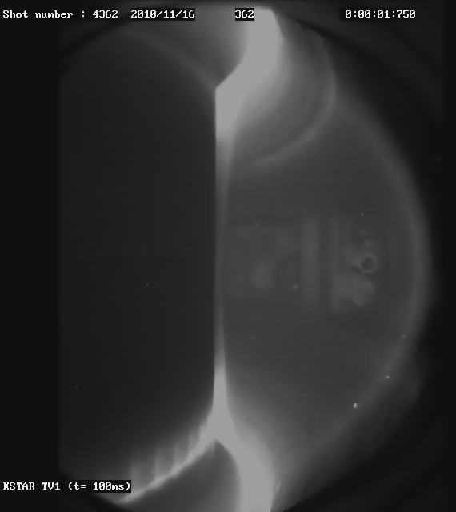

KSTAR 2D/3D ECE imaging systems
H
G
G
H
Comibined
with MIR
KSTAR (2012)
shot 4362
B₀ ~ 2 T
T_{e0} ~ 2 keV
n_{e0} ~ $3×{10}^{19}$ m-³
First simultaneous
2D visualization of the internal kink (m=1)
and
Edge-Localized Modes
(ELMs)
~1m

Slide 6
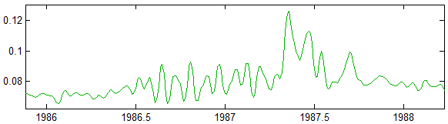
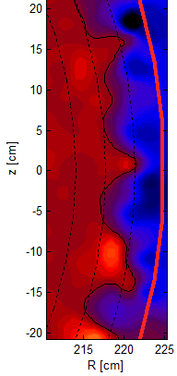
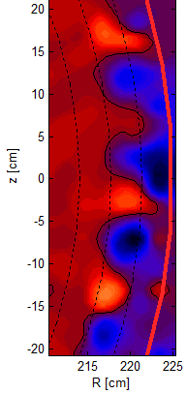
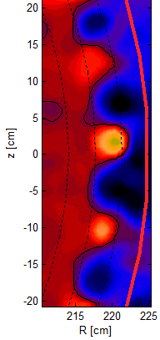
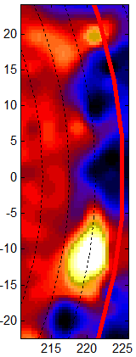

ELM dynamics in KSTAR plasmas
Time evolution of a single ELM
ECEI (V)
4
Shot=4431
2
3
G.S. Yun et al.,
PRL 107 (2011)
1
Initial growth to saturation
Time (ms)
crash phase
1
0 μs
2
100 μs
3
200 μs
4
855 μs

Slide 7
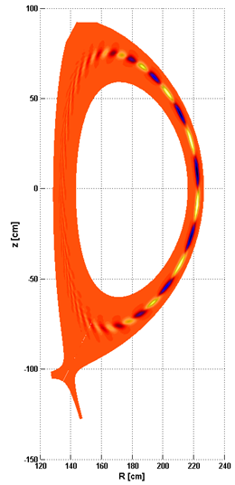
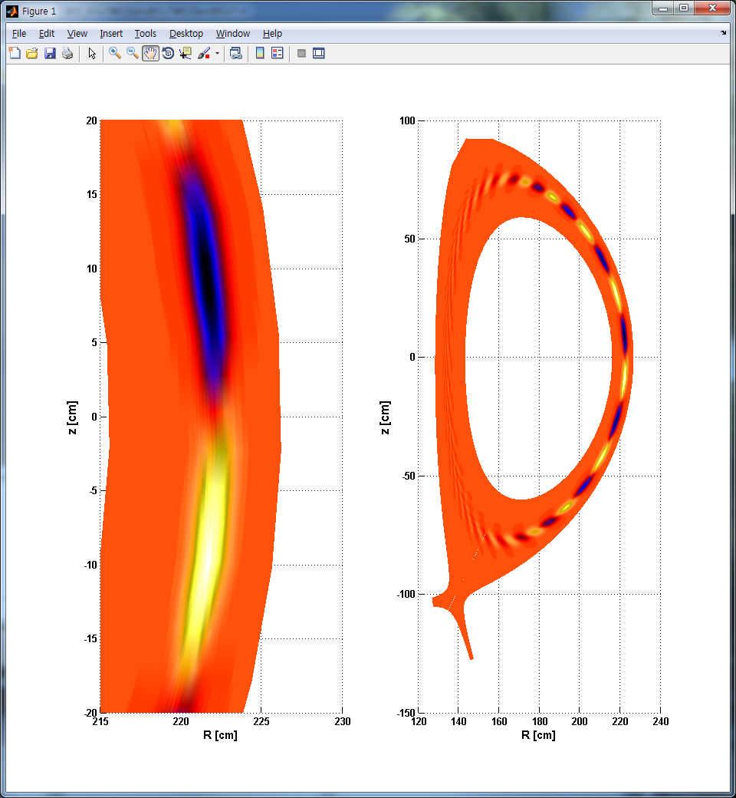
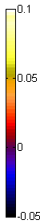
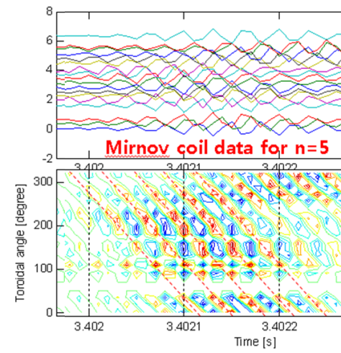

Validation of the stationary ELM
BOUT++ Simulation (linear) of
the n=5 ELM
2D image of an ELM
Toroidal mode number (n=5) is identified by the magnetics
q- and pressure profiles from EFIT are used to get the 2D image of the n=5 mode w/ the max. growth rate
$$\frac{δT_{ece}}{\left\langle T_{ece}\right\rangle }$$
215
220
225
230
R [cm]
Outcomes
Poloidal mode spacing is
incorrect !
Radial thickness is too thin !
KSTAR shot #6123 @ t~3.4s

Slide 8

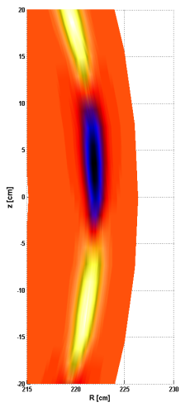
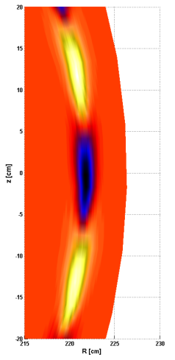
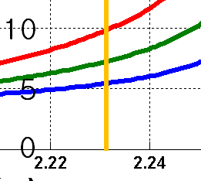

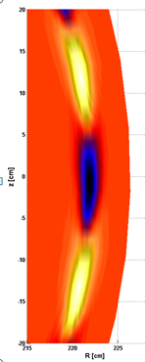
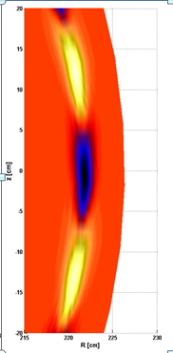
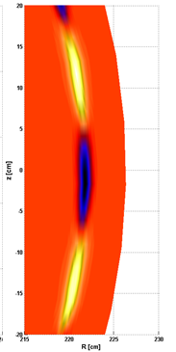

Parametric dependence of the mode structure
A) Poloidal mode spacing is sensitive to the local q-value
#1
#2
#3
Identification of the bootstrap current (J_{b}) due to P’ and ν* changes w/ 3D system !!
B) Radial thickness and growth rates sensitive to P’
#1
#2
#4

Slide 9
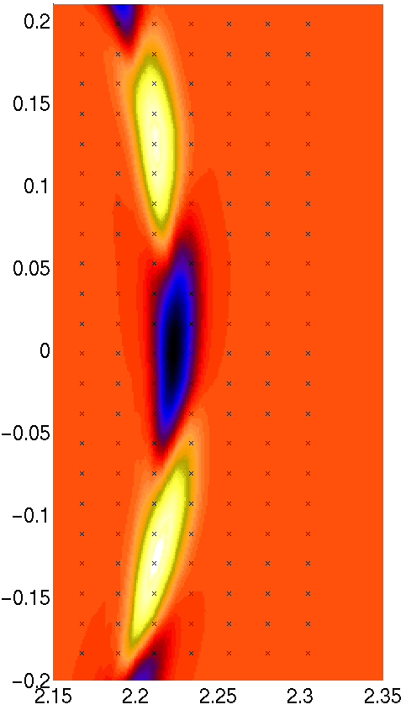
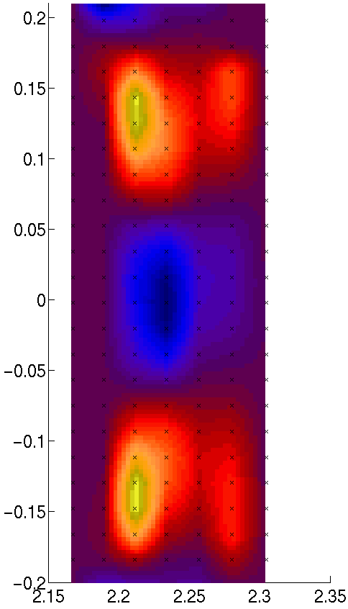
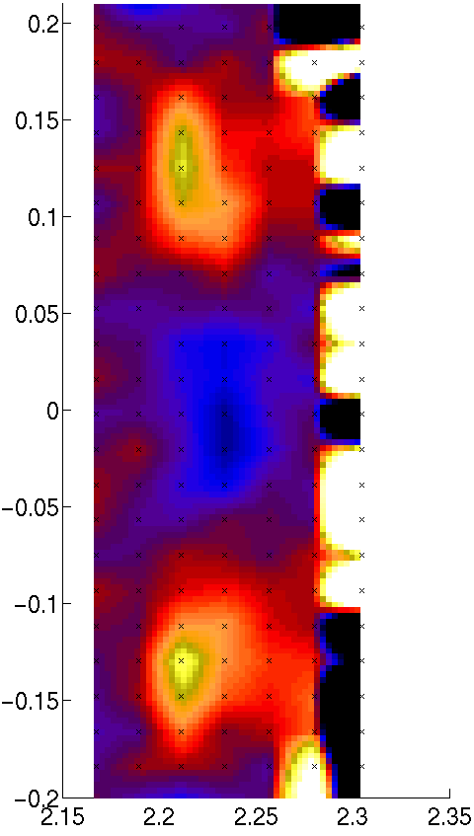
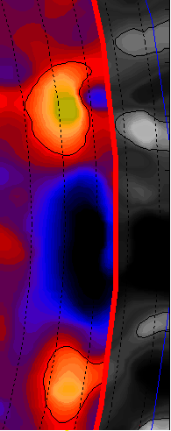



Synthetic image with the system noise
Finite radial resolution of the system broadens the image
A phantom image appears outside the separatrix due to ECE
downshift from inside (known phenomenon) -- finite system
noise and wall reflections may complicates the interpretation
Ignore images contaminated by downshifts.
BOUT++
Simulation
Synthetic
Image
Synthetic image
with system noise
Measured Image
$$\frac{δP}{\left\langle P\right\rangle }$$
$$\frac{δT_{ECE}}{\left\langle T_{ECE}\right\rangle }$$

Slide 10
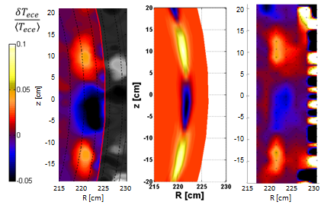
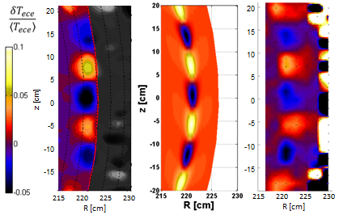
Optimum pressure profile for KSTAR ELMs
Measured
image
Simulated
image
Synthetic
image
ELMs in KSTAR H-modes
Discrete n numbers were observed (n~5 and n~10)
Pressure scale length is proportional to n number (consistent w/ observation)
n=5
mode
Optimum pressure profiles
for n=5 and n=10 modes
n=5
n=10
mode
n=10

Slide 11

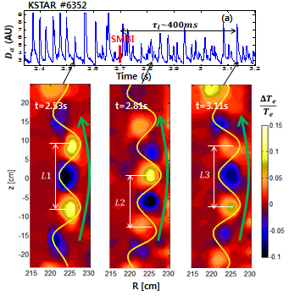
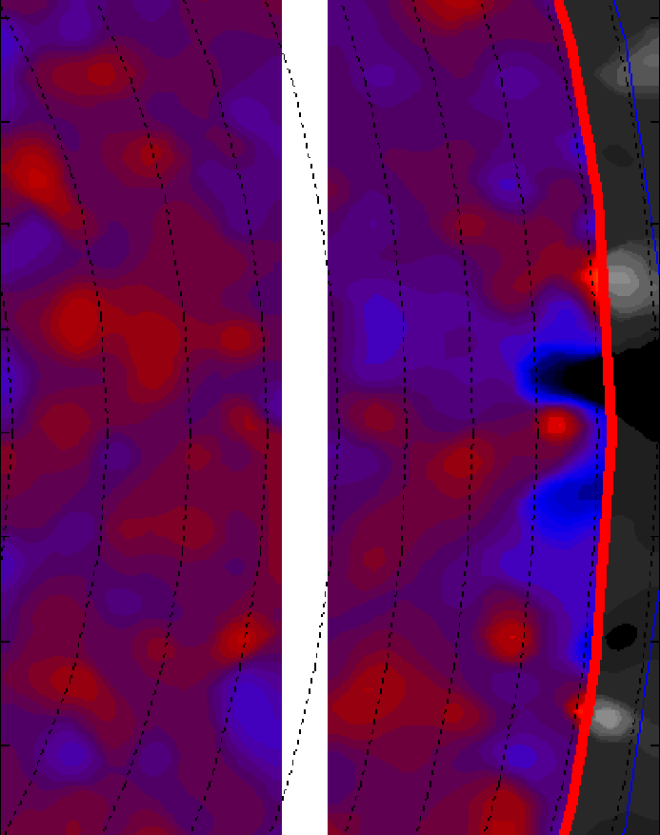
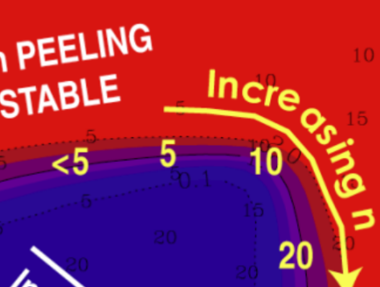
Response of the ELMs to perturbations
Resonant Magnetic Perturbation (n=1)
Supersonic Molecular Beam Injection
A
B
C
A
B
C
L1~L3 > L2
Well defined mode numbers
No steady filaments
RMP case
unstable n~10 to marginally
unstable n~5,10) may require a
reduction of J_{b} & P’ (observed
reductions in P’ & ν*)
No signature of the applied
stochastic magnetic island (i.e.
interference in magnetic
diffusion time scale)
SMBI case
L1 – L2 is correlated w/ the [increasedν* (decreased P’)]
L2 – L3 is correlated w/ the [decreased ν* (increased P’)]
No change in n number?
J_{b} change – local q change?
Peeling/Ballooning
mode model (T. Osborne)
Notes:
Low (High) collisionality regimes
n mode change is wrong direction based on P’
m(q) mode change is also in wrong direction

Slide 12

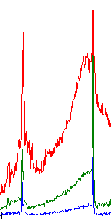
Response of the ELMs from RMP (n=1)
D_{α}(AU)
Pedestal
Te (AU)
RMP
D_{α}(AU)
Unstable n~10 ELM
Marginally stable n~5 and n~10 ELM
Line
density
Te (AU)
3.1 3.2 3.3 3.4 3.5
Time (s)
Transition from stable to marginally stable
Freq.
(KHz))
~35 ms
Te (AU)
Pedestal
ch#5
Time
ELM frequency increases (6 to 8 kHz)
No change in poloidal spacing
of the mode (n~10)
LCFS ch #3
T_{e} gradient increases

Slide 13
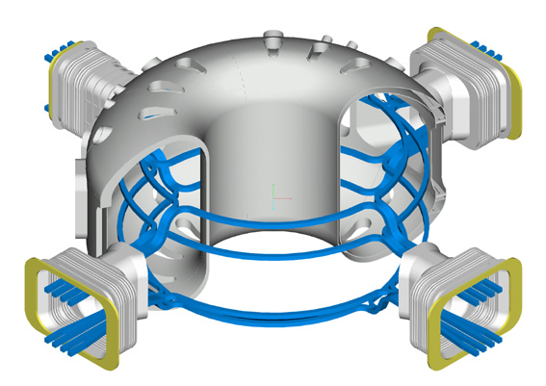
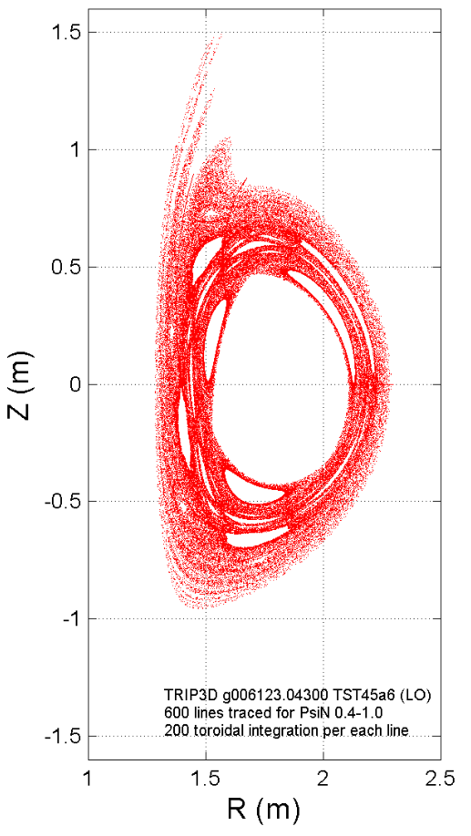
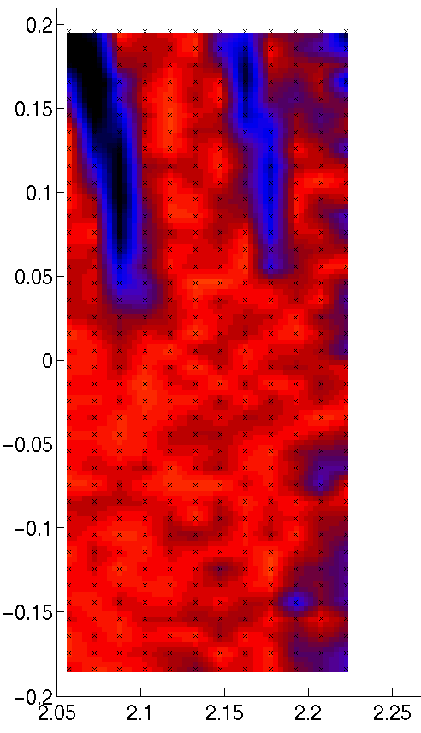





Basic physics and role of RMP (e.g. n=1)
Stochastic islands
from n=1 RMP
(Vacuum fields)
Synthetic (+noise) image of islands
+B_{r}
I_{p}, B_{T}
$$θ$$
$n=1$, $+90$ phase
+
+
$$B_{plasma}$$
Top
+
+
Middle
+
+
bottom
$$φ$$
Configuration of the n=1 RMP
in KSTAR
Also other configuration such
as n=2 (even and odd parity)

Slide 14

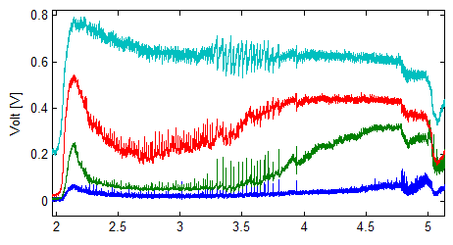
Temperature profile evolution during RMP
Base H-mode pedestal (n~10 ELM) → Steepness of the pedestal (n=5 ELM) → Further steepness of the pedestal (ELM-free: no room for ELM to grow)
The observation is consistent w/ the optimum growth rate of the ELMs (from n=10 to n=5)
Ch.7
Time history of LFS ECEI raw data
Ch.5
ㅡ LFS ch.3
ㅡ LFS ch.4
ㅡ LFS ch.5
ㅡ LFS ch.7
Temperature profile evolution during RMP
Filament(pedestal)
Ch.4
Ch.3
Time [s]

Slide 15
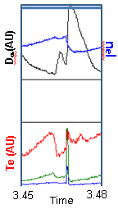
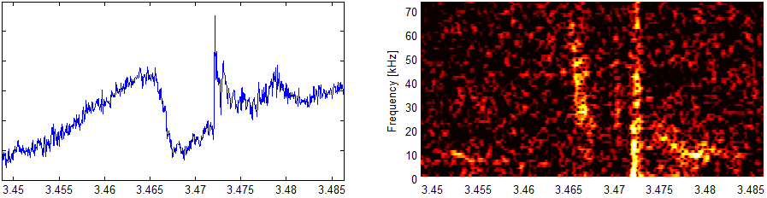
Marginally unstable n~5,10 modes during RMP
Single n=5 ELM
After crash of the n~5 ELM, n~10 mode appears.
Peeling dominated regime (low n ) – role of J_{b} is important for marginally unstable n~5, ~10
ELM crash
ELM crash
Te(A.U.)
Freq. (kHz)
Frequency change is due to the change in plasma rotation not toroidal/ poloidal mode number change
Rotation changes from E_{r} ?
E_{r} from charge imbalance ?
Charge imbalance from loss of density (primarily electrons)
n~5
n~5
n~10

Slide 16
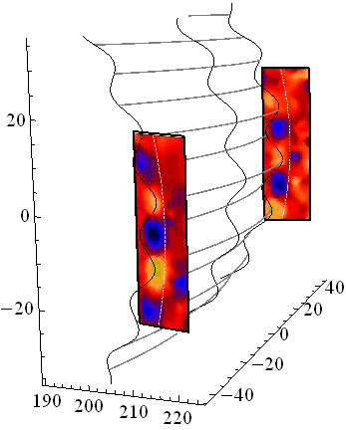

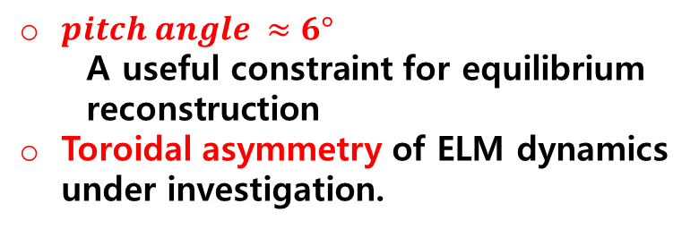
3D measurement of the n=10 ELM
Apparent rotation direction of the 2012 ELM
is opposite to that of the 2010 & 2011 ELM
ELMs*
NOT A SIMULATION
2nd ECEI
1st ECEI
$pitch angle ≈6°$
  A useful constraint for equilibrium reconstruction
Toroidal asymmetry of ELM dynamics under investigation.
(shot#7328, t=7,.917s)
16

Slide 17

Modulation and toroidal asymmetry of the ELMs

Slide 18



3D measurement of other instabilities in progress
Internal kink (sawtooth)
m/n=2/1 tearing
NOT A SIMULATION
NOT A SIMULATION
(shot#7446, t=2.873s)
(shot#7131, t=3.7s)

Slide 19
Summary of “Seeing is believing”
Visualization is a powerful tool for complex physics
  More than a decade of work on real time ECEI in various toroidal devices (TEXTOR, AUG, DIII-D, KSTAR, EAST, Tore-Supra, SST)
Verification and validation of MHD physics in KSTAR
  Observed ELMs are verified by synthetic images
    Poloidal mode number is a sensitive to the local q value for a fixed n number [m=nq]: P’ is for growth rates - radial thickness.
    Instrumental and emissivity broadenings must be considered !
  Responses to the external perturbations used for validation of ELM physics
    RMP(n=1) changes the unstable n~10 ELM into marginally unstable n~ 5,10 ELMs and then stabilize (?) all.
    No clear signature of stochastic magnetic islands from RMP
    Mode number changes are qualitatively consistent with the peeling/ballooning mode model (in J_{b} and P’ space)
    Further study of the role of J_{b} in high/low ν* plasma
New progress toward 3D imaging and 2D turbulence (2012 KSTAR campaign) !

Slide 20








POSTECH Center for Fusion Plasma Diagnostics and Steady State Operation
Univ. of York, UK
AUG Germany
Tore Supra
France
IPP, China
KFKI Hungary
Kyushu Univ.
General Atomics
Univ. Colorado
MIT
LLNL
KNU
SNU
Sogang Univ.
UNIST
Positions for Prof. (tenure track), Visiting researchers, Postdoc, and PhD Students available at POSTECH center

Slide 21



Interpretation of Edge ECE imaging
Near the pedestal foot and outside, ECE signals come mostly from inside, a well-known phenomenon called downshift.
JET H-mode pedestal
E. de la Luna et al., 34th EPS (2007)
n_{e}
T_{e}
ECE downshift
(not localized)
Localized ECE
R (cm)

Slide 22




Steeper pedestal
KSTAR
ASDEX-Upgrade
DIII-D
P (arb.)
n_{e}
T_{e}
A clear ELM filament structure has not been observed.
Because the radial size of filament < ECEI resolution ?
215
220
225
230
Classen et al., Rev. Sci. Instrum. 81 (2010)
R [cm]

