Slide 1
AIMS briefing to NSTX-U group:
Accelerator-based surface diagnostic for plasma-wall interactions science
Dennis Whyte
Zach Hartwig, Harold Barnard, Brandon Sorbom, Pete Stahle, Richard Lanza
D. Terry, J. Irby, G. Dekow & C-Mod engineering staff
Plasma Science and Fusion Center
Massachusetts Institute of Technology
@
^{08 AUG 12}
^{CAARI 2012}
^{Fort Worth, TX}
^{08 AUG 12}

Slide 2
New in-situ diagnostics are required to significantly advance PWI science in magnetic fusion devices
Ex-situ diagnostics and “benchtop” PWI experiments are critically limited
  Unable to replicate tokamak-relevant PWI conditions (“benchtop”)
  Limited PFC surfaces available for measurement (IBA)
  “Archaeological” measurements lack dynamic PWI information (IBA)
In-situ PWI surface diagnostics are severely limited in deployment and unable to meet all requirements
The ideal PFC surface diagnostic would provide measurements:
  in-situ without vacuum break
  on a shot-to-shot frequency for time resolution and PWI dynamics
  of large areas of PFC surfaces (poloidally and toroidally resolved)
  of elemental/isotope discrimination to depths of ~10 microns

Slide 3
AIMS exploits intra-pulse capabilities of a tokamak and deuteron-induced reactions to investigate PWI
AIMS (Accelerator-based In-situ Materials Surveillance) derives from two key observations:
  The tokamak magnetic fields can be used between plasma shots to steer a charged particle beam to PFC surfaces of interest
  The gammas and neutrons produced by low-energy, deuteron-induced nuclear reactions provide a comprehensive diagnostic tool for PWI
PWI Issue | Nuclear reaction | Induced particle energy (MeV)
Fusion fuel retention | ²H(d,n)³He ³H(d,n)⁴He | E_{n} = 2 – 4 MeV E_{n} = 17 – 19 MeV
Erosion / redeposition | ⁶Li(d,p+g)⁷Li ⁸Be(d,p+g)⁹Be | E_{g} = 0.478 E_{g} = 0.718
Wall conditioning | ¹¹B(d,p+g)¹²B ¹⁶O(d,p+g)¹⁷O | E_{g} = 0.953, 1.674 E_{g} = 0.871
Impurity transport | Accessible Low-Z reactions | E_{g} <= 5 MeV

Slide 4
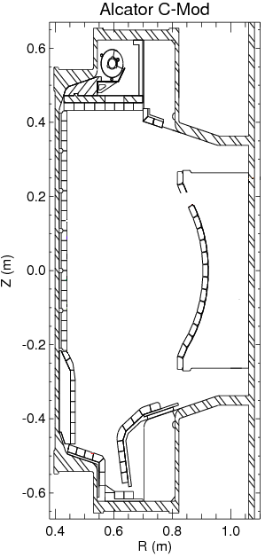
Basic principles for AIMS on Alcator C-Mod: in-situ ion beam analysis
Radio Frequency Quadrupole (RFQ) linear accelerator injects 0.9 MeV D+ beam into vacuum vessel through a radial port
RFQ LinAc
beamline

Slide 5
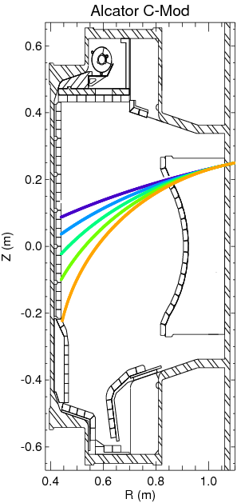
Basic principles for AIMS on Alcator C-Mod: in-situ ion beam analysis
Radio Frequency Quadrupole (RFQ) linear accelerator injects 0.9 MeV D+ beam into vacuum vessel through a radial port
Tokamak magnetic fields provide steering via the Lorentz force
RFQ LinAc
beamline
Toroidal field provides poloidal steering :
Vertical field provides toroidal steering :

Slide 6

Basic principles for AIMS on Alcator C-Mod: in-situ ion beam analysis
Radio Frequency Quadrupole (RFQ) linear accelerator injects 0.9 MeV D+ beam into vacuum vessel through a radial port
Tokamak magnetic fields provide steering via the Lorentz force:
D+ induce high Q nuclear reactions with low Z isotopes in PFC surfaces producing ~MeV neutrons and gammas
RFQ LinAc
beamline
Toroidal field provides poloidal steering :
n
γ
Vertical field provides toroidal steering :

Slide 7
Basic principles for AIMS on Alcator C-Mod: in-situ ion beam analysis
Radio Frequency Quadrupole (RFQ) linear accelerator injects 0.9 MeV D+ beam into vacuum vessel through a radial port
Tokamak magnetic fields provide steering via the Lorentz force:
D+ induce high Q nuclear reactions with low Z isotopes in PFC surfaces producing ~MeV neutrons and gammas
In-vessel detection and energy spectroscopy provides a wealth of information on PFC surface
composition and conditions
RFQ LinAc
beamline
Toroidal field provides poloidal steering :
Gamma and neutron detectors
n
γ
Vertical field provides toroidal steering :
Reentrant
vacuum
tube

Slide 8
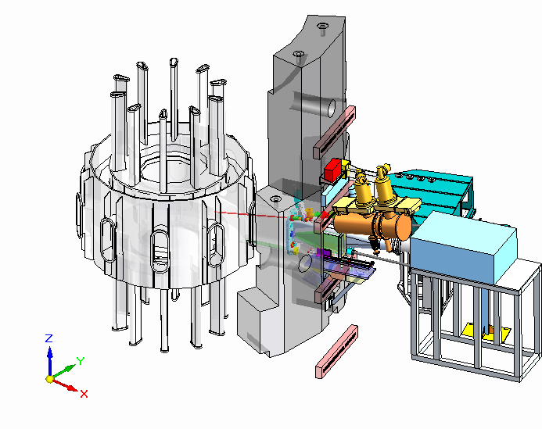
AIMS was fits into the extremely crowded area around C-Mod's horizontal ports
Concrete igloo
(shielding)
HiReX Sr
Spectrometer
(Plasma diagnostic)
Vacuum vessel
Impurity injector
(plasma transport
studies)
Accelerator-based ents
*
Lyman-alpha camera
(plasma diagnostic)
Hard X-Ray Camera
(fast electron diagnostic)

Slide 9
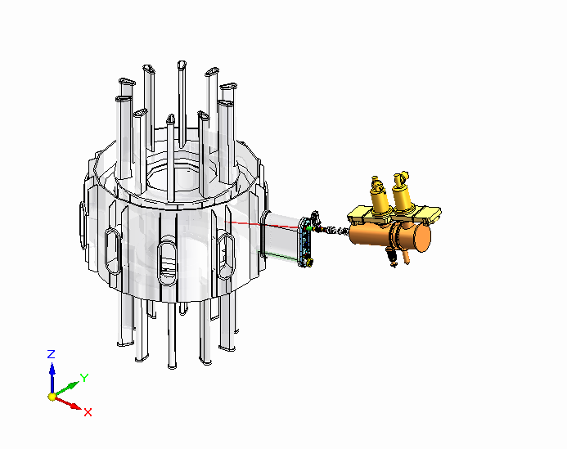
AIMS was designed to fit amidst the extremely crowded area around C-Mod's horizontal ports
A solid model with cutaways of the proposed
installation location for AIMS on Alcator
C-Mod. (Lots of stuff not shown!)

Slide 10
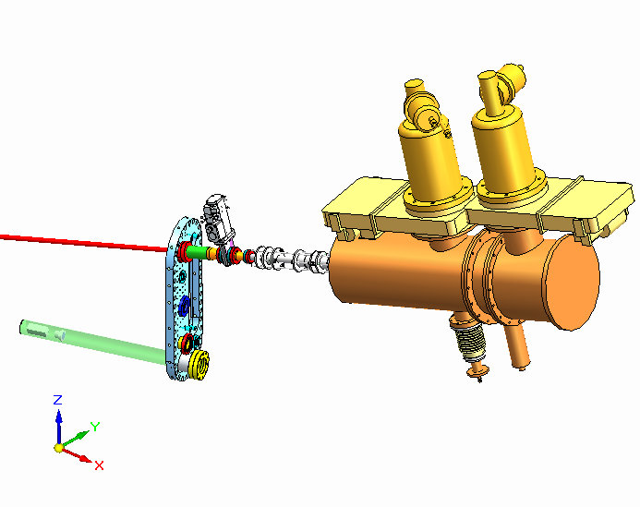
Installed AIMS: RFQ accelerator, focusing quadrupole beamline, reentrant tube, and particle detectors
Cryopumps
(provide vacuum)
Gate valve
(vacuum
barrier)
Gate
valves
0.9 MeV
deuteron
beam
Quadrupole
(beam
focusing)
RFQ cavity
(accelerates
deuterons)
Neutron and
gamma
detectors
Reentrant
vacuum
tube
RF input
(provides
accelerating
electric field)

Slide 11
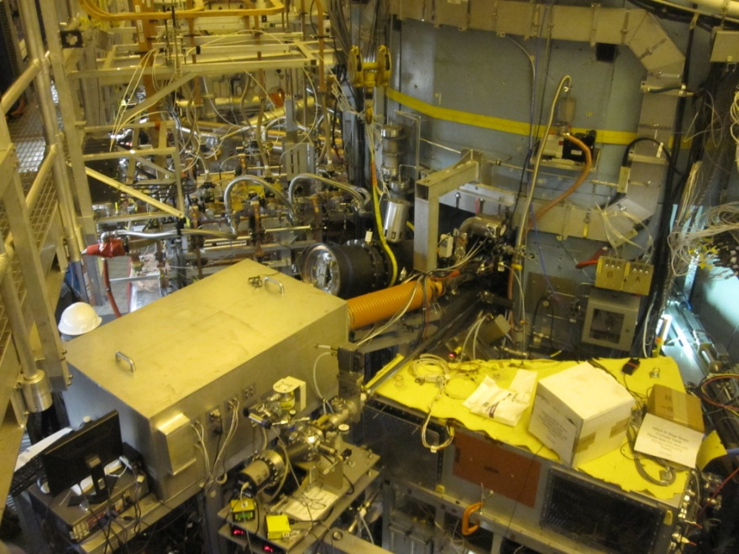
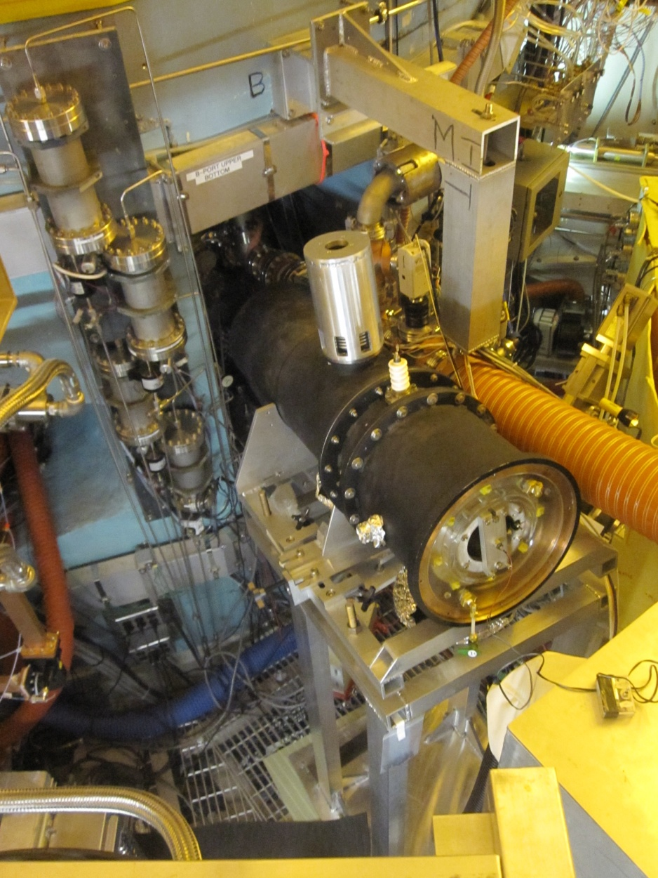
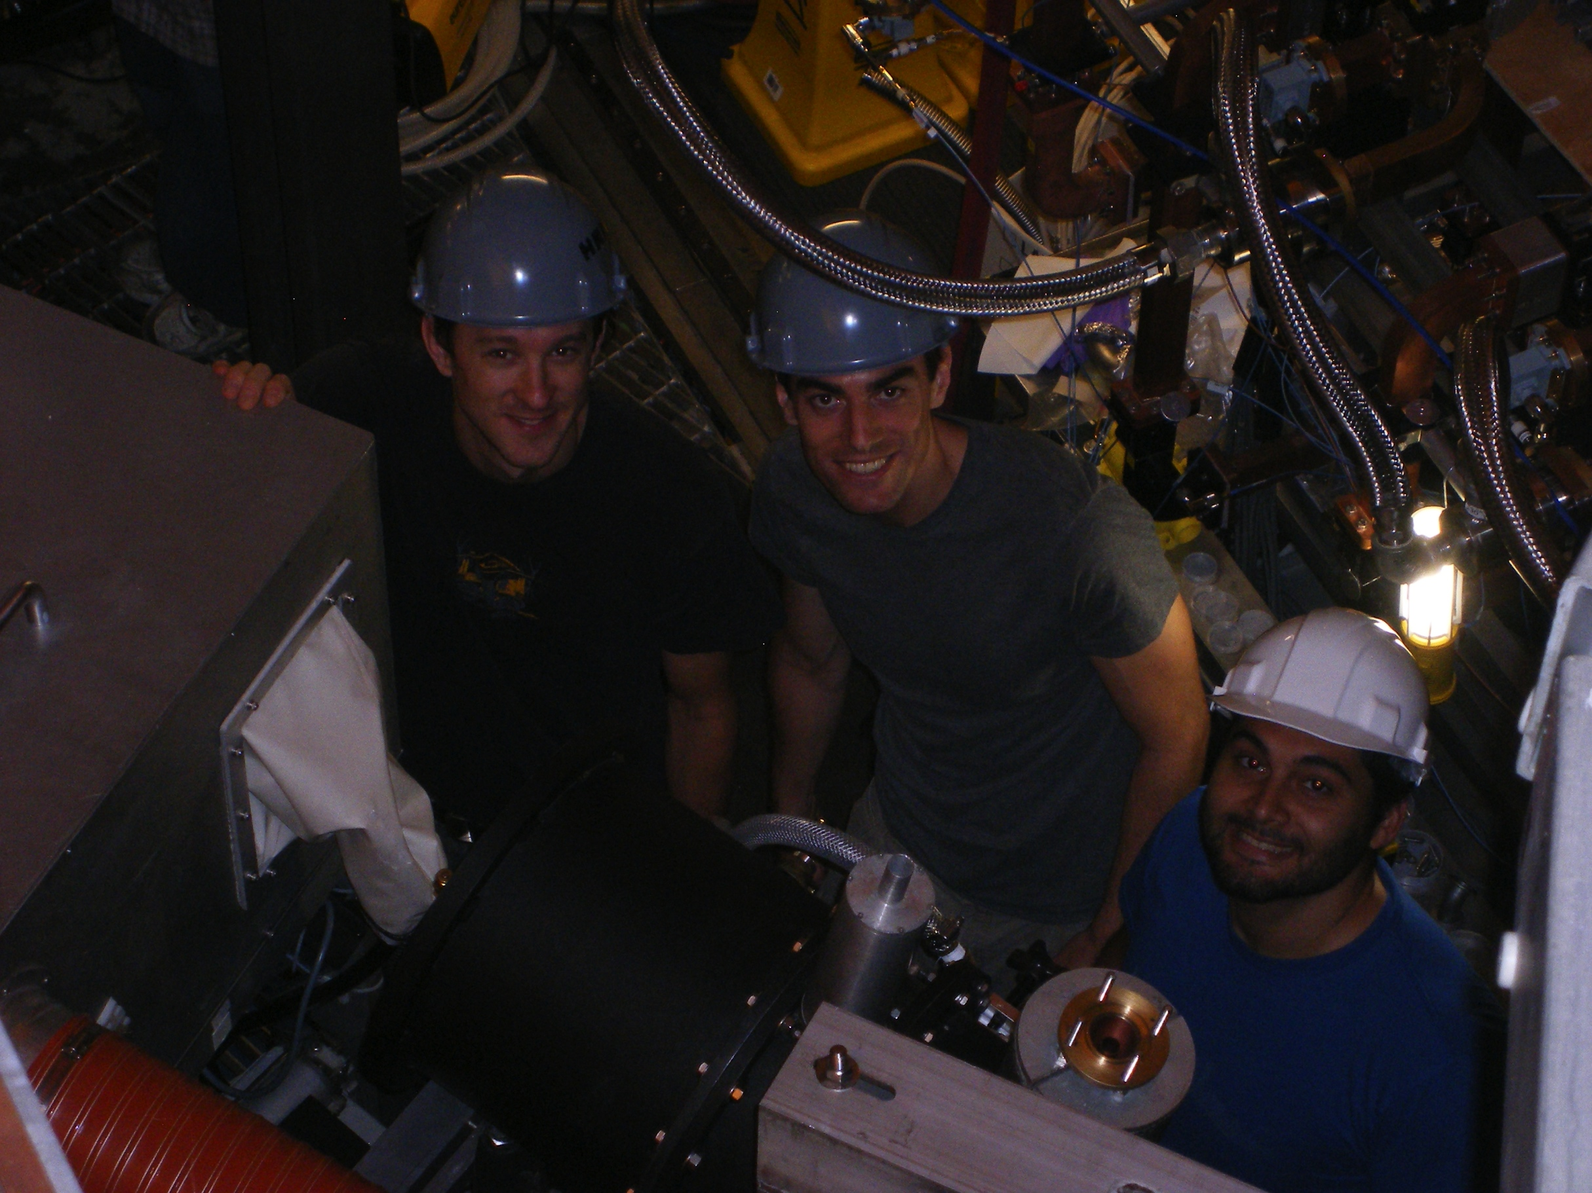
AIMS was installed on C-Mod

Slide 12
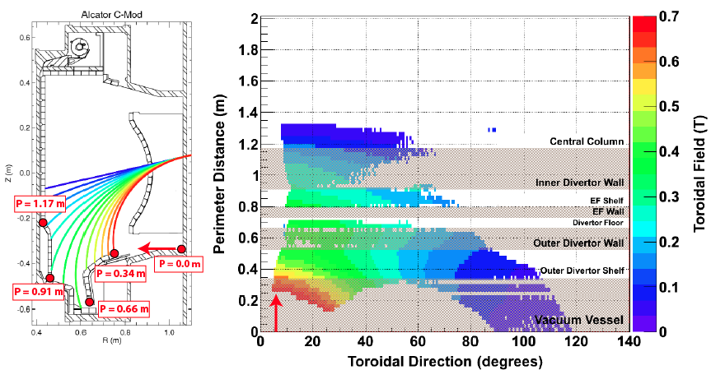
Beams can be steered poloidally and toroidally:
Will need to explore this with NSTX-U ~cw B capability + ports

Slide 13
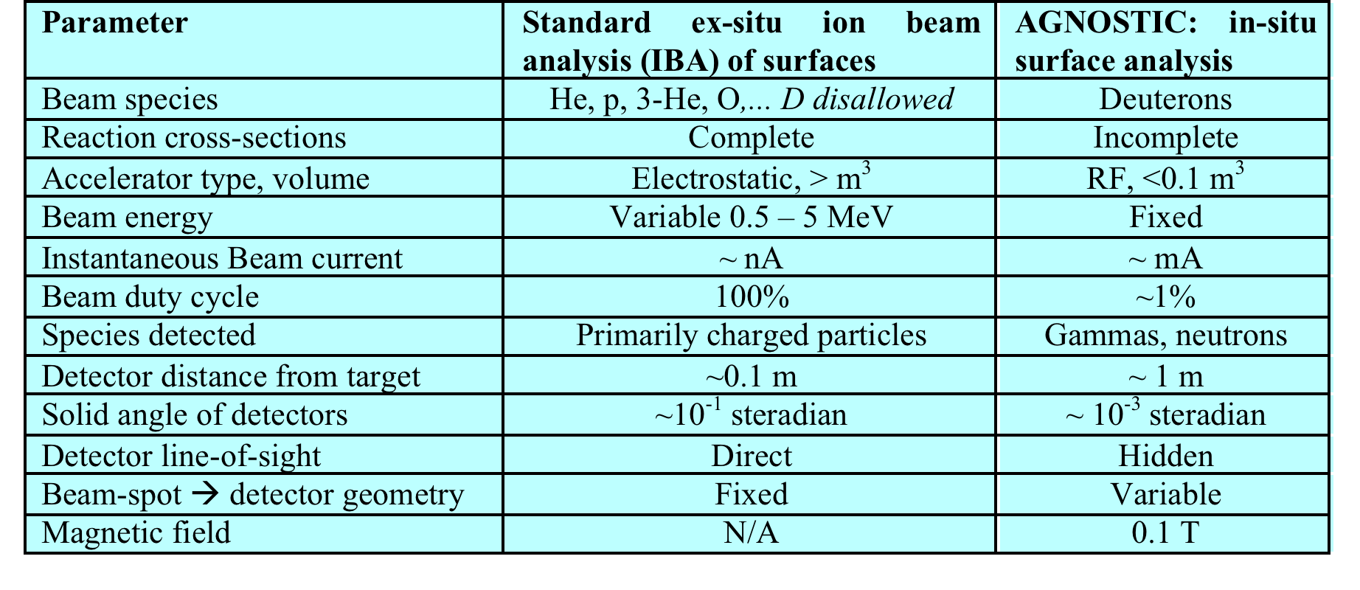
AIMS provides non-perturbing, quantitative measurement of surface isotopes/elements; but is effectively a re-invention of Ion Beam Analysis
Time [10 us/div]

Slide 14
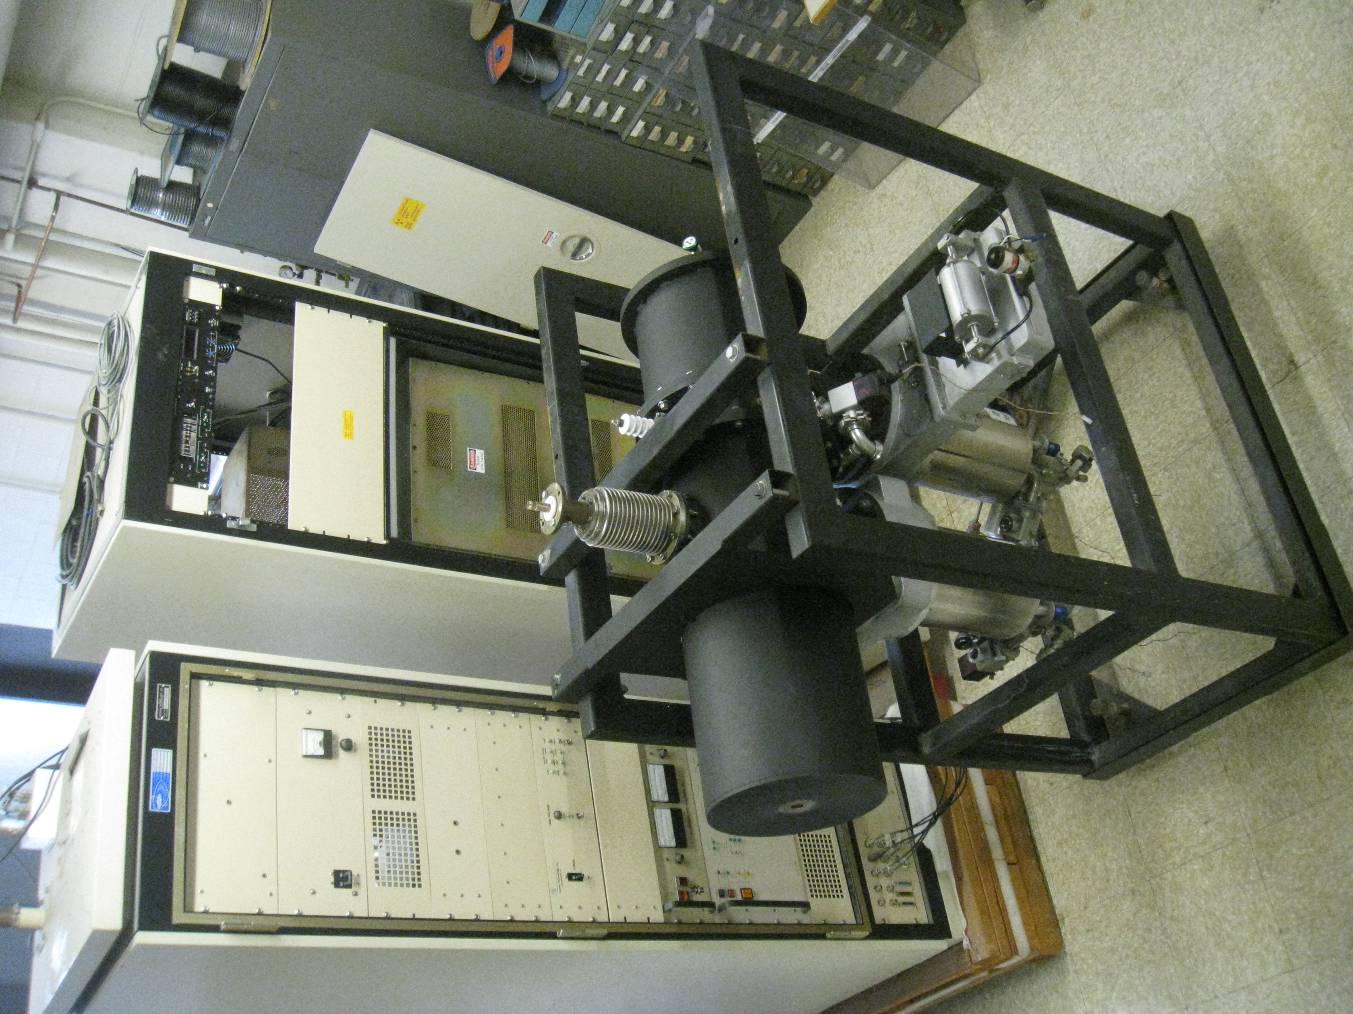
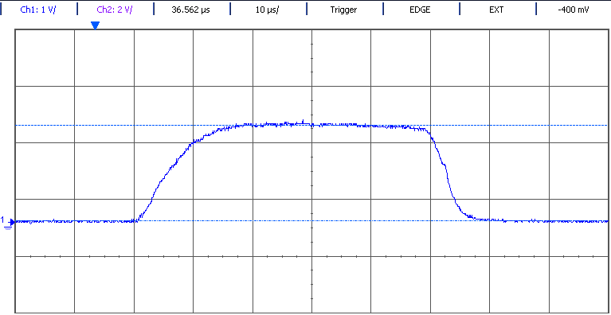
An 0.9 MeV deuteron RFQ accelerator has been completely refurbished and upgraded
~25 year old prototype RFQ (radiofrequency quadrupole)
accelerator from Accsys Inc has been completely
refurbished and modernized
  New RF tubes and coax; digital control
  systems; new vacuum system;
  ~0.9 MeV deuterons, < 2% duty factor,
  ~2 mA peak current, ~50 uA avg current
  Beam spot using permanent focusing quadru-
  pole magnets is ~1 cm at 2 m from RFQ exit
l
Voltage [1V/div] (Calibration 1V/mA)
50us, 2mA beam pulse
Time [10 us/div]

Slide 15
A compact LaBr₃:Ce scintillator coupled to an Si-APD provides high-resolution gamma spectroscopy
AGNOSTIC particle detection must
be performed in an extremely
hostile environment
● High neutron flux (~10¹³ m⁻² s⁻¹)
● High magnetic fields (< 0.1 T)
● Mechanical shock (~200 g)
● Compact geometry (~cm)
● High counts rates (<10⁵ / s)

Slide 16
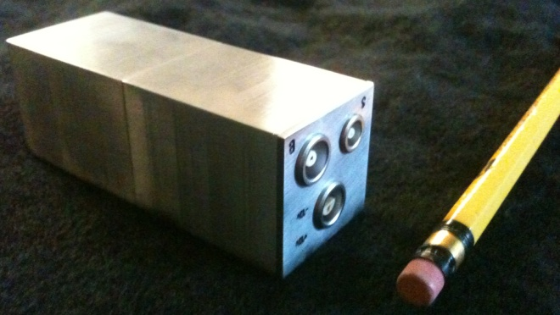
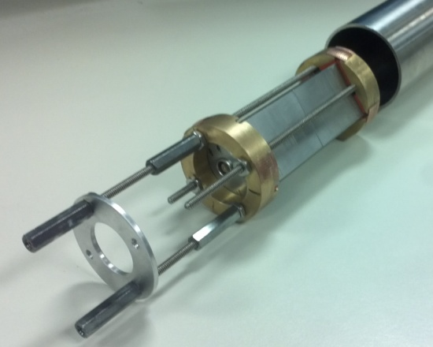
A compact LaBr₃:Ce scintillator coupled to an Si-APD provides high-resolution gamma spectroscopy
A photo of the LS detector next to a pencil for
scale (left) and within its reentrant cartridge (right)
AGNOSTIC particle detection must
be performed in an extremely
hostile environment
● High neutron flux (~10¹³ m⁻² s⁻¹)
● High magnetic fields (< 0.1 T)
● Mechanical shock (~200 g)
● Compact geometry (~cm)
● High counts rates (<10⁵ / s)
A 0.9 x 0.9 x 3.5 cm LaBr₃:Ce crystal coupled to a Hamamatsu silicon avalanche photodiode in a ruggedized stainless steel housing was fabricated by Saint-Gobain for AIMS

Slide 17
A compact LaBr₃:Ce scintillator coupled to an Si-APD provides high-resolution gamma spectroscopy
A photo of the LS detector next to a pencil for
scale (left) and within its reentrant cartridge (right)
AGNOSTIC particle detection must
be performed in an extremely
hostile environment
● High neutron flux (~10¹³ m⁻² s⁻¹)
● High magnetic fields (< 0.1 T)
● Mechanical shock (~200 g)
● Compact geometry (~cm)
● High counts rates (<10⁵ / s)
A 0.9 x 0.9 x 3.5 cm LaBr₃:Ce crystal coupled to a Hamamatsu silicon avalanche photodiode in a ruggedized stainless steel housing was fabricated by Saint-Gobain for AIMS
Energy resolution typically a factor of
2 to 3 better than NaI(Tl) detector; photo-
peak statistics excellent despite 30x smaller sensitive volume than NaI(Tl) detector
LS Detector response to 661.7 keV gammas

Slide 18
Advanced digital detector waveform acquisition and post-processing enable AIMS particle detection
Pulse
inspection
Discrimin-
ators
Baseline
restorers
Timers
Integrat-
ors
Particle (n/γ)
discrimination
LaBr₃
Waveform
Digitizers
With DPP
Digital
memory
EJ301
Spectroscopy
= Digital operations replace analog electronics
= Digital memory enables off-line analysis
Pile-up
deconvolution

Slide 19
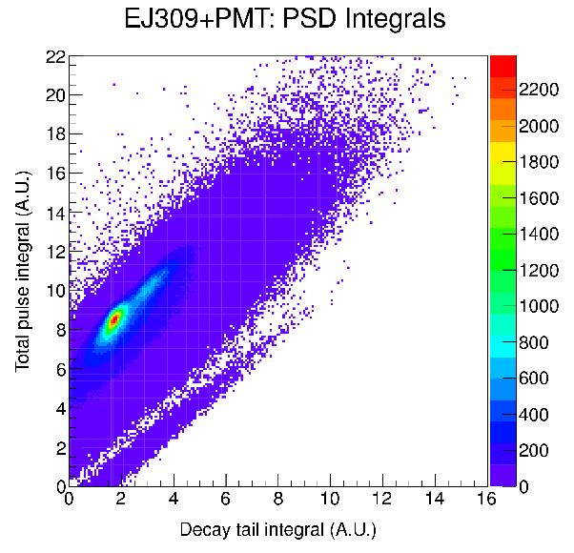
Advanced digital waveform acquisition and post-processing enable AIMS particle detection
Gammas
Neutrons
Pulse
inspection
Discrimin-
ators
Baseline
restorers
Timers
Integrat-
ors
Particle (n/γ)
discrimination
LaBr₃
Waveform
Digitizers
With DPP
Digital
memory
EJ301
Spectroscopy
= Digital operations replace analog electronics
= Digital memory enables off-line analysis
Pile-up
deconvolution

Slide 20
Advanced digital detector waveform acquisition and post-processing enable AIMS particle detection
Pulse
inspection
Discrimin-
ators
Baseline
restorers
Timers
Integrat-
ors
Particle (n/γ)
discrimination
LaBr₃
Waveform
Digitizers
With DPP
Digital
memory
EJ301
Spectroscopy
= Digital operations replace analog electronics
= Digital memory enables off-line analysis
Pile-up
deconvolution

Slide 21
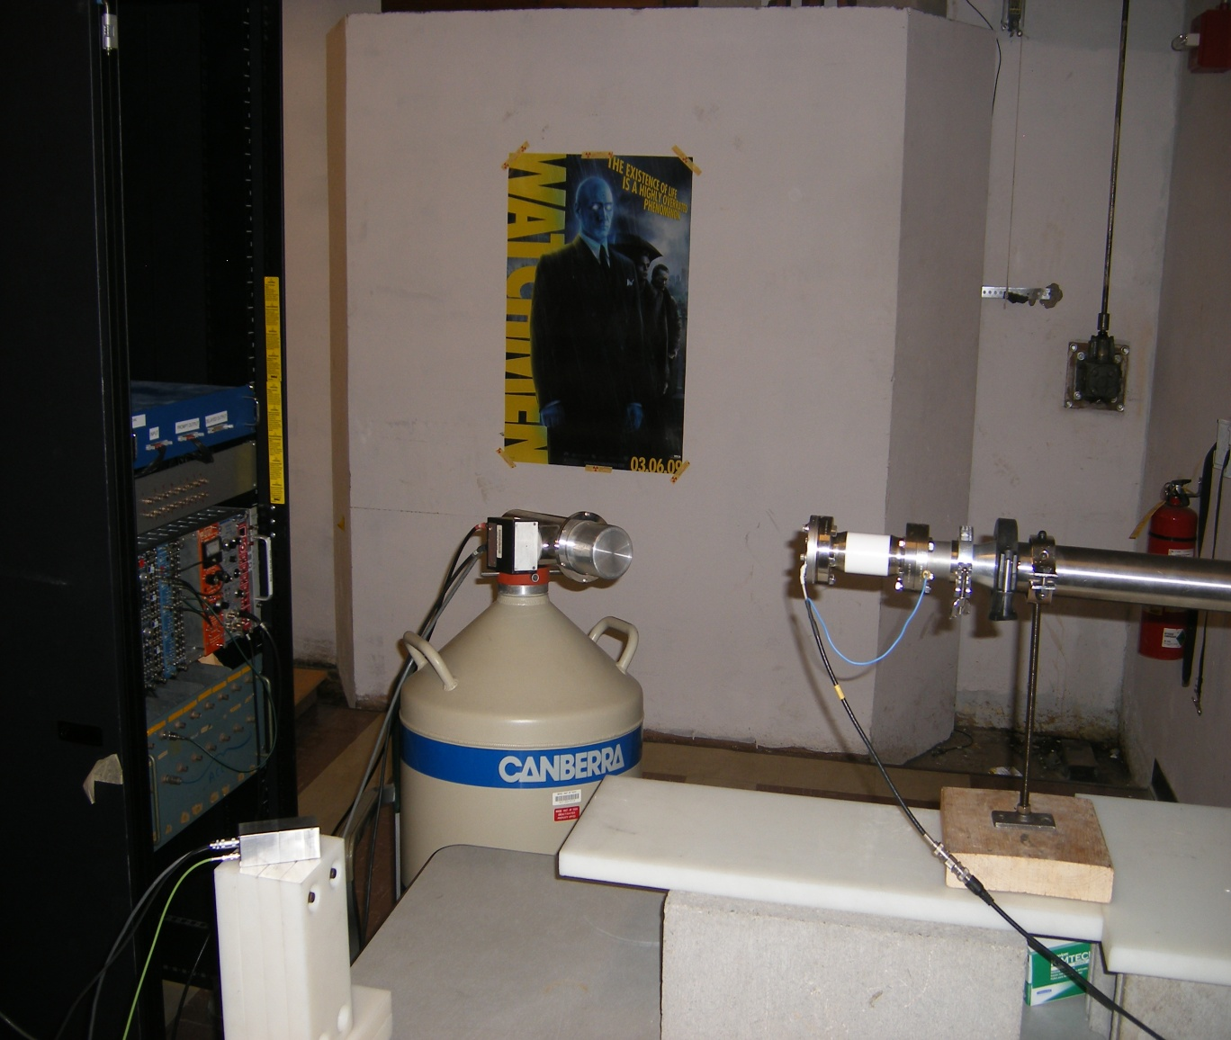
Mockup first-wall measurements were conducted with AIMS in the laboratory
Experiments to simulate the actual PWI measurements on C-Mod were conducted ex-situ in the laboratory
Beam: ~0.9 MeV Deuterons
0.1% duty cycle
50 us bunches
30 Hz rep rate
Target: C-Mod Molybdenum PFC Tiles from inner wall
Objective: Validate ability to monitor wall conditions by quantifying boron and oxygen isotopes
C-Mod vacuum
vessel
Neutrons
PFCs
LaBr3-SiAPD
gamma detector
~900 keV
Deuterons
Gamma rays
Gamma rays

Slide 22
AIMS “proof-of-principle” measurements in the laboratory & C-Mod

Slide 23
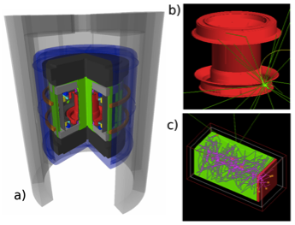
ACRONYM (built on GEANT4) provides full 3-D particle tracking → quantitative interpretation of gamma/neutron spectra through synthetic diagnostics of detectors

Slide 24
Key issues to consider for interfacing AIMS
Port availability for both RFQ and the detectors.
Footprint of RF + HV cabinets that drive RFQ
Beam steering capacity (port + cw B field) and optimization
Radiation safety: RFQ operations require shielding → interlocks to cell access.
Interface to operations: RFQ operations + detectors
Lithium detection schemes to be explored by MIT team
  Know that both Li-6 and Li-7 have high Q nuclear reactions with D but we have to scope detection methods for gammas and neutrons.

Slide 25
Questions

