Slide 1







H-mode confinement and ELM characteristics study in KSTAR
J-W. Ahnª
H.S. Han^{b}, H.S. Kim^{c}, J.S. Ko^{b}, J.H. Lee^{d}, J.G. Bak^{b}, C.S. Chang^{e}, D.L. Hillisª, Y.M. Jeon^{b}, J.G. Kwak^{b}, J.H. Lee^{b}, Y. S. Na^{c}, Y. K. Oh^{b}, H. K. Park^{d}, J.-K. Park^{e}, Y. S. Park^{f}, S. Sabbagh^{f}, S. W. Yoon^{b}, and G. S. Yun^{d}
ªOak Ridge National Laboratory, Oak Ridge, TN, USA
^{b}National Fusion Research Institute, Daejeon, Korea
^{c}Seoul National University, Seoul, Korea
^{d}Pohang University of Science and Technology, Pohang, Korea
^{e}Princeton Plasma Physics Laboratory, Princeton, NJ, USA
^{f}Columbia University, New York, NY, USA
NFRI – PPPL collaboration meeting
October 21 – 22, 2013

Slide 2
Outline
L-H power threshold and H-mode confinement study
Characterization of various types of ELMs
  ELM categorization
  Magnetics and ECEI data
  Preliminary stability analysis
Study of Small ELM regime
Summary

Slide 3
Outline
L-H power threshold and H-mode confinement study
Characterization of various types of ELMs
  ELM categorization
  Magnetics and ECEI data
  Preliminary stability analysis
Study of Small ELM regime
Summary

Slide 4
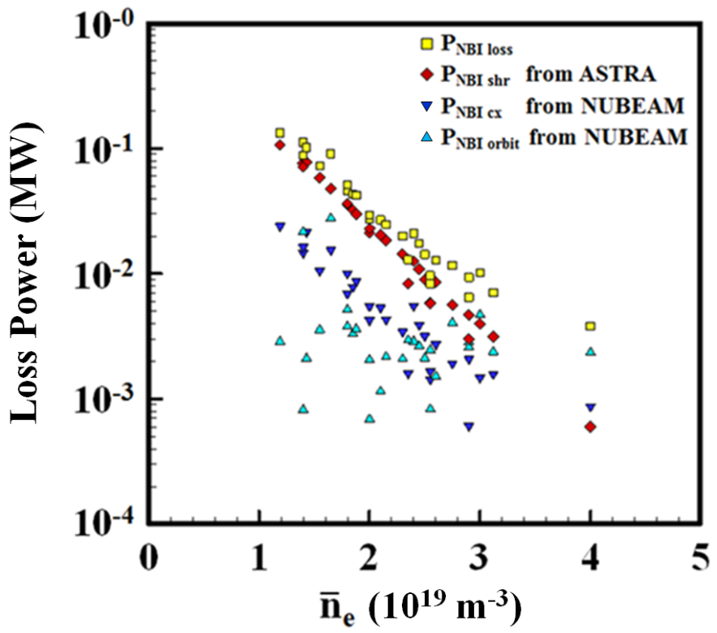
Fast ion component is calculated by ASTRA
Weiland pedestal model → W_{fast}~10-30% of W_{tot}
W_{fast} is found to be a strong function of density
→ Effect of fast ion confinement more important in low density
4

Slide 5
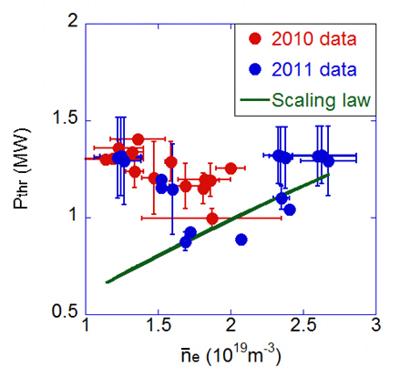
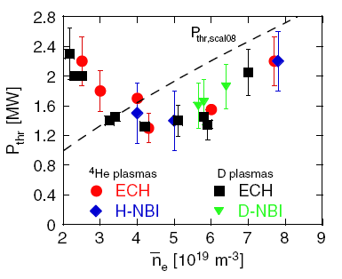
Power scan yielded P_{thr} roll-over in low density
KSTAR, Ahn, NF 52 (2012), 114001
ASDEX-U, Ryter, NF 49 (2009), 062003
Evaluated P_{thr} agrees with multi-machine scaling law above ~2x10¹⁹m⁻³
Roll-over of P_{thr} below ~2x10¹⁹m⁻³. Similar to results from other tokamaks
Higher P_{thr} in 2012 due to impurity and higher H/D ratio
5

Slide 6
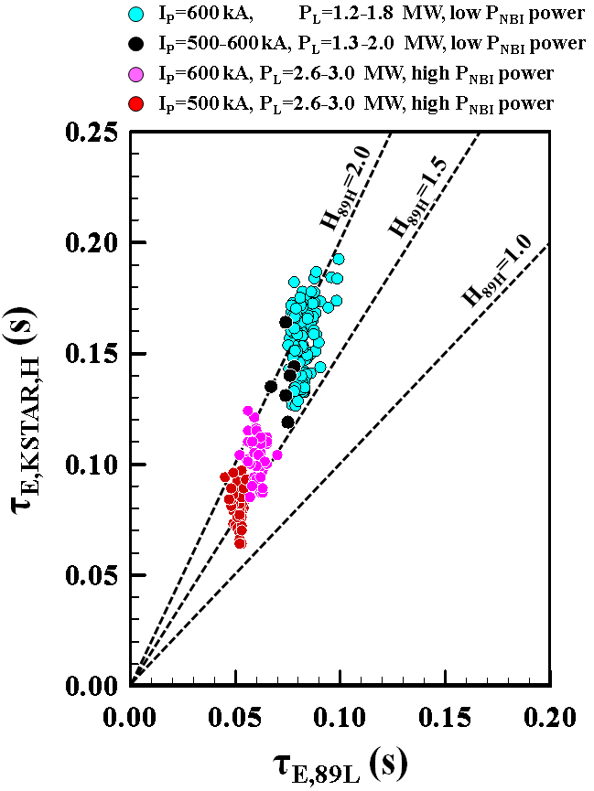
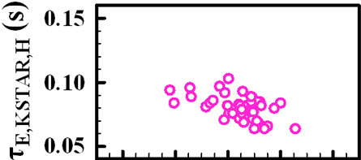
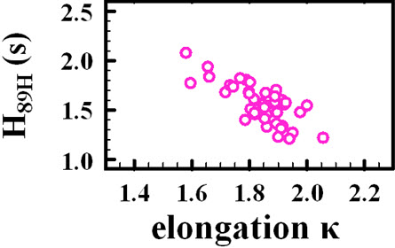
Dependence on I_{p} and power agrees but κ disagrees with multi-machine scaling
Selected H_{89p} database for I_{p}, power, and κ dependence
Clear positive dependence on I_{p} and negative on power → consistent with scaling law
Why confinement degrades with κ?
→ Wall condition & high impurity??
H.S. Kim (SNU)

Slide 7

Isotope effect on P_{thr} and τ_{E}
Results from other machines
  P_{thr} $∝$ A_{i}⁻¹ and τ_{E} $∝$ A_{i}^{α} (α =0.2 – 0.5)
  Results from KSTAR
  Clear increase of P_{thr} for 2012 data (H/D=0.5 – 0.6, P_{thr} > 1.5 MW), compared to 2011 data (H/D=0.2 – 0.4, P_{thr} ~ 1MW)
  Confinement also decreases with higher H/D ratio
J.S. Ko
(NFRI)

Slide 8
Outline
L-H power threshold and H-mode confinement study
Characterization of various types of ELMs
  ELM categorization
  Magnetics and ECEI data
  Preliminary stability analysis
Study of Small ELM regime
Summary

Slide 9
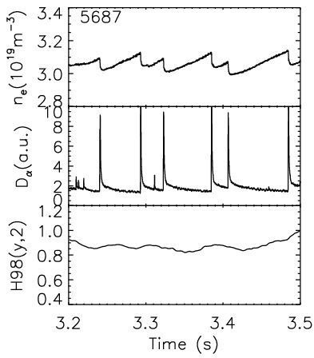
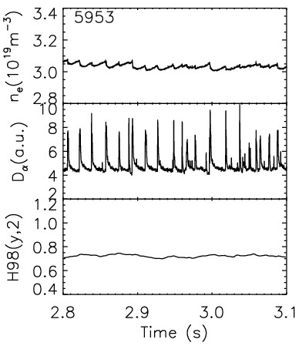
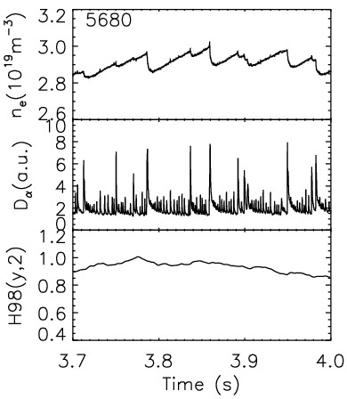
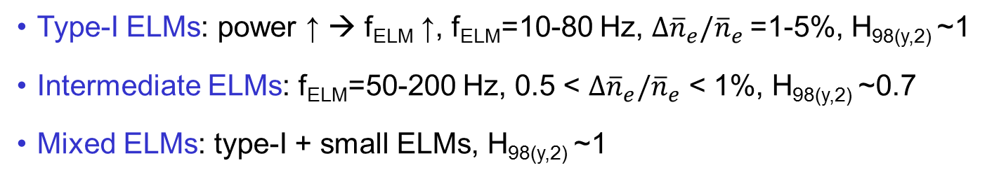
Multiple types of ELMs have been observed
Type-I ELMs
Intermediate ELMs
Mixed (type-I + small) ELMs
Type-I ELMs: power ↑ → f_{ELM} ↑, f_{ELM}=10-80 Hz, $∆{\overline{n}}_{e}/{\overline{n}}_{e}$=1-5%, H_{98(y,2)} ~1
Intermediate ELMs: f_{ELM}=50-200 Hz, 0.5 < $∆{\overline{n}}_{e}/{\overline{n}}_{e}$ < 1%, H_{98(y,2)} ~0.7
Mixed ELMs: type-I + small ELMs, H_{98(y,2)} ~1

Slide 10
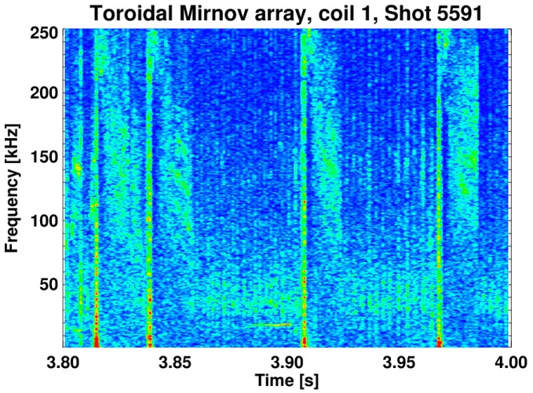
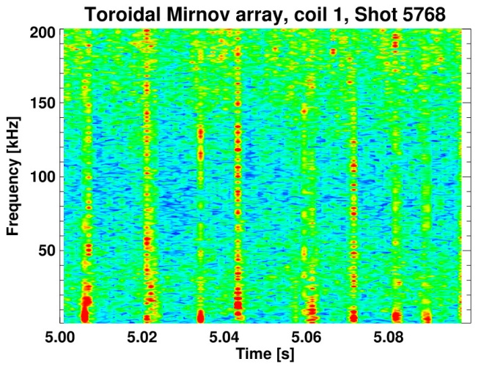
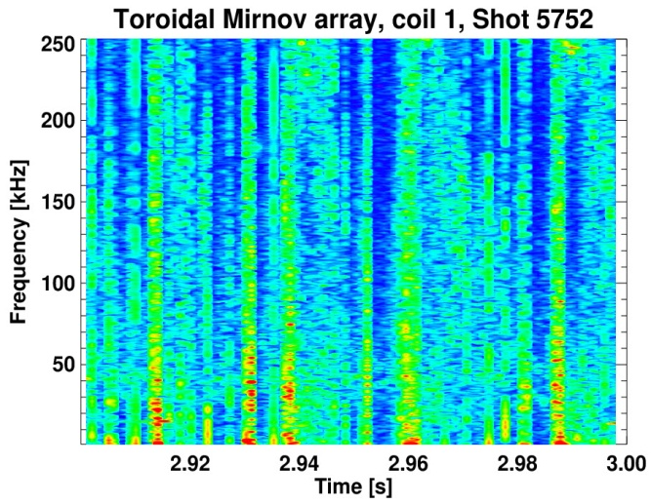
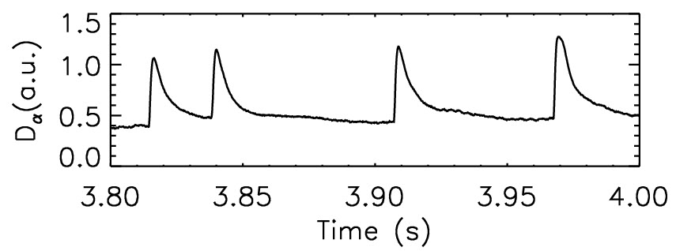
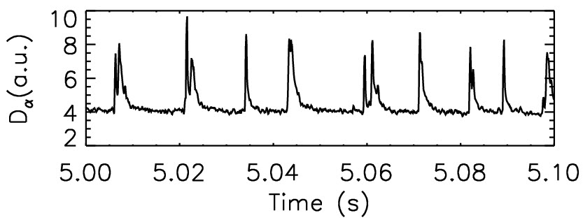
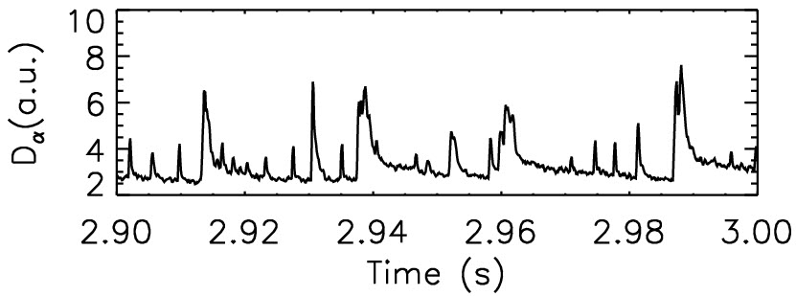
Magnetics data show distinctive features for each ELM type
Type-I ELMs
Intermediate ELMs
Mixed ELMs
precursors
Type-I ELMs: long lasting (> 20 ms) ELM precursors, low fluctuation level for inter-ELM periods
No precursor for intermediate and mixed ELMs
Broadband fluctuations for inter-ELM periods for intermediate ELMs

Slide 11
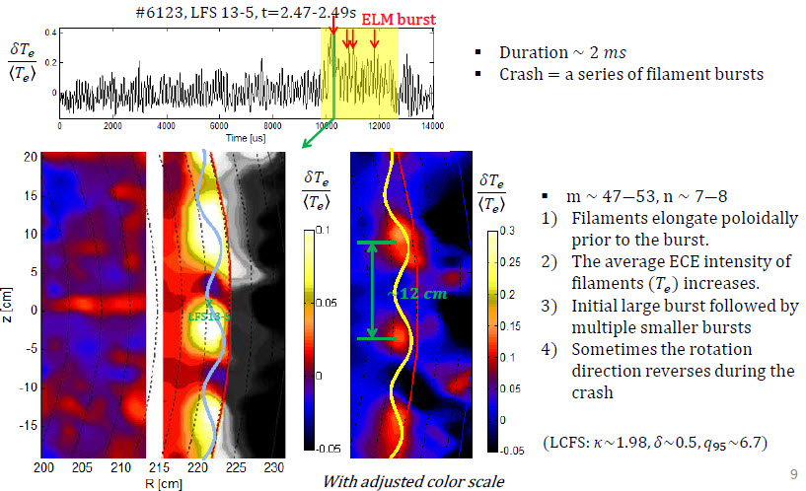
ECEI data provides mode number of ELMs
J.H. Lee (Postech)

Slide 12
Preliminary stability analysis identifies most unstable mode at n~5 for type-I ELMs
  1. #5747@3.7s , ELITE results
from n=5 to n=30
Most unstable mode identified at n~5
More detailed and accurate profile measurement is necessary for stability analysis
  2. #7257@4.5s , MISHKA(n<5) &ELITE results
(n=4)
H.S. Han (NFRI)
12

Slide 13
Outline
L-H power threshold and H-mode confinement study
Characterization of various types of ELMs
  ELM categorization
  Magnetics and ECEI data
  Preliminary stability analysis
Study of Small ELM regime
Summary

Slide 14
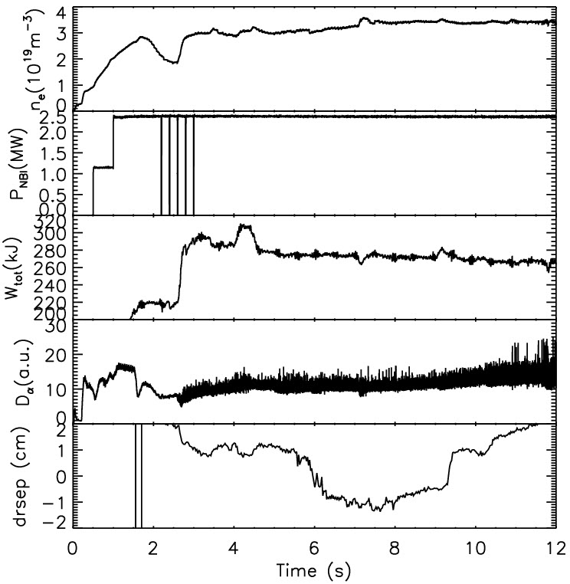
Access to the small ELM regime occurred in a significantly wide operation window
H-mode
Small ELMs occurred at KSTAR in 2011 and 2012 with,
  n_{e}/n_{G} < 0.4
  DN, USN, LSN (|drsep| ≤ 2cm)
  Bean configuration (weak concave on the inner side, limited plasma)
  Up to ~10 s of small ELM phase in 2012: I_{p}=0.6MA, B_{t}=2T, P_{NBI}=2.5MW
7075
LSN
DN
USN

Slide 15
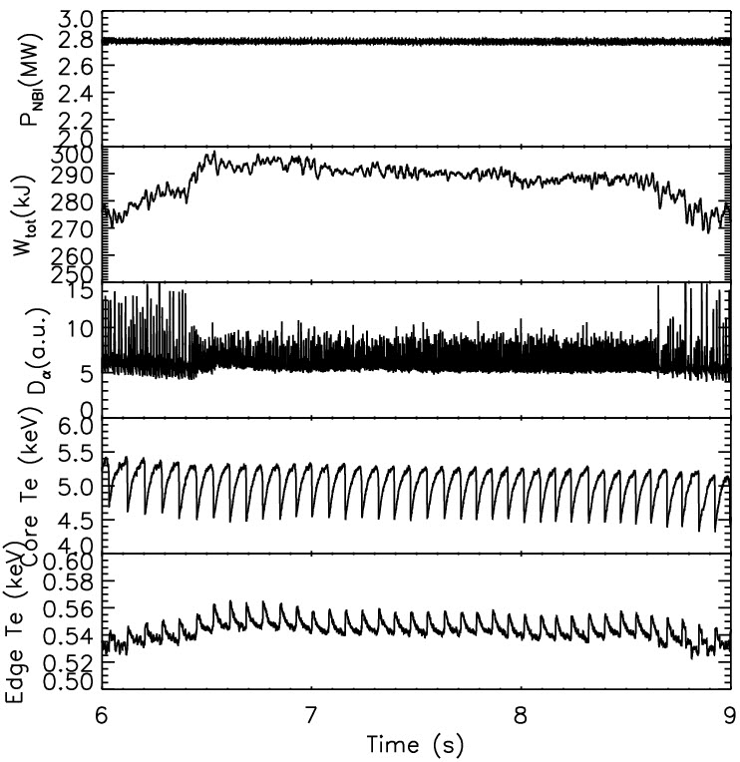
A sustained small ELM regime was successfully produced by controlling plasma shape
Sustained small ELM period
Strong LSN → weaker LSN with |drsep| = 3-4 → 1-2 cm induced small ELMs
Upper triangularity was also raised to create small ELM regime (δ_{top}=0.3 → 0.45)
Plasma stored energy increased during the small ELM period
Edge T_{e} also goes up while core T_{e} remains constant
8155
15

Slide 16
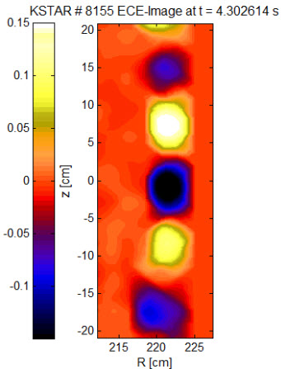
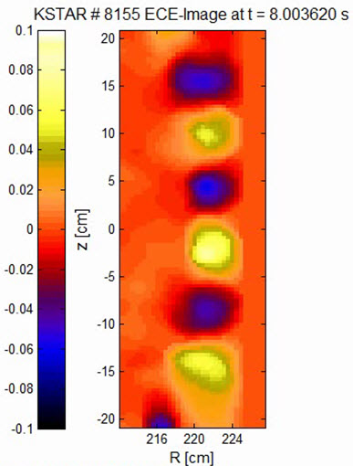
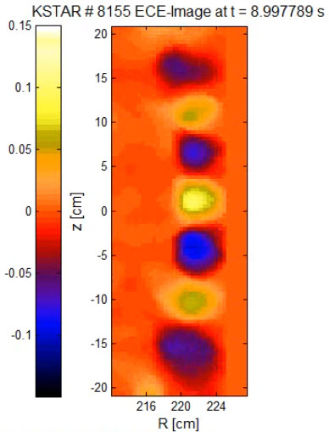
Similar or decreased mode number for small ELMs compared to type-I from ECEI data
Small ELM, t = 4.3 sec
(transient)
Small ELM, t = 8 sec
(sustained)
Large ELM, t = 9 sec
ECEI data from J.H. Lee (Postech)
Small ELMs have similar or lower mode number than large ELMs → Contrary to type-II ELMs (increased mode number)
Higher edge T_{e} and lower n-number → Small ELMs may be on the peeling side

Slide 17
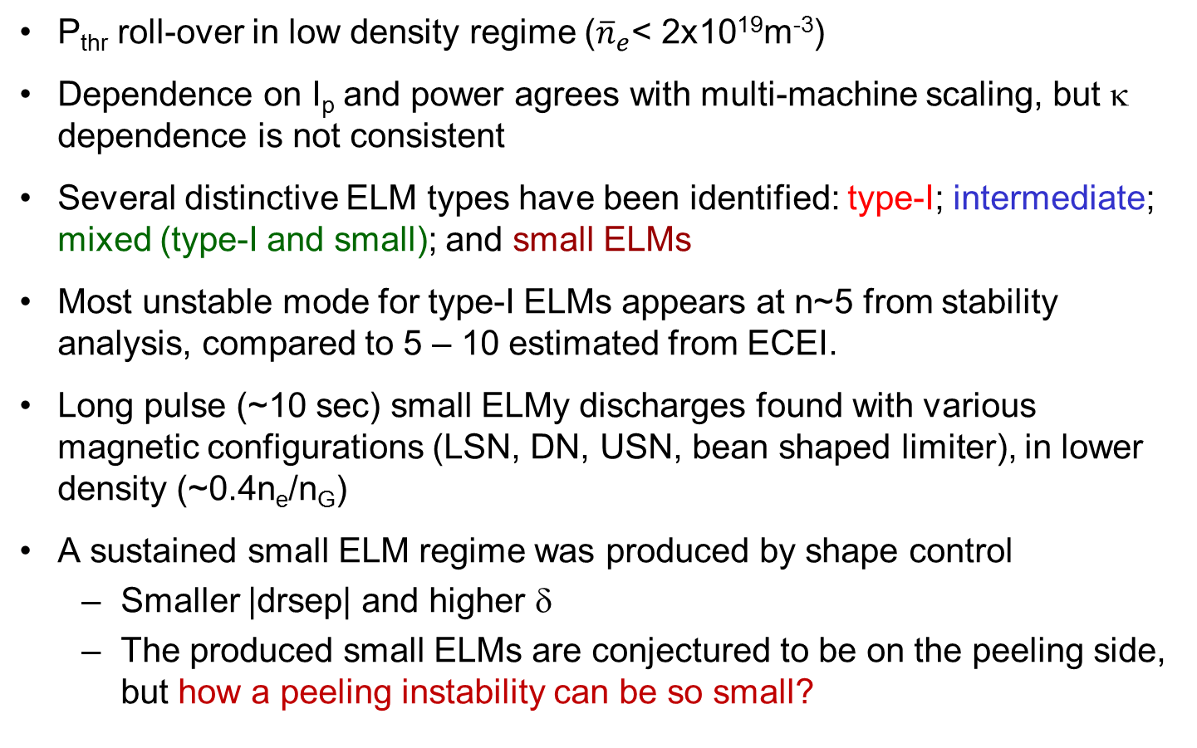
Summary
P_{thr} roll-over in low density regime (${\overline{n}}_{e}$< 2x10¹⁹m⁻³)
Dependence on I_{p} and power agrees with multi-machine scaling, but κ dependence is not consistent
Several distinctive ELM types have been identified: type-I; intermediate; mixed (type-I and small); and small ELMs
Most unstable mode for type-I ELMs appears at n~5 from stability analysis, compared to 5 – 10 estimated from ECEI.
Long pulse (~10 sec) small ELMy discharges found with various magnetic configurations (LSN, DN, USN, bean shaped limiter), in lower density (~0.4n_{e}/n_{G})
A sustained small ELM regime was produced by shape control
  Smaller |drsep| and higher δ
  The produced small ELMs are conjectured to be on the peeling side, but how a peeling instability can be so small?

Slide 18
Backup slides

Slide 19
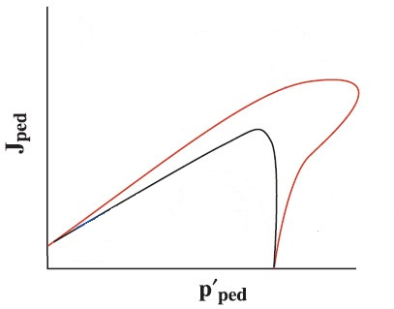
Possible explanation of the produced small ELMs
Large ELM regime:
  Strong LSN (|drsep| = 3-4 cm)
  Weaker shaping (smaller δ)
  Small ELM regime:
  Closer to DN (|drsep| = 1-2 cm), stronger shaping (higher δ) → expansion of stability boundary
8155
Stronger shaping
small ELM
Weaker shaping
large ELM
  T_{e,ped} increase → edge collisionality decrease → j_{b} increase leads to higher j_{ped}
  Mode number of ELM filaments remains similar or slightly decrease → Peeling instability
Move of operation point to the upper side
Question: how the ELM crash on the peeling side can be so small?

Slide 20
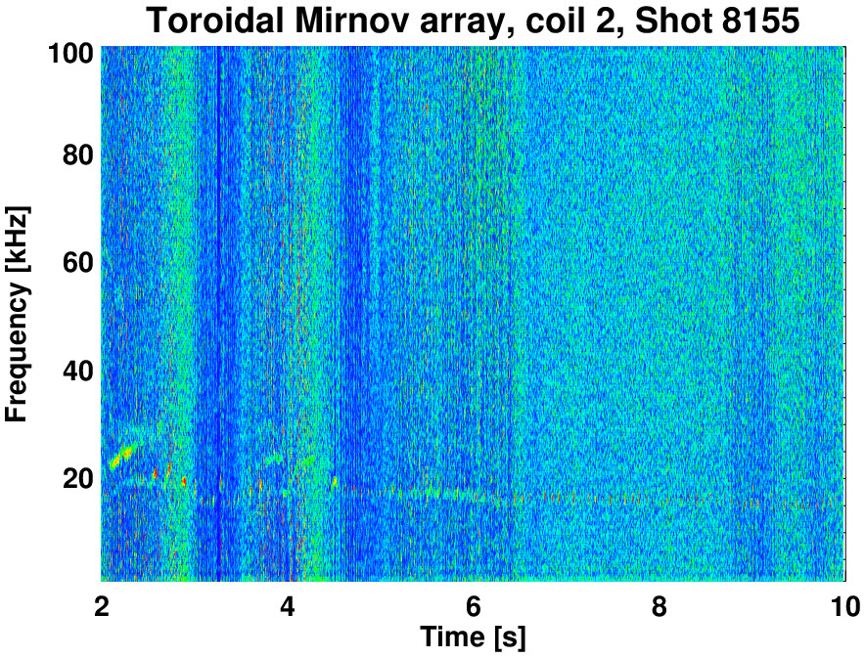
Increased broadband magnetic fluctuations are observed for all small ELM periods
Small ELM periods
Enhanced magnetic fluctuations are observed during the small ELM periods for the whole frequency range (0 – 100kHz) of Mirnov measurement. No coherent mode is found
This is different from any other small ELM regimes

