Slide 1
RF System and Coupling Collaboration
R. Ellis, J. Hosea, N. Bertelli, E. Kolemen, R. Perkins
Presented at NFRI – PPPL Collaboration Meeting
October 21, 2013
Princeton, NJ

Slide 2
Presentation Overview
ECH Collaboration
Introduction to KSTAR ECH Launchers
Long-pulse mirror upgrades
Steady-State mirror upgrade program
NTM stabilization study with fast mirror steering
ICRF Collaboration
ICRF power coupling improvement
Understanding power deposition

Slide 3
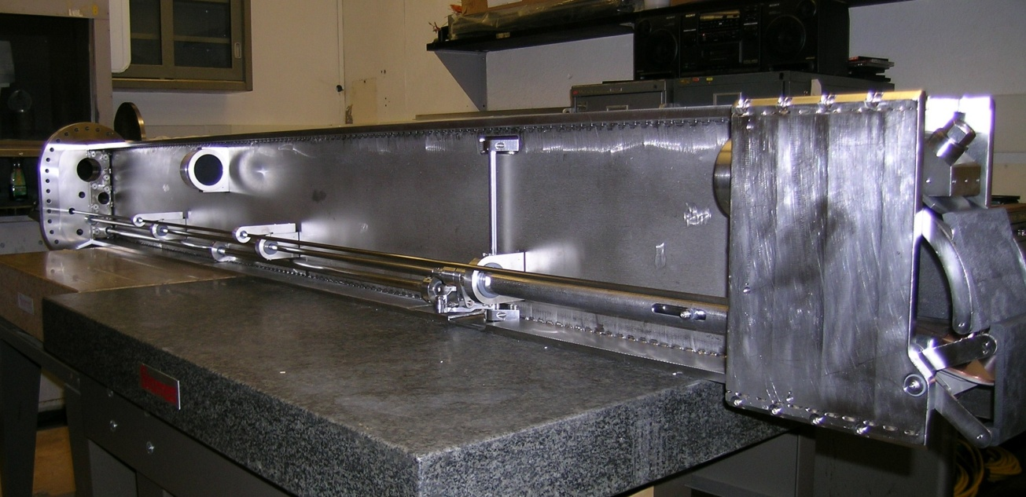
PPPL has supplied two ECH launchers based on our DIII-D ECH launchers
First launcher supplied in 2006; second in 2011.
Original launcher was designed for 500kW, 2 sec, 84 or 110GHz, upgraded to 1MW, 5-10 sec.
Second launcher was designed for 1MW, 5-10 sec, 170GHz, upgraded to 1.5MW, 15 sec.
Electric motors and absolute encoders for poloidal and toroidal steering.
Full co-to-counter toroidal steering, vertical coverage of more than half of plasma.
We are preparing mirror upgrades that will allow steady-state operation of existing launchers.
If cost sharing [$300k + $300k] is available, we plan to build another single-channel steady-state launcher.
Adequate power for NTM stabilization and rotation profile control.

Slide 4
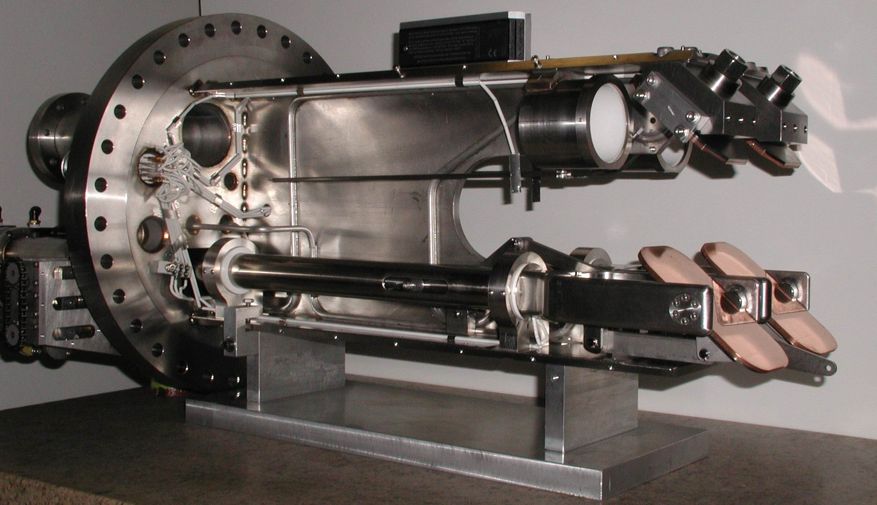
View of mirror arrangement [DIII-D Launcher shown]
fixed
steerable

Slide 5
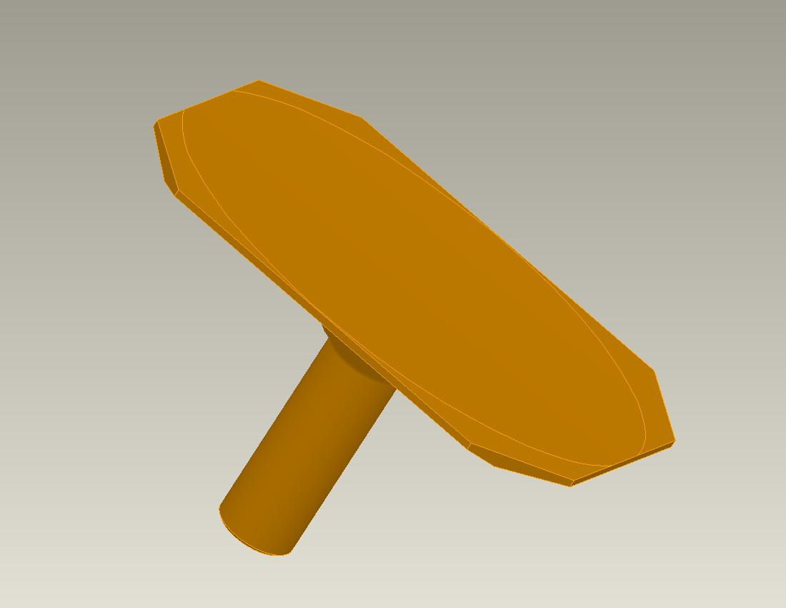
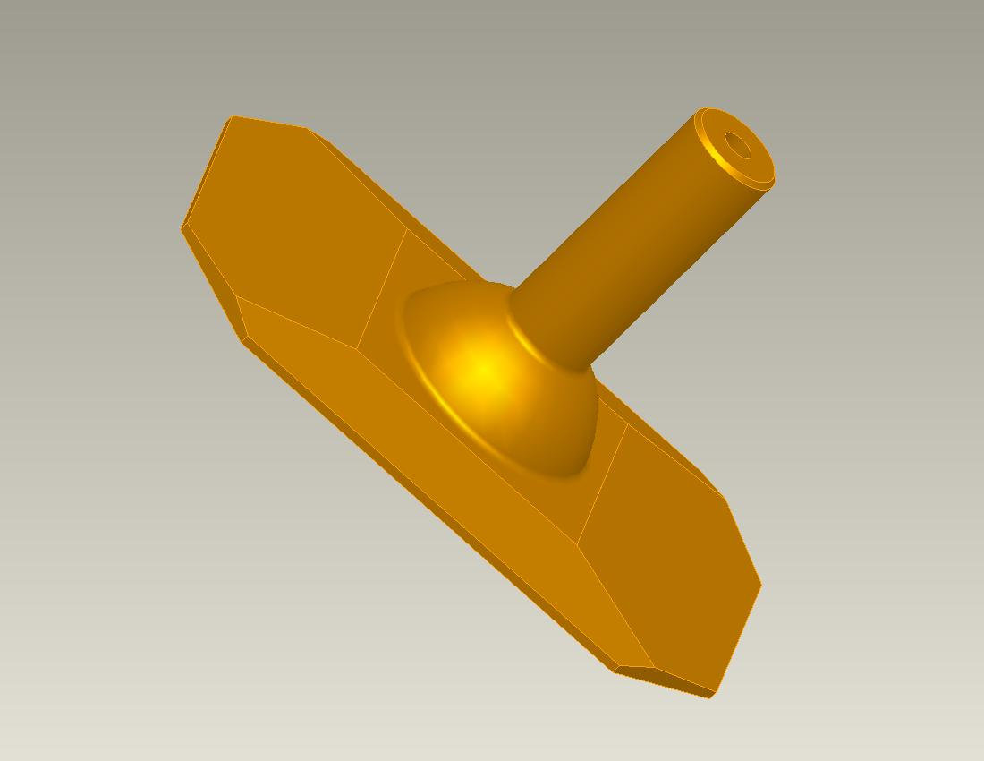
The long pulse fixed mirror is solid Glidcop Al-15, with the rear surface tapered.
RTD location

Slide 6
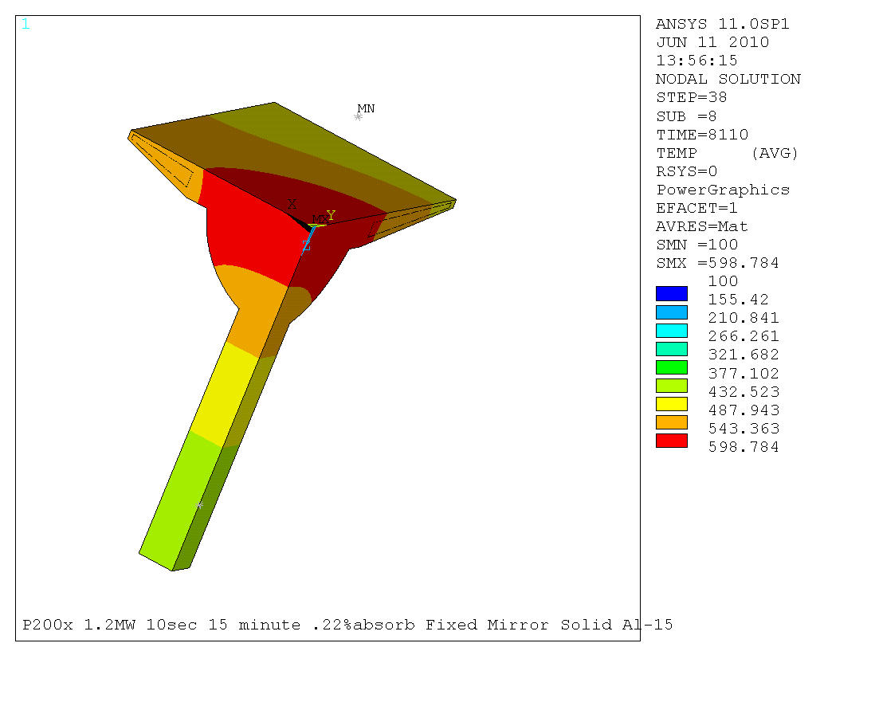
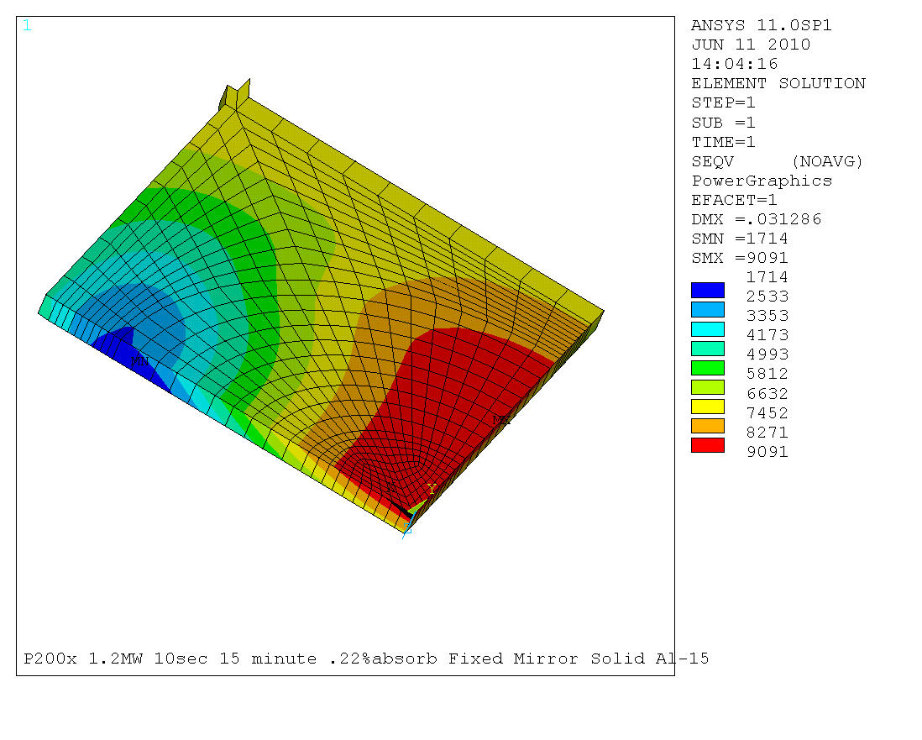
Peak temperatures and stresses in Glidcop mirror are acceptable even when absorption is increased to .22%
Temperature distribution after 10-second pulse.
13.1ksi

Slide 7
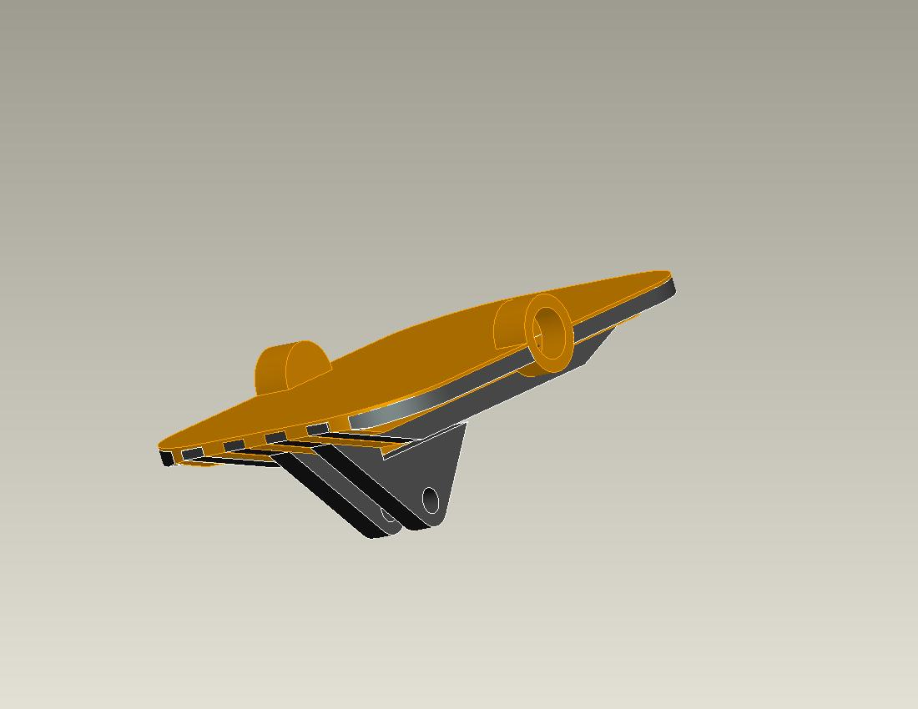
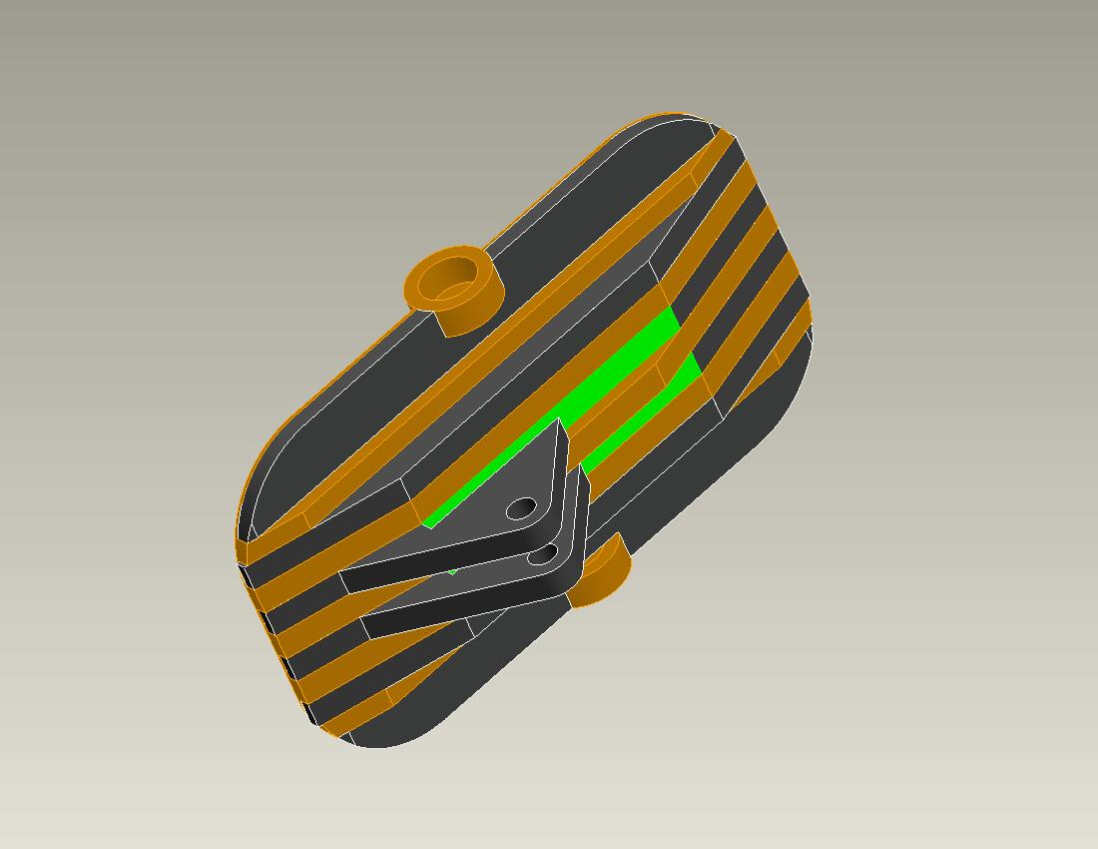
The long pulse steerable mirror is made from a copper alloy block with inlaid stainless steel bars.
Green inlaid bars are also copper.

Slide 8
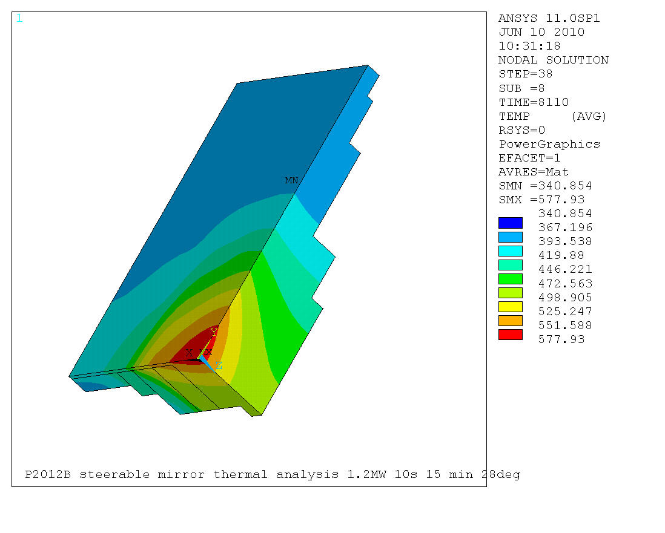
The upgraded, passively cooled mirror incorporates a CuCrZr front surface, central volume
Front surface is .031” [0,8mm] thick, silver plated.
Central volume is 2” [50,8mm] * 1.25” [31,8mm] * .625” [15,9mm], C182.
Temperatures are reduced substantially compared to the old design.
Analysis has 1.2MW at mirror, radiation to 100C sink. 10 pulses, 10s, 15 min.

Slide 9
The Development of a steady-state mirror is the first step towards a steady-state launcher
We propose to start with an actively cooled, fixed mirror to be installed on the 170GHz (2011) launcher.
2014 campaign.
The design goals for a steady-state mirror are challenging:
1MW power at source [800kW at mirror] for 2.5” [64mm] diameter beam.
.16% absorbed by mirror.
Larger size than existing mirror for improved beam optics.
Compatible with existing launcher and its design requirements.
Must withstand eddy current forces due to disruptions.
An initial prototype verified the feasibility of our design concept.
Thick front surface for survivability and fault tolerance.
Modest film coefficient and flow rate for coolant.
Further effort has resulted in a design, backed by analysis, of a steady-state fixed mirror.
The steady-state steerable mirror will be based on this fixed mirror.

Slide 10
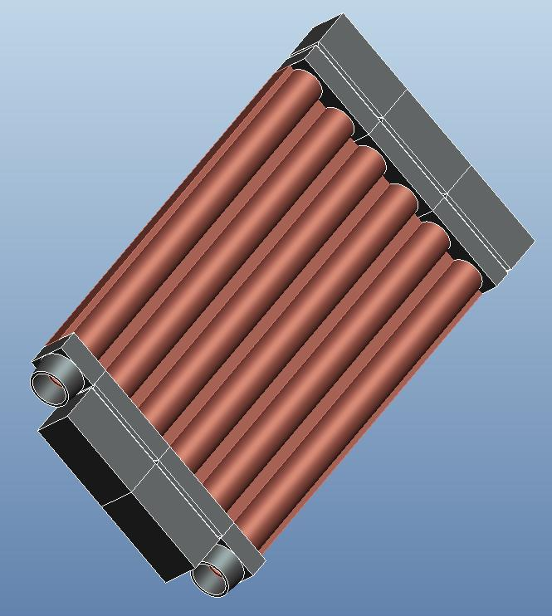
A new prototype has been designed
Protected coolant u-bends
Refined internal plumbing for better survivability.
Constructed from C18150 and 304SS, using brazing techniques developed for DIII-D ECH mirrors.
Thermal and thermal stress analyses have been performed.
Electromagnetic forces, and their resulting stresses, have been analyzed.

Slide 11
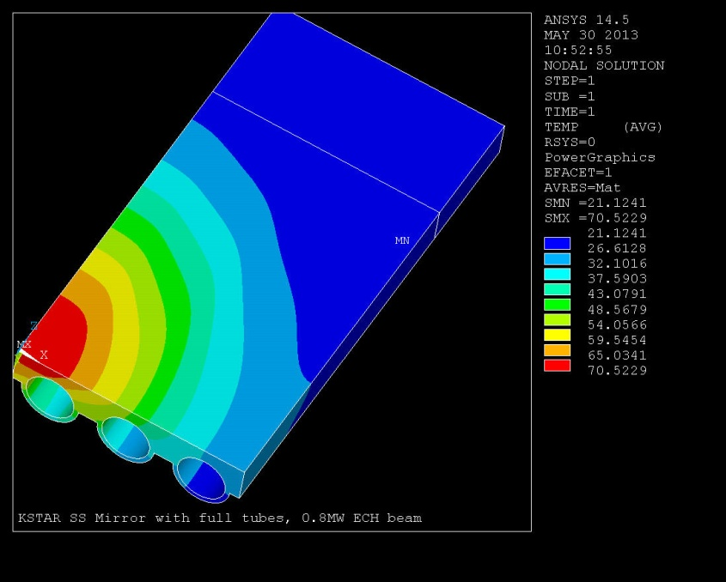
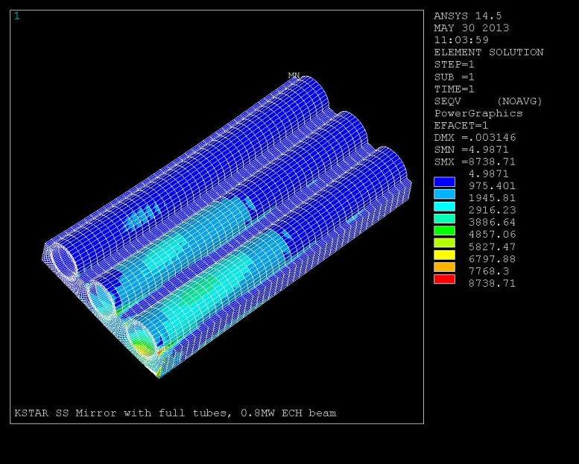
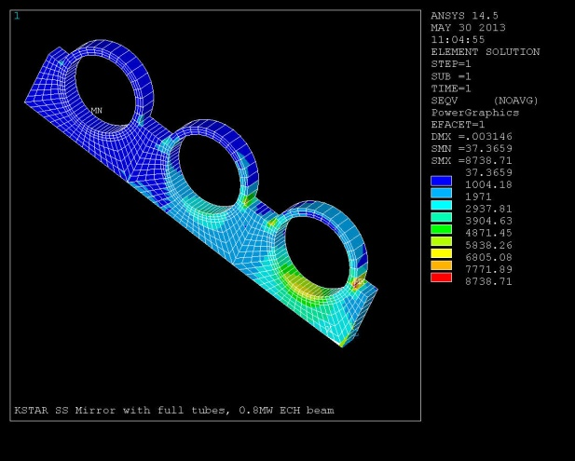
Temperatures and thermal stresses are acceptable for this stage of design
Stresses are in N/cm². Multiply σ_{max} by 1.45 to obtain 12.7ksi [8,76MPa].
Peak thermal stress for C18150 is localized, and can be reduced through refined geometry.

Slide 12
NTM stabilization using ECH fast steering has been successful on DIII-D [E. Kolemen]
DIII-D poloidal steering actuators were upgraded with fast motors.
Control algorithms were upgraded.
Beam is positioned to ~5mm accuracy.
KSTAR mirror actuators are identical to DIII-D; similar upgrades can be implemented.
“Catch and subdue” technique at DIII-D minimizes ECH power requirements for NTM suppression. [<3MW]
Additional power added with planned new ECH launcher for KSTAR will help in providing sufficient ECH power for NTM stabilization on KSTAR.

Slide 15
ICRF Power Coupling Optimization on KSTAR
We propose to collaborate in the optimization of ICRF heating on KSTAR
Investigate if RF system should be modified to maximize voltage standoff/power handling
Investigate edge losses to determine if edge conditions play a role in edge RF power loss as observed for FW coupling on NSTX
Look for losses aligned along magnetic field
Analyze edge loss properties with AORSA code

Slide 16
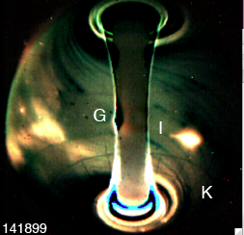
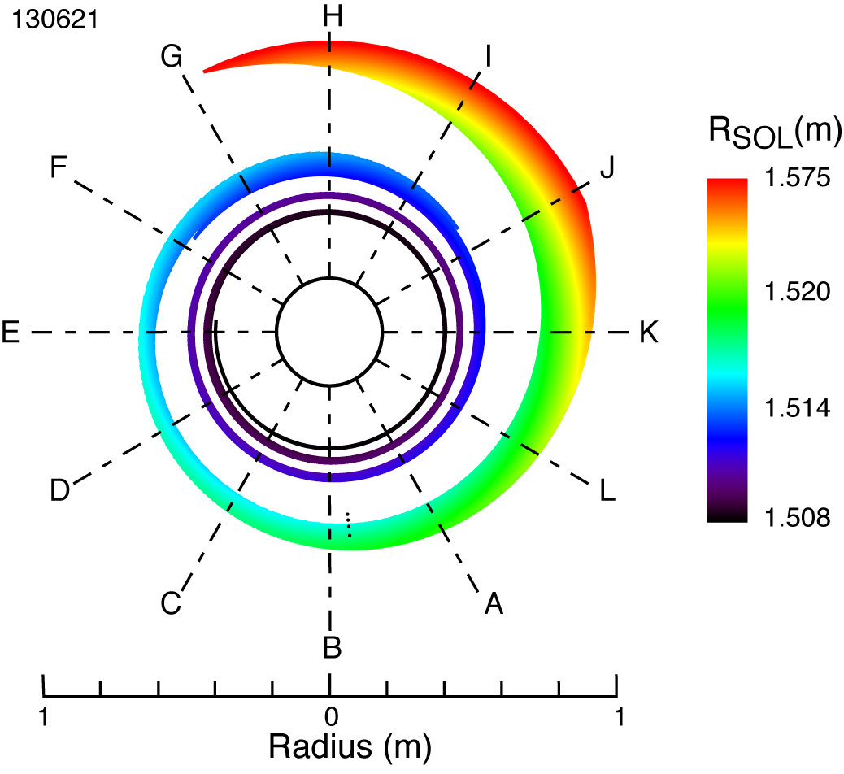
NSTX experiments show large losses of HHFW power in SOL under some conditions
Lost HHFW power deposited in bright hot spirals on upper and lower divertor
Up to ~ 60% of power possibly lost to SOL
Heating efficiency depends on:
magnetic field
edge density
antenna phase
The spiral pattern is explained by field-line mapping
Implies losses occur across width of SOL
Gas injection
[ J. C. Hosea, et al., PoP 15 (2008) 056104]
Antenna
Antenna
RF spirals
[R. J. Perkins, et al., PRL 109 (2012) 045001]
16

Slide 17
Large RF electric field amplitude is found including the SOL region related to the RF edge losses
Re(E_{II})
AORSA with SOL shows significant RF fields outside of LCFS
Possible source of power losses in SOL region
Indication of cavity mode in AORSA simulations on NSTX
Artificial damping inserted in AORSA to understand the RF edge losses
Full wave simulations with AORSA (+ SOL + artificial damping) in KSTAR to study the ICRF heating efficiency and possible edge losses
w/o SOL
w/ SOL
V/m
[Green, et al., PRL 107 (2011) 145001]
[Bertelli, et al., AIP Conf. Proc. (2013), APS invited talk (2013)]
17

Slide 18
Summary
ECH launchers are being upgraded for KSTAR toward sustaining steady-state operation
A new steady state launcher based on the developed steady state mirrors is planned
NTM stabilization will be studied with the ECH launchers on KSTAR
Fast steering will allow accurate tracking of the modes
The combination of 2 high power launchers may be sufficient for complete NTM stabilization
Collaboration on optimizing ICRF power coupling and minimizing edge RF power losses is proposed

