Slide 1
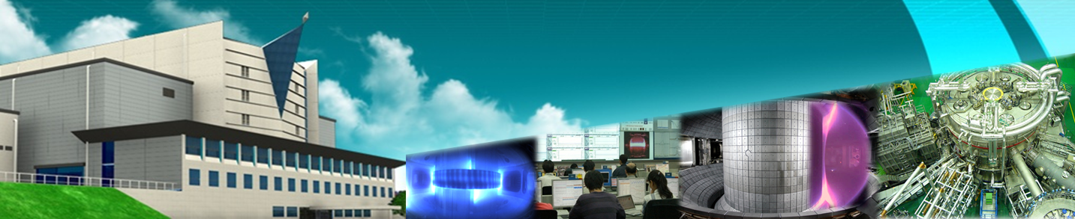


Oct. 2013
Theory and Simulation
Research for KSTAR at NFRI
J.Y. Kim
National Fusion Research Institute (NFRI), Daejeon, Korea

Slide 2
Contents
1. Introduction
2. Pedestal and ELM Control
3. MHD Stability and Energetic Particles
4. Operation Scenario and Divertor/SOL
5. Turbulence and Transport
6. Summary

Slide 3
Introduction
  Two projects for theory and simulation research at NFRI
Internal theory & simulation project
- One of KSTAR research projects
- covering Pedestal, MHD stability, Operation scenario, Divertor/SOL areas
- now, about 8 regular members & 6 graduate students from SNU, KAIST etc.
WCI (world-class-institute) project
- A government-support project for 5 years (2009.12 – 2014. 11)
- mostly focusing on Turbulent transport, including transport barrier, area
- now, about 11 regular members (Korean: 7, Foreigner : 4)

Slide 4
Pedestal and ELM control
Strong emphases in relation to the H-mode and ELM control experiments in KSTAR, and also as ITER urgent issues
trying to cover most sub-areas with a more self-consistent, integrated modeling
* L-H transition trigger & power threshold
* Pedestal build-up process
* Pedestal stability and structure
* Nonlinear ELM behavior
* ELM control by RMP, pellet etc.

Slide 5
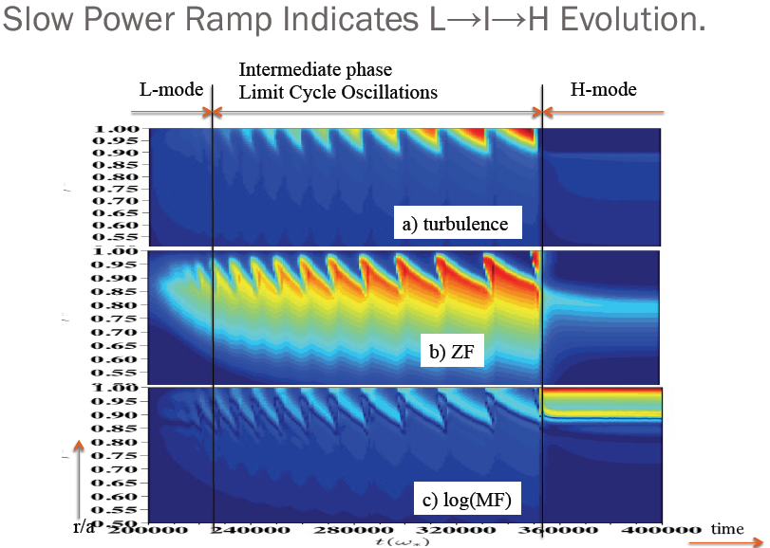
L-H transition and power threshold
5
One of the main research topics of the WCI group
Focusing on the 1.5D predator-pray model, involving turbulent intensity, ZF, MF
Reproduce some features of L-I-H transition
I-phase identified as a multi-predator-prey oscillations of ZF, mean flow and intensity
Oscillating ZF as a trigger to L-H transition
trying to do a more self-consistent simulation with the study of power threshold scaling
A more accurate calculation of neoclassical Er (by grad-Pi or ion orbit loss) also underway
Notes:
Now, I will introduce the intrinis tools of KSTAR which
Provides the physics/eenegieering items for FEC 2012,
One of them the 3D modular invessel coil, low error field/low ripple and 2D ECE diagnostics.
I beliebve these are the main contributer for KSTAR as well as the basic diagnostics and machine

Slide 6
Pedestal build-up
Recent experiments show pedestal structure change during build-up phase, such as
- inward penetration of width with the early saturation of gradient
- different pedestal width evolution of n, T, V_{t} etc.
A simple 1.5D transport code under development to model the build-up process
- in the consideration of ExB shear stabilization & KBM-like mode excitation
where
with
the maximum linear growth rate, and
the ExB shearing rate
Also, a flux-driven simulation using the global BOUT++ code underway for a more
self-consistent calculation of the pedestal build-up process including turbulence dynamics

Slide 7
Pedestal stability and structure
Particularly important from its close relevance to the global performance
A more theory-based model, EPED one, proposed recently for the pedestal structure
A predictive calculation of KSTAR pedestal structure done using the EPED model
with a more detailed study on various parameter dependence (I_{p}, B, n, v*, shape etc.)
(a) I_{P} dependence at a fixed B_{T} = 2T
(b) I_{P} dependence at a fixed q₉₅ = 3.5
Estimated pedestal width
Estimated pedestal width
P-B stable
P-B unstable
- Pedestal height rapidly increases with I_{P} (∝ I_{P}^{1.5}) => an important role to τ_{E, H} ∝ I_{P}^{0.97}
- Pedestal width almost independent of I_{P} => no relevance to poloidal ion Lamar radius

Slide 8
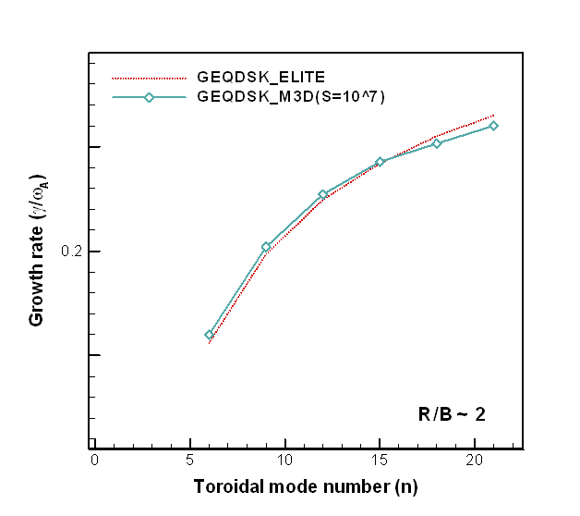
Nonlinear ELM behavior
ELM is believed to be due to the destabilization of the P-B mode, but still not clear
- how the nonlinear destabilization occurs
- what is the origin of different ELM types (type-I, II, III, small ELMs etc.)
- how ELM behavior change occurs with various ELM control tools
Nonlinear simulation started using M3D & BOUT++ (in collaboration with PPPL/LLNL)
- linear benchmark done first between M3D-ELITE for the CBM18 circular plasma
- nonlinear simulation being performed for the CBM18 & D-shape KSTAR plasmas
CBM-18 model
Relatively good agreement
between M3D and ELITE codes
Dominant mode changes from medium-n
to low-n during the nonlinear evolution

Slide 9
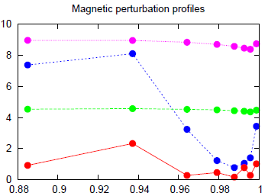
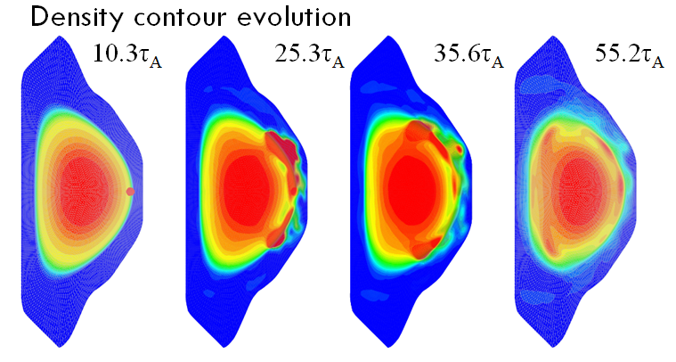
ELM control (Pellet, RMP etc.)
9
Pellet pace-making : a preliminary simulation done for the KSTAR plasma model using M3D
RMP control : RMP field penetration calculated for KSTAR plasma using XGC0 + M3D codes
Vacuum, +90 phase
Plasma, +90 phase
Vacuum, mid-FEC alone
Plasma, mid-FEC alone
- ELM generation observed with pellet injection
- Strong shielding occurs, except near
pedestal top in the +90 phase
may explain why RMP suppression observed only in +90 phase?
9
Notes:
Now, I will introduce the intrinis tools of KSTAR which
Provides the physics/eenegieering items for FEC 2012,
One of them the 3D modular invessel coil, low error field/low ripple and 2D ECE diagnostics.
I beliebve these are the main contributer for KSTAR as well as the basic diagnostics and machine

Slide 10
MHD Stability and Energetic Particles
- Now, focusing on the subjects related to the KSTAR initial experiments,
with relatively small manpower
* Sawtooth and internal MHD modes with ECH/ECCD effect
* Disruption load and characteristics in KSTAR model
* Fast ions loss with 3D perturbed field

Slide 11
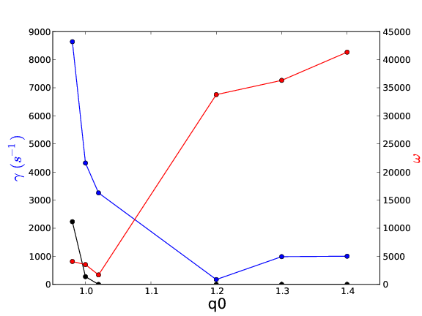
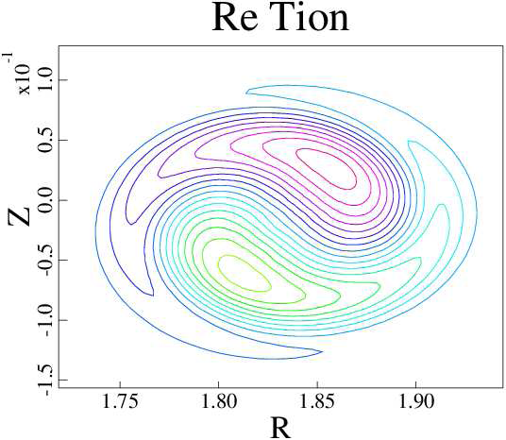
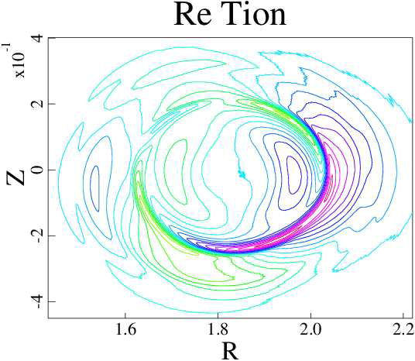
Sawtooth & Internal MHD modes with ECH/ECCD effect
  Several interesting behaviors observed with ECH/ECCD in KSTAR
  - Dual flux tubes in the core of sawtoothing plasma [G.S. Yun et al, PRL(2012)]
  - Excitation of internal MHD modes, as a possible source of rotation damping [J. Seol et al, PRL(2012)]
  - Destabilization of 2/1 tearing mode during ramp-up (H.H. Lee et al., recently accepted in PRL)
  These believed due to energetic electron itself or change of q-profile
  A simulation study started using NIMROD code to see the energetic electron effect
  - similar method with the energetic ion case, but with the change of mass and charge
  Up to the artificial M_{e}>0.01M_{i}, no big difference between energetic ions and electrons, and some destabilization of internal MHD mode observed near q₀ ∼1
q₀=0.98
q₀=1.3
with energetic
electrons
without
energetic electrons
11

Slide 12
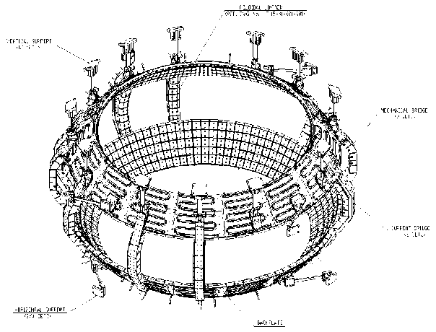
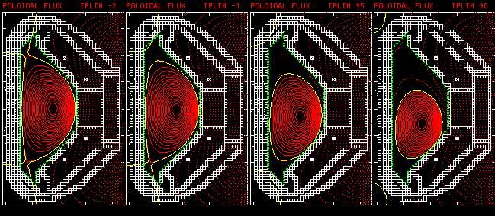
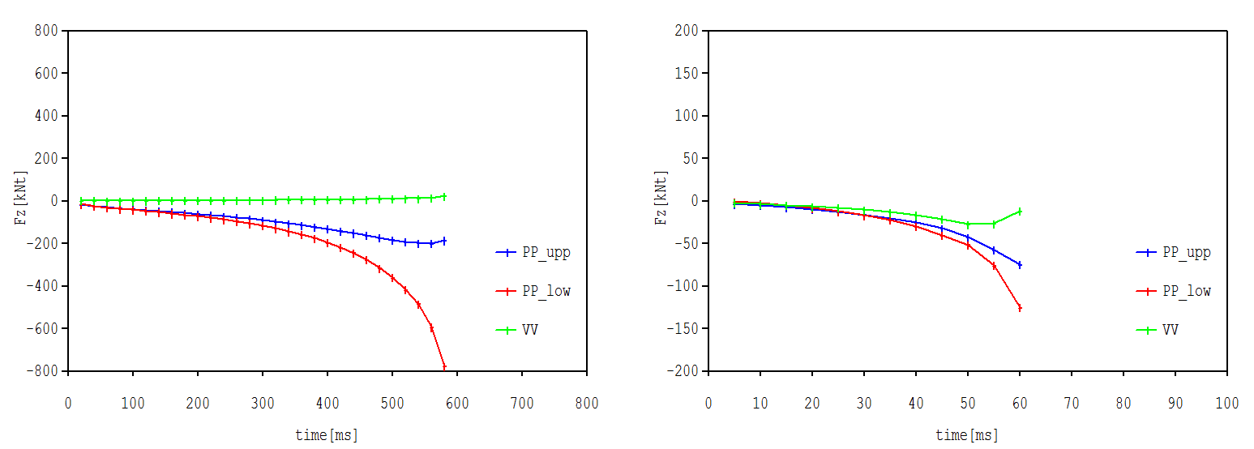
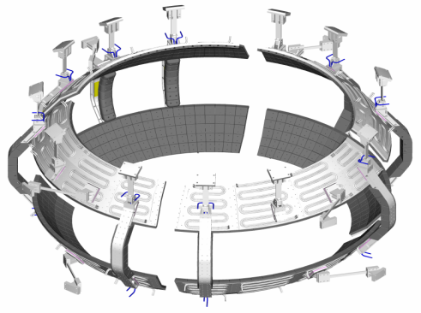
Disruption load and characteristics in KSTAR
KSTAR passive stabilizer modified to no saddle structure during the final fabrication phase
Disruption simulation done using TSC to estimate the load for the new structure
- about one order increase in growth rate, while about 6 times decrease in vertical force
VDE simulation using TSC
Saddle loop with current bridge
Vertical force
(old model)
Vertical force
(new model)
No saddle
A more detailed 3D simulation using M3D code to be performed (in collaboration with PPPL)

Slide 13
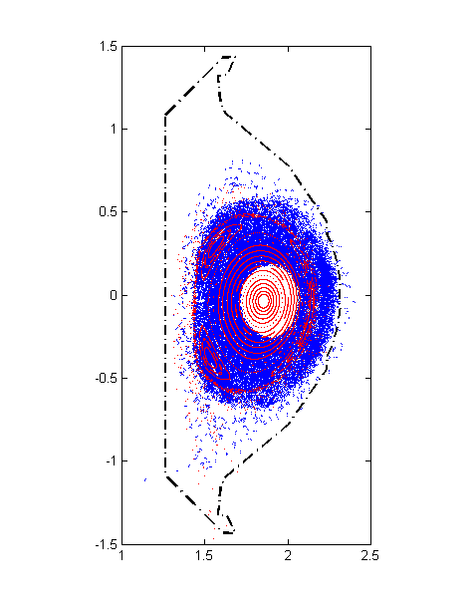
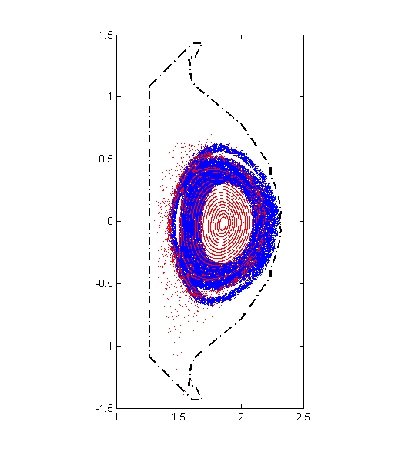
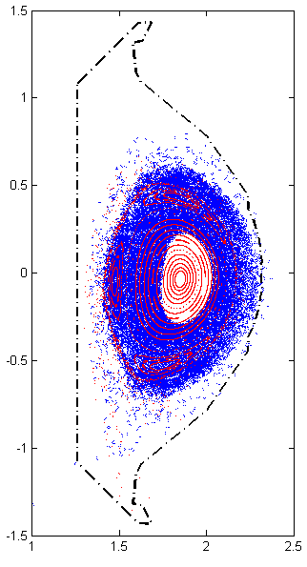
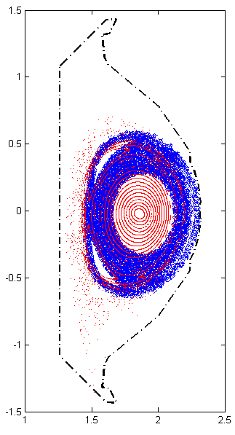
Fast ions loss with 3D perturbed field
Experimental study being performed in KSTAR for the fast ions loss due to the external applied edge magnetic field in relation to ELM control by RMP
- fast ions orbit being calculated using the Lorentz-orbit code, to analyze the data
Shot# 9056, near t=5.0sec
Shot# 9092, near t=6.0sec
C-port (FILD position)
K-port
(opposite position)
C-port (FILD position)
K-port
(opposite position)
Various energetic particles driven modes being also observed in KSTAR
- Linear stability analysis and nonlinear simulation study to be performed soon

Slide 14
Operation Scenario and Divertor/SOL
- Now, focusing on the near-term KSTAR operation scenarios, in relation to
the upgrade of KSTAR heating/CD & divertor/fueling systems
* Hybrid scenario and heating/CD optimization for the 2nd phase
* Detached divertor operation
- Relatively small manpower, particularly in divertor/SOL area

Slide 15
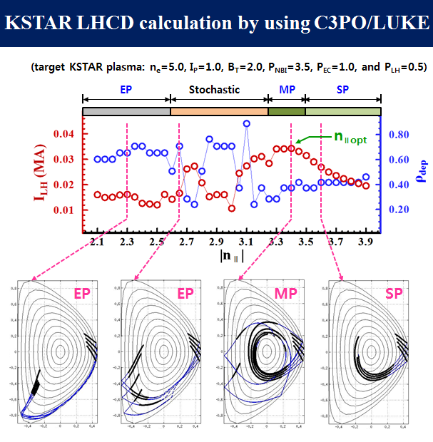
Hybrid scenario & Heating/CD system optimization
Some design issues in relation to the upgrade of KSTAR heating/CD systems
- NBI2 : on-axis or off-axis, co or counter
- LHCD : optimum n_{ll} value for the CD efficiency maximization
Hybrid scenario modeling by using CRONOS
(for P_{NBI} = 4MW(co, on)+2MW(co, off-axis), P_{ECH} = 2MW)

Slide 16
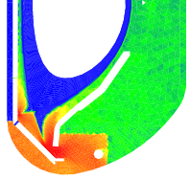
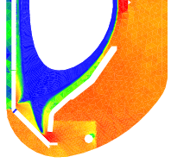
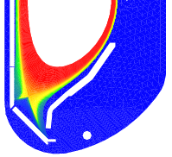
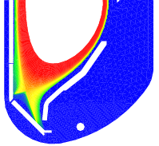
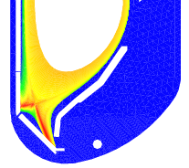
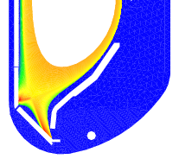
Detached divertor operation & Gas-puffing system
optimization
Average Flux on the Outer Divertors
Gas Puffing
n_{D2}
Gas Puffing
T_{e}
Gas puffing on the PFR region is attractive to control neutral particles outside passive plates.
When gas puffed on the PFR region, Heat flux decreased more effectively compared with OMP gas puffing cases.
Gas puffing on the PFR region makes detachment when gas puffed more than 7x10²¹D₂/s.
n_{e}
PFR 6.4×10²¹
OMP 6.4×10²¹

Slide 17
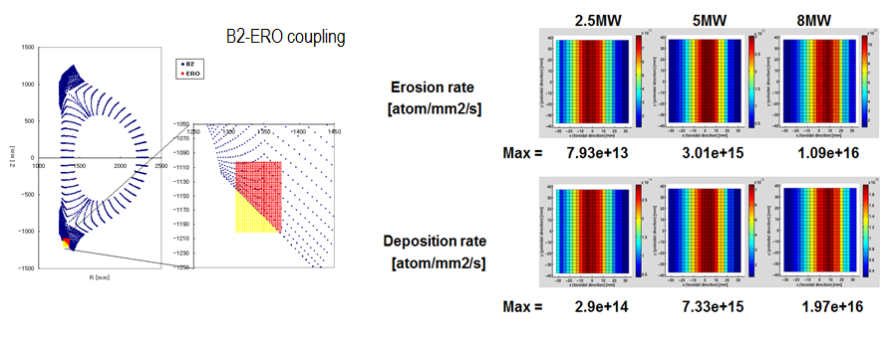
Plasma-wall Interaction
A preliminary simulation study of erosion, deposition rates of C in KSTAR divertor plate being
performed through the coupling of B2 and ERO codes
- Initial results show how erosion & deposition rates increase with heating power
in the relatively low divertor-region plasma temperature case (Te ∼Ti ∼ 1-10eV)

Slide 18
Turbulence and Transport
- Extensive studies being performed for various subjects, such as
* intrinsic rotation
* ITB formation
* ETB formation
* non-local transport etc.
Also, a substantial effort being made for the development of the global
(or full-f) codes, based on the gyrofuild, gyrokinetic, and hybrid schemes
* global electromagnetic gyrofluid code based on BOUT++
* full-f electrostatic gyrokinetic code using semi-Lagragian method
* full-f electromagnetic hybrid code by combining ion-gyrokinetic & electon-fluid

Slide 19
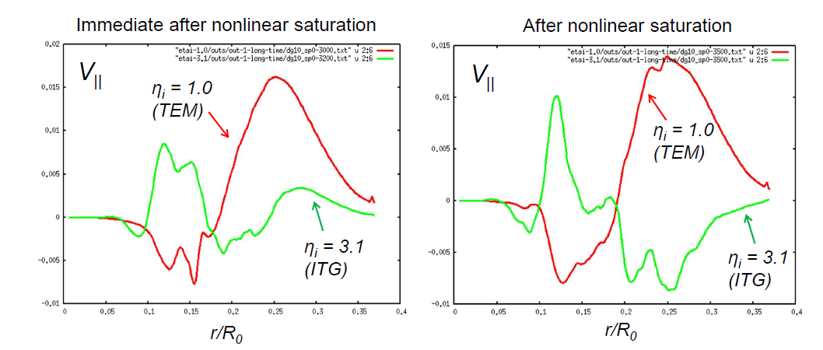
Gyrokinetic simulation study of intrinsic rotation generation
Sign flip in intrinsic torque observed with the dominant turbulence transition between
TEM ↔ ITG from the simulation using gKPSP code (δf PIC gyrokinetic code)
Dipolar pattern of intrinsic flow profile → boundary condition decide net sign of rotation in plasma
Rotation damping observed in ECH plasma may due to ITG → TEM transition & resulting torque reversal (experimental data analysis underway)

Slide 20
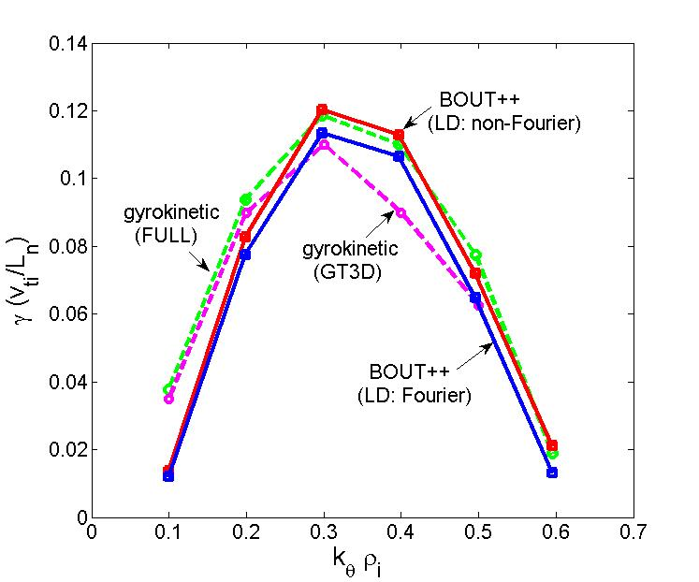
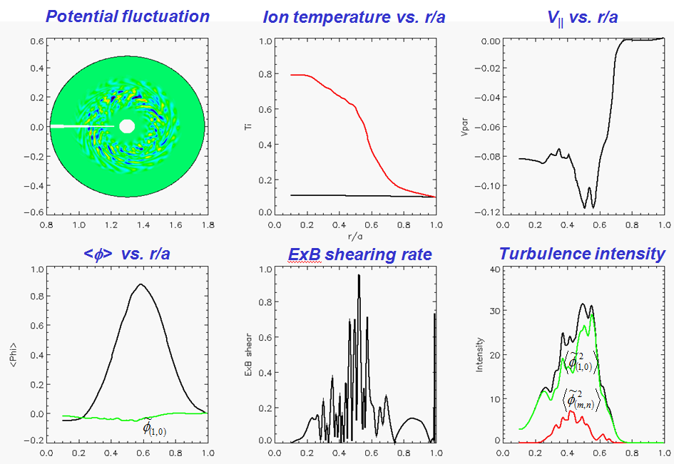
Development of global EM gyro-fluid code
A global core gyrofluid code developed using BOUT++ framework (LLNL collaboration)
Linear calculations for ITG show excellent agreements with gyro-kinetic results
Initially, nonlinear simulation underway for the flux-driven ITB formation (with non-resonant
modes), as well as ETB formation
  Cyclone base case
20

Slide 21
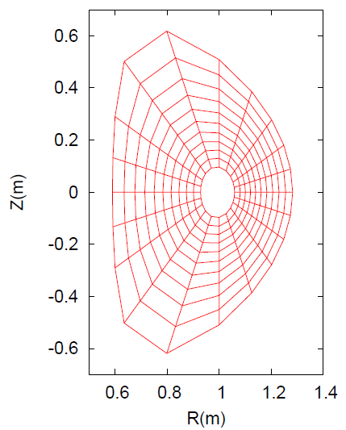
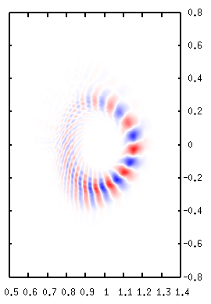
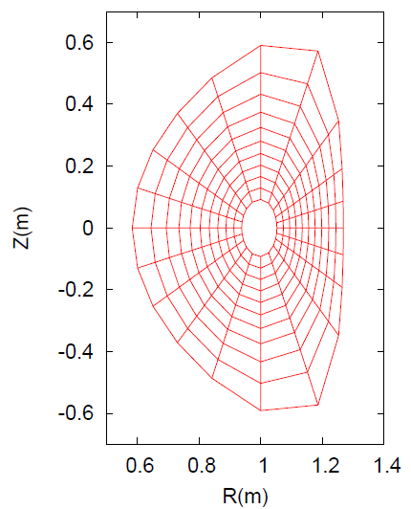
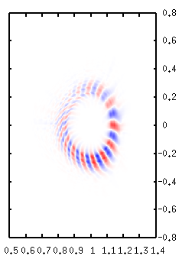
Development of full-f ES gyro-kinetic code
using Semi-Lagrangian scheme to combine the advantages of both PIC and continuum codes
Coulomb collision operator included for full neoclassical physics simulation
General geometry i.e. shaped equilibrium configuration
D-shape
Inverted D-shape

Slide 22
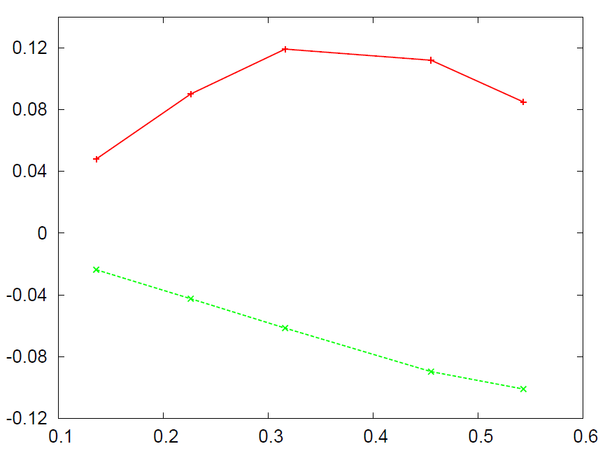
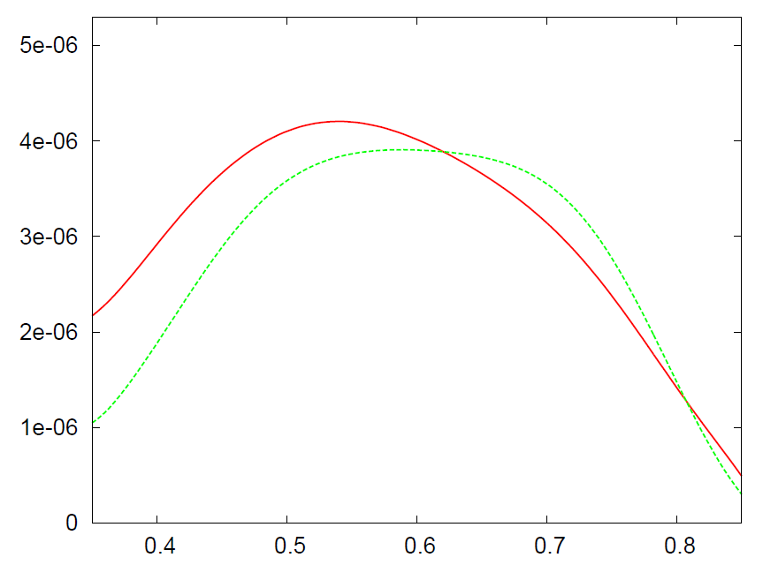

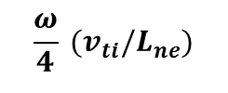

Development of full-F ES gyro-kinetic code
Almost finished in the electrostatic limit
Benchmark test results are in good agreement with theory and previous works.
Linear ITG simulation
with cyclone parameters
Neoclassical benchmark test
Heat Flux (Simulation)
Heat Flux (Chang-Hinton Formula)
Nonlinear benchmark simulation to be performed soon
The code will be also extended to the EM code by using hybrid scheme

Slide 23
Summary
  Theory and simulation research for KSTAR at NFRI now being performed over most areas through the two projects (WCI & internal)
  Relatively, strong emphases being put on the Pedestal and ELM control area in relation to H-mode experiments in KSTAR
  A substantial effort also being made for the Turbulence and Transport area, with the development of global (or full-f) integrated simulation codes, based on the gyrofluid, gyrokinetic, and hybrid schemes
  Research activities in other areas, such as MHD stability, energetic particles, operation scenario, divertor/SOL are still relatively weak
  So, particularly hoping to increase more collaborations on these areas

Slide 24
Future Collaboration Opportunities (PPPL)
Energetic particles
- Linear stability analysis and nonlinear simulation of TAE, BAE, EPM etc.
- Transport effect by energetic particle driven modes etc.
MHD stability & disruption
- 3D physics, Linear MHD stability analysis of LM, NTM, RWM etc.
- Nonlinear simulation of resistive MHD modes
- 3D disruption simulation with 2D or 3D structure model etc.
Operation scenario and Divertor/SOL
- Advanced operation scenario modeling for KSTAR
- Plasma-wall interaction modeling etc.
Transport and Pedestal
- Global integrated simulation over whole region using full-f gyrokinetic or hybrid code etc.

