Slide 1
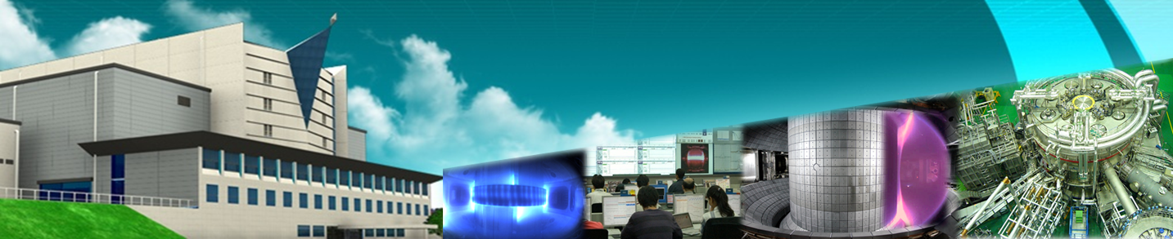












Princeton, Oct. 21, 2013
KSTAR
Current Status and Future Plan
Jong-Gu Kwak
National Fusion Research Institute (NFRI), Daejeon, Korea

Slide 2
Research opportunity with KSTAR
Before and after the first plasma of KSTAR at 2007
There were collaboration meetings(with seminar) between NFRI and PPPL about KSTAR.
Since then, via KSTAR PAC and FEC satellite meeting,
The formal reporting was given to USA colleagues
KSTAR completed its first phase of experiments and now steps into the next five year plan
so it is necessary to call for collaboration meeting
After this talk, I expect
PPPL colleagues are familiar with the recent KSTAR achievements
and to figure out the new collaboration opportunity

Slide 3
Contents
  Introduction to KSTAR
    Original Mission/ History
  What we achieved during last five years
    Machine performance
    New findings
  The next five year plan(What do we do)
  summary

Slide 4
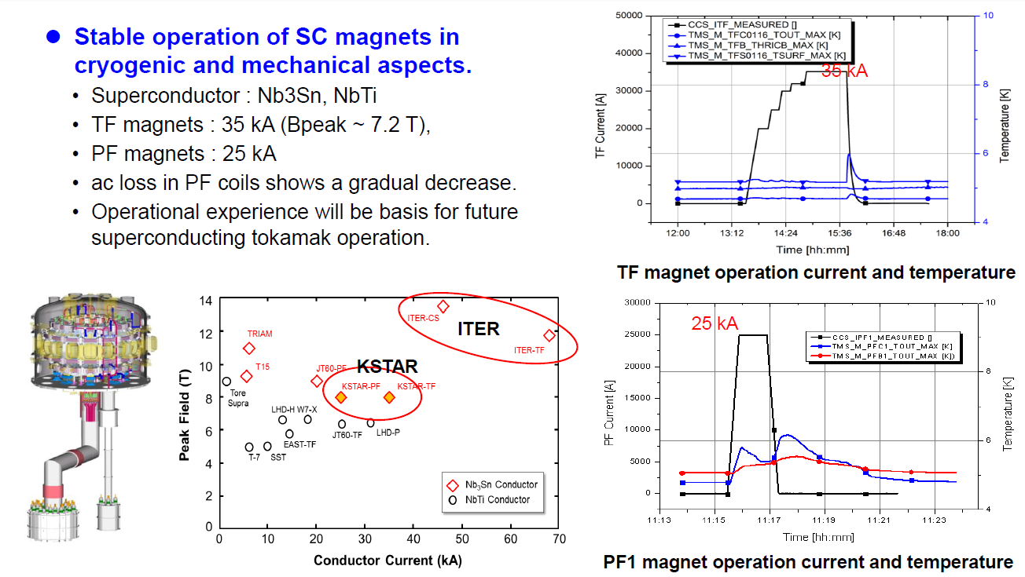
Mission of KSTAR
To achieve the SC tokamak construction and operation experience
To explore long pulse capability and the physics and technology of high performance Steady state operation

Slide 5
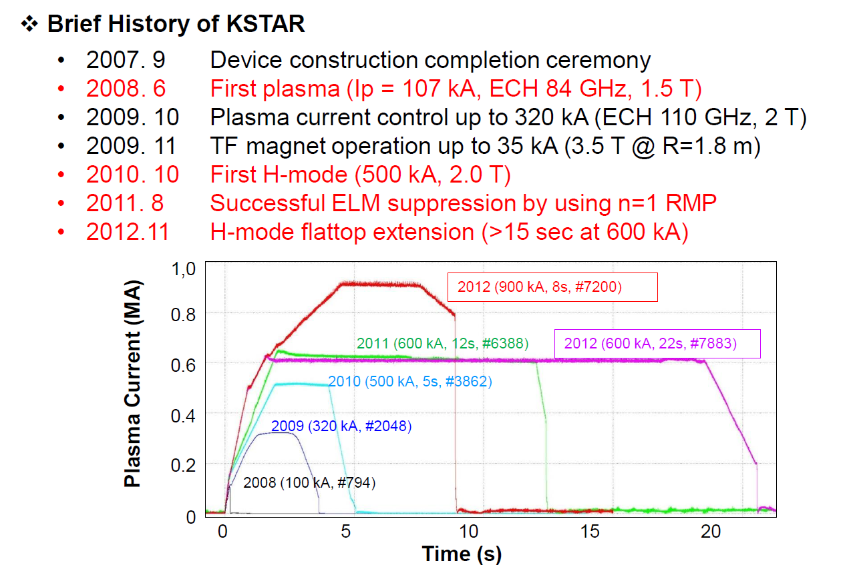
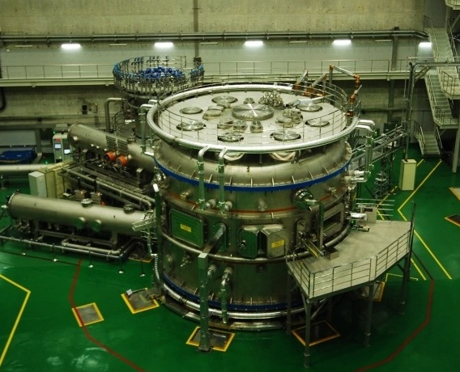
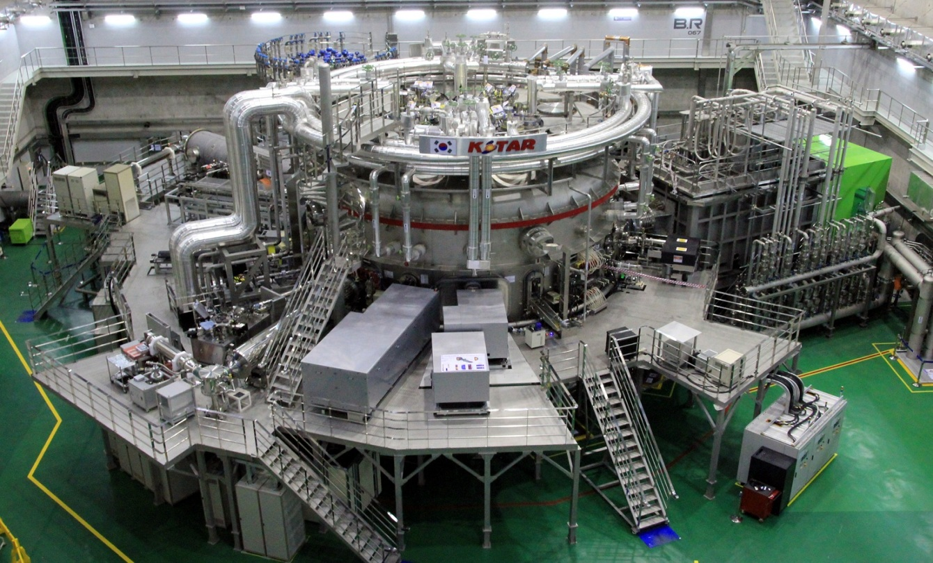
Progress of tokamak
2008
2013
2013. 8. H-mode flattop was extended to 20s

Slide 6
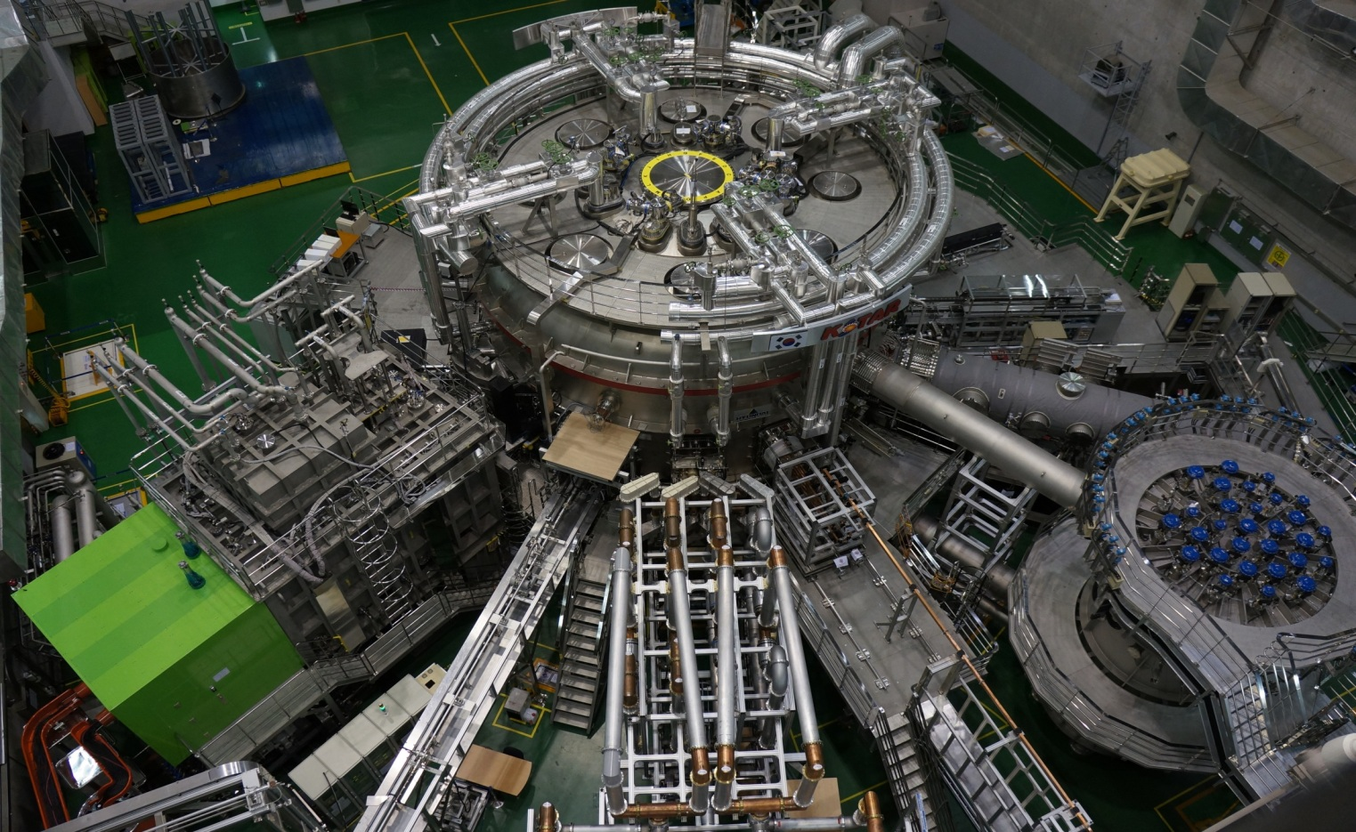
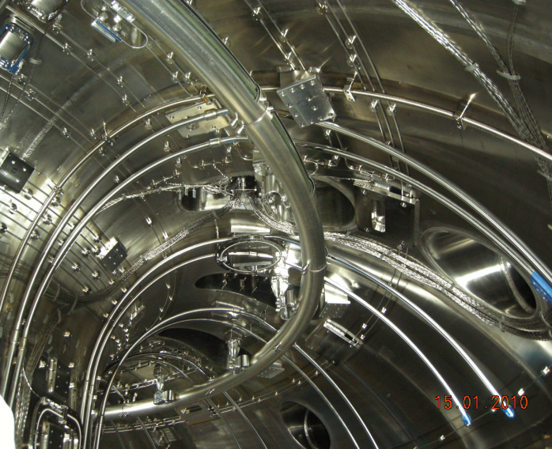
Present machine status of KSTAR (2013)
NBI-1
(PNB, co-tangential)
(2 beams, 3MW/95keV)
170 GHz ECH
(1 MW/10 s)
Full Graphite PFCs
( Water cooling pipe is installed, however, pump is not installed)
110 GHz ECH
(0.7 MW/2 s)
30 MHz ICRF
(0.5 MW/3 s)
5 GHz LHCD
(0.5 MW/2 s)
Divertors
invessel Cryopump
(etc. cryo cooling tube was installed,
But cryoplant(1kW) is not installed)
Baffle
IVCP

Slide 7
What we achieved during last five years in tokamak performance
- Unique feature of machine
H-mode
Long pulse capability under SC coils
Exceeding no wall limits
Toward advanced inductive mode

Slide 8
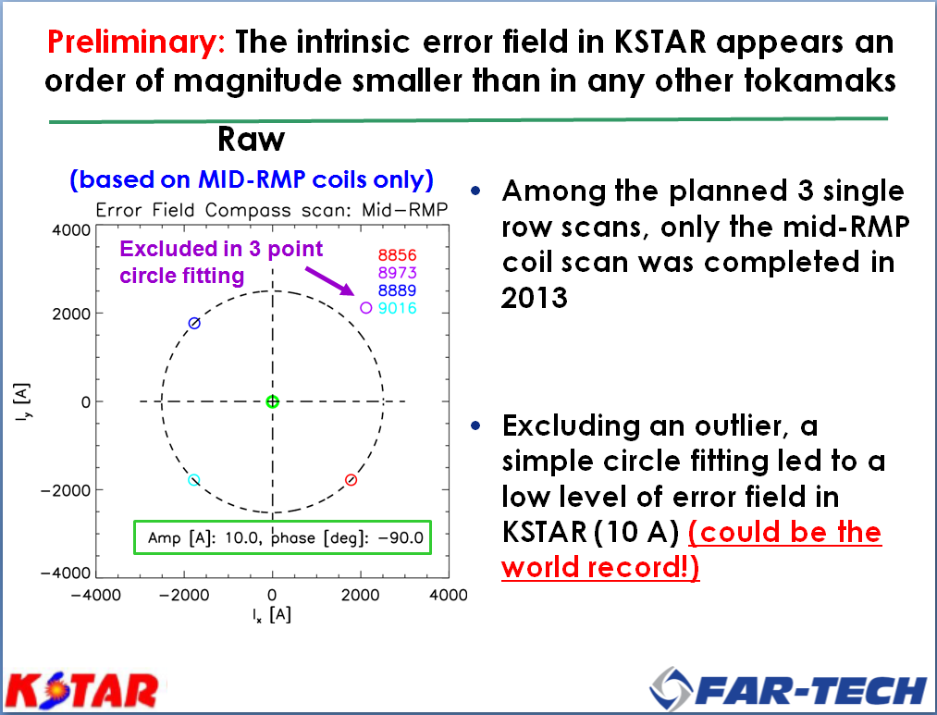
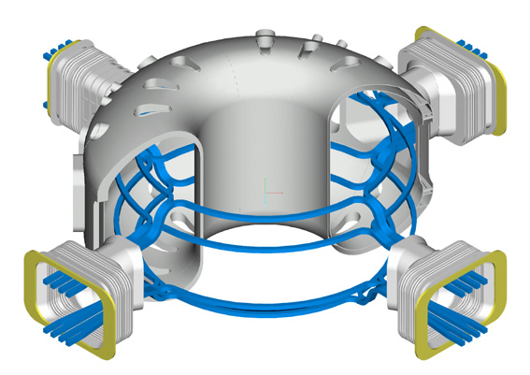
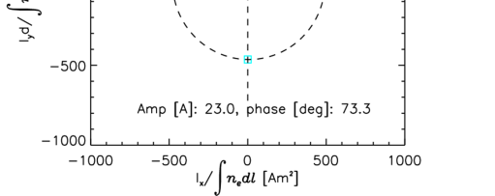
Unique features
8
Intrinsically low toroidal ripple and perhaps low error field
Error field : very low value was detected (δB/B~10⁻⁵)
Modular 3D field coils (3 rows/4column of coils)
Provide flexible poloidal spectra of low n magnetic perturbations
n=1, 0 phase
n=1, +90 phase
n=2, odd
θ
+
+
-
-
top
+
+
-
-
top
+
-
+
-
B_{P}
+
+
-
-
mid
-
+
+
-
mid
+
+
-
-
bot
-
-
+
+
bot
-
+
-
+
Full angle scan shows that the error field would be lower than sub Gauss (resonant field at q=2/1 based on IPEC calculations)
φ
Notes:
Now, I will introduce the intrinis tools of KSTAR which
Provides the physics/eenegieering items for FEC 2012,
One of them the 3D modular invessel coil, low error field/low ripple and 2D ECE diagnostics.
I beliebve these are the main contributer for KSTAR as well as the basic diagnostics and machine

Slide 9
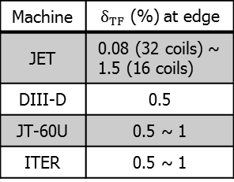
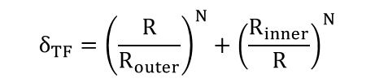
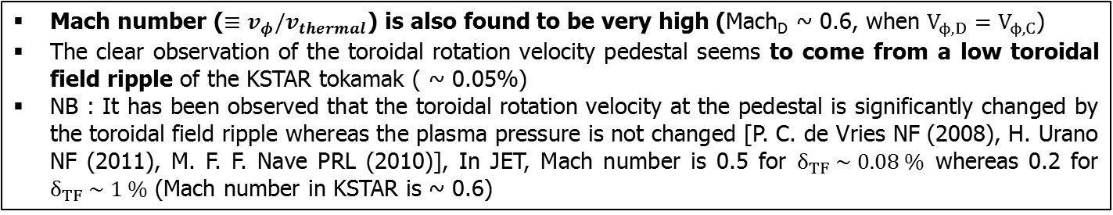
Pedestal in toroidal rotation velocity profile
LCFS
Machine | $δ_{TF}$ (%) at edge
JET | 0.08 (32 coils) ~ 1.5 (16 coils)
DIII-D | 0.5
JT-60U | 0.5 ~ 1
ITER | 0.5 ~ 1
$$δ_{TF}={\left(\frac{R}{R_{outer}}\right)}^{N}+{\left(\frac{R_{inner}}{R}\right)}^{N}$$
Mach number ($≡v_{φ}/v_{thermal}$) is also found to be very high (Mach_{D} ~ 0.6, when $V_{ϕ,D}=V_{ϕ,C}$)
The clear observation of the toroidal rotation velocity pedestal seems to come from a low toroidal field ripple of the KSTAR tokamak ( ~ 0.05%)
NB : It has been observed that the toroidal rotation velocity at the pedestal is significantly changed by the toroidal field ripple whereas the plasma pressure is not changed [P. C. de Vries NF (2008), H. Urano NF (2011), M. F. F. Nave PRL (2010)], In JET, Mach number is 0.5 for $δ_{TF} \sim 0.08 \%$ whereas 0.2 for $δ_{TF} \sim 1 \%$ (Mach number in KSTAR is ~ 0.6)

Slide 10
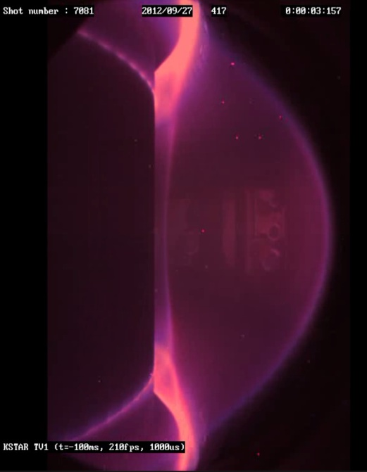
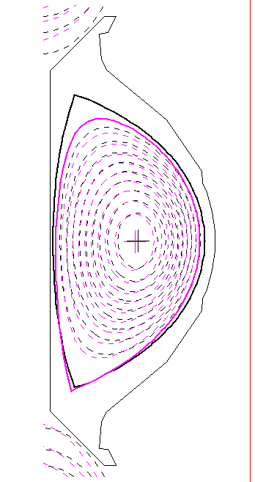
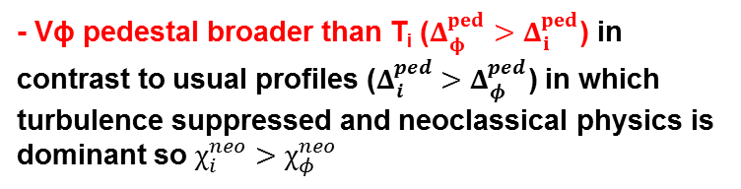


H-modes (Firstly success in 2010 in KSTAR)
$$Δ_{φ}^{ped}$$
$$Δ_{i}^{ped}$$
- Central deuterium co-NBI heated
P_{NBI} ≥ 3 MW , P_{ECRH} ~ 1 MW
- Balanced double null, lower & upper single nulls
( Kappa ~ 1.8, Delta ~ 0.6)
- Stored energy ~ 0.4 MJ
- Strong rotation ~ 300 km/s (n_{e} ~ 3x10¹⁹/m³)
- All Graphite PFCs (Boron & overnight GDC)
- Typically Type-I ELMs
(Type-III & mixed at low power, high density)
- Vϕ pedestal broader than T_{i} ($Δ_{φ}^{ped}>Δ_{i}^{ped}$) in contrast to usual profiles ($Δ_{i}^{ped}>Δ_{φ}^{ped}$) in which turbulence suppressed and neoclassical physics is dominant so $χ_{i}^{neo}>χ_{φ}^{neo}$

Slide 11
H-mode confinement is in accordance with ITER89 scaling
(except for negative trend with elongation)
0.15
τ_{E,KSTAR}
#7883
H_{89-p}=2.0
H_{89-p}=1.5
I_{p} = 0.6 [MA]
0.10
H_{89-p}=1.0
P_{NBI} [MW]
0.05
0.06
n_{e} [10¹⁹ m⁻³]
τ_{E,KSTAR} (s)
Dα [a.u.]
1.5 ≤ H₈₉ ≤ 2.0
0.04
τ_{E,89-p scaling}
Stored energy W_{tot} [MJ]
2.5
H_{89-p}
I_{P}=600kA, P_{loss}=1.2-1.8 MW (2011)
2.0
I_{P}=500kA, P_{loss}=1.3-2.0 MW (2012)
Elongation(κ)
I_{P}=600kA, P_{loss}=2.6-3.0 MW (2012)
1.5
I_{P}=500kA, P_{loss}=2.6-3.0 MW (2012)
1.0
Magnetic Flux [Vs]
τ_{E,89-p scaling} (s)
1.4
1.6
1.8
2.0
2.2
elongation κ
Larger impurity build-up at high κ in 2012
H/D ratio at 2011 : ~20 % vs ~40 % at 2012 ( less than 10% variation in H_{89-p} )

Slide 12
Longer phase of H-mode flattop (t_{H-mode}~20s) in 2013
#9388
Better shape control in 2013
Stationary line density
(better X-point control)
Disruption at t=21.4 s
due to limit of electricity of grid
(VAr limit) not due to flux limit
With better PF control logics and motor-generator(2 GJ), longer pulse will be available in next campaign
  Based on experiments, Ohmic flux available more than 50 second operation in Ip= 1 MA even with P_{NBI} ~ 3 MW
  3.8 Wb (up to 1 MA ramp-up) + 0.15 Wb/s*50 s = 11.3 Wb < 12 Wb limit
Good shaping control warrants long pulse as well as good confinement

Slide 13
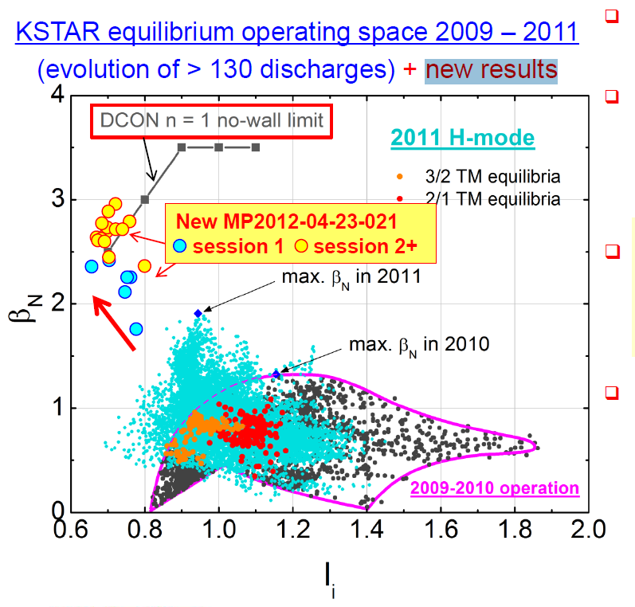
KSTAR is approaching and exceeding no-wall MHD stability limit
By Early heating for low l_{i}
(Better Ip ramp-up scenario)
Optimizing B_{T} & I_{p}
  B_{T} in range 1.3-1.5 T
  I_{p} in range 0.5-0.7 MA
Max β_{N}/l_{i} ~ 4.1
β_{N}~ 2.5, l_{i}~ 0.7
100% increase from 2011
- Rotating n=1, 2 mode activities observed in core
S. Sabbagh & Y. Park
(Columbia Univ)

Slide 14
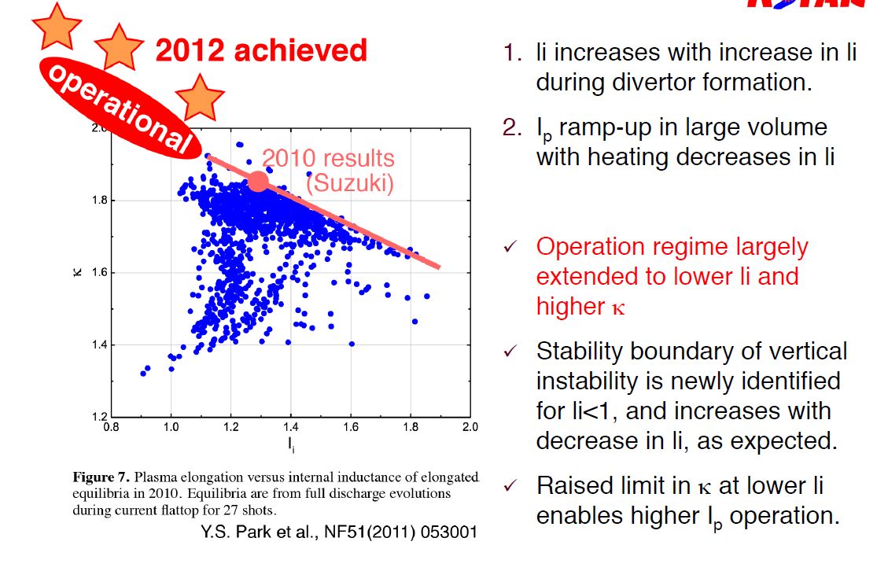
Operation regime extended to lower l_{i} & higher κ w/o sawtooth suitable for advanced scenario
T. Suzuki (JAEA)

Slide 15
Better TS profiles with similar pedestal position
(TS provide the data not routine, but at specific shot)
15
Pedestal structure both in Thomson & CES for H-mode
(further comparison is on-going)
Issue of TS calibration
Only relative change must be considered
t=2.1 s : L-mode
t=2.3 s: transition
t=2.5 s: H-mode

Slide 16
What we found and are investigating in detail
TM and ELM behavior using ECE-i
ELM control using RMP and ECCD
Pedestal width of rotation
Fast ion loss associated with 3D field
Validation of theoritical prediction
(Rotation breaking, NTV offset)

Slide 17
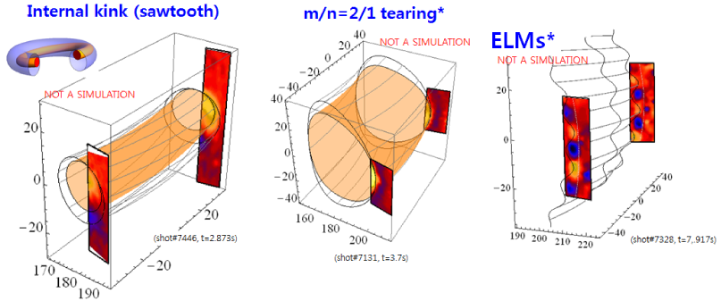
2D & 3-D visualization of fluctuations using ECEI
17
Two ECEI systems installed with 22.5 degree space in toroidal angle
  𝒑𝒊𝒕𝒄𝒉 𝒂𝒏𝒈𝒍𝒆 ≈ 𝟔° ( A useful constraint for equilibrium reconstruction)
  Toroidal asymmetry of ELM dynamics under investigation.
G. S. Yun, et al. PRL (2011) & (2012)

Slide 18

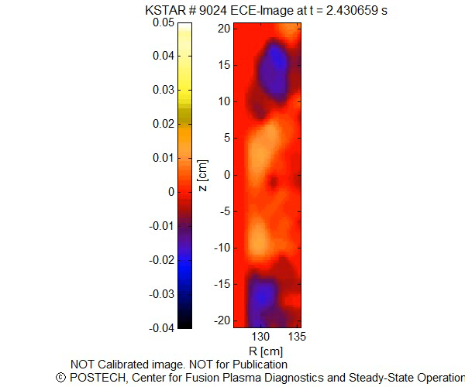
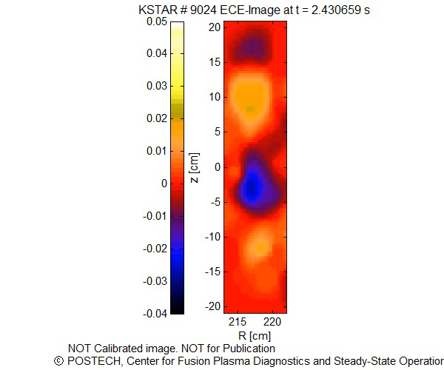


High-field size imaging of ELM structure
18
Jaehyun Lee, G.S Yun, M. Kim, M.J. Choi, H.K. Park (POSTECH)
C.W. Domier, N.C. Luhmann, Jr. (UC Davis)
Understand the global geometry and flow of the ELM filaments
$$V_{pol}\sim V_{E×B}$$
$$V_{tor}×\tan{α}$$

Slide 19
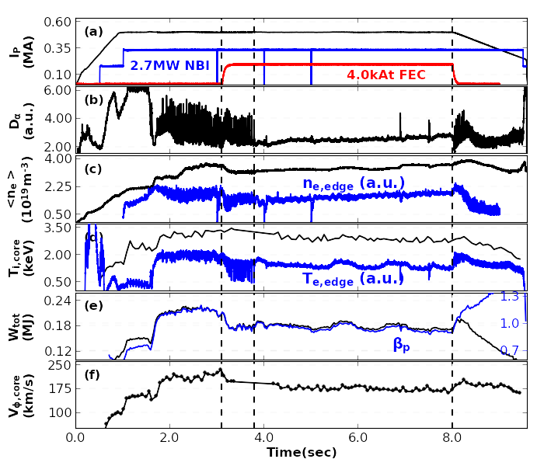
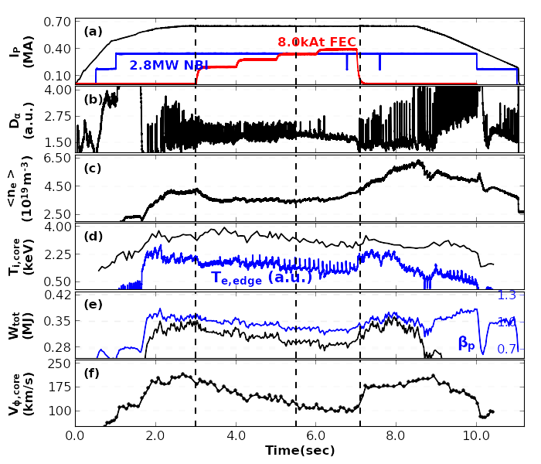
ELM-suppressions have been demonstrated using
both n=1 or n=2 RMP with specific q window
19
#7821
#8060
n=1 (+90 phase) RMP at q₉₅~6.0
n=2 RMP (mid-FEC only) at q₉₅~4.1

Slide 20
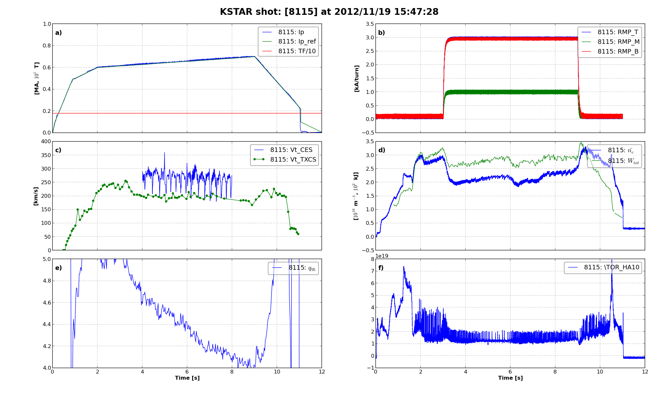
ELM suppression is achieved with using the combination of n=1 and 2
n=1 (middle) NOR n=2 (top/bottom) NA field ALONE has not shown the ELM suppression yet.
The q-window (4.3~4.5) in ELM suppression is observed during I_{p} scan (q-scan).
NB : q~6 at n=1, q~3.7 at n=2, q~4.5 at n=1+2 ( wide q window)
I_{p}
Schematic Diagram
RMP
Top IVCC
Upper IVCC
Upper Vertical
Control Coil
V_{t}
Upper Radial
Control Coil
Top FEC
n_{e}, W_{tot}
Middle FEC
Lower Radial
Control Coil
q₉₅
Bottom FEC
Lower Vertical
Control Coil
D_{alpha}
Bottom IVCC
Lower IVCC
Extending q window space at ELM suppression

Slide 21
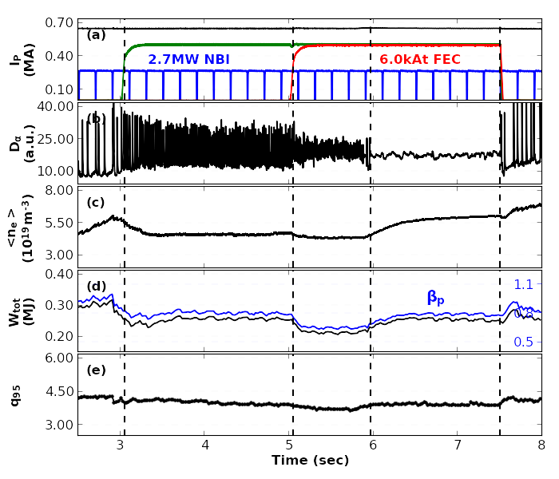
By varying selective RMP setup(top/bot, or top/mid/bot), ELMs was suppressed or mitigated in n=2 (+90) RMP
21
#9286: I_{p}=0.65MA, B_{T}=1.8T ➔ q₉₅~4.0
ELM suppression under 6.0kAt n=2 RMP at q₉₅~4.0
Initially ELMs mitigated by n=2 even (top/bot) RMP
As mid-FEC currents added (n=2,+90 RMP), ELMs further mitigated and then suppressed
Note that ELM-suppressed phase showed better confinements than that in ELM-mitigated phase
- See changes on <n_{e}>, W_{tot}, and β_{p}
#9286
n=2 even (top/bot)
mitigation
n=2 (+90, top/mid/bot)
suppresion

Slide 22
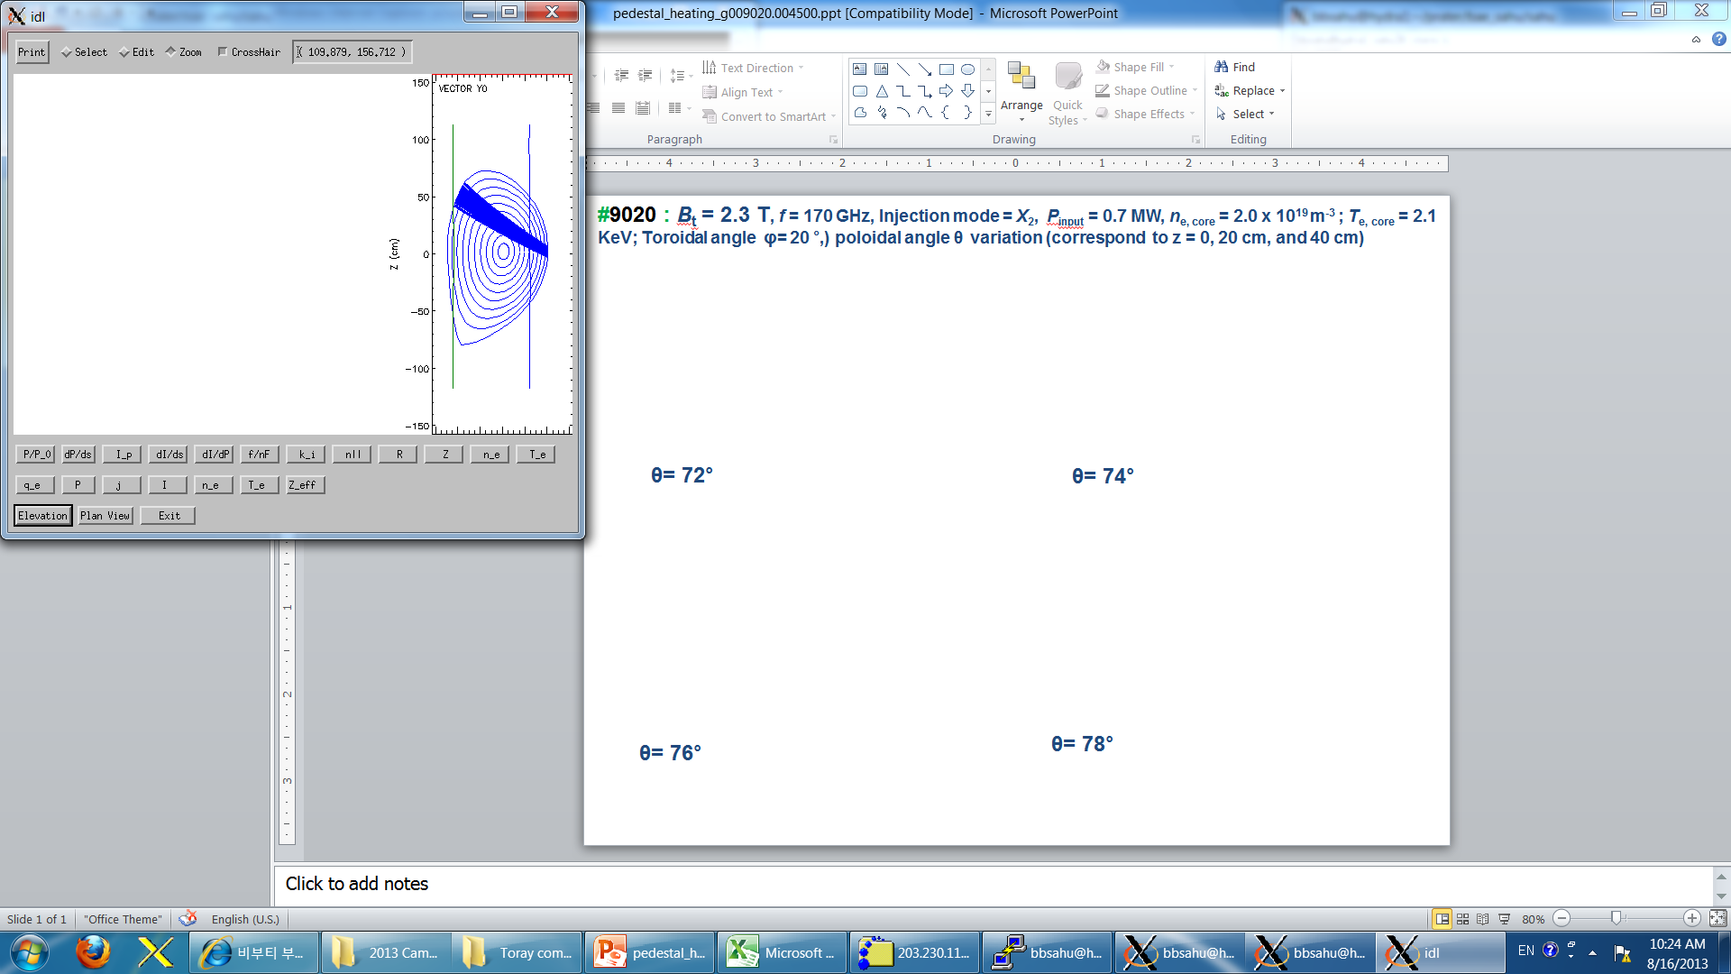
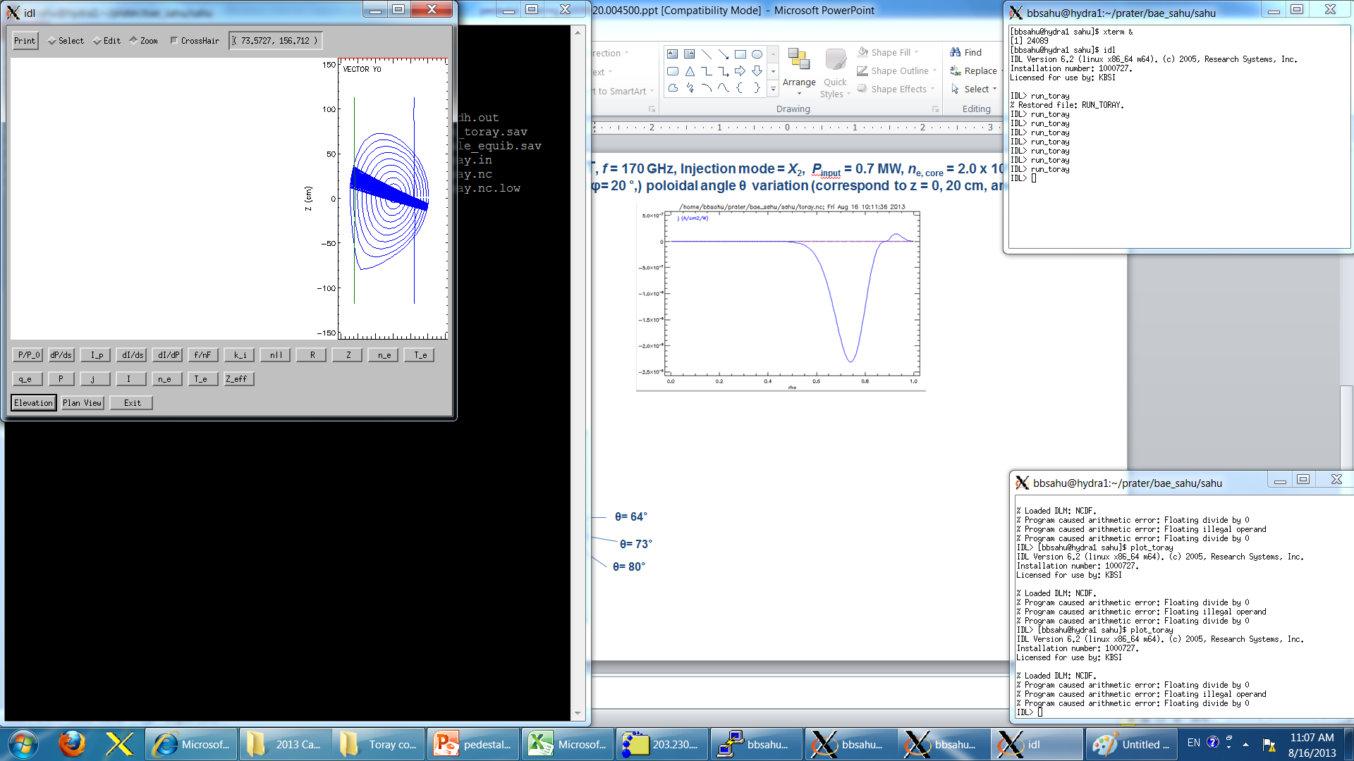
ELM mitigation effect observed by injecting ECCD at pedestal
Poloidal angle scan
ρ_{pol} ~ 0.86
ρ_{pol} ~ 0.90
ρ_{pol} ~ 0.94
ρ_{pol} ~ 0.98
ρ_{pol} ~ 0.94
ρ_{pol} ~ 0.86
TORAY-GA
2nd Harmonics deposition at LFS
Mitigation stronger at larger ρ_{pol}
f_{ELM} ~30 [Hz]
∆WELM ~20 [kJ]
∆NeL ~0.16 [10¹⁹/m3]
∆T_{e,ped} ~0.4 [keV]
f_{ELM} ~60 [Hz]
∆WELM ~ 4 [kJ]
∆NeL 0.05 [10¹⁹/m3]
∆T_{e,ped} 0.3 [keV]
f_{ELM} ~90 [Hz]
∆WELM ~2 [kJ]
∆NeL 0.16 [10¹⁹/m3]
∆T_{e,ped} 0.4 [keV]
No ECH
ρ_{pol}
~ 0.86
ρ_{pol}
~ 0.98
Profiles & fluctuations are
under investigation

Slide 23
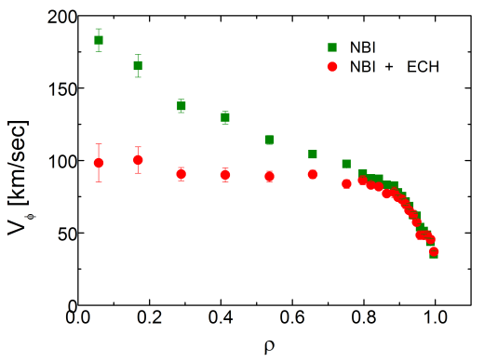
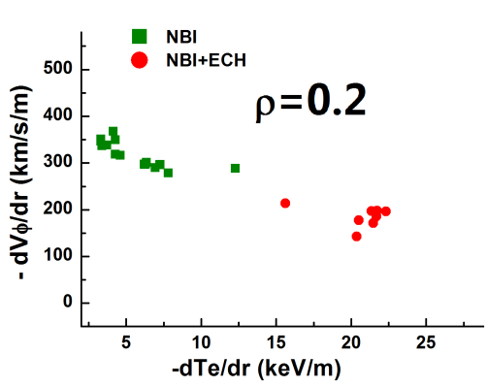
Significant rotation control also by core ECH
(Te decrease was also measured by XICS)
On-axis ECH (400kW) to co-NBI plasmas
  Counter-current torque in core: – ΔV_{ϕ}/V_{ϕ} ~ 30%
  Strong correlation: –Δ(∇V_{ϕ}) ~ +Δ(∇T_{e})
Core intrinsic torque reversal upon ITG→TEM by T_{e} steepening
  Linear gyrokinetic analysis: ITG→TEM occurs for ρ=0.2 ~0.5 depending on density profile ➔ density profile is important!
  Momentum and particle transport are strongly coupled
  More data analysis (density and fluctuation) ongoing
Possibly MHD plays a role in rotation change
  The internal kink mode generally appears when ECRH is injected inside q=1 surface
  The NTV enhanced by ECRH-induced internal kink mode damps rotation
Y. Shi et al., IAEA FEC 2012
J. Seol et al., Phys. Rev. lett. (2012)
Notes:
Toroidal rotation is important for control of stability and transport in tokamaks. the tendency of confined tokamak plasmas to self-accelerate to a state of intrinsic rotation has been identified and understanding the intrinsic rotation related with Rice scaling would be one of the issues. By changing ambient turbulence via the non-diffusive residual stress. one of control knobs for the micro-turbulence population is the heating mix of NBI (heats ion, and so drives ITG) and ECRH (heats electrons, and so can drive CTEM). In this study, we investigate the effect of ECRH heating on NBI-driven toroidal rotation profiles in L-mode and H-mode discharges in the KSTAR tokamak. 1.3 MW of NBI are injected in the co-current direc
IN addition, Rotation drop with ECH injection to NBI driven plasmas often accompanies the MHD activity such as the internal kink mode inside q=1 surface. So interpretating the torque changes is underway using NTV effect from internal kink mode driven by ECH. The magnetic field perturbation driven by the internal kink mode causes the NTV, which is otherwise assumed to be negligible. Note that other machinces, D3D, Adesx already showed the results

Slide 24
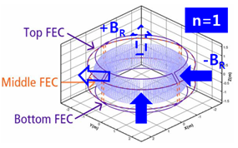
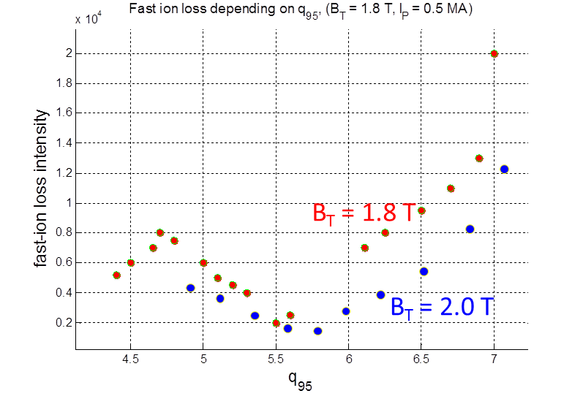
Fast ion loss associated with 3-D magnetic perturbation (resonant, n=1, +90°, I_{p} scan)
24
ELMy case
ELM suppression case
Scintillator-based fast-ion loss detector
Energy: 30 – 1000 keV
Pitch-angle: 30° – 87°
I_{p} scan with various conditions:
Seems to be existing edge helicity (q₉₅) window to increase or decrease fast-ion loss during RMP
Maybe fast-ions exploring at the edge/SOL are mainly affected.
Fast-ion loss at ELM suppression is much larger than at ELMy case.
Figure courtesy of M. Garcia-Munoz

Slide 25
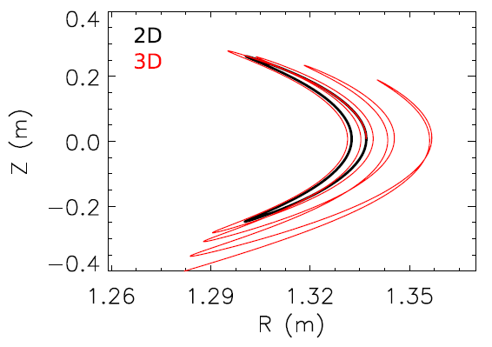
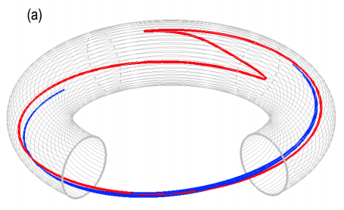
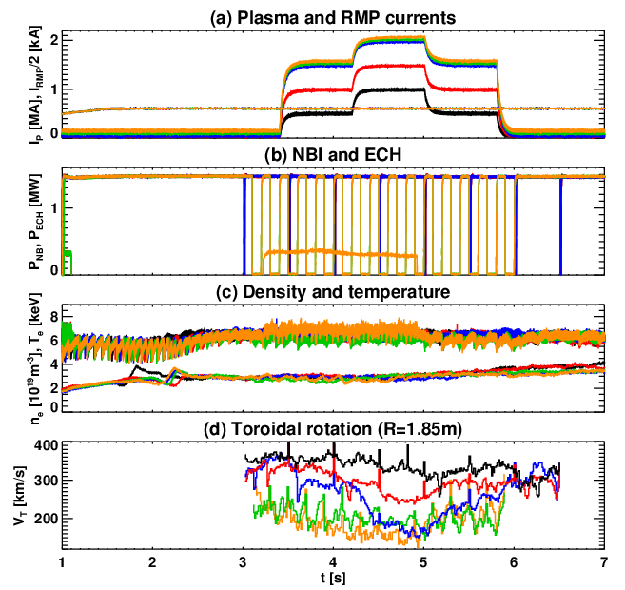
Bounce harmonic resonance in rotation braking
25
RMP causes NTV transport
Braking increases when orbits are nearly closed
Rotation itself reduces rotation braking by phase-mixing
RMP n=1 pulse is used for rotation braking (damping)
Rotation braking becomes stronger in a particular rotation level
  Braking becomes stronger when rotation decreases, but becomes weak when rotation further decreases
Braking peak observed is consistent with the 2nd BH, but actual analysis should be done (1st BH is suspected)
Jong-kyu Park, et al. PRL (2013) accepted
Validation of theoretical prediction

Slide 26
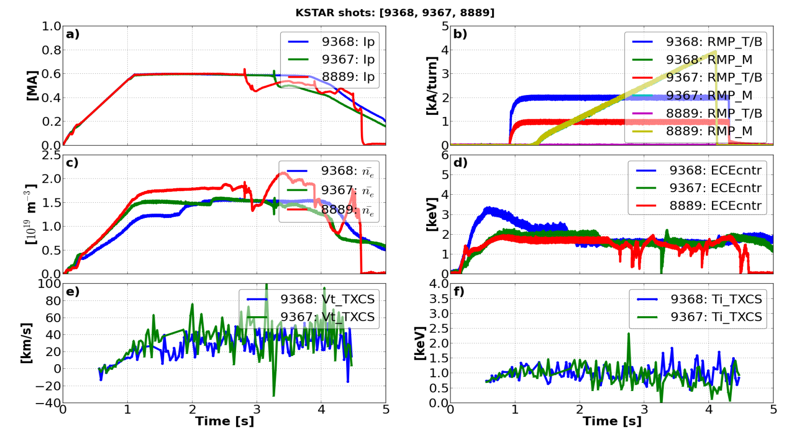
Higher n=2 even field(NRMF) discharge is less susceptible to final locking by n=1 field.
Theoritical background (A.J. Cole et al., 2007 Phys. Rev. Letters): The plasma is less susceptible to error-field penetration and locking, by a factor that depends on the non-resonant error-field amplitude.
n=1 field is gradually increased to cause the final locking.
n=2 even field is constantly applied during n=1 field increase.
Early locking
#8889 (no n=2) > #9367 (n=2, 1 kA/t) > #9368 (n=2, 2 kA/t)
No locking
Run-away
Relative change
Validation of theoretical prediction

Slide 27
Future
Original aim of SC machine
Research plan and roadmap

Slide 28
Toward the original aim of KSTAR and future
Final goal : Steady state operation with active profile controls
(to the time scales that wall processes were in equilibrium with the plasma)
In the next five years, focus would be long-pulse operation with high beta
Demonstrating current tokamak performance for long pulse on time scales much longer than the resistive current relaxation time
Intrinsically stationary state with minimum profile control(ne, Ip, shaping, beta)
In addition, exploring ITER urgent issues will be an important mission such as divertor heat-load control.
To do that, understanding of control physics parameters and securing various control knobs of particle, heat and rotation are essential
this effort should be done with highly concentrating and optimizing methods considering limited our resources.
There also remains many engineering issues such as the sustainment of heating power, heat removal(diverter), magnetic senor issues in long-pulse operation

Slide 29
Research highlight in 2nd phase (2013-2017)
Investigation of ITER operation scenario in long-pulse high beta plasma
Sustainment of long-pulse ITER reference scenario in H-mode (β_{N}>2, t_{pulse}>50s)
Extension of KSTAR dimensionless parameters close to ITER class (ν*, ρ*, n/n_{GW})
Optimization of heat loads on the first wall and divertor (ITER hot issues)
Reliable control of ELMs and disruptions in long-pulse discharges
Control of divertor heat loads and core impurity accumulations
Effect of metal PFCs on the plasma performance
Realization of active plasma control in long-pulse discharges
Development of realtime diagnostics and control of plasma current profiles
Active MHD control including NTMs, ELMs, and RWMs
Extension of advanced operation modes to reactor relevant conditions
Development of long-pulse Hybrid-mode (β_{N}>2.5)
Investigation of Advanced inductive-mode characteristics at V_{T}~0 and T_{e}~T_{i}

Slide 30
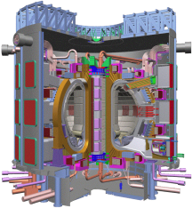
Research roadmap in 2nd phase
2013 2014 2015 2016 2017
Long-pulse ITER Operation
Experiments on long-pulse
ITER reference scenario
β_{N} ~2 for 30s
β_{N} ~2 for 50s
optimal operation
with limitations of SC PF coils
β_{N} ~2.5 for 50s
Heatloads on Dirvetor/Firstwall
Control of ELMs( RMP)
10s >
Pre-cursor detection
for disruptions
Radiative divertor
in long-pulse
Experiments on
optimal divertor shapes
High-Z impurity transport
Tungsten firstwall
Realtime Control & Diagnostics
Integrated ELM control
NTM control
RWM control
Integration of
plasma current profile
Fully integrated PCS
in long-pulse operaion
Control of n_{e}/T_{e} profiles
Advanced operation modes
Quiescent
H-mode
Extension of Hybrid-mode in long-pulse
Te~Ti experiments
vT~0 experiments
Upgrade of
Major Hardwares
NB: 5.5MW
Thomson
IVCP
NB: 6MW
ECH: 1MW
MSE/IRC
PFC(water)
NB: 6MW
ECH: 2MW
RWM PS
NB: 6MW
ECH: 3MW
W-divertor

Slide 31

Next 5-yr upgrade plan of KSTAR heating systems
Upgrade plan considering limited budget
NBI-2
Off-axis tangential beam line
(2 MW x 2 beam sources)
170 GHz ECH
(1 MW/300 s)
105/140 GHz ECH
(2 MW/300 s)
NBI-1
(3 beams, 6MW/100keV)
105/140 GHz ECH
(1 MW/300 s)
30 MHz ICRF
(2 MW/300 s)
5 GHz LHCD
(1 MW/300 s)
More than double of present heating power

Slide 32
Ready for future
Control knob
Momentum, NTM(Sawtooth), Disruption,
density
Diagnostic capability
RWM

Slide 33
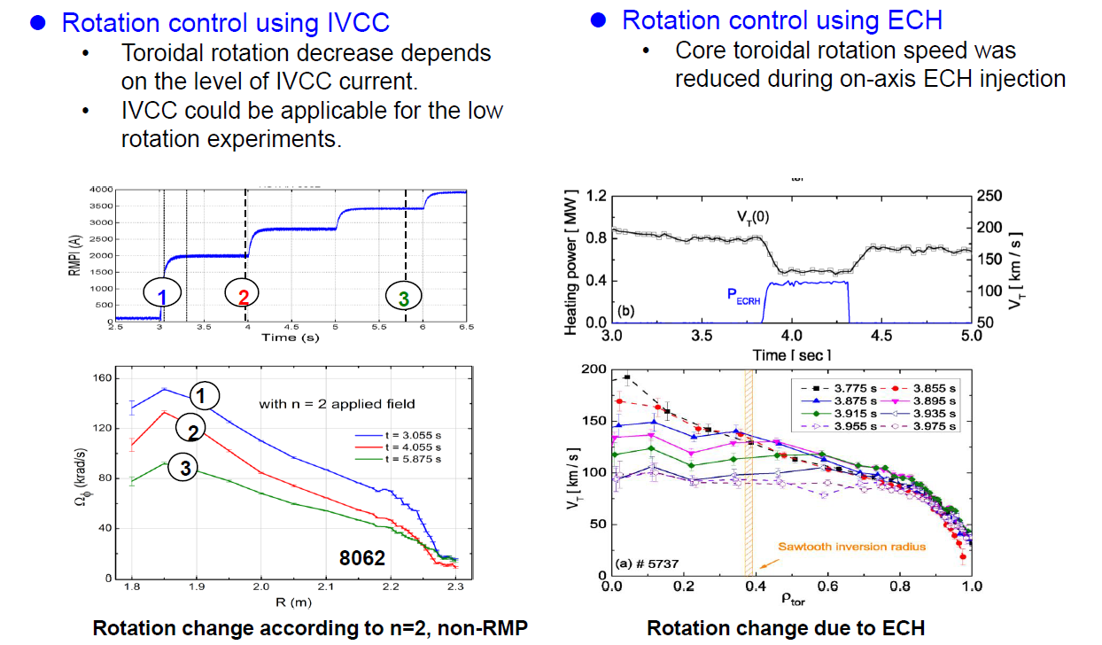
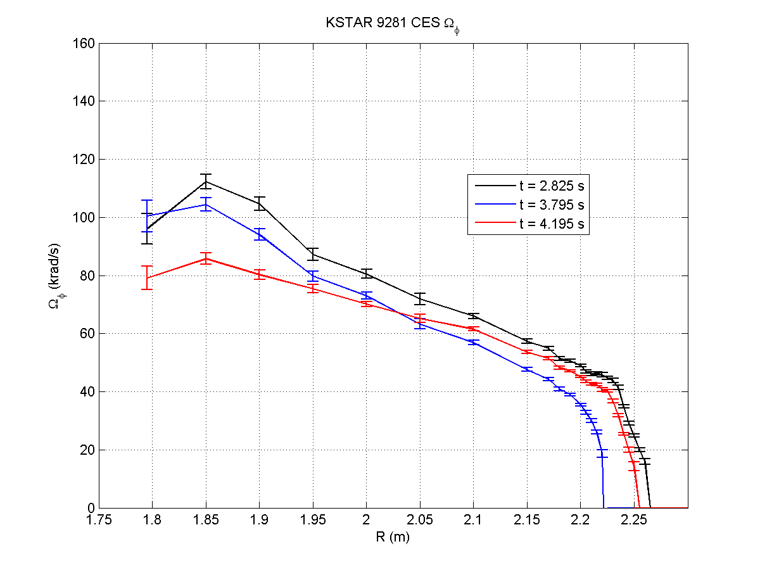
Non-Resonant Magnetic Perturbation and ECH provides effective tools for rotation control
Rotation profile alteration
with combined IVCC n = 2 NTV
+ ECH (110 + 170G)Hz)
Rotation profile before n = 2
and ECH
Ω_{φ} (krad/s)
n = 2 NTV + ECH
9281
n = 2 NTV alone
R (m)
Not optimized

Slide 34
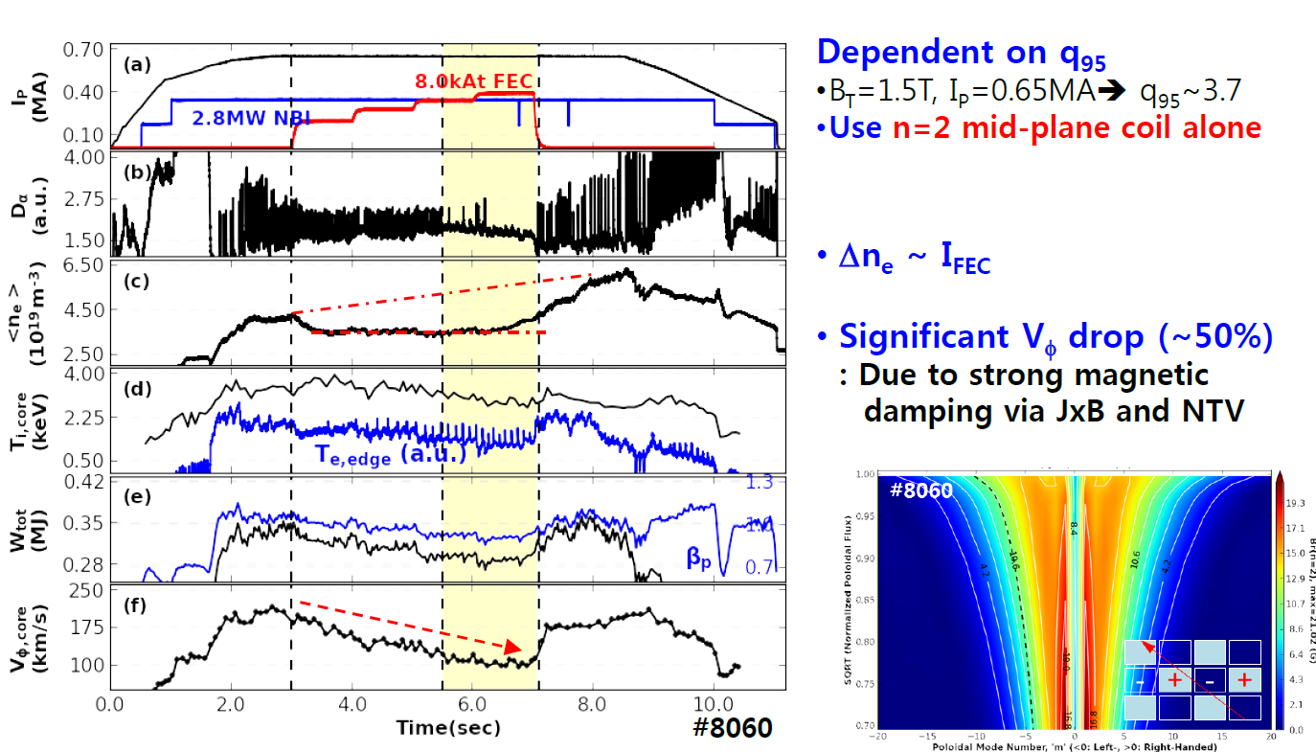
RMP could be a good option for density control (pump-out), in addition to ELM control
w/o in-vessel cryopump, line density is kept stationary in ELMy H-mode discharges
Effect of Non-resonant component is weak for density pump-out
Invessel cryo pump is routinely operated in 2015
Pellet would be available around 2016

Slide 35
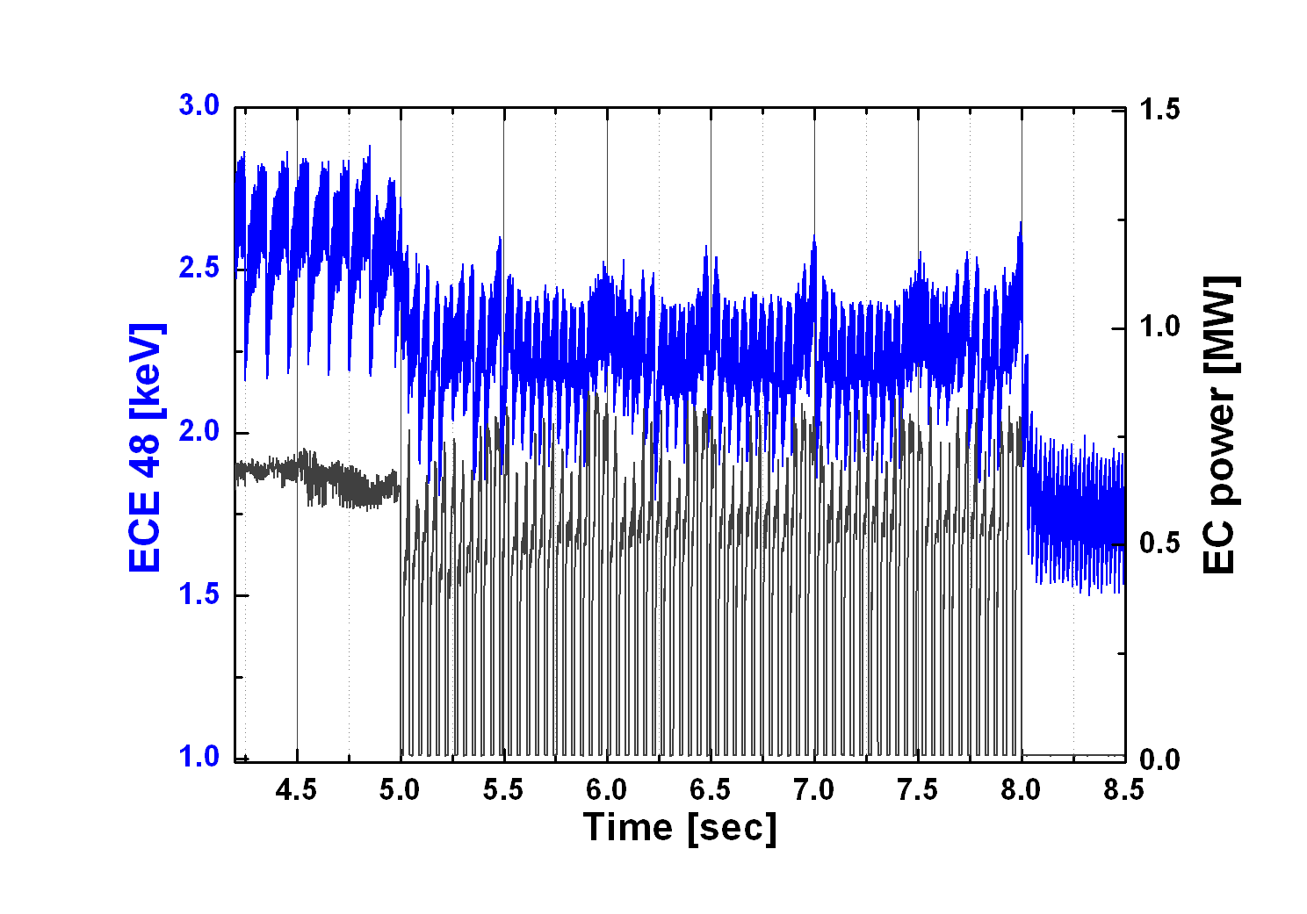
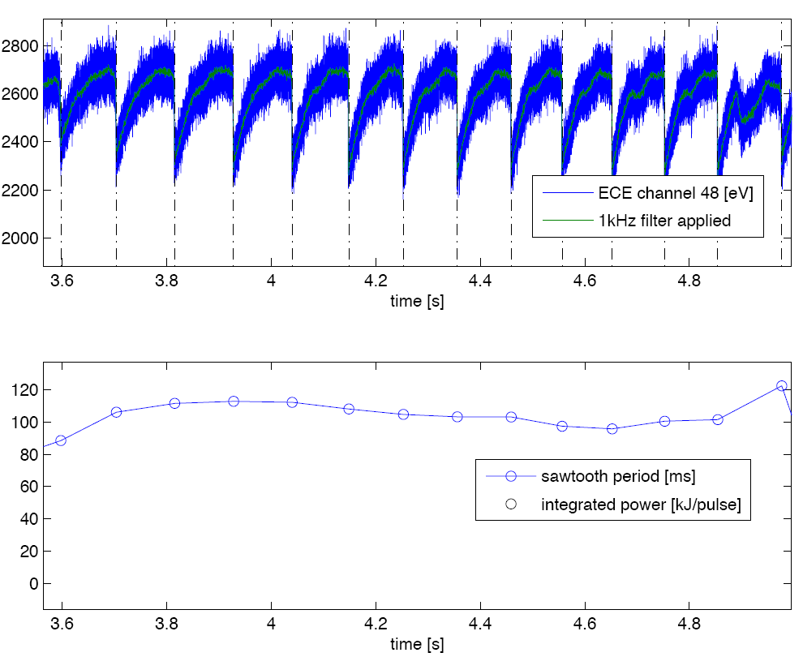
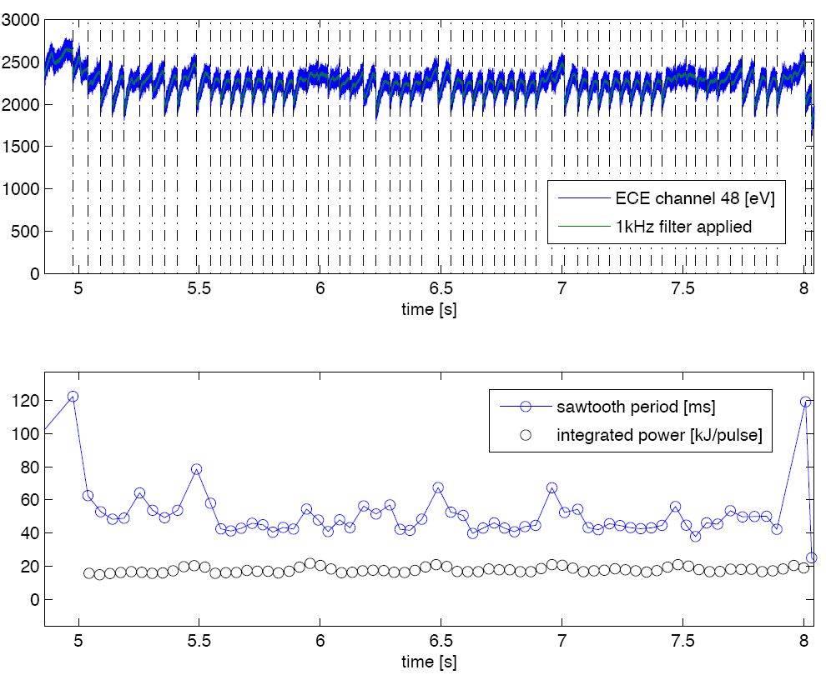

Sawtooth / NTM control ( Sawtooth locking)
35
ECH/CD is very efficient to modify the sawtooth period ^{[1]}
By tailoring the profiles of j_{CD} which is associated by the magnetic shear on the q=1 surface (= s₁)
  Experimental results are well corresponded with the other tokamaks
Possible of injection locking by the modulated EC beam ^{[2,3]}
EC injection
  z=26 cm from mid-plane
  τ_{set}=43 msec (=23 Hz with 70 % duty)
Sawteeth are regulated at τ_{saw}~ 43 ms
EC Modulation freq. τ_{set}=23 Hz (=43 msec)
[1] C. Angioni, T.P. Goodman, M.A. Henderson and O. Sauter, Nucl. Fus. 43 455 (2003)
[2] T. P. Goodman et al., Phys. Rev. Lett. 106 245002 (2011)
[3] G. Witvoet et al., Nucl. Fusion 51 103043 (2011).

Slide 36
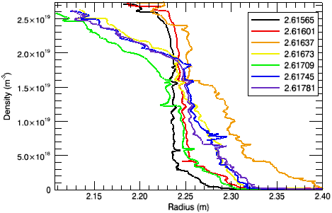
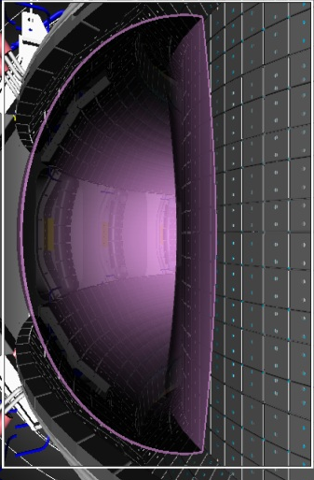
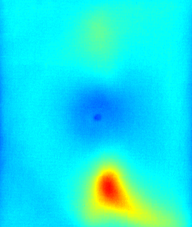
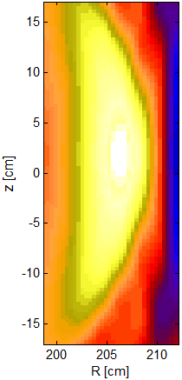
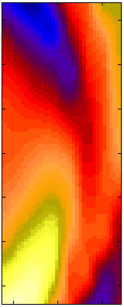
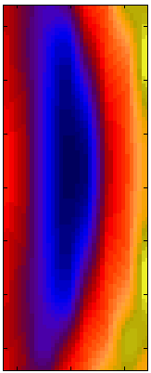
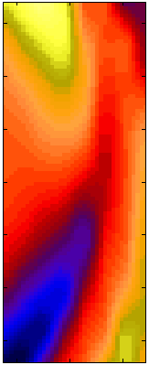
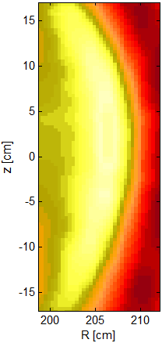








Upgrade plan for profile diagnostics
High resolution Thomson/ECE : n_{e}/T_{e} profile control – RMP/SMBI(2014)
Poloidal/Toroidal CES : rotation profile control (2015) – NRMF/ECH
MSE/Li-beam (both polarimetric+spectral) : current profile control (2015)
2D/3D ECE imaging : sawtooth/NTM/AEs control (2016)
Reflectometry : mid-plane gap control (2014)
$δT_{e}/〈T_{e}〉$
synthetic image from Ren’s model
$δT_{e}/〈T_{e}〉$
measured
ECEI image
Potentials for real-time determination of LCFS by X-mode reflectometry
Potentials for real-time pattern matching of positions of by X/O - points of tearing modes by 2D ECE imaging (M. J. Choi, POSTECH)
1200
1320
2250
Imaging bolometer

Slide 37


Upgrade plan for In-vessel Control Coils
  In addition to the fast vertical control and static RMP operation, various control research using in-vessel coils and broadband power supplies
    5 sets of broadband power supplies (+/- 4kA, +/- 1 kV, dc to a few kHz)
    ELM mitigation / triggering / suppression using RMP or NRMP (n=1, 2)
    Fast or slow Error Field Correction
    NTV rotation profile alternation / control
    Feedback stabilization of Resistive Wall Modes
S. Sabbagh & Y. Park
(Columbia Univ)
Effective control of RWM with given power supplies & optimized SLs

Slide 38
Summary
  KSTAR is ready for long-pulse operation and pulse length is successfully extended to more than 10 seconds
      With heating & CD capability(~10 MW)
      With decent level of plasma current up to 1 MA (B_{T}=2.5 T)
      With efficient isoflux shape control
  KSTAR is ready for the high beta and MHD study above no-wall limit
  starts to develop advanced scenario target without sawteeth using early diverting
  & heating
  KSTAR is equipped with efficient techniques for rotation & density control in long-pulse operation (n=1 & n=2 external coils, ECH heating) and improving diagnostic systems.
  KSTAR is focusing the long-pulse advanced target with ITER urgent issues during the next five years and this efforts should be done with highly concentrating and optimizing methods considering limited our resources and collaboration is essential.

Slide 39
  Thanks,
  Welcome to KSTAR researches.
  KSTAR conference, Feb. 2014
  KSTAR 2014 campaign, Sep.(plasma experiment)
  From KSTAR delegation
  Pedestal(Siwoo),
  MHD(Byongho)
  Transport(Chunho)
  Theory/Modelling(Jinyong)
  From PPPL
  MHD(Steve), H-mode(Joon Wook), NTV(Jongkyu), ECH(Ellis)

