Slide 1




NSTX-U
Supported by
NSTX-U / KSTAR Collaboration Opportunities
Jonathan Menard (PPPL)
NSTX-U Program Director
Coll of Wm & Mary
Columbia U
CompX
General Atomics
FIU
INL
Johns Hopkins U
LANL
LLNL
Lodestar
MIT
Lehigh U
Nova Photonics
Old Dominion
ORNL
PPPL
Princeton U
Purdue U
SNL
Think Tank, Inc.
UC Davis
UC Irvine
UCLA
UCSD
U Colorado
U Illinois
U Maryland
U Rochester
U Tennessee
U Tulsa
U Washington
U Wisconsin
X Science LLC
Culham Sci Ctr
York U
Chubu U
Fukui U
Hiroshima U
Hyogo U
Kyoto U
Kyushu U
Kyushu Tokai U
NIFS
Niigata U
U Tokyo
JAEA
Inst for Nucl Res, Kiev
Ioffe Inst
TRINITI
Chonbuk Natl U
NFRI
KAIST
POSTECH
Seoul Natl U
ASIPP
CIEMAT
FOM Inst DIFFER
ENEA, Frascati
CEA, Cadarache
IPP, Jülich
IPP, Garching
ASCR, Czech Rep
NFRI – PPPL Collaboration Meeting
PPPL
October 21, 2013

Slide 2
Thanks to our KSTAR/NFRI visitors for coming to PPPL!
A few goals for this meeting:
Identify research areas of common interest for possible collaboration w/ NSTX-U (this talk) and PPPL more broadly
Identify research contacts to facilitate future collaboration
Enhance KSTAR/NFRI researcher participation on NSTX-U, possibly through extended stays at Princeton/PPPL

Slide 3
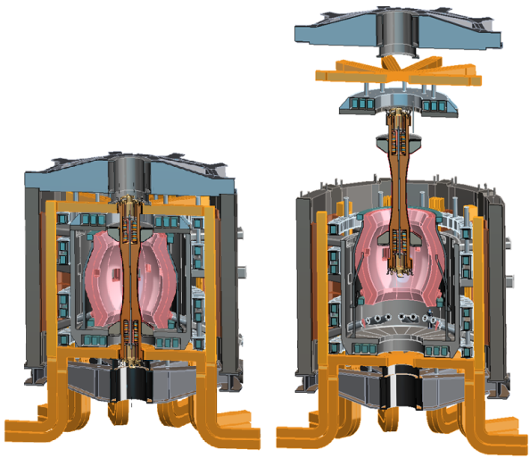
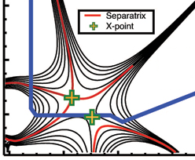
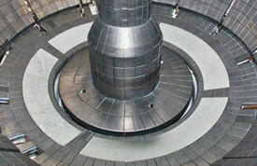

NSTX Upgrade mission elements
Advance ST as candidate for Fusion Nuclear Science Facility (FNSF)
Develop solutions for the plasma-material interface challenge
Explore unique ST parameter regimes to advance predictive capability - for ITER and beyond
Develop ST as fusion energy system
ST-FNSF
“Snowflake”
Lithium
ITER

Slide 4

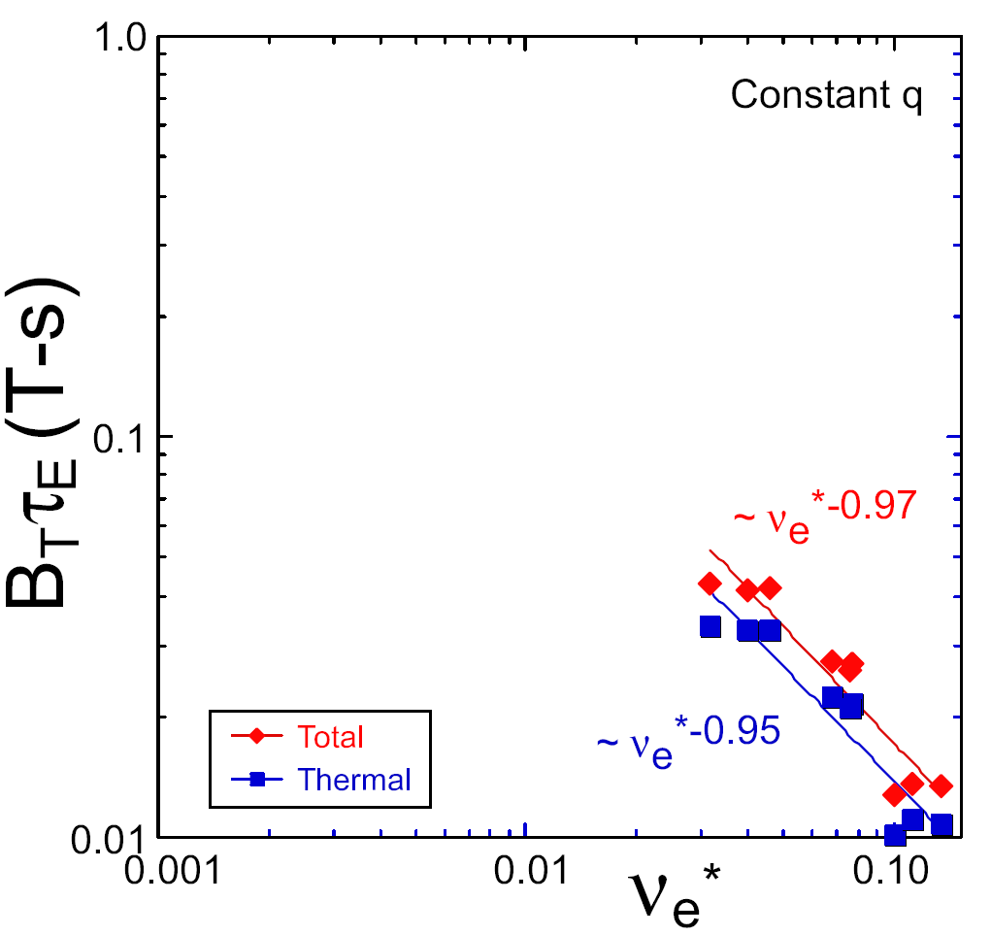
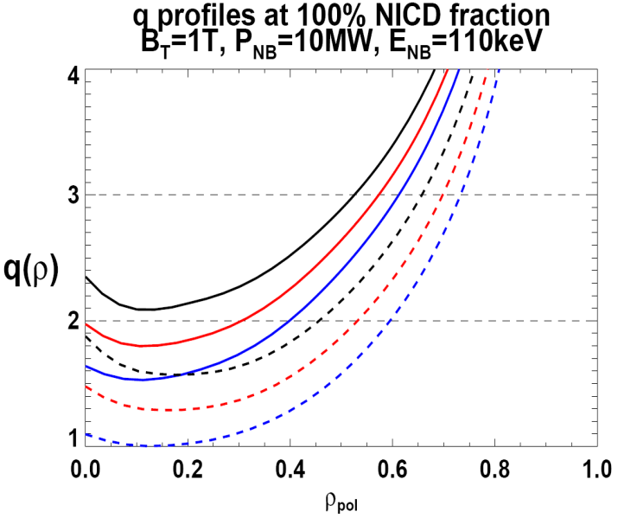

NSTX Upgrade incorporates 2 new capabilities:
Previous
center-stack
New
center-stack
ST-FNSF
Reduces ν* → ST-FNSF values to understand ST confinement
  Expect 2x higher T by doubling B_{T}, I_{P}, and NBI heating power
  5x longer pulse-length
  q(r,t) profile equilibration
  Test non-inductive ramp-up
constant q, β, ρ∗
NSTX Upgrade
?
NSTX
ITER-like scaling
TF OD = 20cm
TF OD = 40cm
Normalized e-collisionality ν_{e}* ∝ n_{e} / T_{e}²
I_{P}=0.95MA, H_{98y2}=1.2, β_{N}=5, β_{T} = 10%, B_{T} = 1T, P_{NBI} = 10MW, P_{RF} = 4MW
  2x higher CD efficiency from larger tangency radius R_{TAN}
100% non-inductive CD with core q(r) profile controllable by:
  NBI tangency radius
  Plasma density, position (not shown)
n
e
/
n
Greenwald
0.95
0.72
R_{TAN} [cm]
__________________
50, 60, 70, 130
60, 70,120,130
70,110,120,130
Present NBI
New 2nd NBI

Slide 5
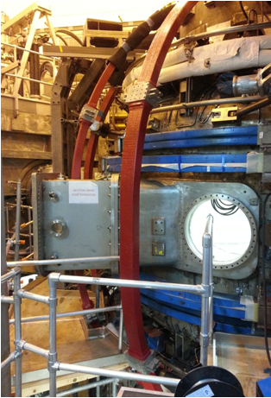
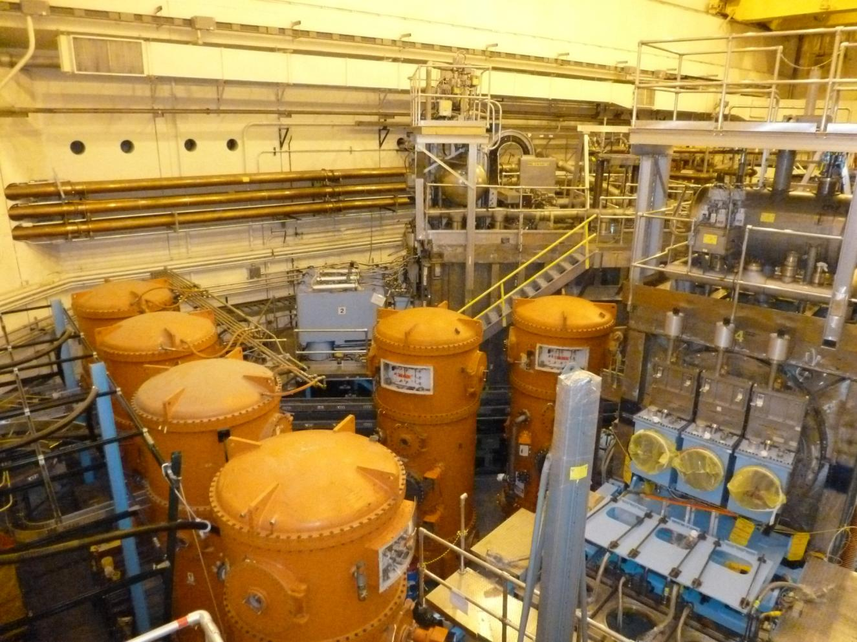
NSTX Upgrade project on schedule and cost
Good progress on 2nd NBI, device structural enhancements
New tangential NBI injection port installed
2 new outer TF coils installed
2nd NBI installed
High Voltage Enclosures in-place

Slide 6
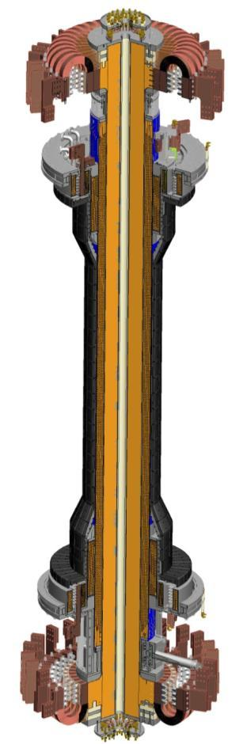
Centerstack is the critical path and highest risk
Components & Hardware
  Flex connectors – delivered
  PF 1b,a,c coils – awarded
  PFC Tiles - delivered and being machined
  Casing - delivered
Inner TF Bundle
  VPI 4 Quadrants - Completed
  VPI Full Bundle - Completed
OH Solenoid
  OH Conductor delivered
  Aqua-pour process – underway
  Begin winding OH solenoid – November
  VPI OH – Jan-Feb 2014
Centerstack Assembly
  Delivery to NSTX Test Cell - May 2014

Slide 7
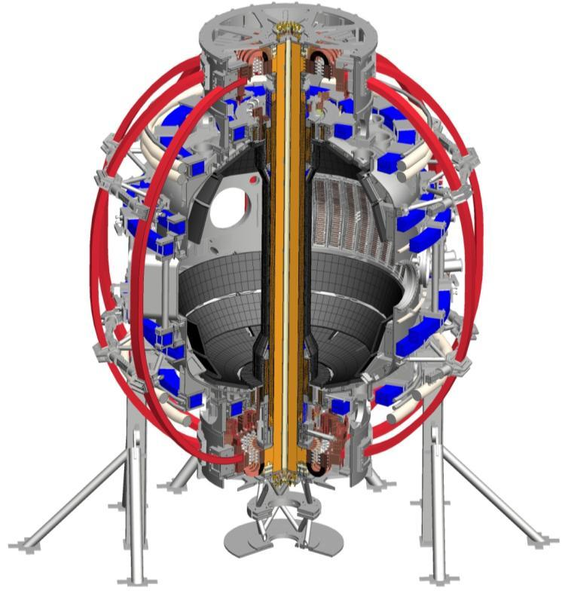
NSTX-U operations schedule / plan
New centerstack installation planned for spring / summer 2014 - less than 1 year away
First plasma: late fall 2014
Start research program:
late 2014 - early 2015

Slide 8
Highest priority research goals for NSTX-U:
Demonstrate 100% non-inductive sustainment
Access reduced ν* and high-β combined with ability to vary q and rotation
Develop/understand non-inductive start-up, ramp-up
(overdrive) for ST-FNSF with small/no solenoid
4. Develop high-flux-expansion “snowflake” divertor +
radiative detachment to mitigate high heat fluxes
5. Assess high-Z + liquid Li plasma facing components
Longer-term (5-10 year) goal:
Integrate 100% non-inductive + high β and τ_{E} + divertor solution + metal walls

Slide 9
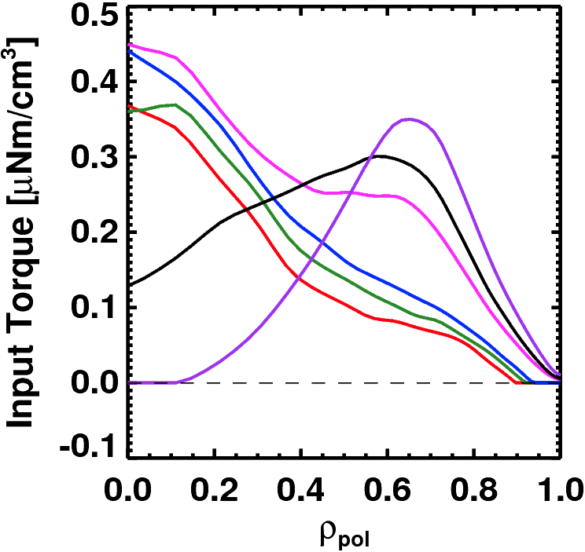
Advanced Scenarios and Control 5 Year Goals:
Rotation Profile Actuators
100% non-inductive operation
Lower ν*: high-current, partial-inductive scenarios, extend to long-pulse
Implement axisymmetric control algorithms and tools
  Current and rotation profile control
  Improved shape and vertical position control
  Heat flux control for high-power scenarios
Develop disruption avoidance by controlled plasma shutdown
Torque Profiles From
6 Different NB Sources
Largest R_{tan}
Neutral
Beams
(TRANSP)
Smallest R_{tan}
Also torques from 3D fields

Slide 10
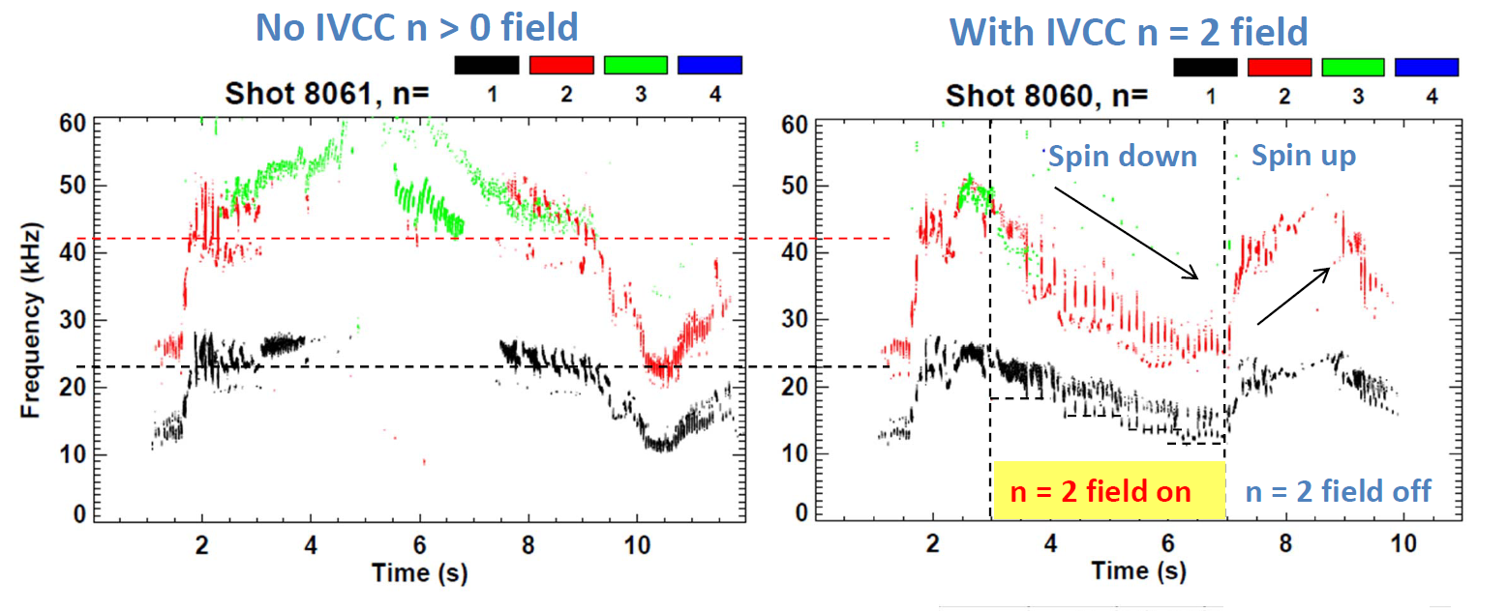
Collaboration opportunity:
KSTAR also using 3D fields for NTV/rotation control, ELM/EF control
KSTAR Data:

Slide 11
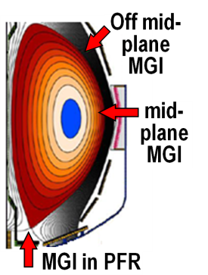
Macroscopic Stability 5 Year Goals:
Study effects of reduced ν*, q and rotation on LM, RWM, NTM
Test state-space control for EF, RWM for ITER, next-steps
Assess 3D field effects to provide basis for optimizing stability through rotation profile control by 3D fields
  EF penetration, rotation damping, ELM triggering and suppression
Understand disruption dynamics, develop prediction and detection, avoidance, mitigation
  Enhance measurements of disruption heat loads, halos
  Develop novel particle delivery techniques for mitigation:
    MGI in private-flux-region (PFR), electromagnetic particle injector

Slide 12
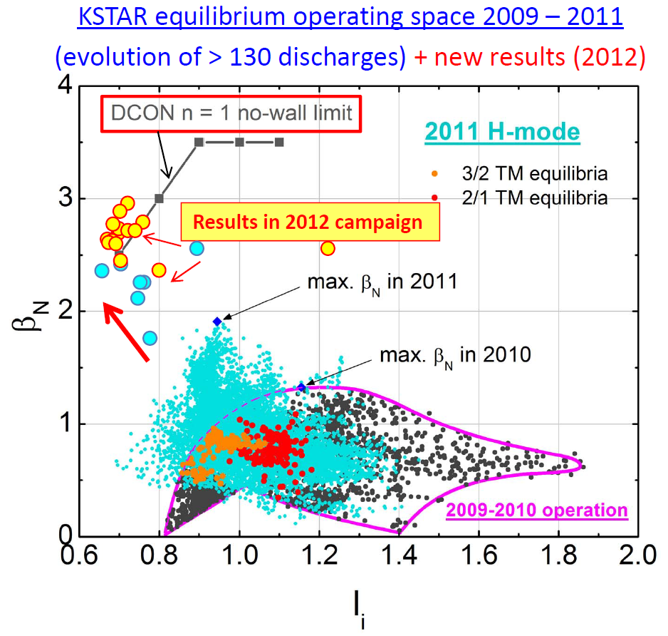
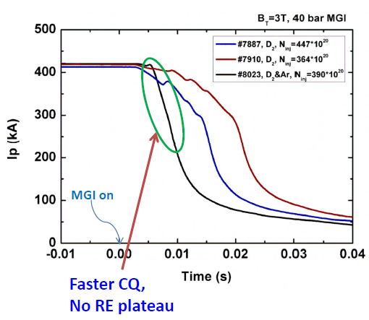
Collaboration opportunity:
KSTAR operating near no-wall stability limit, testing massive gas injection
KSTAR Data:

Slide 13
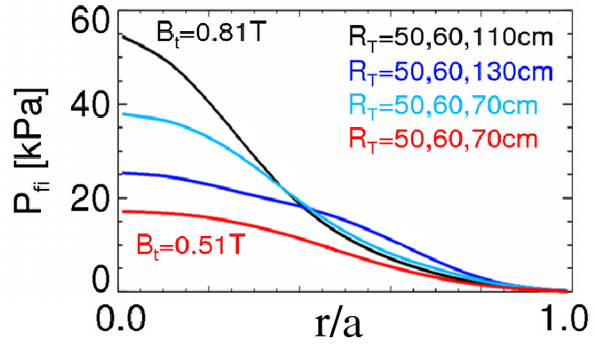
Energetic Particle 5 Year Goals:
Develop predictive tools for projections of *AE-induced fast ion transport in FNSF and ITER
  Compare data to simulation, develop reduced models
    ORBIT, NOVA-K, M3D-K, HYM to understand mode-induced transport
Vary fast-ion instability drive using NBI, q, rotation, 3D fields
Measure *AE mode structure
  Magnetics, BES, reflectometry
Characterize fast ion transport vs. *AE type
Assess requirements for fast-ion phase-space engineering
  AE spectroscopy, also stability control using NBI, q, rotation, 3D fields

Slide 14
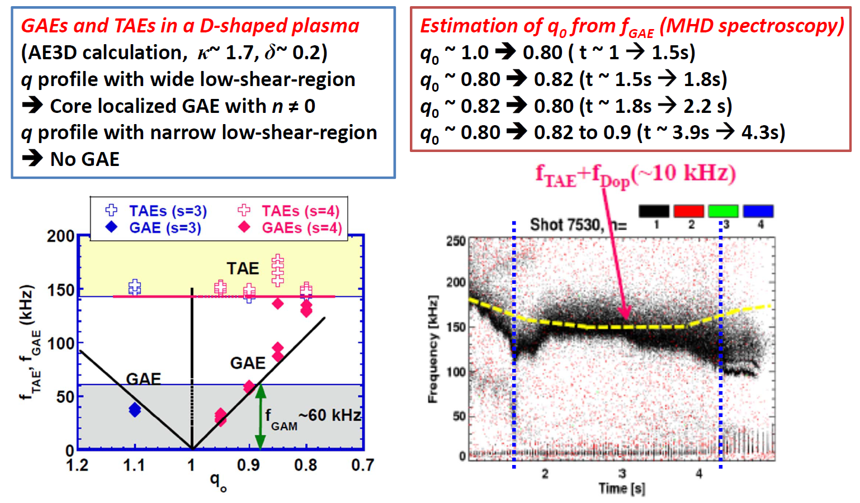
Collaboration opportunity:
KSTAR also observes Alfvén eigenmodes from NBI, fast-ion loss from MHD
KSTAR Data:

Slide 15
Transport and Turbulence 5 Year Goals:
Characterize H-mode global energy confinement scaling in the lower collisionality regime of NSTX-U
Identify modes causing anomalous electron thermal, momentum, particle/impurity transport
  Exploit scaling dependencies of modes
    Example: μ-tearing χ_{e} ~ ν¹, ETG χ_{e} ~ ν⁰
  Relate predicted turbulence to data:
    Low-k (BES), δB (polarimetry), high k_{r} & k_{θ} (μ-wave)
  Builds on identification of ETG w/ novel high-k_{r} scattering in NSTX
Establish and validate reduced transport models

Slide 16
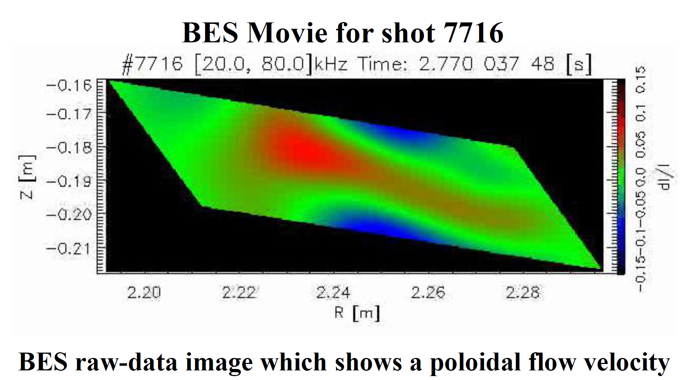
Collaboration opportunity:
KSTAR beginning to measure low-k turbulence with BES (also MIR, ECEI)
KSTAR Data:

Slide 17
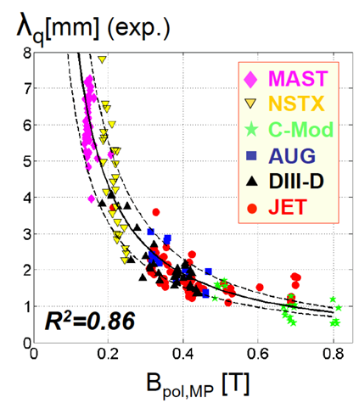
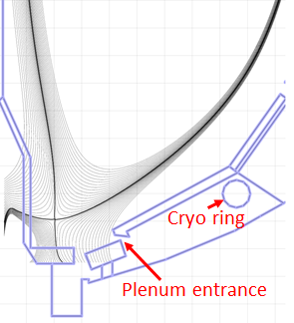
Boundary Physics, SOL/Divertor, PMI 5 Year Goals:
Assess, optimize, control pedestal structure, transport, stability
Assess and control divertor heat fluxes
  Measure SOL widths at lower ν, higher B_{T}, I_{P}, P_{SOL}
    Compare data to fluid and gyro-kinetic models
  Assess, control, optimize snowflake/X-divertor
  Develop highly-radiating divertor w/ feedback control
  Assess impact of high-Z tile row(s) on core impurities
Establish, compare particle control methods
  Validate cryo-pump physics design, assess density control
  Compare cryo to lithium coatings for n_{e}, impurity, ν* control
Explore Li/liquid-metal plasma material interactions
  Li surface-science, continuous vapor-shielding, material migration and evolution, lab R&D: flowing Li loops, capillary-restrained Li surfaces

Slide 18
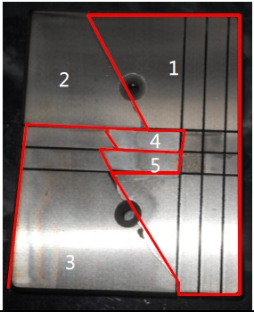
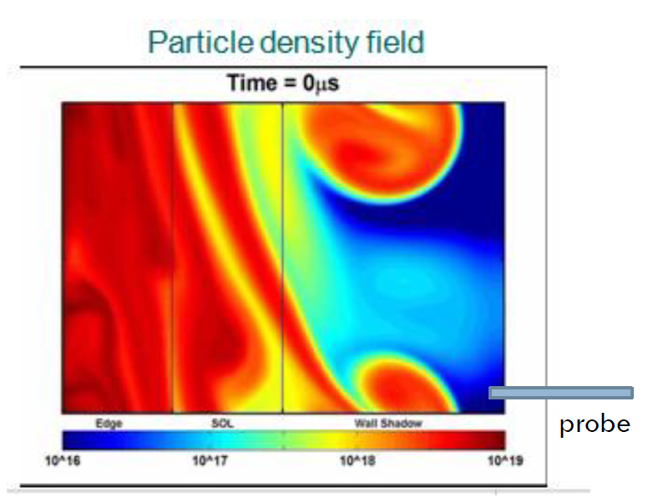
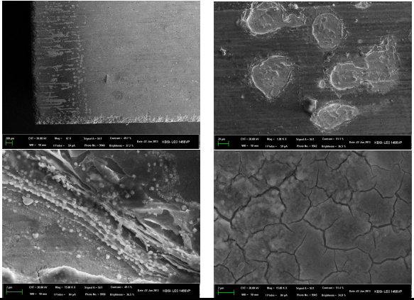
Collaboration opportunity:
KSTAR studying castellated W, W surface effects & dust, far-SOL transport
KSTAR Data:

Slide 19
Summary
NSTX-U and KSTAR research programs have many common goals
Many collaboration opportunities when NSTX-U begins operation in 2015

Slide 20
Backup

Slide 21
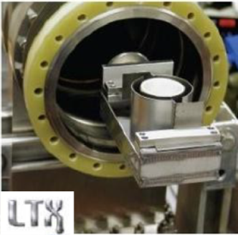
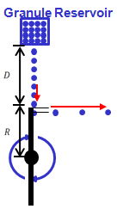

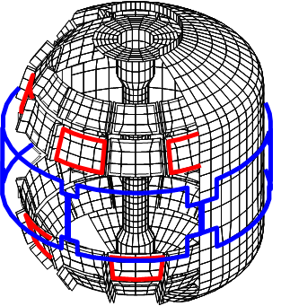
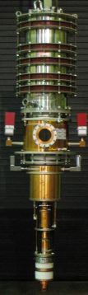
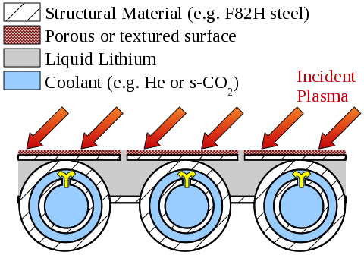
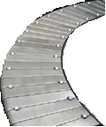
Proposed longer-term facility enhancements:
(2014-2018)
Improved particle control tools
  Control deuterium inventory and trigger rapid ELMs to expel impurities
  Access low ν*, understand role of Li
Disruption avoidance, mitigation
  3D sensors & coils, massive gas injection
ECH to raise start-up plasma T_{e} to enable FW+NBI+BS I_{P} ramp-up
  Also EBW-CD start-up, sustainment
Begin transition to high-Z PFCs, assess flowing liquid metals
  Plus divertor Thomson, spectroscopy
Upward Li evaporator
Divertor cryo-pump
Li granule injector (LGI)
Midplane + off-midplane non-axisymmetric control coils (NCC)
Extended low-f MHD sensor set
1-2MW
28 GHz
gyrotron
High-Z tiles
Actively-supplied, capillary-restrained, gas-cooled LM-PFC

Slide 22

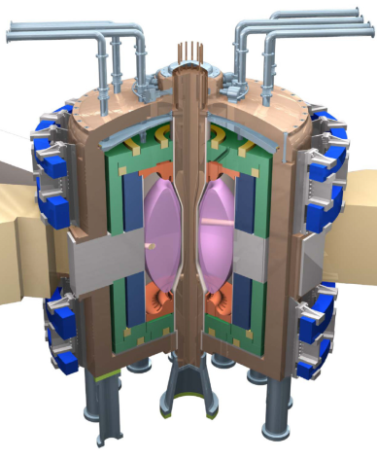
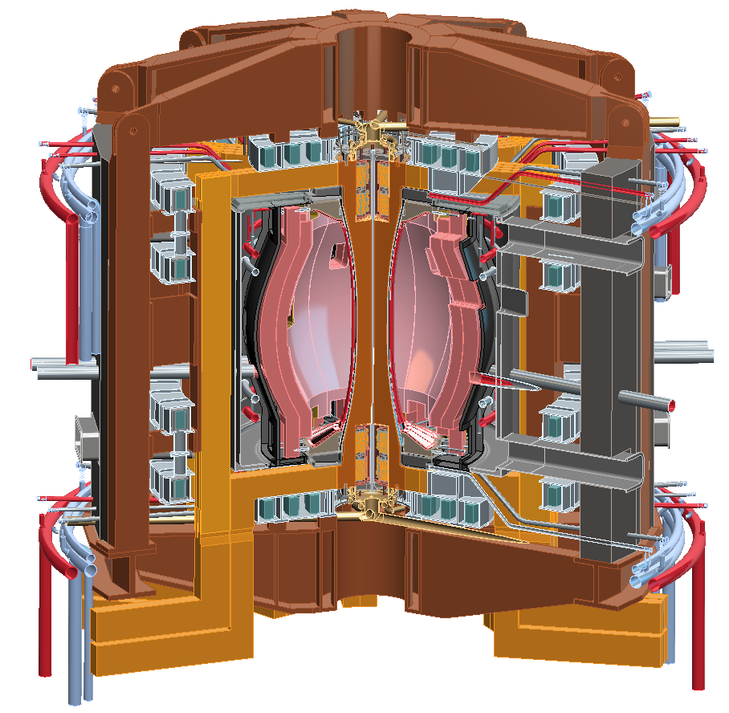
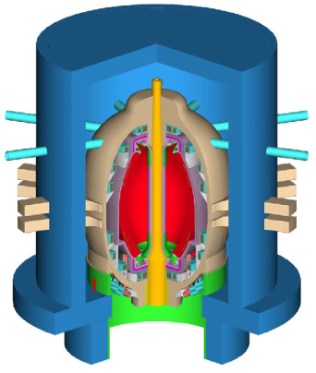
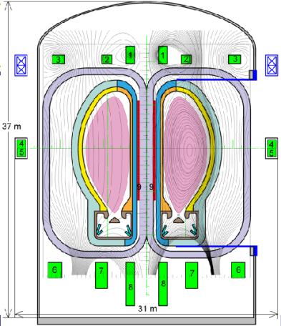
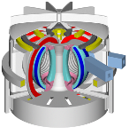
NSTX Upgrade will access next factor of two increase in performance to bridge gaps to next-step STs
Low-A
Power Plants
Parameter | NSTX | NSTX Upgrade | Fusion Nuclear Science Facility | Pilot Plant
Major Radius R₀ [m] | 0.86 | 0.94 | 1.3 | 1.6 – 2.2
Aspect Ratio R₀ / a | ≥ 1.3 | ≥ 1.5 | ≥ 1.5 | ≥ 1.7
Plasma Current [MA] | 1 | 2 | 4 – 10 | 11 – 18
Toroidal Field [T] | 0.5 | 1 | 2 – 3 | 2.4 – 3
Auxiliary Power [MW] | ≤ 8 | ≤ 19* | 22 – 45 | 50 – 85
P/R [MW/m] | 10 | 20 | 30 – 60 | 70 – 90
P/S [MW/m²] | 0.2 | 0.4-0.6 | 0.6 – 1.2 | 0.7 – 0.9
Fusion Gain Q |  |  | 1 – 2 | 2 – 10
ARIES-ST (A=1.6)
JUST (A=1.8)
* Includes 4MW of high-harmonic fast-wave (HHFW) heating power
VECTOR (A=2.3)
Non-inductive start-up, ramp-up, sustainment
Confinement scaling (esp. electron transport)
Stability and steady-state control
Divertor solutions for mitigating high heat flux
Key issues to resolve for next-step STs

Slide 23
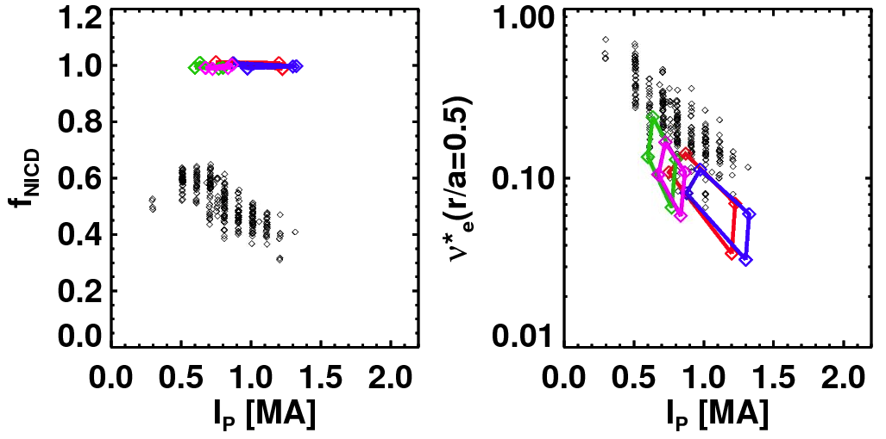
TRANSP simulations support goal of accessing and controlling 100% non-inductive plasma operation
NSTX achieved:
NSTX-U projections (TRANSP):
Maximum sustained non-inductive fractions of 65% w/NBI at I_{P} = 0.7 MA
70-100% non-inductive transiently with HHFW current-drive + bootstrap
100% non-inductive at I_{P} = 0.6-1.3MA for range of power, density, confinement
I_{P}=1 MA, B_{T}=1.0 T, P_{NBI}=12.6 MW
Contours of Non-Inductive Fraction
NSTX-U projections
Total non-inductive current fraction
NSTX Results
H_{98y2}
via high harmonic FW
I_{p} (MA)

Slide 24
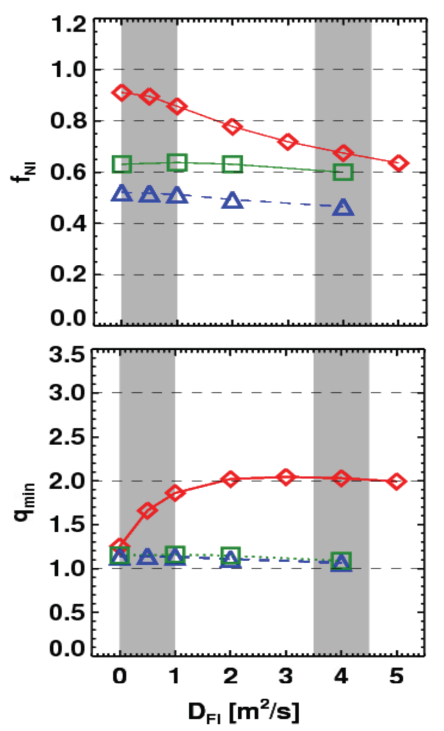
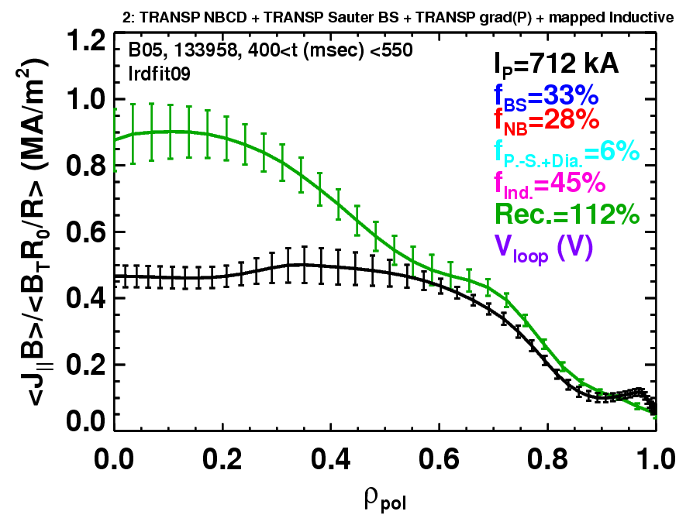
Rapid TAE avalanches could impact NBI current-drive in advanced scenarios for NSTX-U, FNSF, ITER AT
NSTX-U TRANSP simulations
NSTX: rapid avalanches can lead to
redistribution/loss of NBI current drive
Discrepancy between reconstruction and total assuming
classical J_{NBCD}
1 MA, 1T, H₉₈=1, near non-inductive
1.6 MA, 1T, partial inductive
1.2 MA, 0.55T, high β_{T}
All: f_{GW}=0.7, H₉₈=1
Minor radius
700kA high-β_{P} plasma with rapid
TAE avalanches has time-average D_{FI} = 2-4m²/s

Slide 25
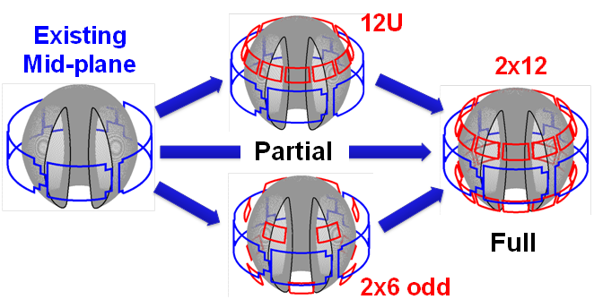
NSTX/NSTX-U is making leading contributions to high-β_{N} stability physics, and assessing possible 3D coil upgrades
n=1 MHD spectroscopy: high β_{N} can be more stable
  Combination of rotation and current profile effects at high beta
  Important for advanced scenarios
Resonant Field
Amplification (G/G)
Identified several off-midplane 3D coil sets favorable for profile and mode control
  ~40% increase in n=1 RWM β_{active} / β_{no-wall}
  ~5x reduction in n=1 EF resonant torque
  ~10-100x variation in ratio of non-resonant to resonant n=3 torque in edge
    Important for control, understanding of RMP ELM control, NTV rotation profile control
NCC options:

Slide 26
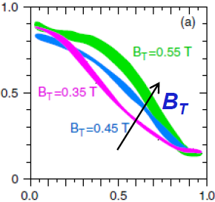
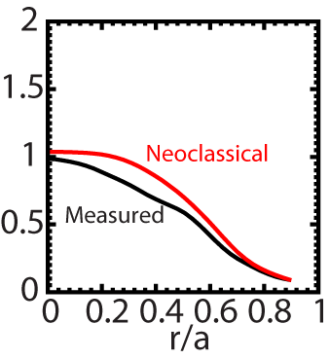
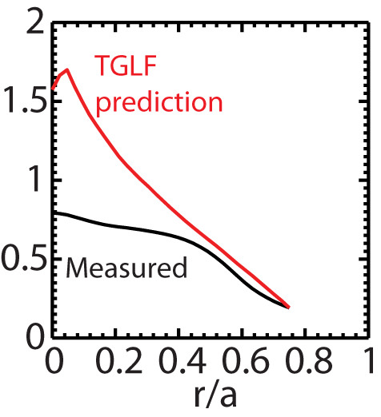
Beginning to test/utilize transport models to predict NSTX temperature profiles, identify possible missing physics
NSTX H-modes showed broadening of T_{e} profile as B_{T} was increased
  Similar broadening trend observed with increased lithium deposition
  B_{T}τ_{E} scales as ~1/ν* in both datasets
T_{e} (keV)
r/a
Utilizing neoclassical + drift wave models to simulate NSTX T_{i} and T_{e} profiles (collaboration with GA)
  Need model for χ in edge region
  Discrepancy in core T_{e} prediction for beam-heated H-modes
T_{i} (keV)
T_{e} (keV)
Over-prediction of core T_{e} in NSTX may be due to transport from GAE/CAE modes not included in gyro-Landau-fluid model

Slide 27

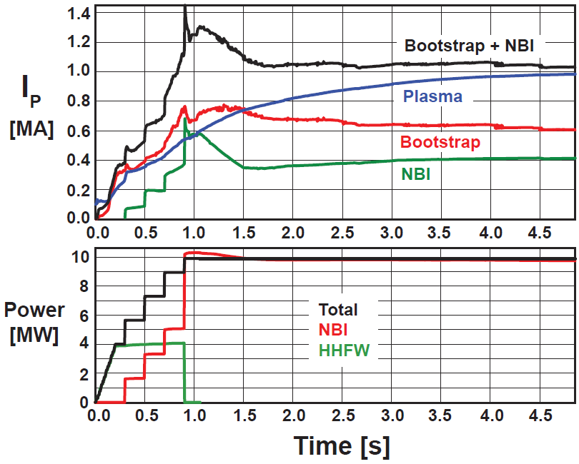
Simulations support non-inductive start-up/ramp-up strategy
TSC code (2D) successfully simulates CHI I_{P} ~200kA achieved in NSTX
TRANSP: NSTX-U more tangential NBI → 3-4x higher CD at low I_{P} (0.4MA)
TSC: non-inductive ramp-up from 0.4MA to 1MA possible w/ BS + NBI
1.0 ms
1.6 ms
2.7 ms
2
1
Z (m)
0
-1
-2
0
1
2
0
1
2
0
1
2
R (m)
R (m)
R (m)
TSC + tools included in 5 year plan support CHI I_{P} → 400kA in NSTX-U
  Higher injector flux, toroidal field, CHI voltage
  1MW 28GHz ECH (increases T_{e})
But, RF heating (ECH and/or HHFW) of CHI likely required to couple to NBI

Slide 28
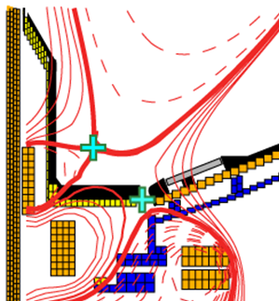
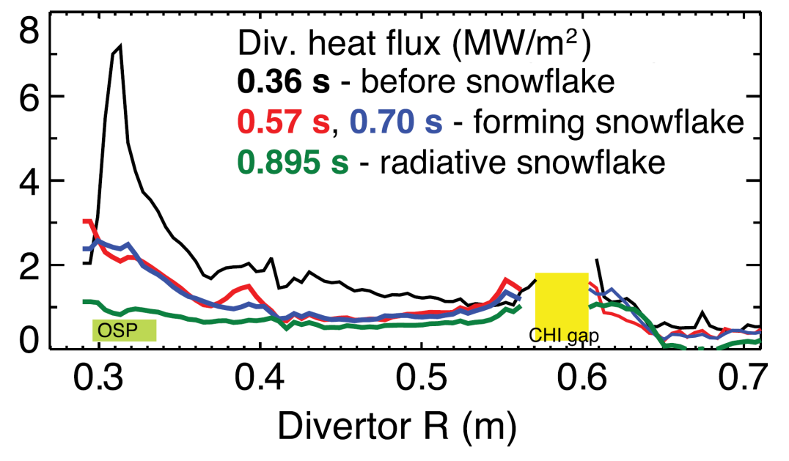
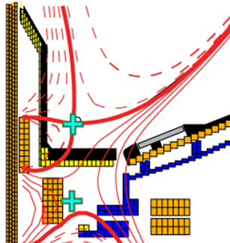
Snowflake divertor effective for heat flux mitigation
NSTX: can reduce heat flux by 2-4× via partial detachment
Snowflake → additional x-point near primary x-point
  NSTX: High flux expansion = 40-60 lowers incident q⊥
  Longer field-line-length promotes temperature drop, detachment
Standard Divertor
Snowflake Divertor

Slide 29
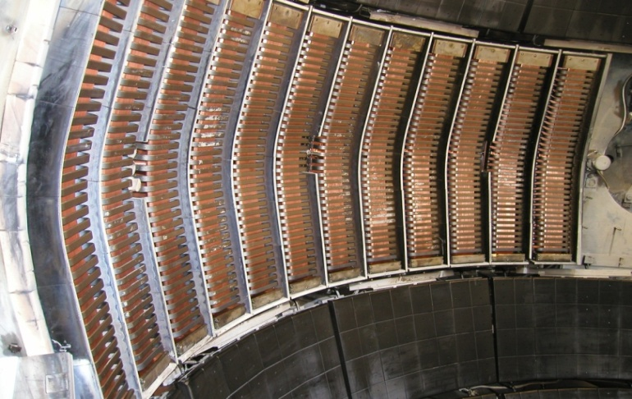
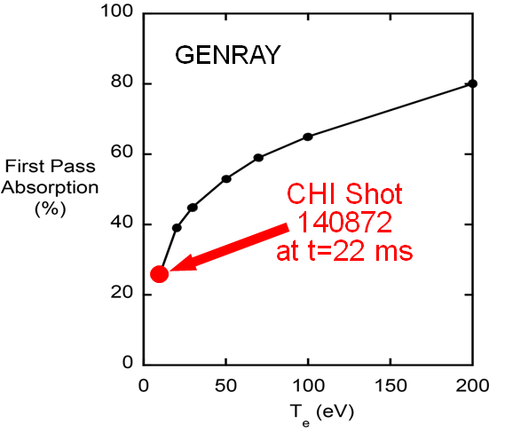
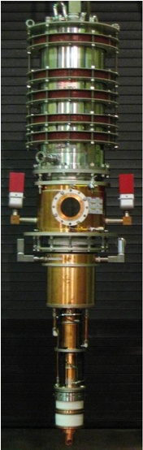
Start-up/Ramp-up + RF Heating/Current Drive Goals:
Test higher-current CHI start-up (~400kA)
Test NBI + bootstrap current overdrive/ramp-up
Develop HHFW and EC heating for fully non-inductive plasma current start-up and ramp-up
  Extend HHFW to higher power (3-4MW), demonstrate HHFW-driven 100% non-inductive at 300-400kA
    Goal: maintain I_{P} to confine 2nd NBI fast-ions
Validate advanced RF codes for NSTX-U, predict RF performance in ITER and FNSF
  Use ECH (~1MW, 28GHz), then HHFW to increase T_{e} of CHI plasmas for NBI
  Test high-power EBW to generate start-up current - builds on MAST results

Slide 30
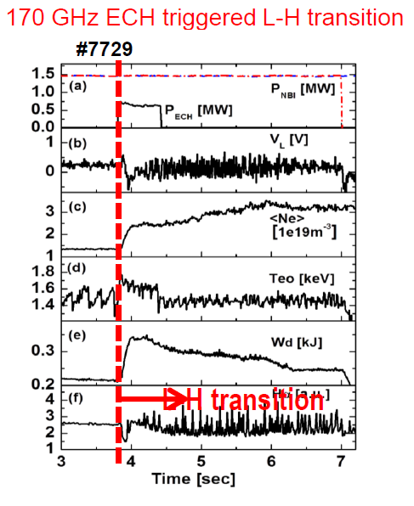
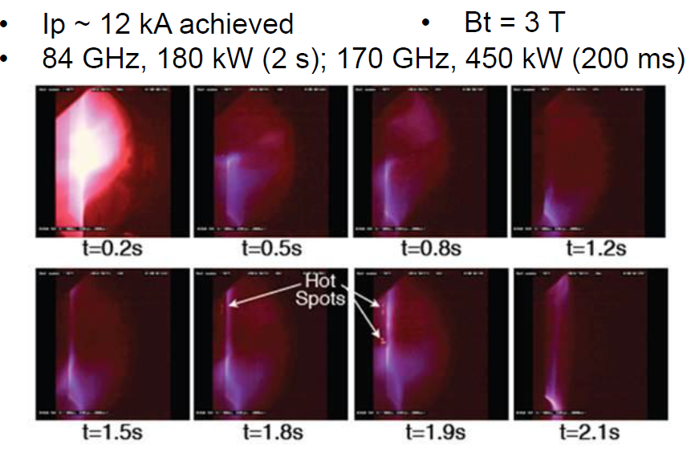
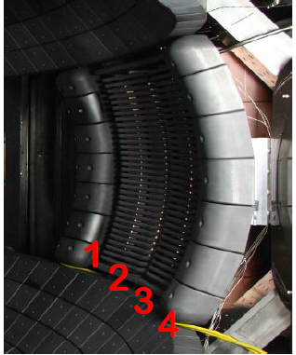
Collaboration opportunity:
KSTAR using ECH, developing ICRF, testing non-solenoidal start-up (Kyoto)
KSTAR Data:

