Slide 1




Research Topics on Pedestal Physics at KSTAR
Si-Woo Yoon
on behalf of Boundary Physics Division
National Fusion Research Institute (NFRI), Daejeon, Korea
Domestic & International Collaborators

Slide 2
Contents
Characteristics of H-mode discharges
  L-H transition, confinement, typical H-mode discharges, stimulated transition
Status of pedestal diagnostics
  Validation of profile & fluctuation
  profiles : Thomson Scattering, Charge Exchange Spectroscopy, Reflectometry,
  fluctuations :Beam emission spectroscopy, Imaging of Electron cyclotron emission
Research topics on pedestal physics
  ELM mitigation / control
  (Resonant magnetic perturbation, edge ECRH, supersonic molecular beam injection)
  Pedestal evolution during ELM cycle
  (dynamics, mode structure)
  Searching for small ELM regimes
Near term research plan
  Fast pedestal profile measurements including j║ , E_{r} , & V_{pol} with cross-check
  (Li-Zeeman, poloidal CES, MSE, DBS)
  ELM physics/control in ITER relevant condition
  Transport in pedestal region (particle pinch, turbulence, ZF)

Slide 3
Characteristics of H-mode discharges

Slide 4
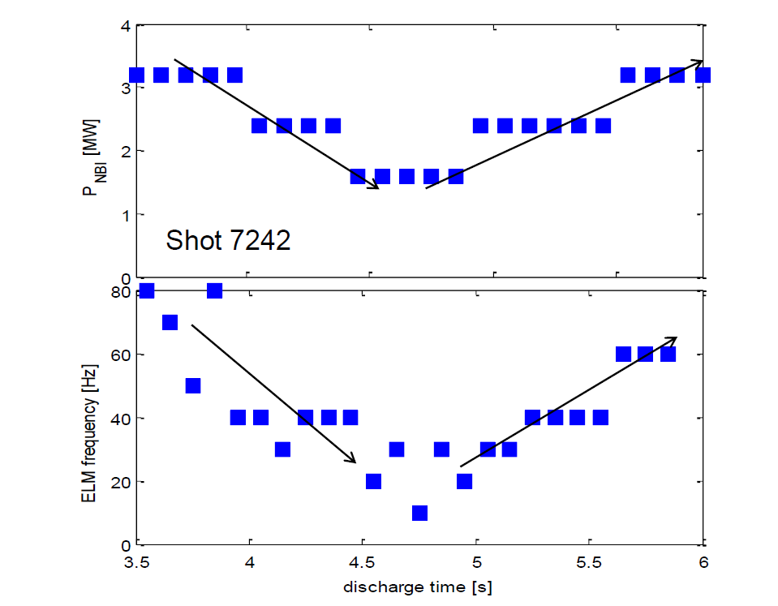
KSTAR Pedestal & ELM characteristics
Shot 7242
NBI power scan shows type-I character
2x PNBI -> ~2x f_{ELM}

Slide 5
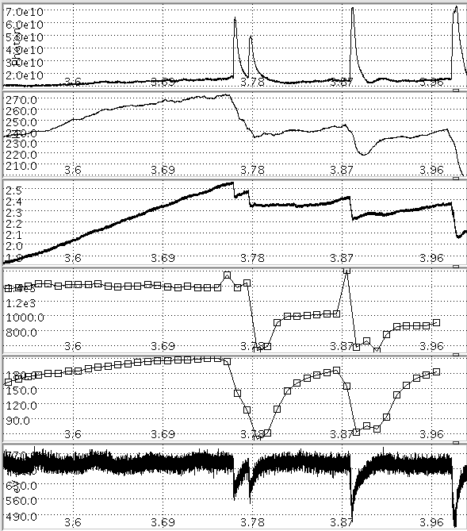
Pedestal evolution in-between ELMs
D_{α} Div [a.u.]
#7552
Different time scales during ELM cycle
(For large infrequent ELMs)
- Thermal (T_{e,ped} & T_{i,ped})
Fast bulidup & saturation
Faster saturation of Te
Rotation
steady increase in entire phase
Rotation (& shear) is the main driver?
(need pedestal density measurement)
Fluctuation analysis is on-going
(using Edge BES)
W_{MHD} [kJ]
N_{e} [1e¹⁹/m³]
CES
T_{i,ped} [eV]
V_{t,ped} [km/s]
CES
T_{e,ped} [eV]
ECE
Time [s]

Slide 6
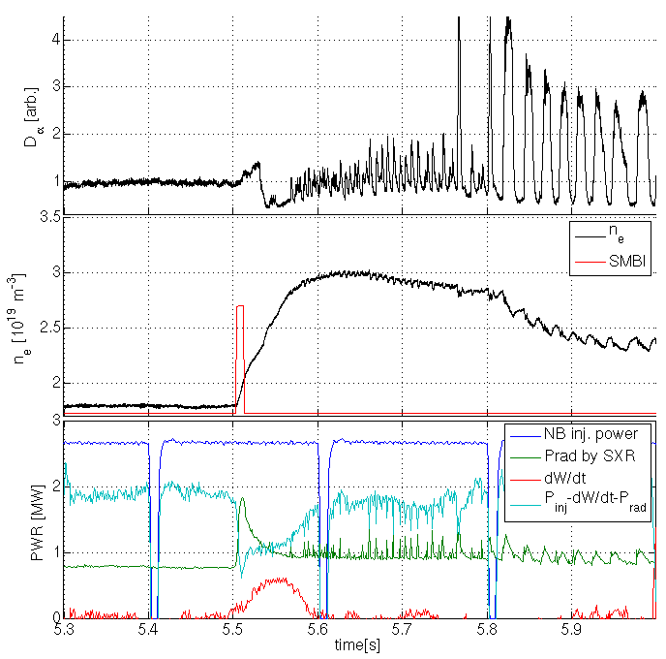
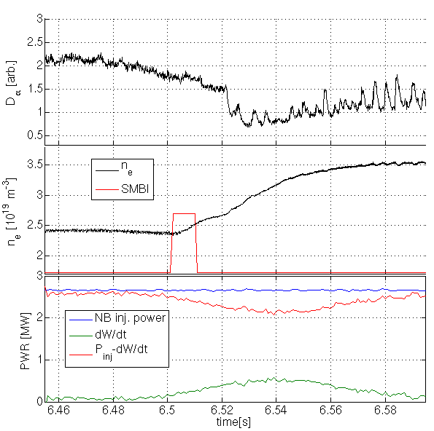
With SMBI, Stimulated transitions found with 30% reduced absorbed power
L-mode
Stimulated
Transition
(~300 ms)
Back transition
(vertical oscillations)
Triggering of L-H & small ELM is observed by 8 ms of SMBI
- Transition occurred for less absorbed power
P_{abs}= P_{inj} – dW/dt - P_{rad}
(cyan line)
#9078
B_{T} = 2.5 T
#9077
B_{T} = 2.0 T
ne ~2.3e19
SMBI (8 ms)
Known
density
turnover
P_{abs}

Slide 7
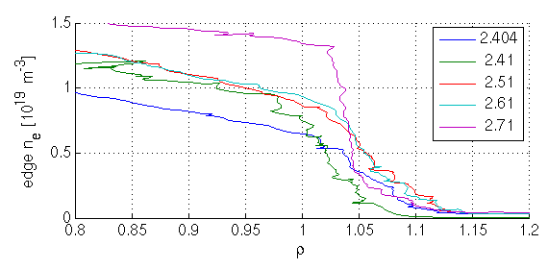
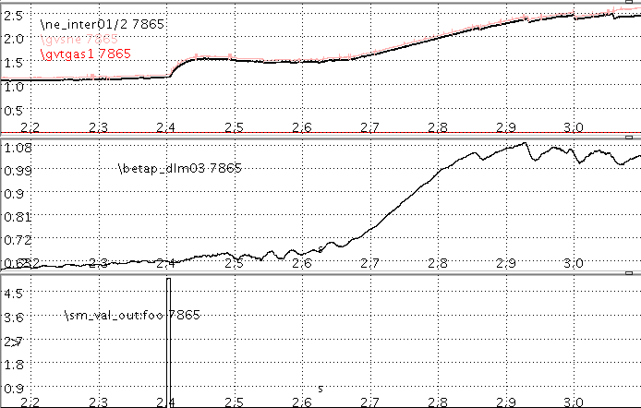
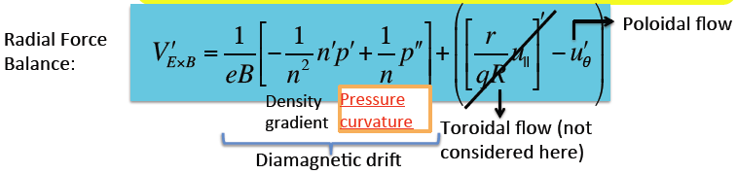
Edge profile changes are accompanied for the stimulated dynamics
Before
SMBI
After
SMBI
H-mode
Ped.
Lower n_{e} branch case (#7865)
The induced density profile steepening is maintained more than ~200 ms until the H-mode onset at 2.65s
  Longer than particle confinement time
Possible mechanism:
SMBI deposit on pedestal →local profile changes → changes on
K. Miki, PRL 2013
cf. DIII-D 1.3 mm smaller pellet scan did not report any stimulated transition with no change on pedestal (2013)
Edge reflectometry
@ 7865
ne
SMBI injection
at 2.4 s, #7865
Time [s]

Slide 8
Status of pedestal diagnostics

Slide 9
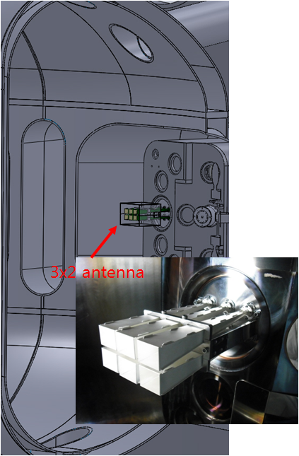
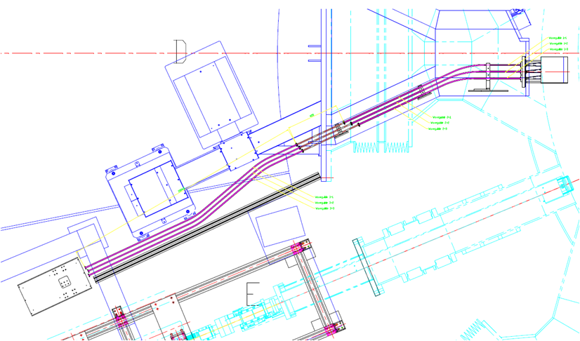
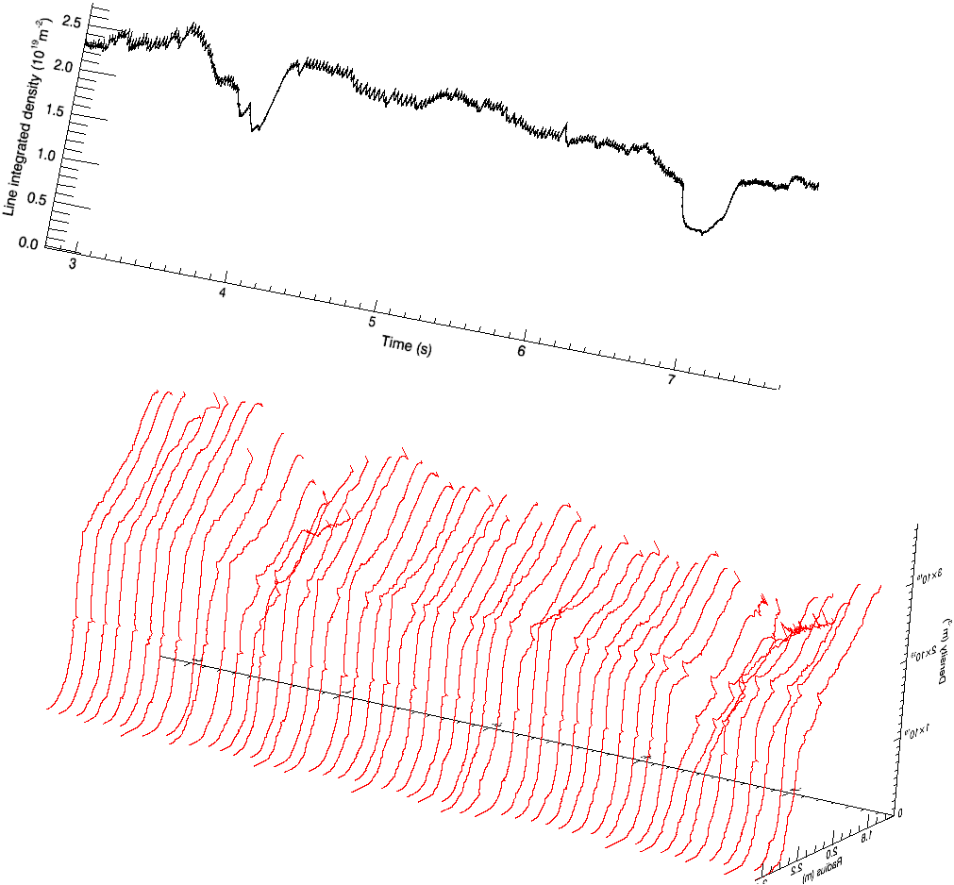
Profile Reflectometry which covers full radial range
D-port
Reflectometry Specifications
# of channel | 3 bands (Q, V, and W)
frequency | 33.6-54 GHz (Q band) 48-72 GHz (V band) 72-108 GHz (W band)
time resolution | 25 μs
spatial resolution | 0.5 mm
maximum storage | 160 ms (32 Mbytes memory)
antenna | pyramidal long horn antenna (40 mm x 32 mm x 300 mm)
antenna position | antenna entrance @ R = 2.624 m
#9422

Slide 10
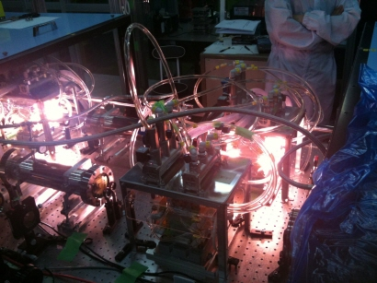
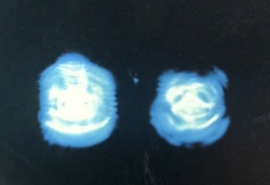
Specification of KSTAR Thomson scattering system
KSTAR Thomson scattering system(2013)
Te : 10eV~1.5keV (edge), 500eV~20keV (core)
ne : 3Х10¹²~2 Х10¹⁴ ㎝⁻³
17spatial points (core 5, edge 12 points)
Spatial Resolution : <10cm (core), <10mm (edge)
Polychromator 17ea (core 5ea by NFRI, edge 12ea by NIFS)
Laser : ~5J, 100Hz Nd:YAG Laser, 1064nm
5J, 100Hz, 1064nm Double laser line
A-line
2.5J, 100Hz
A
B
B-line
2.5J, 100Hz
Plasma center
λ=1064nm, pulse width ~20nsec
18mm
* LASER system rented from JAEA
Edge
Core
Calibrated by
Rayleigh scattering with N₂
Spectral calibration with W (tungsten) light
Measuring Position

Slide 11
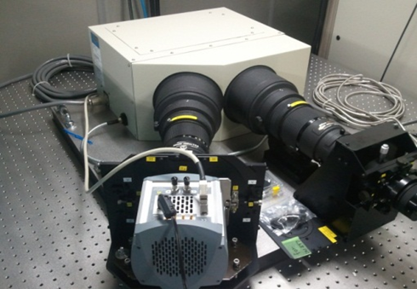
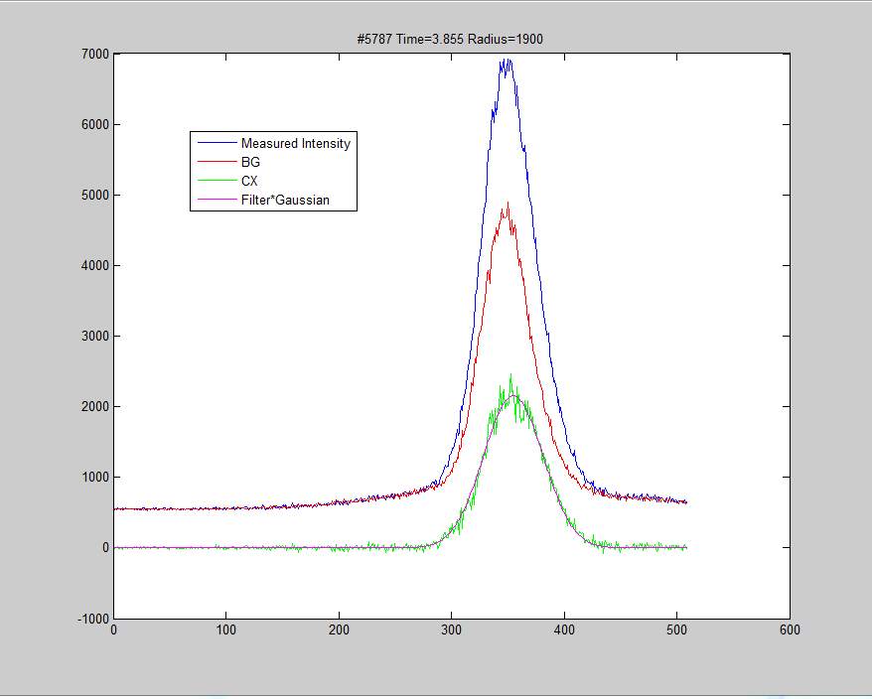
Charge Exchange Spectroscopy on KSTAR
Name | CES specification in 2013
Time resolution | 10 msec (100 Hz)
Spatial resolution | 20 ~ 50 mm (Core), 5 mm (Edge)
Ti & V_{f} range | > 100 eV & > ~ km/sec
System location | Active CES – M port
No. of Channels | 32 points (Max.51points available)
NBI modulation | 5Hz 95% duty rate (requirement)
Impurity | C_{VI} (529.05 nm)
Spectrometer | DS-spectrometer (DU897), K-spe.

Slide 12
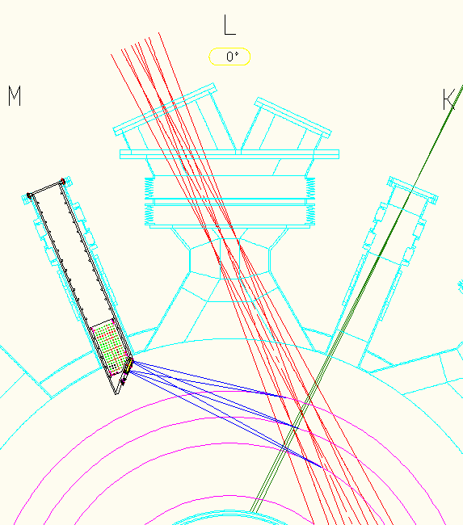
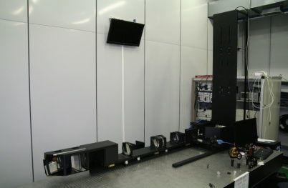
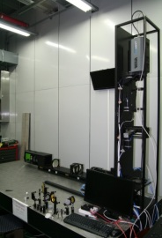
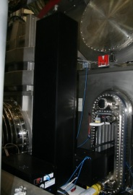
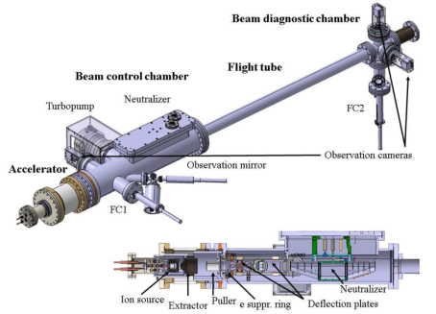
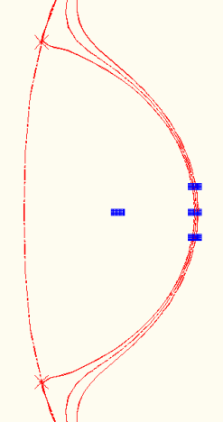
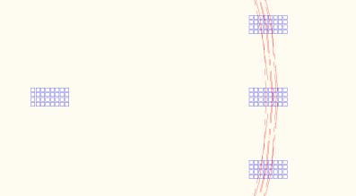
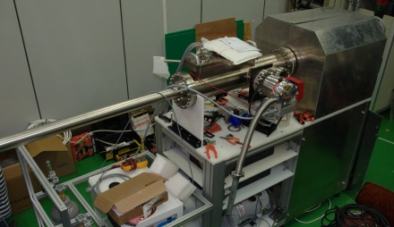
Li/D Beam Emission Spectroscopy System
BES Specifications
Local (Resolution) | 1 cm
2D (Pixel) | 4x8 (will be upgraded to 4x16)
Fast (Sampling) | 2 MHz
Fluctuation (SNR) | ~ 150 (~ 3% background)
Meas. Position | Radial & Vertical Scan (shot by shot)
Filter | Heatable (for fine tuning) Rotatable (for background cal.) Changeable (for Li/D)
Cameras | APD (fast) / CMOS (high res.)
Time Range | up to 100 sec
D Beam
(Heating)
Li Beam
(Diagnostics)
BES Optics
Edge
Measurement
Positions
Core
3rd
1st
2nd
Li Beam Parameter
Diameter | 2 cm (in the plasma) 10 cm (defocused)
Current | ~ 2 mA
Energy | < 60 keV
Pulse Length | 20 s
Species | Lithium (neutralized by Sodium)
Ion Source
Radial & Vertical
Positioning

Slide 13
Typical KSTAR Pedestal profiles
Pedestal structure both in Thomson & CES for H-mode
(further comparison is on-going)
Issue of TS calibration
Only relative change must be considered
t=2.1 s : L-mode
t=2.3 s: transition
t=2.5 s: H-mode

Slide 14
Initial comparison showa good correlation between ECE & TS
Value of T_{e,ped} are in good agreement
Position of separatices < ~ 1 cm
ECE could be used for fast pedestal Te measurements with B_{T}>2.6 T
Density need better laser calibration
(also with Li-BES)

Slide 15
Research topics on pedestal physics

Slide 16
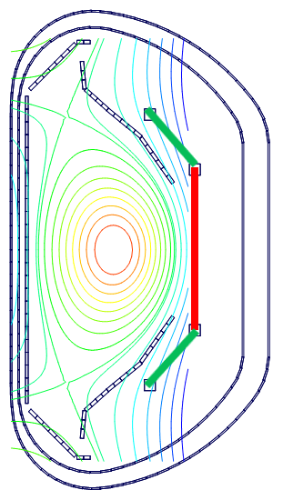
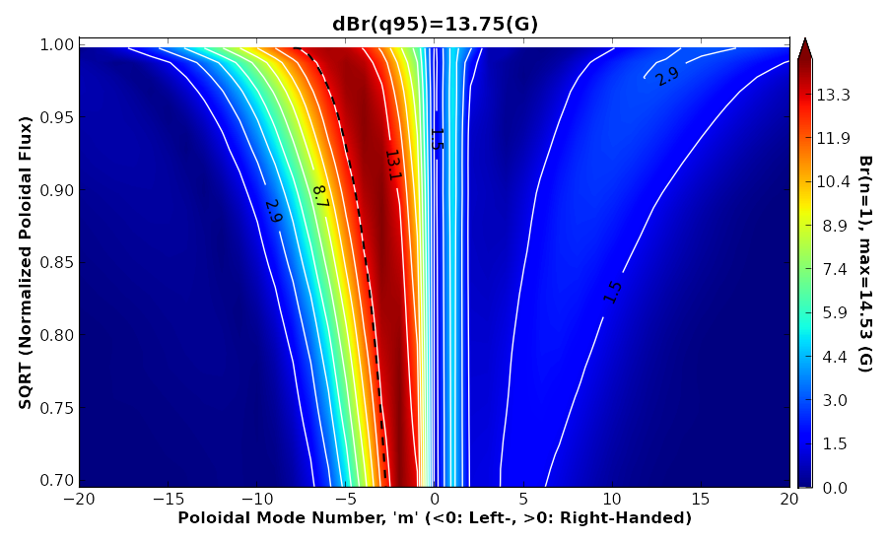
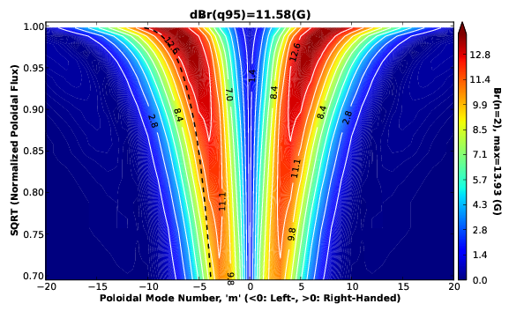
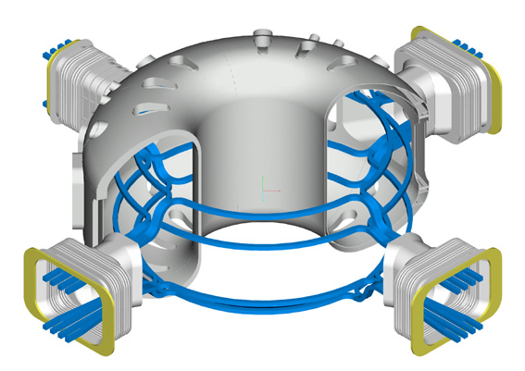
Optimal RMP configurations for KSTAR
FEC coils used for RMP = 3 (poloidal) x 4 (toroidal)
Top-FEC
Mid-FEC
+
+
-
-
Optimal n=1 RMP
: +90 deg. phase
-
+
+
-
-
-
+
+
Bot-FEC
+
-
+
-
Optimal n=2 RMP
: +90 deg. phase
-
+
-
+
+
-
+
-

Slide 17
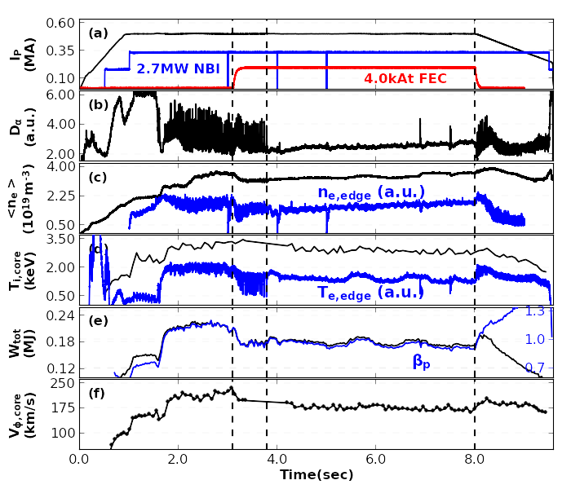
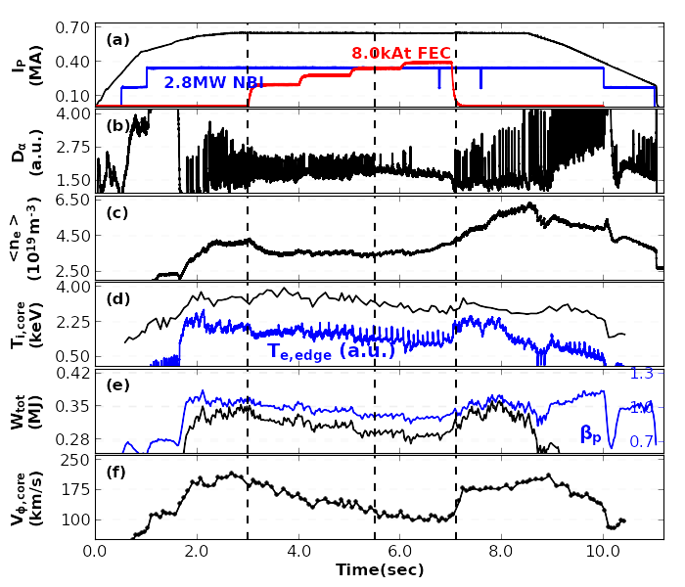
In 2012, ELM-suppressions have been successfully demonstrated using both n=1 or n=2 RMP
#7821
#8060
Y. M. Jeon, PRL2012
n=1 (+90 phase) RMP at q₉₅~6.0
n=2 RMP (mid-FEC only) at q₉₅~4.1

Slide 18
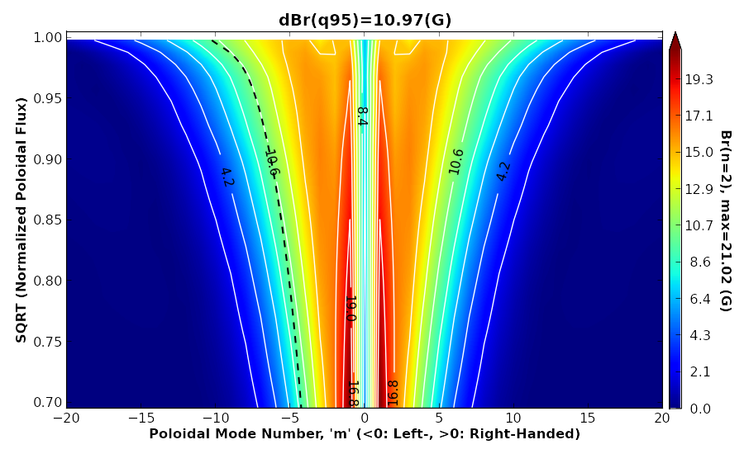
A generalized criterion suggested for ELM-suppression
#7821
#7821 (n=1, +90 deg)
δB_{R}(ψ_{N}=0.95)/B_{T} =13.7x10⁻⁴/1.8
~7.71x10⁻⁴
#8060 (n=2, mid-FEC only)
δB_{R}(ψ_{N}=0.95)/B_{T} =10.97x10⁻⁴/1.5
~7.31x10⁻⁴
n=1 +90 deg
q₉₅~6.0
δB_{R}(ψ_{N}=0.95)
~13.7G
+
+
-
-
-
+
+
-
ELM-suppression requires
δB*_{R95}≡δB_{R}(ψ_{N}=0.95)/B_{T}
δB*_{R95} > 6×10⁻⁴
-
-
+
+
#8060
Similar ELM-suppression by ‘+90 phased n=2 RMP’ is expected with less FEC currents if the generalized criterion is valid, since ‘+90 phased RMP’ is more resonant by a factor of 1.7.
n=2 mid-FEC
q₉₅~4.1
δB_{R}(ψ_{N}=0.95)
~10.97G
-
+
-
+

Slide 19
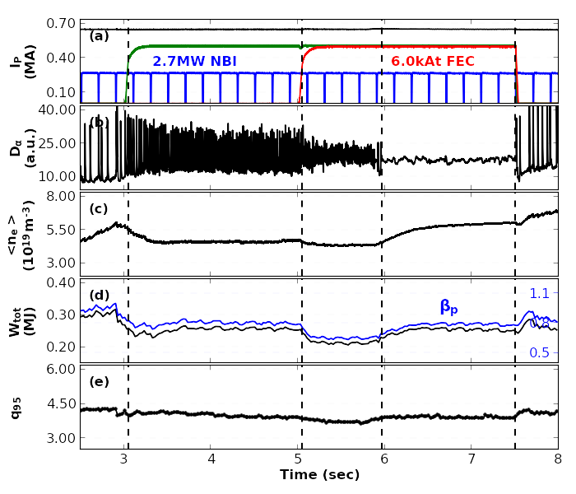
ELMs suppressed using +90 phased n=2 RMP
#9286: I_{p}=0.65MA, B_{T}=1.8T ➔ q₉₅~4.0
ELM suppression under 6.0kAt n=2 RMP at q₉₅~4.0
Initially ELMs mitigated by n=2 even (top/bot) RMP
As mid-FEC currents added (n=2,+90 RMP), ELMs further mitigated and then suppressed
Note that ELM-suppressed phase showed better confinements than that in ELM-mitigated phase
- See changes on <n_{e}>, W_{tot}, and β_{p}
#9286
n=2 even (top/bot)
n=2 (+90, top/mid/bot)

Slide 20
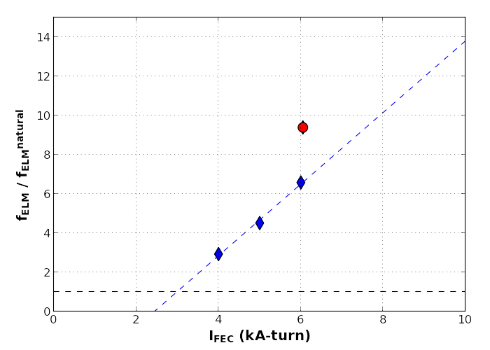
ELM responses to n=2 RMP field strength
Blue points: ELM mitigation by different n=2 FEC currents in identical discharges (q₉₅~4.0)
Strong linear correlation between ELM freq. change and FEC currents
Red point: mitigated ELM at just outside ELM-suppression window of q₉₅ (during q₉₅ scan)
f_{ELM} change reached up to a factor of ~10
((Bifurcation))
With 6.0kA n=2 RMP fields, ELM-mitigation was bifurcated to ELM-suppression state
No response
ELM-mitigation
ELM-suppression
I_{FEC,threshold}
Transport bifurcation occurred
(Q) Can we get to the point marked with , by applying I_{FEC}=8.0kAt at q₉₅ outside suppression window ?

Slide 21
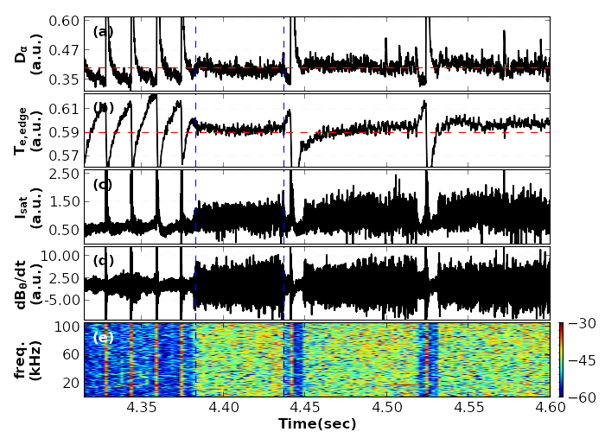
Distinctive fast time scale phenomena that are directly linked to the transition to ELM-suppressed state
Distinctive features observed …
Increased base-level of D_{α}
Saturated growth of T_{e,edge}
Increased fluctuation of I_{sat} on divertor
Broadband increase of EM fluctuations
All of these “fast time-scale phenomena” were “precisely synchronized”
How we can understand all of these consistently ?
At the moment of transition to ELM-suppression in KSTAR #7820. RMP was applied in whole period here

Slide 22
How the uniform broadband increase of EM fluctuations can be produced ?
Features of observed EM fluctuation change
Broadband (actually full range up to ~250kHz) frequency
Uniform spectrum power
Only possible with a bursty event such as shown in ELM-crashes
cannot be explained with coherent MHD activities
A persistent bursty event may be activated in the plasma edge, which produces broadband EM fluctuations
At the moment of transition to ELM-suppression in KSTAR #7820. RMP was applied in whole period here

Slide 23
Rapidly increased, steady fluctuations on Ion saturation current suggests a persistent bursty event as well
Rapid increase of I_{sat} fluctuation in the inter-ELM period
Rapid decrease of I_{sat} fluctuation prior to the next ELM crash
Precise synchronization with EM fluctuation
Spiky fluctuation on I_{sat} → bursting event
➔ A persistent, rapidly repeating bursting event produces a steady spiky fluctuations on I_{sat}
At the moment of transition to ELM-suppression in KSTAR #7820. RMP was applied in whole period here

Slide 24
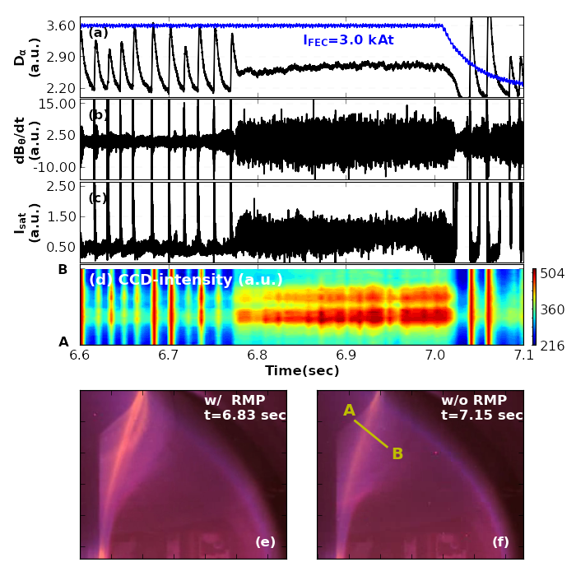
The persistent bursty event occurred in the plasma edge
: Increased D_{α} emission near the plasma boundary
Emission from CCD ∝ D_{α}
No clear change on topology at the transition
Only emission intensity was increased strongly
The persistent bursting event in the plasma edge leads increased neutral recycling near the plasma boundary, thus increasing D_{α} emission

Slide 25
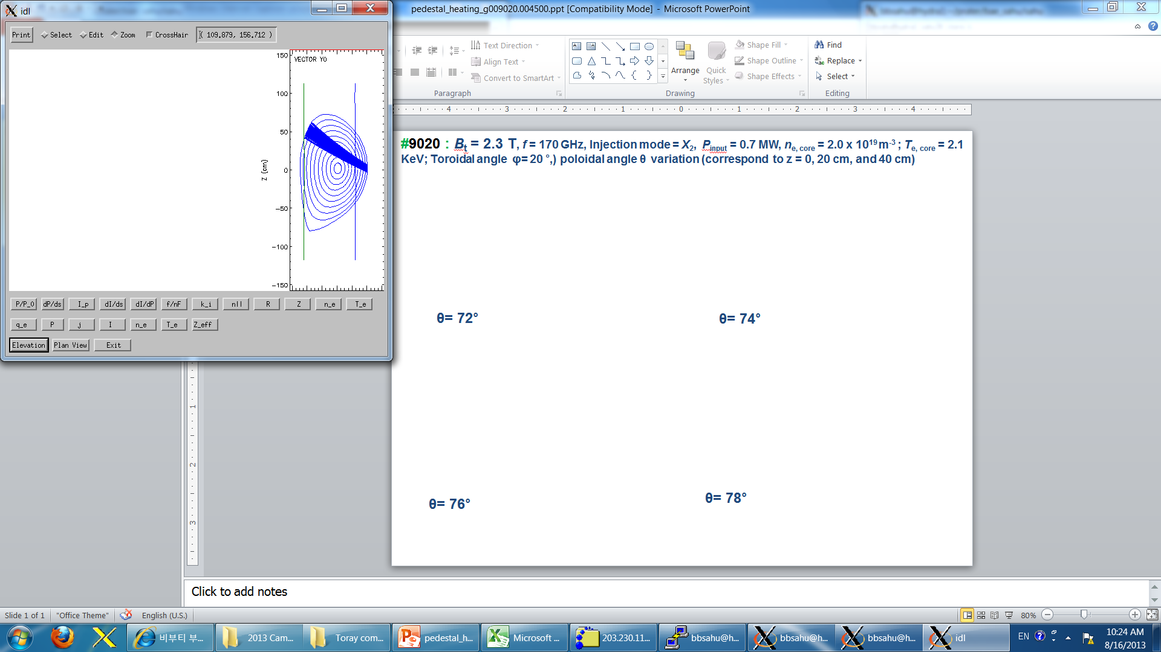
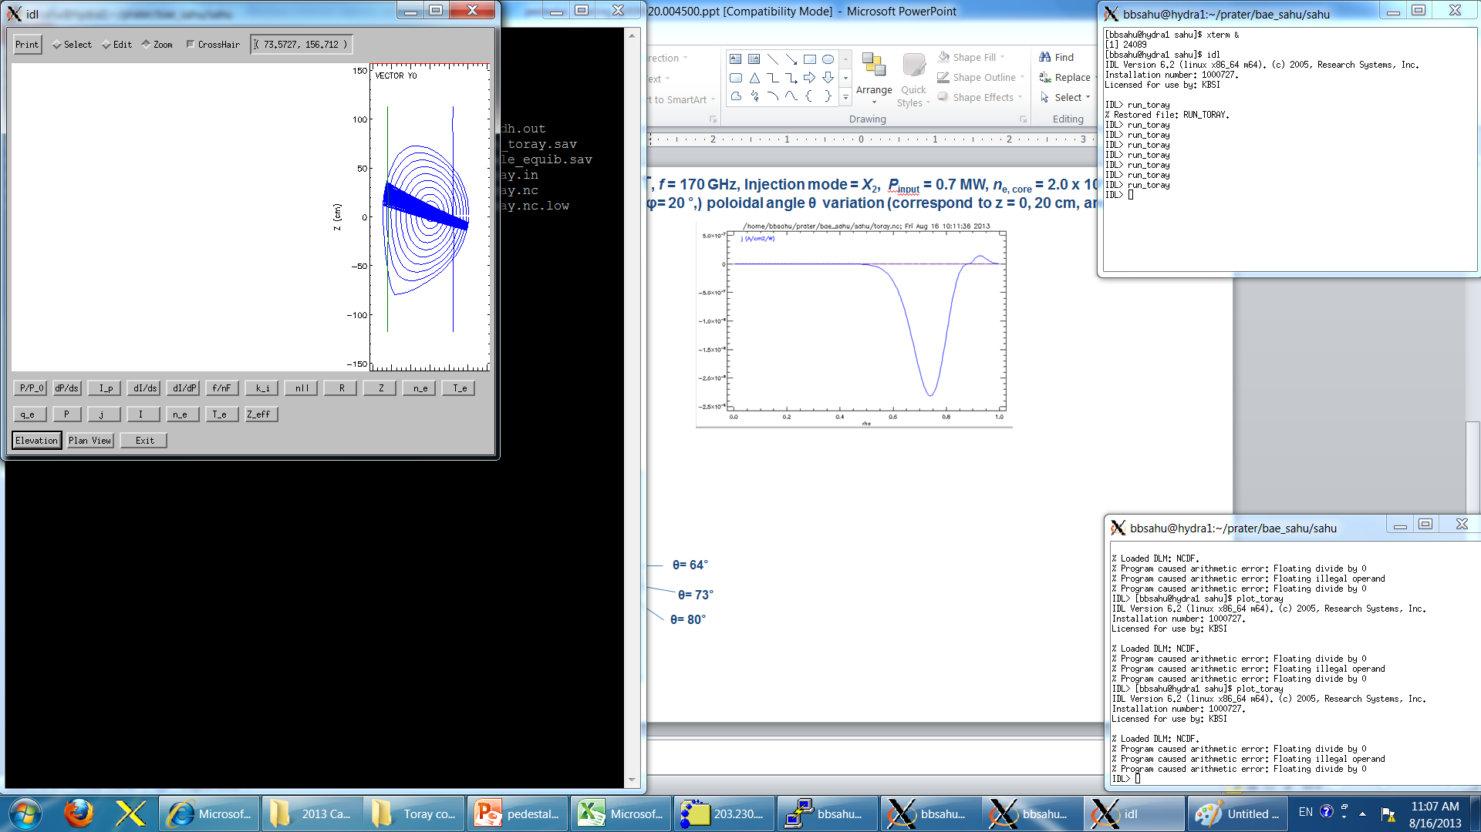
Scan of position of ECH deposition
Poloidal angle scan
ρ_{pol} ~ 0.86
ρ_{pol} ~ 0.90
ρ_{pol} ~ 0.94
ρ_{pol} ~ 0.98
ρ_{pol} ~ 0.94
ρ_{pol} ~ 0.86
TORAY-GA
2nd Harmonics deposition at LFS
Mitigation stronger at larger ρ_{pol}
f_{ELM} ~30 [Hz]
∆W_{ELM} ~20 [kJ]
∆ n_{eL} ~0.16 [10¹⁹/m3]
∆T_{e,ped} ~0.4 [keV]
f_{ELM} ~60 [Hz]
∆W_{ELM} ~ 4 [kJ]
∆ n_{eL} 0.05 [10¹⁹/m3]
∆T_{e,ped} 0.3 [keV]
f_{ELM} ~90 [Hz]
∆W_{ELM} ~2 [kJ]
∆n_{eL} 0.06 [10¹⁹/m3]
∆T_{e,ped} 0.15 [keV]
No ECH
ρ_{pol}
~ 0.86
ρ_{pol}
~ 0.98
Profiles & fluctuations are
under investigation

Slide 26
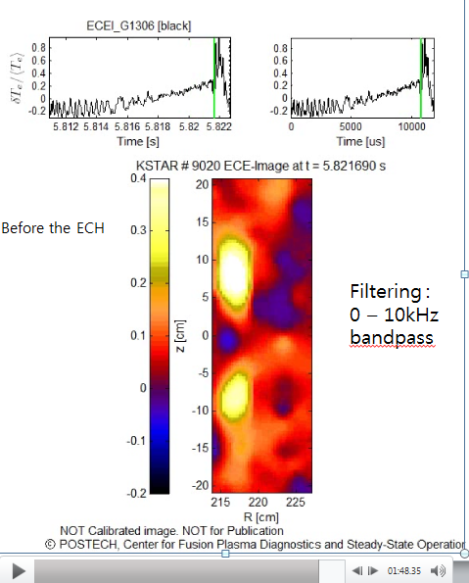
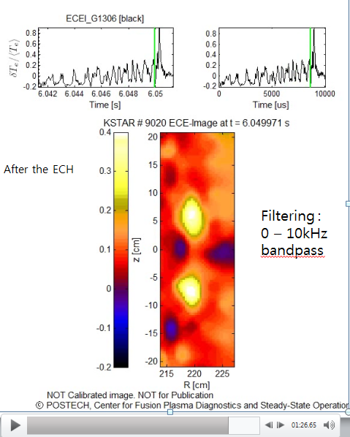
Similar ELM crash but more fluctuation during ELM cycle (J. H. Lee, POSTECH)
w/o ECH
w ECH
Larger fluctuations
Judging from ECEI, there is no significant change in mode structure
Slightly higher m with ECH

Slide 27
Similar ELM crash but more fluctuation during ELM cycle (J. H. Lee, POSTECH)
10% drop of density
Strong pump-out
at midplane injection
Low freq fluctuations
(10 kHz)
Localized in pedestal
Similar modes also in density fluctuation
(by D-BES)

Slide 28
Change of pedestal profile during ECH injection
ELM averaged difference of pedestal profiles
w/o ECH
w ECH
t=7.095 s (w/o ECH)
t=8.095 s (w ECH)
Issue of TS calibration
Only relative change must be considered
t=7.095 s (w/o ECH)
t=8.095 s (w ECH)
Large scatter in TS Te at SOL region

Slide 29

Temporary transition to grassy ELMs by Supersonic Molecular Beam Injection
Type-I like
Type-III like
Grassy ELMs
8ms pulse
10ms pulse
Marginal drop of stored energy

Slide 30

A simple cellular automata model predicts best mitigation case with shallow deposition of SMBI
Scanning SMBI deposition size and injection location
<A>/<A₀> : ELM amplitude ratio (A₀ = w/o AGI)
f / f₀ : ELM frequency ratio
(f₀ = w/o AGI)
Region for effective mitigation
(%)
(%)
amount of deposition (δn) divided by line averaged pedestal density (n)
y
x
deposition point (0 = pedestal top, 1 = pedestal edge)
Pedestal base injection effectively mitigates ELM with deposition size greater than a critical level.
Critical deposition size is minimum number of grains which can drive a pedestal cell over hard limit.

Slide 31
Near term research plan in pedestal physics
Fast pedestal profile measurements
ELM-resolved full sets of pedestal profiles for detailed stability analysis
Detailed cross-validation of all the dynamic parameters
p_{ped} : TS(2012), profile reflectometry(2013), r-ECE(2010), Li-BES (2013), t-CES(2010)
j|| + E_{r} + V_{p,t} : MSE(2015), Li-Zeeman(2015), p-CES (2015), ECEI (2010)
ELM physics/control in ITER relevant condition
  Extension of ELM control technique to ITER based on physics understanding
  Validation of long-pulse RMP suppression in ITER Similar Shape
  Detailed measurements of profile & fluctuation change during ELM control
  Searching for small/no ELM regimes (drsep, I-mode, QH-mode, …)
Transport in pedestal region
  ELM dynamics and identification of background turbulence in the pedestal region
  Validated local measurements of k||, k┴ & v┴ : DBS, MIR and D-BES
  Identification of background transport (Micro-tearing, Flow-shear ITG, k-Ballooning, …)
  Relation between fluctuations and transport : radial particle & thermal pinches
L-H transition Physics
  Mechanism for L-H & H-L transition
  Effect on L-H transition by SMBI & RMP : minimizing power threshold in ITER
  I-phase during H-L back transition : slow back-transition

Slide 32
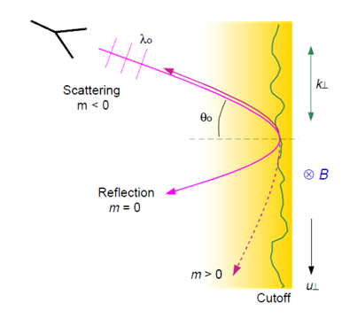
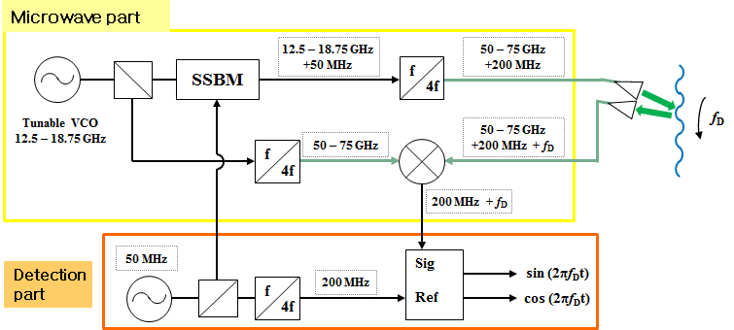
KSTAR Doppler Reflectometry (2014)
V-band X-mode Doppler Back-Scattering (DBS) System
Heterodyne system using a single side band modulator (SSBM)
Frequency regime in the plasma edge : V-band (50-75 GHz)
Antenna tilt angle Θ_{o} : 10°-12°
max. k⊥= 5.5-6.5 cm⁻¹ @ 75 GHz
f_{D} ~ 1.7-2.6 MHz @ u⊥~20-30 km/s (H-mode)
k⊥ ≈ 2k_{o}sinΘ_{o}
ω_{D} ≈ u⊥k⊥
u⊥ = v_{E×B +}v_{ph}
E_{r} ≈ -v_{E×B} B
pedestal regime

Slide 33
Lithium-beam Zeeman polarimetry (2015)
KSTAR Li-beam system was successfully commissioned in 2013.
The Li-Zeeman emission is at its maximum around the pedestal region (R=2.22–2.25 m).
Parameter
Diameter | 2 cm (FWHM / fully focused in the plasma), 10 cm (defocused)
Current | 2-4 mA
Energy | 60 keV
Pulse Length | 20 s
Species | Lithium (possible upgrade to Sodium)
The Zeeman split greater than the instrumental broadening was observed with Bt > 2.8T. Li-beam emission.
9239
9427
9426

