Slide 1




NSTX-U
NSTX-U
Supported by
Supported by
JRT15
Coll of Wm & Mary
Columbia U
CompX
General Atomics
FIU
INL
Johns Hopkins U
LANL
LLNL
Lodestar
MIT
Lehigh U
Nova Photonics
ORNL
PPPL
Princeton U
Purdue U
SNL
Think Tank, Inc.
UC Davis
UC Irvine
UCLA
UCSD
U Colorado
U Illinois
U Maryland
U Rochester
U Tennessee
U Tulsa
U Washington
U Wisconsin
X Science LLC
J.W. Berkery¹, S.A. Sabbagh¹, J.-K. Park ²
¹Columbia U., ²PPPL
Culham Sci Ctr
York U
Chubu U
Fukui U
Hiroshima U
Hyogo U
Kyoto U
Kyushu U
Kyushu Tokai U
NIFS
Niigata U
U Tokyo
JAEA
Inst for Nucl Res, Kiev
Ioffe Inst
TRINITI
Chonbuk Natl U
NFRI
KAIST
POSTECH
Seoul Natl U
ASIPP
CIEMAT
FOM Inst DIFFER
ENEA, Frascati
CEA, Cadarache
IPP, Jülich
IPP, Garching
ASCR, Czech Rep
PPPL
December 6, 2013

Slide 2
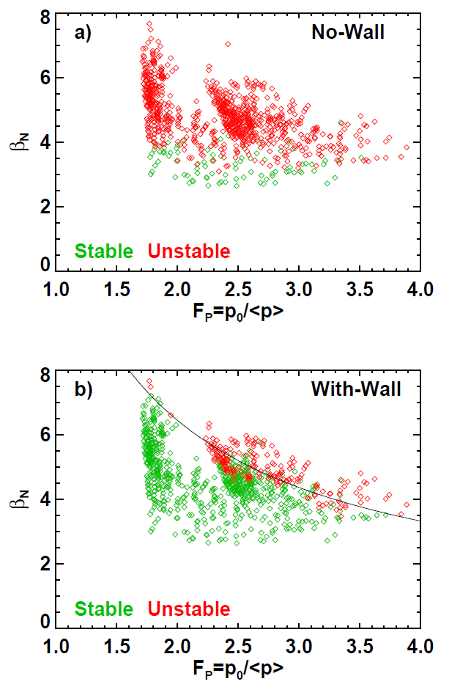
“Broadened pressure profiles generally improve global stability”
NSTX disruptivity
NSTX-U projected ideal stability

Slide 3
MS TSG suggestions for the direction of the JRT15
Focus on:
details of plasma at pressure peaking / current peaking/broadening disruptive limits, and how to avoid such limits (previous slide)
the impact of broadened current and pressure profiles on stability in plasmas that are close to being fully non-inductive
pressure peaking / current profile data in light of a plasma under active MHD control
how these zeroth order parameters can be influenced by more modern hypotheses – e.g. kinetic stabilization
different dependencies not explicitly stated in the JRT15: the effect of rotation, q, anisotropic EP distribution…

Slide 4
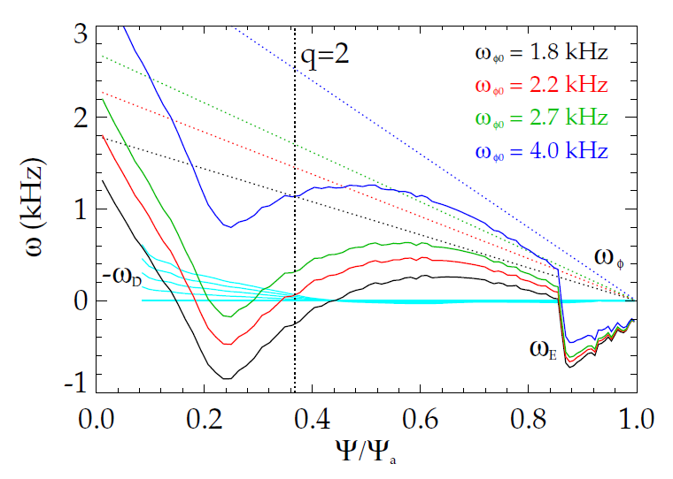

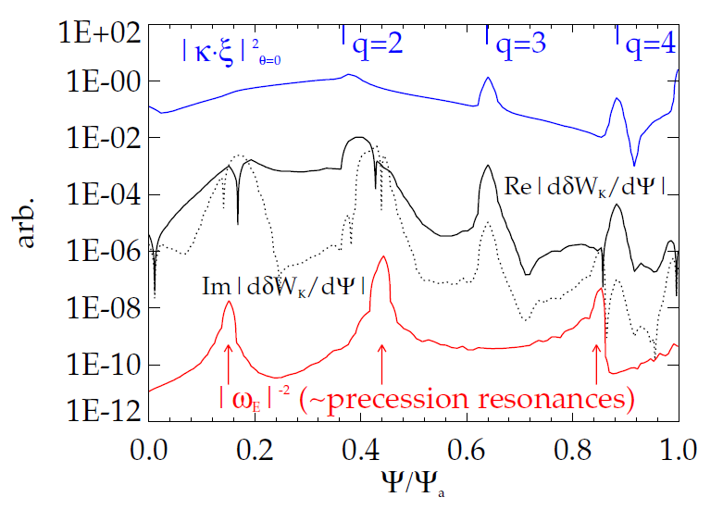
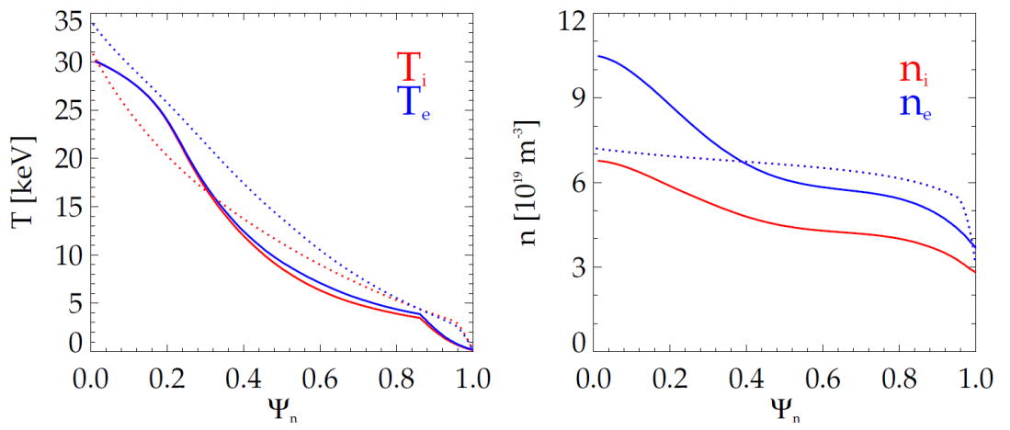
Pressure profile effects kinetic stability by changing the location of mode-particle resonances
Example: ITER case with ITB:
Strong internal gradients create large ω*
  Cause difference between ω_{φ} and ω_{EXB}.
  Enables resonance with precession
  drift of trapped thermal ions if ω_{φ} is low.
Strong gradients
dashed lines = “standard” ITER advanced scenario

Slide 5
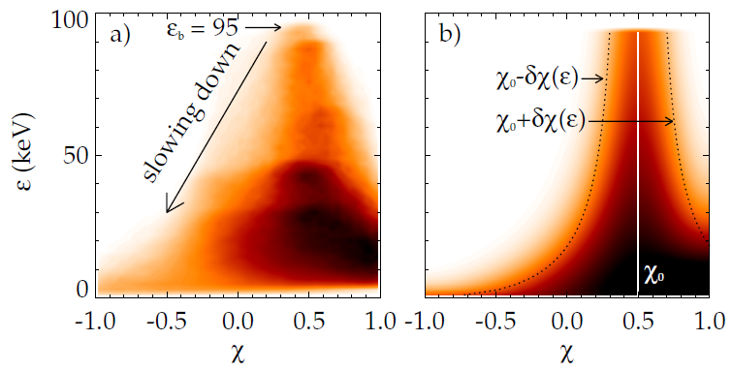
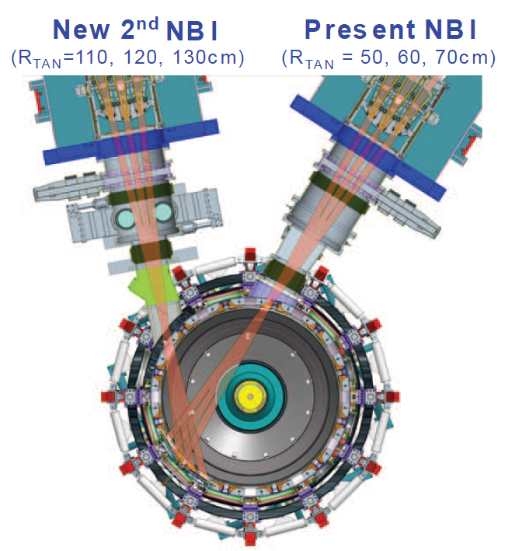
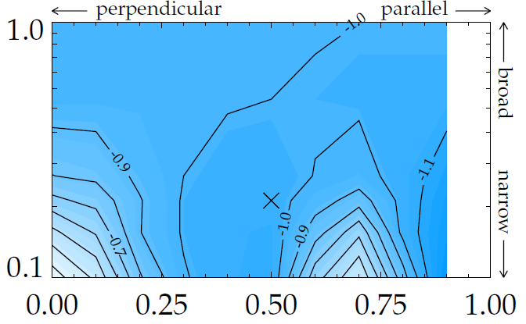
“Validate theoretical models of… global stability response to varied heating and current drive deposition”
Anisotropy of EPs can effect stability and we plan to study this in NSTX-U
Contours of γτ_{w} with isotropic thermal particles
+ anisotropic EPs: fluid correction and δW_{K}
Fluid + Kinetic Effects
spread δχ₀
~NSTX
injection pitch χ₀

Slide 6
Study of classical and neoclassical tearing mode stability vs. pressure gradient and q-shear
Classical and neoclassical tearing modes can be more important in NSTX-U, despite the favorable Glasser and curvature effects, due to high pressure and bootstrap current fraction
Study on classical tearing mode
  Can be destabilized by both pressure and current broadening
  Resistive DCON can be used to more precisely estimate classical tearing mode index △′ and can be compared with experiments
Neoclassical tearing mode (NTM)
  In low aspect ratio, neoclassical and resistive interchange effects can be comparable
  Depending on (p′/q′) and (p′/q′)², respectively, and thus can be further destabilized if current broadening leads to q-shear reduction
Study can be extended onto rotational-shear stabilization as shown in NSTX

Slide 7
xxx

Slide 8
JRT15
Conduct experiments and analysis to quantify the impact of broadened current and pressure profiles on tokamak plasma confinement and stability. Broadened pressure profiles generally improve global stability but can also affect transport and confinement, while broadened current profiles can have both beneficial and adverse impacts on confinement and stability. This research will examine a variety of heating and current drive techniques in order to validate theoretical models of both the actuator performance and the transport and global stability response to varied heating and current drive deposition.

