Slide 1

JET-ILW pedestals, known knowns, known unknowns and unknown unknowns
S. Saarelma
CCFE, UK

Slide 2
Co-authors
IAEA presentations: C. Maggi¹, C. Challis¹, C. Giroud¹, E. de la Luna², E. Joffrin³,
Other contributions: M. Beurskens¹, L. Frassinetti⁴, M. Groth⁵, A. Järvinen⁵, M. Leyland⁶, JET contributors*
EUROfusion Consortium, JET, Culham Science Centre, Abingdon, OX14 3DB, UK
¹CCFE, Culham Science Centre, Abingdon, OX14 3DB, UK
²Laboratorio Nacional de Fusion, CIEMAT, 28040, Madrid, Spain
³CEA-Cadarache, Association Euratom-CEA, 13108 St Paul-lez-Durance France.
⁴Division of Fusion Plasma Physics, School of Electrical Engineering, Royal Institute of Technology, Stockholm, Sweden
⁵Aalto University, Otakaari 4, 02150 Espoo, Finland
⁶York Plasma Institute, Department of Physics, University of York, Heslington, York, YO10 5DD, UK.
*See the Appendix of F. Romanelli et al., Proceedings of the 25th IAEA Fusion Energy Conference 2014, St Petersburg, Russia

Slide 3
Terms
Known knowns: Things we understand
Known unknowns: Things we have seen in the experiment, but don’t understand yet
Unknown unknowns: Things we haven’t yet seen in the experiment, but could be important

Slide 4
Outline
W compatible pedestals
Slow ELMs
Impurity seeding
EPED testing
Power scan, high and low gas

Slide 5
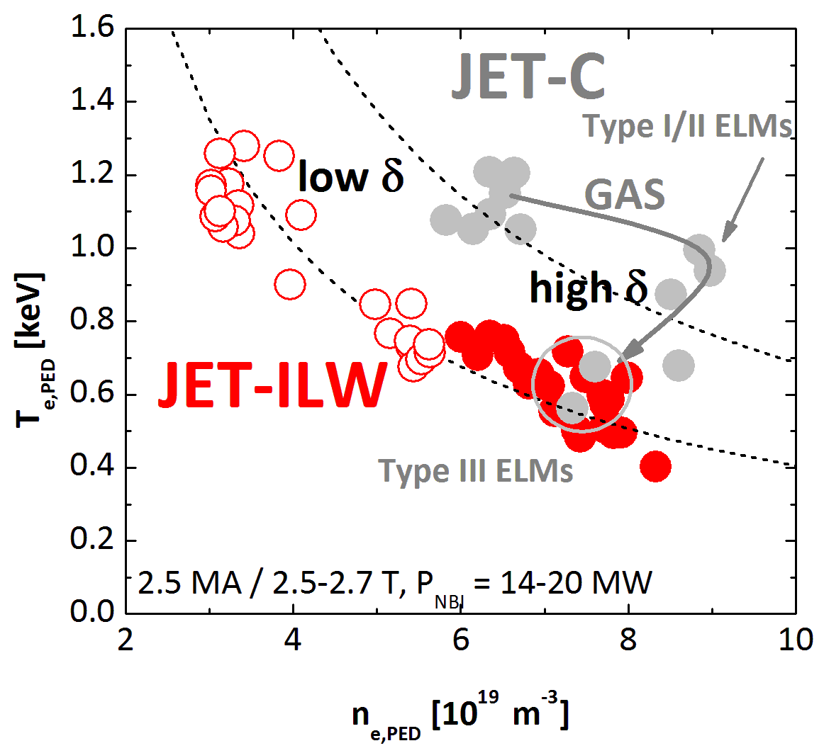
Smaller pedestals in JET-ILW at high gas
JET-ILW uses gas fuelling to control W, but it also decreases the pedestals and global confinement.
JET-C
JET-ILW

Slide 6
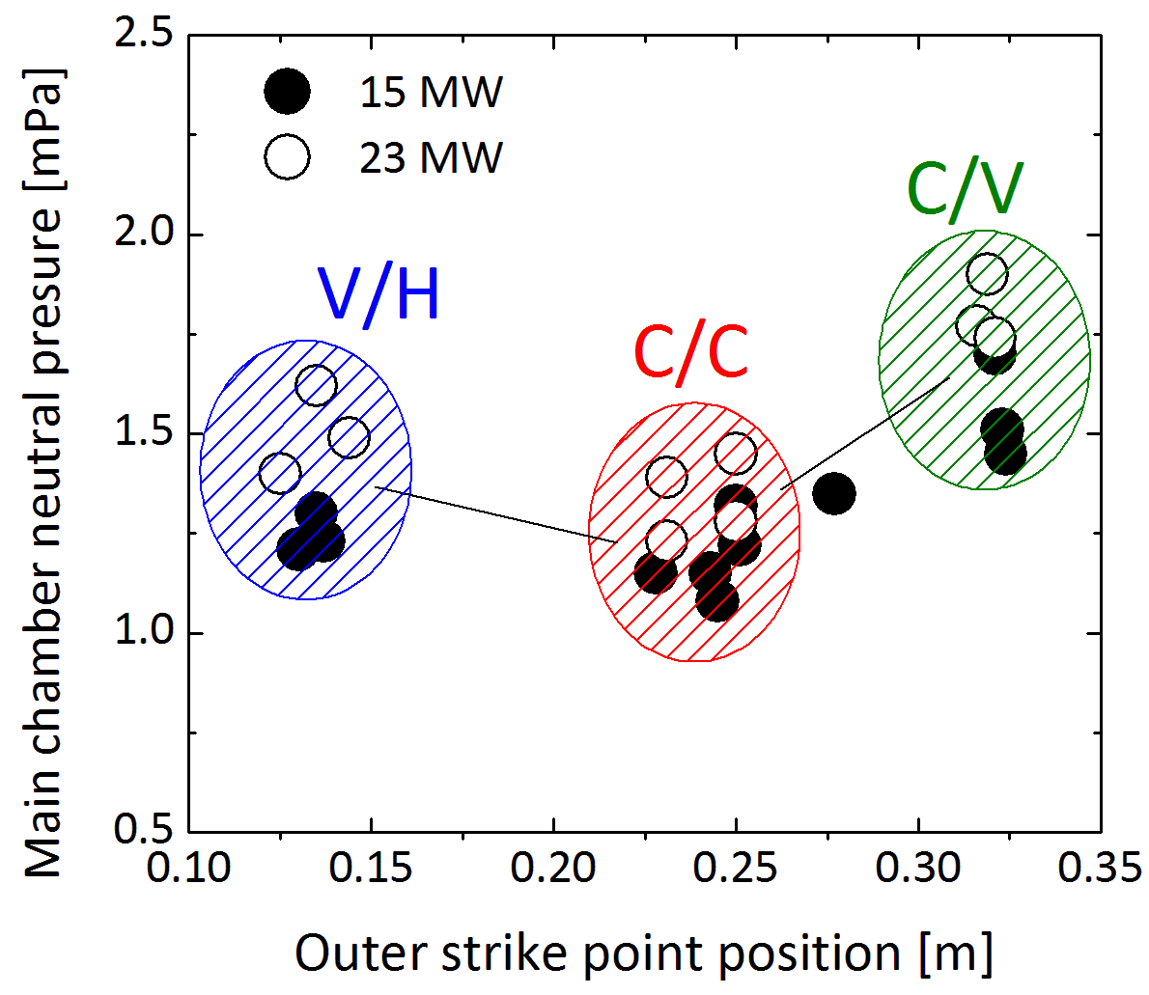
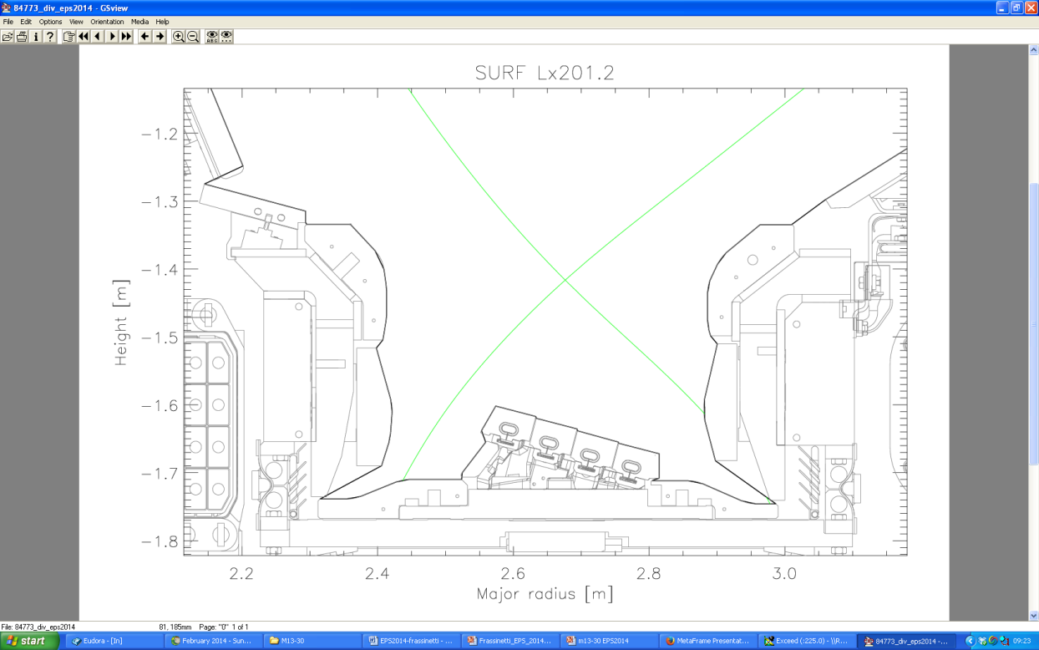
Varying the plasma neutral content
Neutral D content increases when
  D₂ injection rate is increased ← W control tool
  Divertor configuration is varied from C/C or V/H → C/V (pumping efficiency + neutrals recirculation to main chamber)
V/H
C/C
C/V
-1.2
-1.4
-1.6
-1.8
Low δ
Height [m]
2.2 2.4 2.6 2.8 3.0
Major Radius [m]
Cryopump
[Tamain, PSI 2014], [Frassinetti, EPS 2014], [Joffrin IAEA 2014]

Slide 7
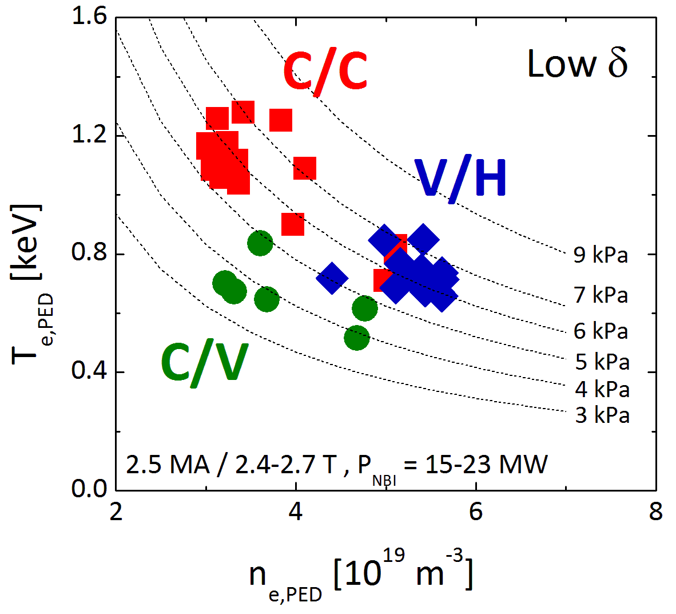
Pedestal pressure and neutrals
C/C: good pumping + lower neutral content → n_{e,PED} ⬇, T_{e&i,PED} ⬆
C/V: good pumping + higher neutral content → n_{e,PED} ⬇, low T_{e&i,PED}
V/H
C/C
C/V
-1.2
-1.4
-1.6
-1.8
Low δ
Height [m]
2.2 2.4 2.6 2.8 3.0
Major Radius [m]
Cryopump

Slide 8
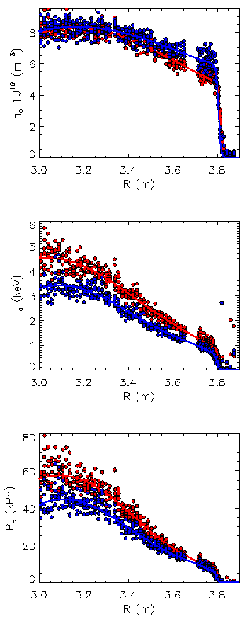
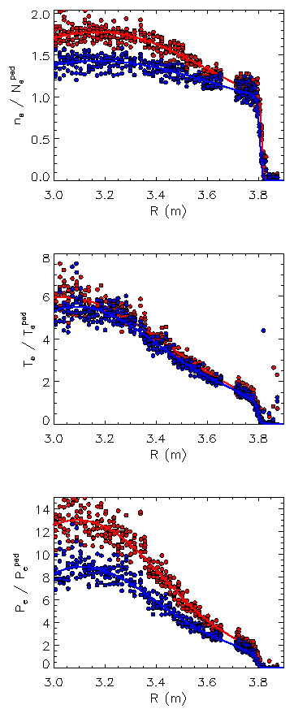
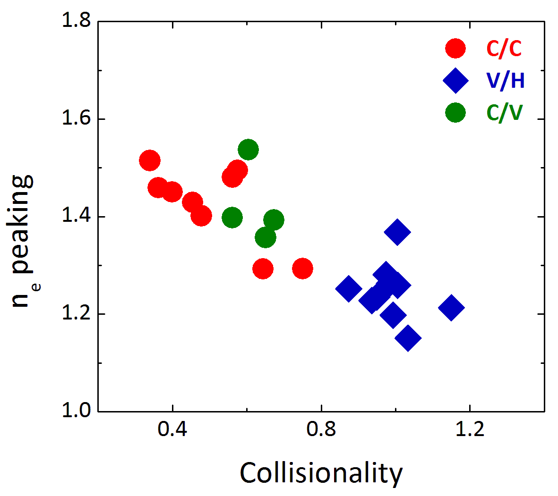
In C/C, H₉₈ ~ 1 and β_{N} ~ 1.8 at 2.5MA
V/H → C/C
Increase of W_{th} at similar p_{PED} but lower collisionality
n_{e}
n_{e} normalized
T_{e}
T_{e} normalized
V/H → C/V
Low pedestal and core pressure
p_{e}
p_{e} normalized
[Frassinetti, EPS 2014]

Slide 9
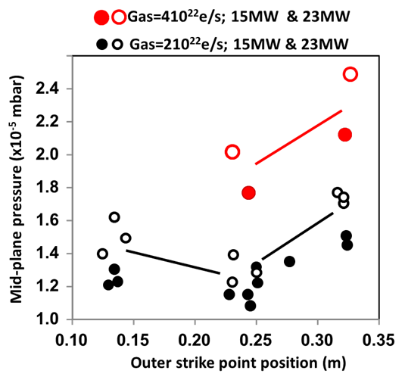
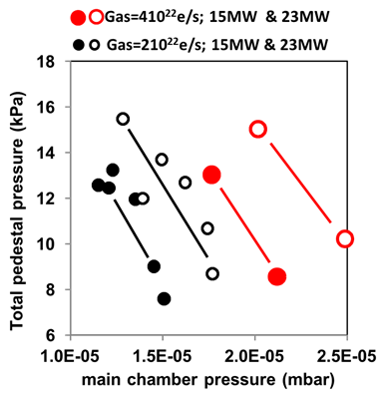
Neutral pressure clearly correlates with the pedestal height
C/V
C/C
V/H
The mechanism of neutrals regulating the pedestal is still open.

Slide 10
Outline
W compatible pedestals
Slow ELMs
Impurity seeding
EPED testing
Power scan, high and low gas

Slide 11
Slow ELMs
ELMs in JET-ILW have much longer duration than in JET-C
Nitrogen seeding recovers similar fast ELMs as in JET-C
Slow ELMs also seen in AUG with full W wall [Schneider 2014]

Slide 12
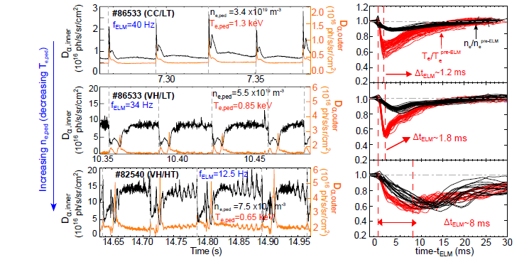
Slow ELMs are “negative” ELMs
Fast ELMs can be recovered also by placing strike point to the maximum pumping position.
The slow ELMs are “negative” in D_{α}.
MHD activity for only 300-400μs.
Proposed explanation: W acts temporarily as a sink to particles.

Slide 13
Slow ELMs lead to high ELM losses
Blue&Cyan: JET-C
Red: JET-ILW, unseeded, fast ELMs
Green: JET-ILW N₂ seeded
Black: JET-ILW slow ELMs
Grey: Loarte PPCF 2003

Slide 14
Outline
W compatible pedestals
Slow ELMs
Impurity seeding
EPED testing
Power scan, high and low gas

Slide 15
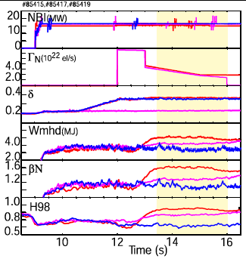
Confinement rise with N linked to δ
Without N:
the benefit of triangularity on confinement is lost
With N:
  In low δ plasma, N seeding increases stored energy by ~15%
  In high δ plasma, N seeding increases stored energy by ~40% !
→ Re-establish with N the benefit of δ on confinement as in JET-C
Notes:
Show neped/ngw

Slide 16
Pedestal height of N-seeded high-δ
ELM-averaged data
P_{e,ped} (kPa)
T_{e,ped} (keV)
n_{e,ped} (10¹⁹m⁻³)
HT high-δ
VT high-δ
Nitrogen
ELM-average pedestal pressure and temperature increase with N seeding in high-δ HT and VT plasmas
Opposite trend for the pedestal density → likely linked to the difference in divertor geometry and its effect on neutral recycling.

Slide 17
Pedestal height of N-seeded high-δ
pre-ELM data
Nitrogen
Pre-ELM pedestal pressure shows a smaller increase with N-seeding in high-δ VT plasmas.
Common feature between high-δ HT and VT: increase in T_{e,ped}

Slide 18
Low-Z impurity effects on pedestal
Impurities lower the bootstrap current, which is the dominant current component at the edge.
Low-Z impurities dilute the (edge) plasma and result in lower p_{ped} for the same T_{e} and n_{e} profiles.
Radiation from impurities lowers the separatrix temperature.
Calculated using formulas in
Sauter et al. PoP 1999/2002

Slide 19
T_{e,sep} is used to fix the radial position of the profiles
EFIT equilibrium is not accurate enough to accurately fix the profiles from Thomson scattering with respect to the separatrix location.
Before stability analysis we shift the measured profiles (both T_{e} and n_{e}) to be consistent with the modelled T_{e,sep}.
shift

Slide 20
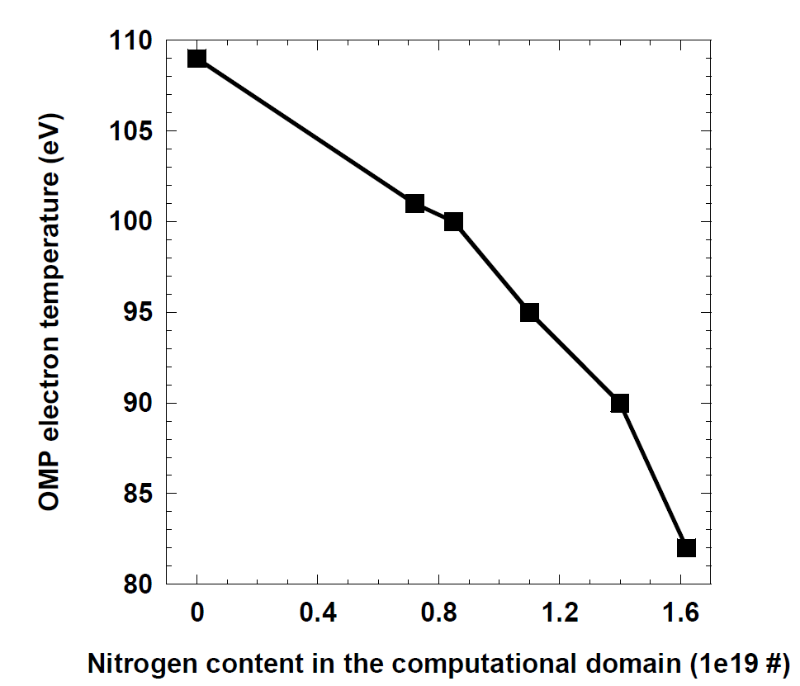
T_{e,sep} decreases with the increasing impurity content
EDGE2D-EIRENE SOL-modelling for steady-state inter-ELM profiles, Beryllium sputtering included.

Slide 21
T_{e,sep} and pedestal stability
Moving the pedestal inwards (with lower T_{e,sep}) leads to the expansion of the peeling-ballooning stability diagram ”nose”.
Note that the low current part of the diagram is not affected.
Pressure
Pressure gradient

Slide 22
Self-consistent analysis of the T_{e,sep} effect on pedestal
Vary the T_{e,ped} self-consistently with the bootstrap current and find the marginally stable T_{e,ped} value.
10% increase of T_{e,ped} by lowering T_{e,sep} from 100 eV to 80 eV.

Slide 23
The effect of impurity type on stability
With fixed T_{e,sep} and Z_{eff}, the low-Z impurities lead to most improvement of T_{e,ped}.
The improvement is due to ion dilution.
At high Z_{imp} the dilution is less effective and the reduction of the bootstrap current cancels the stability improvement.
Marginally stable T_{e,ped} for varying Z_{impurity}, fixed T_{sep}=100eV
Be
C
N
Ne

Slide 24
Impurities in pedestal: all the effects combined
T_{sep}
Ion dilution
Modified j_{bs}
Pedestal widening with height:
Optimal impurity: as low Z as possible, radiates in the edge

Slide 25
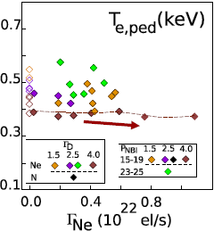
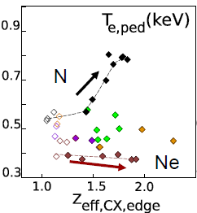
Neon does not recover pedestal like nitrogen

Slide 26
VT N-seeded not PB limited
JET-ILW VT+ N
Stored energy increases but ELMs are small and not typical of type-I ELMs.
Experimental points in stability diagrams are far removed from PB boundary: ELMs not type-I

Slide 27
Outline
W compatible pedestals
Slow ELMs
Impurity seeding
EPED testing
Power scan, high and low gas

Slide 28
High δ D₂ & N₂ (Z_{eff} ≈ 2.0)
JET-C: pedestal height and width span across range of EPED1 predictive accuracy (±20%)
JET-ILW p_{e,ped}: In good agreement for D₂ whereas measurements show increase with N₂ at the extremity of predictive accuracy
JET-ILW Δ_{pe}: broadens to extremity of prediction accuracy
31 (33)

Slide 29
Pedestal structure with D₂ and N₂
2.5MA/2.7T, High Triangularity, V/H Configuration
With increasing D₂ rate, pressure gradient decreases and width increases at constant β_{pol}
N₂ Γ_{el}
D₂ Γ_{el}
D₂ Γ_{el}
N₂ Γ_{el}
With increasing N₂, temperature pedestal widens and peak density gradient increases
[Leyland, Nucl. Fusion, accepted]

Slide 30
Pedestals at high gas not on the peeling-ballooning boundary
High gas Type I plasmas are close but not limited by high-n ballooning modes.
Question: Is the Sauter formula giving the right bootstrap current at high collisionality?

Slide 31
Gyrokinetic analysis of the pedestal
Local flux tube simulation (GS2) indicates that JET pedestal is stable to KBMs due to high bootstrap current
JET-C, #79498, 2.5MA /2.7T
[Saarelma, Nucl. Fusion 2013]

Slide 32
Outline
W compatible pedestals
Slow ELMs
Impurity seeding
EPED testing
Power scan, high and low gas

Slide 33
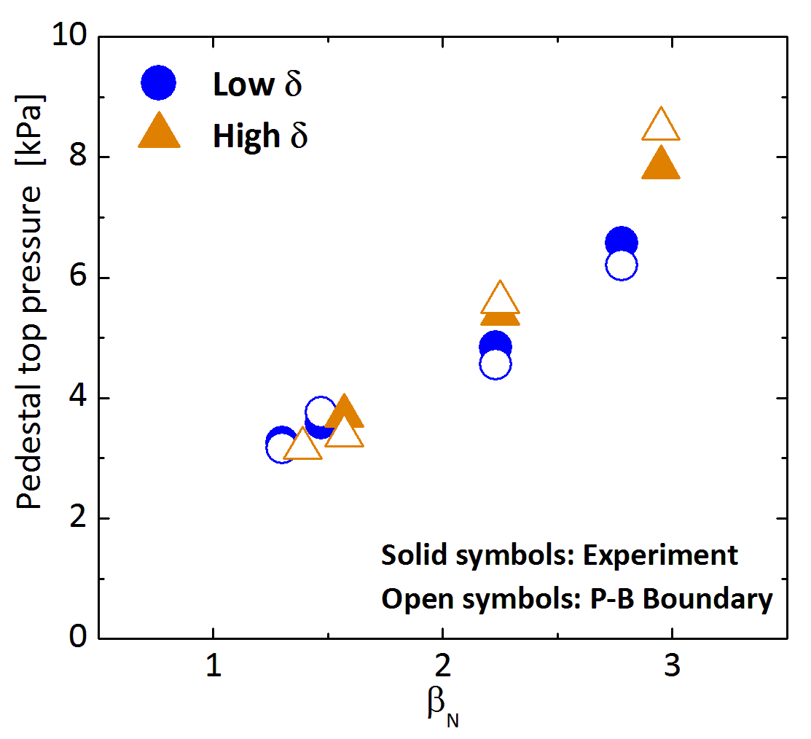
Pedestal stability consistent with P-B
Increasing core pressure stabilises ballooning modes due to Shafranov shift, which raises P-B boundary
Pedestals limited by intermediate-n P-B instabilities before type I ELM crash, both at low and high δ
Low D₂ gas injection

Slide 34
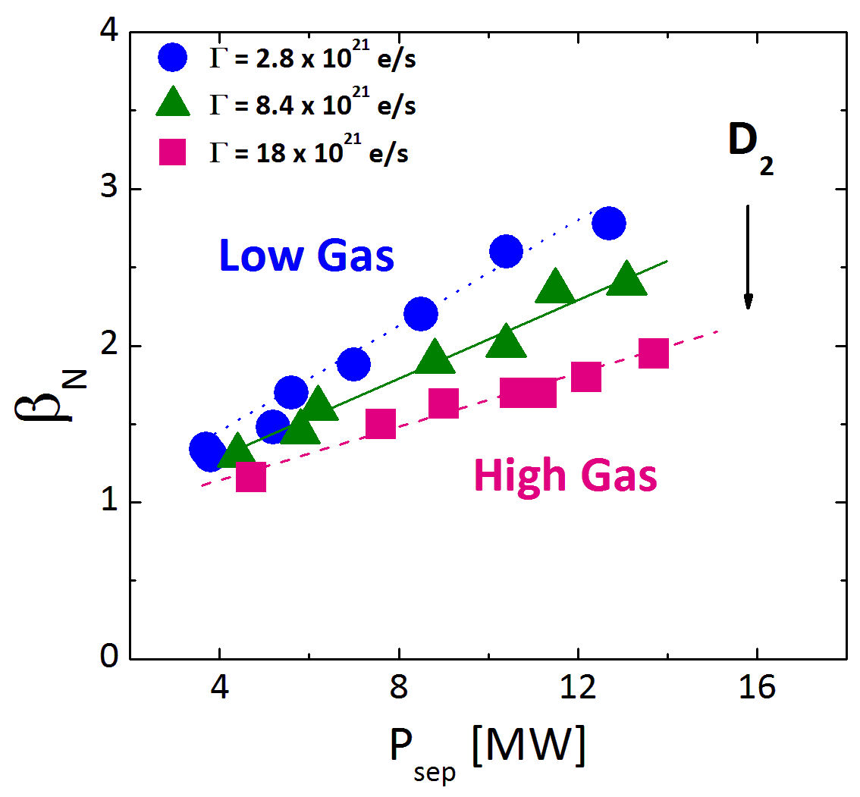
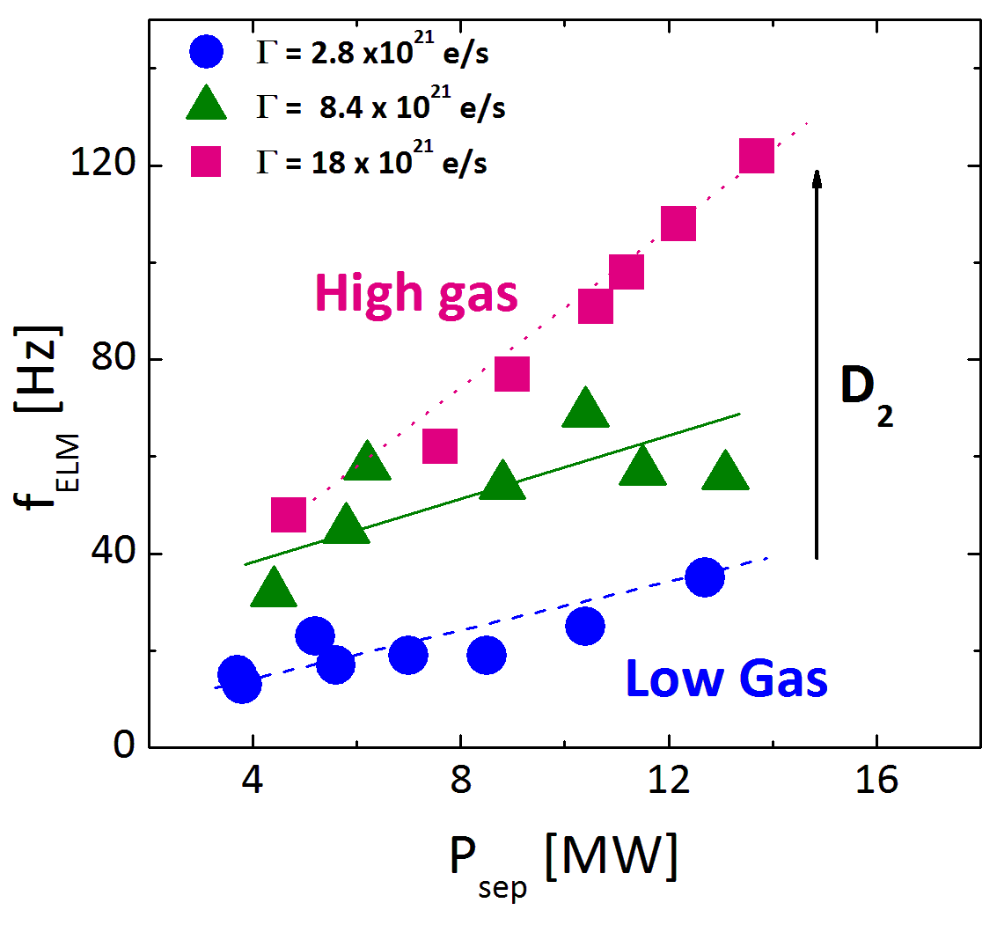
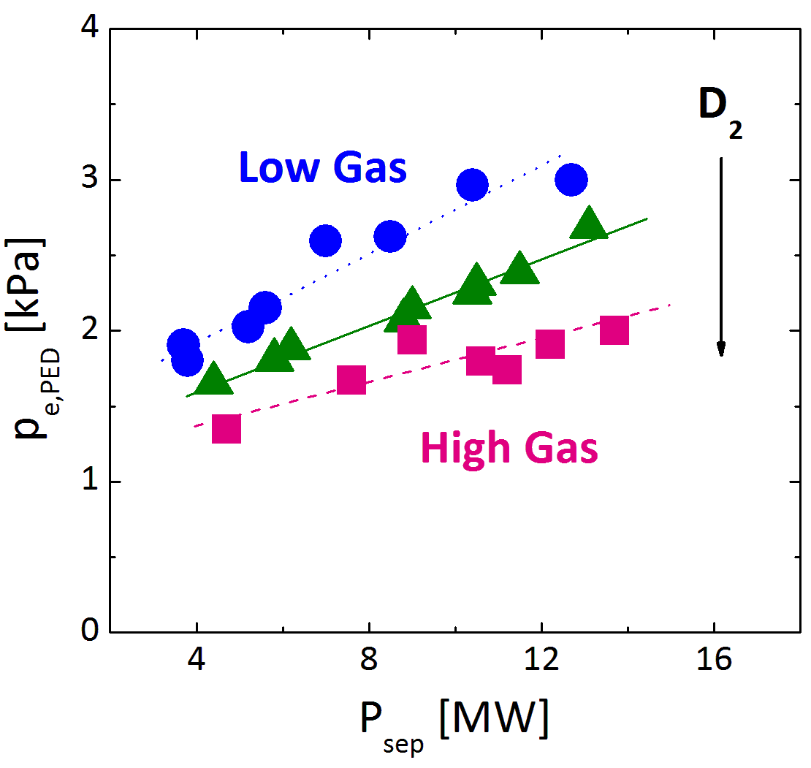
Power scans at higher gas rates
Higher D₂ gas rate, typical of JET-ILW steady H-modes
1.4MA /1.7T, Low triangularity
Lower β_{N} at higher D₂ gas rate
Type I ELMs
Lower p_{PED} at larger gas rate
(P_{sep} = P_{heat} – P_{rad,bulk})

Slide 35
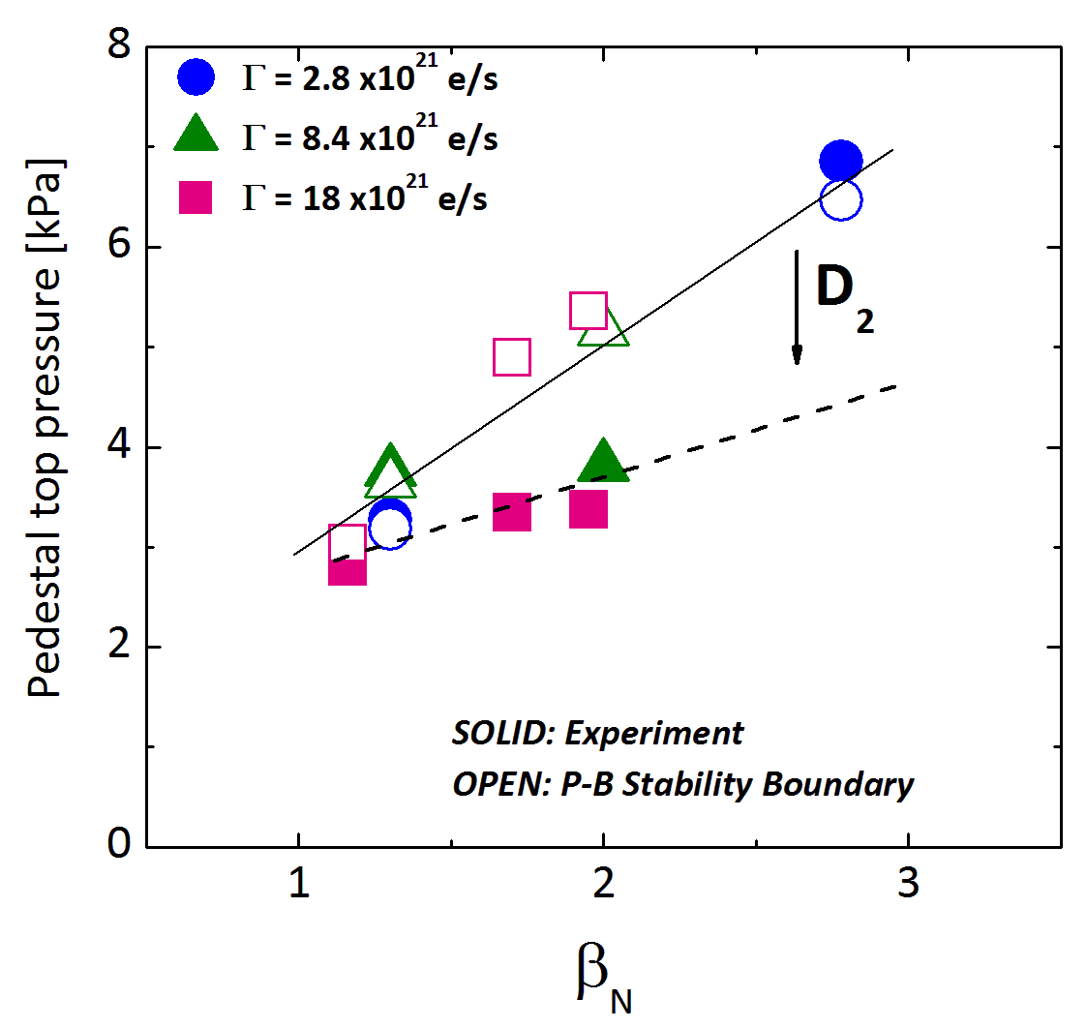
Peeling-Ballooning stability
At low gas rates, pedestals are at P-B boundary
At high gas rates, pedestals are stable to P-B modes at higher beta
All type I ELMy H-modes
Weaker increase of pedestal pressure with power at high D₂ gas rates is not consistent with peeling-ballooning model

Slide 36
Virtuous cycle
Impurity seeding
Increased heating
Increased low-Z impurity content in the pedestal
Access the “nose” of the PB-stability diagram (only high-δ)
Increased core pressure
Higher stability limit in for α
Higher bootstrap current in the pedestal
Peaked core density
Increased pedestal temperature
Lower collisionality in the pedestal
Lower collisionality
Wider pedestal
Increased core temperature
Stiff profiles

Slide 37
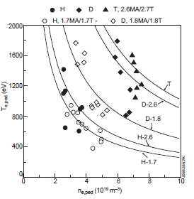
Unknown unkowns
Isotope effect on pedestals (H-campaign cancelled)
  Important for coming DT-campaign
The effect of other low-Z impurities (seeded CD₄, B, etc.)
[Saibene NF 1999]

Slide 38
Summary of open questions
The effect of neutrals on pedestals
  Divertor configuration and gas-fuelling has clearly a strong effect on pedestals. What is the mechanism?
Slow ELMs
  What is the mechanism that leads to much longer lasting ELM losses?
Impurity effects with ELMs
  Different pedestal improvement seen in ELM-averaged and pre-ELM pedestals.
  Type III ELMs in N2-seeded plasmas have higher ELM averaged pedestals than Type I unseeded plasmas.

