Slide 1
Up-Gradient Particle Flux Driven by Nonlinear Sheared Flow-to-Fluctuation Energy Transfer
L. Cui^{1, 2}, G. R. Tynan^{1, 2}, P.H. Diamond^{1, 3}, S.C. Thakur^{1, 2} and C. Brandt²
¹Center for Momentum Transport and Flow Organization,
²Center for Energy Research,
³Center for Astrophysics and Space Sciences (CASS) & Department of Physics,
UC San Diego, La Jolla, CA, 92093 USA
12/18/2014 PPPL

Slide 2
Outline
Background
  Drift wave instability and Zonal flow
  Turbulent particle transport
  Observations of Inward particle flux in different devices
Experimental Setup
  Controlled Shear Decorrelation eXperiment (CSDX)
  Diagnostics and methods of analysis
  Definition of Reynolds work
Up-Gradient Particle Flux
  Identification of net Inward Particle Transport
  Nonlinear Sheared Flow-to-Fluctuation Energy Transfer
Summary and open questions

Slide 3
Background

Slide 4
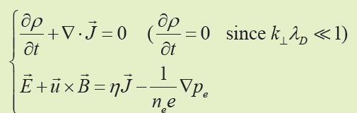
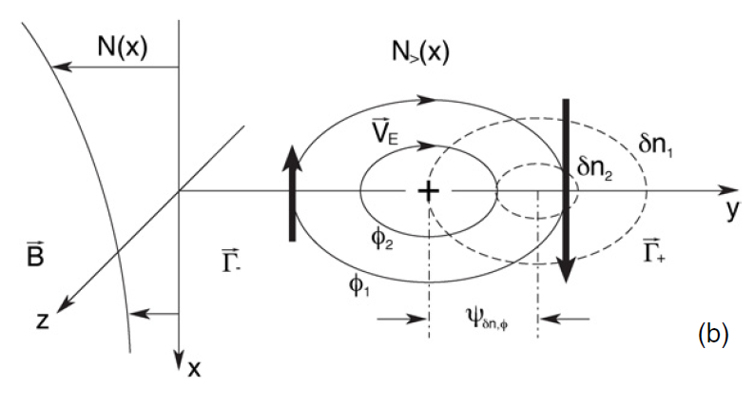
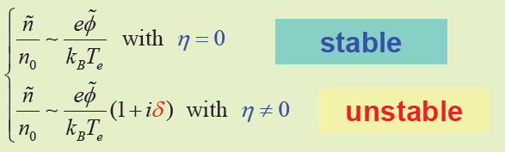



Simple Collisional Drift Wave Instability
Charge continuity and electron momentum equation:
dispersion relation: $ω= ω_{r}+iω_{i}$
Finite electron dissipation:
phase shift between $\tilde{n} and \tilde{φ}$
net particle transport down the density gradient!
Resistive Drift Waves with $E_{∥}≠0$Driven Unstable by Density Gradients.

Slide 5
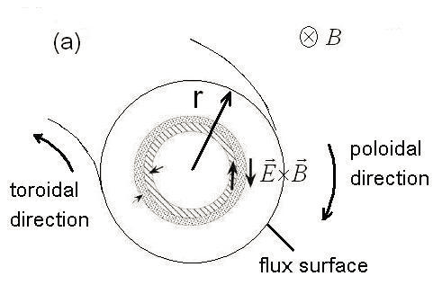
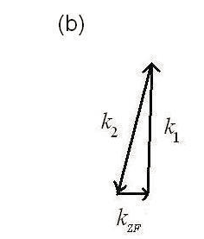
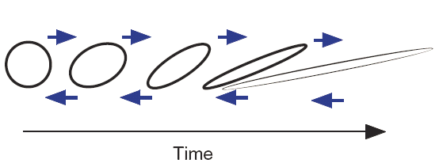
Schematics of Zonal Flow
Zonal flow: radially sheared axisymmetric flow.
  Turbulence driven
  Localized in radial extent
  m=n=0
Disparate scale interaction
(c)
[Diamond et al, PPCF (2005)]

Slide 6
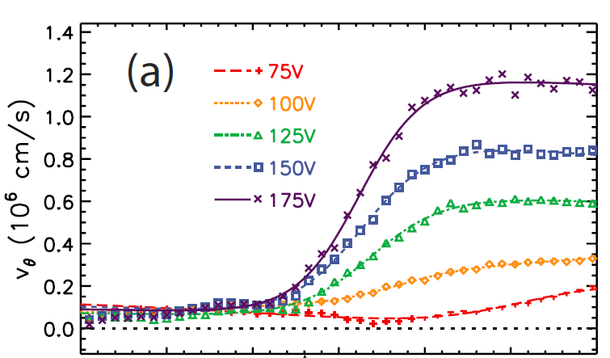
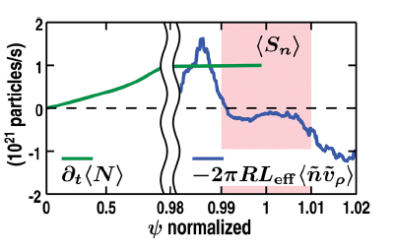
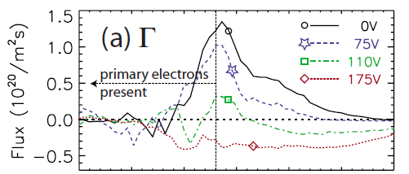
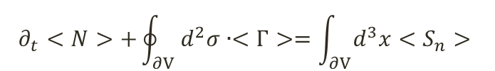
Inward particle transport in different devices
DIII-D Tokamak
  H-mode pedestal
LAPD
  Strong shear; external biasing
$$∂_{t}<N>+\oint_{∂V}{d^{2}σ∙<Γ>=\int_{∂V}{d^{3}x<S_{n}>}}$$
Transport term
[S. H. Muller et al Pop(2011)]
[T. A. Carter et al Pop (2009)]

Slide 7
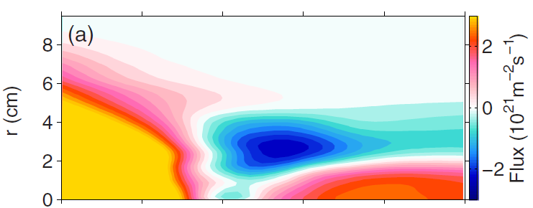

Net inward turbulent particle flux
CSDX
  linear helicon plasma device
Many devices have reported the inward particle transport observations, while so far no clear explanations for the mechanism:
what causes the inward particle flux?
Net inward particle flux
7

Slide 8
Experimental Setup

Slide 9
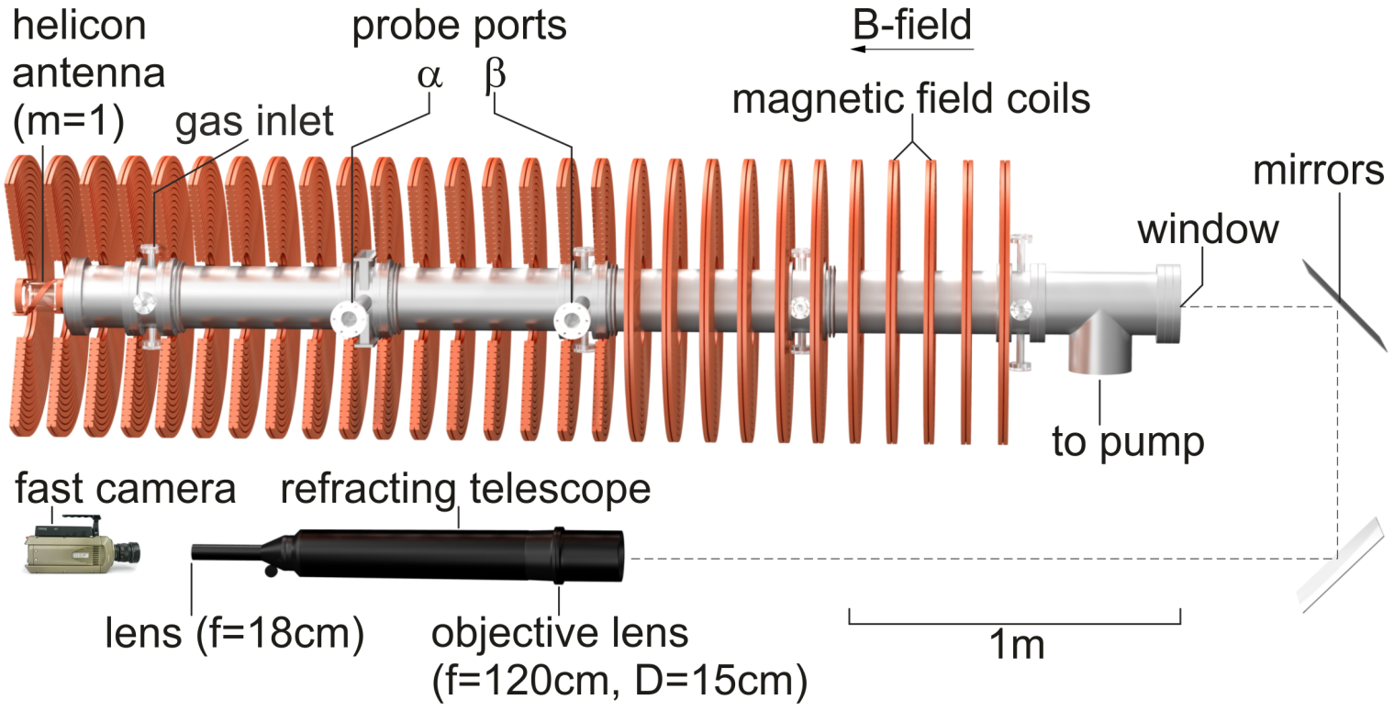
Experimental setup - CSDX

Slide 10
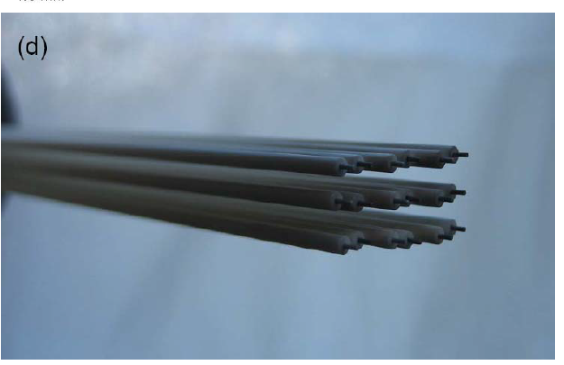
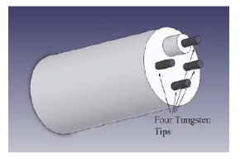
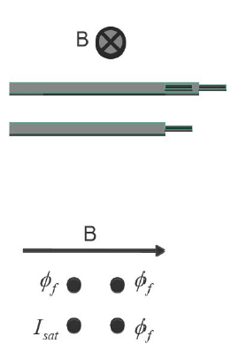
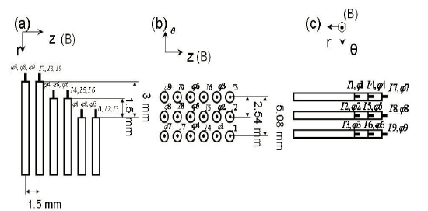
Diagnostics - Langmuir probes
18-tip probe 4-tip probe

Slide 11
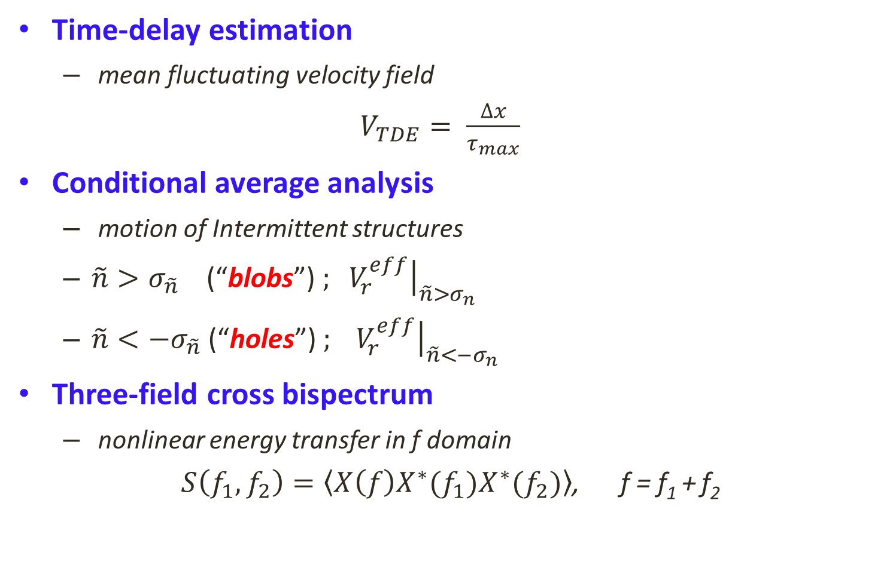
Methods of analysis
Time-delay estimation
  mean fluctuating velocity field
$V_{TDE}= \frac{∆x}{τ_{max}}$
Conditional average analysis
  motion of Intermittent structures
  $\tilde{n}>σ_{\tilde{n}}$ (“blobs”) ${\left.; V_{r}^{eff}\right|}_{\tilde{n}>σ_{n}}$
  $\tilde{n}<−σ_{\tilde{n}}$ (“holes”) ${\left.; V_{r}^{eff}\right|}_{\tilde{n}<−σ_{n}}$
Three-field cross bispectrum
  nonlinear energy transfer in f domain
$S\left(f_{1},f_{2}\right)=\left\langle X\left(f\right)X^{∗}(f_{1})X^{∗}(f_{2})\right\rangle$, f = f₁ + f₂

Slide 12
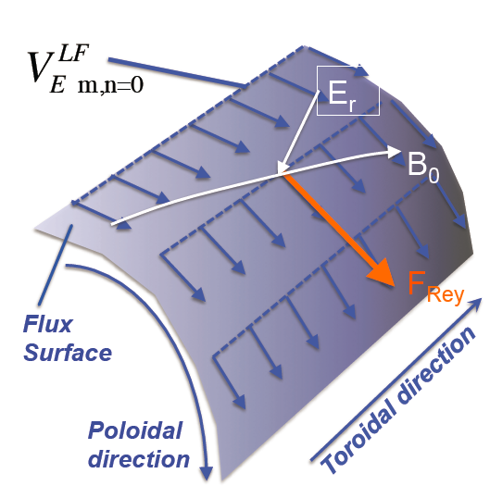



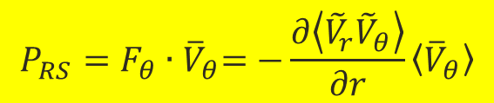
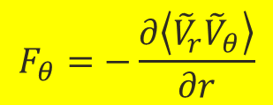
Flow-Turbulence: two-way energy transfer
$${\overline{V}}_{θ}$$
$$F_{θ}=−\frac{∂\left\langle {\tilde{V}}_{r}{\tilde{V}}_{θ}\right\rangle }{∂r}$$
Reynolds Force:
[Diamond and Kim Phys. Fluids 1991]
RS work:
$$P_{RS}=F_{θ}{∙\overline{V}}_{θ}=−\frac{∂\left\langle {\tilde{V}}_{r}{\tilde{V}}_{θ}\right\rangle }{∂r}\left\langle {\overline{V}}_{θ}\right\rangle$$
$$P_{RS}>0$$
Turbulence Nonlinearly drives flow
$$P_{RS}<0$$
Turbulence N.L driven by flow
$F_{θ}{∙\overline{V}}_{θ}<0$ ${\left\langle \tilde{n}{\tilde{V}}_{r}\right\rangle =Γ}_{turb}<0$ (inward flux)

Slide 13
Previous studies on CSDX
  Development of Weak DW Turbulence
  Turbulence-driven Zonal Flow

Slide 14
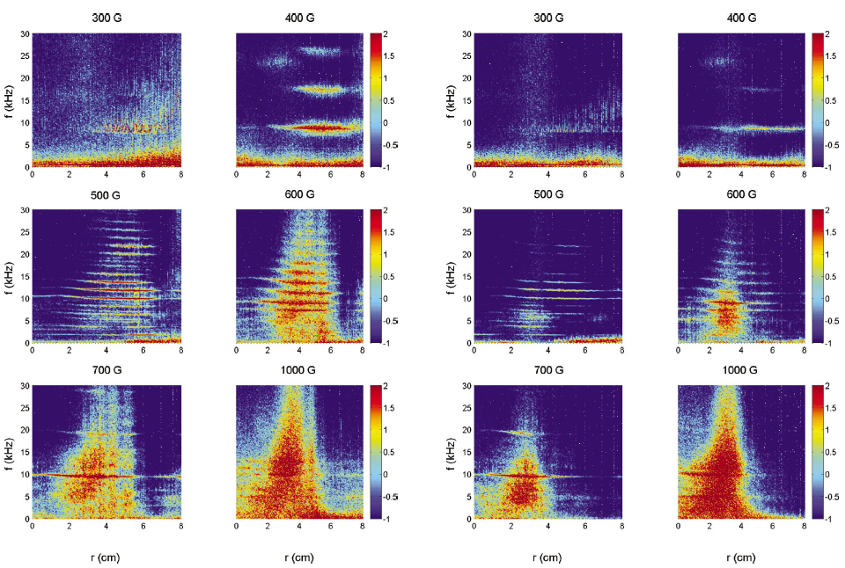


  Development of Weak Turbulence from Drift Waves
Potential fluctuation
Density fluctuation
$$∇n_{max}$$
$$∇n_{max}$$
[Burin et al, Phys. Plasmas (2005)]

Slide 15
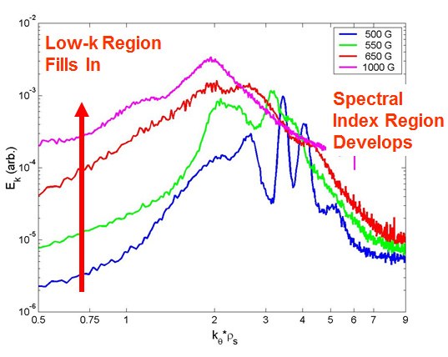
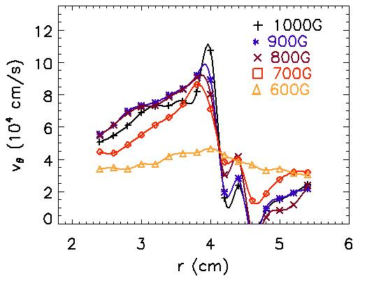
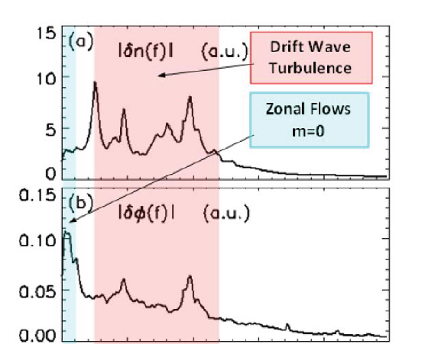
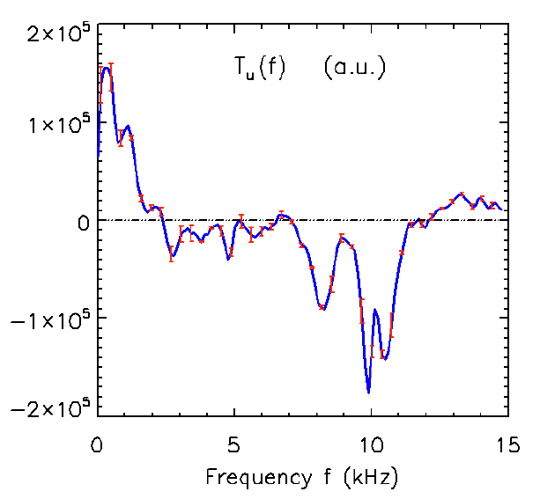
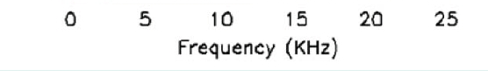

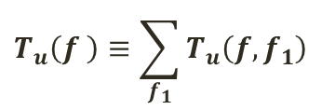
Turbulence-driven Zonal Flow observed
$$T_{u}\left(f,f_{1}\right)≡$$
$$−Re\left\langle {{\vec{u}}_{⊥f}^{}}^{∗}∙({\vec{u}}_{⊥f_{2}}^{}∙∇_{⊥}{\vec{u}}_{⊥f_{1}}^{})\right\rangle$$
$$f=f_{1}+f_{2}$$
Autospectra B =1000G
(a)density, (b) potential
[M.Xu et al Pop (2009)]
$$T_{u}\left(f \right)≡\sum_{f_{1}}{T_{u}\left(f,f_{1}\right)}$$
Net kinetic energy transfer rate
gaining energy
Shear flow develops with increased B field
Non-local inverse
energy transfer
[Z.Yan et al., Phys. Plasmas (2010)]
losing
energy
[Burin et al, Phys. Plasmas (2005)]
[M.Xu et al Pop (2010)]
15

Slide 16
Up-Gradient Particle Flux
  Identification
  Explanation

Slide 17
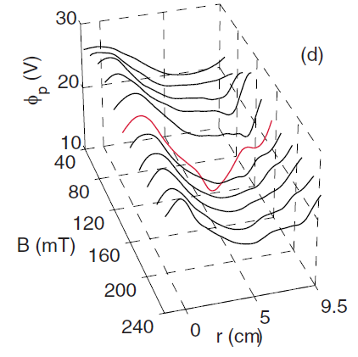
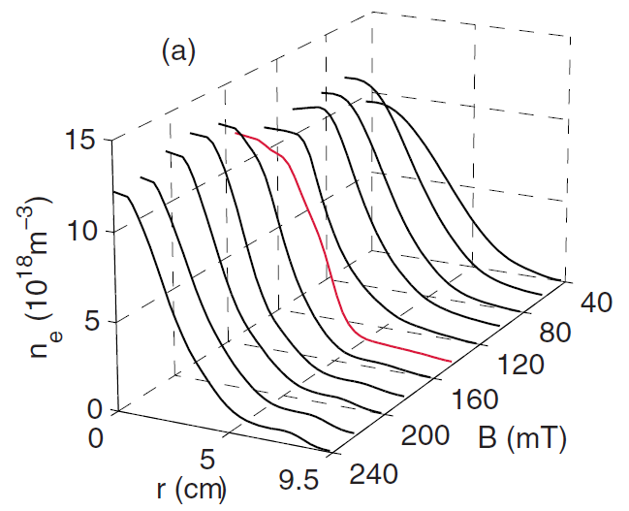
$∇n_{0} ,∇Φ_{p}$steepest at $B_{cr}\sim 1400G$
Equilibrium profiles

Slide 18
Net inward turbulent particle flux by Langmuir probe
Net inward particle flux
Onset of inward flux

Slide 19
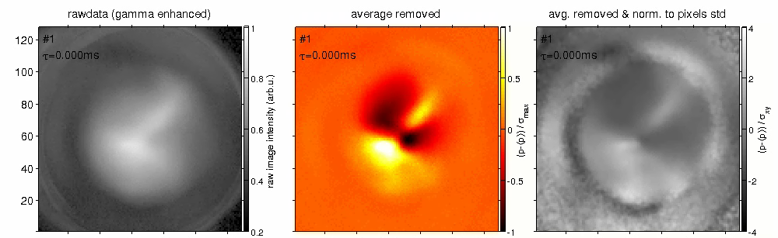
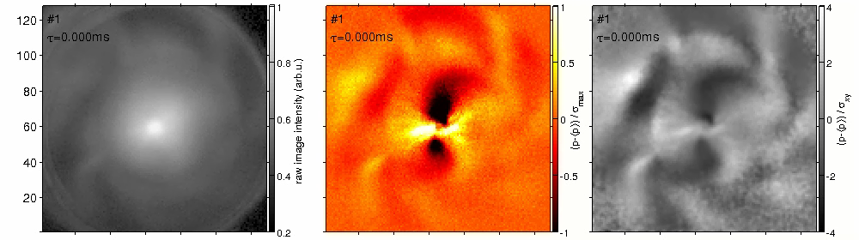
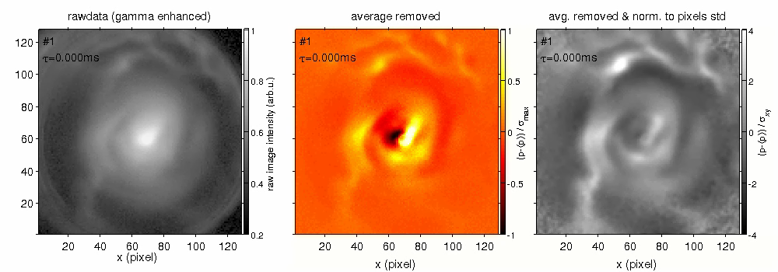

Imaging data confirms inward particle transport
Raw data
Ave. removed
Normalized
1000G
1300G
2400G
Notes:
Pronounced

Slide 20
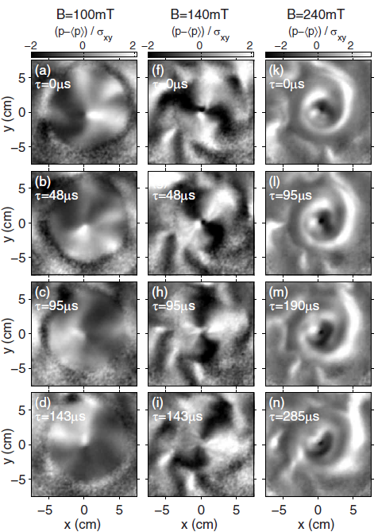
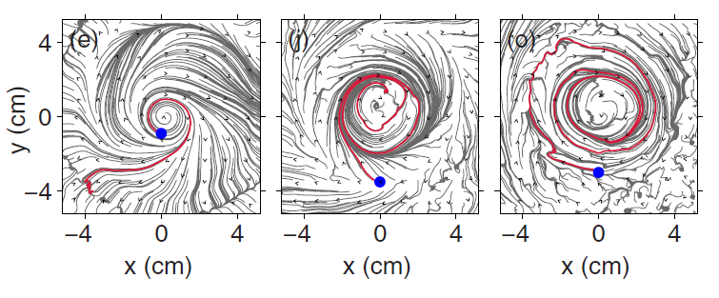
Imaging data confirms inward particle transport
B=1000G B=1300G B=2400G
1000G
1300G
2400G

Slide 21
Inward flux confirmed by independent diagnostics
Intensity flux VS particle flux

Slide 22
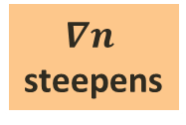


Motion of Intermittent structures
$$∇n$$
steepens
$${(∇n)}_{max}$$
$${(∇v)}_{max}$$
B =1300G
blobs propagate inwards
holes propagate outwards.
Opposite to blob/hole dynamics density gradient relaxation
structure dynamics are material to the total turbulent flux.

Slide 23
Up-Gradient Particle Flux
  Identified net inward particle transport by both Langmuir probes and fast camera.
  Explanation

Slide 24


  Nonlinear Sheared Flow-to-Fluctuation Energy Transfer
$$∇n│max$$
The up-gradient flux occurs when and where the shear flow drives the fluctuations.
fluctuations NL drives shear flow
Strong Velocity shear $∇v│max$
Velocity shear
in ion diamagnetic direction
shear flow NL drives fluctuations

Slide 25
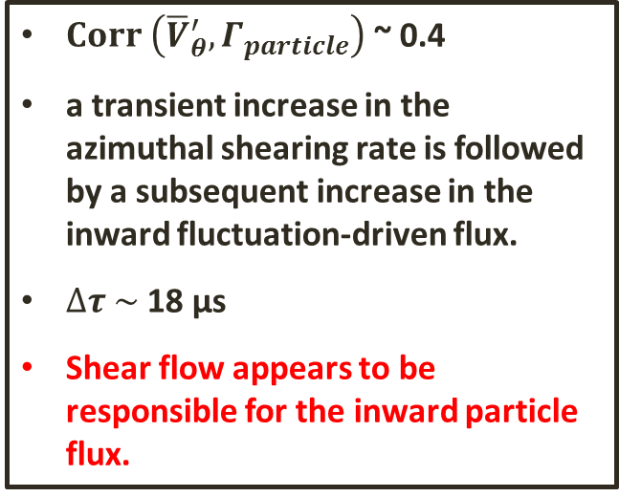
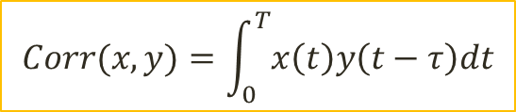
Causality b/t shear flow and the inward flux
Cross correlation between shear rate and inward particle flux
B = 1300G, r = 4.75cm
$Corr \left({\overline{V}}_{θ}^{′}, Γ_{particle}\right)$ ~ 0.4
a transient increase in the azimuthal shearing rate is followed by a subsequent increase in the inward fluctuation-driven flux.
$∆τ \sim$18 μs
Shear flow appears to be responsible for the inward particle flux.
$$Corr(x,y)=\int_{0}^{T}{x\left(t\right)y\left(t−τ\right)dt}$$

Slide 26

Turbulence-driven ZF
Freq-resolved Particle flux
the low-freq flows are gaining energy from the finite-freq fluctuations
$${∇v}_{max}$$
Net Kinetic energy transfer rate
r = 6 cm, B = 1300G

Slide 27
Flow-driven fluctuations
Freq-resolved Particle flux
Shear flow drives fluctuations when and where a net inward flux occurs
Net Kinetic energy transfer rate
r = 4.5 cm, B = 1300G

Slide 28
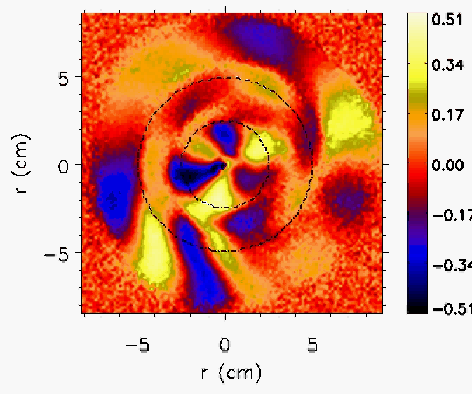
Filtered f = 5 kHz structure motion

Slide 29
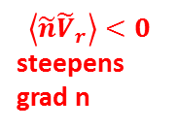

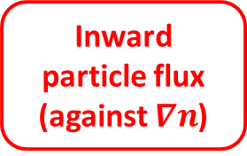


A new feedback loop in DWT-ZF system
[Diamond et.al PPCF (2005)]
High k dissp.
Low k dissp.
Free Energy
$∇n$ drive
Reynolds work>0
Collisional drift wave turbulence
Zonal Flow
$$\left\langle \tilde{n}{\tilde{V}}_{r}\right\rangle >0$$
flattens grad n
Turbulence
saturation
Strong
shear
$$\left\langle \tilde{n}{\tilde{V}}_{r}\right\rangle <0$$
steepens grad n
Free energy $∇v$ drive
Inward particle flux
(against $∇n$)
Reynolds work<0
drives
fluctuations

Slide 30
Summary and open questions

Slide 31
Summary
  Our experiments directly show the shear flow can be a source of free energy that can cause an up-gradient particle flux.
  As a result the density gradient is enhanced
  A new feedback loop in the regulation of time-averaged density and velocity gradients by the coupled drift turbulence-sheared flow system.

Slide 32
Open Questions
Role of magnetic shear effect needs to be considered. [T.chiueh et al. Phys. Fluids (1986)]
Need for a theory that considers flow shear as an additional spatially separated free energy source.

Slide 33
Possible relevance to confinement devices
Previous tokamak experiments have shown inward turbulent flux coincident with strong edge pressure gradients and E×B shear flows . These observations are reminiscent of the results reported here.
  COULD SIMILAR MECHANISMS BE AT WORK IN TOKAMAK EDGE PEDESTAL?

Slide 34
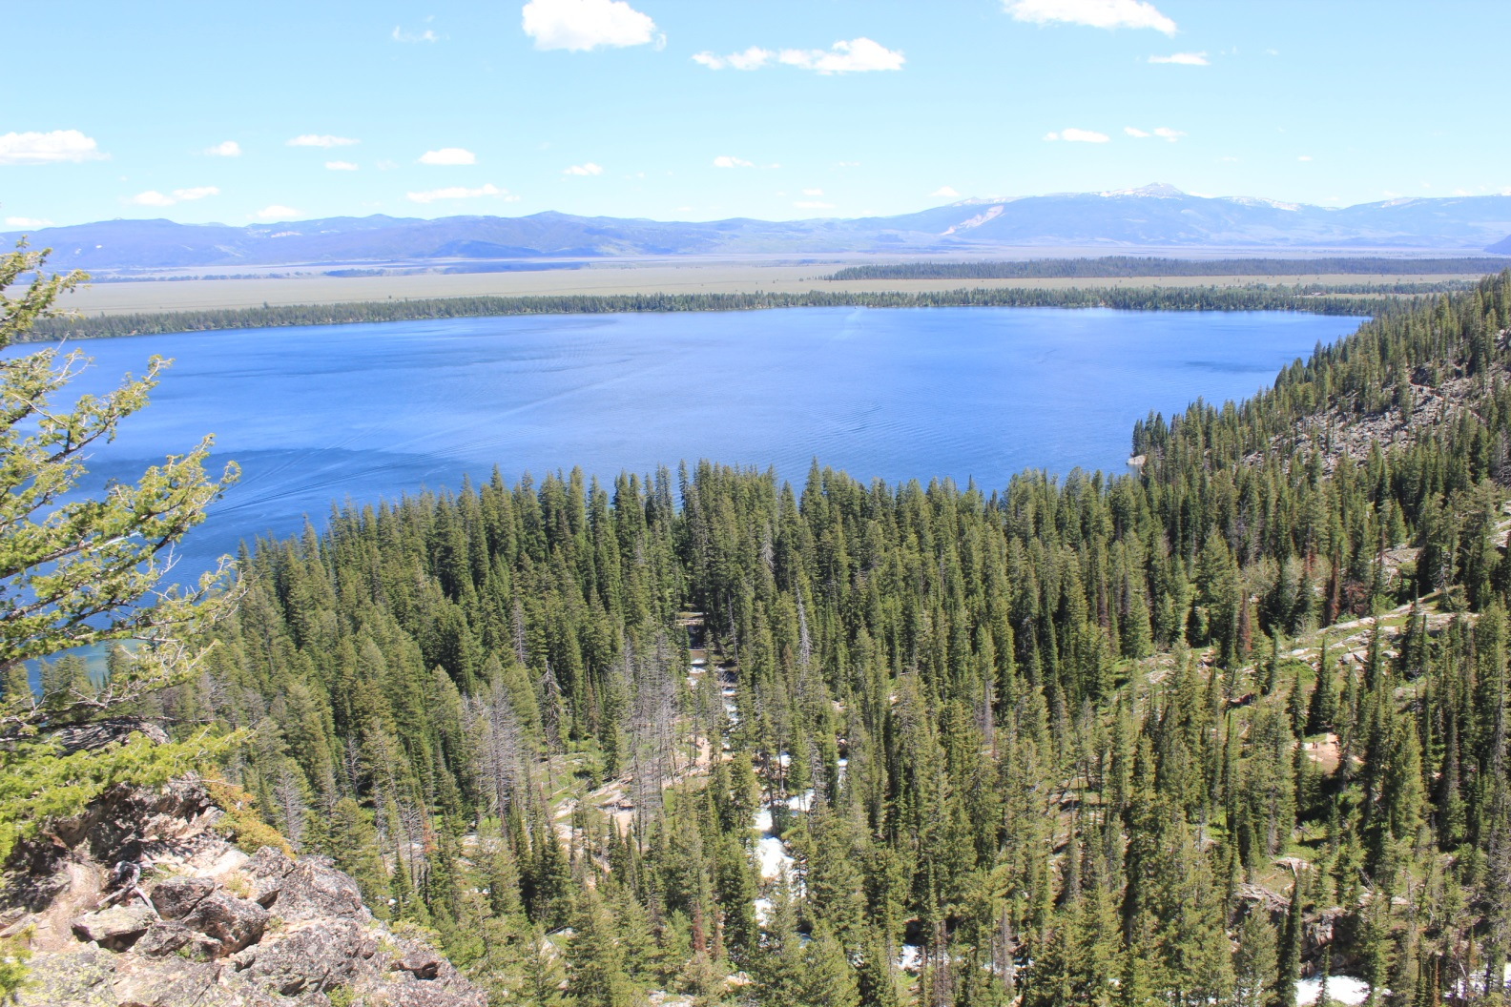
Thank You for your attention!

Slide 35
Backup Slides

Slide 36
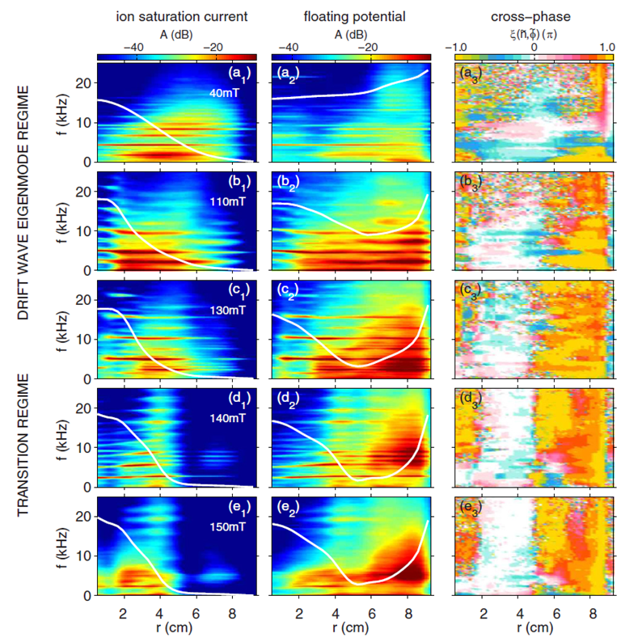
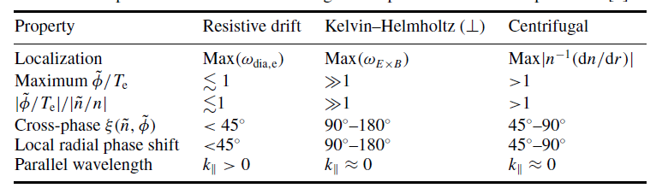
Linear KH instability
Jassby 1972 Phys. Fluids

Slide 37
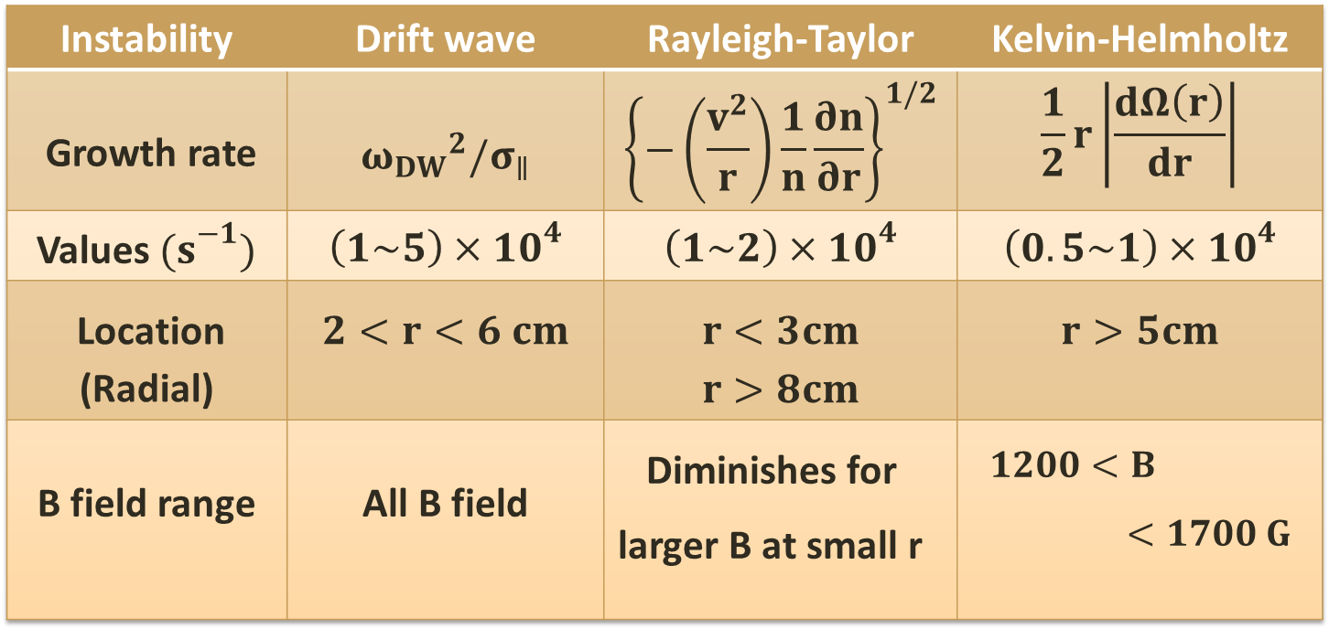
Identification of the instabilities
Linear growth rate
Instability | Drift wave | Rayleigh-Taylor | Kelvin-Helmholtz
Growth rate | $${ω_{DW}}^{2}/σ_{∥}$$ | $${\left\{−\left(\frac{v^{2}}{r}\right)\frac{1}{n}\frac{∂n}{∂r}\right\}}^{1/2}$$ | $$\frac{1}{2}r\left|\frac{dΩ\left(r\right)}{dr}\right|$$
Values${ (s}^{−1})$ | $$\left(1\sim 5\right)×{10}^{4}$$ | $$\left(1\sim 2\right)×{10}^{4}$$ | $$\left(0.5\sim 1\right)×{10}^{4}$$
Location (Radial) | $$2<r<6 cm$$ | $$r<3cm$$ $$r>8cm$$ | $$r>5cm$$
B field range | All B field | Diminishes for larger B at small r | $$1200<B<1700 G$$
Notes:
The radial localization of the instabilities and their appearance in parameter space is determined by the availability
of the free energy sources that drive these instabilities: density gradient for DW, strong rotation for the R–T and velocity shear
in case of the K–H. To understand the origin of the underlying instability mechanisms, one can look for the locations (both in
radius and B) for the maximum linear growth rate of the three instabilities.

Slide 38
Is inward flux caused by linear KH?
Spatial locations different:
  Linear KH : r > 5 cm
  Inward particle flux: 3cm < r < 5 cm
RS work is non-zero:
  Nonlinear process
We don’t think it is the linear KH causes the inward flux.

