Slide 1

Initial results from XMP-108 ‘TMB sequencing’
C. H Skinner, J.P. Allain, F. Bedoya, W. Blanchard, D. Cai,
B.E. Koel, M. Jaworski, F. Scotti
NSTX-U Physics Meeting
B318 PPPL
11 Jan 2016

Slide 2
Motivation
Wall conditions have profound effect on plasma performance (e.g. JET-ILW; Kotschenreuther colloquium last week)
Aim to advance the scientific understanding
and optimization of wall conditioning by:
  correlating in-vessel spatial coverage of
  conditioning species (boron or lithium)
  and their respective surface chemistries
  to plasma performance.
XMP-108 ‘TMB sequencing’ (this presentation)
XP1505 ‘Optimizing Boronization’ coming later

Slide 3
Previously…
After 2002 boronization:
D-alpha increased x2
VB emission decreased to 1/3
Energy confinement time increased by 30% - 70%
(lower loop voltage).
Ip flattop increased by 50-70%
Access to H-mode plasmas after 3rd boronization.
‘Boronization in Ohmic plasmas’
[NF 42 (2002) 329]
/16

Slide 4
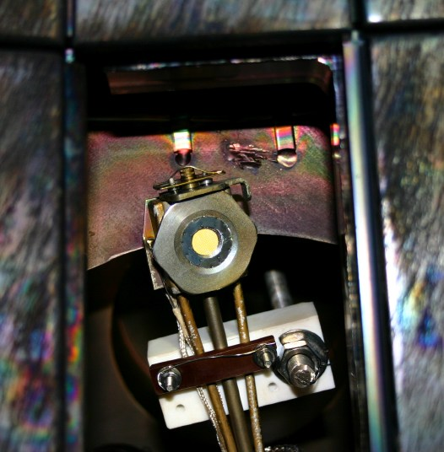
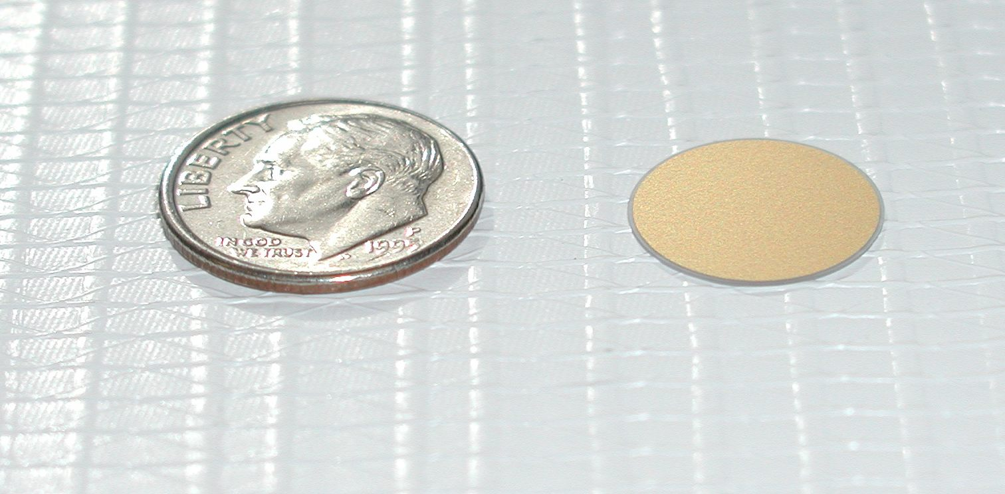
Quartz Microbalance (QMB)
QMB in tile gap
2016 QMB locations:
Bay E top & F bottom,
7 cm ‘behind’ 7 cm wide gap in outerboard divertor tiles
Bay B midplane ~10 cm outboard of limiter
Data acquired continuously 24/7
quartz crystal coated with gold
thermo-couple
  CAVEATS:
  Crystal frequency is also temperature dependent and affected by light
    temperature changes compensated.
    average over ‘glitches’ from GDC light.
    uncertainties ~ Å (~ 1 monolayer atomic scale)
    GDC flux reduced in recess ?
    outgassing of bake deposits ?
  Crystals oscillate near 6 MHz.
  81 Hz/µg/cm² or
  1.3 Hz per angstrom for 1.6 g/cm³
  can measure frequency to < 1 Hz ,
  BUT….
film mass frequency change
crystal mass bare crystal frequency
=
Notes:
FrequencyToAngstrom.xls
Can’t be too greedy in claiming sub monolayer changes.

Slide 5
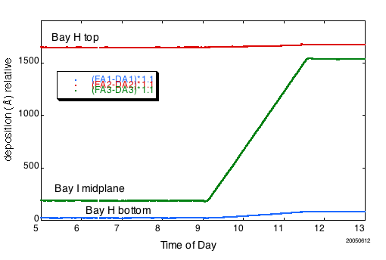
2005 Boron deposition highly non-uniform in NSTX
Totals:
Bay H top 62Å
Bay H bot. 27Å
Bay I mid 1367Å
In 2005:
one dTMB inlet at Bay L midplane.
GDC electrodes Bay K and Bay G midplane
Å thickness based on density 1.6 g/cm³
5/16

Slide 6
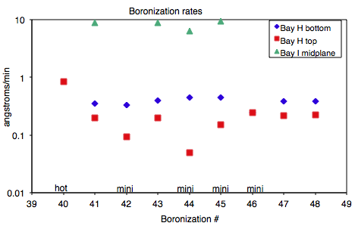
2005 deposition rates in NSTX
Deposition Rates
Bay I midplane: 9 Å/min
Bay H bottom: 0.36 Å/min (x25 lower)
Bay H top: 0.19 Å/min (x47 lower)
6/16

Slide 7
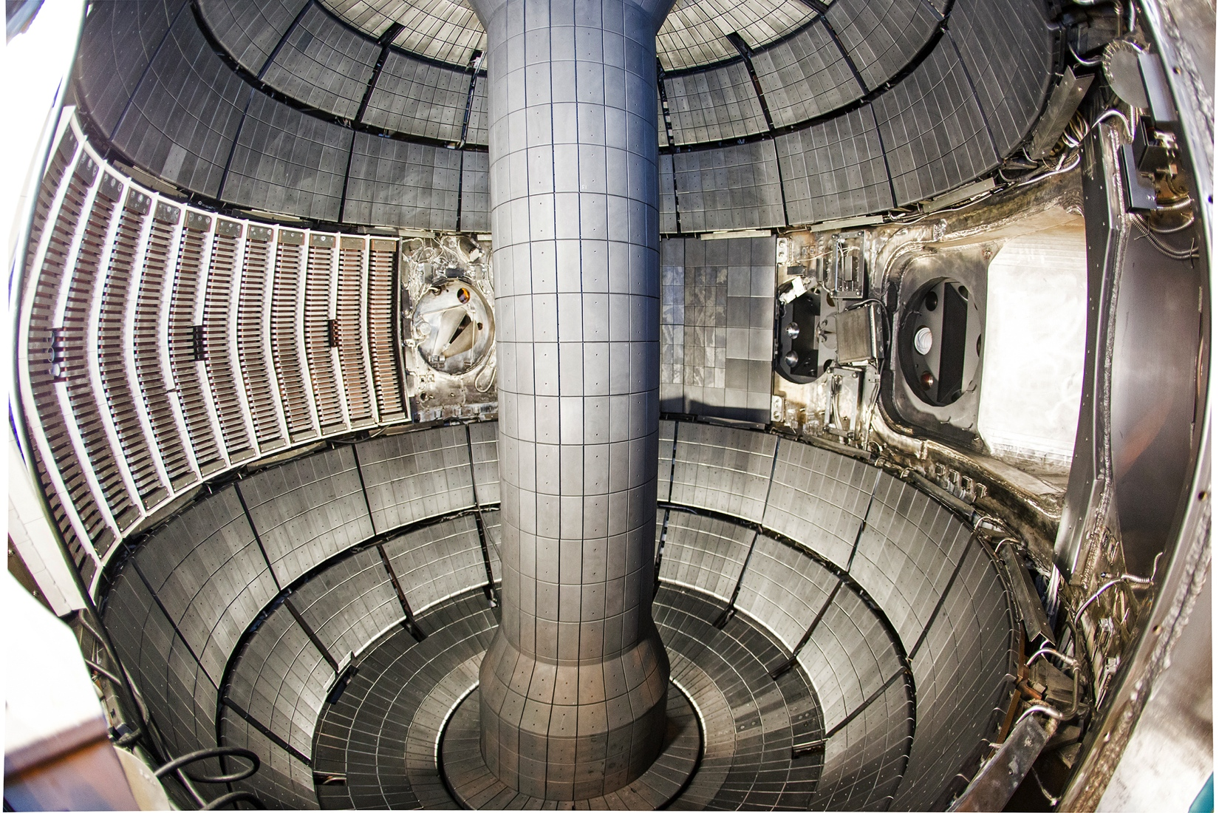
2016 Configuration
QMB
Bay E top
TMB inlet
Bay D CS
GDC
electrode
Bay G mid
QMB
Bay I mid
(ground fault)
QMB
Bay B mid
TMB inlet
Bay F
GDC electrode
Bay K mid
QMB
Bay H bottom
TMB inlet
Bay C
MAPP
/16
Notes:
New TMB system has 3 gas inlets:
Bay I mid-plane centerstack
outboard midplane Bay F/G
Bay C lower divertor.
GDC electrodes
Bay K
Bay G
QMBs are at:
Bay E top
Bay B mid
Bay H bottom

Slide 8
XMP-108 Sequence:
1st boronization, 4 Jan 2016
2 mtorr 5% dTMB 95% He GDC (41 min each)
  1.5 g d-TMB from Bay D upper CS injector
  1.5 g d-TMB from Bay F midplane injector
  1.5 g d-TMB from Bay C lower injector
4 mtorr 5% dTMB 95% He GDC (25 min each)
  1.5 g d-TMB from Bay D upper CS injector
  1.5 g d-TMB from Bay F midplane injector
  1.5 g d-TMB from Bay C lower injector
2 mtorr 100% He-GDC (2 h)
MAPP XPS analysis before and after boronization, then after weeks plasmas.
D₃C
D₃C
B
D₃C
deuterated tri-methyl boron
Notes:
39 torr pressure drop in TMB bottle each step.

Slide 9
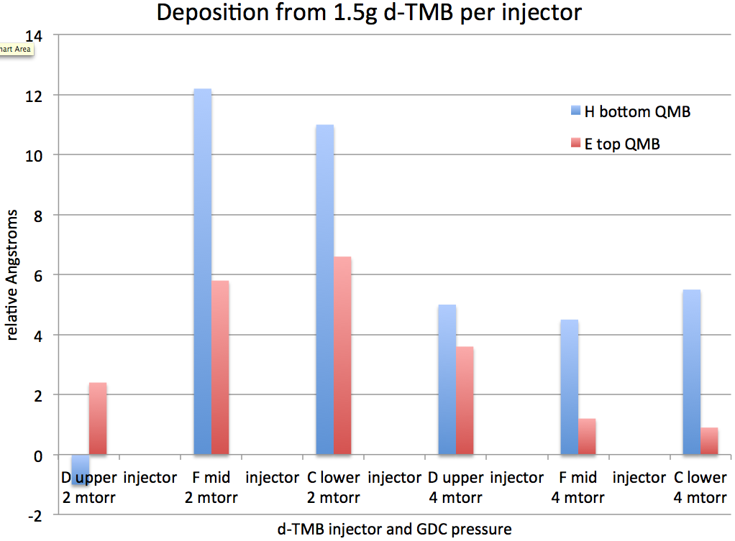
Deposition low on divertors
Results:
Deposition not uniform
Calculation: 1.5g d-TMB spread uniformly over 40 m²
= 233Å (@ 1.6g/cm³)
conclude d-TMB range
< 2 m
2 mtorr GDC gives more uniform deposition
Total deposition from GDC beginning to end:
  H bottom 39 Å
  E top 23 Å
  B mid 292Å
  Bay B mid QMB signal affected strongly by GDC.
  Difference before and after whole sequence related to mass
Notes:
39 torr pressure drop in TMB bottle each step.

Slide 10
QMB Summary
  B deposition still heavily weighted to midplane. Deposition on divertors 5-10x less than midplane
    improved over 2005 value of x25 – x47 with only midplane d-TMB injection
    GDC electrodes are at midplane.
    reconsider moveable GDC probe at divertor ?
  More divertor deposition at 2 mtorr GDC pressure
    presumably due to longer mean free path

Slide 11
Proposal for tonight’s boronization
  Run GDC at 2 mtorr only
  Operate F mid, C lower, D upper injectors separately (as before, but in different order to last week).
  Turn GDC off for 10 mins every 1.5 g d-TMB.
  (to remove effect of GDC light on Bay B mid QMB).
  Make all adjustments to GDC % power at beginning of each injection interval, then leave constant (to avoid ‘glitches’).

Slide 12
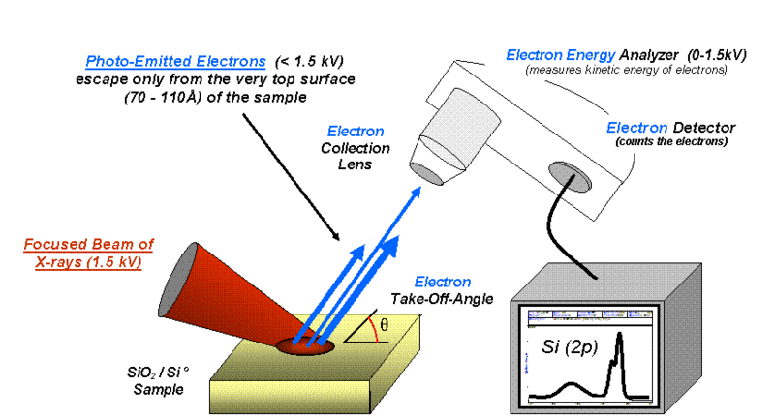
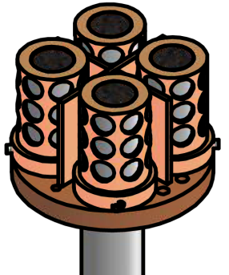
MAPP shows changes in surface chemistry
Materials Analysis Particle Probe (MAPP)
  JP Allain, B Heim, F Bedoya, R Kaita et al…
X-ray Photoelectron Spectroscopy
photoelectrons
electron energy analyser
X-ray beam
sample
Analysis
Chamber
XPS spectrum shows elemental composition (and chemical shifts)
Sample holder with 4 samples
https://commons.wikimedia.org/wiki/File:System2.gif
EFIT02 142512 @ 547 ms
Notes:
From ‘NSTX_PAC29_Lithium_Skinner.ppt’ and
https://commons.wikimedia.org/wiki/File:System2.gif

Slide 13
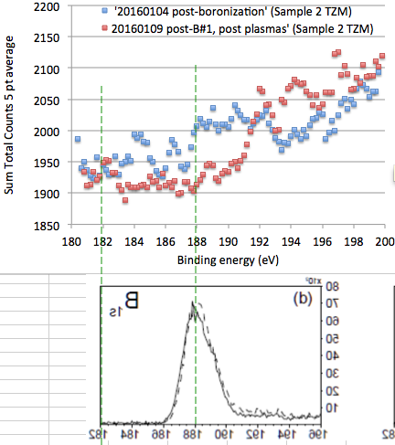
Preliminary XPS data - boron
  MAPP XPS spectrum of TZM sample after 1st boronization and after 4d of plasmas
  data limited by poor S/N
  hint of boron XPS line
  (XPS less sensitive for boron)
  B₂O₃ peak expected at 193 eV
  shift to Be-O after a weeks plasmas ?
  compare to high resolution HR-XPS spectrum of boronized sample from RFX, measured in Koel’s lab on campus (Bilel Rais - Talk on 2 Feb).
  Plan to take MAPP samples to Koel lab for HR-XPS analysis in maintenance period.
  Also improve MAPP alignment
B
B₂O₃
Notes:
MAPP data / 20160109 post-B#1, post plasmas.xlsx / Boron before and after plasmas.xlsx / 20160104 worksheet
“Figure 7: B 1s,'as received' surface before (dotted line) and after (continuous line) 10' of Ar+ sputter-cleaning.”
See JP email 1/11/16 re Be-O shifts.

Slide 14
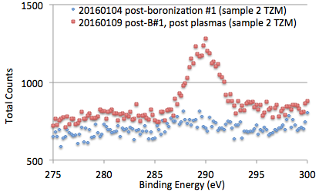
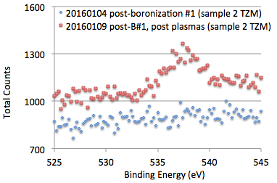
MAPP XPS evidence for carbon migration, and boron oxidation
  Carbon XPS spectrum of TZM sample after 1st boronization and after 4d of plasmas
  Evidence of carbon migration to TZM
  Oxygen XPS spectrum of TZM sample after 1st boronization and after 4d of plasmas
  Evidence of boron oxidation after 4 d plasmas
C
O
Notes:
MAPP data / 20160109 post-B#1, post plasmas.xlsx / Carbon before and after plasmas.xlsx

Slide 15
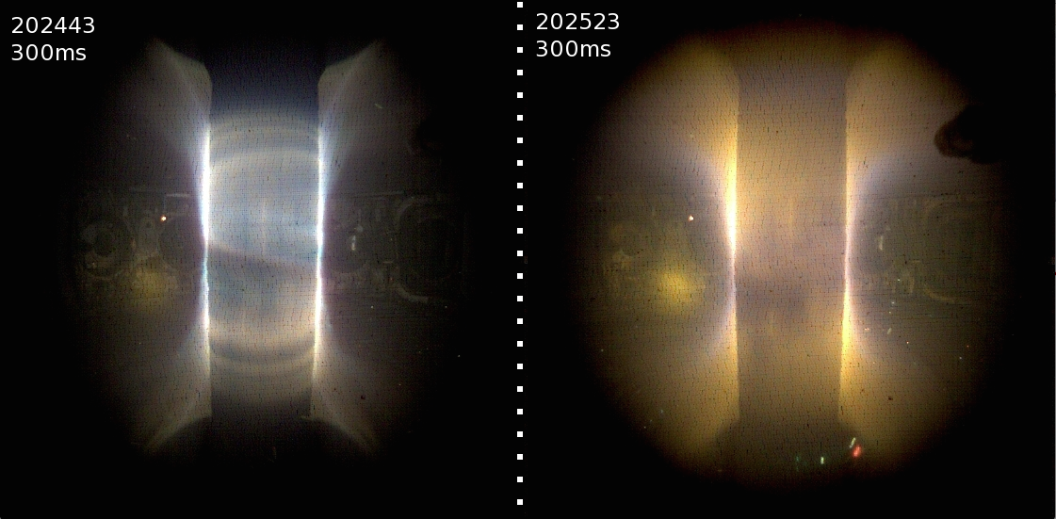
Plasma TV
M. Jaworski
Before boronization 20160104 After boronization
Plasma TV (fcplayer miro4-18380), @ 300 ms, 0.4 ms exposure, Bay B midplane, no filters.
Notes:
Jaworski BoronComparisonImage.jpg
Copy/paste – for no reason insert picture degrades resolution. Maybe there is an encapsulated thumbnail that gets pasted.

Slide 16
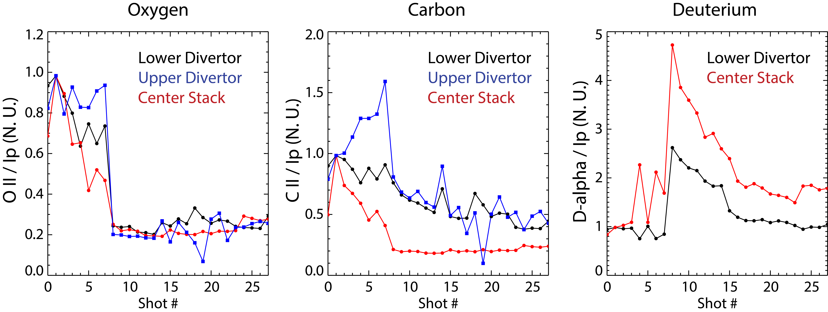
Oxygen reduction after boronization
Inner wall limited discharges, deuterium pre-fill, LFS He fueling
After boronization, reduction in O II (4416Å) from center stack, lower and upper divertors
Some reduction in C II (5145Å) (boronization + variability due to discharge development?)
No clear boron signature on filterscopes but boron lines observed on VIPS2 (3451Å, 4940Å, …)
F. Scotti, V.A. Soukhanovskii
Notes:
Shot numbers are in chronological order, but not sequential (fizzles eliminated).
Intensity normalized at shot 1
Email 1/11/16: from Felippo’s IDL program the list of discharges included and the times of interest.
shots=[ 202436, 202437, 202438, 202439, 202440, 202441, 202442, 202443, 202521, 202522, 202523, 202530, 202531, 202532, 202533, 202546, 202551, 202552, 202554, 202556, 202564, 202565, 202567, 202573, 202574, 202575, 202576, 202577]
tin=0.2
tend=0.3

Slide 17
Summary
  QMB:
  QMB deposition on divertors 5-10x less than midplane
    uniformity improved over 2005 values of x25 – x47 with only midplane d-TMB injection
    more divertor deposition at 2 mtorr GDC pressure
    > presumably due to longer mean free path
  MAPP:
  Exciting first XPS data - reveals changes in NSTX-U
  surface chemistry !
  Opens window to correlate surface conditions with plasma performance

Slide 18
QMB details…
QMB analysis in detail

Slide 19
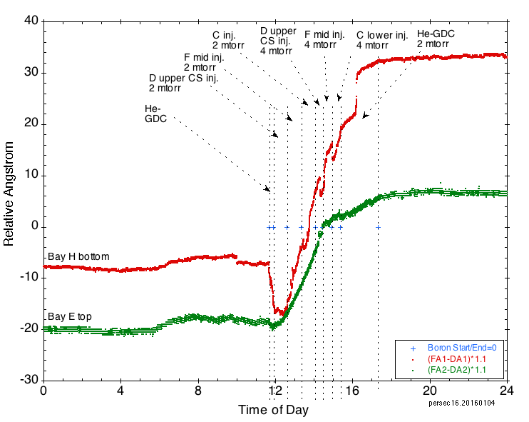
Divertor deposition 20160104
‘laminations’ due to bit noise in TC measurement
Notes:
persec16_20160104d.qpc

Slide 20
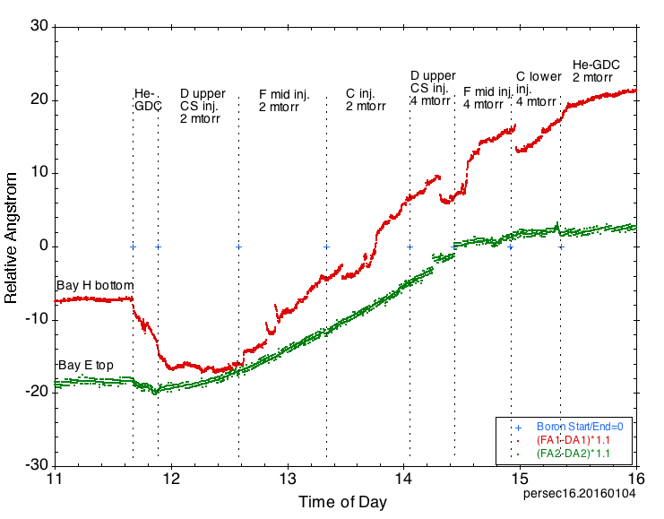
D-TMB deposition on divertor
  Conclude:
  Deposition low compared to ~1400 Å for 9 g d-TMB uniform coverage of 40 m²
  More divertor deposition at 2 mtorr
Notes:
persec16_20160104c.qpc
Glitches could be Scott adjusting GDC V and I through power %.

Slide 21
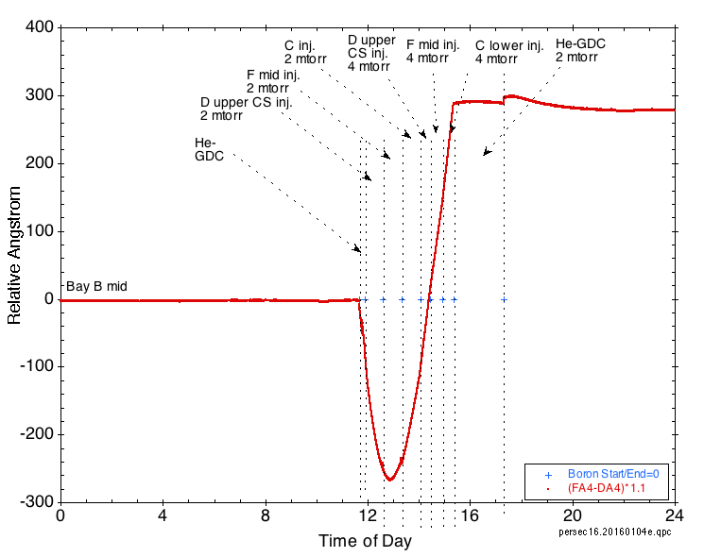
D-TMB deposition at midplane
  Bay B mid QMB signal affected strongly by GDC.
  Total GDC end – GDC beginning = 292 Å
Notes:
persec16_20160104e.qpc
Seems light from GDC affects frequency

Slide 22
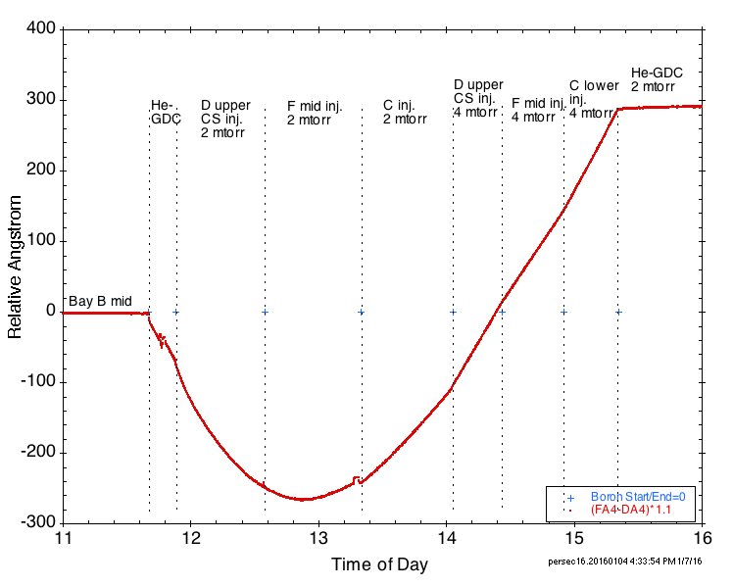
D-TMB deposition at midplane
  Bay B mid QMB signal affected strongly by GDC light.
  Total GDC end – GDC beginning = 292 Å
Notes:
persec16_20160104f.qpc
Seems light from GDC affects frequency

Slide 23
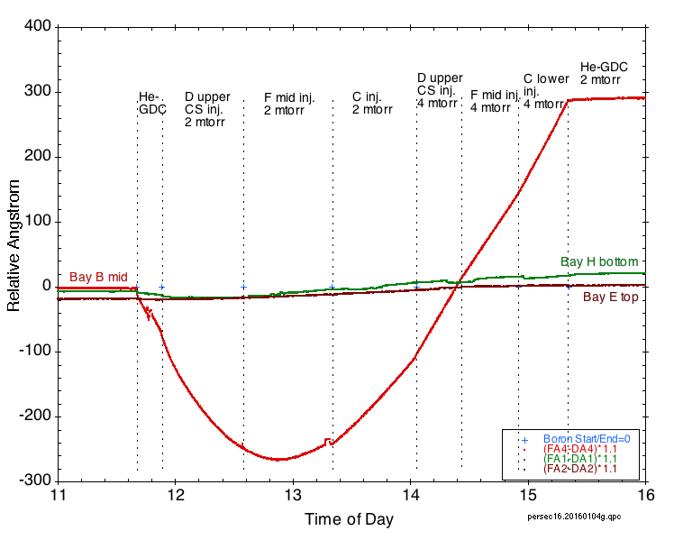
All three QMBs
Notes:
persec16_20160104f.qpc
Seems light from GDC affects frequency

Slide 24
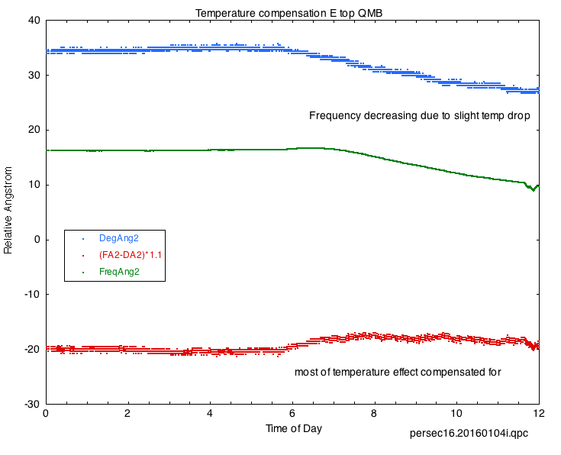
Temperature compensation E top QMB
Calculated temperature effect
Frequency decreasing with temperature drop
QMB signal
QMB signal after temperature compensation
Notes:
persec16_20160104i.qpc

Slide 25
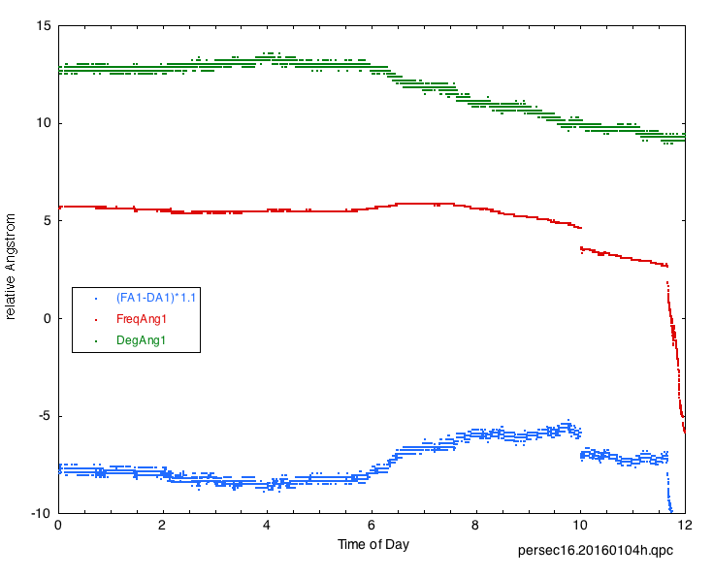
Temperature compensation H bottom QMB
Calculated temperature effect
Frequency decreasing with temperature drop
QMB signal
QMB signal after temperature compensation
Notes:
persec16_20160104h.qpc

