Slide 1

Status of H-mode Discharge Development on NSTX-U
Devon Battaglia
On behalf of the entire NSTX-U team
NSTX-U Monday Science Meeting
April 25, 2016

Slide 2
Outline
Three unique H-mode scenarios have been observed during NSTX-U commissioning
  Differentiated by the nature of MHD activity and operational limits
H-mode scenario development has benefited from continued improvements in EFC
Scenario that produced the best discharges to date was difficult to repeat in the final week of operations
  Appears discharges were running with low q shear
Working toward establishing target ELMy H-mode scenarios over a range I_{p} and B_{t} to support XPs
  Preference is scenarios with periods of minimal MHD activity

Slide 3
Best H-mode discharges at each maintenance break
Typical shape for
204118
204112
203679
Typical shape for
202946
202946 Feb – no EFC
203679 March – EFC v1
202112 April – EFC v2
202118 April – EFC v2

Slide 4
Three notable H-mode scenarios have been achieved with different MHD & “limits”
High l_{i} (> 0.8)
  Bursty modes keep β_{N} < pressure peaking limit
  Max β_{N} ~ 5 at l_{i} ~ 1.15, β_{N}/l_{i} ~ 4.4 (EFC v1)
Mid l_{i} (~ 0.7)
  Early mode limits rise in β_{N} with q_{min} < 2
  Mode disappears, followed by desired period of reduced MHD until β_{N}/l_{i} ~ 4.4 (EFC v1)
Low l_{i} (~ 0.6)
  Elevated q_{min}, minimal early mode
    β_{N}/l_{i} > 4.4 is ok with q_{min} > 2
  Entrance of q_{min} = 2 with β_{N}/l_{i} > 4.4 was a problem until 2nd version of EFC
  Minimal MHD, shots can approach no-wall limit
  Difficult to repeat, sensitive to details of L-H transition
L-H
204011
q₀ ≤ 2
β_{N}/l_{i} ~ 4.4
203679
L-H
q₀ ≤ 2
204112
L-H
q₀ ≤ 2

Slide 5
Three operational limits observed
(Dataset using first version of Low-β EFC)
Database of EFIT02 equilibriums, P_{NBI} > 2 MW, n_{e,edge} > 10¹³ cm⁻³
Limit depends on q_{min}
Green points near F_{p} limit
Blue points exceed β_{N}/l_{i} limit
Orange points exceed
q*/q_{min} limit

Slide 6
High-l_{i} scenario moves along F_{p} limit until it gets to β_{N}/l_{i} ~ 4.4 with q_{min} < 2
L-H
Record β_{N} at l_{i} = 1.08
F_{p} = p₀/<p> EFIT02

Slide 7
High-l_{i} scenario moves along F_{p} limit until it gets to β_{N}/l_{i} ~ 4.4 with q_{min} < 2
L-H

Slide 8
Mid-l_{i} and low-l_{i} appear to have q_{min} > 2 for a period following L-H transition
High l_{i}
Mid l_{i}
Low l_{i}
β_{N}/l_{i} < 4.4 with q_{min} < 2
  Limit with EFC v1
  Mid l_{i} has early mode that keeps β_{N}/l_{i} < 4.4 at entry of q_{min} = 2
Low l_{i}: β_{N}/l_{i} > 4.4 at q_{min} > 2
  No β_{N}/l_{i} limit with q_{min} > 3
  β_{N}/l_{i} < 4.8 when 2 < q_{min} < 3
  Entry of q_{min} = 2 with β_{N}/l_{i} > 4.4 ends the shot

Slide 9
Entry of q_{min} = 2 surface when β_{N}/l_{i} > 4.4 ends “low-l_{i}” shots (with EFC v1)
“Low-l_{i}”
“Mid-l_{i}”

Slide 10
β_{N}/l_{i} limits increase with next version of EFC
New phase of EFC for last week of ops
  EFC v2 from compass scan with 1MW heated L-mode
    Previous version: shot length metric in ohmic L-mode
Discharges now survive entry of q_{min} = 2, β_{N}/l_{i} > 4.4
  Late beam (450ms) raises β_{N}/l_{i} toward 6
    β_{N}/l_{i} ~ 6 NSTX no-wall limit
High l_{i}
Mid l_{i}
Low l_{i}

Slide 11
Best shots also approach F_{p} limit
Light green:
Blue & green conditions
High l_{i}
Mid l_{i}
Low l_{i}

Slide 12
Best shot (204112) has long phase with minimal MHD with q_{min} < 2

Slide 13
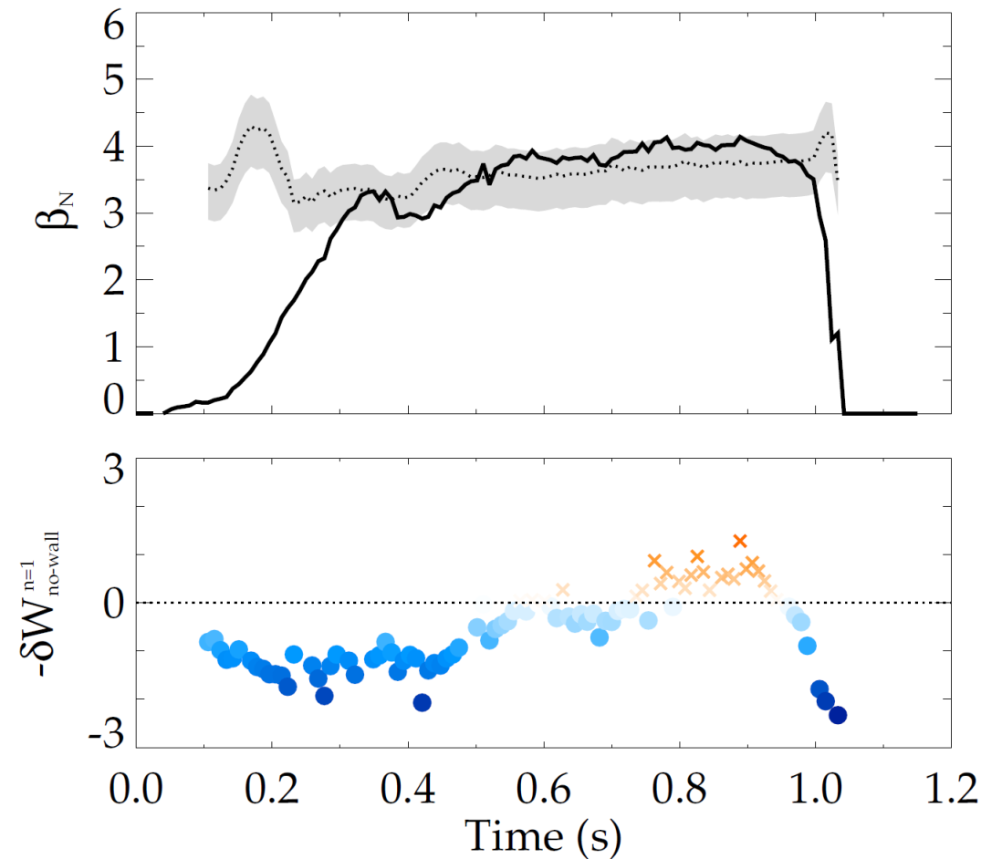
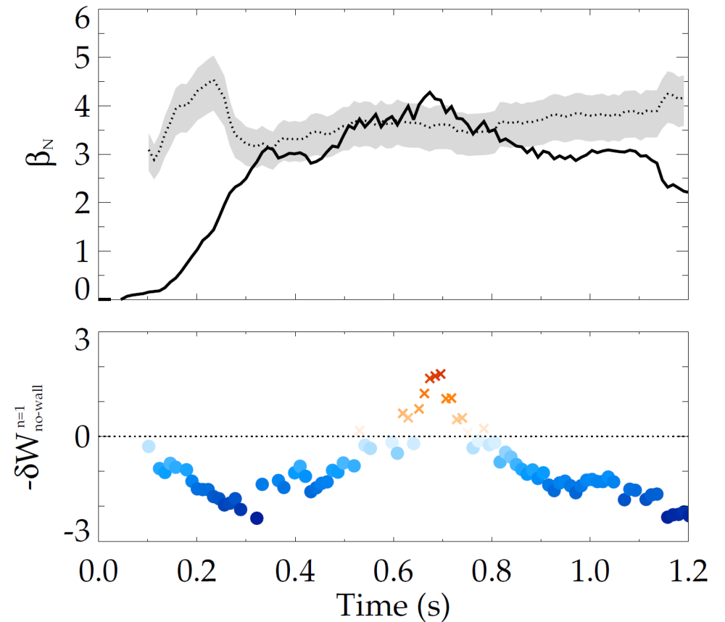
DCON confirms NSTX-U above the no-wall limit;
NSTX-based model gives good estimate
NSTX-U H-mode discharges: 204112
204118 (April 2016)
Composite no-wall limit model
Composite no-wall limit model
DCON
DCON
Above no-wall limit
Above no-wall limit
Below
Below
J.W. Berkery, S.A. Sabbagh (Columbia University)
NSTX no-wall limit model ([J.W. Berkery et al., Nucl. Fusion 55, 123007 (2015)]) includes internal inductance, pressure peaking, and aspect ratio, predicts NSTX-U DCON no-wall limit

Slide 14
Low-l_{i} scenario exhibited low repeatability
A number of low-l_{i} scenario shots end ~0.3s with q*/q_{min} < 1
  q* = ε(1+κ²)πaB_{T0}/μ₀I_{p}
  Ratio less than one indicates very little q shear
  Almost all low-li scenarios use NBI: 1C, 1B and 2A
  Evolution very sensitive to L-H timing, density
Future: increase κ to raise edge q in rampup

Slide 15
Wall conditioning & control development
H-mode development XMPs were run immediately following full-bottle boronizations
  First 1-3 shots following boronization had Type-III ELMs
  Oxygen steadily rises with each full-power discharge
  First two times this was done: the L-H transition became less dependable by the end of the day (~ 20 full power shots)
  Final time, the L-H transition was reliable at the end of the day
    Increased P_{NBI} prior to transition from 4 to 5 MW
  Final week, started ¼ bottle evening boronizations
    Looks viable to support ½ day H-mode experiments
X-point and d_{rsep} control integrated into a mid-l_{i} H-mode scenario
  Valuable tool for easier shape changes, dependable timing of diverting and L-H transition

Slide 16
Summary
Over the three weeks of operations in March-April:
  Demonstrated repeatability of “mid-l_{i}” scenario
    Used this scenario to integrate improved shape control
  Developed “low-l_{i}” scenario
    Reduced early MHD and lower l_{i} is attractive
    Required improved EFC to get past ~ 0.5s
    Shot was difficult to repeat … source of operational limit is now established and motivates path for future shot development
  Established boronization scheme for the near-term while conditioning the inner divertor plate
H-mode scenario development will next focus on operations over a range of I_{p}, B_{T}
  Demonstrate robust operation with mid-l_{i} scenario and improved control at B_{T} = 0.65T over a range of I_{P}
  Develop target H-mode scenarios at B_{T} < 0.65T
  Continue development of low-l_{i} scenario at B_{T} = 0.65T

Slide 17
Backup

Slide 18
Three operational limits observed
(Dataset using first version of Low-β EFC)
Database of EFIT02 equilibriums, P_{NBI} > 2 MW, n_{e,edge} > 10¹³ cm⁻³
High l_{i}
Mid l_{i}
Low l_{i}
Green points near F_{p} limit
Blue points exceed β_{N}/l_{i} limit
Orange points exceed
q*/q_{min} limit

Slide 19
Modes appear when β_{N}/l_{i} ~ 4.5
β_{N}/l_{i} = 6 5 4
203653
(example of an ELM-free shot that transiently gets to large β_{N}/l_{i})
203655
203679
L-H timing

Slide 20
Crossing q₀=2 at β_{N}/l_{i} > 4.5 leads to a disruption
Shots before 204061
204049
203971
203989 no data

Slide 21
XMP-142 Goals and progress …
Develop a repeatable ELMy H-mode discharge
  Done, in a sense, with operations on Monday, March 28
  Shots repeated well until timing of switch in shape control
  However, we want a fiducial that incorporates these later developments …
Introduce drsep and X-point control
  Completed on Thursday-Friday of final week, but not integrated with preferred front end
  Still needs some tuning of diverting shape and inner gap evolution
Increase ELM frequency via higher NBI heating
  This was good, produced our best shots
Lengthen period of reduced MHD using changes to the front end evolution
  Progress: low-l_{i} scenario developed (but exploration will never be really done)
Assess impact of fueling sources, beam order
  Progress: established minimum fueling requirements, optimum HFS gas timing
Develop H-mode fiducial over range of I_{p}
Develop H-mode fiducial for lower B_{t}
  Not done, although we have a few good shots that span I_{p} = 0.8 – 1 MA
  Breakdown and rampup viable for I_{OH} = 8kA precharge down to 0.35T

Slide 22
Operations following 203679 indicated inner divertor needed conditioning
Shot 203679 was the first shot to put considerable power on the inner divertor
  The next five shots failed to get an H-mode transition
  Blamed on elevated oxygen, radiated power signals
One element of
XMP-142 is to
condition lower inner
divertor target to
achieve repeatable
discharges

