Slide 1
Measurement of the NTV offset rotation profile in KSTAR
S.A. Sabbagh¹, Y.-S. Park¹, J.Y. Kim², W. Ko², K.C. Shaing³, Y.S. Bae², J.G. Bak², J. Chung², S.H. Hahn², Y. In², Y. Jeon², J.H. Kim², J. Ko², J.G. Kwak², S.G. Lee², Y.K. Oh², H.K. Park⁴, J.K. Park⁵, S.W. Yoon²
¹Department of Applied Physics, Columbia University, New York, NY, USA
²National Fusion Research Institute, Daejeon, Korea
³National Cheng Kung University, Tainan, Taiwan
⁴UNIST, Ulsan, Korea
⁵Princeton Plasma Physics Laboratory, Princeton, NJ, USA
presented at the
NSTX-U Physics Meeting
PPPL
September 12th, 2016
Princeton, NJ
(Supported by U.S. DOE grant DE-FG02-99ER54524)
V1.4

Slide 2
Overview Outline of this Talk
Two parts to this talk
  Main part: (Very) recent measurement of NTV offset rotation profile in KSTAR
  Second separate result: NTV rotation braking with global n = 1, non-pitch-aligned 3D field

Slide 3
The NTV Offset Rotation Profile was recently directly measured in KSTAR
Motivation
  Plasma rotation highly important for tokamak stability and confinement
  Future fusion devices are envisioned to have far less momentum input
  ➔ If sufficiently strong, this rotation could provide stabilization and improved performance in ITER and future devices
Outline
  Goal 1: Use an innovative technique to measure the NTV offset rotation profile on KSTAR for the first time - COMPLETED
    NTV offset V_{φ} profile directly measured
  Goal 2: Use new counter-I_{p} target plasma to measure the NTV offset rotation profile on KSTAR – TO BE DONE
    Reverse-I_{p} target plasma under development by Jay Kim

Slide 4
Present experiment directly measured the V_{0-NTV} profile with no NBI momentum
What did we do?
  Used ECH for plasma heating, avoided issues of strong NBI torque
  Measured intrinsic rotation using NBI as a diagnostic beam for CES
Issues related to experiments with NBI torque
  T_{NBI} term in torque balance
    Is computed, not directly measured
    Is typically much larger than the T_{NTV} component due to offset rotation ➔analysis is prone to error
    The profile of T_{NBI} matters – not just zero net input torque from NBI
Companion experiment to proposed NSTX-U experiment
  Original, approved proposal XP1062 for NSTX using HHFW (2010 !)
  Proposal “NTV steady-state offset velocity at reduced torque with HHFW” submitted to NSTX-U Research Forum (2015)

Slide 5
Intrinsic Torque due to Neoclassical Toroidal Viscosity (NTV) – a controllable momentum source
(K.C. Shaing, K. Ida, S.A. Sabbagh, Nucl. Fusion 55 (2015) 125001)
(Y. Sun, K. Liang, K.C. Shaing, et al. Nucl. Fusion 51 (2011) 053015)
Full Theory
  The non-ambipolar difference of ion and electron flux due to the application 3D fields yields a so-called “offset rotation profile”, V_{0-NTV}
  Generally, the local rotation speed can be either in the co- or counter-I_{p} direction if dominated by electron/ion flux, respectively
    The electron effect is ignored in most papers on the topic
Highly Simplified Theory
  Consider a highly simplified theory to help understand characteristics
  Simplified NTV torque profile: T_{NTV} = C₁ δB² (V_{φ} – V_{0-NTV})
  Simplified V_{0-NTV} profile: V_{0-NTV} = C₂ dT_{i}/dr – C₃ dT_{e}/dr (for future analysis)
    Electron effects can dominate at low collisionality – important for ITER
  Unlike “intrinsic rotation”, the T_{NTV} can be controlled by the applied 3D field spectrum and strength

Slide 6
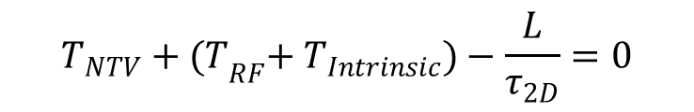
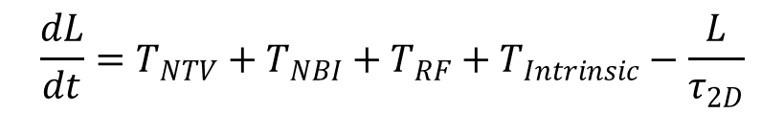


Consider simple torque balance equation to further understand expected dynamics (I)
$$\frac{dL}{dt}=T_{NTV}+T_{NBI}+T_{RF}+T_{Intrinsic}−\frac{L}{τ_{2D}}$$
Simple torque balance
Consider equations with/without 3D field (in steady-state)
Use simple NTV model to express offset rotation
(e.g. W. Solomon, et al., Phys. Plasmas 17 (2010) 056108, Equation 8)
$$T_{NTV}+{(T}_{RF}+{ T}_{Intrinsic})−\frac{L}{τ_{2D}}=0$$
(with 3D field ➔ L ➔ IV/R)
$${(T}_{RF}+{ T}_{Intrinsic})−\frac{L(0)}{τ_{2D}}=0$$
(without 3D field ➔ L(0) ➔ IV_{I}/R)
$${T_{NTV}=C}_{1}δB^{2}{(V_{∅}−V}_{0−NTV})$$

Slide 7
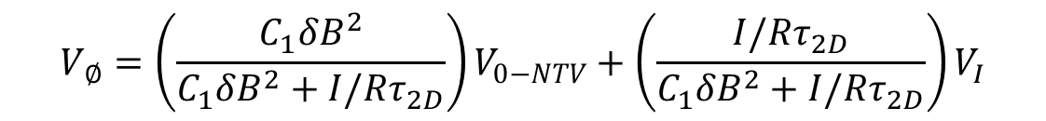
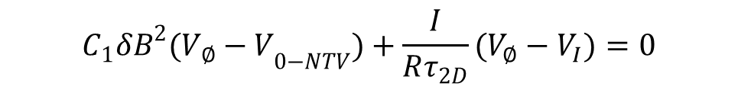
Consider simple torque balance equation to further understand expected dynamics (II)
Combine equations
  Assume (T_{RF} + T_{intrinsic}) not function of 3D field; use simple T_{NTV} model
Expected dynamics
    δB = 0: V_{φ} = V_{I}
    low δB: measured V_{φ} profile close to V_{I}
    increased δB and (|V_{φ}| >> |V_{0-NTV}|): V_{φ} ➔ V_{0-NTV}
    sufficiently high δB: V_{φ} saturates to V_{0-NTV}
$$C_{1}δB^{2}{(V_{∅}−V}_{0−NTV})+\frac{I}{Rτ_{2D}}(V_{∅}−V_{I})=0$$
- (V_{I} is the toroidal velocity measured without 3D field applied)
- I ➔ moment of inertia
$${V_{∅}=\left(\frac{C_{1}δB^{2}}{C_{1}δB^{2}+I/Rτ_{2D}}\right)V}_{0−NTV}+{\left(\frac{I/Rτ_{2D}}{C_{1}δB^{2}+I/Rτ_{2D}}\right)V}_{I}$$
(on each ψ surface)
a)
V_{I}
b)
V_{φ}
c)
d)
V_{0-NTV}
δB

Slide 8
Technique to measure NTV offset V_{φ} profile
Measure here
140 GHz ECH
(core deposition)
Ip (MA)
ECH
ECH
NBI A
NBI B (and add C if needed by CES)
t(s)
2.8s
6.3s
Ip (MA)
4.0 kA
3D
field
2.8 kA
t(s)
Brief summary of success (~ 10s long pulses)
  NBI used as diagnostic worked well – CES has good data – V_{φ} profile measured
  n = 2 field varied – scans with and without density feedback
    Without density feedback: 2.0, 2.8, 3.2, 4.0 kA/turn
    With density feedback: (at least) 1.0, 2.0, 2.4, 2.8, 3.2, 4.0 (δB² factor of 16 change)
  Clear changes to CES measured V_{φ} evolution due to varied n = 2 field strength

Slide 9
Results from first time point measured (2.8s)

Slide 10
Two techniques were used to measure the rotation profile approaching V_{0-NTV}
CES rotation profile extrapolated back to start of NBI
  Involves an extrapolation 10 - 20 ms earlier in time
  similar to technique used by Podesta on NSTX (2009) to measure intrinsic rotation in HHFW plasmas
CES rotation profile analysis re-analyzed to the earliest possible time after the start of NBI
The best technique to use is still being evaluated
  CES was re-analyzed just a few days ago
  Results are qualitatively similar, exact rotation values change a bit
  Will show results from both techniques

Slide 11
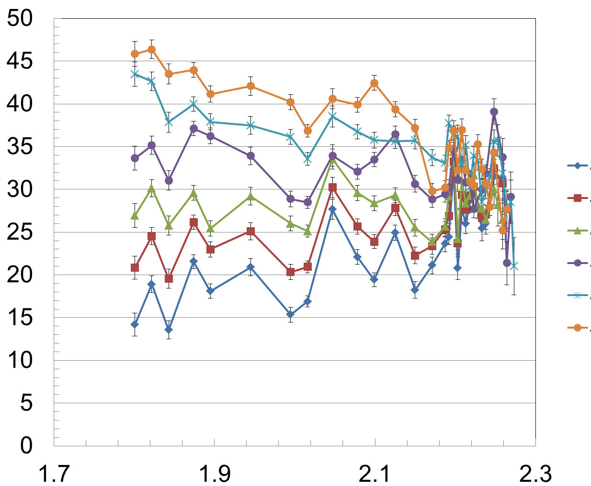
Analysis of CES data and NBI diagnostic technique measures intrinsic V_{φ} from ECH
Co-NBI spinup
t = 2.805s (extrapolated)
V_{φ} (km/s)
t = 2.815s (extrapolated)
t = 2.825s
t = 2.835s
t = 2.845s
t = 2.855s
Intrinsic rotation profile at t_{NBI} = 0
16317
R (m)
The excellent (low error) KSTAR CES diagnostic required for this analysis

Slide 12
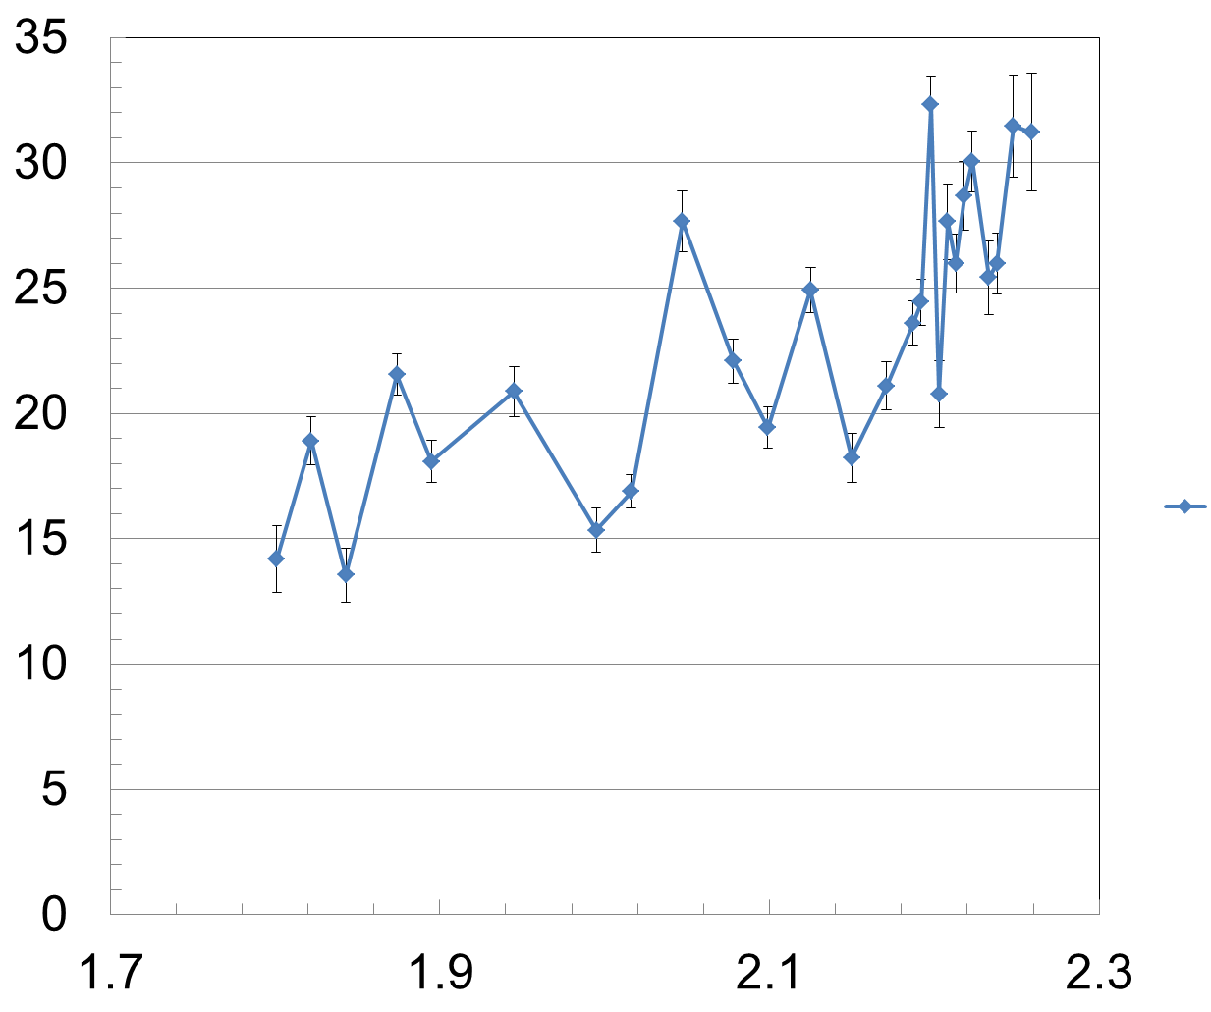
Condition a): the intrinsic V_{φ} from ECH establishes our δB = 0 reference V_{φ} profile
Intrinsic rotation profile δB = 0
V_{φ} (km/s)
t = 2.805s (extrapolated)
16317
R (m)
Note: core rotation speed is FAR slower than with NBI (by ~ factor 5 - 10)

Slide 13
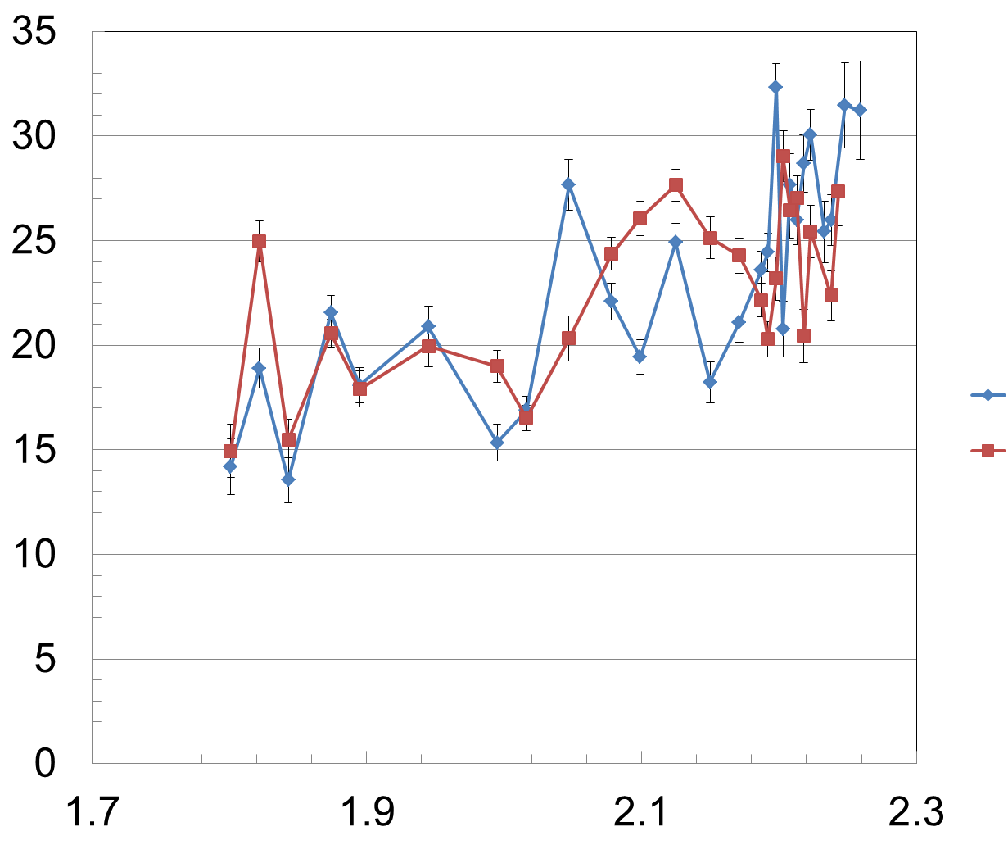
Condition b): at 1.0 kA/turn, δB is small and V_{φ} is close to the V_{φ} with no 3D field
Intrinsic rotation profile δB = 0
V_{φ} (km/s)
Shot (IVCC current (kA/turn))
16317 (0.0)
16313 (1.0)
t = 2.805s
R (m)

Slide 14
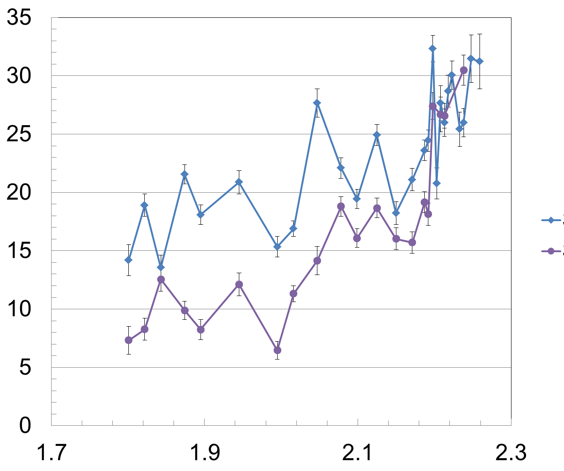
Condition c): at 2.4 kA/turn, δB is sufficiently large to make V_{φ} approach V_{0-NTV}
    Clear change in rotation profile
    Velocity increases on outer surfaces
Intrinsic rotation profile δB = 0
V_{φ} (km/s)
Shot (IVCC current (kA/turn))
16317 (0.0)
16314 (2.4)
t = 2.805s
R (m)

Slide 15
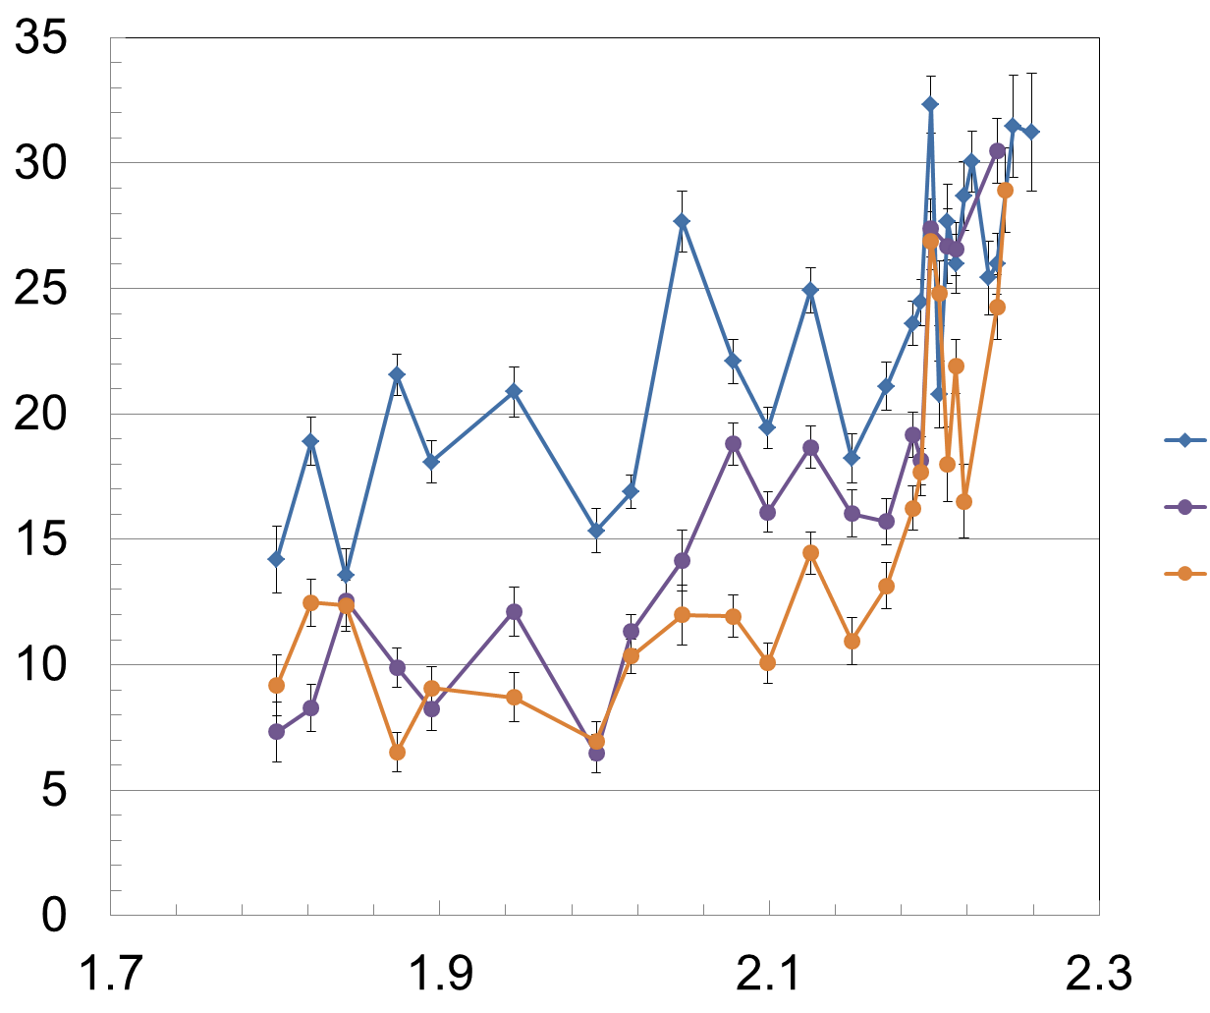
Condition d): at 3.2 kA/turn, δB is sufficiently large to make V_{φ} saturate to V_{0-NTV} in the core
Intrinsic rotation profile δB = 0
Shot (IVCC current (kA/turn))
V_{φ} (km/s)
16317 (0.0)
16314 (2.4)
16315 (3.2)
t = 2.805s
R (m)

Slide 16
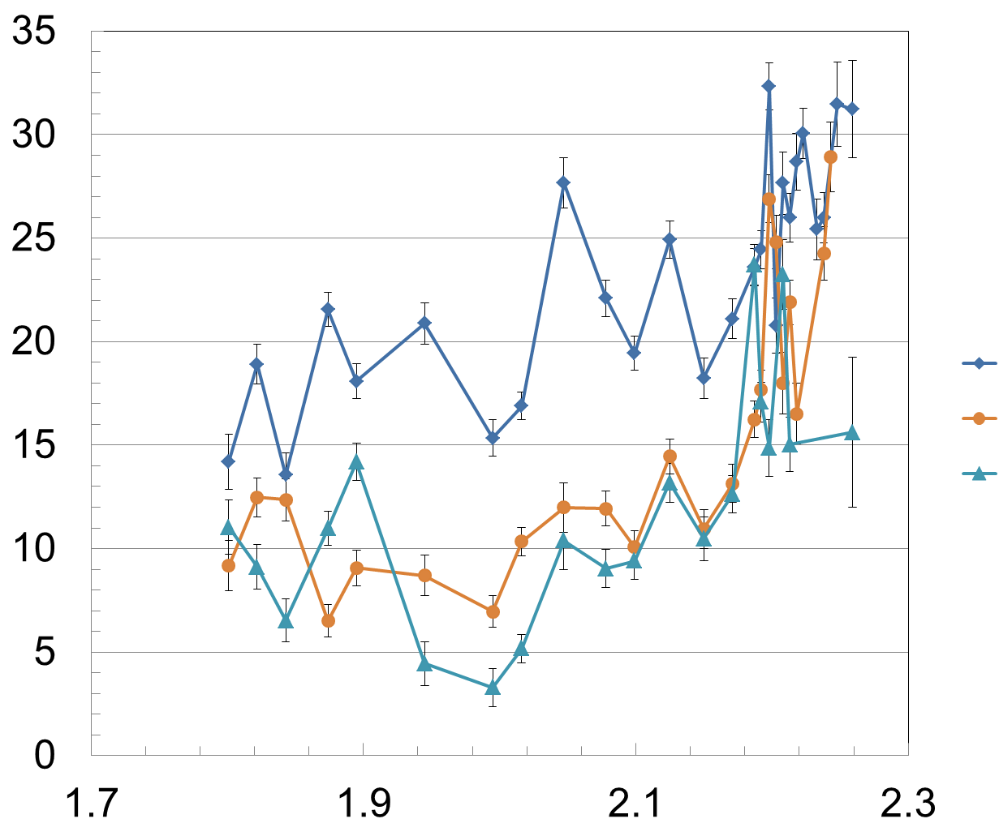
Condition d): at 4.0 kA/turn, δB sufficiently large to make V_{φ} saturate to V_{0-NTV} in core+outer region
Intrinsic rotation profile δB = 0
Shot (IVCC current (kA/turn))
V_{φ} (km/s)
16317 (0.0)
16315 (3.2)
16316 (4.0)
t = 2.805s
R (m)
The saturated rotation profile ➔ V_{0-NTV}

Slide 17
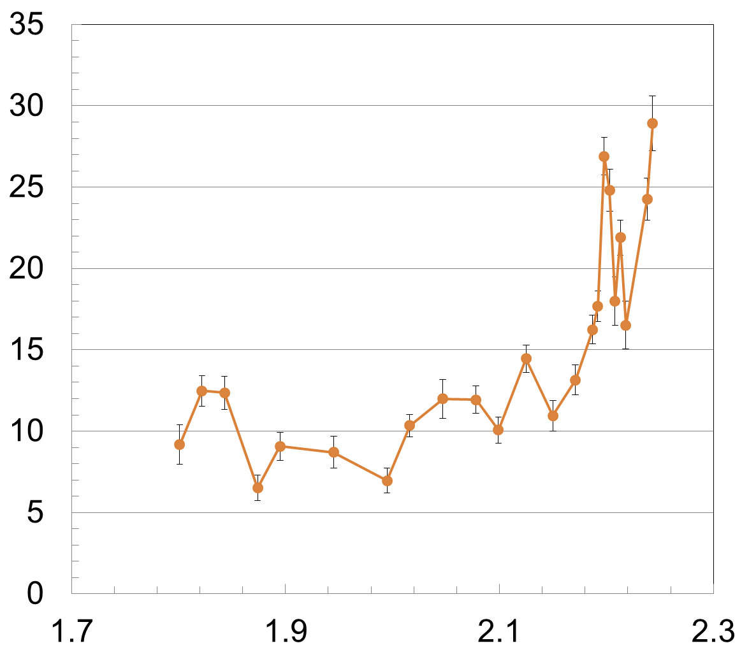
Unique result: resulting saturated V_{0-NTV} profile is in the co-Ip direction – electron NTV dominates
Measured V_{0-NTV} profile
Consistent w/theory: The ratio of ion to electron NTV torque is (T_{i}/T_{e})^{3.5}(M_{i}/M_{e})^{0.5}=0.15
  electron NTV offset should dominate
  theory expects V_{0-NTV} in the CO-I_{p} direction
First time that
  NTV offset profile directly measured
  NTV measured in the co-I_{p} direction
Notably strong velocity shear in outer region
V_{φ} (km/s)
Co-Ip direction
16315, t = 2.805s
R (m)

Slide 18
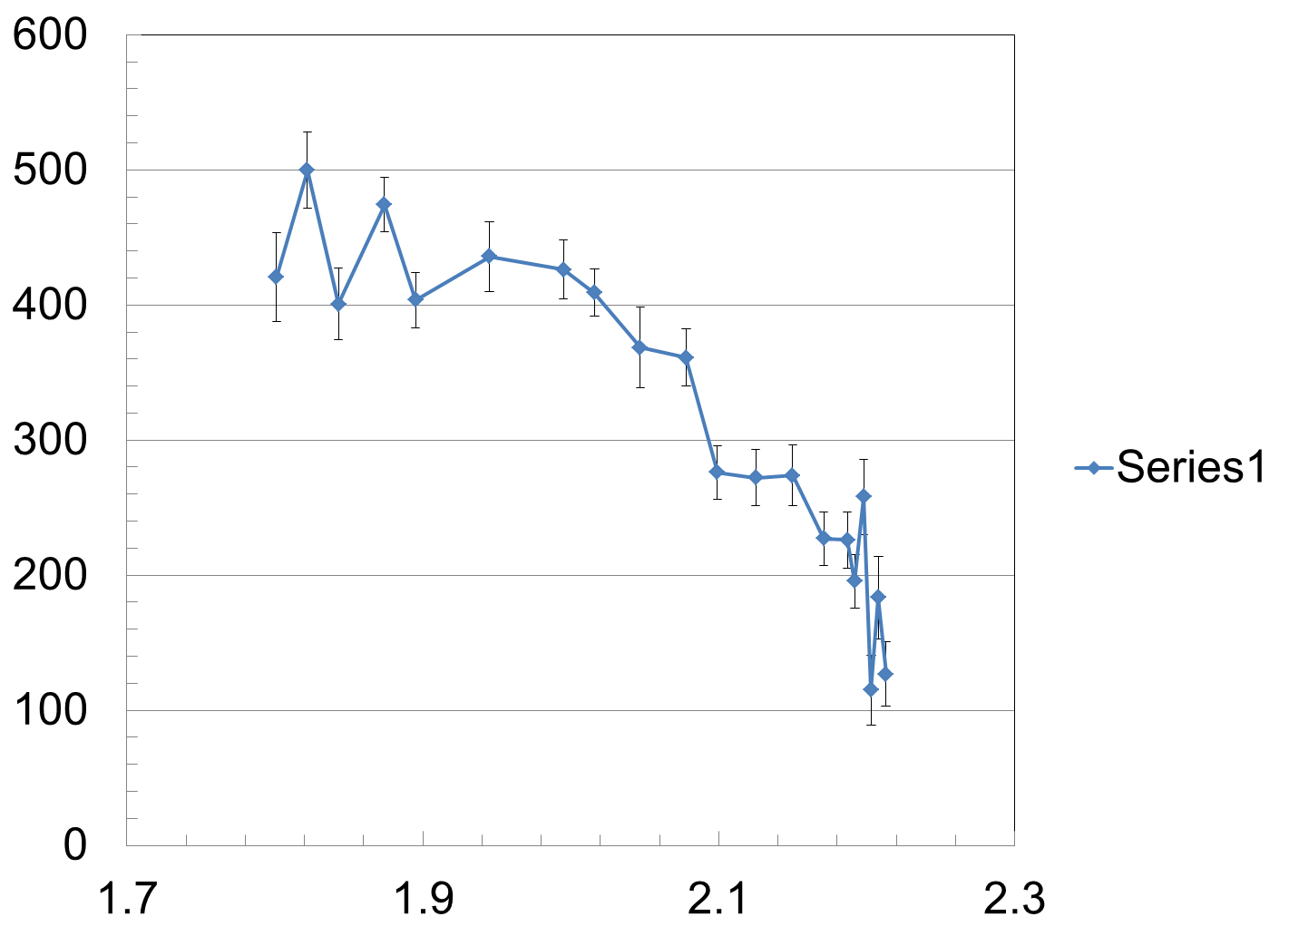
Comparison of V_{0-NTV} profile to gradient in T profile shows a correlation: T_{i} profile
Measured T_{i} profile (CES)
T_{i} (eV)
Strong ∇T_{i}
Weaker T_{i} gradient in the core ➔ weak V_{0-NTV}
Stronger T_{i} gradient further out ➔ stronger V_{0-NTV}
16316, t = 2.825s
Measured V_{0-NTV} profile
V_{φ} (km/s)
16315, t = 2.805s
R (m)

Slide 19
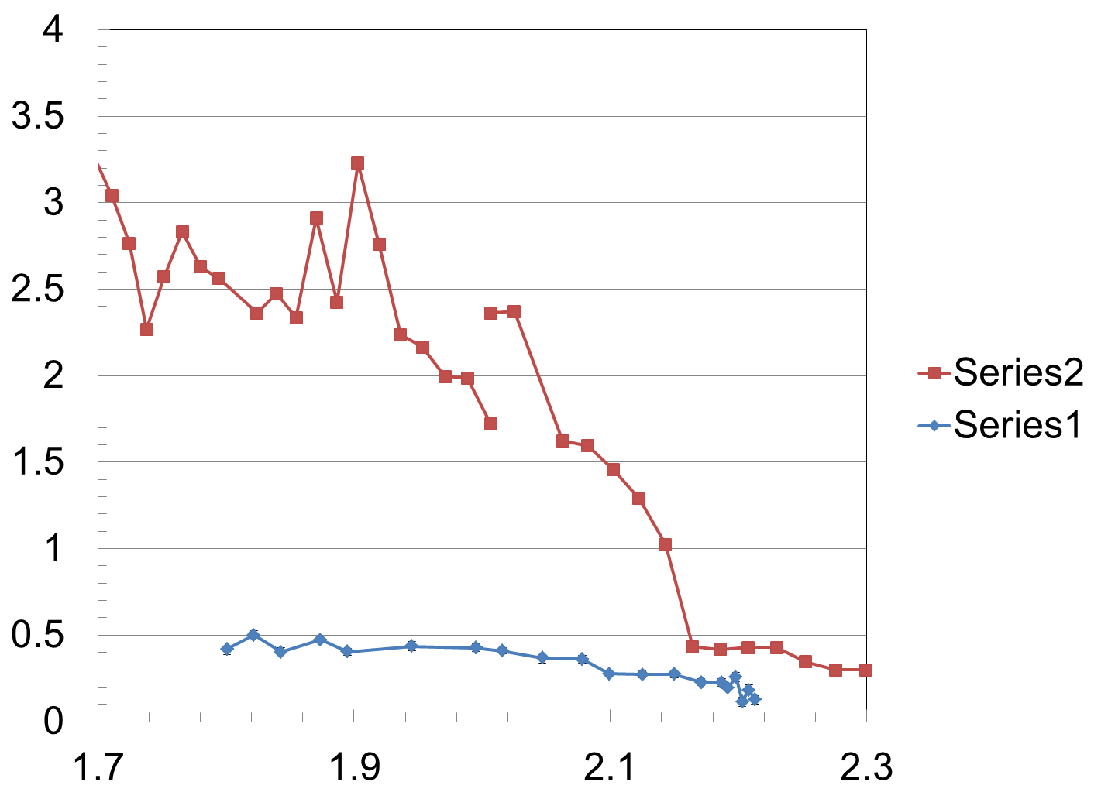
Comparison of V_{0-NTV} profile to gradient in T_{e} profile requires further analysis
T_{e} profile (ECE)
16316, t = 2.80s
T (keV)
T_{e} is about 5 times larger than than T_{i}
Stronger T_{e} gradient seems to be inside stronger V_{0-NTV} region
  Need to check the ECE mapping to R
T_{i} profile (CES)
16316, t = 2.825s
Measured V_{0-NTV} profile
V_{φ} (km/s)
16315, t = 2.805s
R (m)

Slide 20
Results from second time point measured (6.3s)

Slide 21
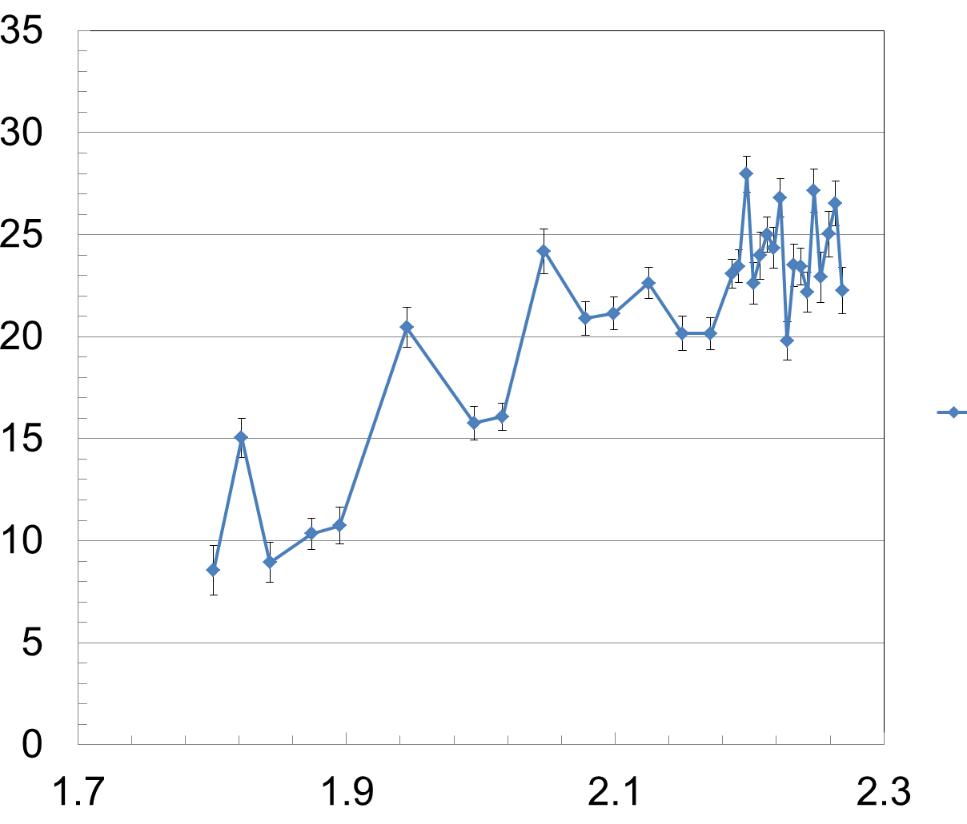
Condition a): the intrinsic V_{φ} from ECH establishes our δB = 0 reference V_{φ} profile
Intrinsic rotation profile δB = 0
V_{φ} (km/s)
t = 6.305s
(CES re-analysis)
16317
R (m)

Slide 22
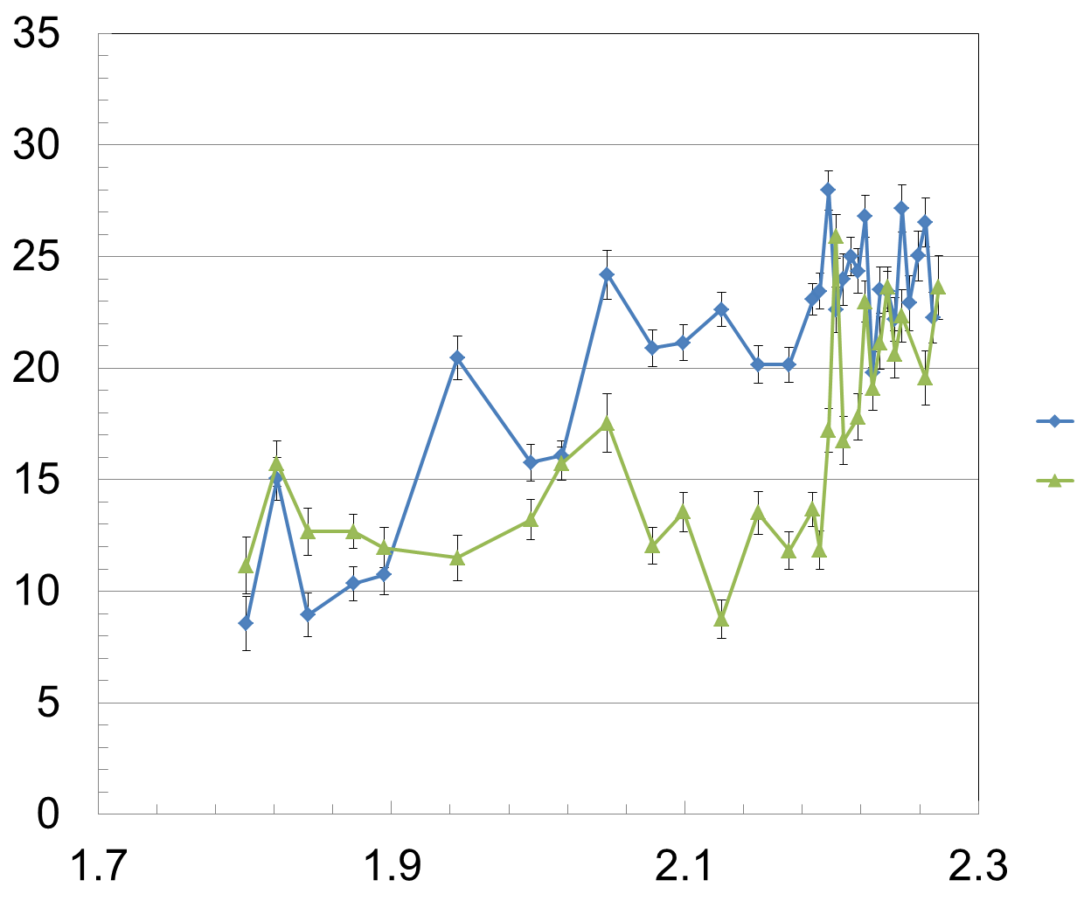
Condition b): at 1.0 kA/turn, δB accelerates the core a small amount, slows further out
Intrinsic rotation profile δB = 0
V_{φ} (km/s)
Shot (IVCC current (kA/turn))
16317 (0.0)
16315 (1.0)
t = 6.305s
R (m)

Slide 23
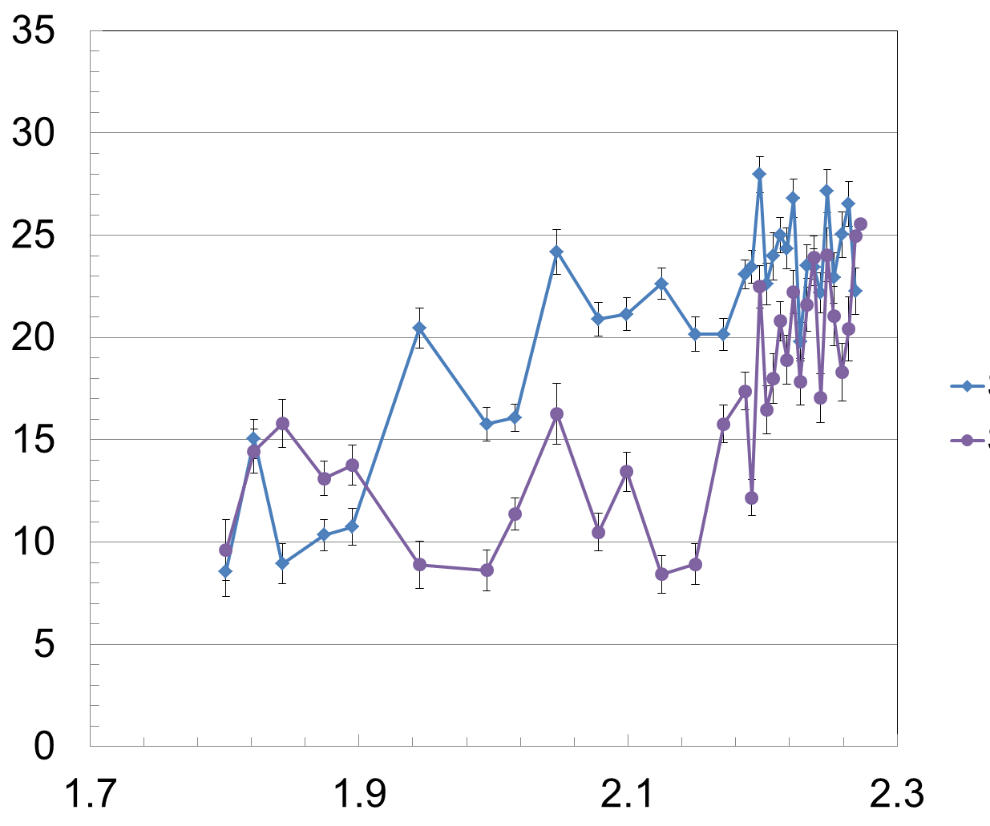
Condition c): at 1.6 kA/turn, core continues to accelerate, while plasma further out slows
Intrinsic rotation profile δB = 0
V_{φ} (km/s)
Shot (IVCC current (kA/turn))
16317 (0.0)
16314 (1.6)
t = 6.305s
R (m)

Slide 24
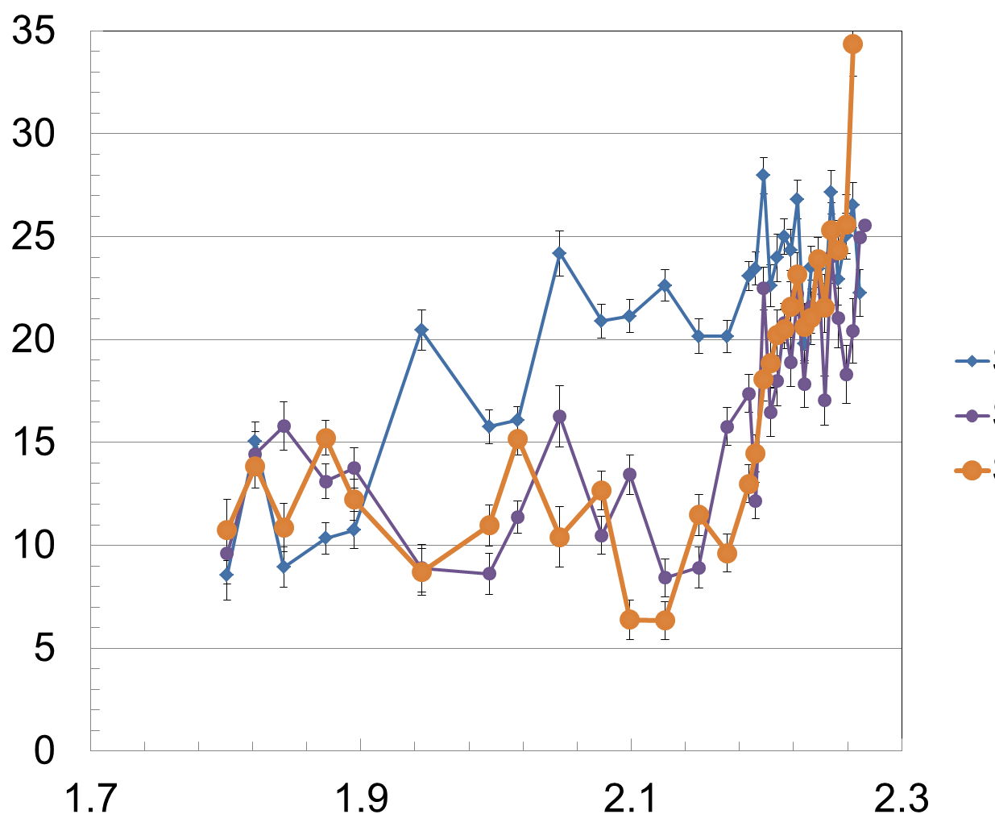
Condition d): at 2.4 kA/turn, profile is largely saturated, stronger V_{φ} shear forms at large R
Intrinsic rotation profile δB = 0
Shot (IVCC current (kA/turn))
V_{φ} (km/s)
16317 (0.0)
16314 (1.6)
16313 (2.4)
t = 6.305s
R (m)

Slide 25
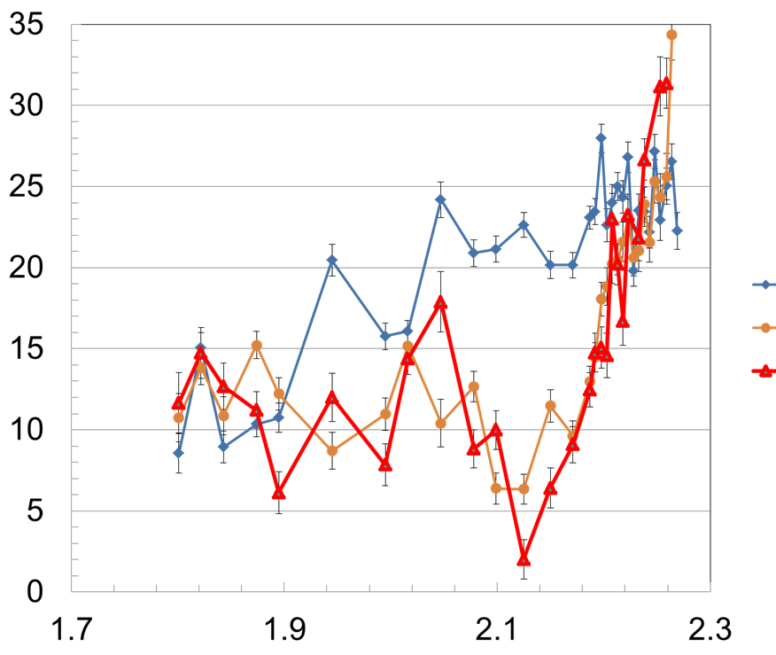
Condition d): at 3.2 kA/turn, much stronger V_{φ} shear at large R is confirmed
Intrinsic rotation profile δB = 0
Shot (IVCC current (kA/turn))
V_{φ} (km/s)
16317 (0.0)
16313 (2.4)
16312 (3.2)
Average shear (R > 2.14m)
    V⁻¹(dV/dr) (ECH) = 1.1 m⁻¹
    V⁻¹(dV/dr) (V_{0-NTV}) = 15.4m⁻¹
t = 6.305s
R (m)
15 times greater shear !

Slide 26
Why are the present results unique and important?
Why unique?
  First time that V_{0-NTV} profile has been directly measured w/ T_{NBI} = 0
  First time V_{0-NTV} has been measured dominated by electron effects
    V_{0-NTV} profile measured in the co-I_{p} direction for the first time
Why important?
  Co-I_{p} directed V_{0-NTV} can be higher than ECH-induced co-I_{p} rotation in edge region
  Rotation shear in the outer plasma region is 15 times stronger than rotation shear due to ECH
ITER relevant: |V_{0-NTV}| is strong compared to ITER modeling
  ITER 15 MA simulations: Ω_{φ} ~ 2 krad/s in edge region
  Recent KSTAR experiment: Ω_{φ} > 12 krad/s in edge region (scaling?)
  Potential to greatly increase rotation shear in outer plasma region

Slide 27
Several next-steps to address regarding V_{0-NTV} understanding
Perform non-linear least squares fit of V_{φ} vs. δB² (at each R)
  This will quantitatively determine how close measured V_{φ} is to V_{0-NTV}
V_{0-NTV} profile scaling with plasma parameters
  Data from present experiment may provide some answers
V_{0-NTV} profile comparison to theory – including electron effects
  All known experimental publications only consider V_{0-NTV} ~ d(Ti)/dr
Comparison of present results to ohmic intrinsic rotation
  Results published by S.G. Lee, et al.
Run second part of experiment using reversed-I_{p} plasma

Slide 28
STEP 2: Use Counter-Ip to measure NTV offset V profile
Step 1 (Completed)
NBI
0.75s steps
0.75s steps
0.75s steps
Measurement here
Ip (MA)
NBI source C
ECH
NBI source B
NBI source A
t(s)
NBI dropouts for CES (as needed)
Ip (MA)
4.0 kA
3D
field
t(s)
Set-up Target Plasma Shots
  For counter-Ip shot (2016) 15884: Bt = 2.3T, Ip = 0.51 MA, q95 = 6, Ip flattop = 1s - 7s; ECH set for BEST OUTER HEATING
Setup for IVCC 3D fields
  Step 2B: Start with IVCC = 4.0 kA (n = 2 midplane coils ONLY - like FIRST STEP of shots 13433 or 13446 )
  Step 2D: Start with IVCC = 4.0 kA (n = 2 midplane + n = 1 non-pitch-aligned (0 deg) - like FIRST STEP of shot 13436 )

Slide 29
  Second separate result: NTV rotation braking with global n = 1, non-pitch-aligned 3D field

Slide 30
STEP 3: Isolate NTV torque profile using fast IPS (I)
n = 2 mid
(4.5s duration)
n = 1: 0 deg
(4.5s duration)
n = 1: 180 deg
(4.5s duration)
Attempt two or three IVCC levels per spectrum; attempt three spectra / shot if pulse allows
0.75s steps
0.75s steps
0.75s steps
A
Ip (MA)
NBI
t(s)
NBI dropouts for CES (~ 0.66 Hz)
B
n = 1: 0 deg
(4.5s duration)
n = 1: 180 deg
(4.5s duration)
n = 2 mid
(4.5s duration)
Ip (MA)
NBI
t(s)
NBI dropouts for CES (~ 0.66 Hz)
Set-up Shots
  (2016) Target 15778 (Bt = 1.8T); (2015) Target plasmas 13302 (Bt = 2.0T), 13433 (Bt = 2.6T), 13446 (Bt = 1.8T)
Setup shots for IVCC timing
  Vary applied field magnitude and spectrum (2 or three steps using n = 2 midplane; n = 1 non-pitch-aligned; n = 1 pitch-aligned ➔ shots 13433 , 13446
  Take second shot, changing the order of the IVCC current steps ➔ shots 13434
A
B

Slide 31
STEP 3: Isolate NTV torque profile using fast IPS (II)
n = 2 mid, n = 1, 0 deg (non-pitch-align)
(4.5s duration)
n = 2 mid, n = 1, 180 deg (pitch align)
(4.5s duration)
n = 2 mid, n = 1, 0 deg (non-pitch-align)
(4.5s duration)
Attempt two or three IVCC levels per spectrum; attempt three spectra / shot if pulse allows
0.75s steps
0.75s steps
0.75s steps
Ac
Ip (MA)
NBI
t(s)
NBI dropouts for CES (~ 0.66 Hz)
Bc
Ip (MA)
NBI
t(s)
NBI dropouts for CES (~ 0.66 Hz)
Shots with COMBINED non-resonant field spectra (n = 2 + n =1 non-pitch-aligned)
  Vary applied field magnitude fixed combined spectrum (n = 2 midplane; n = 1 non-pitch-aligned: ➔ shots 13437, 13447
  Take second shot, changing the order of the IVCC current steps ➔ shots 13436
Ac
Bc

Slide 32
Important new results were ALSO found in “Step 3” of the experiment (7 shots)
Significantly stronger non-resonant n = 2 NTV braking was found compared to our 2015 experiment, apparently due to high plasma performance (T_{i})
The n = 1 non-pitch-aligned field spectrum – concluded last year to allow non-resonant braking – was found to disrupt the plasma this year
  Apparently due to higher T_{i} this year
  Hypothesis is that stronger non-resonant n = 1 breaking gives way to resonant 3D field penetration and locking
  Reduces confidence that n = 1 non-resonant field can be reliably used for core plasma rotation control

Slide 33
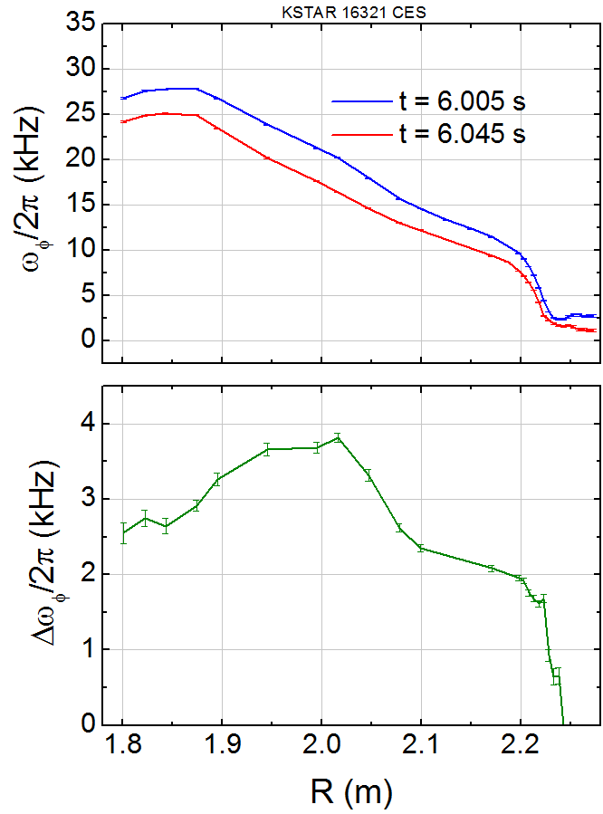
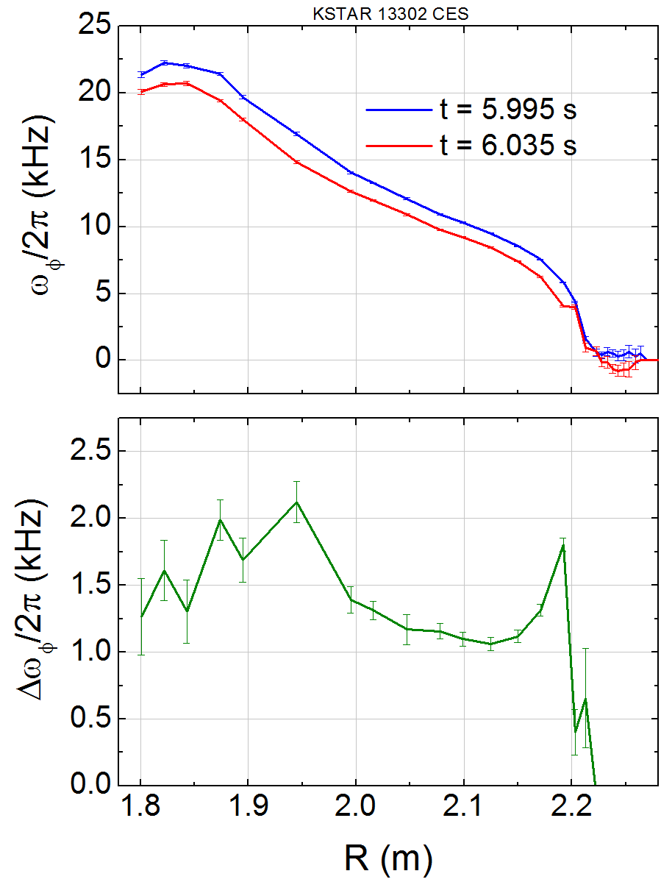
Stronger n = 2 non-resonant NTV in Monday’s experiment than in 2015
NTV n = 2 braking (2016)
NTV n = 2 braking (2015)
Note: scale change

Slide 34
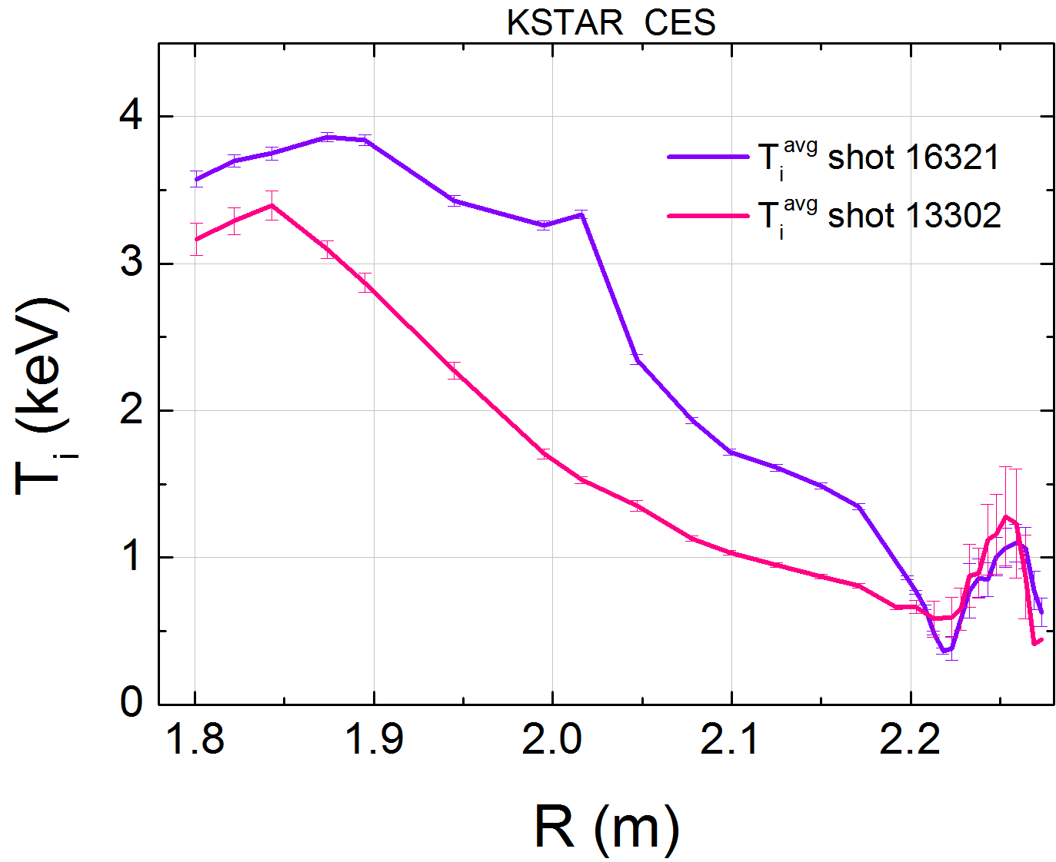
Stronger n = 2 non-resonant NTV during 2016 run apparently due to increased T_{i}
(2016)
(2015)
NTV torque in “1/ν” regime scales as T_{i}^{2.5}

Slide 35
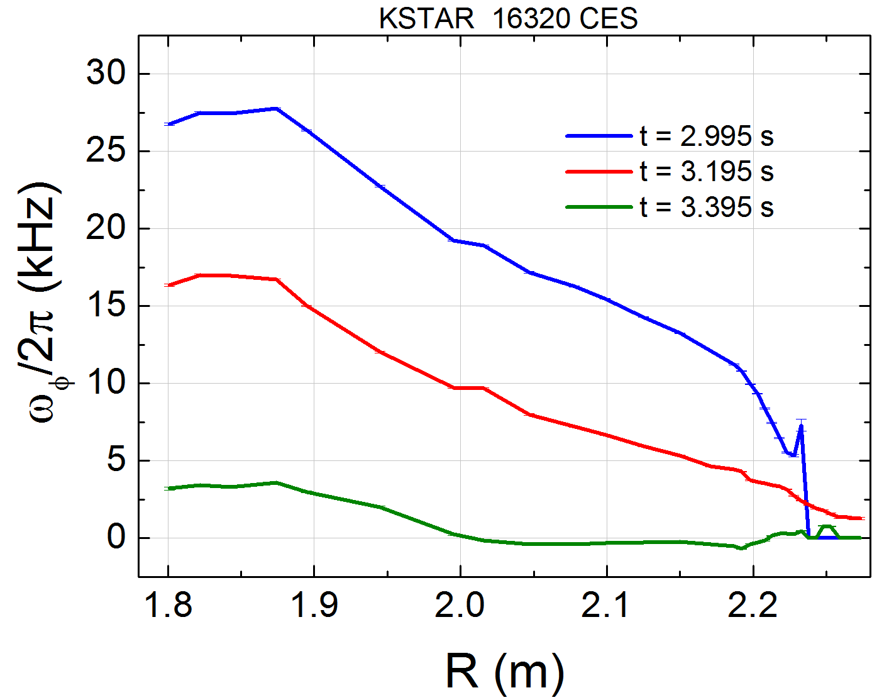
n = 1 non-pitch-aligned 3D field spectrum now apparently leads to resonant field penetration/locking
Before 3D field
Non-resonant
period
Profile locked
NTV braking appears non-resonant to start, but V_{φ} eventually bifurcates

Slide 36
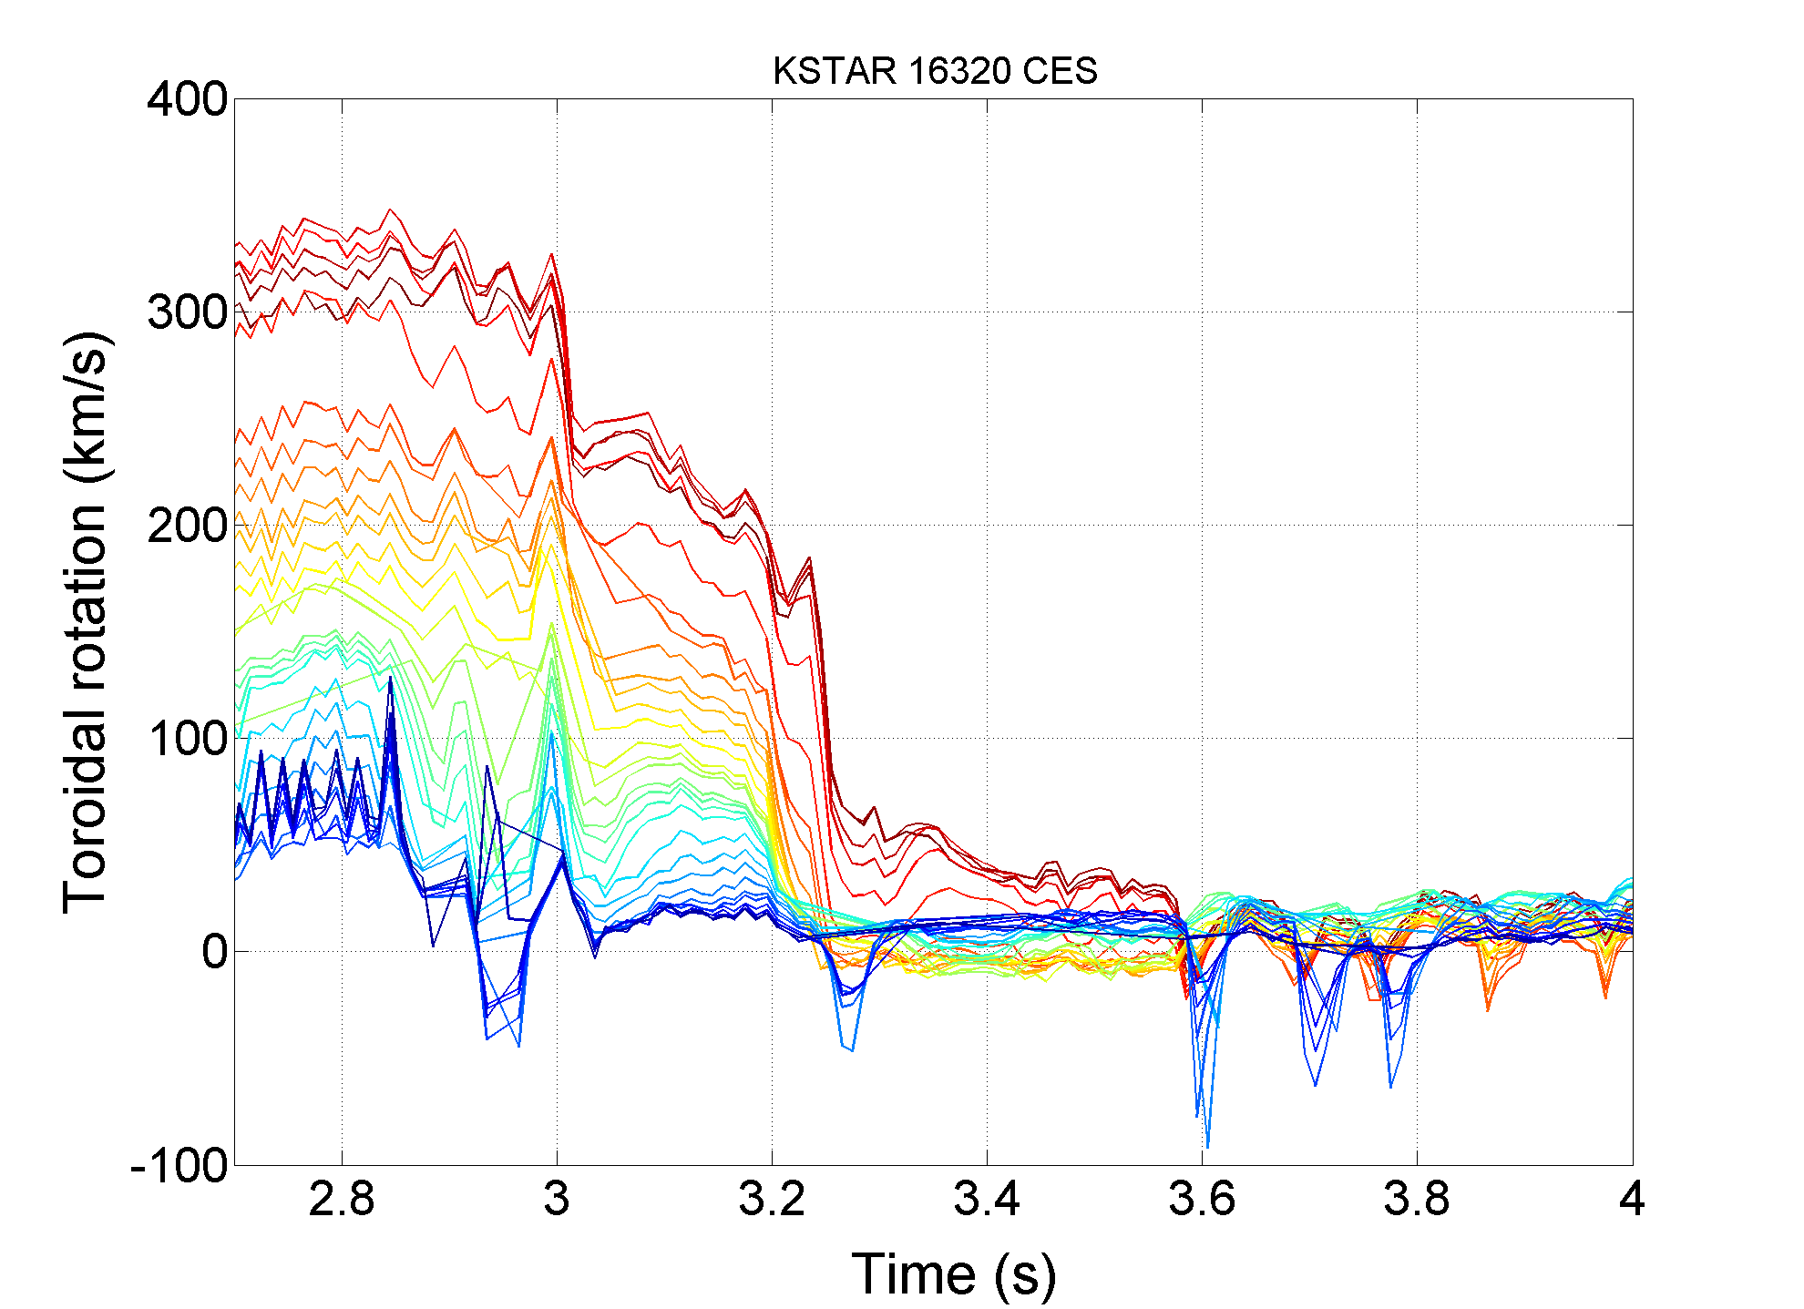
n = 1 non-pitch-aligned 3D field spectrum now apparently leads to resonant field penetration/locking
Non-resonant
period
Resonant field
Penetration/bifurcation
NTV braking appears non-resonant to start, but V_{φ} eventually bifurcates

Slide 37
Supporting slides follow

Slide 38
STEP 3: Long-pulse shots that need to be taken
  IVCC setup 13434 (type (B)), 13436 (type (Bc))
  IVCC setup 13443 (constant current steps)
  Divertor gas puffing – setup from shots: 13443 (0.6v), 13442 (0.7V)
B_{t} = 1.8 T
  Suggested 2016 target is 15778; reduce I_{p} to 0.5 from 0.6 MA and match Ip rise time of a shot like 13433, 13434
  Shots to take:
    type (B) (IVCC setup 13434), type (Bc) (IVCC setup 13436) (2 shots)
    NO divertor gas puff (constant IVCC steps like 13443) (1 shot)
    with divertor gas puff 0.6V (constant IVCC steps like 13443) (1 shot)
B_{t} = 2.0 T
  Shots to take: (Increase B_{t} = 2.0T from above)
    NO divertor gas puff (constant IVCC steps like 13443) (1 shot)
    with divertor gas puff 0.6V (constant IVCC steps like 13443) (1 shot)

Slide 39
MP2015-05-23-001 “Isolation of NTV torque profile” on KSTAR established isolated NTV profile using IPS capability
IVCC n = 2 configuration
n = 1 pitch non-aligned
n = 1 pitch aligned
Plasma rotation
Change in plasma rotation
(Y.S. Park, S.A. Sabbagh, Y. Jeon., et al., (approved by U.S. Committee for IAEA FEC 2016)
Results show non-resonant NTV characteristics; broad NTV torque profile
  Δω_{φ} does not change sign across profile (non-resonant); Δω_{φ} ~ 0 near plasma edge
  3D field spectrum varied: similar Δω_{φ} profiles, n = 1 pitch non-aligned has largest NTV
➔ Present experiment aims to create distinct NTV profiles ⬅ NOT enough time given for this

