Slide 1
NSTX-U Recovery Project Update NSTX-U Physics Meeting
S.P. Gerhardt
PPPL B318
7/10/17

Slide 2
Slide title
PPPL Extent of Condition Notable
Polar Region Update
Coil Updates
Tile Updates
Near-term Reviews

Slide 3
Now Finishing Up the Completion of the Extent of Condition Notable
Complete an extensive extent-of-condition review of NSTX-U to identify all design, construction, and operational issues. Prepare a corrective action plan (CAP) to include cost, schedule, scope, and technical specifications of actions. Provide an interim progress report by March 31, 2017, and complete the CAP review and send the final report to DOE by September 30, 2017.
We were given further guidance on the format of report, and asked to submit this report by 7/13/17
To be clear, this was all very positive
Many many intense meetings in the last ~3 weeks to improve our estimates of cost and scope for the Recover project.
Starting formal WAF (Work Authorization Form) review meetings this week.
Draft of report is in final review process, iterating within PPPL management.

Slide 4
Polar Region Update
Extent of Condition Committee strongly recommended:
Use of induction from either the TF or OH coil to heat the CS casing.
Elimination of both ceramic insulators.
Elimination of O-rings where possible in favor of welded lip seals.
PPPL seriously examined these recommendations.
Issues common to either heating case
Both coils have insulation system not typically deployed on continuous AC systems
Glass/kapton/resin (OH) or glass/resin (TF) not highly corona resistant.
Very large single-phase load…would mandate significant power supply work
For TF: 10 Hz, 1200 V pk-pk, 4.6 kA pk-pk
Low frequency needed to keep current out of bellows
In principle, could use a reconfigured transrex supply
For OH: 60 Hz, 5600 V pk-pk, 560 A pk-pk
Higher frequency required to contain heating to the CS
Would require dedicated new supply

Slide 5
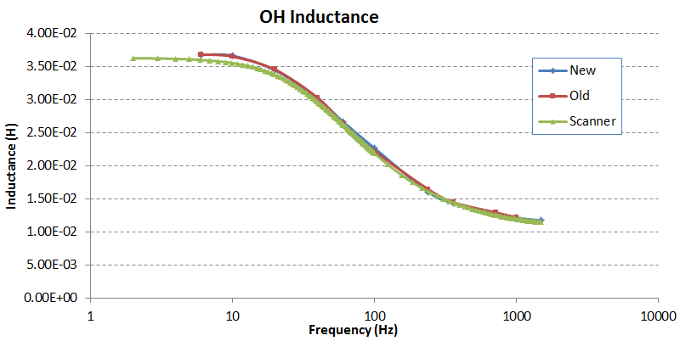
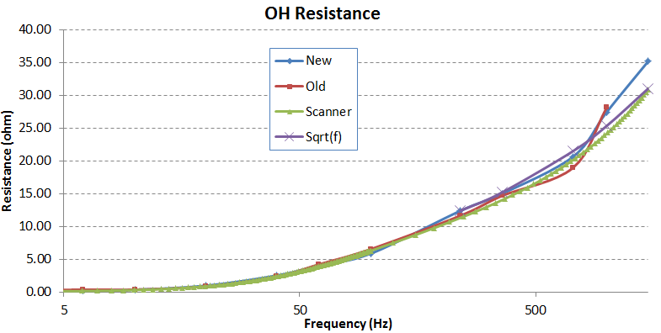
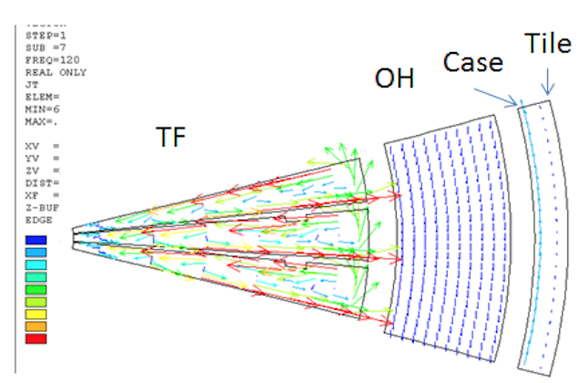
Polar Region Update
TF additional concerns:
Unintended parasitic heating of other loops.
Heating of the bellows:
>150 C bellows temperature rise predicted even with nearby shunts
Aquapour constraints
OH additional concerns:
Unintended parasitic heating of other loops, including PF-1 coil supports
Heating of the TF with OH induction
Final position recommended by PPPL:
Maintain a single insulator.
Advantages can be articulated for retaining either upper or lower; recommendation was to retain the upper.
Assess if more ductile insulator material can be used.
Use double O-rings everywhere.
Appears we are close to having EoC concurrence on this path.
Terminal Resistance and Inductance of Free-Standing OH Coil
5
50
500
Frequency

Slide 6
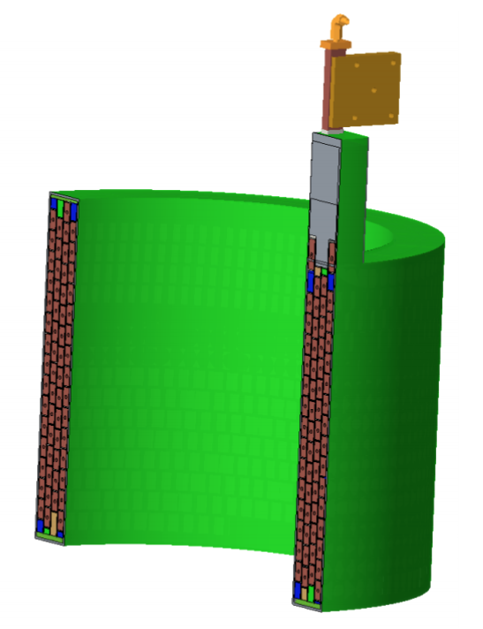
Coil Updates: Mandrel Free Coils
EoC strongly recommended designs for coils that facilitate turn-to-turn testing.
Functionally, that means coils that are not permanently affixed to the mandrels on which they are wound.
Forced us to revisit the winding tooling.
Mandrel-free Coil
Winding Mandrel Concept with Tapered Insert

Slide 7
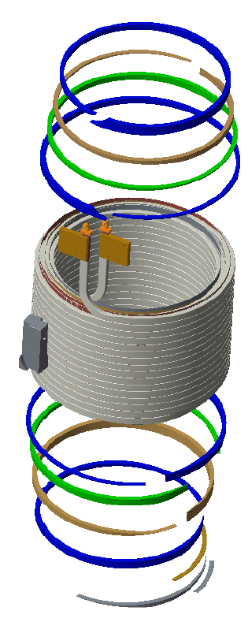
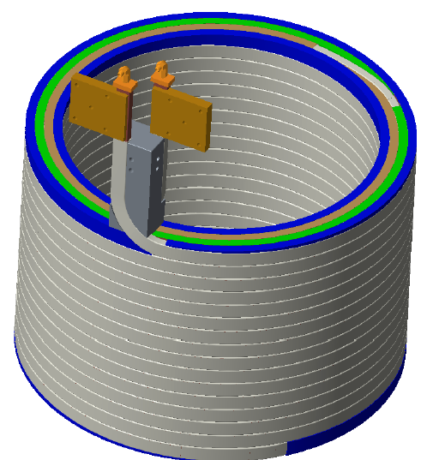
Coil Updates: Prototypes
We intend that any shop making replacement PF-1 coils shall produce a prototype first that is subject to testing.
This includes PPPL fabrication
Prototype looks like a PF-1a, which has the largest conductor, tightest bend radius, largest cross section
Prototype FDR held, RFQ issues, vendor pre-proposal call held.

Slide 8
Tile Updates
Most tiles not qualified for 2 MA, 1T halo current loading.
Resolving this is not a negotiable issue – must survive disruptions
Most tiles have issues with full heating power with low radiation fraction and a standard divertor.
Can (somewhat) trade tile performance against future optimization of divertor physics, plasma control
Present design philosophy:
IBDV, IBDH, OBDR1 | Farther OBD, CSAS | CSFW
Full Halo Current Loading | Full Halo Current Loading via Modest Changes to Fasteners | Attempt to qualify for halo current loading based on material testing
Highest Practical Heat Flux Handling (probably 5-6 MW/m² for 5 seconds) | “Best Effort” on Heat Fluxes (probably 3.-4 MW/m² for 5 seconds)
May use small-tile designs, fishscaling | Likely flat tiles, designed chamfers

Slide 9
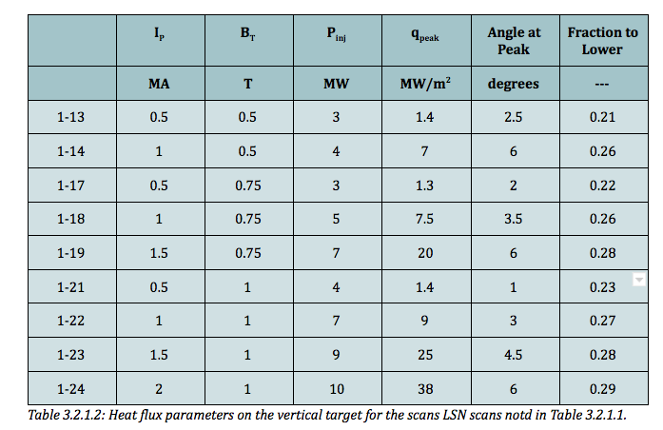
Also Making Use of TSG Input to Refine Requirements
Working with PFC WG to develop equilibria, heat flux estimates for cases of interest.
Presently working on two memos:
CSAS and far OBD
CSAS requirements generally set by L-mode (T&T TSG Requests)
Far OBD set by L-mode and MAPP requests
IBDV
Worst cases set by LSN H-modes (DivSol, Pedestal Requests)
Is ongoing, not ready for a formal discussion
Example: Vertical Target Heat Fluxes From dr_{sep}=-6mm DivSol Requests

Slide 10
Next Critical Reviews
CDR August 1-3
Will cover key elements of the redesign:
New inner-PF coils
New PFCs
Modifications to the vessel
Improvement to Bakeout
Machine mechanical instrumentation
External and internal review
Research team is obviously invited to attend portions that are of interest to them.
Cost and Schedule Review September 8th

