Slide 1
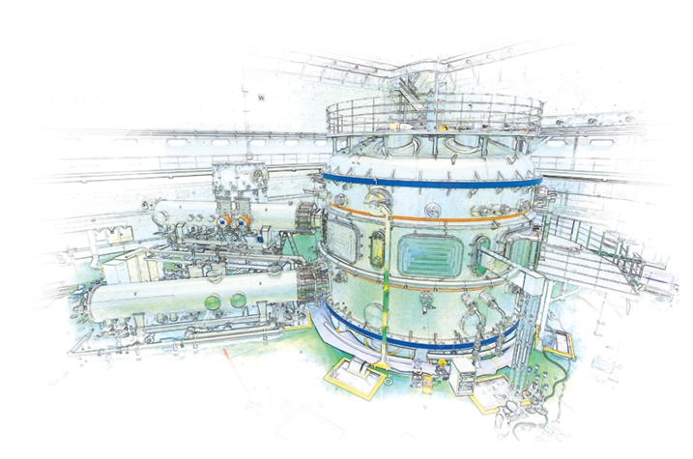
Transport and stability analyses supporting disruption prediction in high beta KSTAR plasmas*
J.-H. Ah${\text{n}}^{1}$, S.A. Sabbag${\text{h}}^{1}$, Y.S. Par${\text{k}}^{1}$, J.W. Berker${\text{y}}^{1}$, Y. Jian${\text{g}}^{1}$, J. Riqueze${\text{s}}^{1}$,
H.H. Le${\text{e}}^{2}$, L. Terzol${\text{o}}^{2}$, S.D. Scot${\text{t}}^{3}$, Z. Wan${\text{g}}^{3}$, A.H. Glasse${\text{r}}^{4}$
$^{1}$Columbia University, $^{2}$NFRI, $^{3}$PPPL, $^{4}$University of Washington
NSTX-U Physics meeting
29 November 2017
PPPL
*Work supported by U.S. DoE under contract DE-SC0016614

Slide 2
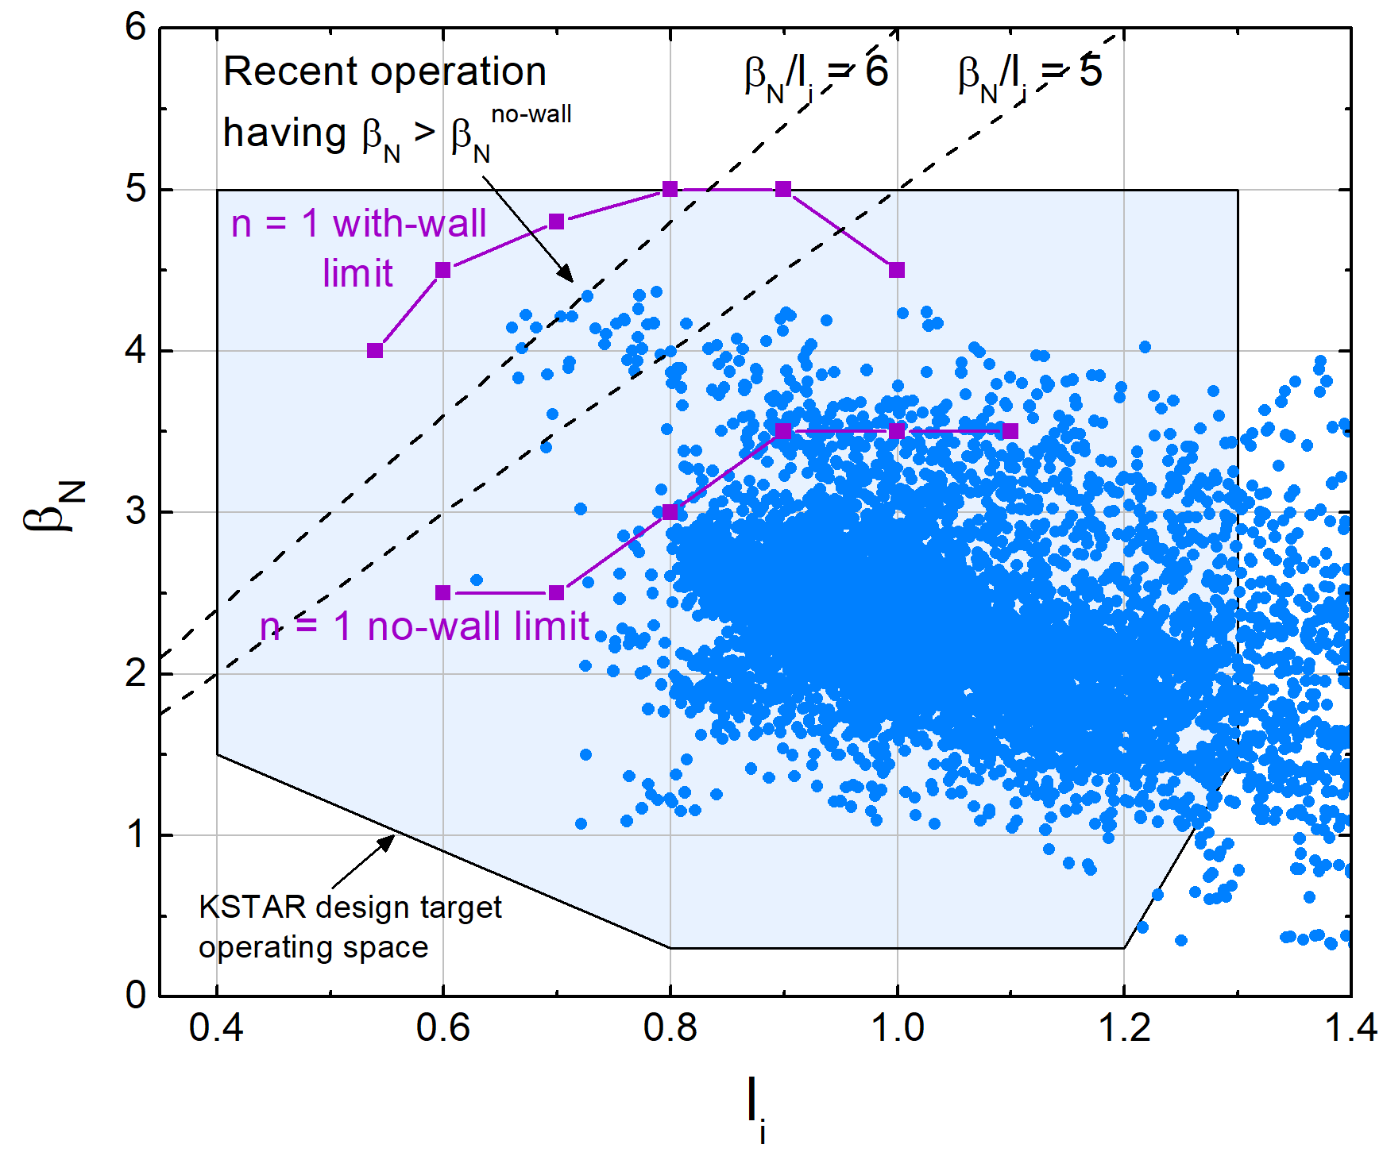
Motivation : Sustain high-$β$ operating regime for efficient fusion production
Targeting sustained high $β_{N}$ advanced tokamak operation at reduced internal inductance ($l_{i}$) above ideal MHD limits
Avoid MHD instability
High non-inductive current
fraction ($f_{NI}$) for sustainment
Stability analysis essential
for disruption event
characterization and
prediction using DECAF code
S.A. Sabbagh et al., Phys. Plasmas 9 2085 (2002)
Y.S. Park et al., Phys. Plasmas 21 012513 (2014)
I. Voitsekhivitch et al., Nucl. Fus. 49 055026 (2009)
J.W. Berkery et al., APS DPP 2017, CP11.00093
Y.S. Park et al., APS DPP 2017, UP11.00055

Slide 3
Outline : Transport, equilibrium and stability analysis of high-$β$ KSTAR shots
Interpretive TRANSP analysis
Equilibrium from EFIT (e.g. kinetic EFIT)
KSTAR experimental data as inputs ($N_{e}$, $T_{e}$, $T_{i}$, $ω_{φ}$, …)
Non-inductive current fraction ($f_{NI}$) and profiles computed
Effects on plasma stability
MHD mode stability analysis :
Global mode ideal MHD analysis kink, ballooning, RWM) : DCON
Resistive mode stability analysis: Resistive DCON
Kinetic resistive wall mode (RWM) stability analysis: MISK
TRANSP : See http://transpweb.pppl.gov
Y. Jiang et al., APS DPP 2017, UP11.00056 & following talk
A.H. Glasser, Phys. Plasmas 23 072505 (2016)
A.H. Glasser et al., Phys. Plasmas 23 112506 (2016)
J. Berkery et al., Nucl. Fusion 55 123007 (2015); B. Hu et al., Phys. Plasmas 12 057301 (2005)

Slide 4
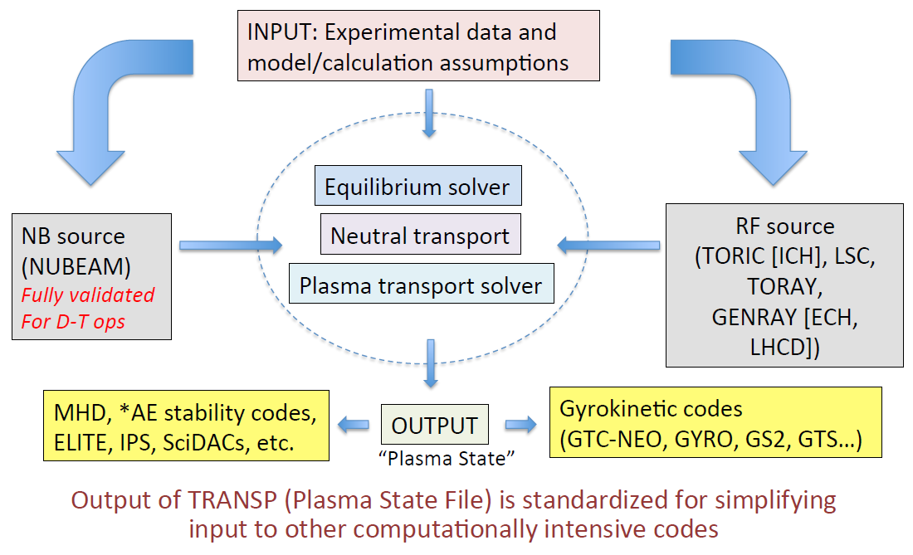
TRANSP : Time dependent 1.5D tool for interpretive/predictive analysis
S. Kaye et al., TUG meeting 2015

Slide 5
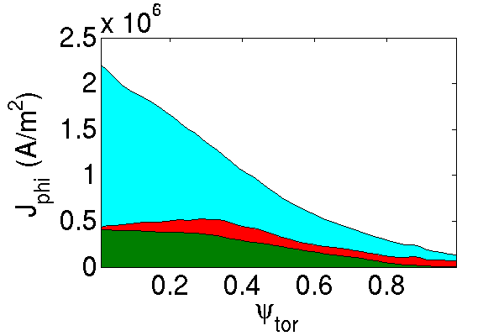
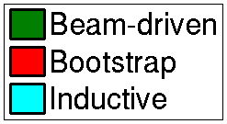
High non-inductive current fraction required for long pulse, high-$β$ plasmas
$I$(Non-inductive) = $I$(Beam-driven) + $I$(Bootstrap)
KSTAR plasmas can have high non-inductive current fraction ($f_{NI}$>70%)
Need to examine dependence on plasma quantities ($N_{e}$, $T_{i}$, $β_{p}$,…)
#18499 t=4.2s
Inductive
$f_{NI}≃$39%
KSTAR plasma with low
non-inductive fraction
for comparison
Non-inductive

Slide 6
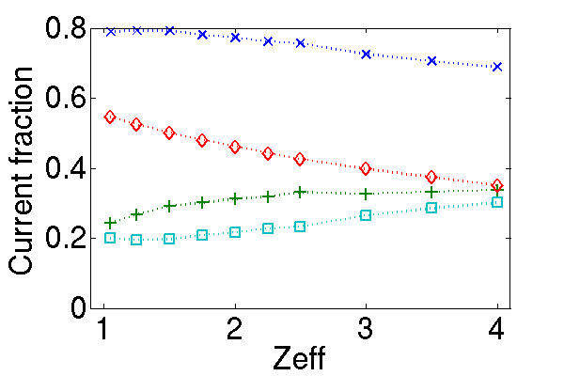
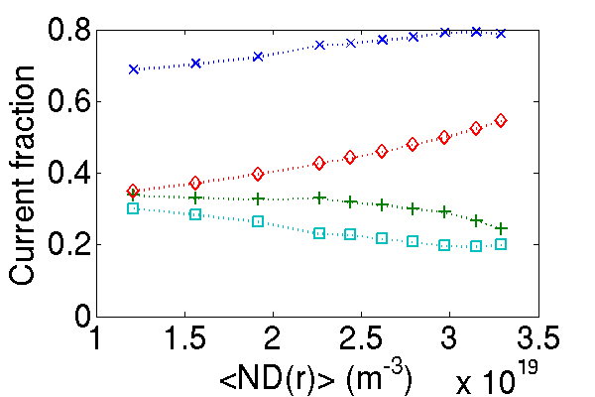
High non-inductive plasmas not sensitive to $Z_{eff}$ variation
Interpretive TRANSP with KSTAR #17228 t=2s measurements
$Z_{eff}$ measurement not available $Z_{eff}$ profile set constant
Scan on $Z_{eff}$ alters ion density variation
As $Z_{eff}$ increases ($N_{D}$ decreases) :
Beam driven current $↑$, Bootstrap current $↓$

Slide 7
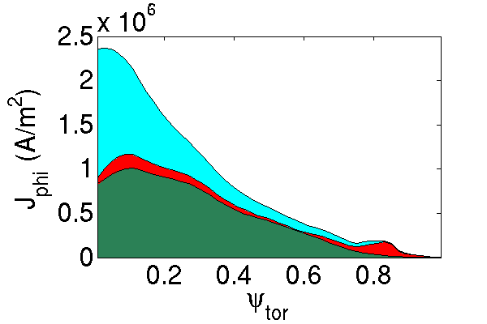
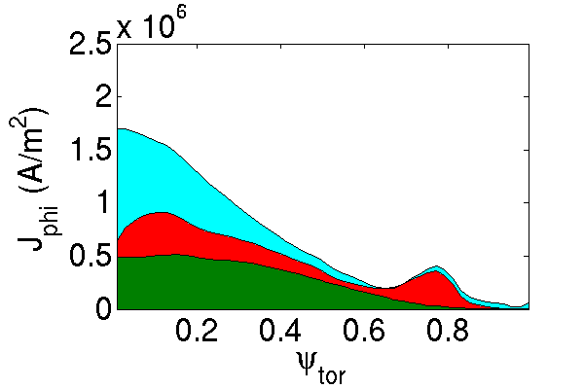
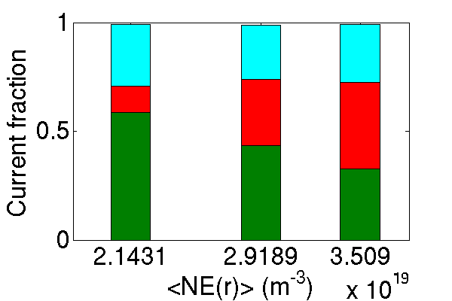
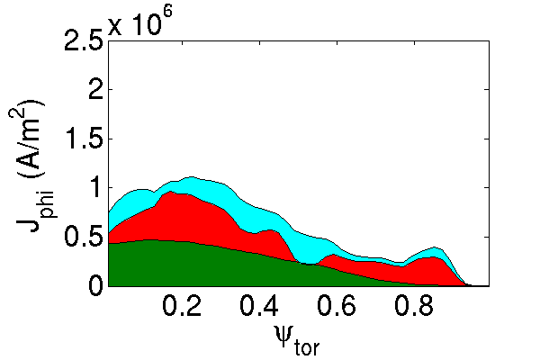
Bootstrap current fraction increases as electron density increases
A : #15334 t=1.8s
B : #16325 t=2.05s
A
B
C
C : #17228 t=2s

Slide 8
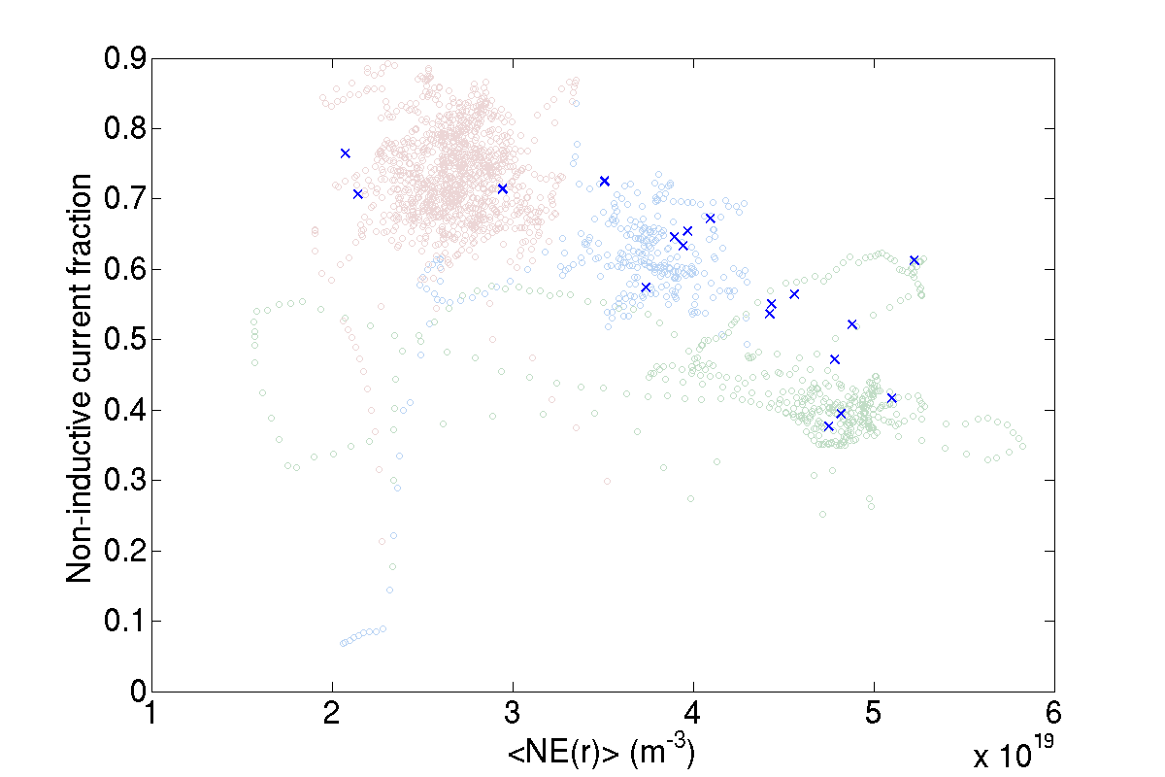
High non-inductive fraction can occur in different KSTAR operational scenarios
Bootstrap bump
High $β_{N}$
ITB
ITB Edge bootstrap bump
High $β_{N}$ H-mode L-mode
Color code throughout
this presentation

Slide 9
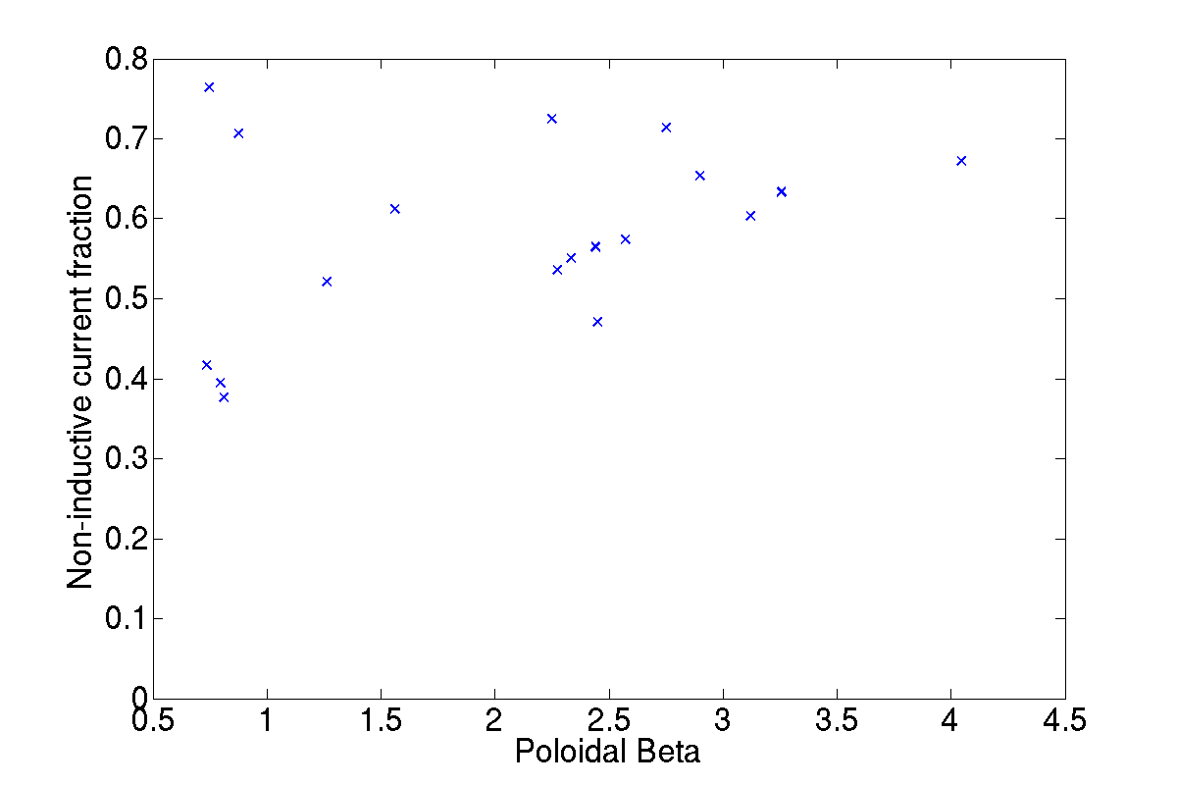
Increase of non-inductive current fraction $f_{NI}$due to increasing $β_{p}$, ITB, edge bootstrap current
Bootstrap bump
ITB
High $β_{N}$
ITB Edge bootstrap bump
High $β_{N}$ H-mode L-mode

Slide 10
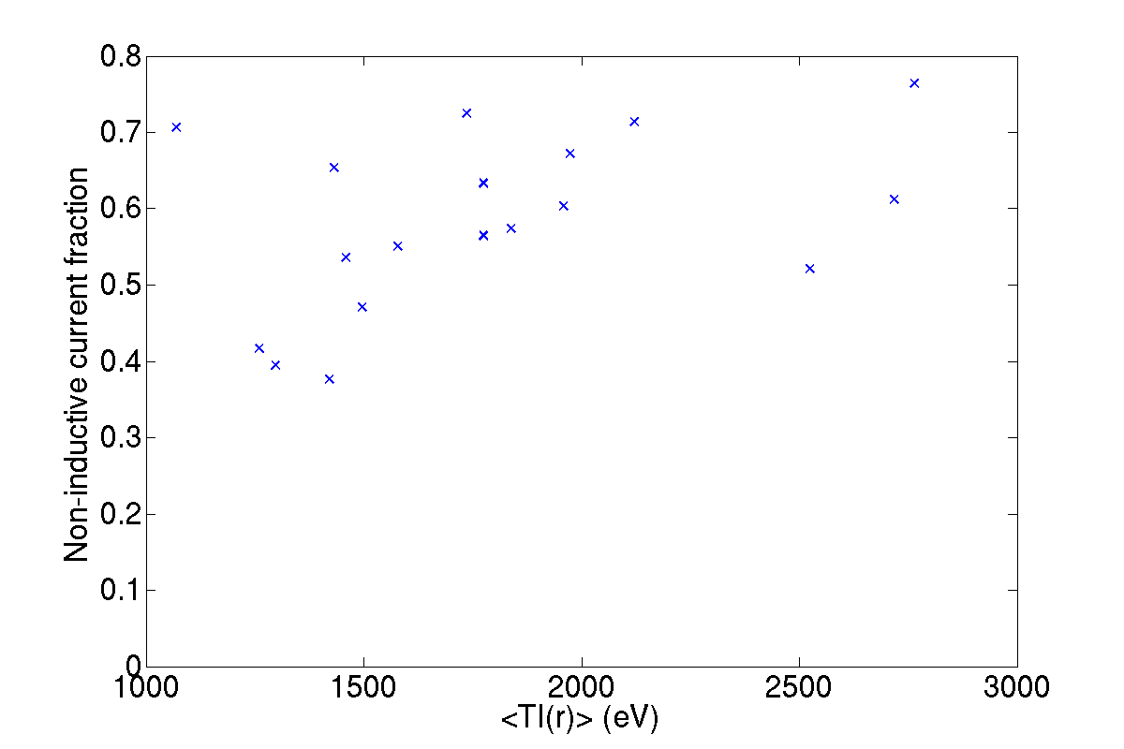
The presence of edge bootstrap in H-mode plasmas significantly increases $f_{NI}$
Bootstrap bump
ITB
High $β_{N}$
ITB Edge bootstrap bump
High $β_{N}$ H-mode L-mode

Slide 11
Total non-inductive current fraction $f_{NI}$ increased due to edge ‘bootstrap bump’
Strong bootstrap current fraction in edge region increases significantly $f_{NI}$
#16325 t=2.05s
$f_{NI}≃$71%

Slide 12
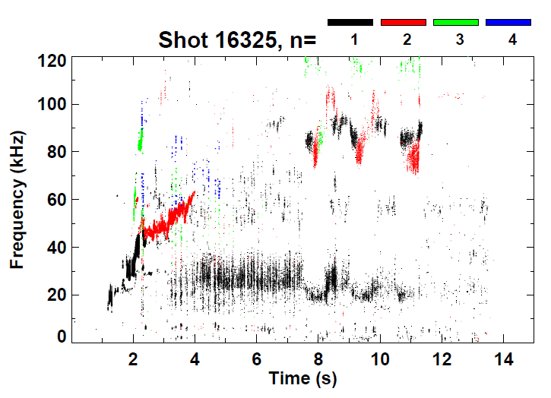
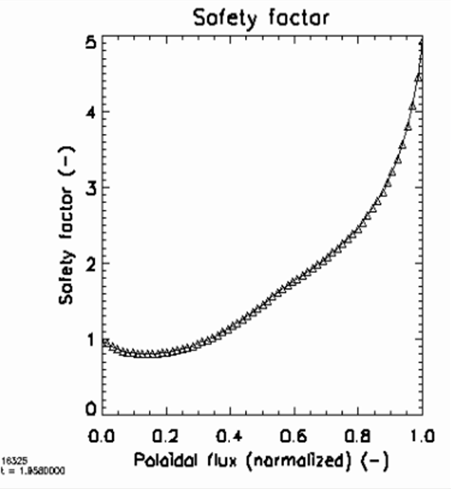
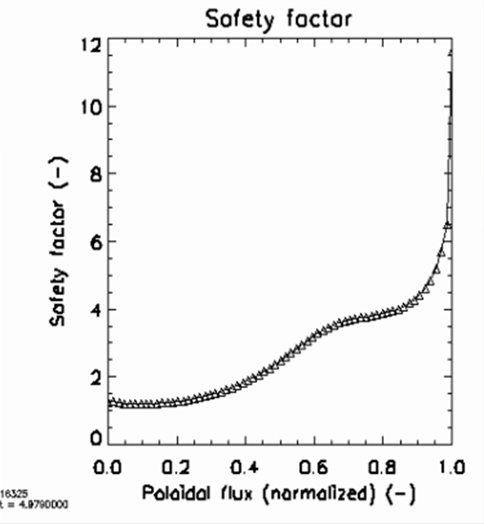
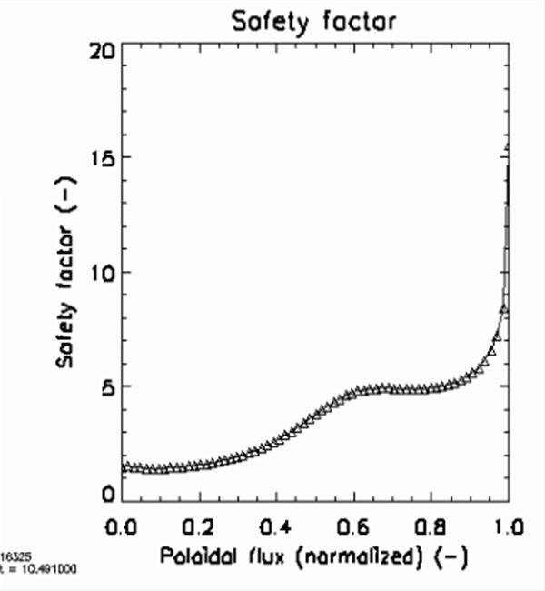
Kinetic EFIT reconstructed low-sheared $q$-profiles consistent with MHD stability
MHD spectrogram shows $n=1$ mode activity when $q_{min}<1$
Low-sheared $q$-profiles in higher $q$ region
Plasma is quiescent phase
t=1.958s
t=1.955s
t=4.979s
t=10.491s
$$q_{min}<1$$

Slide 13
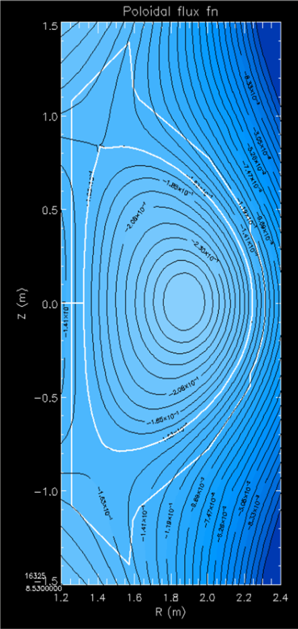
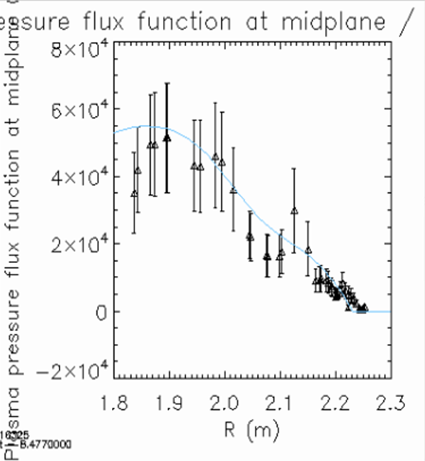
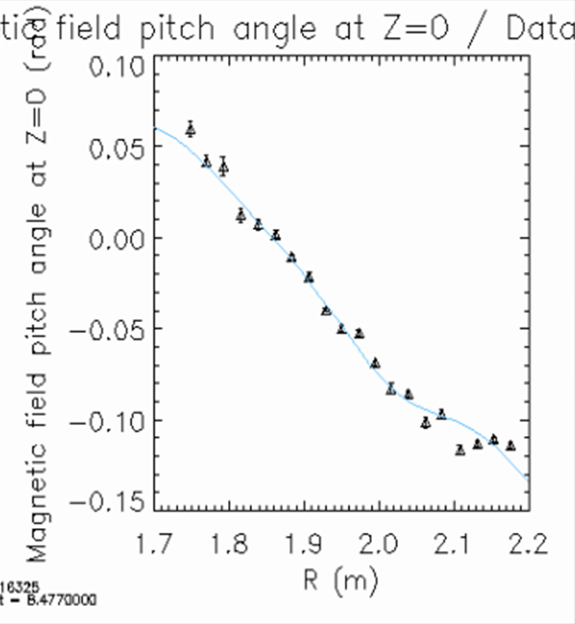
$q$-profiles are reconstructed from equilibria using magnetic pitch angle measurements
#16325 t=8.53s
$P(ψ)$ at $Z=0$
Pitch angle at $Z=0$
Y. Jiang et al., APS DPP 2017, UP11.00056 & next talk

Slide 14
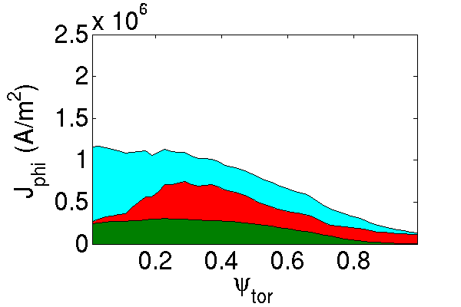
Total non-inductive current fraction $f_{NI}$increased by core bootstrap current due to ITB
Stronger core bootstrap current fraction compared to H-mode
#18476 t=2.1s
$f_{NI}≃$61%

Slide 15
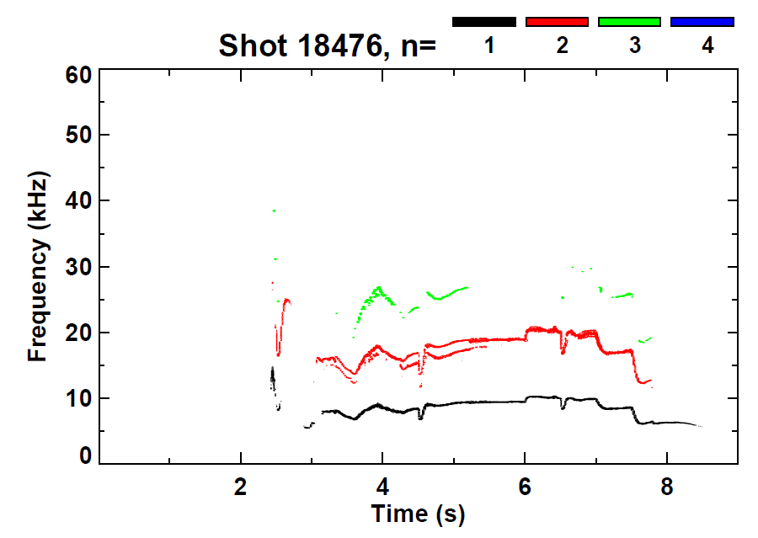
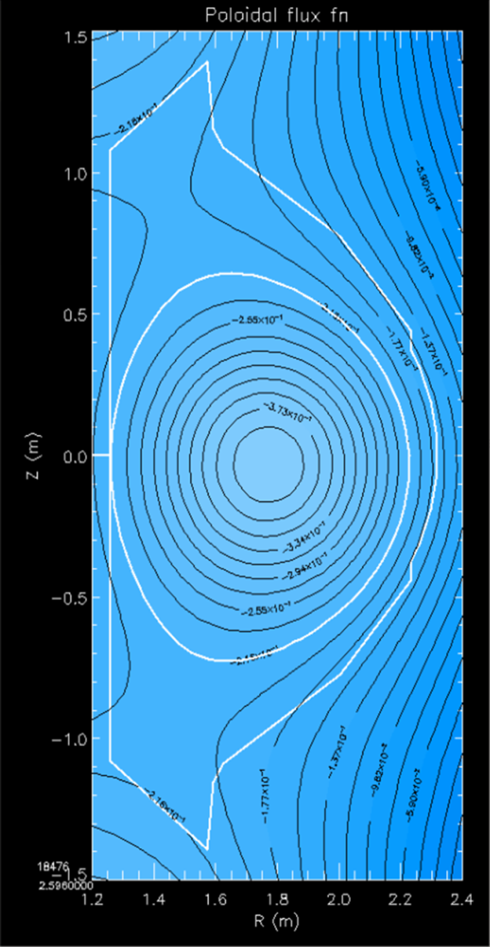
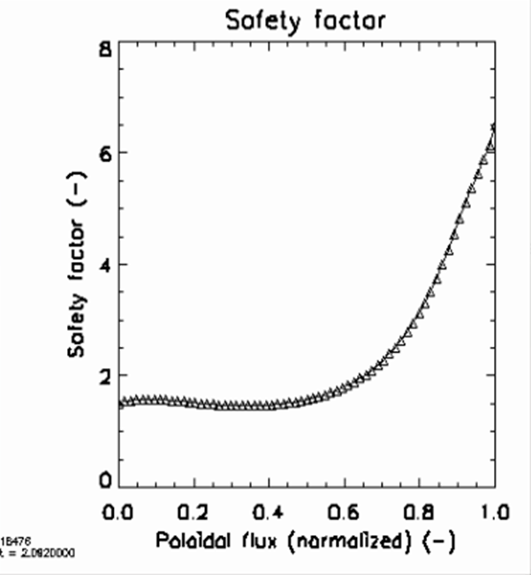
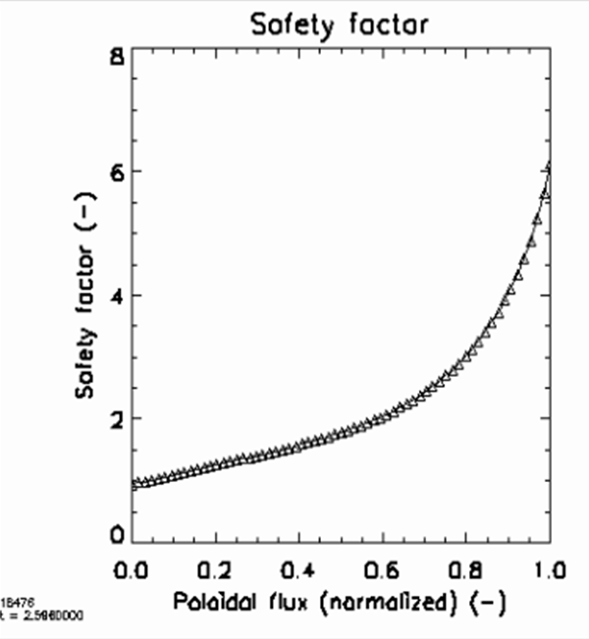
$q$-profiles of ITB / limiter plasmas have significant differences
#18476 t=2.596s
t=2.082s
t=2.596s
ITB
Limiter

Slide 16
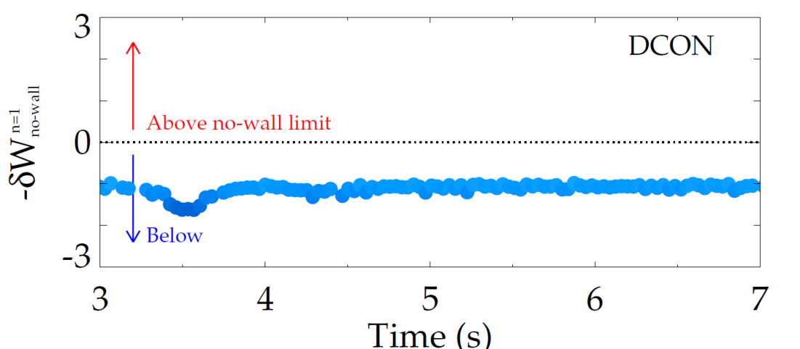
Ideal global stability analysis of new KSTAR kinetic equilibria examined with ideal DCON
Ideal δW calculations
with DCON
Indication whether
plasmas above or
below $n=1$ no-wall
$β$ limit
Ideal stability
(below $n=1$ no-wall limit)
during later phase
as expected
Plasma total stored energy vs. time
4
3
2
1
0
-1
KSTAR
#18476
A.H. Glasser, Phys. Plasmas 23 072505 (2016)
Stored energy (10⁵J)
ITB
Limiter plasma
0 2 4 6 8 10
Time (s)
See also : Y.S. Park et al., APS DPP 2017, UP11.00055

Slide 17
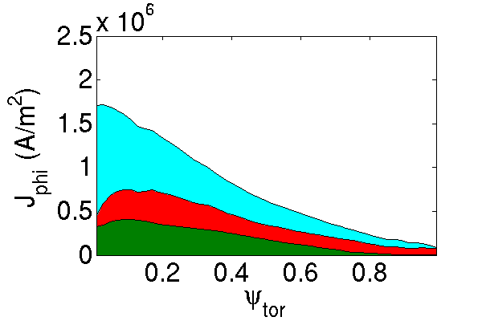
Increased core bootstrap current in H-mode due to increased $∇$P
Stronger bootstrap current fraction in core region compared to L-mode, due to stronger pressure gradient
Still significant inductive current fraction (especially in the core)
#18402 t=6.28s
$f_{NI}≃$55%

Slide 18
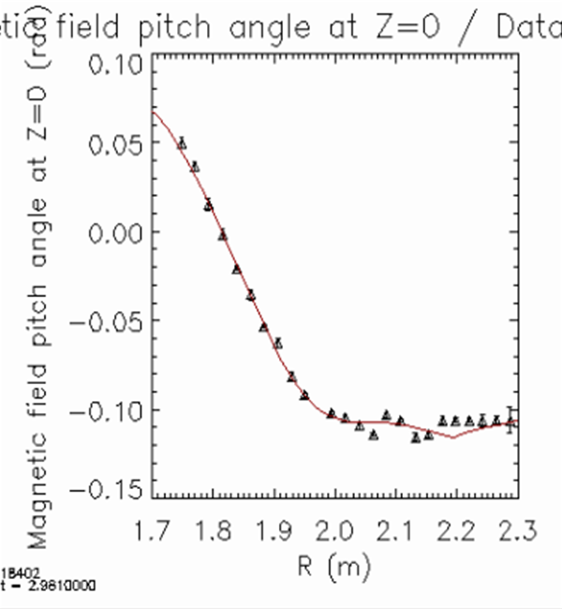
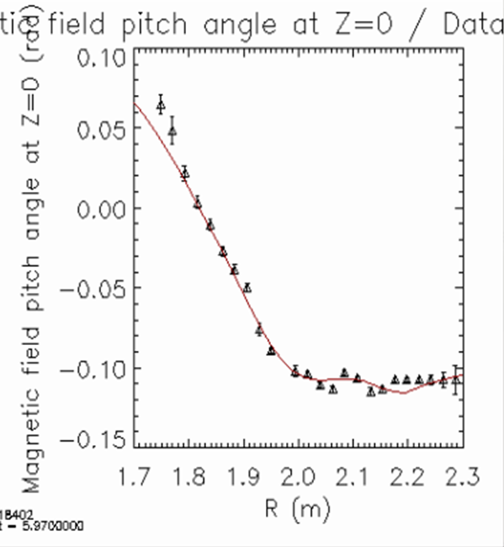
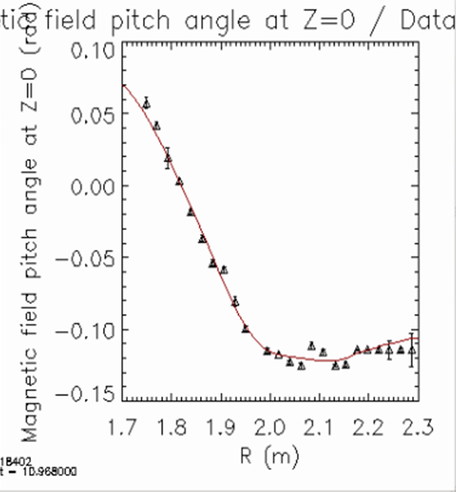
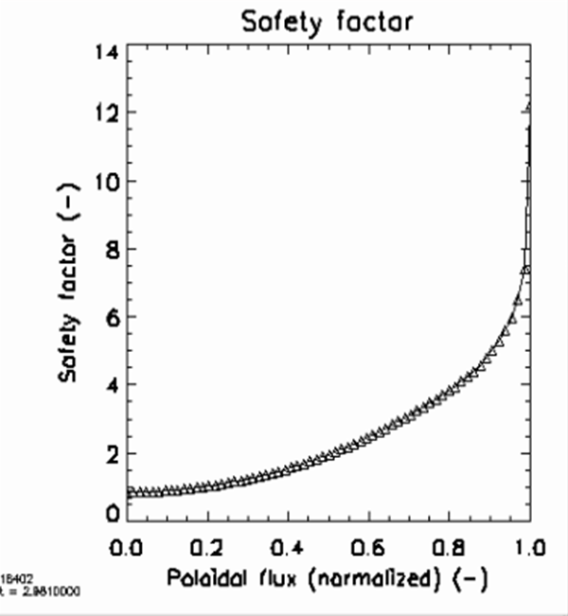
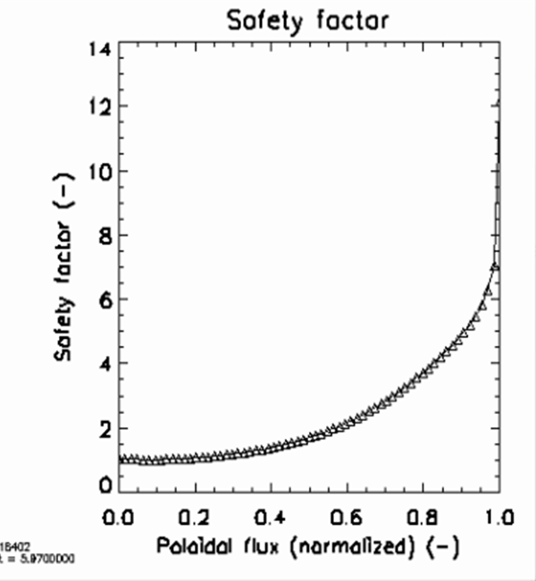
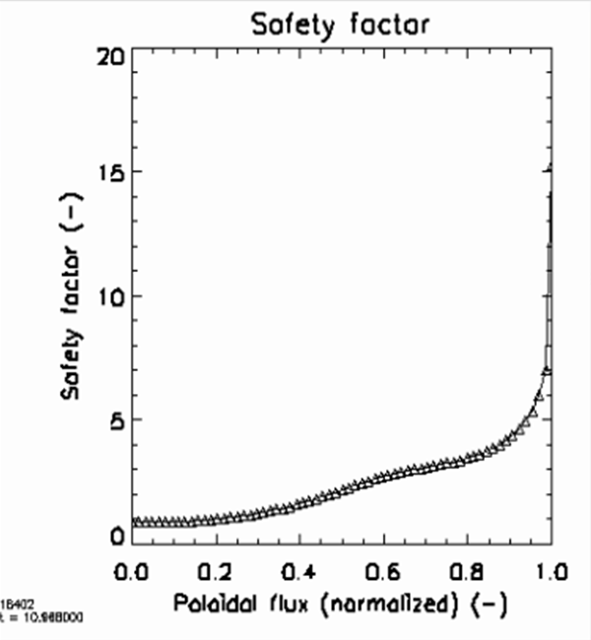
$q$-profiles reconstructed from kinetic equilibria show evolution of magnetic shear
Pitch angle at $Z=0$
Pitch angle at $Z=0$
Pitch angle at $Z=0$
t=2.981s
t=5.970s
t=10.948s

Slide 19
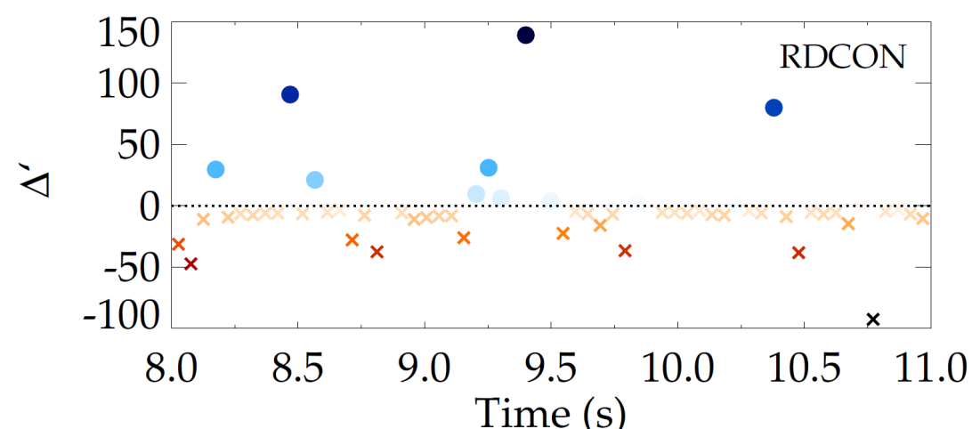
Resistive DCON : a new tool for MHD stability analysis used on KSTAR for the first time
New resistive DCON code
used to calculate the $q=2$
Δ’ for case with sudden
appearance of $n=1$ mode
Positive Δ’ would indicate classical instability at $q=2$
Calculation shows a near marginal Δ’ at $q=2$ around time of mode onset
Requires further analysis
A.H. Glasser et al., Phys. Plasmas 23 112506 (2016)
Resistive DCON
?

Slide 20
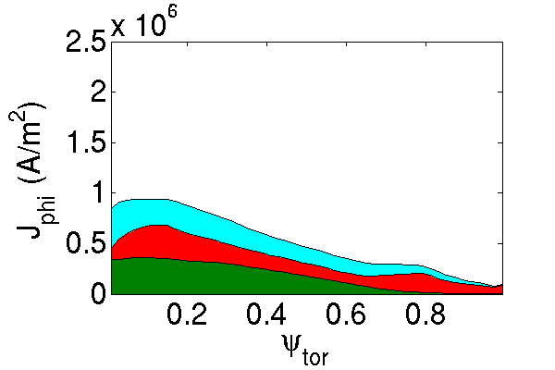
A broad non-inductive current fraction profile in high $β_{N}$ plasma operation
Significant and broad bootstrap current fraction compared to
L-mode plasmas
Inductive current fraction significantly decreased compared to L- or H-mode plasmas
#16295 t=1.75s
$f_{NI}≃$67%

Slide 21
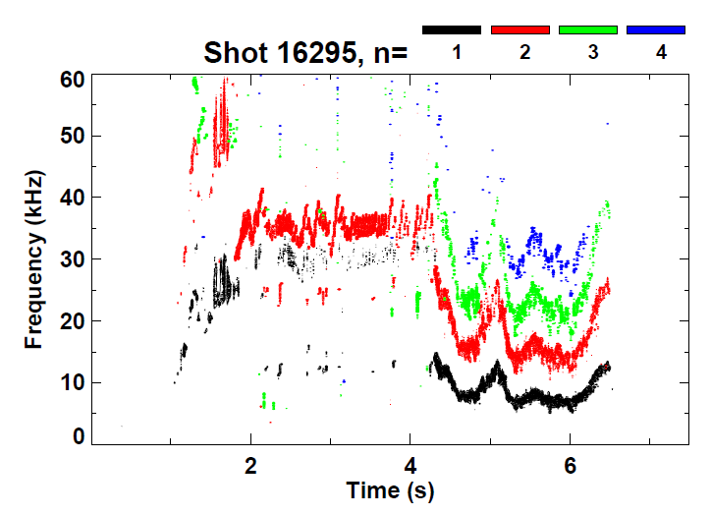
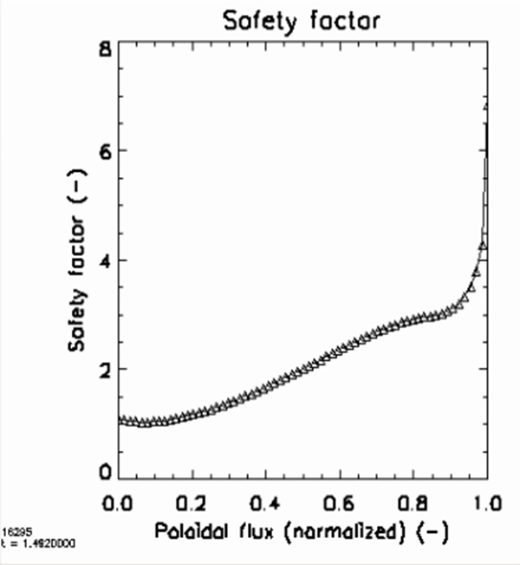
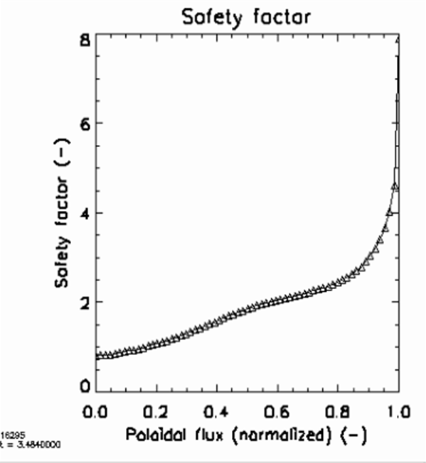
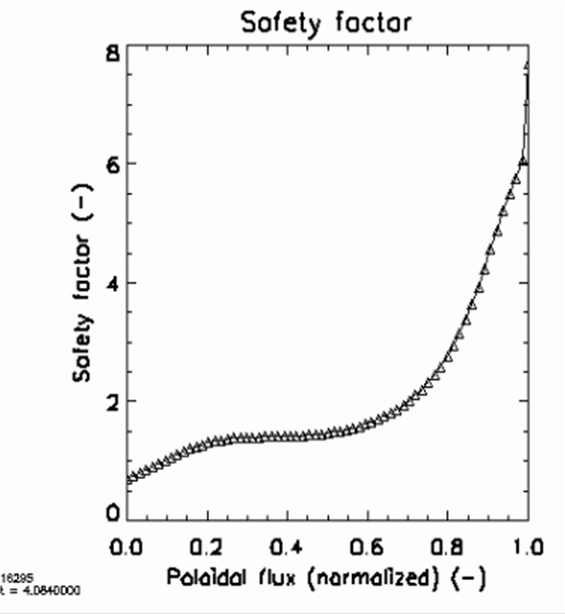
End of high-$β_{N}$ phase due to onset of $n=1$ mode
MHD spectrogram shows onset of $n=1$ mode at t$≃$4.2s
End of high-$β$ phase
Detailed stability analysis shown in
Y.S. Park et al., APS DPP 2017, UP11.00055
t=1.482s
t=3.484s
t=4.084s

Slide 22
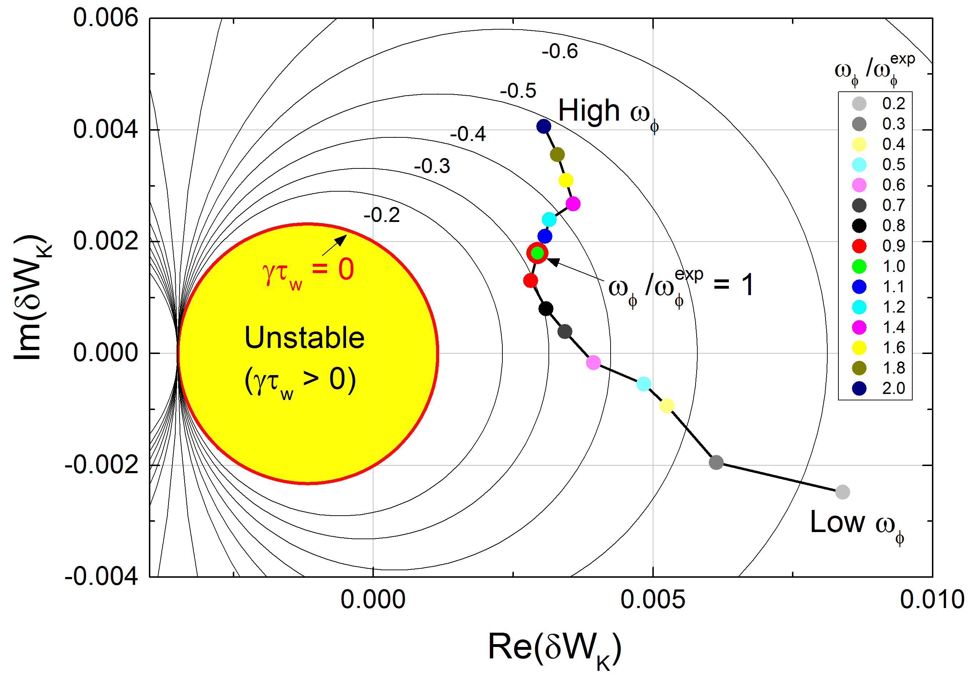
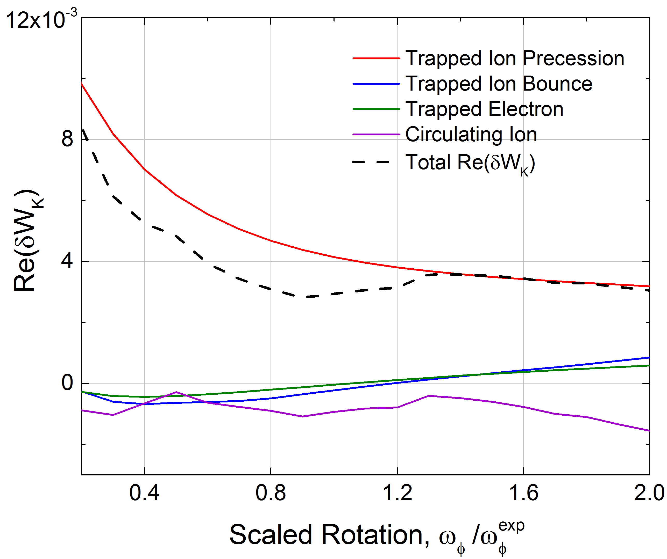
Calculations of kinetic modifications to ideal stability examined with MISK code
[J.W. Berkery et al., Nucl. Fusion 55, 123007 (2015)]
MISK Calculations
Benchmarked
Compared to Experiments
Fluid terms
Kinetic effects:
Collisionality
Rotation
MISK kinetic stability calculations for KSTAR with previous magnetics only equilibrium and without energetic particles
KSTAR
#16295
@2.315s
Y.S. Park et al., APS DPP 2016

Slide 23
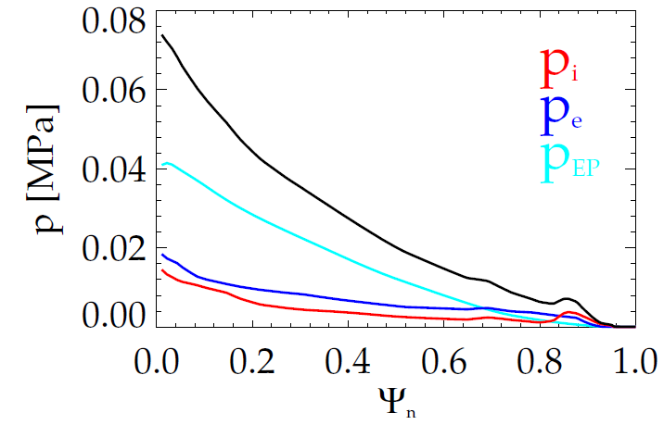
Kinetic global stability analysis of new KSTAR kinetic equilibria is commencing
KSTAR #16325 @11.975s
p_{tot}
TRANSP analysis of new kinetic KSTAR equilibria gives EP pressure
KSTAR discharge with high non-inductive fraction, bootstrap current bump, and large energetic particle (EP) fraction
Experimental plasma was stable to global MHD modes (RWM), has varying rotating MHD
Time point analyzed for global stability was free of MHD activity

Slide 24
MISK kinetic stability analysis indicates large stabilizing effect of energetic particles
Unstable region
KSTAR
#16325
@11.975s
unstable
Without EPs
Without
EPs
stable
With EPs
With EPs
MISK calculations find the equilibrium is stable to resistive wall modes (consistent with experiment)
Close to marginal stability with variation of the experimental rotation profile and without considering energetic particles
Energetic particles contribute large stabilizing effect (due to large EP fraction)

Slide 25
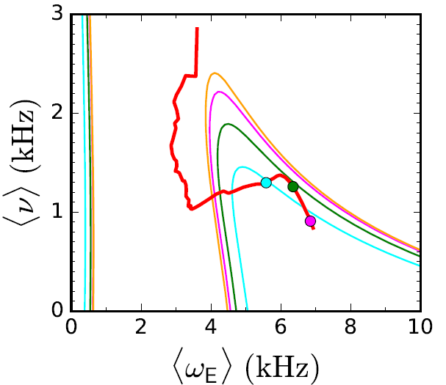
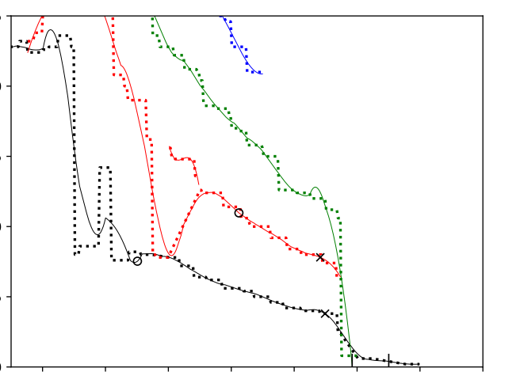
Present KSTAR research will now provide input to Disruption Event Characterization And Forecasting (DECAF) code
DECAF identifies disruption event chains and predicts events in those chains using warning algorithms (including stability models)
Global MHD stability models
Automated Identification of rotating MHD bifurcation, locking
Prediction of MHD mode onset with resistive DCON
C_{β}
Collisionality
unstable
region
J.W. Berkery et al., Phys. Plasmas 24 056103 (2017)
Rotation
J.W. Berkery et al., APS DPP 2017, CP11.00093
25
20
n = 4
J.D. Riquezes et al., APS DPP 2017, UP11.00053
15
f(kHz)
10
n = 3
n = 2
5
bifurcation
n = 1
0
t(s)
0.66
0.70
0.74
0.78

Slide 26
Examination of KSTAR transport and stability supporting disruption prediction and avoidance research has begun
Interpretive TRANSP analyses show high non-inductive current fraction in advanced tokamak KSTAR operation regimes
While the total non-inductive current fraction is high (up to 75% in plasmas examined), the non-inductive profile can vary substantially
The resultant q profiles in these regimes (verified by kinetic equilibrium reconstruction including MSE) can yield varied stability
Interesting flat q shear regions form that may correlate with observed plasma stability, depending on the q level at which they appear
Continuing analysis provides physics understanding toward attaining stable long pulse, high performance KSTAR operation
Aim to optimize stable plasma trajectories to KSTAR design target plasmas
Set up predictive TRANSP runs for the 2018 scenarios with 2nd NBI system

Slide 27
Back-up slides

Slide 28
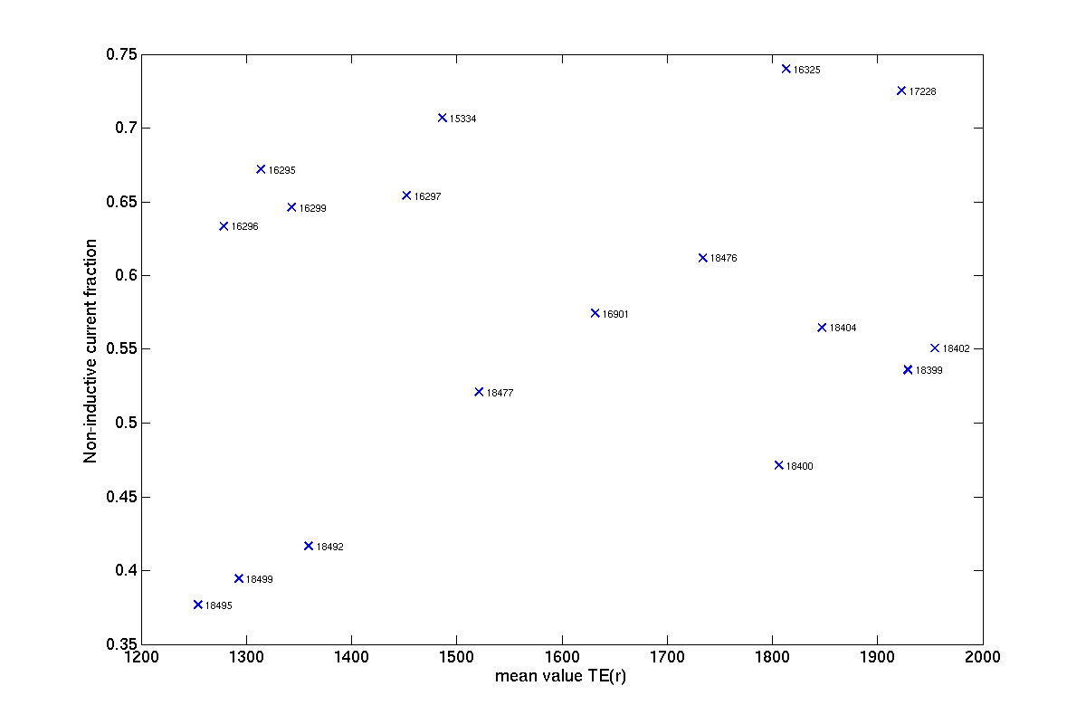

Slide 29
Transport and stability analyses supporting disruption prediction in high beta KSTAR plasmas*
59th APS DPP annual meeting
J.-H. Ah${\text{n}}^{1}$, S.A. Sabbag${\text{h}}^{1}$, Y.S. Par${\text{k}}^{1}$, J.W. Berker${\text{y}}^{1}$, Y. Jian${\text{g}}^{1}$, J. Riqueze${\text{s}}^{1}$,
H.H. Le${\text{e}}^{2}$, L. Terzol${\text{o}}^{2}$, S.D. Scot${\text{t}}^{3}$, Z. Wan${\text{g}}^{3}$, A.H. Glasse${\text{r}}^{4}$
$^{1}$Columbia University, $^{2}$NFRI, $^{3}$PPPL, $^{4}$University of Washington
*Work supported by U.S. DoE under contract DE-SC0016614

Slide 30
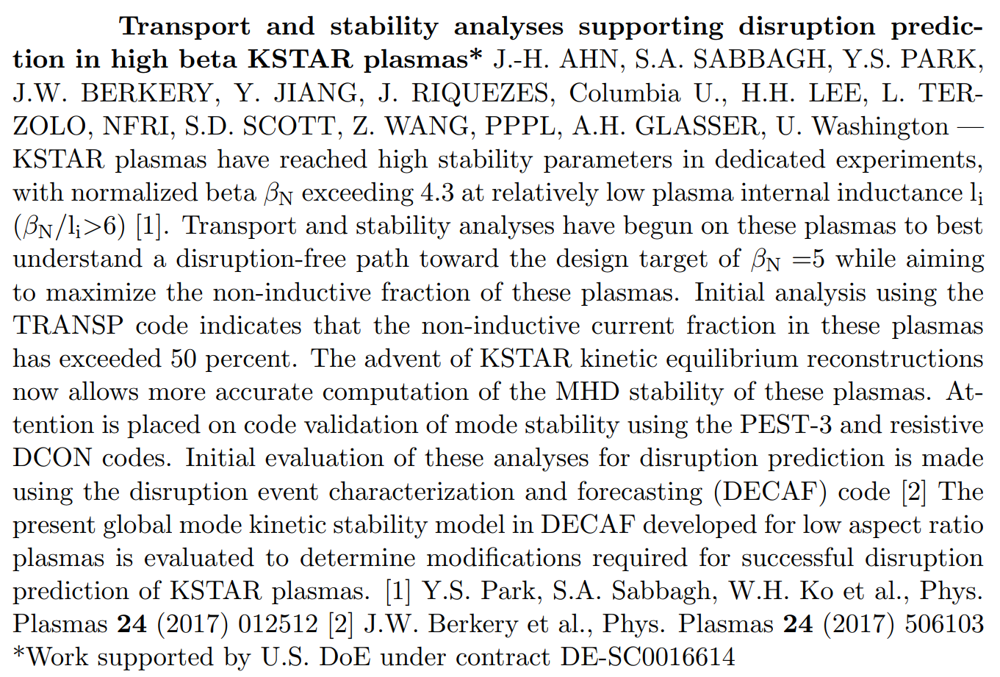
Abstract

Slide 31
Outline : Transport, equilibrium and stability analysis of high-$β$ KSTAR shots
Interpretative TRANSP analysis
Equilibrium from EFIT (e.g. kinetic EFIT)
KSTAR experimental data as inputs ($N_{e}$, $T_{e}$, $T_{i}$, $ω_{φ}$, …)
Non-inductive current fraction ($f_{NI}$) and profiles computed
Effects on plasma stability
MHD mode stability analysis :
Ideal/Resistive DCON (kink, balooning, RWM)
MISK kinetic code using energetic particle profiles from TRANSP
Global mode stability analysis
See http://transpweb.pppl.gov
Y. Jiang et al., this conference, UP11.00056
A.H. Glasser, Phys. Plasmas 23 072505 (2016)
A.H. Glasser et al., Phys. Plasmas 23 112506 (2016)
B. Hu et al., Phys. Plasmas 12 057301 (2005)

Slide 32
Application to the Disruption Event Characterization And Forecasting (DECAF) code
DECAF identifies disruption event chains and predicts events in those chains using warning algorithms (including stability models)
Global MHD stability boundary models
Identification of rotating MHD bifurcation and mode locking
Prediction of MHD mode onset with resistive DCON
J.W. Berkery et al., Phys. Plasmas 24 056103 (2017)

Slide 33
Conclusion and prospect
Interpretive TRANSP analyses show high non-inductive current fraction in high-beta KSTAR shots
Classification of plasma onto different operation regimes from total current composition
Equilibrium reconstruction and stability analyses show further prospect for :
Future scenario development
Disruption event characterization and prediction

