Slide 1
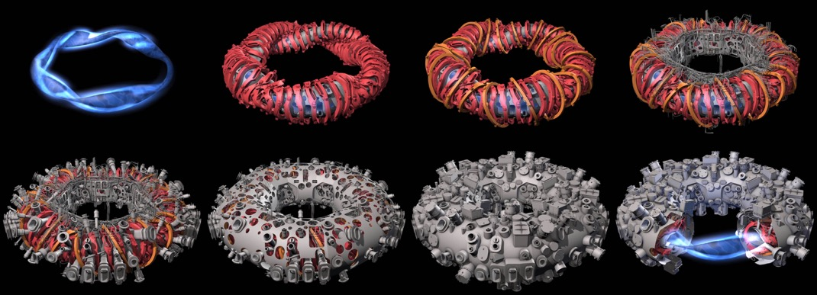
Investigations of the role of neoclassical transport in ion-root plasmas on W7-X
Novimir Pablant on behalf of the W7-X Team
2019-01

Slide 2

















Many thanks to the whole Wendelstein 7-X Team
Special thanks to my co-authors:
A. Langenberg, A. Alonso, J. Baldzuhn, C.D. Beidler, L.G. Böttger, S. Bozhenkov,
K.J. Brunner, R. Burhenn, A. Dinklage, E. Edlund, G. Fuchert, O. Ford, D.A. Gates,
J. Geiger, O. Grulke, M. Hirsch, U. Hoefel, Z. Huang, Y. Kazakov, J. Knauer,
J. Kring, H. Laqua, M. Landreman, S. Lazerson, H. Massberg, O. Marchuck,
Mollen, E. Pasch, A. Pavone, M. Porkolab, S. Satake, T. Schroeder, J. Svensson,
P. Traverso, Y. Turkin, J.L. Velasco, A. Von Stechow, F. Warmer, G. Weir, R.C. Wolf,
D. Zhang and the W7-X Team

Slide 3
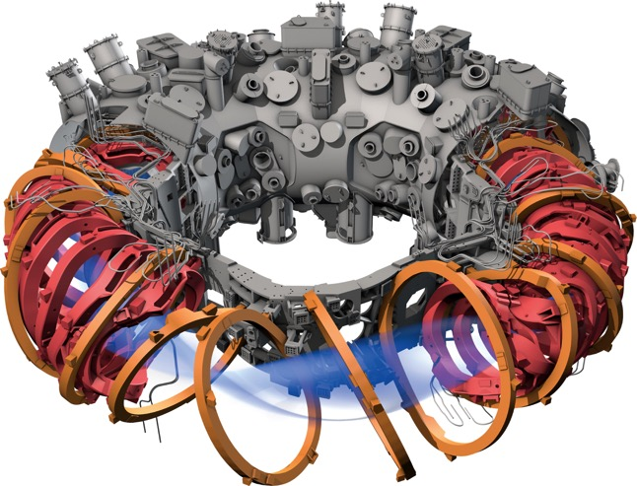

The first operational phase of Wendelstein 7-X concluded on October 18, 2018
W7-X is the worlds first large scale
optimized stellarator.
The plasma shape and coil set have been optimized to reduce neoclassical transport.
(along with other optimizations)
Expected operating scenario:
  High density (2x10²⁰ m⁻³)
  Electron heating with ECRH
  Negative radial electric field (ion-root)
  Volume averaged beta ~ 5%
First operation phase of W7-X featured:
  Up to 7.0 MW of ECRH power
  Uncooled graphite island divertor
  200 MJ injected power
T. Pedersen [2016], R. Wolf [2016], T. Klinger [2016]

Slide 4
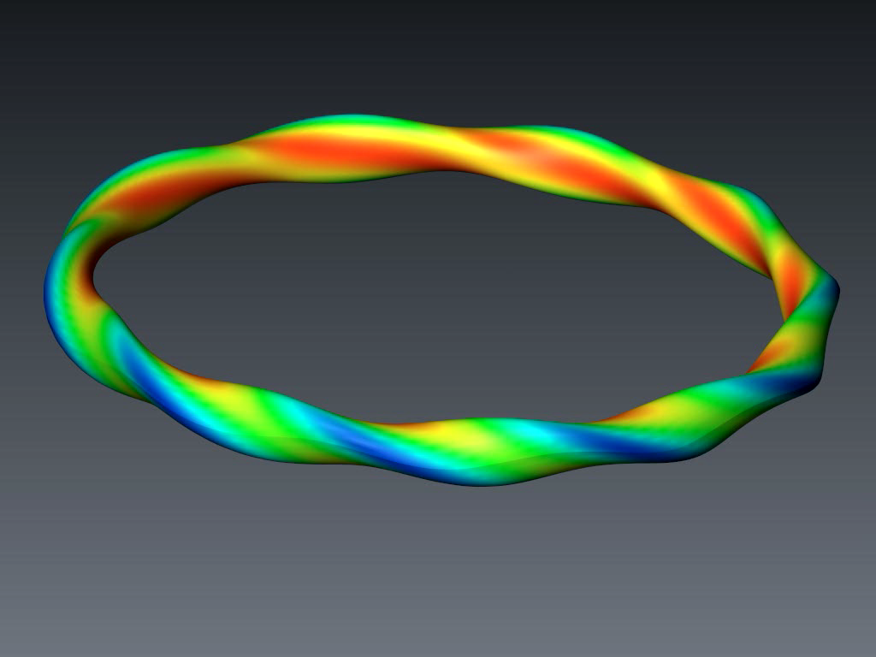
In a classical stellarator trapped particles are not well confined and drift across flux surfaces
Shown is the orbit of a 50 keV ion in a classical stellarator of similar size to W7-X.
This energy scales to an
α-particle in a reactor scale device.

Slide 5
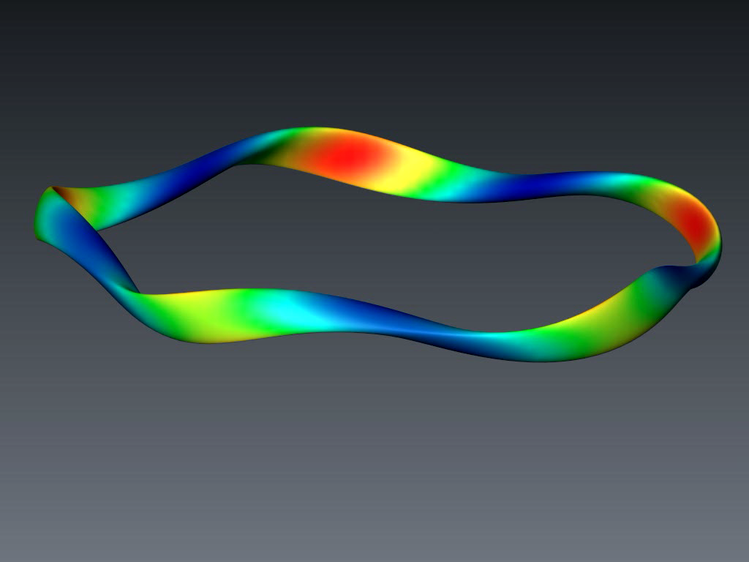
Optimization of the magnetic field can provide good confinement of both passing and trapped particles
Shown is the orbit of a 50 keV ion in a optimized stellarator of similar size and design as W7-X.
This energy scales to an
α-particle in a reactor scale device.

Slide 6
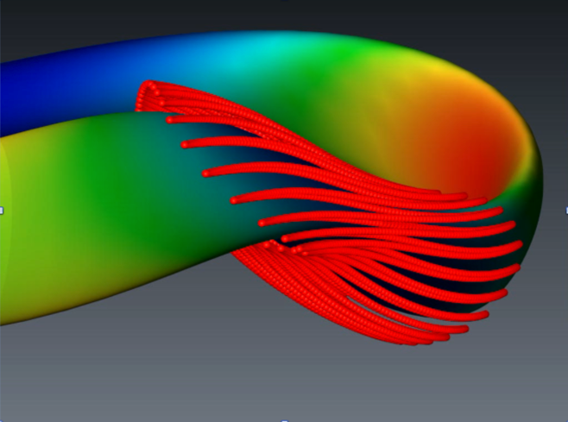
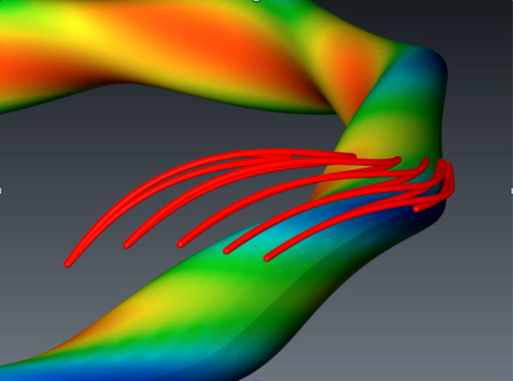
Optimization of the magnetic field can provide good confinement of both passing and trapped particles
Optimized Stellarator
Classical Stellarator
Shown is the orbit of a 50 keV ion in a optimized stellarator of similar size and design as W7-X.
This energy scales to an
α-particle in a reactor scale device.

Slide 7
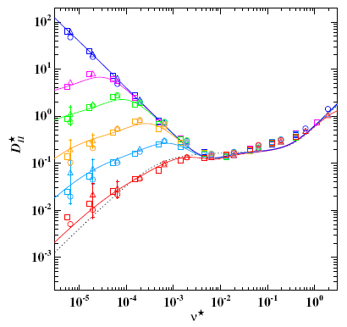
In stellarators transport is strongly dependent on the radial electric field
At low collisionalities the radial electric field is expected to substantially affect neoclassical heat and particle transport.
This is different than in tokamaks.
For a tokamak:
  Particle fluxes are intrinsically ambipolar.
  Particle fluxes and neoclassical transport
  are independent of Er.
Monoenergetic
trasnport coeff. D₁₁*
C.D. Beidler [2011]
[C.D. Beidler et al. NF 51, (2011)]

Slide 8
In stellarators transport is strongly dependent on the radial electric field
At low collisionalities a large positive Er
is expected to substantially reduce neoclassical heat transport.
This is different than in tokamaks.
For a tokamak:
  Particle fluxes are intrinsically ambipolar.
  Particle fluxes and neoclassical transport
  are independent of Er.
Monoenergetic
trasnport coeff. D₁₁*
Equivalent Tokamak
C.D. Beidler [2011]
[C.D. Beidler et al. NF 51, (2011)]

Slide 9
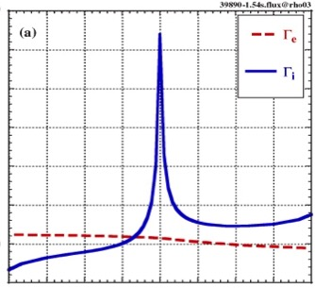
In stellarators the radial electric field plays a special role in plasma confinement
Neoclassical ion and electron
particle fluxes are affected by
the radial electric field.
  Local ambipolarity is only
  consistent with particular
  values of Er.
At high densities with
Te ~ Ti there is typically
a single solution for Er:
  ion root (Er < 0)
Ion root (Er < 0)
3
Γ_{e}
T_{e} ~ T_{i}
Γ_{i}
Γ [10¹⁹m⁻²s⁻¹]
Γ_{e} =Γ_{i}
0
-4
-2
0
2
4
E_{r} [kV/m]
M. Yokoyama [2007], A, Dinklage [2016]

Slide 10
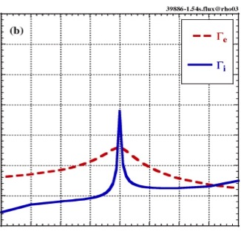
In stellarators the radial electric field plays a special role in plasma confinement
Neoclassical ion and electron
particle fluxes are affected by
the radial electric field.
  Local ambipolarity is only
  consistent with particular
  values of Er.
With low collisionalities and
Te >> Ti there are typically
three possible Er solutions:
  electron root (Er > 0)
  ion root (Er < 0)
  unstable root
Turbulent particle fluxes are
expected to be intrinsically
ambipolar.
Ion root (Er < 0)
Electron root (Er > 0)
3
Γ_{e}
3
T_{e} ~ T_{i}
T_{e} >> T_{i}
Γ_{e}
Γ_{i}
Γ_{i}
Γ [10¹⁹m⁻²s⁻¹]
Γ [10¹⁹m⁻²s⁻¹]
Γ_{e} =Γ_{i}
Γ_{e} =Γ_{i}
0
0
-4
-2
0
2
4
-4
-2
0
2
4
E_{r} [kV/m]
E_{r} [kV/m]
M. Yokoyama [2007], A, Dinklage [2016]

Slide 11
Plasma flow on W7-X is measured using an x-ray imaging crystal spectrometer (XICS)
XICS can provide time resolved profile
measurements of:
Ion temperature (T_{i})
Electron temperature (T_{e})
Perpendicular plasma flow (u⊥)
Argon impurity density (n_{Ar})
Relies on emission from highly charged ionization states of Argon (Ar¹⁶⁺), which is seeded into the plasma for diagnostic purposes.
N. Pablant [2018], A. Langenberg [2018]

Slide 12
In stellarators the radial electric field plays a special role in plasma confinement
Neoclassical ion and electron
particle fluxes are affected by
the radial electric field.
  Local ambipolarity is only
  consistent with particular
  values of Er.
With low collisionalities and
Te >> Ti there are typically
three possible Er solutions:
  electron root (Er > 0)
  ion root (Er < 0)
  unstable root
Ion root (Er < 0)
Electron root (Er > 0)
3
Γ_{e}
3
T_{e} ~ T_{i}
T_{e} >> T_{i}
Γ_{e}
Γ_{i}
Γ_{i}
Γ [10¹⁹m⁻²s⁻¹]
Γ [10¹⁹m⁻²s⁻¹]
Γ_{e} =Γ_{i}
Γ_{e} =Γ_{i}
0
0
-4
-2
0
2
4
-4
-2
0
2
4
E_{r} [kV/m]
E_{r} [kV/m]
M. Yokoyama [2007], A, Dinklage [2016]

Slide 13
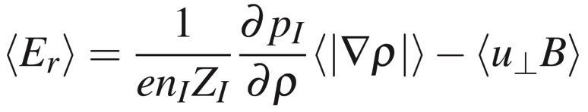
Perpendicular flow is directly related to the radial electric field through force balance
The radial force balance relates the perpendicular velocity and the radial electric field.
  Perpendicular velocity can be measured using the XICS diagnostic.
    XICS is primarily sensitive to u⊥ due to the viewing geometry.
  The ion pressure gradient is small for flat ion pressures and weighted by the impurity charge.
    Pressure gradient term is easily accounted for in both
    experimental and theoretical calculations.
Pressure Gradient Term
(small)
Perpendicular Velocity Term (from u ⨉ B)
Notes:
Fix Boozer labels.

Slide 14
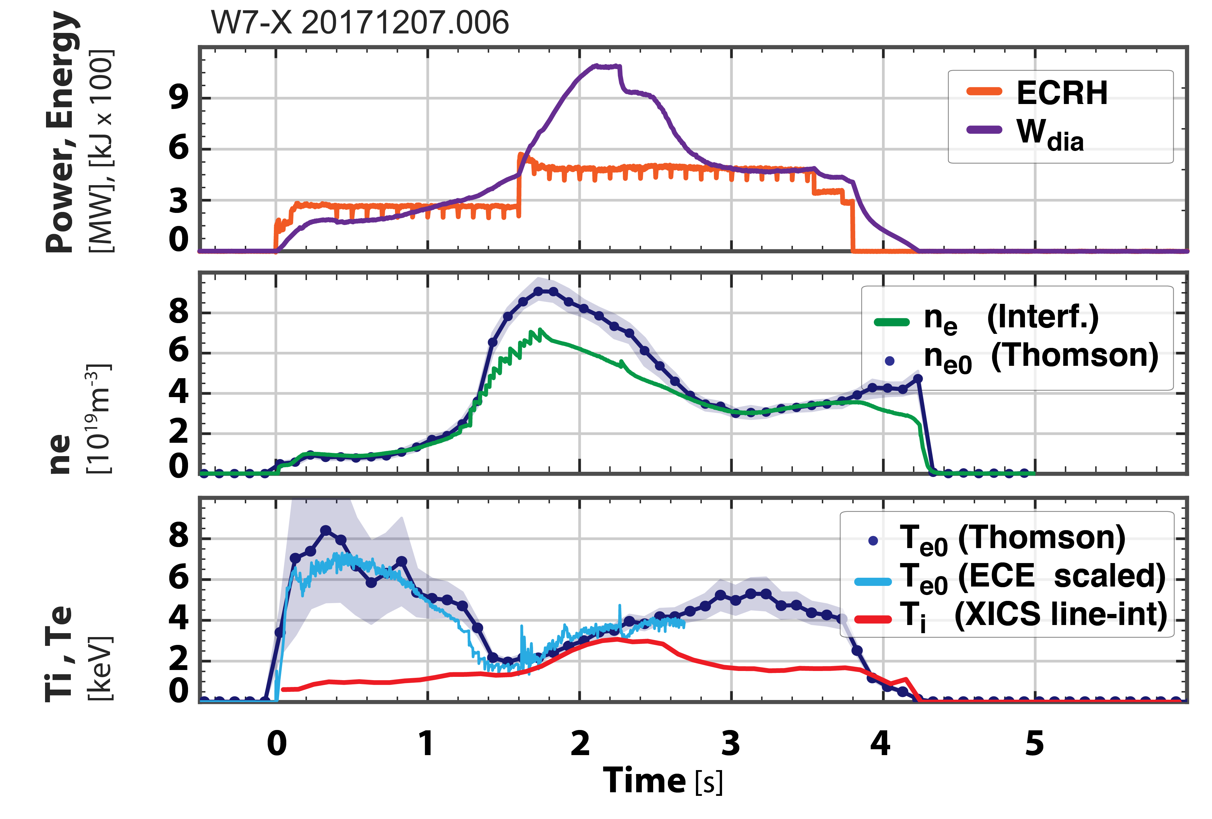
Pellet fueling on W7-X has produced high performance plasmas with Ti ~ Te
Injection of cryogenic hydrogen pellets has allows access to high-performance plasmas characterized by:
  Temperature equilibration (Te ~ Ti)
  High densities density peaking
  Limited duration: 30 Hz for 1 second
Achieved parameters with pellet fueling:
  Density n_{e0} ~ 1.0 x 10²⁰ m⁻³
  Heating: 5MW ECRH
  Stored Energy: 1.1 MJ
  Triple product: 0.6 × 10²⁰ m⁻³ keV s
  (World record for stellarators)
This type of plasmas scenario can be reliably reproduced.
  Only ECRH heating of electrons!
S. Bozhenkov [2018 - IAEA], T. Klinger [2018 - IAEA], T.S. Pedersen [2018 - PPCF]

Slide 15
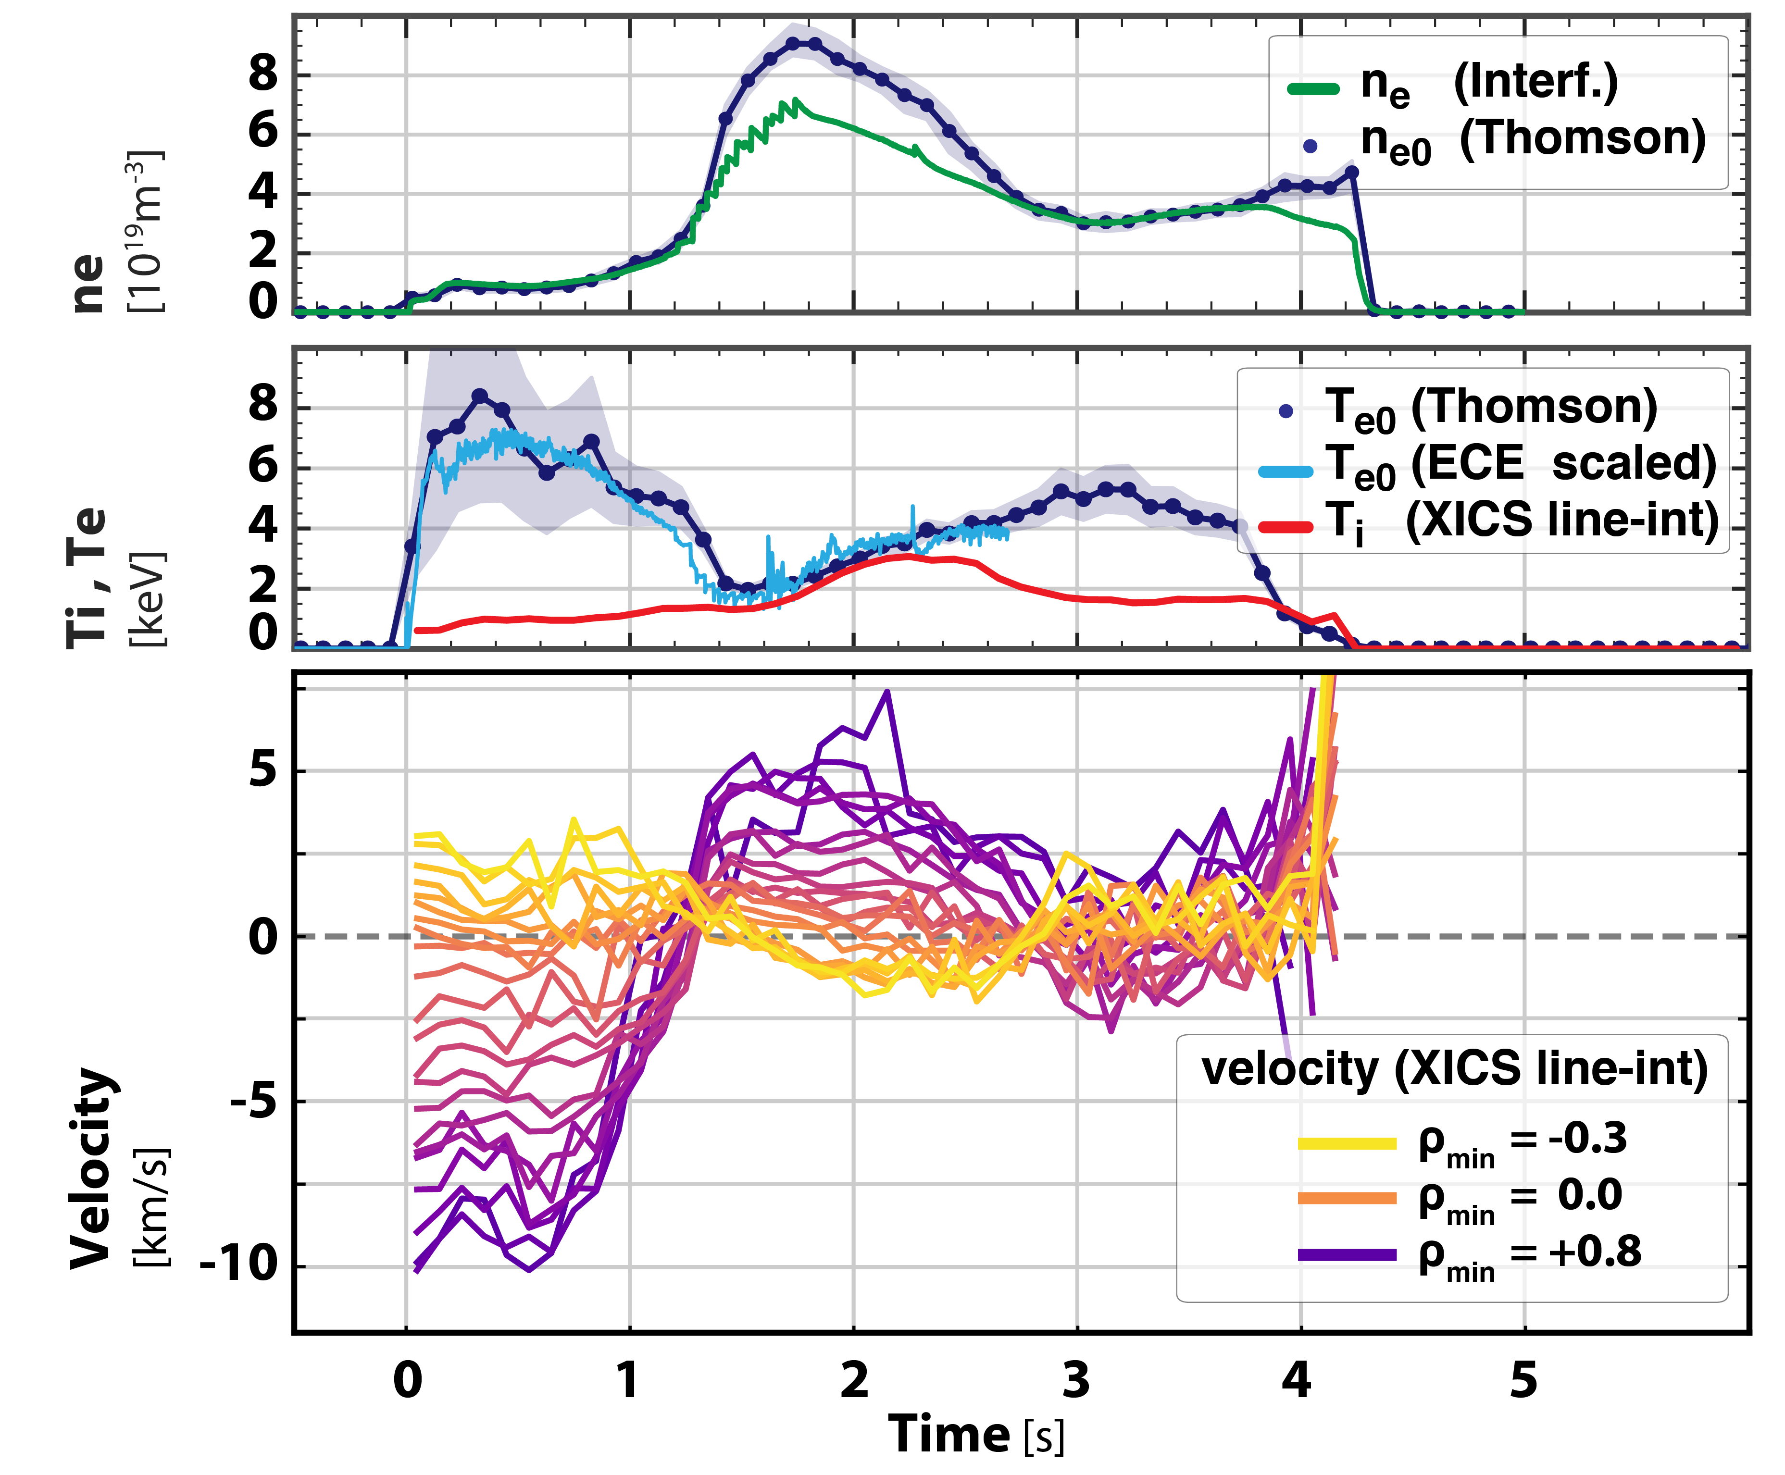
Dramatic changes seen in the perpendicular plasma flow as the plasma profiles evolve
Changes in the perpendicular plasma rotation indicate that the radial electric field is evolving.
Evolution of the plasma rotation happens in sync with the evolution of the temperature and density profile.
  Expected behavior from neoclassical theory.

Slide 16
Dramatic changes seen in the perpendicular plasma flow as the plasma profiles evolve
Changes in the perpendicular plasma rotation indicate that the radial electric field is evolving.
Evolution of the plasma rotation happens in sync with the evolution of the temperature and density profile.
  Expected behavior from neoclassical theory.
Tomographic inversion is used to find the perpendicular flow profile from the line-integrated measurements.
  Allows the Er profile to be inferred

Slide 17
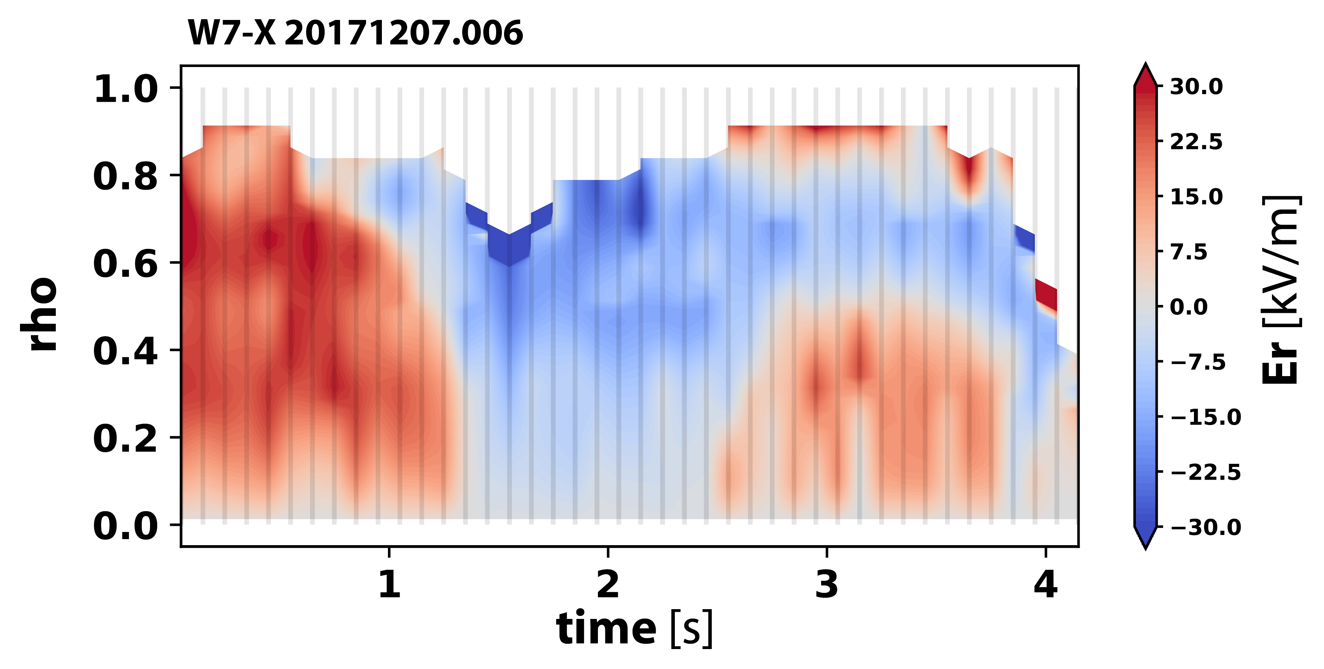
First experimental measurements of ion-root plasmas on Wendelstein 7-X
  Negative radial electric field → ion-root

Slide 18

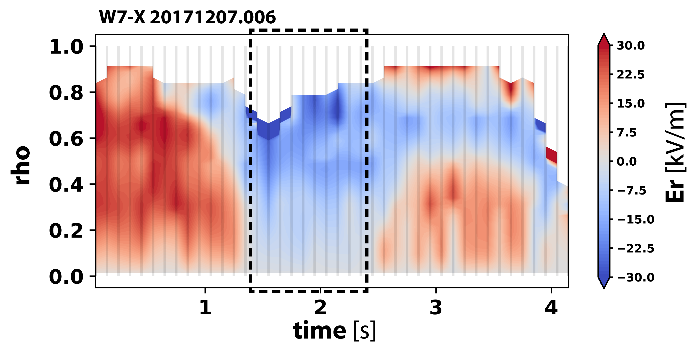
First experimental measurements of ion-root plasmas on Wendelstein 7-X
ion-root
  Ion-root observed during the period when the ion and electron temperatures are equilibrated (Te ~ Ti).

Slide 19
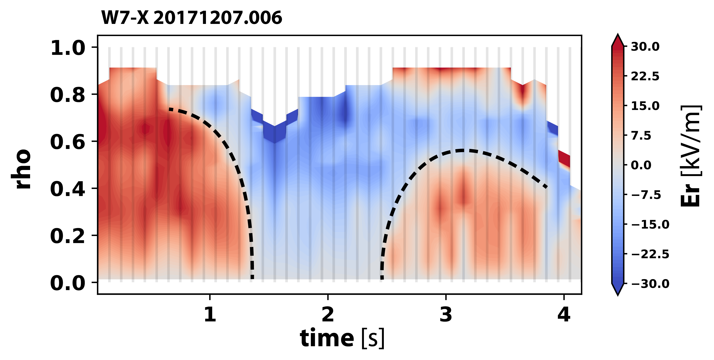
The crossover radius from ion-root to electron root evolves with the plasma temperatures
ion-root
  When Te >> Ti: Er is in the electron-root over nearly the entire plasmas radius.
  As Te approaches Ti: the electron-root region shrinks towards the plasma core.
  When Te ~ Ti: Er is in the ion-root.

Slide 20
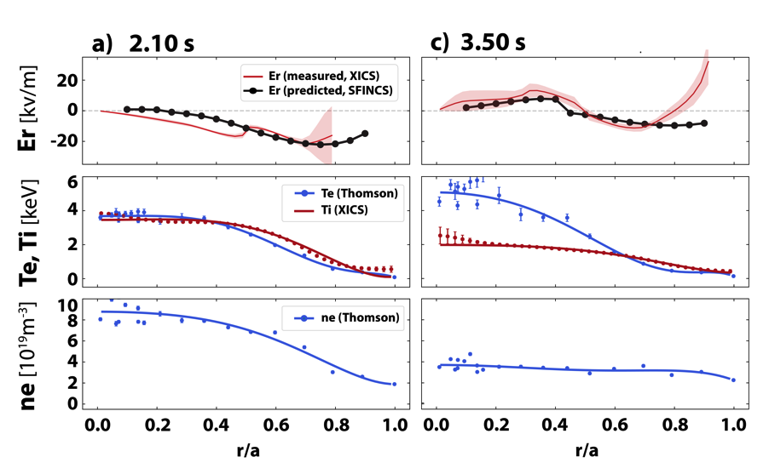
Neoclassical predictions of the radial electric field match the measured profiles
The ambipolar radial electric field can be predicted from the measured Te, Ti and ne profiles.
Neoclassical calculations by the SFINCS code:
  4D Drift-Kinetic continuum code
Neoclassical predictions for Er profiles show similar structure and magnitude.
  Good agreement over a wide range of plasma conditions.
Agreement between measurements and predictions of Er profiles
provides confidence in calculations of Neoclassical transport!

Slide 21
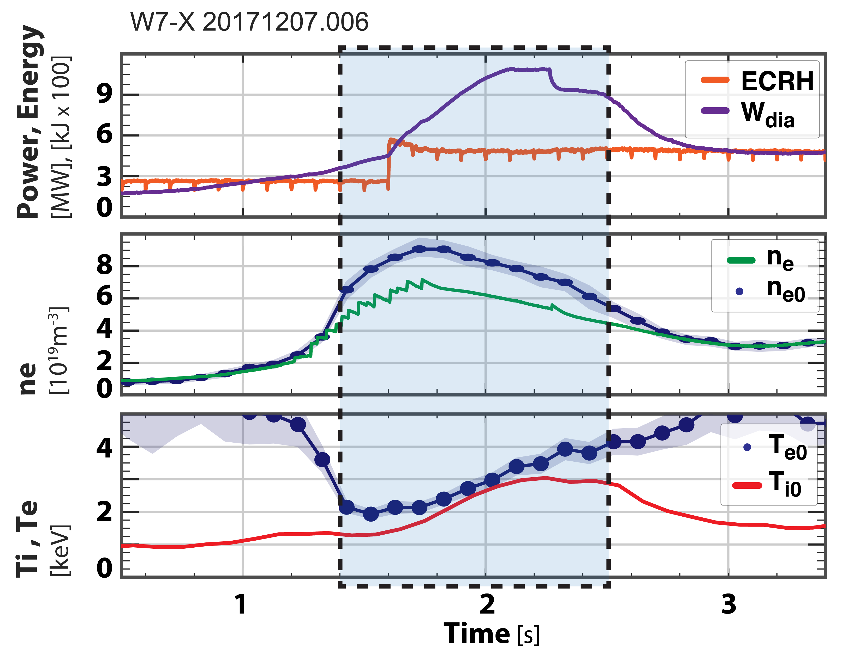
Conditions for achieving ion root
In program 20171207.006:
The ion-root phase is associated with:
  Beginning of density peaking
  Temperature equilibration
At the start and end of the ion-root period the density is observed to be at the same value.
  ne & ne0 ~ 0.4 x 10²⁰ m⁻³
ECRH power and plasma temperatures
are dramatically different:
  Input power: 2MW vs. 5MW
  Te & Ti: 1.5 keV vs. 3.0 keVc

Slide 22
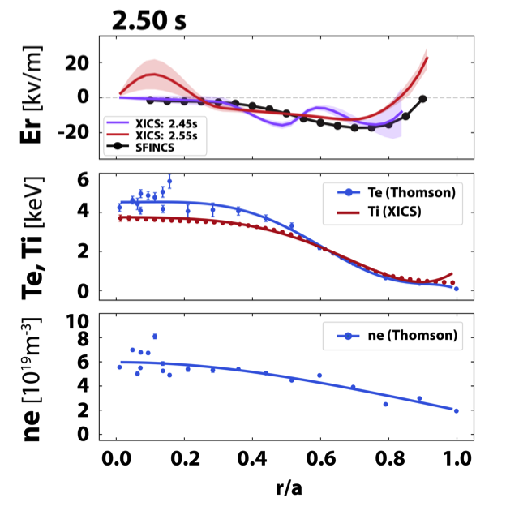
Conditions for achieving ion root
In program 20171207.006:
The ion-root phase is associated with:
  Beginning of density peaking
  Temperature equilibration
At the start and end of the ion-root period the density is observed to be at the same value.
  ne & ne0 ~ 0.4 x 10²⁰ m⁻³
ECRH power and plasma temperatures
are dramatically different:
  Input power: 2MW vs. 5MW
  Te & Ti: 1.5 keV vs. 3.0 keVc

Slide 23
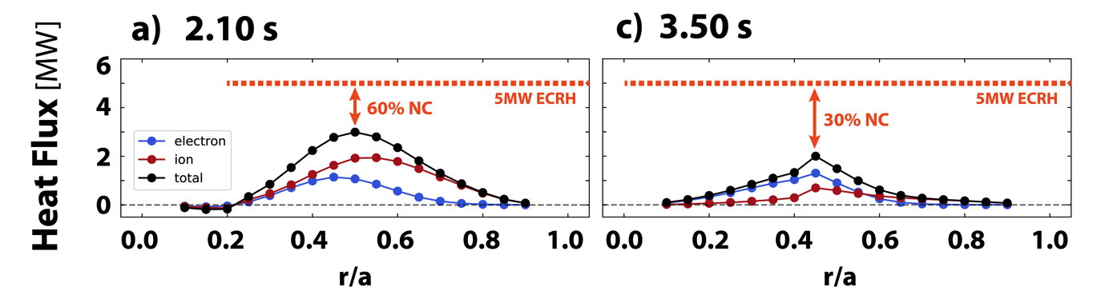
A larger fraction of the total core transport appears to be neoclassical during the ion-root phase
During ion-root phase (collisional coupled):
  Ion heat-flux is greater than electron heat-flux
  Neoclassical ≈ 60% of total heat-flux
Neoclassical calculations have been made with several codes and show good agreement.
  SFINCS, DKES, NTSS, FORTEC-3D
During electron-root phase:
  Electron heat-flux is dominant.
  Neoclassical 20-30% of total heat-flux
S. Bozhenkov [2018 – IAEA], N. Pablant [2018 – IAEA]

Slide 24
Is a reduction in turbulent transport responsible for the improvement in confinement?
Electron density fluctuations are measured by the Phase Contrast Imaging (PCI) diagnostic.
In W7-X, density fluctuations typically scale with the density (ñ/n ~ constant).
After pellet injection a clear reduction in the the ratio of ñ/n is observed.
This reduction in turbulence may explain the improvement in core confinement.
Open question:
  Does the radial electric field play a direct role in changing the turbulent behavior?
TURBULENT
REDUCTION
PELLETS
A. Von Stechow [2018], O. Grulke [2018 – IAEA]

Slide 25
Is a reduction in turbulent transport responsible for the improvement in confinement?
Electron density fluctuations are measured by the Phase Contrast Imaging (PCI) diagnostic.
In W7-X, density fluctuations typically scale with the density (ñ/n ~ constant).
After pellet injection a clear reduction in the the ratio of ñ/n is observed.
This reduction in turbulence may explain the improvement in core confinement.
Open question:
  Does the radial electric field play a direct role in changing the turbulent behavior?
ION-ROOT PHASE
A. Von Stechow [2018], O. Grulke [2018 – IAEA]

Slide 26
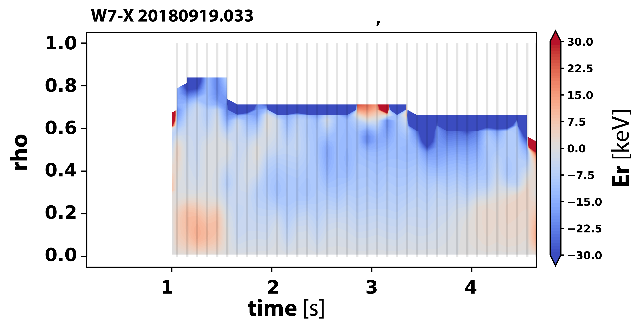
Access to ion-root plasmas:
Neutral Beam Heating
Ion-root conditions can also be achieved with pure NBI heating.
  Ti > Te, profiles have similar shape.
  55 keV injection energy, 3.5 MW injected power.
NBI plasmas have several similarities to the pellet fueled discharges:
  High density with peaked density profiles
  Reduction in turbulent ñ/n observed
NBI PHASE

Slide 27
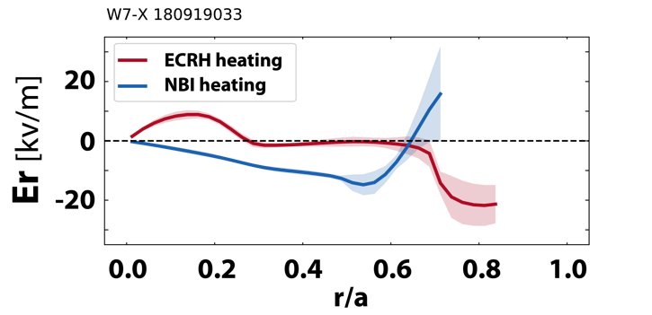
Access to ion-root plasmas:
Neutral Beam Heating
Ion-root conditions can also be achieved with pure NBI heating.
  Ti > Te, profiles have similar shape.
  55 keV injection energy, 3.5 MW injected power.
NBI plasmas have several similarities to the pellet fueled discharges:
  High density with peaked density profiles
  Reduction in turbulent ñ/n observed

Slide 28
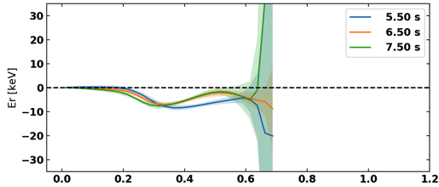
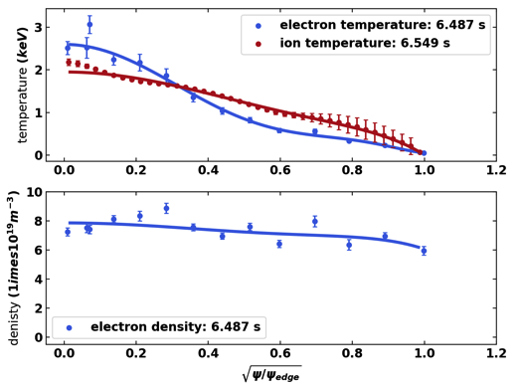
Access to ion-root plasmas:
Steady state with gas fueling? off-axis heating?
Steady state densities above 1.0 x 10²⁰ m⁻³
can be achieved in W7-X through hydrogen gas fueling.
  Results in very flat density profiles.
At these high densities it is possible to approach thermal equilibration.
  However, Te and Ti profiles shapes are not generally similar.
Off-axis heating can also be used to bring the temperatures together by reducing and broadening the Te profile.
Observations so far seem to indicate radial electric fields close to zero.
  Ion-root plasmas may have been achieved but further analysis is still required.

Slide 29
Conclusions
High-density Ion-root plasmas have been observed in W7-X.
  These are the conditions for which W7-X has been optimized.
  (High beta operation not yet demonstrated.)
Equilibration between ions and electrons possible with only electron heating.
  Ti ~ Te achieved at high densities with both O2 and X2 ECRH heating.
Good agreement between measured Er profiles and neoclassical predictions.
  Agreement seen over a wide range of plasma conditions.
  Provides confidence in the validity of neoclassical calculations in W7-X.

Slide 31
Part 2:
Highlights from the first W7-X divertor campaign
Novimir Pablant on behalf of the W7-X Team
Slides courtesy of Robert Wolf
2019-01

Slide 32
Wendelstein 7-X has been optimized with respect to a number of different parameters
The plasma shape and coil set have been optimized:
1. High quality vacuum magnetic surfaces
2. Good finite equilibrium properties
3. Reduced Neoclassical transport
4. Plasma stability up to <β> ~5%
5. Minimization of bootstrap current and Shafranov shift
6. Good collisionless fast particle confinement
7. Modular coil feasibility
Physics research goals:
• Verify stellarator optimizations
• Verify performance of island divertor design
• Demonstrate plasma density control at high densities
• Explore impurity confinement
Engineering research goals:
• Sustain high density, high performance steady state operation.
• Demonstrate steady state high heat flux handling

Slide 33
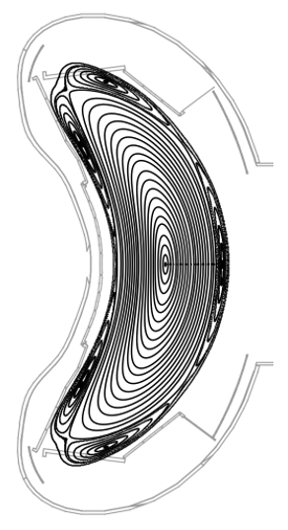
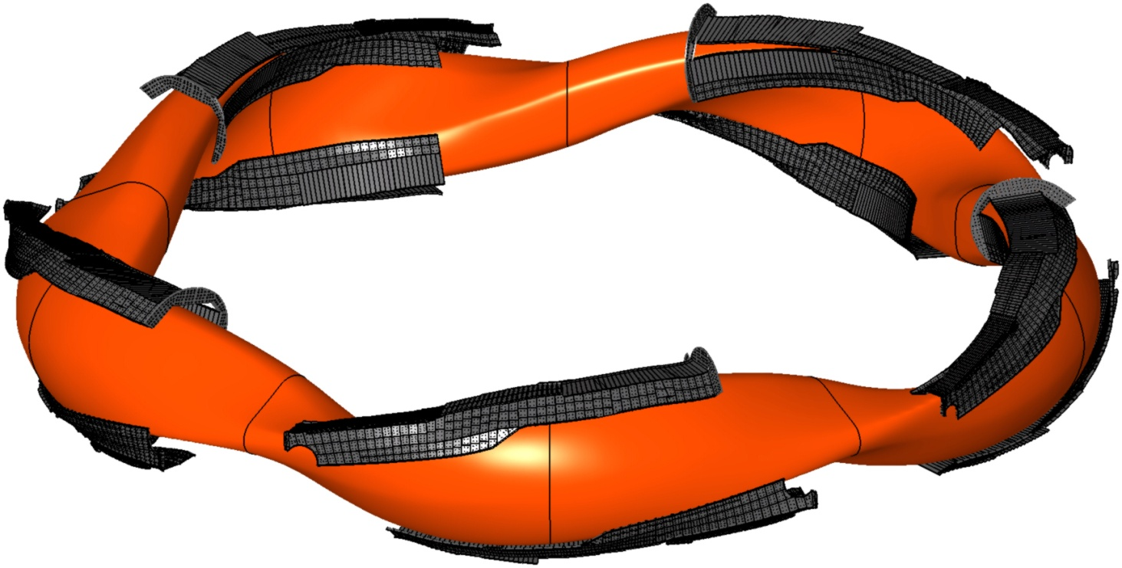
Resonant magnetic island divertor
Controlled heat and particle exhaust using open magnetic field lines intersecting dedicated target plates
Notes:
(Poincare plots) - standard configuration

Slide 34
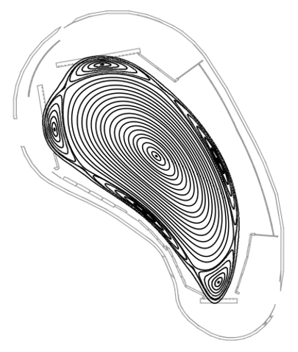
Resonant magnetic island divertor
Controlled heat and particle exhaust using open magnetic field lines intersecting dedicated target plates
Notes:
(Poincare plots) - standard configuration

Slide 35
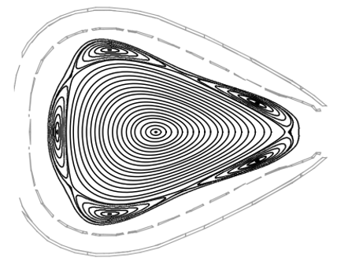
Resonant magnetic island divertor
Controlled heat and particle exhaust using open magnetic field lines intersecting dedicated target plates
Notes:
(Poincare plots) - standard configuration

Slide 36
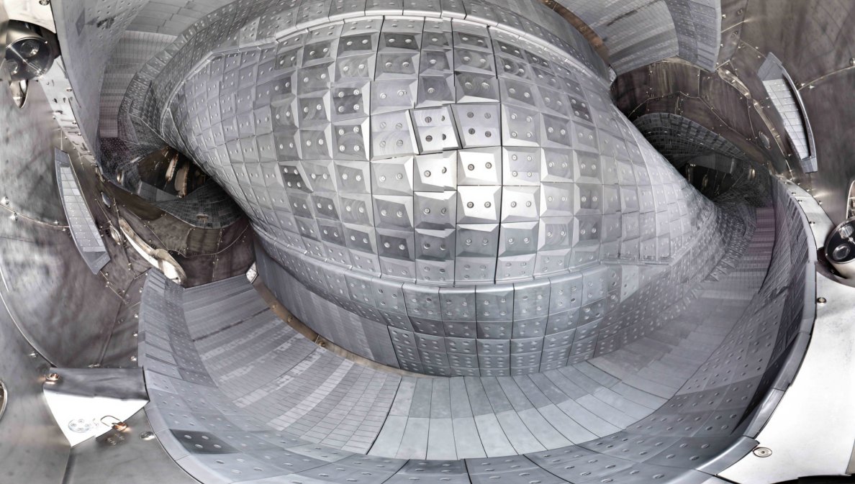
Fisheye view into the plasma vessel
Heat shield (graphite tiles)
Stainless steel panels
Divertor (graphite)

Slide 37
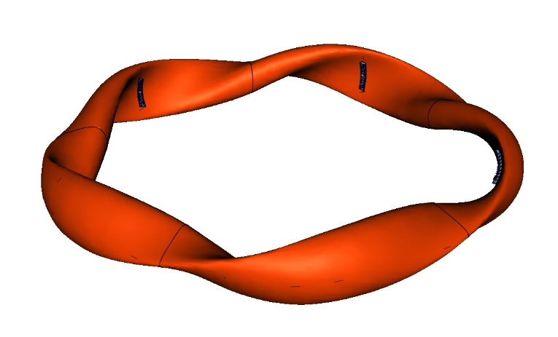
Staged approach to steady-state operation
OP 2: 2021 …
Steady-state operation
Actively cooled divertor configuration
P_{ECRH} ~ 10 MW (cw)
P_{NBI} ~ 10 MW, P_{ICRH} ~ 2 MW (10 s)
P/A ≤ 10 MW/m²
Technical limit 30 minutes @ 10 MW
Limiter
OP 1.2: 2017 / 2018
Uncooled divertor configuration
P_{ECRH} < 8 MW
P_{NBI} < 4 MW
∫ P dt ≤ 80 MJ … 200 MJ
τ_{pulse} ~ 10 s … 100 s
OP 1.1: 2015 / 2016
Limiter configuration
P_{ECRH} < 5 MW
∫ P dt ≤ 4 MJ
τ_{pulse} ~ 1 s
Divertor

Slide 38
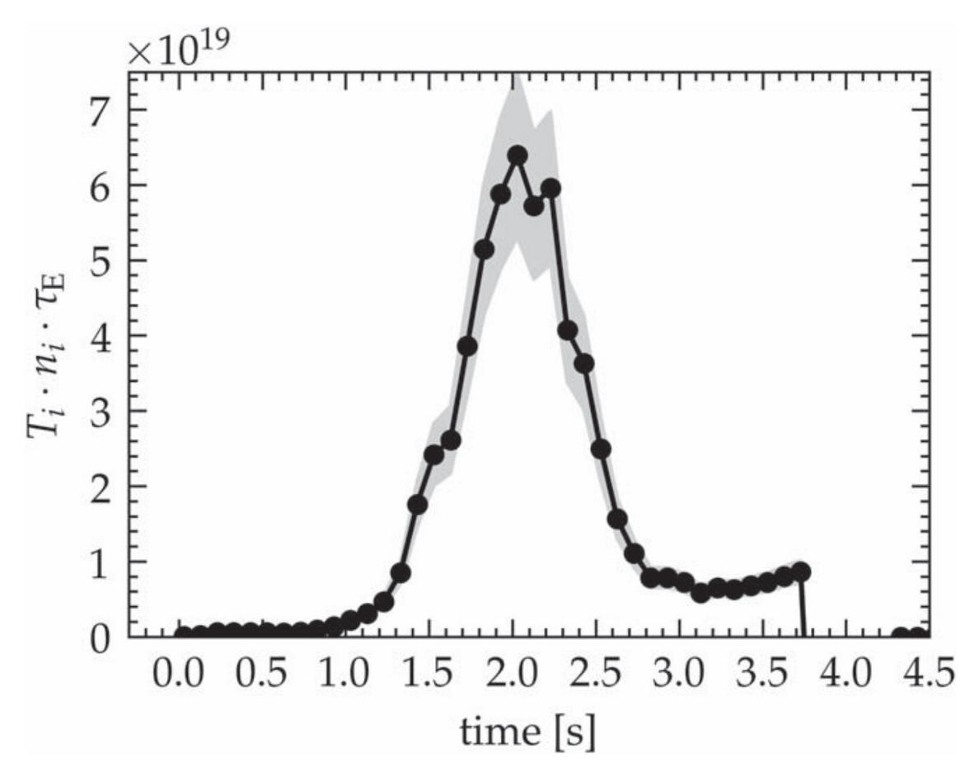
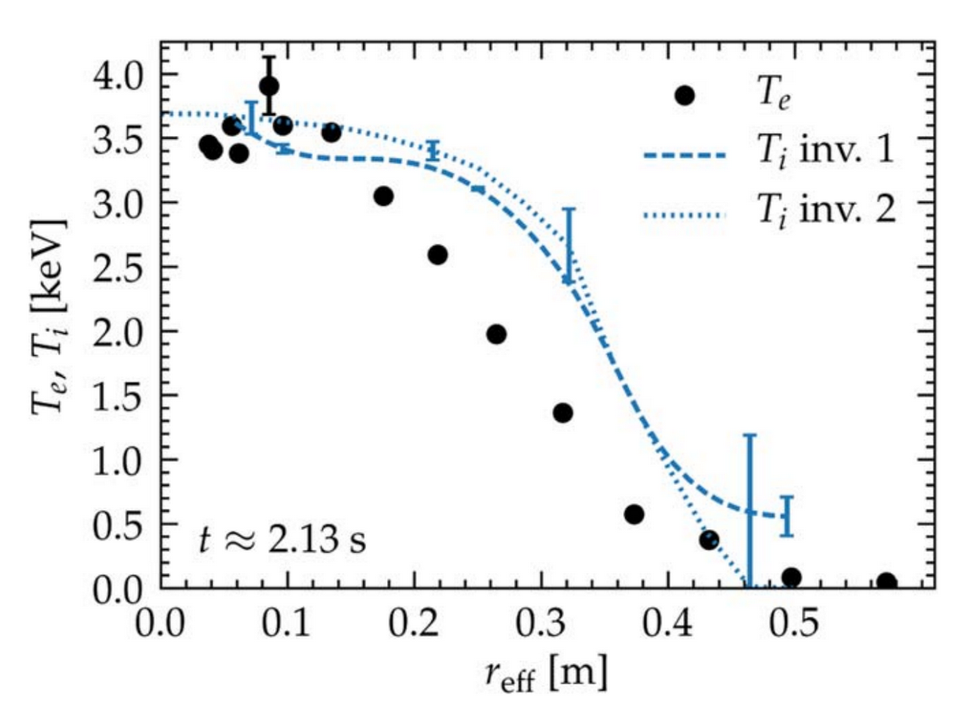
Record triple product achieved with X2-ECRH and pellets
Density increase by pellets and ECRH below X2 cut-off density
5 MW ECRH (max. 7 MW)
n_{e} ≤ 1×10²⁰ m⁻³
T_{i} = T_{e} ≤ 3.8 keV
Central β reaches 3.7 %
Energy confinement time τ_{E} ≤ 220 ms (1.4×τ_{ISS04})
Record triple product for stellarators (transiently)
n T_{i} τ_{E} ~ 6.8×10¹⁹ keV m⁻³ s
Highest triple product to date (in large tokamaks, transiently)
n T_{i} τ_{E} ~ 10²¹ keV m⁻³ s
Notes:
(record triple product shot) - inverse standard configuration
Important
Good confinement at high Ti, indicates that optimization of neoclassical is working, however for real verification temperatures still too low
Ignition
n T_{i} τ_{E} > 10²² keV m⁻³ s

Slide 39
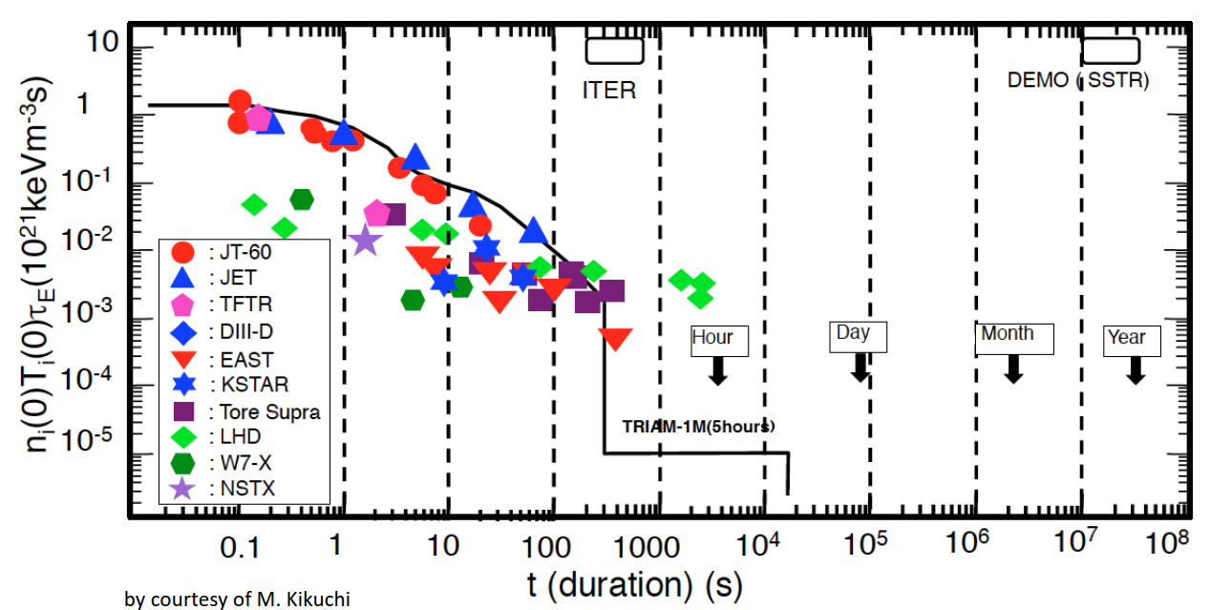
On the way to high performance steady-state operation
W7-X OP2
OP1.2
OP1.1
OP1.2
W7-X
Courtesy of M. Kikuchi
T. Sunn Pedersen et al, Phys. Plasmas 24 (2017) 055503
Notes:
30 s detached plasma: 0,6 MJ/5MW * 2,5 keV (Te = Ti) * 0,9 (Zeff = 1,5) * 0,9*10^20 m-3 = 0,24 * 10^20 keV m-3 sec
100 s plasma: 0,3 MJ / 2,1 MW * 1,6 keV (Ti) * 3,8*1019 m-3 * 0,9 (assuming Zeff = 1,5) = 0,8*10^19 keV m-3 sec

Slide 40
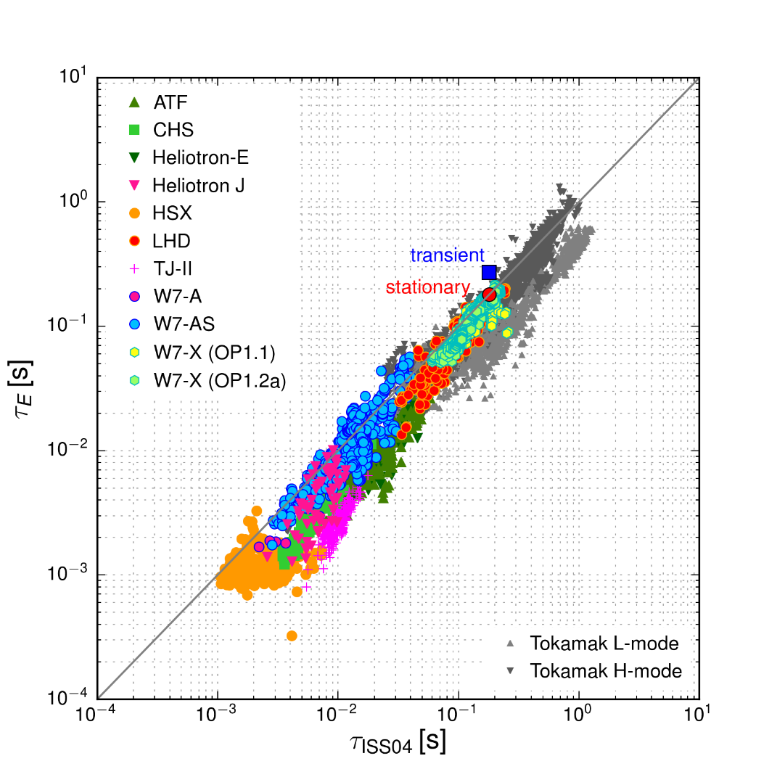
Scaling of energy confinement time
Record divertor (OP1.2) plasma (transient)
Stationary divertor (OP1.2) plasma
Divertor plasma (OP1.2) data
Limiter plasma (OP1.1) data

Slide 41
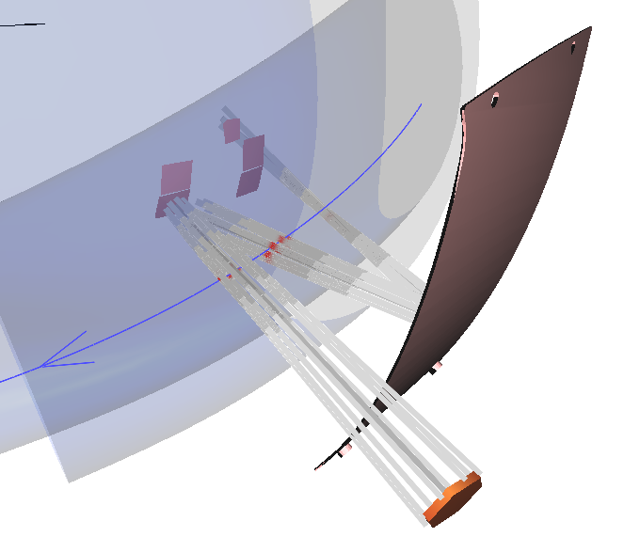
Higher plasma density require 2nd harmonic O-mode (O2) ECRH
O2-ECRH requires a multi-pass absorption scheme
X2-mode ECRH up to cut-off
< 1.2 ·10²⁰ m⁻³
For higher densities O2-mode polarization
O-mode requires multi-pass absorption (single beam absorption ~70%)
Special holographic mirrors guarantee defined beam path through plasma centre (covered by tungsten)
For each beam individual holographic reflection tile
Polished steel
panel
ECRH beam
(front steering launcher at LFS)
Notes:
Further increase density …

Slide 42
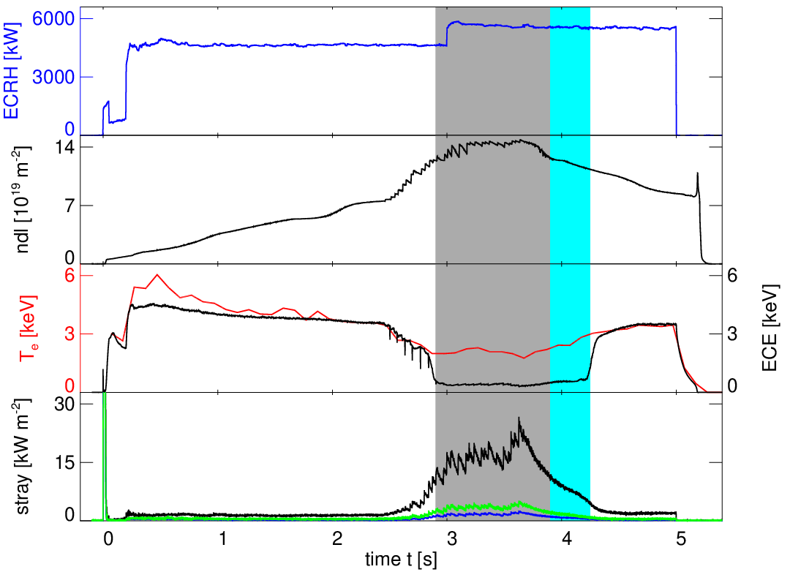
First demonstration of O2-ECRH above X2 cut-off
6
Overall ECRH-power
Startup in X2-mode
Add O2-mode
Change X2 to O2
ECRH [MW]
3
X2-mode contribution
0
14
Increase of density
with pellets
ndl [10¹⁹m⁻²]
7
0
6
ECE close to 140 GHz indicates cut-off:
n_{e0} ≈ 1.5×10²⁰ m⁻³
T_{e} [keV]
3
ECE [keV]
0
2.2 keV
70 – 80%
30
2.9 keV
90%
Stray radiation still acceptable < 50 kW/m²
Absorption ∼ T_{e}²
Stray radiation
[kW m⁻²]
Module 2
Module 3
Module 4
15
0
0
1
2
3
4
5
Time [s]
T. Stange, PO5.00002
Notes:
(O2 pellet shot) - standard configuration
First ever demonstration of pure O2 ECRH in magnetic confinement devices (w/o other auxiliary heating)
Plasma generation requires X2-mode ECRH
Development of viable scheme changing from X2- O2-polarization
O2 heating far beyond X2-cut-off successfully demonstrated: n_{e} ≈ 1.4 ·10²⁰ m⁻³
For higher densities O2-mode polarization necessary
However, single beam absorption for O-mode at ~70% requires multi-pass absorption scheme
Prerequisite for W7-X high density plasmas which a necessary to validate 1/ν ion transport regime.
It was absolutely unclear if the transition could be managed while Te was dropping, O2 coupling strongly depends n Te
Envisaged plasma parameters at W7-X are 10^20 m^-3 at temperatures of 3keV. However, operation close to the X2-cutoff of 1.2*10^20 m^-3 is a safety issue. For this reason, a triple-beam-path scenario was developed to allow the use of O2-mode-heating which has a single path absorption of only 70%. Individual holographic tiles were used at the inboard-side to refract the beams back through the magnetic axis independent on the orientation of the tile. This allows a third path after reflection at a polished steel panel.
The time traces show a discharge where O2 heating far beyond the X-cutoff was demonstrated. The startup is realized by 3 gyrotrons in X-mode-polarization. 200ms after the startup six further gyrotrons in O-mode-polarization were used. For switch-over from X2 to O2 two possibilities were tested: two startup gyrotrons were shut off during the change of the polarizer mirrors (only the elliptical polarizers are shown, which change the sense of rotation). However, the change of the polarizers during operation is also possible as obvious for the other startup-gyrotron. Around t=2.5s the density was rapidly increased by use of pellets. The temperature decreases at the same time from 5keV down to 2keV leading to higher stray radiation. The X2-cutoff indicated by the ECE does not further increase the stray radiation level which is in general below the expected value of about 50kW/m^-3. Optimal operation with almost full absorption is achieved with 3keV at densities 10^20 m^-3.

Slide 43
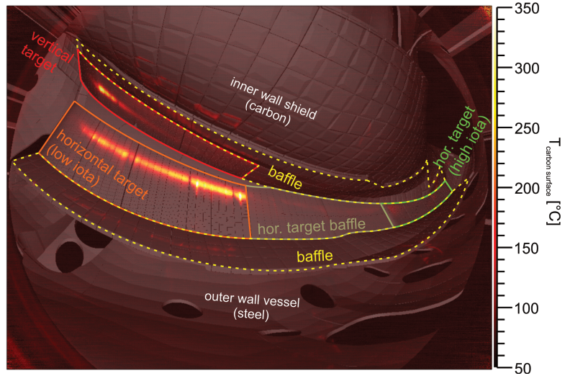
Infra-red observation of all 10 divertor modules

Slide 44
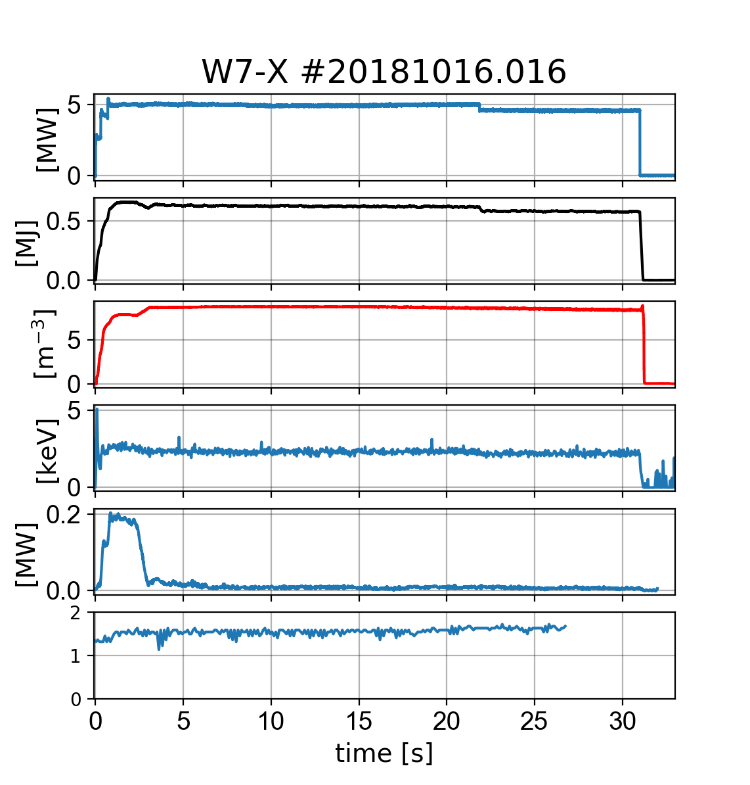
Detachment across all 10 divertor modules over half a minute
5 MW of O2-ECRH heating (150 MJ)
Interferometer based density feedback control
Pulse duration not limited by plasma performance
Divertor neutral pressure ~ 6-7x10⁻⁴ mbar
Z_{eff} stays roughly constant.
P_{ECRH}
W_{dia}
[10¹⁹
m⁻³]
10
n_{e}
T_{e, TS}
P_{div}
Detachment
Z_{eff}
Notes:
Special divertor gas valves (thermal helium beam diagnostic) has been used for fuelling
#20181016.016 - standard configuration
to be fair I have to point out that the discharge was limited by the transmission capability of the ECRH system.
At the moment we have a bottle neck, by air temperature increase close to the launcher when we run with all beams. For 1 beam at one launcher we had already achieved stationary condition at the 100 s shot, but full power is not yet possible. Anyway we plan to improve the situation soon and test the transmission already in 2019 to insure long pulse operation in OP2.

Slide 45
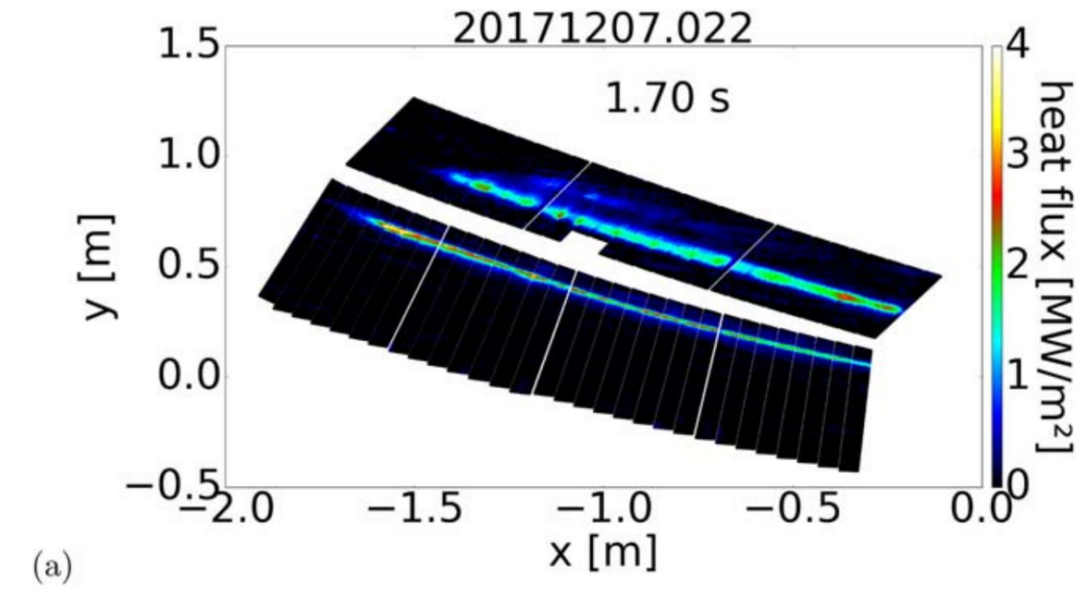
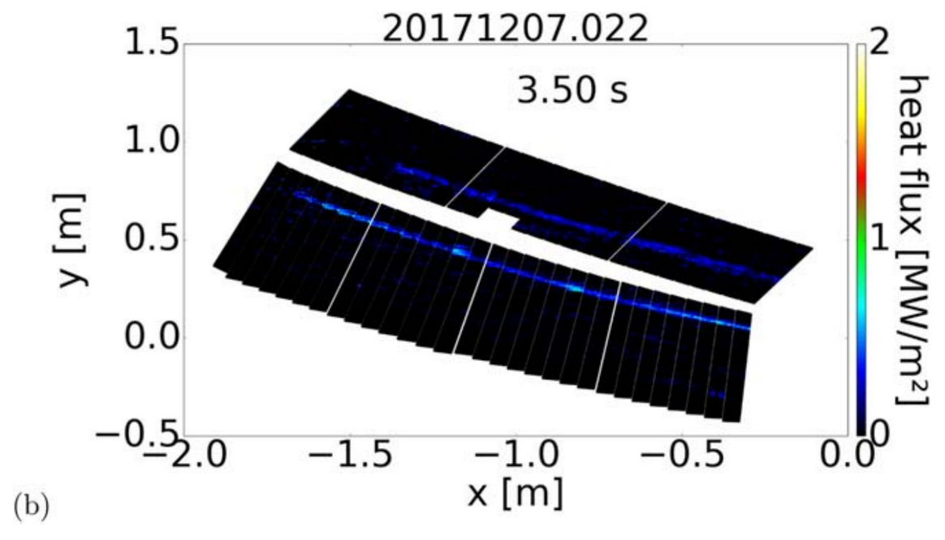
Detachment across all 10 divertor modules over half a minute
5 MW of O2-ECRH heating (150 MJ)
Interferometer based density feedback control
Pulse duration not limited by plasma performance
Divertor neutral pressure ~ 6-7x10⁻⁴ mbar
Z_{eff} stays roughly constant.
Notes:
Special divertor gas valves (thermal helium beam diagnostic) has been used for fuelling
#20181016.016 - standard configuration
to be fair I have to point out that the discharge was limited by the transmission capability of the ECRH system.
At the moment we have a bottle neck, by air temperature increase close to the launcher when we run with all beams. For 1 beam at one launcher we had already achieved stationary condition at the 100 s shot, but full power is not yet possible. Anyway we plan to improve the situation soon and test the transmission already in 2019 to insure long pulse operation in OP2.

Slide 46
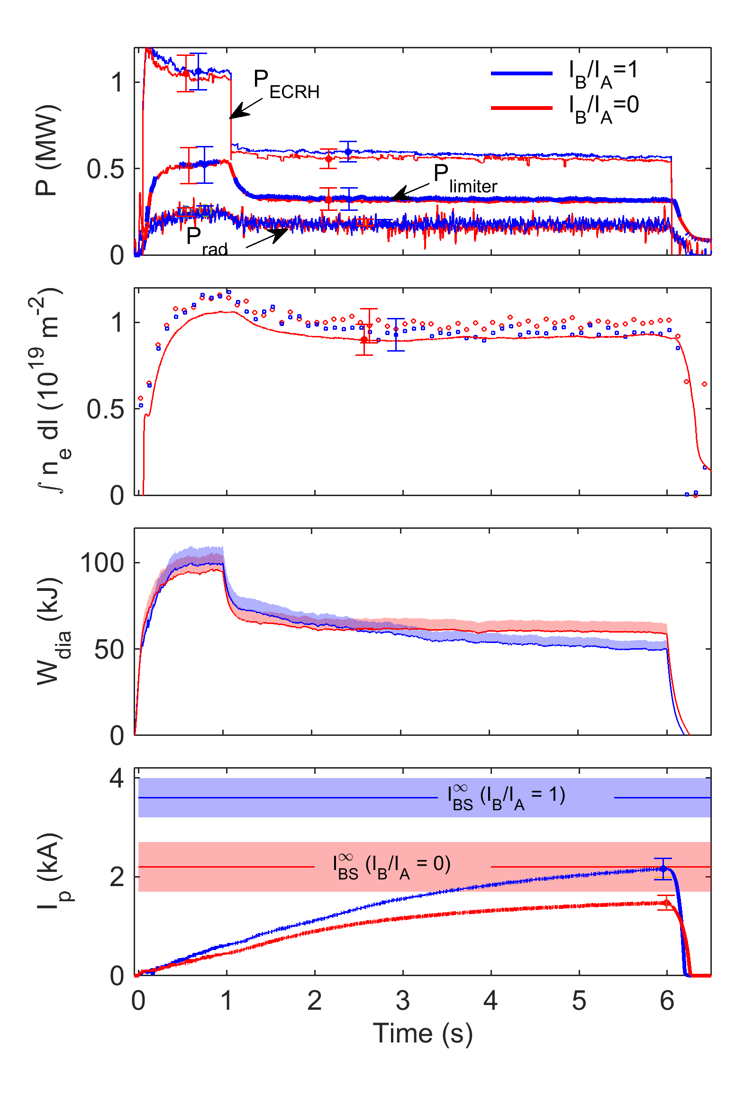
Bootstrap current minimization (limiter plasma)
Two nearly identical plasmas in √ν-regime dominated by strong ambipolar E_{r}
Essential differences: Mirror ratio, ε_{eff}
⇒ Different bootstrap currents
Toroidal curvature & helical component of magnetic field were the same (different ε_{eff} does not play a role in the √ν-regime)
⇒ Same neoclassical energy transport / heat fluxes
Ratio of bootstrap currents (no current drive) match neoclassical predictions
Bootstrap current minimization: Factor 3.5 smaller than in equivalent tokamak
A. Dinklage et al., A. Dinklage et al. (2018) Nature Physics doi:10.1038/s41567-018-0141-9
Notes:
Briefly explain evolution of plasma current: Initially, screening current prevent the build-up of the current. These currents decay on an L/R time scale which, depending on temperature, are on the order of 30 seconds.
About slide 53: there are more observations in several configurations that confirm the bootstrap current calculations. These were presented by Kian in the last MHD group meeting. But they pointed out that they needed to include an adjustable ~1kA offset in the experimental current, which can be possibly driven by unintended ECCD, to get a good theory/experiment match.

Slide 47
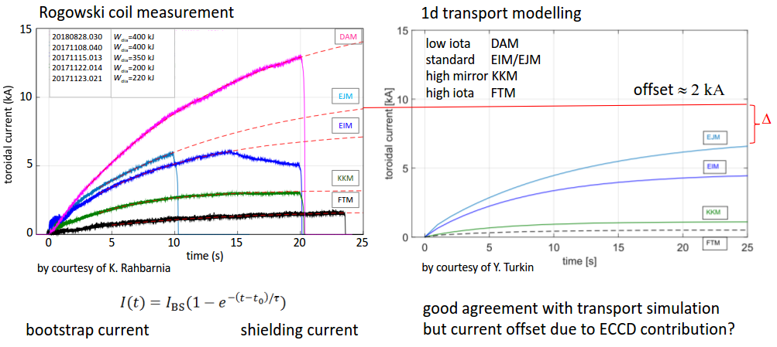
Dependence of bootstrap current on magnetic field configuration

Slide 48
Extra Slides

Slide 49
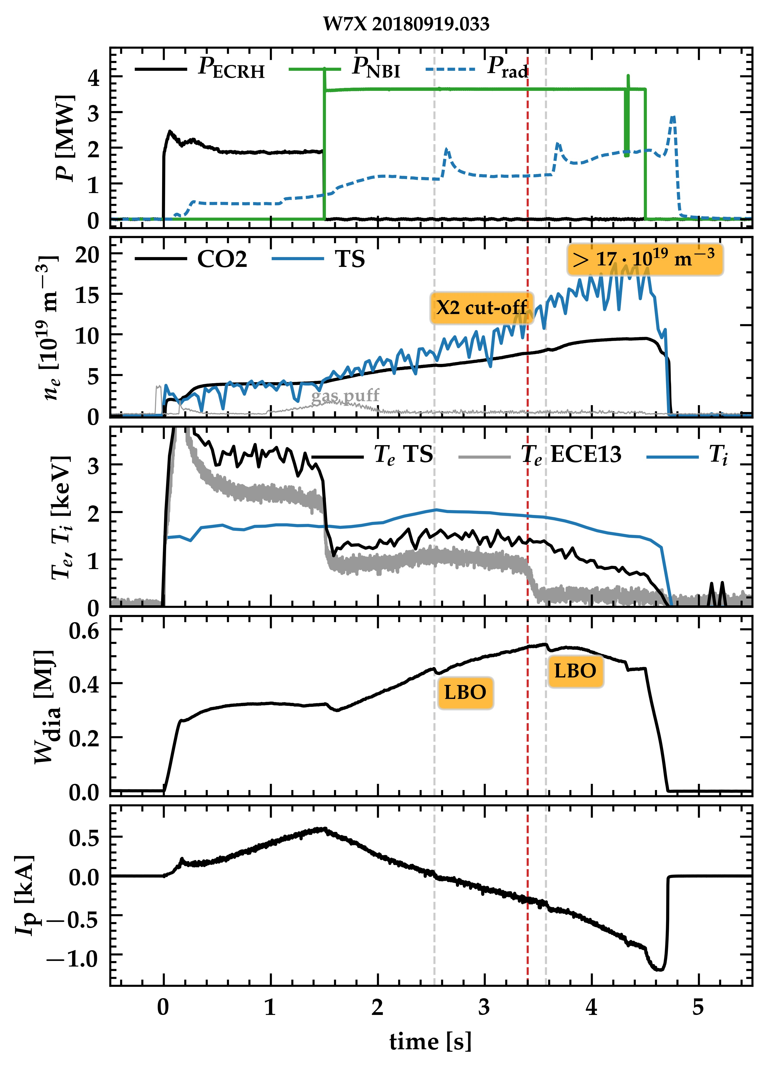
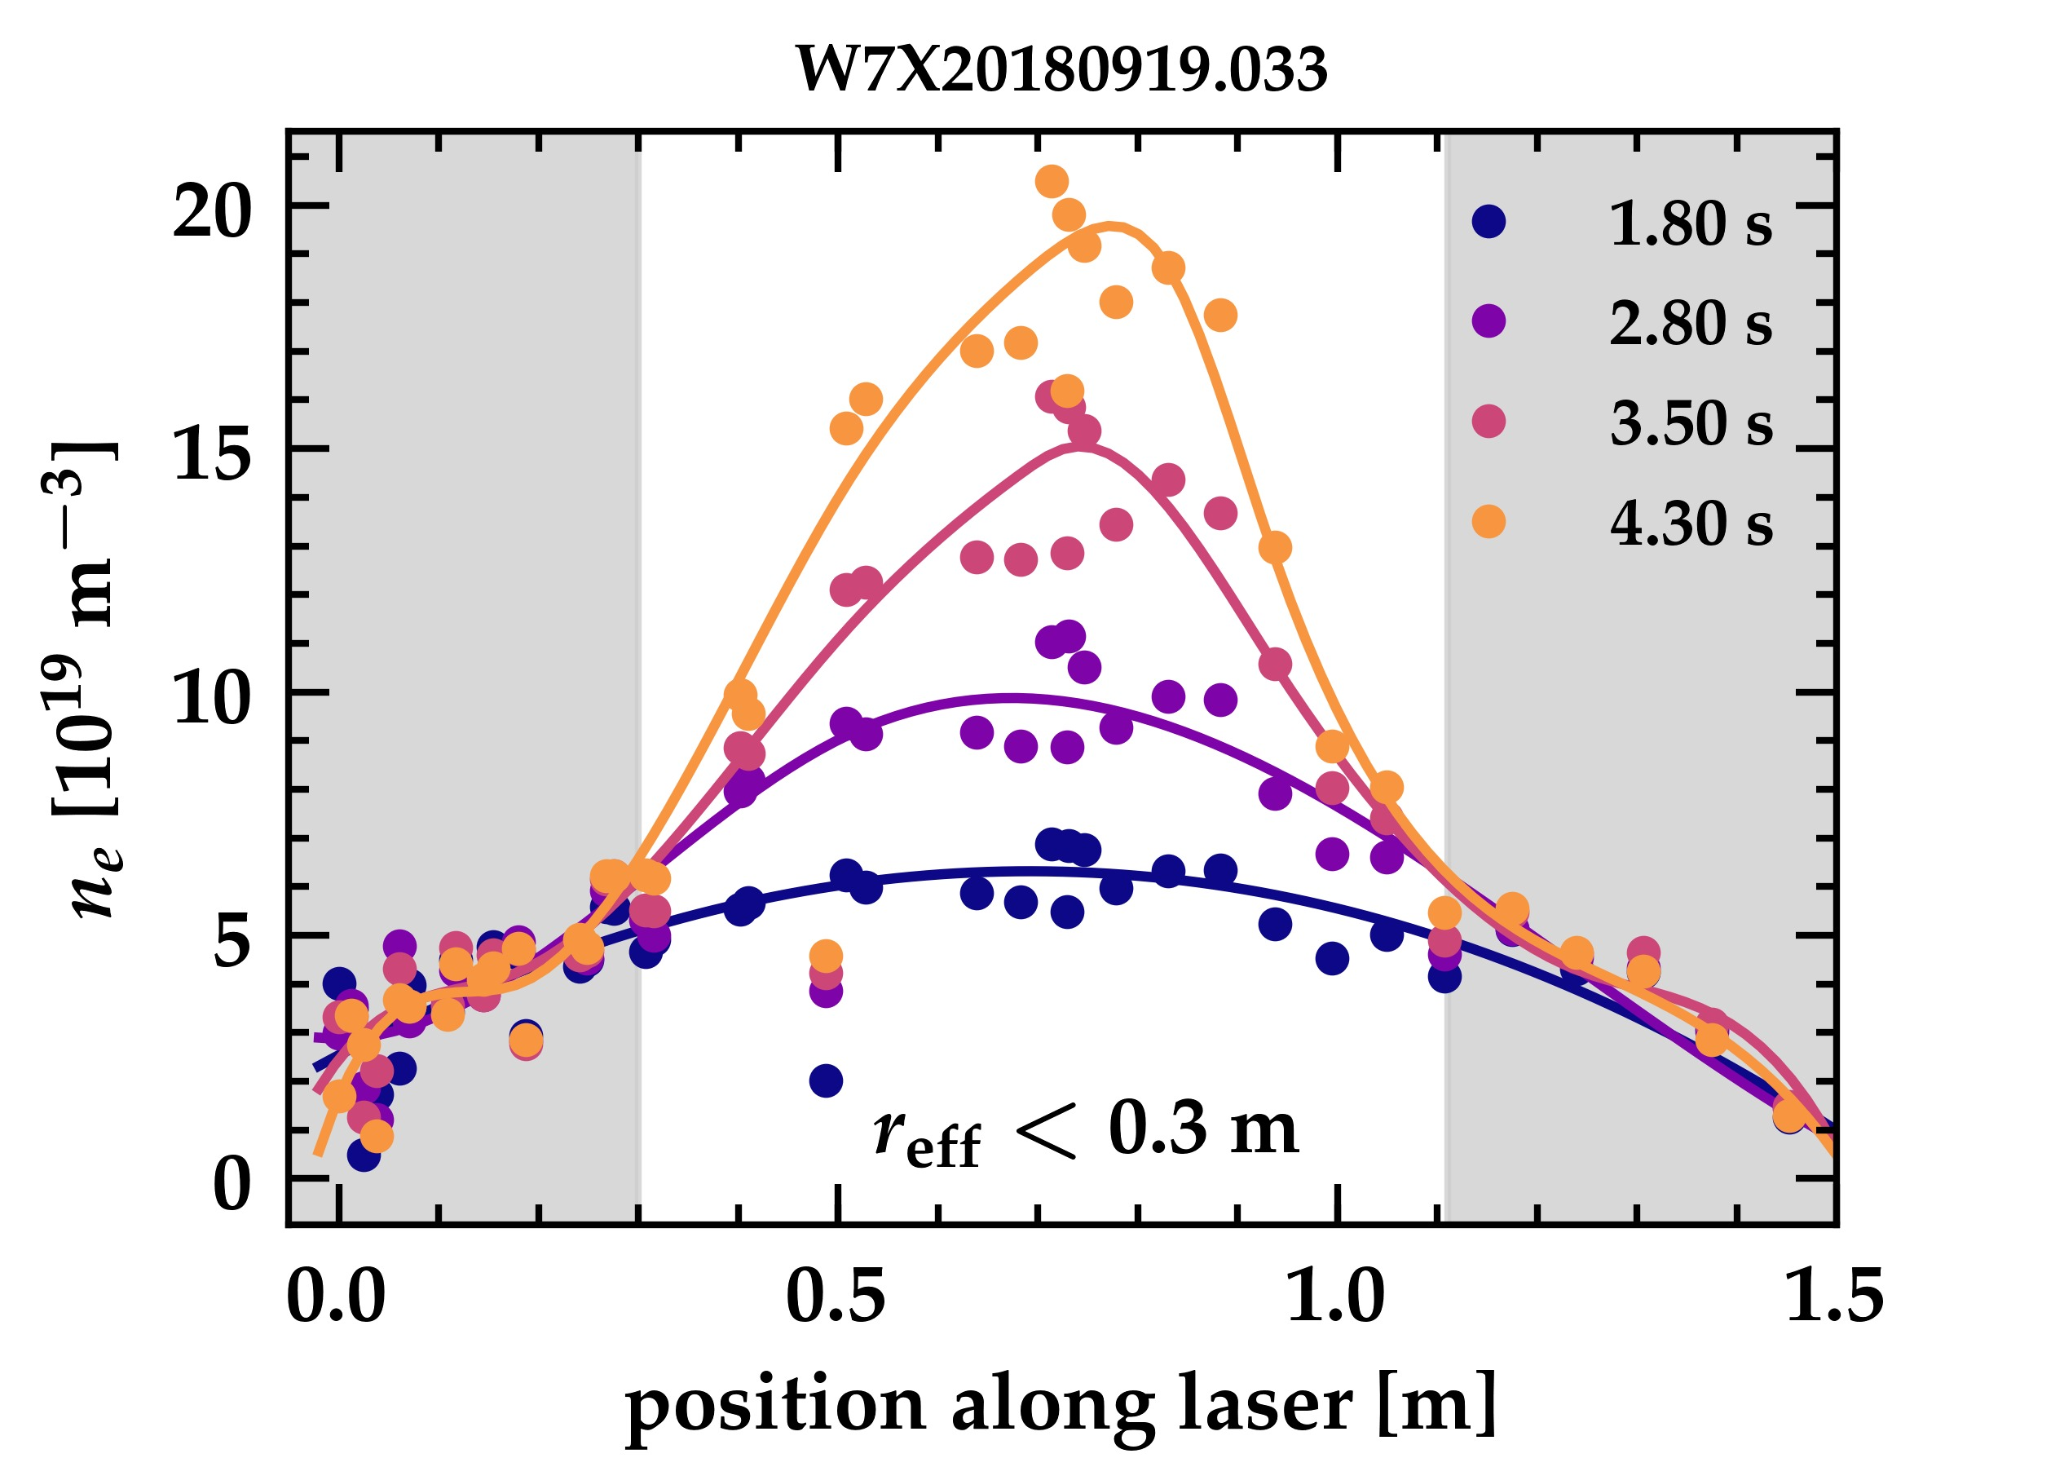
Pure NBI heating changes (particle) transport
n_{e}
(Thomson
scattering)
Plasma can be sustained by pure NBI heating
Centrally peaked high density plasma develops
Density peaking can be controlled with ECRH
Pure NBI heating with n_{e0} = 2×10²⁰ m⁻³ demonstrated
Notes:
#20180919.033 - standard configuration

Slide 50
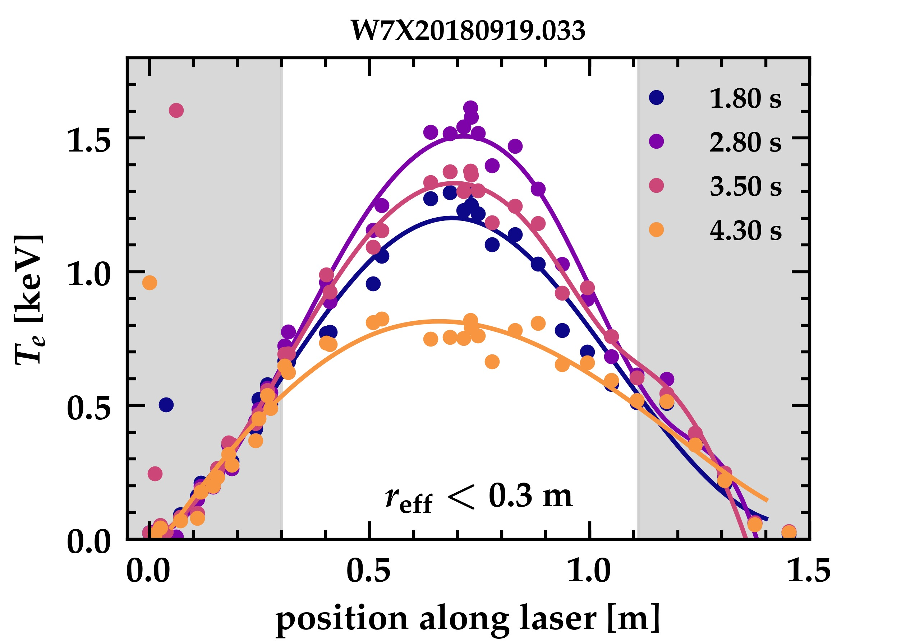
Pure NBI heating changes (particle) transport
T_{e}
(Thomson
scattering)
Plasma can be sustained by pure NBI heating
Centrally peaked high density plasma develops
Density peaking can be controlled with ECRH
Pure NBI heating with n_{e0} = 2×10²⁰ m⁻³ demonstrated

Slide 51
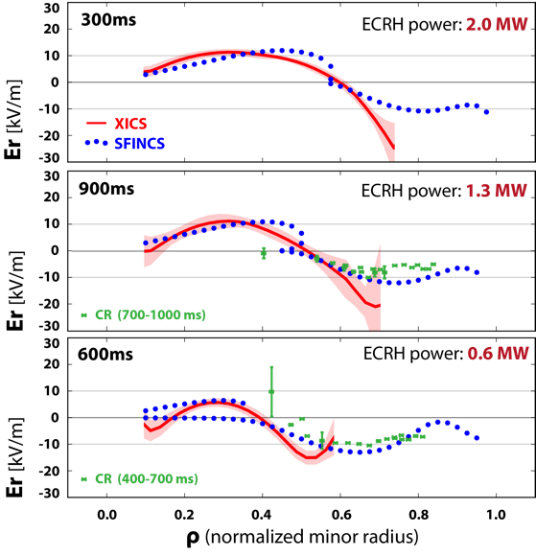
Measured radial electric field at W7X provides confidence in neoclassical calculations
The ambipolar radial electric field can be predicted
from the measured Te, Ti and ne profiles.
Neoclassical calculations by the SFINCS code:
  SFINCS: 4D Drift-Kinetic continuum code.
  Includes compressible ExB drift.
Neoclassical predictions for Er show similar
structure and magnitude to measured profiles.
  Crossover from electron-root to ion-root in
  excellent agreement.
Measurements of Er from the Correlation Reflectometer agree well with neoclassical
in the outer portion of the plasma.
N. Pablant, et al. Physics of Plasmas, 25, 022508 (2018)

Slide 52
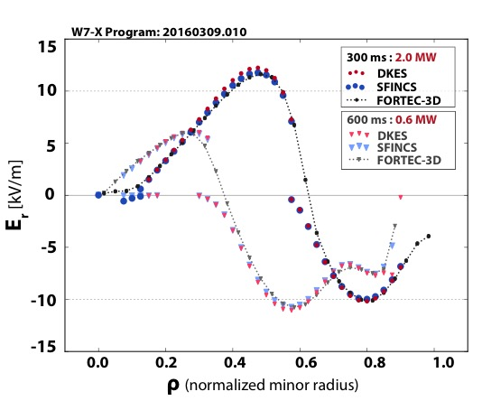
Validation and cross comparison of neoclassical transport calculations in stellarators
State of the art codes for calculation of neoclassical transport has been validated and compared at both W7-X and LHD.
  fortec-3d S. Satake (NIFS)
  sfincs M. Landreman (University of Maryland)
  dkes W. van Rij (ORNL)
  Comparison to measured radial electric fields provides experimental validation of the code results.
  Comparisons between codes allows regimes of code validity to be studied.
These results represent the first experimental validation and cross-comparison of neoclassical transport calculations on W7-X!
N. Pablant, Physics of Plasmas, 25, 022508 (2018)

Slide 53
Initial investigations on the role of of neoclassical transport in W7-X plasmas have begun
Neoclassically the majority of heat is lost through the electron channel.
  Expected due to weak coupling between electrons and ions at low densities.
At high power the maximum neoclassical transport in the core is about 50% of the input heating power.
  Turbulence and radiation losses are expected
  to dominate in the edge.
Likely candidates to explain the remaining heat transport or heat loss:
  Turbulent transport
  radiation losses
  charge exchange losses
M. Landreman, M. Hirsch [2016], H. Maassberg

