Slide 1

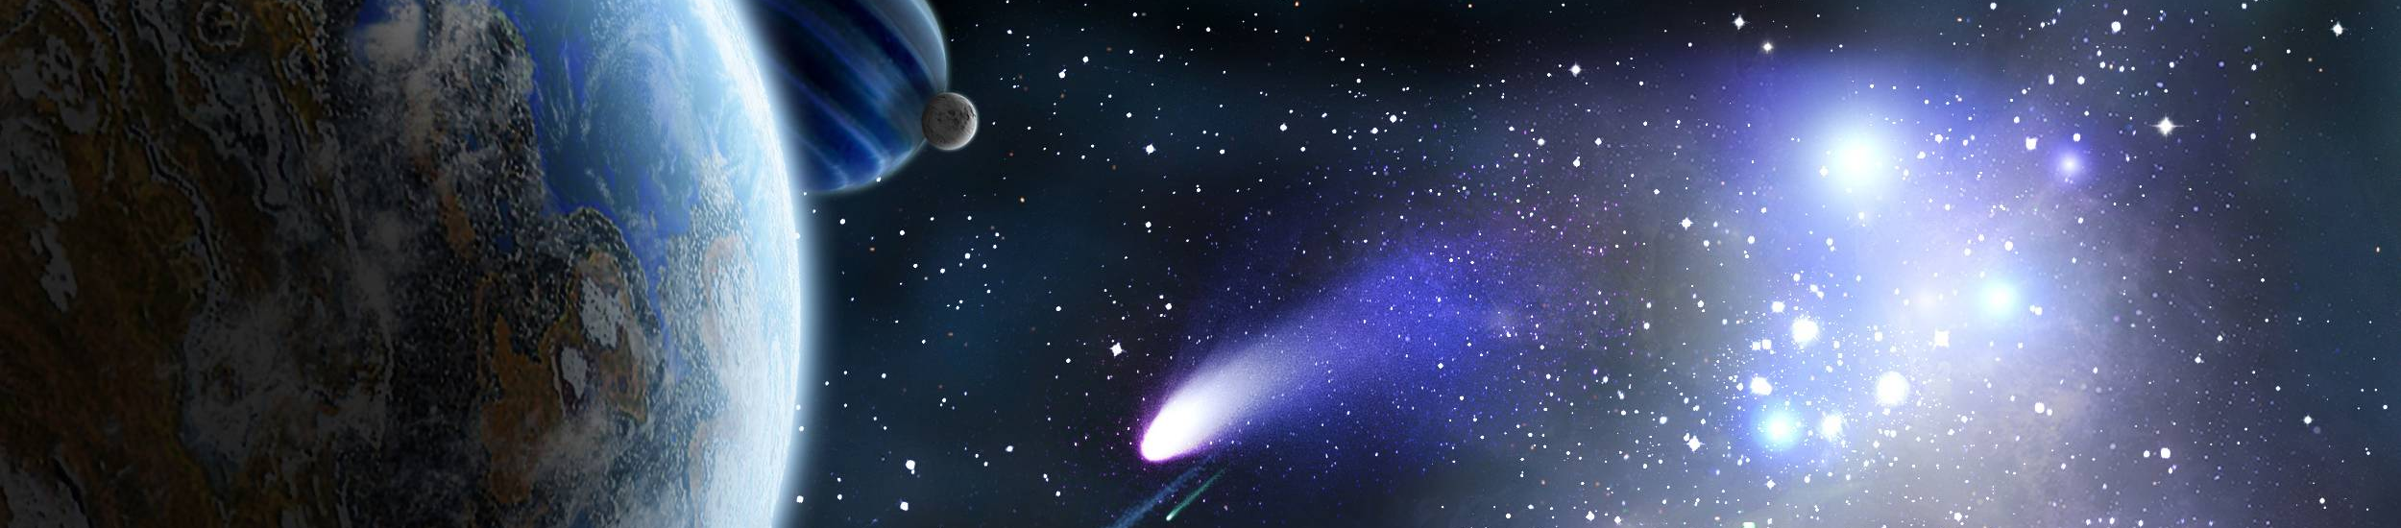
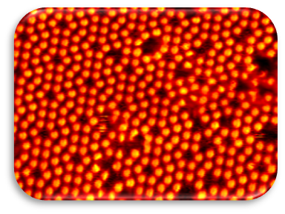
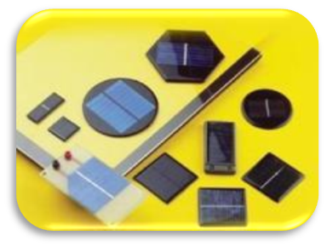
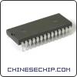
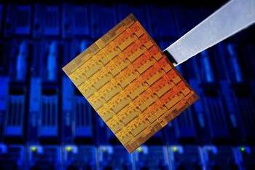

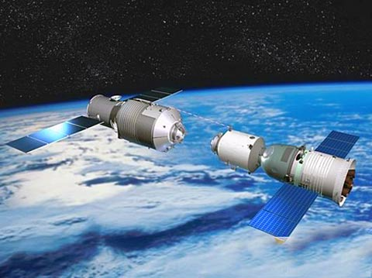
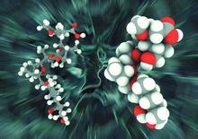
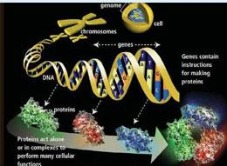
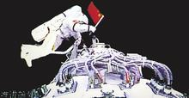

空间环境地面模拟装置
“十二五”国家重大科技基础设施建设项目
Space Environment Simulation and Research Infrastructure
Overview of the Design of 3D magnetic Reconnection and Dipole Experiments at Harbin Institute of Technology
Yang Ren^{1,2}, Hantao Ji^{1,2}, Xiaogang Wang¹, Peng E¹, Aohua Mao¹, Zhibin Wang¹, Qingmei Xiao¹, Chijie Xiao³, Quanming Lu⁴, Weixing Ding⁴
¹Harbin Institute of Technology, Harbin, China
² Princeton Plasma Physics Laboratory, Princeton University, Princeton, NJ 08543
³Peking University, Beijing, China
⁴University of Science and Technology of China, Hefei, China
Laboratory for Space Environment and Physical Sciences
Harbin Institute of Technology
Notes:
Good morning, ladies and gentleman!
As a member of HDX team, it is a great honor for me to have the opportunity to present the progresses of HDX here.
My name is Wang Zhibin. I am a member of HDX team and I am now a research assistant at Harbin institute of technology.

Slide 2
Harbin Experiments Will Provide a Unique Laboratory Platform for Studying Important Space-relevant Questions
A unique set of coils to generate the relevant magnetic geometry
A wide range of plasma parameters, allowing parametric studies of physics processes and exploration of different physics regimes
The large size of the experiment (5 m in diameter for vacuum vessel) making S >10⁴ , L/½_{i} > 50 possible to study global effects, e.g. single X-line to multiple X-line in magnetic reconnection
A variety of operational scenarios targeting important space-relevant problems
Notes:
电子MHD参数空间，并不能很好的模拟自然中的磁重联过程，因为MHD适用的范围对整个磁重联的过程很重要，同时引入了人工的边界条件

Slide 3
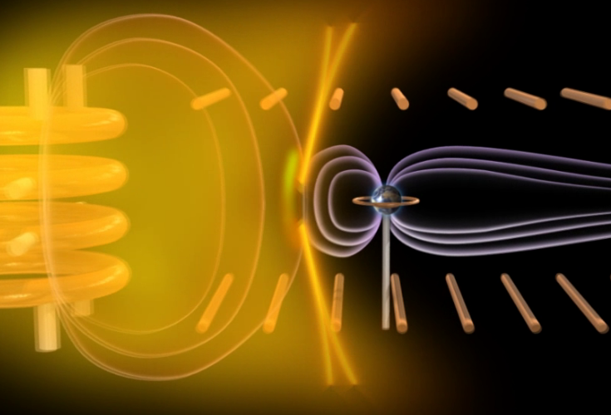
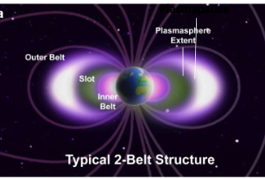
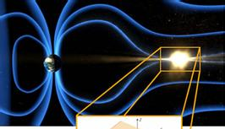
Space Plasma Environment Research Facility (SPERF) is being Constructed at Harbin
AREX-3D
DREX
T-REX
Asymmetric Reconnection EXperiment-3 Dimensional (AREX-3D)
Dayside magnetopause reconnection
Dipole Research Experiment (DREX)
Acceleration/loss and wave-particle interaction of energetic particles
The influence of magnetic storms on the inner magnetosphere
Tail Reconnection Experiment (T-REX)
3D magnetic reconnection at magnetotail
Plasma waves excited by high speed outflow
Dipolarization process
Notes:
The SPERF is composed of three systems. That is Asymmetric Reconnection EXperiment (AREX) , Dipole Research EXperiment (DREX) , and Tail Research EXperiment (T-REX). AREX is mainly research the three dimensional dyaside magnetopause reconnection, while the DREX system mainly investigate the acceleration/loss and wave-particle interaction of energetic particles and also the influence of magnetic storms on the inner magnetosphere. While T-REX will investigated the 3d magnetic reconnection at magnetopause and magnetotail, and also hydromagnetic waves excited by high speed flow and also is able to research the dipolarization process.
在这简单介绍一下SPERF，它由三个实验研究段组成，分别是非对称磁重联研究段、偶极场实验研究段以及磁尾实验研究段。非对称磁重联研究段主要研究向阳面磁层顶三维非对称快速磁重联过程，偶极场实验研究段则研究辐射带高能粒子的产生、加速及输运过程，并且能进行磁暴扰动模拟研究，而磁尾实验研究段主要研究磁层，特别是磁尾区非对称三维磁重联过程、高速流激发磁流体波过程，以及偶极化过程及其对偶极场区的影响。

Slide 4
Outline
Background and motivation
  A brief review of relevant terrella, reconnection and dipole experiments
Overview of
  Plasma parameters
  AREX-3D, T-REX and DREX designs and scenarios
  Engineering design progress
Summary

Slide 5
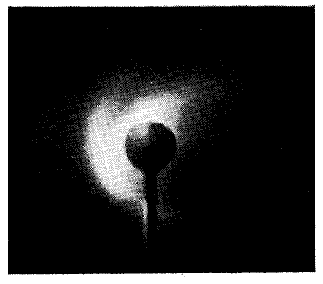
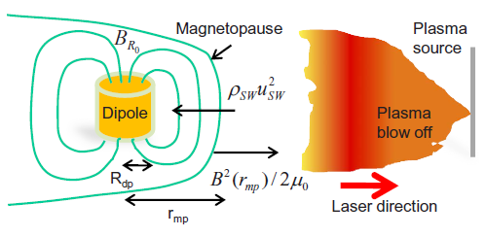
Past and Present Terrella Experiments
All Terrella experiments focusing on global phenomena, e.g. bow shock
  Magnetized/unmagnetized fast plasma flow interaction with dipole field
    To simulate large scale solar wind interaction with magnetosphere
  Kinetic effects in reconnection region not well studied
SPERF will explore both local and global reconnection dynamics by driving reconnection with a unique set of coils
  To produce relevant 3D magnetic geometry
N Kawashima and S. Mori, PoF, 1965
L~ 4 cm, ½_{i}/L~1
P. Brady et al., PoP, 2009

Slide 6
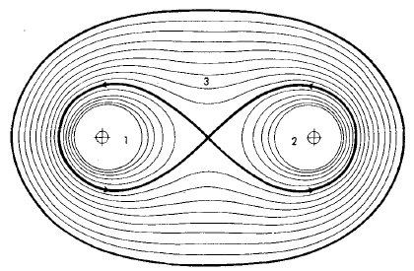
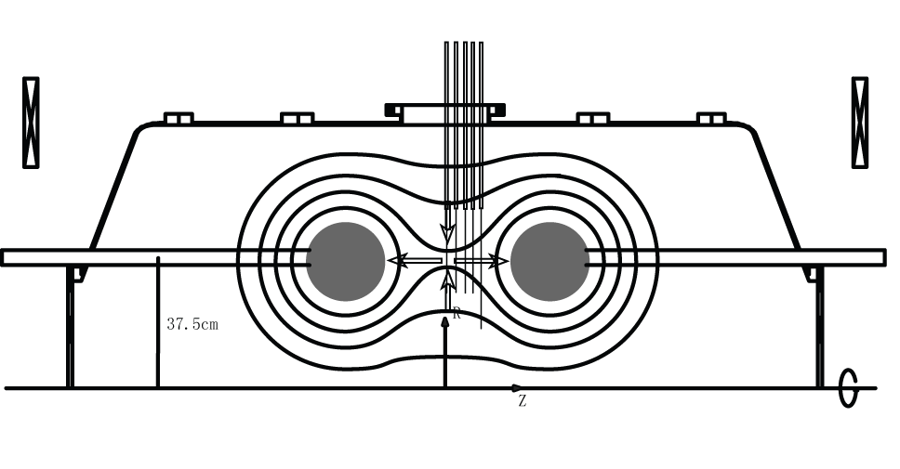
Magnetic Reconnection Experiments Evolve from EMHD to MHD Regime
Early laboratory study of magnetic reconnection was conducted in pinch and linear devices
  Ion gyroradius on the order of machine size (EMHD) and S~1-10
All present devices operate in MHD regime with ion gyroradius much smaller than machine size
  Strong magnetic field ~100-1 kG
  A wide range of machine size (~1-10 m)
  A variety of ion species: H, D, He, Argon
  S>>1
Bratehanhl and Yeates, PoF, 1970
Yamada et. al, PoP, 1997

Slide 7
All Recent Reconnection Experiments Have either Linear or Toroidal Geometry
Device | Where | Geometry | Q’s
3D-CS | Russia | Linear | 3D, heating
LAPD | UCLA | Linear | Heating, waves
TS-3/4 | Tokyo | Toroidal, merging | Rate, heating
MRX | Princeton | Toroidal, merging | Rate, heating, scaling
SSX | Swarthmore | Toroidal, merging | Heating
VTF | MIT | Toroidal with guide B | Reconnection onset
RSX | Los Alamos | Linear, flux rope merging | 3D, Boundary
RWX | Wisconsin | Linear | 3D, Boundary
VINETAII | Max-Planck | Linear | 3D
TREX | Wisconsin | Toroidal | Energy, 3D
FLARE | Princeton | Toroidal | All above
SPERF will be able to investigate a range of important reconnection issues in magnetospheric geometry
Notes:
7
这是一个对现有磁重联装置的更全面的的列表。可以分为两种位型，线性和环形。各个装置有不同的研究侧重点，总体上它们都满足MHD的参数要求。

Slide 8
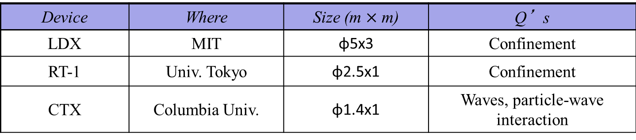
Recent Dedicated Dipole Experiments Focused more on Plasma Confinement
Dipole geometry was long thought as an attractive candidate for fusion applications due to its predicted good plasma confinement properties, e.g. Bergstrom et al., NF 1962
  Recent dipole experiments, like LDX and RT-1, feature levitating capability to improve plasma confinement
DREX at Harbin has a similar goal as that of CTX, featuring much larger size plasma and much wider range of plasma parameters
  Particle energization and transport with interaction with whistler waves and Alfven waves
Device | Where | Size (m $×$ m) | Q’s
LDX | MIT | φ5x3 | Confinement
RT-1 | Univ. Tokyo | φ2.5x1 | Confinement
CTX | Columbia Univ. | φ1.4x1 | Waves, particle-wave interaction
Notes:
8
这是一个对现有磁重联装置的更全面的的列表。可以分为两种位型，线性和环形。各个装置有不同的研究侧重点，总体上它们都满足MHD的参数要求。

Slide 9
A wide Range of Plasma Parameters can be Achieved in SPERF
Plasma generation using inductive, microwave and electrode-discharge (cold and hot cathode) methods allow SPERF to achieve a wide range of plasma parameters
  Asymmetry in plasma parameter: high/low plasma density at experimental magnetosheath/dipole sides
  A range of magnetic field magnitude using coil geometry and current arrangements
Large achievable S (>10⁴) and L/ρ_{i} (>50) makes SPERF ideal to investigate global effects, i.e. MHD scale
 | Experimental magnetosheath side | Experimental dipole side
n_{e} (cm⁻³) | 10¹²-10¹³ | 10¹¹-10¹³
T_{i}（eV） | 3-10 | 3-10
T_{e}（eV） | 5-10 | 5-10
B | 100-200 G | 300-400 G
Total beta | 0.008-0.8 | 0.0002-0.2
L/ ρ_{e} | 2000-5600 | 6000-11000
L/ ρ_{i} | 50-170 | 150-340
S | 3400-20000 | 3000-120000
L ~ 150 cm

Slide 10
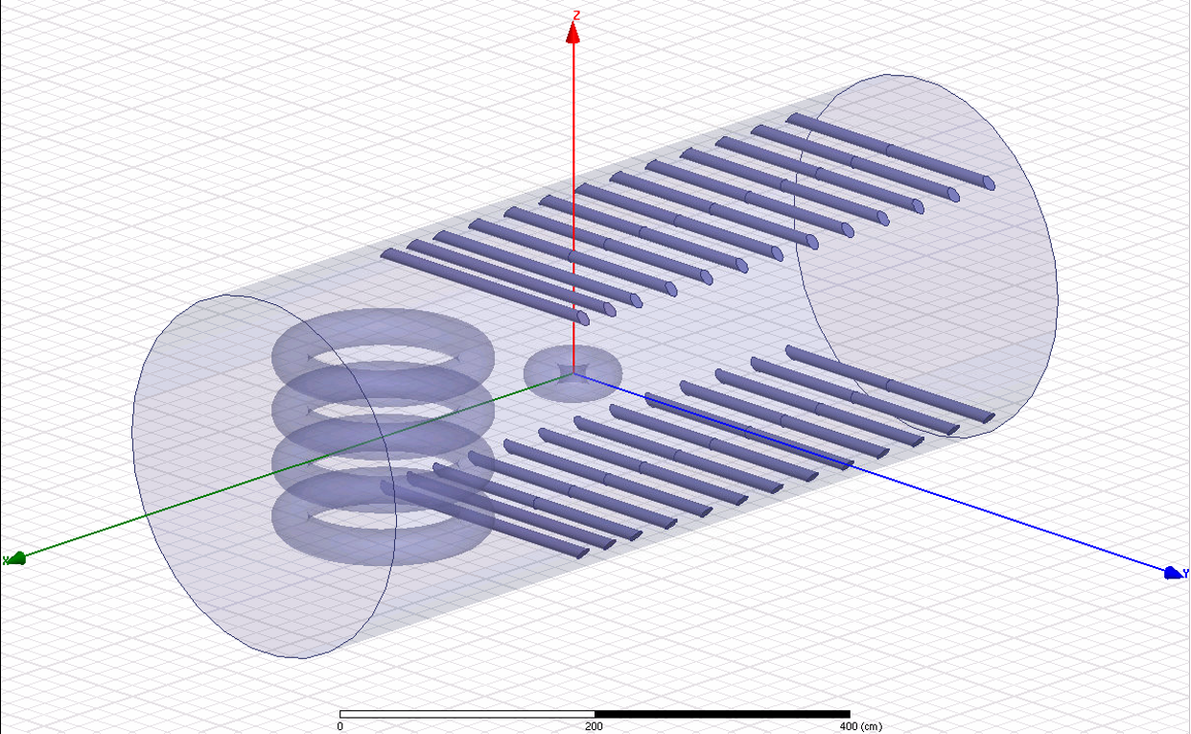
A unique Set of Coils are Used in SPERF to Generate Required Magnetic Field Geometry
4 FLARE size flux cores with both toroidal and poloidal windings (75 cm major radius and 15 cm minor radius )
Tail coils
Dipole coil
Coil currents
Used for magnetostatic calculations from Maxwell finite element analysis software
Coil supporting structure neglected

Slide 11
AREX-3D design and operational scenarios

Slide 12
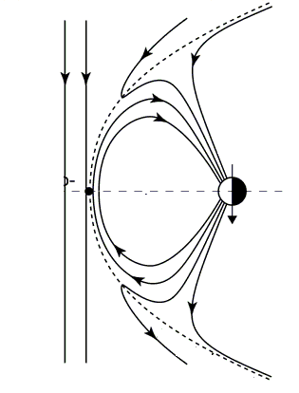
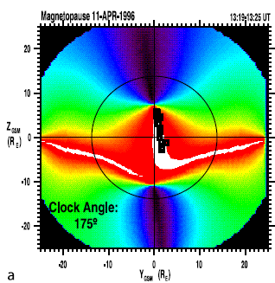
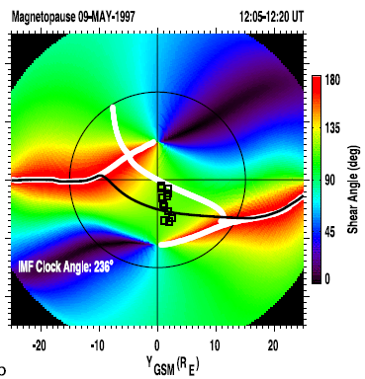
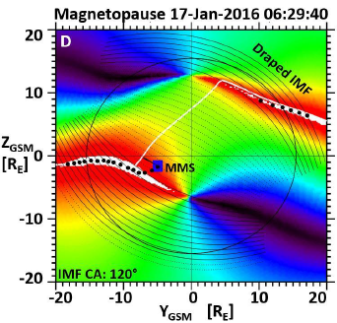
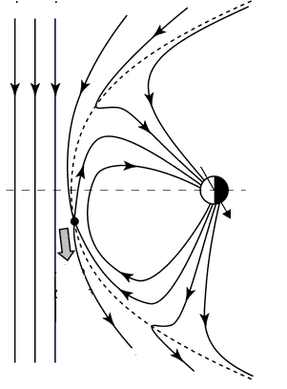
AREX-3D Aims to Study Asymmetric Magnetic Reconnection in the Magnetopause Geometry
Crucial questions to address:
  Where does reconnection to occur with different interplanetary magnetic field (IMF) direction and magnitude?
  What type of reconnection to occur? Anti-parallel vs component (with guide field)
  How are energy and particle transport affected by different IMF direction and magnitude?
Earth
Magneto-
sphere
Magneto-
sheath
Oblique IMF with large dipole tilt
Anti-parallel IMF
Oblique IMF
Trattner et al., JGR 2007
Trattner et al., JGR 20018

Slide 13
AREX-3D Aims to Study Asymmetric Magnetic Reconnection in the Magnetopause Geometry
A dipole field and a large scale and a large scale uniform magnetic field are required to reproduce the magnetopause geometry
  The dipole field from a dipole coil -> the earth’s magnetosphere
  The large scale uniform magnetic field -> the Interplanetary Magnetic Field (IMF)
Earth
Magneto-
sphere
Magneto-
sheath

Slide 14
Simulating IMF with Flux Cores and Tail Coils
Tail coils (shaping coils)
Flux cores

Slide 15
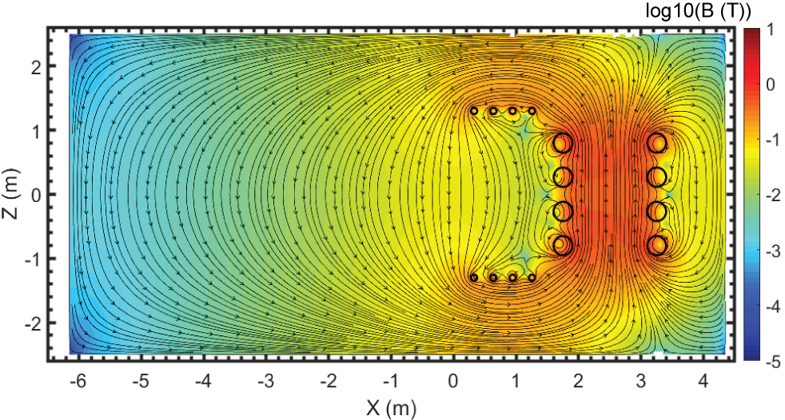
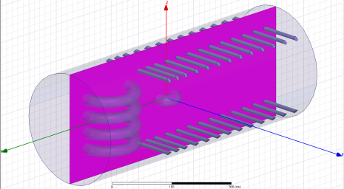
Simulating IMF with Flux Cores and Tail Coils
Flux cores and a part of the tail coils are used to produce a large scale uniform magnetic field
IMF is simulated geometrically, not dynamically, without super-sonic flow drive
Tail coils (shaping coils)
Flux cores

Slide 16
Simulating IMF with Flux Cores and Tail Coils
Flux cores and a part of the tail coils are used to produce a large scale uniform magnetic field
IMF is simulated geometrically, not dynamically, without super-sonic flow drive
Tail coils (shaping coils)
Flux cores

Slide 17
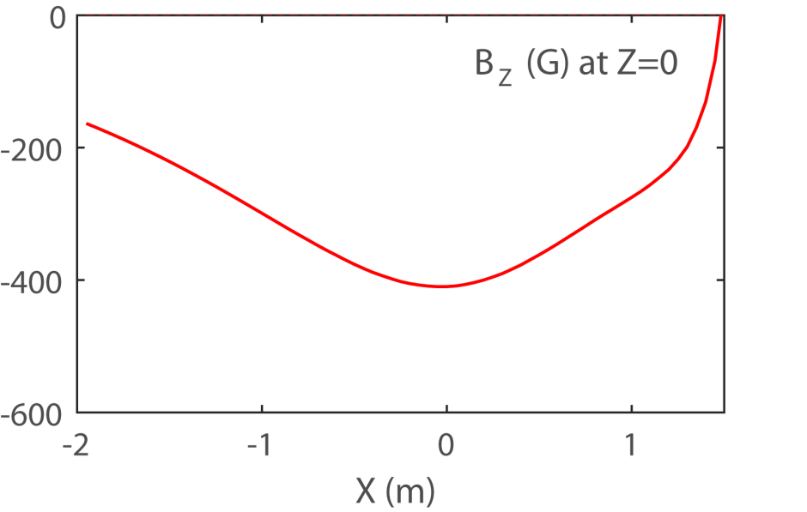
Simulating Interplanetary Magnetic Field (IMF) with Flux Cores and Tail Coils
The current and timing of each coil is independently controllable
The vertical positions of flux cores and tail coils are adjustable
AREX-3D has great flexibility in controlling IMF magnitude and shaping, i.e. draping around dipole

Slide 18
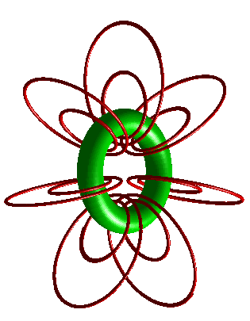
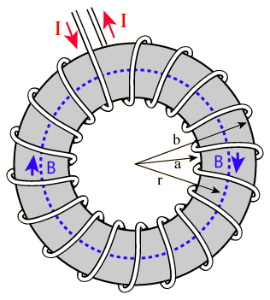

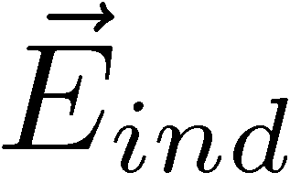
Flux Cores will be Used to Produce Plasma and Reconnection Magnetic Field
PF coils to generated reconnecting magnetic field
TF coils used to breakdown gas to generate plasma inductively
PF coils
TF coil
Primary electron

Slide 19
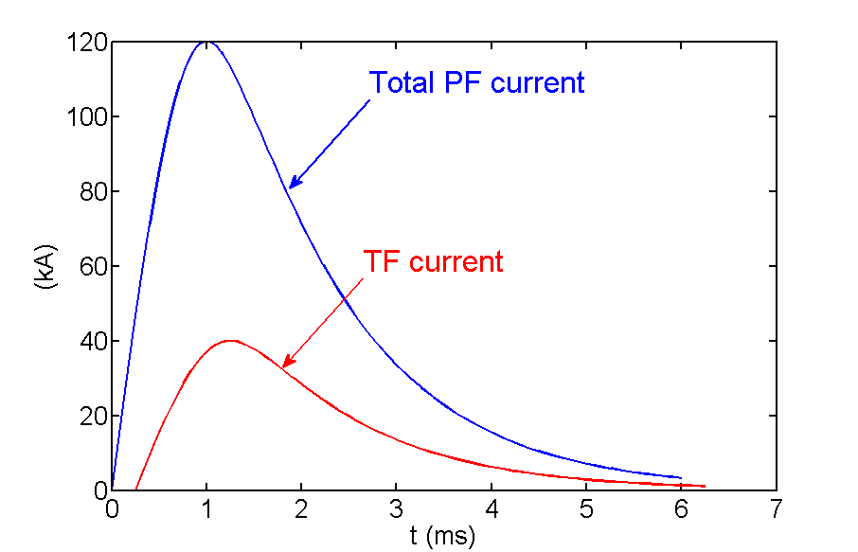
Plasma is Generated and Reconnection is Driven by Ramping Coil Currents
PF coils are energized first to generate vacuum magnetic field
TF coils are energized ~ 250 ¹s later to generated plasmas
Both PF coil current ramp-up and plasma pressure drives reconnection
  Total reconnection time ~ 500 ¹s >> ¿_{A}<10 ¹s
Time period of reconnection

Slide 20
Magnetopause Reconnection with Southward IMF
Earth
Magneto-
sphere
Magneto-
sheath

Slide 21

Identify Magnetic Reconnection in the Symmetric Plane

Slide 22
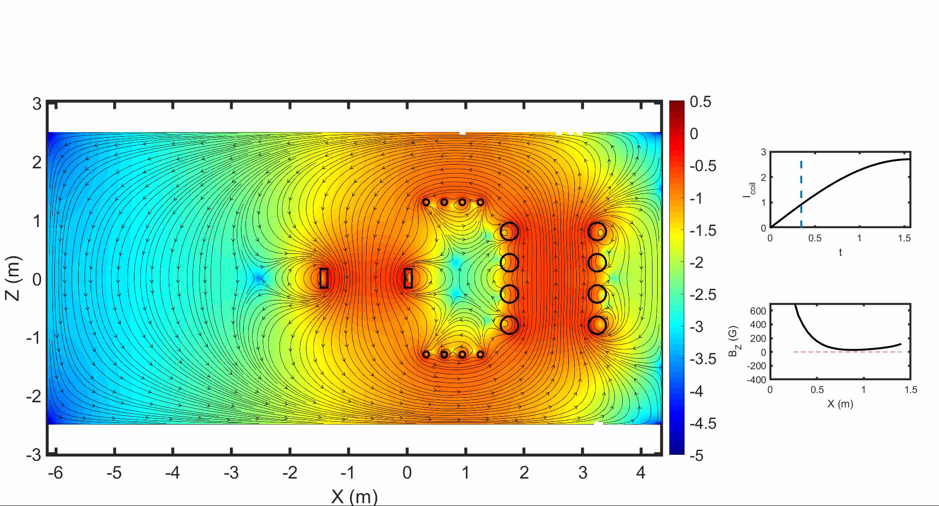
Reconnection is Driven by Ramping up Flux Core Current
Magneto-
sphere
Magneto-
sheath

Slide 23
Reconnection is Driven by Ramping up Flux Core Current
Magneto-
sphere
Magneto-
sheath

Slide 24
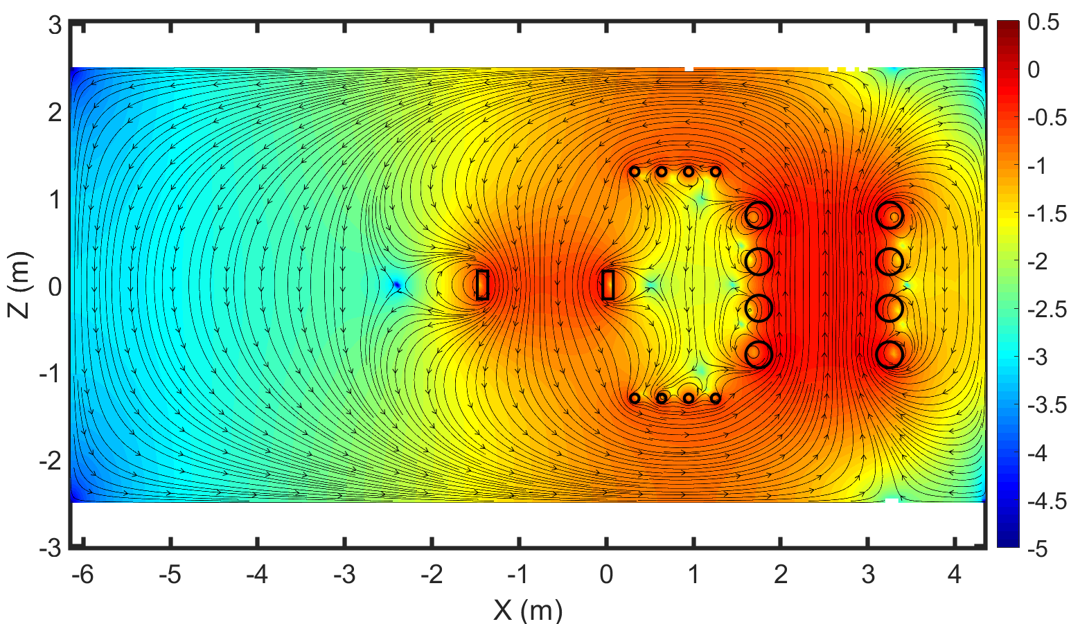
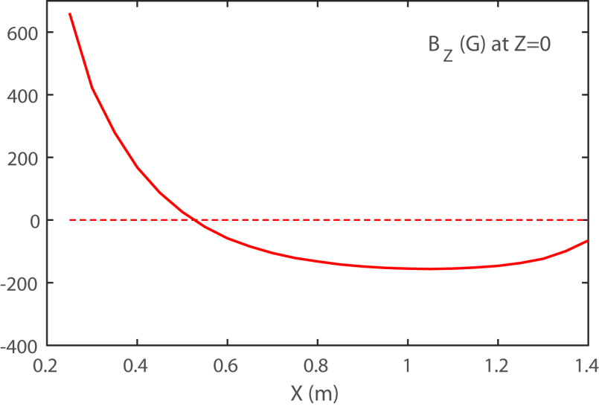
Reconnected Field Lines Geometrically Resemble Their Counterparts in Space
Magneto-
sphere
Magneto-
sheath
Magnetosheath-side

Slide 25
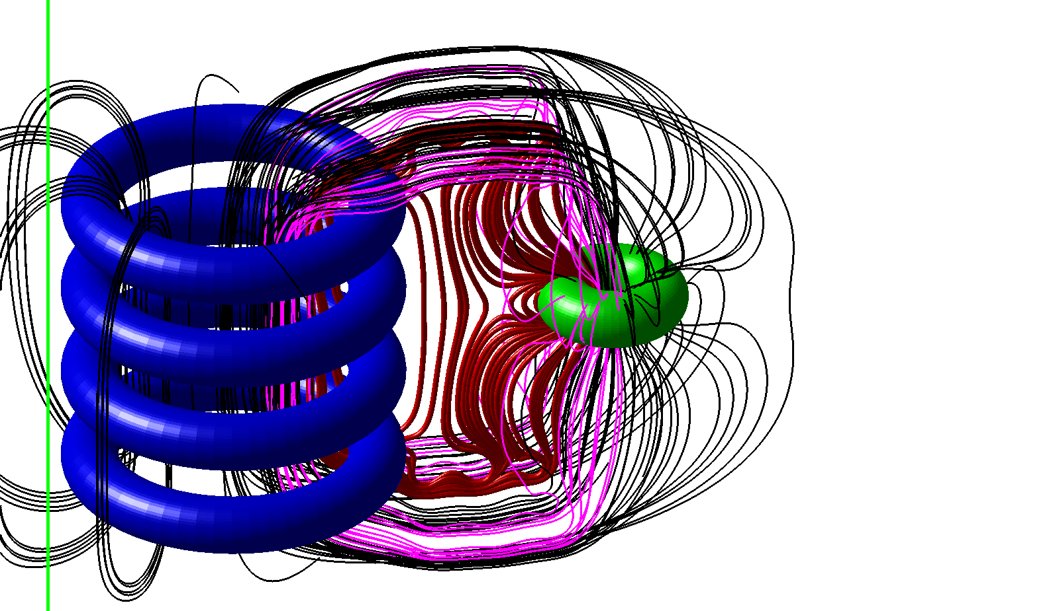
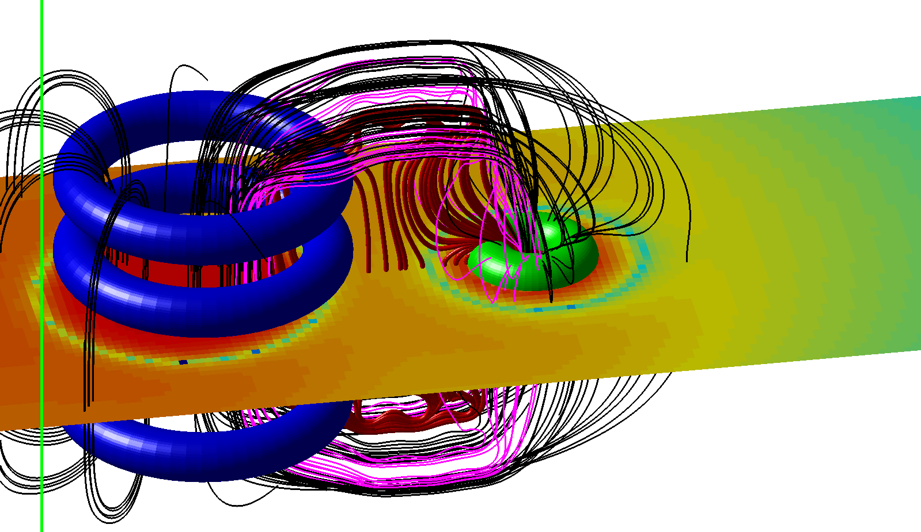
X-line is Clearly Identified
X-line
|B_{Z}|
Reconnection is purely 3D
An X-line is formed around the dipole coil

Slide 26
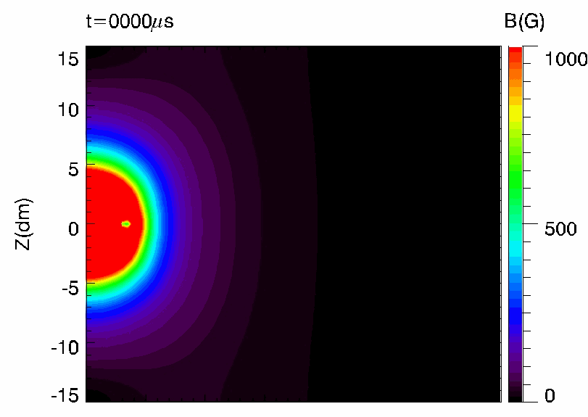
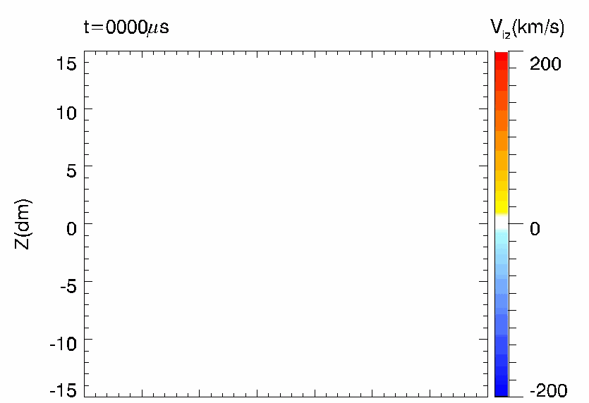

Global Hybrid Simulation Shows 3D Reconnection Driven with the Experimental Scheme
Formation of X-line as seen in vacuum field calculations
Plasma flow consistent with reconnection outflow
Dipole
Flux cores

Slide 27
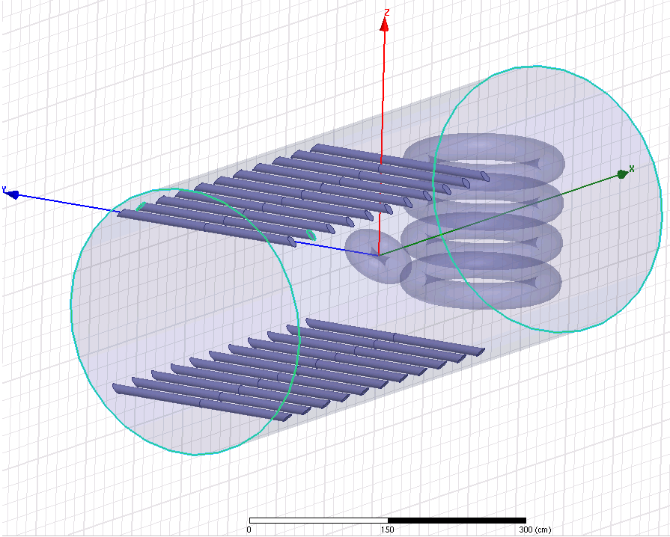
Capability of Rotating Dipole Allows Simulating Directional Change in IMF
The rotatable dipole plus changing coil currents allows simulating change in IMF direction

Slide 28
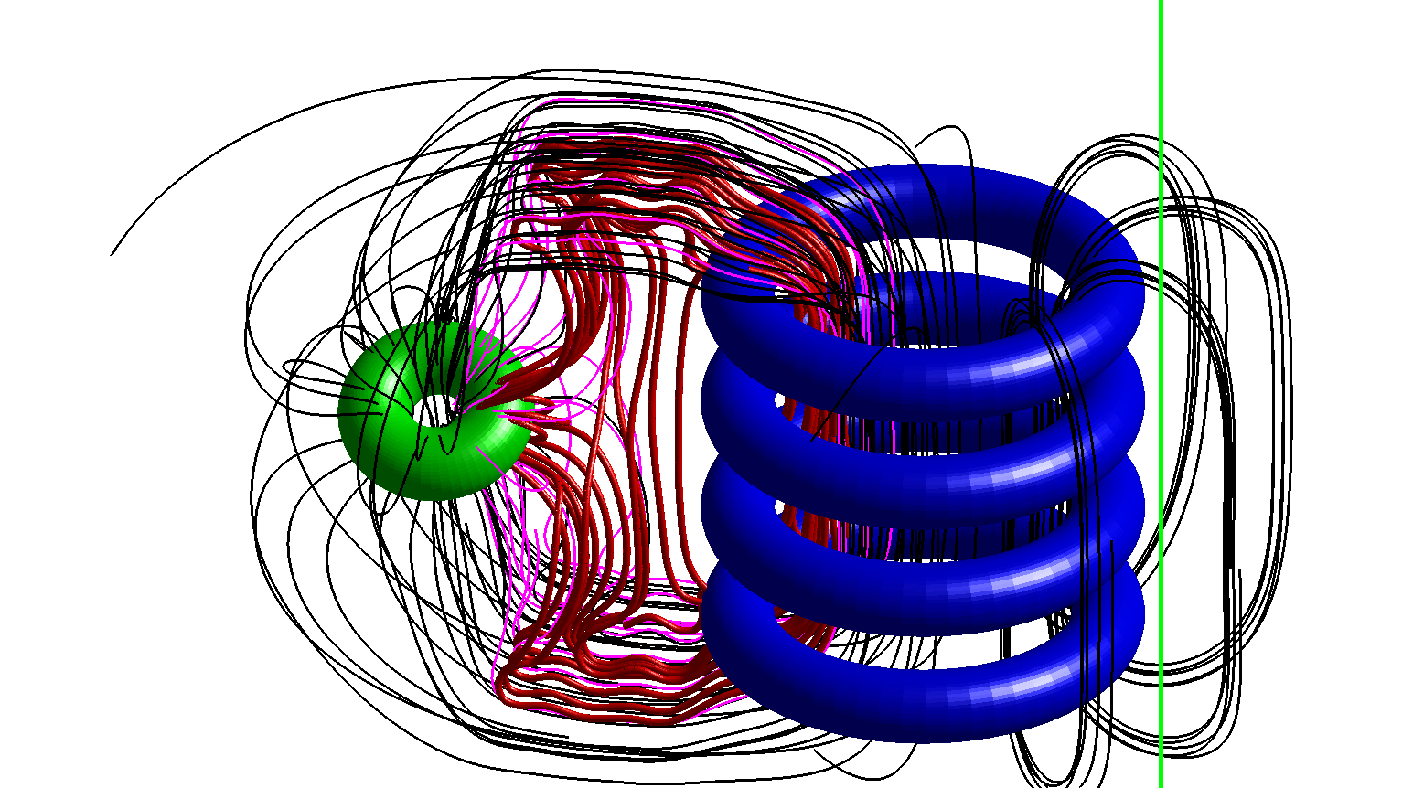
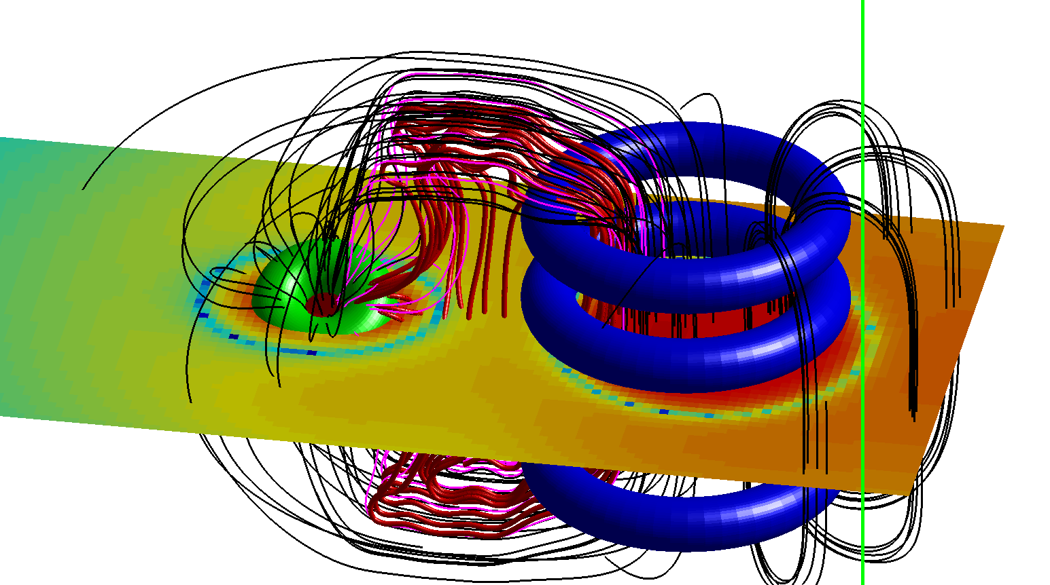
Reconnection Happens with a Guide Field
|B_{Z}|
X-line
Dipole is rotated 30 degree with respect to the X axis (horizontal axis pointing form the dipole to flux cores)
An X-line is also identified

Slide 29
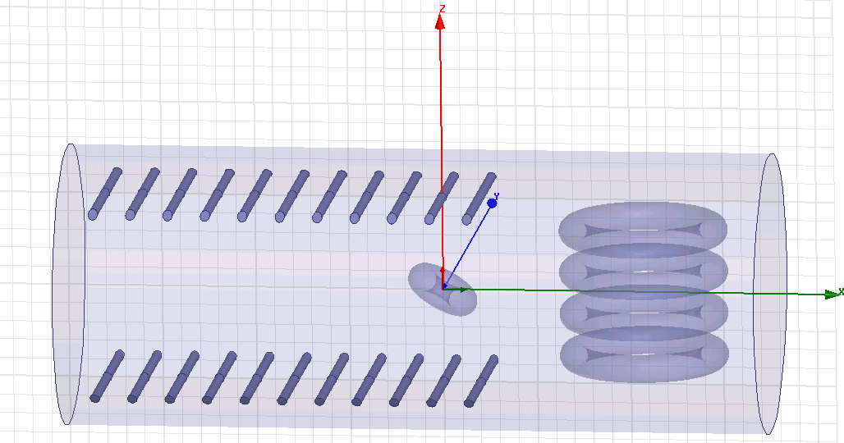
Dipole can be Tilted toward the Flux Cores

Slide 30
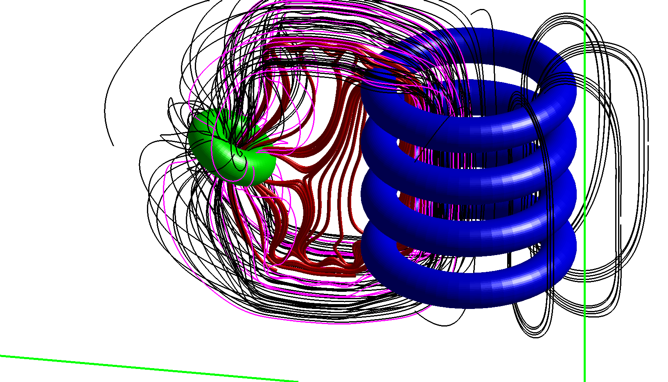
Magnetic Reconnection Geometry Mimics that in Space

Slide 31
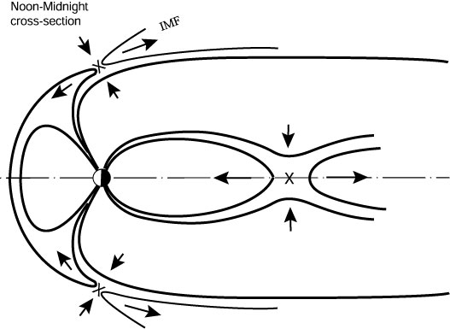
Magnetopause Reconnection with Northward IMF

Slide 32
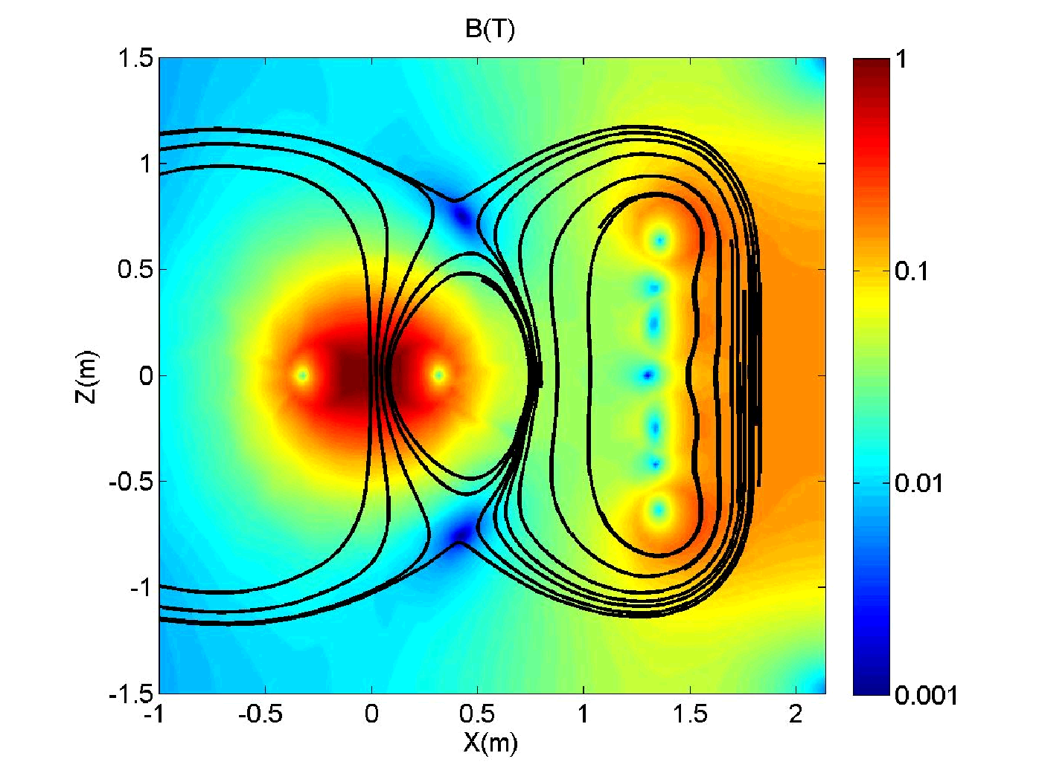
Magnetopause Reconnection with Northward IMF is to be Implemented by Changing Coil Current Direction
X-point

Slide 33
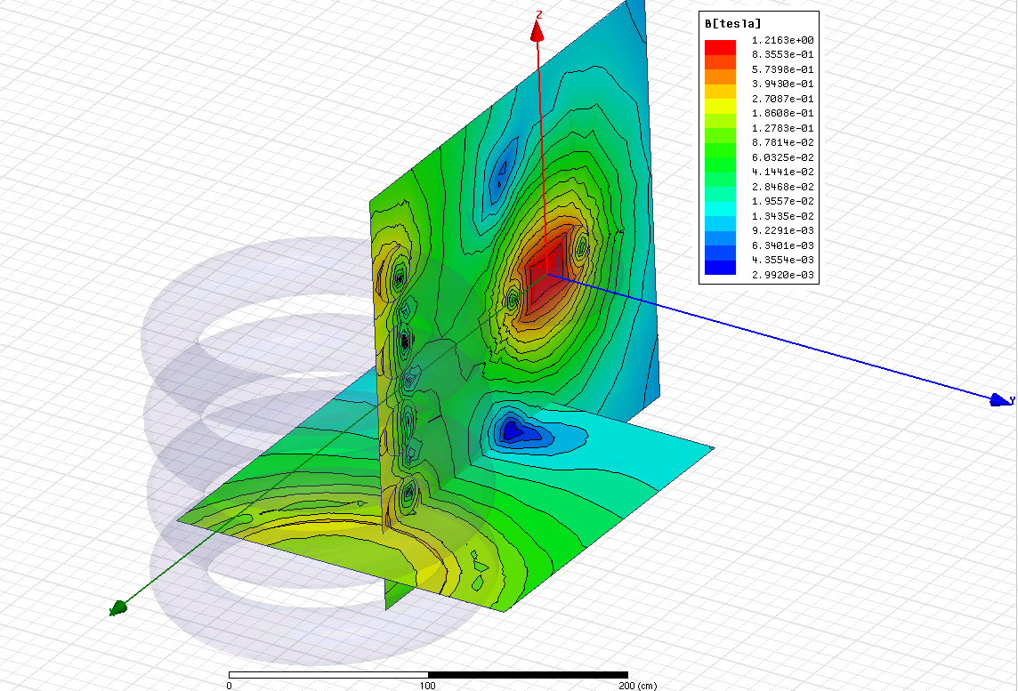
A Magnetic-Null Point is Formed
Magnetic-null point

Slide 34
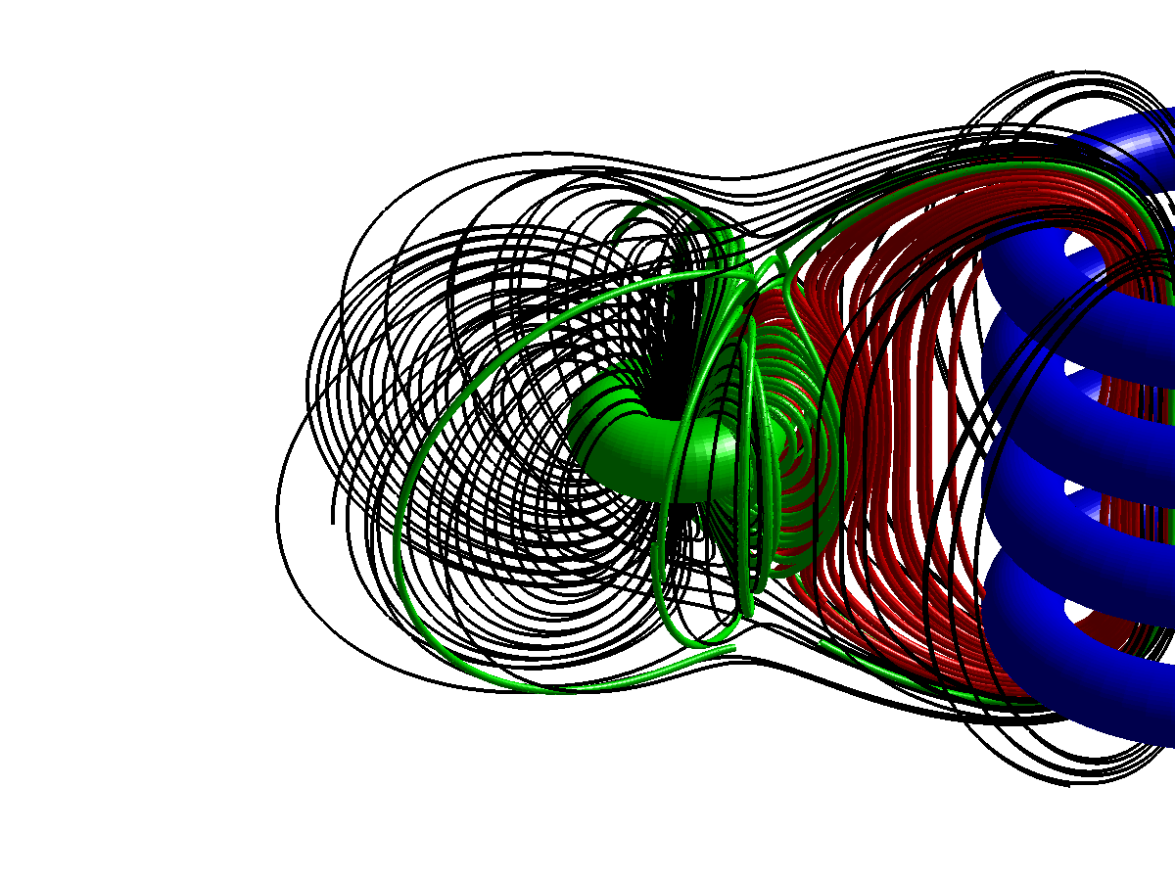
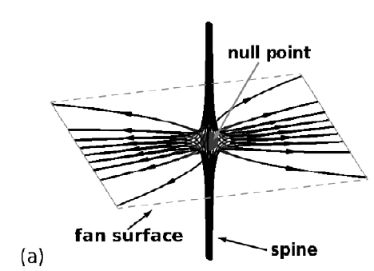
Fan and Spine Structure can be Identified close to the 3D Null Point
Pontin, 2011, “Adv. Space Res.”
Observed in space, 2006, Xiao et al., Nature Phys.

Slide 35
T-REX operational scenarios

Slide 36
Magnetotail Reconnection

Slide 37
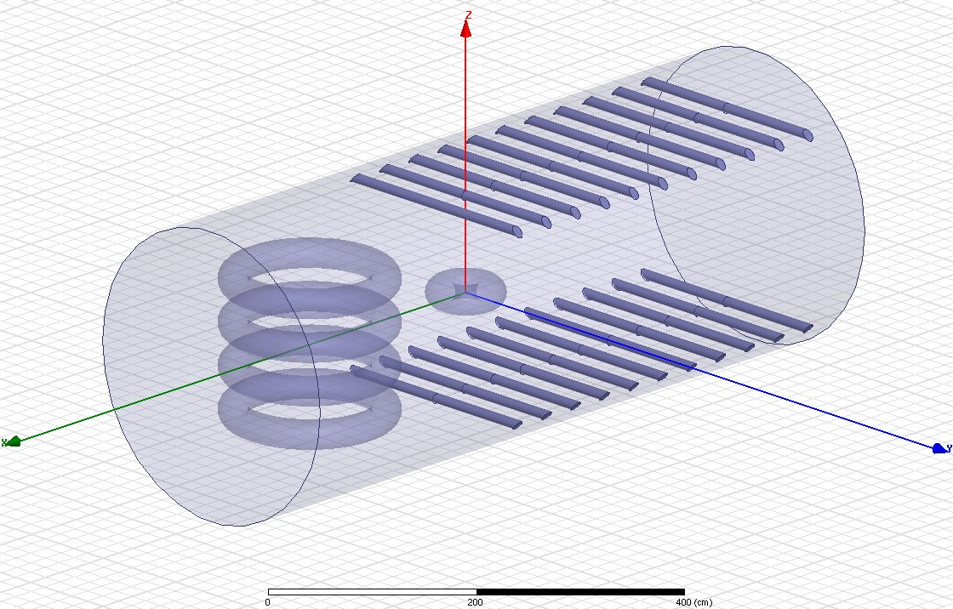
All Tail Coils are Used to Drive Magnetotail Reconnection
The tail coils will have the individual capabilities to move up/downward to provide more flexibility to shape tail region magnetic field geometry

Slide 38
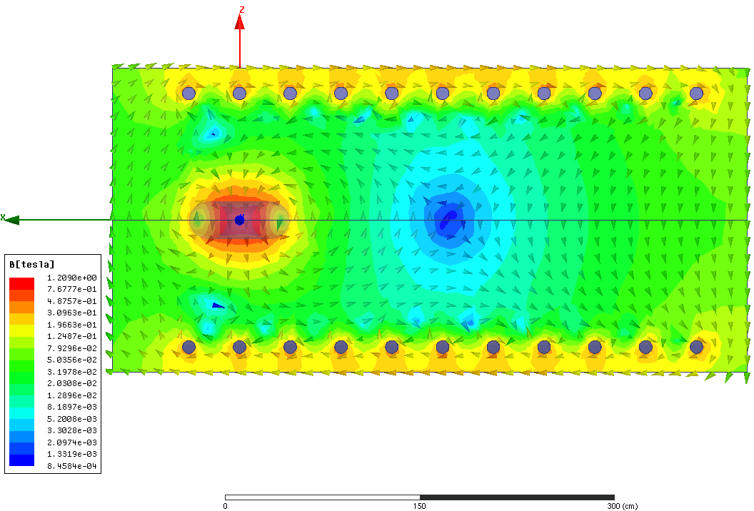
A Well-defined X-point is Generated in the Tail Region
ECRH will be used to generate plasma in the tail region
Ramping up tail coil current to drive reconnection
Not to be implemented in the initial phase due to budget constraint

Slide 39
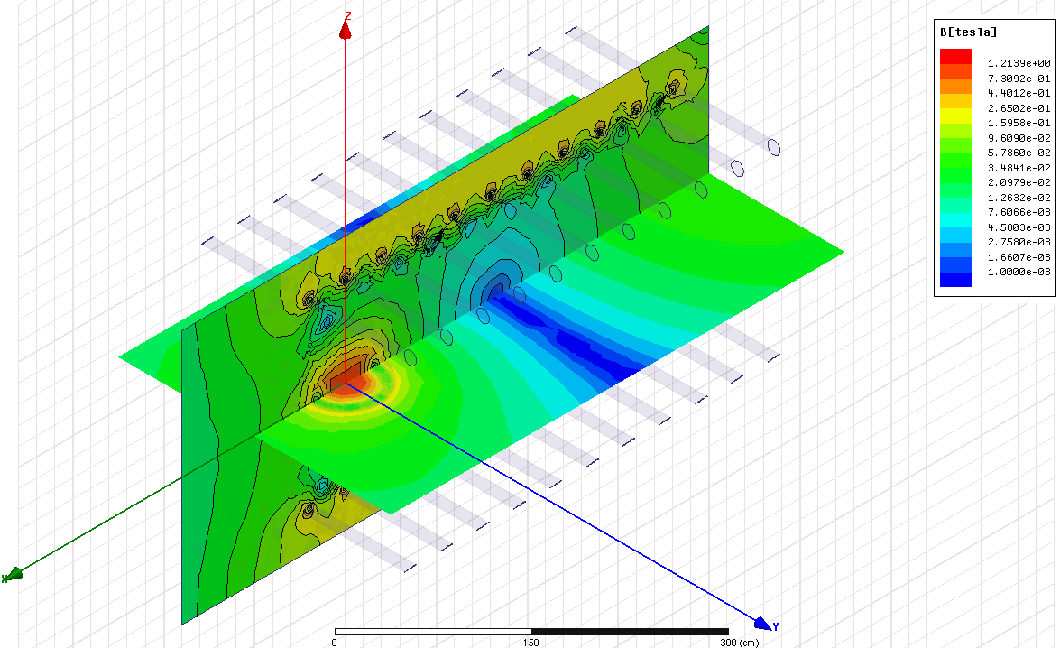
An Elongated X-line is Identified in 3D

Slide 40


Other Operational Scenarios
Magnetotail reconnection
  Mirror coil(LaB₆)
  Plasma gun
  Dipole (gas in)
Hydromagnetic waves excitation and Dipolarization
  Dipole(Plasma)
  Plasma gun

Slide 41
DREX operational scenarios

Slide 42

Dipole-only Scenario
Wave-particle interactions
  Alfven wave launched with external antennas
  Whistler wave (chorus-like) excited by T_{e} anisotropy from ECRH (Huang et al. , CPB, 2018)
Energetic particle transport
Plasma generated by ECRH (low density) and/or cold cathode discharge (high density and high ionization ratio)
Notes:
For scenario one, only the dipole coil is turn on, which produces a dipole magnetic field configuration and to provide the plasma environment of the inner magnetosphere for the study of wave-particle interactions and energetic particle transport. The dipole coil will operate in pulse mode with a flattop duration of about 10ms. The magnetic field is about 500G at a distance of 2m, which is used to simulate the Geosynchronous orbit region.

Slide 43

  Magnetic storm scenario
Perturbation coil
GSO region
Response during magnetic storm
Notes:
The third scenario is magnetic storm scenario. In this case, a magnetic distortion produced by the perturbation coil to explore the response of the inner magnetosphree during magnetic storm. It induces a 20-30% of the local magnetic field in the simulated GSO. The black curve is Bz component distribution along the axis of the chamber without the perturbation coil
环电流变化对高能带电粒子的影响：【脉冲磁场运行模式：以模式（1）为初始条件，“磁暴”线圈脉冲式增强，模拟磁暴过程对捕获粒子的影响。】

Slide 44




Magnetic storm scenario
W/O perturbation coil
Simulated GSO region
With perturbation coil
20-30%
Notes:
Here is the comparison of the magnetic configuration without and with perturbation coil. 20-30% change in 1ms can produce equivalent to the ring current change during the geomagnetic storm.

Slide 45


SPERF Engineering Design
Notes:
This is the future plans of HDX
First, Completing the Feasibility Research Report at the end of 2015.
Second, Experimental setup design and diagnostics planning begins in the year 2015 and will be finished at the end of 2016.
Third, First phase of engineering design is in the year of 2016.
Fourth, construction phase begins at 2016 and will be finished in 2019.
Finally, operation phase begins in the year of 2019.

Slide 46

Good Progress in the Engineering Design of Internal Coil Sets has been Made
Flux cores
Notes:
This is the future plans of HDX
First, Completing the Feasibility Research Report at the end of 2015.
Second, Experimental setup design and diagnostics planning begins in the year 2015 and will be finished at the end of 2016.
Third, First phase of engineering design is in the year of 2016.
Fourth, construction phase begins at 2016 and will be finished in 2019.
Finally, operation phase begins in the year of 2019.

Slide 47
Good Progress in the Engineering Design of Internal Coil Sets has been Made
Dipole
Coil and perturbation coil
Notes:
This is the future plans of HDX
First, Completing the Feasibility Research Report at the end of 2015.
Second, Experimental setup design and diagnostics planning begins in the year 2015 and will be finished at the end of 2016.
Third, First phase of engineering design is in the year of 2016.
Fourth, construction phase begins at 2016 and will be finished in 2019.
Finally, operation phase begins in the year of 2019.

Slide 48
Good Progress in the Engineering Design of Internal Coil Sets has been Made
Cold cathode mesh and anode ring
Notes:
This is the future plans of HDX
First, Completing the Feasibility Research Report at the end of 2015.
Second, Experimental setup design and diagnostics planning begins in the year 2015 and will be finished at the end of 2016.
Third, First phase of engineering design is in the year of 2016.
Fourth, construction phase begins at 2016 and will be finished in 2019.
Finally, operation phase begins in the year of 2019.

Slide 49
Good Progress in the Engineering Design of Internal Coil Sets has been Made
Magnetopause shaping coil (part of tail coils)
Notes:
This is the future plans of HDX
First, Completing the Feasibility Research Report at the end of 2015.
Second, Experimental setup design and diagnostics planning begins in the year 2015 and will be finished at the end of 2016.
Third, First phase of engineering design is in the year of 2016.
Fourth, construction phase begins at 2016 and will be finished in 2019.
Finally, operation phase begins in the year of 2019.

Slide 50
Good Progress in the Engineering Design of Internal Coil Sets has been Made
Mirror coils
Notes:
This is the future plans of HDX
First, Completing the Feasibility Research Report at the end of 2015.
Second, Experimental setup design and diagnostics planning begins in the year 2015 and will be finished at the end of 2016.
Third, First phase of engineering design is in the year of 2016.
Fourth, construction phase begins at 2016 and will be finished in 2019.
Finally, operation phase begins in the year of 2019.

Slide 51





Modular Design of Power Supply will Benefit Future SPERF Operation
Flexibility：the number of modules and discharge timing adjustable；
Safety: Stored energy distributed；
Efficiency：Easy to replace faulty modules and reducing downtime；
Mirror coils
Direct parallel discharge of all capacitors
Modular design: independent modules discharges separately
Notes:
This is the future plans of HDX
First, Completing the Feasibility Research Report at the end of 2015.
Second, Experimental setup design and diagnostics planning begins in the year 2015 and will be finished at the end of 2016.
Third, First phase of engineering design is in the year of 2016.
Fourth, construction phase begins at 2016 and will be finished in 2019.
Finally, operation phase begins in the year of 2019.

Slide 52
SPERF Timeline
  Completing Feasibility Research Report (2015-2016)
  R/D for critical physics and engineering issues (2015-2018)
  3. Engineering design and optimization (2016-2018)
  4. Construction (2017 – 2020)
  5. Operation (2020 - )
plans
Time
2015
2016
2017
2018
2019
2020 +
1
2
3
4
5
Notes:
This is the future plans of HDX
First, Completing the Feasibility Research Report at the end of 2015.
Second, Experimental setup design and diagnostics planning begins in the year 2015 and will be finished at the end of 2016.
Third, First phase of engineering design is in the year of 2016.
Fourth, construction phase begins at 2016 and will be finished in 2019.
Finally, operation phase begins in the year of 2019.

Slide 53
Summary
A unique set of magnetic coils enables SPERF to explore important physic questions relevant to space physics
A wide range of plasma parameters, using different plasma generation methods, can be achieved by SPERF allowing detailed studies of physics underlying 3D reconnection and particle energization/transport
Further 3D global Hybrid and MHD simulation with experimental geometry will be pursued

