Slide 1

Prediction of the nonlinear character of Alfvénic instabilities and their induced fast ion losses
Vinícius Duarte¹,
in collaboration with
Nikolai Gorelenkov¹, Herb Berk², Roscoe White¹, Eric Fredrickson¹, Mario Podestà¹,
Mike Van Zeeland³, David Pace³ and Bill Heidbrink⁴
¹Princeton Plasma Physics Laboratory
²University of Texas, Austin
³General Atomics
⁴University of California, Irvine
Work funded by DOE under contracts DE-AC02-09CH11466 and DE-FC02-04ER54698 and through the SciDAC project “Integrated Simulation of Energetic Particles in Burning Plasmas”
NSTX-U / Magnetic Fusion Science Meeting - March 16th 2020
Notes:
V&V exercises, Motivated 2 DIII-D dedicated experiments, Read 5Y plan; talk about CGM (refresh what it is); predictive modeling, transp;
Refresh what was covered at the MIT School
predicting energetic particle transport in Advanced Tokamak scenarios, which is a major Challenge described by the current DIII- D 5-year Plan.

Slide 2
Outline
Part I: Prediction of the nonlinear spectral character of Alfvén waves
Chirping vs quasi-steady frequency responses and the applicability of reduced models
A criterion for the chirping onset
Analysis of NSTX and DIII-D data
Predictions for ITER scenarios
Part II: Reduced quasilinear modeling of fast ion losses
Development of the broadened quasilinear framework
Verification and validation exercises
Integration of the Resonance Broadened Quasilinear (RBQ) code into TRANSP
  modeling of DIII-D critical gradient experiments

Slide 3
Outline
Part I: Prediction of the nonlinear spectral character of Alfvén waves
Chirping vs quasi-steady frequency responses and the applicability of reduced models
A criterion for the chirping onset
Analysis of NSTX and DIII-D data
Predictions for ITER scenarios
Part II: Reduced quasilinear modeling of fast ion losses
Development of the broadened quasilinear framework
Verification and validation exercises
Integration of the Resonance Broadened Quasilinear (RBQ) code into TRANSP
  modeling of DIII-D critical gradient experiments

Slide 4
Alfvén waves can exhibit a range of bifurcations upon their interaction with fast ions
Each chirp induces fast ion losses
NSTX
N
Chirping is a gateway to avalanches
DIII-D
Heidbrink, Plasma Phys. Control. Fusion 37 937 (1995)
Podestà et al, Nucl. Fusion 51 063035 (2011)
Major question: why is chirping common in spherical tokamaks and rare in conventional tokamaks?

Slide 5
Chirping is supported by phase-space holes and clumps
Lilley and Nyqvist, Phys. Rev. Lett. 102, 195003 (2014)
hole
Stochasticity hinders the formation of holes and clumps, preventing chirping
clump
Two typical scenarios for fast ion losses:
Diffusive transport (typical for fixed-frequency modes)
can be modeled using reduced theories
  e.g., quasilinear theory
Convective transport (typical for chirping frequency modes)
Requires capturing full phase-space dynamics
  expensive nonlinear simulations

Slide 6
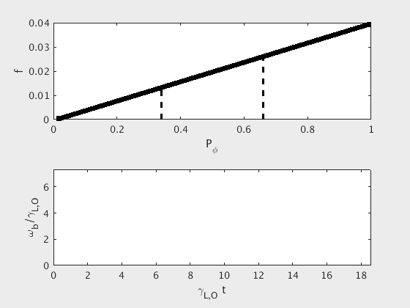
Chirping is supported by phase-space holes and clumps
Lilley and Nyqvist, Phys. Rev. Lett. 102, 195003 (2014)
hole
Stochasticity hinders the formation of holes and clumps, preventing chirping
clump
Resonance Broadening Quasilinear (RBQ) code
(later in this talk)
Two typical scenarios for fast ion losses:
Diffusive transport (typical for fixed-frequency modes)
can be modeled using reduced theories
  e.g., quasilinear theory
Convective transport (typical for chirping frequency modes)
Requires capturing full phase-space dynamics
  expensive nonlinear simulations

Slide 7
Outline
Part I: Prediction of the nonlinear spectral character of Alfvén waves
Chirping vs quasi-steady frequency responses and the applicability of reduced models
A criterion for the chirping onset
Analysis of NSTX and DIII-D data
Predictions for ITER scenarios
Part II: Reduced quasilinear modeling of fast ion losses
Development of the broadened quasilinear framework
Verification and validation exercises
Integration of the Resonance Broadened Quasilinear (RBQ) code into TRANSP
  modeling of DIII-D critical gradient experiments

Slide 8
A criterion for the likelihood of chirping onset in tokamaks
Starting point: the evolution equation for mode amplitude A near marginal stability:
Berk, Breizman and Pekker, PRL 1996
Lilley, Breizman and Sharapov, PRL 2009

Slide 9
A criterion for the likelihood of chirping onset in tokamaks
Starting point: the evolution equation for mode amplitude A near marginal stability:
Berk, Breizman and Pekker, PRL 1996
Lilley, Breizman and Sharapov, PRL 2009
stabilizing
destabilizing (makes integral sign flip)
Blow up of A in a finite time-> system enters a strong nonlinear phase (chirping likely)

Slide 10
A criterion for the likelihood of chirping onset in tokamaks
Starting point: the evolution equation for mode amplitude A near marginal stability:
Berk, Breizman and Pekker, PRL 1996
Lilley, Breizman and Sharapov, PRL 2009
stabilizing
destabilizing (makes integral sign flip)
Blow up of A in a finite time-> system enters a strong nonlinear phase (chirping likely)
Chirping criterion:
>0: fixed-frequency solution likely
<0: chirping likely to occur
(nonlinear prediction from linear physics elements->incorporated into the linear NOVA-K code )
Duarte et al, Nucl. Fusion 57 054001 (2017)

Slide 11
A criterion for the likelihood of chirping onset in tokamaks
Starting point: the evolution equation for mode amplitude A near marginal stability:
Berk, Breizman and Pekker, PRL 1996
Lilley, Breizman and Sharapov, PRL 2009
stabilizing
destabilizing (makes integral sign flip)
Blow up of A in a finite time-> system enters a strong nonlinear phase (chirping likely)
Chirping criterion:
>0: fixed-frequency solution likely
<0: chirping likely to occur
(nonlinear prediction from linear physics elements->incorporated into the linear NOVA-K code )
The criterion ( ) predicts that micro-turbulence should be key in determining the likely nonlinear character of a mode, e.g., fixed-frequency or chirping
Duarte et al, Nucl. Fusion 57 054001 (2017)

Slide 12
Outline
Part I: Prediction of the nonlinear spectral character of Alfvén waves
Chirping vs quasi-steady frequency responses and the applicability of reduced models
A criterion for the chirping onset
Analysis of NSTX and DIII-D data
Predictions for ITER scenarios
Part II: Reduced quasilinear modeling of fast ion losses
Development of the broadened quasilinear framework
Verification and validation exercises
Integration of the Resonance Broadened Quasilinear (RBQ) code into TRANSP
  modeling of DIII-D critical gradient experiments

Slide 13
Correlation between chirping onset and a marked reduction of the turbulent activity in DIII-D
Diffusivity drop due to L→H mode transition
Strong rotation shear was observed
This observation motivated DIII-D experiments to be designed to further test the hypothesis of low turbulence associated with chirping
Duarte et al, Nucl. Fusion 57 054001 (2017)

Slide 14
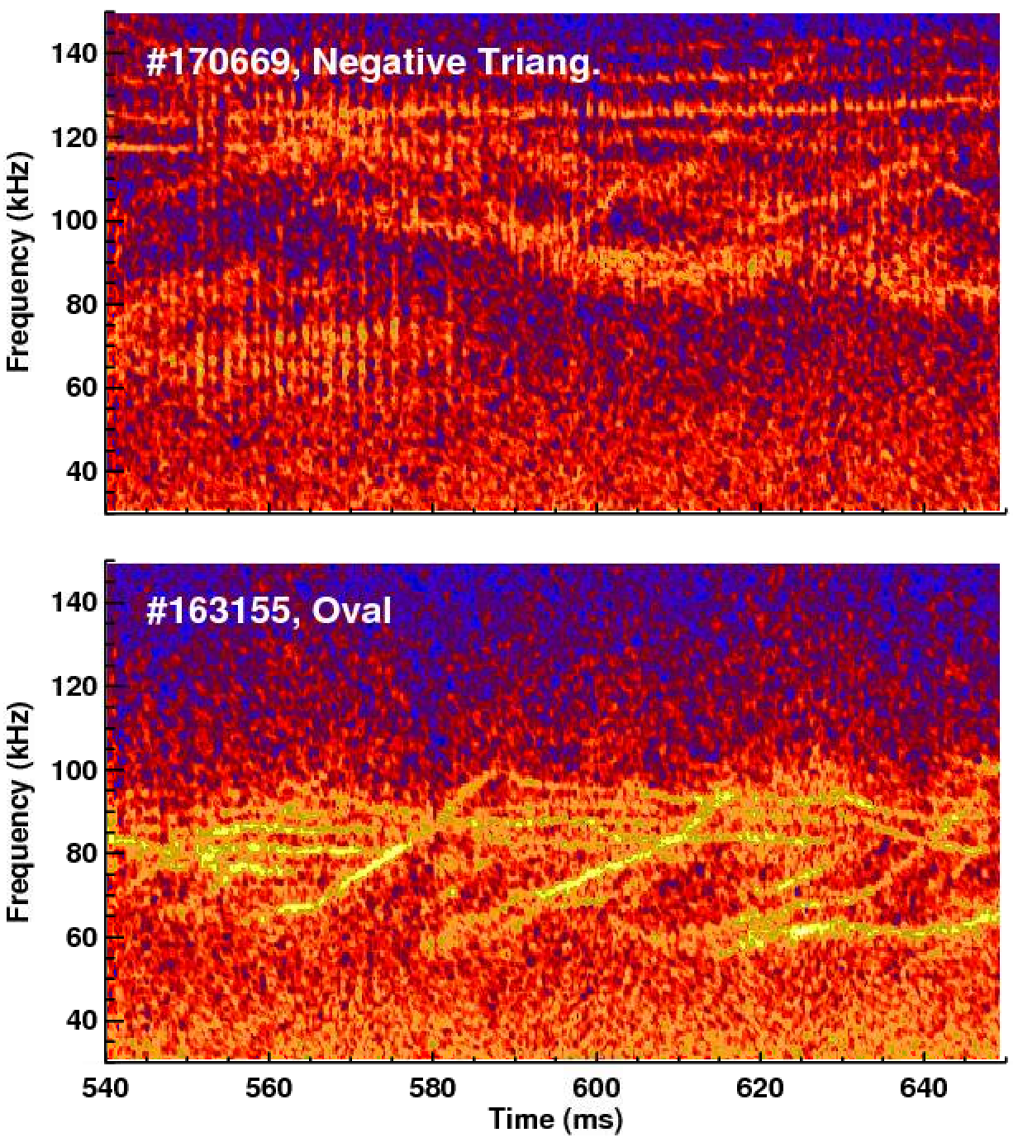
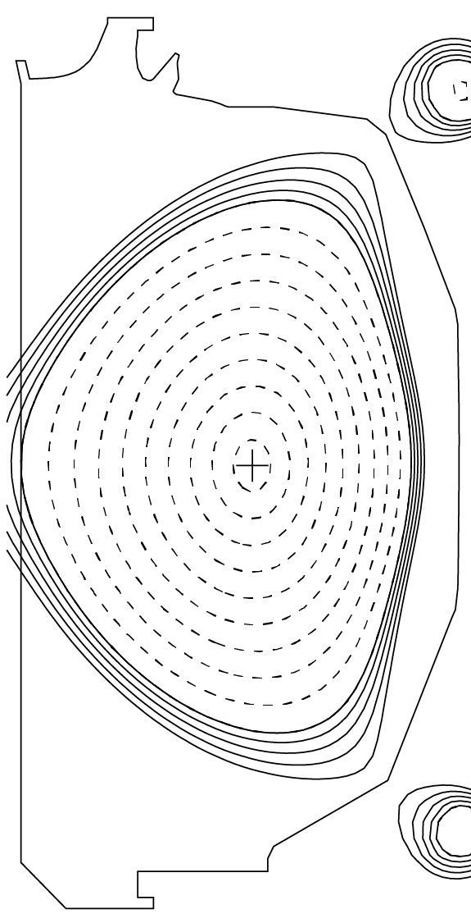
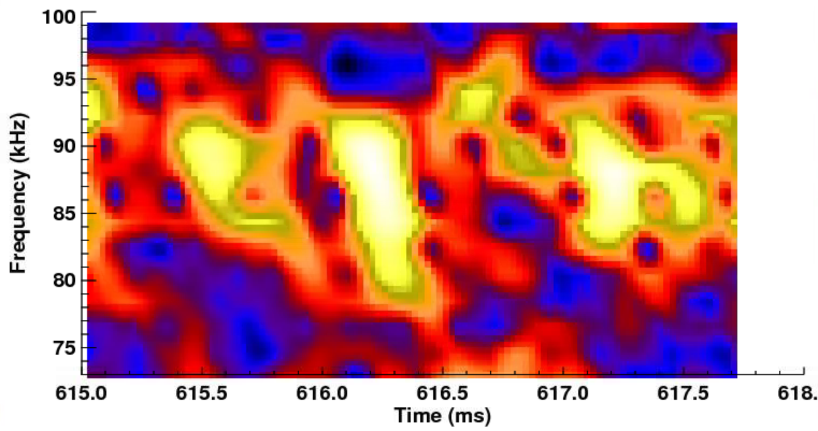
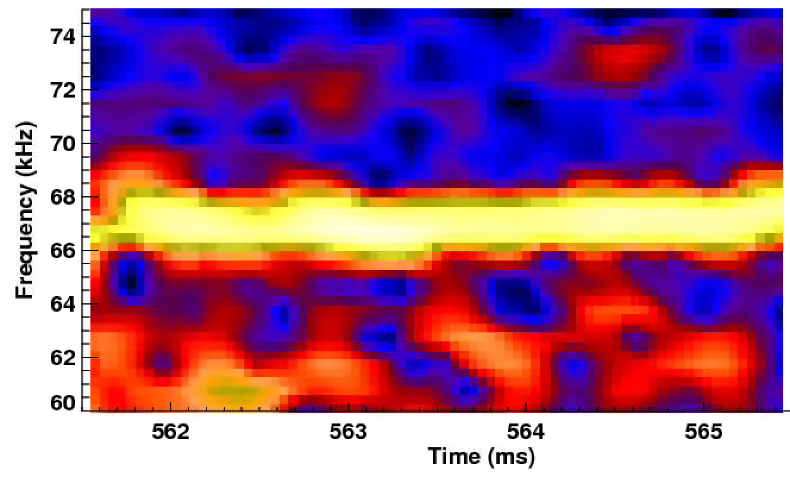
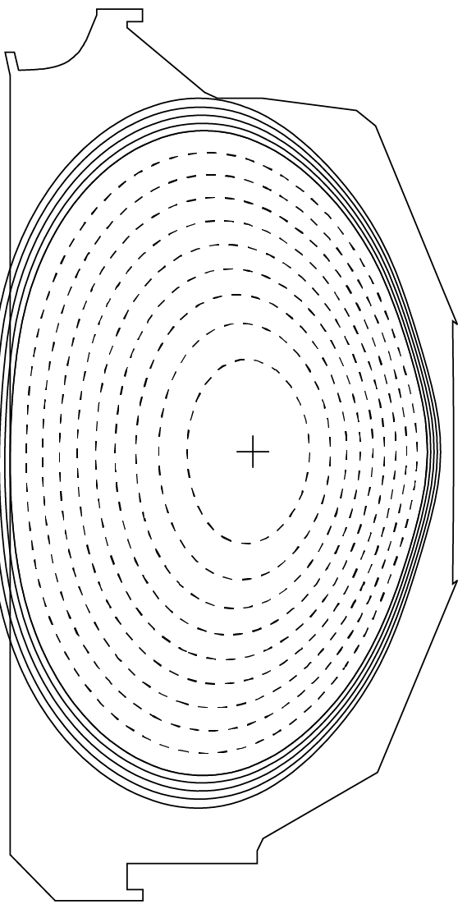
Dedicated experiments showed that chirping is more prevalent in negative triangularity DIII-D shots
Transport coefficients calculated in TRANSP are 2-3 times lower in negative triangularity, as compared to the the usual positive/oval triangularity
Van Zeeland et al, Nucl. Fusion 59 086028 (2019)
Notes:
The TCV results showed that the eigenmodes are more sheared and that contributes to reduce turbulence
zoom the chirping and the fixed-freq

Slide 15
Dedicated experiments showed that chirping is more prevalent in negative triangularity DIII-D shots
Transport coefficients calculated in TRANSP are 2-3 times lower in negative triangularity, as compared to the the usual positive/oval triangularity
>0: fixed-frequency
<0: chirping
Van Zeeland et al, Nucl. Fusion 59 086028 (2019)
Notes:
The TCV results showed that the eigenmodes are more sheared and that contributes to reduce turbulence
zoom the chirping and the fixed-freq

Slide 16
Dedicated experiments showed that chirping is more prevalent in negative triangularity DIII-D shots
Transport coefficients calculated in TRANSP are 2-3 times lower in negative triangularity, as compared to the the usual positive/oval triangularity
>0: fixed-frequency
<0: chirping
Van Zeeland et al, Nucl. Fusion 59 086028 (2019)
Notes:
The TCV results showed that the eigenmodes are more sheared and that contributes to reduce turbulence
zoom the chirping and the fixed-freq

Slide 17
GTS global gyrokinetic analyses show turbulence reduction for rare NSTX Alfvénic transitions from fixed-frequency to chirping
Electrostatic turbulence fluctuation
Before chirping, 265ms
Peak of the most intense mode
During chirping, 290ms
Electrostatic turbulence fluctuation
Before chirping, 265ms
Peak of the most intense mode
During chirping, 300ms
Duarte et al, Nucl. Fusion 58 082013 (2018)

Slide 18
Chirping criterion explains different spectral behavior in spherical vs conventional tokamaks
chirping, NSTX
fixed-frequencies, DIII-D and TFTR
Arrows represent how much turbulent diffusion changes the prediction with respect to collisions alone
Transport in NSTX in mostly neoclassical at the ion scale
Duarte et al, Nucl. Fusion 57 054001 (2017)
Chirping is ubiquitous in NSTX but rare in DIII-D, which is consistent with the inferred fast ion micro-turbulent levels
Similar agreement was later found in ASDEX-U [Lauber et al, IAEA inv. talk 2018]

Slide 19
Outline
Part I: Prediction of the nonlinear spectral character of Alfvén waves
Chirping vs quasi-steady frequency responses and the applicability of reduced models
A criterion for the chirping onset
Analysis of NSTX and DIII-D data
Predictions for ITER scenarios
Part II: Reduced quasilinear modeling of fast ion losses
Development of the broadened quasilinear framework
Verification and validation exercises
Integration of the Resonance Broadened Quasilinear (RBQ) code into TRANSP
  modeling of DIII-D critical gradient experiments

Slide 20
Alfvénic chirping is unlikely but cannot be ruled out in ITER
Predictions for the most unstable (n=7-11) TAEs in ITER are near threshold between fixed frequency and chirping, based on TRANSP analysis, requiring Q>10
Duarte et al, Nucl. Fusion 58 082013 (2018)
Notes:
Ratio

Slide 21
Validated chirping criterion predicts when fast ion transport can be modeled with reduced models
Reduced transport models are only applicable when details of phase-space dynamics are unimportant (no chirping modes)
Nonlinear theory has been used to develop a criterion for when chirping is likely to occur
Stochasticity destroys phase space coherence necessary for chirping
  less turbulence favors chirping → confirmed in negative triangularity experiments
  Chirping criterion explains why chirping is ubiquitous in NSTX and rare in DIII-D
    predicts that chirping is possible but unlikely in ITER

Slide 22
Outline
Part I: Prediction of the nonlinear spectral character of Alfvén waves
Chirping vs quasi-steady frequency responses and the applicability of reduced models
A criterion for the chirping onset
Analysis of NSTX and DIII-D data
Predictions for ITER scenarios
Part II: Reduced quasilinear modeling of fast ion losses
Development of the broadened quasilinear framework
Verification and validation exercises
Integration of the Resonance Broadened Quasilinear (RBQ) code into TRANSP
  modeling of DIII-D critical gradient experiments

Slide 23
Critical gradient behavior in DIII-D suggests that quasilinear modeling is a viable tool for fast ion relaxation
Critical gradient is often observed in DIII-D - stiff, resilient fast ion profiles as beam power varies
-stochastic fast ion transport (mediated by overlapping resonances) gives credence in using a quasilinear approach
Fully nonlinear modeling of fast ion interaction with Alfvénic modes in a realistic tokamak is numerically expensive
Reduced (but still realistic) modeling can be exploited if linear mode properties do not change faster than the equilibrium, e. g.,
  eigenstructure
  resonance condition
Simulations need to cope with the simultaneous excitation of multiple unstable Alfvénic instabilities
Collins et al, Phys. Rev. Lett. 116, 095001 (2016)
Notes:
fast-ion transport suddenly becomes stiff above a critical threshold in the presence of many overlapping small-amplitude Alfvén eigenmodes

Slide 24
Resonance-broadened quasilinear (RBQ) diffusion model
-a reduced but yet a realistic framework-
Formulation in action and angle variables
Diffusion equation:
Mode amplitude evolution:
Broadening is the platform that allows for momentum and energy exchange between particles and waves.
  Heuristic broadening recipes historically used
  Physics-based determination of the resonance broadening function was only very recently achieved
The model is applicable for both single/isolated resonances and also multiple and overlapping ones.
Berk et al, Nucl. Fusion 35 1661 (1995); Duarte, PhD thesis (2017); Gorelenkov, Duarte, Podestà and Berk, Nucl. Fusion 58 082016 (2018)
Broadened delta
-_
eigenstucture
information

Slide 25
First-principles analytical determination of the collisional resonance broadening
Starting with the kinetic equation:
Blue curve: pitch-angle scattering
Red curve: Krook collisions
(from collisions, turbulence,…)
Broadening functions
Near marginal stability, perturbation theory can be employed to show that a quasilinear transport equation naturally emerges, with the resonance functions given by
Distribution modification
The use of the obtained resonance broadening functions implies that essential features of nonlinear theory, such as the growth rate and the saturation level, are automatically built into a reduced QL theory
Duarte et al, Phys. Plasmas 26, 120701 (2019)

Slide 26
Outline
Part I: Prediction of the nonlinear spectral character of Alfvén waves
Chirping vs quasi-steady frequency responses and the applicability of reduced models
A criterion for the chirping onset
Analysis of NSTX and DIII-D data
Predictions for ITER scenarios
Part II: Reduced quasilinear modeling of fast ion losses
Development of the broadened quasilinear framework
Verification and validation exercises
Integration of the Resonance Broadened Quasilinear (RBQ) code into TRANSP
  modeling of DIII-D critical gradient experiments

Slide 27
Verification of the analytical predictions against ORBIT simulations of Alfvénic resonances
Modification of the distribution function vs canonical toroidal momentum
Red and black: guiding-center ORBIT simulation results for two different levels of collisionality
Green: analytic fit
White, Duarte et al, Phys. Plasmas 26, 032508 (2019)

Slide 28
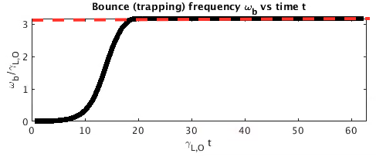
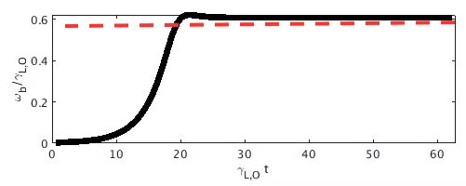
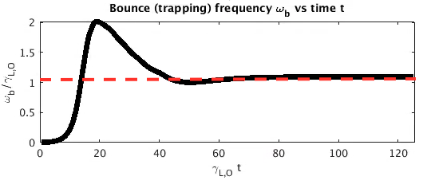
Quasilinear simulations replicate analytical predictions for the mode saturation amplitude from nonlinear theory
Definitions: initial linear growth rate , mode damping rate and trapping (bounce) frequency (proportional to square root of mode amplitude)
Collisionless case
Collisional cases
Close to marginal stability²:
Far from marginal stability³:
Undamped case¹
Expected saturation levels from analytic theory are shown by
¹Fried et al, Report No. PPG-93 (UCLA,1972); ²Berk et al. Plasma Phys. Rep, 23(9), 1997; ³Berk and Breizman. Phys. Fluids B, 2(9), 1990

Slide 29
Outline
Part I: Prediction of the nonlinear spectral character of Alfvén waves
Chirping vs quasi-steady frequency responses and the applicability of reduced models
A criterion for the chirping onset
Analysis of NSTX and DIII-D data
Predictions for ITER scenarios
Part II: Reduced quasilinear modeling of fast ion losses
Development of the broadened quasilinear framework
Verification and validation exercises
Integration of the Resonance Broadened Quasilinear (RBQ) code into TRANSP
  modeling of DIII-D critical gradient experiments

Slide 30
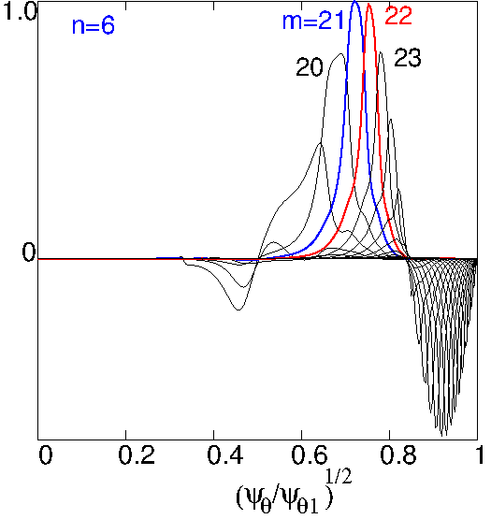
Verification of RBQ runs for the collisional evolution of an Alfvénic wave
DIII-D discharge 153072
Mode
structure
Resonance
broadening
Idealized bump-on-tail scaling (obtained using Dirichlet boundary conditions on both ends of the domain):
Gorelenkov, Duarte et al, Phys. Plasmas 26, 072507 (2019)

Slide 31
RBQ is interfaced with TRANSP: multi-mode case
11 unstable Alfvénic modes at 805ms
Distribution at 805ms - DIII-D shot 159243
Gorelenkov, Duarte et al, Phys. Plasmas 26, 072507 (2019)

Slide 32
RBQ is interfaced with TRANSP: multi-mode case
11 unstable Alfvénic modes at 805ms
Distribution at 805ms - DIII-D shot 159243
Gorelenkov, Duarte et al, Phys. Plasmas 26, 072507 (2019)
Collins et al, Phys. Rev. Lett. 116, 095001 (2016)

Slide 33
Summary
Prediction of Alfvénic spectral character
Chirping criterion determines when reduced models, such as quasilinear, can be applied
  also explains why chirping is more common in spherical tokamaks
DIII-D negative triangularity experiments confirm prediction that chirping is more prevalent when turbulence is reduced
The criterion ITER scenarios are predicted to be near boundary between chirping and fixed-frequency behavior
Quasilinear modeling
The Resonance Broadened Quasilinear (RBQ) model exactly preserves key properties of the full nonlinear system
  Extensively verified and validated
Integration in TRANSP enables predictions in realistic scenarios
  Captures hollow fast ion profiles observed in DIII-D discharges

Slide 34
Ongoing study on the evolution of toroidal Alfvén modes in DIII-D, with a changing drive due to beam blips
Amplitude evolution for a single mode near marginal stability:
DIII-D shot 176523
Duarte et al, Nucl. Fusion 59 044003 (2019)
Amplitude A vs time t for nonlinear simulation (green) and the analytic formula (black)
The INPA signal is being used as a proxy for the mode drive
[Duarte and Van Zeeland, in progress]

Slide 35
Thank you

Slide 36
Backup slides

Slide 37
First-principle analytical determination of the collisional resonance broadening – part I
Start with the kinetic equation:
(from collisions, turbulence,…)
Periodicity over the canonical angle allows the distribution to be written as a Fourier series:
Near marginal stability, a perturbation theory can be developed in orders of
which leads to the ordering . When memory effects are weak, i.e., ,

Slide 38
Self-consistent formulation of collisional quasilinear transport theory near threshold
A QL theory naturally emerges when considering kinetic theory near threshold when collisions occur at a time scale faster than the phase mixing time scale.
The QL plasma system automatically replicates the nonlinear growth rate and the wave saturation levels calculated from full kinetic theory near marginality, with a rather complex time-delayed integro-differential equation (Berk, Breizman and Pekker, Phys. Rev. Lett. 1996)

Slide 39
Determining the parametric dependencies of the broadening from single mode saturation levels
The broadening is assumed with the parametric form where the coefficients and are determined in order to enforce QL theory to replicate known nonlinear saturation levels:
Limit near marginal stability³
→
Limit far from marginal stability⁴
→
Resonance-broadened quasilinear formalism can cope with both situations of isolated and overlapping modes
³H. L. Berk et al. Plasma Phys. Rep, 23(9), 1997 ⁴H. L. Berk and B. N. Breizman. Phys. Fluids B, 2(9), 1990
Top-hat, square resonance function heuristically assumed

Slide 40
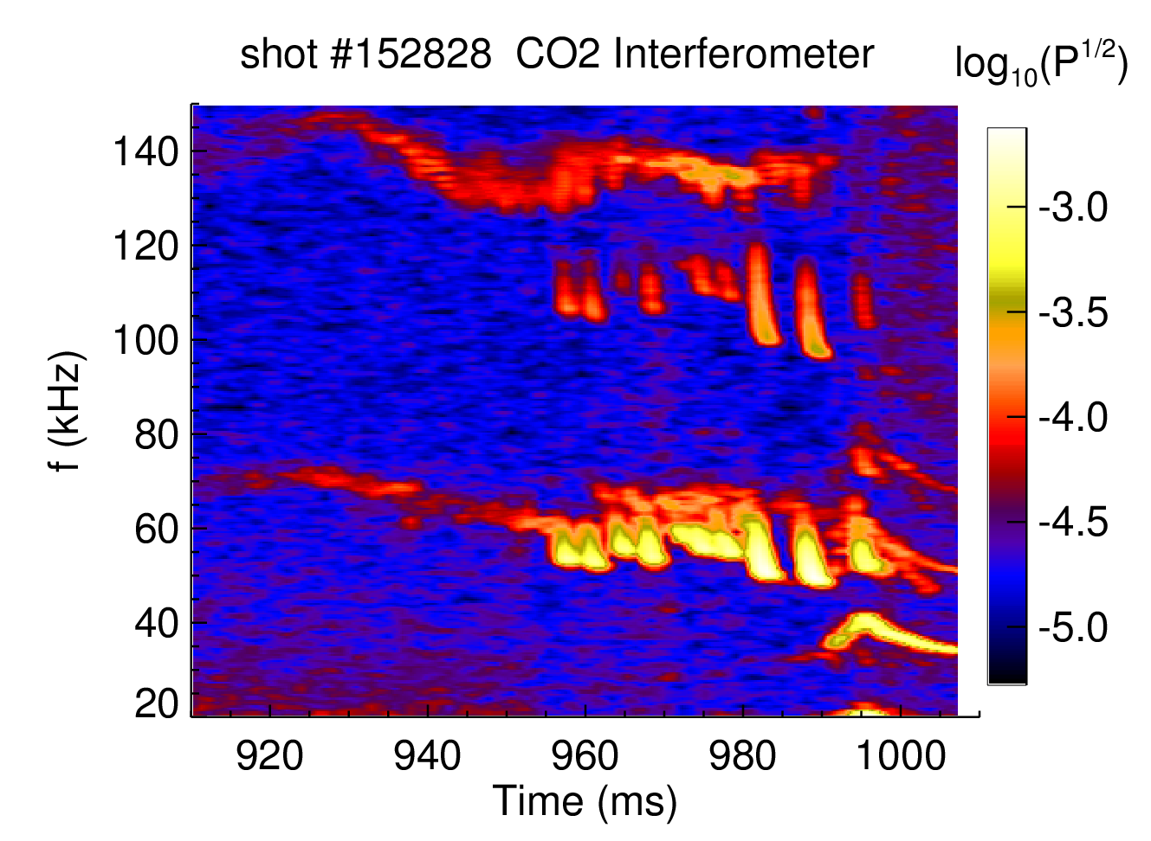
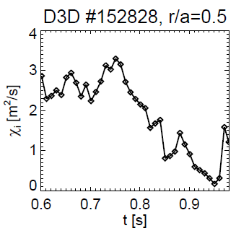
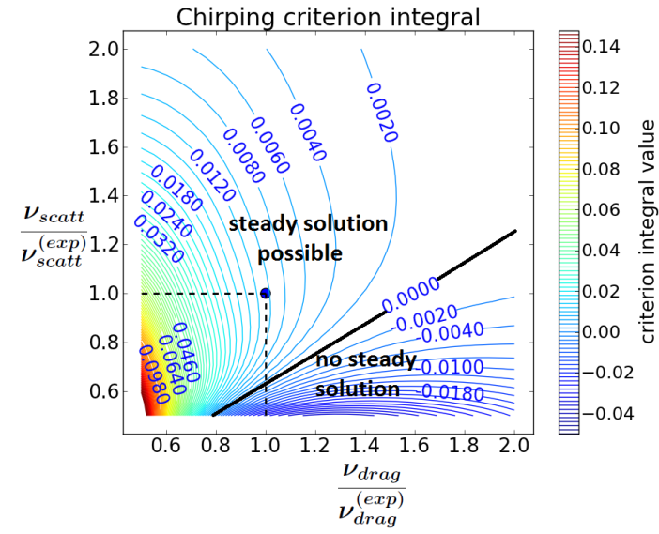
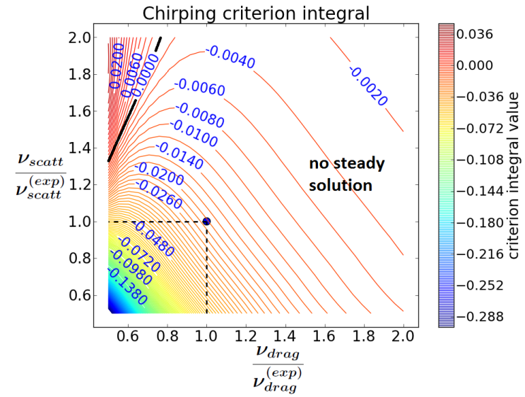
Characterization of a rarely observed chirping mode in DIII-D
Diffusivity drop due to L→H mode transition
Strong rotation shear was observed
TRANSP run
Diffusivity
vs
time
Before chirping, at 900ms: D~1m²/s
During chirping, at 960ms: D~0.2m²/s
Duarte et al, Phys. Plasmas 24, 122508 (2017)

Slide 41
A criterion for the likelihood of chirping onset in tokamaks
Starting point: lowest-order nonlinear correction to the evolution of mode amplitude A:
-_
-_
Berk, Breizman and Pekker, PRL 1996
Lilley, Breizman and Sharapov, PRL 2009
stabilizing
destabilizing (makes integral sign flip)
Blow up of A in a finite time-> system enters a strong nonlinear phase (chirping likely)
Chirping criterion:
>0: fixed-frequency solution likely
<0: chirping likely to occur
(nonlinear prediction from linear physics elements->incorporated into NOVA-K code )
The criterion ( ) predicts that micro-turbulence should be key in determining the likely nonlinear character of a mode, e.g., fixed-frequency or chirping
Duarte et al, Nucl. Fusion 57 054001 (2017).

Slide 43
The overlapping of resonances lead to losses due to global diffusion
Broadened QL theory is designed to address both regimes of isolated and overlapping resonances
  the fast ion distribution function relaxes while self-consistently evolving the amplitude of modes
      H. Berk, B. Breizman, J. Fitzpatrick, and H. Wong, Nucl. Fusion 35, 1661 (1995).

Slide 44
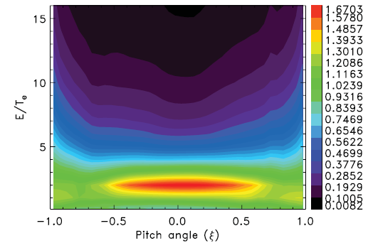

Correction to the diffusion coefficient: the inclusion of electrostatic microturbulence
Microturbulence can well exceed pitch-angle scattering at the resonance¹
From GTC gyrokinetic simulations for passing particles:²
As pitch-angle scattering, microturbulence acts to destroy phase-space holes and clumps
Unlike DIII-D and TFTR, transport in NSTX in mostly neoclassical
Complex interplay between gyroaveraging, field anisotropy and poloidal drift effects leads to non-zero EP diffusivity³
¹Lang and Fu, PoP 2011
²Zhang, Lin and Chen, PRL 2008
³Estrada-Mila et al, PoP 2005
Ratio of fast ion diffusivity to thermal ion diffusivity²
Pueschel et al, NF 2012 gives similar microturbulence levels

Slide 45
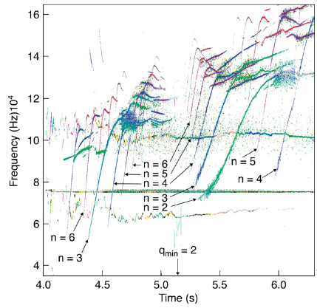
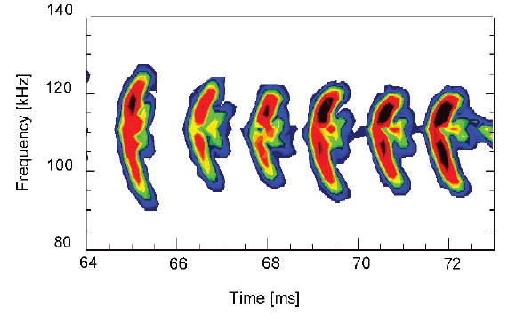
Two types of frequency shift observed experimentally
Frequency sweeping
frequency shift due to time-dependent background equilibrium
MHD eigenmode
timescale: ~100ms
Frequency chirping
frequency shift due to trapped particles
does not exist without resonant particles
timescale: ~1ms
Sharapov et al, PoP 2006
Pinches et al, NF 2004

Slide 46
Nonlinear vs Quasilinear approach
Requires particles to remember their phases from one trapping bounce to another;
Full kinetic approach necessary;
Entropy is conserved in the absence of collisions;
Convective transport.
Requires particles to forget their phase (via collisions, turbulence or mode overlap);
Assumes that the modes remain linear (therefore NOVA is suited) while the distribution function is allowed to slowly evolve nonlinearly in time;
Entropy increases due to particle memory loss (due to phase averaging).
Diffusive transport.

