Slide 1







Experimental Approach and
Physics Background
of Hybrid Scenarios in KSTAR
Yong-Su Na and M.S. Park
on behalf of KSTAR Team and Collaborators
PLARE, Department of Nuclear Engineering, Seoul National University, Seoul, Korea
ysna@snu.ac.kr
Magnetic Fusion Science Meeting, June 8, 2020

Slide 2

Contents
Yong-Su Na et al, NF in press (2020)
Introduction
Definition of Hybrid Scenario in KSTAR
Experimental Approaches to Establish Hybrid Scenarios
Characteristics of Plasma Performance w.r.t. MHD Activities
Origins of Confinement Enhancement
- Performance Analysis
- Kinetic Profile Analysis
- Power Balance Analysis
- Linear Gyro-kinetic Analysis
- Pedestal Stability Analysis
Hypothesis of Confinement Enhancement Mechanism
Collaboration with PPPL
Summary and Future Work

Slide 3
Definition of Hybrid Scenarios

Slide 4



Introduction – Requirement of Fusion Reactor
High fusion performance (high nτT)
Figure of merit 1
Normalised fusion gain
$$G=β_{N}H/q_{95}^{2}$$
⇒ “Integrated Advanced Scenario”
main goal of KSTAR
Steady-state operation (f_{NI} = 1)
Figure of merit 2
Bootstrap current fraction
$$β_{p}$$
Long pulse operation (τ_{pulse} ≫ τ_{W})
Profile & MHD control, particle & power handling, engineering issues

Slide 5
Introduction – Hybrid Scenario
q-profiles
for ITER | Baseline (Reference H-mode with ELMs)
Plasma current (MA) | 15
B_{T} (T) | 5.3
q₉₅ | 3.0
Q value | 10
Operating time (s) | 400
5
4
3
2
1
monotonic shear
0
0
0.5
1
r/a

Slide 6
Introduction – Hybrid Scenario
q-profiles
for ITER | Baseline (Reference H-mode with ELMs) | Hybrid (Advanced Inductive) | Steady-state (Fully non-inductive current drive)
Plasma current (MA) | 15 | 12 (15) | 9
B_{T} (T) | 5.3 | 5.3 | 5.3
q₉₅ | 3.0 | ~4 | ~5
Q value | 10 | 10 ( > 20) | 5
Operating time (s) | 400 | 3000 | 5000
5
strong
4
reversed
shear
3
2
weak
1
monotonic shear
0
0
0.5
1
r/a

Slide 7
Introduction – Hybrid Scenario
q-profiles
for ITER | Baseline (Reference H-mode with ELMs) | Hybrid (Advanced Inductive) | Steady-state (Fully non-inductive current drive)
Plasma current (MA) | 15 | 12 (15) | 9
B_{T} (T) | 5.3 | 5.3 | 5.3
q₉₅ | 3.0 | ~4 | ~5
Q value | 10 | 10 ( > 20) | 5
Operating time (s) | 400 | 3000 | 5000
5
strong
4
reversed
shear
3
2
weak
Operating with a high fusion gain for a very long pulse duration by the combination of a lower current and a lower loop voltage for engineering tests of reactor-relevant components, such as breeding blankets.
Characteristics
  Without or mild sawtooth activity.
  High performance
  Stationary (no sophisticated profile control needed)
~flat shear
1
monotonic shear
0
0
0.5
1
r/a

Slide 8
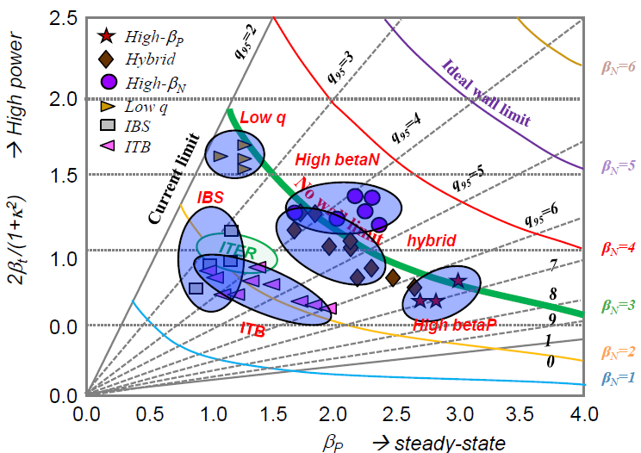
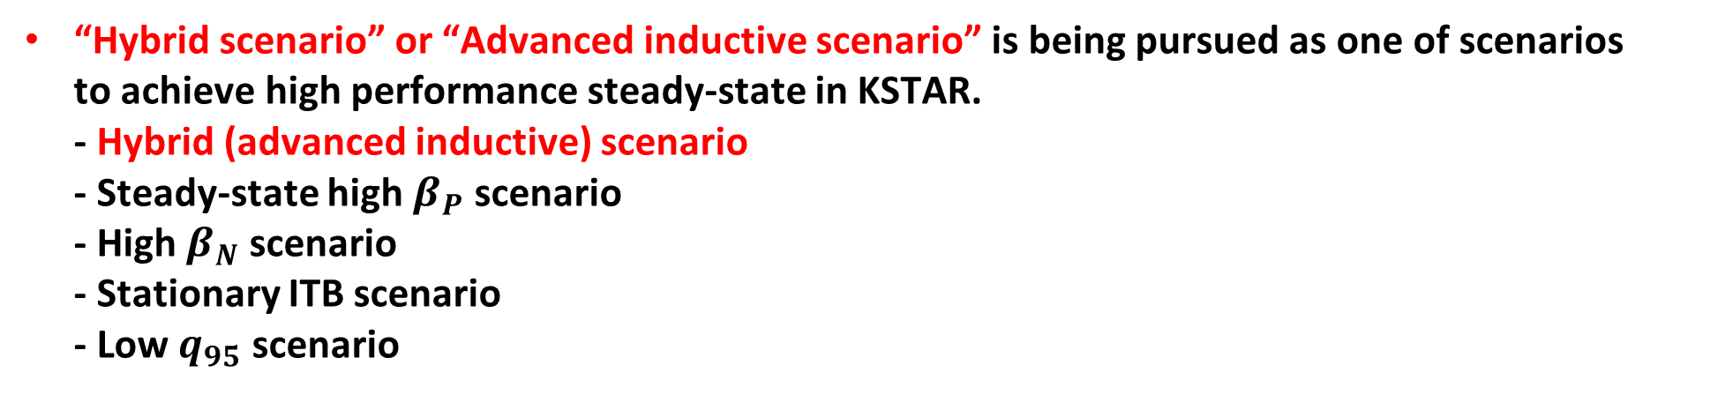
Introduction – Hybrid Scenario
“Hybrid scenario” or “Advanced inductive scenario” is being pursued as one of scenarios
to achieve high performance steady-state in KSTAR.
- Hybrid (advanced inductive) scenario
- Steady-state high $β_{P}$ scenario
- High $β_{N}$ scenario
- Stationary ITB scenario
- Low $q_{95}$ scenario
Hybrid scenario can sustain high normalized
fusion gain ($G≡β_{N}H_{89}/q_{95}^{2}$) in stationary conditions.
Our goal is sustaining high normalized fusion gain
with fully non-inductive current drive in
reactor-relevant conditions.

Slide 9
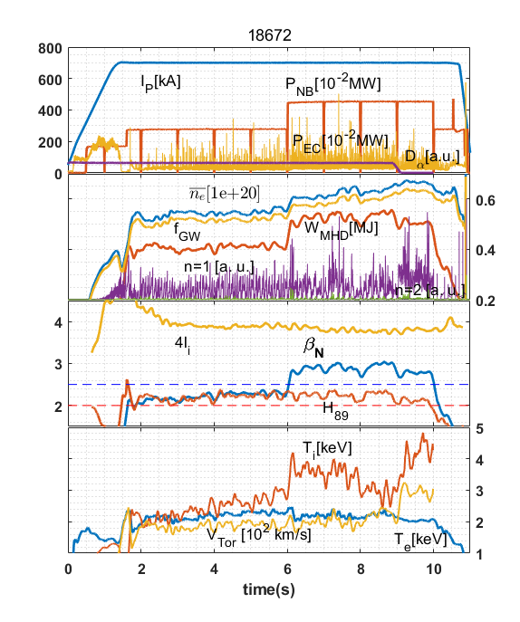
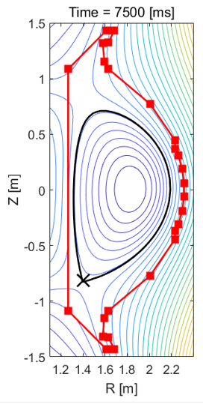
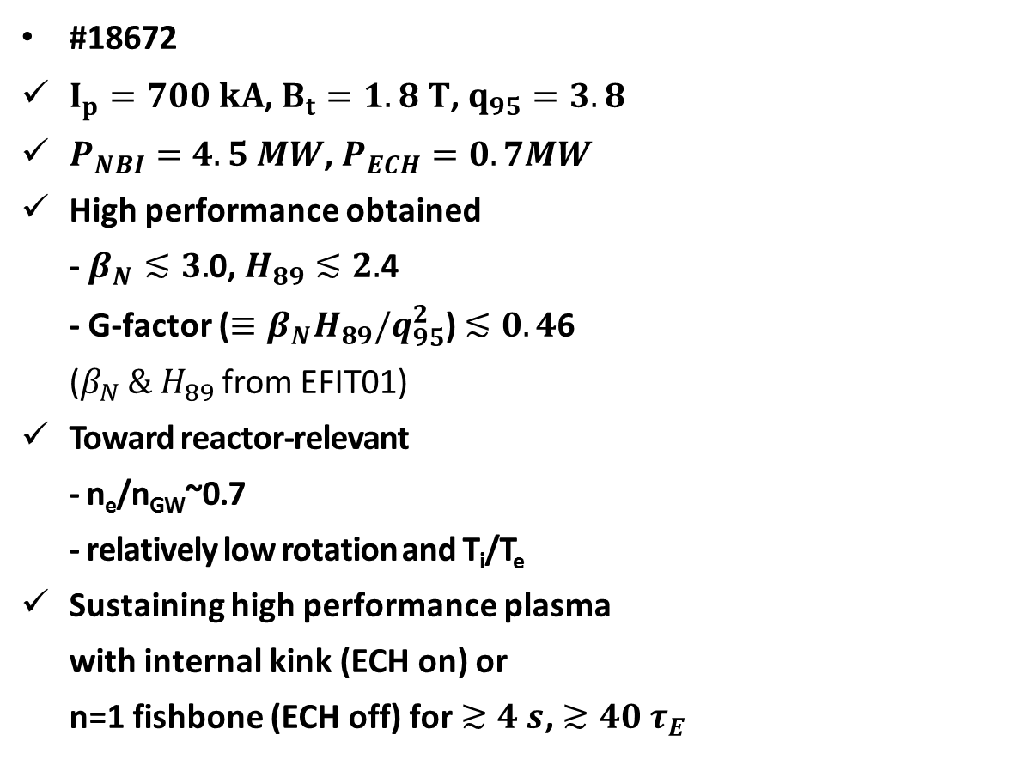
Introduction – Hybrid Scenario
#18672
$I_{p}=700 kA$, $B_{t}=1.8 T$, $q_{95}=3.8$
$P_{NBI}=4.5 MW$, $P_{ECH}=0.7MW$
High performance obtained
- $β_{N}≲3.$0, $H_{89}≲2.$4
- G-factor ($≡β_{N}H_{89}/q_{95}^{2}$) $≲0.4$6
($β_{N }\& H_{89}$ from EFIT01)
Toward reactor-relevant
- n_{e}/n_{GW}~0.7
- relatively low rotation and T_{i}/T_{e}
Sustaining high performance plasma
with internal kink (ECH on) or
n=1 fishbone (ECH off) for $≳4 s$, $≳40 τ_{E}$

Slide 10
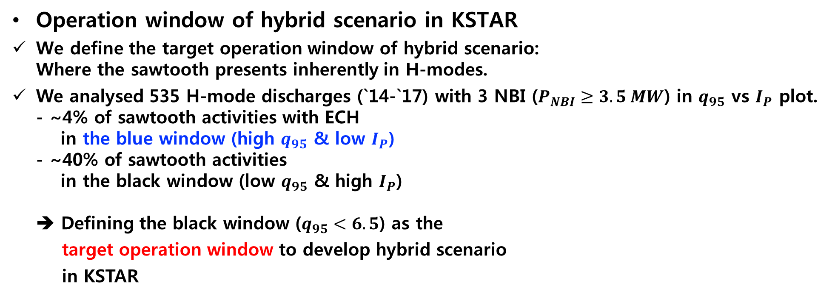
Target Operation Window of KSTAR Hybrid Scenario
Operation window of hybrid scenario in KSTAR
We define the target operation window of hybrid scenario:
Where the sawtooth presents inherently in H-modes.
We analysed 535 H-mode discharges (`14-`17) with 3 NBI ($P_{NBI}≥3.5 MW$) in $q_{95}$ vs $I_{P}$ plot.
- ~4% of sawtooth activities with ECH
in the blue window (high $q_{95}$ & low $I_{P}$)
- ~40% of sawtooth activities
in the black window (low $q_{95}$ & high $I_{P}$)
➔ Defining the black window ($q_{95}<6.5$) as the
target operation window to develop hybrid scenario
in KSTAR

Slide 11
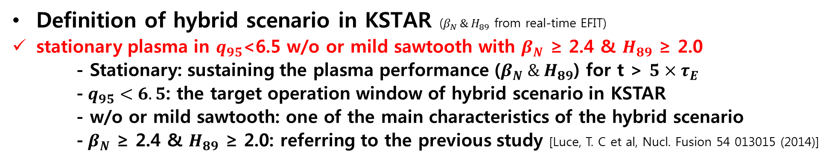
Definition of Hybrid Scenario in KSTAR
Definition of hybrid scenario in KSTAR ($β_{N }\& H_{89}$ from real-time EFIT)
stationary plasma in $q_{95}$<6.5 w/o or mild sawtooth with $β_{N}$ $\text{≥}$ 2.4 & $H_{89}$ $\text{≥}$ 2.0
- Stationary: sustaining the plasma performance ($β_{N} \& H_{89}$) for t > $5×τ_{E}$
- $q_{95}<6.5$: the target operation window of hybrid scenario in KSTAR
- w/o or mild sawtooth: one of the main characteristics of the hybrid scenario
- $β_{N}$ ≥ 2.4 & $H_{89}$ ≥ 2.0: referring to the previous study [Luce, T. C et al, Nucl. Fusion 54 013015 (2014)]

Slide 12
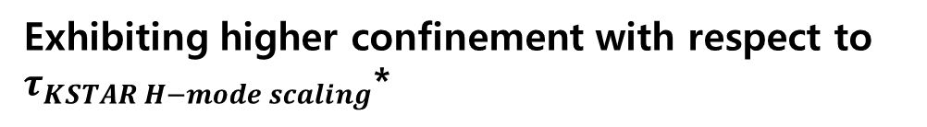
Definition of Hybrid Scenario in KSTAR
Definition of hybrid scenario in KSTAR ($β_{N }\& H_{89}$ from real-time EFIT)
stationary plasma in $q_{95}$<6.5 w/o or mild sawtooth with $β_{N}$ $\text{≥}$ 2.4 & $H_{89}$ $\text{≥}$ 2.0
- Stationary: sustaining the plasma performance ($β_{N} \& H_{89}$) for t > $5×τ_{E}$
- $q_{95}<6.5$: the target operation window of hybrid scenario in KSTAR
- w/o or mild sawtooth: one of the main characteristics of the hybrid scenario
- $β_{N}$ ≥ 2.4 & $H_{89}$ ≥ 2.0: referring to the previous study [Luce, T. C et al, Nucl. Fusion 54 013015 (2014)]
Exhibiting higher confinement with respect to $τ_{KSTAR H−mode scaling}$*
*[H.-S. Kim et al, Nucl. Fusion 54 083012 (2014)]
Note: Internal inductance (li3 < 1.05) and the shape of
q-profile are also used for categorising hybrid
scenario if MSE is available.

Slide 13
Experimental Approaches to Establish
Hybrid Scenarios

Slide 14
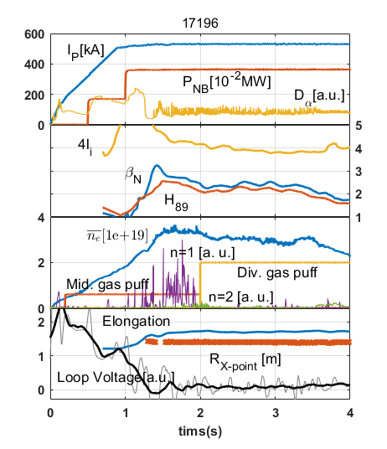
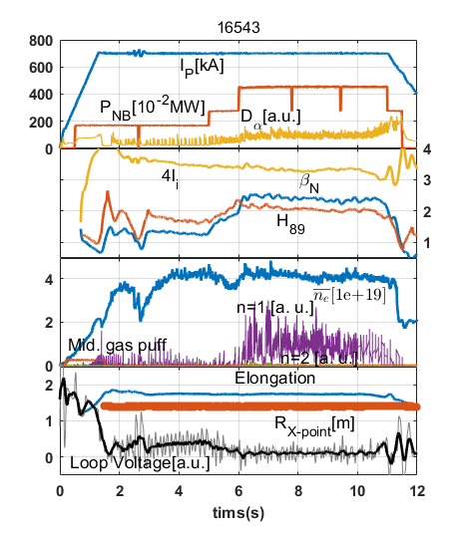
Access to Hybrid Regime in KSTAR
Early heating
Early NBI heating during the current ramp-up is widely used to obtain hybrid scenario in various tokamak devices.
Most hybrid scenarios were obtained
with this recipe.
(Basic operation scenario in KSTAR)
Early heating with adjusting
main heating time
Based on early heating scenario,
main heating time is adjusted to
optimise plasma performance.
Fishbone (n=1) usually appears and
sustains in the main heating phase.

Slide 15
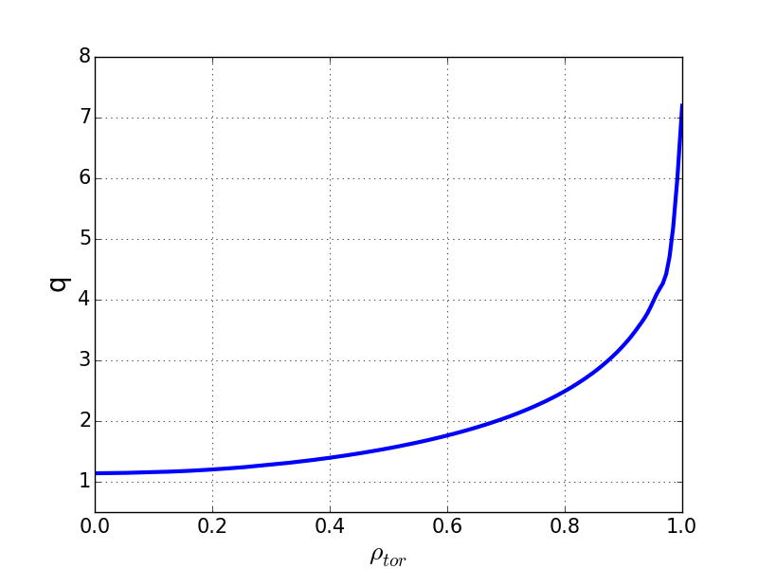
Access to Hybrid Regime in KSTAR
Early heating
Early NBI heating during the current ramp-up is widely used to obtain hybrid scenario in various tokamak devices.
Most hybrid scenarios were obtained
with this recipe.
(Basic operation scenario in KSTAR)
#16543 MSE-EFIT
Early heating with adjusting
main heating time
Based on early heating scenario,
main heating time is adjusted to
optimise plasma performance.
Fishbone (n=1) usually appears and
sustains in the main heating phase.

Slide 16
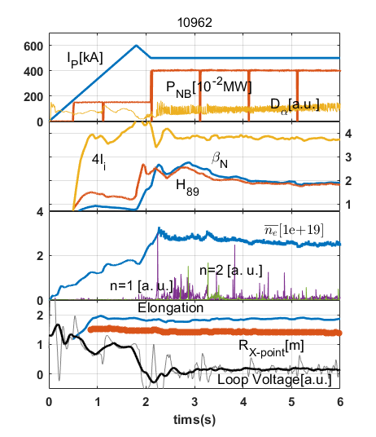
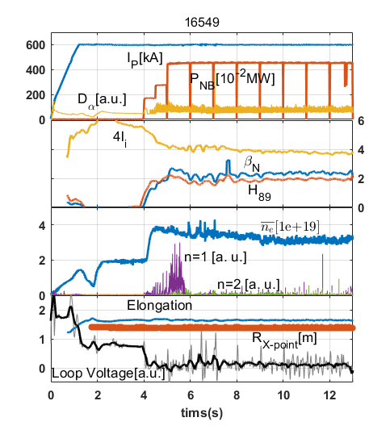
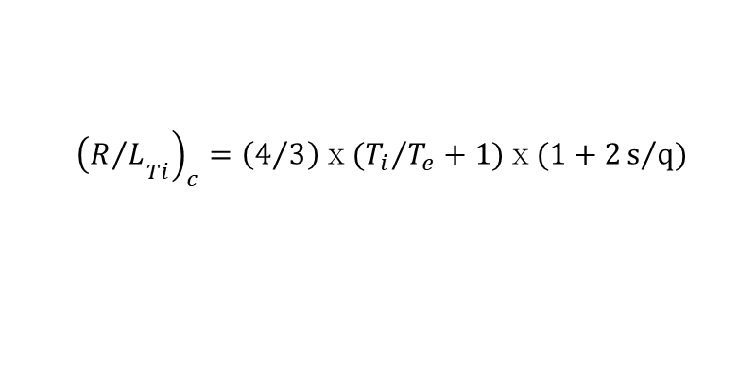
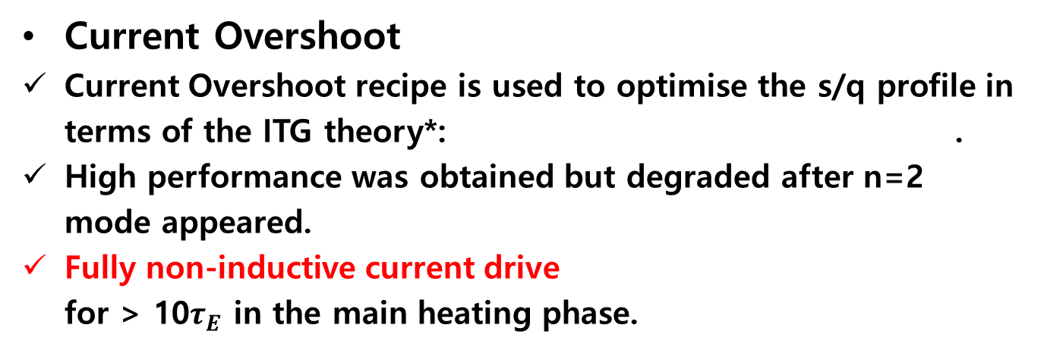
Access of Hybrid Regime in KSTAR
Current Overshoot
Current Overshoot recipe is used to optimise the s/q profile in terms of the ITG theory*: .
High performance was obtained but degraded after n=2 mode appeared.
Fully non-inductive current drive
for > 10$τ_{E}$ in the main heating phase.
$${\left.{\left(R/L\right.}_{Ti}\right)}_{c}=\left(4/3\right)ⅹ({T_{i}}/{T_{e}}+1)ⅹ(1+2s/q)$$
Late heating
The full heating is applied in the
current flattop phase after the current
is mostly diffused.
Fishbone (n=1) sustains for 1 s and
n=2 mode sustains during the rest of
the main heating phase.
*[S.C. Guo and F. Romanelli, Phys. of Plasmas 5 520 (1993)]

Slide 17
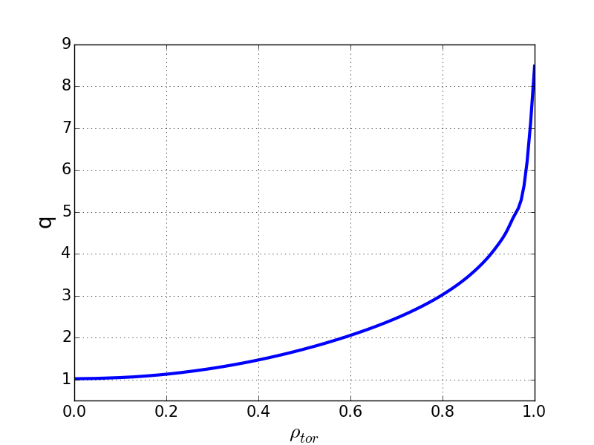

Access of Hybrid Regime in KSTAR
Current Overshoot
Current Overshoot recipe is used to optimise the s/q profile in terms of the ITG theory*: .
High performance was obtained but degraded after n=2 mode appeared.
Fully non-inductive current drive
for > 10$τ_{E}$ in the main heating phase.
$${\left.{\left(R/L\right.}_{Ti}\right)}_{c}=\left(4/3\right)ⅹ({T_{i}}/{T_{e}}+1)ⅹ(1+2s/q)$$
#16549 MSE-EFIT
Late heating
The full heating is applied in the
current flattop phase after the current
is mostly diffused.
Fishbone (n=1) sustains for 1 s and
n=2 mode sustains during the rest of
the main heating phase.
*[S.C. Guo and F. Romanelli, Phys. of Plasmas 5 520 (1993)]

Slide 18
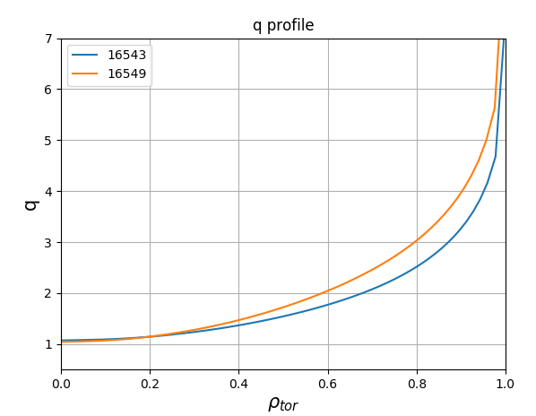
Access of Hybrid Regime in KSTAR
Current Overshoot
Current Overshoot recipe is used to optimise the s/q profile in terms of the ITG theory*: .
High performance was obtained but degraded after n=2 mode appeared.
Fully non-inductive current drive
for > 10$τ_{E}$ in the main heating phase.
$${\left.{\left(R/L\right.}_{Ti}\right)}_{c}=\left(4/3\right)ⅹ({T_{i}}/{T_{e}}+1)ⅹ(1+2s/q)$$
Late heating
The full heating is applied in the
current flattop phase after the current
is mostly diffused.
Fishbone (n=1) sustains for 1 s and
n=2 mode sustains during the rest of
the main heating phase.
Late heating
Early heating with adjusting
main heating time
*[S.C. Guo and F. Romanelli, Phys. of Plasmas 5 520 (1993)]

Slide 19
Characteristics of Plasma Performance
w.r.t. MHD Activities

Slide 20
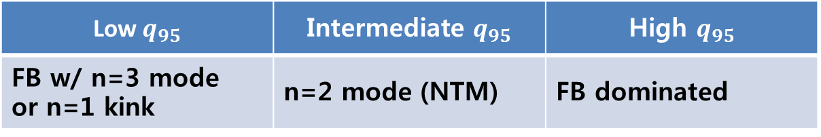
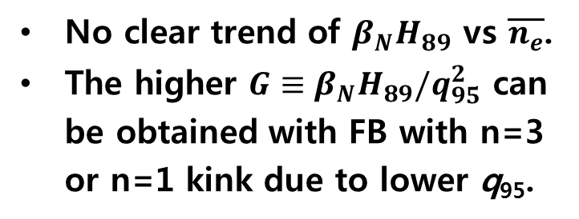

Characteristics of Plasma Performance w.r.t. MHD Activities
n=1 FB and n=2 mode are the main instabilities observed in KSTAR hybrid scenarios.
Dominant modes
Low $q_{95}$ | Intermediate $q_{95}$ | High $q_{95}$
FB w/ n=3 mode or n=1 kink | n=2 mode (NTM) | FB dominated
$$G≡β_{N}H_{89}/q_{95}^{2}$$
No clear trend of $β_{N}H_{89}$ vs $\overline{n_{e}}$.
The higher $G≡β_{N}H_{89}/q_{95}^{2}$ can be obtained with FB with n=3 or n=1 kink due to lower q₉₅.

Slide 21
Origins of Confinement Enhancement

Slide 22
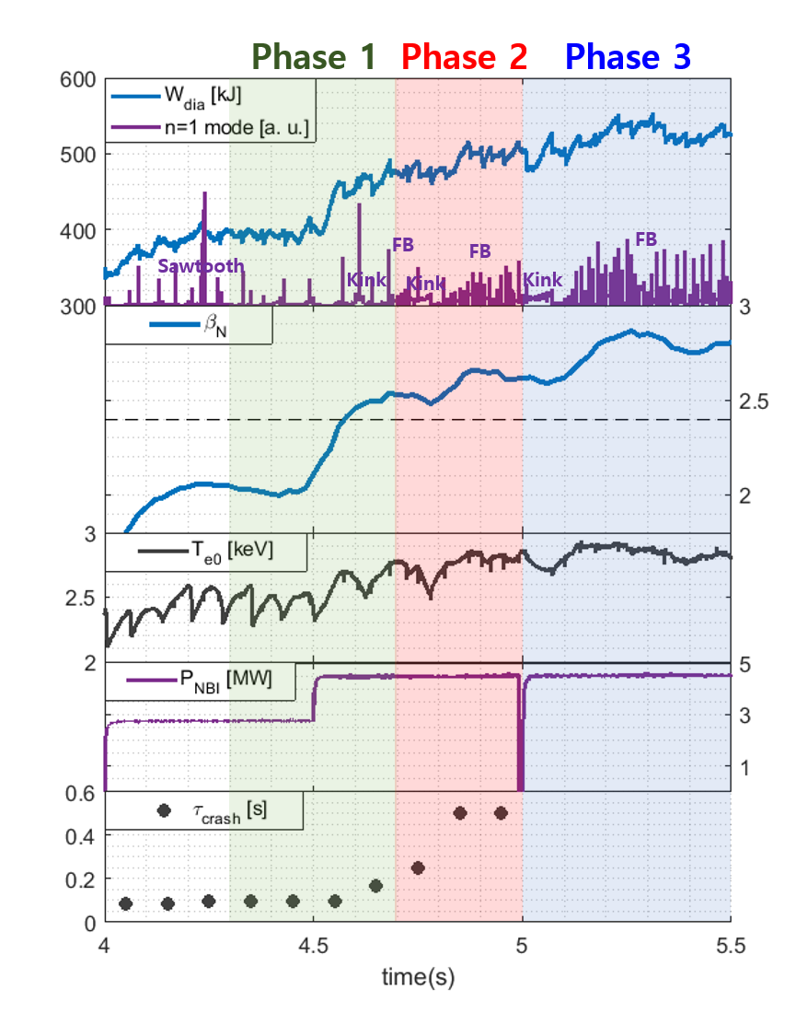
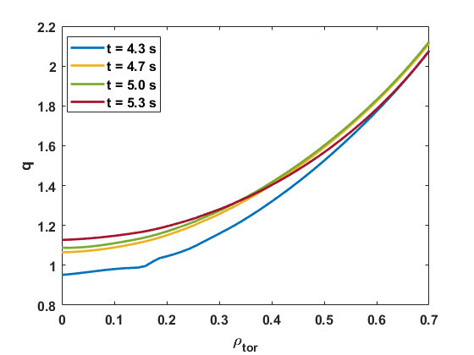
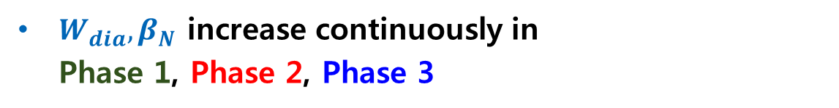
Performance Enhancement in KSTAR hybrid mode
A discharge (#16545) with a slow transition analysed: 3 steps of performance enhancement observed after 3rd NBI.
$W_{dia}{, β}_{N}$ increase continuously in
Phase 1, Phase 2, Phase 3
Sawtooth changes to kink and Fishbone (FB).
Performance analysis is conducted at
4.3 s,
4.7 s,
5.0 s,
5.3 s
#16545

Slide 23
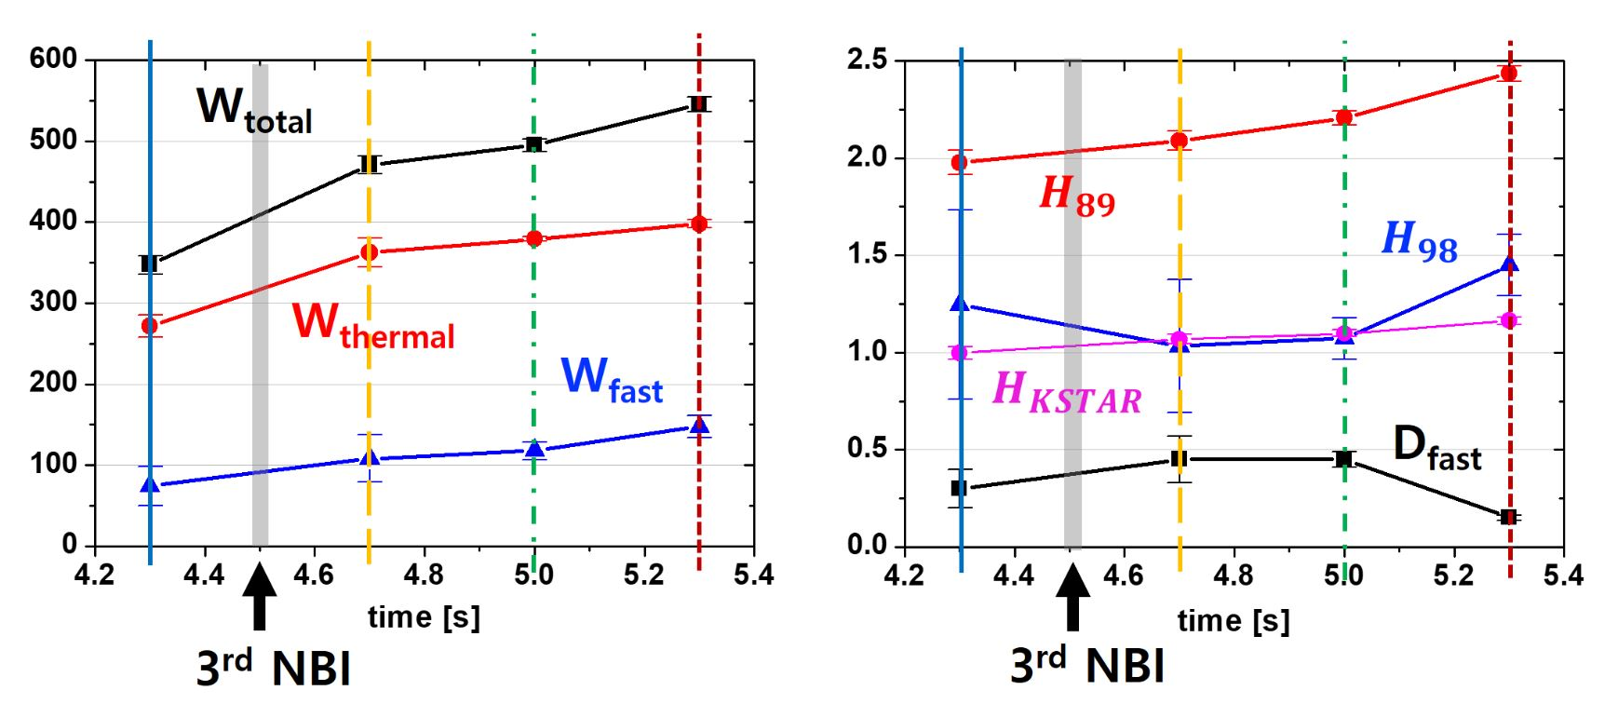
Performance Analysis
NUBEAM (version Jun 2011 vsn) simulation: $W_{fast}$ and $P_{abs}$ calculated
($W_{MHD} \& H_{89}$ from MSE-EFIT)
H_{KSTAR} by KSTAR H-mode scaling law
[H.-S. Kim et al, Nucl. Fusion 54 083012 (2014)]
Phase 1 (blue → yellow): $W_{total}$ ↑ with $W_{thermal}$, $W_{fast}$ ↑, $H_{89}$, $H_{KSTAR}$ ↑, no $H_{98}$ improvement
Phase 2 (yellow → green):$W_{total}$ ↑ with $W_{thermal}$, $W_{fast}$ ↑, $H_{89}$ , little $H_{KSTAR}$, $H_{98}$ improvement
Phase 3 (green → red): $W_{total}$ ↑with $W_{fast}$, $W_{Thermal}$ ↑, $H_{89}$, $H_{KSTAR}$, $H_{98}$↑
For 4.3-5.0 s, increase of H89 without H98 increase implies fast ion confinement enhancement without thermal confinement enhancement.

Slide 24
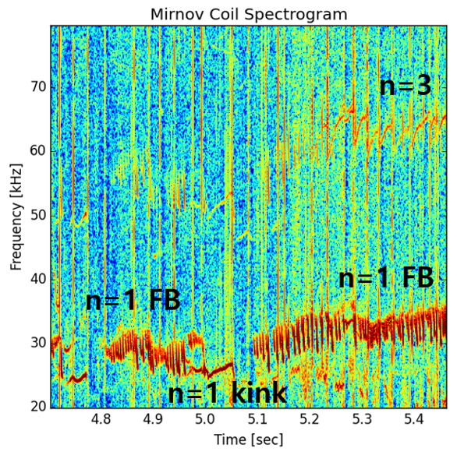
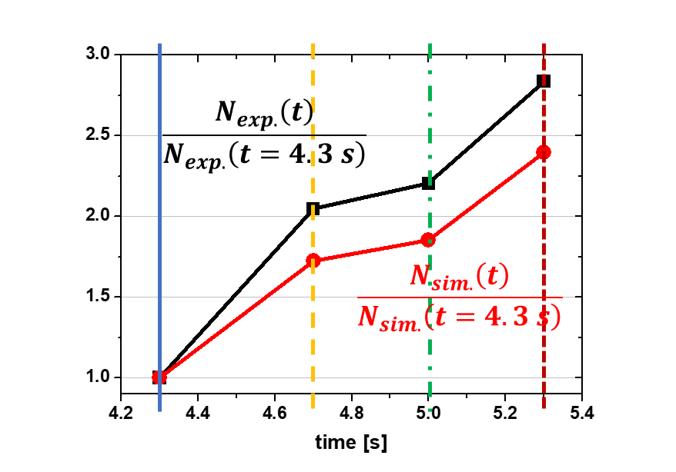
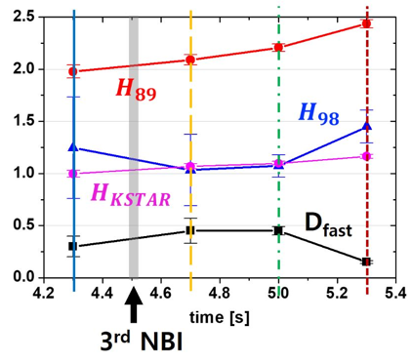
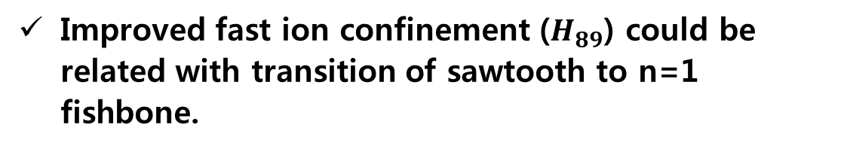
Performance Analysis
NUBEAM (version Jun 2011 vsn) simulation
Fast ion content continuously increases.
Neutron flux increment ratio by NUBEAM captures the experimental trend from fission chamber.
Improved fast ion confinement ($H_{89}$) could be related with transition of sawtooth to n=1 fishbone.

Slide 25
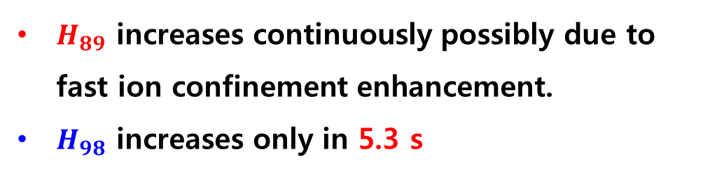
Performance Analysis
$H_{89}$ increases continuously possibly due to
fast ion confinement enhancement.
$H_{98}$ increases only in 5.3 s
→ Why?
Profile analysis
Power balance analysis
Linear gyro-kinetic analysis
Linear pedestal MHD stability analysis

Slide 26
Profile Analysis

Slide 27
Profile Analysis
core↑
core↑
core↑
core↑
pedestal↑
pedestal↑
core↑

Slide 28
Profile Analysis
core↑
pedestal↑
pedestal↓

Slide 29
Profile Analysis
core↑
core↑
core↑
pedestal↑
core↓
pedestal↑
pedestal↓
off-axis↑
off-axis↓
on-axis↓

Slide 30
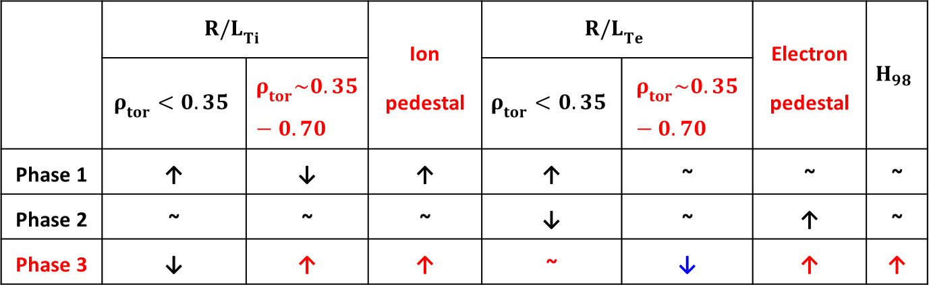
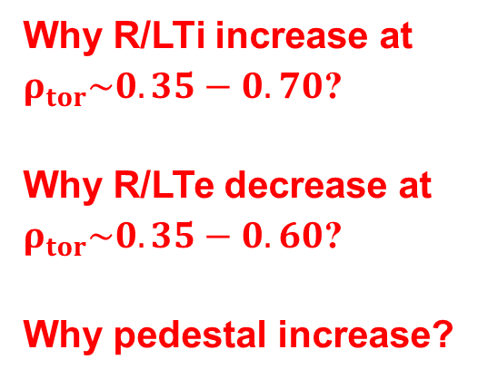
Profile Analysis
core↑
core↑
off-axis↑
off-axis↓
on-axis↓
pedestal↑
pedestal↑
 | $${R/L}_{Ti}$$ |  | Ion pedestal | $${R/L}_{Te}$$ |  | Electron pedestal | $$H_{98}$$
 | $$ρ_{tor}<0.35$$ | $$ρ_{tor}\sim 0.35−0.70$$ |  | $$ρ_{tor}<0.35$$ | $$ρ_{tor}\sim 0.35−0.70$$
Phase 1 | ↑ | ↓ | ↑ | ↑ | ~ | ~ | ~
Phase 2 | ~ | ~ | ~ | ↓ | ~ | ↑ | ~
Phase 3 | ↓ | ↑ | ↑ | ~ | ↓ | ↑ | ↑
Why R/LTi increase at $ρ_{tor}\sim 0.35−0.70$?
Why R/LTe decrease at $ρ_{tor}\sim 0.35−0.60$?
Why pedestal increase?

Slide 31
Power Balance Analysis
on-axis↓
off-axis↑
off-axis↓
Ion: The normalised temperature gradient lengths tend to increase.
Electron: The normalised temperature gradient lengths tend to decrease.
Stiffness mitigation?
Turbulence change?
→ Gyro-kinetic analysis

Slide 32
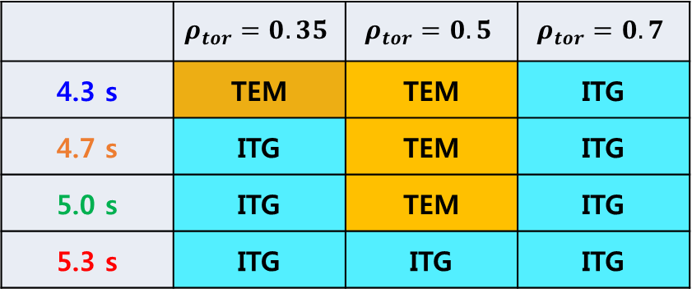
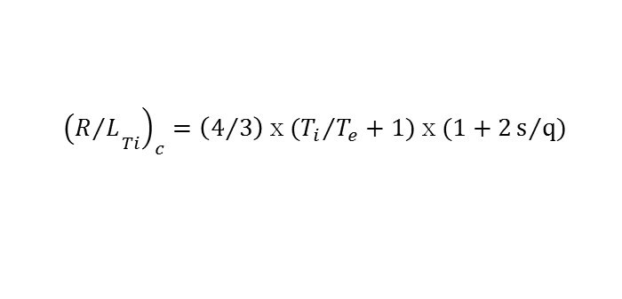
Gyro-kinetic Analysis: Dominant Microinstbility
GKW (Gyro-Kinetic Workshop): Nonlinear gyro-kinetic flux tube code
 | $$ρ_{tor}=0.35$$ | $$ρ_{tor}=0.5$$ | $$ρ_{tor}=0.7$$
4.3 s | TEM | TEM | ITG
4.7 s | ITG | TEM | ITG
5.0 s | ITG | TEM | ITG
5.3 s | ITG | ITG | ITG
$${\left.{\left(R/L\right.}_{Ti}\right)}_{c}=\left(4/3\right)ⅹ({T_{i}}/{T_{e}}+1)ⅹ(1+2s/q)$$
[S.C. Guo and F. Romanelli, Phys. of Plasmas 5 520 (1993)]
(R/L_{Ti})_{c}
(R/L_{Ti})_{c}
4.7 s
5.0 s
R/L_{Ti}
R/L_{Ti}
4.3 s
5.3 s

Slide 33


Gyro-kinetic Analysis at 5.3 s: EM Effect
$ρ_{tor}$= 0.35
$ρ_{tor}$= 0.70
The EM effect slightly increases and significantly decreases the linear growth rate for $k_{θ}ρ_{i}$ < 0.5 and $k_{θ}ρ_{i}$ > 0.5, respectively at $ρ_{tor}$= 0.35.
The similar trend is observed at $ρ_{tor}$= 0.70, but the stabilisation effect is almost negligible for $k_{θ}ρ_{i}$ > 0.5.
Why significant EM effect only in $ρ_{tor}$= 0.35?

Slide 34

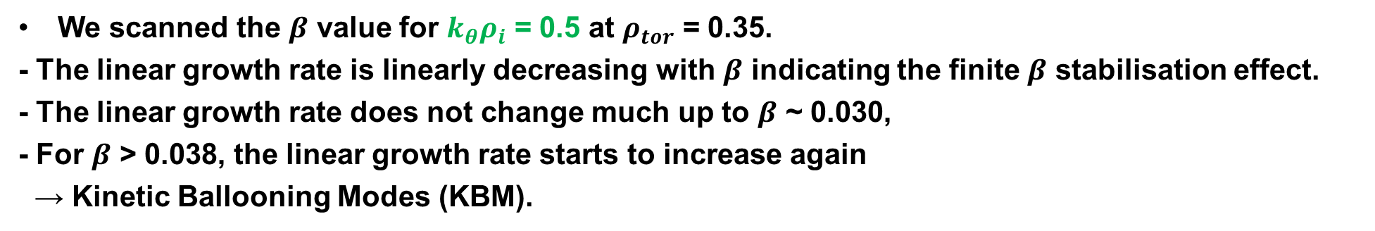
Gyro-kinetic Analysis at 5.3 s: $β$ Stabilization Effect
$ρ_{tor}$= 0.35
$k_{θ}ρ_{i}$ = 0.5
β_{crit}
Exp.
value
We scanned the $β$ value for $k_{θ}ρ_{i}$ = 0.5 at $ρ_{tor}$ = 0.35.
- The linear growth rate is linearly decreasing with $β$ indicating the finite $β$ stabilisation effect.
- The linear growth rate does not change much up to $β$ ~ 0.030,
- For $β$ > 0.038, the linear growth rate starts to increase again
→ Kinetic Ballooning Modes (KBM).

Slide 35
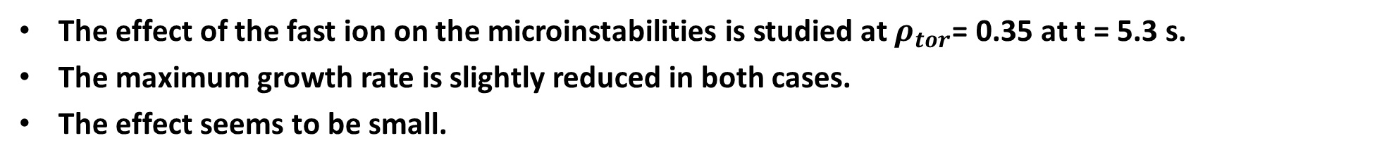
Gyro-kinetic Analysis at 5.3 s: Fast Ion Effect
Electrostatic .vs. Electromagnetic
w/o (blank) .vs. w/ fast ion (filled)
The effect of the fast ion on the microinstabilities is studied at $ρ_{tor}$= 0.35 at t = 5.3 s.
The maximum growth rate is slightly reduced in both cases.
The effect seems to be small.

Slide 36
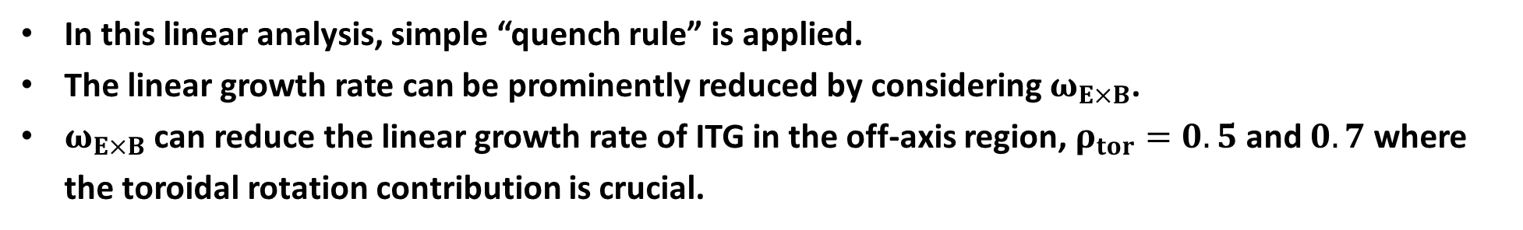




Gyro-kinetic Analysis: $ω_{E×B}$ Effect
$$ρ_{tor}=0.35$$
$$ρ_{tor}=0.5$$
$$ρ_{tor}=0.7$$
In this linear analysis, simple “quench rule” is applied.
The linear growth rate can be prominently reduced by considering $ω_{E×B}$.
$ω_{E×B}$ can reduce the linear growth rate of ITG in the off-axis region, $ρ_{tor}=0.5$ and $0.7$ where the toroidal rotation contribution is crucial.

Slide 37
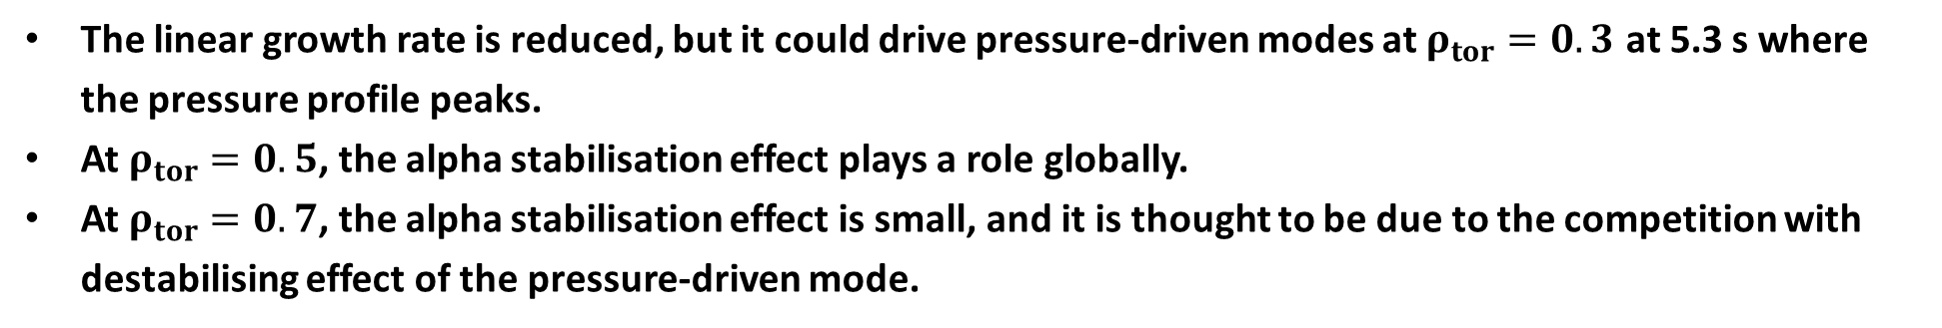



Gyro-kinetic Analysis: $α$ Stabilization Effect
$$ρ_{tor}=0.35$$
$$ρ_{tor}=0.5$$
$$ρ_{tor}=0.7$$
The linear growth rate is reduced, but it could drive pressure-driven modes at $ρ_{tor}=0.3$ at 5.3 s where the pressure profile peaks.
At $ρ_{tor}=0.5$, the alpha stabilisation effect plays a role globally.
At $ρ_{tor}=0.7$, the alpha stabilisation effect is small, and it is thought to be due to the competition with destabilising effect of the pressure-driven mode.

Slide 38
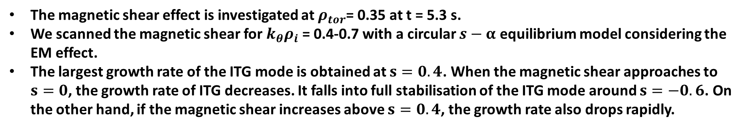
Gyro-kinetic Analysis at 5.3 s: Magnetic Shear Effect
Exp.
value
The magnetic shear effect is investigated at $ρ_{tor}$= 0.35 at t = 5.3 s.
We scanned the magnetic shear for $k_{θ}ρ_{i}$ = 0.4-0.7 with a circular $s−α$ equilibrium model considering the EM effect.
The largest growth rate of the ITG mode is obtained at $s=0.4$. When the magnetic shear approaches to $s=0$, the growth rate of ITG decreases. It falls into full stabilisation of the ITG mode around $s=−0.6$. On the other hand, if the magnetic shear increases above $s=0.4$, the growth rate also drops rapidly.

Slide 39
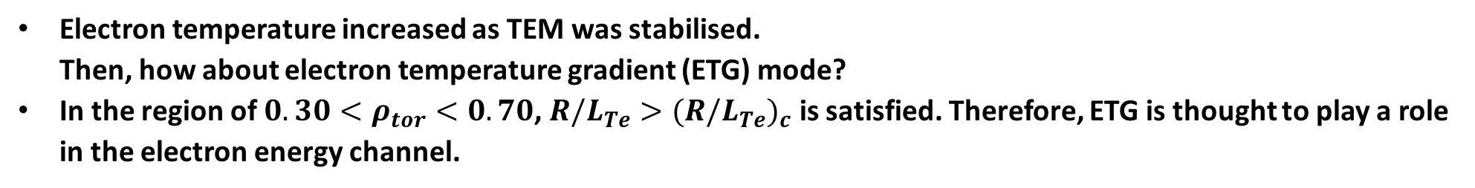
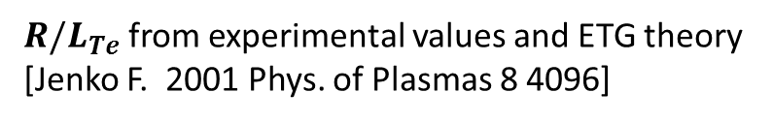
Gyro-kinetic Analysis at 5.3 s: ETG Mode
off-axis↓
${R/L}_{Te}$ from experimental values and ETG theory [Jenko F. 2001 Phys. of Plasmas 8 4096]
Linear gKPSP simulations at 5.3 s of shot 16545
Electron temperature increased as TEM was stabilised.
Then, how about electron temperature gradient (ETG) mode?
In the region of $0.30<ρ_{tor}<0.70$, ${{{R/L}_{Te}>(R/L}_{Te})}_{c}$ is satisfied. Therefore, ETG is thought to play a role in the electron energy channel.
In gKPSP simulation, the ETG mode is unstable at $ρ_{tor}=0.5$ and $0.7$, which globally agrees with the theory.

Slide 40


Pedestal Stability Analysis: Diamagnetic Effect
$$γ/ω_{A} =0.03$$
$γ/ω_{i∗} =0.25$
The linear edge stability is analysed with CHEASE(equilibrium) and MISHKA(stability).
The PBM stability was improved with the PBM stability boundary.
The change in the boundary with $γ/ω_{i∗} =0.25$ is more pronounced.
The diamagnetic effect is thought to boost the increase of pedestal height
according to the improved PBM stability.
Since the pedestals stay on the ‘nose’ of the stability boundary,
they can utilise the broadened boundary so that the pedestal height can increase.

Slide 41
EPED Analysis: Shafranov Shift Effect
Time (s) | li3 (Exp.) | li3 (Criterion 1)
4.3 | 0.75 | 1.02
4.7 | 0.72 | 1.06
5.0 | 0.76 | 0.92
5.4 | 0.77 | 0.73
Criterion 1: li from Ohmic+BS
(standard EPED model)
The pedestal height and width is predicted by EPED1 to check the Shafranov shift effect:
$\left|{Δ′}_{s}\right|$ increases from 0.31 to 0.42 during 4.3 s to 5.3 s.

Slide 42
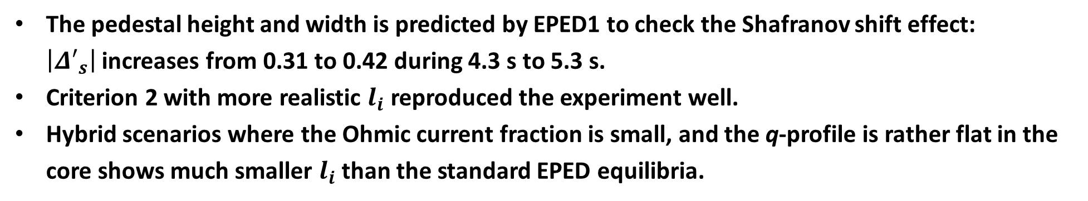
EPED Analysis: Shafranov Shift Effect
Time (s) | li3 (Exp.) | li3 (Criterion 1) | li3 (Criterion 2)
4.3 | 0.75 | 1.02 | 0.76
4.7 | 0.72 | 1.06 | 0.73
5.0 | 0.76 | 0.92 | 0.77
5.4 | 0.77 | 0.73 | 0.76
Criterion 1: li from Ohmic+BS
(standard EPED model)
Criterion 2: li from Ohmic+BS+NBI
The pedestal height and width is predicted by EPED1 to check the Shafranov shift effect:
$\left|{Δ′}_{s}\right|$ increases from 0.31 to 0.42 during 4.3 s to 5.3 s.
Criterion 2 with more realistic $l_{i}$ reproduced the experiment well.
Hybrid scenarios where the Ohmic current fraction is small, and the q-profile is rather flat in the core shows much smaller $l_{i}$ than the standard EPED equilibria.

Slide 43
Hypothesis of Confinement Enhancement Mechanism

Slide 44
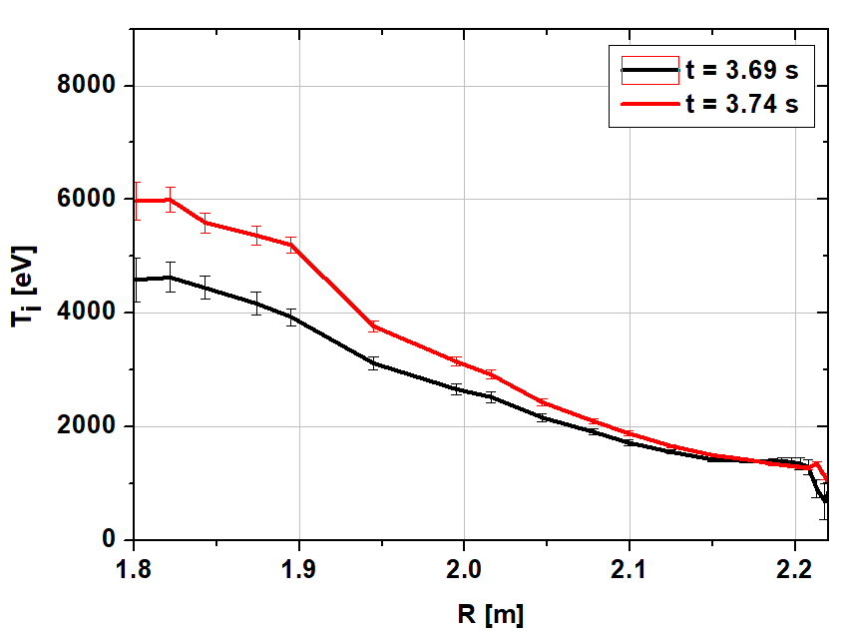








Hypothesis of Confinement Enhancement Mechanism
Primary effect
#20927
Power
$$β_{th}$$
($P_{NB}$)
Fast particle
$$β_{fast}$$
($S_{fast}$)
NBI
Torque
$$V_{tor}$$
($τ_{NB}$)
Current drive
$q$, $s$
($J_{NB}$)

Slide 45

Hypothesis of Confinement Enhancement Mechanism
Primary effect
Profile stiffness
$$β_{th}$$
Secondary effect
Power
($P_{NB}$)
$∆′$ effect
Edge MHD Stability ↑
Pedestal
Height ↑
Fast particle
$$β_{fast}$$
Beam Coupling ↑
($S_{fast}$)
NBI
Torque
$$V_{tor}$$
($τ_{NB}$)
Current drive
$q$, $s$
($J_{NB}$)

Slide 46
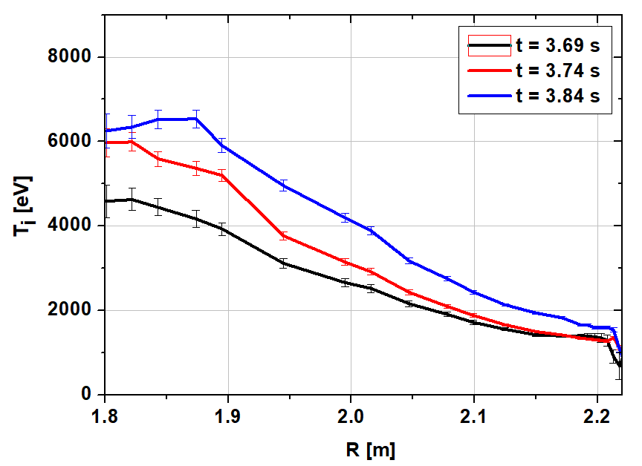
Hypothesis of Confinement Enhancement Mechanism
Primary effect
Profile stiffness
$$β_{th}$$
Secondary effect
Power
($P_{NB}$)
$∆′$ effect
Edge MHD Stability ↑
Pedestal
Height ↑
Fast particle
$$β_{fast}$$
Beam Coupling ↑
($S_{fast}$)
NBI
Torque
$$V_{tor}$$
($τ_{NB}$)
Current drive
$q$, $s$
($J_{NB}$)

Slide 47






Hypothesis of Confinement Enhancement Mechanism
Primary effect
Profile stiffness
$$β_{th}$$
Secondary effect
Power
($P_{NB}$)
$∆′$ effect
Edge MHD Stability ↑
Pedestal
Height ↑
Fast particle
$β$ stabilisation
$$β_{fast}$$
($β_{th}<β<β_{crit}$)
Beam Coupling ↑
($S_{fast}$)
NBI
Fast particle stabilisation
$α$ stabilisation
Tertiary effect
Torque
$$V_{tor}$$
$$ω_{E×B}↑$$
Core Turbulence ↓
($τ_{NB}$)
$$s\sim 0$$
Core Confinement ↑
Current drive
$q$, $s$
Hybrid profile
$$q\left(0\right)\sim 1$$
Core MHD Stability ↑
($J_{NB}$)

Slide 48
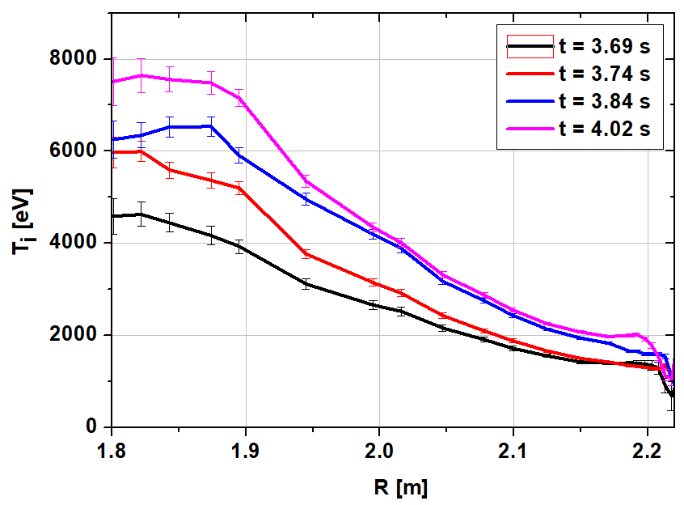
Hypothesis of Confinement Enhancement Mechanism
Primary effect
Profile stiffness
$$β_{th}$$
Secondary effect
Power
($P_{NB}$)
$∆′$ effect
Edge MHD Stability ↑
Pedestal
Height ↑
Fast particle
$β$ stabilisation
$$β_{fast}$$
($β_{th}<β<β_{crit}$)
Beam Coupling ↑
($S_{fast}$)
NBI
Fast particle stabilisation
$α$ stabilisation
Tertiary effect
Torque
$$V_{tor}$$
$$ω_{E×B}↑$$
Core Turbulence ↓
($τ_{NB}$)
$$s\sim 0$$
Core Confinement ↑
Current drive
$q$, $s$
Hybrid profile
$$q\left(0\right)\sim 1$$
Core MHD Stability ↑
($J_{NB}$)

Slide 49
Collaboration with PPPL

Slide 50
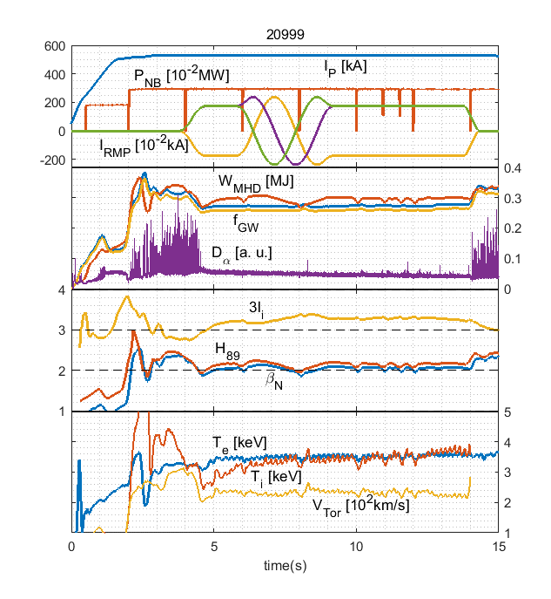

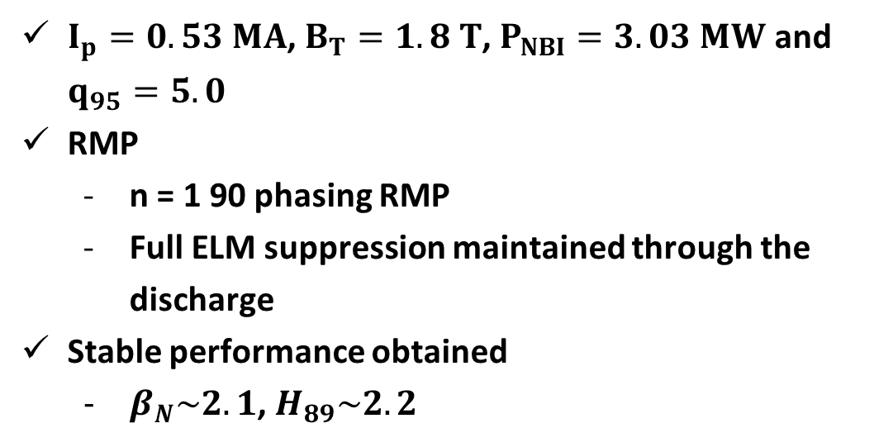
ELM Suppression/Mitigation by RMP (R. Nazikian)
Full ELM suppression (#20999, KSTAR 2018 experiment)
$I_{p}=0.53 MA$, $B_{T}=1.8 T$, $P_{NBI}=3.03 MW$ and $q_{95}=5.0$
RMP
  n = 1 90 phasing RMP
  Full ELM suppression maintained through the discharge
Stable performance obtained
  $β_{N}\sim 2.1$, $H_{89}\sim 2.2$
$$\overline{n_{e}} \left[1e+20m^{−3}\right]$$

Slide 51
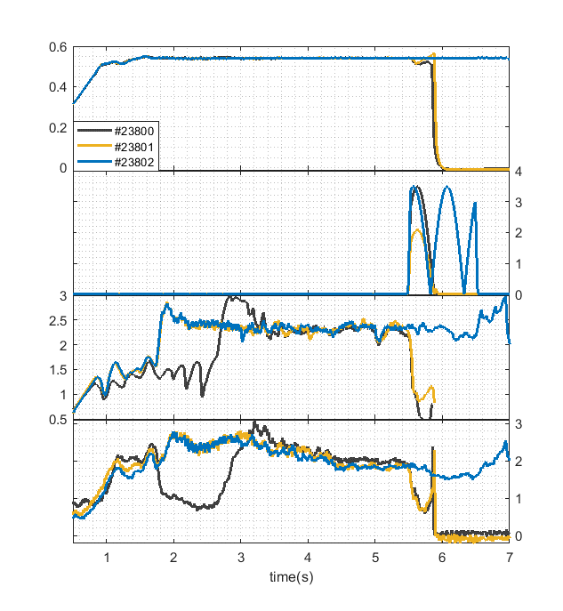




3D field (S.M. Yang, J.K. Park)
RMP/QSMP with Double null (KSTAR 2020 experiment)
Locked by RMP
Ip [MA]
The transition to “Grassy ELM state” could be reached using RMP at high $β_{p}$(1.5~2.0) plasma in DIIID. [R. Nazikian et al., NF]
However, the plasma is terminated by RMP even with reduced amount of current
(3.5 kA -> 2.1 kA, plasma still locked by RMP (90p)).
It turns out that plasma is much sensitive to RMP in double null than single null.
This is being analysed by IPEC through PPPL collaboration.
QSMP is applied as piggyback in DN.
Plasma still survived even with 3.5kA IVCC current, unlike RMP case.
3.5 kA
2.1 kA
$I_{IVCC}/\sqrt{2}$ [kA]
$$β_{N}$$
Double null
T/B: 2.1 kA
M: 1.75 kA
Single null(#22972)
T/B: 2.8 kA
M: 2.8 kA
Locking threshold :
$\overline{n_{e}}$ [$10^{19}m^{−3}]$

Slide 52







3D field (S.M. Yang, J.K. Park)
23805
NRMP with Double null (KSTAR 2020 experiment)
$I_{RMP}$(0P) [kA]
Since large ExB flow shear resulting from the strong peaking of toroidal rotation can reduce transport and electrostatic fluctuations [I. Voitsekhovitch, et al., Physics of Plasmas 6.11:4229-4238,1999.], the increased core rotation is a good candidate for improvement for $β_{N}$ and $W_{mhd}$.
As NRMP (5.5s~6.5s, 0p) is applied, $V_{Tor}$ (250 km/s → 190 km/s) is decreased successfully. $T_{i}$ didn’t make much difference as they were originally intended.
However, $β_{N}$ hasn’t changed much, contrary to expectations that the change of core rotation by NRMP will affect to $β_{N}$.
Although the $β_{N}$ value is oscillating, it appears to be caused by continuous changes in the plasma configuration. Further analysis will be conducted.
$$β_{N}$$
$T_{i}$ [keV]
$\overline{n_{e}}$ [$10^{19}m^{−3}]$
$V_{Tor}$ [km/s]
Drsep [m]

Slide 53





Turbulence Driven Current (W. Wang, M.-G. Yoo)
[C.C. Petty et al, Nucl. Fusion 56 016016 (2016)]
[Yong-Su Na et al, Nucl. Fusion 46 232 (2006)]
There is anomaly in current diffusion in hybrid scenarios.
- Hyper-resistive term (Caper, NF 07)
- Flux pumping by (3,2) TM (Petty, PRL 09)
- Enhanced NC resistivity due to (1,1) mode (Takizuka, NF 14)
- Dynamo action by interchange mode (Jardin, PRL 15)
- …
[W.X. Wang et al, Nucl. Fusion 59 084002 (2019)]

Slide 54

Summary
Hybrid scenarios are under development in KSTAR defined as
“stationary discharges with $β_{N}$ $\text{≥}$ 2.4 & $H_{89}$ $\text{≥}$ 2.0 in $q_{95}$ < 6.5 w/o or mild sawtooth”.
The hybrid scenarios are pursued by various experimental approaches.
→ $β_{N}≲2.$9, $H_{89}≲2.3$ & G-factor ($≡β_{N}H_{89}/q_{95}^{2}$) $≲0.4$2 is obtained and sustains
during the main heating phase ($≳40 τ_{E}$).
Performance enhancement of KSTAR hybrid scenario is studied in a slow transition phase
with performance analysis, kinetic profile analysis, power balance analysis, gyro-kinetic analysis and pedestal MHD stability analysis.
It was found that the enhancement is from both the core and the pedestal.

Slide 55

Summary
The linear gyro-kinetic simulation reveals that
  - Finite β stabilisation effect could play a role in the core region.
  - $ω_{E×B}$ could reduce the linear growth rate of ITG in the off-axis region.
  - The alpha stabilization effect is also found around $ρ_{tor}=0.5$.
  - Magnetic shear ~ 0 can stabilise ITG.
  - TEM is stabilized but the ETG mode is estimated to sit around $ρ_{tor}=0.5−0.7$.
The pedestal stability analyses show that
- Diamagnetic effect contributes to broaden the peeling-ballooning stability boundary.
- Shafranov shift plays an important role to increase the pedestal height.
A mechanism of confinement enhancement is suggested.
- Core-edge interplay is thought to be the most important factor.
PPPL collaborations are on-going for ELM suppression/mitigation, 3D physics,
and anomaly in current diffusion

Slide 56
Future Work
Keep in pursuing development of reactor-relevant hybrid scenarios with upgraded H&CD systems
and plasma control systems; higher performance, steady-state, low T_{i}/T_{e}, low rotation, ELM suppression, power exhaust control in long pulse operation over the wall saturation time.
Address the different behaviour between the ion and the electron channel and between energy, particle, and momentum channels.
Integrated modelling to acquire a comprehensive understanding of confinement enhancement by considering interplay between transport and MHD, e.g. including the FB effect to the fast particle redistribution and subsequent influence on thermal confinement.
Non-linear GK simulations together with fluctuation measurements to assess impact of zonal flows and further effect of fast ions and electromagnetic stabilisation.
Variation of the rotation profile particularly in the pedestal region linked with the intrinsic rotation and its impact on KBM and PBM.
understand the role of the q = 1 surface and anomaly in current diffusion.

Slide 57

Thank You

Slide 58
Supplementary

Slide 59

1999
Chapter 8: Plasma operation and control, ITER Physics Basis
Nucl. Fusion 39 2577 (1999)

Slide 60


2001
ITER: opportunity of burning plasma studies
Y. Shimomura et al PPCF 43 A385 (2001)

Slide 61


2007
More recently, the development of magnetic configurations with a wide volume of low magnetic shear and a central value of q close to 1 has resulted in quasistationary discharges with improved confinement and high values of normalized
beta. They are also characterized by a low
level of MHD activity. These discharges
extrapolate to the performance needed for
the ‘hybrid’ scenarios foreseen for ITER.
Chapter 1: Overview and summary,
Progress in the ITER Physics Basis
Nucl. Fusion 47 S1 (2007)
Chapter 6: Steady state operation, Progress of ITER Physics Basis
Nucl. Fusion 39 2577 (1999)

Slide 62
2007
Improved confinement and beta have been observed with low shear (= high βp = ’hybrid’) operation scenarios in many tokamaks.
If similar normalized parameters were achieved in ITER, it would
provide an attractive scenario with
high Q (>10), long pulse (>1000 s)
operation with beta < no-wall limit and
benign ELMs.
Chapter 1: Overview and summary,
Progress in the ITER Physics Basis
Nucl. Fusion 47 S1 (2007)
Chapter 6: Steady state operation, Progress of ITER Physics Basis
Nucl. Fusion 39 2577 (1999)

Slide 63
2007
A hybrid scenario in which the plasma current is driven by a combination of inductive and non-inductive currents is intended to provide operation with a long burn time (>1000 s), high fluence/shot and Q > 5 with a high reliability for engineering tests.
(Ip = 12-14 MA, H98(y, 2) = 1 and βN ∼ 2)
An advanced hybrid scenario is a hybrid scenario, aiming at producing high fusion yield and features a higher beta limit with an optimized current profile, a lower current and a lower loop voltage, which would allow operating with a high fusion gain (Q ∼ 10) for long pulse duration. Examples for this type of operation using zero magnetic shear in the centre achieving βN near 3 were given. The advanced hybrid scenarios are often simply called hybrid scenarios.
the rapid progress made recently, and described below, implies that the hybrid scenario is now considered as an advanced reactor relevant scenario. Future developments of such a scenario might even lead to the concept of ‘quasi steady state’ reactor.
Chapter 6: Steady state operation, Progress in the ITER Physics Basis
Nucl. Fusion 47 S285 (2007)

Slide 64
2014
Operation at high normalized pressure (βN) and q95 < 4 may provide an alternative means to enhance the fusion power while still operating at 15 MA, rather than raising the current to 17 MA, which is the present contingency plan. Operation at high βN and 15MA would also be a potential route to very high fusion gain (Q > 20) in the event the confinement quality is high. To take into account the broader possibilities of these scenarios for ITER, the term ‘advanced inductive’ scenario, rather than the often-used term ‘hybrid’ scenario, will be applied here to plasmas meeting the criteria of βN ≥ 2.4 and H98y2 ≥ 1 in stationary operation (tdur ≥ 5τE) in present-day experiments.
Development of advanced inductive scenarios for ITER
T.C. Luce et al, Nucl. Fusion 54 013015 (2014)

Slide 65
Summary of Definitions
 | Ip (MA) | H98 | Q
Hybrid | < 15 | 1 | > 5
Advanced hybrid | < 15 | ≳ 1 | ~ 10
Advanced inductive | 15 | ≳ 1 | > 20

Slide 66
Profile Analysis

Slide 67
Profiles of shot 16545 on KSTAR @ 4.7 s

Slide 68
Profiles of shot 16545 on KSTAR @ 5.0 s

Slide 69
Profiles of shot 16545 on KSTAR @ 5.3 s

Slide 70

Hypothesis of Confinement Enhancement Mechanism
#20927

Slide 71

Hybrid Scenario – 2019 KSTAR Experiment
#22674
  $I_{p}$ = 0.7 MA, $B_{t}=1.8 T$, $P_{total}$ = 5.4 MW
  Triangularity scan (3~8 s, $δ_{lower}$: 0.80 → 0.94)
  Double null configuration (8.5 s ~ 10 s)
No considerable impact on performance by triangularity scan
But with double null configuration, significant change of $β_{N}$ (2.35 → 2.8), $T_{e0}$(5 keV → 6.7 keV),
$W_{MHD}$(410 kJ → 520 kJ)
Considerable drop of the loop voltage (0.24 V → 0.07V).
Pedestal analysis is on-going.

Slide 72






Plasma Shaping Effect on Pedestal (Hybrid scenario)
KSTAR Hybrid discharge with plasma shape scan (#22674)
Ip = 0.7MA, B_{T} = 1.8T, P_{beam} = 4.8MW
<Equilibrium from kinetic EFIT>
4000ms
7000ms
9000ms
$R_{X}$ control at 3~8s
Double Null at 8~10s
Rx[m]
(Lower
Xpnt location)
$$β_{n}, β_{p}$$
Near the lower X-point
Time[s]
Meaningful beta rise

Slide 73


Plasma Shaping Effect on Pedestal (Hybrid scenario)
KSTAR Hybrid discharge with plasma shape scan (#22674)
Ip = 0.7MA, B_{T} = 1.8T, P_{beam} = 4.8MW
< j-$α$ Stability boundary from kinetic EFIT>
DN shape
$R_{X}$ control at 3~8s
Double Null at 8~10s
Rx[m]
(Lower
Xpnt location)
$$β_{n}, β_{p}$$
The equilibrium is located in the ballooning region so the PBM stabiliSation with DN shape is favorable
to pedestal performance.
Time[s]
Meaningful beta rise

