Slide 1
Tracking Publications at PPPL
Introducing ORCID for institutional reporting

Slide 2
Presentation Sections
Project Contacts
Institutional Reporting Challenges
DOE ORCID Consortium
PPPL/Princeton University Data Management Working Group
Implementing ORCID at PPPL
Identifying “Trusted Users”

Slide 3
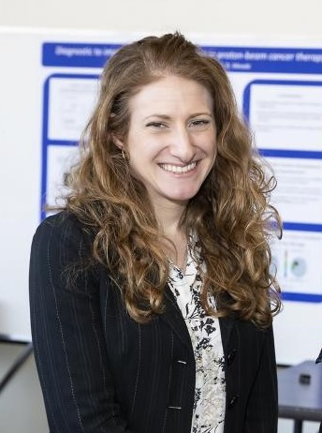
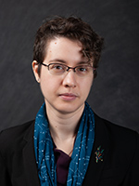
Project Contacts
Aileen Pritch
…for all things Publications & Data Management
(Call me, text me, email me – I’m here to help!)
Anya Bartelmann
Library Services, Access to Research and Resources, Research Consultations
Henry Munoz
ORCID Profile “Trusted User”

Slide 4
Institutional Reporting Challenges
Need:
Tools to improve the accuracy, timeliness, and automation of data collection processes for reporting and promoting PPPL research products
Identified processes:
Collection of research product data for PEMP and DOE data calls
Manual discovery and entry of Publications KPI metadata
Formatting attribution/inconsistencies in promotion processes
Linking publications to supporting research data
Accurate and consistent attribution of funding/sponsorship
User facility publications and proposal tracking

Slide 5
Institutional Reporting Challenges
How do OTHER labs address these process challenges?
How do these labs and research institutions “integrate” these processes with publication data and collection tools?
Collection of research product data for PEMP and DOE data calls
Manual discovery and entry of Publications KPI metadata
Formatting attribution/inconsistencies in promotion processes
Linking publications to supporting research data
Accurate and consistent attribution of funding/sponsorship
User facility publications and proposal tracking
- Integrated Publications reporting system, managed by centralized department
Many use ORCID.
- Publications reporting system is primary source for dashboards and reports
- Profile and institutional CV tools are available
- Integrated Publications reporting system links associated files
- Integrated Publications reporting system informs other systems
- Data and systems begin and end with forms, integrated with other business processes

Slide 6
DOE ORCID Consortium
ORCID provides a persistent digital identifier (an ORCID ID) that distinguishes you from every other researcher and ensures that your work is recognized by linking all professional research activities—affiliations, grants, publications, peer review, awards, etc.
ORCID ID is:
A persistent digital identifier
Universal, tied to you and not your institution/database
Widely used by publishers, funders, and research institutions
A tool to reduce risk of errors and save time
Benefits:
Easy to create and use
Trusted user delegates and automatic updates available
Ensure credit for your research publications, grant applications, and more

Slide 7
DOE ORCID Consortium
ORCID provides a persistent digital identifier (an ORCID ID) that distinguishes you from every other researcher and ensures that your work is recognized by linking all professional research activities—affiliations, grants, publications, peer review, awards, etc.
ORCID ID is:
A persistent digital identifier
Universal, tied to you and not your institution/database
Widely used by publishers, funders, and research institutions
A tool to reduce risk of errors and save time
Benefits:
Easy to create and use
Trusted user delegates and automatic updates available
Ensure credit for your research publications, grant applications, and more
Henry will introduce a test case at PPPL in later slides

Slide 8
DOE ORCID Consortium
As of April 1, 2020, DOE now hosts a federal ORCID consortium membership.
DOE-affiliated organizations (nat’l labs, user facilities, libraries, etc.) are now members, using, collecting, and integrating individual ORCID iDs and ORCID API services to track research outputs and awards, determine the impact of user facilities, and evaluate the outcomes of outreach efforts.
This month, PPPL has submitted a requisition and is in the process of approving an MOU to become the 6th member of this consortium, giving PPPL an institutional membership to ORCID.
Access to this membership and its services are anticipated for the beginning of FY 2021.

Slide 9
DOE ORCID Consortium
What does an institutional membership offer PPPL?
5 API keys (integration with systems);
administrative support to consortium members;
assistance with planning ORCID integrations;
centralized technical support contact to all members; and
consortium documentation and technical documentation repositories.
Community of Practice
In addition to the premium membership features, the US Government ORCID Consortium establishes a Community of Practice:
Open to all Consortium members
Designed to share best practices, use cases, challenges, integration ideas
Opportunities for cross facility/office collaborations, multi-program efforts
Offers benchmarking to Consortium members.
ORCID/DOE webinars and workshops

Slide 10
DOE ORCID Consortium
This Community of Practice will allow PPPL to review success stories of ORCID implementation at other labs.
Below are some examples of systems/programs being implemented at Argonne and PNNL:
Tracking collaborators and User Facility access
Equipment tracking at User Facilities
Publications submissions to OSTI for Public Access compliance
Institutional reporting for PEMP
PeopleSoft registration of new users/employees
Implementing a universal proposal system for single- and multi-lab User Facilities
Performance/promotion management – awards and recognition
Managing attribution of funding support for diverse research portfolios

Slide 11
PPPL/Princeton University Data Management
Working Group
To tackle data management challenges and investigate ORCID system improvements, PPPL has partnered with Princeton University Data Services and Princeton University Libraries.
This working group:
proposes methods to automate and integrate processes for more efficient reporting, and
guides sub-groups in the development of service and training programs for enhanced researcher support.
Sub-groups will be focused on the following initiatives:
ORCID integration strategies for advanced institutional reporting and researcher CV management
Updating PPPL’s Data Management Plan, training materials, and programs for researchers for better alignment with University best practices
Technical improvements to publications and data management repository functions for ease and more efficient delivery of services

Slide 12
PPPL/Princeton University Data Management
Working Group
To tackle data management challenges and investigate ORCID system improvements, PPPL has partnered with Princeton University Data Services and Princeton University Libraries.
This working group:
proposes methods to automate and integrate processes for more efficient reporting, and
guides sub-groups in the development of service and training programs for enhanced researcher support.
Sub-groups will be focused on the following initiatives:
ORCID integration strategies for advanced institutional reporting and researcher CV management
Updating PPPL’s Data Management Plan, training materials, and programs for researchers for better alignment with University best practices
Technical improvements to publications and data management repository functions for ease and more efficient delivery of services

Slide 13
Implementing ORCID at PPPL
Identify processes for improvement via APIs
Complete all departmental presentations
Aug 20
Sept 20
Oct 20
Nov 20
Dec 20
March CY21
Become DOE consortium member
Test upgraded functions and workflows/
Deploy working group for analysis
Schedule departmental presentations
…And then?
PPPL will need all PPPL researchers to commit to creating research profiles to pursue these integrated processes for true automation of data.

Slide 14
Identifying Trusted Users
How do I create a profile?
What if I don’t have time to maintain my profile?
What if I have questions?
Where do I start?
PPPL “Trusted Users” Program – a train-the-trainer model
Trusted Users can:
Set up automated reporting from databases
“Clean” publications lists for duplicates and metadata errors
Compile consistent data call responses
Assist with CV management for promotion, grant applications
Provide one-on-one assistance when needed

Slide 15
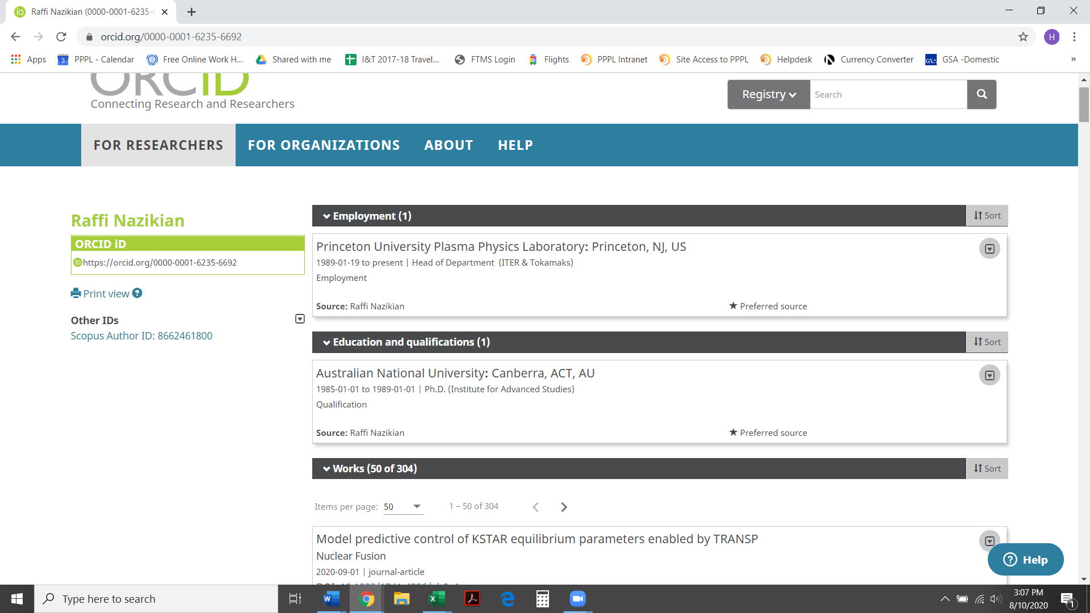
Identifying Trusted Users
A successful test case:
Raffi Nazikian = author;
Henry Munoz = Trusted User

Slide 16
Identifying Trusted Users

Slide 17
Questions?
Aileen Pritch
Manager, Requirements & Publications
O: 609-243-2245
C: 848-203-4005
apritch@pppl.gov
Anya Bartelmann
Astrophysics, Mathematics, Physics and Plasma Physics Librarian
O: 609-258-3150
abartelm@princeton.edu
Henry Munoz
Assistant to ITER & Tokamaks Department
O: 609-243-3258
C: 570-994-5533
hmunoz@pppl.gov

