Slide 1








An investigation of low recycling, low collisionality and high performance with lithium conditioning in LTX-β
NSTX-U / Magnetic Fusion Science Meeting
Dec – 9, 2021
Anurag Maan
Dennis Boyle
Dick Majeski
George Wilkie
Manaure Francisquez
Elizabeth Perez
Robert Kaita
Santanu Banerjee
William Capecchi
Ron Bell
Vlad Soukhanovskii
Chris Hansen
Laura Zhang
Evan Ostrowski
Bruce Koel
Drew Elliott
Shigeyuki Kubota
David Donovan
Ted Biewer
Filippo Scotti

Slide 2
Overview
Lithium Tokamak eXperiment (LTX) - Context
Surface analysis for Lithium Tokamak eXperiment-β
  Sample Exposure Probe
  Lithium Plasma Facing Component (PFC) Evolution
  Plasma Performance and correlation with PFC evolution
Recent diagnostic and operational upgrades to LTX-beta
  Langmuir probe
  Lyman-alpha array
  Supersonic Gas injector
  Newer lithium evaporators
Performance improvement with increased lithiumization
  Flat temperatures
  Effective particle confinement time
  Reduced Lyman-alpha emission
  DEGAS2 analysis
New Gkeyll simulations inform on the impact of collisionality with increased lithiumization

Slide 3
Overview
Lithium Tokamak eXperiment (LTX) - Context
Surface analysis for Lithium Tokamak eXperiment-β
  Sample Exposure Probe
  Lithium Plasma Facing Component (PFC) Evolution
  Plasma Performance and correlation with PFC evolution
Recent diagnostic and operational upgrades to LTX-beta
  Langmuir probe
  Lyman-alpha array
  Supersonic Gas injector
  Newer lithium evaporators
Performance improvement with increased lithiumization
  Flat temperatures
  Effective particle confinement time
  Reduced Lyman-alpha emission
  DEGAS2 analysis
New Gkeyll simulations inform on the impact of collisionality with increased lithiumization

Slide 4
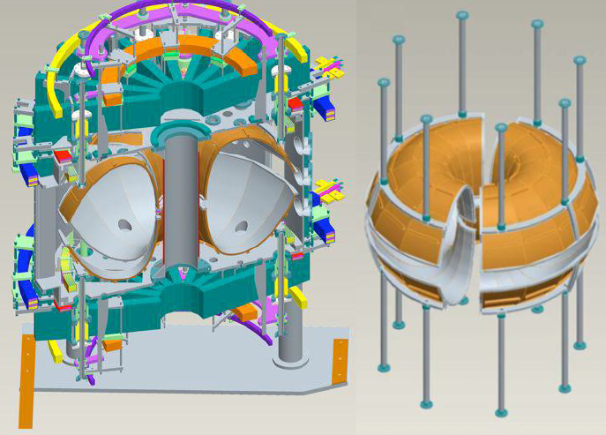
LTX and LTX-beta overview
Parameters |  | LTX | LTX-β | Planned
Major Radius | R₀ | 34 – 40 cm
Minor Radius | a | 20 – 26 cm
Vacuum Pumping |  | 6,000 L/s | 12,000 L/s | 13,000 L/s + Ti
Li Heat/Evap/Cool time |  | 200/10/100 mins | 10/10/10 mins | 5/5/5 mins
Toroidal Field | B_{T} | 0.17 – 0.2 T | 0.3 T | 0.34 T
Plasma Current | I_{p} | < 85 kA | 140 kA | 150 kA
Plasma Duration | t_{shot} | < 50 ms | < 50 ms | 100 ms
Beam Power | P_{NBI} | 0 | 300 - 700 kW | 300 - 700 kW
Beam Duration | t_{NBI} | 0 | 5-6 ms | 10-30 ms
1.4 m

Slide 5
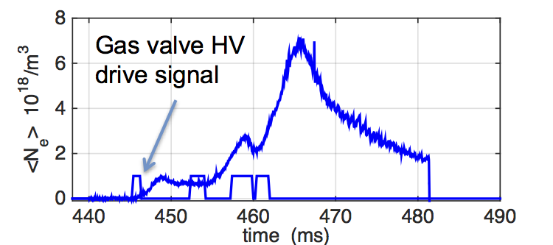
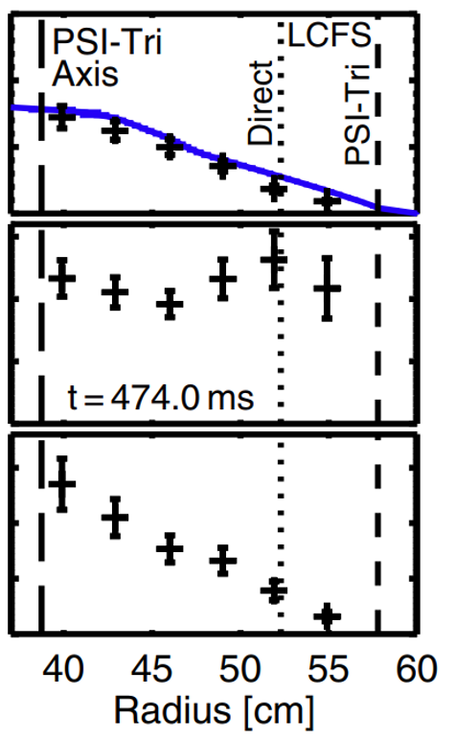
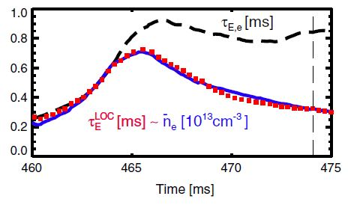
LTX – Key experimental result – Hot edge, collisionless SOL, improved confinement
Notable SOL features (D. Majeski, PoP, 2017)
Low collisionallity (banana regime) – neo-classical effects cannot be ignored in the SOL
Edge density reduces after lithium application and edge temperatures increase
Large connection length (5-10 m)
Pitch angle scattering times >> SOL transit times -> SOL particles are likely mirror confined
Need kinetic modelling of the SOL – but sheath limited models for ‘back of the envelope’ estimates
D. Boyle et. al., Phys Rev Letters, 2017
Also recently reproduced by SPECTOR General Fusion

Slide 6
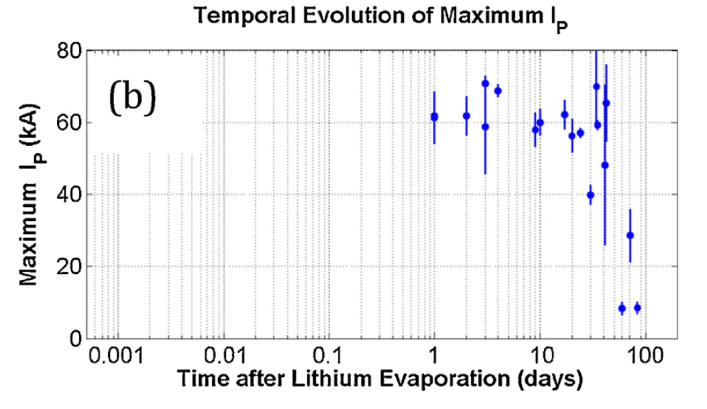
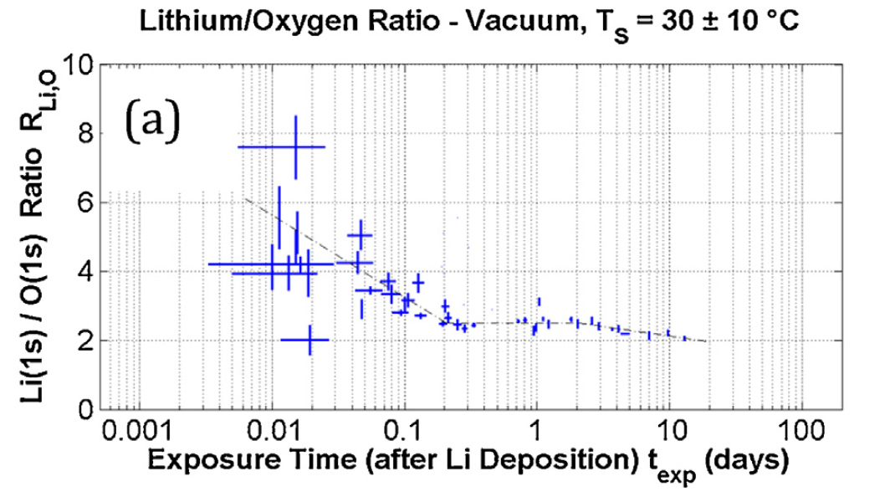
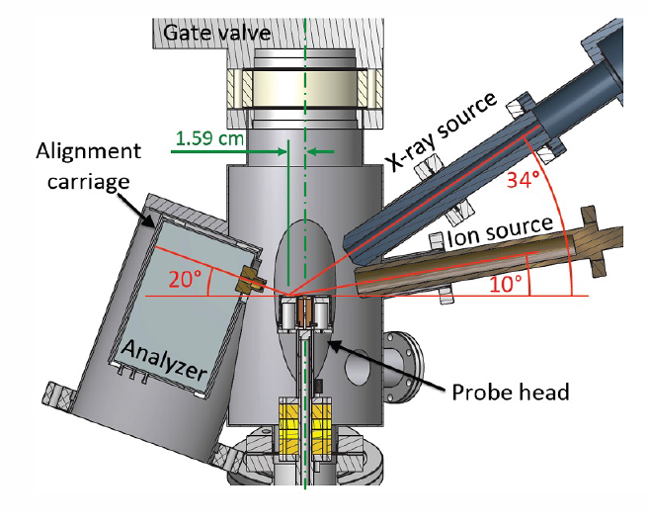
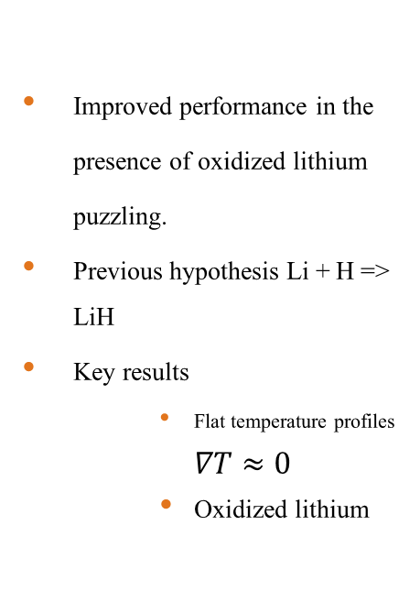
Improved performance in the presence of oxidized lithium
Improved performance in the presence of oxidized lithium puzzling.
Previous hypothesis Li + H => LiH
Key results
    Flat temperature profiles $∇T$ $≈0$
    Oxidized lithium
M. Lucia, PhD Thesis, 2015
Li₂O, LiOH
R. Kaita et. al., Fusion Engr. and Des., 2017

Slide 7
Overview
Lithium Tokamak eXperiment (LTX) - Context
Surface analysis for Lithium Tokamak eXperiment-β
  Sample Exposure Probe
  Lithium Plasma Facing Component (PFC) Evolution
  Plasma Performance and correlation with PFC evolution
Recent diagnostic and operational upgrades to LTX-beta
  Langmuir probe
  Lyman-alpha array
  Supersonic Gas injector
  Newer lithium evaporators
Performance improvement with increased lithiumization
  Flat temperatures
  Effective particle confinement time
  Reduced Lyman-alpha emission
  DEGAS2 analysis
New Gkeyll simulations inform on the impact of collisionality with increased lithiumization

Slide 8
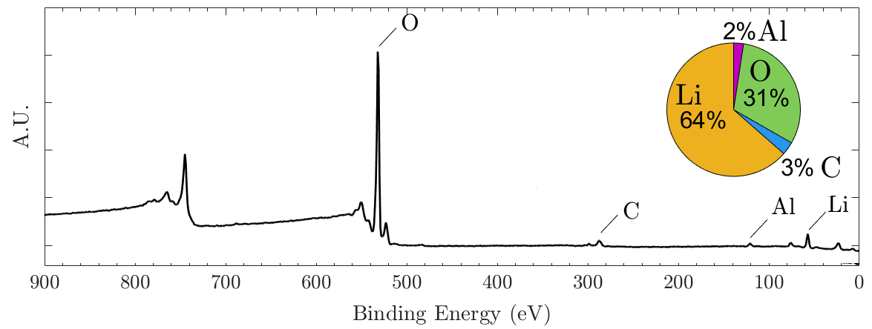
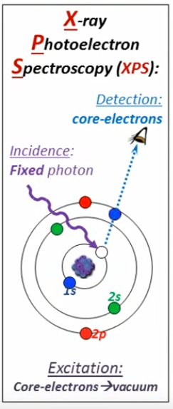
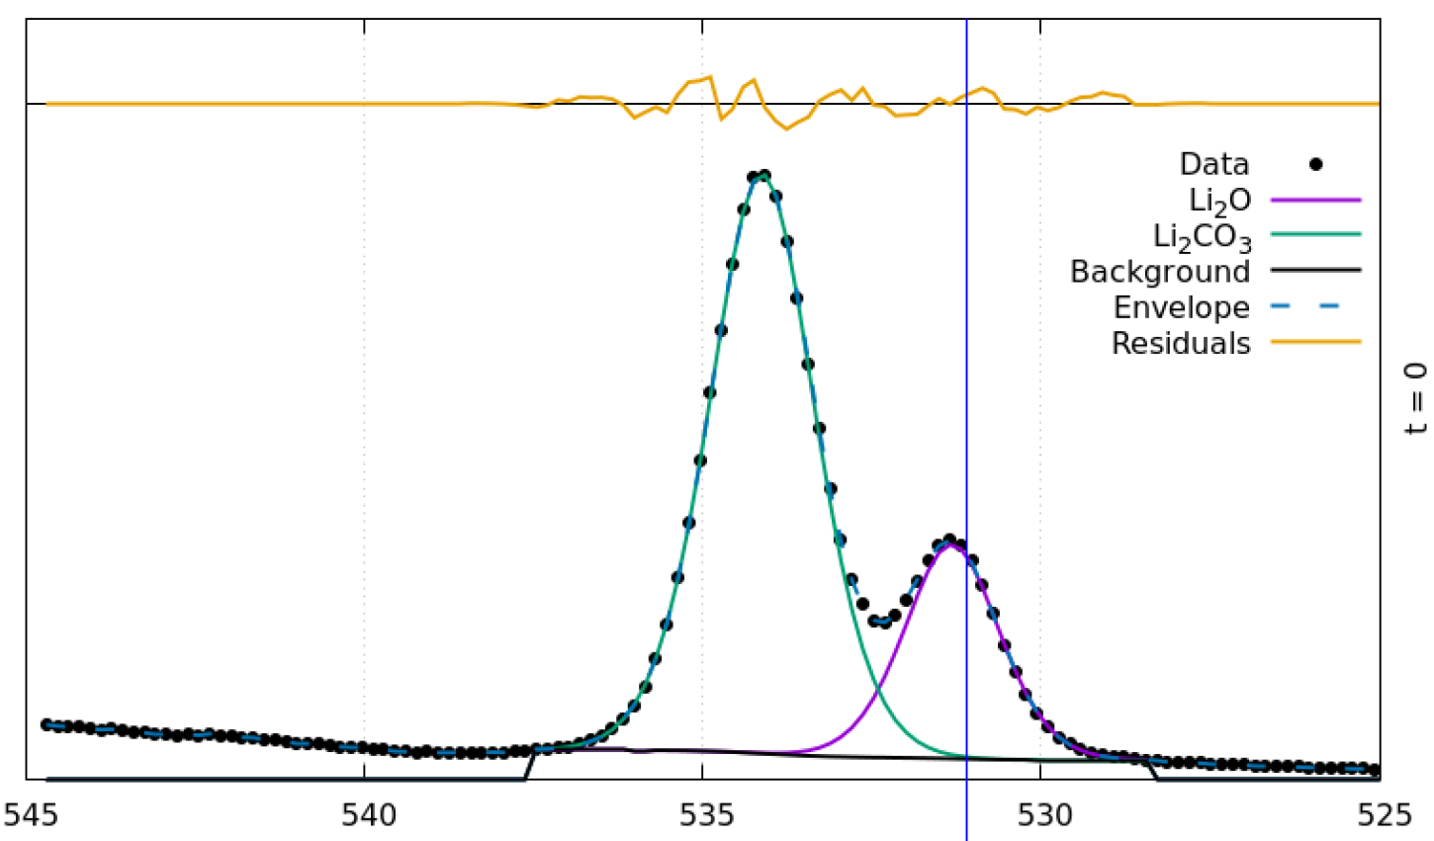
X-Ray photoelectron elemental and chemical composition
XPS broad energy range scan for Lithium on LTX-β
Elemental composition
  Photoionization cross-sections
Chemical composition
  Binding energies
XPS Narrow Energy range O(1s) scan of a Lithium Sample
O(1s)
8

Slide 9
LTX XPS data did not have high enough resolution to ID compounds
Elemental and Chemical composition
  Photoionization cross-sections
  Binding energies
No chemical composition information available.
Conclusions based solely on elemental abundances
NEED HIGH RESOLUTION!!

Slide 10
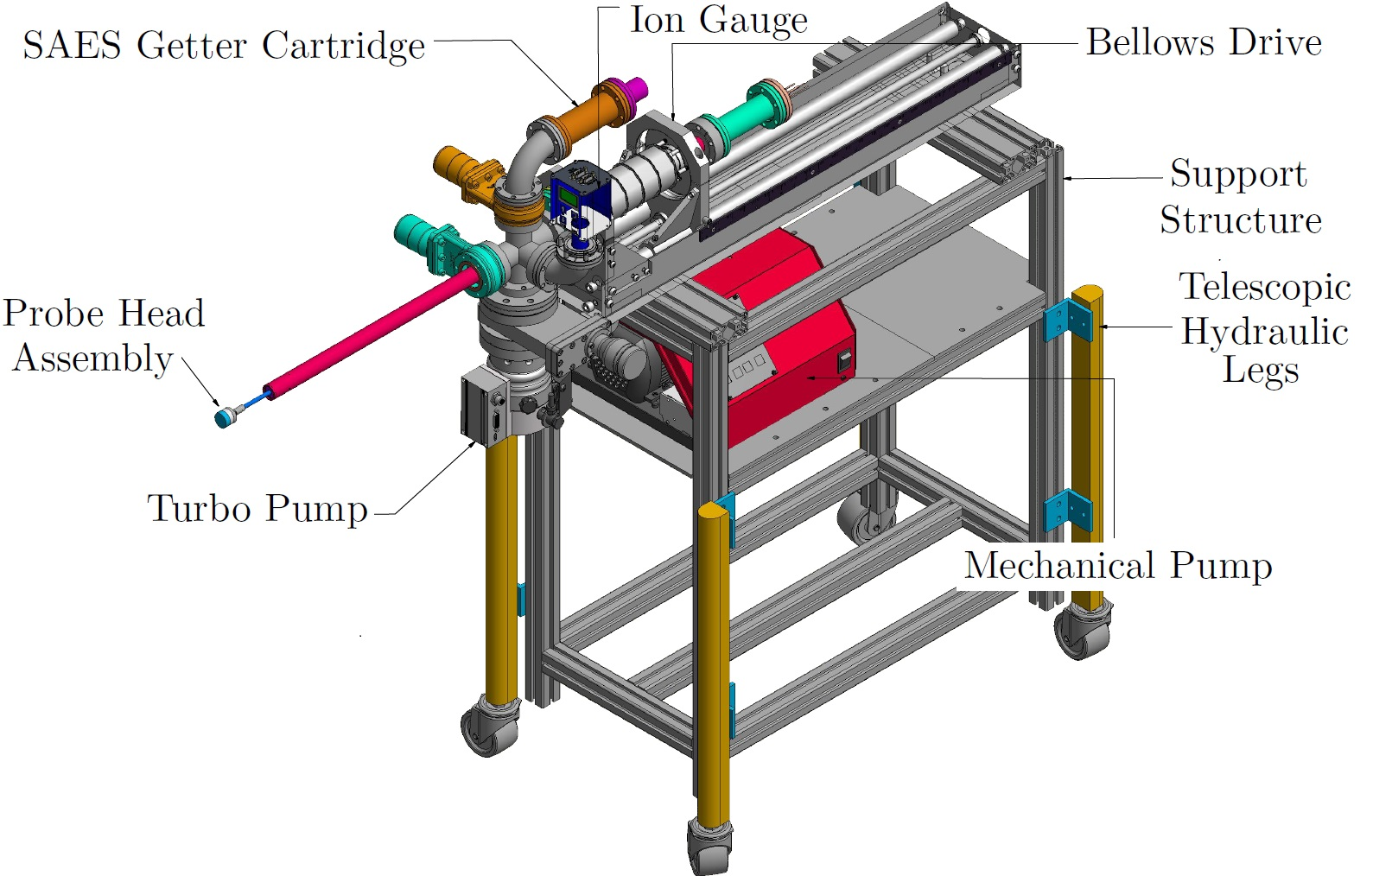
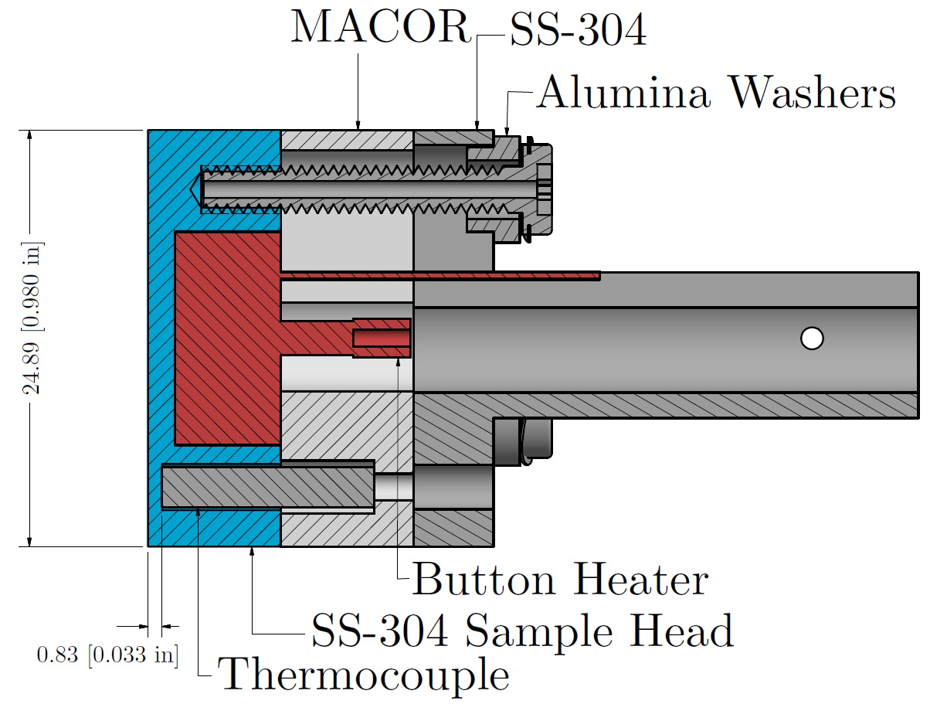
Sample Exposure Probe – Enable high resolution XPS measurements
A Maan, et. al., Review of Scientific Instruments 91, 026104 (2020)

Slide 11
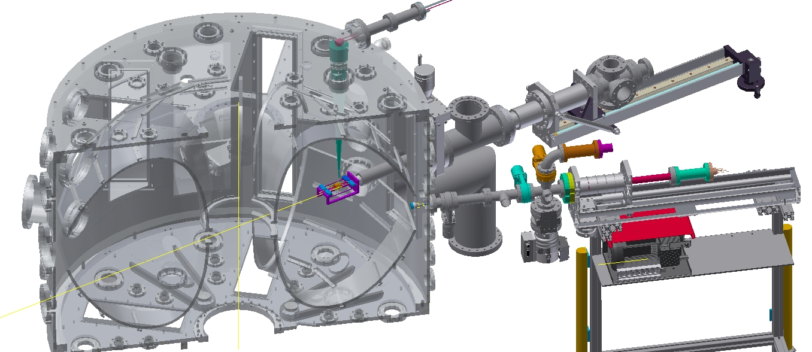
Lithium and plasma exposure

Slide 12
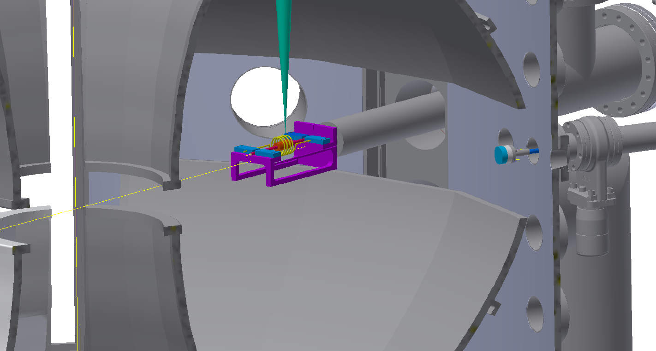
Lithium and plasma exposure

Slide 13
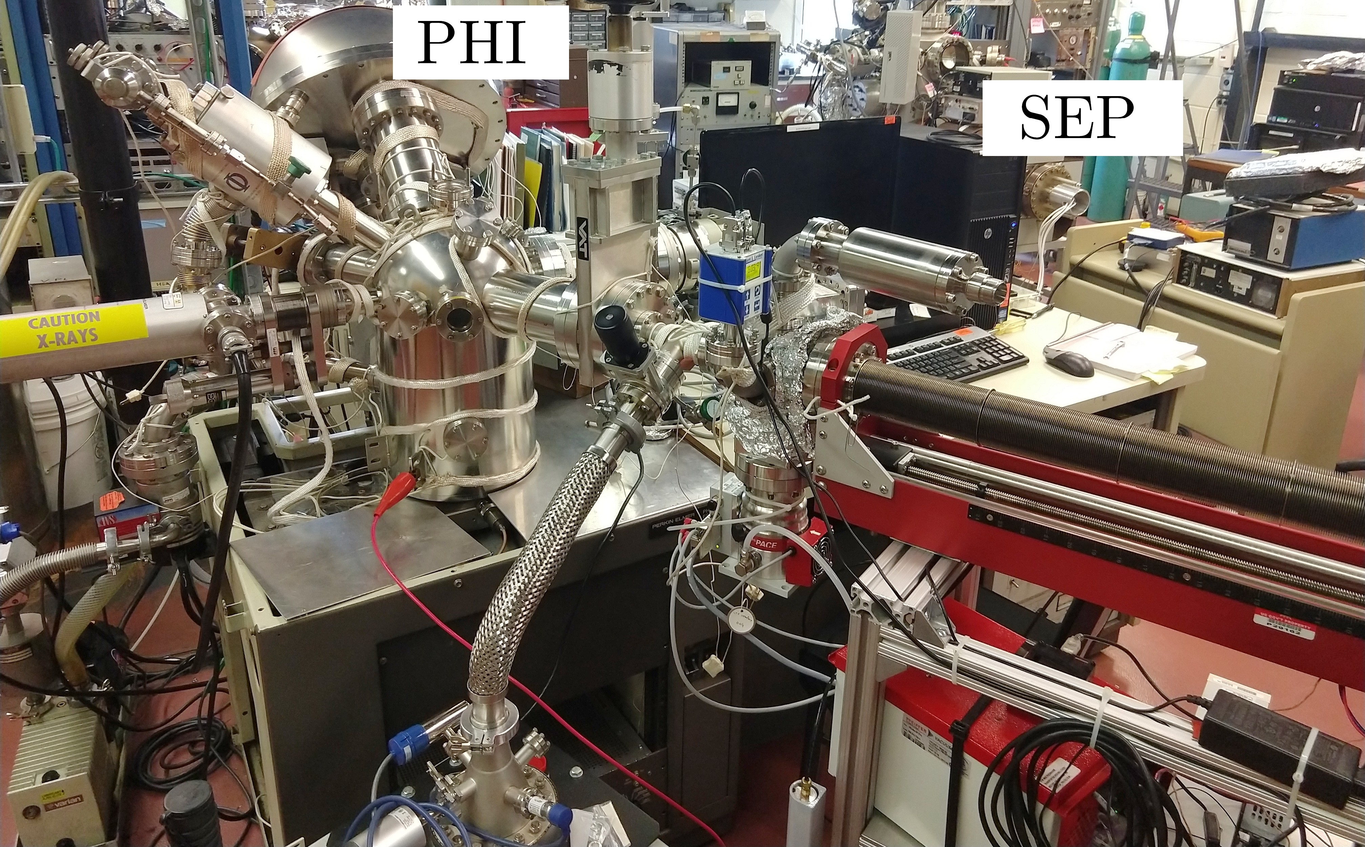
Transfer and Scan

Slide 14
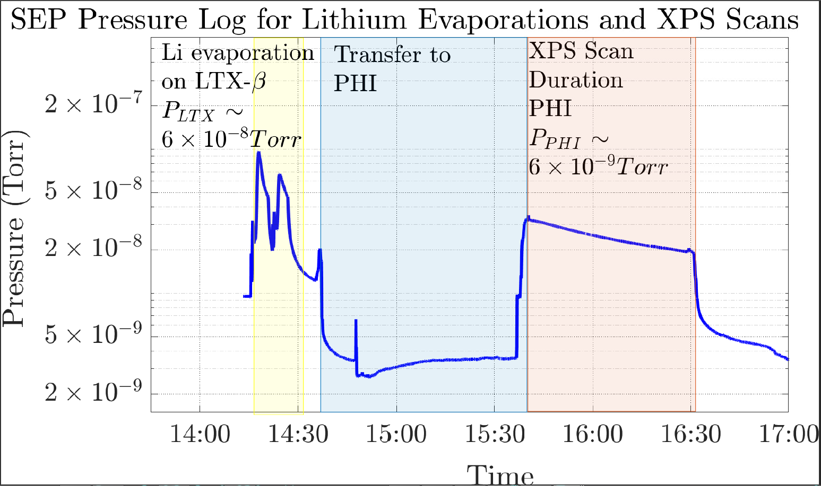
Transfer and scan
14

Slide 15
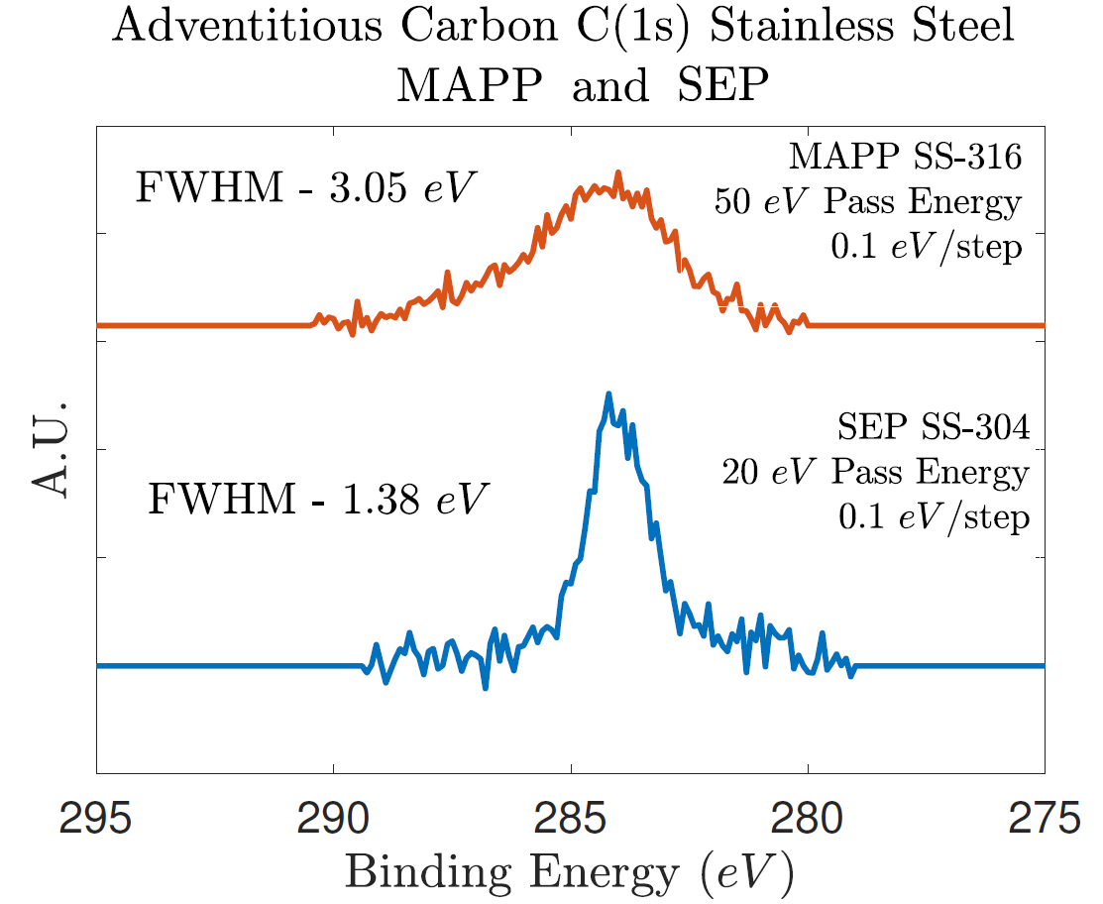
Transfer and scan
MAPP - LTX
PHI + SEP – LTX-β
15

Slide 16
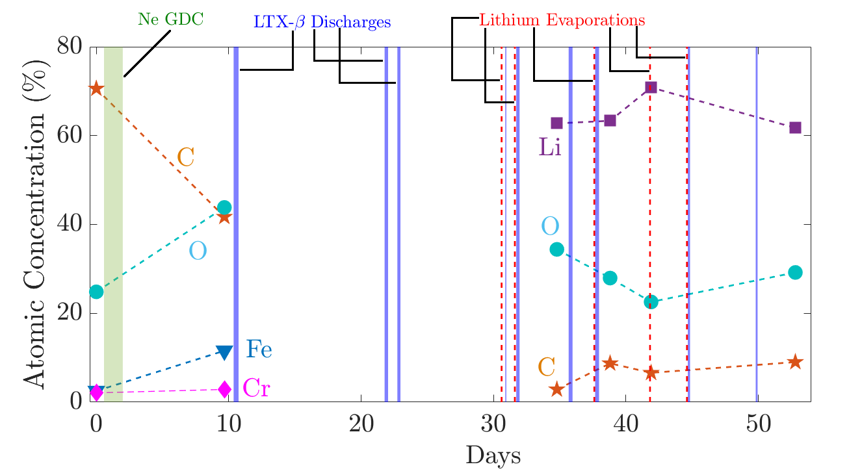
Lithium PFC Evolution for LTX-β
A. Maan et al., IEEE Transactions on Plasma Science, vol. 48, no. 6, pp. 1463-1467.

Slide 17
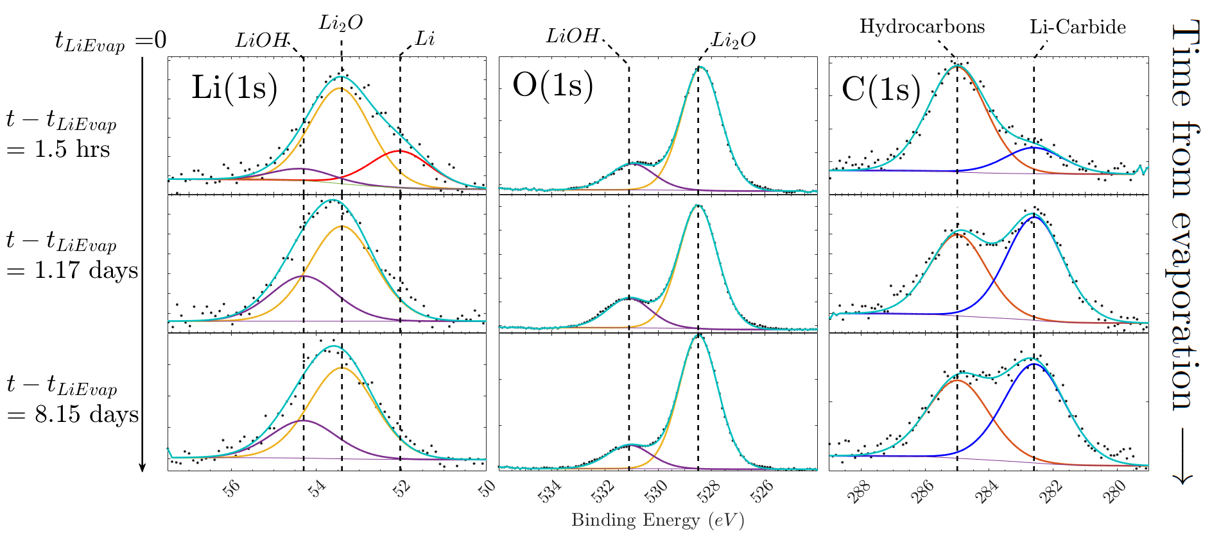
Lithium PFC Evolution and Chemical Species Identification

Slide 18
Lithium PFC Evolution and Chemical Species Identification

Slide 19
Lithium PFC Evolution and Chemical Species Identification
  Surface rich in chemical species
  Best case scenario
  Primary surface constituent Li₂O
  LiOH grows after Li₂O
  First in-vacuo observation of lithium compound evolution in a tokamak

Slide 20

Lithium PFC Evolution and Chemical Species Identification
$$∼1.2nm$$
  Surface rich in chemical species
  Best case scenario for current experiments
  Primary surface constituent Li₂O
  LiOH grows after Li₂O
  First in-vacuo observation of lithium compound evolution in a tokamak

Slide 21
Lithium PFC Evolution and Chemical Species Identification
  Surface rich in chemical species
  Best case scenario for current experiments
  Primary surface constituent Li₂O
  LiOH grows after Li₂O
  First in-vacuo observation of lithium compound evolution in a tokamak

Slide 22
Lithium PFC Evolution and Chemical Species Identification
  Surface rich in chemical species
  Best case scenario for current experiments
  Primary surface constituent Li₂O
  LiOH grows after Li₂O
  First in-vacuo observation of lithium compound evolution in a tokamak

Slide 23
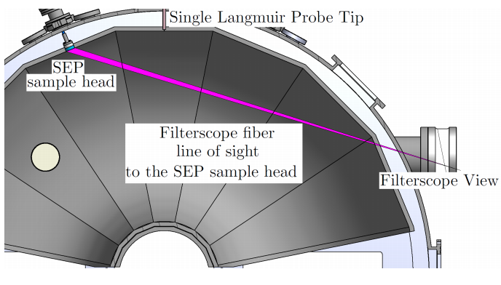
How does surface oxidation affect plasma performance?
Compare
LTX-beta old lithium coating passivated with Argon backfill+vent
Baked to 200 C, wait to cool down and make plasma
Deposit lithium
Wait for long time scales ~ 1 week
Make plasma

Slide 24
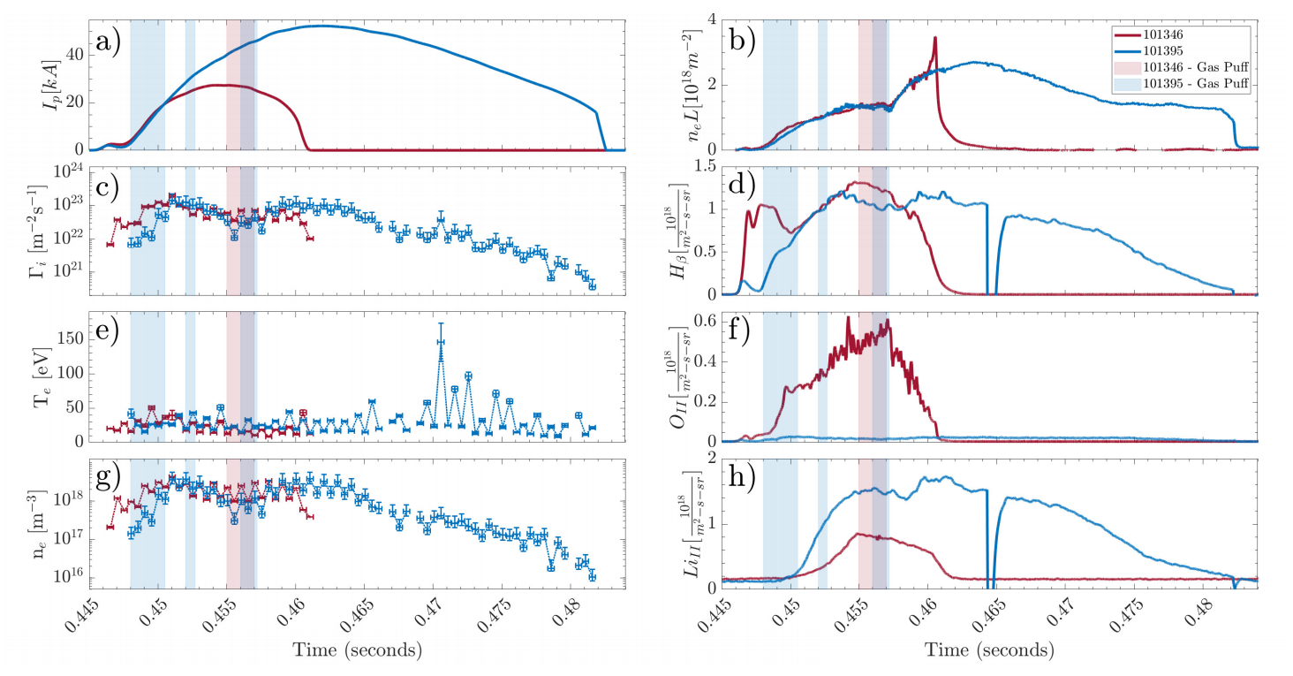
Plasma performance improves
Current and duration improve
Oxygen line emission goes down
Lithium line emission increases
Probe density decreases and temperature increases after gas puff

Slide 25
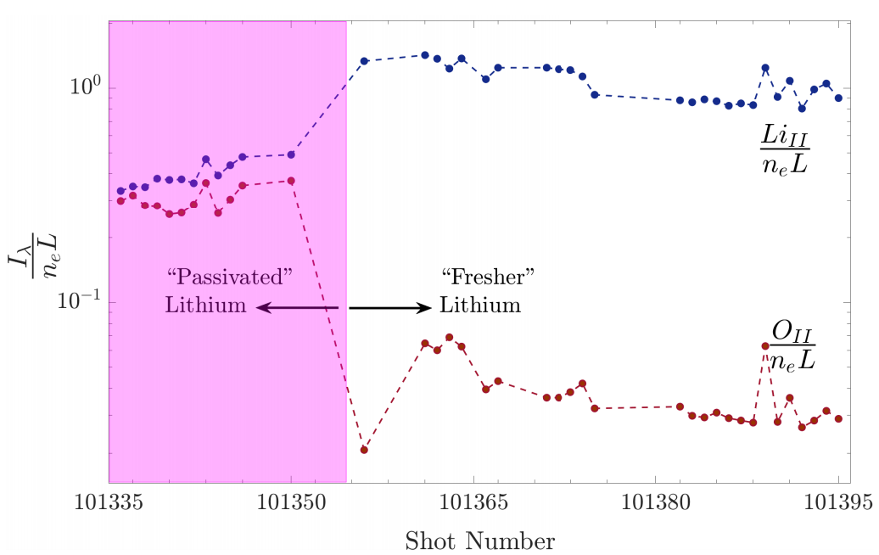
Plasma performance improves
Current and duration improve
Oxygen line emission goes down
Lithium line emission increases
Probe density decreases and temperature increases after gas puff

Slide 26
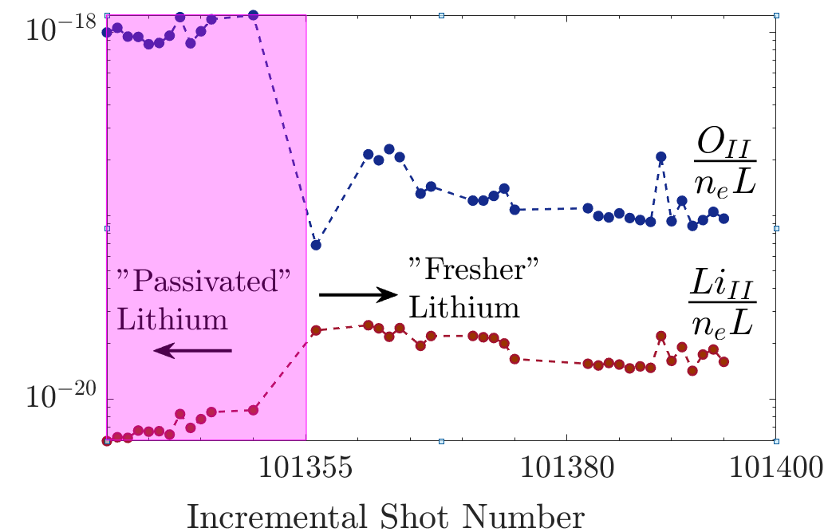
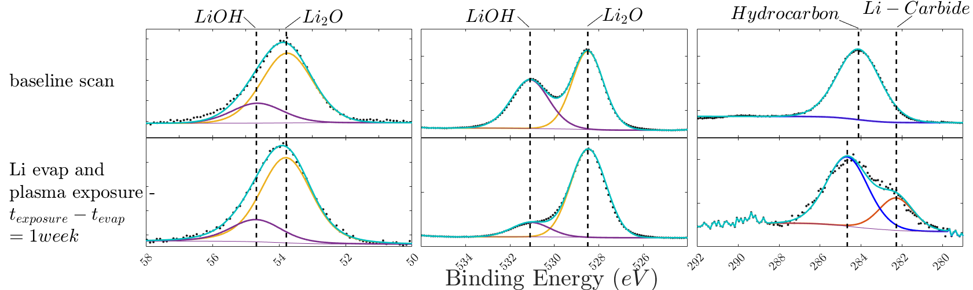
Direct measure of changes in surface and co-relation with plasma performance
Lithium Oxide seems to improve performance by reducing oxygen impurity content as opposed to LiOH.
First Direct in vacuum characterization of lithium compounds on a tokamak PFC
A Maan et al 2021 Plasma Phys. Control. Fusion 63 025007

Slide 27
Overview
Lithium Tokamak eXperiment (LTX) - Context
Surface analysis for Lithium Tokamak eXperiment-β
  Sample Exposure Probe
  Lithium Plasma Facing Component (PFC) Evolution
  Plasma Performance and correlation with PFC evolution
Recent diagnostic and operational upgrades to LTX-beta
  Langmuir probe
  Lyman-alpha array
  Supersonic Gas injector
  Newer lithium evaporators
Performance improvement with increased lithiumization
  Flat temperatures
  Effective particle confinement time
  Reduced Lyman-alpha emission
  DEGAS2 analysis
New Gkeyll simulations inform on the impact of collisionality with increased lithiumization

Slide 28
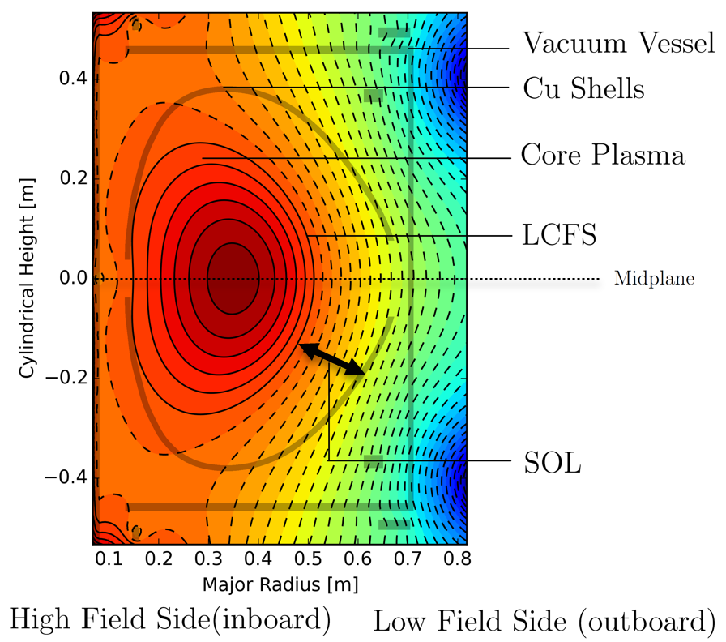
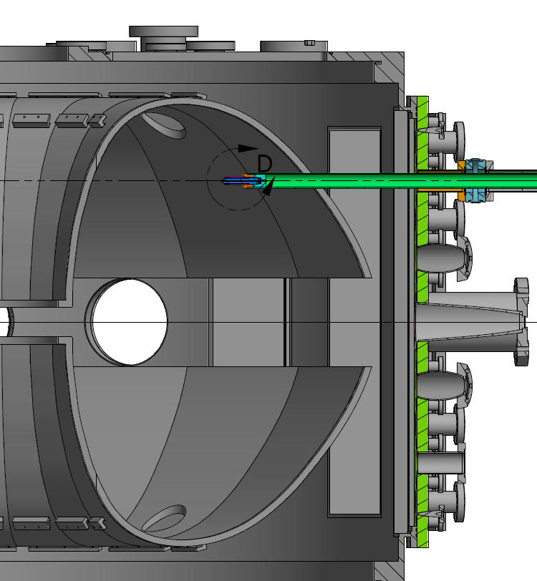
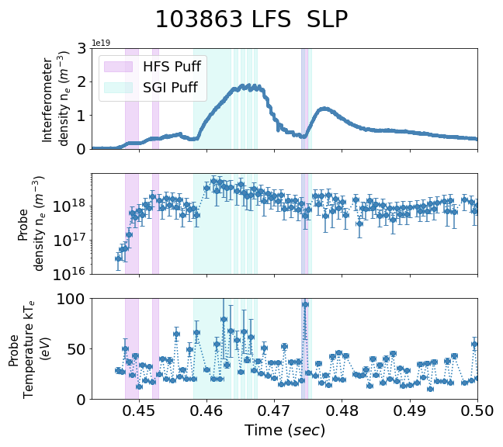
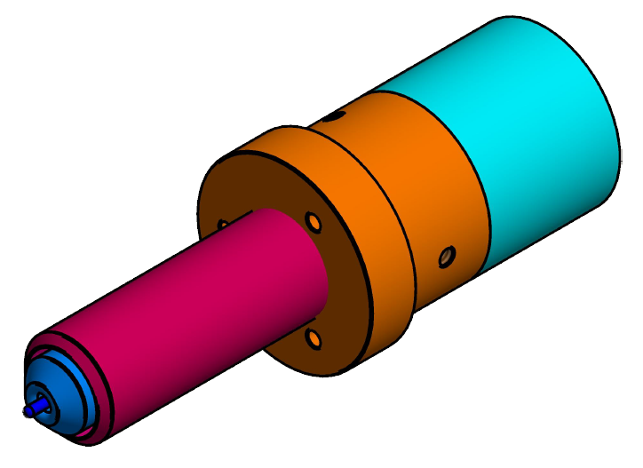
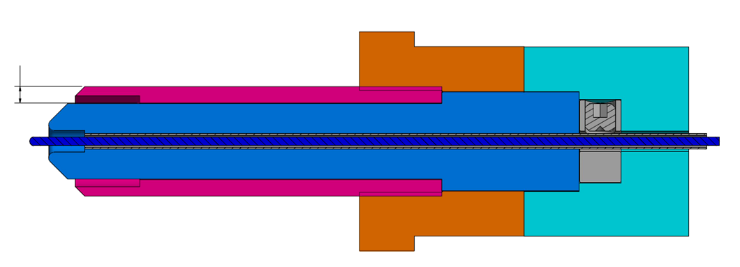
Low field side Single Langmuir Probes
NEW Single tipped, swept with 1kHz triangular wave – 200 V peak to peak
Mounted off-midplane to avoid run-away electrons during low density phases
1.91mm[0.075 in]
MACOR Insulator
TZM Sheath
Steel mounting piece
Tungsten probe tip (1 mm)
Boron Nitride insulator

Slide 29
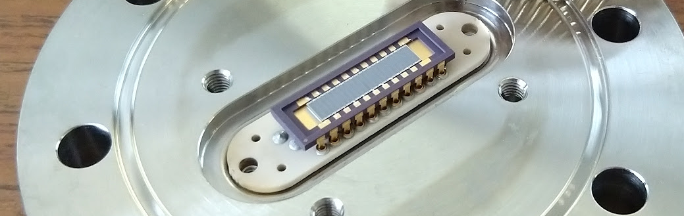
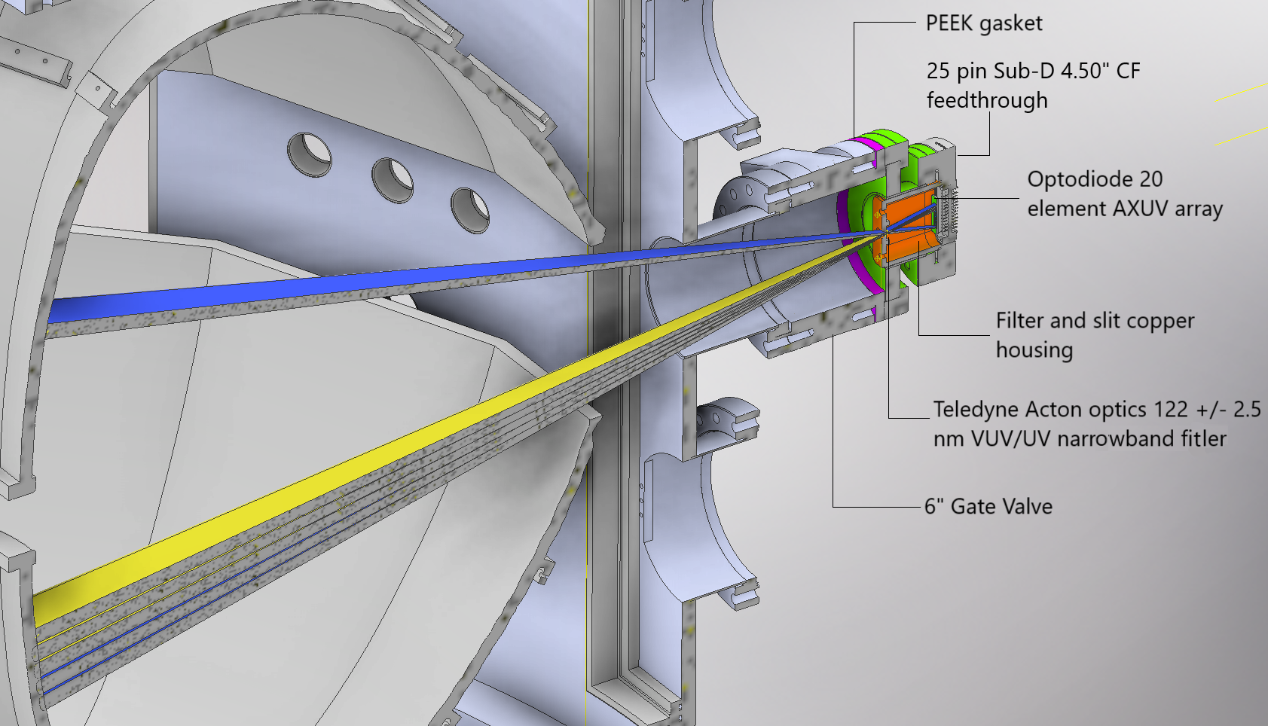
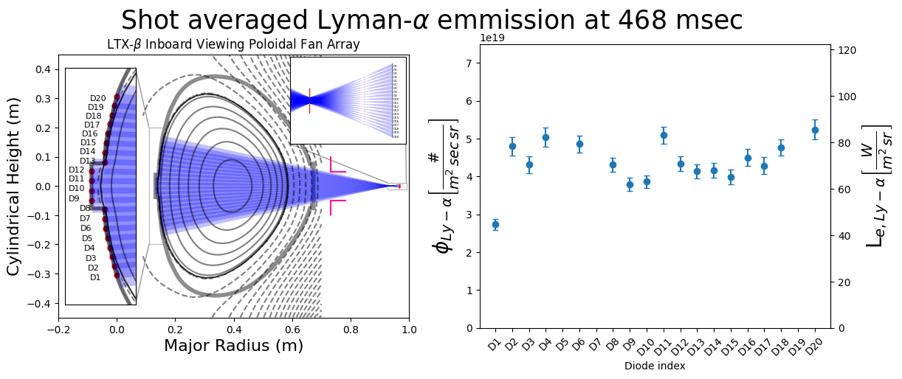
Poloidal Lyman-Alpha array
Light reflection from metal PFCs complicate recycling measurement
20 Element AXUV photodiode array to measure Lyman-Alpha emission
Crucial for recycling measurement
Low reflection from Li and Li compounds at 121.6 nm

Slide 30
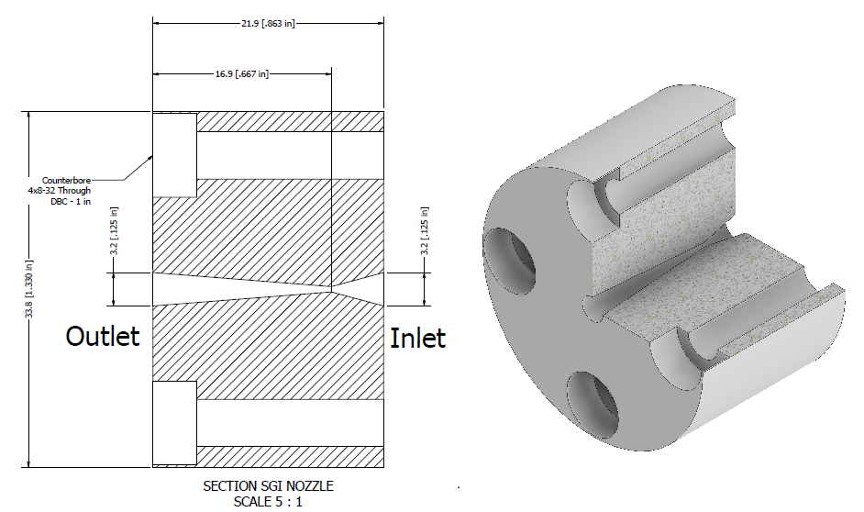
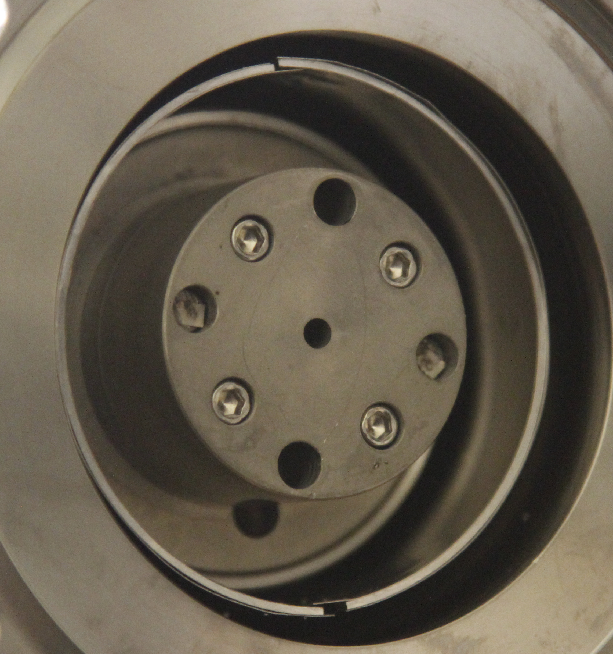
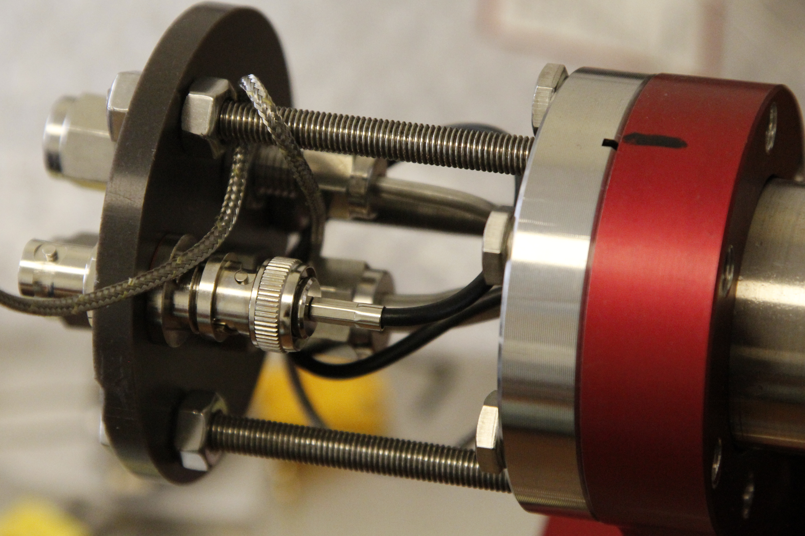
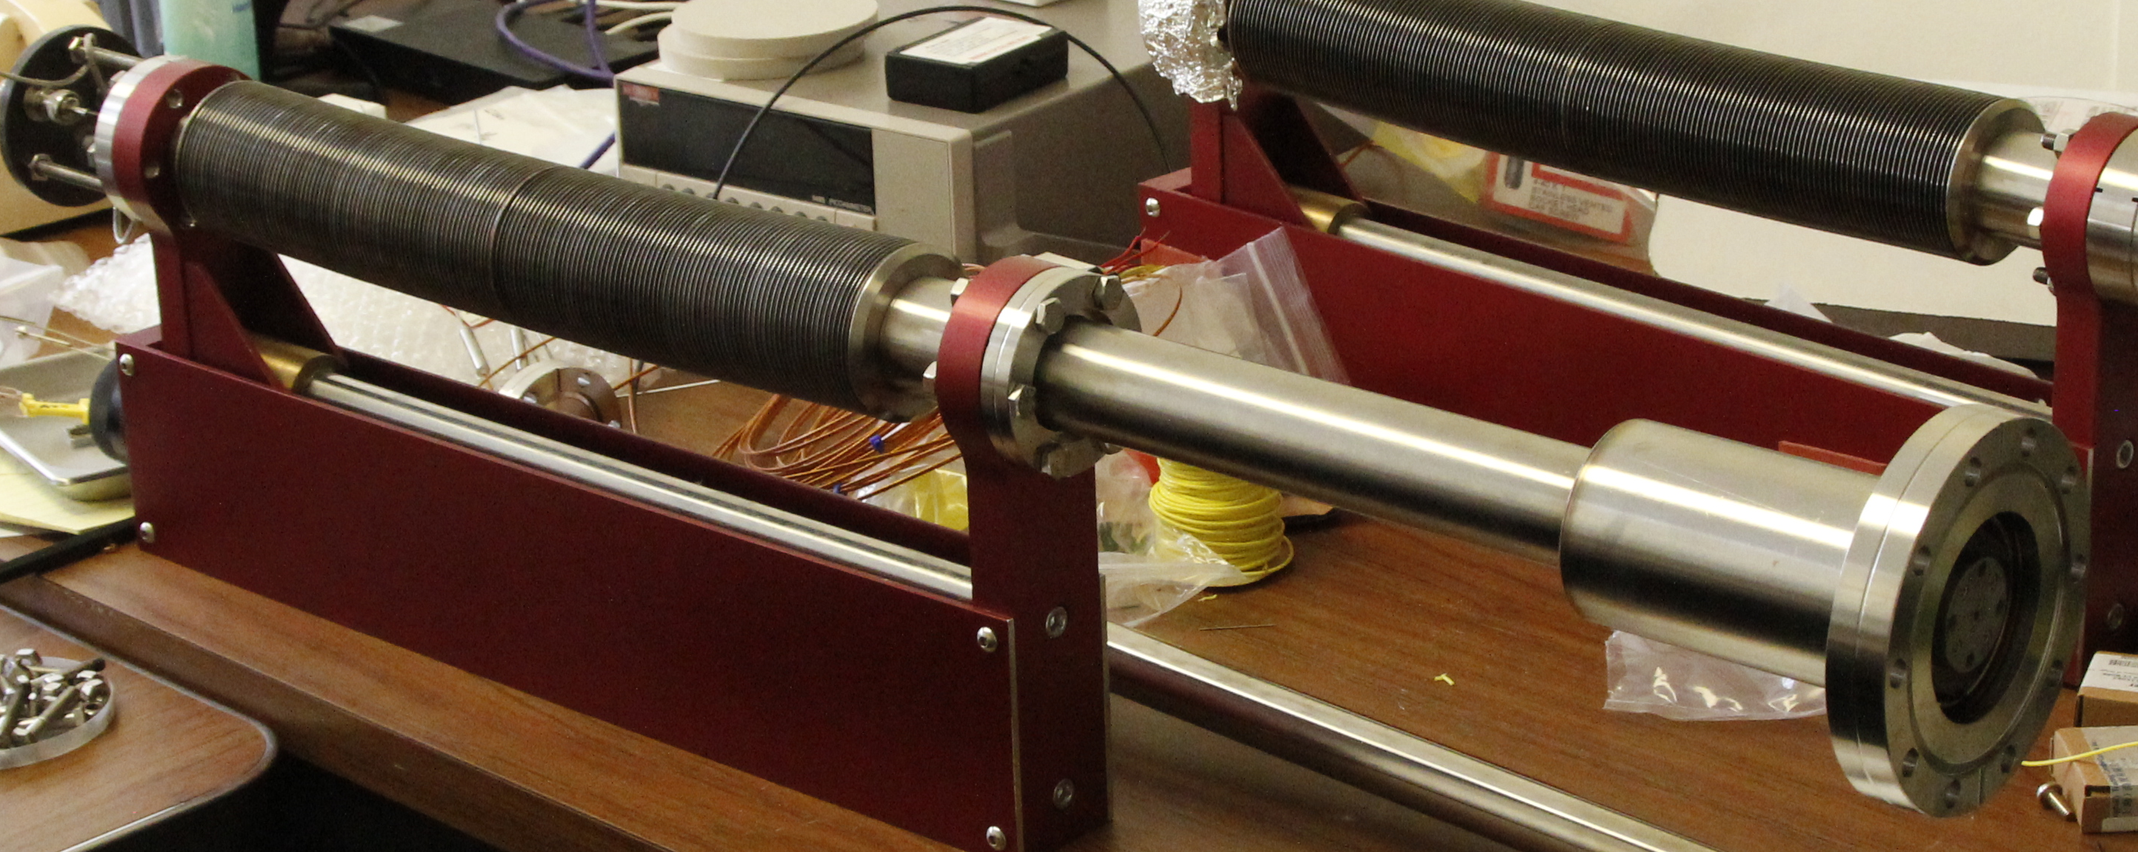
Supersonic Gas Injector - Design
Proximity of supersonic gas injector (SGI) valve to nozzle eliminates edge cooling from residual gas in line for conventional gas puffer
High levels of conventional gas puffing is incompatible with a hot – low recycling edge
Improvements include a double walled heatshield and a vortex tube for hot shells operation
Mounted vertically through a shell penetration closer to the high field side
SGI location
SGI Nozzle
Gas inlet
SGI Nozzle
Trigger
Heat shield
T/C
PV-10 housing
Cooling channel
Final bellows mounted assembly

Slide 31
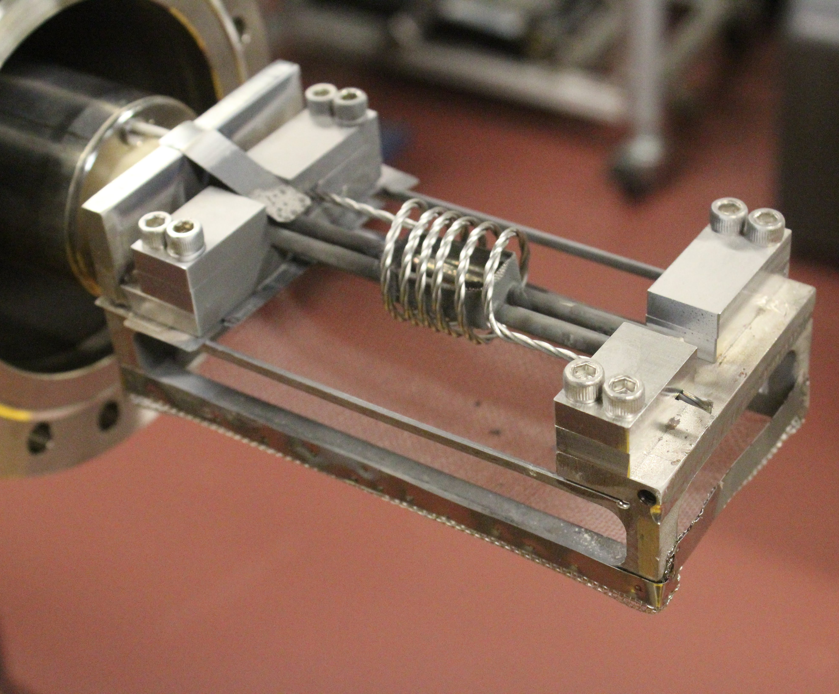
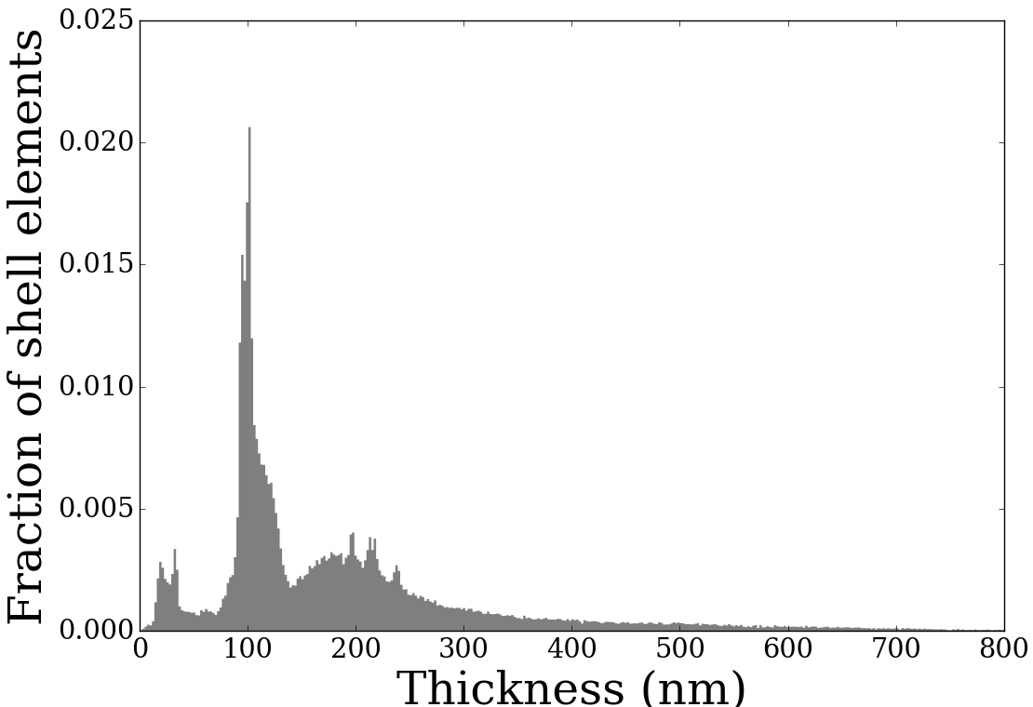
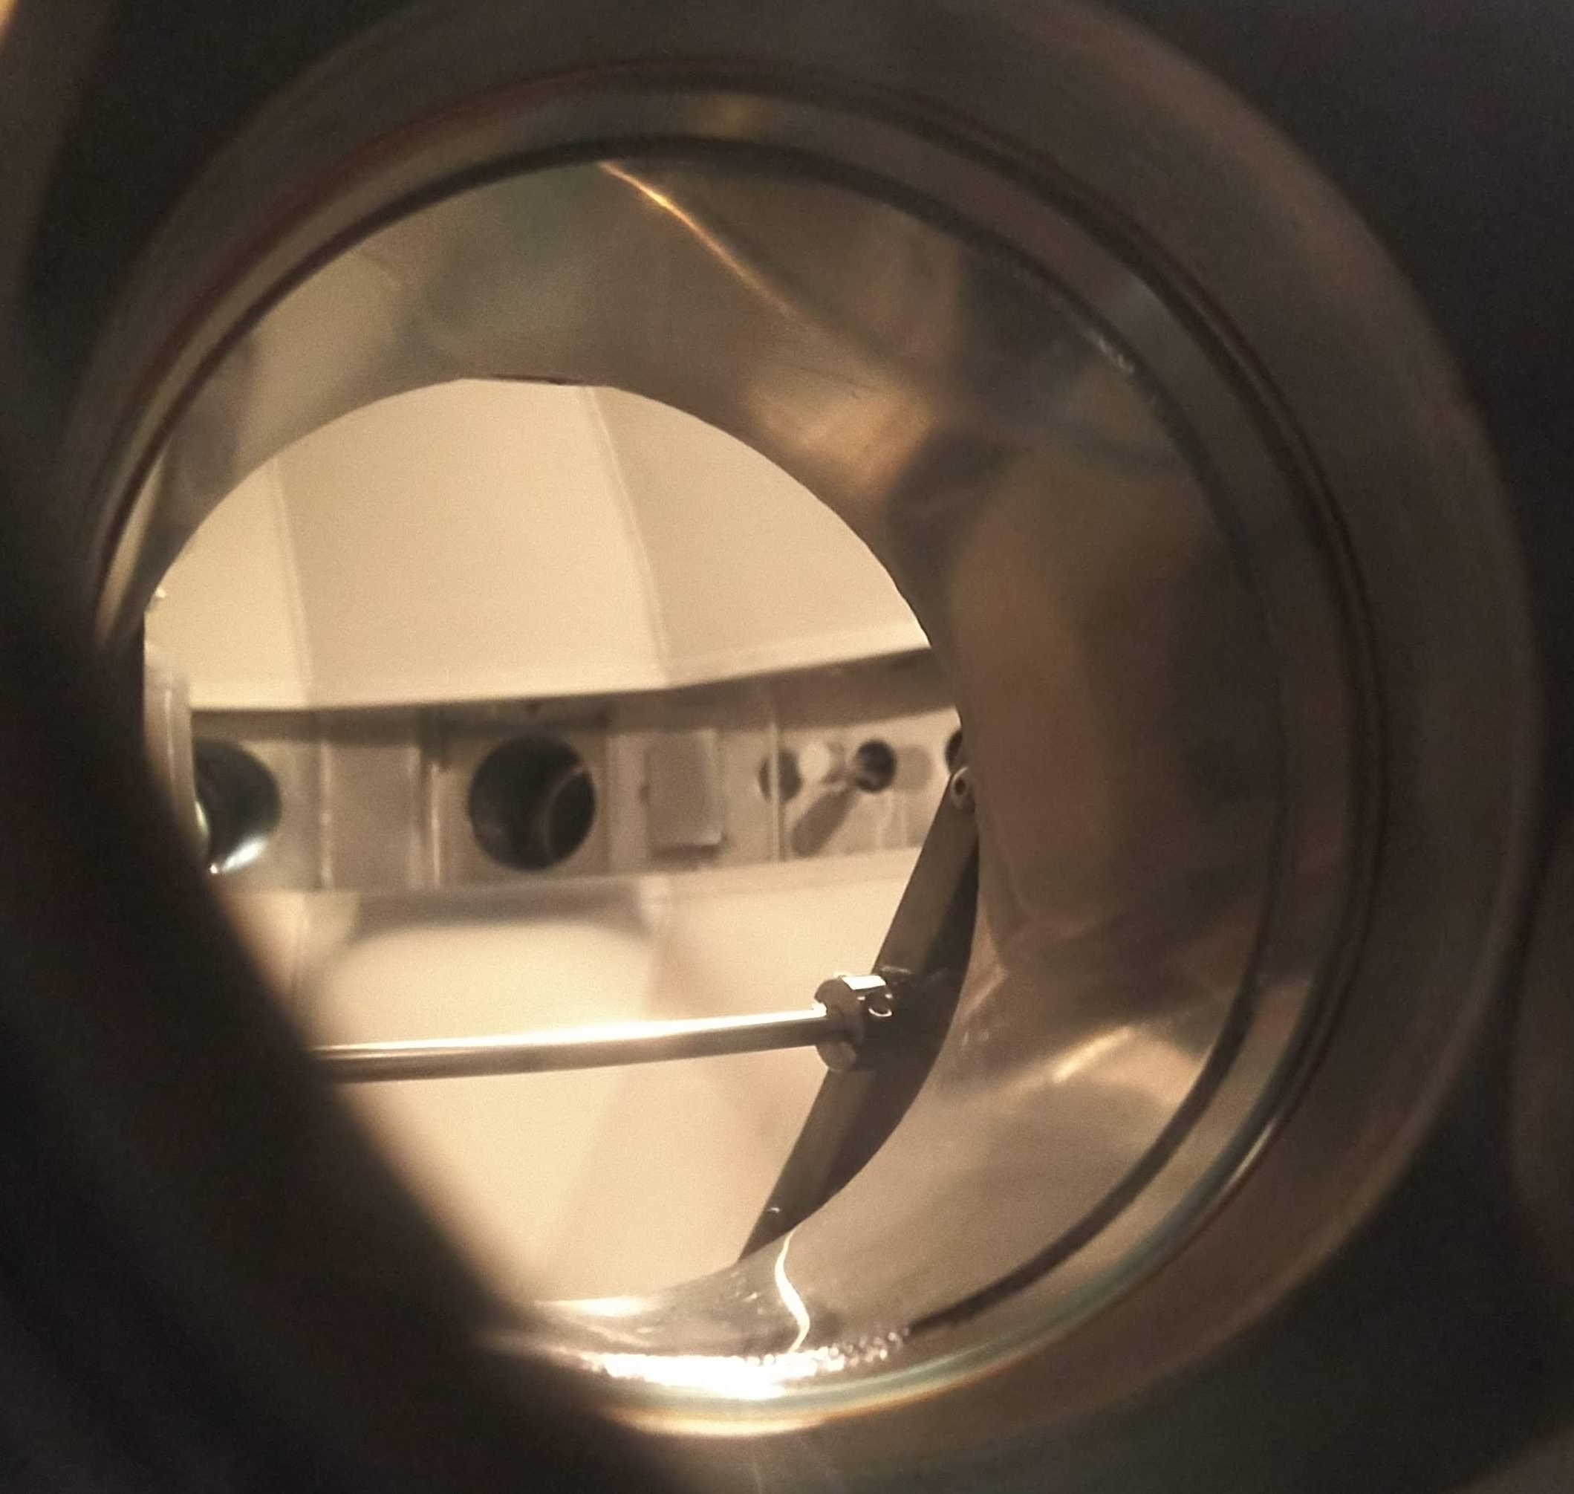
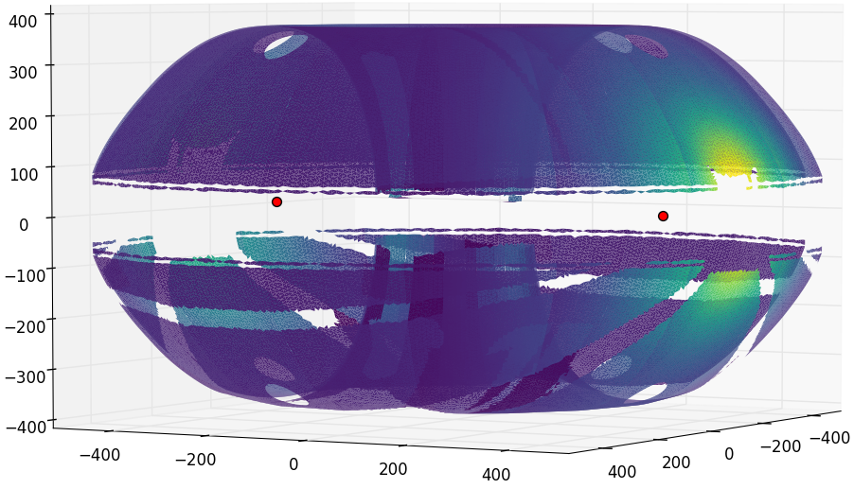
Lithium Evaporators for LTX-beta – Mark-I
  Few minutes per evaporation
  1-1.5 Hr between evaporation and run
  Point source approximation predicts most of the PFC covered

Slide 32
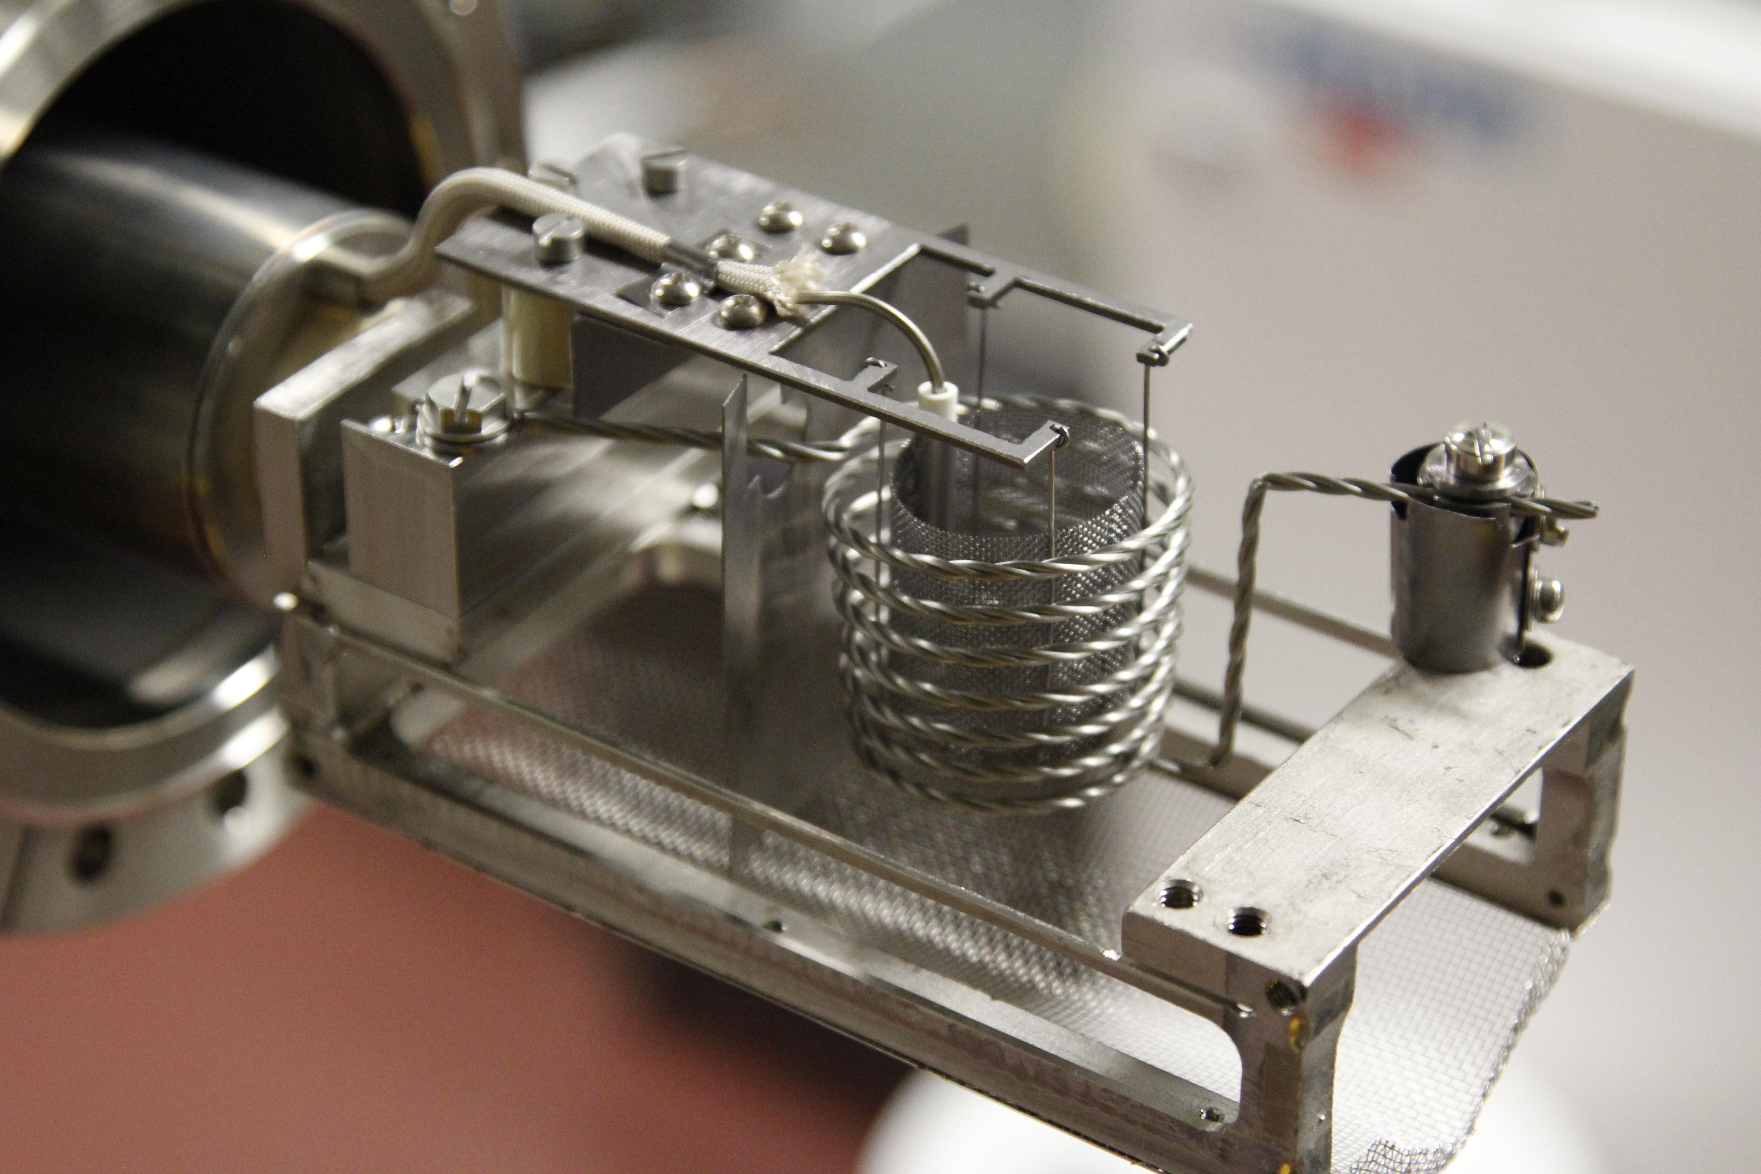
Lithium Evaporators for LTX-beta – Mark-II
  New lithium evaporators.
  Few minutes per evaporation
  1-1.5 Hr between evaporation and run
  Point source approximation predicts most of the PFC covered

Slide 33
Overview
Lithium Tokamak eXperiment (LTX) - Context
Surface analysis for Lithium Tokamak eXperiment-β
  Sample Exposure Probe
  Lithium Plasma Facing Component (PFC) Evolution
  Plasma Performance and correlation with PFC evolution
Recent diagnostic and operational upgrades to LTX-beta
  Langmuir probe
  Lyman-alpha array
  Supersonic Gas injector
  Newer lithium evaporators
Performance improvement with increased lithiumization
  Flat temperatures
  Effective particle confinement time
  Reduced Lyman-alpha emission
  DEGAS2 analysis
New Gkeyll simulations inform on the impact of collisionality with increased lithiumization

Slide 34
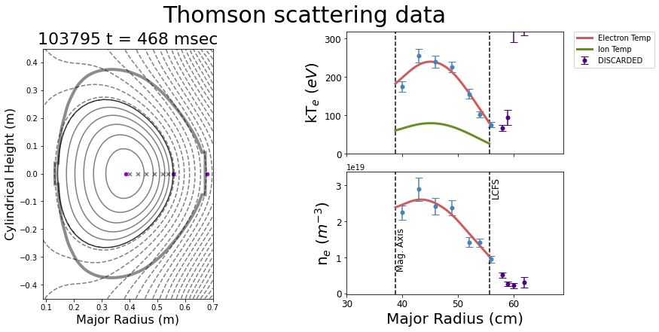
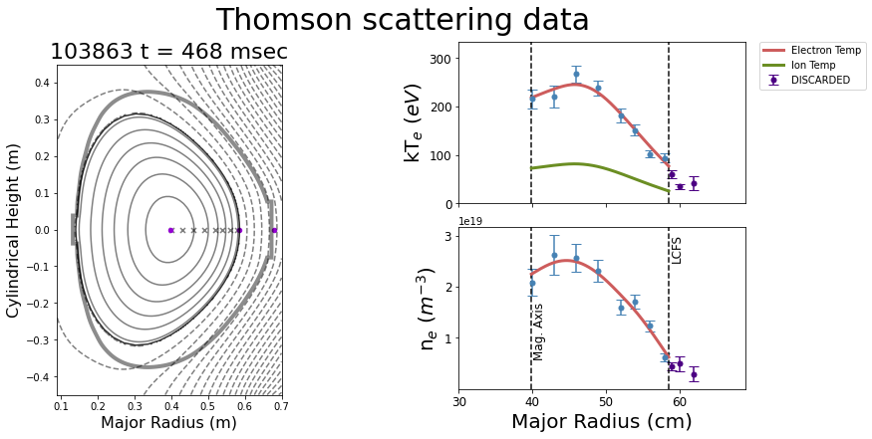
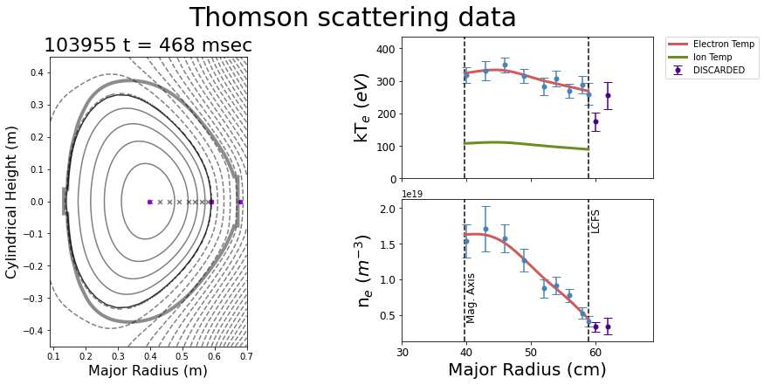
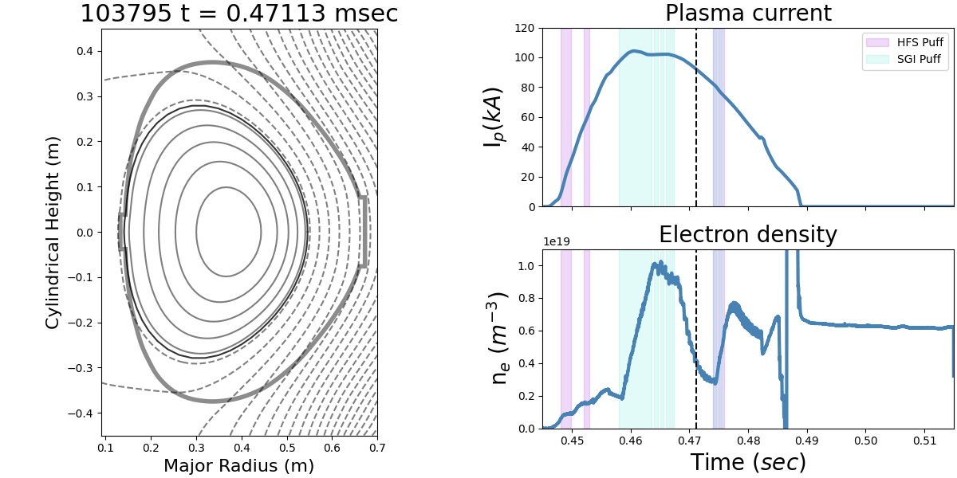
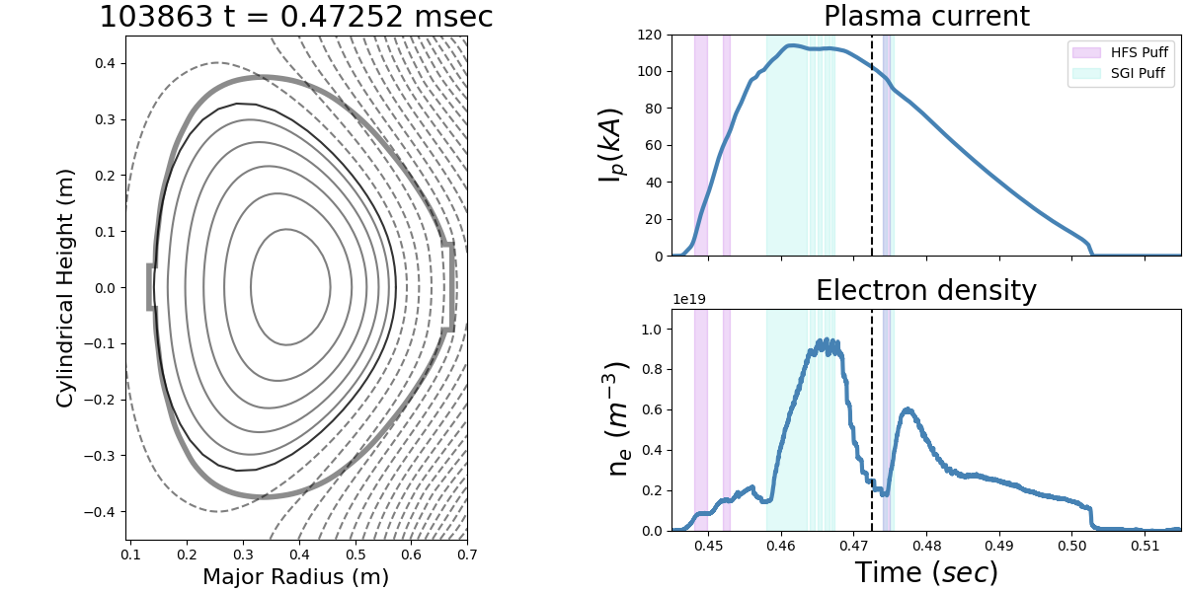
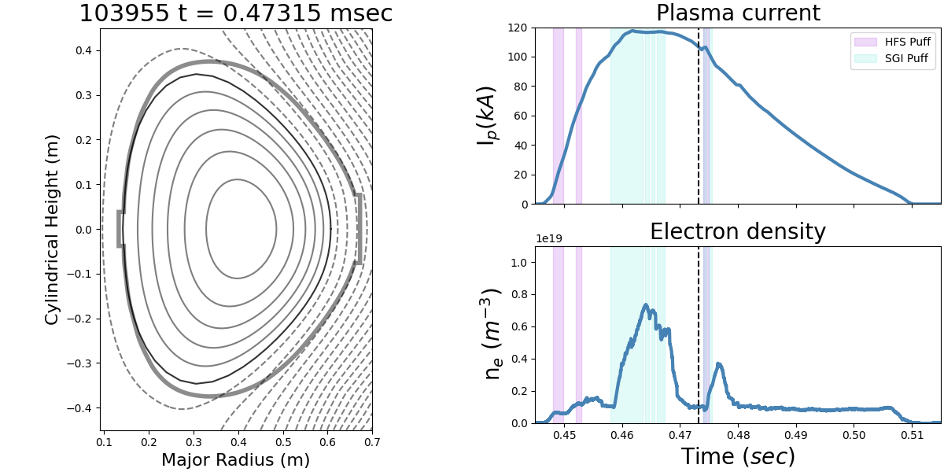
Plasma performance improves with thicker lithium coatings
  Plasma current increases
  Peak density reduces
  Density decay time reduces
  Shots last longer
  Temperature profiles relax and become more flat
  Edge densities drop
Core density and temperatures at peak density t=468 msec
Old Li*
322 mg Li
863 mg Li
Old Li*
322 mg Li
863 mg Li

Slide 35
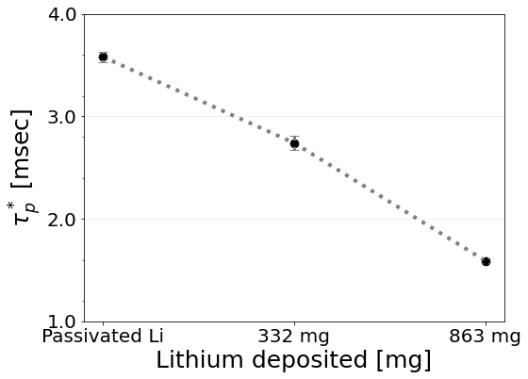
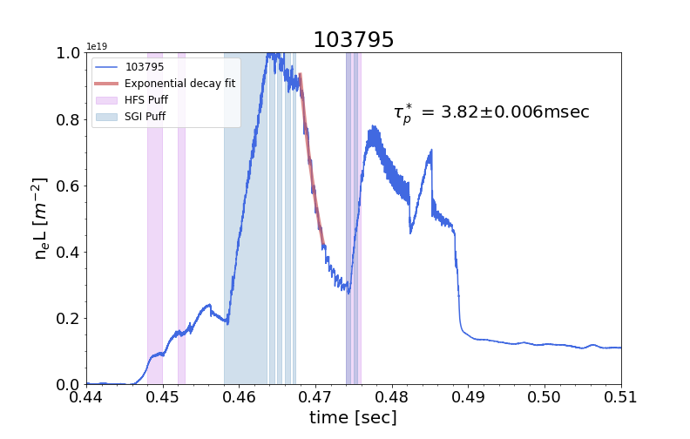



Effective particle confinement time reduces with increased lithiumization
  Efficient edge fueling with a supersonic gas injector enables an effective particle confinement to be estimated.
  $$N_{e}=N_{e}\left(0\right)\exp\left[−\frac{t}{{τ_{p}}^{∗}}\right],$$
  where,
  $${τ_{p}}^{∗}=\frac{τ_{p}}{1−R}$$
Old Li
322 mg Li
863 mg Li

Slide 36

Effective particle confinement time reduces with increased lithiumization
  Efficient edge fueling with a supersonic gas injector enables an effective particle confinement to be estimated.
  $$N_{e}=N_{e}\left(0\right)\exp\left[−\frac{t}{{τ_{p}}^{∗}}\right],$$
  where,
  $${τ_{p}}^{∗}=\frac{τ_{p}}{1−R}$$
Old Li*
322 mg Li
863 mg Li

Slide 37


Lyman Alpha array intensity progressively reduces with more lithium
Least Li
  Lyman-alpha array signal shows progressive reduction with increasing lithiumization for the same fueling sequence
  The decay rate of signal intensity after a puff is also seen to reduce with more lithium
  Comparing Lyman alpha signal intensities across different timepoints at similar line averaged density also shows a similar reduction, indicating a trend independent of density.
Most Li

Slide 38


Lyman Alpha array intensity progressively reduces with more lithium
  Lyman-alpha array signal shows progressive reduction with increasing lithiumization for the same fueling sequence
  The decay rate of signal intensity after a puff is also seen to reduce with more lithium
  Comparing Lyman alpha signal intensities across different timepoints at similar line averaged density also shows a similar reduction, indicating a trend independent of density.

Slide 39






SOL profile measured using Thomson scattering and Langmuir probe data
  SOL density and temperature is approximated using an exponential decay fit using data from the main TVTS system and the low field side Langmuir probe.
  Extrapolation of density decay from fit to TVTS data agrees well with the probe data
  Probe temperature measurement likely specious for hot edge, new low field side TS optics should solve this!
Old Li
322 mg Li
863 mg Li

Slide 40


DEGAS2 analysis yields low recycling
  Ignoring ion trapped fractions yields really low recycling coefficients
  Overall trend of reduced recycling with increased lithiumization persists
  The trend agrees with other observations that indicate reduced recycling.
    Reduced Lyman alpha emission reduction
    Quicker density decay
    Flat temperature profiles

Slide 41
Overview
Lithium Tokamak eXperiment (LTX) - Context
Surface analysis for Lithium Tokamak eXperiment-β
  Sample Exposure Probe
  Lithium Plasma Facing Component (PFC) Evolution
  Plasma Performance and correlation with PFC evolution
Recent diagnostic and operational upgrades to LTX-beta
  Langmuir probe
  Lyman-alpha array
  Supersonic Gas injector
  Newer lithium evaporators
Performance improvement with increased lithiumization
  Flat temperatures
  Effective particle confinement time
  Reduced Lyman-alpha emission
  DEGAS2 analysis
New Gkeyll simulations inform on the impact of collisionality with increased lithiumization

Slide 42

Gkeyll used for gyrokinetic simulations of open field lines in the SOL
Simulation domain collapsed on a poloidal cross-section
Gkeyll evolves the long-wavelength gyrokinetic equation.
Solved in 1D along the field line coupled with a field equation for potential.
Necessary due to long collisional mean-free paths in the SOL relative to the connection length
Free parameter and convergence scans completed, able to match experimental data at midplane
Full simulation domain

Slide 43


Collisionality scans show reduced particle and heat flux with as collisionality is reduced
Old Li*
Numerically swept collision frequency
Midplane density increases with reduction in collisionality but edge density reduces
Temperature rises with reduction in collisionality
Particle and heat flux go down

Slide 44

Collisionality scans show reduced particle and heat flux as collisionality is reduced
Old Li*
863 mg
Numerically swept collision frequency
Midplane density increases with reduction in collisionality but edge density reduces, likely indicates trapping
Temperature rises with reduction in collisionality
Particle and heat flux go down
Introduction of lithium reduces collision frequency, note, the magnitudes on y axis are different

Slide 45
Summary
First direct in vacuum identification of Lithium compounds on a fusion reactor first wall
Li in tokamak Plasma Facing Components (PFCs) oxidizes to Li₂O, which maintains favorable performance (like Li) by reducing impurities and recycling
Multiple diagnostic and operational upgrades to LTX-beta enable recycling analysis and SOL characterization
Recycling analysis with DEGAS2 and other indicators show reduced recycling coefficients as more lithium is evaporatively deposited on LTX PFC
New Gkeyll analysis shows favorable reduction in particle and heat flux to the walls with more lithiumization

Slide 46

Thank you

Slide 47
Backup

Slide 48






DEGAS2 analysis yields low recycling
  TRANSP indicated energy confinement time is within an error bar of the effective particle confinement time for lowest recycling case.
  Comparison of energy confinement time at peak density shows reduced energy confinement, likely due to much lower density for the low recycling case (almost half)
  Comparison of energy confinement time at constant density shows improved energy confinement with reduced recycling.
Peak density
Constant density

Slide 49



Low field side Single Langmuir Probes
Last low field side probe blew up! – Spewed Aluminum everywhere

Slide 50



TRANSP shows low collisionality core plasma
Old Li*
322 mg Li
863 mg Li

