Slide 1
Neoclassical transport in resonant magnetic perturbation edge localized mode suppressed plasmas in DIII-D
Priyanjana Sinha
Princeton Plasma Physics Laboratory
Nate Ferraro
Princeton Plasma Physics Laboratory
Emily Belli
General Atomics
Monday Physics Meeting– 13th December 2021

Slide 2
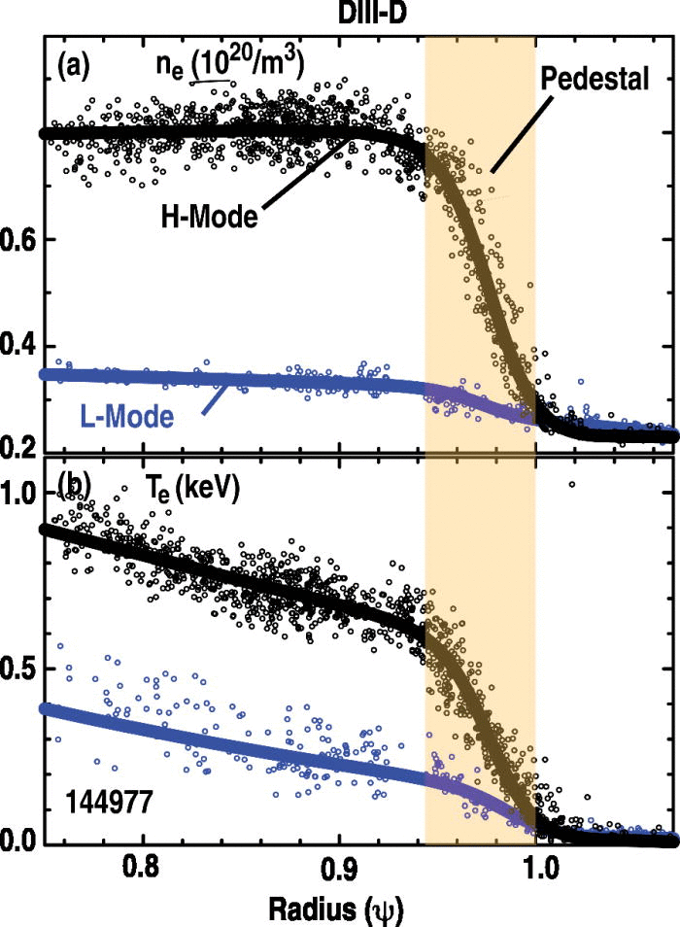
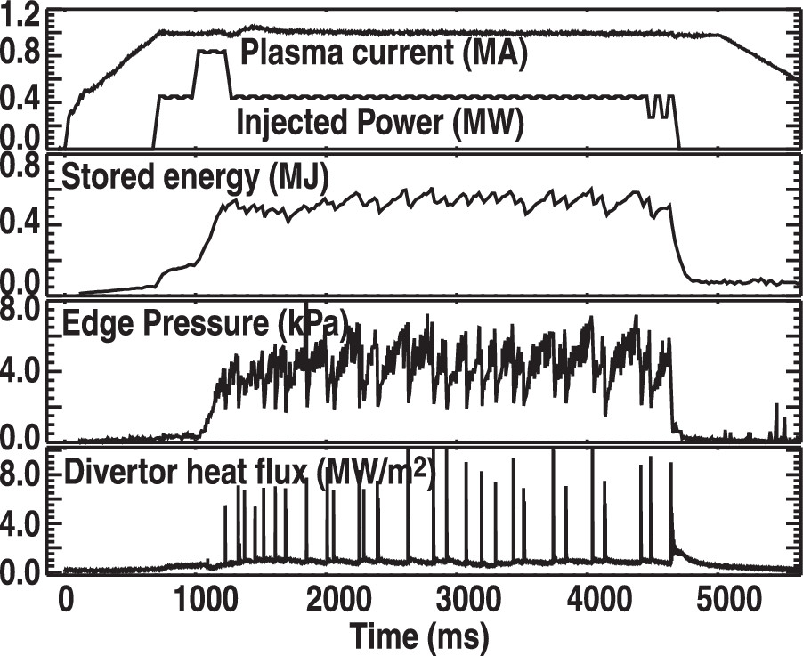
Introduction
H-mode: characterized by steep n and T gradient at the edge
causes instabilities Edge-localized modes (ELMs)
leads to periodic bursts of particles and energy on plasma facing components (PFCs)
degradation of PFCs
The edge H-mode profiles of (a) electron density and (b) electron temperature measured by Thomson scattering in DIII-D. L-mode profiles are also shown for contrast [1]
H-mode discharge in DIII-D with (a) plasma current and auxiliary heating power (b) plasma stored energy, (c) edge pedestal electron pressure (d) peak divertor heat flux [1]
[1] A.W.Leonard, Physics of Plasmas (2014)

Slide 3
Introduction
Method to mitigate/eliminate ELMs:
small 3D non-axisymmetric magnetic perturbations
called Resonant magnetic perturbations (RMPs)
RMPs reduces the density at the pedestal also called “density pump-out caused by RMPs ”
RMPs also reduces central plasma density
detrimental to plasma performance
Our work explores the role of neoclassical transport in RMP-ELM suppressed plasmas :
understand density pump-out
to see if ELM suppression is correlated with neoclassical fluxes specifically near the top of the pedestal, and see if it could be limiting the pedestal width
Changes in the edge-plasma profiles with various magnetic perturbation levels [1]
[1] Todd E. Evans et.al, Nature Physics (2006)

Slide 4
Outline
Description of the codes
Workflow
Results
Conclusions

Slide 5
Description of the code: M3DC1

Slide 6
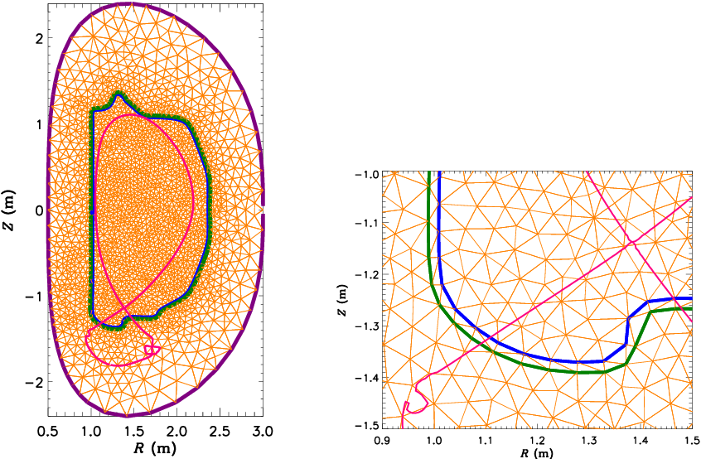
M3D-C1: Extended magnetohydrodynamic (MHD) code
Initial-value finite-element fluid code
It uses a non-uniform, unstructured triangle-based grid that ensures the continuity of scalar fields and their first-derivatives across element boundaries
The computational domain for the code extends beyond the LCFS and includes the open field line region
The M3D-C1 mesh is divided into plasma region, a resistive wall region and an external vacuum region
Mesh used in M3D-C1 showing different simulation domain [1]
[1] N.M.Ferraro et al. Physics of Plasmas (2016)

Slide 7






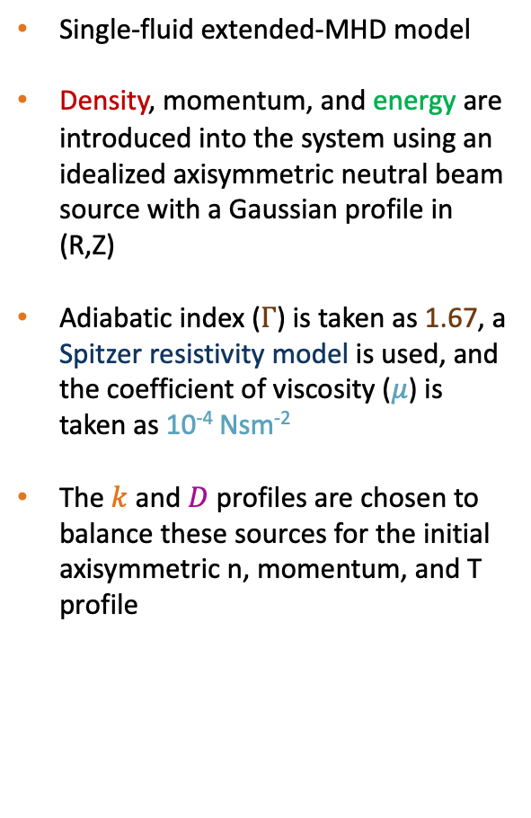
M3D-C1: Single-fluid plasma model used to calculate MHD equilibrium
Single-fluid extended-MHD model
Density, momentum, and energy are introduced into the system using an idealized axisymmetric neutral beam source with a Gaussian profile in (R,Z)
Adiabatic index ($Γ$) is taken as 1.67, a Spitzer resistivity model is used, and the coefficient of viscosity ($μ$) is taken as 10⁻⁴ Nsm⁻²
The $k$ and $D$ profiles are chosen to balance these sources for the initial axisymmetric n, momentum, and T profile
$\frac{∂ni}{∂t}$ + $∇∙$ $niv$= $∇∙\left(D∇ni\right)+σi$
$mi ni\left[\frac{∂v}{∂t}+v∙∇v\right]$ = $J X B −∇p − ∇∙ Π −mi σi v$
$ne\left[\frac{∂Te}{∂t}\text{ +}v∙∇Te+\left(Γ−1\right)Te∇∙ v\right]$+ $σe Te$ =($Γ−1)(ηJ2+Qe −∇∙qe −Πe:∇v)$
$ni\left[\frac{∂Ti}{∂t}\text{ +}v∙∇Ti+\left(Γ−1\right)Ti∇∙ v\right]$+ $σi Ti$ =($Γ−1)( Qi −∇∙qi −Πi:∇v+\frac{1}{2}\left(miσi v2\right))$
$\frac{∂B}{∂t}$ = $− ∇ X E$
$Πi$= $−(∇v+∇vT)μ$
$E$= $ηJ$ - $v X B$
$$qi=−ki ∇ \left(Ti\right)+k||i bb⋅∇\left(Ti\right)$$
$$qe=−ke ∇ \left(Te\right)+k||ebb⋅∇\left(Te\right)$$

Slide 8
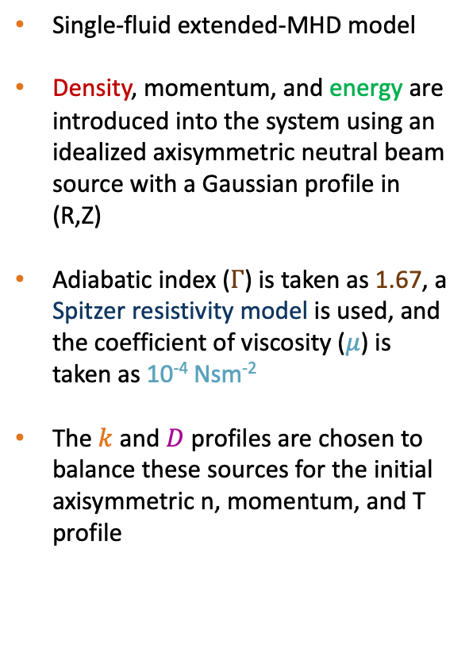
M3D-C1: Single-fluid plasma model used to calculate MHD equilibrium
Single-fluid extended-MHD model
Density, momentum, and energy are introduced into the system using an idealized axisymmetric neutral beam source with a Gaussian profile in (R,Z)
Adiabatic index ($Γ$) is taken as 1.67, a Spitzer resistivity model is used, and the coefficient of viscosity ($μ$) is taken as 10⁻⁴ Nsm⁻²
The $k$ and $D$ profiles are chosen to balance these sources for the initial axisymmetric n, momentum, and T profile
M3DC1
[at t=0 with no RMP]
model n, T profiles + gaussian source
Ion density profile
Diffusion coefficient
Ion temperature profile
Thermal conductivity

Slide 9
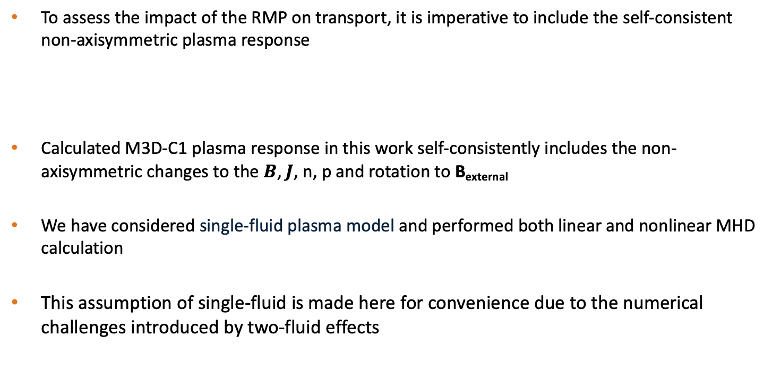
M3D-C1: Calculates self-consistent non-axisymmetric plasma response
To assess the impact of the RMP on transport, it is imperative to include the self-consistent non-axisymmetric plasma response
Calculated M3D-C1 plasma response in this work self-consistently includes the non-axisymmetric changes to the $B$, $J$, n, p and rotation to B_{external}
We have considered single-fluid plasma model and performed both linear and nonlinear MHD calculation
This assumption of single-fluid is made here for convenience due to the numerical challenges introduced by two-fluid effects
B_{total} = B_{external} + B_{plasma}

Slide 10
Description of the code: NEO

Slide 11
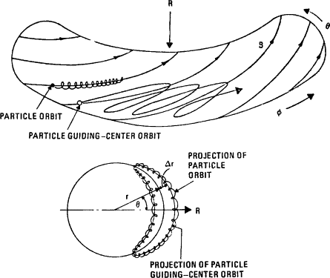
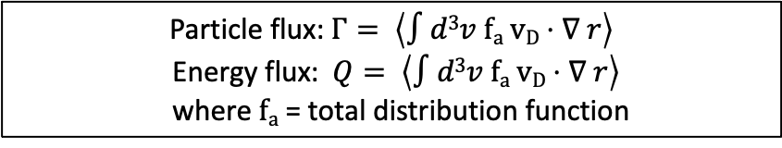
NEO: Solves DKE and calculates neoclassical transport
RMPs gives rise to non-axisymmetric equilibrium
Particles gets trapped and experience drifts
3D-NEO has an improved capability to handle non-axisymmetric geometry
Solves the standard Drift Kinetic Equation (DKE)
NEO uses the full linearized Fokker-Planck multi-species collisional operator
$DKE: \frac{∂fa}{∂t}$ + $(v||b+vD+vE)∇∙$ $f$_{a} $−\frac{zae}{ma}⋅\left(v||b+vD \right)$ $∇\frac{∂fa}{∂ε}+μ\frac{∂fa}{∂μ}=Ca+Sa$
Particle flux: $Γ= \left\langle ∫d3v fa vD⋅∇ r\right\rangle$
Energy flux:$Q= \left\langle ∫d3v fa vD⋅∇ r\right\rangle$
where $fa$ = total distribution function
Trapped banana orbits in tokamak [1]
Ref: E A Belli and J Candy 2015 Plasma Phys. Control. Fusion 57 05401
[1] T. Kammash, Alternative Energy Sources (1981)

Slide 12
Workflow

Slide 13
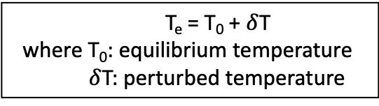
Workflow: M3D-C1 equilibrium surfaces approximated as Te isotherms
The DKE formulation requires the the magnetic surfaces to be free of any stochasticity and islands
M3D-C¹
The magnetic surfaces equilibrium calculated by M3D-C1 is represented in the form of isotherms of electron temperature
T_{e} = T₀ + $δ$T
where T₀: equilibrium temperature
$δ$T: perturbed temperature
Poincaré plot for M3D-C1 equilibrium
Isotherm plot for M3D-C1 equilibrium

Slide 14
Workflow: M3D-C1 equilibrium surfaces approximated as Te isotherms
The DKE formulation requires the the magnetic surfaces to be free of any stochasticity and islands
M3D-C¹
The magnetic surfaces equilibrium calculated by M3D-C1 is represented in the form of isotherms of electron temperature
By taking Te isosurfaces approximation we exclude transport effects resulting from nonintegrable magnetic geometry, and capture only the effects due to the "kinking" of surfaces
The M3D-C1 calculation itself does self-consistently include parallel thermal transport across islands and stochastic regions, but these are not added to the neoclassical fluxes presented here
We do not claim to evaluate changes to turbulent transport, or effects due to drift-kinetic physics in nonintegrable fields
T_{e} = T₀ + $δ$T
where T₀: equilibrium temperature
$δ$T: perturbed temperature
Poincarè plot for M3D-C1 equilibrium
Isotherm plot for M3D-C1 equilibrium

Slide 15
Workflow: Local, ideal equilibria calculated using Le3
The DKE formulation requires the the magnetic surfaces to be free of any stochasticity and islands
M3D-C¹
Le3
The magnetic surfaces equilibrium calculated by M3D-C1 is represented in the form of isotherms of electron temperature
Calculates the local equilibrium using surface geometry provided by M3D-C1 and ensures the goodness of the flux surfaces
T_{e} = T₀ + $δ$T
where T₀: equilibrium temperature
$δ$T: perturbed temperature

Slide 16
Workflow: Local neoclassical transport calculated using NEO
The DKE formulation requires the the magnetic surfaces to be free of any stochasticity and islands
M3D-C¹
Le3
NEO
The magnetic surfaces equilibrium calculated by M3D-C1 is represented in the form of isotherms of electron temperature
Calculates the local equilibrium using surface geometry provided by M3D-C1 and ensures the goodness of the flux surfaces
Solves DKE and calculates neoclassical transport properties
T_{e} = T₀ + $δ$T
where T₀: equilibrium temperature
$δ$T: perturbed temperature

Slide 17
Results

Slide 18
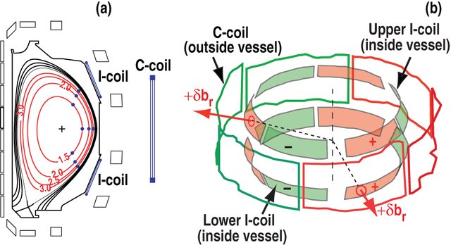
DIII-D tokamak
DIII-D is a conventional tokamak with a minor radius r = 0.67 m and major radius R= 1.67m
DIII-D uses a set of 12 in-vessel perturbation coils so-called I-coils (6 upper and 6 lower) to control ELMs
The dominant toroidal mode number in RMP ELM suppression experiments on DIII-D is typically n = 2 or n = 3
In this work we have considered well-diagnosed cases covering both n=2 response for a range of poloidal RMP spectrum (#158115) and n=3 response including sustained periods of ELM suppression in DIII-D's ITER Baseline Scenario (#160921)
I-coil and C-coil arrays of DIII D with plasma 126006 [1]
[1] Schaffer M J et al. , 23rd IEEE/NPSS Symposium on Fusion Engineering. IEEE, 2009.

Slide 19
Results for n=3 RMP ELM-suppressed shot in DIII-D

Slide 20
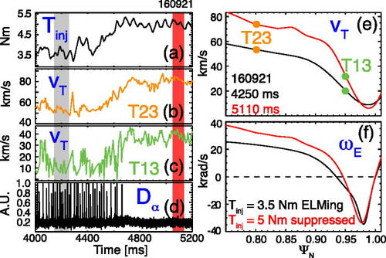
DIII-D shot #160921: Increase in NBI torque leads to ELM suppression
The motivation behind the experiment was to assess the level of ELM control that could be achieved in the ITER Baseline Scenario (IBS)
Only the upper I-coil current was operated with n = 3 and RMP current = 6 kA
The input torque was stepped up from 3.5 Nm to 5 Nm between leading to suppression of ELMs
Hypothesis: ELMs are suppressed when the plasma transitions from an ideal screened response to a tearing response at a resonant surface that prevents expansion of the pedestal to an unstable width
Evolution of (a) 𝑇_{𝑖𝑛𝑗}, edge toroidal rotation 𝑣_{𝑇} at (b) Ψ_{N} = 0.8, and (c) the top of the pedestal (𝛹_{𝑁}=0.95), and (d) ELM behavior from divertor recycling 𝐷_{α} across a ramp in 𝑇_{𝑖𝑛𝑗} from 3.5 Nm to 5 Nm, leading to RMP ELM suppression. Radial profiles of (e) 𝑣_{𝑇} and (f) ω_{E} at the times indicated by the vertical bars in (a)–(d) [1]
[1] R.A. Moyer et al., Physics of Plasmas (2017)

Slide 21
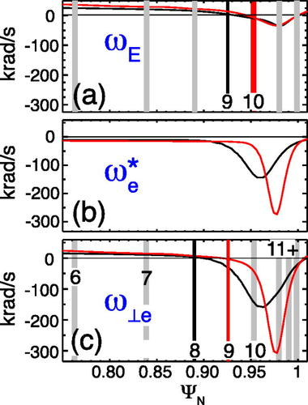
DIII-D shot #160921: Increase in NBI torque leads to ELM suppression
The motivation behind the experiment was to assess the level of ELM control that could be achieved in the ITER Baseline Scenario (IBS)
Only the upper I-coil current was operated with n = 3 and RMP current = 6 kA
The input torque was stepped up from 3.5 Nm to 5 Nm between leading to suppression of ELMs
Hypothesis: ELMs are suppressed when the plasma transitions from an ideal screened response to a tearing response at a resonant surface that prevents expansion of the pedestal to an unstable width
Evolution of (a) 𝑇_{𝑖𝑛𝑗}, edge toroidal rotation 𝑣_{𝑇} at (b) Ψ_{N} = 0.8, and (c) the top of the pedestal (𝛹_{𝑁}=0.95), and (d) ELM behavior from divertor recycling 𝐷_{α} across a ramp in 𝑇_{𝑖𝑛𝑗} from 3.5 Nm to 5 Nm, leading to RMP ELM suppression. Radial profiles of (e) 𝑣_{𝑇} and (f) ω_{E} at the times indicated by the vertical bars in (a)–(d) [1]
[1] R.A. Moyer et al., Physics of Plasmas (2017)

Slide 22
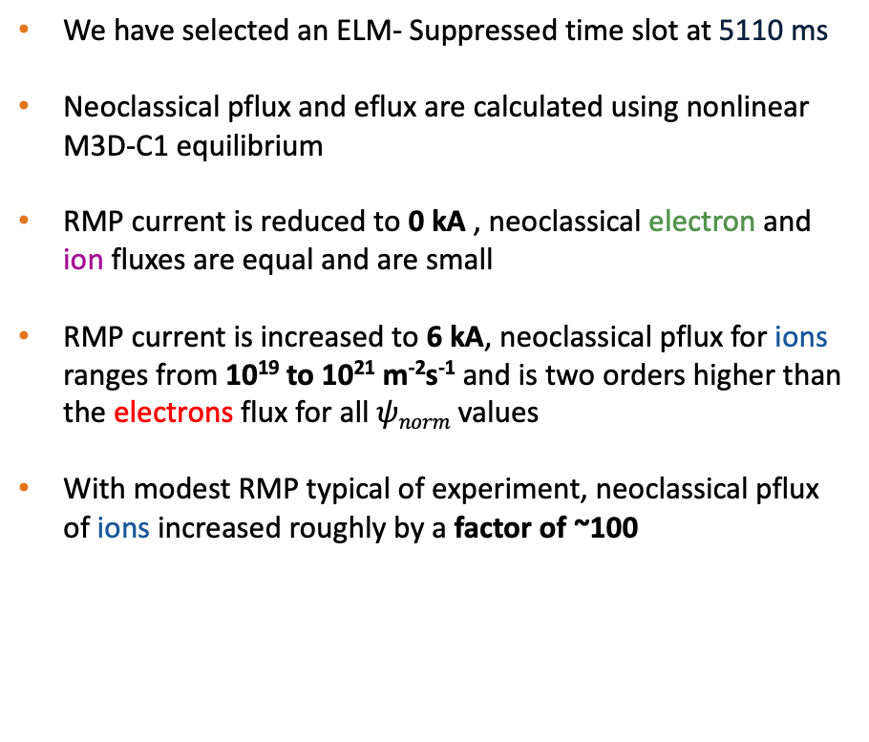
DIII-D shot #160921: Modest RMP strongly enhances neoclassical ion flux
We have selected an ELM- Suppressed time slot at 5110 ms
Neoclassical pflux and eflux are calculated using nonlinear M3D-C1 equilibrium
RMP current is reduced to 0 kA , neoclassical electron and ion fluxes are equal and are small
RMP current is increased to 6 kA, neoclassical pflux for ions ranges from 10¹⁹ to 10²¹ m⁻²s⁻¹ and is two orders higher than the electrons flux for all $ψnorm$ values
With modest RMP typical of experiment, neoclassical pflux of ions increased roughly by a factor of ~100

Slide 23
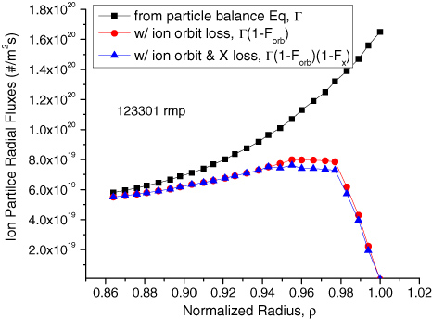
DIII-D shot #160921: Calculated neoclassical fluxes are comparable to experimentally inferred empirical radial fluxes
Inferring the particle flux from experiments can be challenging, especially in the edge, due to uncertainties in the particle sources
Previous estimates of the particle fluxes in comparable ELMing H-mode DIII-D discharges have found net radial particle fluxes comparable to the ion neoclassical fluxes that we obtain here
Convective and diffusive ion particle fluxes calculated from the ion particle balance equation, with and without correction for ion-orbit loss and X-loss [1]
[1] W.M. Stacey et al., Nuclear Fusion (2012)

Slide 24
DIII-D shot #160921: Calculated neoclassical fluxes are comparable to experimentally inferred empirical radial fluxes
Caveat :
We calculate the non-ambipolar neoclassical transport. In reality, the non-ambipolar transport will persist only for a short time until ambipolarity is restored through evolution of E_{r}
We can use the measured E_{r} profiles, which must represent the ambipolar solution in reality, and but we calculate the only neoclassical contribution to the transport (which may be non-ambipolar) with the given profiles
A full accounting of how external torques, turbulent transport, neoclassical transport, and ion loss balance to ensure ambipolarity is a worthy endeavor reserved for future work

Slide 25
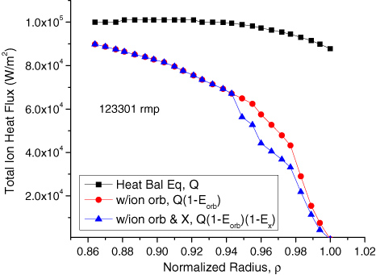
DIII-D shot #160921: Calculated neoclassical fluxes are comparable to experimentally inferred empirical radial fluxes
3D-energy flux for both ions and electrons rises significantly from their 2D-axisymmetric values
3D energy fluxes obtained here using NEO are close to experimentally inferred ion heat fluxes in RMP discharges in DIII-D plasmas
Total ion conductive and convective heat fluxes calculated from the ion heat balance equation, with and without correction for ion-orbit and X-loss [1]
[1] W.M. Stacey et al., Nuclear Fusion (2012)

Slide 26
DIII-D shot #160921: Nonlinear calculations important to model perturbed magnetic geometry in the pedestal region
Are nonlinear MHD calculations necessary?
Linear M3D-C1 calculations were performed with the same initial profiles and transport parameters similar to that used for nonlinear calculated using nonlinear M3D-C1 run
RMP = 0.01 kA
RMP = 6 kA
At low RMP values, the equilibrium obtained using linear and nonlinear M3D-C1 runs yield similar neoclassical ion particle flux results
As the RMP current is increased to experimental value i.e. 6 kA, the difference in neoclassical particle fluxes becomes larger

Slide 27
Results for n=2 DIII-D shot with a varying RMP spectrum

Slide 28
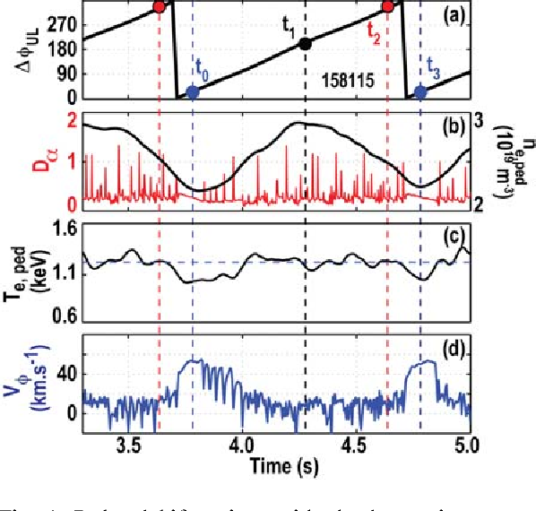

DIII-D shot #158115: Density pump-out correlated to I-coil phasing
H-mode discharge in which both sets of I-coils were used and operated at n = 2 with RMP current = 4kA
The relative phase of upper and lower I coil are modulated sinusoidally at a frequency of 1 Hz
Plasma response and the observation of ELM suppression were strongly correlated with the relative phasing of the coil rows, and is maximum at $∆ϕ$ =0
Pedestal bifurcations with slowly varying resonant fields. (a) Upper and lower row I-coil relative phase. (b) Dα light near the outer strike point (red) and pedestal density n_{e,ped} (black). (c) Pedestal electron temperature T_{e,ped}. (d) Edge impurity velocity in the co-IP direction [1]
[1] R.Nazikian et.al, Physical Review Letter (2015)

Slide 29
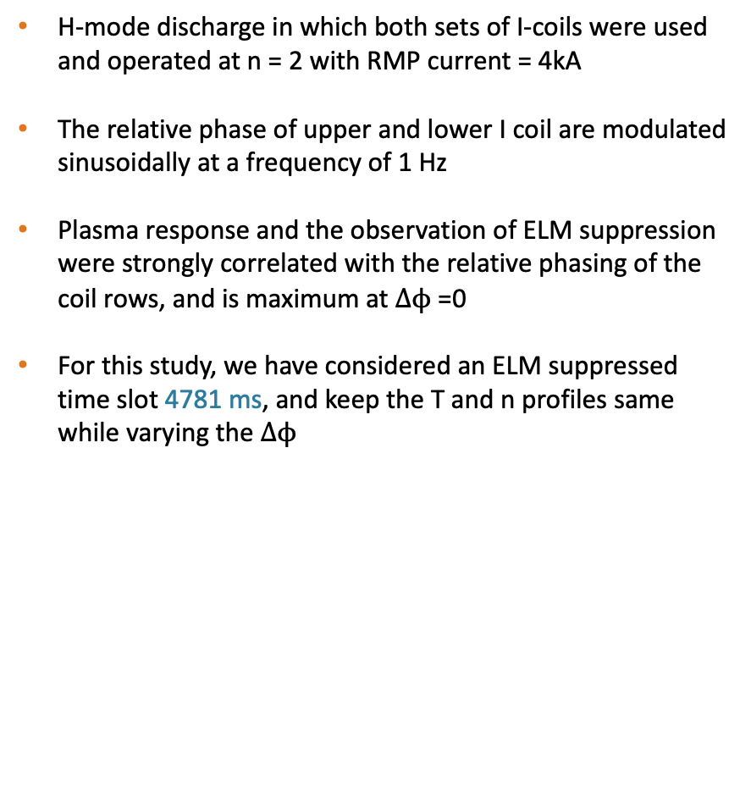
DIII-D shot #158115: Density pump-out correlated to I-coil phasing
H-mode discharge in which both sets of I-coils were used and operated at n = 2 with RMP current = 4kA
The relative phase of upper and lower I coil are modulated sinusoidally at a frequency of 1 Hz
Plasma response and the observation of ELM suppression were strongly correlated with the relative phasing of the coil rows, and is maximum at $∆ϕ$ =0
For this study, we have considered an ELM suppressed time slot 4781 ms, and keep the T and n profiles same while varying the $∆ϕ$
Pedestal bifurcations with slowly varying resonant fields. (a) Upper and lower row I-coil relative phase. (b) Dα light near the outer strike point (red) and pedestal density n_{e,ped} (black). (c) Pedestal electron temperature T_{e,ped}. (d) Edge impurity velocity in the co-IP direction [1]
[1] R.Nazikian et.al, Physical Review Letter (2015)

Slide 30
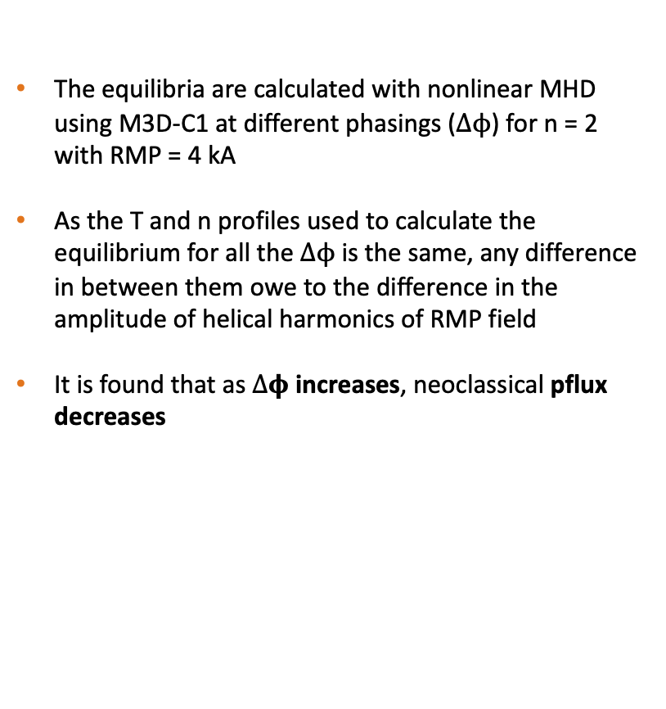
DIII-D shot #158115: Neoclassical particle flux correlated to I-coil phasing
The equilibria are calculated with nonlinear MHD using M3D-C1 at different phasings ($∆ϕ$) for n = 2 with RMP = 4 kA
As the T and n profiles used to calculate the equilibrium for all the $∆ϕ$ is the same, any difference in between them owe to the difference in the amplitude of helical harmonics of RMP field
It is found that as $∆φ$ increases, neoclassical pflux decreases

Slide 31

DIII-D shot #158115: Neoclassical particle flux correlated to total resonant field
Are neoclassical particle fluxes related to resonant field?
Amplitude of resonant helical harmonics is largest for $∆ϕ$= 0 and reduces as$∆ϕ$ increases

Slide 32
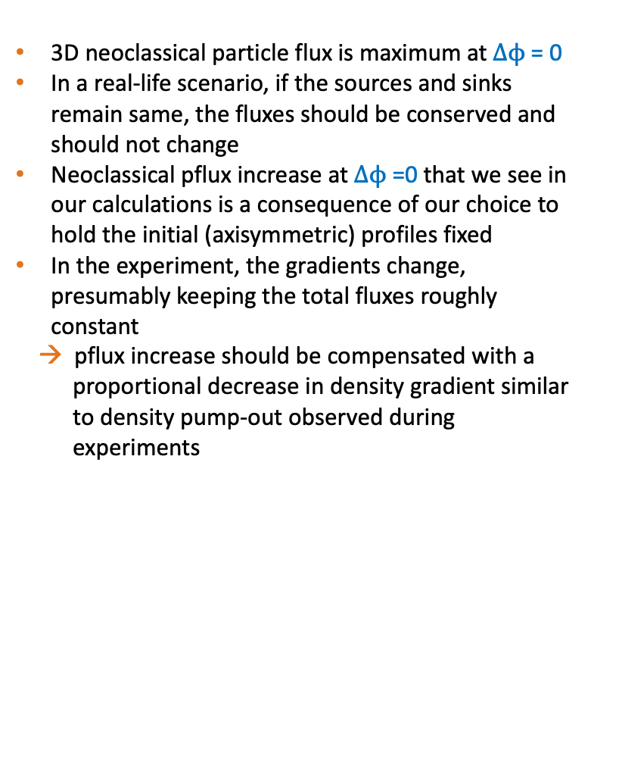
DIII-D shot #158115: Neoclassical fluxes obtained in the phase study confirms density pump-out
Can neoclassical particle fluxes we obtain explain density pump-out as seen in the experiment?
3D neoclassical particle flux is maximum at $∆ϕ$= 0
In a real-life scenario, if the sources and sinks remain same, the fluxes should be conserved and should not change
Neoclassical pflux increase at $∆ϕ$=0 that we see in our calculations is a consequence of our choice to hold the initial (axisymmetric) profiles fixed
In the experiment, the gradients change, presumably keeping the total fluxes roughly constant
→ pflux increase should be compensated with a
proportional decrease in density gradient similar
to density pump-out observed during
experiments

Slide 33
Conclusions

Slide 34
Conclusions
An efficient method has been developed in this work for calculating the neoclassical transport in realistic perturbed tokamak geometry
The neoclassical transport is found to be dramatically increased even modest RMPs
The neoclassical calculations reproduce the dominant features of the observed particle transport which strongly suggests that neoclassical transport is an important transport mechanism in the H-mode edge in the presence of RMPs
Our findings don't exclude the possibility of enhanced turbulent transport with RMPs, but rather emphasizes that the enhancement of neoclassical transport is important and can’t be neglected
The results indicate that at experimentally relevant RMP current values, the perturbation theory breaks down in pedestal and nonlinear MHD is needed to calculate accurate equilibrium

