Slide 1
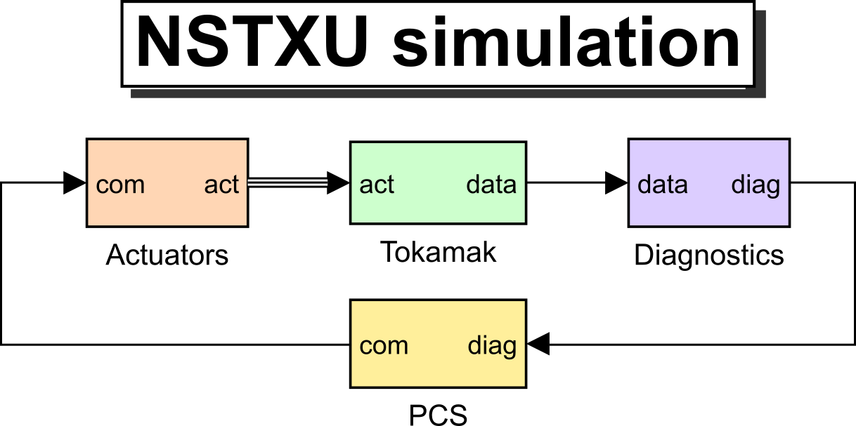

NSTX-U whole-device simserver simulation based on GSevolve for analysis and control development
A.S. Welander, A. Pajares, W.P. Wehner,
D.J. Battaglia, M.D. Boyer,
and K.E. Thome
San Diego, CA
May 2, 2022
GS-evolve

Slide 2
Overview of the GSevolve simserver simulation
GSevolve
      free-boundary simulation
      evolves Grad-Shafranov equilibrium including current and pressure profiles
      Simserver
Connects with Plasma Control System (PCS), so plasma controlled with same control software as experiment
      Purposes
Control algorithm and scenario dev
Examples: DIII-D negative triangularity scenarios [Marinoni PoP 2019]
DIII-D: Power supply chopper latching detected in poor scenario setups
Available on PPPL-portal
And GA-iris
GS-evolve

Slide 3
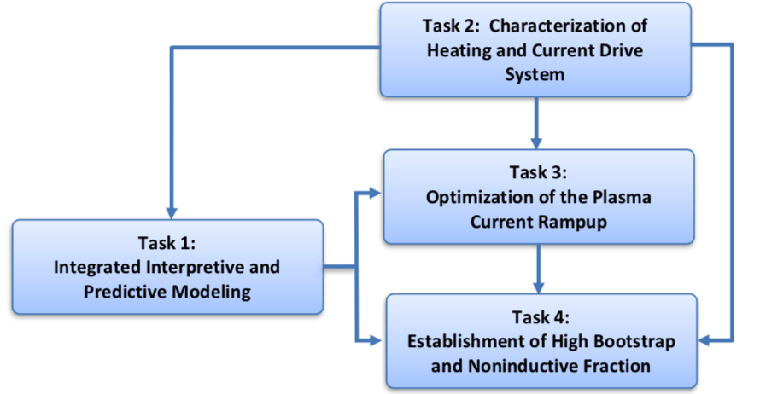
This work is associated with a GA-NSTX-U experimental collaboration project
Project:
Objective:
Broken into several interrelated tasks
These slides describe work related to task 3
“Predict-First Modeling and Experimental Demonstration of fully Noninductive Scenario in NSTX-U”
Contribute to Objective 2 in NSTX-U 5 Year Plan
“Develop operation at large bootstrap fraction and advance the physics basis required for non-inductive and low-disruptivity operation of steady-state compact fusion devices”

Slide 4
Progress to date on NSTX-U simulation development
  NSTX-U GSevolve functions updated to include current profile evolution
  Simulation models updated / calibrated for NSTX-U
  NSTX-U shots have been simulated successfully ​including reproducing growth rate of VDE shots
Introduced FITSIM for analysis of poorly controlled shots
Numerical optimal control tools in development for designing open-loop li trajectory through ramp-up

Slide 5
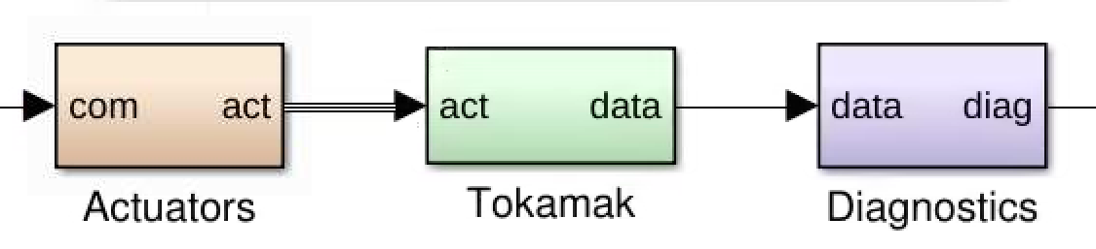
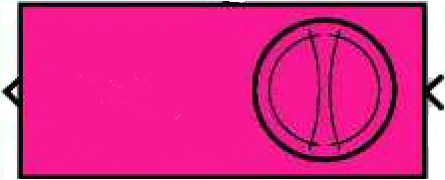
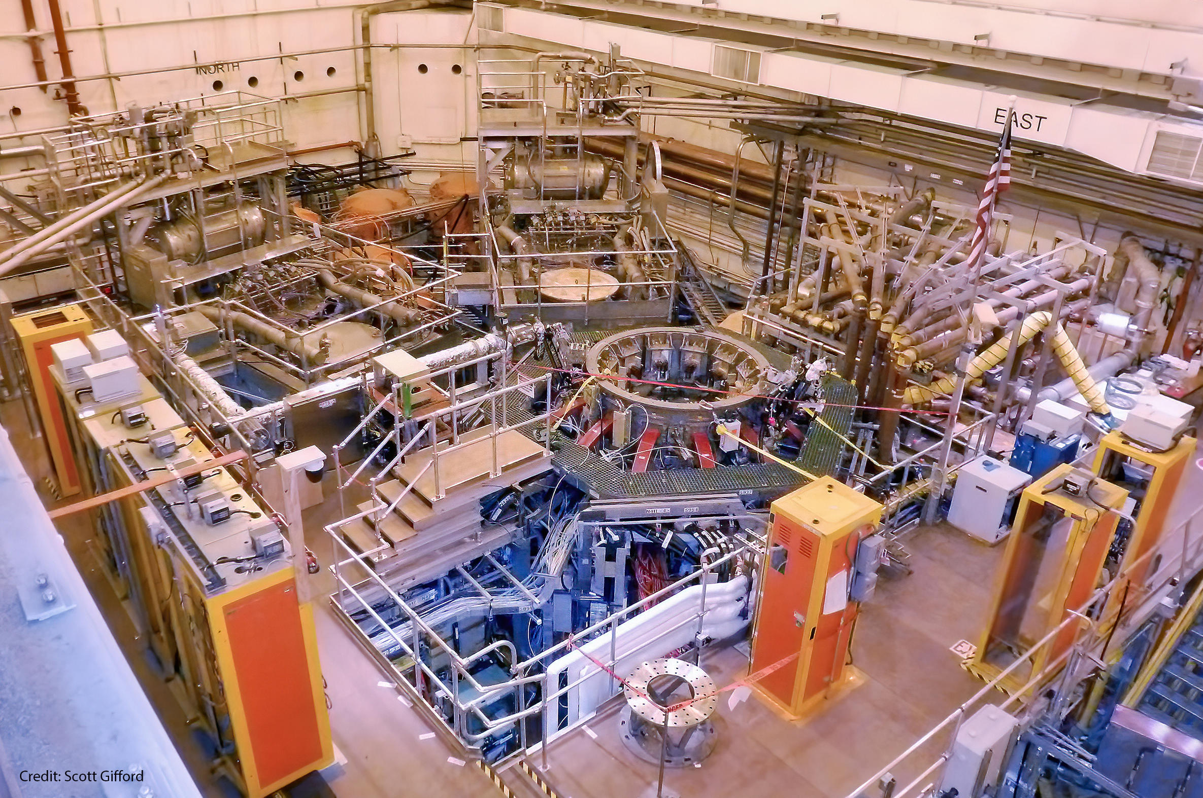
The NSTX-U simulation can be controlled by the actual Plasma Control System (PCS)
Simulation of all hardware between PCS output and input from before plasma begins until the end
  Actuators: models of power supplies, neutral beams, gas
  Tokamak: model of neutral density and breakdown, plasma pressure and current, and equilibrium evolution
  Diagnostics: measurements with noise and filtering
Simulation implemented in MATLAB Simulink within TokSys environment
Simulation NSTX-U
  NSTX-U
  Plasma Control
  System
Real NSTX-U

Slide 6
The NSTX-U simulation can be controlled by the actual Plasma Control System (PCS)
Simulation of all hardware between PCS output and input from before plasma begins until the end
  Actuators: models of power supplies, neutral beams, gas
  Tokamak: model of neutral density and breakdown, plasma pressure and current, and equilibrium evolution
  Diagnostics: measurements with noise and filtering
Simulation implemented in MATLAB Simulink within TokSys environment
Simulation NSTX-U
  NSTX-U
  Plasma Control
  System
Real NSTX-U

Slide 7
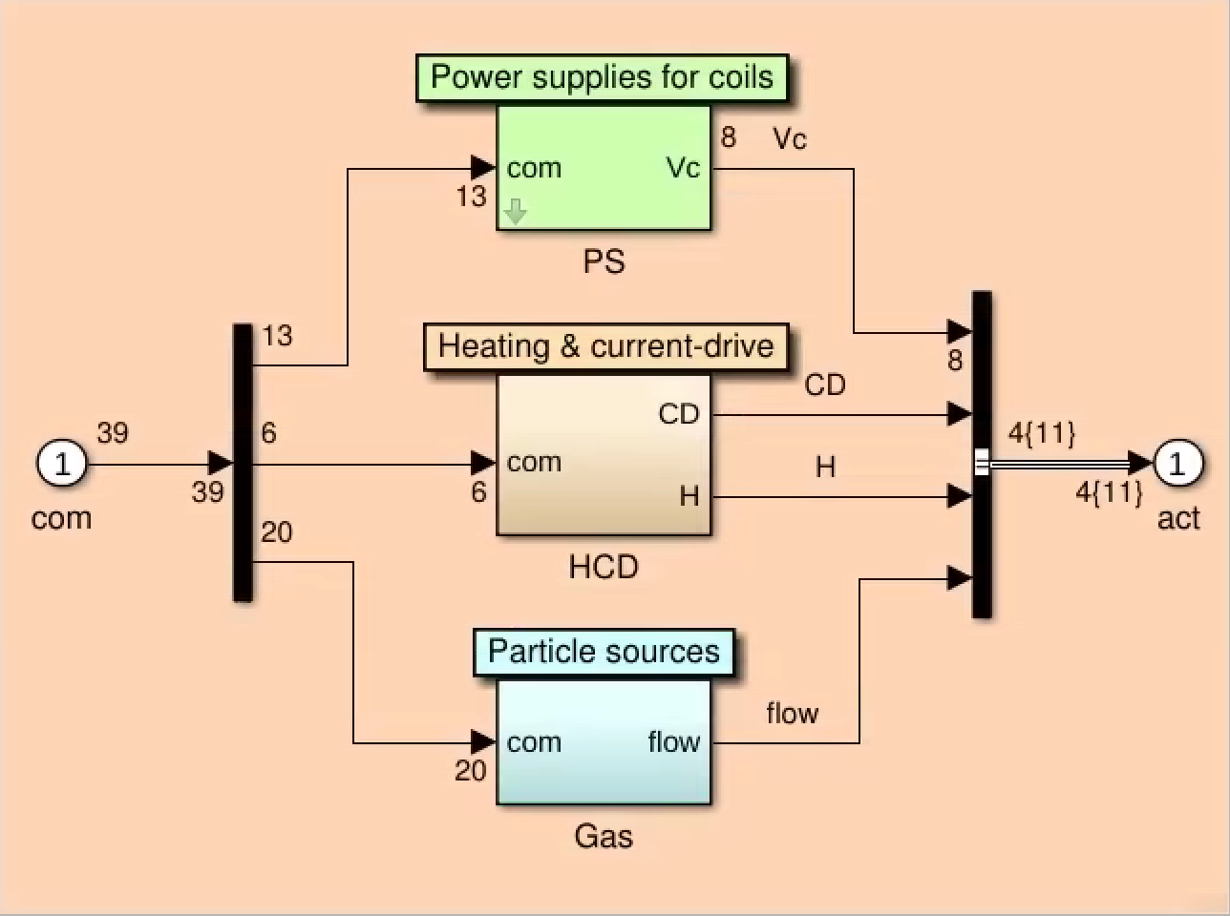
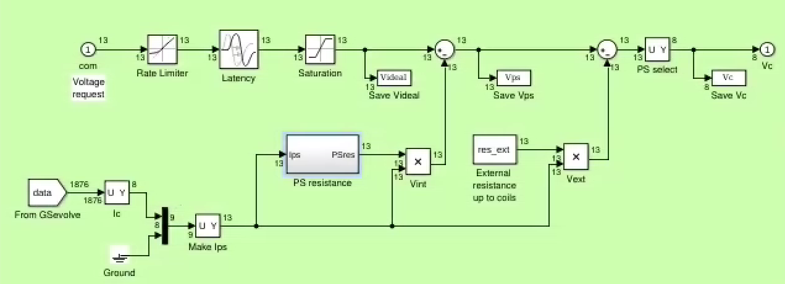
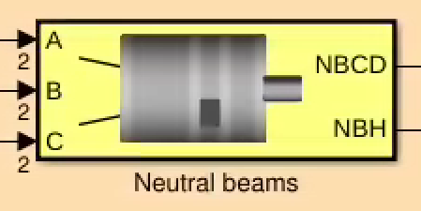
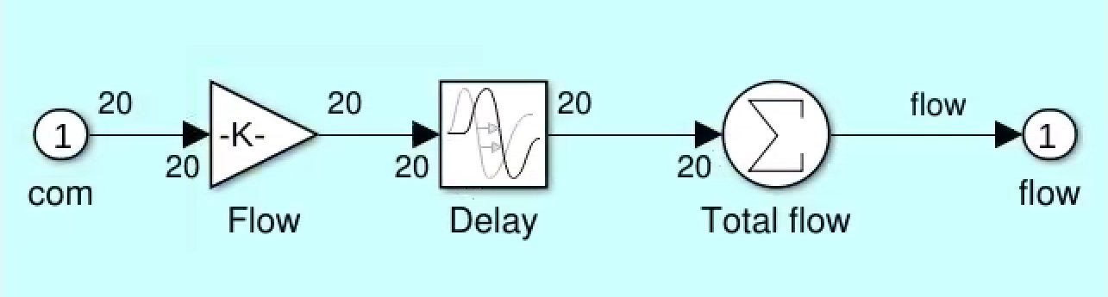
Subsystem Actuators simulates coil current power supplies (PS), neutral beam heating & current drive (HCD), and gas flow
Power Supplies
  bipolar or unipolar, latency, saturation, internal resistance
HCD
  Beams
  High harmonic fast wave (soon)
Gas

Slide 8
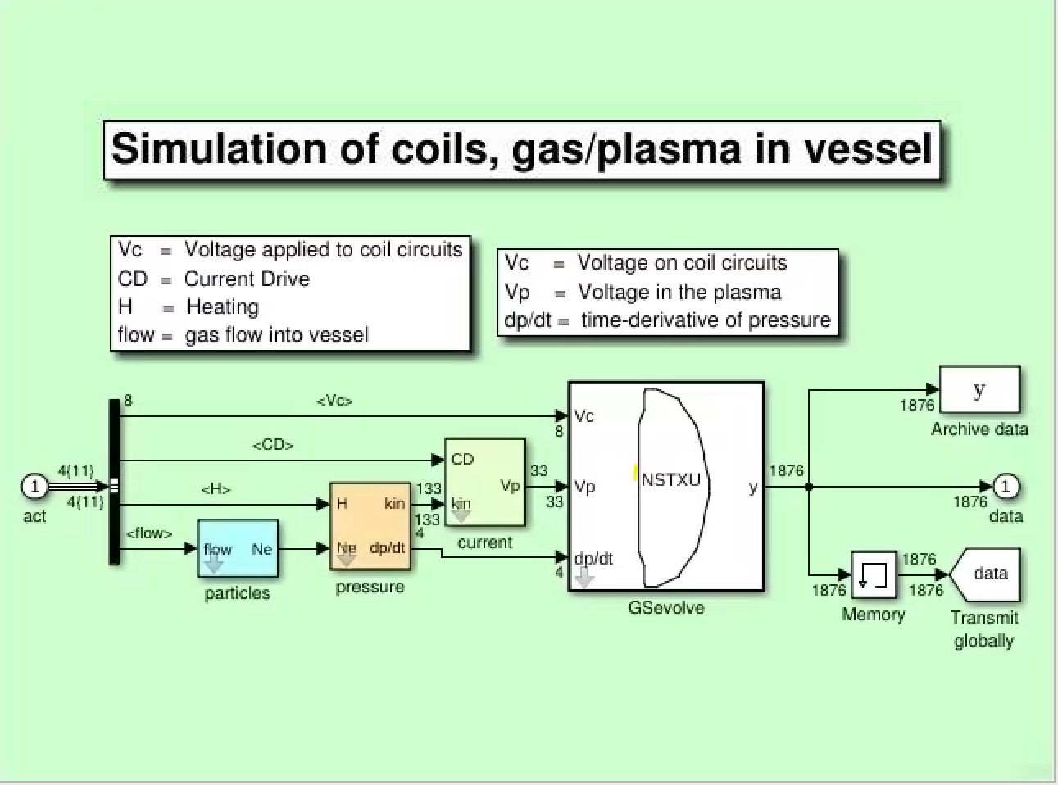
Subsystem Tokamak simulates particles, pressure, current; resulting voltage on coils, plasma, and dp/dt are input to GSevolve
Particles:
  evolution of neutrals, breakdown, charged particles
Pressure:
  dp/dt is function of heating and power losses
  H = heating by beams
Current:
  Loop voltage Vp = L1t*parallel resistivity*induced current density, L1t = distance along field lines
  CD = current driven by beams
  Bootstrap current is function of ne, Zeff, Te, Ti, equilibrium geometry
Equilibrium data transmitted back to all three subsystems

Slide 9
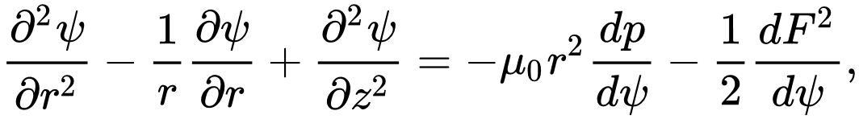
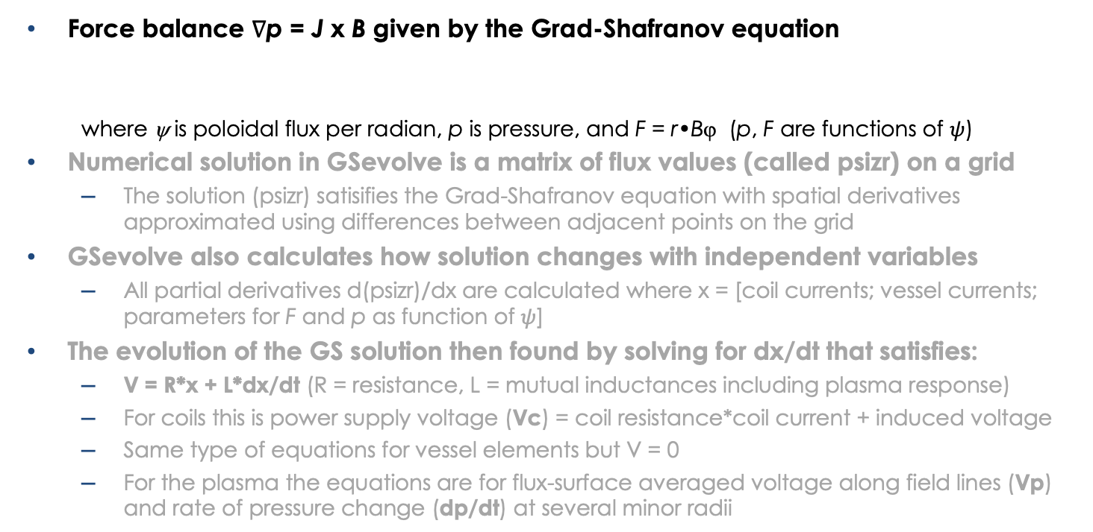
The GSevolve module evolves the Grad-Shafranov equation
(Fusion Engineering & Design, 2019 Vol 146, part B, pages 2361-2365)
Force balance ∇p = J x B given by the Grad-Shafranov equation
  where ψ is poloidal flux per radian, p is pressure, and F = r•Bϕ (p, F are functions of $ψ$)
Numerical solution in GSevolve is a matrix of flux values (called psizr) on a grid
  The solution (psizr) satisifies the Grad-Shafranov equation with spatial derivatives approximated using differences between adjacent points on the grid
GSevolve also calculates how solution changes with independent variables
  All partial derivatives d(psizr)/dx are calculated where x = [coil currents; vessel currents; parameters for F and p as function of $ψ$]
The evolution of the GS solution then found by solving for dx/dt that satisfies:
  V = R*x + L*dx/dt (R = resistance, L = mutual inductances including plasma response)
  For coils this is power supply voltage (Vc) = coil resistance*coil current + induced voltage
  Same type of equations for vessel elements but V = 0
  For the plasma the equations are for flux-surface averaged voltage along field lines (Vp)
  and rate of pressure change (dp/dt) at several minor radii

Slide 10
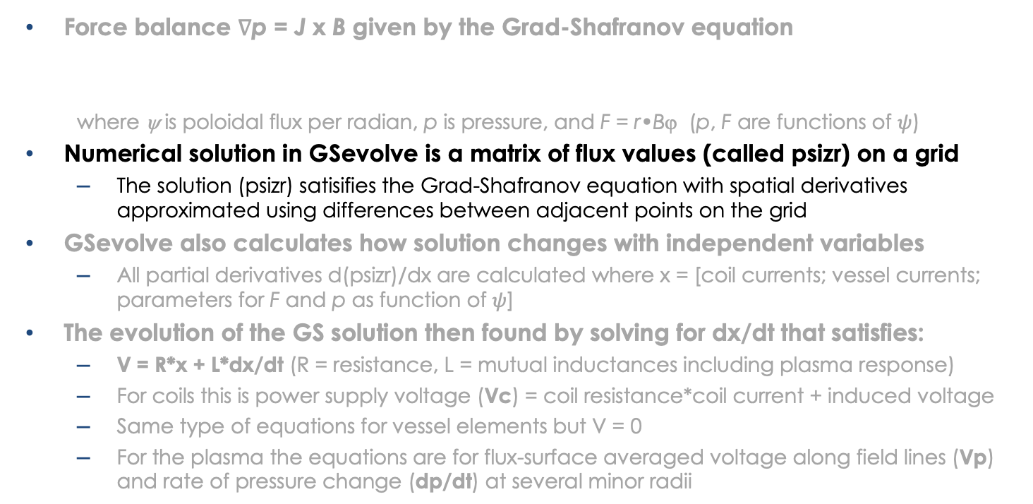
The GSevolve module evolves the Grad-Shafranov equation
(Fusion Engineering & Design, 2019 Vol 146, part B, pages 2361-2365)
Force balance ∇p = J x B given by the Grad-Shafranov equation
  where ψ is poloidal flux per radian, p is pressure, and F = r•Bϕ (p, F are functions of $ψ$)
Numerical solution in GSevolve is a matrix of flux values (called psizr) on a grid
  The solution (psizr) satisifies the Grad-Shafranov equation with spatial derivatives approximated using differences between adjacent points on the grid
GSevolve also calculates how solution changes with independent variables
  All partial derivatives d(psizr)/dx are calculated where x = [coil currents; vessel currents; parameters for F and p as function of $ψ$]
The evolution of the GS solution then found by solving for dx/dt that satisfies:
  V = R*x + L*dx/dt (R = resistance, L = mutual inductances including plasma response)
  For coils this is power supply voltage (Vc) = coil resistance*coil current + induced voltage
  Same type of equations for vessel elements but V = 0
  For the plasma the equations are for flux-surface averaged voltage along field lines (Vp)
  and rate of pressure change (dp/dt) at several minor radii

Slide 11
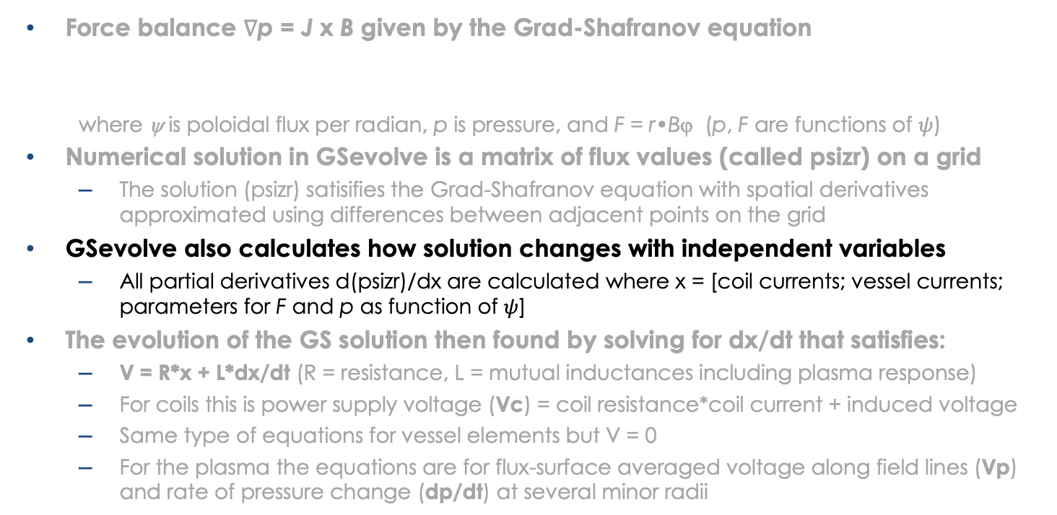
The GSevolve module evolves the Grad-Shafranov equation
(Fusion Engineering & Design, 2019 Vol 146, part B, pages 2361-2365)
Force balance ∇p = J x B given by the Grad-Shafranov equation
  where ψ is poloidal flux per radian, p is pressure, and F = r•Bϕ (p, F are functions of $ψ$)
Numerical solution in GSevolve is a matrix of flux values (called psizr) on a grid
  The solution (psizr) satisifies the Grad-Shafranov equation with spatial derivatives approximated using differences between adjacent points on the grid
GSevolve also calculates how solution changes with independent variables
  All partial derivatives d(psizr)/dx are calculated where x = [coil currents; vessel currents; parameters for F and p as function of $ψ$]
The evolution of the GS solution then found by solving for dx/dt that satisfies:
  V = R*x + L*dx/dt (R = resistance, L = mutual inductances including plasma response)
  For coils this is power supply voltage (Vc) = coil resistance*coil current + induced voltage
  Same type of equations for vessel elements but V = 0
  For the plasma the equations are for flux-surface averaged voltage along field lines (Vp)
  and rate of pressure change (dp/dt) at several minor radii

Slide 12
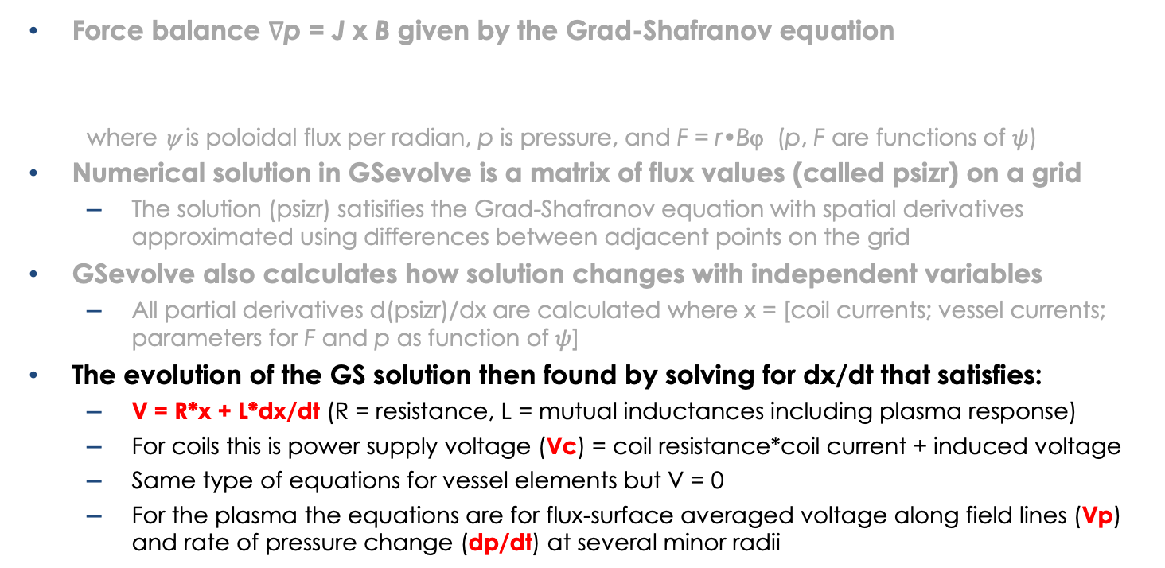
The GSevolve module evolves the Grad-Shafranov equation
(Fusion Engineering & Design, 2019 Vol 146, part B, pages 2361-2365)
Force balance ∇p = J x B given by the Grad-Shafranov equation
  where ψ is poloidal flux per radian, p is pressure, and F = r•Bϕ (p, F are functions of $ψ$)
Numerical solution in GSevolve is a matrix of flux values (called psizr) on a grid
  The solution (psizr) satisifies the Grad-Shafranov equation with spatial derivatives approximated using differences between adjacent points on the grid
GSevolve also calculates how solution changes with independent variables
  All partial derivatives d(psizr)/dx are calculated where x = [coil currents; vessel currents; parameters for F and p as function of $ψ$]
The evolution of the GS solution then found by solving for dx/dt that satisfies:
  V = R*x + L*dx/dt (R = resistance, L = mutual inductances including plasma response)
  For coils this is power supply voltage (Vc) = coil resistance*coil current + induced voltage
  Same type of equations for vessel elements but V = 0
  For the plasma the equations are for flux-surface averaged voltage along field lines (Vp)
  and rate of pressure change (dp/dt) at several minor radii

Slide 13
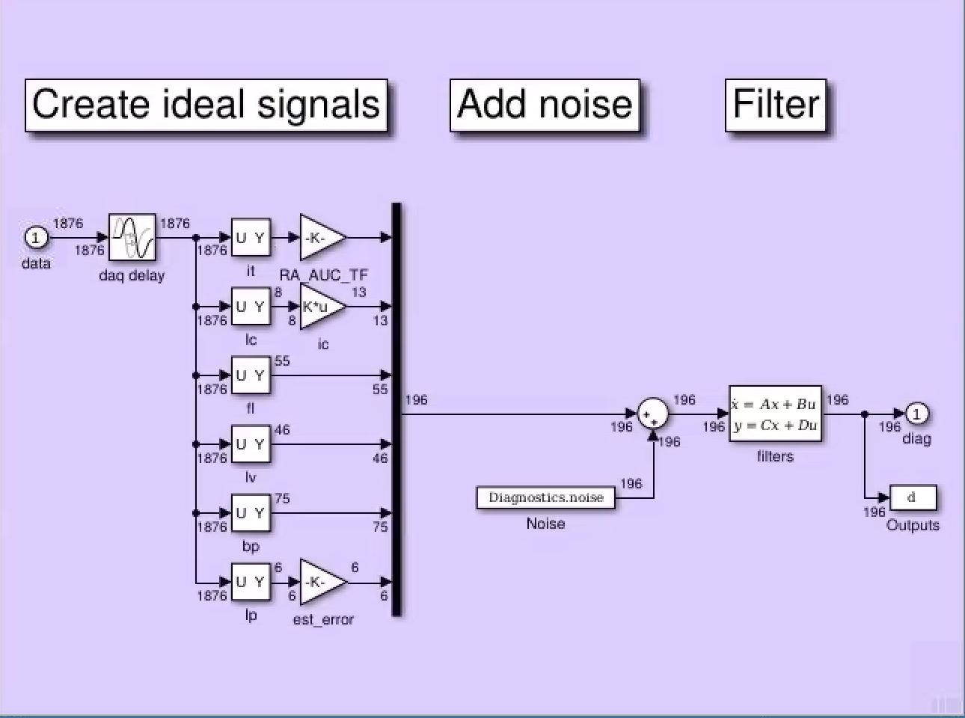
Subsystem Diagnostics simulates measured signals
GSevolve configured to produce all that is measured with flux loops and B probes (e.g. difference between two loops)
  signals that correspond to point names are simply selected in the GSevolve output vector
    it = toroidal field coil current
    ic = OH, PF coil currents
    fl = flux loops
    lv = voltage loops
    bp = B probes
    Ip = Ip estimator
Noise and drift added
Filtering before digitizing

Slide 14
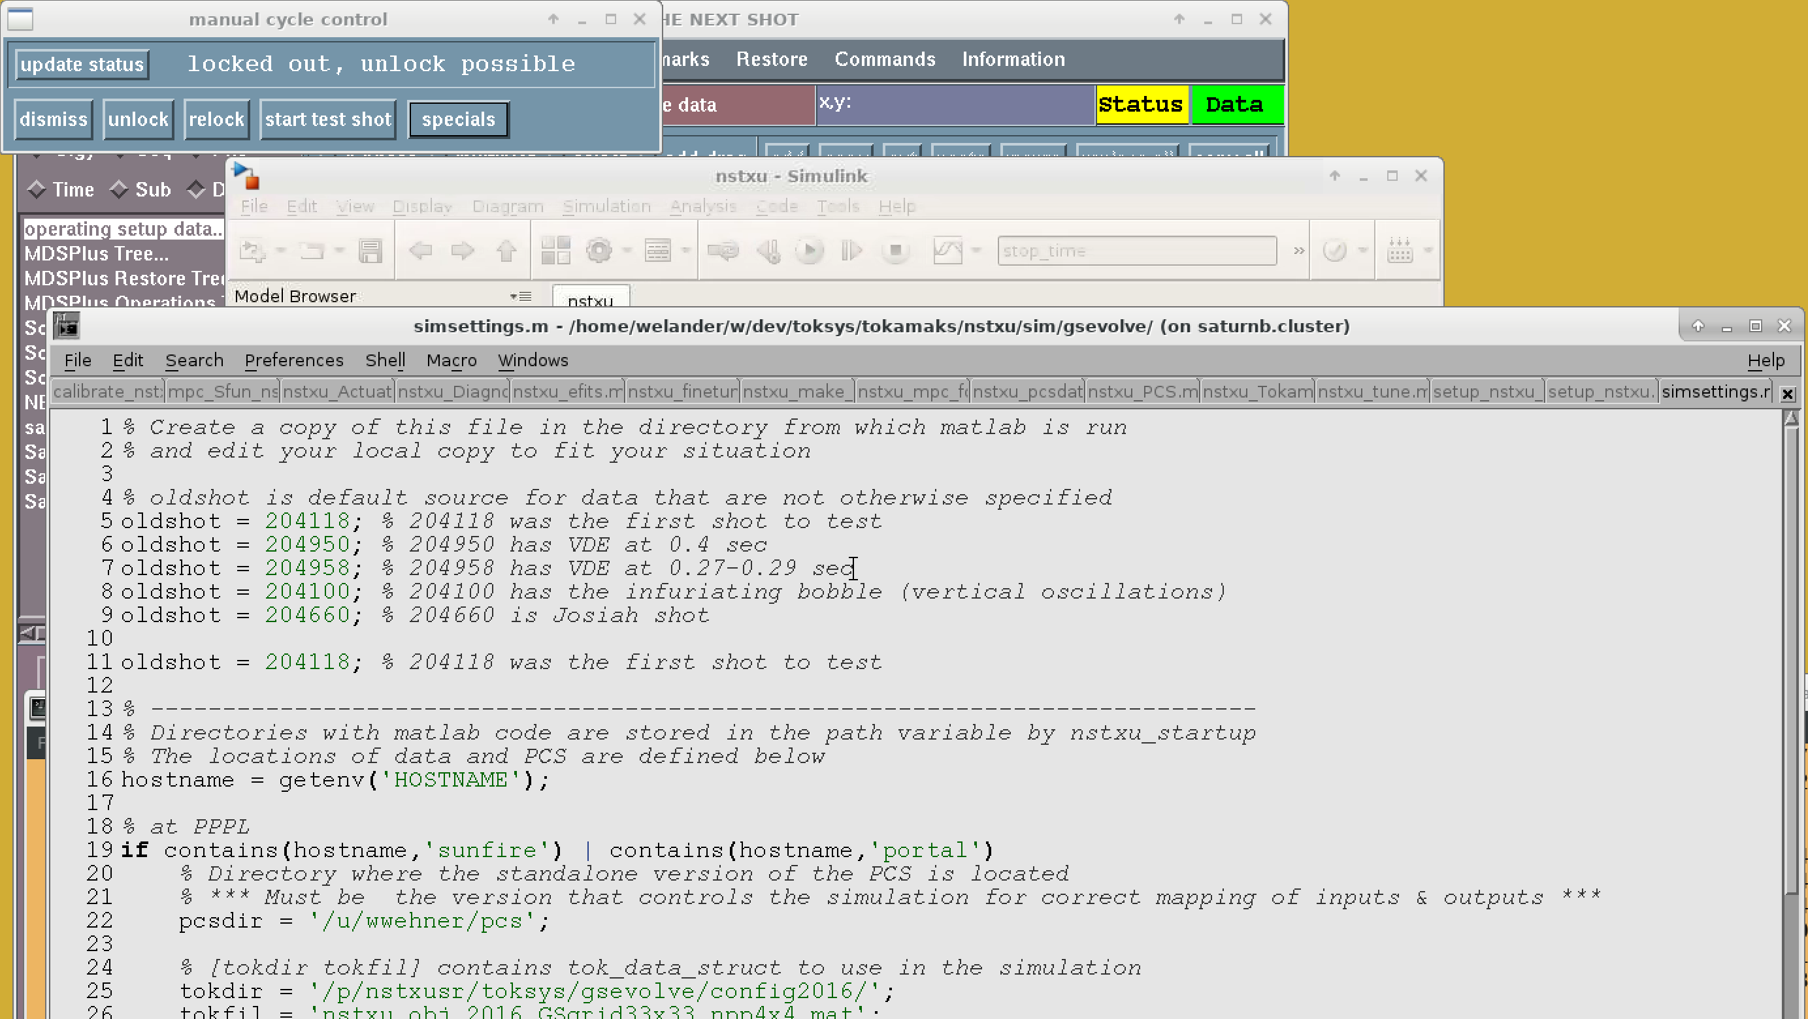
Running a simulation can be as easy as tell it an old shot number, restore PCS settings for that shot, and press "start test shot"
Available on
PPPL: portal (soon)
GA: iris

Slide 15
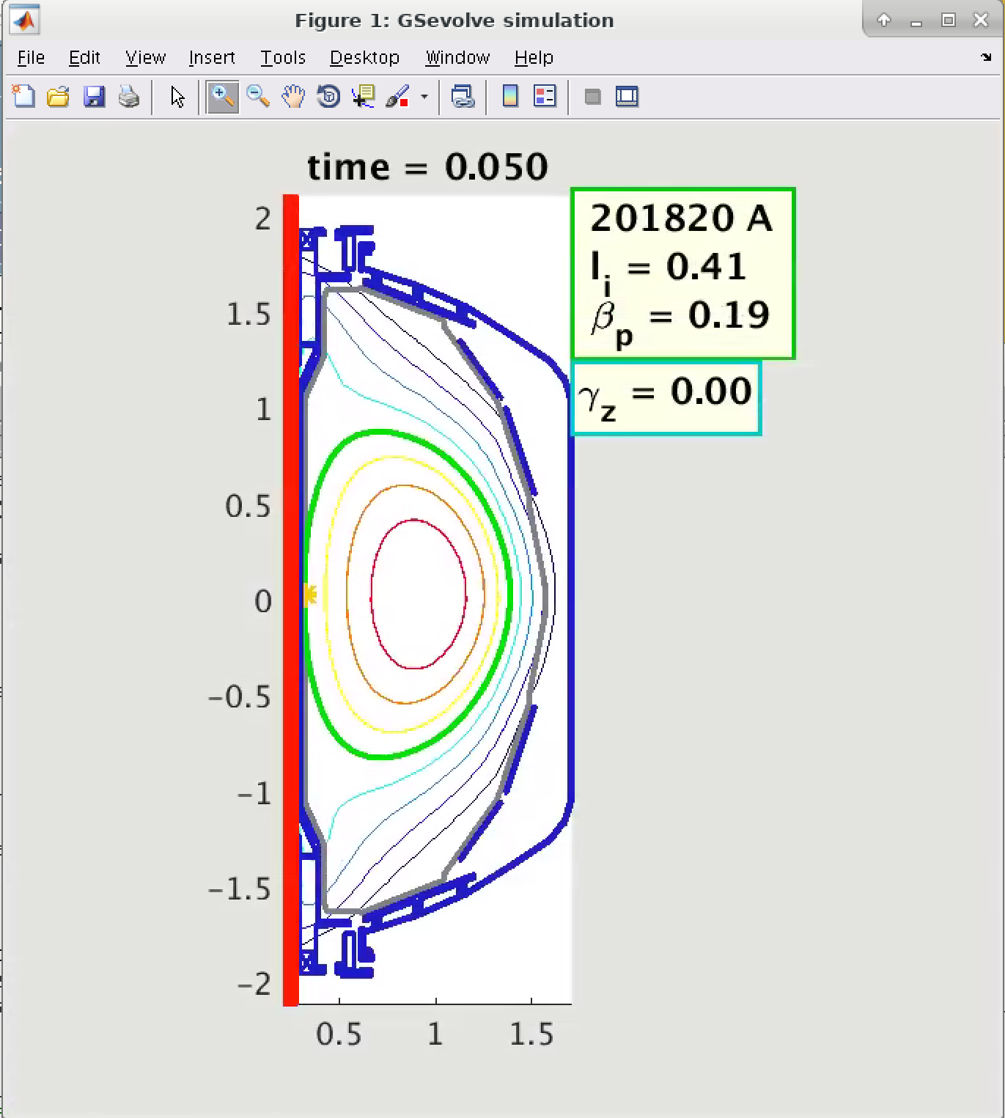
Running a simulation can be as easy as tell it an old shot number, restore PCS settings for that shot, and press "start test shot"
And watch it in real time

Slide 16

Running a simulation can be as easy as tell it an old shot number, restore PCS settings for that shot, and press "start test shot"
And watch it in real time

Slide 17
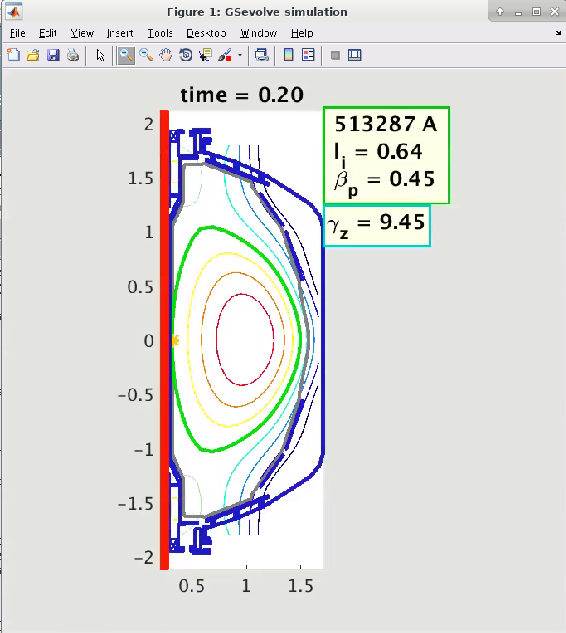
Running a simulation can be as easy as tell it an old shot number, restore PCS settings for that shot, and press "start test shot"
And watch it in real time

Slide 18
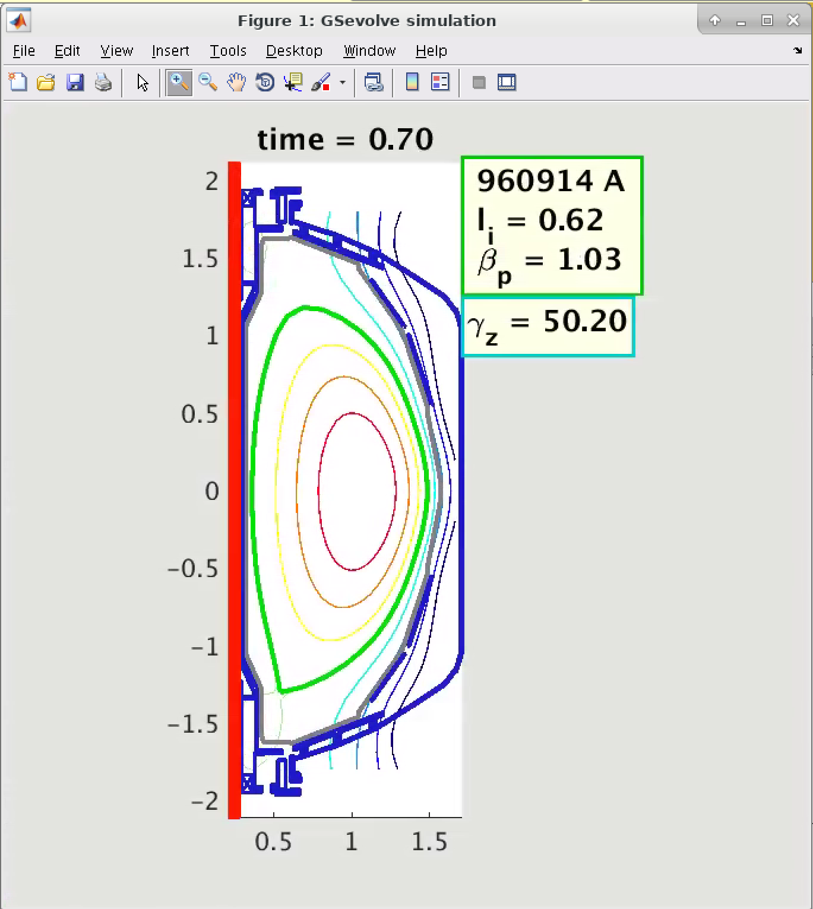
Running a simulation can be as easy as tell it an old shot number, restore PCS settings for that shot, and press "start test shot"
And watch it in real time

Slide 19
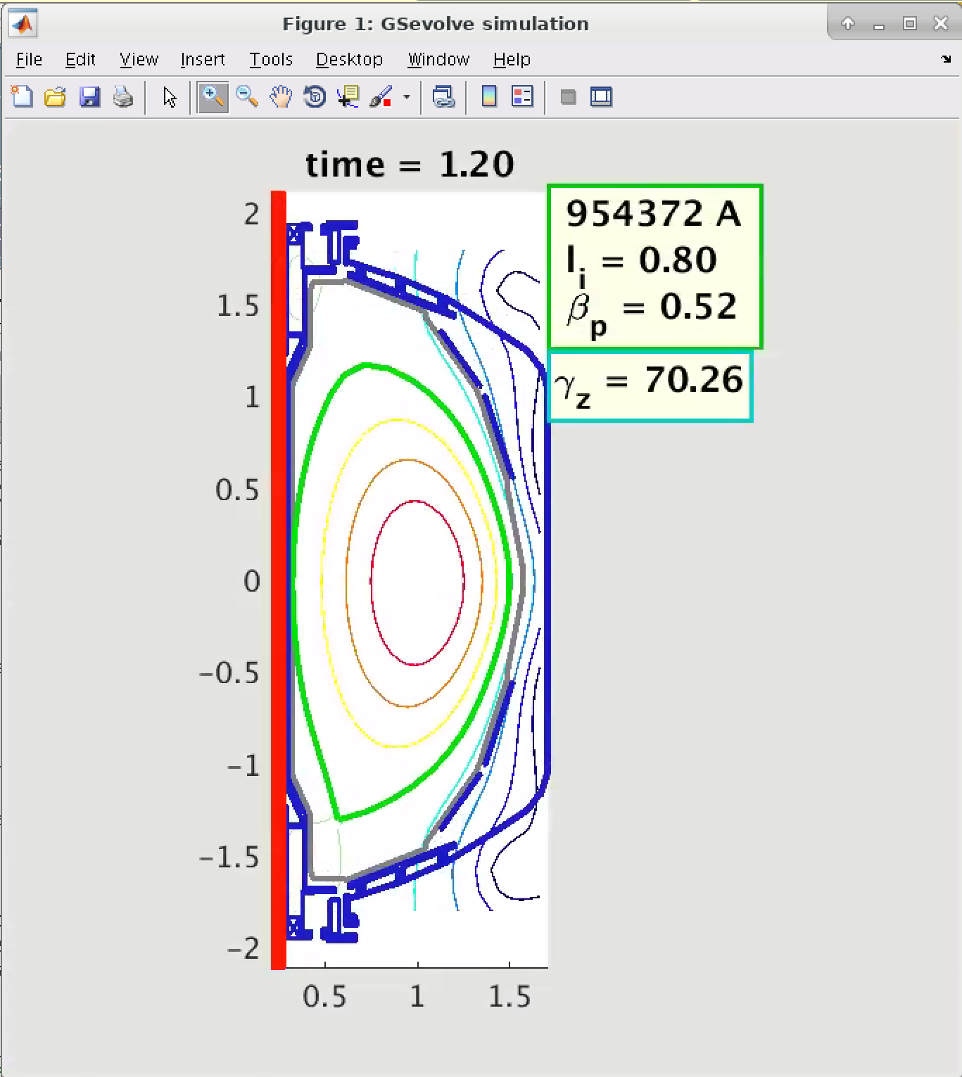
Running a simulation can be as easy as tell it an old shot number, restore PCS settings for that shot, and press "start test shot"
And watch it in real time

Slide 20
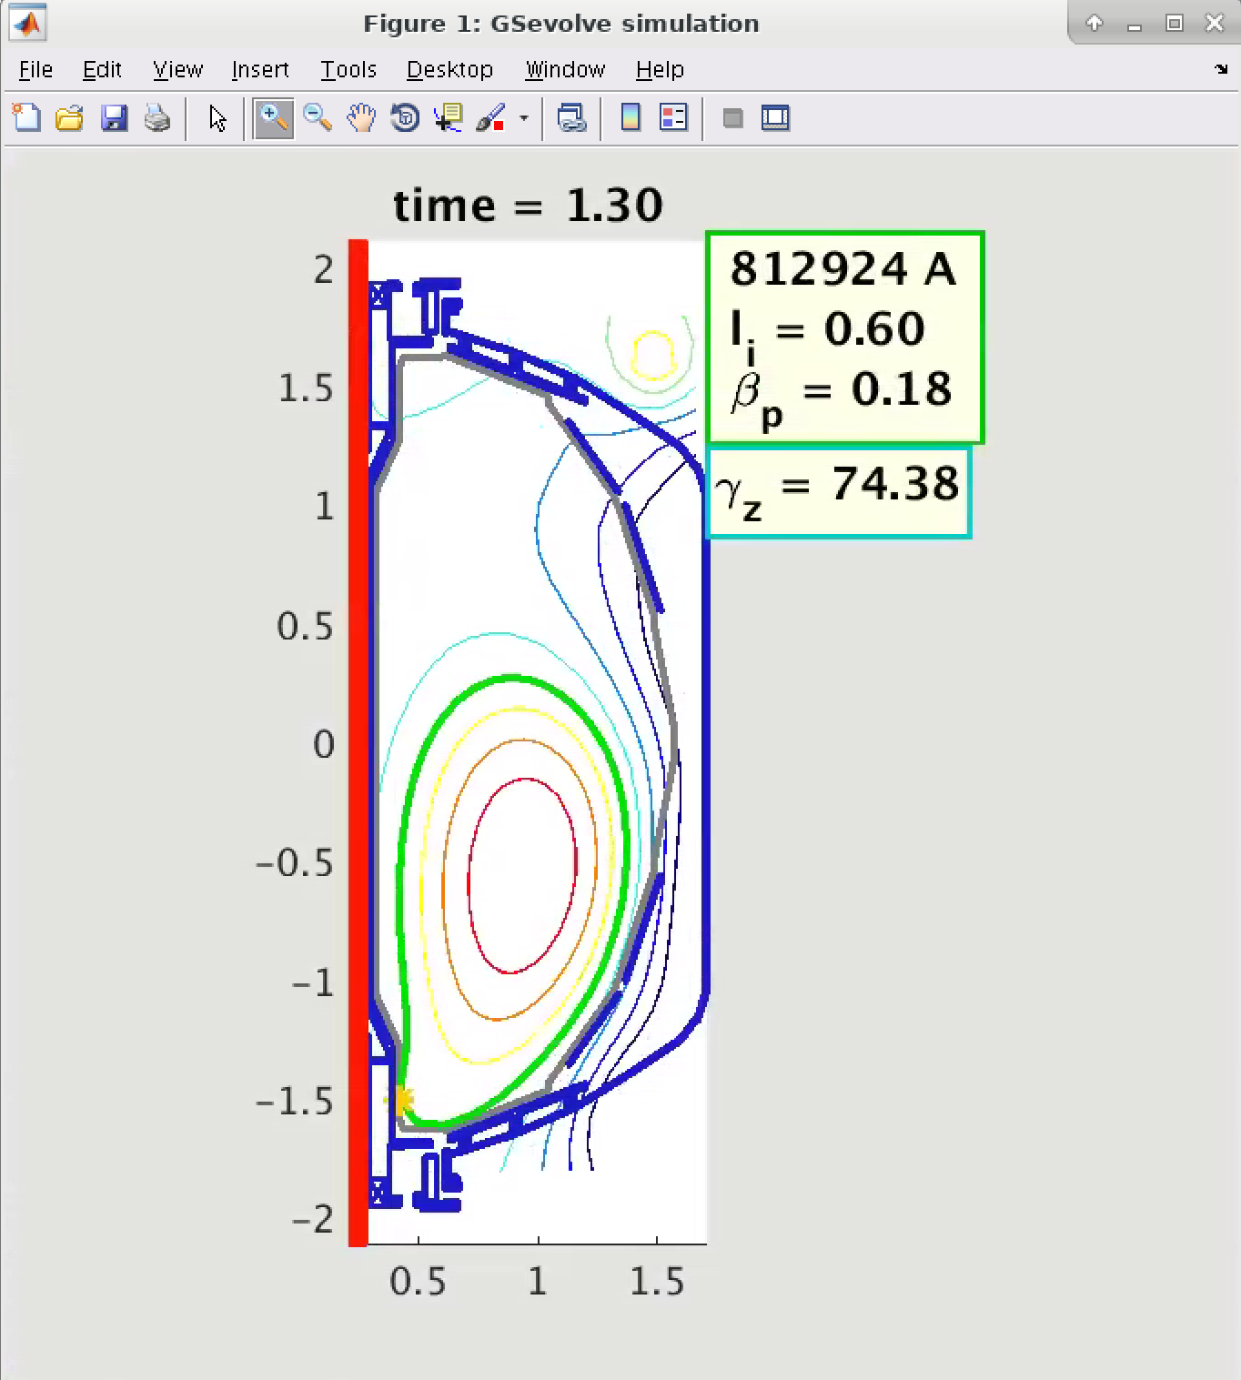
Running a simulation can be as easy as tell it an old shot number, restore PCS settings for that shot, and press "start test shot"
And watch it in real time
Demo on how to run simulations on May 5th

Slide 21
Shot 204118 reproduced in simulation from start to end
Shot 204118 reproduced from breakdown though termination
Simulation reproduces the real shot l_{i} value
Simulated current profile combines noninductively driven current and inductive current evolving by Ohm’s law
Simulated boundary follows EFIT analysis of real shot
Simulated coil currents commanded by PCS control match real shot
Ohmic coil matching indicates correct bulk plasma resistance
H-mode
High NI fraction

Slide 22
Shot 204118 reproduced in simulation from start to end
Shot 204118 reproduced from breakdown though termination
Simulation reproduces the real shot l_{i} value
Simulated current profile combines noninductively driven current and inductive current evolving by Ohm’s law
Simulated boundary follows EFIT analysis of real shot
Simulated coil currents commanded by PCS control match real shot
Ohmic coil matching indicates correct bulk plasma resistance
Low resolution profile approximated by splines
This year extend the spatial resolution of the profile evolution

Slide 23
Shot 204118 reproduced in simulation from start to end
Shot 204118 reproduced from breakdown though termination
Simulation reproduces the real shot l_{i} value
Simulated current profile combines noninductively driven current and inductive current evolving by Ohm’s law
Simulated boundary follows EFIT analysis of real shot
Simulated coil currents commanded by PCS control match real shot
Ohmic coil matching indicates correct bulk plasma resistance
Breakdown / Rampup
Flattop
Termination

Slide 24
Shot 204118 reproduced in simulation from start to end
Shot 204118 reproduced from breakdown though termination
Simulation reproduces the real shot l_{i} value
Simulated current profile combines noninductively driven current and inductive current evolving by Ohm’s law
Simulated boundary follows EFIT analysis of real shot
Simulated coil currents commanded by PCS control match real shot
Ohmic coil matching indicates correct bulk plasma resistance
Other shots have also been simulated

Slide 25
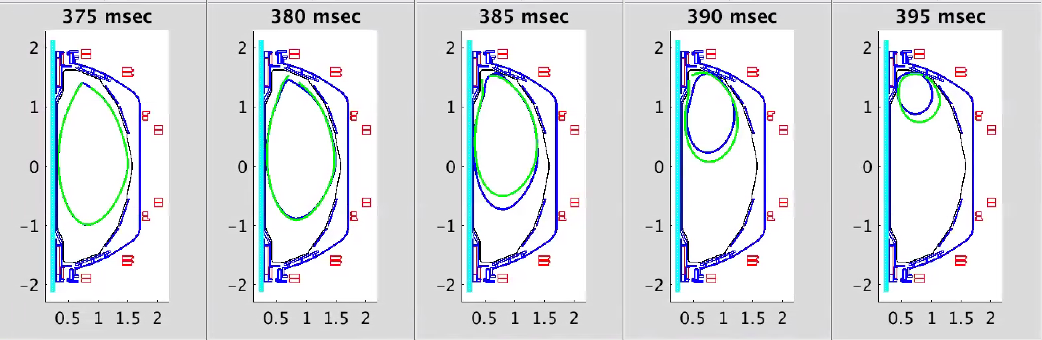
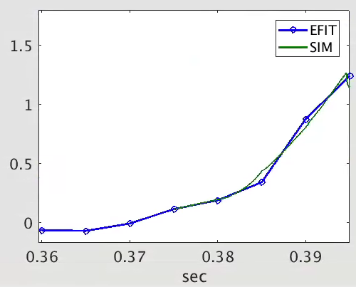
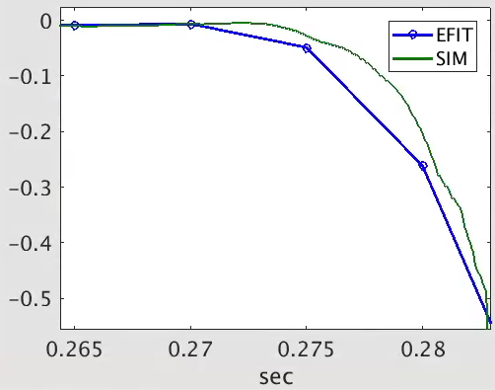
Shot 204950 ends with Vertical Displacement Event (VDE), reproduced in simulation
Two VDE shots have been simulated
Blue is EFIT
Green is simulation
Zcur vs time for 204950
Zcur vs time for another shot (204958)

Slide 26
Poorly controlled experimental shots not always reproduced in simulations
If shot is poorly controlled experimentally and touch point repeatedly changes between inner and outer limiter, there is a risk for mismatch due to high sensitivity to initial conditions
FITSIM is a simulation mode that can assist in analysis of poorly controlled shots
FITSIM replaces the regular NSTX-U PCS with an all-knowing powerful controller that makes the simulation reproduce the experiment. The result can provide insight into the cause of the instability
All-knowing means it uses all state info from GSevolve
Powerful means it can control li, betap, plasma flux, and even the toroidal gap resistance in passive plates

Slide 27
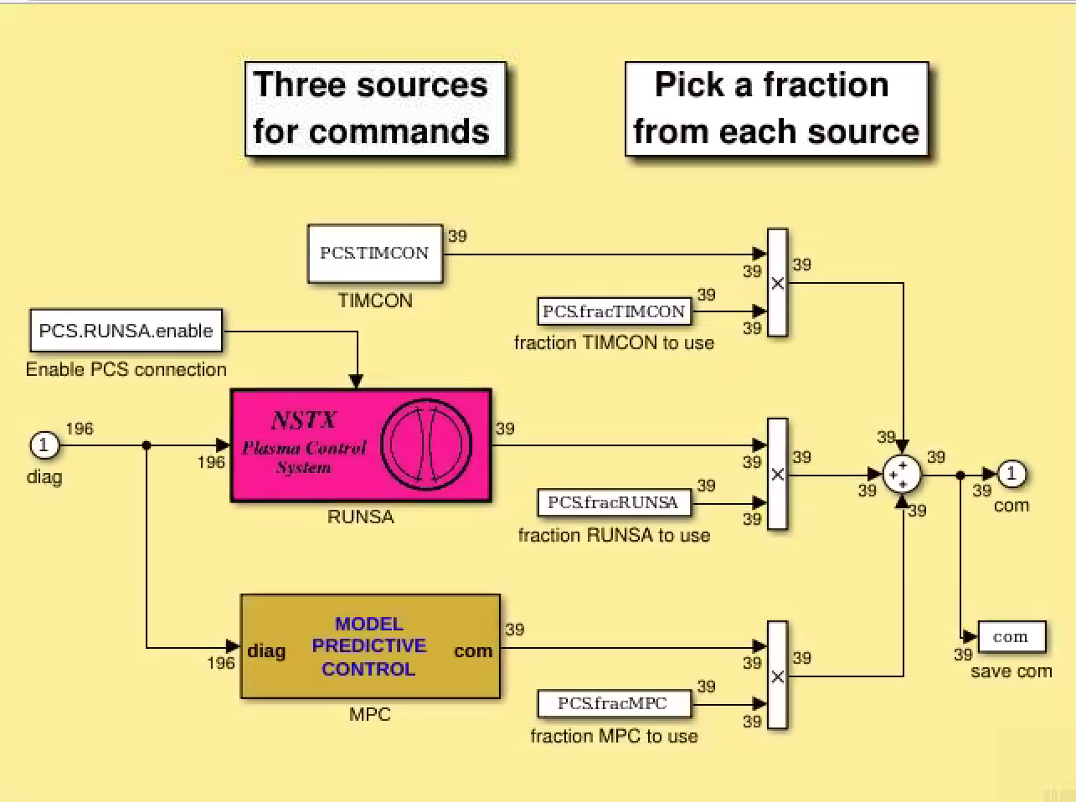
The PCS subsystem contains three options for control
TIMCON:
  Feedforward commands only
RUNSA:
  Connects to actual NSTX-U PCS
MPC:
  Model-predictive controller has complete knowledge about plasma response and calculates best control solution per cost function
  One use is "FITSIM-simulation" with control of all of Vc, Vp, dp/dt, (and resistance in toroidal gaps of passive stabilizers) to make diagnostics match old shot

Slide 28
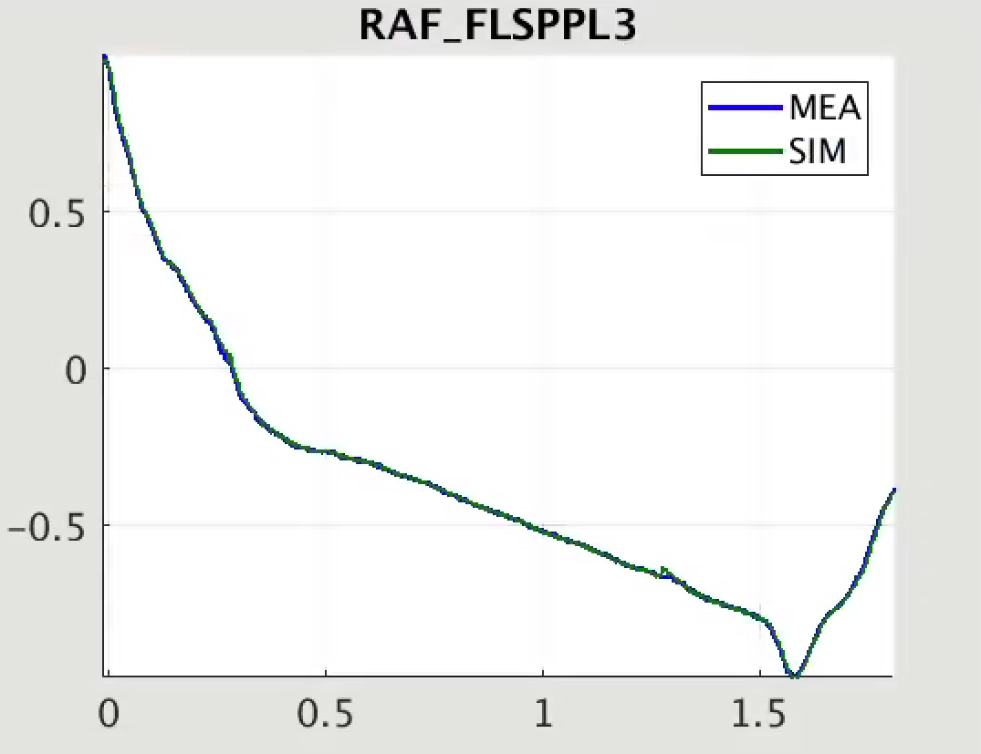
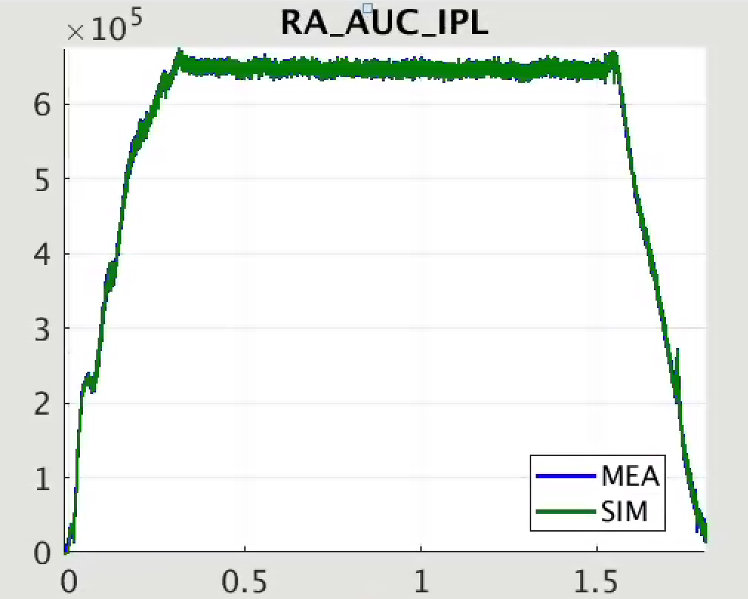
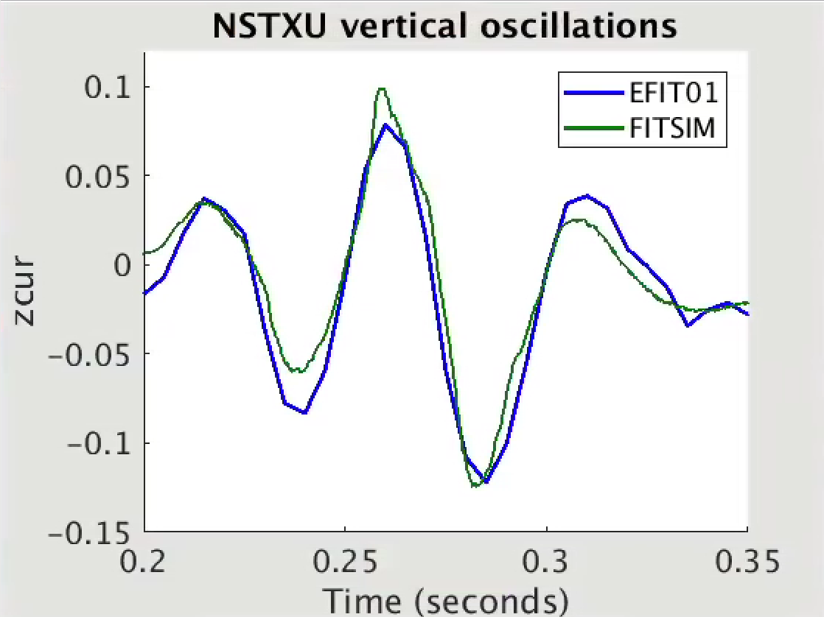
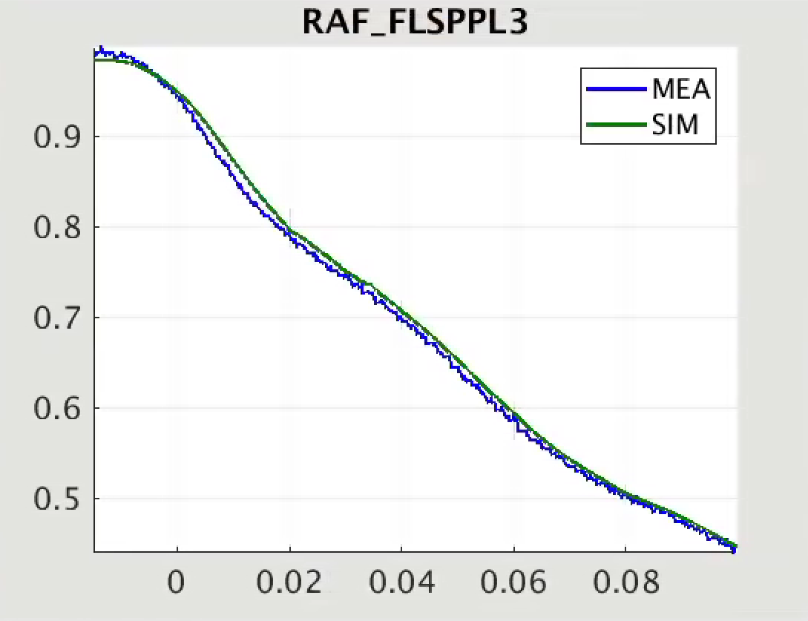
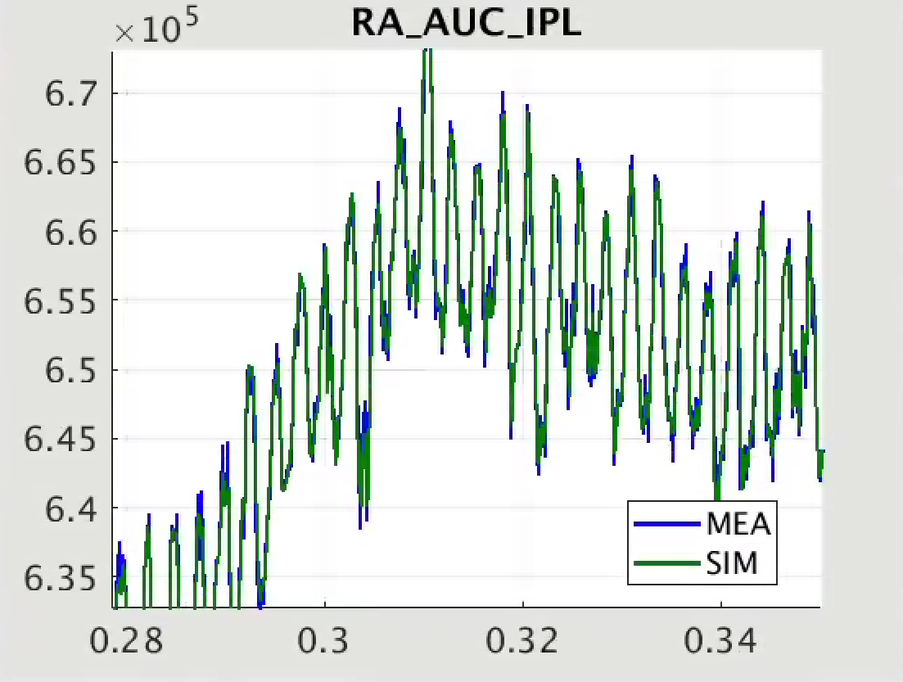
FITSIM matches all diagnostics well from start to end
Useful for analysis and fine-tuning of models
Example showing "bobble shot" 204100 with vertical oscillations
Measured and simulated signals for a flux loop
Ip estimator and simulated Ip
EFIT01 and FITSIM
Zoomed
Zoomed

Slide 29
Future and current work GOAL: Employ GSevolve & numerical optimal control for robust scenario development
Current shot development relies largely on manual timing of events, i.e. L-H timing, limited to diverted timing. GSevolve & numerical optimal control can aid shot development before experiment
Specific Control Topics to be addressed with GSevolve + Numerical optimal control tool
                Vertical stability issues and associated dithering between USN & LSN
                Reach diverted equilibrium faster (before H-mode) for better VDE avoidance
                Robust ramp-up control, i.e. achieve target plasma scenario (high-kappa, low-li, high NI-fraction) with robustness to beam
                dropouts, varying wall conditions, deviations from desired li, kappa trajectory

Slide 30
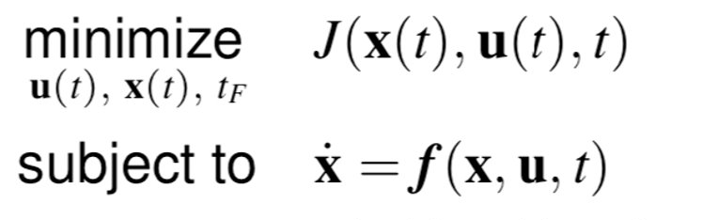
Numerical optimal control informed by the GSevolve model can be used for generalized feedforward control design
1.
Run a GSevolve simulation
Extract from GSevolve simulation the time-dependent plasma dynamics
Construct optimal control problem, solve for control law to meet goals
Re-run the simulation with updated control inputs
Repeat steps 2-4 until convergence
2.
3.
Numerical optimal
Control
extract
Dynamics
From GSevolve
simulation

Slide 31
Summary: GSevolve simulation tool will enable robust NSTX-U rampup control
GSevolve simserver enables a whole device simulation of NSTX-U appropriate for shape control and ramp-up control
GSevolve-based simulation has been updated from NSTX to NSTX-U parameters and updated for current version of the PCS
The model has been used to design feedforward shape control
Work will continue with further control development for robust ramp-up to mean scenario design goals of low li, high kappa, high NI fraction
Demo on how to run GSevolve simulations on May 5th at 2pm ET/11 am PT during Scenario and Control SWG

Slide 32
END
Extra slides

Slide 33
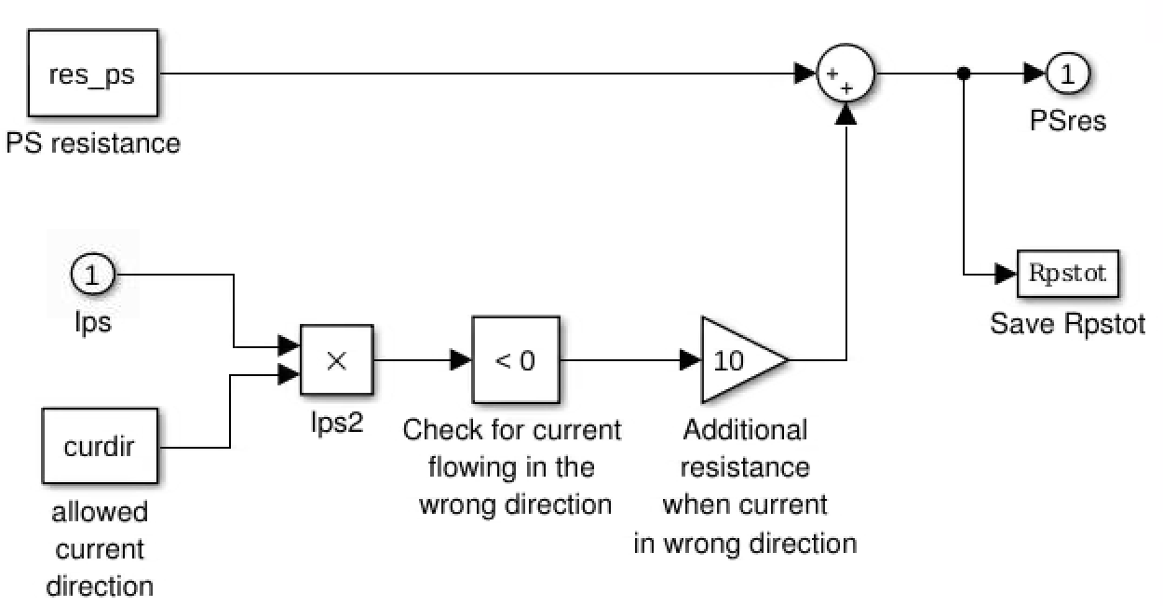
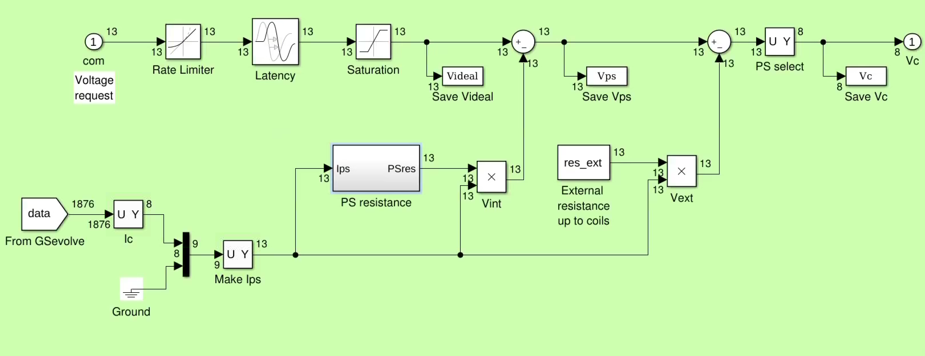
Subsystem Actuators/PS simulates power supplies for coils
Voltage request goes through rate limiter, latency, saturation
Voltage due to internal/external resistance subtracted
Internal resistance goes high if current in wrong direction in unipolar supply
Power supplies that are used are selected and sent to GSevolve module

