Slide 1

Stuck in the Rough: How Aging Reactor Walls May Exhibit Lower Erosion [DOE Highlight]
This work is from: “Computational investigation of ion incident angles and material erosion of micro-rough graphite and silicon carbide divertor surfaces” S. Abe et al., Phys. Plasmas 29, 102503 (2022), APS Invited
sabe@pppl.gov
Shota Abe^{1,2}, C.H. Skinner¹, A. Liu^{3,1}, J. Garcia^{4,1}, Z. Lin², S. Bringuier⁵, T. Abrams⁵, and B.E. Koel¹
¹ Princeton Plasma Physics Laboratory, USA
² Department of Chemical and Biological Engineering, Princeton University, USA
³ Department of Nuclear, Plasma, and Radiological Engineering, University of Illinois at Urbana-Champaign, USA
⁴ Department of Mechanical Engineering, San Diego State University, USA
⁵ General Atomics, San Diego, USA
NSTX-U / Magnetic Fusion Science Meeting, PPPL, NJ, USA, March 6, 2023

Slide 2


Slide 3
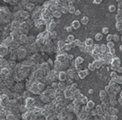
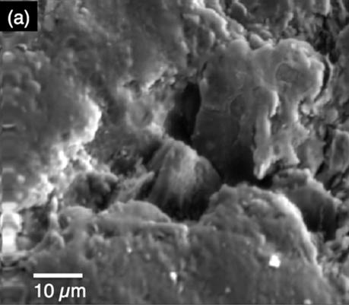
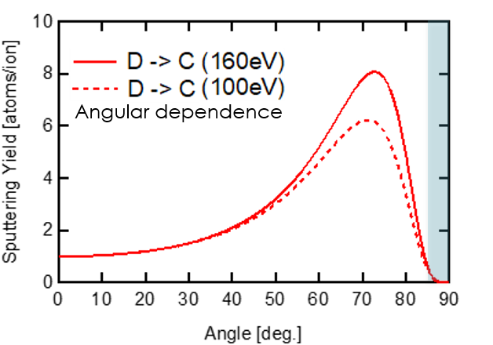
Surface structure is a key parameter of fusion divertor PMI
θ
SiC
Rough surfaces of PFC
Graphite
Ion
Erosion
Strong dependency on incident angle
→
→
Abrams et al., NF 2021
Sputtering Yield [atoms/ion]
Shadowing
Impurity & T trapping
Behrisch, Eckstein, “Sputtering by Particle Bombardment“ (2007)
Polar Angle (θ)
Effects of rough surfaces on erosion and ion-shadowing are investigated

Slide 4
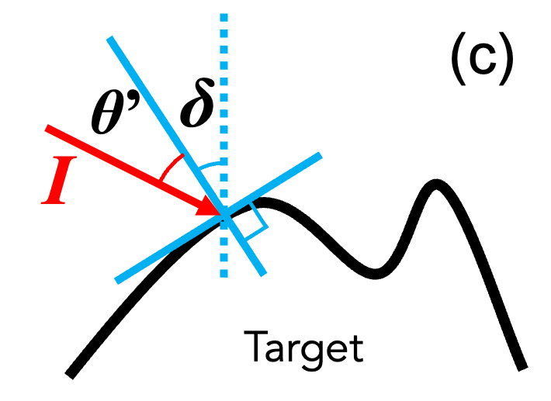
Key parameter: Surface Inclination Angle Distribution (SIAD)
Key parameter
Surface Inclination Angle δ
Local incident ion angle
Cupak 2021 Appl. Surf. Sci.
θ
Ion

Slide 5
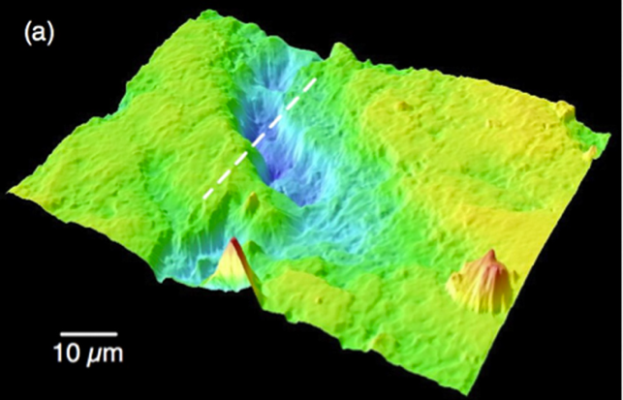
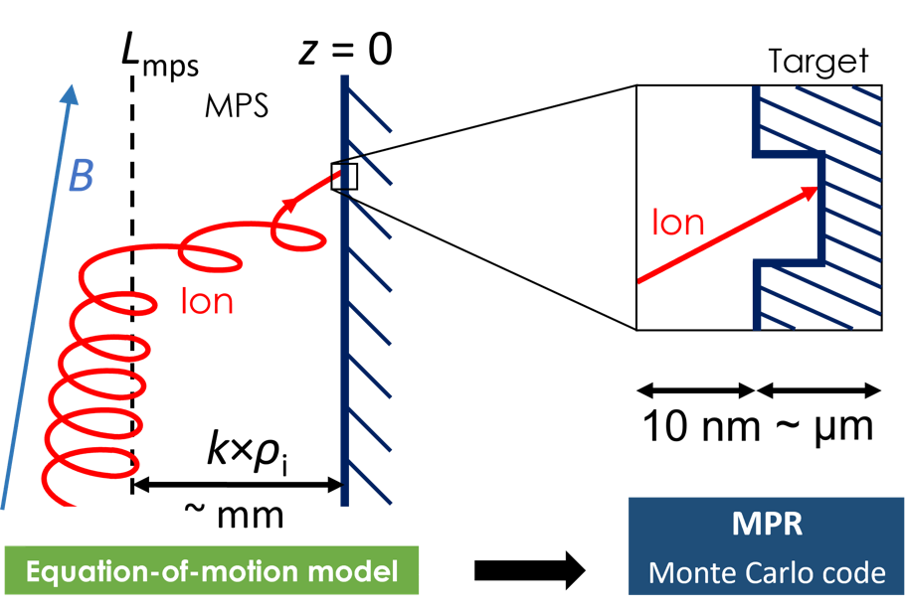
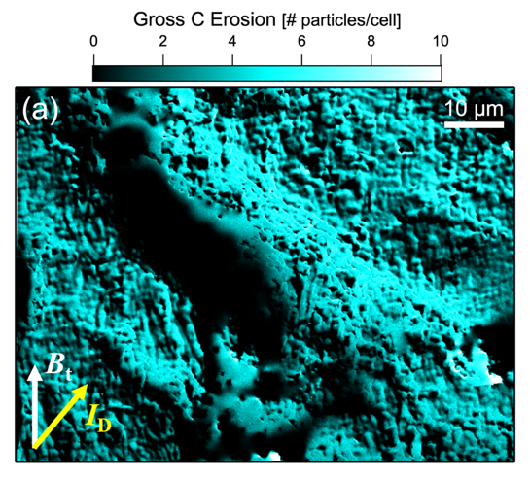
Workflow using two models
Lasa and Coburn
github.com/ORNL-Fusion/
Input surface data
Micro-Patterning and Roughness (MPR)
Skinner
NME 2019
(2)
NSTX-U graphite
(confocal microscopy)
Input
L_{MPS}
(1)
Input
Output
Incident ion angle distribution (IAD)
Input
Difference from previous works
(1) Calculated IADs using verified sheath length
(2) Real (measured) surface data
Erosion
Ion shadowed area

Slide 6
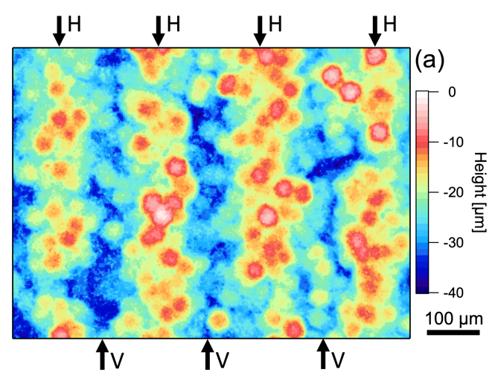
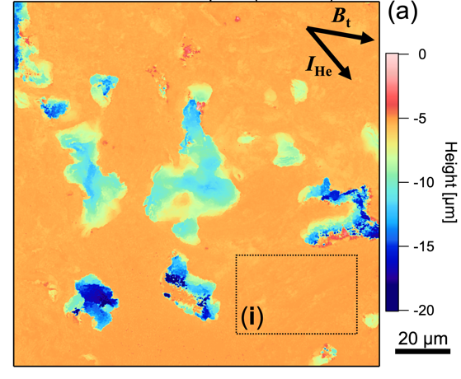
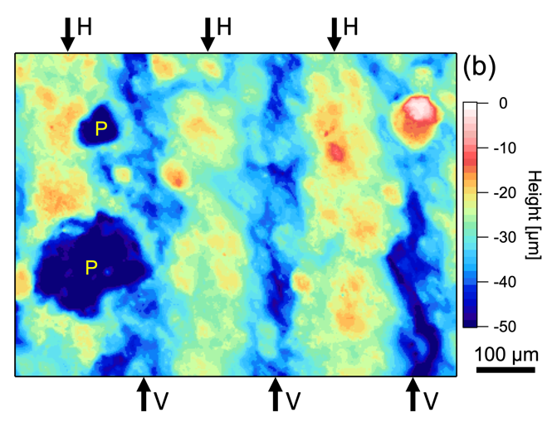
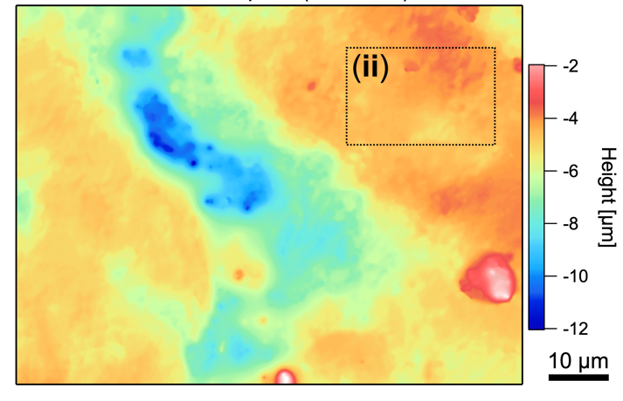
4 divertor surfaces were scanned for computational study
Measured by
confocal microscopy
DIII-D tile
SiC
1250x950 μm
R_{RMS} = 6.6 μm
Before exposures
DIII-D DiMES
Graphite
130x130 μm,
(i) 40x25 μm
R_{RMS} = 1.9 μm,
(i) 0.1 μm
subarea
subarea
NSTX-U
Graphite
85x65 μm,
(ii) 16x16 μm
R_{RMS} = 1.3 μm,
(ii) 0.3 μm
DIII-D tile
SiC
1200x1200 μm
R_{RMS} = 8.0 μm
After exposures

Slide 7

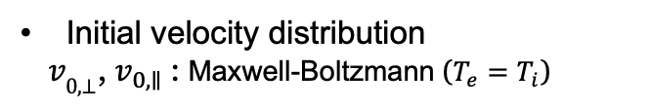

IAD calculation inputs and assumptions
Incident ion angle distribution (IAD) calc.
Equation-of-motion (EOM)
F = e(E + v×B)
v₀
Potential profile
$$φ\left(z\right)=ΛT_{e}e^{− \frac{2z}{L_{MPS}}}$$
Initial velocity distribution
$v_{\text{0,}\text{⊥}}$, $v_{0,∥}$: Maxwell-Boltzmann ($T_{e}=T_{i}$)
Borodkina CPP 2016
Stangeby 2000 IOP Publishing
(-3 < $Λ$ < -2.4)
L_{MPS} = 3×ρ_{i} (ρ_{i}: Ion gyro radius)
Collisionless: L_{MPS} (~mm) << λ_{MFP} (~cm)
This factor ”3” was determined in Abe et al., Nucl. Fusion 62, 066001 (2022)
λ_{ChargeExchange} ~ 0.1 mm when n_{e} = n_{n} = 10²¹ m⁻³ (ITER)
Hence, we examined n_{e} = 10¹⁹-10²⁰ m⁻³

Slide 8
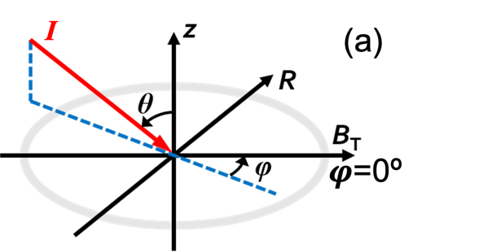
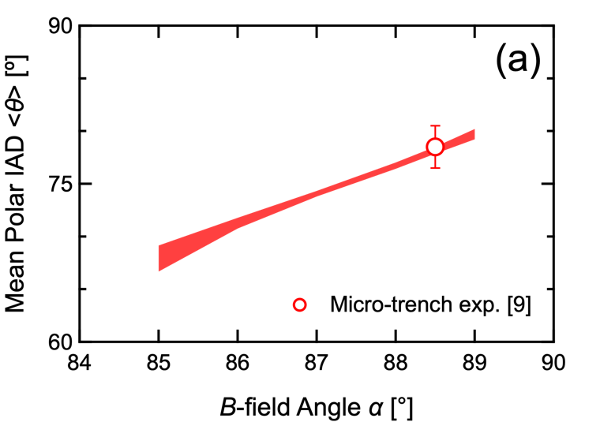
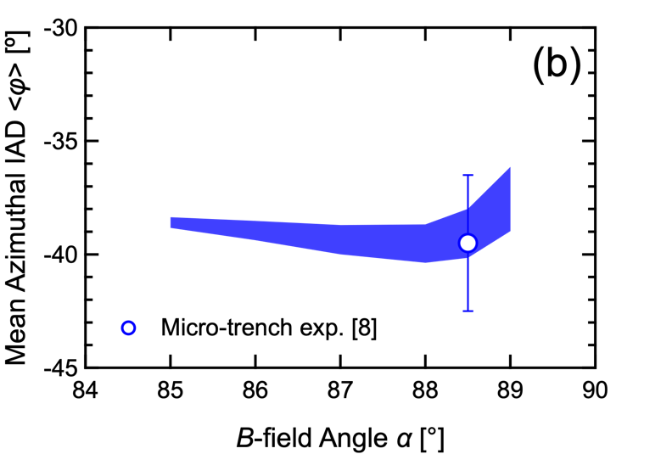
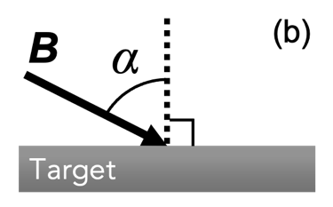
Takeaway1: General IADs at divertor surface were also found
Incident ion angle distribution (IAD) calculation
Result
Result
Plasma parameters
Polar IADs are sensitive to B-field incident angle α
α = 88.5° case was verified by micro-trench experiment
Incident ion: D⁺
T_{e} = 10-30 eV
n_{e} = 10¹⁹-10²⁰ m⁻³
B = 1-5 T
Abe 2021 NME
Those IADs are global for any divertor plasmas having plasma parameters shown on the left

Slide 9
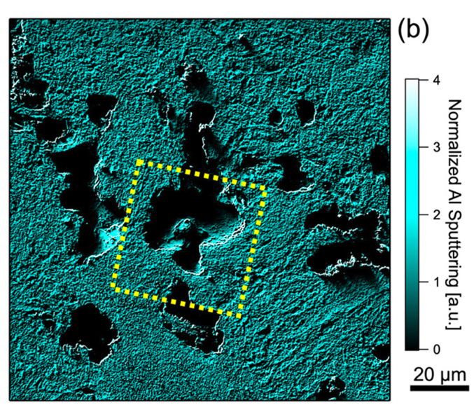
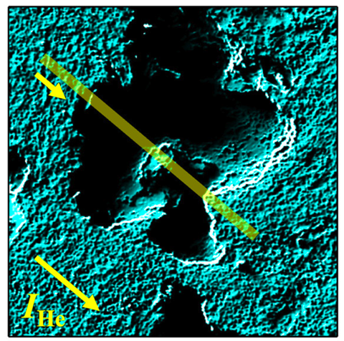
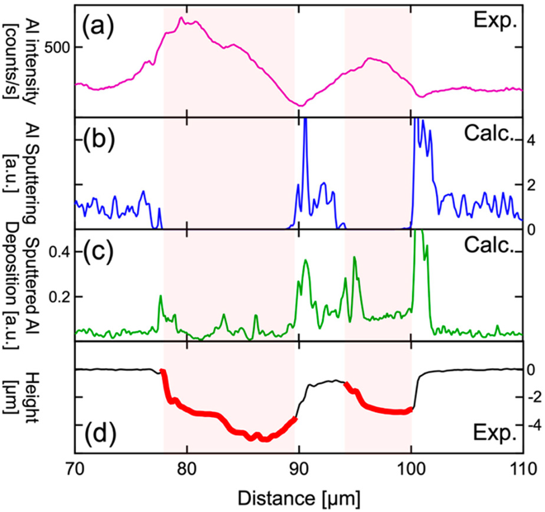
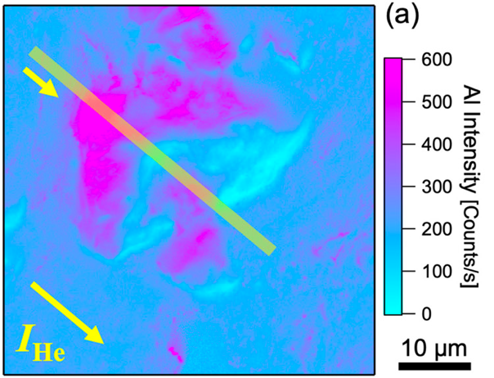
DiMES graphite surface was experimentally benchmarked
Exp.
Skinner
NME 2019

Slide 10
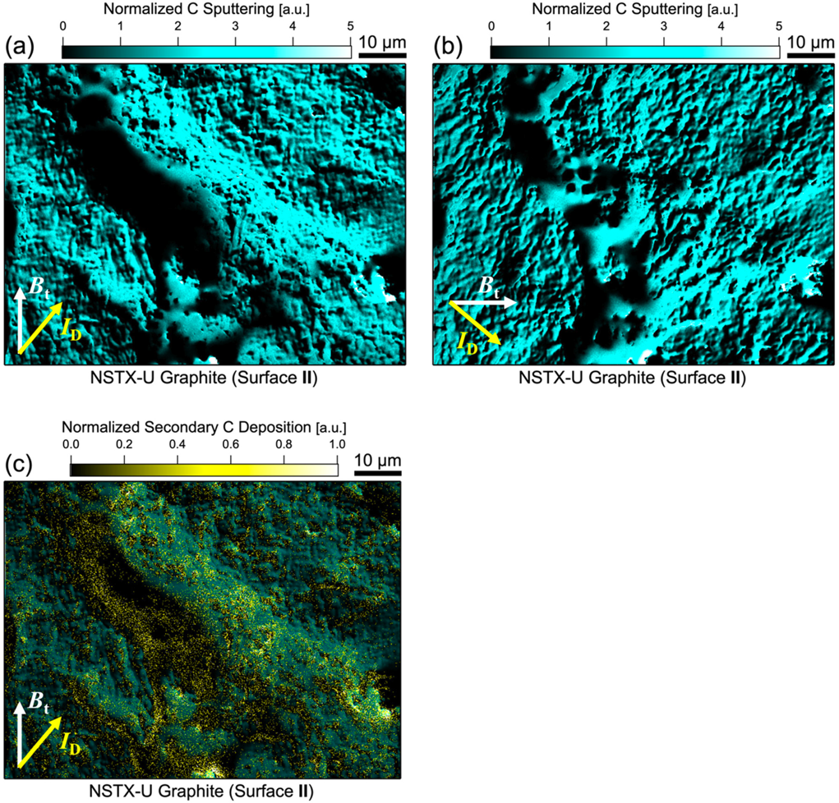
Erosion and ion shadowed area were quantified
Large shadowed area in micro-valley
Redeposition << Erosion
Species redeposited at neighboring area
~5%

Slide 11
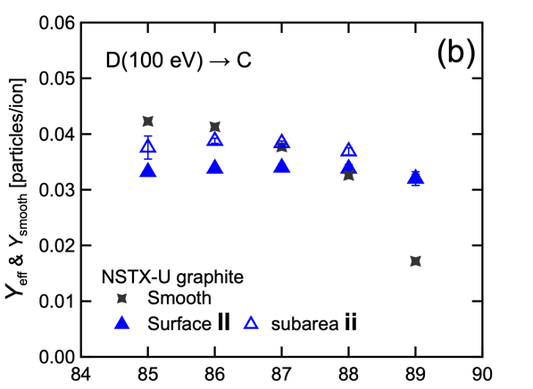
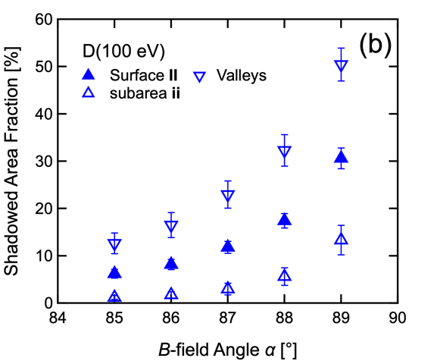
Erosion and ion shadowed area were quantified
Erosion
Large shadowed area in micro-valley
Redeposition << Erosion
Species redeposited at neighboring area
~5%
Ion Shadowed Area

Slide 12
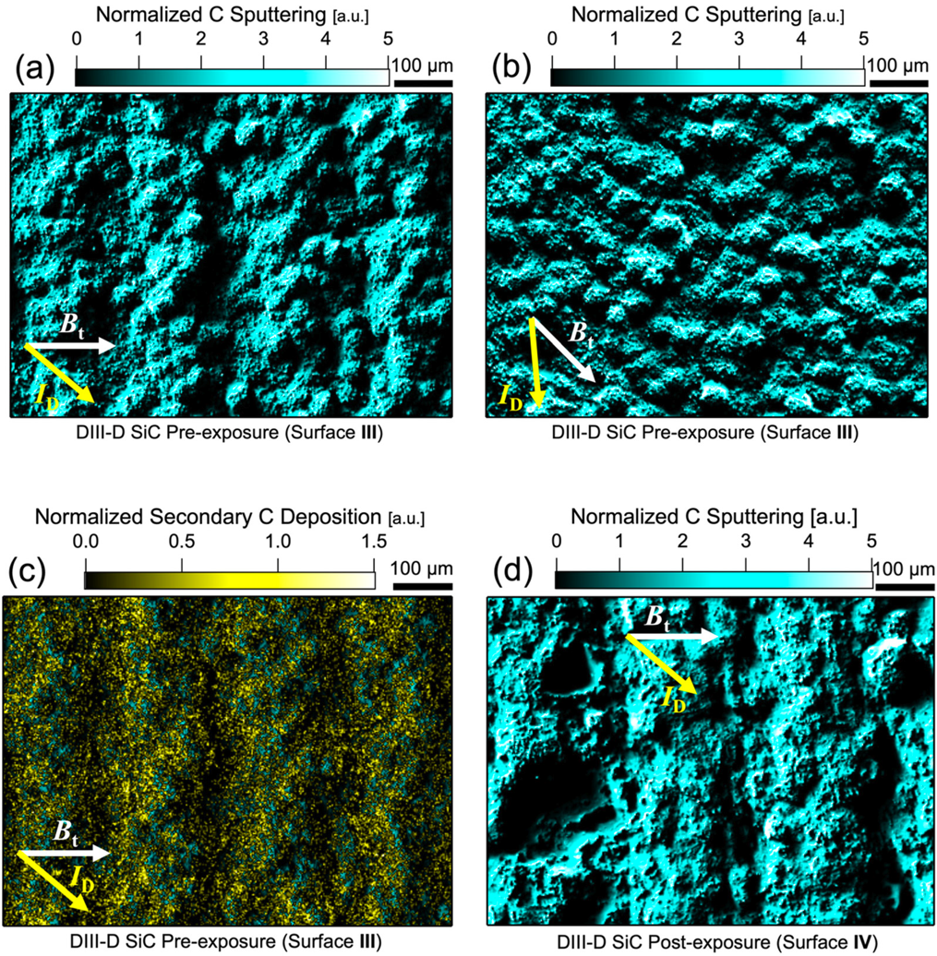
Erosion and ion shadowed area were quantified

Slide 13
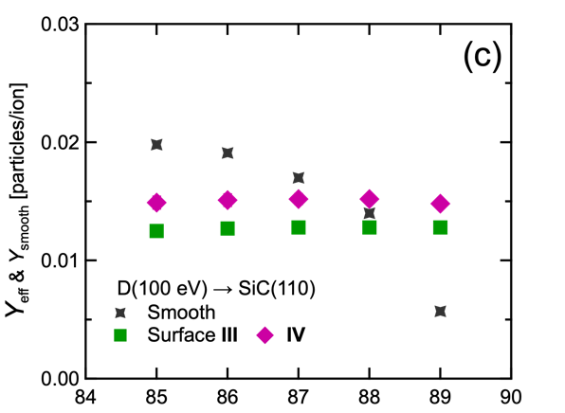
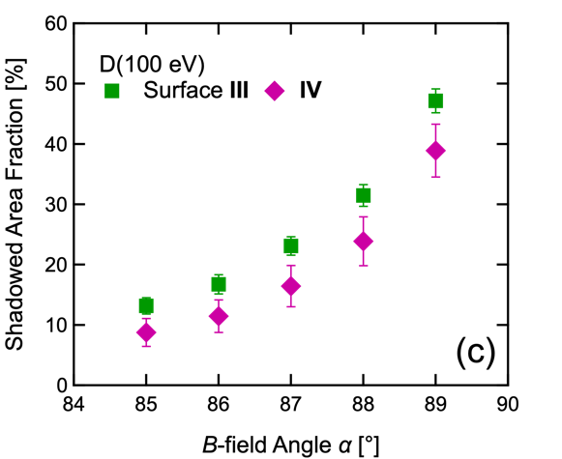
Erosion and ion shadowed area were quantified
Erosion
Ion Shadowed Area

Slide 14
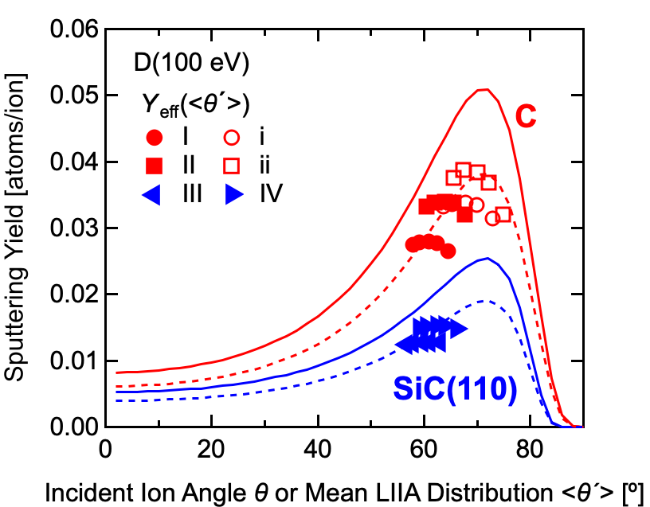
R_{rms} is NOT good parameter to explain PMI! SIAD is!!
Behrisch, Eckstein, “Sputtering by Particle Bombardment“ (2007)
Bringuir NME (2019)
Ion Shadowed Area
Erosion
Database sputtering yield
More roughness ≠ more shadow
More roughness ≠ less erosion
Local incident ion angle (LIIA) predicts the erosion (75% of smooth surface sputtering yield)
Go to next slide: SIAD (Surface Inclination Angle Distribution) is the best parameter
SIAD can be used to determine LIIA

Slide 15
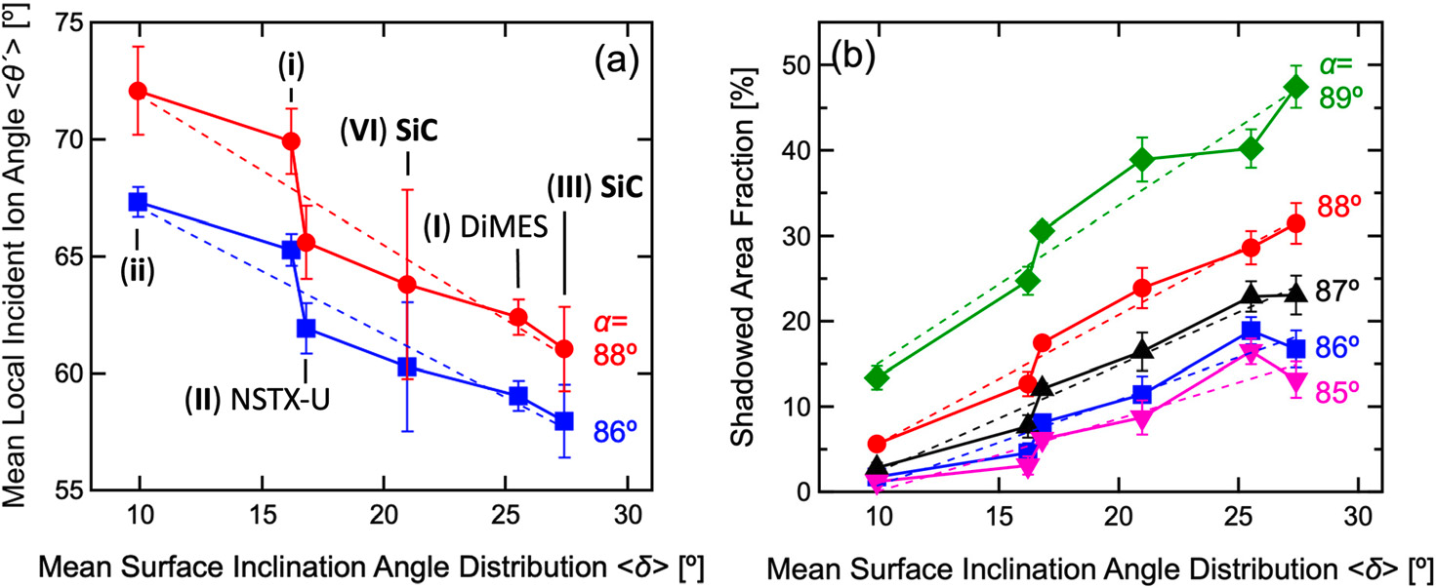
Takeaway2: General results were found for erosion and redeposition predictions on any divertor surfaces
Local Incident Ion Angle
Ion Shadowed Area
Key parameter
Surface Inclination Angle δ
Local incident ion angle
Cupak 2021 Appl. Surf. Sci.
Incident ion: D⁺
T_{e} = 10-30 eV
n_{e} = 10¹⁹-10²⁰ m⁻³
B = 1-5 T
To predict
To predict
Impurity Redeposition
Tritium Trapping
Erosion

Slide 16
Summary
The Surface Inclination Angle Distribution (SIAD) is the key parameter to predict the Local Incident Ion Angle (LIIA) and ion shadowed area on rough surfaces.
Using LIIA and sputtering yield data of a flat surface, we can predict the erosion of rough surfaces.
Global IADs were calculated as a function of B-field incident angle.
Thank you!
Acknowledgements: Ane Lasa, Jonathan Coburn, Christopher P. Chrobak, Jerome Guterl, Igor Bykov, Eduardo Marin, Arturo Domingues, DeeDee Ortiz, Koel (PU) group
This work is supported by U.S. DOE under DE-AC02-09CH11466, DE-FC02–04ER54698, DE-AC02-09CH11466, and Princeton’s High Meadows Environmental Institute

Slide 17
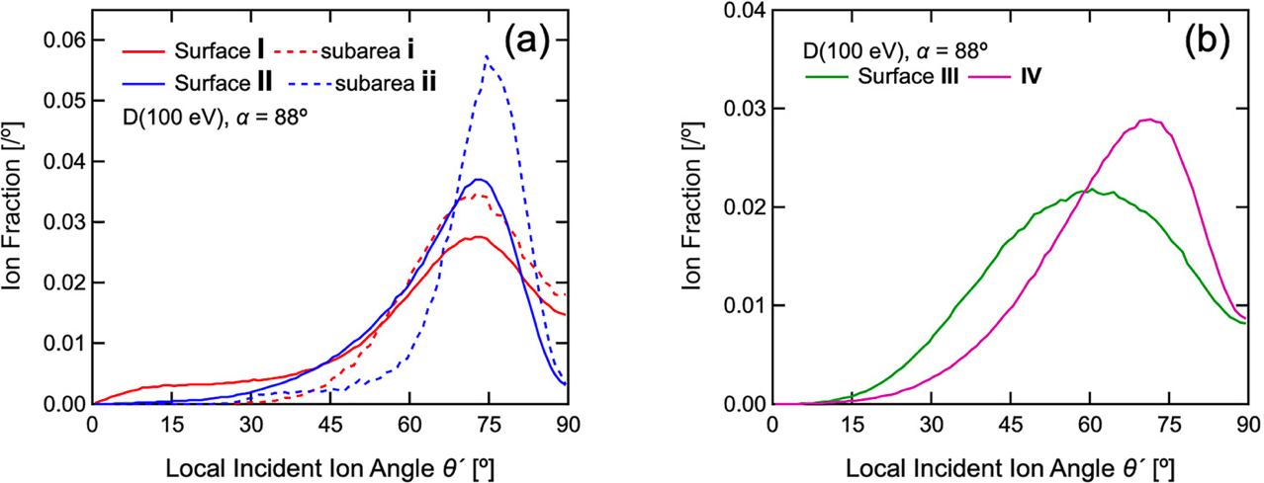
IAD becomes broader due to surface structure
Flat surface

Slide 18
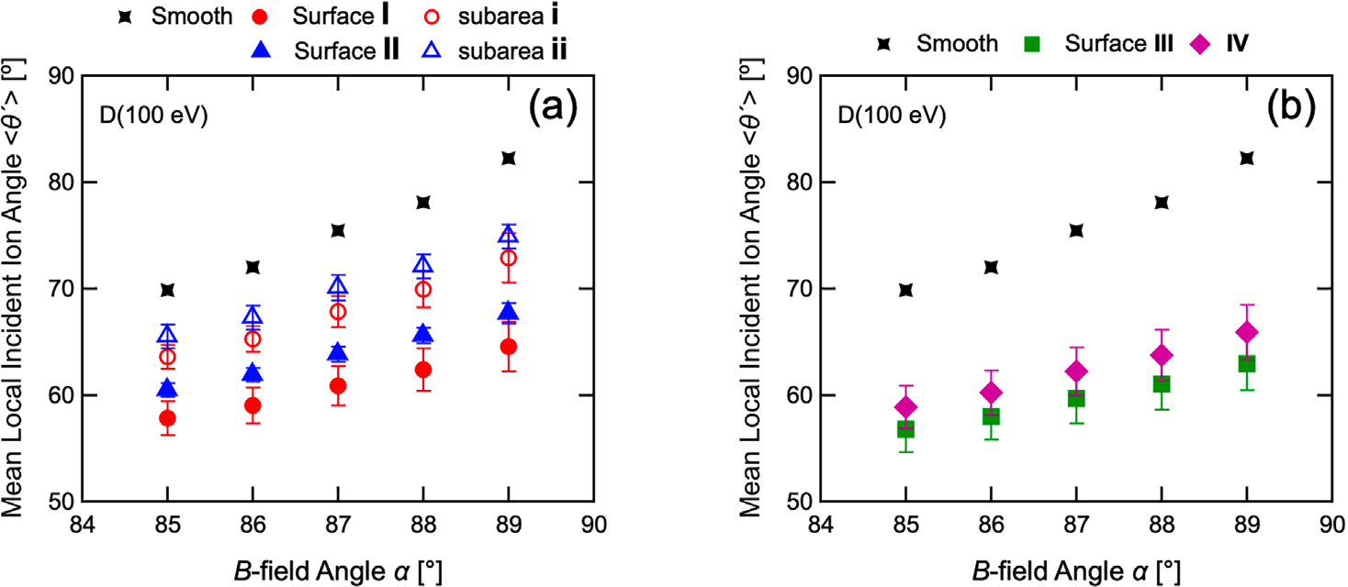
Calculation of local incident ion angle

