Slide 1
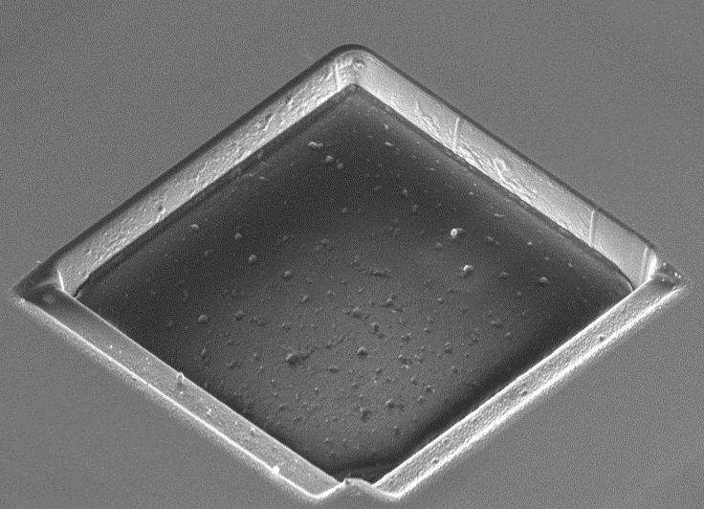
Summary and updates of the micro-trench method for impurity deposition and incident ion angle measurements
Shota Abe
Staff Research Physicist, Princeton Plasma Physics Laboratory, USA
NSTX-U / Magnetic Fusion Science Meeting
PPPL, NJ, USA, March 6, 2023

Slide 2
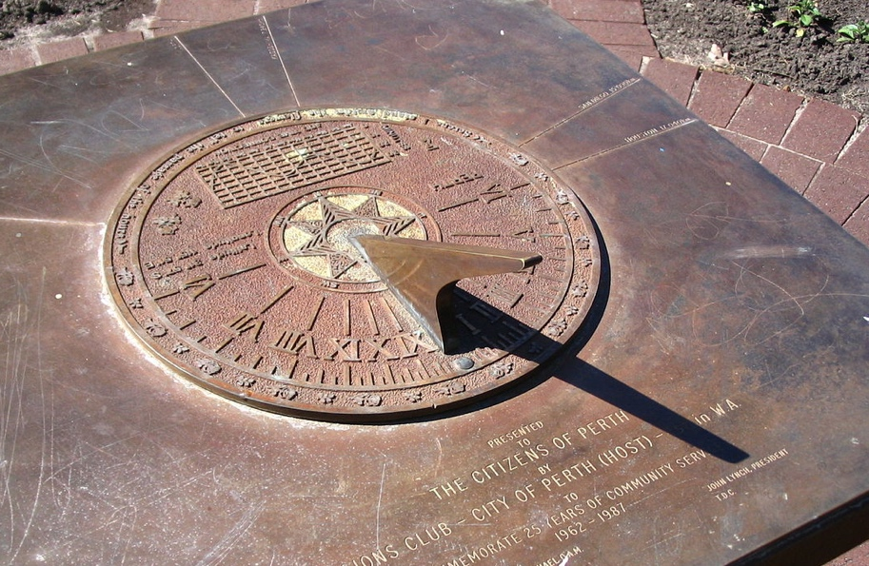
Keyword: Shadowing
Shadowing is useful
Sundial has measured
time & season since 1500 BC
Wikipedia

Slide 3
Keyword: Shadowing
Shadowing is useful
Sundial has measured
time & season since 1500 BC
Sun location
Wikipedia

Slide 4
Keyword: Shadowing
Shadowing is useful
Sundial has measured
time & season since 1500 BC
Incident
photon
direction
Sun location
$$θ$$
$$φ$$
Incident photon angles
Wikipedia
Azimuth ϕ
Polar (Altitude) θ
Time
Time & season

Slide 5
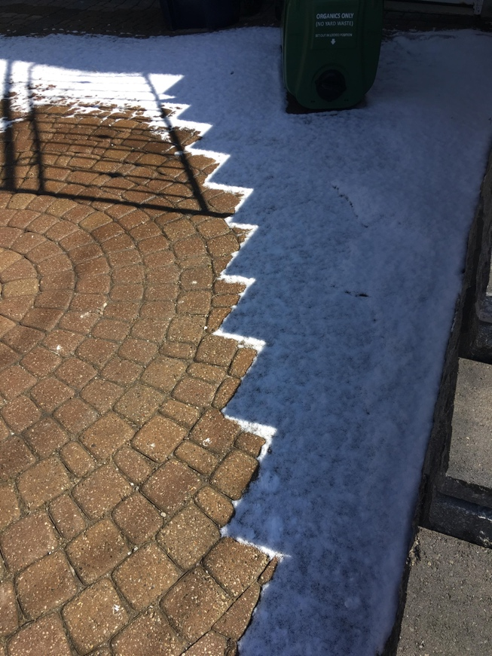
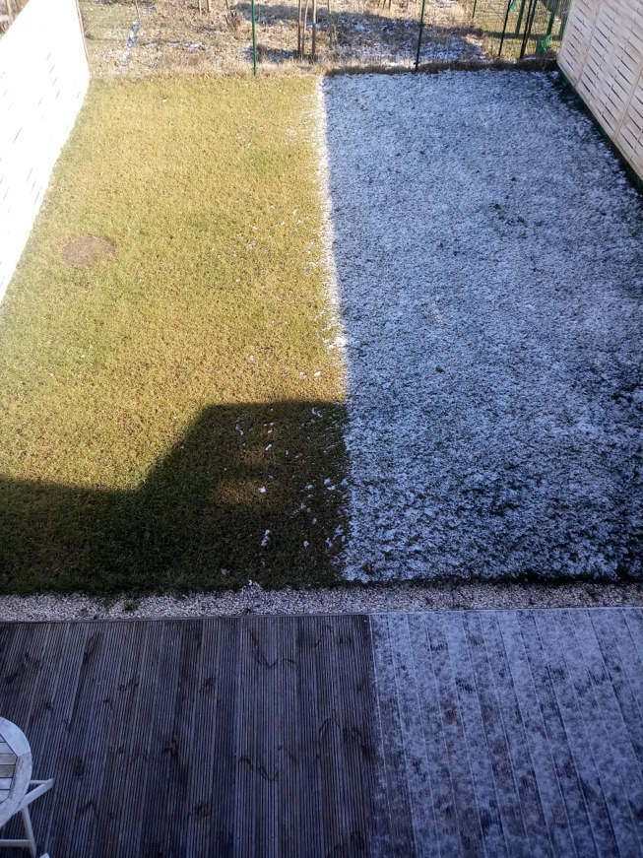
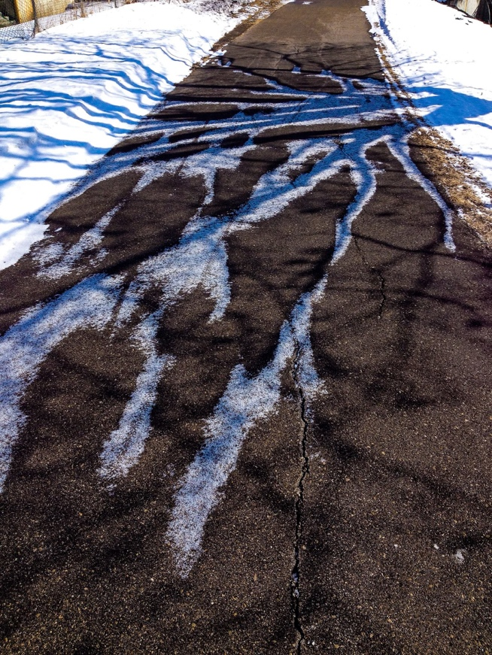
Shadowing affects erosion (melting) patterns on the surface
reddit.com
reddit.com, @u/DankPastaMaster
reddit.com, @u/banana-nou

Slide 6
Incident ion angle measurement

Slide 7
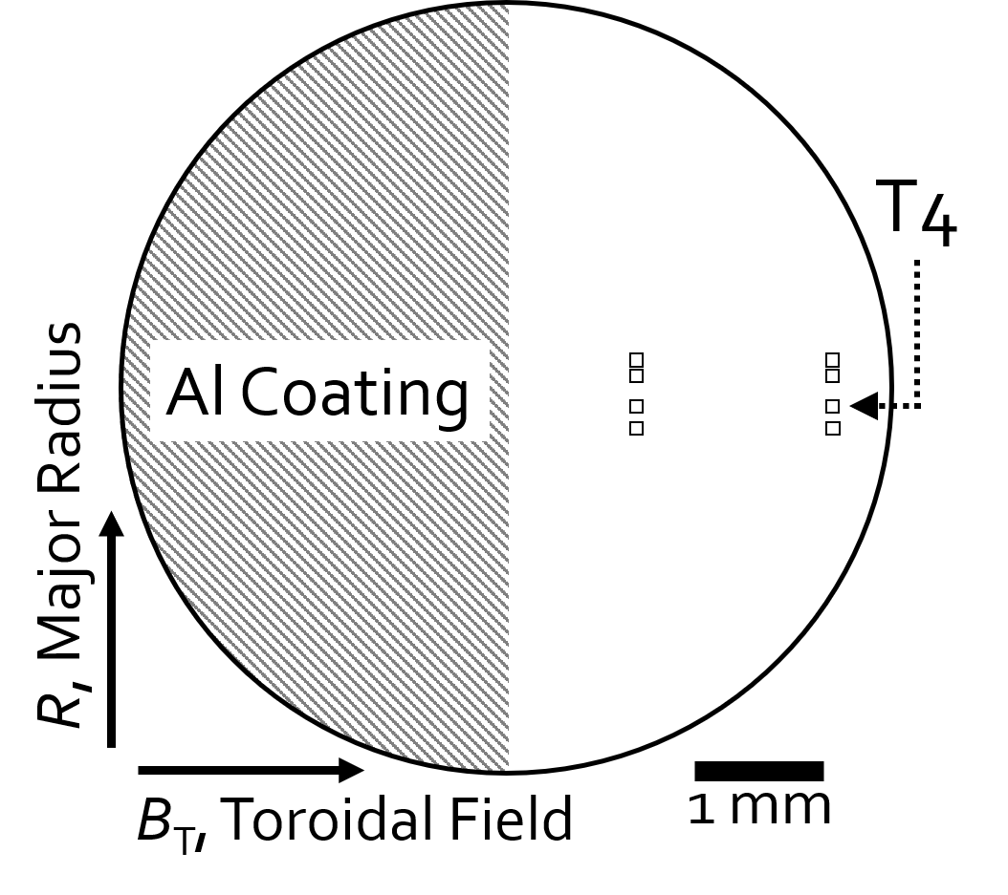
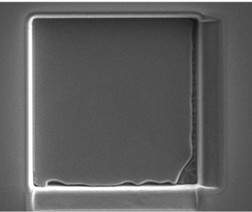
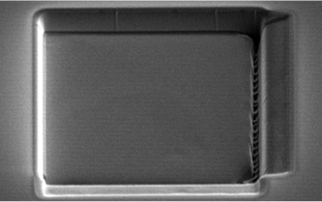
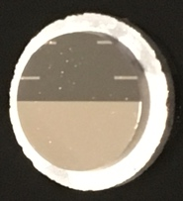
Micro-trench technique uses ion shadowing effect to reveal D ion incident direction
Micro trenches fabricated by focused ion (Ga) beam (FIB)
SEM before exposure
Si sample disc
30x30x4 µm deep
S1
Micro-
trenches
Top
view
45º
view

Slide 8
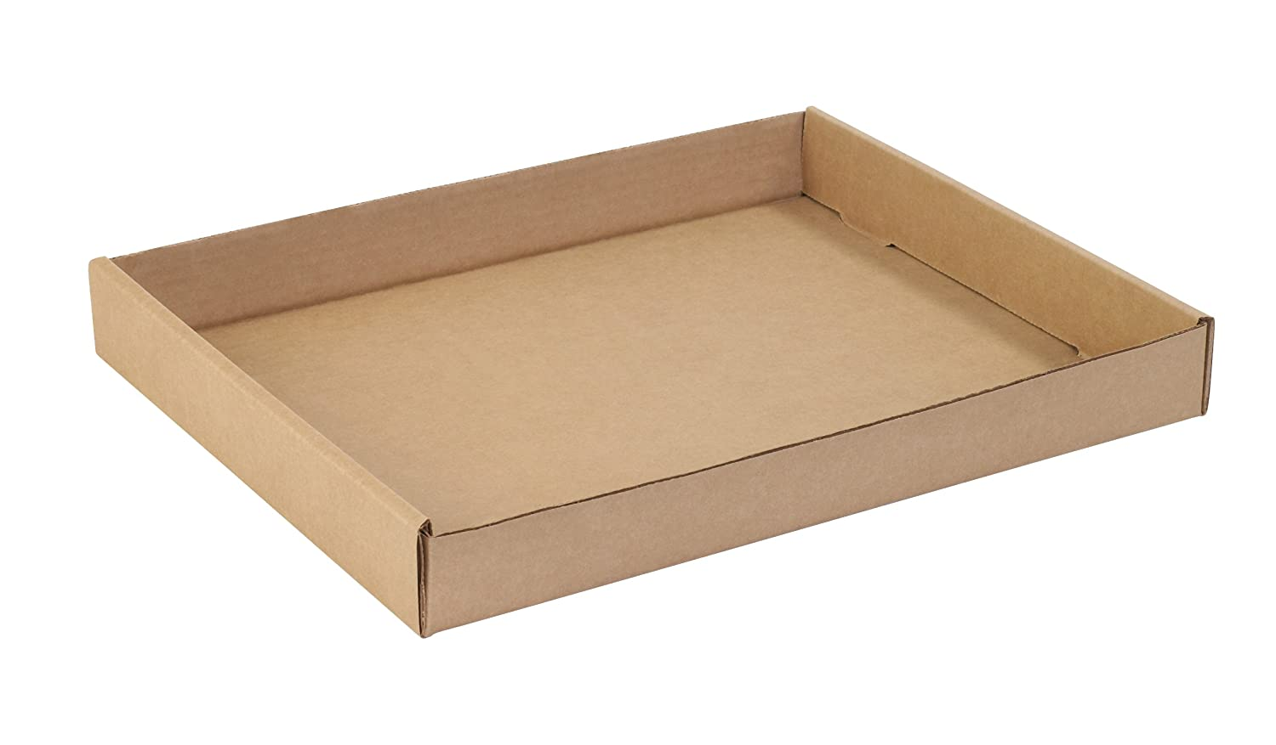
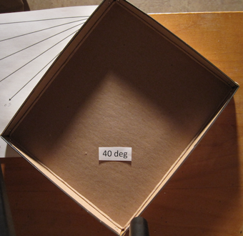
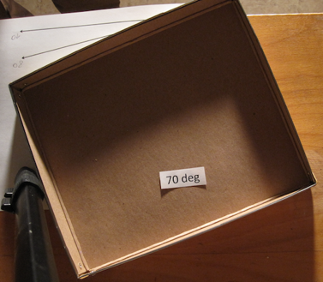
Micro-trench technique uses ion shadowing effect to reveal D ion incident direction
Micro trenches fabricated by focused ion (Ga) beam (FIB)
SEM before exposure
Si sample disc
Reported
30x30x4 µm deep
S1
amazon.com
Micro-
trenches
Top
view
ϕ
θ
45º
view
C.H. Skinner

Slide 9
Micro-trench technique uses ion shadowing effect to reveal D ion incident direction
Micro trenches fabricated by focused ion (Ga) beam (FIB)
C ions
from graphite walls
SEM before exposure
1-3% of ion flux
Si sample disc
D Ions
Reported
30x30x4 µm deep
S1
Al C
Micro-trench
Micro-
trenches
Top
view
D Ions
Shadowed
Sputtered
45º
view
S. Abe 2021 NME 27 100965

Slide 10
Micro-trench technique uses ion shadowing effect to reveal D ion incident direction
Micro trenches fabricated by focused ion (Ga) beam (FIB)
C ions
from graphite walls
1-3% of ion flux
Si sample disc
D Ions
S1
Al C
Micro-trench
Micro-
trenches
D Ions
Shadowed
Sputtered
reddit.com, @u/DankPastaMaster
S. Abe 2021 NME 27 100965

Slide 11
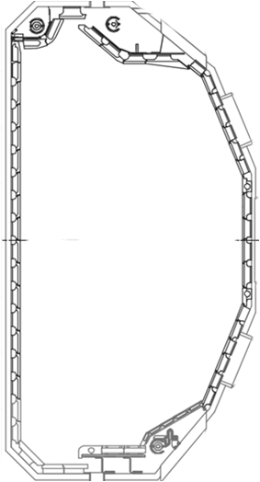
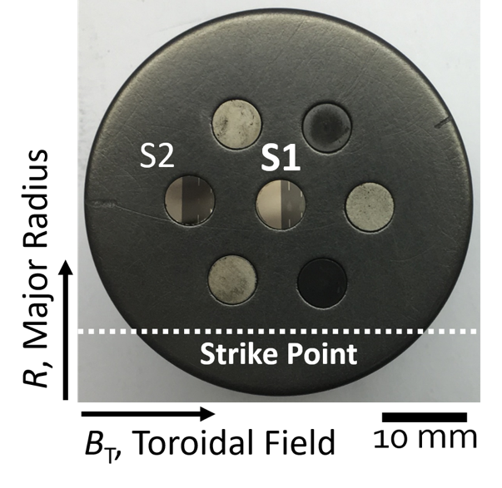
Engineered samples exposed on DiMES
DIII-D
Plasma parameters
DIII-D attached deuterium L-mode plasma
T_{e} ~ 30 eV, n_{e} ~ 10¹⁹ m⁻³, I┴ ~ 10²² cm⁻²s⁻¹,
t_{exp} = 10 s , T_{surf} < 250 ºC
DiMES head
C - Graphite
DiMES head location
Si sample disc
DiMES
IB
S1
LP
Micro-
trenches
OSP

Slide 12
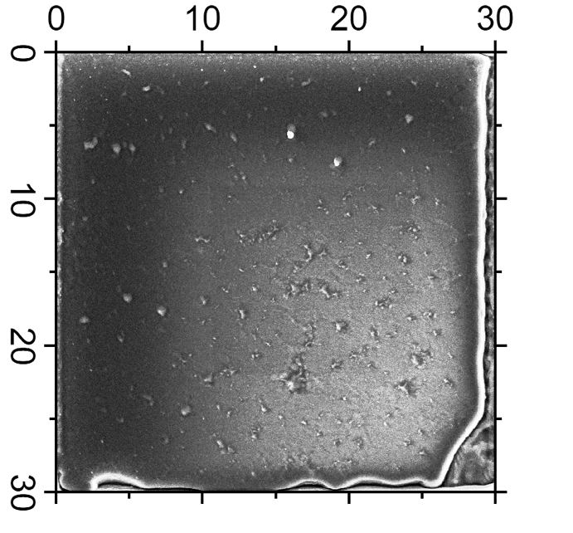
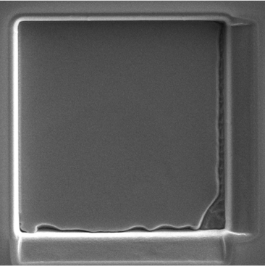
Impurities are redeposited and trapped in the D ion shadowed area
Before exposure
After exposure
y
µm
x
x
y
Tilted view
R
B_{T}
B_{T}
SEM images
Dark area = impurity deposition

Slide 13
Impurities are redeposited and trapped in the D ion shadowed area
Before exposure
After exposure
y
µm
x
x
y
Tilted view
Deposition
Erosion
R
B_{T}
B_{T}
SEM images
Dark area = impurity deposition

Slide 14
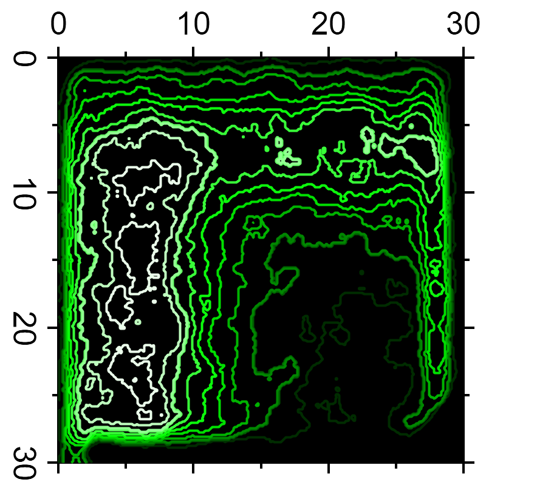
Polar and azimuthal ion incident angles measured by analyzing the impurity deposition pattern
Energy dispersive X-ray spectroscopy
SEM image after exposure
C EDS intensity (deposition)
C ~ 30 at. %
µm
µm
[a.u.]
Max
Int.
R
B_{T}
C concentration in shadowed area > 10x
Gross deposition rate ~ 10 nm/s
Abe 2021 PS

Slide 15
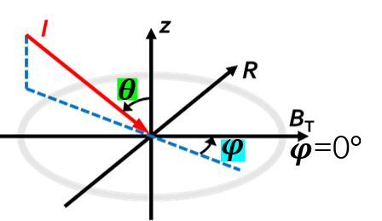
Polar and azimuthal ion incident angles measured by analyzing the impurity deposition pattern
Energy dispersive X-ray spectroscopy
SEM image after exposure
C EDS intensity (deposition)
C ~ 30 at. %
µm
µm
[a.u.]
$$θ$$
Max
Int.
$$φ$$
$θ \sim$ 80º
$φ$= -40º
First detailed experimental measurement
R
Abe 2021 NME
Abe 2022 Nucl. Fusion
B_{T}
What is the important physics behind this observation?

Slide 16
Sheath length determination

Slide 17
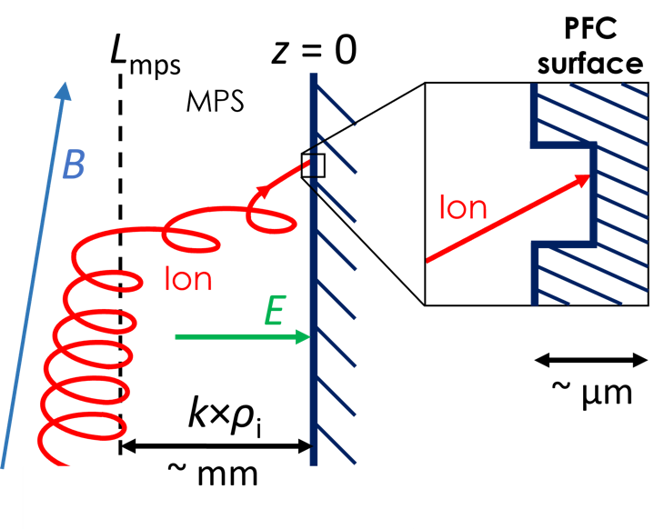
’Reverse engineering’ of sheath potential (length) from the measured ion incident angle
B
When α < 5º, wide electric sheath, magnetic pre-sheath (MPS) or Chodura sheath : L_{MPS} ~ k×ρ_{i}
L_{MPS} is an input parameter of PMI codes: ERO etc
α
Measured
Incident
ion angle
Measured
Plasma parameters
Ion velocity
Sheath potential (E-field) affects the ion trajectory

Slide 18
’Reverse engineering’ of sheath potential (length) from the measured ion incident angle
B
When α < 5º, wide electric sheath, magnetic pre-sheath (MPS) or Chodura sheath : L_{MPS} ~ k×ρ_{i}
L_{MPS} is an input parameter of PMI codes: ERO etc
α
Measured
Incident
ion angle
Measured
Plasma parameters
Ion velocity
k: Free parameter
Sheath potential (E-field) affects the ion trajectory

Slide 19
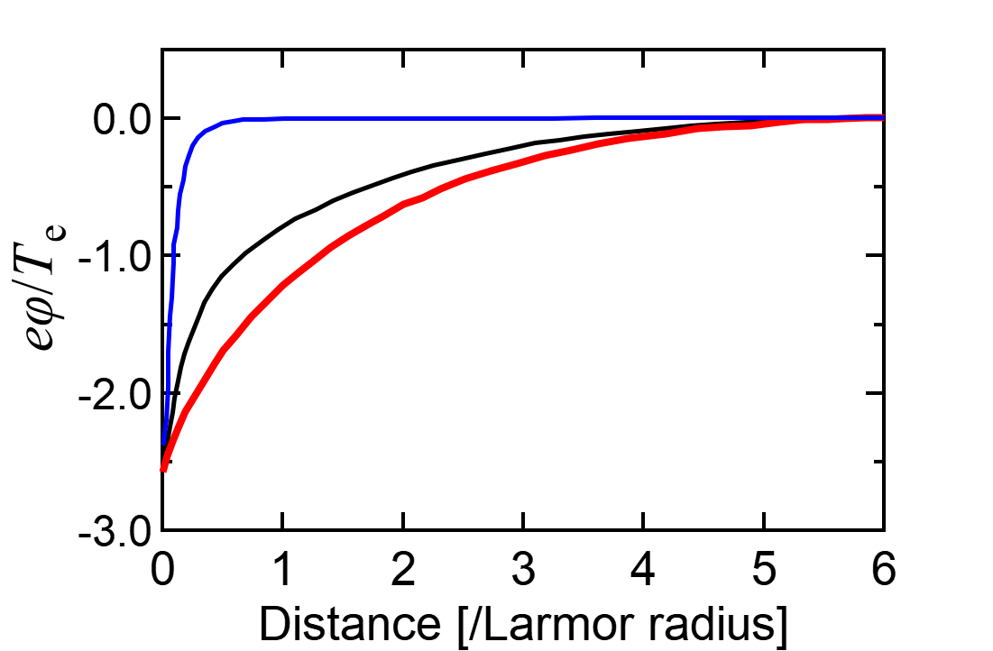
’Reverse engineering’ of sheath potential (length) from the measured ion incident angle
B
When α < 5º, wide electric sheath, magnetic pre-sheath (MPS) or Chodura sheath : L_{MPS} ~ k×ρ_{i}
L_{MPS} is an input parameter of PMI codes: ERO etc
α
Coulette PPCF 2016
DS boundary
90º
10º
MPS (No DS)
k = 3
α = 2º
$$φ\left(z\right)=ΛT_{e}e^{− \frac{2z}{L_{MPS}}}$$
Borodkina CPP 2016
k: Free parameter
Sheath potential profile by kinetic simulation
Sheath potential (E-field) affects the ion trajectory

Slide 20
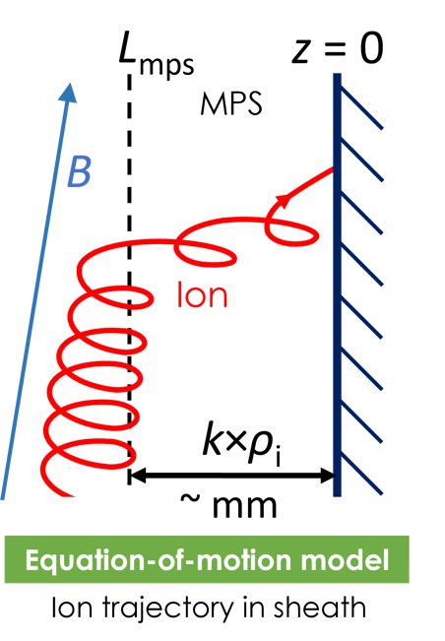
Ion trajectories calculated for various sheath lengths
DIII-D attached deuterium L-mode plasma
T_{e} ~ 30 eV, n_{e} ~ 10¹⁹ m⁻³, α = 1.5º
E
$$v_{\text{0}}$$
k×ρ_{i}
Free parameter

Slide 21
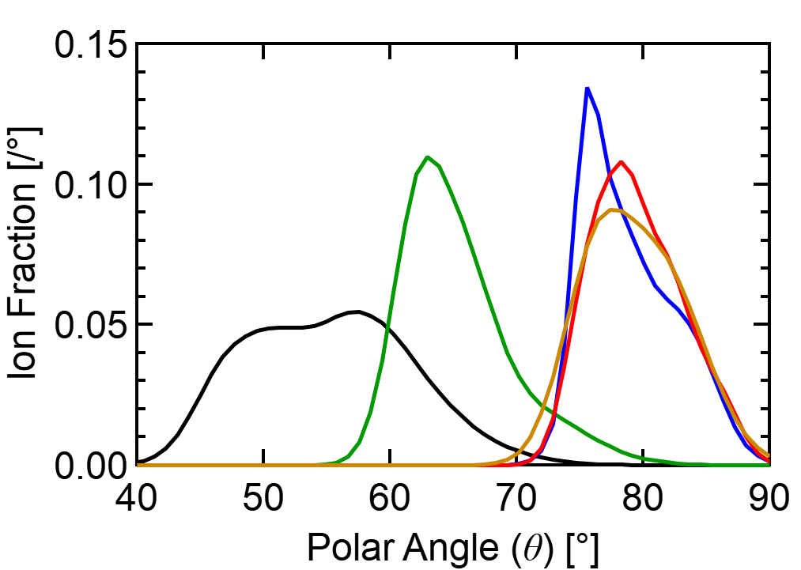
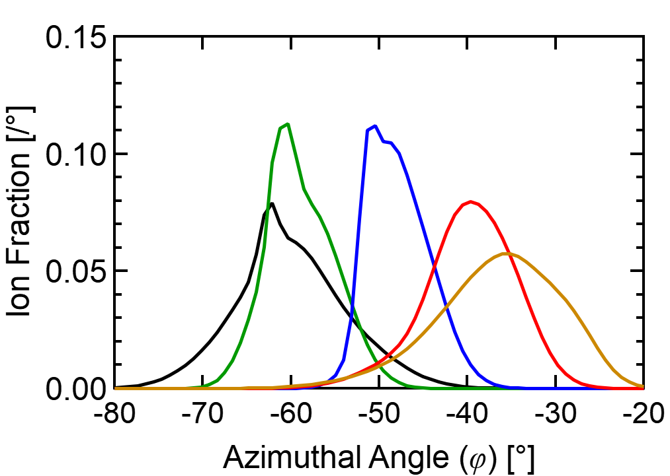
Ion trajectories calculated for various sheath lengths
DIII-D attached deuterium L-mode plasma
T_{e} ~ 30 eV, n_{e} ~ 10¹⁹ m⁻³, α = 1.5º
IADs by Equation-of-Motion
Exp.
Exp.
Polar
Azim.
$$θ$$
$$φ$$
1
1
k = 3
2
k = 3
k = 0.5
4
E
0.5
$$v_{\text{0}}$$
k×ρ_{i}
agreed with k ~ 3 of kinetic model prediction
Coulette PPCF 2016
First experimental determination of the tokamak sheath length
Abe. 2022 Nucl. Fusion

Slide 22
Deposition and erosion measurements

Slide 23
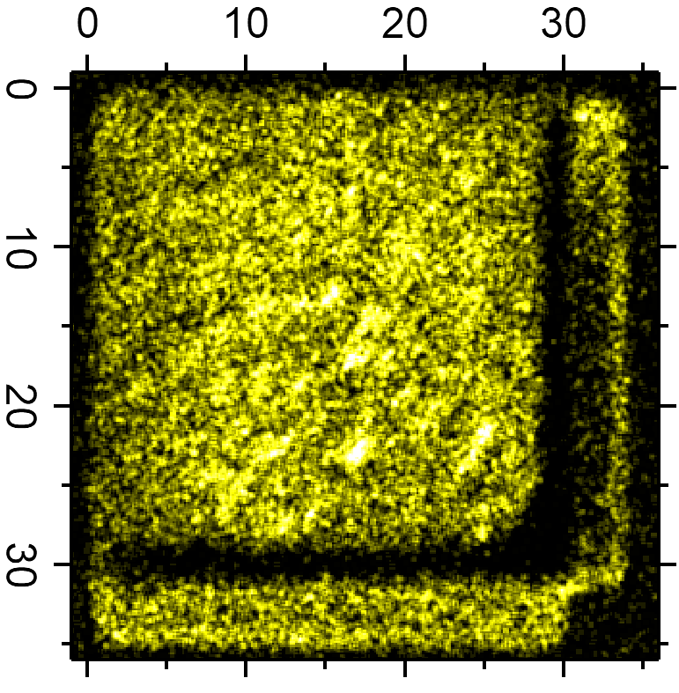
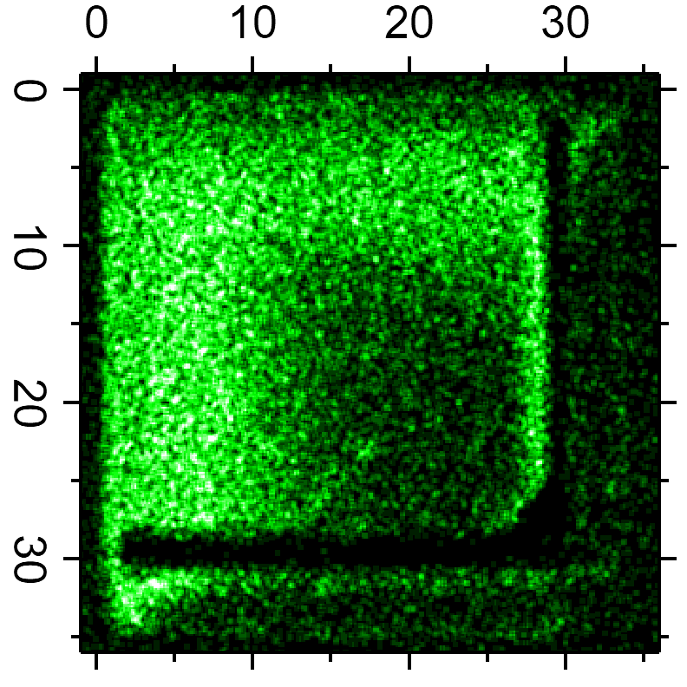
Micro-trench also measured Si erosion and C deposition rates
Ga
C^{x+}
D⁺
Si surface
B_{T}
C
Ga layer
Original trench surface
~30 nm (TRIM)
C deposition

Slide 24
Micro-trench also measured Si erosion and C deposition rates
Ga
Result of L-mode discharges
Si erosion rate
3.5 nm/s
C deposition rate
11 nm/s
Si surface
B_{T}
Erosion
Rate
by AFM
C
Reference
Ga layer
Original trench surface
~30 nm (TRIM)
C deposition
Gross C deposition rate (without D sputtering) by AFM

Slide 25
Ongoing/upcoming works

Slide 26
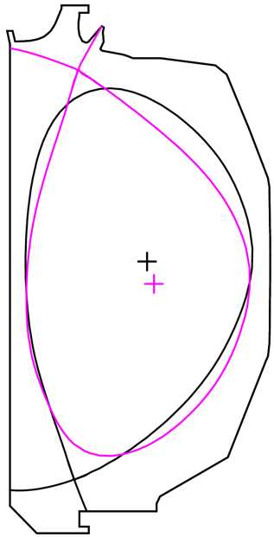
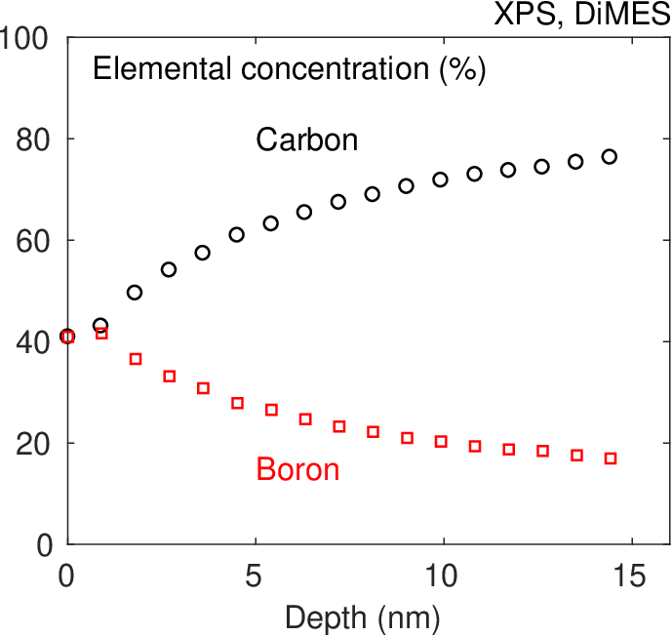
Gross deposition measurement of IPD coatings in DIII-D
IPD
IPD
IPD
Effective (net) B:C film growth rate ~1-2 nm/s (0.1 nm per mg of B) was found in DIII-D
Gross deposition rate? MT can answer
We will apply the micro-trench method for boron and lithium IPD this year in DIII-D
along with composition analysis of the deposited layers
USN
LSN
RTWC with boron powder
A. Bortolon et al 2019 Nucl. Mater. and Energy 19 384-389
R. Lunsford et al 2019 Nucl. Fusion 59 126034
F. Effenberg et al 2022 Nucl. Fusion 62 106015

Slide 27
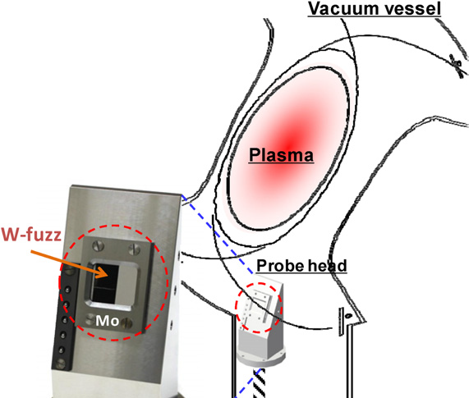
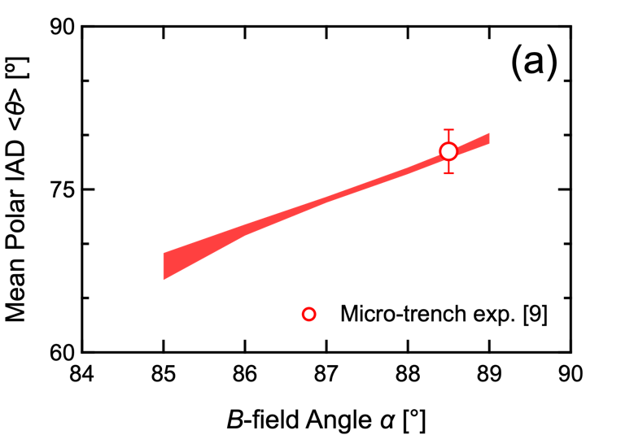
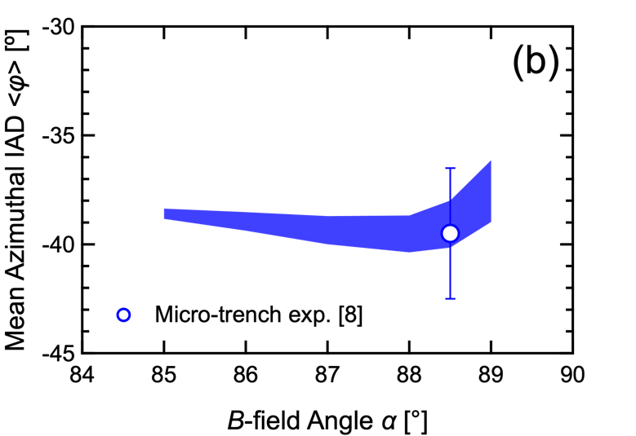
Applications for different plasma parameters
We did the model validation with D plasmas
How about other ion species?
H and He plasma measurements as a collaboration with LHD, NIFS (Prof. Masuzaki) in 2024
LHD has FIB for micro-trench fablication, EDS for composition analysis
Answers C gross deposition
Deep trench gives C incident angle
Adjustable angle of the LHD probe head lets us investigate different B field incident angle (DIII-D we tried only α=88°)
DIII-D plans H plasma discharge in June 2023
H-mode exposure as collaboration with Sandia (Dr. Coburn) in April 2023
Tokitani 2011

Slide 28
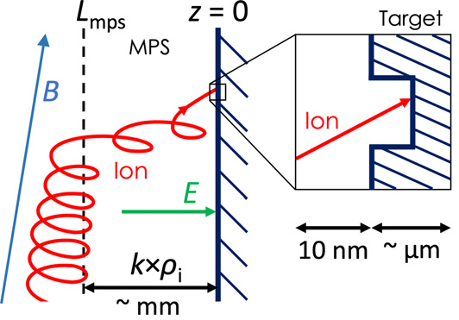
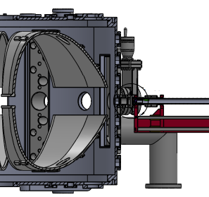
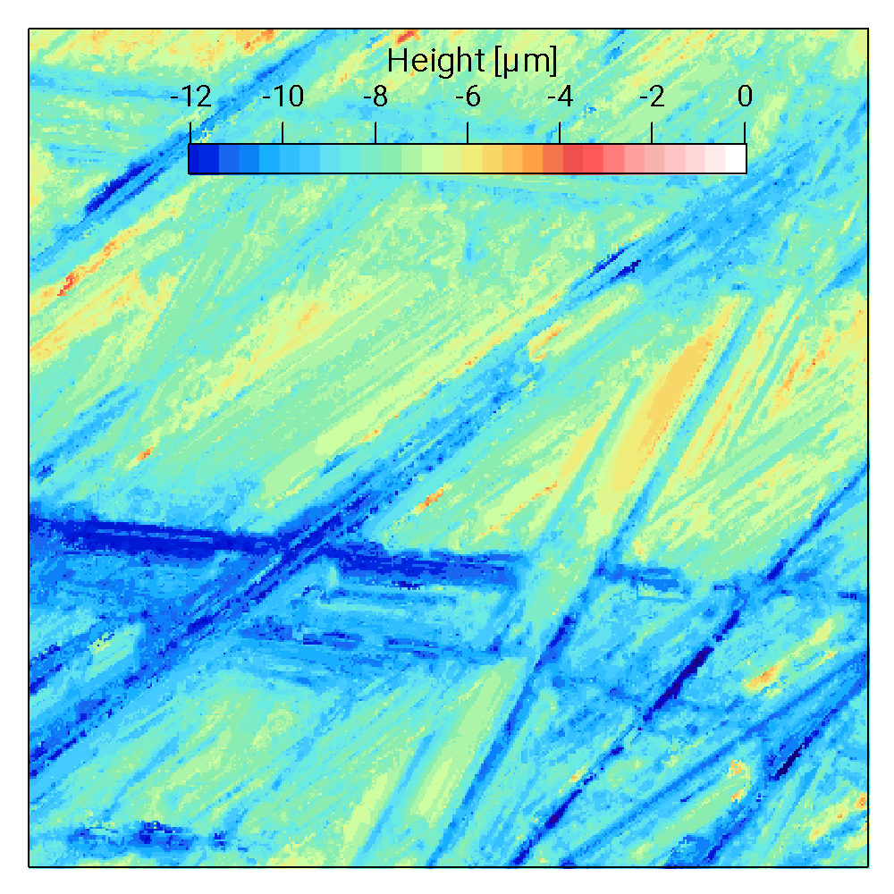
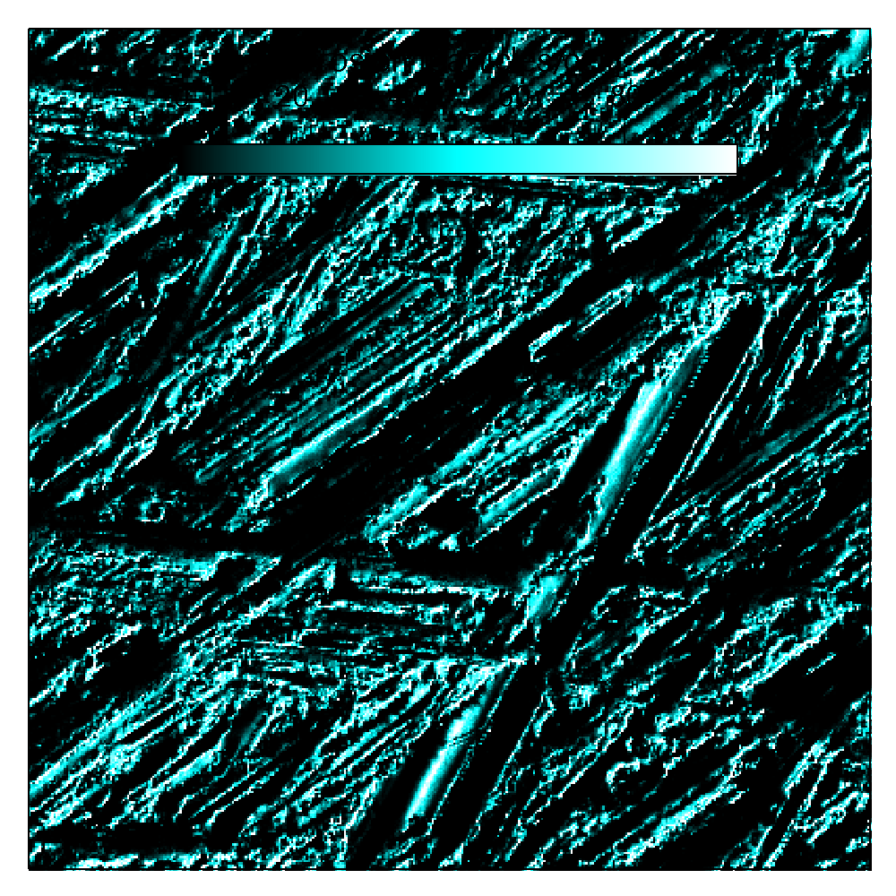
Investigations on Incident Ion Angle, Sheath and Roughness Effects for better PMI understanding
Ion Angle Probe (IAP)
Incident Ion
Angle
Microtrench
Sample
30 μm
Langmuir
Prove
Heater
Expected Deposition Pattern
MPR
Monte-Carlo
Equation-of-motion
Microtrench Method
Incident Ion Angle
Li deposition Rate
Net Li Sputtering Rate
IAP
MPR Calculation
Sputtering Yield on Rough-surface
Shadowed Area
Confocal Microscopy
on SS LTX Wall
MPR Calculation
S. Abe, PoP,NF,NME,PS 2021-2022
Jhovanna Garcia, Euichan Jung, Anurag Maan (PPPL)

Slide 29
sabe@pppl.gov
Micro-trench technique for:
Incident ion angle measurement
Impurity deposition (gross) rate measurement
Erosion rate measurement
References:
DIII-D DiMES micro-trench
S. Abe et al. 2022 Nucl. Fusion 62 066001
2021 Phys. Scr. 96 124039
2021 Nucl. Mater. Energy 27 100965
Thank you!
Acknowledgements: Bruce E. Koel (PU) group, C.H. Skinner, I. Bykov, Y.W. Yeh, A. Lasa, J. Coburn, D.L. Rudakov, C.J. Lasnier, H.Q. Wang, A.G. McLean, T. Abrams, C. Chrobak, R. Akhmechet, Z. Lewicka, D. Barth, J. Schreiber, G. Cheng, D. Buchenauer, J. Whaley, R. Kolasinski, F. Zhao, B. Harrop, D. Coulette, G. Manfredi

